Slide 1
Reduced-Complexity Models (RCMs) for Air Quality Impact Assessment: A Tutorial
Prof. Peter J. Adams
CMAS Webinar: December 18, 2019
Collaborators: Elisabeth Gilmore, Jinhyok Heo, Jason Hill, Julian Marshall, Nick Muller, Chris Tessum

Slide 2
Outline
Why reduced-complexity models?
Model descriptions
Intercomparison and evaluation
How to and best practices
Future directions
Feedback

Slide 3
Advantages of CTMs
RCMs are a complementary tool
CTMs will always be essential
  research on science, processes behind AQ
  major rules deserve CTM-based impact analysis
  gold standard: benchmark the RCMs

Slide 4
Advantages of RCMs
Same as CTMs but faster, right? No…
Expand the community that considers air quality health effects
Explore broader space of control scenarios
Optimization
Make as a component for integrated assessment
Allow rigorous treatment of uncertainty (e.g. Monte Carlo)
Perform quick analyses on variety of topics

Slide 5
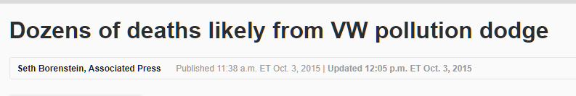
Quick and Timely Analyses
“…allowed VWs to spew enough pollution to kill somewhere between 16 and 94 deaths over seven years”
Holland et al. 2016

Slide 6
Integrated Energy, Climate, and Air Decision Analysis
Climate impact metrics exist and widely used
  Social Cost of Carbon ($ damages / ton emitted)
  Global Warming Potential (GWP)
  Single values: location of emissions / exposure does not matter
Air quality, exposure, health needs spatially resolved tools
  Social costs ($/ton emitted) as a function of location
  Much energy systems work ends with quantifying changes in emissions rather than concentrations, health, monetized benefits

Slide 7
Impact Assessment
Chemical transport models (CTMs) vs reduced-form models
$ damages per incremental ton

Slide 8
Available RCMs
APEEP
  Air Pollution Emission Experiments and Policy
  Nick Muller (CMU, formerly Middlebury)
  Gaussian dispersion + simple chemistry
EASIUR
  Estimating Air pollution Social Impacts Using Regression
  Peter Adams and Jinhyok Heo (CMU)
  statistical model fitting tagged CTM simulations
InMAP
  Intervention Model for Air Pollution
  Chris Tessum and Julian Marshall (UW, formerly Minn)
  annual-average CTM with process rates from WRF-Chem

Slide 9
Overview: APEEP
Based on Gaussian Plume (Turner, 1994).
Modified to approximate atmospheric chemistry (reduced form approach).
  SO₂, NO_{x}, NH₃, VOC PM_{2.5}
  NO_{x}, VOC O₃
USEPA NEI: Annual emissions for 10,000 individual and spatially aggregated sources.
County resolution
PM_{2.5}, SO₂, NO_{x}, VOC, NH₃ (All emissions of 5 pollutants in the contiguous US.)

Slide 10
One Ton SO₂ Emitted from RE Burger

Slide 11
One Ton SO₂ Emitted from RE Burger

Slide 12
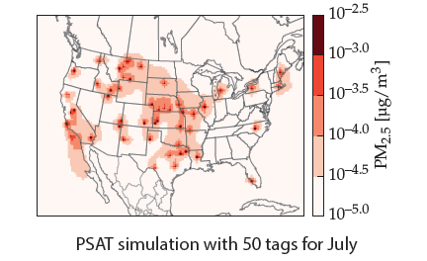
Overview: EASIUR
PSAT = Particulate Source Apportionment Tracking
(Wagstrom et al., 2008)
Use tagged simulations in full CTM (CAMx)
Track plumes and health impacts from marginal emissions at semi-random locations
Allows a large training data set in manageable CPU time

Slide 13
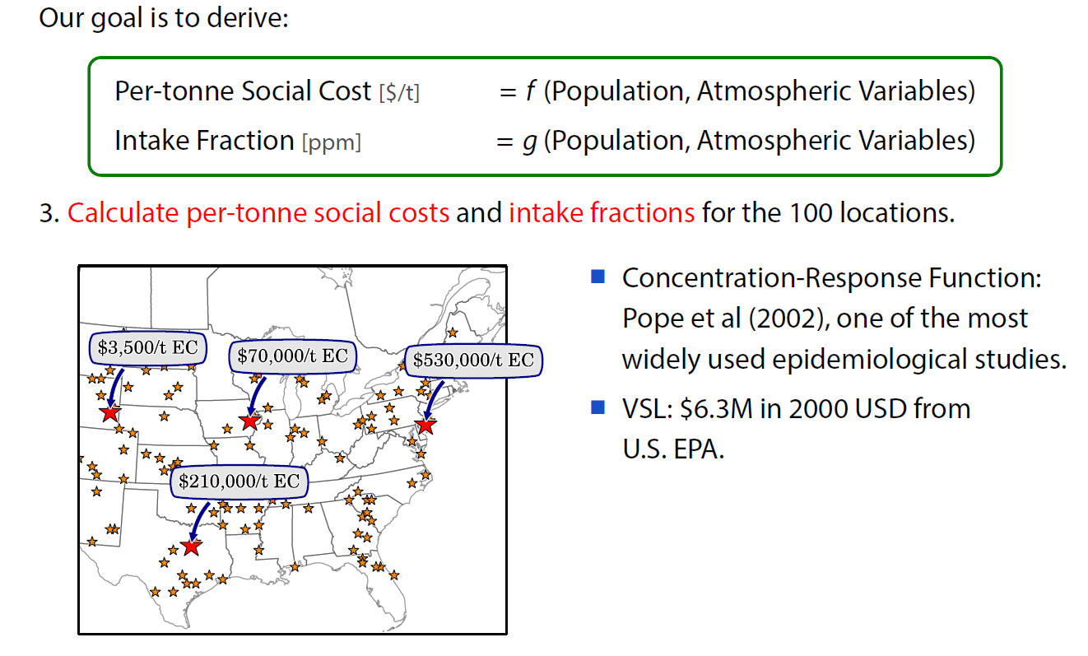
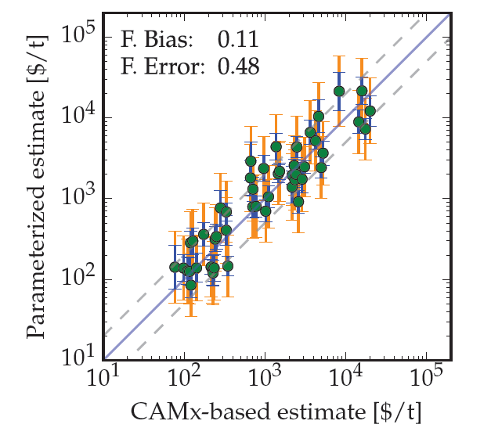
Parameterize Results and Evaluate
NOx (summer) out-of-sample

Slide 14
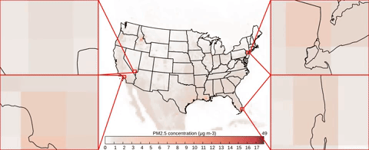
Overview: InMAP
Eulerian (CTM-style) framework
Simplified chemistry (primary + secondary PM_{2.5})
Annual-average temporal resolution
Variable-resolution grid (1 km in urban areas)
2-hr runtime on desktop computer, or SR matrix available
Tessum CW, Hill JD, Marshall JD (2017) InMAP: A model for air pollution interventions. PLoS One 12(4):e0176131.

Slide 15
Description: Takeaway
We have three RCMs, all highly independent of each other

Slide 16
Available Data and Models
RCMs ≠ models in normal sense …
 | Marginal Social Costs ($/ton)
Description | aggregate downwind damages $/ton = f(source location, species)
Availability | all 3 RCMs
Ease of use? | “Lookup table” All three available in common query (www.caces.us) typical analysis might be few hours or days
Applications | aggregate damages from policy most cost-benefit

Slide 17
Available Data and Models
RCMs ≠ models in normal sense …
 | Marginal Social Costs ($/ton) | Source-Receptor Matrix
Description | aggregate downwind damages $/ton = f(source location, species) | impact(receptor location) = f(source location, species)
Availability | all 3 RCMs | all 3 RCMs
Ease of use? | “Lookup table” All three available in common query (www.caces.us) typical analysis might be few hours or days | All three available but in diverse formats; much more data; more work to use (weeks/months)
Applications | aggregate damages from policy most cost-benefit | c(x,y,z) receptor-oriented environmental justice

Slide 18
Available Data and Models
RCMs ≠ models in normal sense …
 | Marginal Social Costs ($/ton) | Source-Receptor Matrix | Underlying Model
Description | aggregate downwind damages $/ton = f(source location, species) | impact(receptor location) = f(source location, species) | what previous two columns are derived from
Availability | all 3 RCMs | all 3 RCMs | InMAP, APEEP
Ease of use? | “Lookup table” All three available in common query (www.caces.us) typical analysis might be few hours or days | All three available but in diverse formats; much more data; more work to use (weeks/months) | depends
Applications | aggregate damages from policy most cost-benefit | c(x,y,z) receptor-oriented environmental justice

Slide 19
Levels of Analysis
Cost-benefit analysis
  what are aggregate benefits/damages from emissions changes?
  not worried about spatially resolved impacts
  easy to support with marginal social costs ($/ton)
  ~hours of effort with spreadsheet once emissions scenario generated
S-R analysis
  want to know where damages occur
  want to reconstruct a concentration field
  can be done but is heavier lift (stay tuned)

Slide 20
Summary of RCMs
Generally, use all three RCMs as robustness check
 | APEEP | EASIUR | InMAP
Underlying structure | National Gaussian dispersion model with simple chemistry | Statistical model derived from a CTM (CAMx) | CTM-like but annually averaged
Horizontal resolution | US counties | 36 km or US counties | Variable, up to 1 km in urban areas
End points considered | PM2.5 mortality plus a host of others | PM2.5 mortality | PM2.5 mortality or user-configurable (full model)
Other | Longest use in literature, more base years | Directly derived from CTM output, seasonal resolution | Spatial resolution, EJ

Slide 21
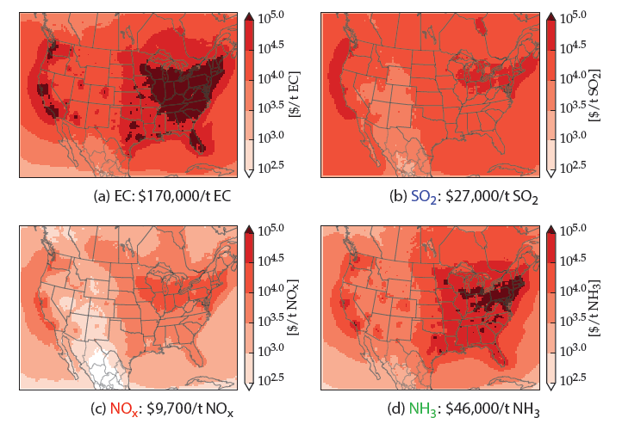
Sample Marginal Damages (EASIUR)
EC
SO₂
These are damages by source location
…for user, this is a “lookup table”
Spatial: Proximity to population centers
Species: PM_{2.5} formation efficiency
NO_{x}
NH₃

Slide 22
Impact Assessment
Health effects and economic valuation

Slide 23
Concentration-Response Function
Premature mortality from chronic (annual-average) PM2.5 exposure
American Cancer Society (ACS) cohort
  6% increase in mortality per 10 μg m⁻³
Harvard 6-Cities
  14% increase in mortality per 10 μg m⁻³
Additional mortality
Baseline mortality
Concentration change
Relative risk

Slide 24
Value of a Statistical Life (VSL)
Willingness to pay to avoid (small) mortality risk
  E.g. additional wages for more dangerous job
  Not value or compensation for life lost
  Economic work tries to infer people’s preferences from market behaviors
  WTP ≠ medical, hospital, or other incurred costs
Value increases with income and inflation
EPA literature review recommends $7.4M ($2006)
  26 studies cited: $0.85 - $19.8 (Weibull distribution)
  Guidelines for Preparing Economic Analyses; National Center for Environmental Economics, Office of Policy, US EPA, 2010.
  https://www.epa.gov/sites/production/files/2017-09/documents/ee-0568-22.pdf

Slide 25
EASIUR Evaluation

Slide 26
County Marginal Social Costs ($/ton)
Primary PM_{2.5}
SO₂
NO_{x}
NH₃

Slide 27
Overview and Intercomparison
Rank-ordering of species makes sense
Primary PM_{2.5} > NH₃ > SO₂ > NO_{x}
Based on efficiency of forming PM_{2.5}
Primary PM_{2.5}
SO₂
NO_{x}
NH₃

Slide 28
Overview and Intercomparison
Emissions-weighted national averages (red dots) are within 50% for most species
75% for NOx
Primary PM_{2.5}
SO₂
NO_{x}
NH₃

Slide 29
Overview and Intercomparison
Elevated vs ground sources are similar
…except primary PM_{2.5}
Primary PM_{2.5}
SO₂
NO_{x}
NH₃

Slide 30
RCM Intercomparison
Social costs ($/ton) of primary PM_{2.5} emissions as a function of source county
InMAP ($/ton)
EASIUR ($/ton)
Ratio: InMAP / EASIUR

Slide 31
RCM Intercomparison
Social costs ($/ton) of primary PM_{2.5} emissions as a function of source county
AP2 ($/ton)
InMAP ($/ton)
Ratio: AP2/InMAP

Slide 32
RCM Intercomparison
Social costs ($/ton) of NOx emissions as a function of source county
AP2 ($/ton)
This was a primary motivation for the AP2 → AP3 version update
EASIUR ($/ton)
Ratio: AP2/EASIUR

Slide 33
RCM Evaluation vs Observations
Use RCMs to predict PM_{2.5} and speciation from EPA AirData
Note our impacts are marginal - do not necessarily expect to reconstruct concentrations in nonlinear system
Model performance similar to a CTM (WRF-Chem)
Models
Species

Slide 34
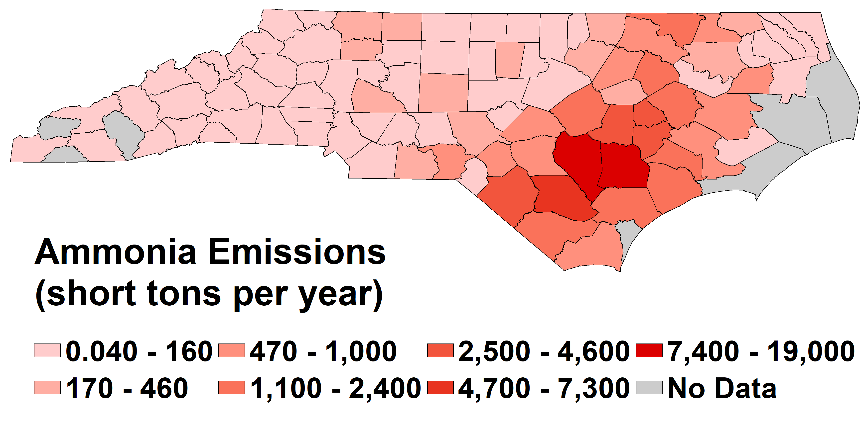
Sample Calculation
What are damages associated with swine production in NC?
(tons/yr)
NEI2011 projected to 2017 / SCC 2805039000

Slide 35
Web Query
Starting point is getting marginal social costs online
  CACES home page: https://www.caces.us/
  RCM query: https://www.caces.us/data

Slide 36
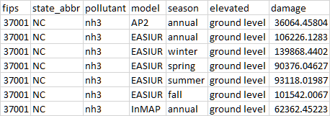
Query Results
… many more entries

Slide 37
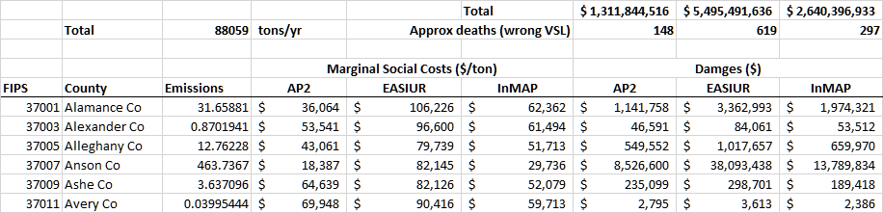
Spreadsheet Analysis
Emissions (from NEI)
Marginal social costs ($/ton) from three RCMs
…and sorted
Damages ($)
= (marginal social cost)
x (emissions)

Slide 38
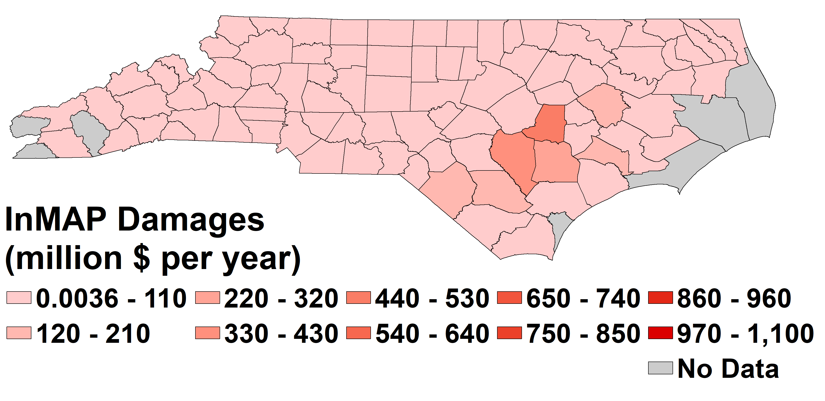

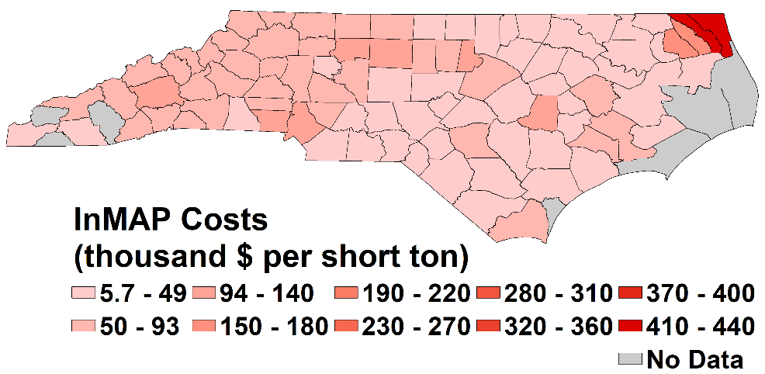
Sample Results: InMAP
(tons/yr)
($1000/ton)

Slide 39
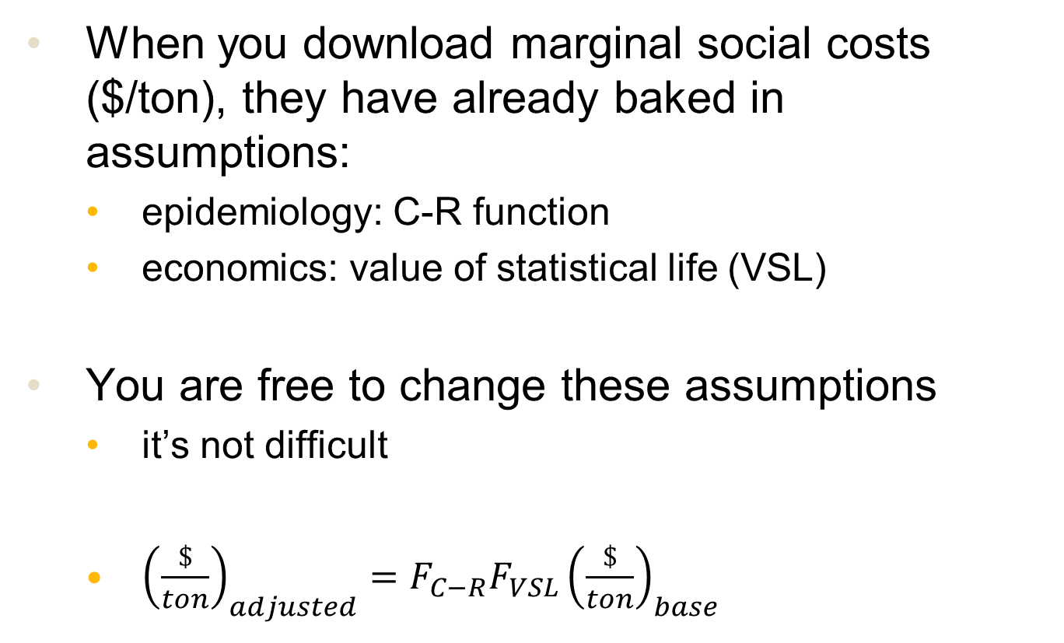
Changing Assumptions
When you download marginal social costs ($/ton), they have already baked in assumptions:
  epidemiology: C-R function
  economics: value of statistical life (VSL)
You are free to change these assumptions
  it’s not difficult
  ${\left(\frac{\$}{ton}\right)}_{adjusted}={F_{C−R}F_{VSL}\left(\frac{\$}{ton}\right)}_{base}$

Slide 40
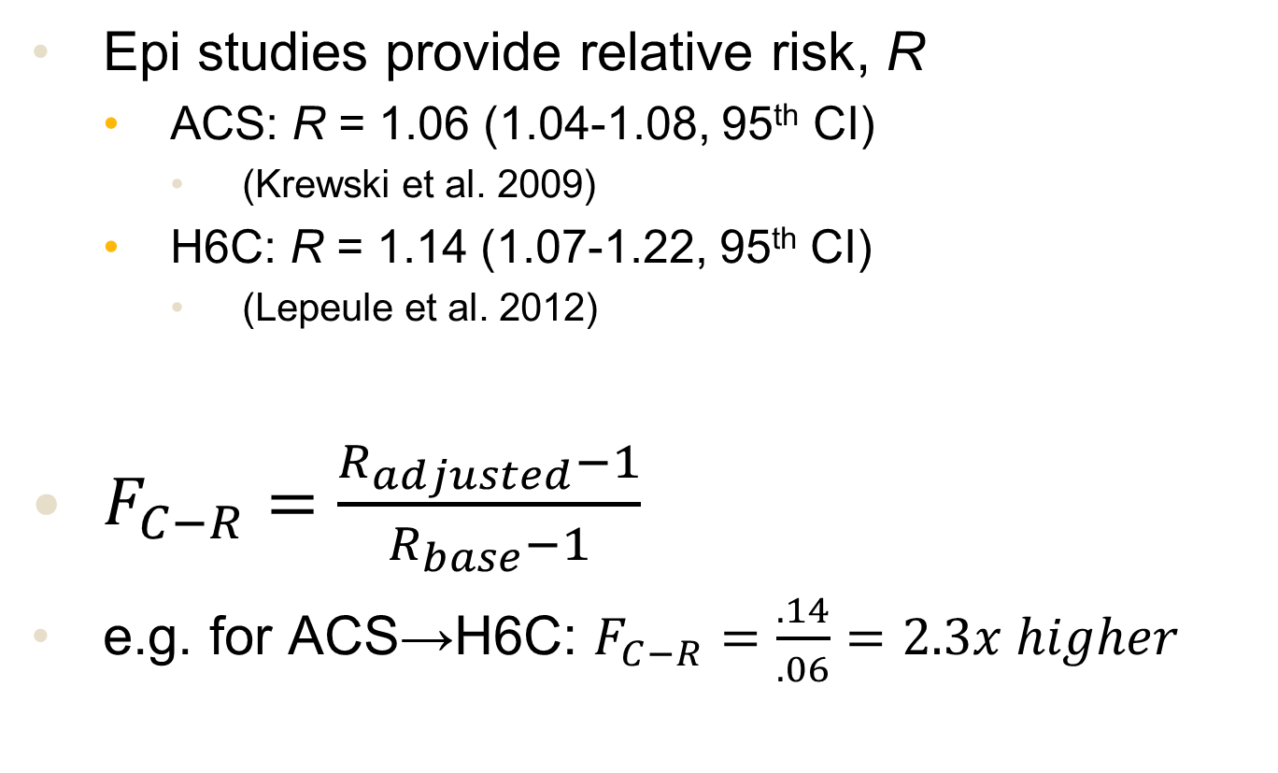
Changing the C-R Function
Epi studies provide relative risk, R
  ACS: R = 1.06 (1.04-1.08, 95th CI)
    (Krewski et al. 2009)
  H6C: R = 1.14 (1.07-1.22, 95th CI)
    (Lepeule et al. 2012)
$F_{C−R}=\frac{R_{adjusted}−1}{R_{base}−1}$
e.g. for ACS→H6C: $F_{C−R}=\frac{.14}{.06}=2.3x higher$

Slide 41
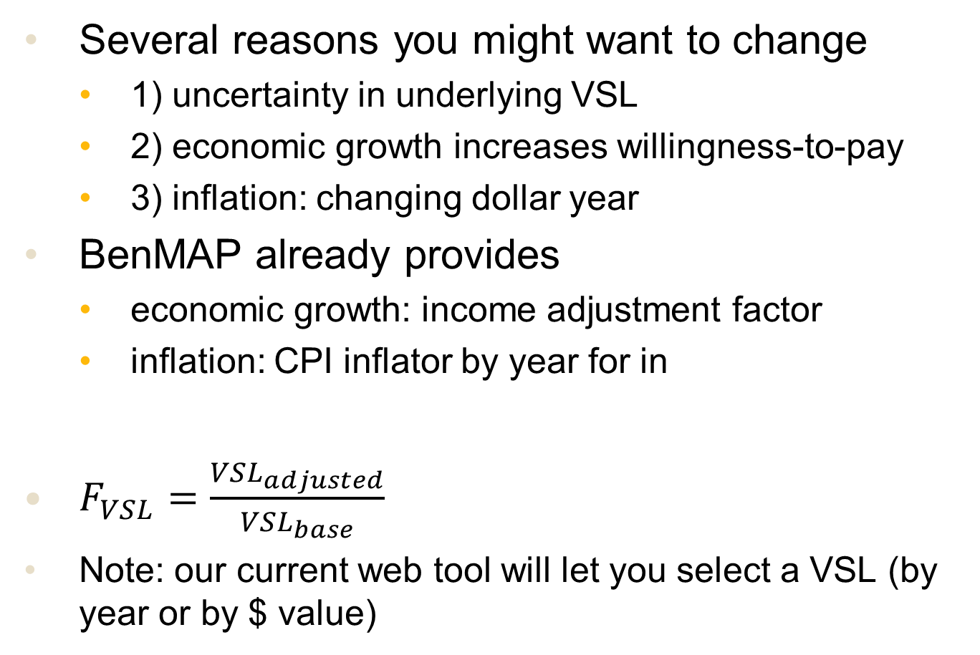
Changing the VSL
Several reasons you might want to change
  1) uncertainty in underlying VSL
  2) economic growth increases willingness-to-pay
  3) inflation: changing dollar year
BenMAP already provides
  economic growth: income adjustment factor
  inflation: CPI inflator by year for in
$F_{VSL}=\frac{{VSL}_{adjusted}}{{VSL}_{base}}$
Note: our current web tool will let you select a VSL (by year or by $ value)

Slide 42
Uncertainty Analysis
Air Quality
  strongly recommend using all three RCMs through standard web query (www.caces.us)
  recall that structure and derivation of three RCMs are strongly independent
Concentration-Response
  ACS and H6C values provided on previous slide
VSL
  EPA-recommended Weibull: $8.8M
  ($0.84-23M, 95th CI; Y2000 income and dollar value)
Can easily apply 95th CI for C-R and VSL to results from three RCMs (or Monte Carlo)

Slide 43
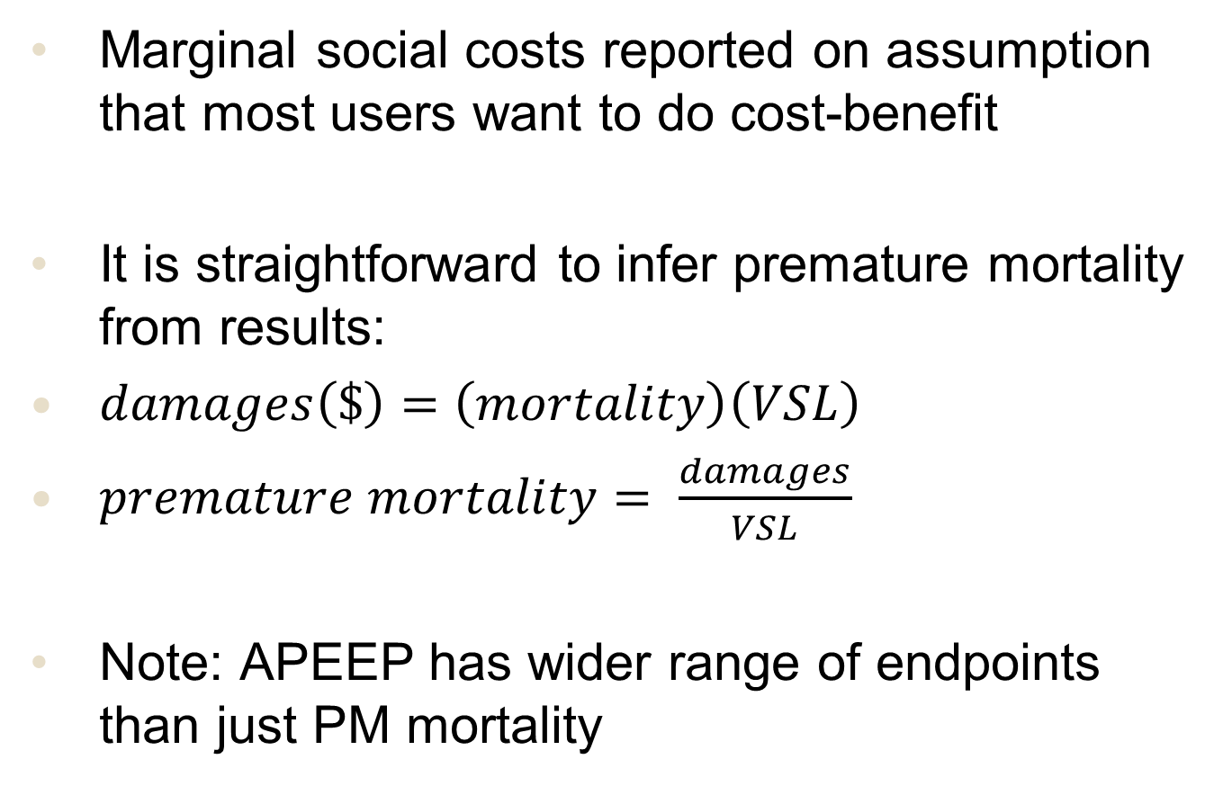
Reporting Premature Mortality
Marginal social costs reported on assumption that most users want to do cost-benefit
It is straightforward to infer premature mortality from results:
$damages\left(\$\right)=\left(mortality\right)\left(VSL\right)$
$premature mortality= \frac{damages}{VSL}$
Note: APEEP has wider range of endpoints than just PM mortality

Slide 44
Marginal Social Costs
These $/ton values are marginal
  i.e. a sensitivity or derivative:
  d(damages) / d(emissions)
Strictly speaking, they apply only to
  small emissions changes
  around the same baseline AQ used to derive
Assumption may be problematic for
  large emissions/policy changes
  evaluation of future (or past) policies (e.g. 2050)
Practically, probably less of an issue

Slide 45
Changing Baseline Year?
$/ton costs are around some baseline year
PM_{2.5} sensitivity to SO₂/NO_{x}/NH₃ changes
CTM-based evidence from Holt et al. (2015) and Pinder et al. (2008)
  SO2 sensitivity up by ~30%
  NOx sensitivity up by ~50%
  NH3 sensitivities down by 25-40%
APEEP has run multiple baseline years, sees similar changes
Changing baseline emissions is probably not a major uncertainty

Slide 46
Intra-County Spatial Variation
InMAP accounts for population / emissions up to 1 km
Changes social costs up to ~50%
More for primary species, larger/urban counties

Slide 47
Planned RCM Development
Support environmental justice analysis
  web query for EJ metrics as well as $/ton damages
  much higher resolution version of EASIUR
Simpler tools for source-receptor matrices
  facilitate receptor-oriented spatial analysis
  creation of concentration fields
  GIS emissions → S-R matrix → GIS conc/damages
VOC/SOA damages from VBS mechanism

Slide 48
For More Information…
First, see common web query
  www.caces.us
But some additional info at RCM web sites:
AP2
  https://sites.google.com/site/nickmullershomepage/home/ap2-apeep-model-2
EASIUR
  http://barney.ce.cmu.edu/~jinhyok/easiur/
InMAP
  http://inmap.spatialmodel.com
Source-receptor analysis (InMAP and EASIUR)
  https://www.inmap.run/blog/2019/04/20/sr/

Slide 49
Conclusions
People: RCMs bring health impact analyses to much broader research and decision community
  spreadsheet analysis (~hours of effort)
Questions: Allow analysis impossible with CTM
They are ready for “prime time”
  three independent RCMs give similar answers
  evaluations vs CTMs and observations
  spatial/species patterns make sense
User-friendly and publicly available
  www.caces.us

Slide 50
Discussion and Feedback
Open for comments and questions…

