Slide 1
Spatial Allocator
Version 4.3
https://www.cmascenter.org/sa-tools/
April 27, 2017
CMAS Webinar Series
Zac Adelman, UNC Institute for the Environment

Slide 2
Geographic Information System (GIS)
A GIS is software for manipulating and displaying geospatial data
GIS software often work with ESRI shapefiles, which are datasets of geospatial features
Polygons of political boundaries, land use categories, and associated attributes (e.g., population density)
Point locations of points of interest (e.g., gas stations or electricity generating facilities)
Line locations of infrastructure and transport routes (e.g., roads, shipping lanes, and pipelines)

Slide 3
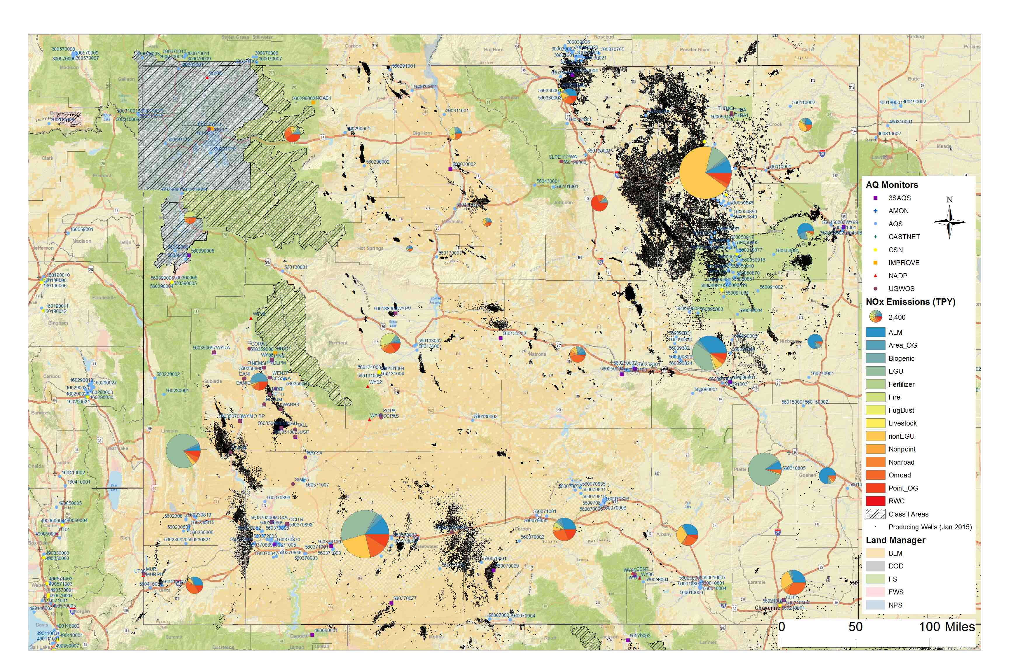
Geographic Information System (GIS)
A GIS is a critical tool in an air quality modeling system for
Preparing and manipulating geospatial input data
Analyzing and displaying spatial trends in the output
Layering modeling output with high resolution mapping data
GIS Map of air quality monitors, oil/gas wells, 2011 county NOx emissions (pie charts), and Federal Land Managers in Wyoming

Slide 4
Spatial Allocator
Set of C and Java tools to manipulate and generate data files related to emissions and air quality modeling
Developed with funding primarily from the U.S. EPA as an open-source software with support for GIS functions common to air quality modeling applications
Built on industry-standard libraries (e.g., GDAL, PROJ.4, netCDF) with support for ESRI shapefiles and many raster data formats (e.g., TIFF, BIL, HDF4, HDF5)
Includes functions specific to preparing input files for WRF, SMOKE, and CMAQ modeling

Slide 5
Spatial Allocator
Vector Tools – C programs for manipulating and performing calculations on spatial data formats such as ESRI shapefiles and netCDF data files
Raster Tools – C/C++ programs for preparing land use and satellite data for input to WRF and CMAQ and for FEST-C simulations
Surrogate Tools – Java interface and utilities for computing spatial surrogates
Distributed as Linux command line, precompiled binaries with c-shell run scripts
Binaries not available for Windows or MacOS

Slide 6
Spatial Allocator – Vector Tools
Allocator (allocator.exe)
spatial computations using shapefiles and I/O API netCDF data
Spatial Surrogate Creation (srgcreate.exe)
calculates spatial surrogates for mapping emissions source locations to modeling grids or polygons
Surrogate Comparison (diffsurr.exe)
compares two ASCII spatial surrogate data files
Shapefile Dump (dbf2asc.exe)
create an CSV file from a shapefile *.DBF component
BELD Landuse Processor (beld3smk.exe and beld4smk.exe)
convert BELD3/4 landuse coverage to a user-defined grid or polygon
I/O API Comparison (diffioapi.exe)
compare two I/O API netCDF files

Slide 7
Spatial Allocator – Vector Tools Allocator Modes
ALLOCATE – Convert data from one geospatial unit to another by summing or averaging attributes
OVERLAY – Determine if two grids/polygons overlap and print the attributes of the overlaid shapes
CONVERT_SHAPE – Change the projection of shapefile
FILTER_SHAPE – Filter by shapefile attributes
Notes:
Allocator ALLOCATE examples: aggregate (sum) county data up to state totals; average a density property from an input polygon to output grid/polygon; convert data from one grid or projection to another; allocate discrete spatial values (e.g., FIPS code or landuse code) to an output polygon or grid based on maximum area of overlap or centroid; area percentages: find the fraction of each modeling grid cell that is covered by the attributes in an intersecting polygon (e.g., land use categories), also use for creating surfzone/ocean files for CMAQ sea salt emissions
Allocator OVERLAY examples: report the attributes in an input data file (points, lines, polygons) that fall within the boundaries of a user-defined region (e.g., modeling grid or administrative boundary); find counties that intersect grid cells (X,Y = FIPS), find grid cells that intersect counties; find points (monitor locations or airports) that are within grid cells;
FILTER SHAPE – Create a new shapefile based on a list of filter attributres from an existing shapefile, e.g., road_type = Interstate or Population Density > 100 ppl/km^2.)
CONVERT SHAPE – transform a shapefile from one map projection to another (e.g., geographic to LCC)

Slide 8
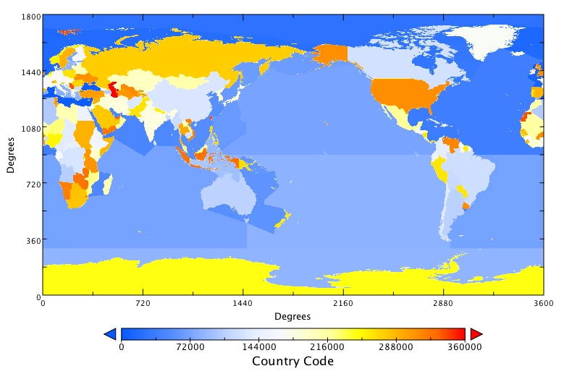
Spatial Allocator – Vector Tools BELD, Ocean File and GEOCODES
Beld3smk & Beld4smk programs convert BELD3/BELD4 netCDF tiles to I/O API netCDF files for input to BEIS biogenic emissions processor
ALLOCATE mode of allocator.exe can be used to prepare modeling input files
Shapefile of open ocean and surfzone locations is used to create a CMAQ OCEAN file for calculating inline seasalt emissions
Shapefile of country boundaries and timezones is used to create a SMOKE GEOCODES file for processing gridded inventory data
Notes:
BELD3 and BELD4 data are available for North America from the CMAS Center for use with these tools

Slide 9
Spatial Allocator – Vector Tools Spatial Surrogates
Most commonly used to map county/state/country total emissions to modeling grid cells
Mapping is based on distributions of spatial attributes, such as housing units, road ways, or point locations (gas stations)
Surrogates can also be used to create mappings to polygons, such as a census tract
Filtering and weight functions provide capabilities to filter/combine shapefile attributes in surrogate calculations
Output data are SMOKE formatted spatial surrogates

Slide 10
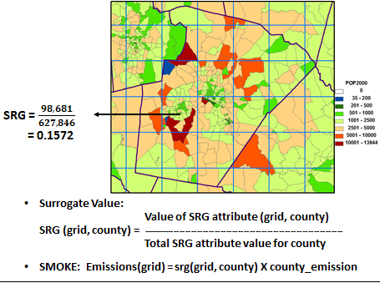
Spatial Allocator – Surrogate Tools
Spatial Surrogate: spatial intersection of an administrative boundary (e.g., county), weight factor (e.g., population density), and modeling grid → The fraction of the population in County A in grid cell (X,Y)
Stand-alone Java tool for generating spatial surrogates for input to SMOKE
Consolidates spatial surrogates input data for batch processing of surrogates
Includes surrogate gapfilling, normalization, and QA utilities

Slide 11
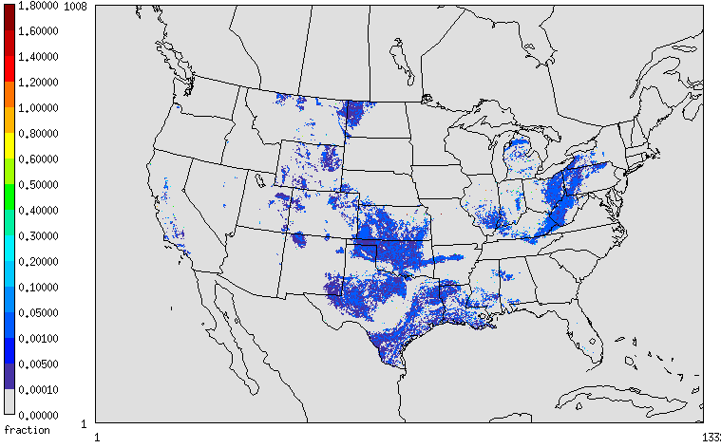
Spatial Allocator – Surrogate Tools Features and Recent Updates
Gapfilling Tool – ensures that every administrative unit in a modeling domain has a surrogate fraction in the intersected modeling grid; 3-levels of gap filling is supported. Example: 1°Urban Housing → 2°Housing → 3°Population → 4°Land
Normalization Tool – ensures that all surrogate fractions = 1.0000
QA Tool – generates four surrogate quality assurance reports: Gapfill, Not1, NoData, Summary
New Features/Updates
64-bit executables
PostgreSQL alternative to srgcreate.exe (coming soon)
Bug fixes
4-km CONUS All Well Surrogate

Slide 12
Spatial Allocator – Raster Tools
Satellite data processing tools
Prepare GOES cloud cover for assimilation into WRF
Prepare NLCD, MODIS, and BELD land cover data for WRF/CMAQ
Convert satellite aerosol and NO2 products to modeling grids for use in air quality model evaluation
Agricultural fertilizer modeling tools
Prepare Environmental Policy Integrated Climate (EPIC) model data for the Fertilizer Emission Scenario Tool for CMAQ (FEST-C)
Generate modeling grid shapefile
Update WRF landuse input with NLCD or MODIS data

Slide 13
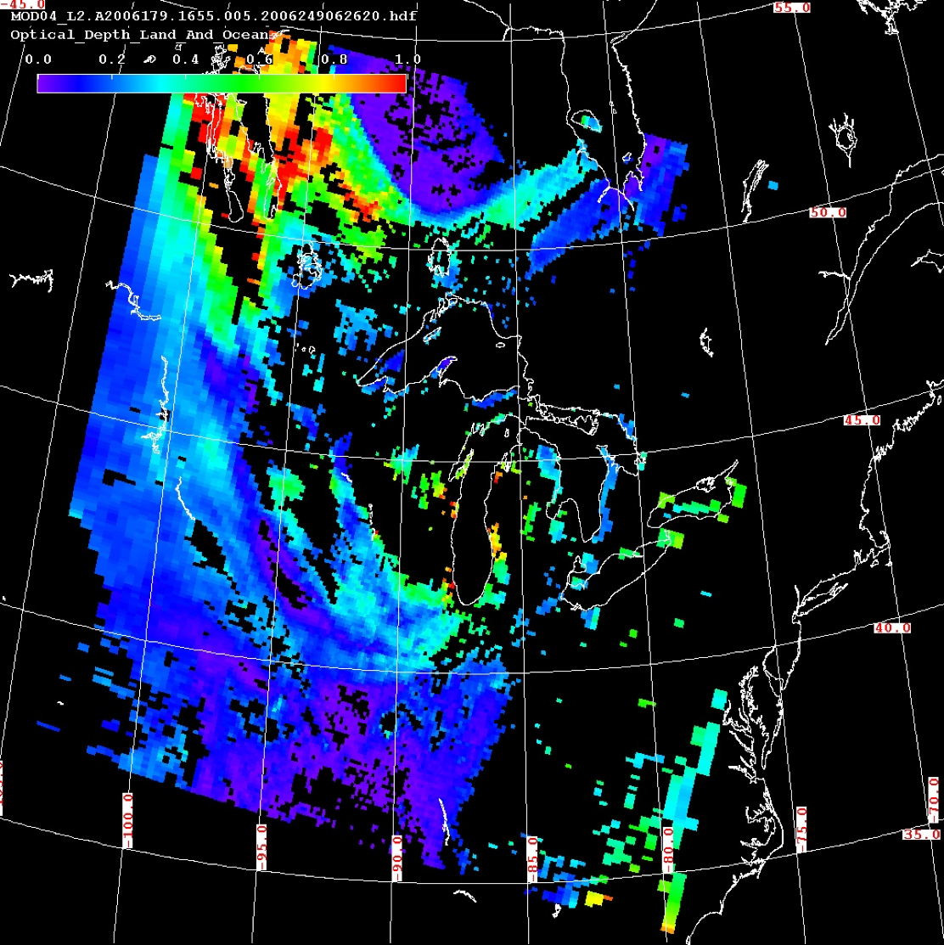
Spatial Allocator – Raster Tools Satellite Data Processing
Land Cover Products
Generate NLCD and MODIS land cover data for WRF and CMAQ
Generate BELD4 land cover data for bi-directional ammonia flux model in CMAQ
Cloud and Aerosol Products
Process GOES cloud cover data (GRIB) to modeling grids for assimilation into WRF
MODIS Level 2 cloud and aerosol products (HDF4) to modeling grids
OMI Level 2 aerosol and NO2 products (HD5) to modeling grids
OMI L2G and L3 aerosol and NO2 products (HD5) to modeling grids

Slide 14
Spatial Allocator – Raster Tools Agricultural Fertilizer Data Processing
The Fertilizer Emissions Scenario Tool (FEST-C; www.cmascenter.org/fest-c) simulates daily fertilizer application information.
The Environmental Policy Integrated Climate (EPIC) model estimates soil productivity
EPIC and FEST-C data are used in the CMAQ bi-directional (bi-di) NH₃ emissions model
The Raster Tools include utilities for:
Processing EPIC and FEST-C input and output data
Converting BELD4 data for CMAQ bi-di modeling
The Vector Tool Beld4smk outputs the same data content. But the output from the Raster Tool should be used for CMAQ bi-di modeling because crop fractions in the two files do not match due to different data resolutions and processing methods.

Slide 15
Agricultural Fertilizer Modeling System for CMAQ
Crops
BELD4 (NLCD/MODIS,FIA, NASS)
Environmental Policy Integrated Climate (EPIC)
Java-base Fertilizer Tool (FEST-C) Interface
Meteorology
WRF
Spatial Allocator Tools
N Deposition
Bi-directional NH₃ Flux modeling
CMAQ
Fertilizer N
Focus on USEPA extended CONUS 12km CMAQ domain
Non-Fertilizer NEI Emission
Inventories

Slide 16
Spatial Allocator – GitHub
Release of version 4.3 is being done through GitHub: https://github.com/CMASCenter/Spatial-Allocator
Codes, scripts, and documentation are all available on GitHub.
Test data and technical support available from http://www.cmascenter.org

Slide 17
Acknowledgements
Financial Support
U.S. EPA OAQPS and ORD
NASA ROSES
Development Team
Vector and Surrogate Tools – Alison Eyth, Limei Ran, Dongmei Yang, Catherine Seppanen, Jo Ellen Brandmeyer
Raster Tools – Limei Ran

Slide 18
Upcoming CMAS Events
Trainings
June 19-23: Introduction to SMOKE (online)
October 18-20: Introduction SMOKE
October 26-27: Introduction to CMAQ
Webinars
May 25: Presenting the C-TOOLS
June 29: TBD
July 27: Presenting AMETv1.3
Conferences
August 28-31: 3rd CMAS Conference South America (Vitória, Espirito Santo, Brazil)
October 23-25: 16th Annual CMAS Conference (Chapel Hill, NC)
For Additional Information
www.cmascenter.org
or email
cmas@unc.edu

