Slide 1
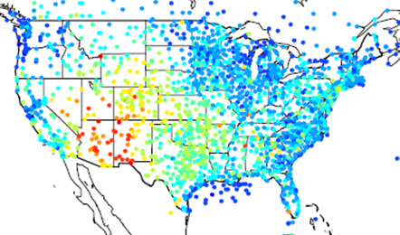
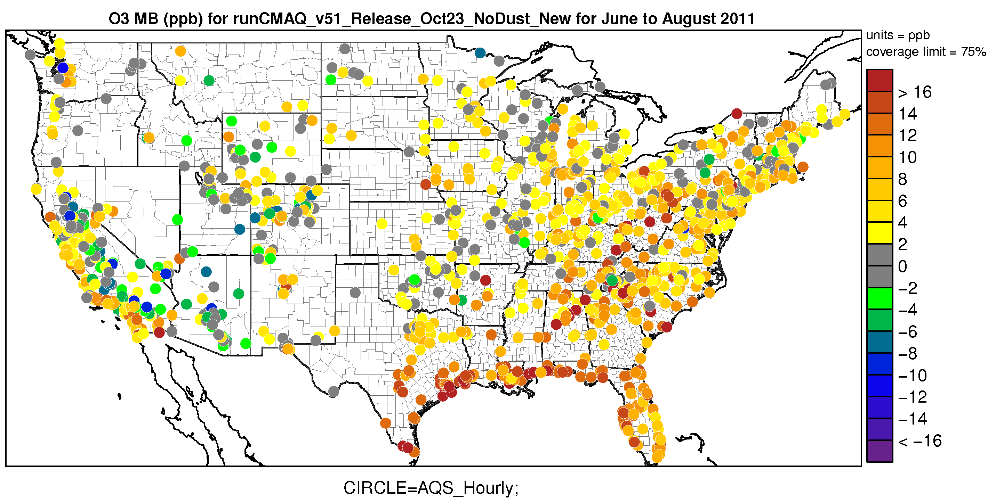
Updates to the Atmospheric Model Evaluation Tool (AMET) version 1.3
Wyat Appel, Robert Gilliam, Zac Adelman
US EPA/UNC-CMAS Webinar July 27, 2017

Slide 2
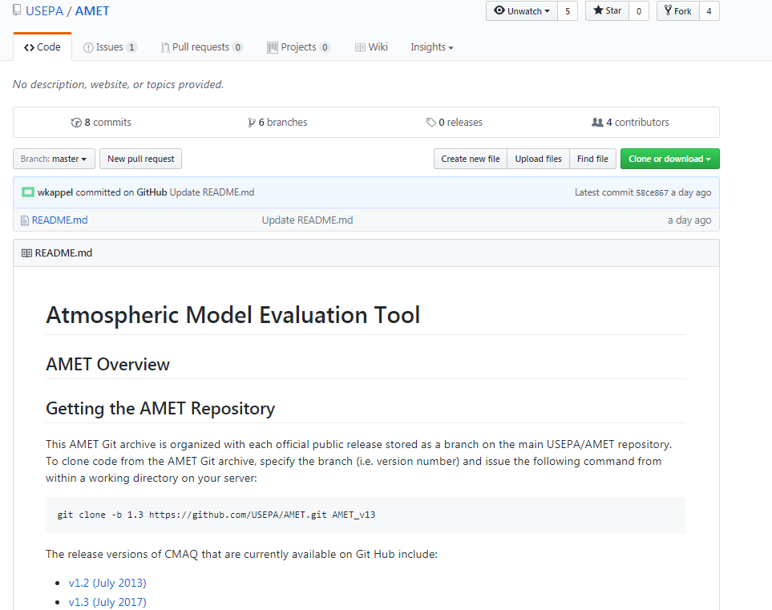
Brief History of AMET
AMET v1.0
Early AMET
AMETv1.2
AMETv1.3
Appel et al. (2011) Environ. Modell. Softw., 26, 434-443.
Bug fixes, new scripts
Significant updates over previous version
Available through GitHub for the first time
First developed by Rob Gilliam for MM5 meteorological applications (early 2000s)
First public release through CMAS Center
AMETv1.1
Extended to AQ applications by Wyat Appel (mid-2000s)
Feb 2008
May 2008
July 2013
July 2017
Minor update
https://github.com/USEPA/AMET

Slide 3
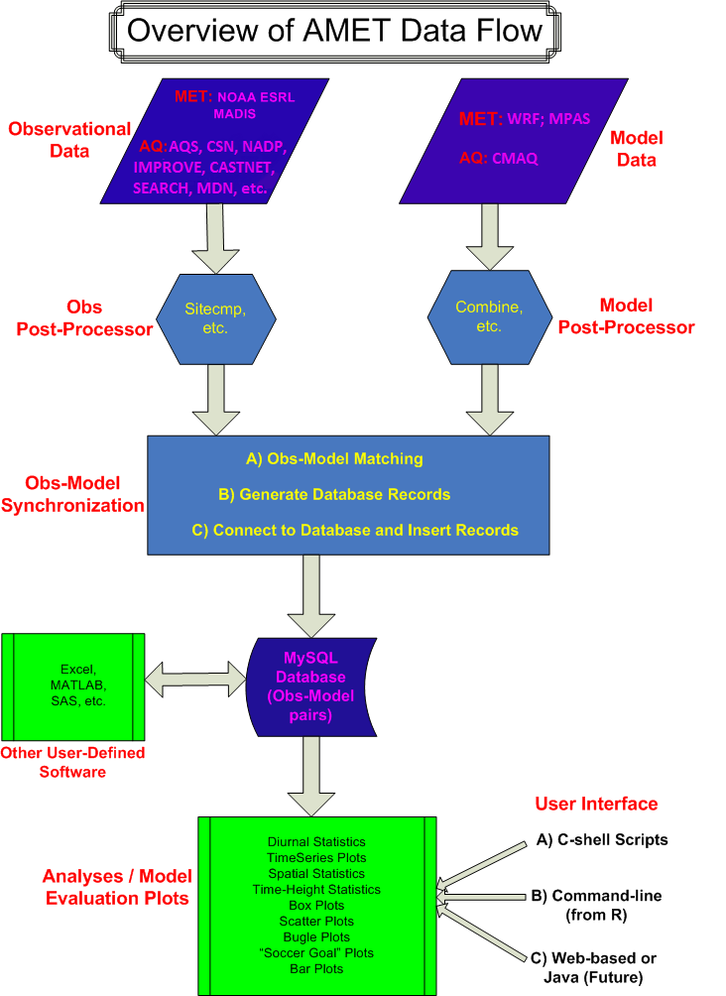
General Overview of AMET
Model evaluation tool for both AQ and MET models
WRF, MPAS (MM5 no longer supported)
CMAQ, CAMx (requires some pre-processing)
Utilizes open source software
MySQL database software: Data storage and access
Fortran (post-processing tools)
R statistical software: Database interface and analysis
Advantages of AMET
Capable of managing large datasets efficiently
Partially automated system, therefore easy to use
Relational database allows for unique querying of data
Pre-defined analysis scripts for common analysis across groups
Users can easily develop their own custom analyses in R
Or leverage output files to do their own analyses
(AQ only)
(AQ only)

Slide 4
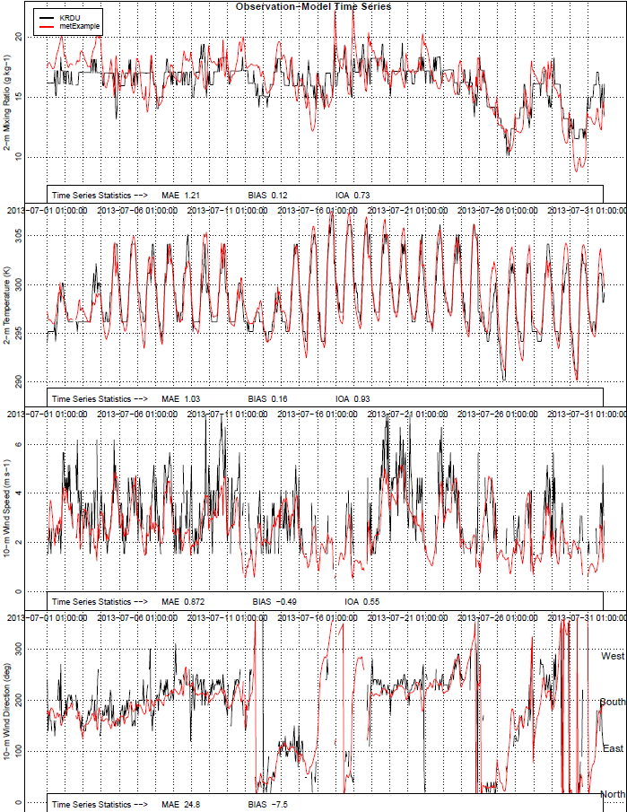
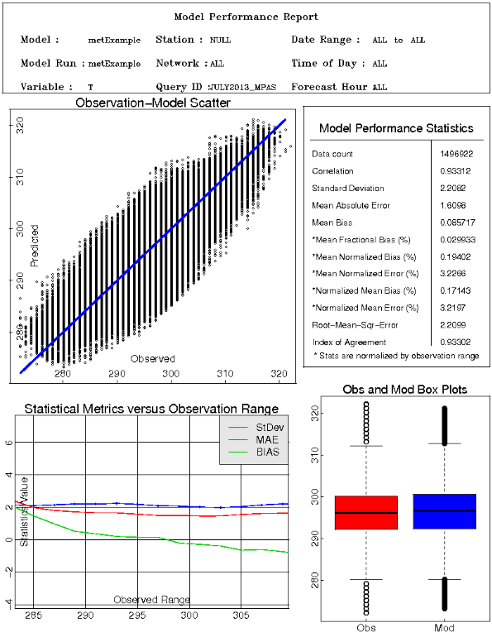
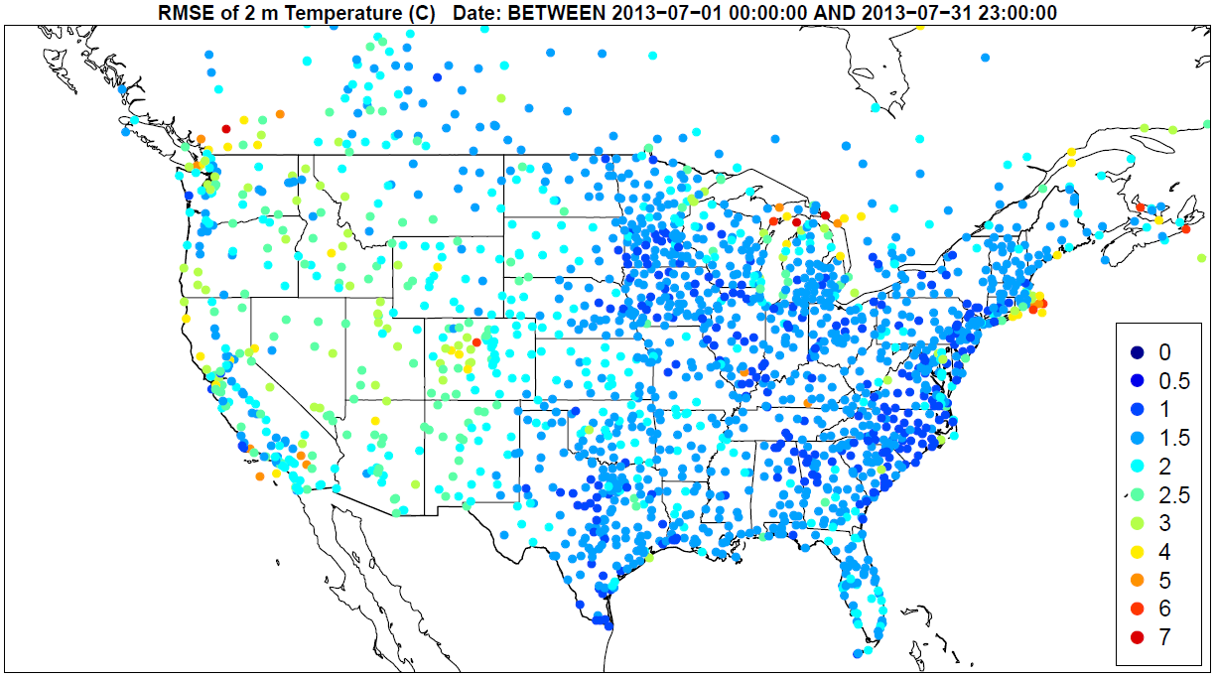
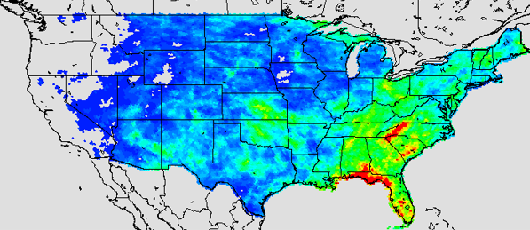
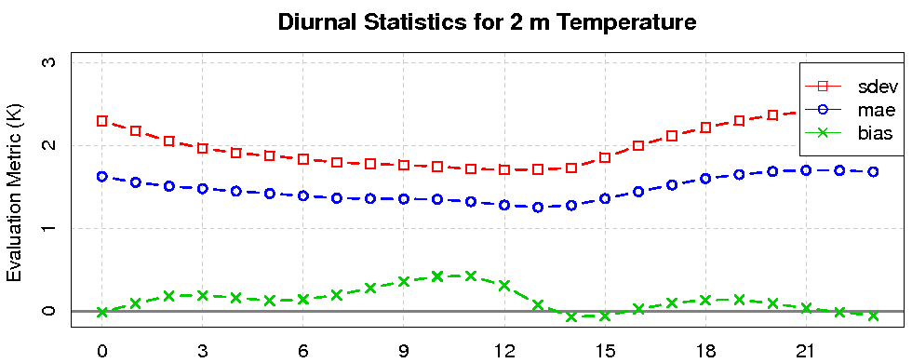
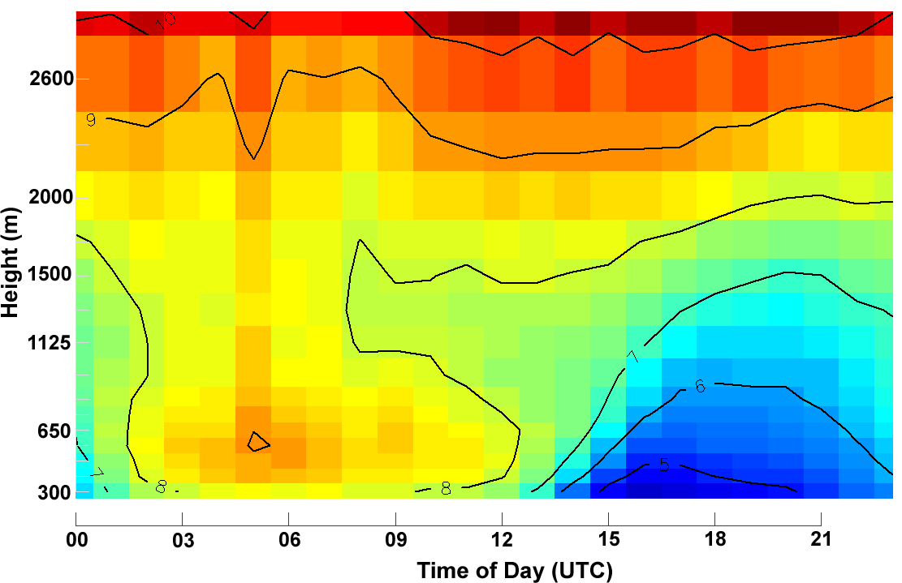
Examples of AMET-MET Module Plots

Slide 5
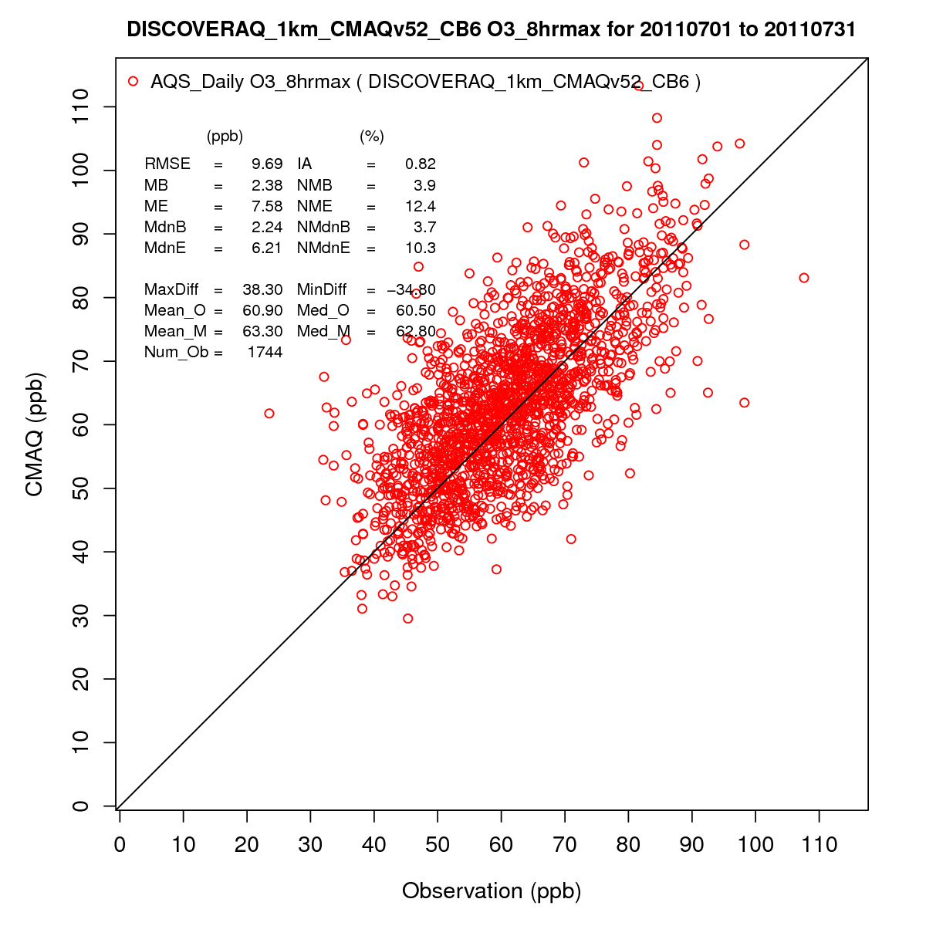
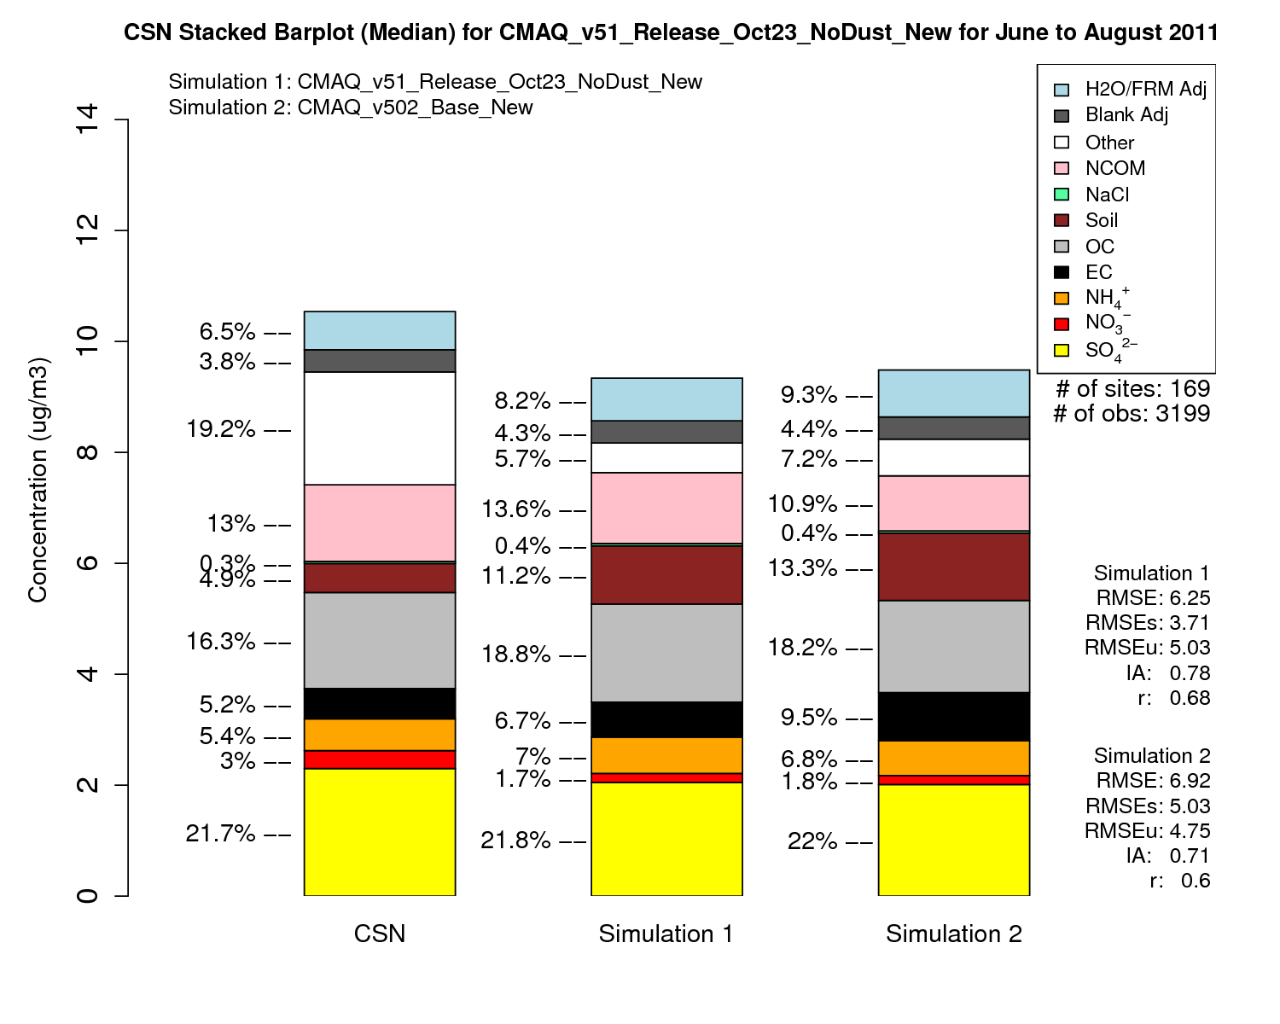
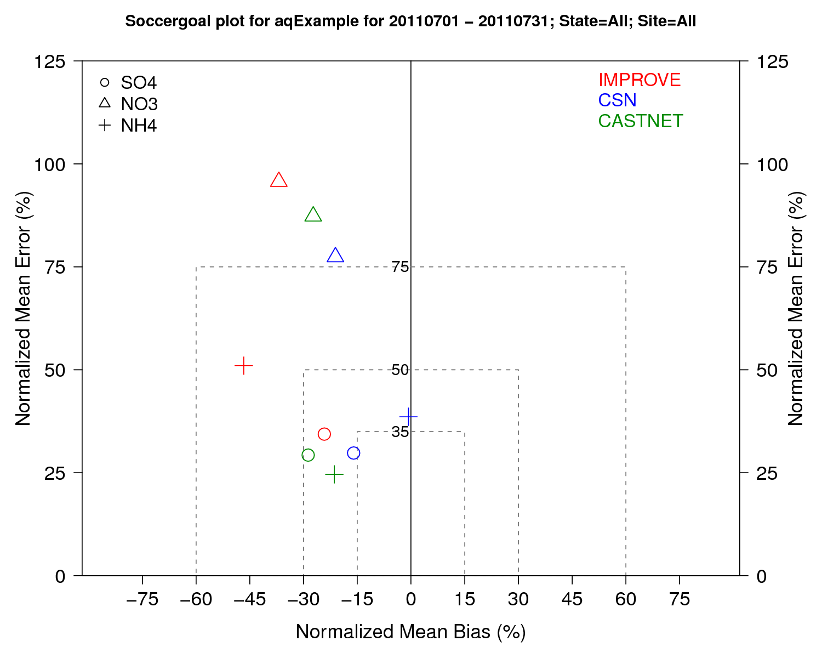
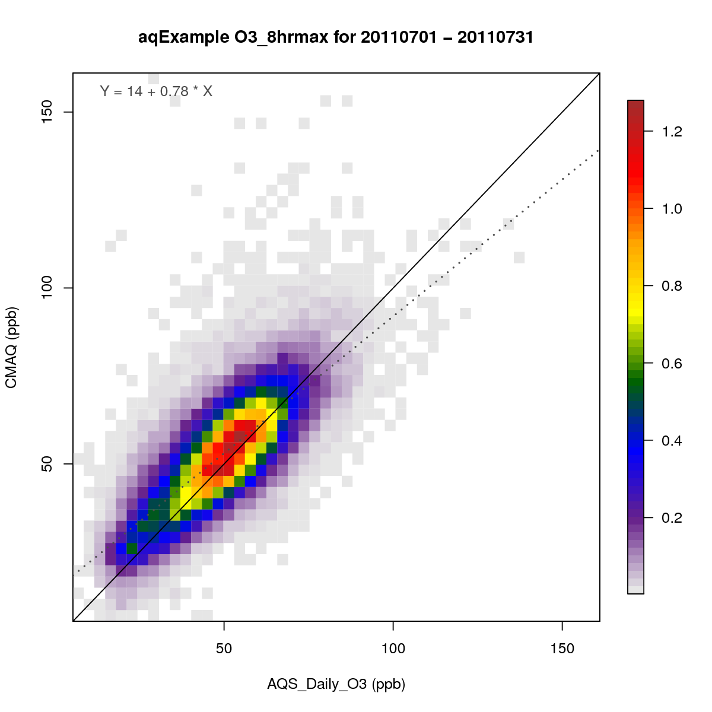
Examples of AMET-AQ Module Plots

Slide 6
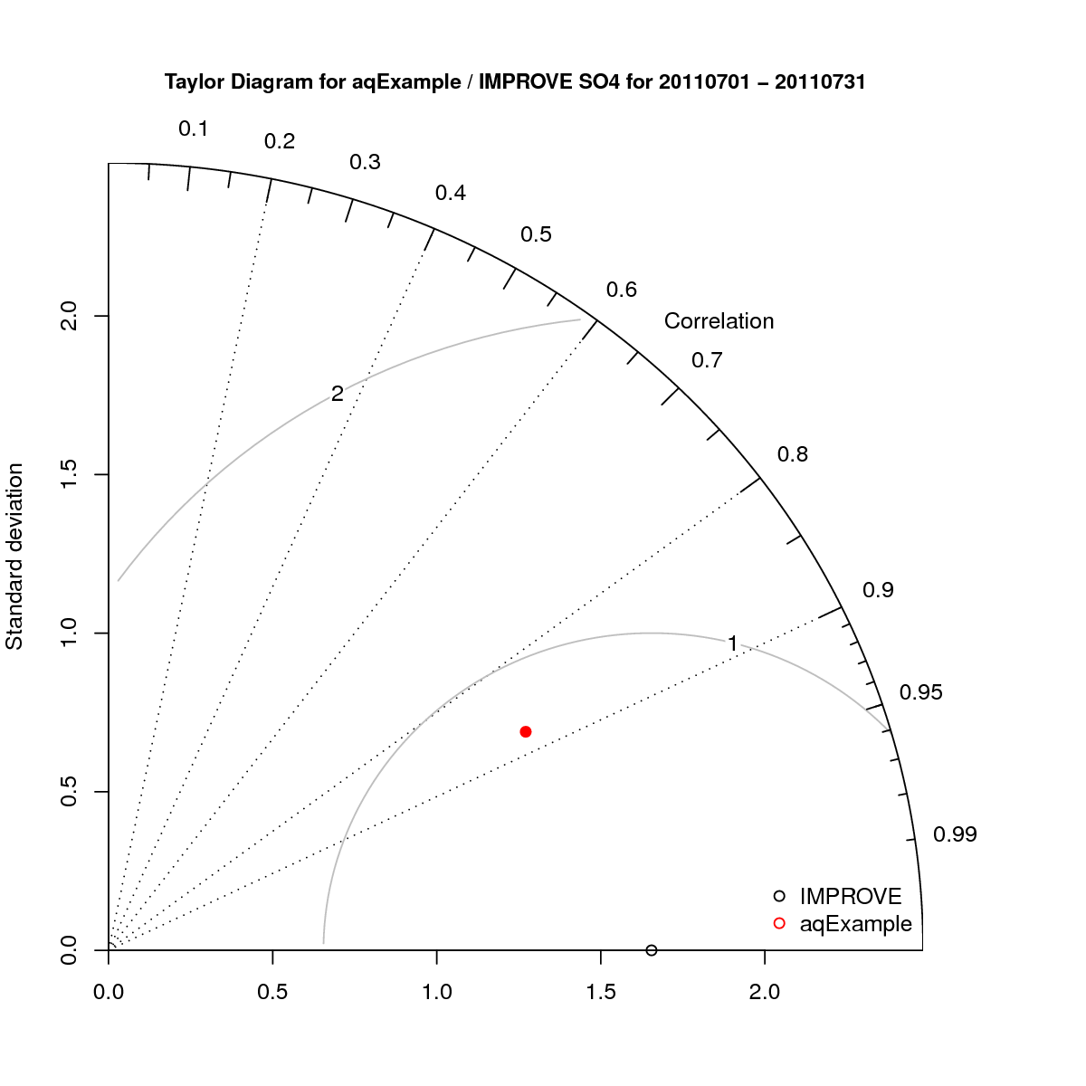
Key Updates to the AMETv1.3 MET and AQ Modules
GitHub version control repository
Easier development, maintenance, and distribution of code
All Perl code has been removed
Perl code has either been deprecated or replaced with R scripts
Database setup and project creation have been simplified
The number of required input files has been reduced
MySQL credential management has been made more robust
Improved MET and AQ data loading speed

Slide 7
Key Updates to the AMETv1.3 MET and AQ Modules
Direct read of MADIS netCDF observation files within R
Simple text file observation format for non-MADIS observations
Dynamic MET site accounting
Added support for the AMON, AIRMON and FLUXNET AQ networks
15 years of AMET compatible AQ observation files available for download
More robust and faster AQ data loading process
Added several AQ new analysis scripts
AMET-AQ “Batch” script for quickly and easily creating plots

Slide 8
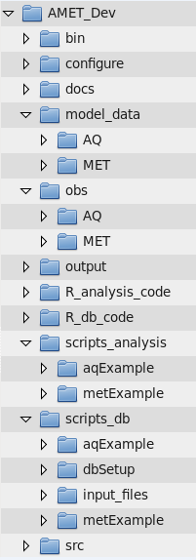
General Overview of AMET: GitHub Code Structure
- External AQ binaries
- R configuration file
- Documentation
- Model output
- Downloaded Met and AQ observations
- Output files for both AQ and MET
- R analysis code
- R model-observation matching code
- Analysis C-Shell scripts
- Model-observation matching and database management C-shell scripts
- Source code for AQ required executables

Slide 9
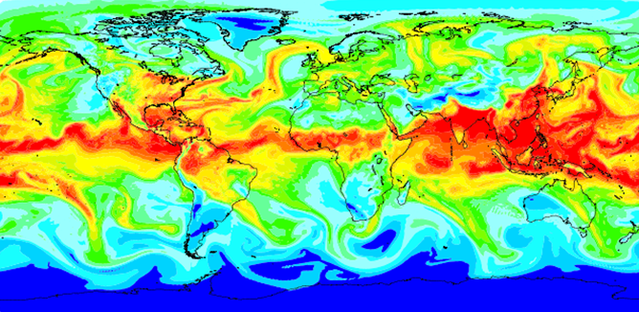
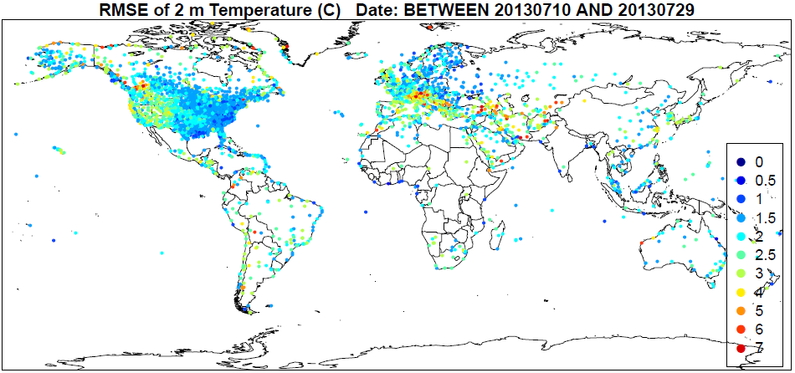
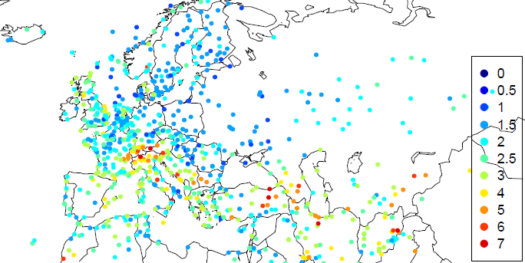
Key Features of AMETv1.3 MET Component
Model for Prediction Across Scales (MPAS) compatibility
MPAS-MADIS obs matching uses barycentric interpolation (center of mass triangulation of surrounding three center grid points implemented by Russ Bullock). Shown to improve statistics over nearest neighbor.
MADIS metar and maritime observation datasets now have global observations, so global model evaluation is doable for MPAS modelers.

Slide 10
Key Updates to the AMETv1.3 MET Module
Simplified project table and database management
Separate database and project creation scripts have been eliminated
Automatically generated (database and project tables) at run-time
Simpler version of the AutoFTP option for acquiring MADIS data
Now done within R using simple native download function
Only observation files that are not in the user’s archive are downloaded
Dynamic MET site accounting
Master site list is updated each observation file read with only new sites
Interpolation weights are only computed for new sites which improved speed
Existing sites and those outside of the model domain are automatically skipped
Option to auto-update “stations” meta-data table
Other updates include:
Automatic skipping of initialization times where diagnostic variables missing or zero
Ability to compare projects/model run time series from different databases

Slide 11
Workflow (MET): Matching Model with Observations
Go to project ID directory ($AMETBASE/scripts_db/) and update the observation-model matching run script matching_surface.csh to reflect new project.

Slide 12
Workflow (MET): Matching Model with Observations
Execute the run script matching_surface.csh
It’s suggested that VERBOSE = T for initial cases until users feel comfortable everything is running as it should
It’s necessary to set UPDATE_SITES = T for the first project or metExample project to populate the stations table (for spatial statistics plots)

Slide 13
Workflow: Statistical Analysis of WRF and MPAS
Analyze the WRF/MPAS-Observation paired data using analysis scripts
cp –r $AMETBASE/scripts_analysis/metExample $AMETBASE/scripts_analysis/myNewProject
Four canned scripts are provided: run_spatial_surface.csh, run_timeseries.csh, run_summary and run_daily_barplot.csh
Settings common across all four analysis scripts and any to follow
or png

Slide 14
Workflow: Statistical Analysis of WRF and MPAS
Settings
run_spatial_surface.csh
./input_files/spatial_surface.input
Outputs: - 2-m temperature, mixing ratio, 10-m wind speed and direction
- Index of agreement, RMSE, MAE and bias of each variable
- Text csv of site specific stats and R data file

Slide 15
Workflow: Statistical Analysis of WRF and MPAS
run_timeseries.csh
./input_files/timeseries.input
Outputs: - 2-m temperature, mixing ratio, 10-m wind speed and direction in 4 panel plot
- Index of agreement, MAE and bias
- Text (csv) of site timeseries and R data file
Settings

Slide 16
Workflow: Statistical Analysis of WRF and MPAS
run_summary.csh
./input_files/summary.input
Outputs: - 2-m temperature, mixing ratio, 10-m wind speed and direction
- Cumulative (all samples) and diurnal statistics
- Text (csv) of cumulative and diurnal statistics
Settings

Slide 17
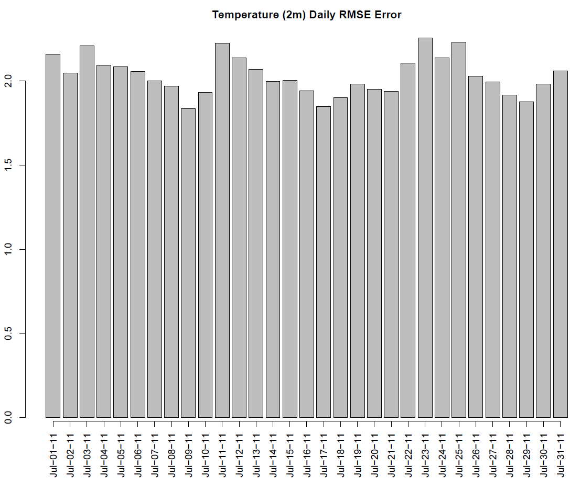
Workflow: Statistical Analysis of WRF and MPAS
run_daily_barplot.csh
./input_files/daily_barplot.input
Outputs: - 2-m temperature, mixing ratio, 10-m wind speed and direction (T, Q, WS, WD)
- RMSE, Correlation and bias
- Text (csv) and R data file
Settings
Text and Rdata file outputs are automatically generated… no setting to turn off.

Slide 18
Add-on MET Evaluation Components
Not all MET components in AMETv1.2 were converted from Perl to R
Development of the surface matching will make it fairly simple to add these components
Updates will be a simple replacement of (R_db_code/MET*) existing matching codes
Git-Hub archive will allow users to easily update and contribute code
RAOB
matching WRF/MPAS with 2-4 times daily rawinsonde soundings (θ, RH, WS, WD)
PROFILER:
Hourly PBL and tropospheric wind profiler matching with WRF/MPAS (θv, WS, WD)
SurfRad:
Shortwave radiation network obs matched with WRF/MPAS at various time scales
ACARS profiles
Aircraft profiler data (θv, WS, WD) matched with WRF/MPAS
PRISM precipitation:
Daily, monthly or episodic matching of WRF/MPAS output
4 km National gridded precipitation dataset from Oregon State University

Slide 19
Overview of the AMETv1.3 AQ Module
Designed to work directly with CMAQ output
Can be modified to work with any data though (e.g. water measurements)
Directly supports data from a number of routine networks
NA: AQS, IMPROVE, CSN, CASTNET, NADP, MDN, SEARCH, AMON, AIRMON, FLUXNET
Europe: AIRBASE, AURN, EMEP, AGANET, ADMN, NAMN
Stores each network separately for more robust analysis
Utilizes Site Compare to do the model/observation matching
Fortran based utility that is provided with CMAQ and AMET
Requires properly formatted observation files
These files are available for download (see next slide)

Slide 20
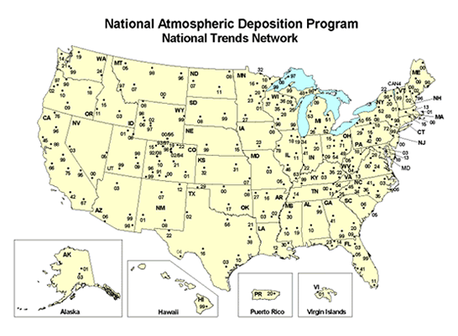
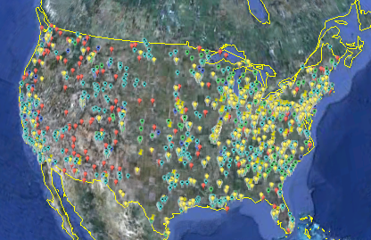
AMET-AQ Observation Data Files
Observations are paired with model data using Site Compare
Site Compare requires properly formatted data files
Unlike the AMET-MET module, AMET-AQ requires pre-generated observation files
User’s were previously given guidance on how to download and format these data
Now however, the AMET-AQ ready files are available for download directly
The CMAS Center has posted these data files on a Google drive
See the CMAS website for instructions on accessing these files
https://www.cmascenter.org/download/data.cfm (North American Air Quality Observation Data)
Note that while these data files are updated periodically, user’s may want to refer to the data source for latest data

Slide 21
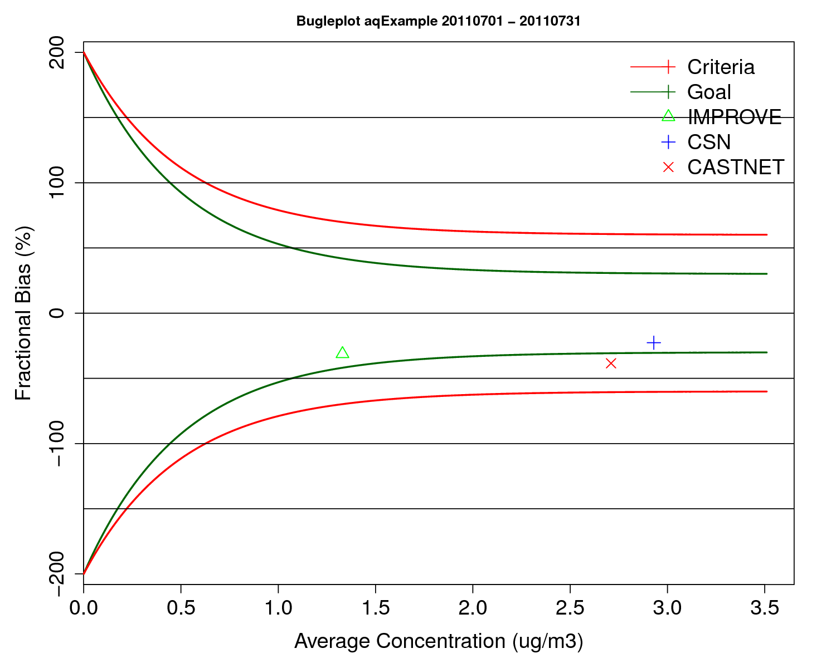
Key Updates to the AMETv1.3 AQ Module
Like the AMET-MET module, Perl code in AMET-AQ has been removed
Added support for the AMON, AIRMON and FLUXNET networks
More robust data loading process
Previously model species were predefined when a new project was created
Unused/unnecessary species were carried along
New method adds species as necessary
This makes it easier to add new species and networks to AMET-AQ
Data loading is also faster due to several code updates
Removed several input files required in AMETv1.2
Added several new analysis scripts and updated almost all the existing scripts

Slide 22
AMET-AQ Analysis
Various AQ analysis scripts
Required input files:
Each analysis script has
its own input file
CMAQ model data (combine files)
AMET-AQ Initialization (database setup)
create_amet_user.csh
delete_db.csh
Required input files:
None
AMET-AQ Project
(project creation and database population)
aqProject.csh
Required input files:
AQ_species_list.input
sites_meta.input
AMET-AQ Batch Analysis
Single AQ analysis script
Required input files:
Single input file
AMET Web Interface (Beta)
PHP based webpage interface for AMET-MET and AMET-AQ
Will be provided as beta code via GitHub for testing
Observation data (CMAS center website)

Slide 23
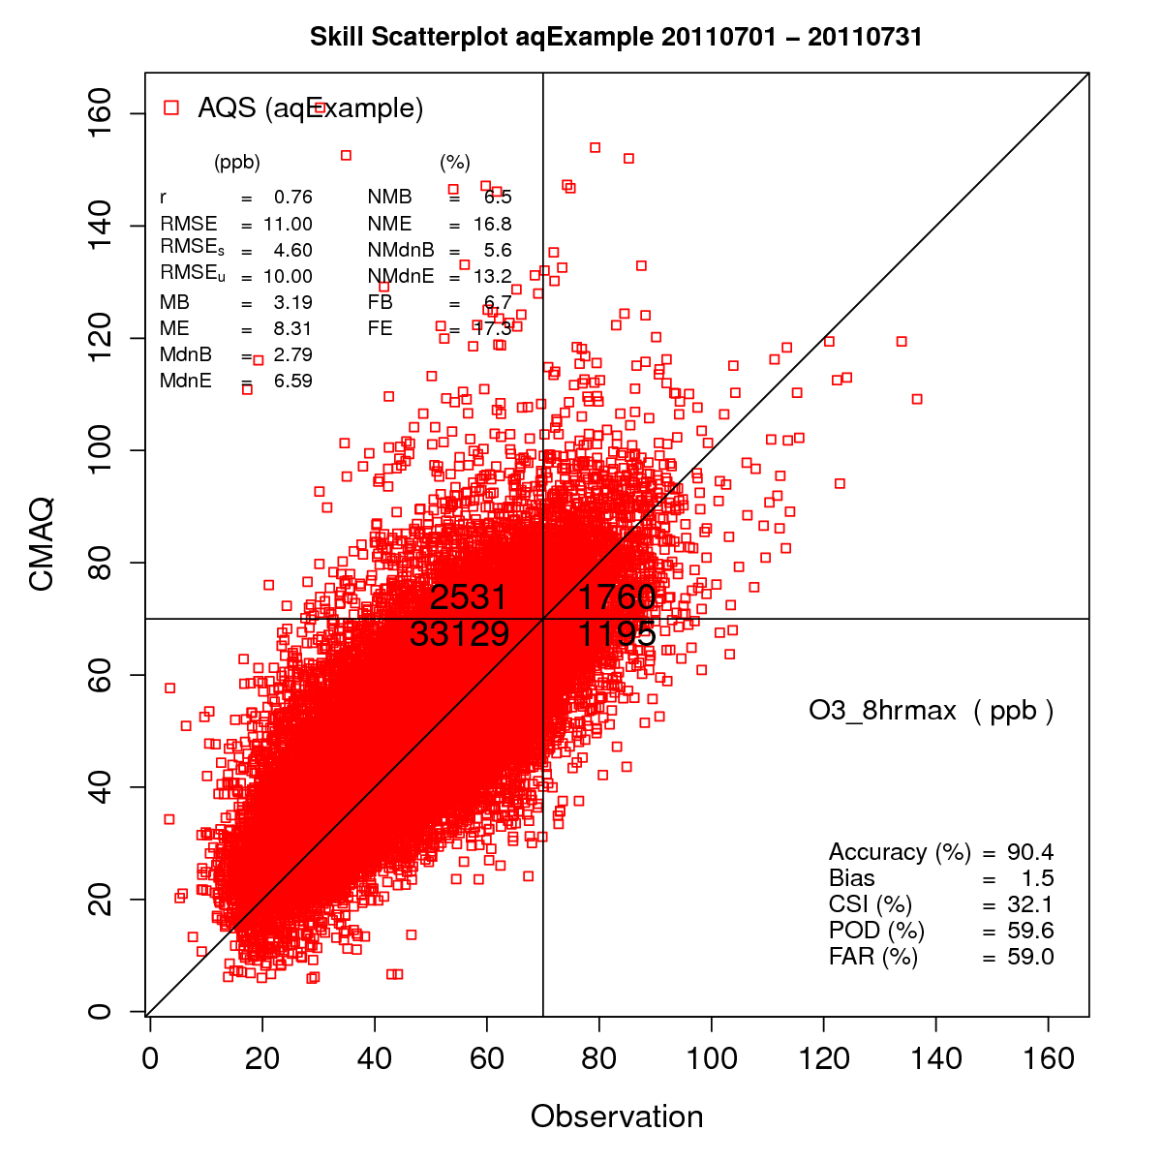
AMETv1.3 AQ Module Query/Plot Options
Temporal specific queries
Date range; specific year, month or day; day of week; hour of day; etc.
Spatial specific queries
State(s); RPOs; pre-defined regions; lat/lon box
Data specific queries
Query based on model/ob value
Cross query with other data
Custom queries can also be created
Can create queries based on any data in the database
Many plots are customizable
Control data ranges, colors, symbols, titles, etc.

Slide 24
Analysis Scripts in the AMET-AQ Module
Boxplot
Hourly
Day of Week
MDA8
Roselle
Solar Radiation
Bugle Plot
Histogram
Overlay File
Spatial Plot
Difference
Model to Model
Ratio
Monthly Stat Plot
Raw Data
Scatter Plots
Binned
Density
Model to Model
Percentiles
Single Network
Forecast Skill
Soil
“Soccergoal” Plot
Spectral Analysis
Stacked Bar Plots
AERO6
Panel
AERO6 Panel
Soil
Stats and Plots
Temporal
Time Series
Model to Model
Multi-Network

Slide 25
Batch Processing Analysis in the AMET-AQ Module
A new “batch processing” analysis script in AMET-AQ in v1.3
Allows for “mass production” of plots using a single script
User can select which plots to create
Utilizes a single namelist file
Can produce all available AQ analysis plots
Neatly organized directory tree is created
Removes the need for configuring and running individual analysis script
Batch script will be part of a unified post-processing script for CMAQ
Currently developing a “master” CMAQ post-processing script
Single script to run combine, site compare and create batch plots
Will not require AMET to be installed (but more options with AMET installed)

Slide 26
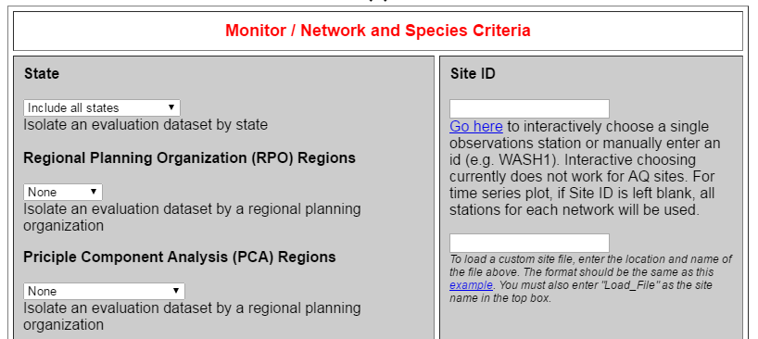
Web-based Graphical User Interface for AMET
Web based (PHP) GUI for AMET
Project selection through a drop-down menu
Easy selection of plotting options
Sub-setting of sites/locations
Overlays on top of existing AMET release code
Requires two additional configuration files
No other AMET code modifications required
Does require user to run Apache web-server
Beta version will be made available on Git-Hub
Limited support available
Web-based GUI has been used at EPA for years with good success

Slide 27
Obtaining AMET and Documentation
AMET now resides in a GitHub repository
https://github.com/USEPA/AMET/tree/master
AMET versions 1.2 and 1.3 are currently available there
Release notes available on AMET GitHub main page
AMET code is also linked from the CMAS Center website
Installation and User’s guides available
https://github.com/USEPA/AMET/blob/1.3/docs/AMET_Users_Guide_v1.md
https://github.com/USEPA/AMET/blob/1.3/docs/AMET_Install_Guide_v13.md
A development space will added to the AMET GitHub repository
Space where user contributed code can be shared
AMET web interface code (beta version) will initially reside here

Slide 28
Obtaining AMET and Documentation

Slide 29
Thanks to:
Zac Adelman (UNC)
Code testing and documentation
Kristen Foley (EPA)
Endless help with GitHub
Ben Murphy (EPA)
Also helped with GitHub
Christian Hogrefe (EPA)
Support for AMET-AQ tools

