Slide 1
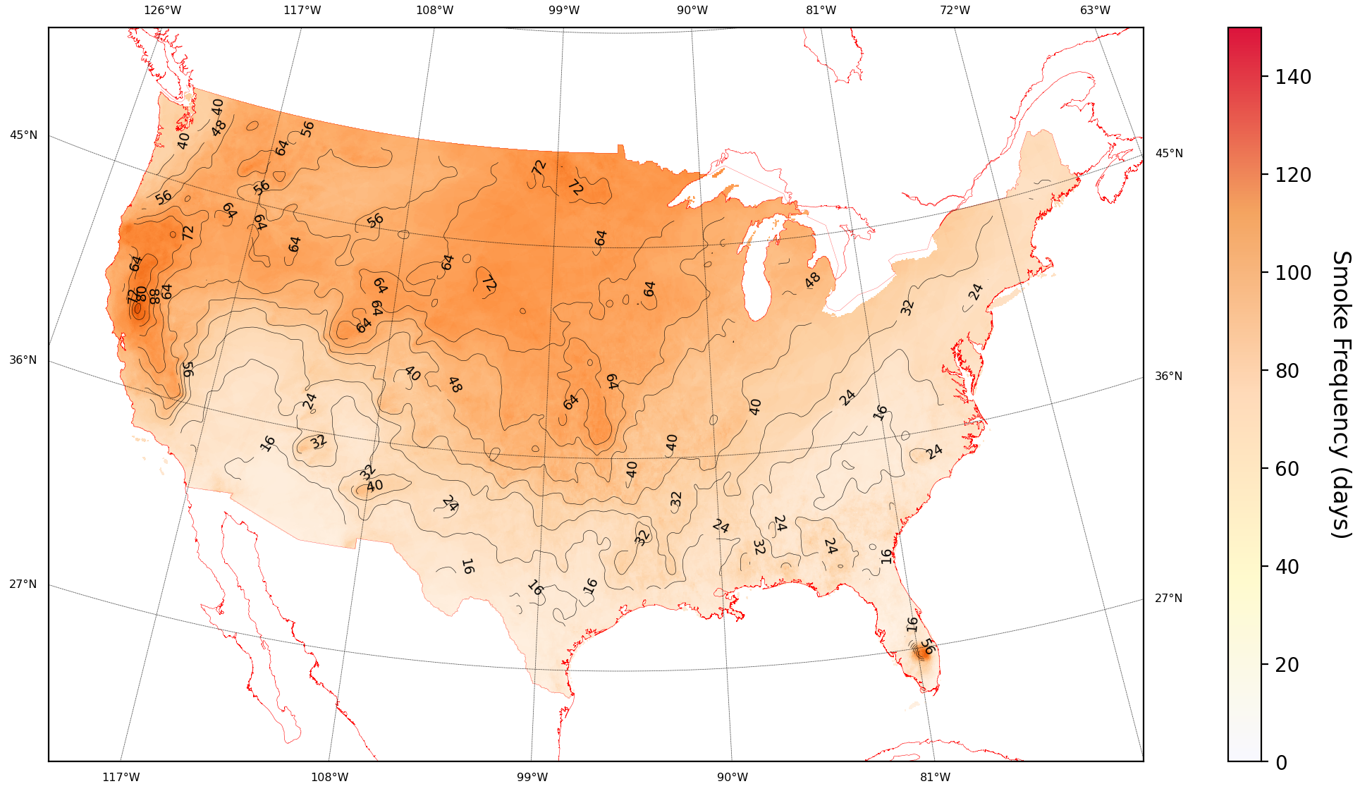
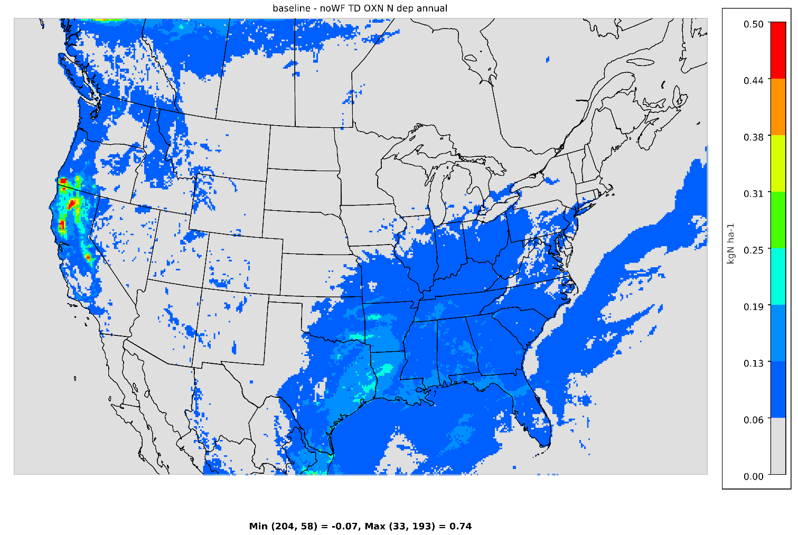
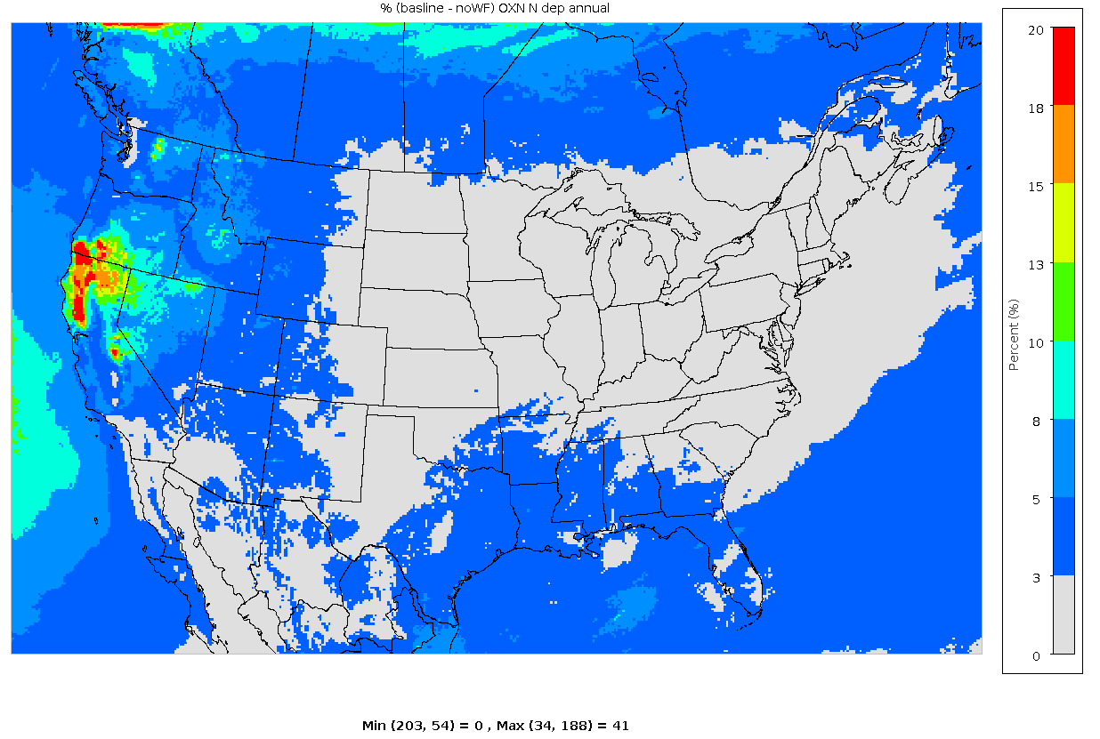
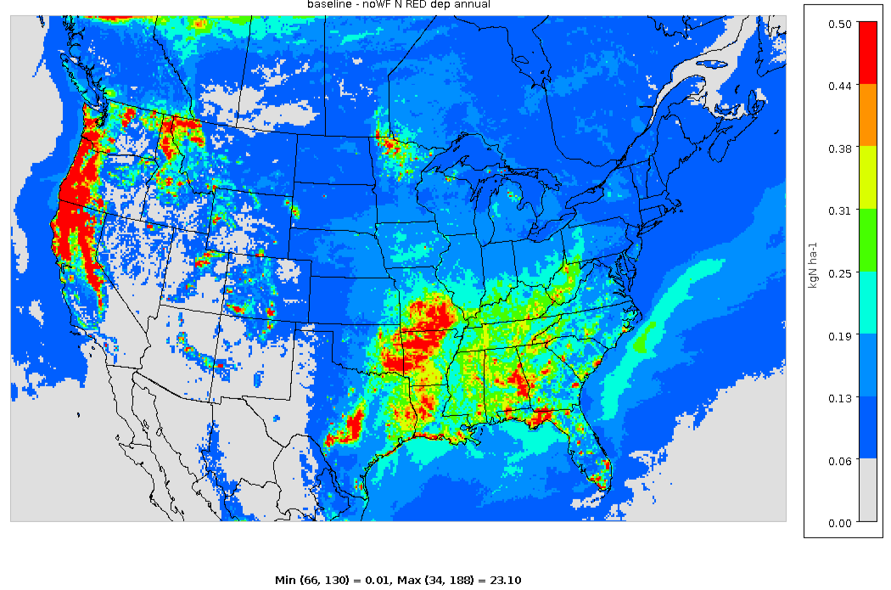
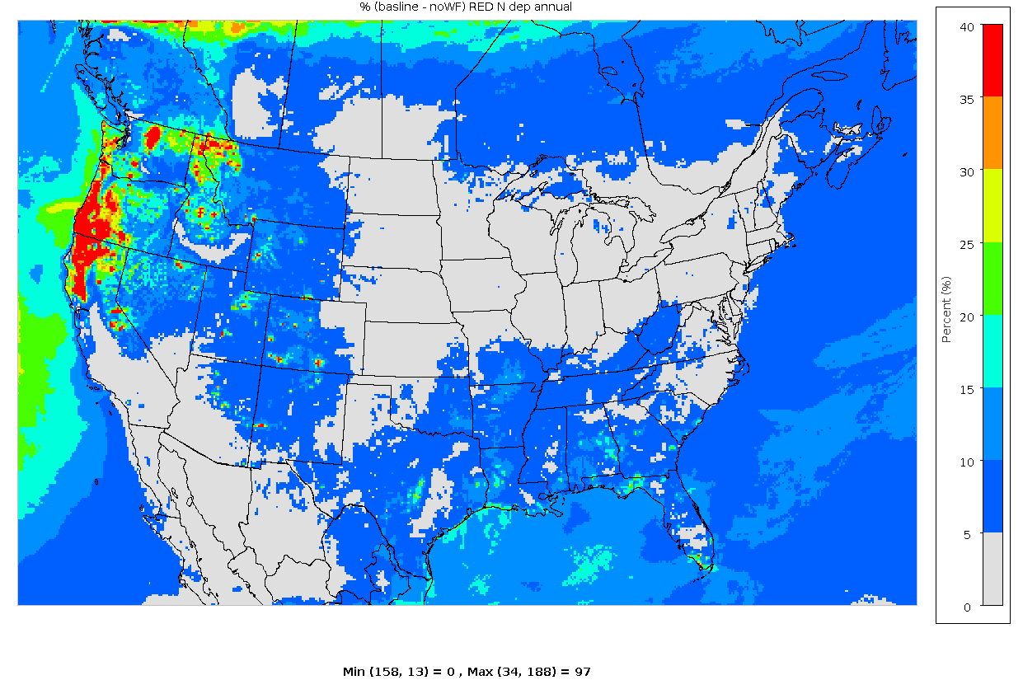
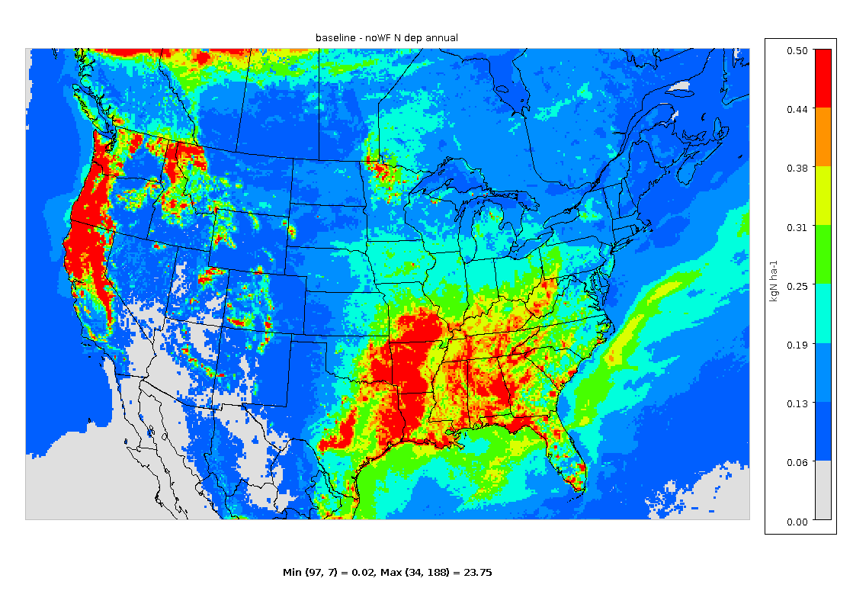
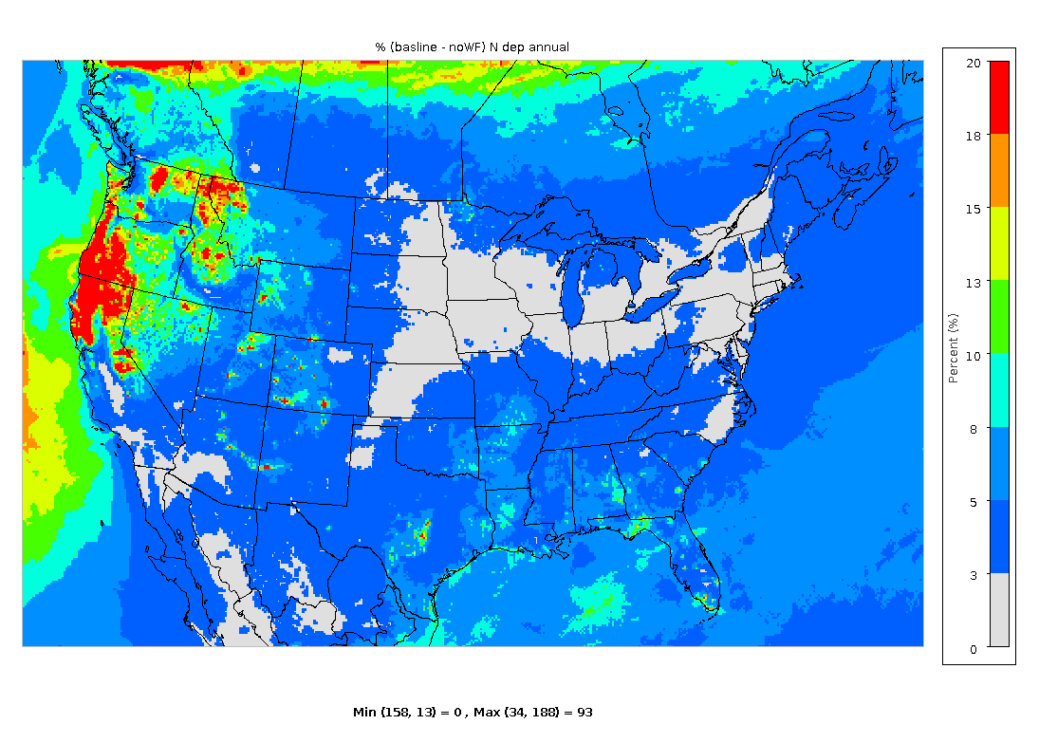
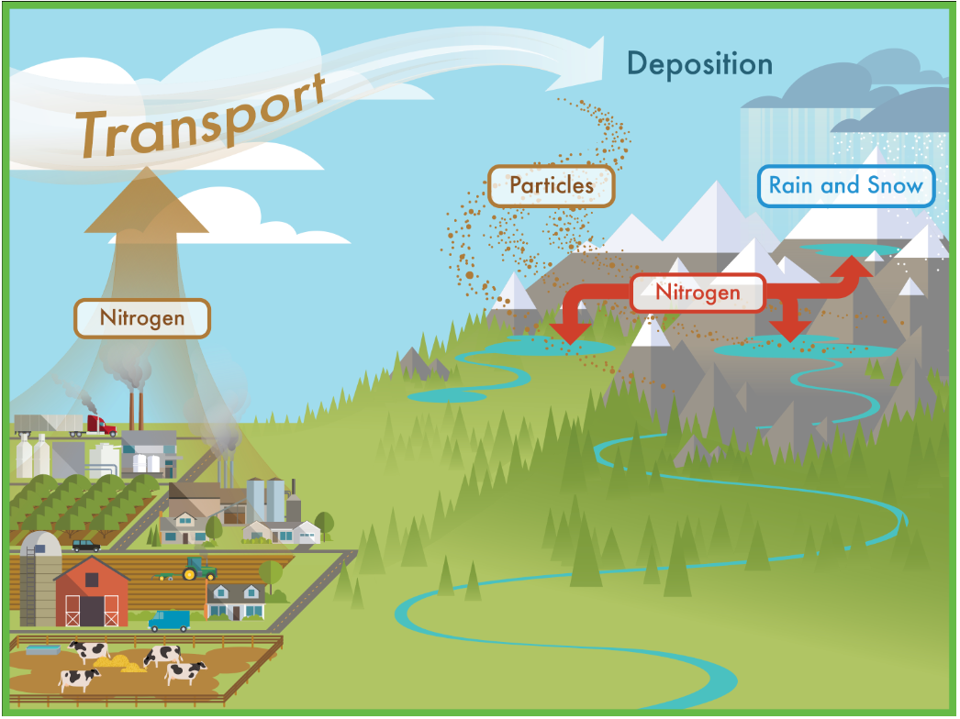
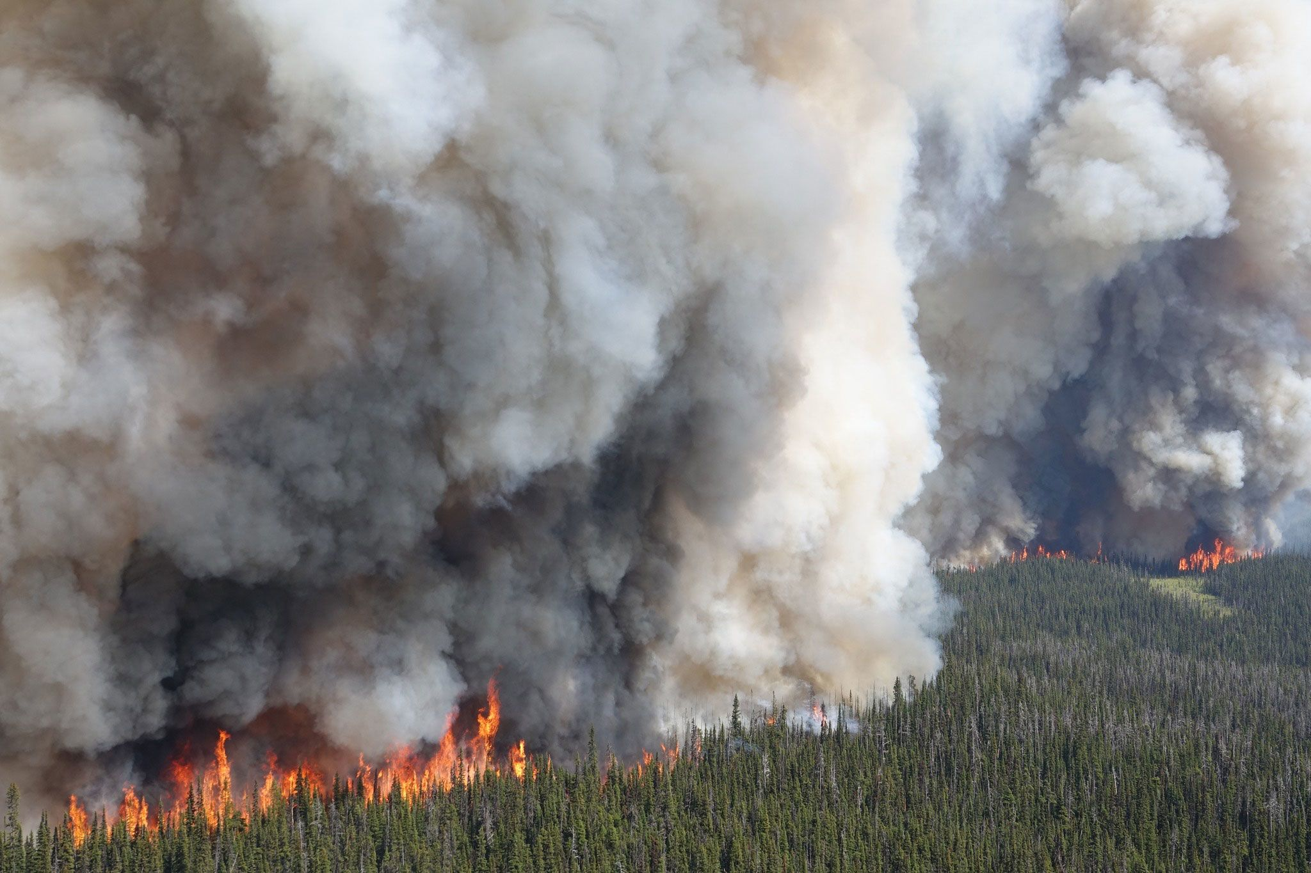
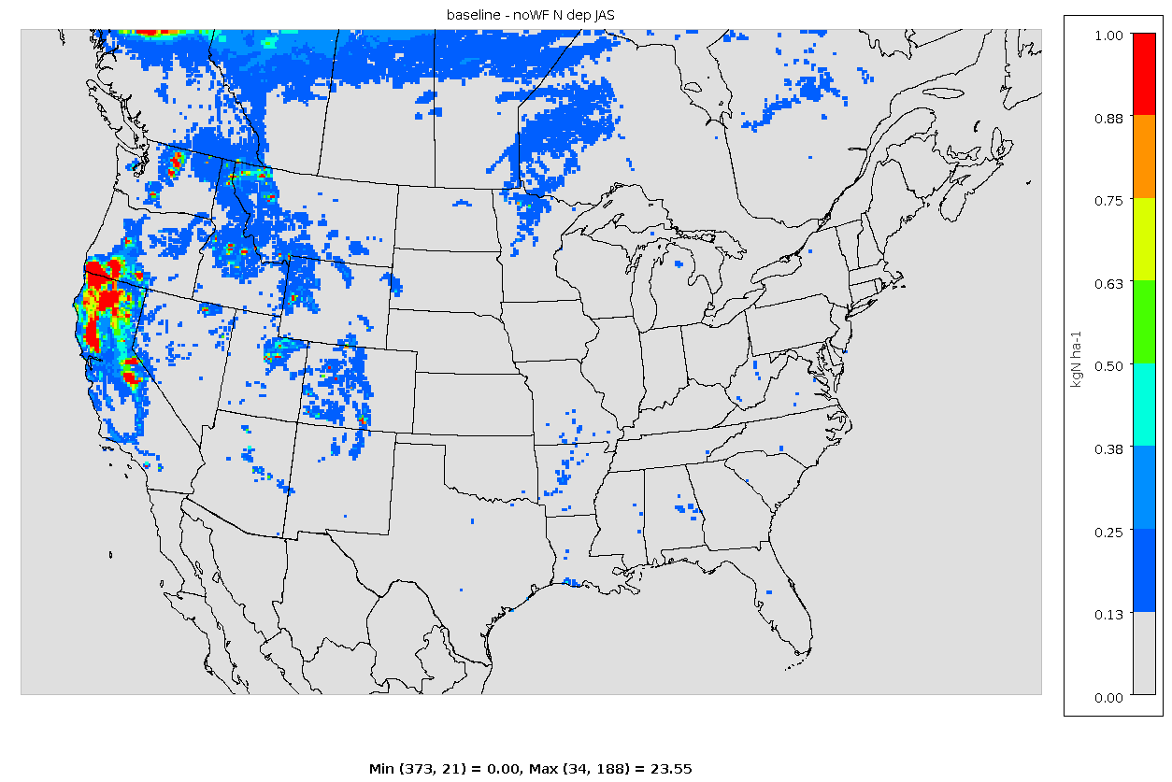
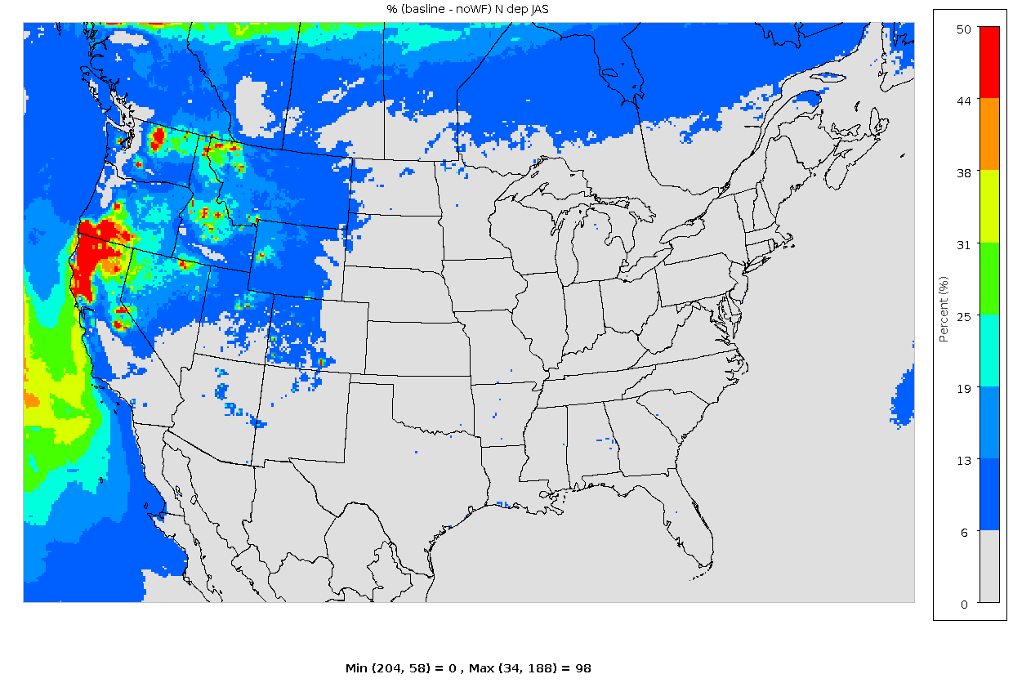
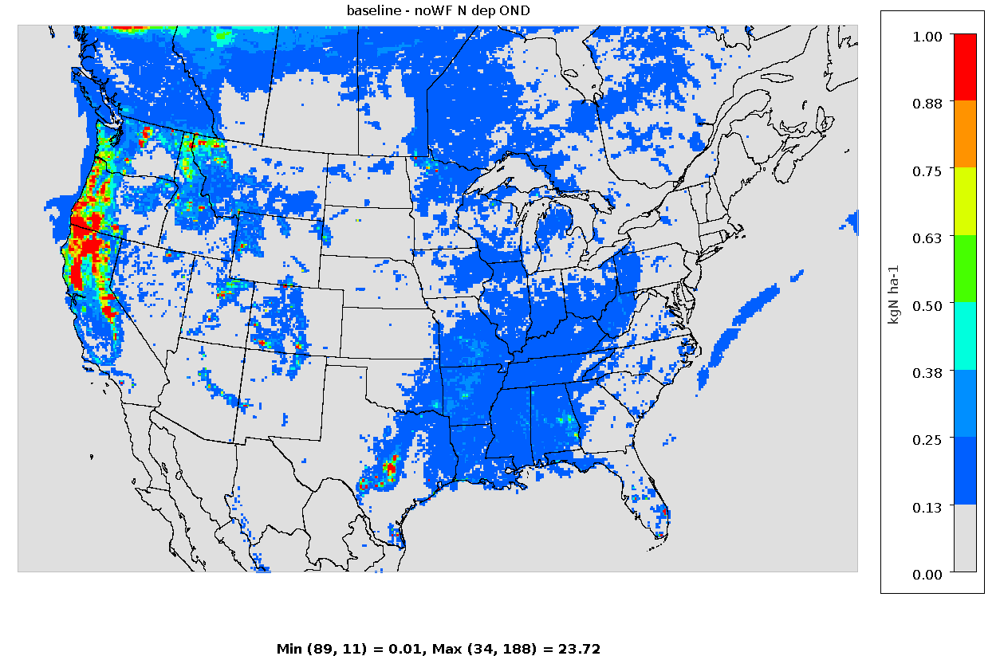
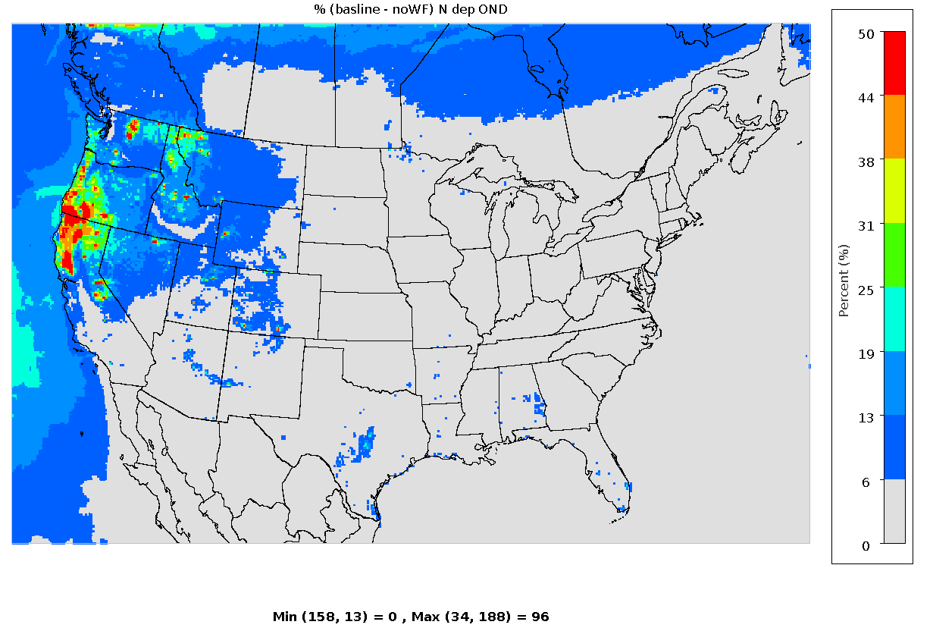
CMAQ estimates of nitrogen deposition
from wildfires across the contiguous United States
Anne Barkley¹, Uma Shankar², Nicole Olson¹, Irena Pavlovic³, Stephen LeDuc², Janice Brahney⁴, Jiahao Wen⁴, Douglas Hamilton⁵
¹Health and Environmental Effects Division, Center for Public Health and Environmental Assessment (CPHEA), Office of Research and Development (ORD), U.S. EPA;
²Integrated Climate Sciences Division, CPHEA, ORD, U.S. EPA; ³Region 9, U.S. EPA; ⁴Utah State University; ⁵North Carolina State University
Burned Area Boundaries and Smoke in 2018
CMAQ Results
Background
Martin Fire
South Sugarloaf
Results: Particle types from North Africa
Oxidized and reduced wildfire N deposition in 2018
Wildfires (WF) have been increasing in recent decades due to climate change, particularly in the western U.S.¹
Atmospheric deposition from WF smoke can be an important source of nutrients like nitrogen (N), particularly for remote and aquatic ecosystems²
Nutrient deposition from WF smoke has been linked to exceedances in critical loads, and potentially negative ecosystem outcomes such as freshwater eutrophication and harmful algal blooms^{3,4} as well as decreased growth and survival of trees⁵
Over the past century, anthropogenic activities have increased nutrient deposition close to thresholds at which ecological damage can occur, meaning that additional inputs of nutrients can cause environmental impact⁶
With WF reaching unprecedented levels in recent years, it is important to update nutrient deposition estimates to more fully understand how climate change is impacting ecosystems
Klondike Fire
Carr Fire
Ranch Fire
Natchez Fire
Camp Fire
Figure 2. WF burned area in 2018 from Monitoring Trends in Burn Severity.
Figure 3. Cumulative smoke distribution in 2018 from NOAA Hazard Monitoring System.
Range = [-0.07 – 0.74 kg/ha]
Range = [0 – 41%]
There were 58,083 WF in 2018, with 8,767,492 total acres burned (https://www.nifc.gov/fire-information/statistics/wildfires)
The largest WFs in the west were (in decreasing order): Martin (NV), Ranch (CA), South Sugarloaf (NV), Carr (CA), Klondike (OR), and Camp (CA) Fires. The Natchez Fire (CA) 1/10th the size of Carr.
Figure 6. Annual absolute (left) and relative (right) contributions of WFs to CMAQ modeled oxidized N deposition (kg N/ha) during 2018.
CMAQ Results
Total wildfire N deposition in 2018
Range = [0.01 – 23.10 kg/ha]
Range = [0 – 97%]
Figure 7. Annual absolute (left) and relative (right) contributions of WFs to CMAQ modeled reduced N deposition (kg N/ha) during 2018.
Figure 1. Schematic showing WF smoke deposition to freshwater ecosystems.
Source: Adapted from the National Park Service.
Contributions from WF of total oxidized N deposition dominated in the West, contributing up to 0.74 kg/ha in northern CA and accounting for up to 41% of total oxidized N deposition.
WFs are the dominant source of reduced N deposition in parts of the West, contributing up to 97%. These results are complementary to Benish et al.⁸ who show increases in reduced N deposition in parts of the western U.S.
Range = 0.02 – 23.75 kg N/ha
Range = 0 – 93%
Figure 4. Annual absolute (left) and relative (right) contributions of WFs to CMAQ modeled N deposition (kg N/ha) during 2018.
Annual total N deposition from WF was highest in the western U.S., reaching nearly 24 kg/ha in northern CA.
The Ranch, Carr, Klondike, Natchez and Camp Fires contributed >20 kg N/ha near or directly downwind.
WF dominated total N dep in the West, contributing up to 93% in parts of northern CA and southern OR.
Hotspots of N deposition in the West accounted for a large fraction of total N deposition. In the eastern U.S., N deposition from WF only accounted for up to ~13% of total N deposition.
Discussion and future work
Contributions of N deposition from WF during 2018 were ecologically significant (i.e., >0.5 kg/ha/yr).
Most of the West has lower critical loads (~2.5 kg N/ha/yr) than the eastern U.S.⁶ Our data show that WF alone can cause exceedances in critical loads near and immediately downwind of WFs, with deposition rates 10x greater than the critical load.
WF size did not always correlate with total N deposition, e.g., the Natchez Fire contributed the highest total N deposition but was 1/10th the size of the Carr Fire, suggesting N dep is influenced by other factors (met, veg type).
Goal: Evaluate and quantify N deposition from wildfire smoke emissions using CMAQ model simulations across the contiguous U.S. during 2018, a high fire year
Seasonal total wildfire N deposition
Jul – Sep (JAS)
Jul – Sep (JAS)
Total N deposition from WF was higher in the second half of the year (Jul – Dec).
The largest effects were in northern CA, southern OR, central WA, and the Sierra Mountains.
WF contributed up to >95% of total N deposition in parts of northern CA and southern OR in both seasons.
Fire season (and thus N deposition) remained elevated into Fall. For example, the Klondike Fire in OR burned Jul – Nov and the Camp Fire in CA started in early Nov.
Methods
We plan to extend our analysis by comparing our results from 2018 to those from 2008-2012⁵ to assess temporal trends in N deposition from WF; quantify phosphorus deposition from wildfires will be quantified using P to EC ratios, similar to Mahowald et al.²; and evaluate ecological impacts of deposition results in downwind water bodies.
Simulations were run using CMAQv5.3.2 at a 12-km horizontal resolution over the contiguous U.S. for 2018 configured with the Surface Tiled Aerosol and Gaseous Exchange (STAGE) bidirectional deposition scheme⁷.
The baseline simulation “CMAQ_{FIRE}” was run to include all emission sources.
This simulation is the same as the EQUATES dataset, and elemental carbon (EC) deposition results were cross-checked against the EQUATES dataset.
A sensitivity test simulation “CMAQ_{NOFIRE}” was performed excluding WF.
N deposition from only WF smoke was determined by calculating CMAQ_{FIRE} – CMAQ_{NOFIRE}.
N deposition was grouped annually and seasonally.
Species included in total N deposition were oxidized species NO_{x}, PANs, organic nitrates, HONO, N₂O₅, TNO₃, and reduced species NH_{x}
Range = 0 – 98%
Acknowledgements
Oct – Dec (OND)
Oct – Dec (OND)
We thank Kristen Foley, Christian Hogrefe, Wyat Appel, Ben Murphy, James Beidler, Shannon Koplitz, George Pouliot, and Byron Rice for their helpful guidance and discussions.
References
Abatzoglou, J.T., and Williams, A.P. Impact of anthropogenic climate change on wildfire across western US forests. (2016). Proc. Natl. Acad. Sci. U.S.A. 113-11770-11775.
Mahowald, N., Jickells, T.D., Baker, A.R., Artaxo, P., Benitez-Nelson, C.R., Bergametti, G., Bond, T.C., Chen, Y., Cohen, D.D., Herut, B., Kubilay, N., Losno, R., Luo, C., Waenhaut, W., McGee, K.A., Okin, G.S., Siefert, R.L., Tsukuda, S. Global distribution of atmospheric phosphorus sources, concentration, and deposition rates, and anthropogenic impacts. (2008). Glob. Biogeochem. Impacts. 22, GB4026.
Olson, N.E., Boaggio, K.L., Rice, R.B., Foley, K.M., LeDuc, S.D. Wildfires in the western U.S. are mobilizing PM2.5-associated nutrients and may be contributing ton downwind cyanobacteria blooms. (2023). Environ. Sci: Processes Impacts.
Brahney, J., Mahowald, N., Ward, D.S., Ballantyne, A.P., Neff, J.C. Is atmospheric phosphorus pollution altering global alpine lake stoichiometry? (2015) Glob. Biogeochem. Cycles. 29, 1369-1383.
Koplitz, S.N., Nolte, C.G., Sabo, R.D., Clark, C.M., Horn, K.J., Thomas, R.Q., Newcomer-Johnson, T.A. The contribution of wildland fire emissions to deposition in the U.S.: implications for tree growth and survival in the Northwest. (2021) Environ. Res. Letters. 16, 024028.
Clark, C.M., Phelan, J., Doraiswamy, P., Buckley J., Cajka, J.C., Dennis, R.L., Spero, T.L. Atmospheric deposition and exceedances of critical loads from 1800-2025 for the conterminous U.S. (2018). Ecol. Appl. 28, 978-1002.
Appel, K. W., Bash, J. O., Fahey, K. M., Foley, K. M., Gilliam, R. C., Hogrefe, C., Hutzell, W. T., Kang, D., Mathur, R., Murphy, B. N., Napelenok, S. L., Nolte, C. G., Pleim, J. E., Pouliot, G. A., Pye, H. O. T., Ran, L., Roselle, S. J., Sarwar, G., Schwede, D. B., Sidi, F. I., Spero, T. L., Wong, D. C. (2021) The Community Multiscale Air Quality Model Version 5.3 and 5.3.1: System Updates and Evaluation, Geosci. Model Dev.
Benish, S. E., Bash, J. O., Foley, K. M., Appel, K. W., Hogrefe, C., Gilliam, R., Pouliot, G. Long-term regional trends of nitrogen and sulfur deposition in the United States from 2002 to 2017, (2022). Atmospheric Chemistry and Physics
United States Environmental Protection Agency. (2021). EQUATESv1.0: Emissions, WRF/MCIP, CMAQv5.3.2 Data -- 2002-2017 US_12km and NHEMI_108km [Dataset], UNC Dataverse
Range = 0 – 96%
Figure 5. Absolute (left) and relative (right) contributions of WFs to CMAQ N modeled deposition (kg N/ha) during the Summer (JAS; top) and Fall (OND; bottom) fire seasons.
The views expressed in this poster are those of the authors and do not necessarily represent the views or policies of the U.S. Environmental Protection Agency.

