Slide 1

Dynamic Coupling of Meteorologically-induced (MetEmis) NH₃ Livestock Emissions with CMAQv5.4
NOAA JTTI (Joint Technology Transfer Initiative) Project
Bok. H. Baek, Siqi Ma, Chi-Tsan Wang, Youhua Tang, Patrick Campbell, and Daniel Tong
George Mason University
CMAS 2024, Chapel Hill, NC

Slide 2
Dynamic Coupling of MetEmis Emission Sources
Meteorologically-induced Emission (MetEmis) Coupler Module that allows dynamically estimate emissions with local meteorological conditions
  Onroad Mobile Emissions
  Agricultural Livestock Emissions
Process-based Emissions Models are needed for dynamical coupling with the CTM systems
  U.S. MOVES that estimates spatiotemporal emissions as function of vehicle-fuel-specific emissions factors, various traffic activities and local ambient temperature and humidity
  Farm Emissions Model (FEM) that estimates NH₃ and VOC emissions as a function of animal-specific emission factors, animal population, farm management practices, and local ambient temperature, wind speed, and precipitations
Not practical to compute emissions from MetEmis sources as an inline module within the CTM due to its complex data requirements and computational resource requirements
CMAQ-MetEmis: Dynamic MetEmis Coupler Module for CMAQ
  CMAQ-MetEmis_MB for Moblile Sources
  CMAQ-MetEmis_LV for Livestock Waste Sources

Slide 3
CMAQ-MetEmis
Developed a new CMAQ inline coupler for Meteorologically-induced Emissions sources (MetEmis)
MetEmis_TBL: Pseudo-layered Temperature-bin Gridded Hourly Emissions (Not Emission Factors)
Dynamically estimate the emissions by interpolating the gridded emissions between the temperature-bins
No computational burden for CMAQ to process Pseudo-layered Temperature-bin Gridded Hourly emissions
Completed CMAQ-MetEmis_MB development based on MOVES Emissions
  Show the MPE improvement on finer spatial resolution CTM simulations
For Livestock waster sector, followed the same MetEmis approach with additional met variable of precipitation which could lower the NH₃ emissions
(Baek et al., GMD 2023)

Slide 4
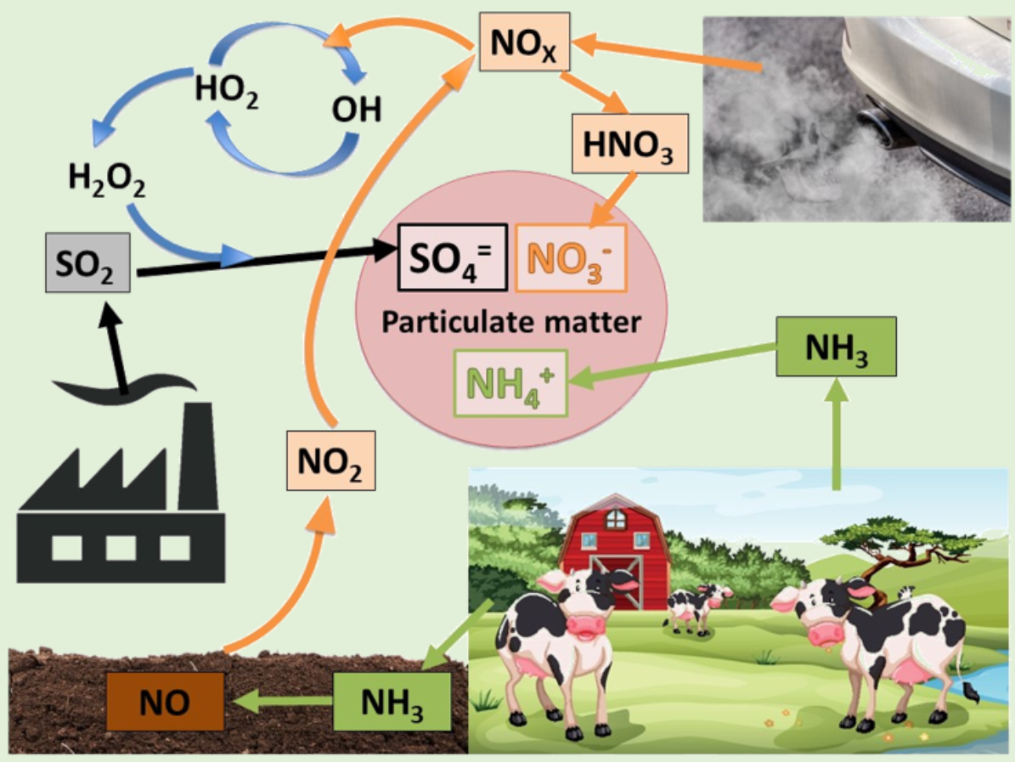
Gas-to-Particle Conversion between NH₃, and Acid Gases
Ammonia: NH₃
Most alkaline pollutants in the atmosphere neutralize the acid gases
Acid Gases: H₂SO₄, HNO₃ and HCl
Acidification of soils and acid rains
Mostly from anthropogenic emissions
Fine Particles: PM_{2.5}
Formed from reactions with Ammonia and Acid Gases
Key emission sector to control the secondary inorganic aerosol (SIA)
But, unlike many controlled emissions, NH₃ emissions from livestock waste is projected to grow in the future
(Stiles, Farming Connect, 2020)

Slide 5
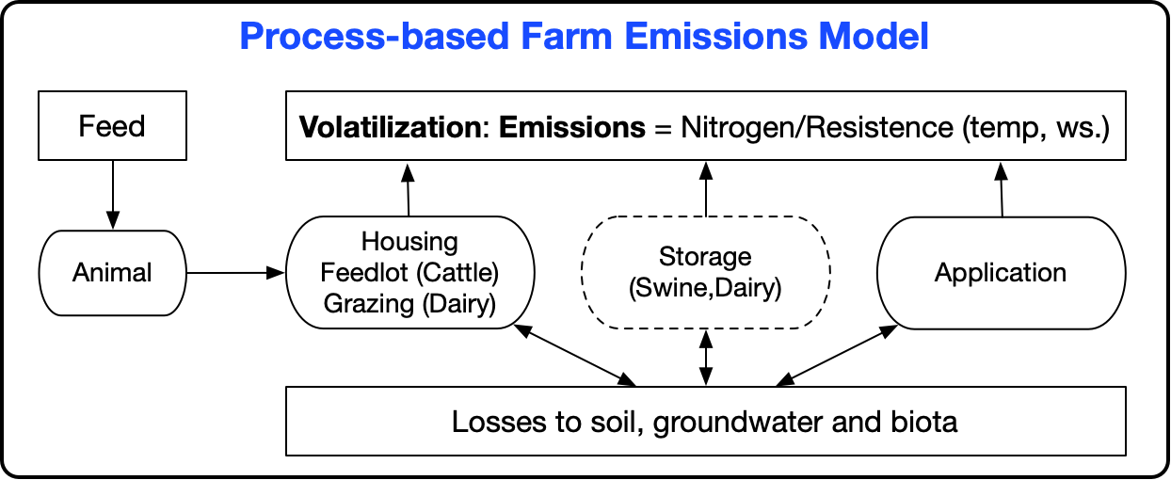
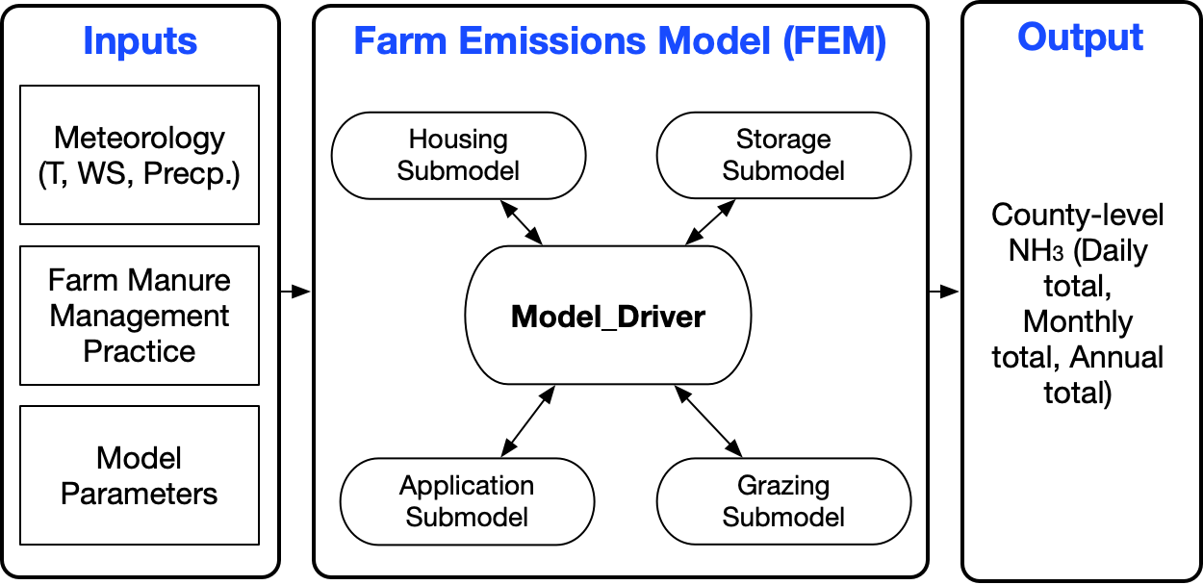
Farm Emission Model (FEM)
Manure types : Dairy, Cattle, Poultry and Swine
  Nitrogen Inputs (manure and urine), Dryness of excretion, Surface for housing /storage, Runoff area,,,,
  pH plays a critical role in NH₃ from housing and storage
Management Practices
  Housing: tiestall, freestall, deep/shallow-pit, manure-belt,,,,
  Storage: lagoon, earthbasion, and slurry tank
  Application: irrigation, injection, training hose, broadcast
  Grazing: seasonal, monthly, weekly, daily.
Meteorology
  Temperature → NH₃ emissions
  Wind speed → NH₃ emissions
  Precipitation → NH₃ emissions
(Pinder et al., 2004)

Slide 6
FEM Submodel Data Flow Diagram
Inputs
Outputs
Submodel
(e.g. swine storage)
For confined animal housing:
﻿r_{s} = H₁ + H₂T
For Beef open feedlots housing:
r_{s} = H₁T + H₂u + C
: H1 and H2 are constants and tuned to capture variability due to temperature and wind speed
Nitrogen and water
From literature or previous submodel
Daily Average Emission Factor
Adjusted parameters
Nitrogen and water balance
(goes to next submodel)
Meteorological data
(temp., WS, precip)
FEM has been used for the official livestock waste emission sector for U.S. EPA NEI since 2014
EF = {A*[TAN]*H} / r
r = r_{a} + r_{b} + r_{s}
r_{a} =Aerodynamic resistances
r_{b} =Quasi-laminar resistance
r_{s} = Surface resistance: Tuned to match measured EFs from observations
Hutchings et al (1996) A model of NH₃ volatilization from a grazing livestock farm

Slide 7
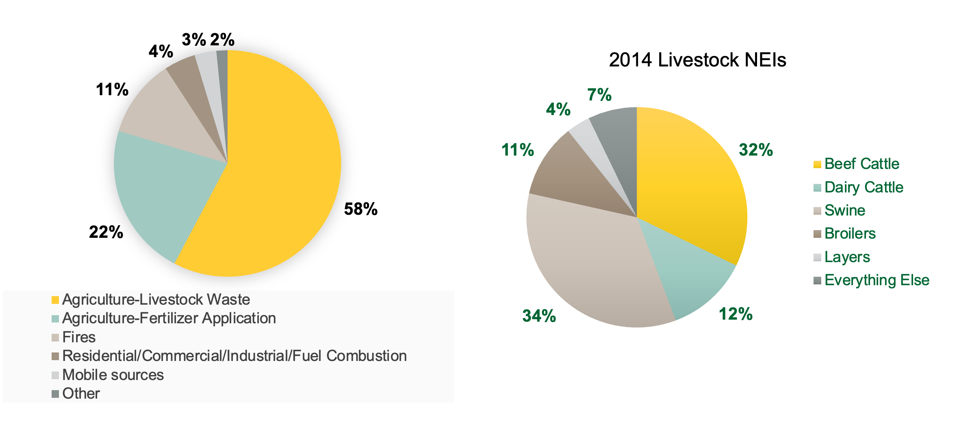
Contributors of NH₃ Emissions in the U.S. (2019)
(?)
(?)

Slide 8
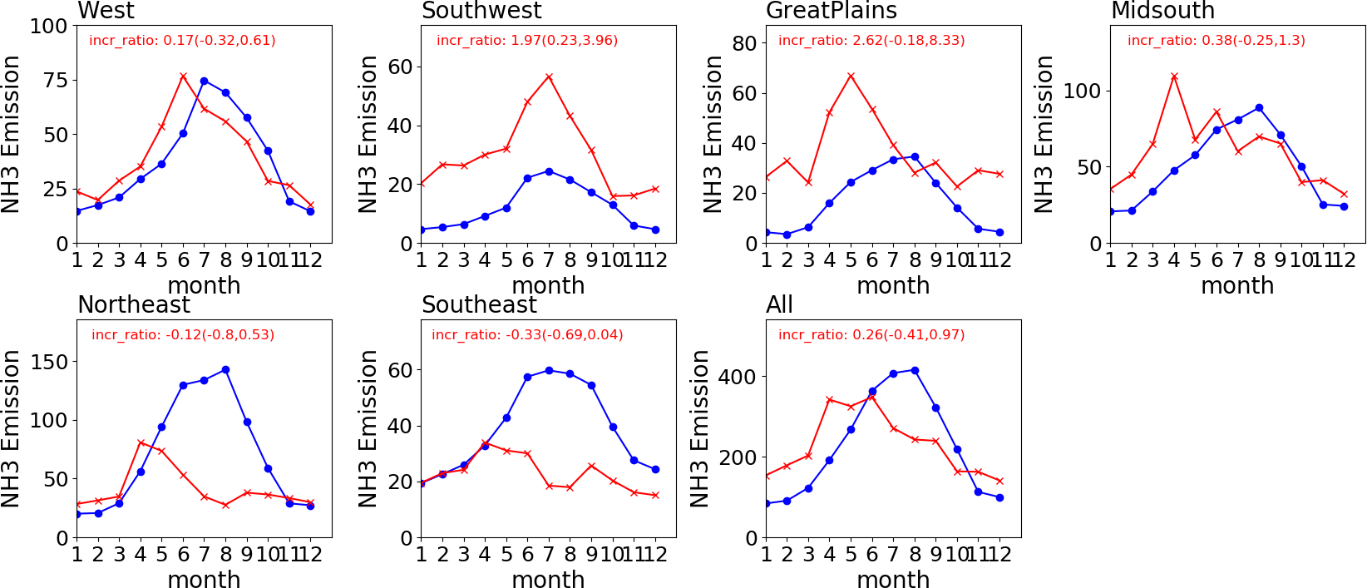
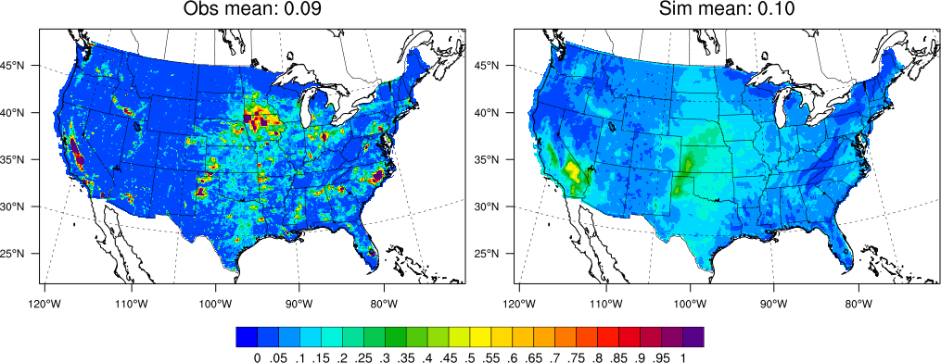
NH₃ Bottom-up vs Top-down Emissions Comparison
(Baek and Xing, ITM, 2023)
Indicating that the significant differences over the Great Plains and Southwest regions
Quantitively questionable due to the uncertainties of NOAA CrIs NH₃ retrievals
US NEI NH₃ | Top-Down NH₃
Spatially difference distribution between BU and TD NH₃ annual total emissions
Temporal trends of NH₃ are different by region due to the seasonal meteorological condition

Slide 9
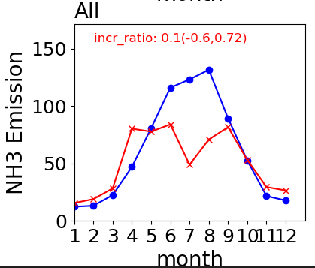
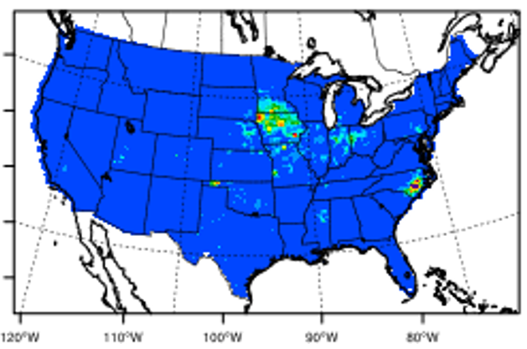
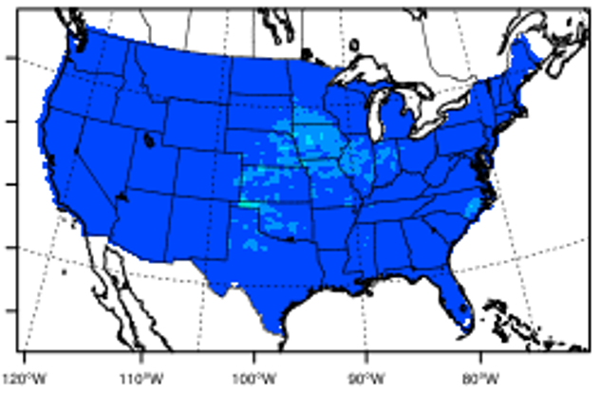
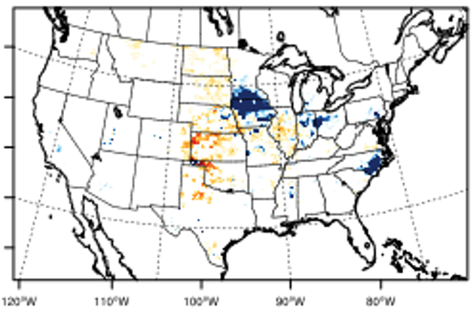
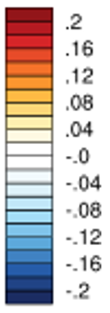
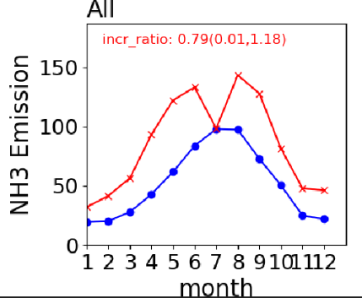
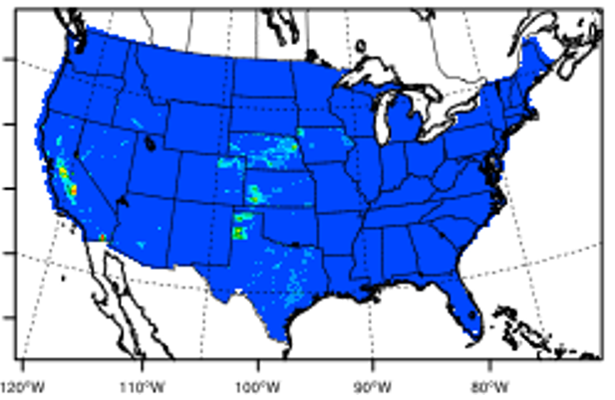
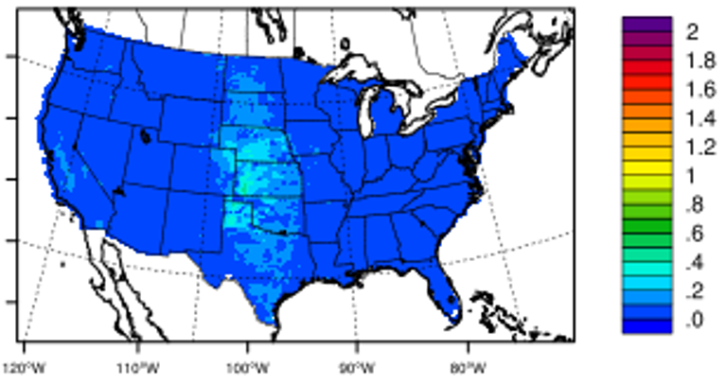
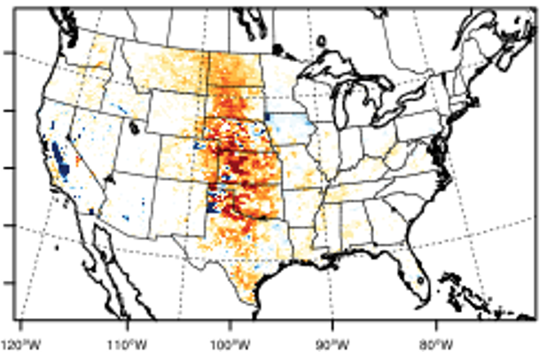
Sector-level NH₃ Emissions Comparison (2020)
(Baek and Xing, ITM, 2023)
Swine
Bottom-up
Top-down
Diff (TD-BU)
Beef Cattle

Slide 10
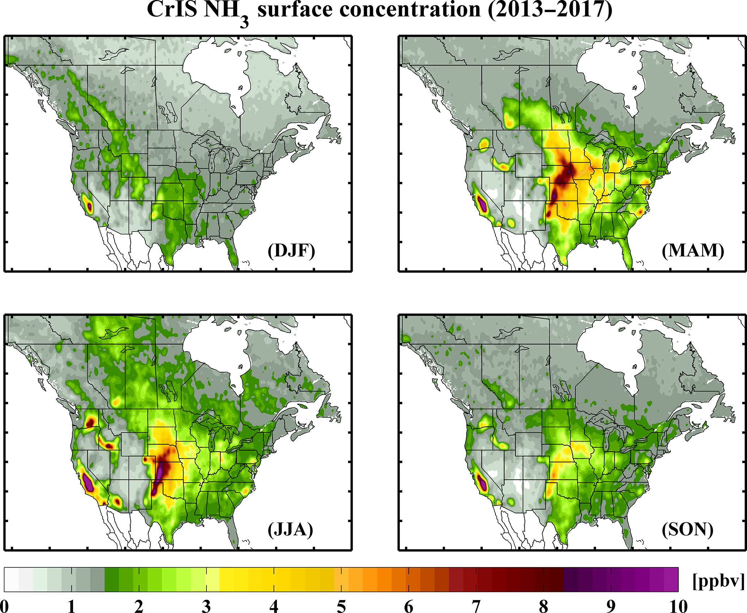
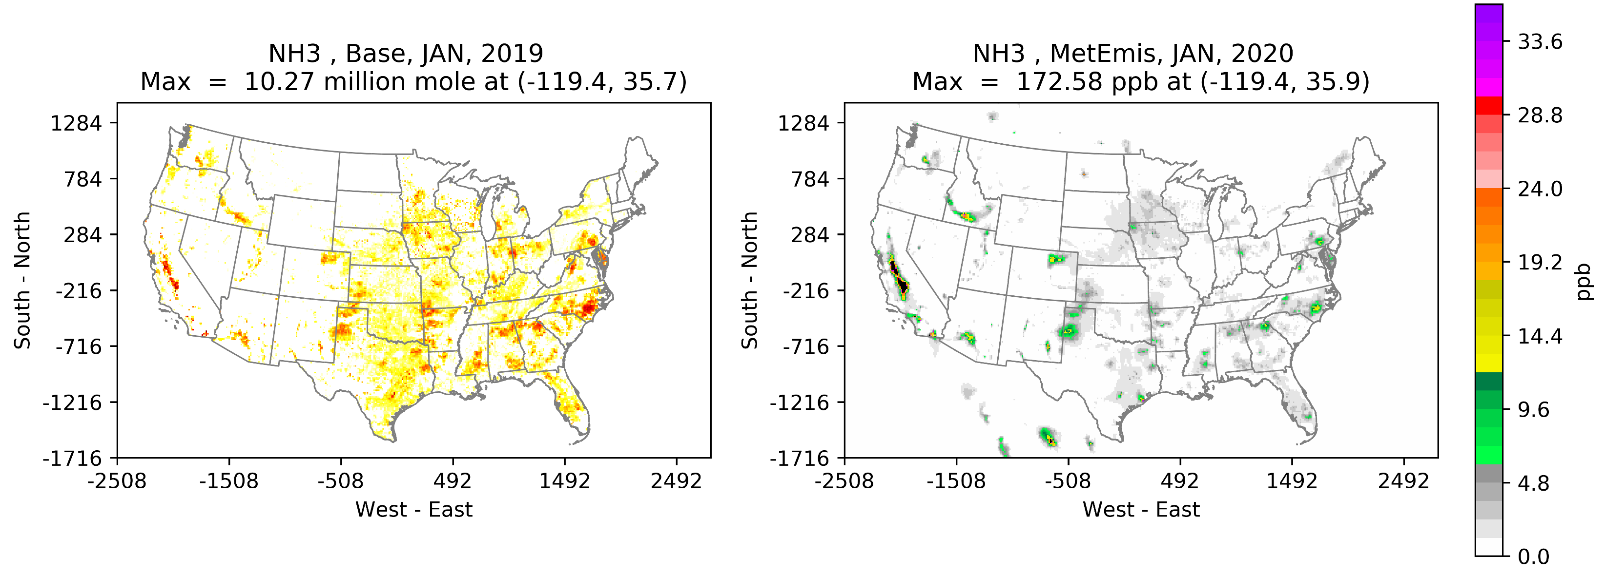
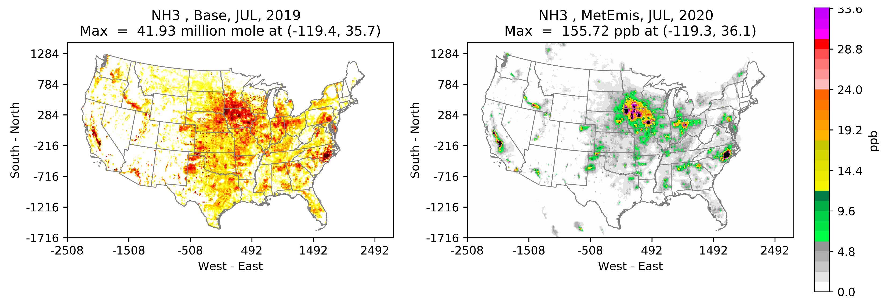
Seasonal Spatial Distribution of [NH₃] b/n Satellite and CMAQ
2020 NH₃ Emissions
2020 CMAQ [NH₃]
2020
2020
(Shepard et al., 2020)
Notes:
In winter time, much less NH3 emissions over the domain but especially under represented especially in the mid-US. In July summer, same lack of NH3 emissions while over NH3 conc from Iowa and NC. Overall, CA NH3 looks reasonable while over estimates of NH3 from IOWA and NC and under-estimated of NH3 from Mid-US.

Slide 11
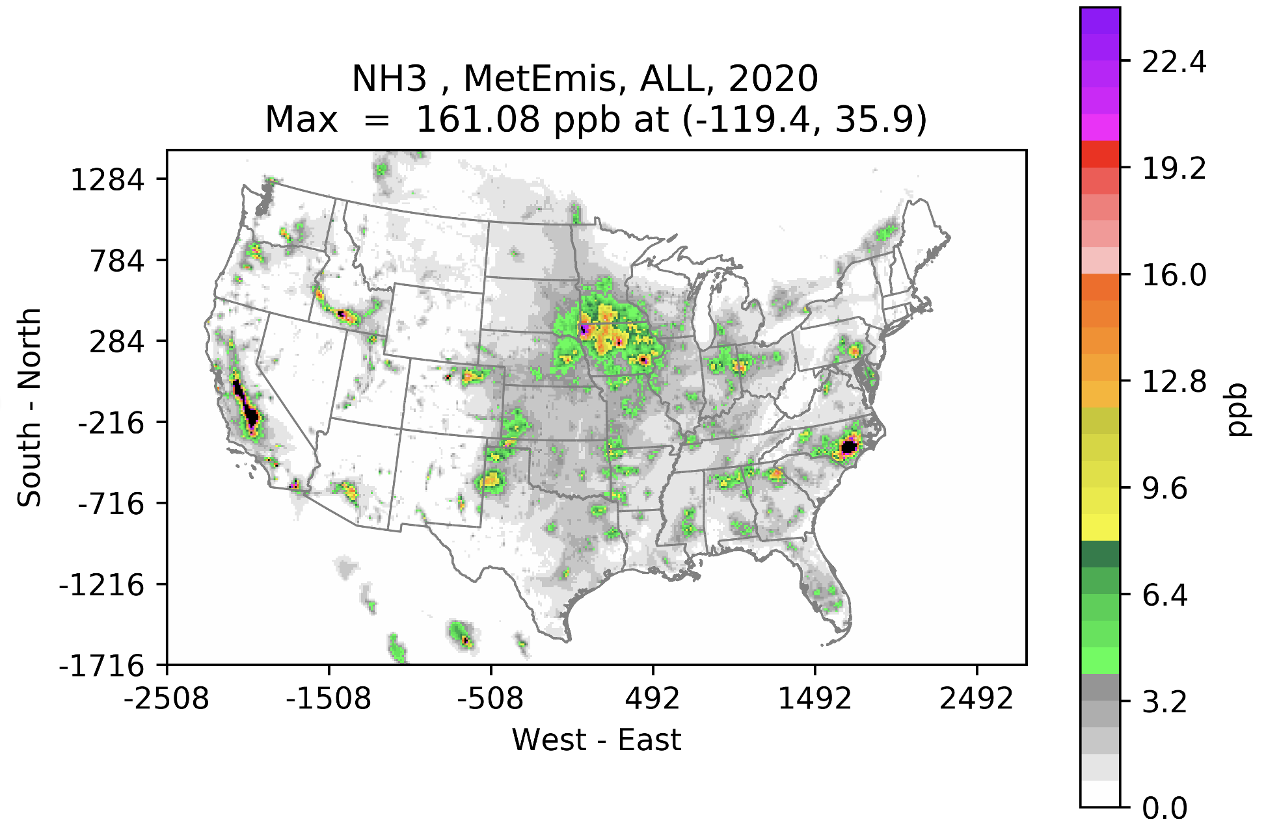
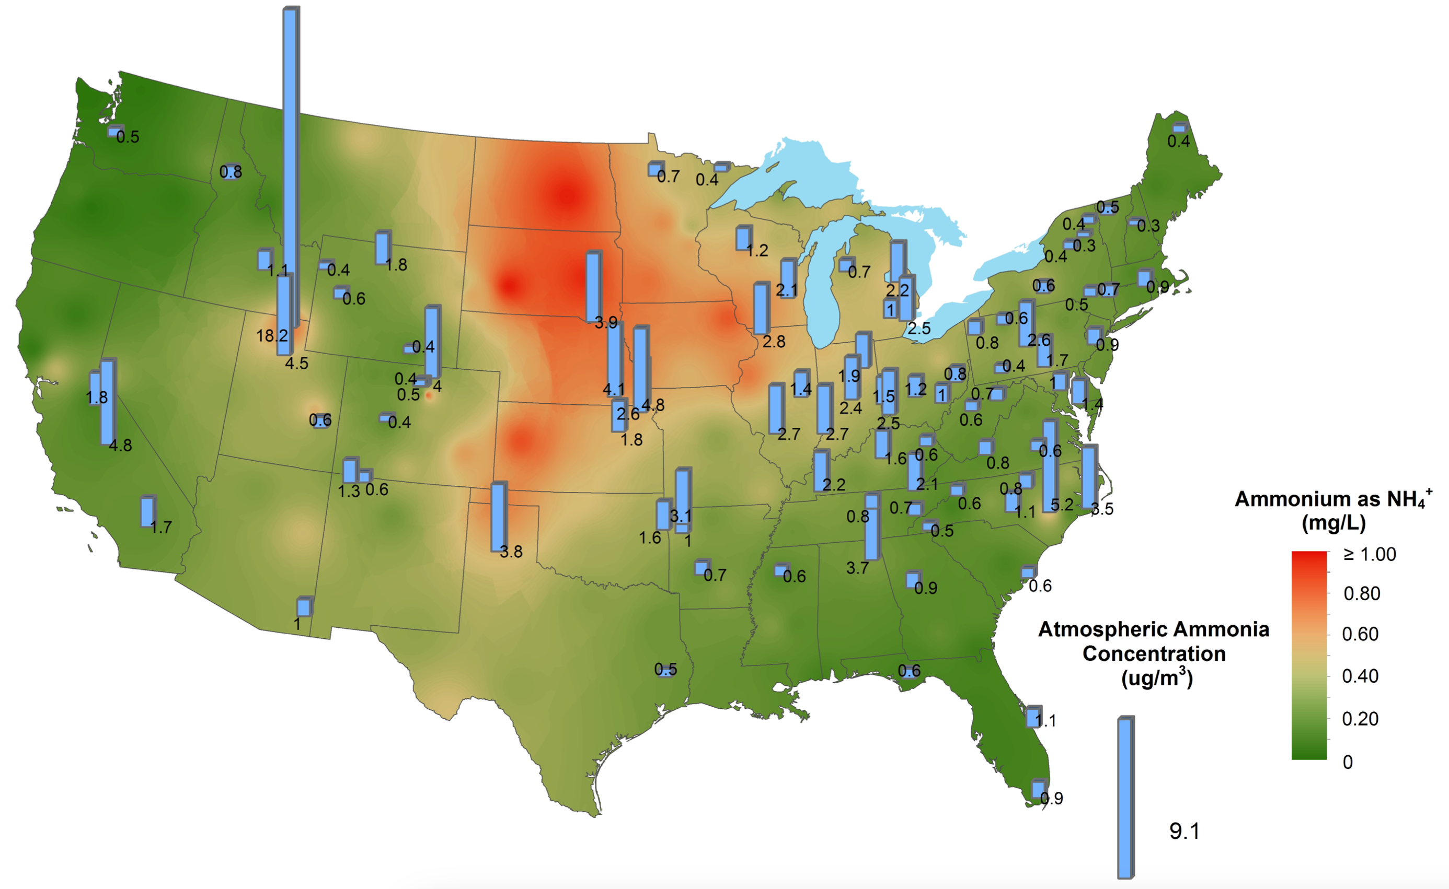
Spatial Distribution of [NH₃] from AMoN and CMAQ
2017 AMoN [NH₃]
Mid-US: Under-estimated NH₃
UT: Extreme under-estimated NH₃
IA & NC: High Over-estimated NH₃
CA: Equivalent NH₃
NADP, 2024
Notes:
In winter time, much less NH3 emissions over the domain but especially under represented especially in the mid-US. In July summer, same lack of NH3 emissions while over NH3 conc from Iowa and NC. Overall, CA NH3 looks reasonable while over estimates of NH3 from IOWA and NC and under-estimated of NH3 from Mid-US.

Slide 12
2020 AMoN vs [NH₃]
Mid-US Under-estimated NH₃ emissions
Black: Base Red: MetEmis
Illinois Indiana Kansas Texas
Utah
California
North Carolina
Notes:
CA where shows consistent high NH3 emissions shows a good correlation with AMoN NH3 conc. While IL, KS, UT state AMoN shows a significant underestimate which is consistent to the findings from NOAA CrIS NH3 conc distribution as well as AMoN observations

Slide 13
Summary [1]
Over-estimated NH₃ emissions from Swine CAFOs in the Iowa and NC
  Revisit the calibrating/updating the NH₃ emission factors (grams/animal)
  Assess the detailed impacts of precipitation on Swine over the Eastern U.S.
Under-estimated NH₃ emissions from the Beef Cattle in the mid-U.S.
  Current approach is based on NH₃ EF x Animal Populations
  Lack of representing the size of beef cattle open feedlots with meteorological impacts
  Need an update of FEM to improve the size of sources and the wind speed impacts on open feedlots
These over/under-estimations of NH₃ findings are consistent with the findings from the top-down NH₃ Inverse modeling method

Slide 14
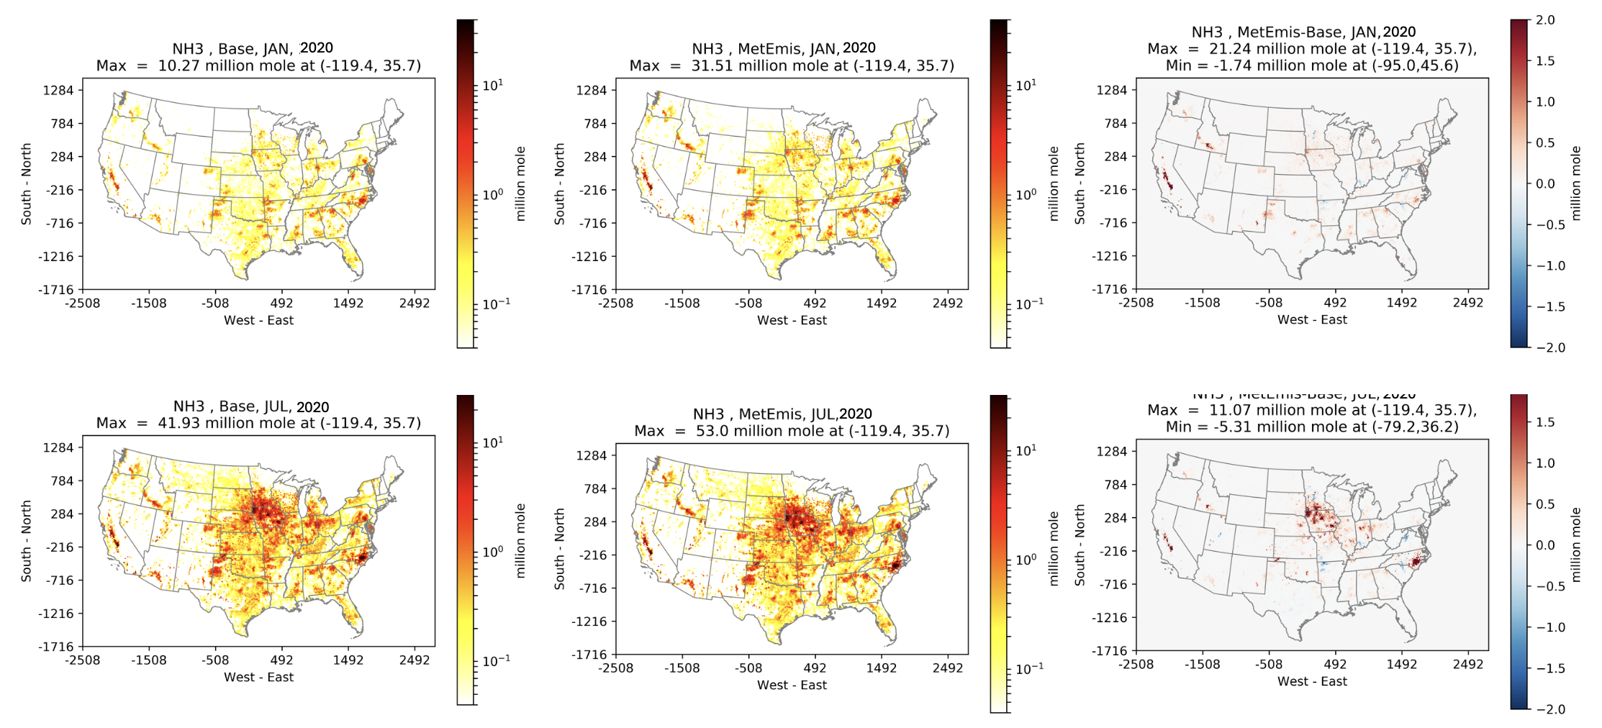
NH₃ Emission Changes (MetEmis-Base)
Notes:
Unlike we witnessed in earlier slides, there are significant impacts on NC eastern area NH3 increase due to the higher ambient temperature.

Slide 15
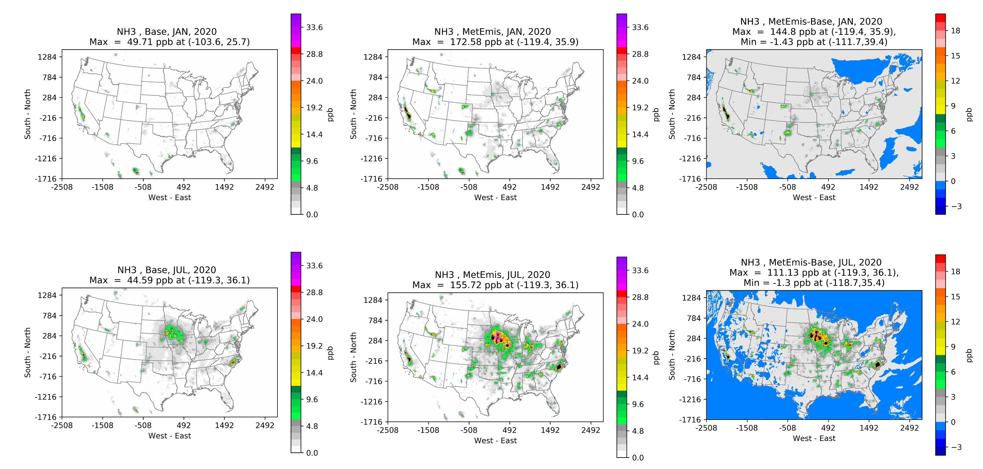
NH₃ Concentration Changes (MetEmis-Base)

Slide 16
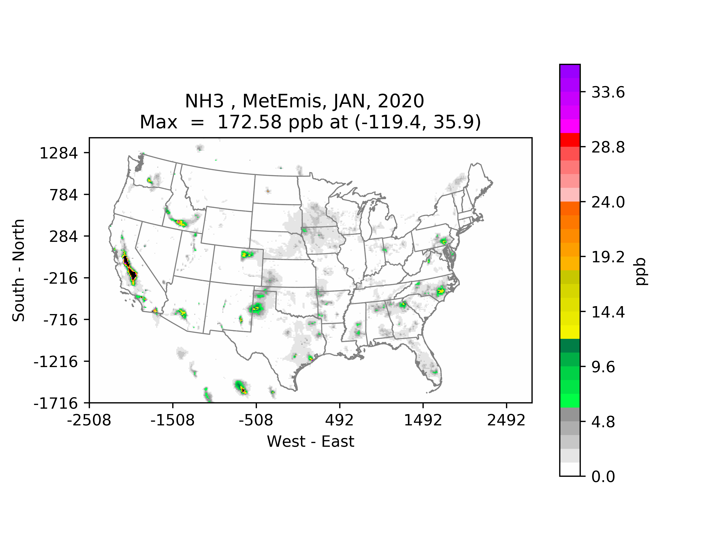
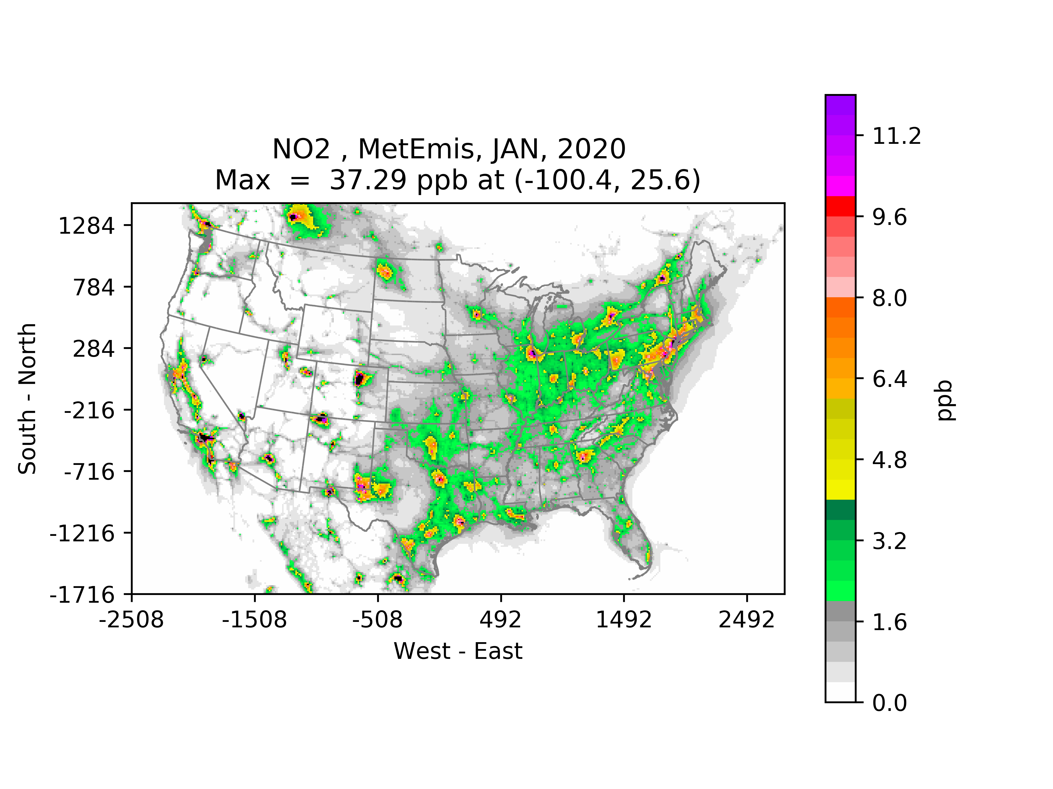
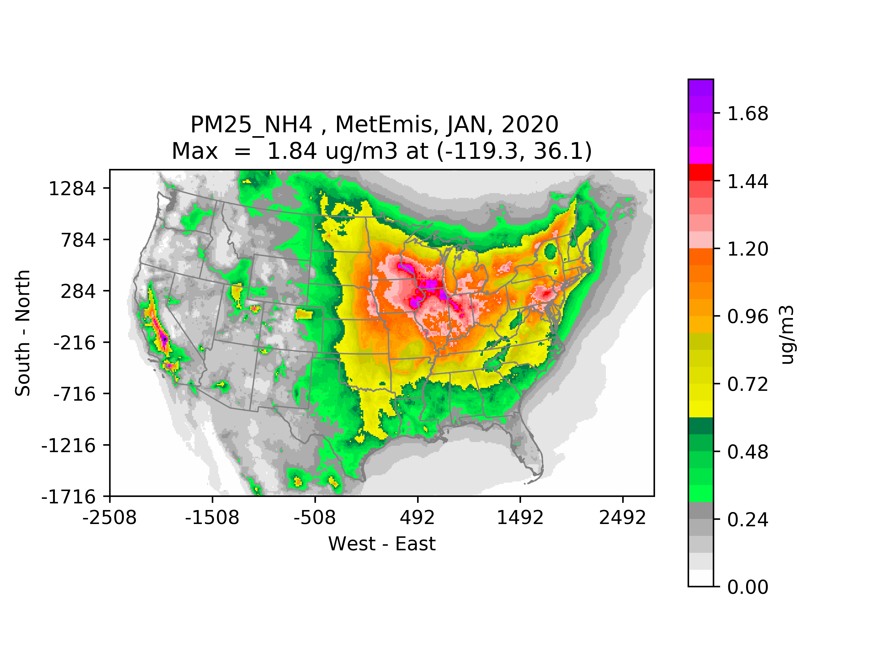
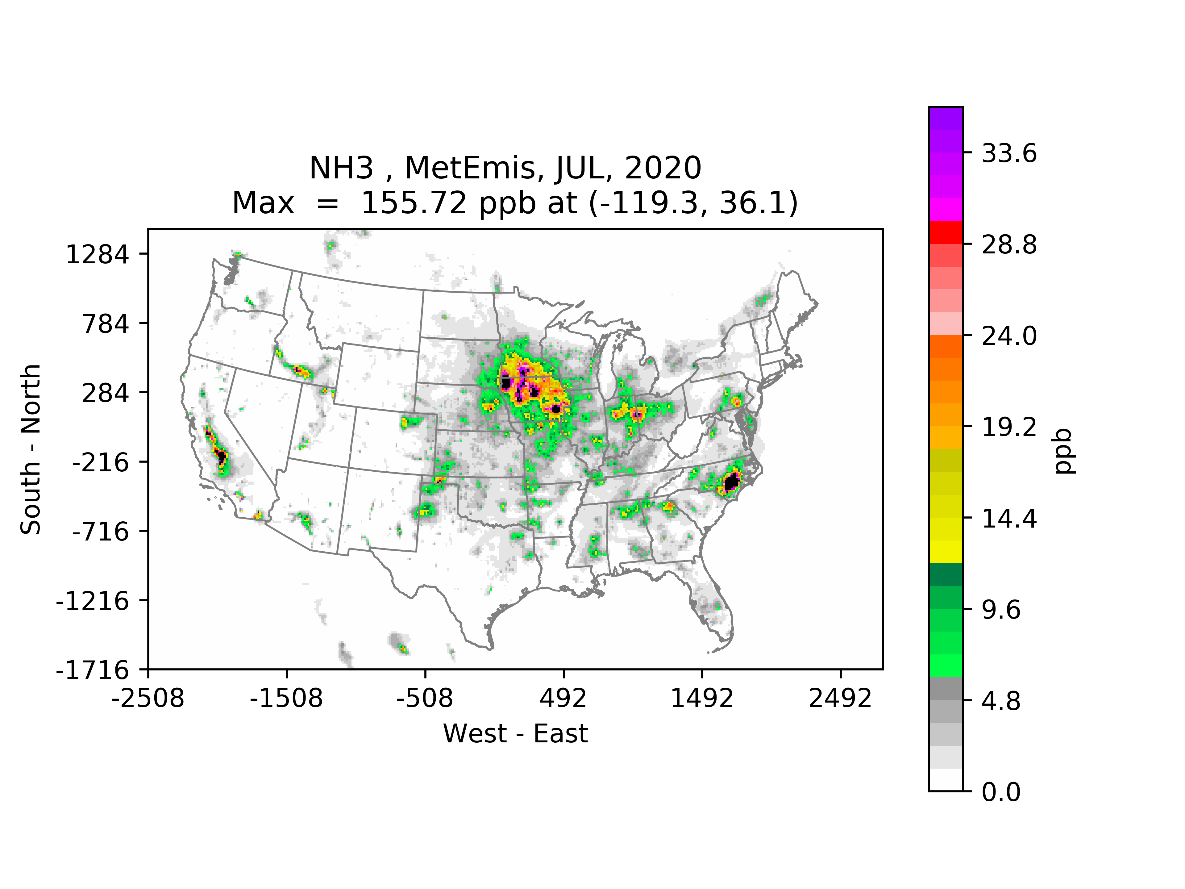
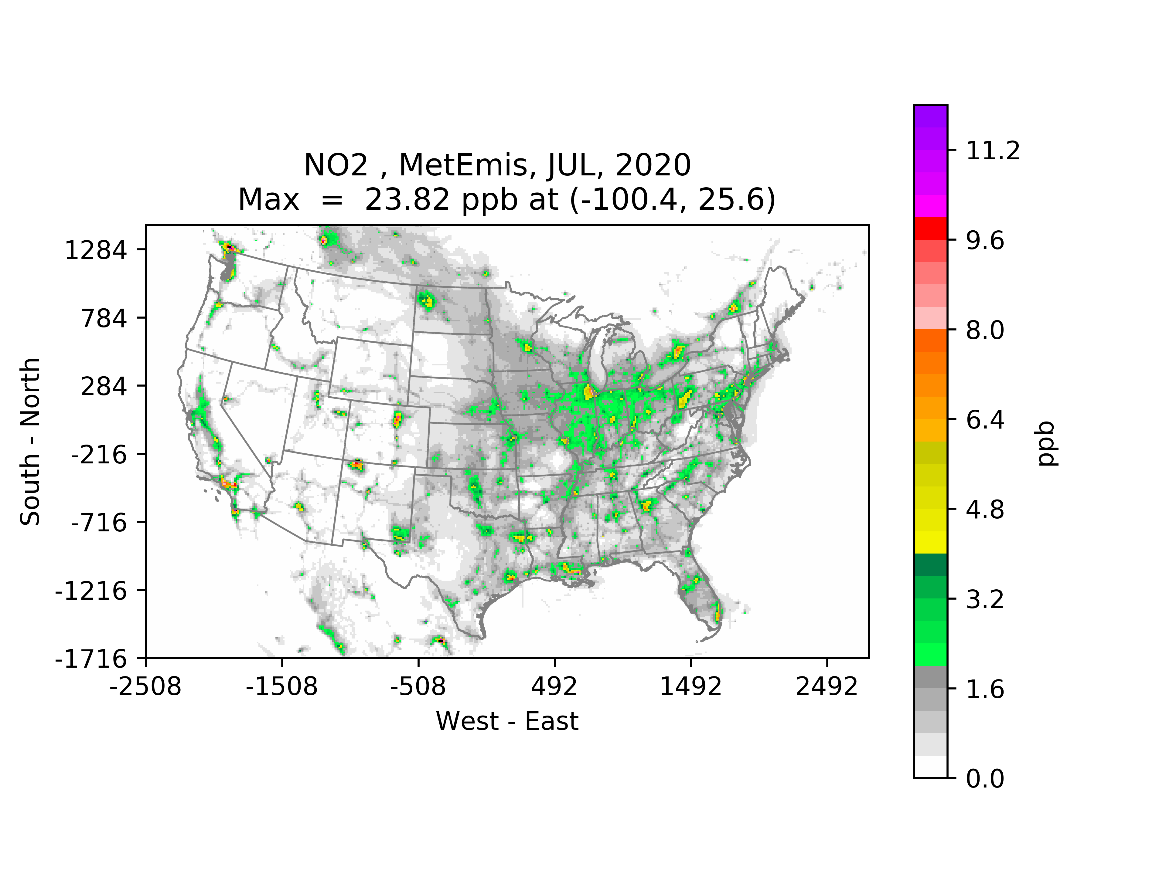
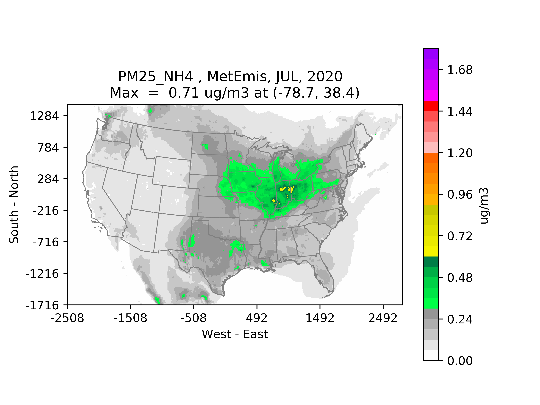
$NH3, NO2 and {NH}_{4}^{+}$ Seasonal Concentrations

Slide 17
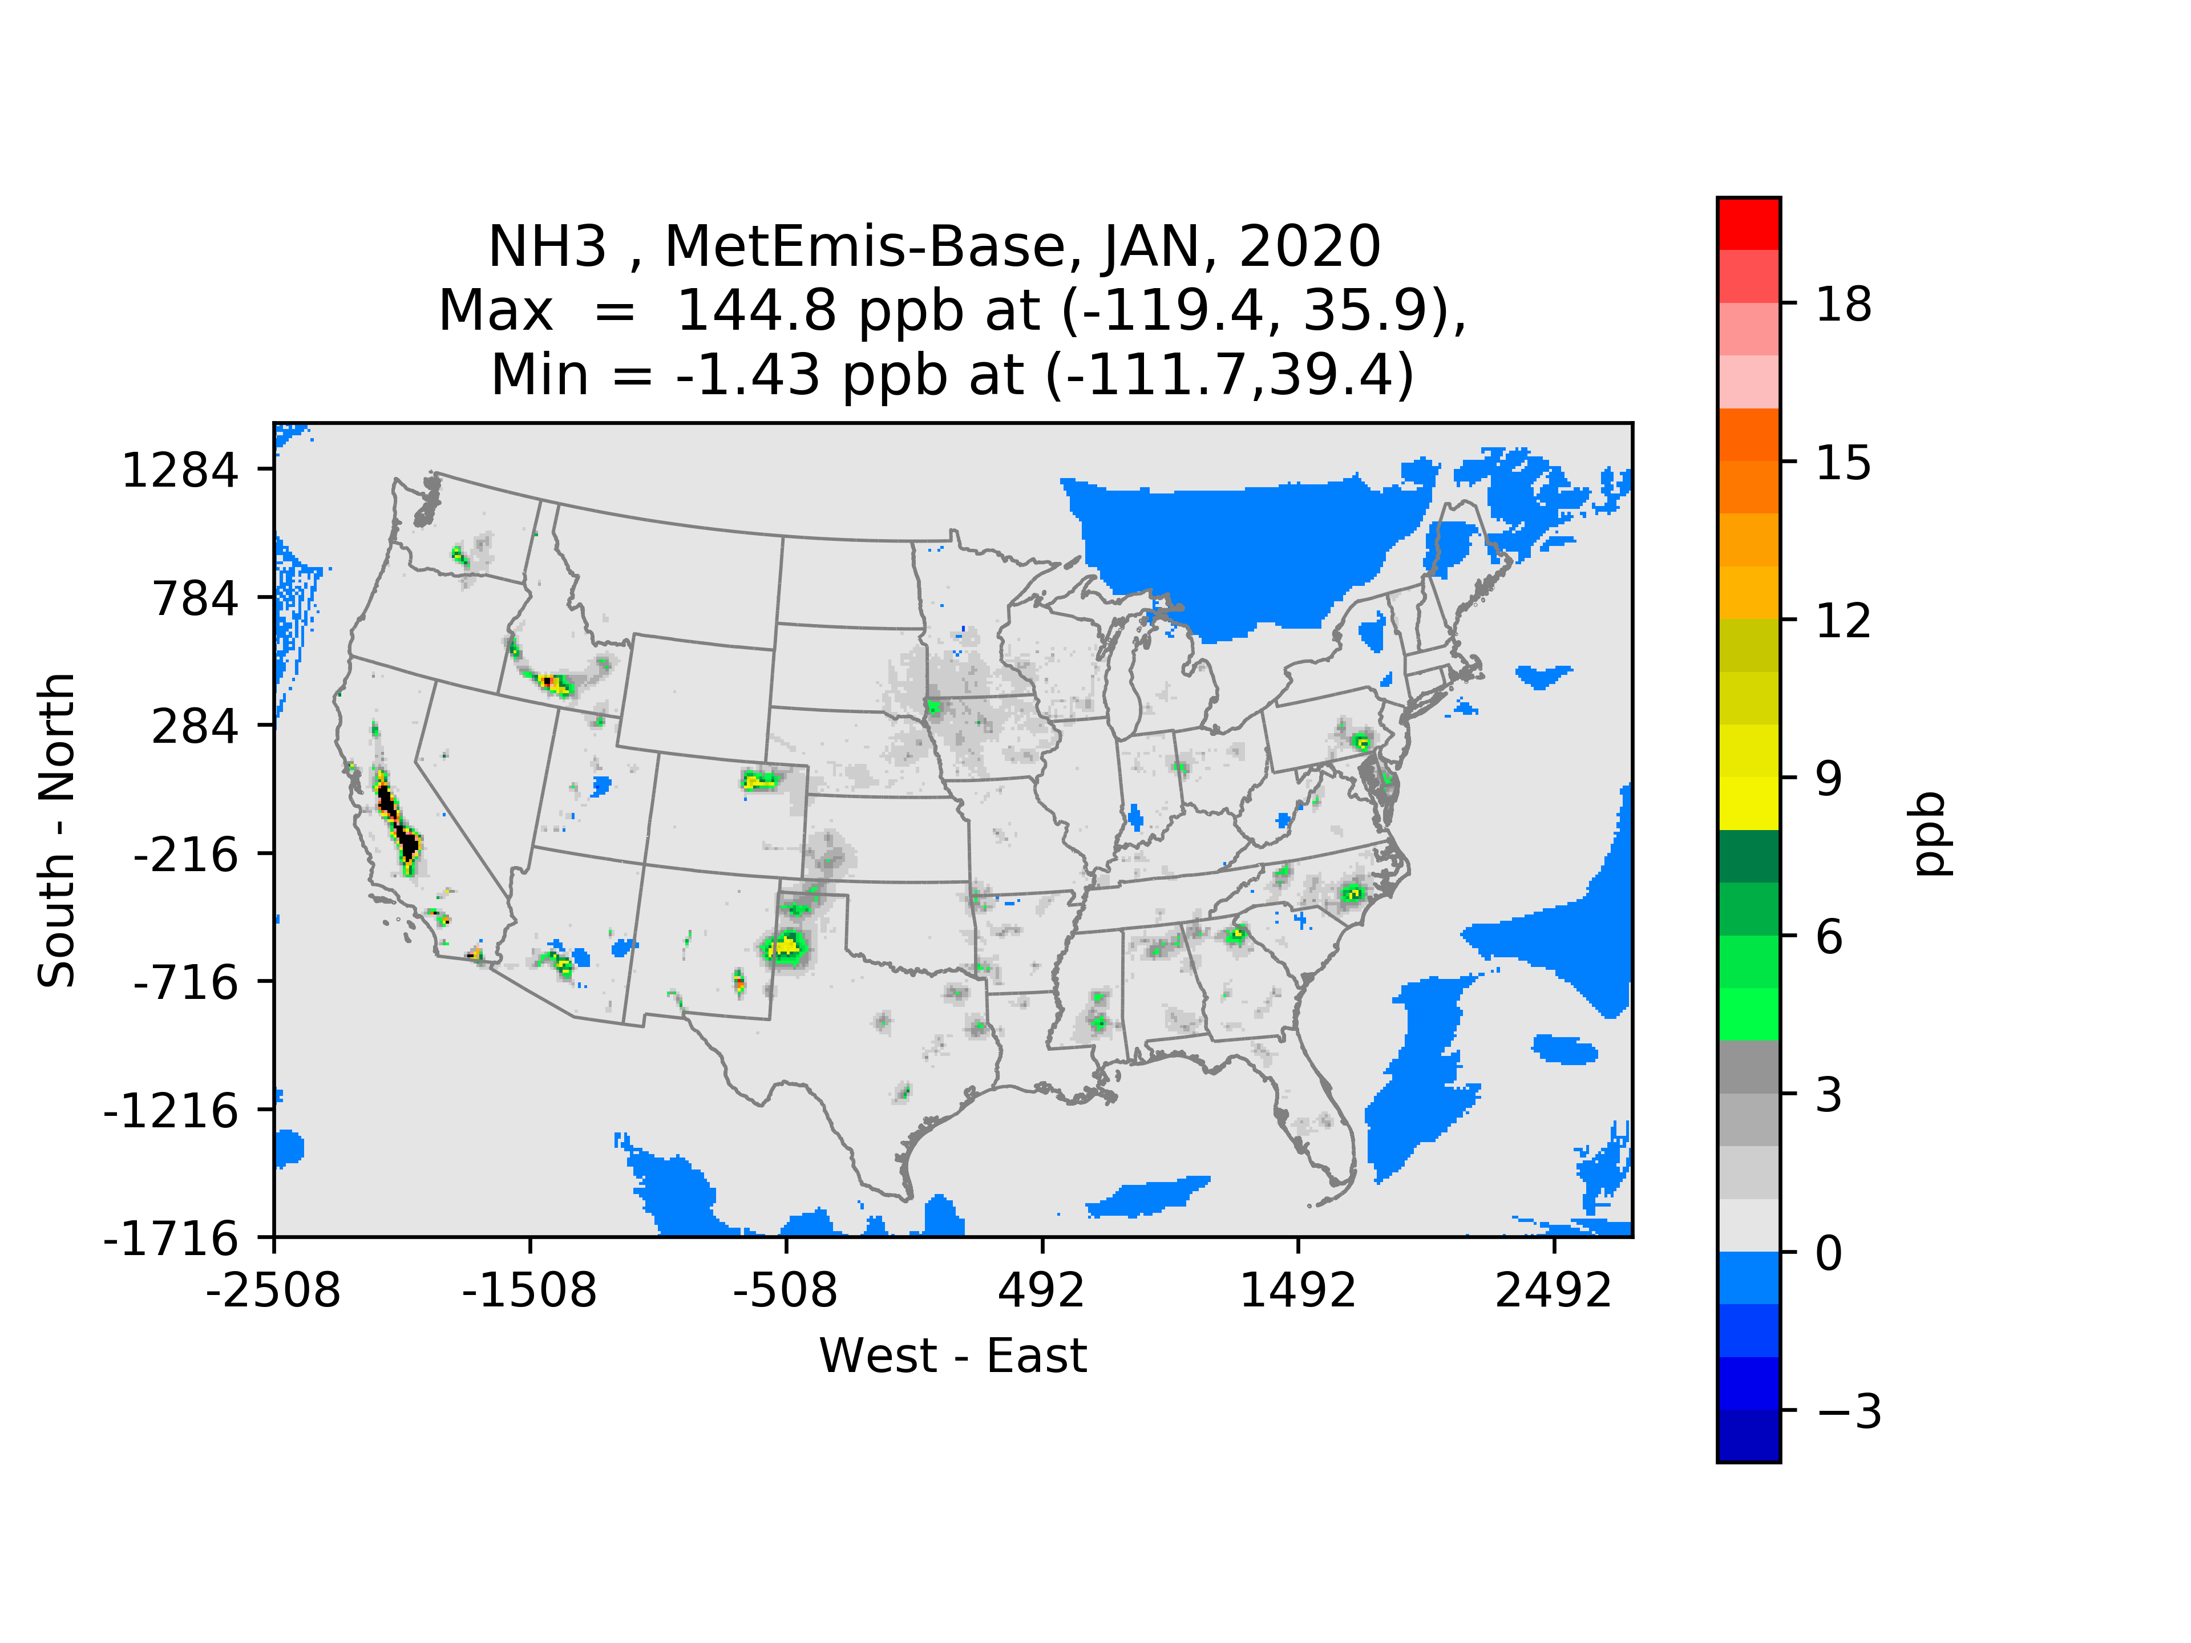
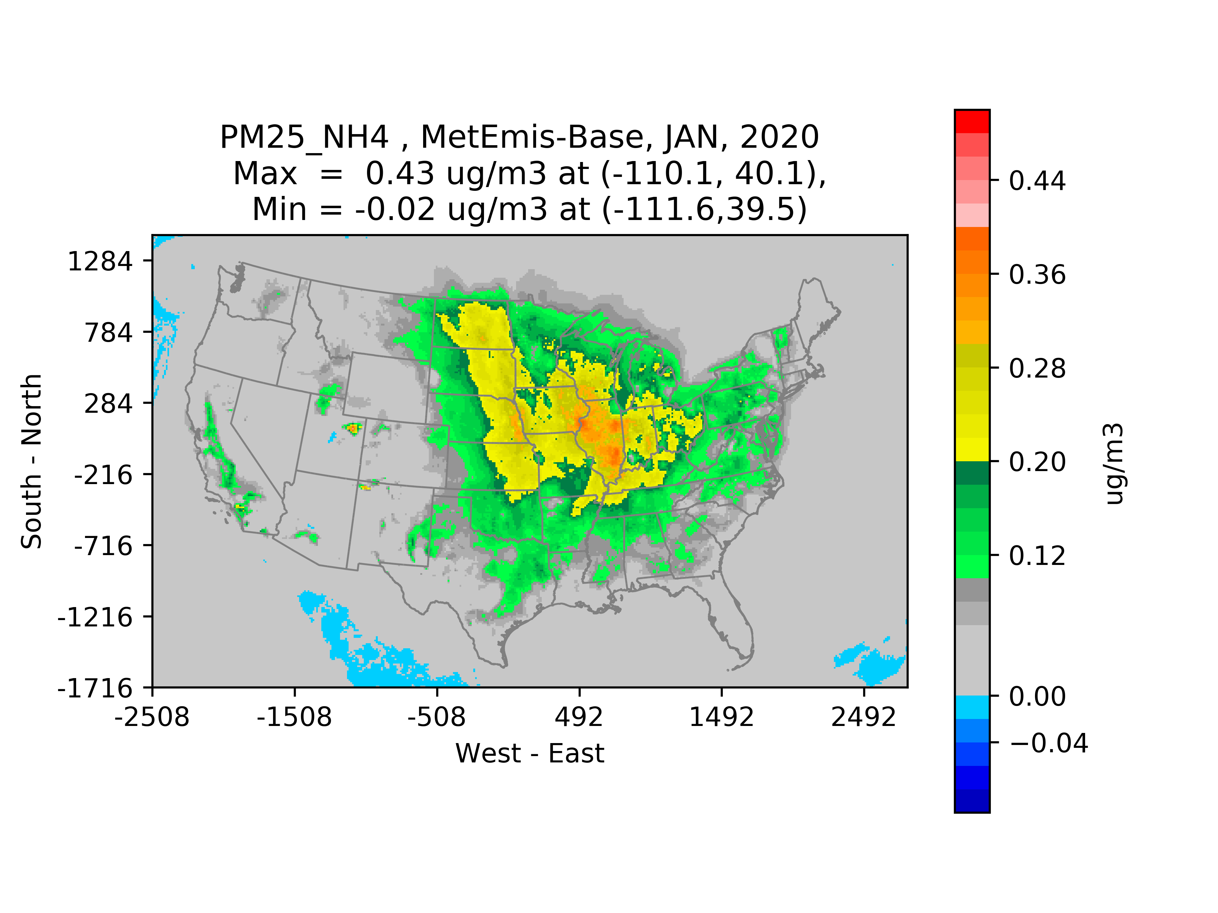
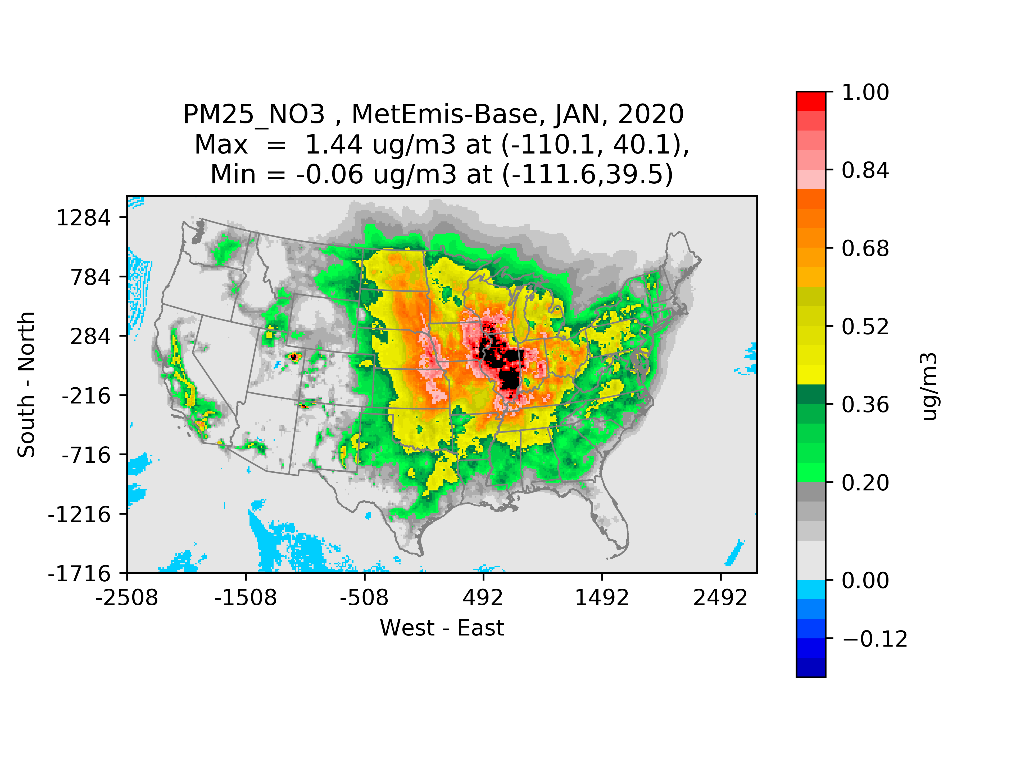
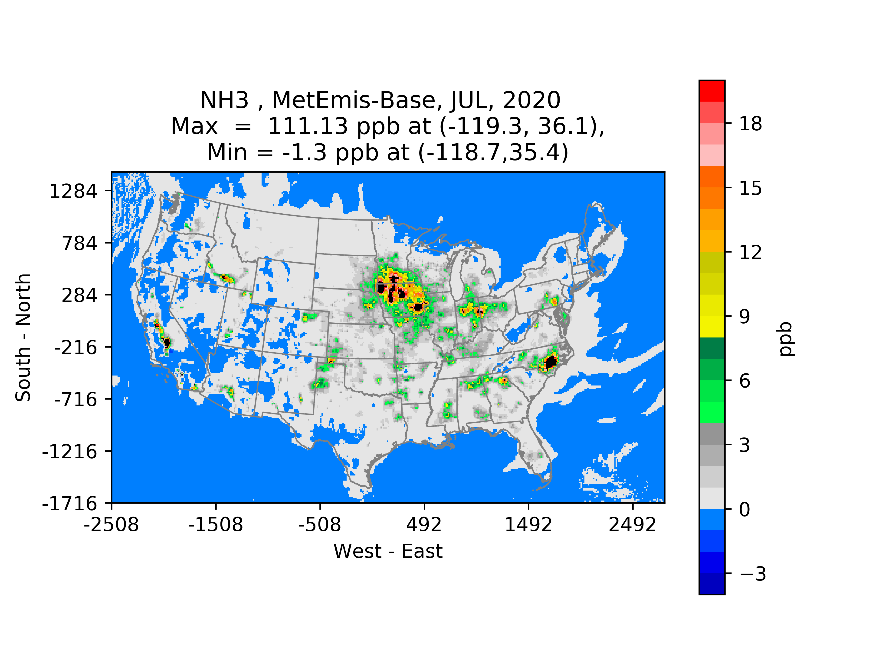
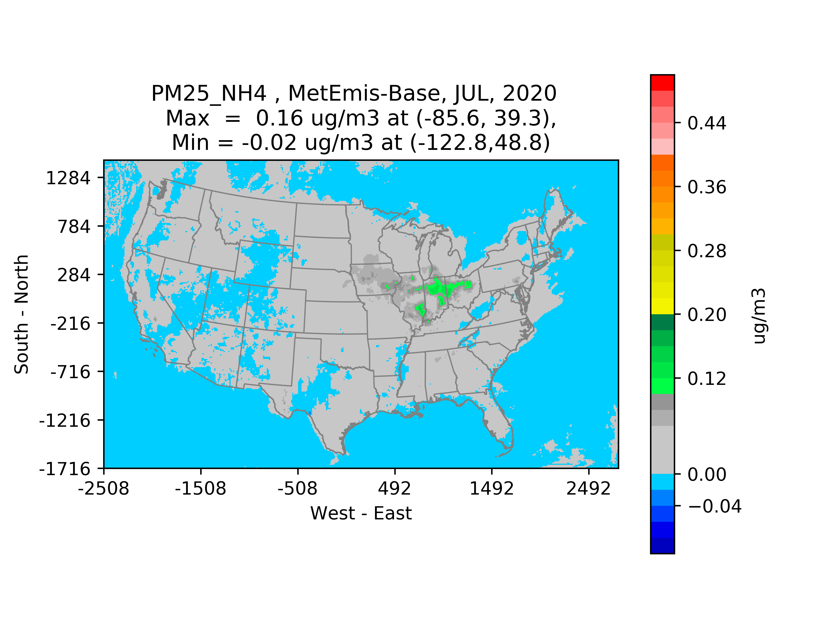
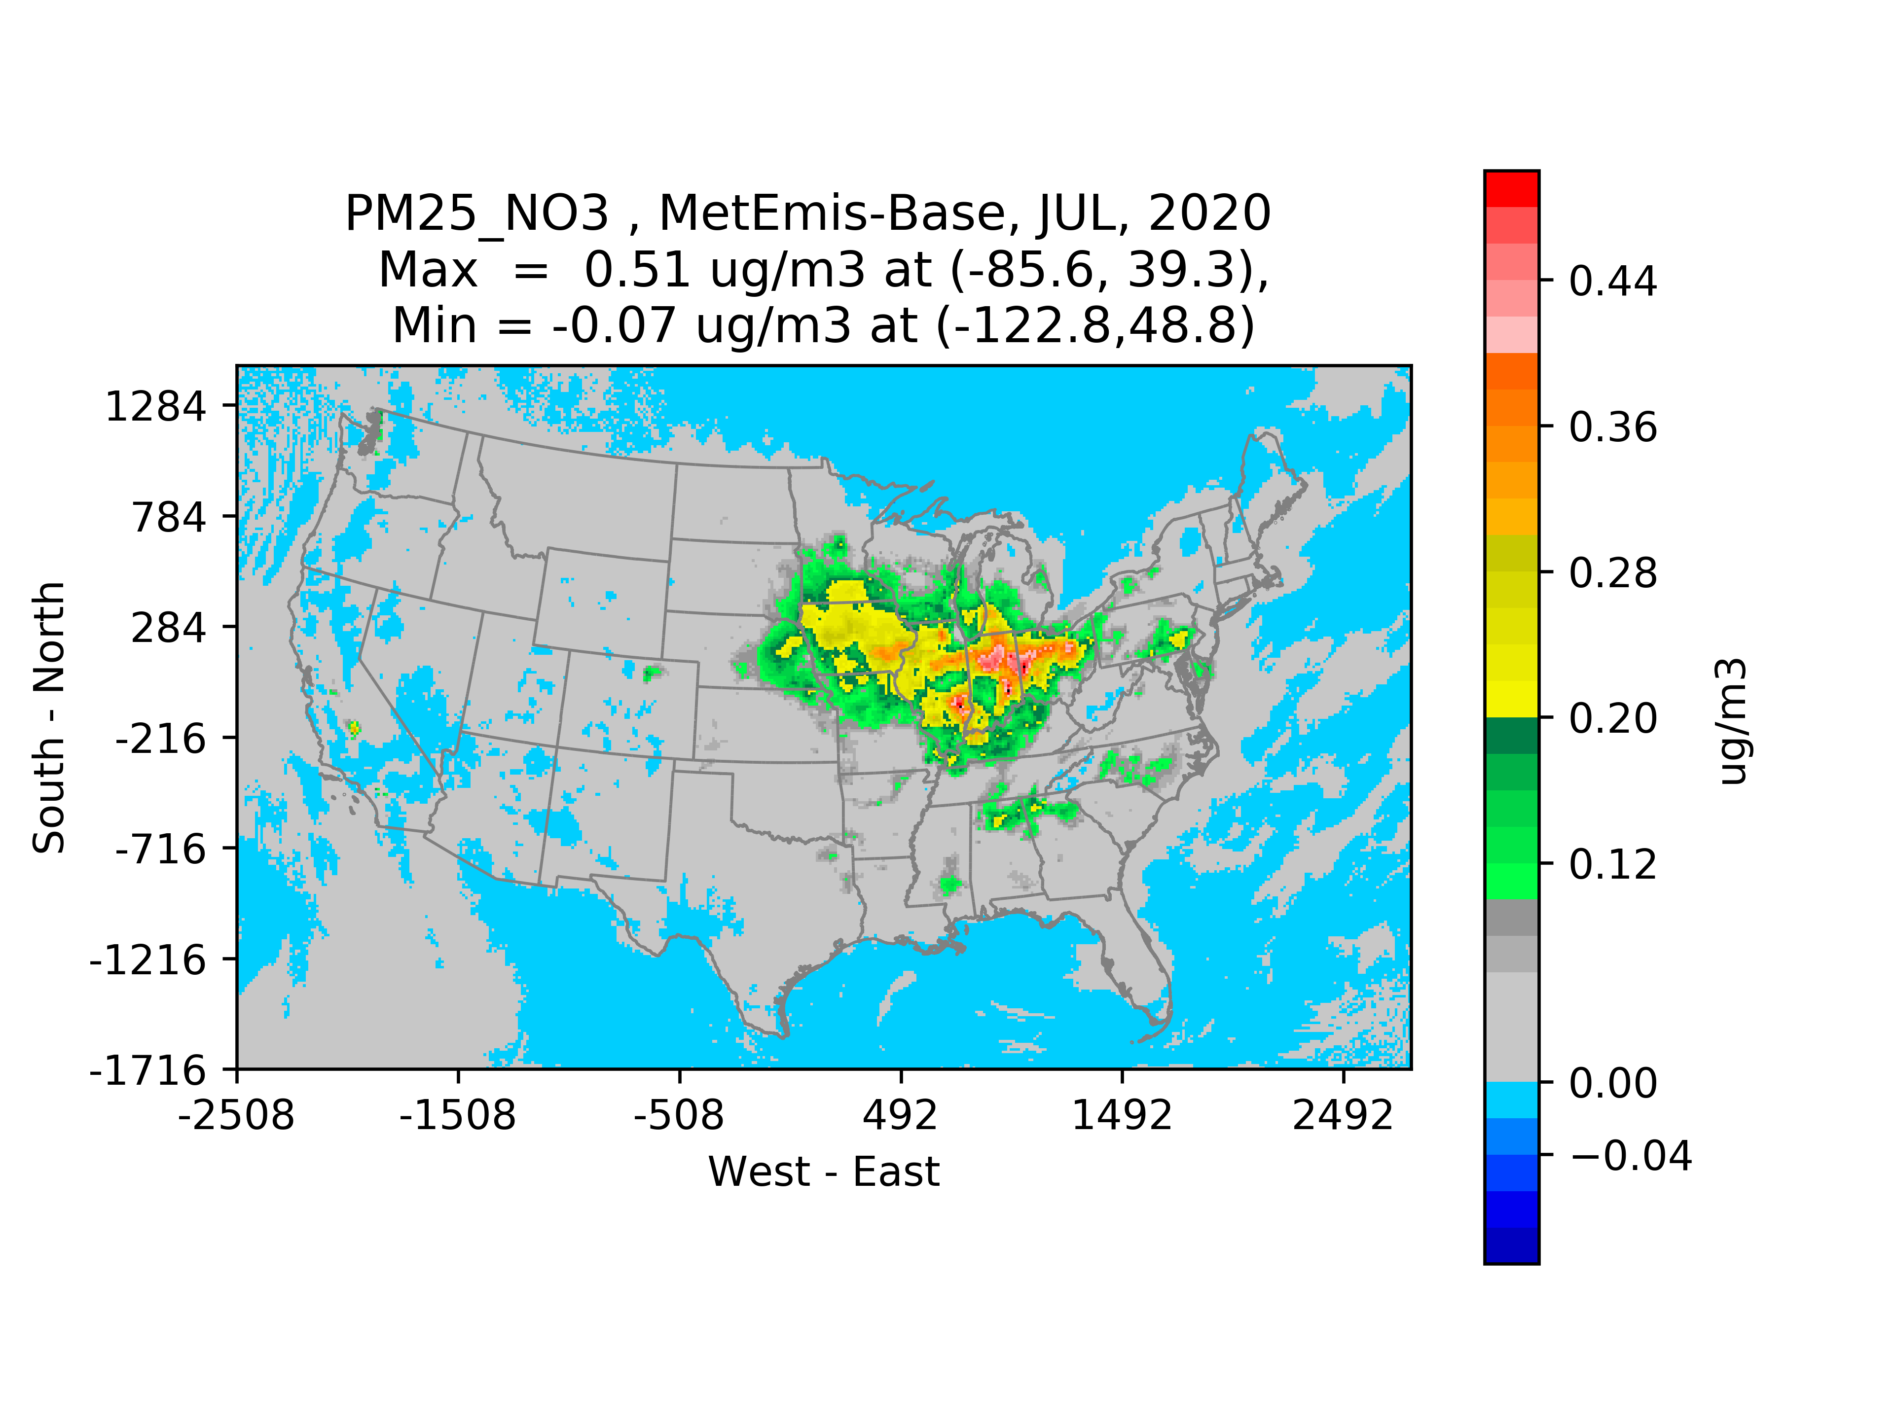
MetEmis Impacts on NH₃ and PM_{2.5}

Slide 18
Summary and Future Works
MetEmis impacts on NH₃ can be greater during the winter season when higher NOx emissions are emitted.
What is next?
  Once the spatial distribution of NH₃ emissions from the livestock waste sector is updated, model performance will be evaluated with AQS dataset
  Dynamic coupling of NH₃ emissions from the Livestock Waste sector could improve their spatiotemporal representations within the CTM system
  Plan to add the wind-speed layers to the MetEmis_TBL for Livestock, which is critical to the emissions from the application and especially from beef cattle open feedlot

Slide 19
Acknowledgement
  U.S. NOAA Joint Technology Transfer Initiative (JTTI)
  U.S. EPA OAQPS
  Ministry of Environment in Korea

