Slide 1
Development of a regional air quality online prediction system
within the Unified Forecast System (UFS) framework
Jianping Huang (NOAA/NWS/NCEP/EMC)
Fanglin Yang (EMC), Ivanka Stajner (NASA), Jeffrey McQueen, Cory Martin, Raffaele Montuoro (EMC)
Kai Wang, Ho-Chun Huang, Brian Curtis, Anna Smoot
Hyundeok Choi, Haixia Liu (EMC, Lynker),
Barry Baker (OAR ARL), Youhua Tang, Patrick Campbell(ARL, GMU). Daniel Tong (GMU)
Georg Grell (OAR GSL)
Hongli Wang, Ruifang Li (GSL, CIRES)
2024 CMAS Annual Conference
James Wilczak (PSL)
Irina Djalalova, Dave Allured (PSL, CIRES)
Shobha Kondragunta (NESDIS STAR)
Chuanyu Xu, Zigang Wei (IMSG, NESDIS STAR)
Fangjun Li and Xiaoyang Zhang (SDSU)
Jack Kain, Youngsun Jung (STI)
Chapel Hill, NC , October 21, 2024

Slide 2
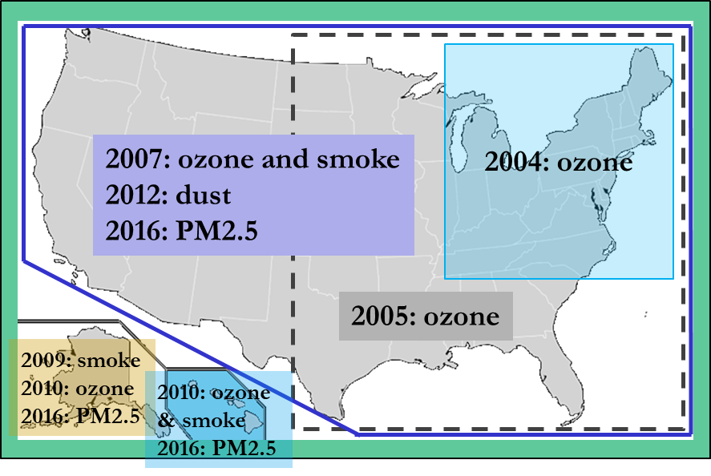
Evolution of National Air Quality Forecast Capabilities
Prediction systems
Chemistry model(s): EPA Community Multiscale Air Quality (CMAQ) model: gas-chemistry mechanisms (e.g., CB06) and aerosol module (e.g., Aero7)
Meteorological models:
NOAA/NCEP North American Mesoscale (NAM) numerical weather prediction models: Eta, WRF/NMM, NMMB
NOAA/NCEP Global Forecast System (GFS)
Meteorology-Chemistry Coupling: Offline
Forecast Guidance:
O3, PM2.5, and smoke: nationwide
Dust: CONUS

Slide 3
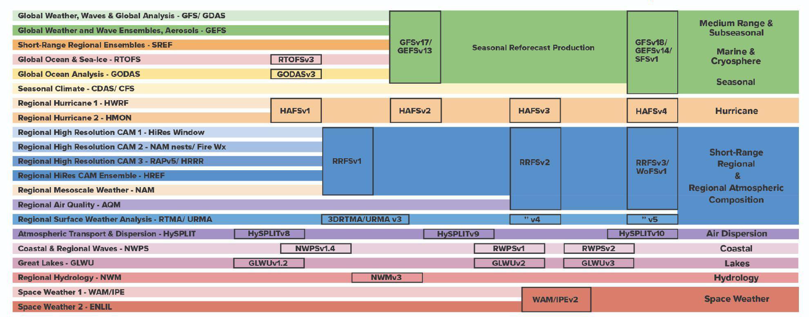
Transition from many operational modeling systems to UFS Applications
UFS-AQM
AQM will be included in the short range regional application. Progress to date focuses on including CMAQ chemistry online in the regional UFS application.

Slide 4
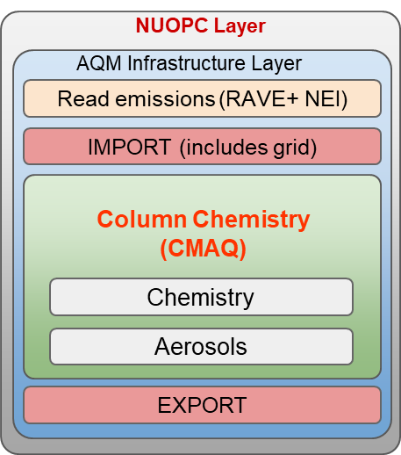
The UFS-AQM Online-coupling Forecast Model
Atmos. Dyncore (FV3)
Atmos. Physics (CCPP)
Writing Component

Slide 5
A flowchart of the UFS-AQM online system (AQMv7.0)
WildFire
Emission
(RAVE)
GEFS/Aero +
Chem. Climat. LBCs
Anthrop.
Emission
UFS-AQM
Coupled forecast model
NEXUS
(NOAA Emission and Exchange Unified System)
CMAQ
(gas-chem. and aerosols)
FV3 Atmos.
(transport/physics)
ICs and BCs
Met fields
Biogenic Emission
UFS_Utils
UPP & Post
(PM_{2.5})
Bias Correction
New parallel emissions preprocessing system
GFS outputs
Products
(CS, AK,HI)
Verification
Notes:
RAVE: Regional ABL and VIIRS fire emissions

Slide 6
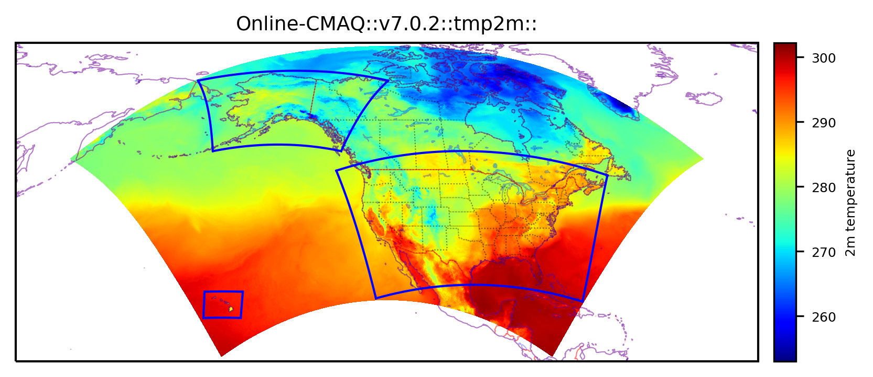
Model Configurations for the AQMv7.0.7 implementation
Atmos. & air quality models | UFS-Atmos + CMAQv5.2 Online-coupling
Gas mechanism & aerosol model | CB6r3 + Aero6
Grid_spacing & vertical levels | 13 km & 65 levels (topped at 0.2 hpa)
Anthropogenic emissions | NEI 2016v1 for CONUS + EDGAR-for-HTAPv2, CEDSv2 & OMI-HTAP for O-CONUS
Fire emissions | RAVE v1 (hourly, 0.03 deg) + Sofiev plumerise algorithm, linearly-distributed, VOCs off
Biogenic & dust emissions | MEGAN v2
Dynamics & physics | FV3 & CCPP GFSv16 suite
Chem-LBCs | AM4 for gases + GEFS for aerosols
AK
CONUS
HI
Huang et al. (BAMS in review)
A single large North American domain covers three operational product domains ( CONUS, AK and HI)
NOAA’s UFS-AQM based AQMv7.0.7 was implemented on May 14, 2024

Slide 7
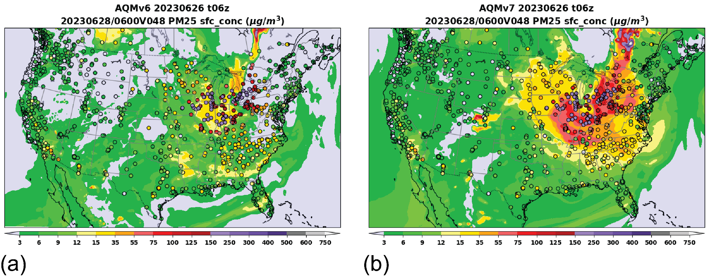
AQMv6 (GBBEPx) vs. AQMv7.0.7 (RAVE v1): PM_{2.5} predictions
Huang et al. (BAMS submission, 2024)

Slide 8
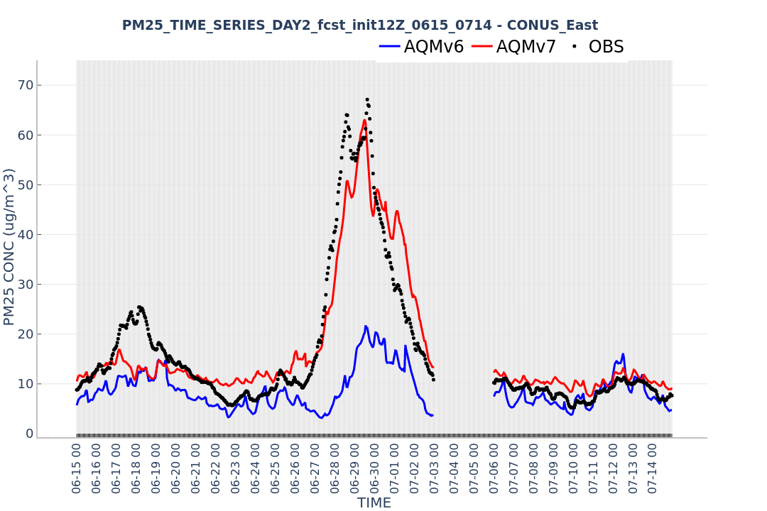
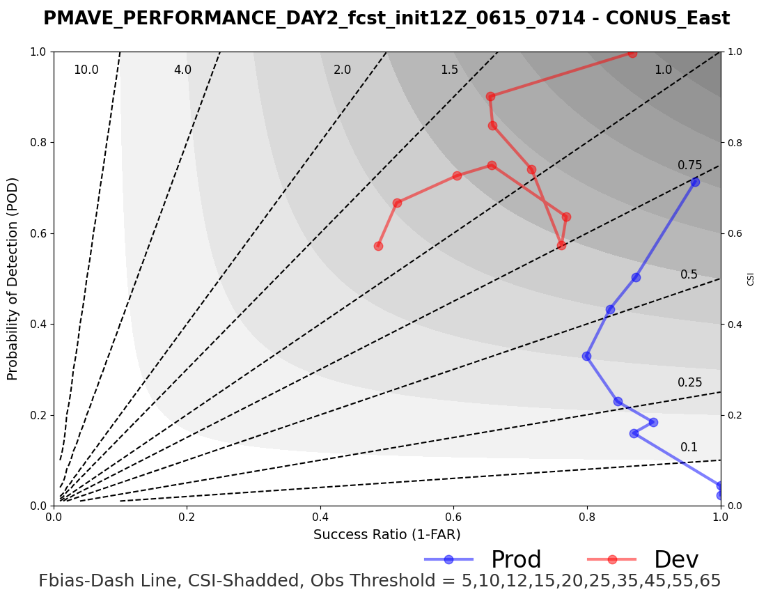
AQMv7 improves PM_{2.5} during Quebec Fire 2023

Slide 9
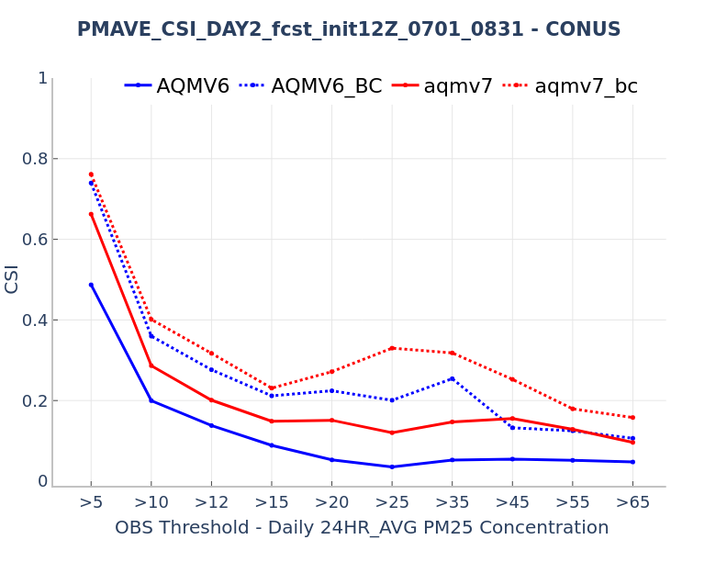
AQMv7.0.7 improves 24-hr ave. PM_{2.5} in summer
AQMv7 demonstrates higher CSI values for 24-hr ave. PM_{2.5} for both the raw model and bias-corrected (BC) products (dashed) than AQMv6.
AQMv7 exhibits enhanced predictive capabilities for PM_{2.5} exceedance events (≥35 ug/m³).

Slide 10
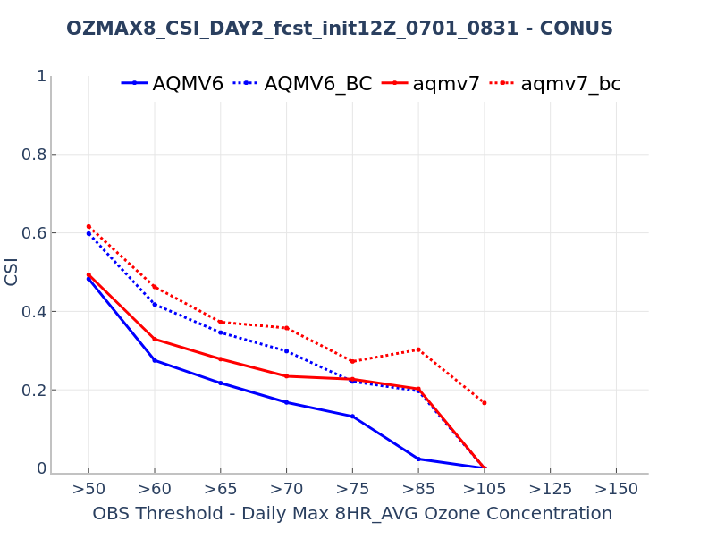
AQMv7.0.7 improves O₃ exceedance predictions in summer
AQMv7 demonstrates higher Critical Success Index (CSI) values for daily max. 8-hour ave. O₃ for both the raw model (solid) and bias-corrected (BC) products (dashed) than AQMv6.
AQMv7 exhibits enhanced predictive capabilities for O₃ exceedance events (≥70 ppb).
better

Slide 11
Upgrade of the AQM operational system: v7.0.8
Major Changes:
Update the Regional hourly Advanced Baseline Imager (ABI) and Visible Infrared Imaging Radiometer Suite (VIIRS) Emissions (RAVE) input datasets from version 1.3 to v2.0, which use observations from NOAA's latest generation of U.S. polar-orbiting satellites (NOAA-21).
Update the list of AirNow's observational surface sites for ozone (O₃) and fine particulate matter (PM_{2.5}) to improve bias-corrected products.
Mitigate overprediction of fugitive dust.
Increase accuracy of predicted dry deposition velocities for small gravitational settling and aerodynamic resistance values.
Implement bug fixes and other code improvements.
Implemented: Oct. 1, 2024

Slide 12
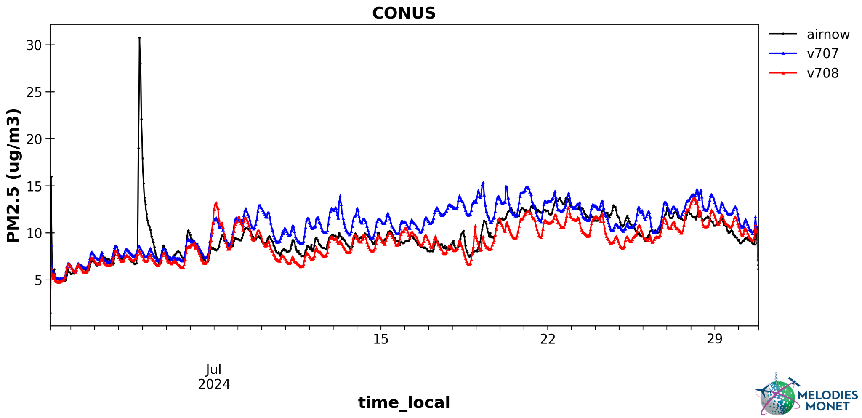
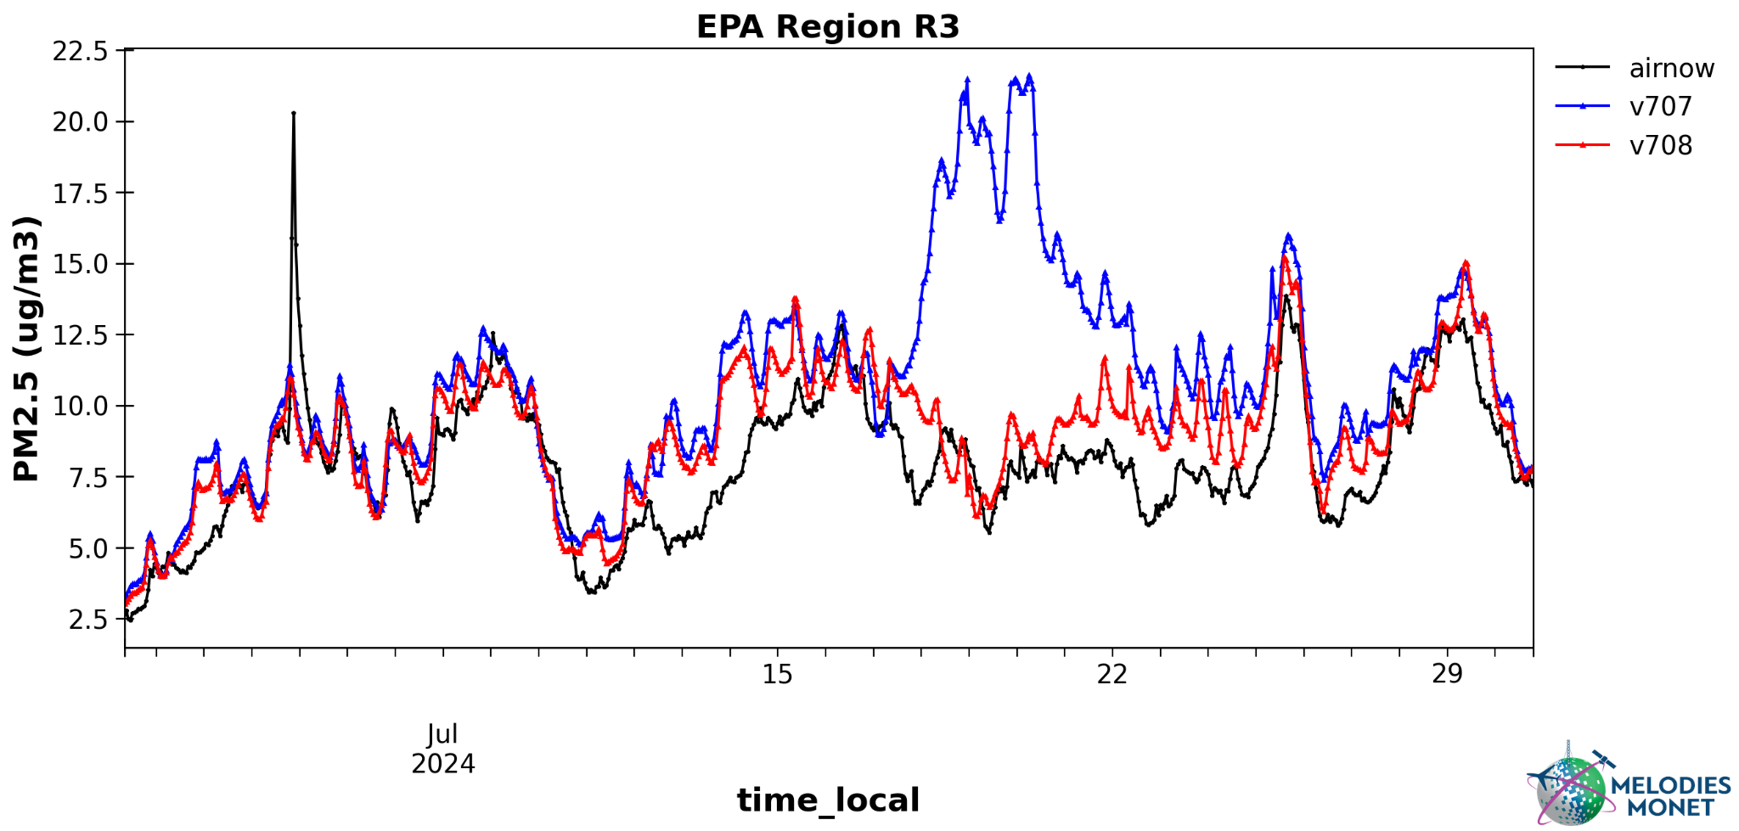
AQMv7.0.8 Improves PM_{2.5} Predictions in July 2024

Slide 13
Proposed changes for AQM v8.0
Increase model grid-spacing resolution from 13 km to 9 km.
Update the UFS-Atmosphere model to use the Finite-Volume Cubed-Sphere (FV3) dynamical core.
Upgrade the Common Community Physics Package (CCPP) to align with the version used in the Global Forecast System (GFS) v17.
Upgrade CMAQ from version 5.2.1 to version 5.4.
Update the National Emission Inventory (NEI) from 2016 to 2019.
Refine fire emission representations and activate Volatile Organic Compound (VOC) emissions from wildfires.
Implement a short training period for PM_{2.5} bias correction during intense wildfire events.
The implementation is planned for December 2025.

Slide 14
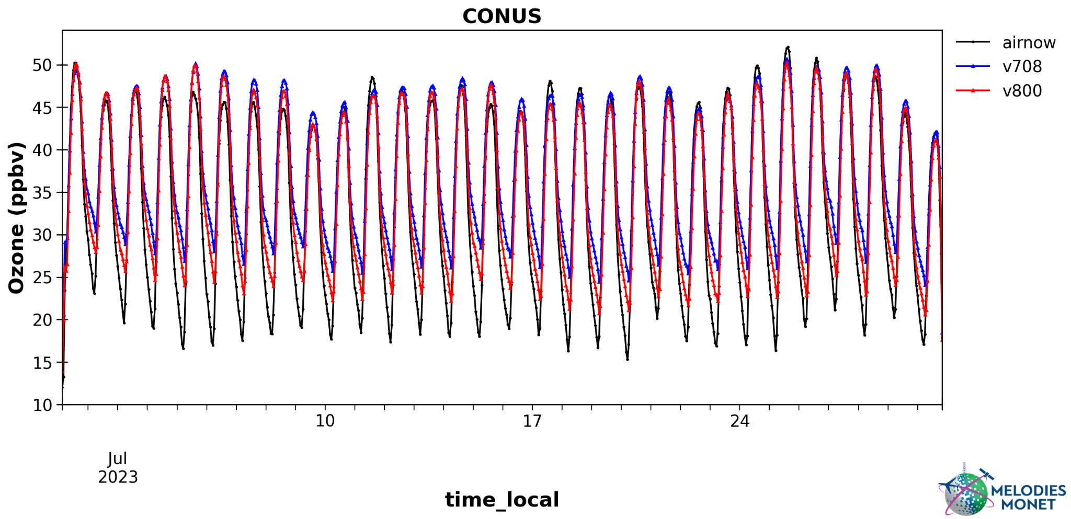
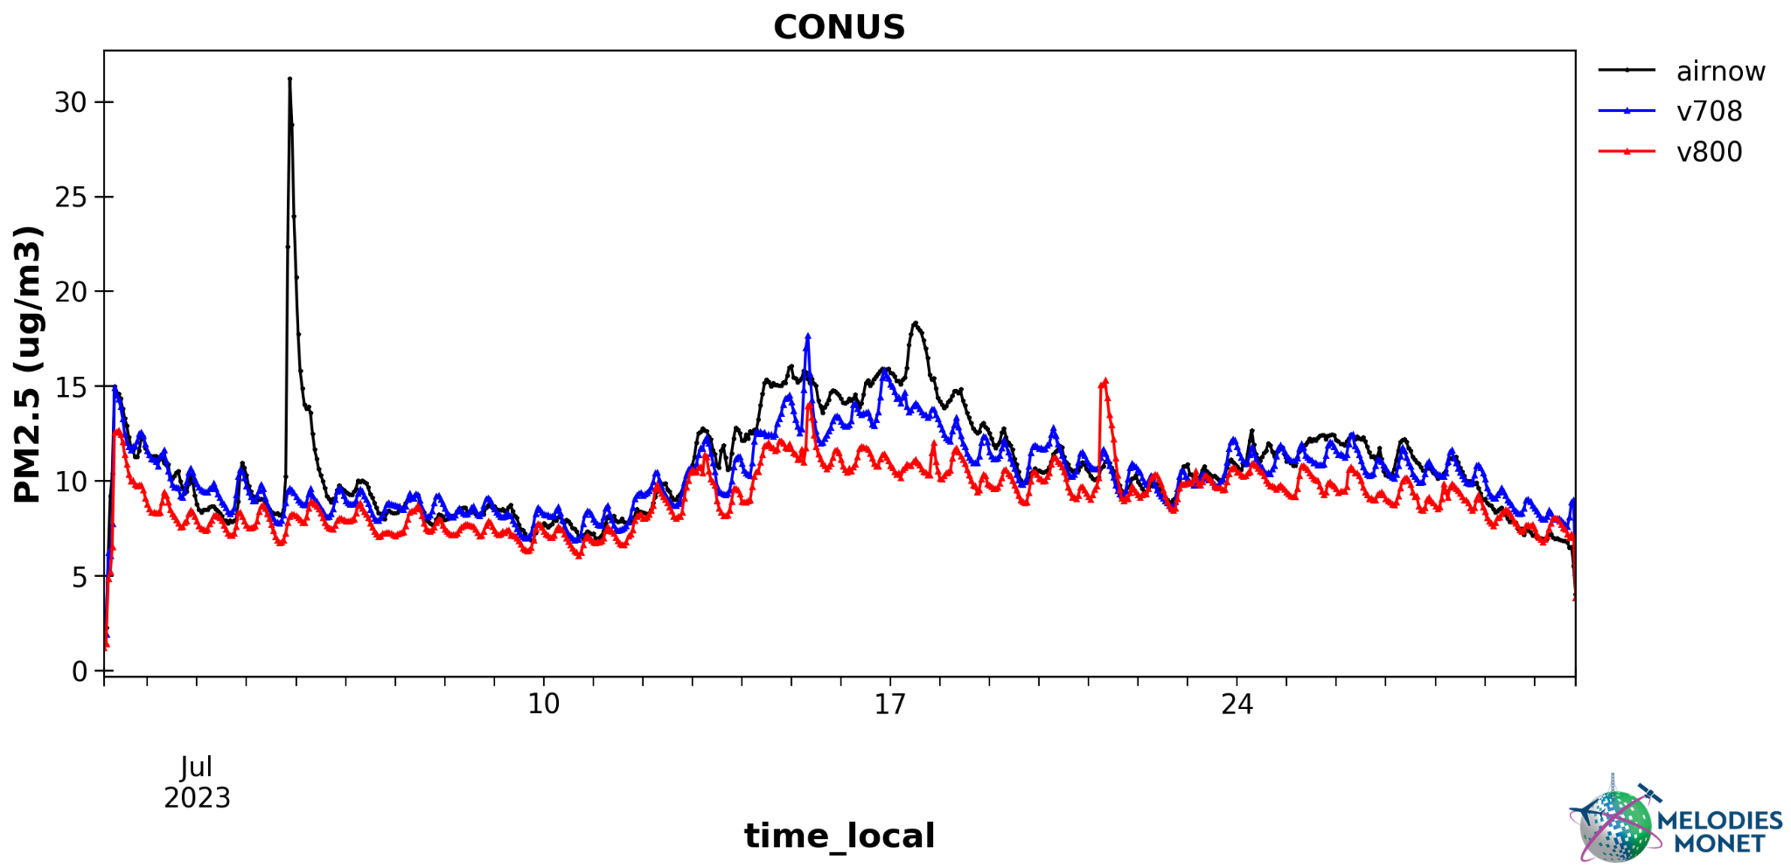
v8.0 improves O₃ predictions (e.g., nighttime)
v8.0: dust module requires refinement

Slide 15
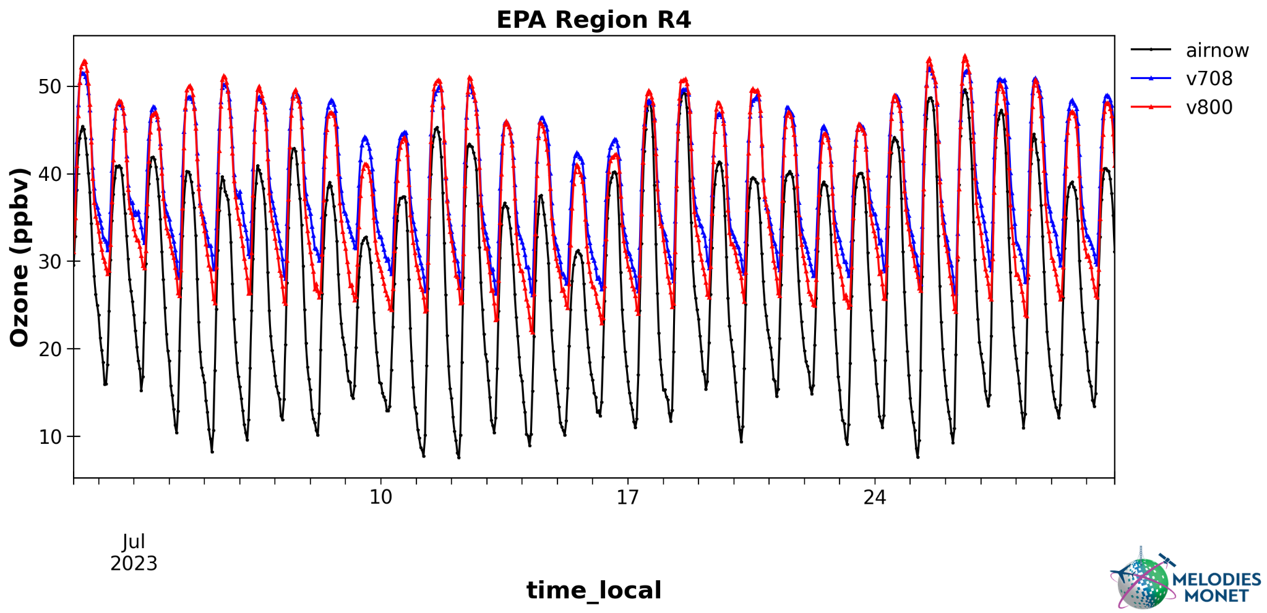
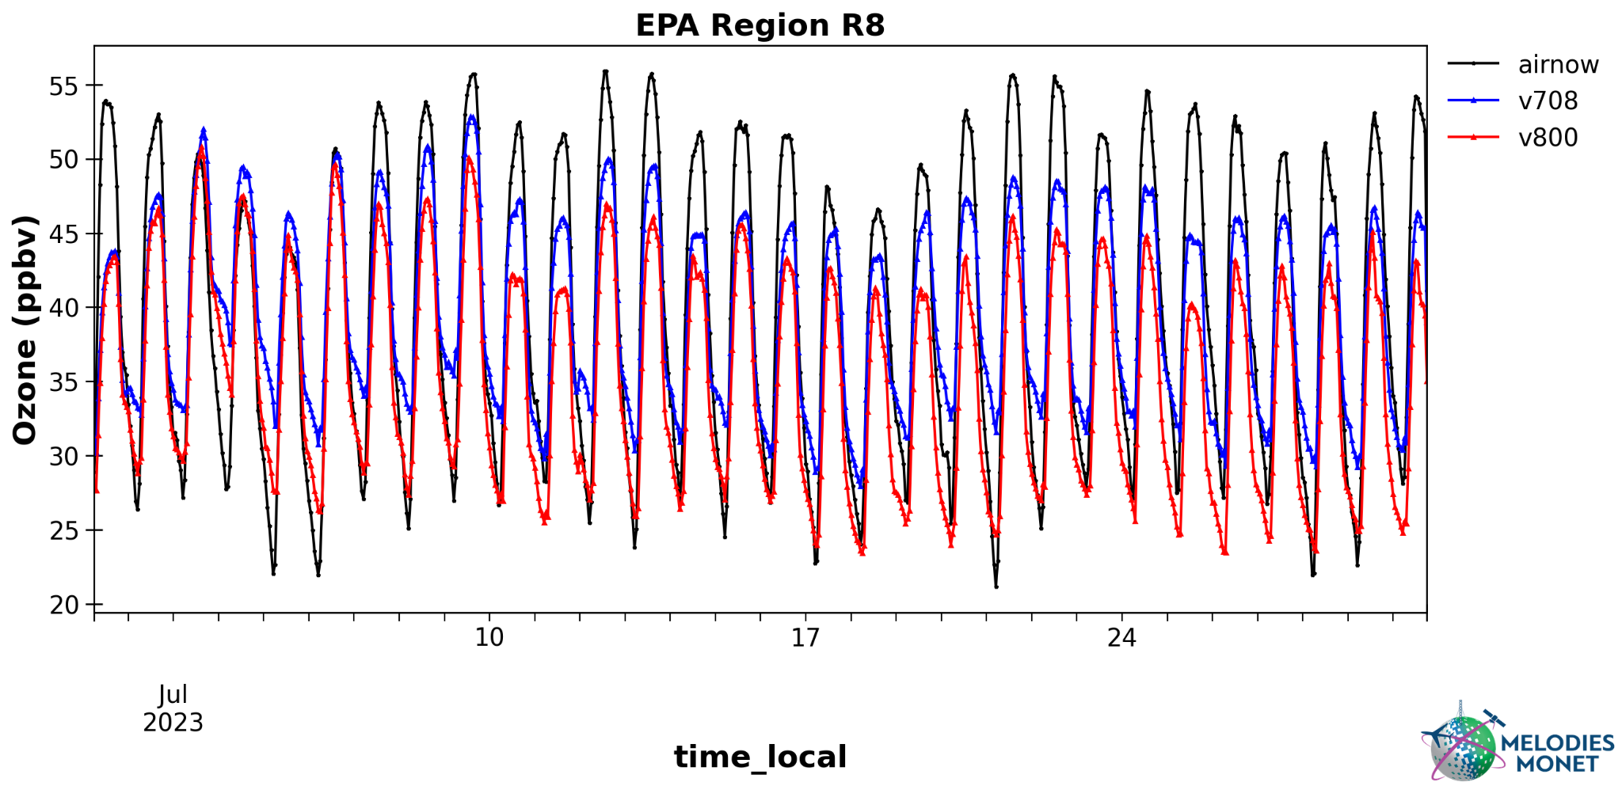
O₃ overpredicted over SEUS and underpredicted in R8

Slide 16
Summary
The first UFS-AQM online system-based AQMv7.0.7 was successfully implemented on May 14, 2024.
An updated version (v7.0.8) was implemented along with code bug fixes to support the upgrade of RAVE v2 fire emission products Oct. 1st, 2024.
Development of AQM v8.0 is underway by refining model grid-spacing, upgrading CMAQ, the UFS-Atmosphere model, and the National Emission Inventory, with implementation planned for Q1 FY 2026.

Slide 17
On-going work and future plans
Incorporate data assimilation (i.e., JEDI) to constrain chemical initial conditions.
Use Tropospheric Monitoring Instrument (TROPOMI) and Tropospheric Emissions: Monitoring of Pollution (TEMPO) retrieval data to constrain ICs of NO₂, O₃, and other chemical species.
Use AirNow surface PM_{2.5}/O₃ and satellite-retrieved AOD to constrain ICs of PM_{2.5}/O₃.
Switch to the MPAS dynamic core.
Higher resolution ( 3 km?) or nested domains for CONUS.
Develop an AI forecast model for further improving AQ predictions.

