Slide 1
US mortality impacts of PM_{2.5} associated with climate change and variability at midcentury using dynamically downscaled global climate and chemistry in WRF and CMAQ
Surendra Kunwar¹
Coauthors: Jared Bowden², George Milly³, Michael Previdi³, Arlene Fiore⁴, J. Jason West¹
¹University of North Carolina at Chapel Hill, Chapel Hill, NC, USA
²North Carolina State Climate Office, Raleigh, NC, USA
³Lamont-Doherty Earth Observatory and Columbia University, Palisades, NY, USA
⁴Massachussetts Institute of Technology, Cambridge, MA, USA
CMAS 2024
Tuesday October 22, 2024

Slide 2
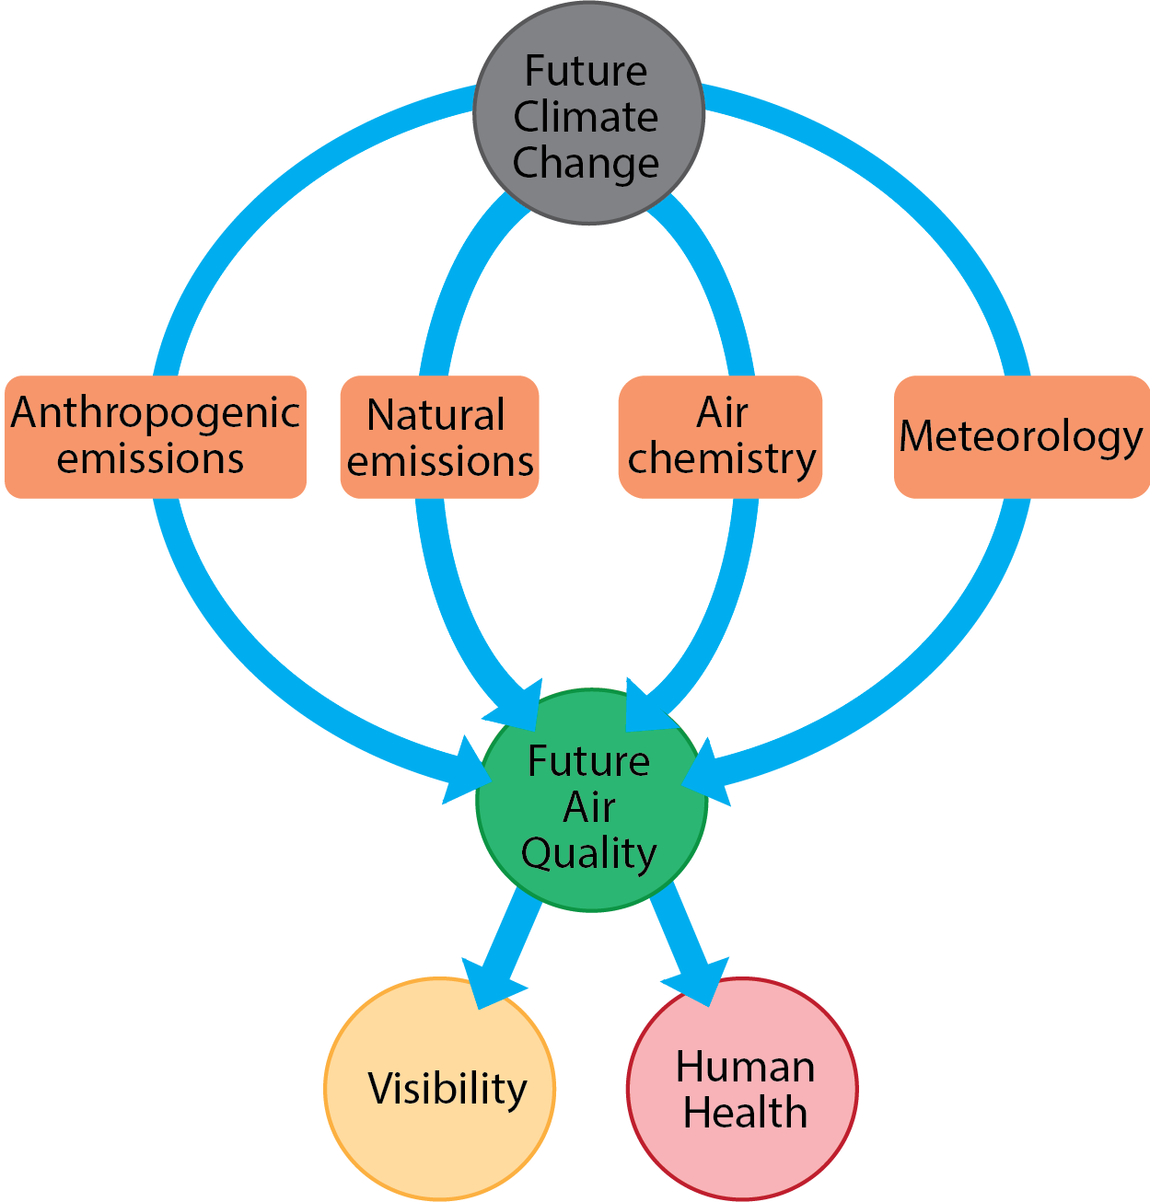
Future Climate Change Impacts on PM_{2.5} Air Quality
Climate change can influence air quality in many ways:
Pathway | Example
Anthropogenic emissions | Warmer summer-> more energy demand for cooling -> more fossil fuel burnt
Natural emissions | Stronger wind -> soil erosion -> release of dust particles Examples: biogenic VOCs, dust, wildfires, sea salt, lightning
Air chemistry | Higher temperature-> accelerated chemical reaction of particles
Meteorology | Less rain -> less washing out of PM Examples: PM ventilation by wind, mixing depth, frontal passage, convection, rain, dry deposition

Slide 3
Past Studies on Future Climate Change Impacts on US PM_{2.5}
Limitations of some earlier regional modeling studies:
downscaled global model to regional scale using single realization of one model to simulate PM_{2.5} changes
averaged 5-10 years’ PM_{2.5} values to represent period of interest
may not have accounted for climate variability
Important to understand the context of climate variability in climate-change impact studies

Slide 4
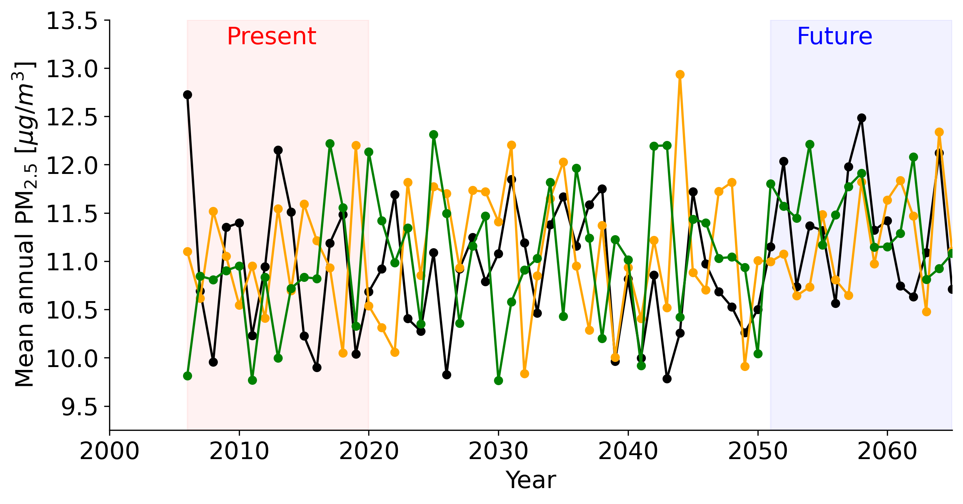
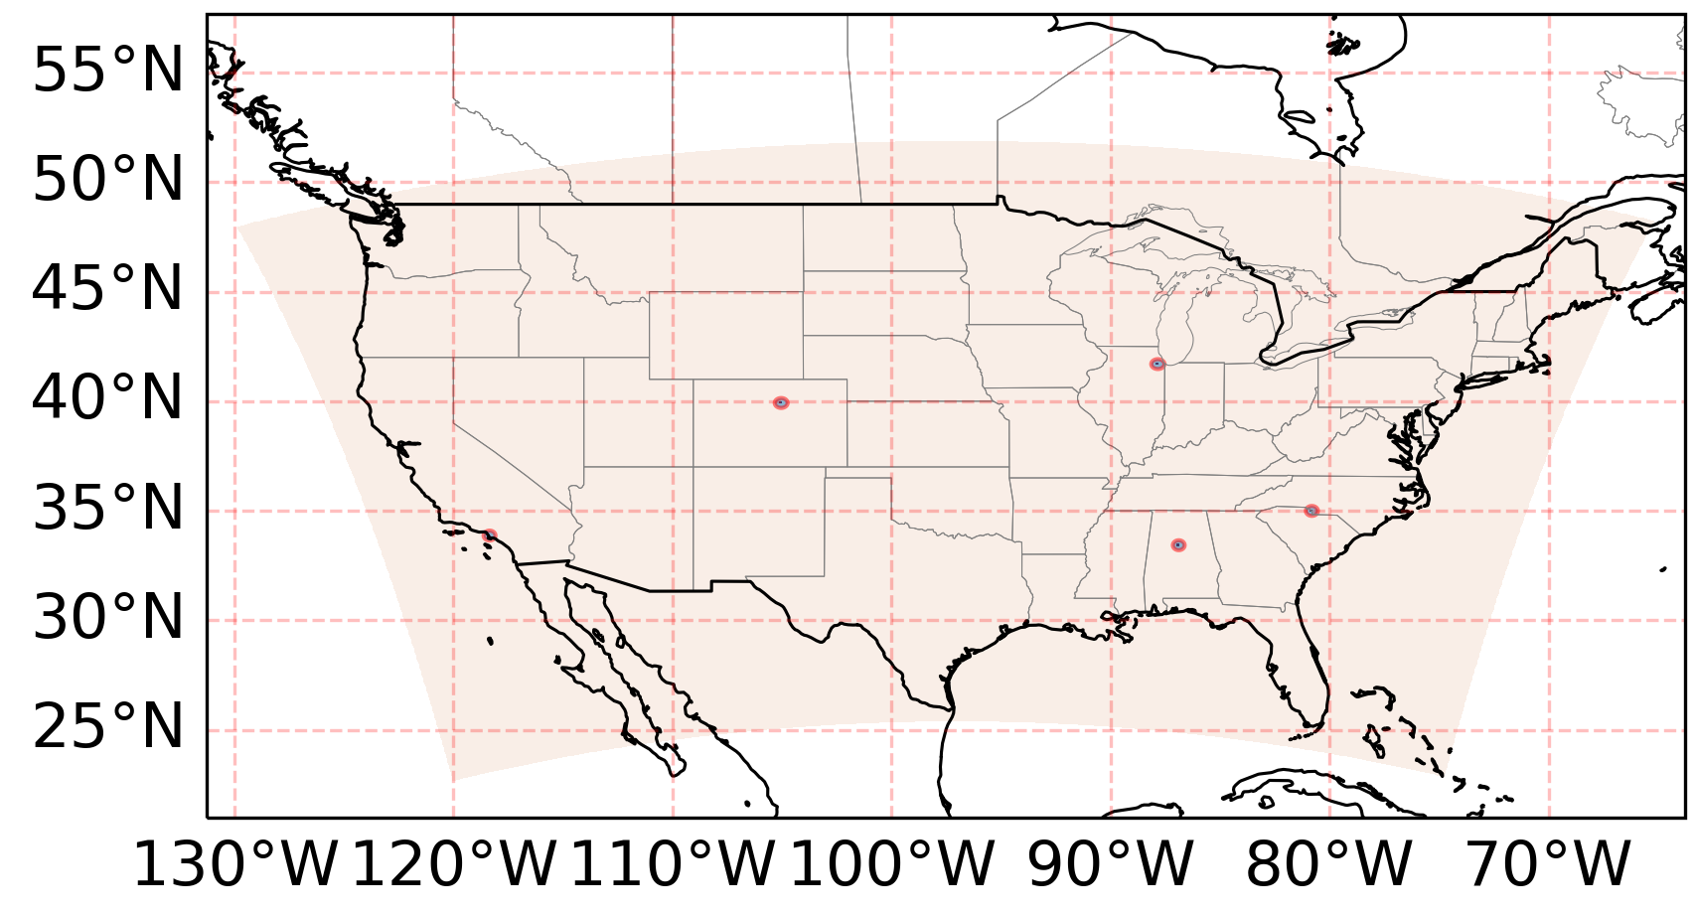
Climate Variability vs Climate Change in a Global Model
PM_{2.5} variability+change illustrated by 3 GFDL ensemble members H1 and H3 at an arbitrary US location:
US location (red dot) for which GFDL ensemble PM2.5 is shown
Internal Variability (noise) can confound Climate Change (signal):
≠
NATURAL CLIMATE VARIABILITY = fluctuation around a steady mean
CLIMATE CHANGE (SIGNAL) = long term change of mean
+
NATURAL FORCING = caused by solar activity, volcanoes
INTERNAL VARIABILITY (NOISE) = internally arising due to chaotic nature of climate system

Slide 5
Study Objective
‘To quantify the impacts of RCP8.5 climate change (in the 2050s compared to the present) and variability on US PM_{2.5} and related human mortality at fine spatial resolution, using a novel approach of combining probability distributions from multi-year global model ensembles with downscaling over the continental US.’
GFDL model
WRF model
CMAQ model
Year 2006-2100
8 selected years dynamically downscaled
3 ens. members
6 hourly output
2.5º X 2.5º grid
Hourly output
12km grid
8 selected years downscaled
Hourly output
12km grid
BenMAP-CE
Health impacts of downscaled years calculated
8 years selected
SMOKE processor
chemistry
emissions
meteorology
meteorology
air quality
Notes:
We use different models to achieve this objective – which we show as a flowchart in next slide.

Slide 6
Steps Towards Constructing Probability Distribution of PM_{2.5} associated Mortality at Fine Scale using Global and Regional Models
3-ensemble, coarse Global Chemistry-Climate Model simulations for 2006-2100 under RCP8.5 scenario
Select 8 GCM years representing high/median PM_{2.5}
Dynamical downscaling of meteorology (WRF 12km)
Air quality downscaling (CMAQ 12km) with inline biogenic, lightning NO_{x}, seasalt emissions
Construct fine scale probability distribution of mean annual PM_{2.5} change between present and future
Study associated probabilistic impacts of PM_{2.5} variability on human health
Study associated probabilistic impacts of climate induced PM_{2.5} changes on visibility
Notes:
Emphasize (1) 8 years are selected from GCM (2) third project will be about visibility

Slide 7
WRF/CMAQ Simulations
Simulations conducted in regional models WRF and CMAQ:
Scenario Name | Time | Meteorology | GFDL IC/BC | Anthropogenic Emissions | # Realizations
PRES | 2006-2020 | 2005 RCP8.5_WMGG | RCP8.5_WMGG | 2016 National Emissions Inventory (NEI) | 4
FUT | 2051-2065 | 2050 RCP8.5_WMGG | RCP8.5_WMGG | 2016 National Emissions Inventory | 4
FUT - PRES = effect of only climate change on future PM_{2.5}
Land Use/Cover remains constant for all WRF/CMAQ simulations
GFDL RCP8.5_WMGG fixes aerosol, precursor emissions at 2006 level
CMAQ simulations use 2016 NEI emissions to reflect current emissions

Slide 8
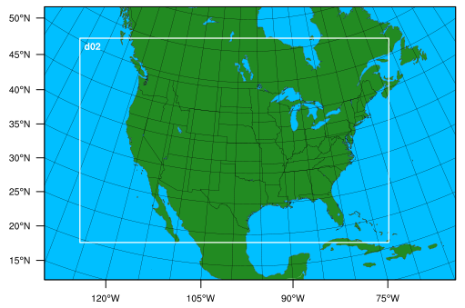
WRF Physics Options
8 selected GFDL years (RCP8.5 meteorology with 2005 emissions) downscaled in WRFv3.8.1.1:
Physics Options used in WRFv3.8.1.1 simulations
Domains used in Simulations
Parameter | Physics options used in WRF simulation
mp_physics = 6 | WSM 6-class graupel scheme microphysics
ra_lw_physics = 4 | RRTMG radiative transfer scheme for longwave radiation
ra_sw_physics = 4 | RRTMG radiative transfer scheme for shortwave radiation
sf_surface_physics = 2 | Unified Noah land-surface model
cu_physics = 1 | Kain-Fritsch (new Eta) scheme for cumulus parameterization
num_land_cat = 40 | 40 land categories of NLCD2011 used
num_soil_cat = 16 | 16 categories of soil data
12km domain
36km domain
* Spectral nudging is applied to moisture for better precipitation results (Spero et al, 2018)

Slide 9
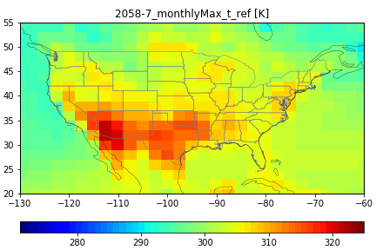
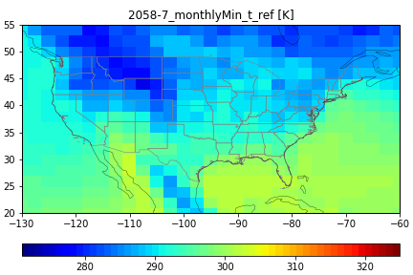
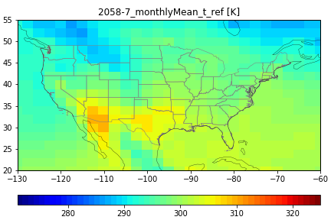
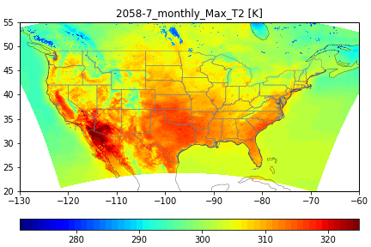
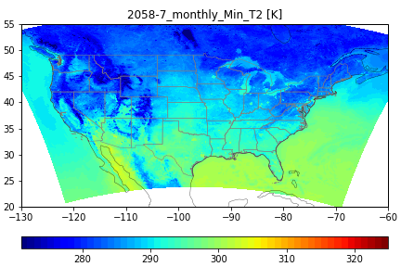
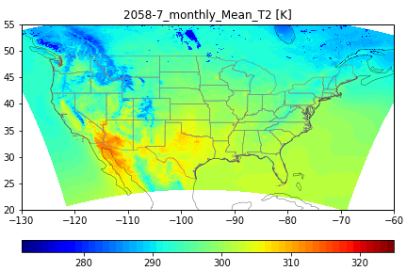
GFDL vs WRF 2m Temperature : July 2058 (ens. H1) Example
General 2-m temperature [T2; units of Kelvin] patterns of GFDL simulations represented in WRF
WRF simulation adds fine scale details
 | T2 July 2058(H1) Maximum | T2 July 2058(H1) Minimum | T2 July 2058(H1) Mean
GFDL 2058 H1
WRF 12km

Slide 10
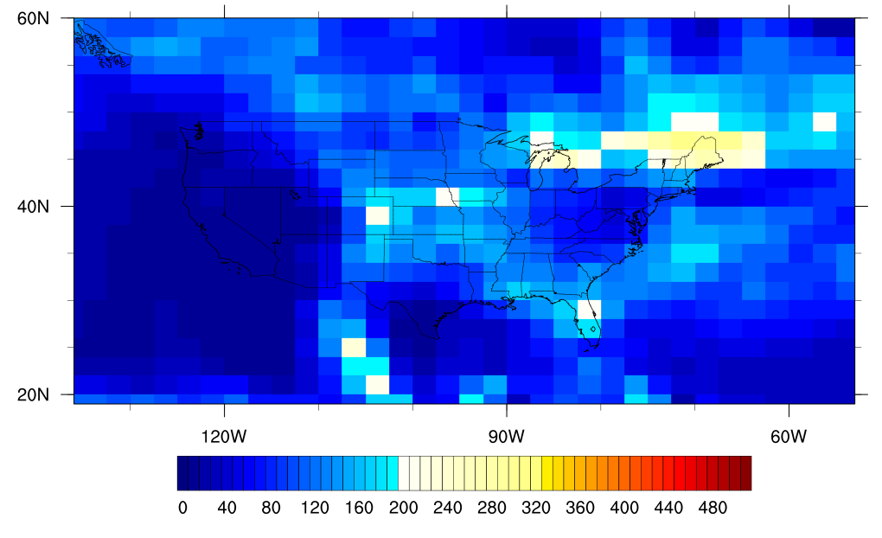
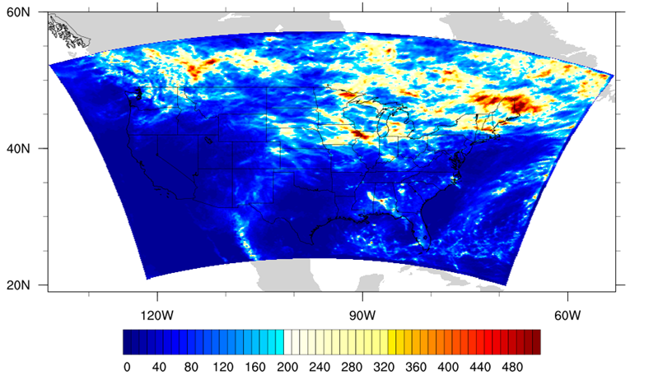
GFDL vs WRF Monthly Precipitation Total: July 2058 (ens. H1)
General precipitation [units mm] pattern of GFDL are represented well in WRF*
WRF simulation adds finer scale details in precipitation
GFDL 2058 H1
WRF 12km
* Spectral nudging applied to moisture in WRF simulations for better precipitation results (Spero et al, 2018)
* July-December 6-month spinup used for surface temperature IC for better Inland lake model results

Slide 11
CMAQ Simulation Setup
12km CONUS domain adopted
Meteorology-sensitive emissions used inline in CMAQ:
sea spray aerosol emission
lightning NO_{x} emissions
biogenic emissions
CMAQ O₃ BC and IC from GFDL modified:
ozone (O₃) overestimation bias-corrected for better matching with observations

Slide 12
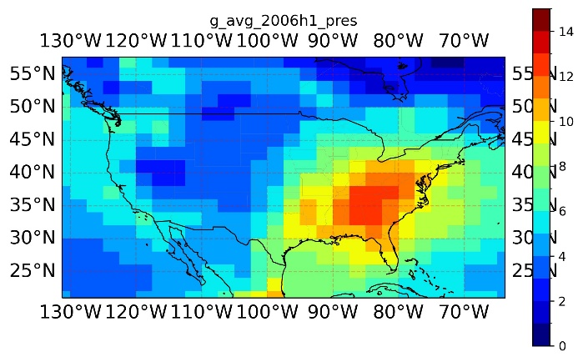
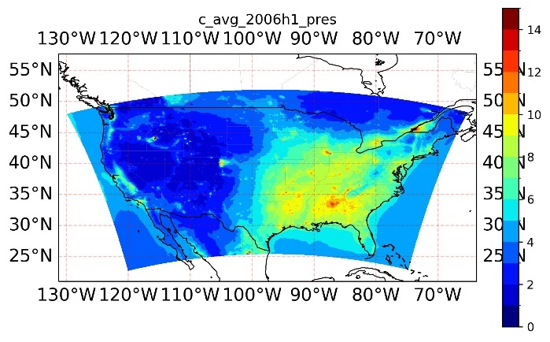
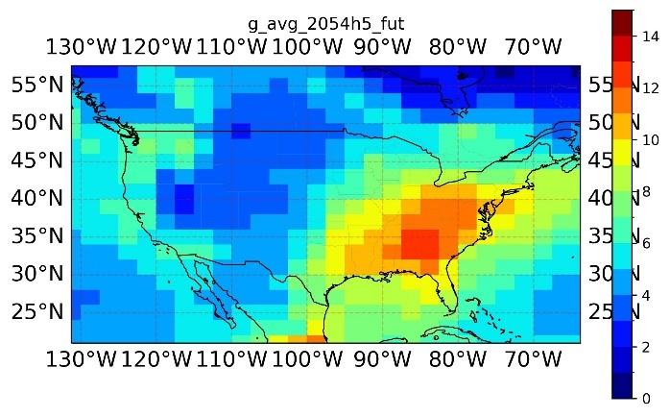
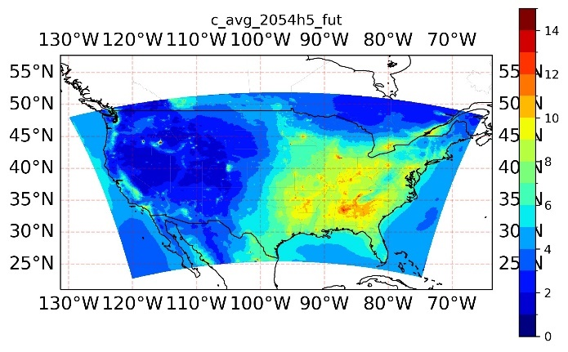
GFDL vs CMAQ vs Observation PM_{2.5}
CMAQ PM_{2.5} is mostly underestimated at regional level (West coast and Southeast):
 | GFDL (μg/m³) | CMAQ 12k (μg/m³) | FRM Observation (μg/m³)
2006 (H1 ens. member)
2054 (H5 ens. Member)

Slide 13
Mean-scaling: Connecting GFDL and CMAQ Annual Average Statistics of PM_{2.5}
To estimate distribution of mean annual PM2.5 in fine scale, Mean-scaling method used:
CMAQ distribution mean (by applying above mean-scaling method):
CMAQ distribution standard deviation (applying mean-scaling):
With mean and stdev. are estimated, PM_{2.5} normal distribution is defined.
$$\frac{CMAQ distribution parameter}{CMAQ 4 year parameter}=\frac{GFDL 45 year average}{GFDL 4 year average}$$
Mean-scale factor
$CMAQ distribution mean=Mean scale factor$ * $CMAQ 4 year mean$
$CMAQ distribution stdev=Mean scale factor$ * $CMAQ 4 year stdev$

Slide 14
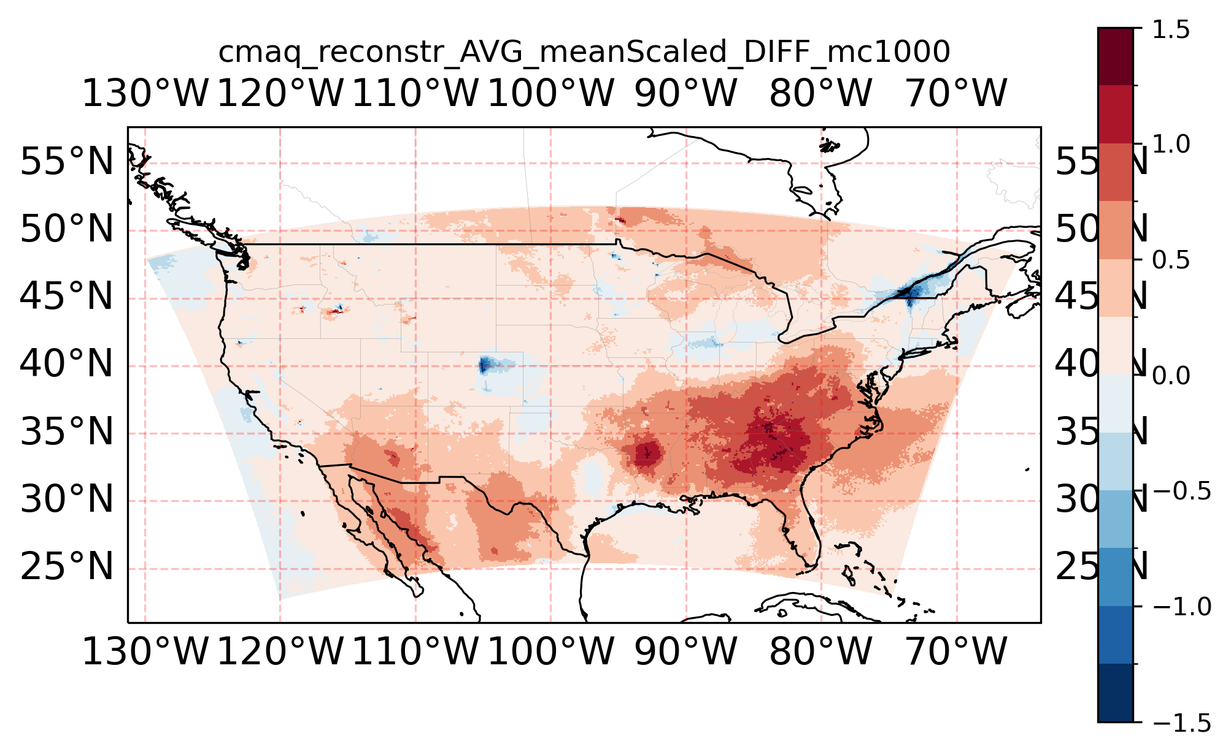
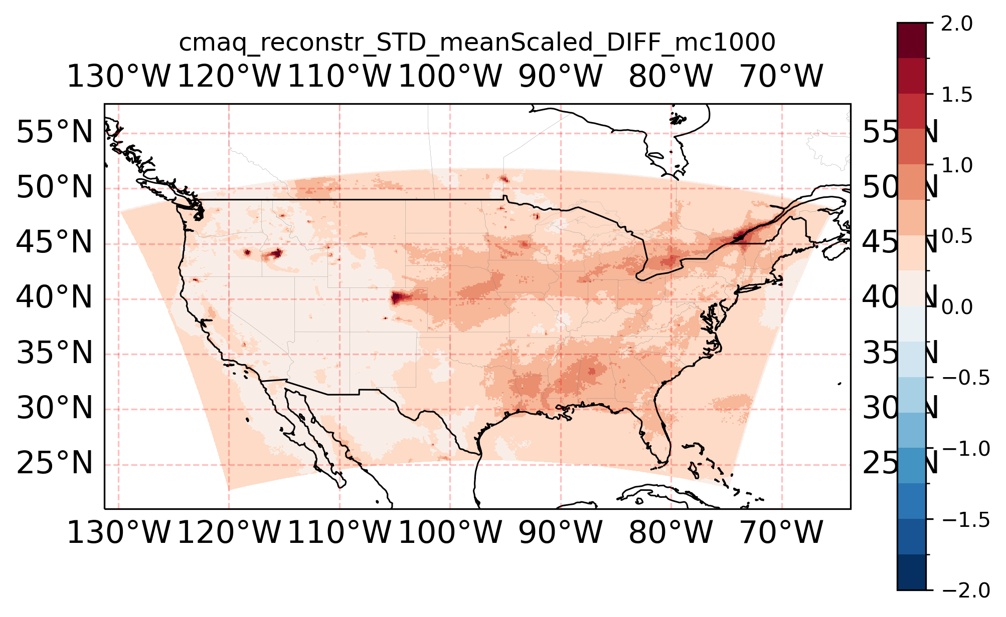
FUT–PRES PM_{2.5} Distribution from Monte Carlo Samples
The mean (left below) and the stdev. (right below) describe the probability distribution (assumed Gaussian) of FUT-PRES mean annual PM_{2.5}:
AVG of FUT-PRES calculated by Monte Carlo Sampling
STDEV of FUT-PRES calculated by Monte Carlo Sampling

Slide 15
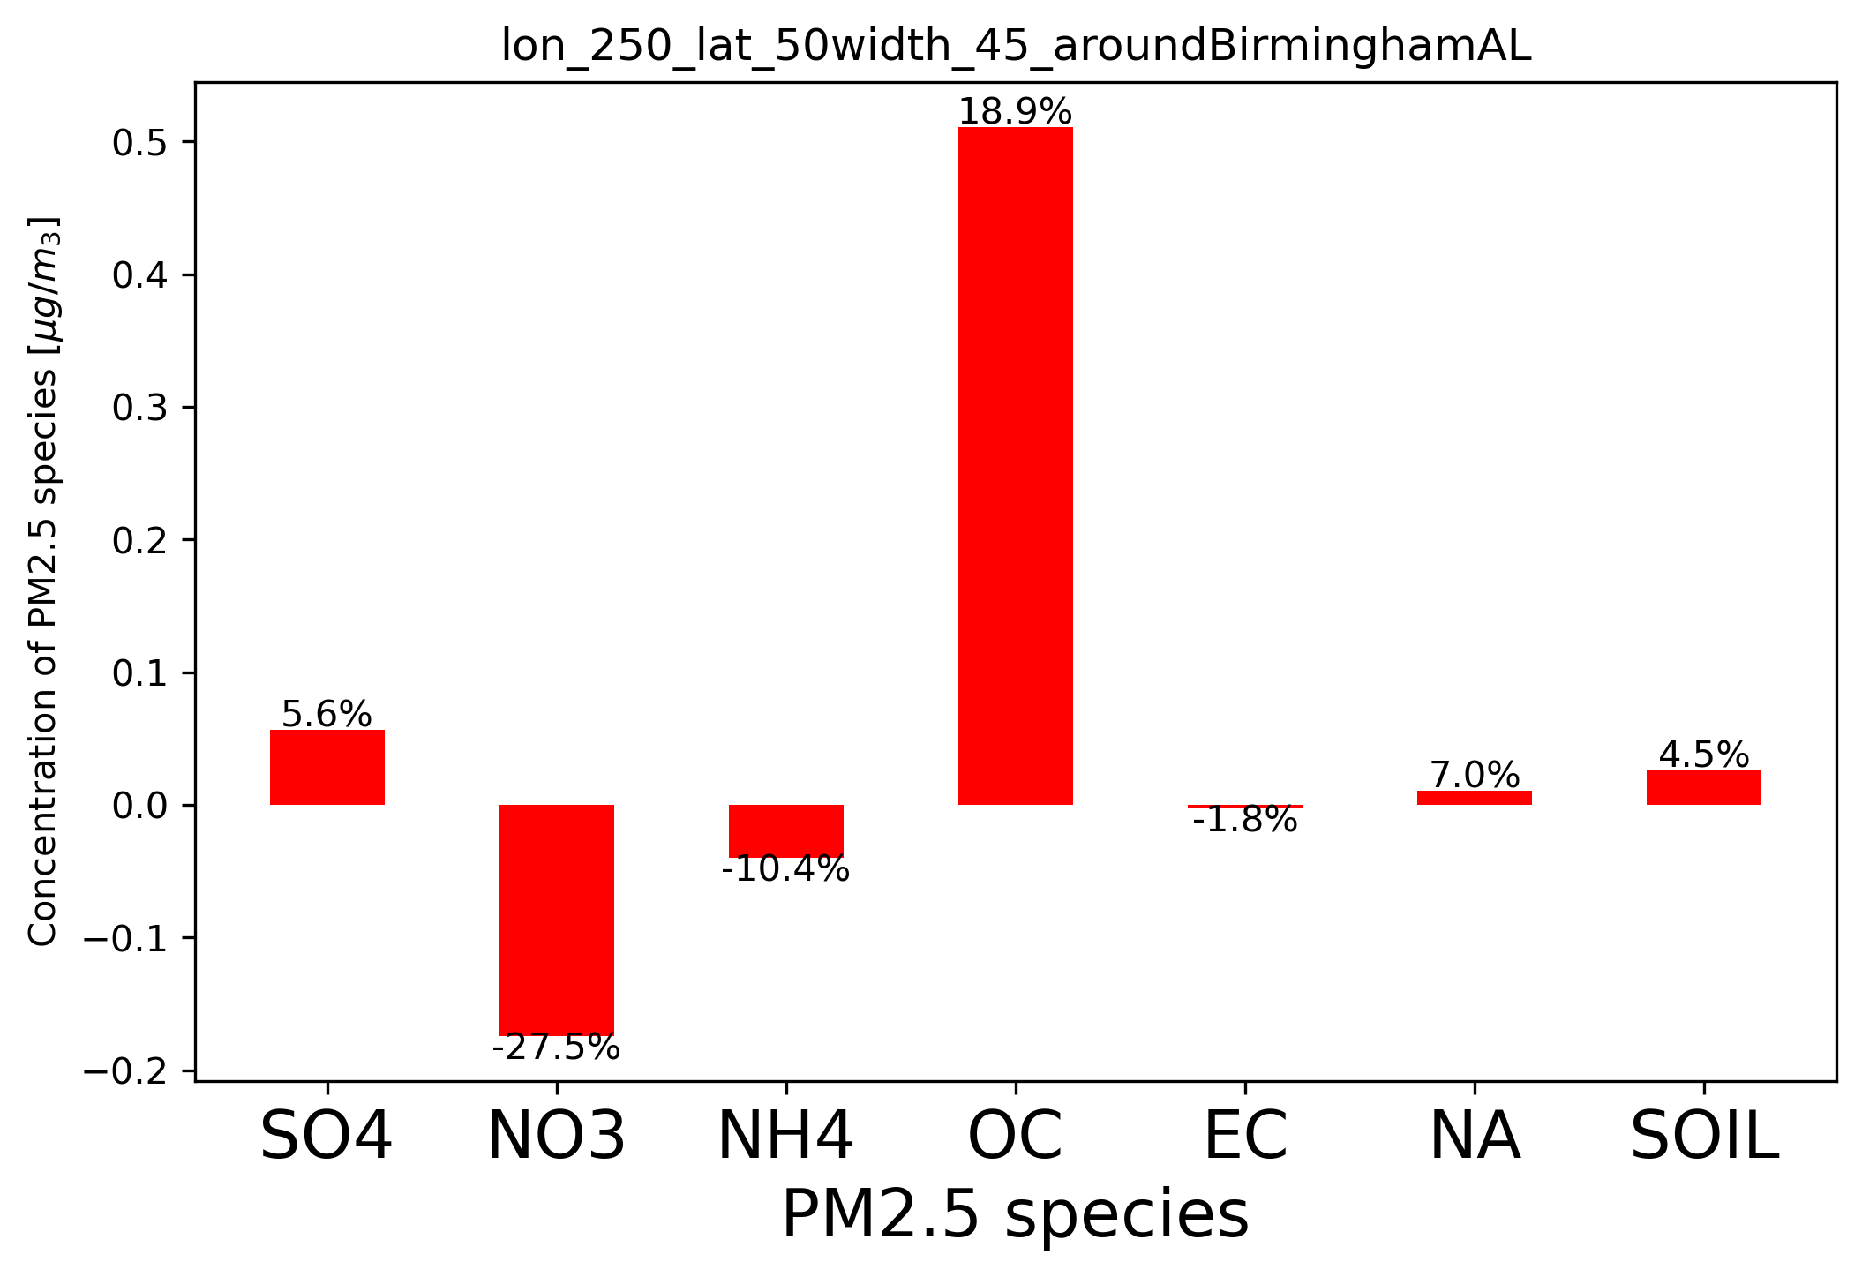
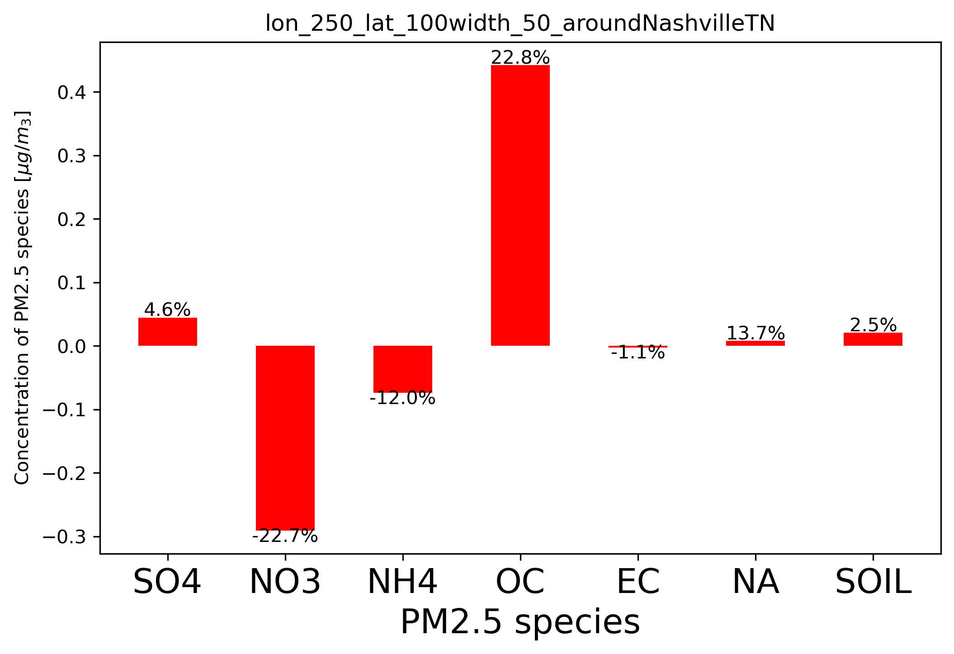
Regional Trends of ΔPM_{2.5} Components
PM_{2.5} mean increase is the highest in
Southern US (50 x 50 CMAQ gridcells aggregated around AL), and
Ohio River Valley (50 X 50 CMAQ gridcells aggregated around TN)
Temperature-led increase in OC is only partly offset by decrease in nitrate component in both regions
Southeast US
Ohio River Valley

Slide 16
Gridcell-specific Results of Mean-scaling of PM_{2.5}: Charlotte, NC
Mean-scaling of the Average and Stdev. of PRES and FUT annual PM_{2.5} describe the Gaussian distribution of mean annual PM_{2.5}at each gridcell
Similarly, health effects of PM_{2.5} due to climate change can be extrapolated in individual gridcells over CONUS domain

Slide 17
Mean Scaling Method for Estimating Annual PM_{2.5} related Mortalities Distribution ~ N(µ,σ)
- CMAQ Gaussian distribution parameters of annual mortalities calculated at each gridcell assuming:
$$\frac{µ_{cmaq,dist}}{µ_{cmaq,4yr}}=\frac{µ_{gfdl,45yr}}{µ_{gfdl,4yr}}$$
GFDL 45-years’ (3 ensemble members times 15 years) binned annual mortality averages
CMAQ distribution mortalities (estimate of DESIRED QUANTITY )
averaged
Mean Scale Factor
CMAQ 4 selected years’ annual mortality average
GFDL 4 selected years’ annual mortality average
averaged
averaged
- CMAQ distribution std. dev. ($σ_{cmaq,dist}$) is obtained from: $\frac{σ_{cmaq,dist}}{σ_{cmaq,4yr}}=\frac{µ_{gfdl,45yr}}{µ_{gfdl,4yr}}$
- Once ${µ_{cmaq,dist} and σ}_{cmaq,dist}$ are calculated, PM_{2.5} normal distribution is defined!

Slide 18
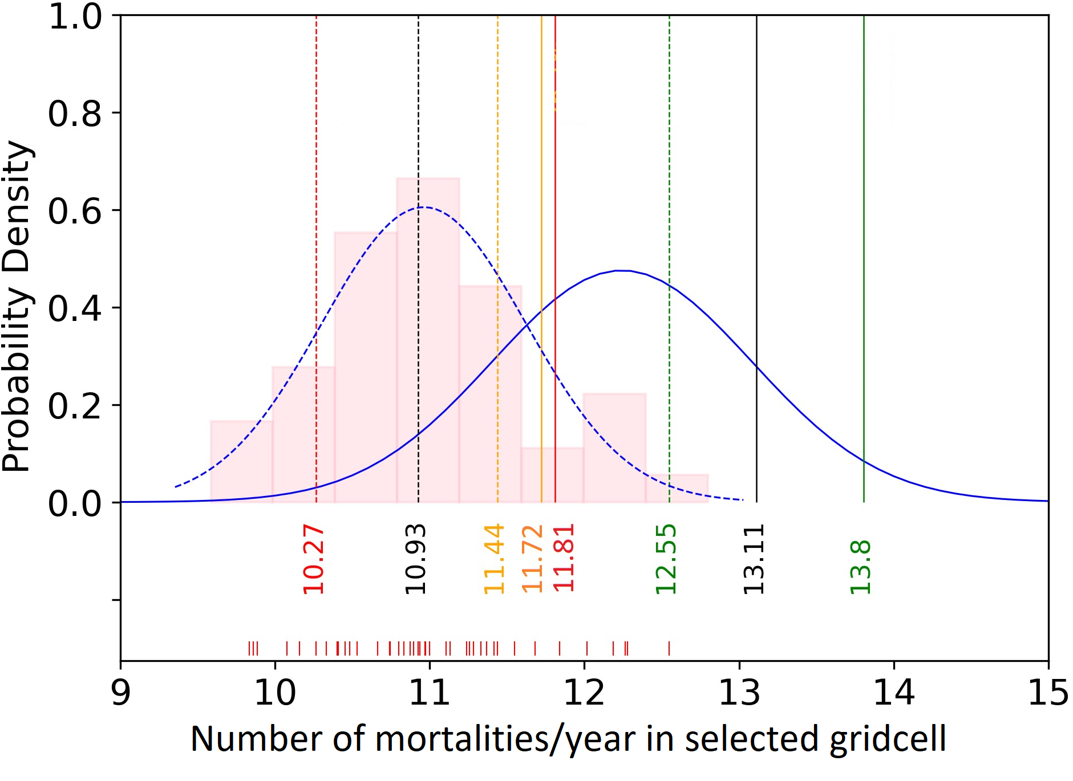
PM_{2.5} Human Health Impacts Distribution due to Climate Change
Illustration of steps to estimate present-day annual mortalities distribution at single gridcell (hypothetical):
1a) Histogram of GFDL based health mortalities
1b) Gaussian fit to GFDL histogram
2) Selected 4 GFDL years’ annual mortalities
3) Corresponding 4 CMAQ years’ mortalities
4) Estimated Gaussian fit to CMAQ
Similar steps taken to estimate midcentury annual mortalities distribution
Impact of climate change on human mortality due to PM_{2.5} changes estimated by Monte Carlo sampling from present and future distributions

Slide 19
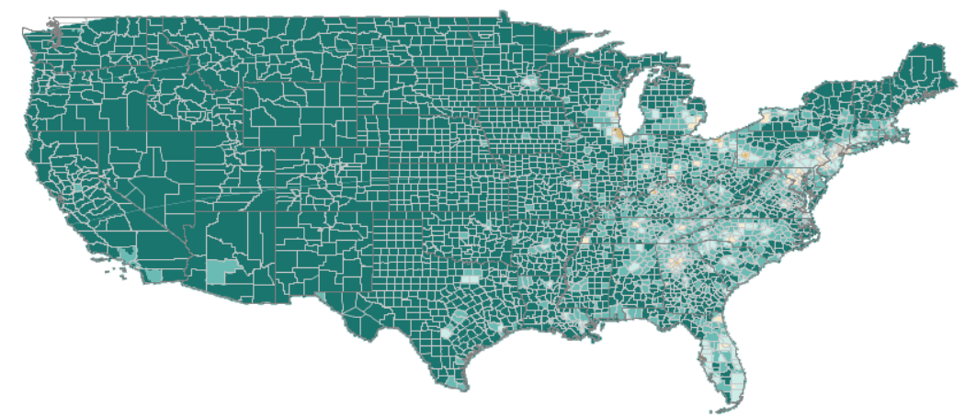
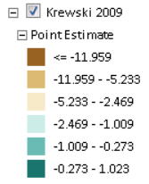
Preliminary Result from BenMAP: PRES-FUT Distribution of Mean Deaths at Gridcell Level
‘PRES-FUT PM_{2.5} distribution mean’ health impacts over CMAQ 12k grid:
Population used: US Census based 2015 population (available within BenMAP)
HIF used: study by Krewski et al., 2009

Slide 20
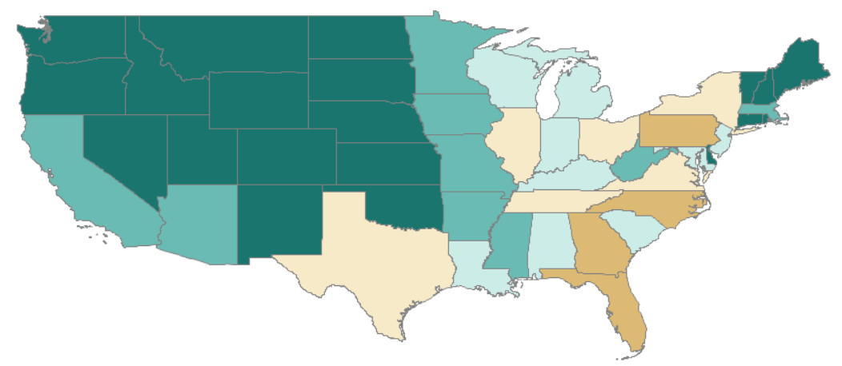
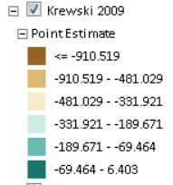
Preliminary Result from BenMAP: PRES-FUT Distribution Mean Deaths Aggregated at State Level
‘PRES-FUT PM_{2.5} distribution mean’ health impacts over CMAQ 12k grid:
CONUS aggregated excess deaths in 2050s compared to the present: 8,712

Slide 21
Conclusion
We quantified climate change impacts on US PM_{2.5} in 2050s compared to present, in the presence of climate variability, by:
using ensemble global model simulation to characterize PM_{2.5} variability,
downscaling meteorology and air quality in selected years to fine resolution (12km),
keeping anthropogenic emissions constant
mapping fine scale probability distributions of PM_{2.5} in individual grid cells
Our novel method:
generated probabilistic information about climate change+variability induced PM_{2.5} changes in individual grid cells
is also being used in health impacts of PM2.5 due to climate change and climate variability at fine resolution
Future steps:
fit different probability distribution models to health impacts of PM_{2.5} to see resulting climate change impact
aggregate FUT-PRES PM_{2.5} health impacts over multiple gridcells (e.g. of a city)
apply similar approach to visibility

Slide 22
Acknowledgment
My PhD Advisor, Collaborators/coauthors, Mentors, Committee, Lab group
NSF’s XSEDE program and UNC Research Computing for computational resources
USEPA (STAR grant #RD83587801), Weiss Urban Livability Fellowship (Graduate School), Don and Jennifer Holzworth Fellowship (Environmental Sciences and Engineering) for funding
LDEO Fiore group (then at Columbia University) for GFDL data; Gus Correa for GFDL data transfer support

Slide 23
Thank You for listening!
Questions/Comments

