Slide 1

Remote Sensing of Ammonia: how it works and what it can tell us
Karen E. Cady-Pereira¹, Jeana Mascio¹, Betsy Berry¹, Elva Kuai³, Enrico Dammers²
1. AER, Lexington, Mass
2. TNO, The Netherlands
3. NASA Jet Propulsion Laboratory, Pasadena, California
CMAS Conference: October 21-23, Chapel Hill, North Carolina
Notes:
Greg has introduced the TROPEES products.

Slide 2
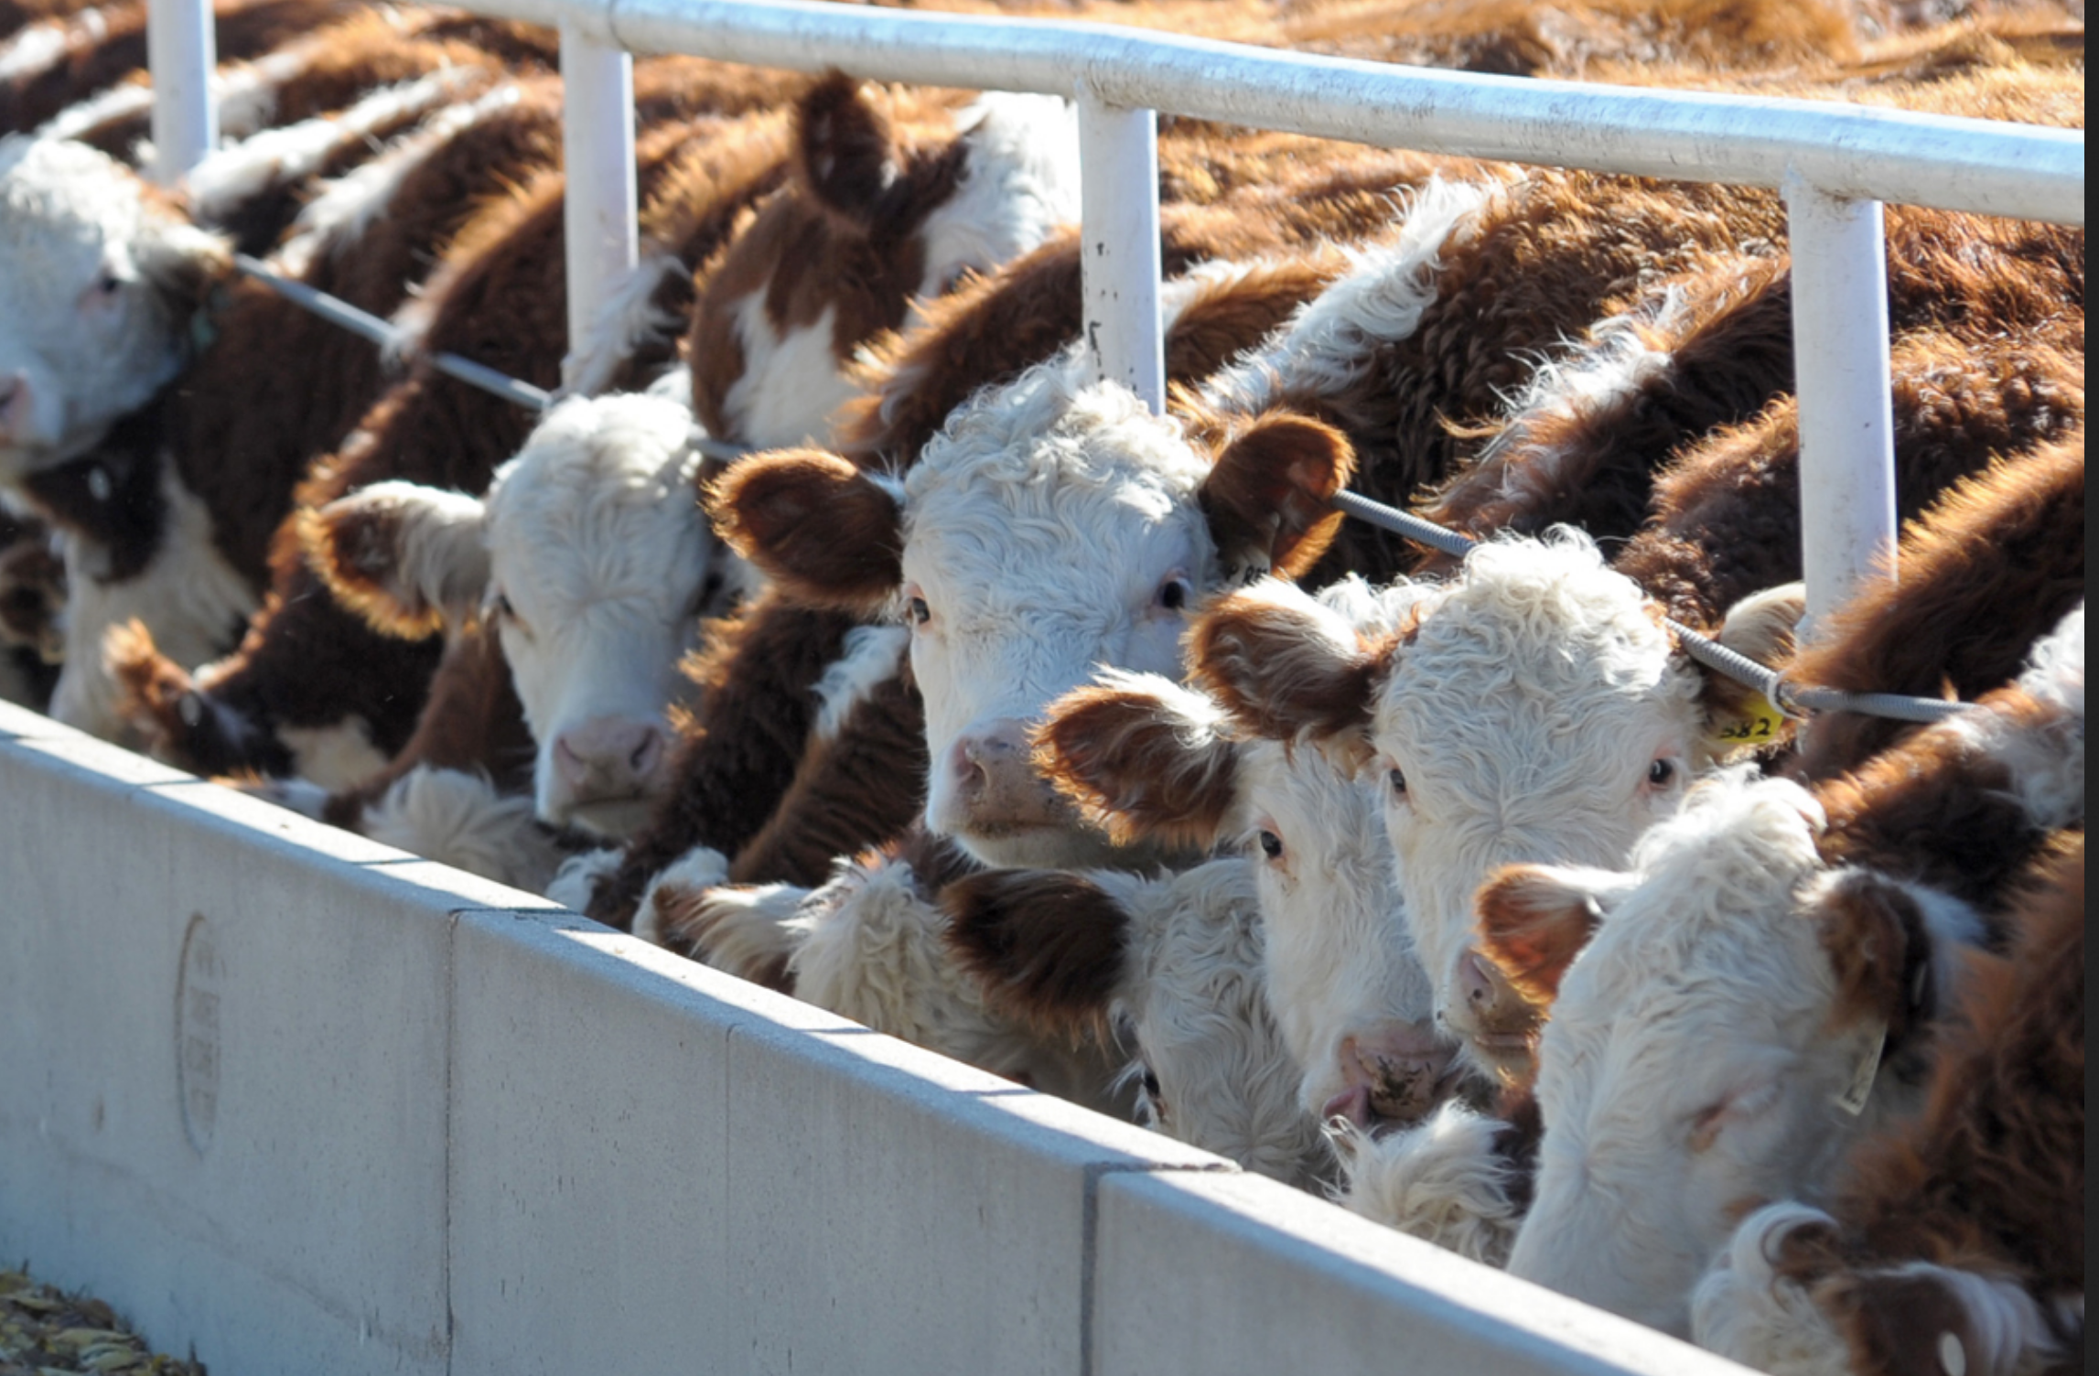
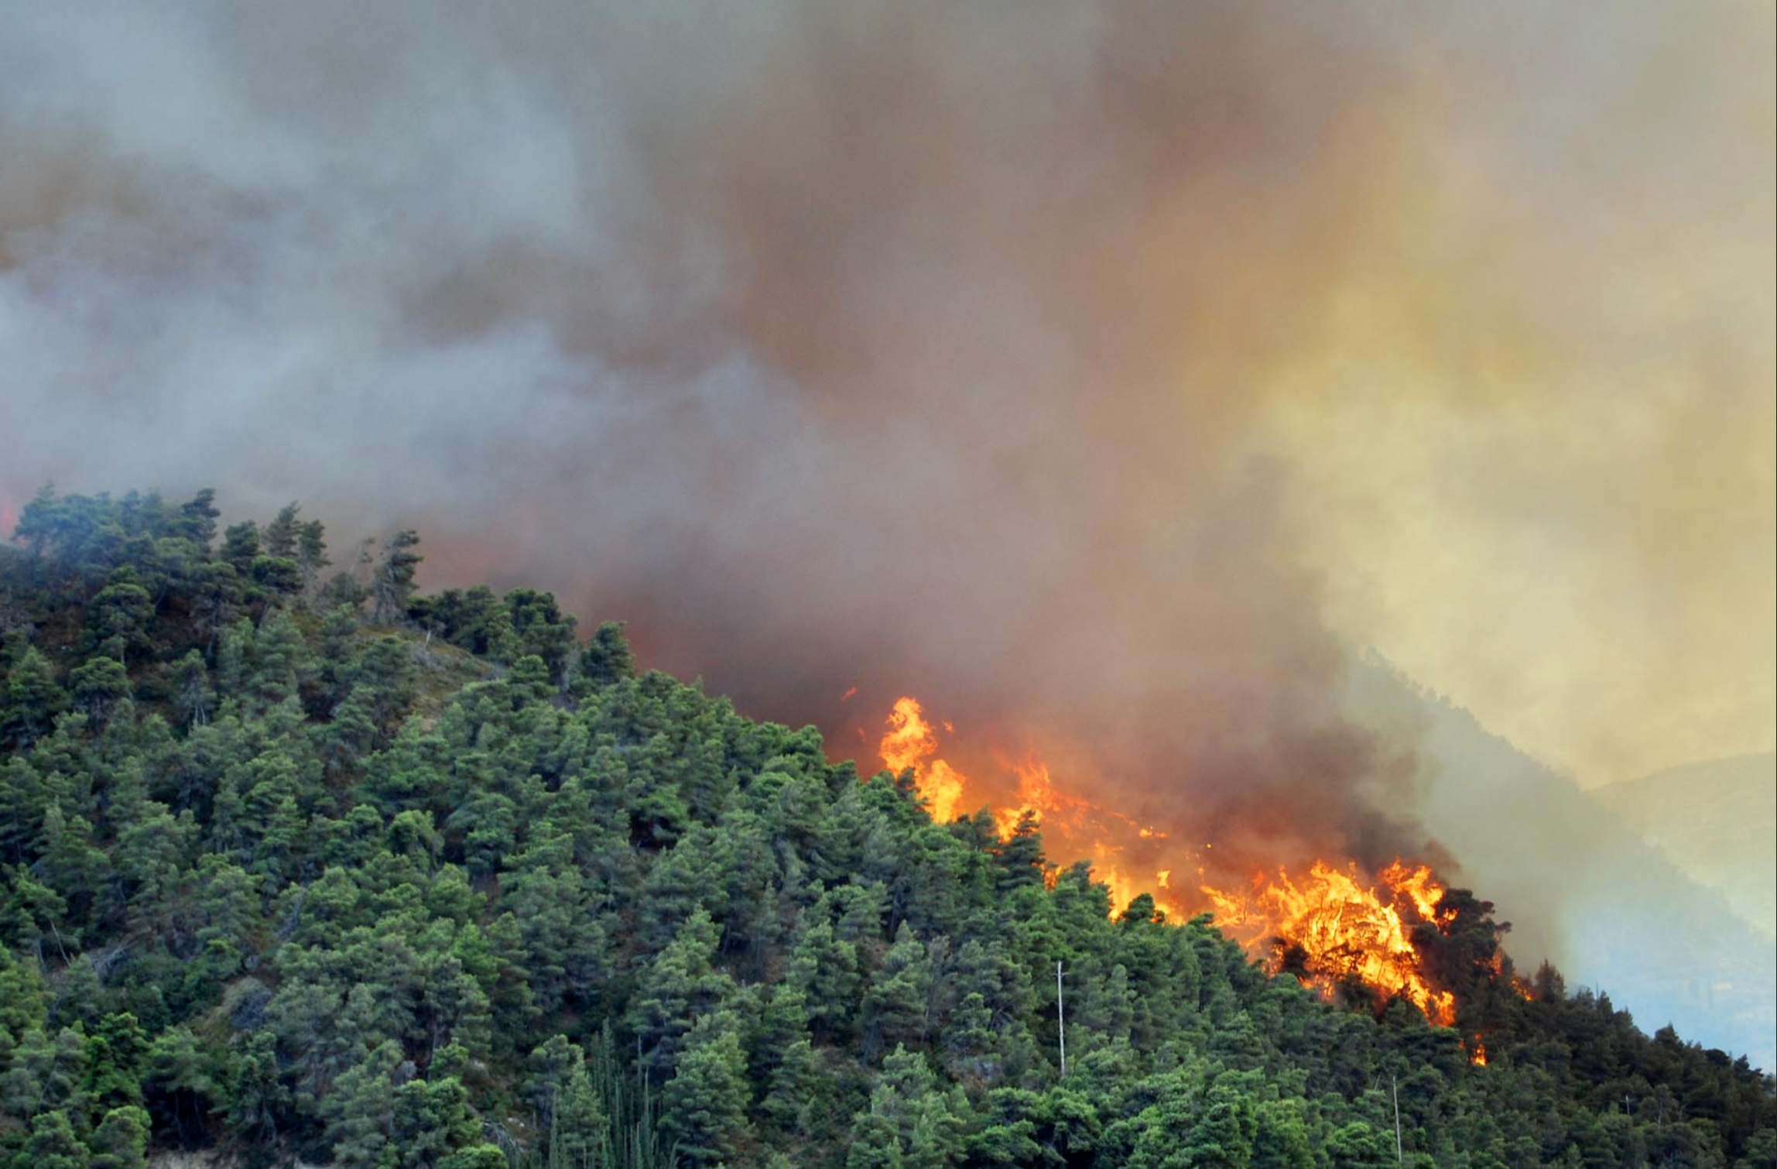
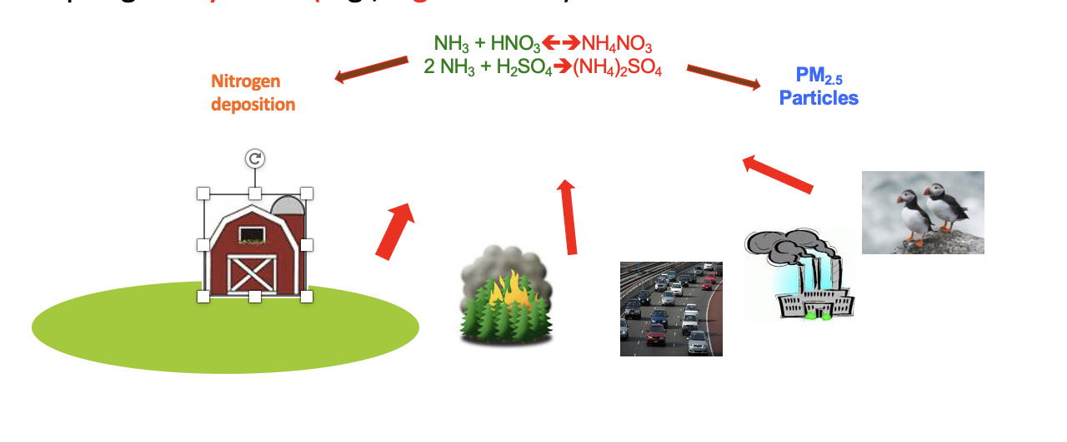
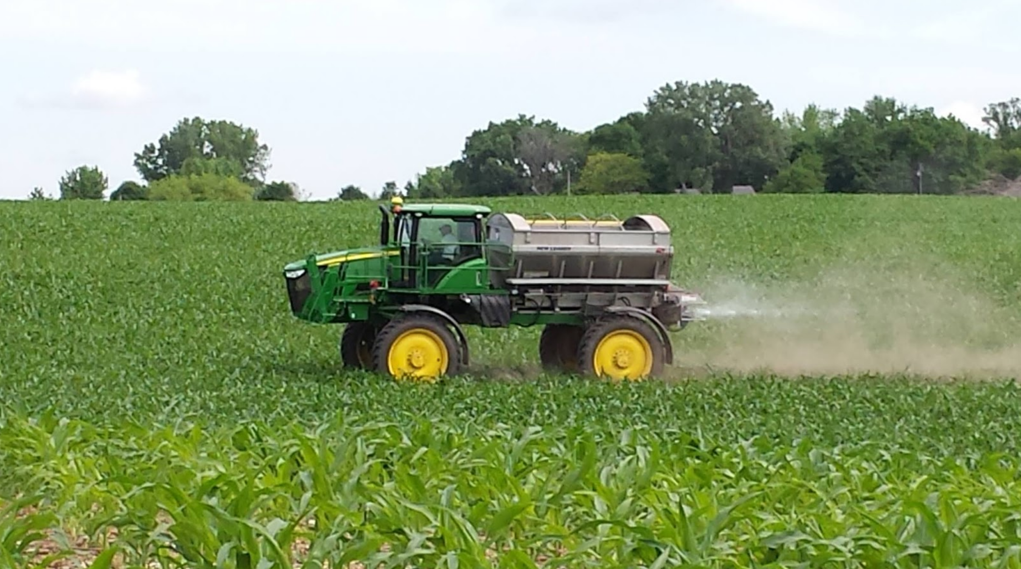
Sources
Principal (80%)
Secondary
Biomass burning
Livestock Waste
Catalytic converters
Fertilizer Application
Notes:
Where does it come from? Sources, PM2.5, can be a significant fraction, deposition, ecosystem disruption, algal blooms. NH3 emissions and concentrations are increasing.

Slide 3
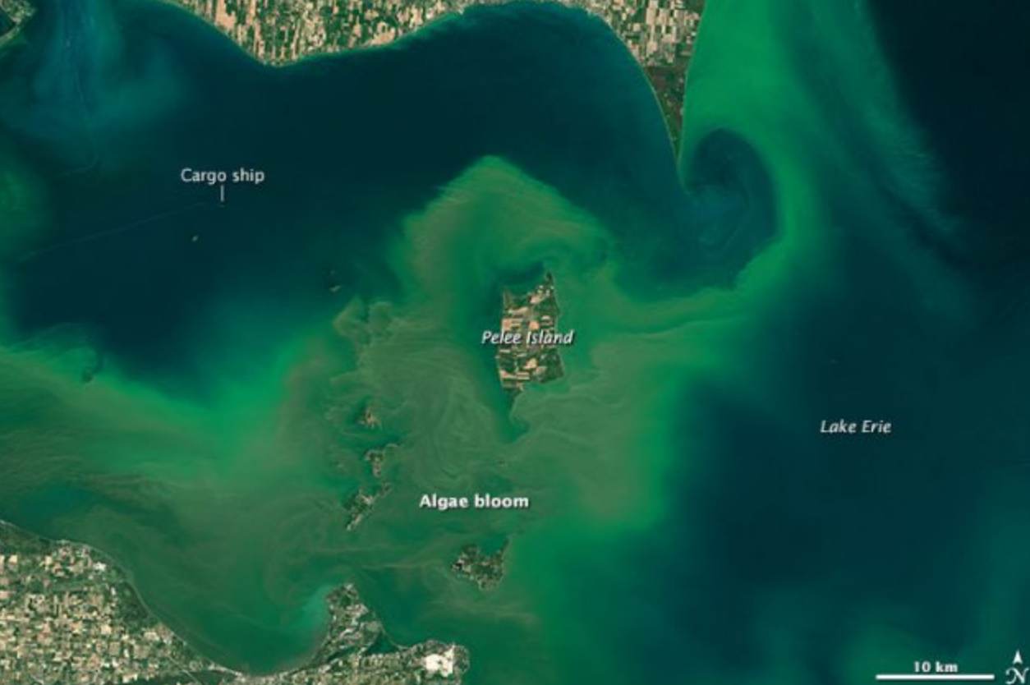

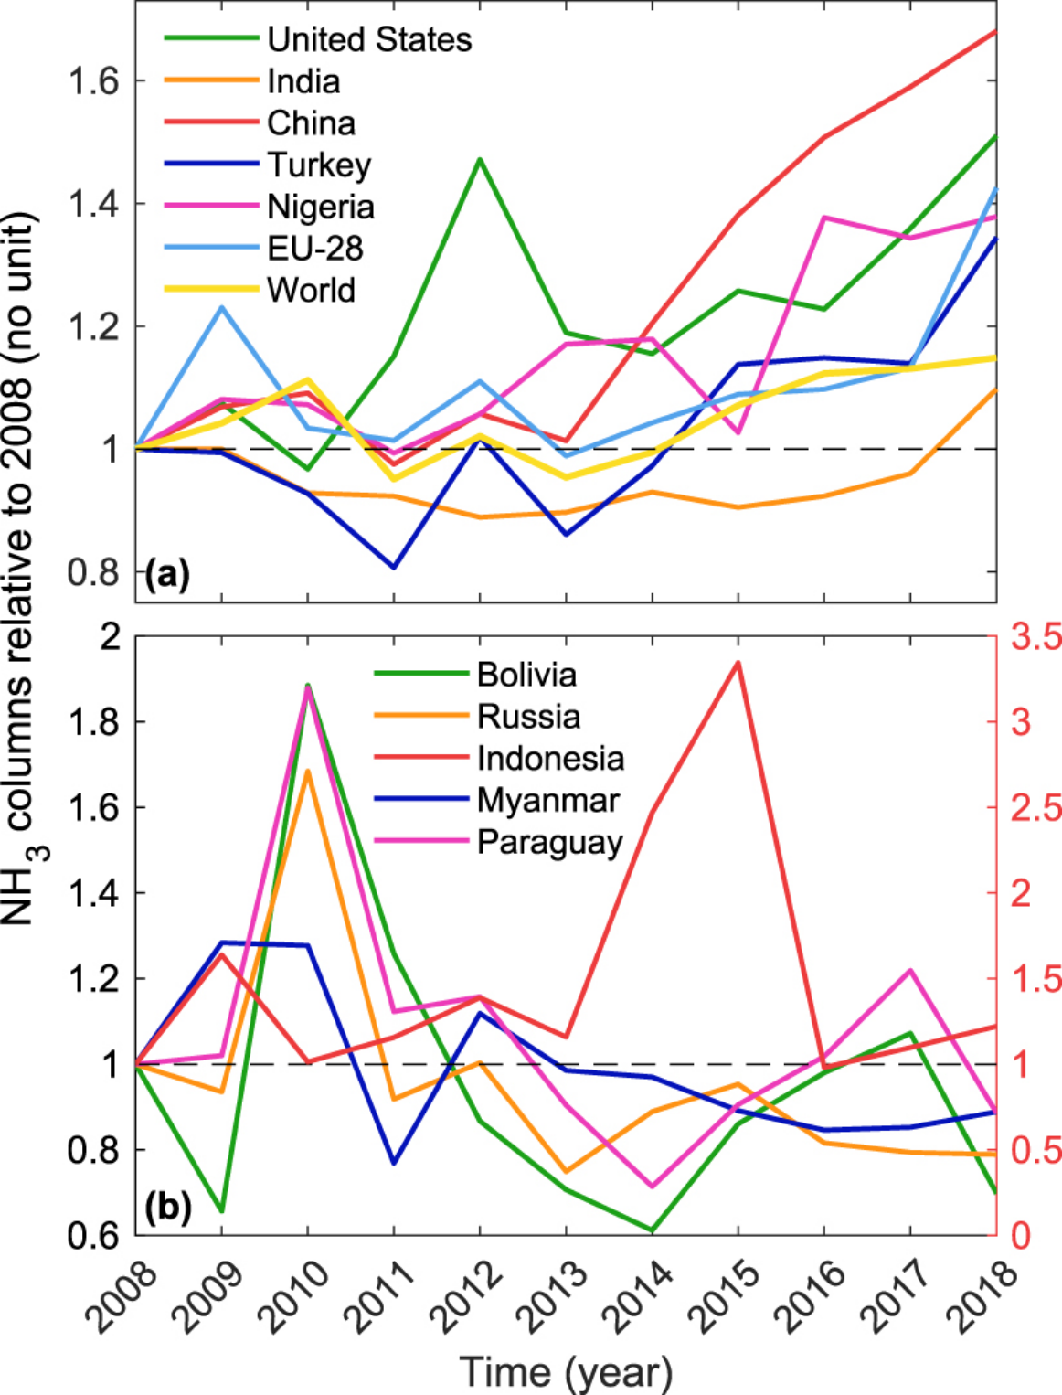
Impact
NH₃ concentrations have been increasing globally
Van Damme et al 2021
Notes:
Why do we care? Reacts with the ….to form, PM2.5, can be a significant fraction, deposition, ecosystem disruption, algal blooms. NH3 emissions and concentrations are increasing. AS NOX and SOX dreductions hit their limits,, reducing ammonia provides another option to slow PM 2.5 formation.And it’s increasing, as these trends from the IASI instrument show. current distribution and future trends.

Slide 4
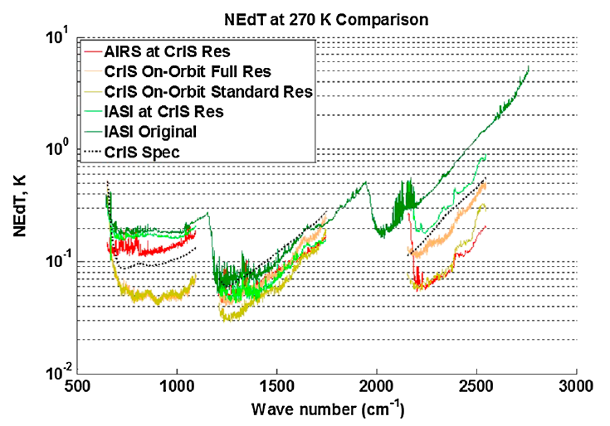

Infrared Sounders
TES (2004-2018)
On NASA AURA
First NH₃ measurements from space
High spectral resolution
Sparse coverage
1:30/13:30 LST overpasses
Interferometer
CrIS (2012-… )
On NASA/NOAA SNPP, JPSS-1,JPSS-2
Scheduled for JPSS-3 and JPSS-4
Global daily coverage
1:30/13:30 LST overpasses
Interferometer
AIRS (2002-2026)
On NASA AQUA
Global daily coverage coverage
1:30/13:30 LST overpasses
Nearing its end-of-life
Radiometer
IASI (2006-… )
On Metop-A/B/C
IASI-NG scheduled for Metop-SG A/B/C
Global daily coverage
9:30/21:30 LST overpasses
Interferometer
Notes:
Four instruments, time,TES (high res,sparse,overpass). AIRS (almost done,also 13:30 overpass, global coverage), CrIS same advantages as AIRS, but much lower noise), IASI (European, also global but earlier overpass and thus wasker signas.

Slide 5
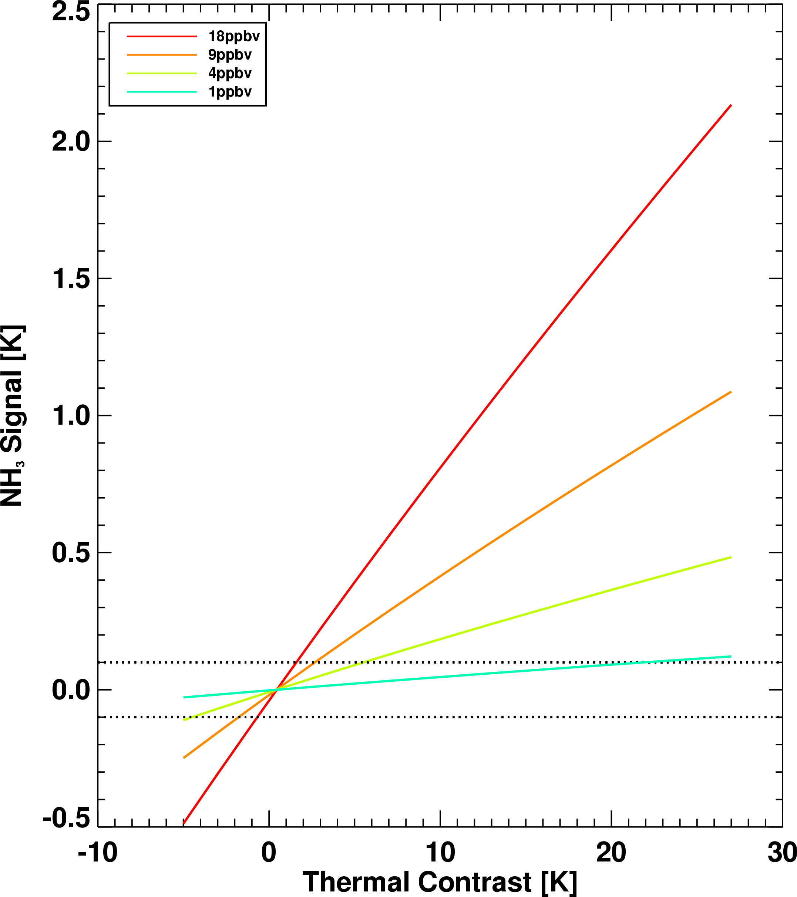
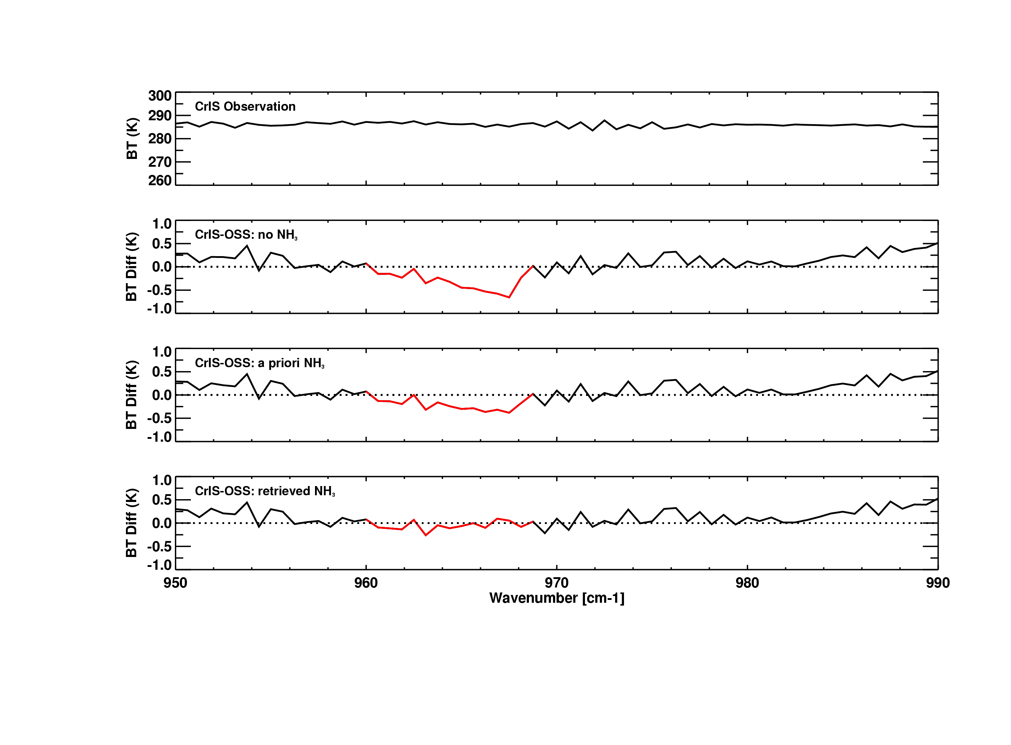
Optimal Estimation for NH₃
Observations
CrIS Obs
Observation – Forward Model Calculations
No NH₃
NH₃
H₂O
O₃
Observations
Observations
Observations
Initial Guess
CrIS Obs
CrIS Obs
CrIS Obs
Observation – Forward Model Calculations
Observation – Forward Model Calculations
No NH₃
No NH₃
O₃
H₂O
O₃
NH₃
H₂O
NH₃
Retrieval
Rodgers, 2000
NH₃ Signal vs TCON
Detectability is ~ 0.25 ppbv under ideal conditions
Thermal contrast plays an important role
Thermal Contrast: Surface- Air Temperature
For more details see: Shephard M.W. and K. E. Cady-Pereira, AMT, 2015
Notes:
Measured radiances,forward model with no NH3, NH3 signal, depends on amount and thermal contrast,

Slide 6
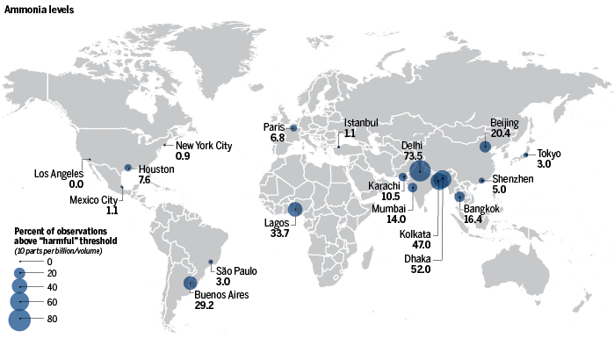
Frequencies of elevated NH₃ occurrences from TES
TES Megacity Observations
2013-2015
eighteen cities
frequent occurrences of elevated NH3 (>10 ppbv)
Delhi, Kolkata, Dhaka
  Traffic, biomass burning, industry
Lagos: local pollution, biomass burning
Paris: transport from surrounding agricultural areas
(Graphic) G. Grullón/Science;
(Data) JPL TES Science Team
https://www.science.org/content/article/here-are-some-world-s-worst-cities-air-quality
Notes:
As part of the TES Science Team I conducted an analysis of multiple trace gases over 18 megacities. One statistic I looked at was the frequency of NH3 observations greater than 10 during the 2013-2015 period. There were some expected results.

Slide 7
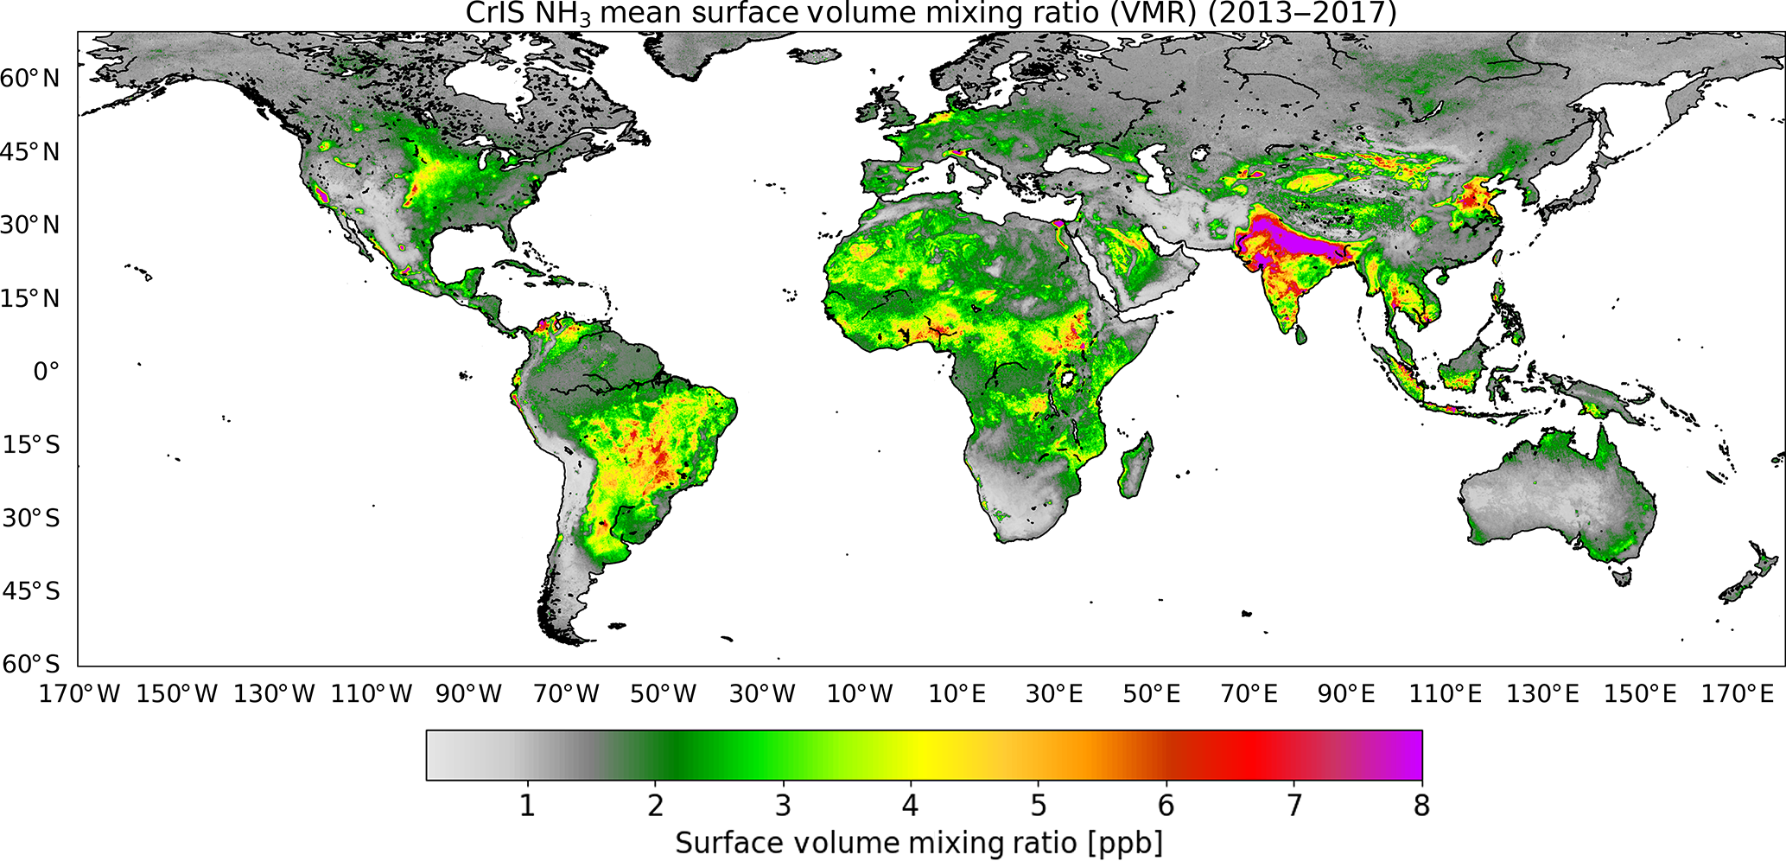
CrIS Mean Surface NH₃ (2013-2017)
Hot spots correspond to areas with intensive agriculture (US Midwest, Central Valley, Central Asia, northwestern Europe), biomass burning (South America, most of Africa, Siberia), or multiple sources (Indo-Gangetic Plain).
Shephard et al., 2020

Slide 8
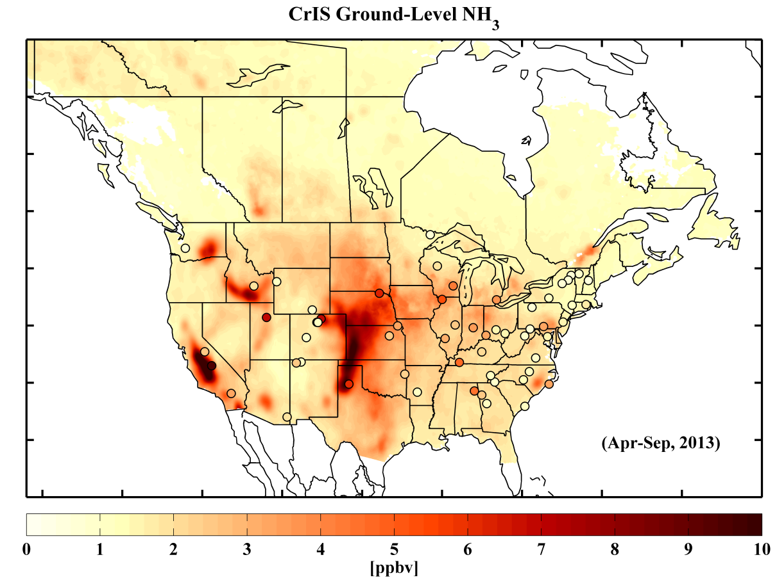
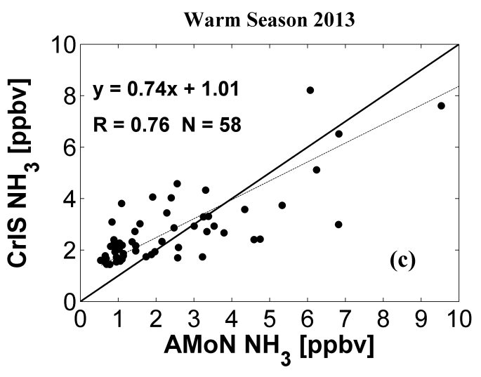
Surface NH₃ from CrIS and the AMoN Network
Good agreement between CrIS and AMoN in spite of sampling differences
IR Sounders: instantaneous profiles over a footprint at least 14 km in diameter
Ground measurements: point data at the surface (often two week means)
Aircraft measurements: instantaneous point samples along a spiral or a path
All measurements come with large uncertainties!
Notes:
How does sounder data compare to in situ measurements? A problem of scales.

Slide 9
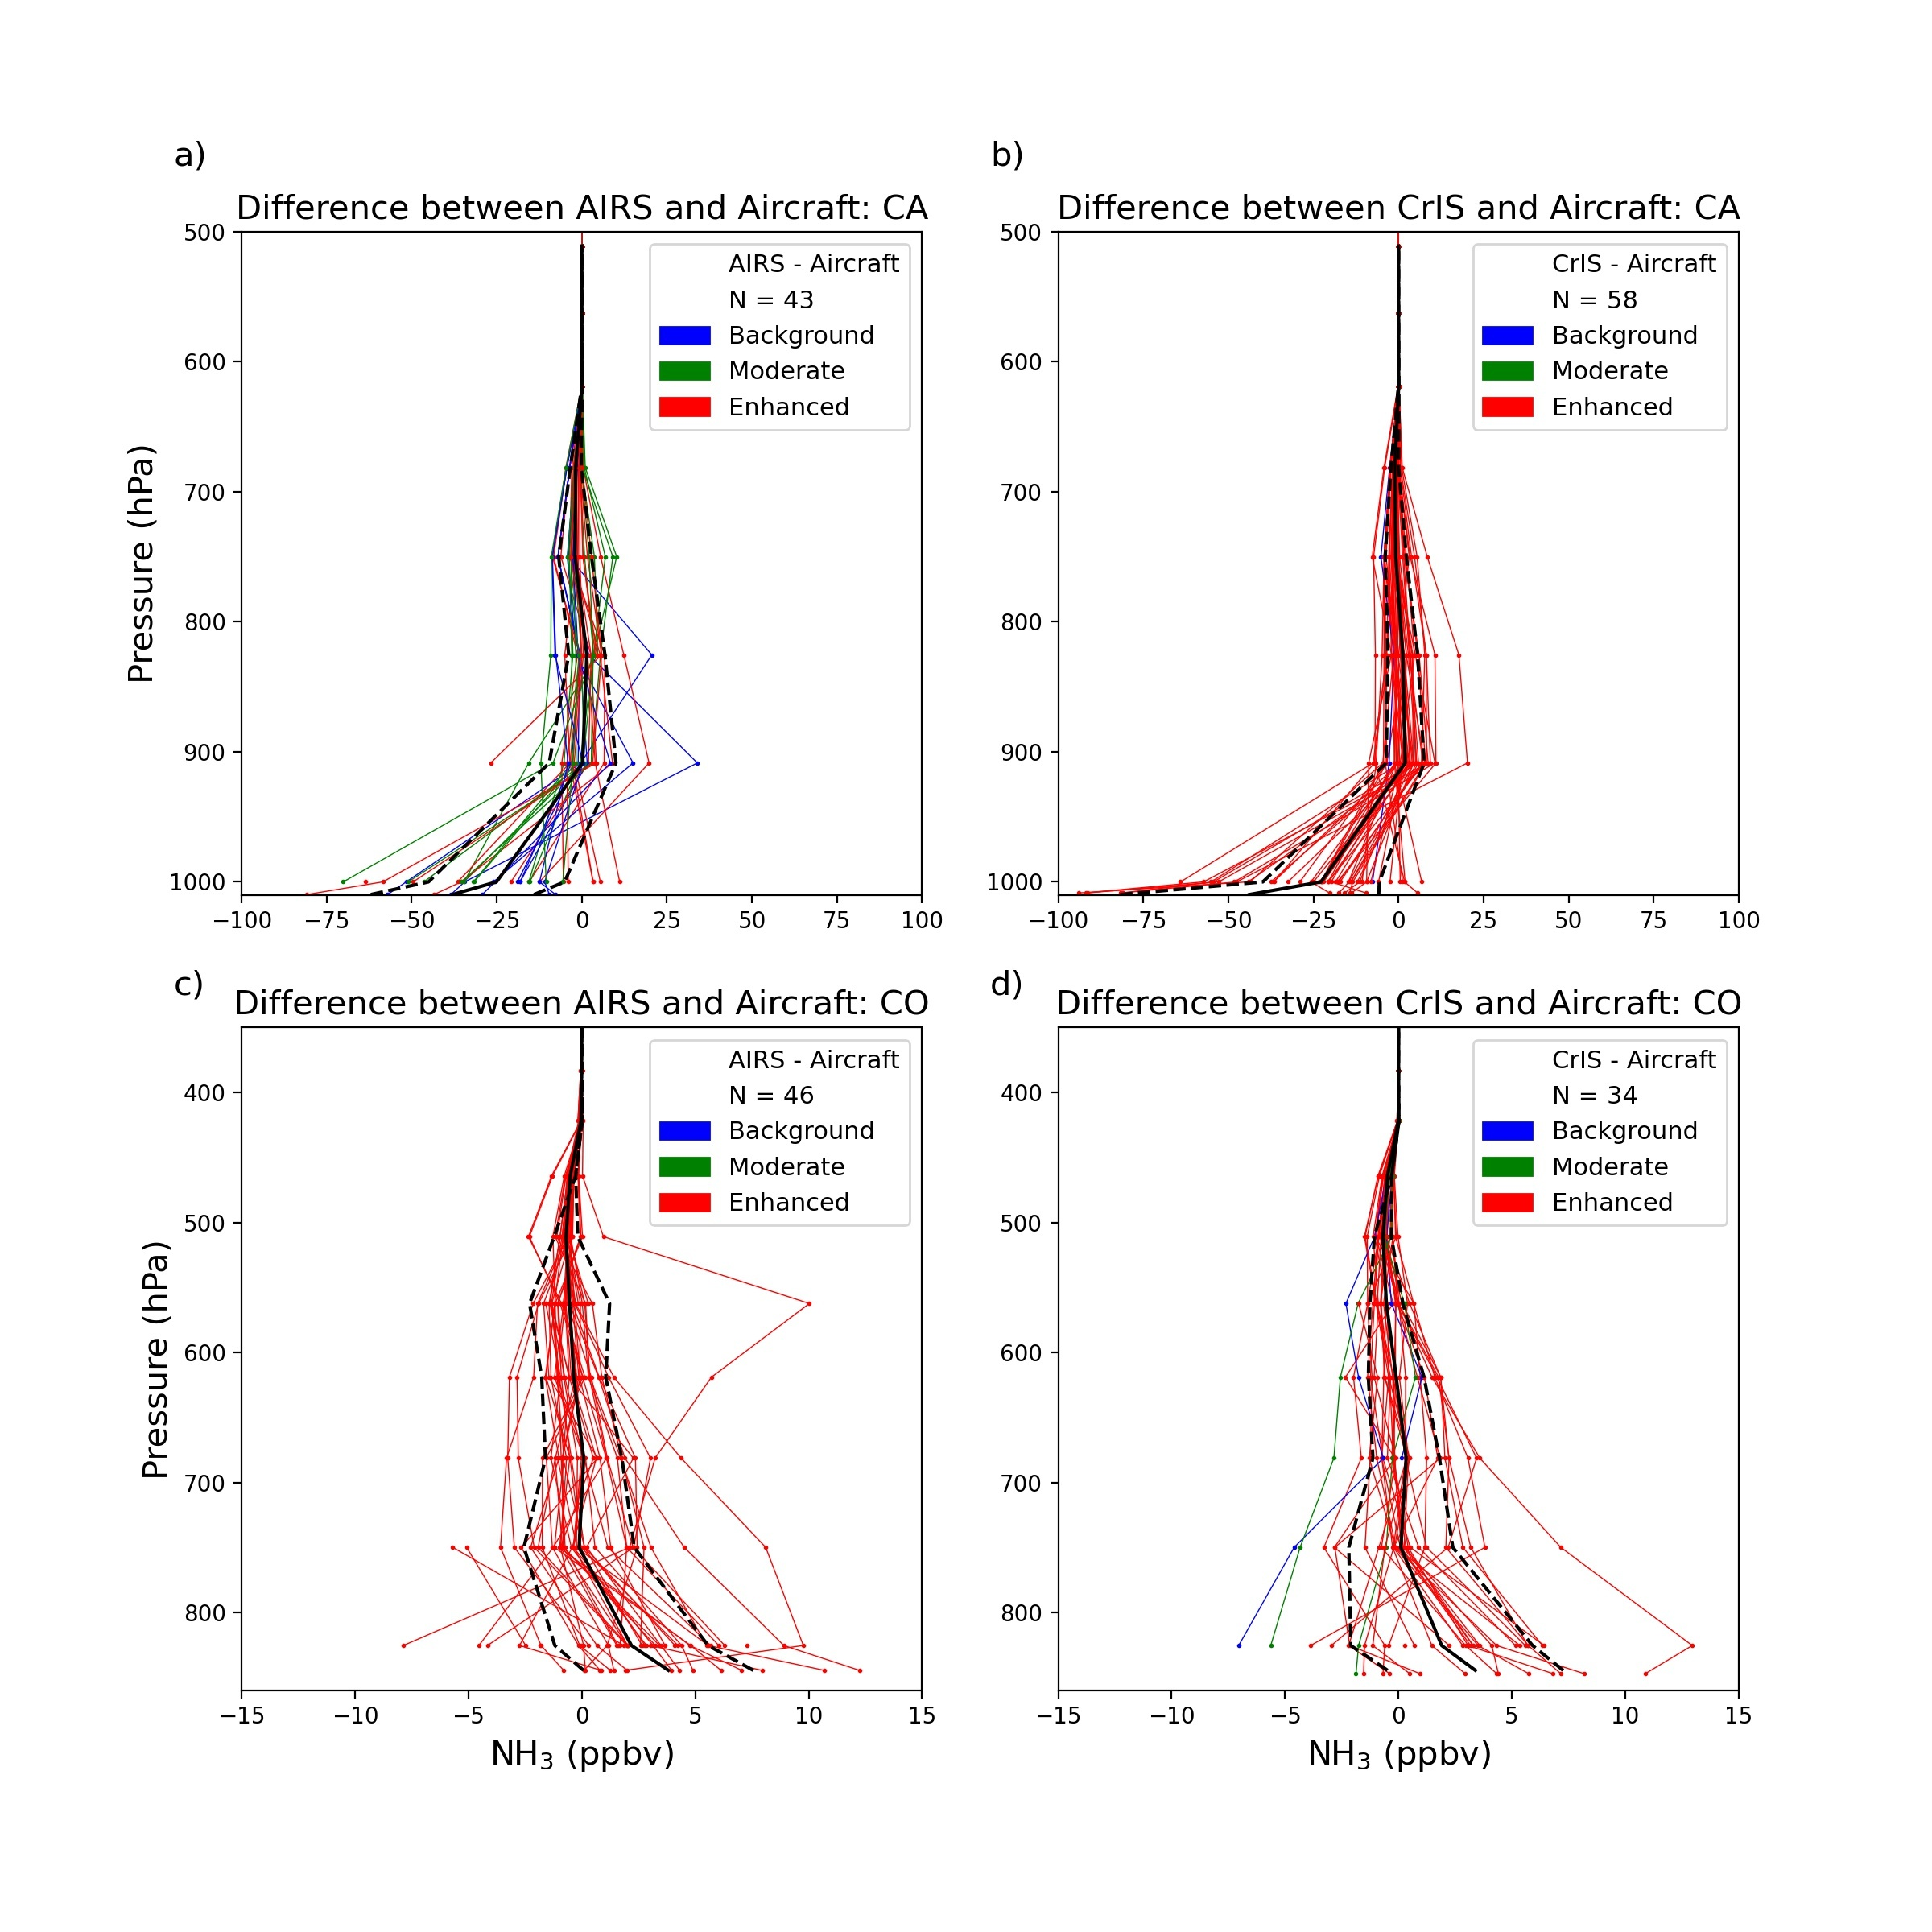
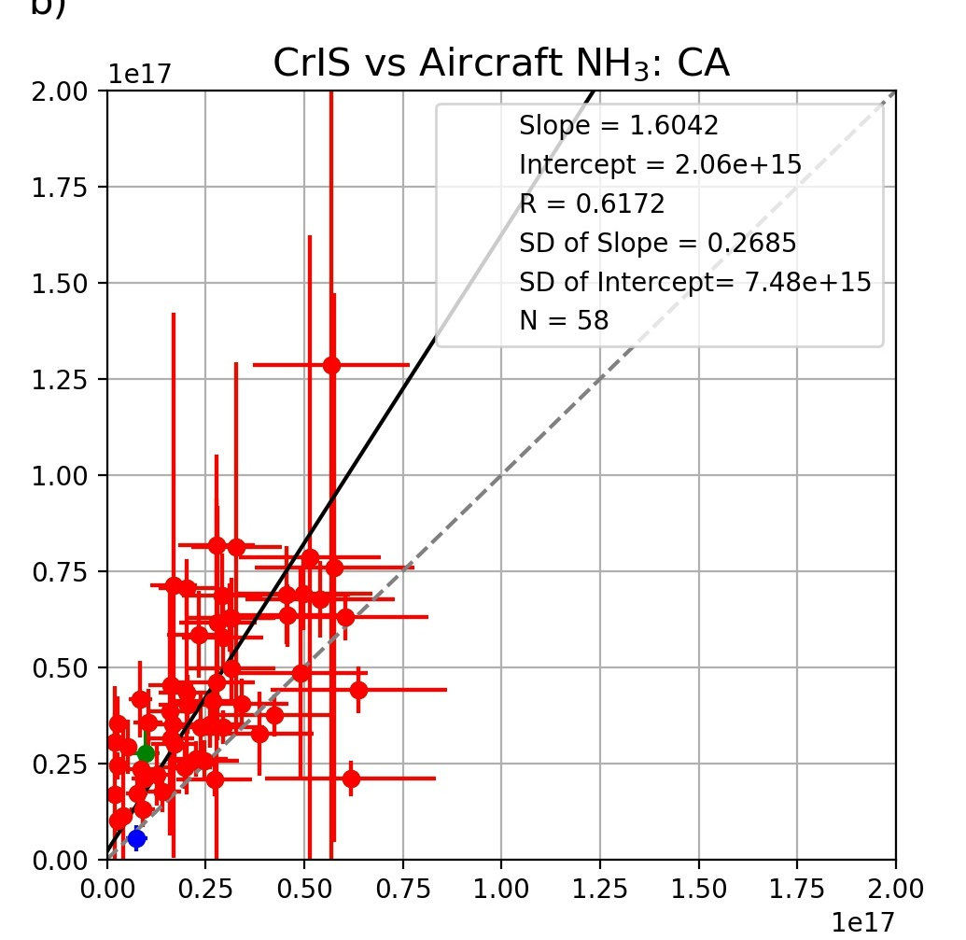
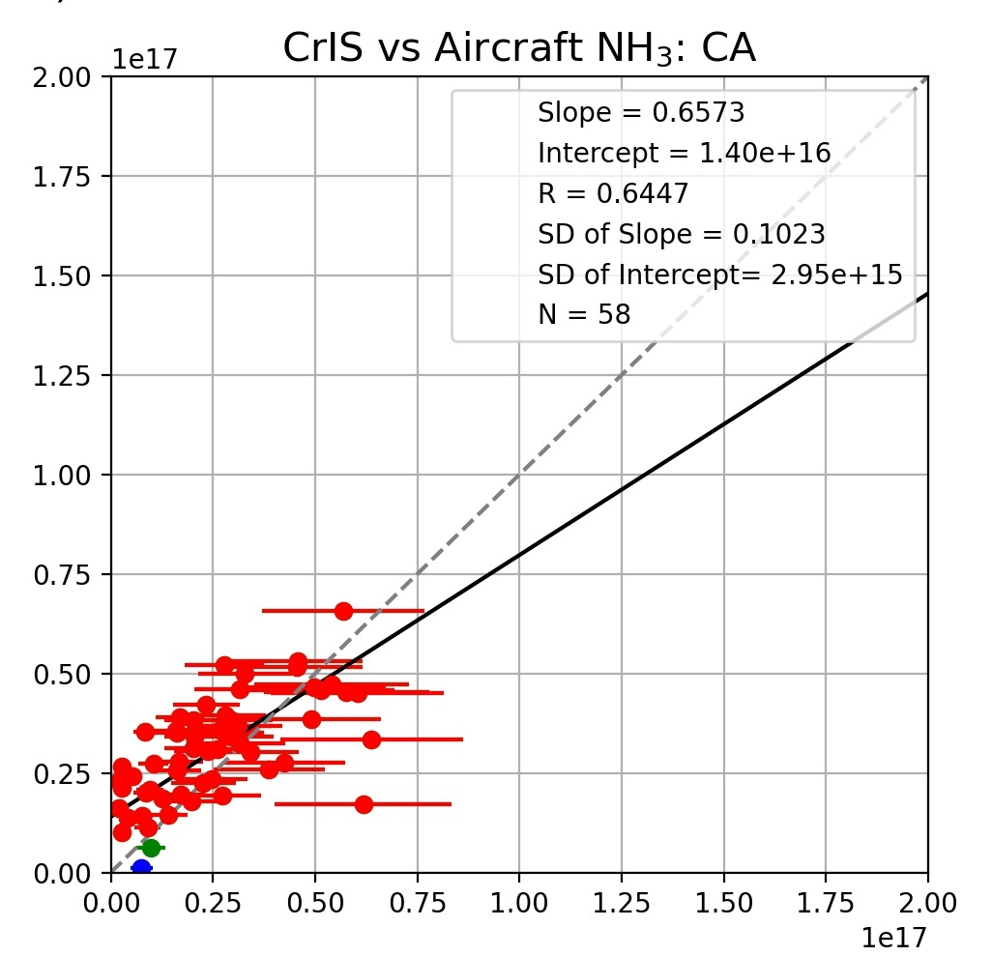
DISCOVER-AQ validation: Central Valley - winter 2013
Central Valley has some of the highest NH₃ levels in the US
Retrieved - Aircraft
PTR-MS
… but DAQ period coincided with persistent thermal inversions
thinner BL and cool surface layer complicate retrievals
-43 ppb bias at surface, 2 ppb at 900 hPa
Aircraft data
Total column up to 700 hPa
Total column up to 900 hPa
Retrieval appears to be shifting NH₃ upwards
Bias possibly due to vertical distribution and PTR-MS lack of sensitivity above 900 hPa
Cady-Pereira et al., 2024
Notes:
High in situ measurements, but inversions make poor conditions for infrared retrievals;

Slide 10
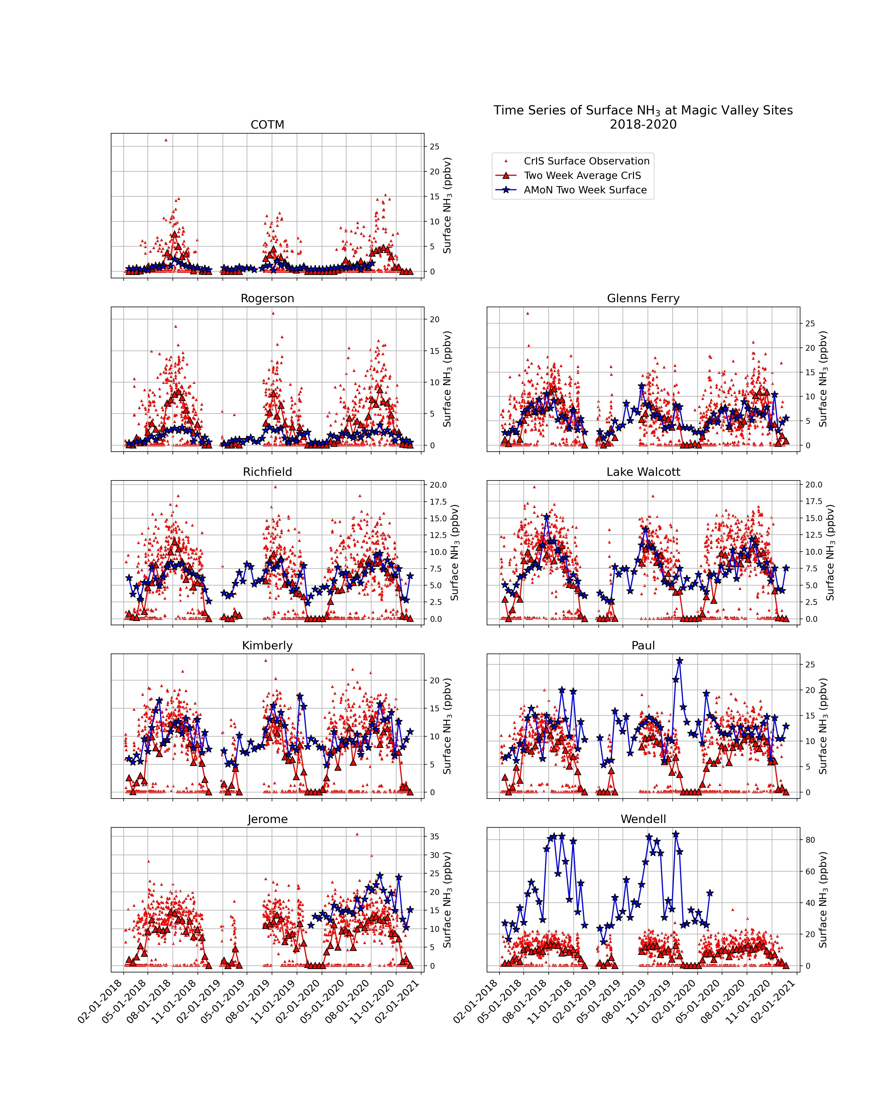
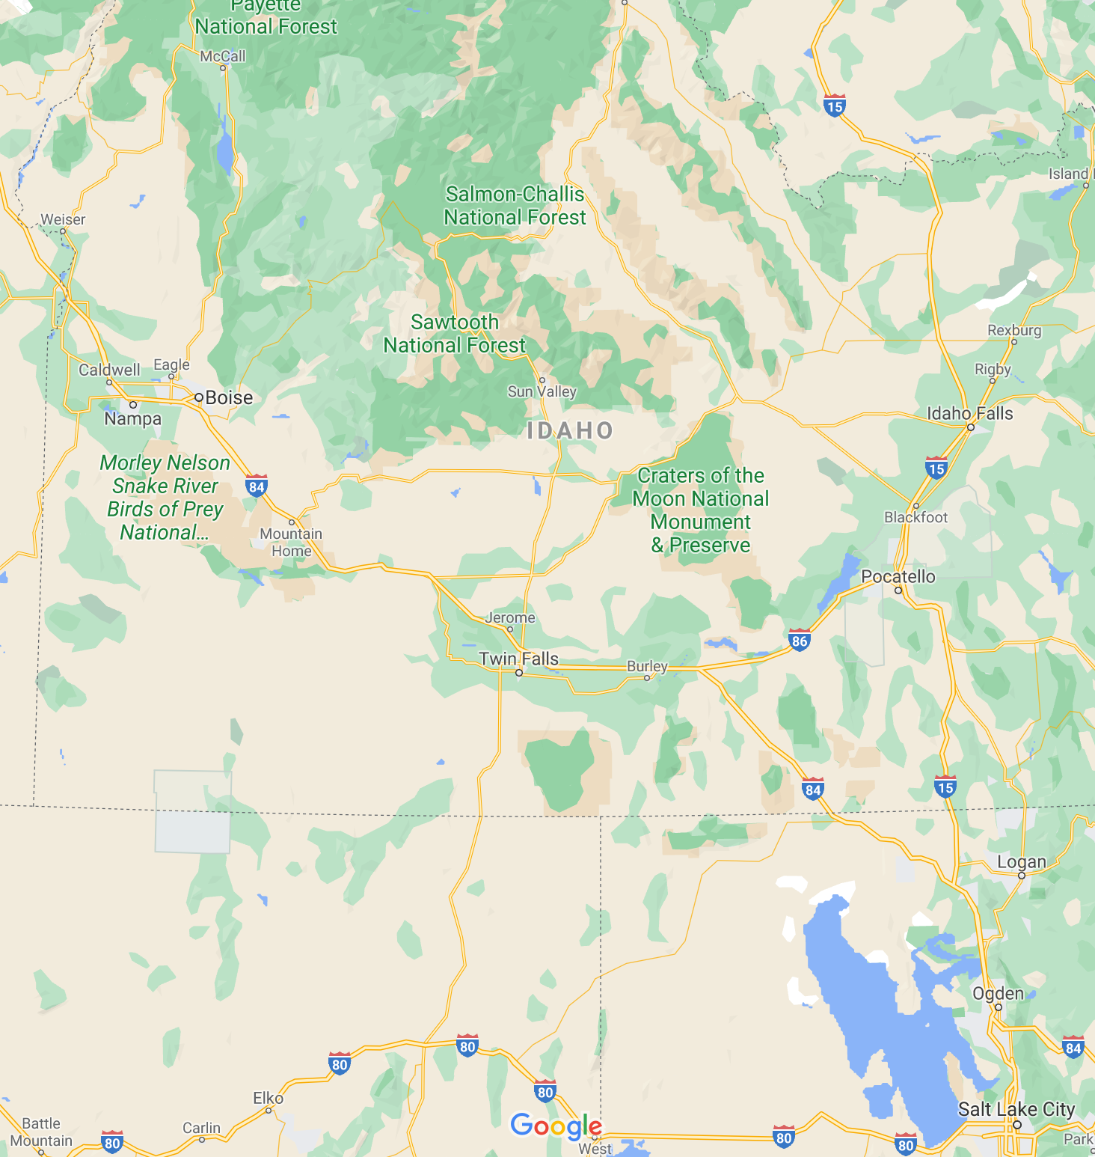
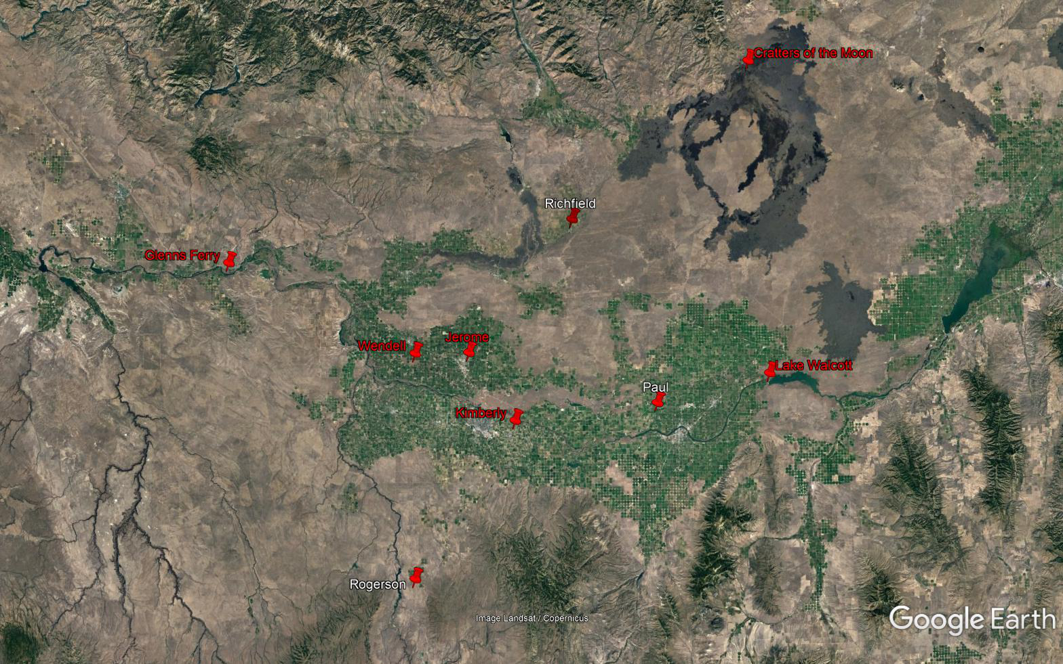
Validation of CrIS NH₃ using USDA network
Magic Valley in Idaho
CrIS NH₃ data:
Co-location: within 15 km
Averaged over two weeks
Ground network: provided two week means of surface NH₃
Radiello passive samplers (AMoN type)
Nine sites, 2018-2020
Intensive dairy activities
Cris captures seasonal cycle but misses some NH₃ spikes
Cady-Pereira et al., 2024
Notes:
USDA set up a network of nine sites in the Magic Valley in Idaho.

Slide 11
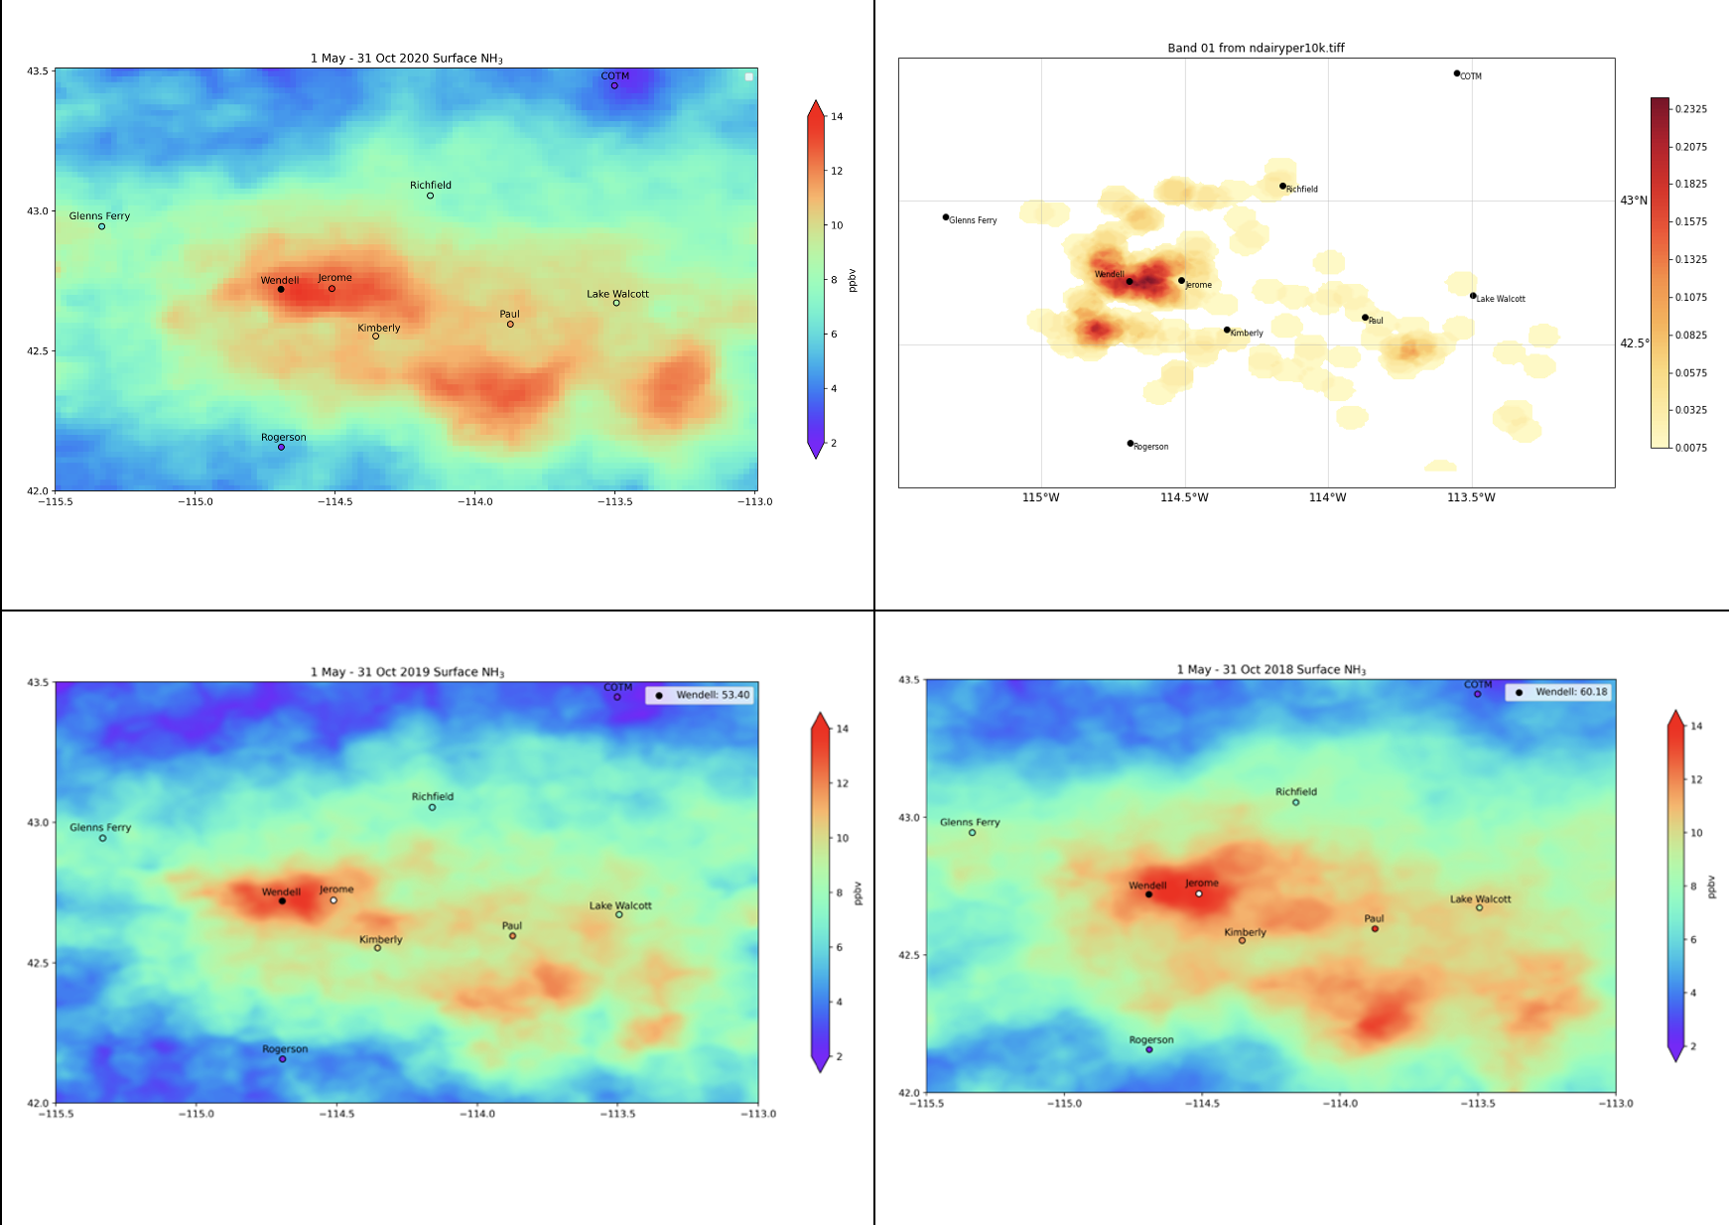
Oversampling and source location
Average CrIS Surface NH₃
Physical oversampling:
average of all pixels within a grid box (0.02 deg) over a selected period (May-October 2020), weighted by the fraction of the pixel within the box AND the spatial response of instrument in that pixel
trades temporal variability for sharpened gradients
Areas with a high dairy density correlate well with high NH₃.
Some monitoring sites are not located within hotspots.
There are NH₃ “clouds” downwind of dairies.
Dairy density
Notes:
One issue with sounder data is coarse resolution (typically around 15km) but can be coarser at the edge the swath. Box is 1.5 vs 2.5 deg

Slide 12
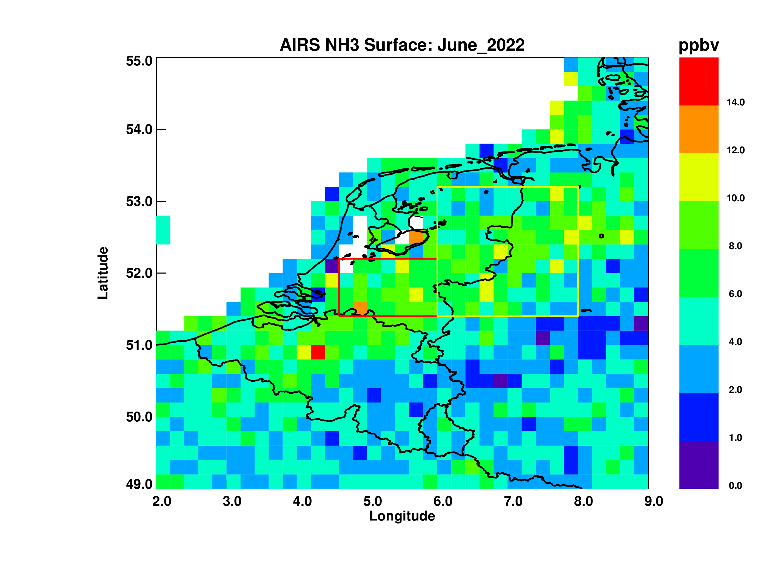
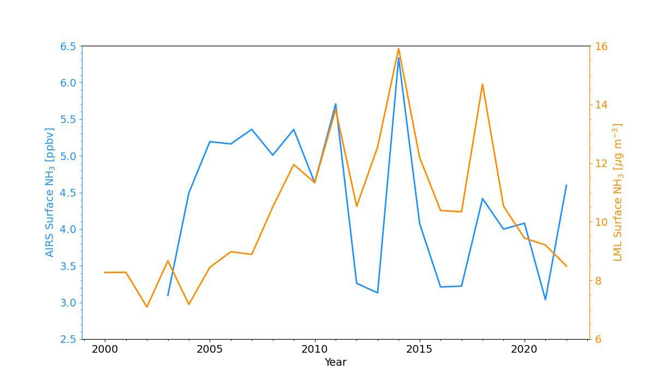
NH₃ in the Netherlands
High NH₃ amounts have caused excess deposition to waterways and nature reserves, which led to new controls:
  18000 development projects blocked
  planned 50% reduction in livestock
  > massive protests: Dutch nitrogen crisis
The Netherlands are a small country
External sources also contribute to high NH₃ levels
Dutch monitoring networks are sparse and mostly situated in low source areas
AIRS can provide better spatial coverage and consistent data going back to 2002
AIRS data co-located with the LML network sites capture most of the interannual variability evident in the in-situ record
Notes:
18 million people; 99.9 million chickens, 11.4 million pigs, 3.8 million head of cattle, 0.8 million sheep and 0.5 million dairy goats; the Netherlands is the world’s second-biggest exporter of agricultural products by value behind the US.
Bordered by Germany and Belgium , which also have large sources of NH3

Slide 13
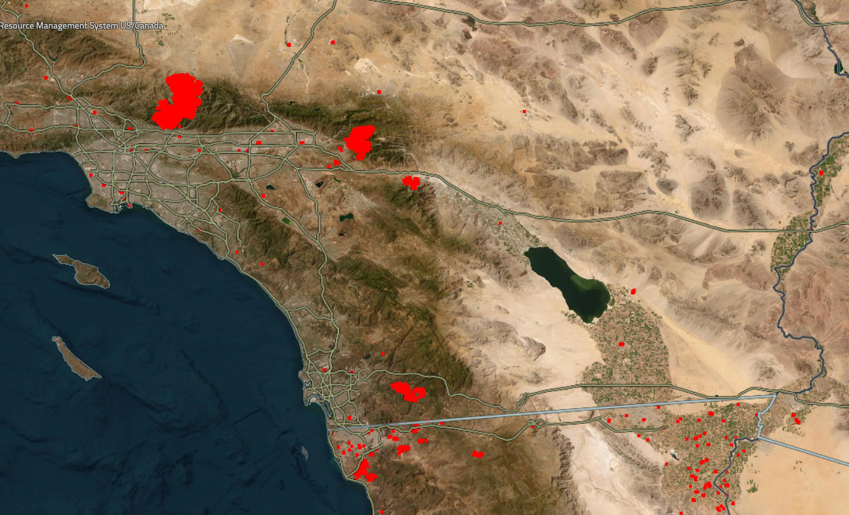
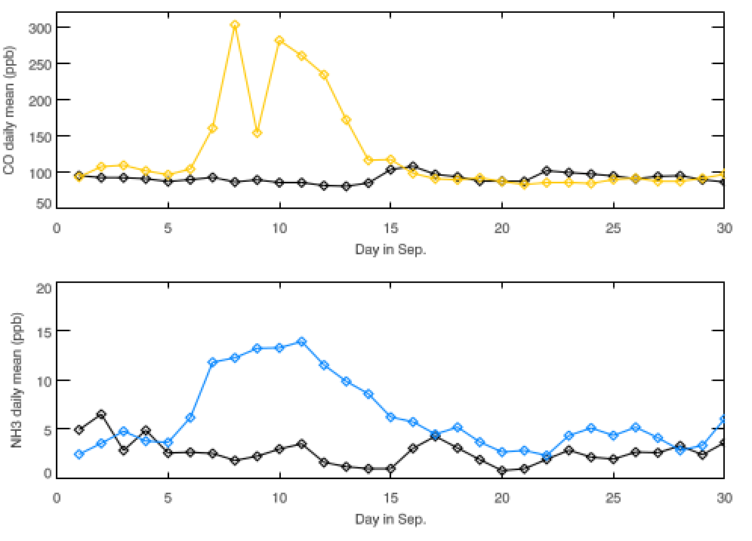
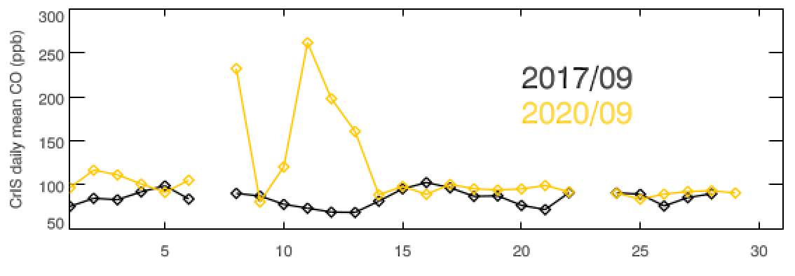
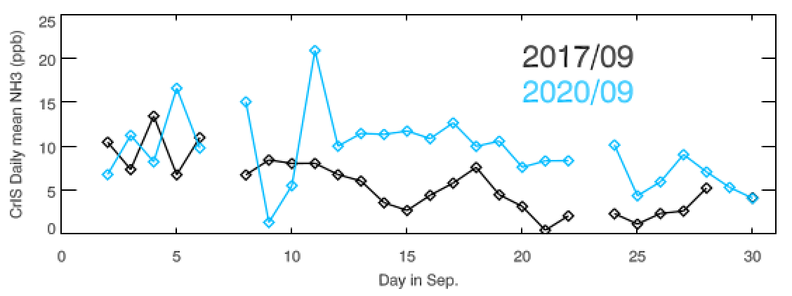
NH₃ from fires in Southern California
Daily active fire detection and thermal anomaly data from MODIS and VIIRS visible channels
CrIS data show significant enhancement in CO and NH₃ during
the September 6-14 period
2020/09
CO
NH3
CO
NH3
2017/09
Imperial Valley
LA Basin
2020/09
Active fire period: 09/06-09/14
2017/09
Notes:
These plots are part of a larger study of NH3 from fires in Southern Calfornia.

Slide 14
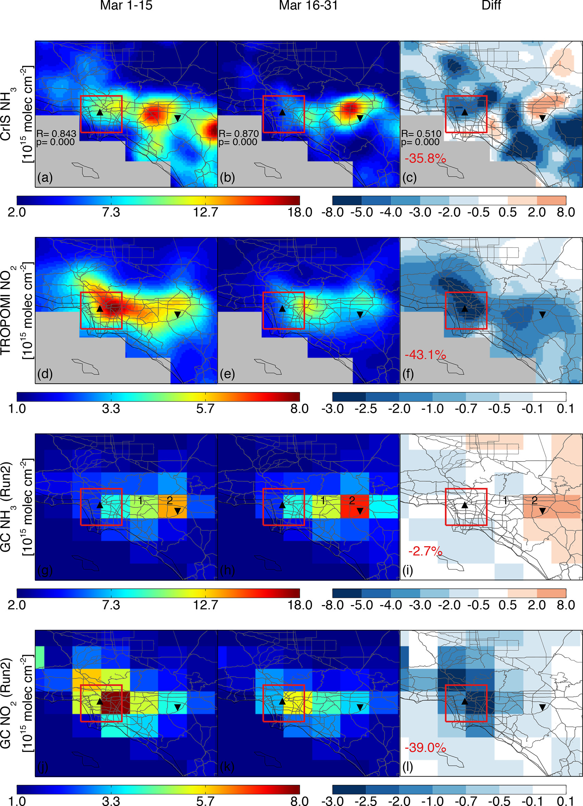
Ammonia (NH₃) emissions from traffic: COVID lockdown study
COVID-19 lockdowns provided a natural experiment
Urban area presented elevated NH₃ and NO₂ before lockdown, but low values for both during the lockdown
This results indicates that a significant fraction of urban NH₃ in the LA area is due to vehicles
First satellite-based confirmation that vehicles are an under-recognized source of urban NH₃ pollution in Los Angeles.
Area dominated by vehicle emissions
Area dominated by agricultural emissions
Figure modified from Cao et al., 2021
Notes:
Hansen Cao, o used CrIS data over LA to look at the impact of the COVID shutdown on NH3 in the LA Basin. Describe.Used this data along with TROPOMI NO2 and GEOS-Chem to provide the first estimate of NH3 from transportation from space.

Slide 15
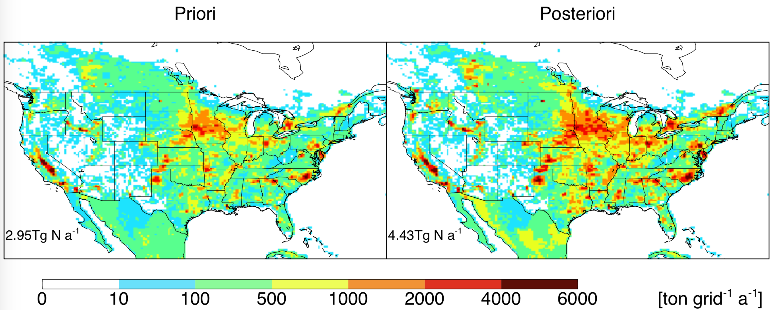
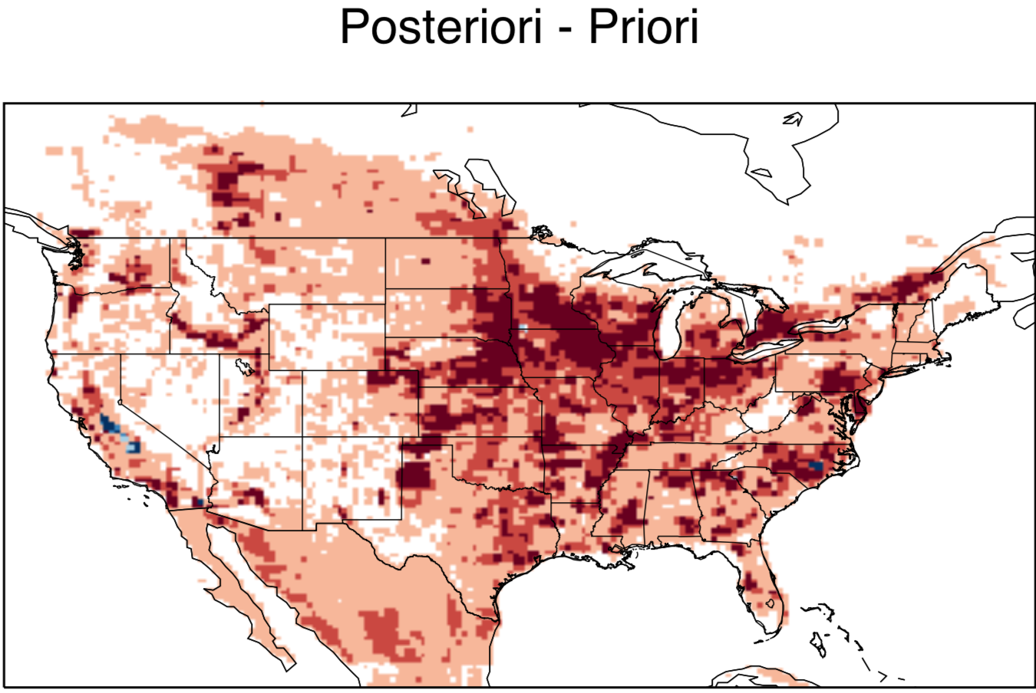
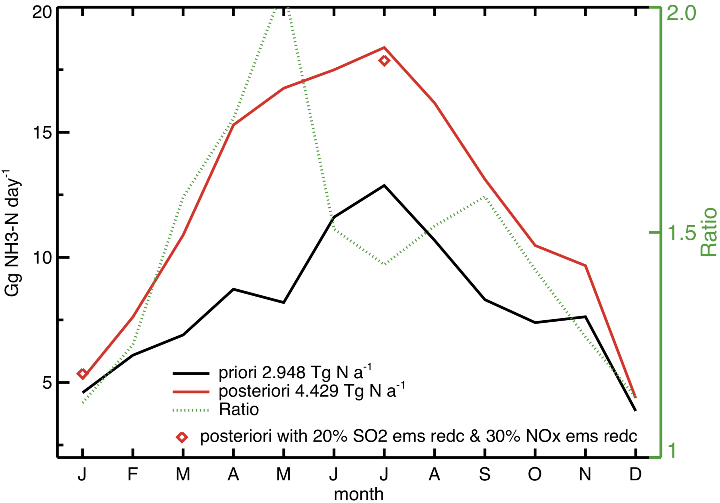
Estimating emissions from CrIS
Prior
Posterior
Cao et al. (2020) applied a 4DVar approach using CrIS 2014 data to improve GEOS-Chem estimates of NH₃ emissions over CONUS
Total posterior annual anthropogenic emission estimate for CONUS is higher than prior estimate by 51%.
Posterior monthly emission for CONUS increased throughout the whole year
Sensitivity tests: 20-30% reductions in SO₂ and NO_{x} emissions led to difference < 4% in posterior
Posterior
2.95 Tg N a⁻¹
4.43 Tg N a⁻¹
Cao et al., 2020
Cao et al., 2020

Slide 16
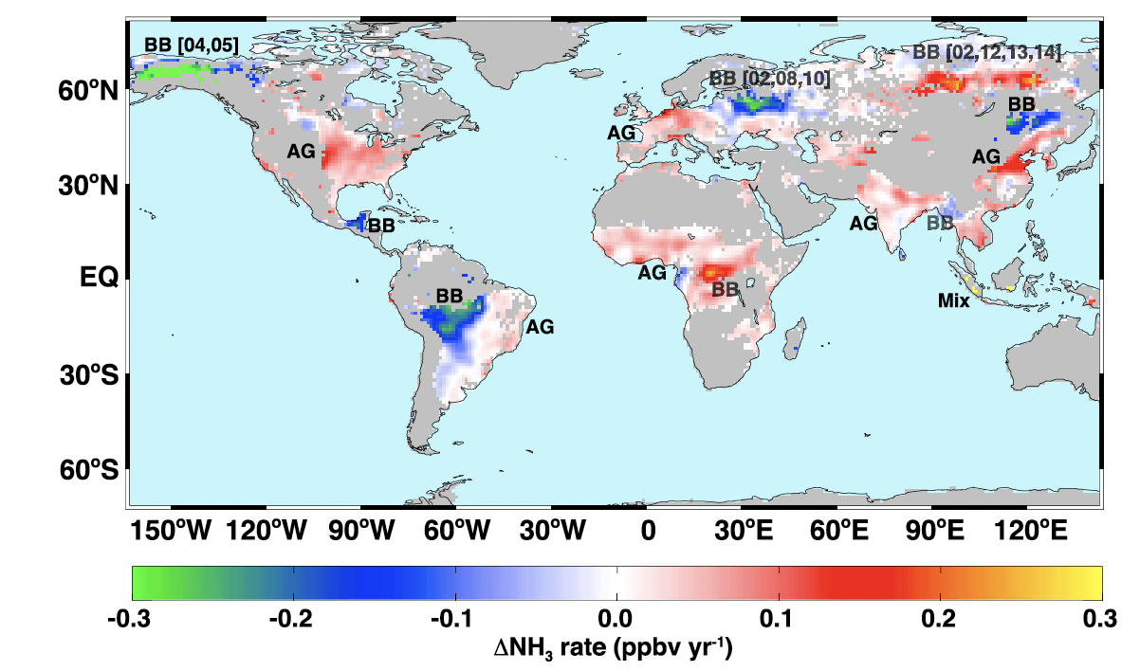
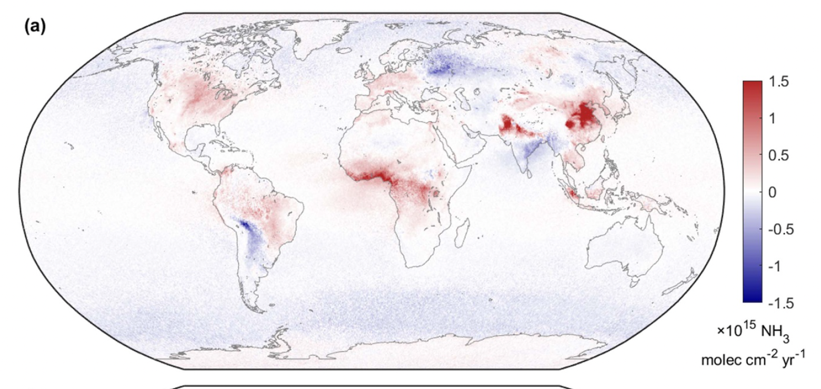
Trends in source regions from AIRS and IASI
AIRS: 2002-2013
IASI: 2008-2018
Van Damme et al., 2021
Warner et al., 2017
Different instruments types (radiometer vs interferometer), different algorithm (OE vs ML), different parameter (level VMR vs column): very similar spatial pattern in the trends.

Slide 17
Summary
NH₃ concentrations obtained by applying optimal estimation radiances measured by infrared sounders have been validated against in situ networks and aircraft data
These data capture:
  global and regional spatial variability
  seasonal cycles
  NH₃ generated by fires
… and can be used to
  locate emission sources
  estimate emissions from traffic
  find trends
  improve model emission inventories
Current and planned IR sounders will provide a data record from 2002 into the 2040s
The NOAA GXS sounder on geostationary GeoXO (planned for 2035) will provide hourly observations over North America

Slide 18
References
Cady-Pereira, K. E., Guo, X., Wang, R., Leytem, A. B., Calkins, C., Berry, E., Sun, K., Müller, M., Wisthaler, A., Payne, V. H., Shephard, M. W., Zondlo, M. A., and Kantchev, V.: Validation of MUSES NH₃ observations from AIRS and CrIS against aircraft measurements from DISCOVER-AQ and a surface network in the Magic Valley, Atmos. Meas. Tech., 17, 15–36, https://doi.org/10.5194/amt-17-15-2024, 2024
Cao,H, et al 2020, Environ. Res. Lett. 15 104082
Cao, H., D. K. Henze, K. Cady-Pereira, B. C. McDonald, C. Harkins, K. Sun, K. W. Bowman, T.-M. Fu, and M, O. Nawaz, 2022. COVID-19 lockdowns afford the first satellite-based confirmation that vehicles are an under-recognized source of urban NH₃ pollution in Los Angeles. Environmental Science & Technology Letters 9 (1): 3–9.
Shephard, M. W., Dammers, E., Cady-Pereira, K. E., Kharol, S. K., Thompson, J., Gainariu-Matz, Y., Zhang, J., McLinden, C. A., Kovachik, A., Moran, M., and Bittman, S.: Ammonia measurements from space with the Cross-track Infrared Sounder: characteristics and applications. Atmospheric Chemistry and Physics, 20(4), pp.2277-2302, 2020.
Van Damme, M., Clarisse, L., Whitburn, S. et al. Industrial and agricultural ammonia point sources exposed. Nature, 564, 99–103 (2018). https://doi.org/10.1038/s41586-018-0747-1
Van Damme et al 2021, Environ. Res. Lett. 16 055017
Warner, J. X., R. R. Dickerson, Z. Wei, L. L. Strow, Y. Wang, and Q. Liang: Increased atmospheric ammonia over the world’s major agricultural areas detected from space, Geophys. Res. Lett., 44, doi:10.1002/2016GL072305, 2017.

Slide 19
Backup slides

Slide 20
TES/AIRS/CrIS NH₃ Algorithm Structure
Optimal estimation (Rodgers, 2000):
Find the profile that minimizes difference between measured (CrIS) and calculated forward model (OSS) radiances
From previous retrievals:
Water vapor profiles
Temperature profiles
Surface temperature
First guess emissivity from
University of Wisconsin database
From each observation:
Radiances
Noise estimate
Optimal estimation first step
Refinements of
  Surface temperature
  Emissivity
Use radiances for
a priori selection from three possible profiles
Cloud screening
Optimal estimation second step
NH₃ profiles
Error estimates
Averaging kernels
For more details see: Shephard M.W. and K. E. Cady-Pereira, AMT, 2015

Slide 21
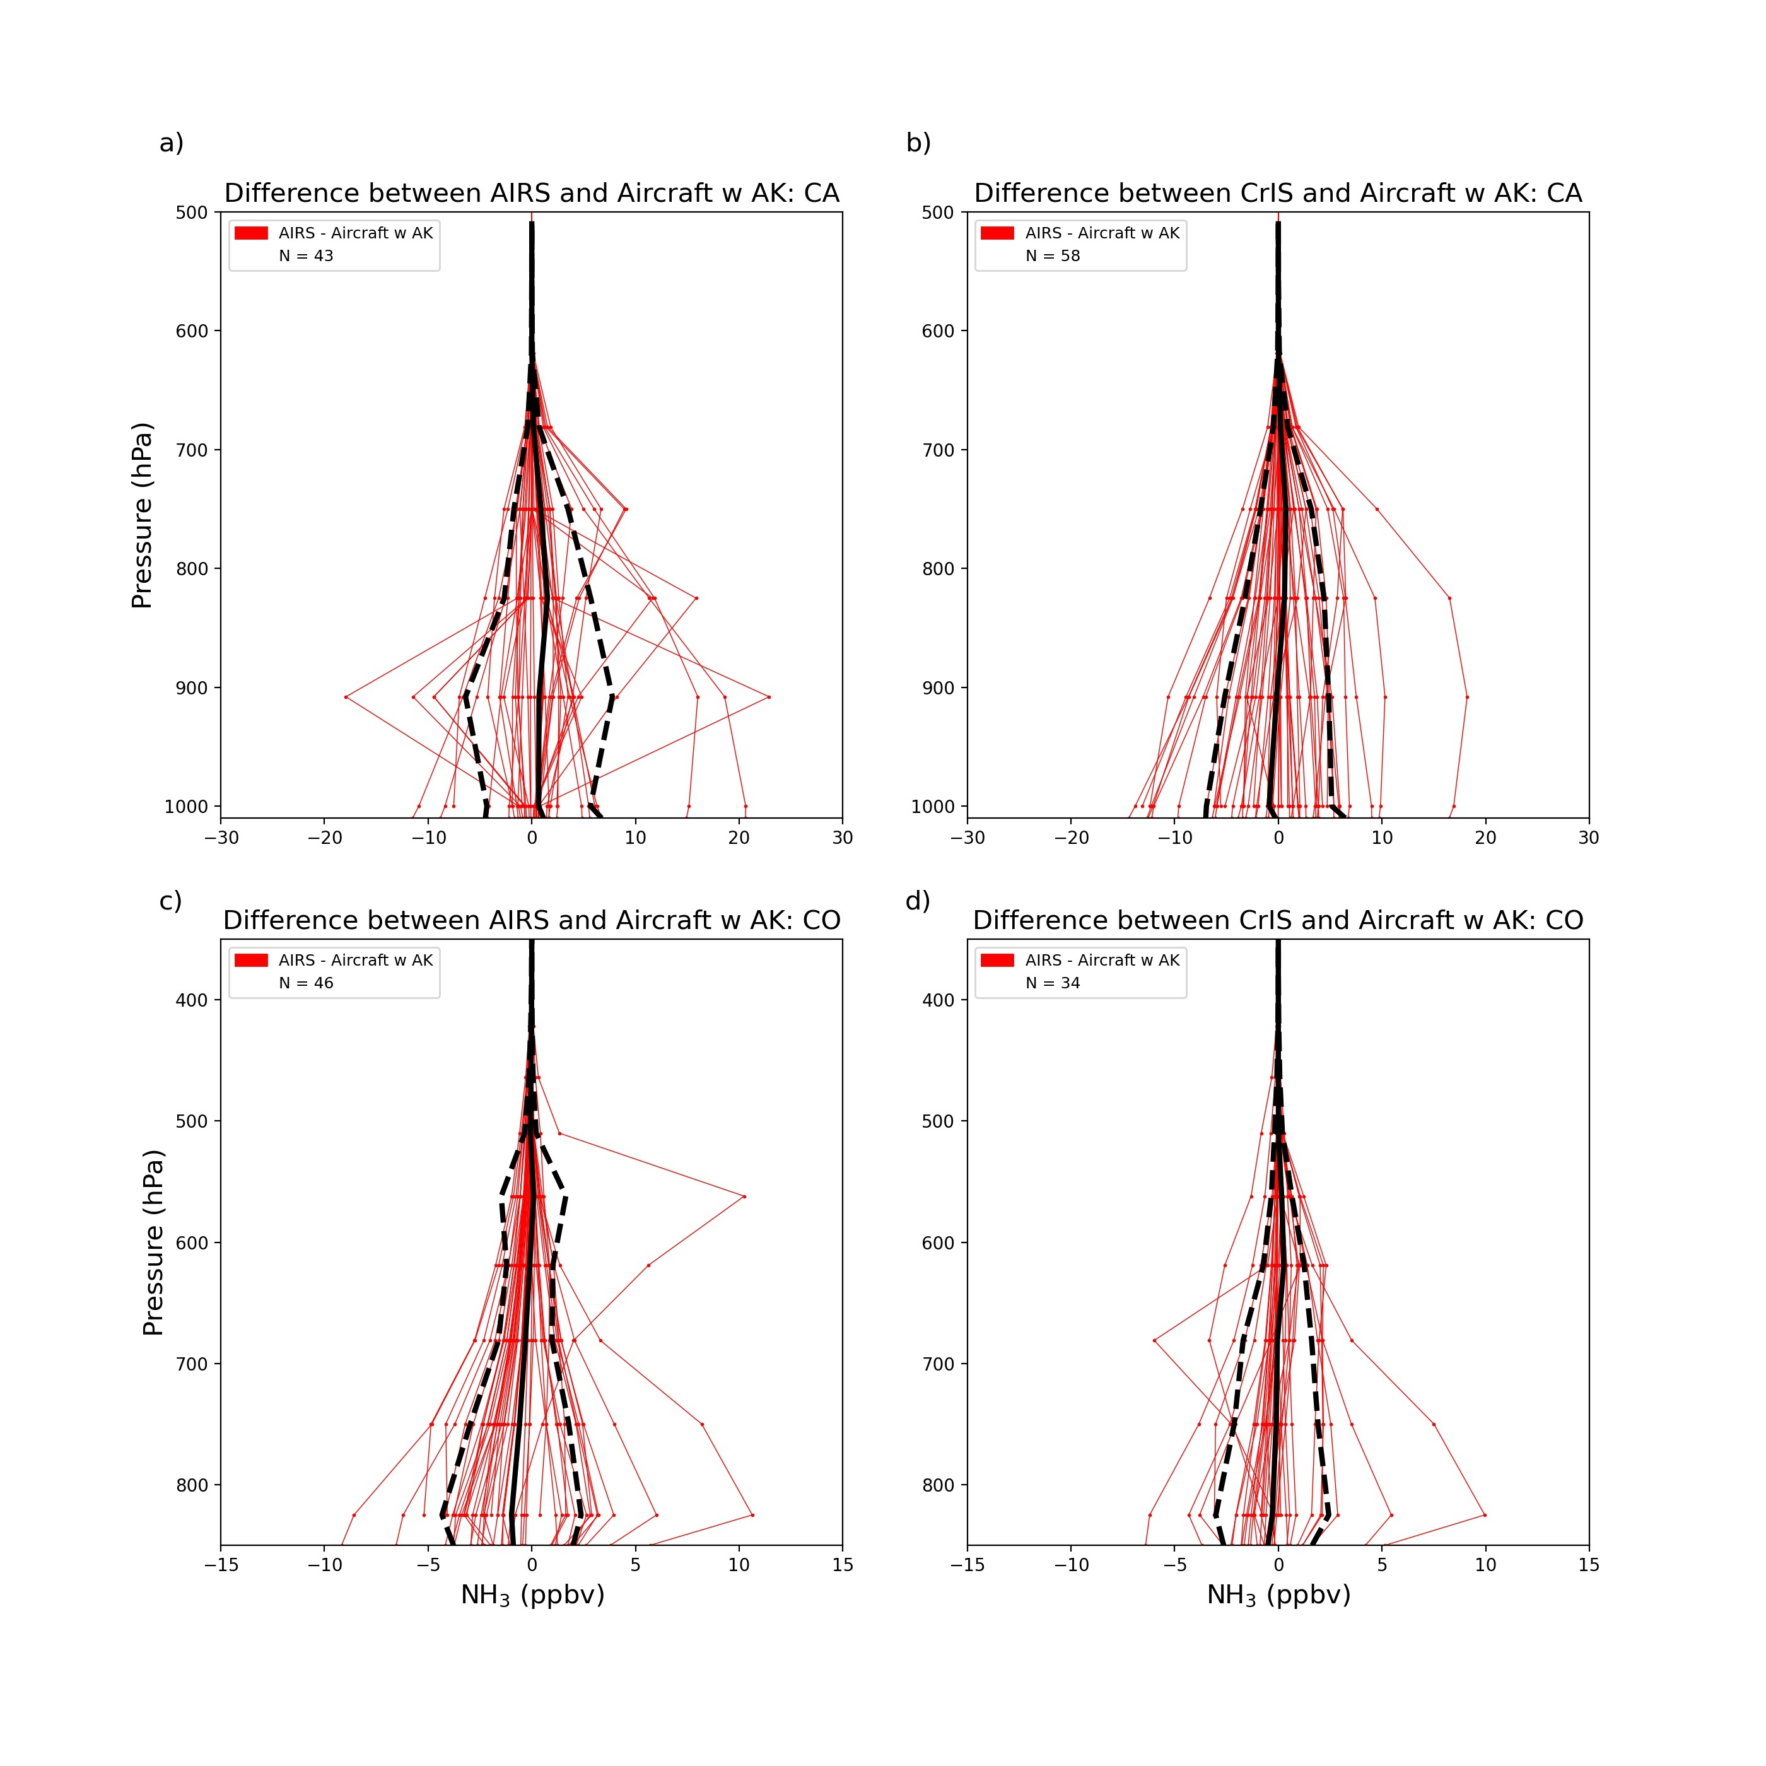
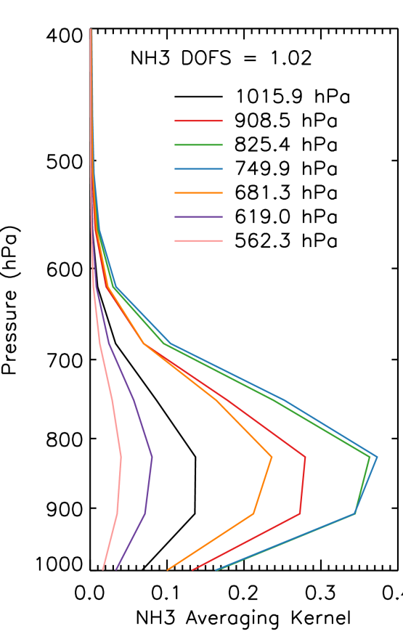

DISCOVER-AQ validation: Central Valley - winter 2013
Retrieved - Aircraft
Retrieved - Aircraft w/AK
Applying the instrument operator
$X$ = X_{apriori} + AK ( X_{aircraft} - X_{apriori} )
AIRS
Sample AK
CrIS
Cady-Pereira et al., 2024
Notes:
High in situ measurements, but inversions make poor conditions for infrared retrievals

