Slide 1


Updates to NOAAs Unified Forecast System Air Quality Model (UFS-AQM): An Evaluation for Summer 2023 Case Studies
NOAA/ARL-George Mason University, NOAA/CSL, and NOAA/NCEP and Others

Slide 2
Background
The National Air Quality Forecast Capability (NAQFC) is changed to online UFS-AQM. It was mainly verified with AIRNow/AQS data for its surface ozone and PM2.5 prediction. During summer 2023, the field experiment of Atmospheric Emissions and Reactions Observed from Megacities to Marine Areas (AEROMMA) took place, and provided comprehensive airborne measurements to evaluate the 3-D full-chemistry performance of NAQFC.
Besides the in-situ measurements, some newly available satellite data could also be used to evaluate the NAQFC’s emission etc.

Slide 3
NAQFC Configuration
Full-chemistry CMAQ mechanism: currently CMAQ 5.2 and moving to CMAQ 5.4
Currently 13km horizontal resolution over North America.
4-cycles-per-day forecast up to 72 hours
Aerosol Lateral Boundary conditions: GEFS-Aerosol
Anthropogenic Emission: National Emission Inventory (NEI) for CONUS, CEDS etc for other regions.
Biogenic Emission: MEGAN scheme
Dust Emission: FENGSHA scheme
Fire Emission: Regional ABI and VIIRS fire Emissions (RAVE) emission. Will be upgraded to RAVE2

Slide 4
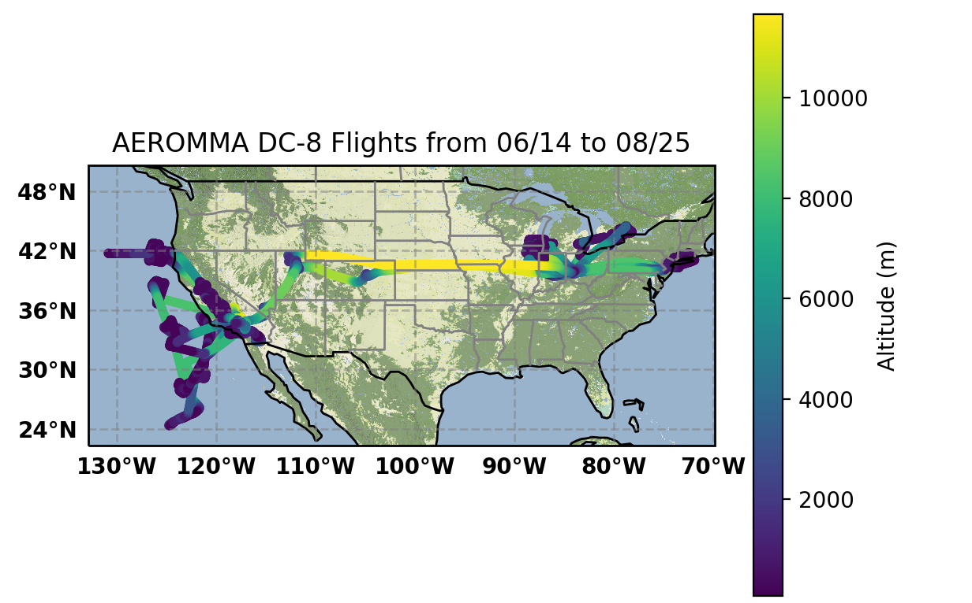

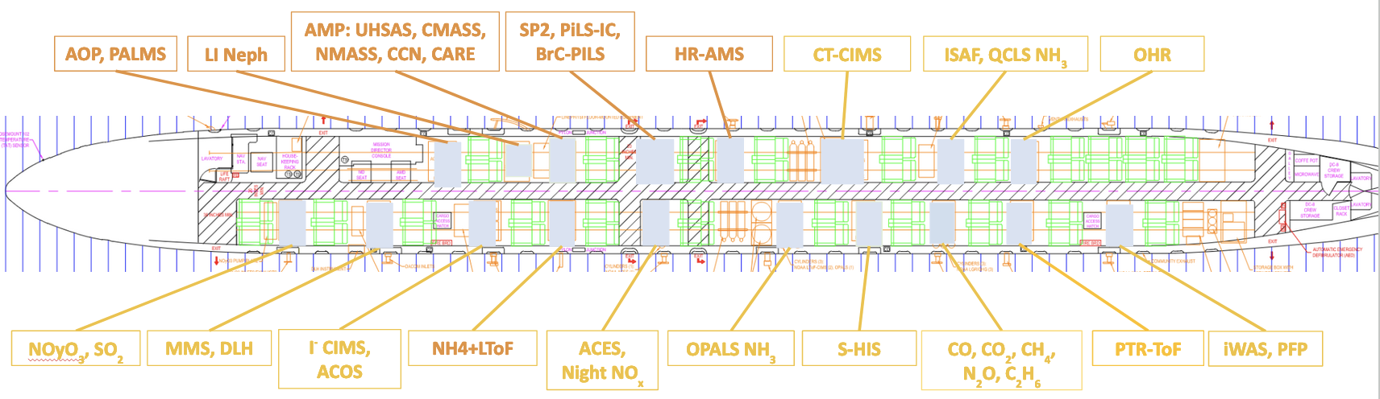
Most AEROMMA flights flew around megacities

Slide 5
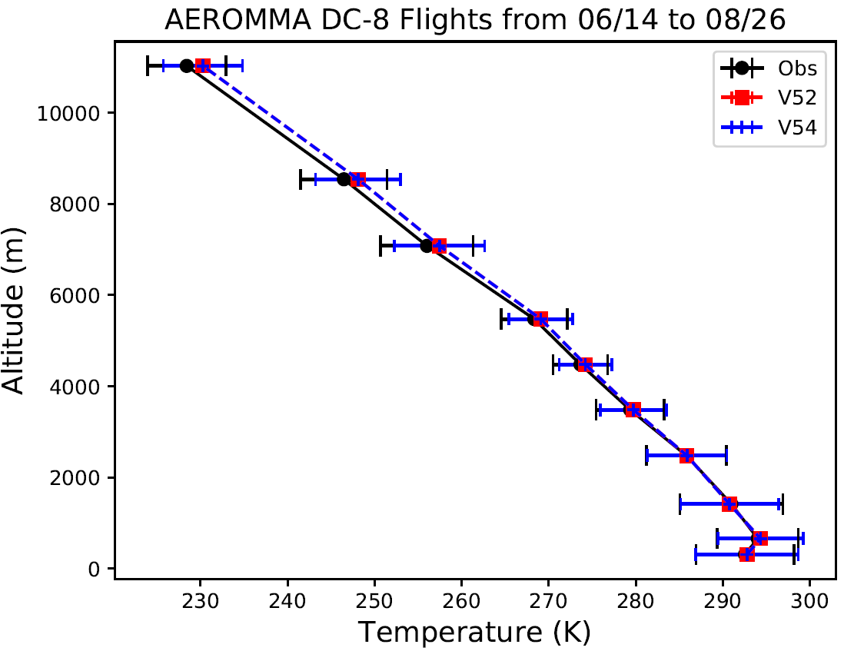
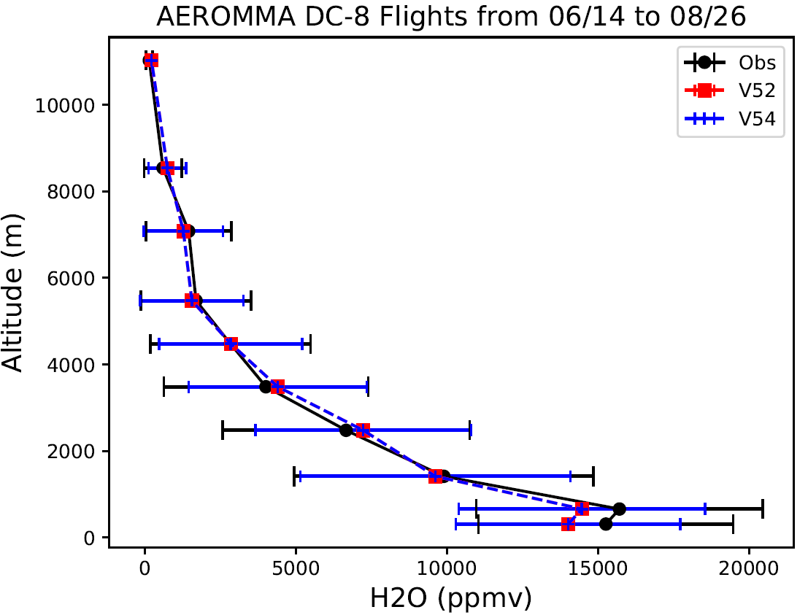
CONUS Meteorology
Dry bias near surface , wet bias near the PBL top

Slide 6
The vertical gradient of modeled winds are too smooth near the tropopause over U.S. West. The model tends to underpredict W by one or two orders of magnitude.

Slide 7
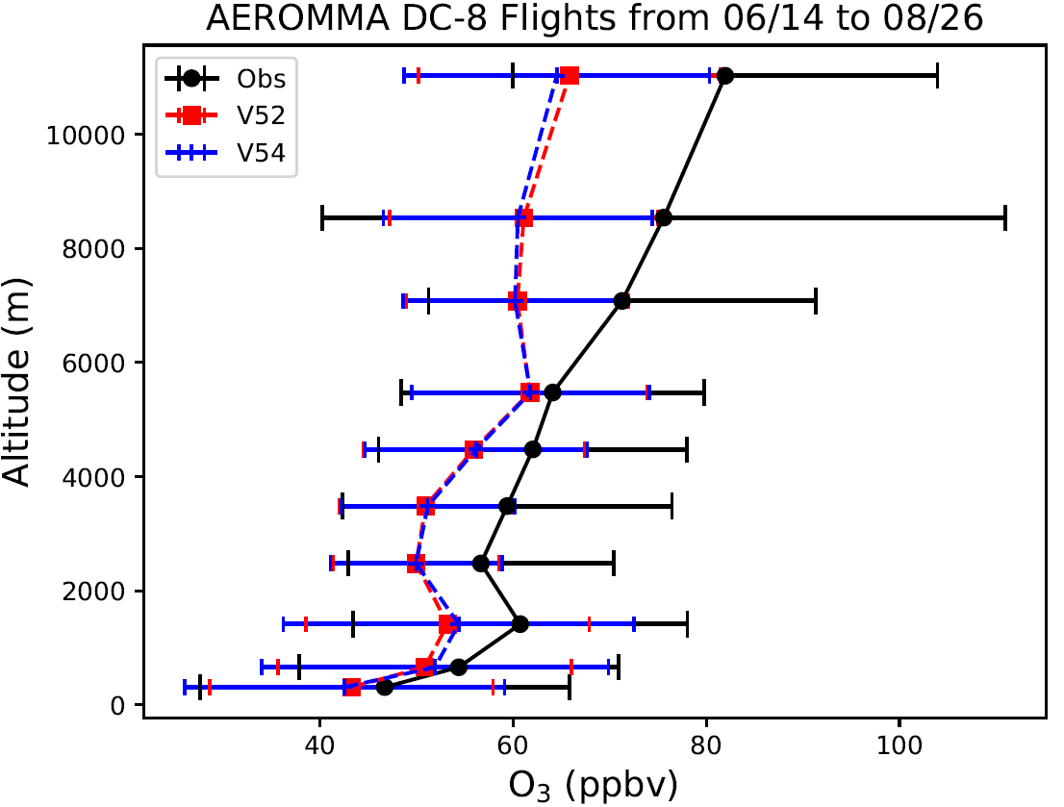
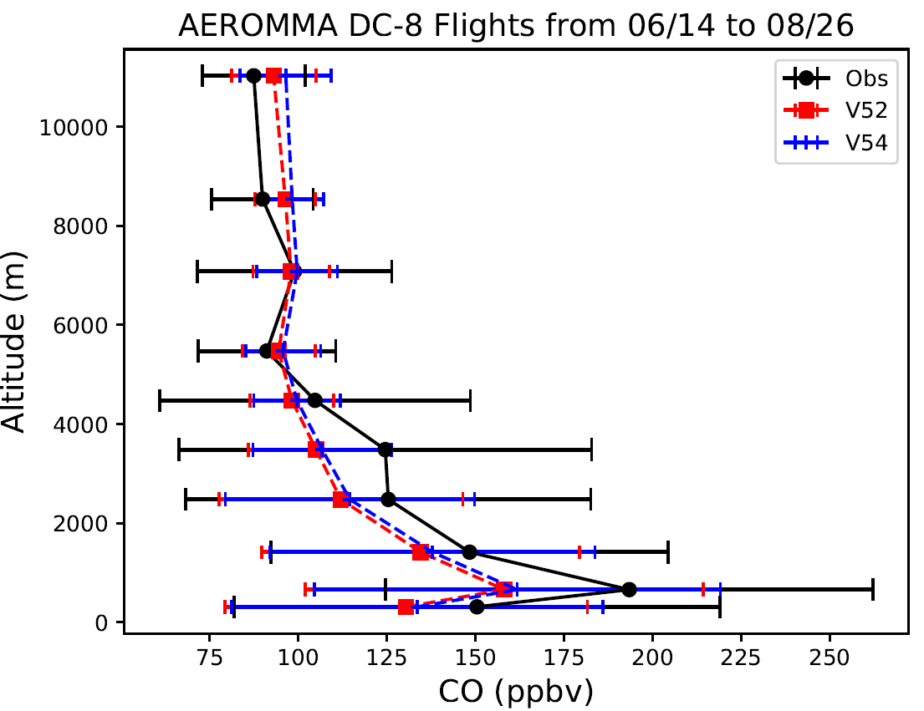
The background ozone and tropospheric CO are underestimated over CONUS, which is related to monthly lateral boundary condition and fire emission.

Slide 8
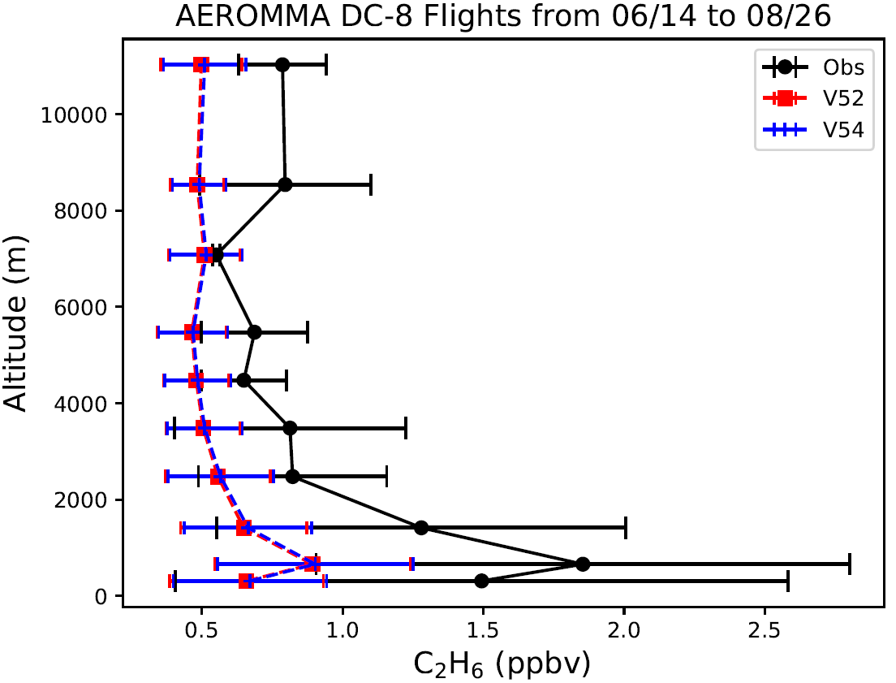
NOz is overpredicted or modeled NOx-to-NOz conversion is too fast.
Models tend to underpredict both background and emission of ethane

Slide 9
The overpredicted NOx-to-NOz conversion leads to underpredictions of ozone production efficiency, represented by the O3-to-NOz ratio, and NOx age and NOx/NOy ratio. It is caused by the model’s well-mixing assumption in each grid cell or insufficient spatial resolution.

Slide 10
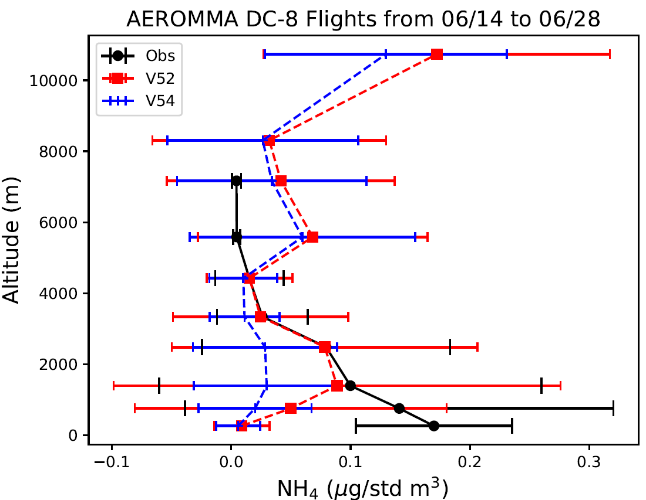
SO₂ undeprediction over U.S. West leads to underprediction of sulfate and ammonium, and overprediction of nitrate. This bias on aerosol compositions could also affect the downstream PM2.5 prediction.
Anions: SO₄²⁻, NO₃⁻, Cl⁻
Cations: Ca²⁺, Mg²⁺, Na⁺, K⁺, NH₄⁺
SO₂ underprediction causes Sulfate and ammonium underpredictions and nitrate overprediction

Slide 11
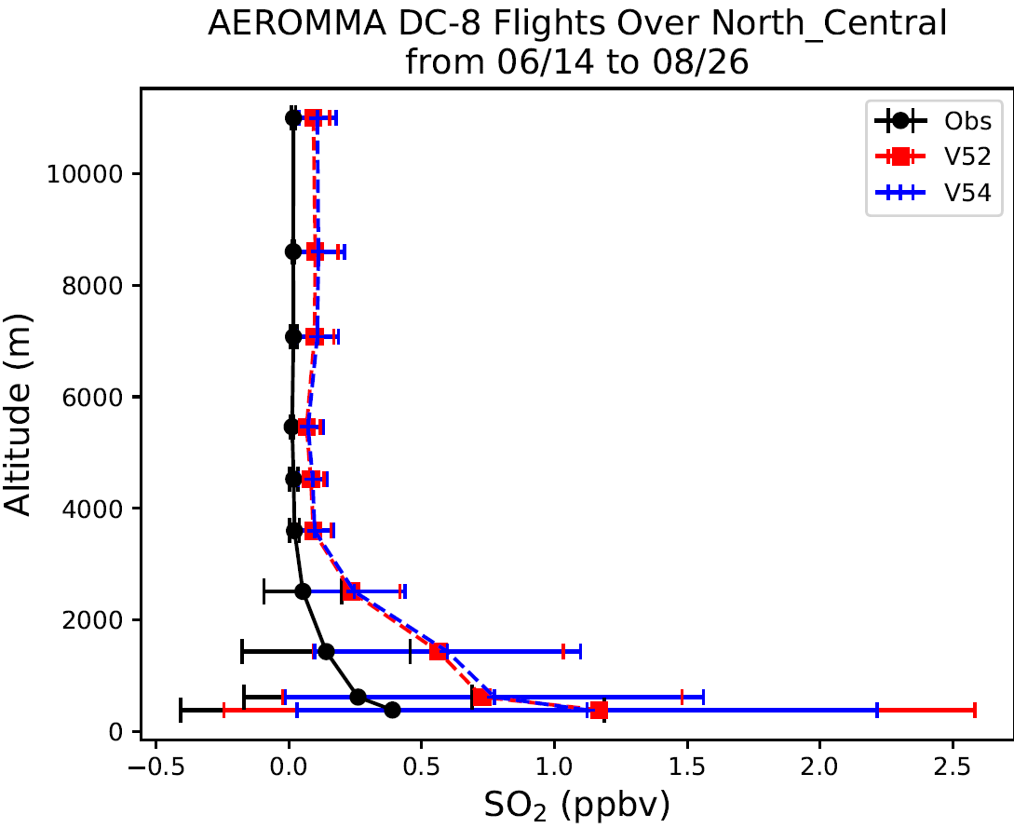
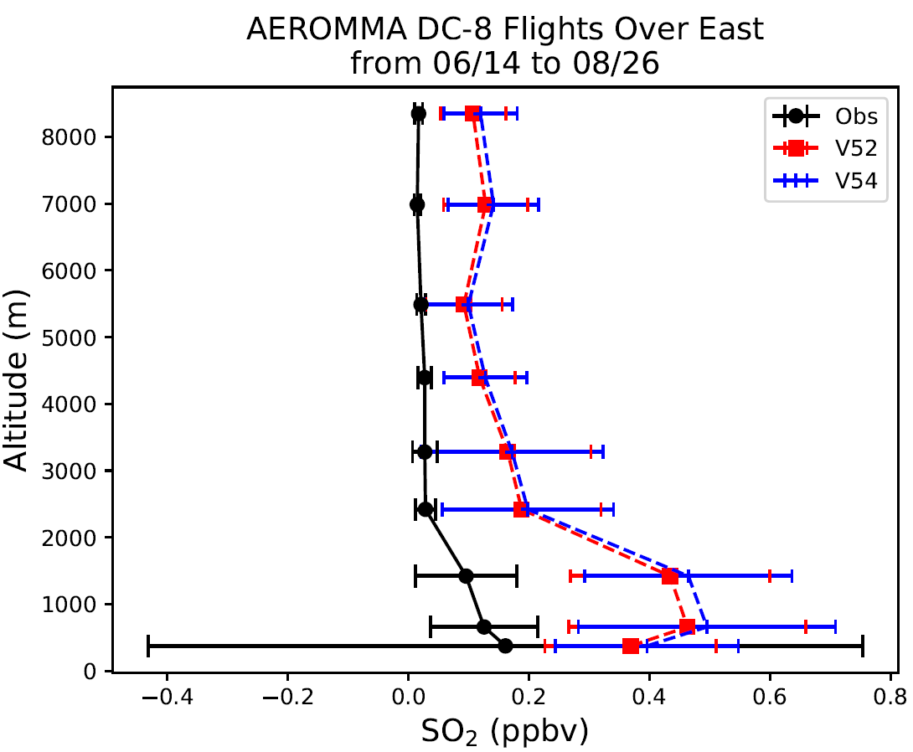
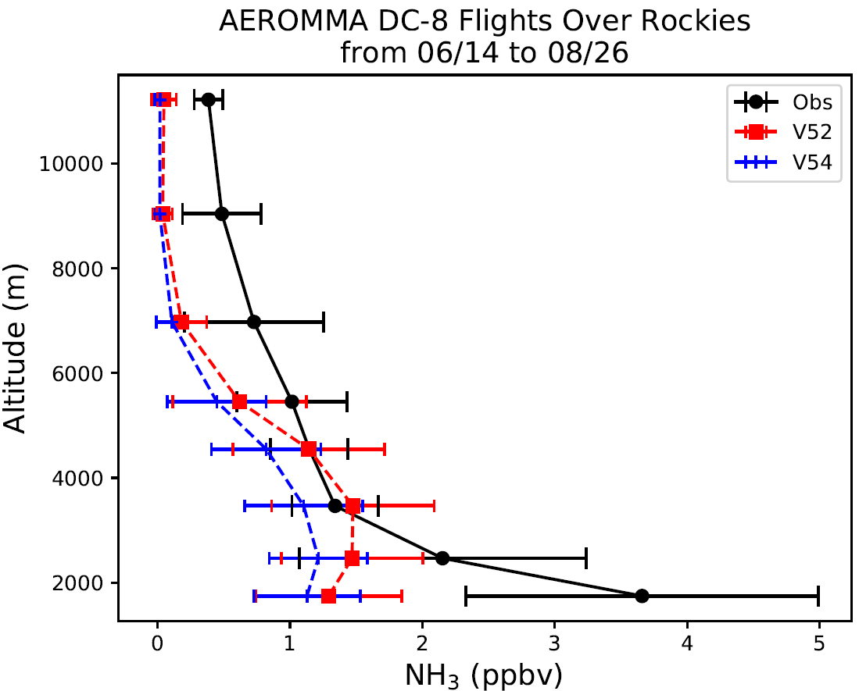
SO₂ over East
SO₂ over Rockies
SO₂ over North Central
NH₃ over Rockies
NO₃ over North Central
NH₃ over East

Slide 12
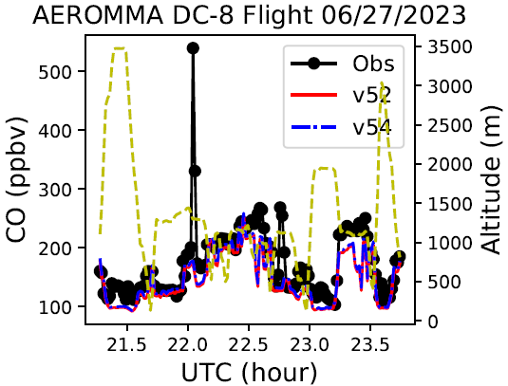
V54 showed better chemical behavior over the LA flight

Slide 13
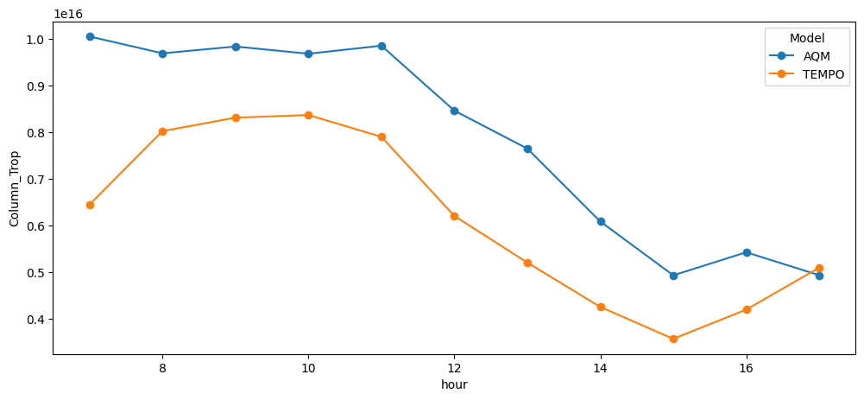
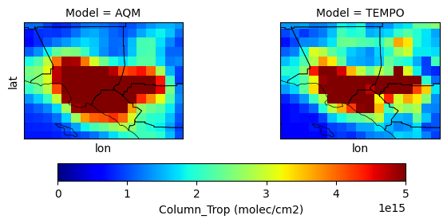
This Cross-Comparison try to address the bias of the NOx emissions over Megacities, reflected by in-situ comparison (slope, mean bias, mean ratio) and TEMPO tropospheric vertical column
Mean bias: 1.72 x 10¹⁵ (+28%)
Los Angeles
Courtesy of Wei Li

Slide 14
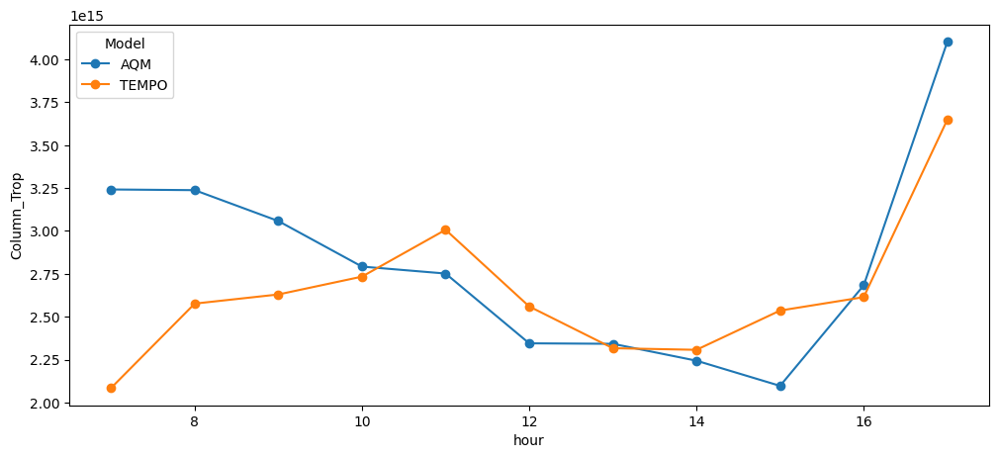
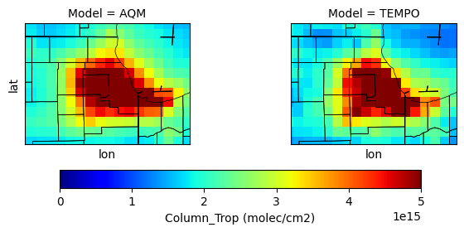
Same but for Chicago
Mean bias: 1.71 x 10¹⁴ (+6%)
Chicago
Courtesy of Wei Li

Slide 15
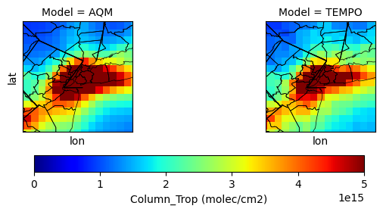
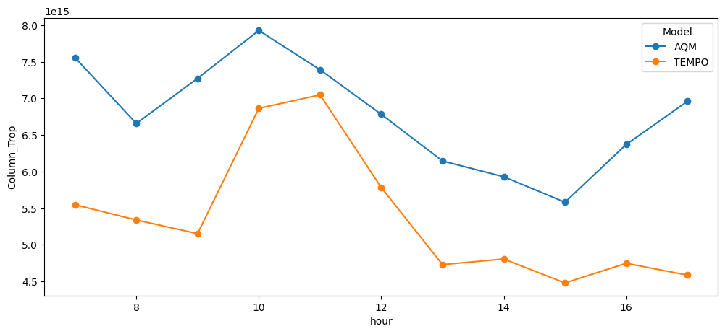
Same but for New York. The discrepancies exist among different species (NOx vs NOy) , as well as in-situ vs TEMPO comparison
Mean bias: 1.41 x 1015 (+26%)
New York City
Courtesy of Wei Li

Slide 16
Summary
The CMAQ5.4 chemistry has stronger photochemical variation than CMAQ 5.2, reflected by its higher ozone product efficiency and lower nighttime ozone.
The model’s well-mixing assumption and insufficient spatial resolution lead to overpredicted NOx consumption and NOz production, and shorter NOx age. CMAQ 5.4 shows slightly better O₃-to-NO_{z} ratio or O₃ production efficency.
The lateral or top boundary conditions for some species need adjustments.
SO₂ is underpredicted over U.S. West and overpredicted in other regions. NH₃ is underepdicted over the CONUS.
The consistency between Satellite and in-situ data could be an issue, and we need to be caution for making emission adjustment based on them.

