Slide 1
Development of Analytic Emissions for the 2022 version 1 Emissions Modeling Platform
Z. Adelman, M. Aldridge, C. Allen, A. Bollman, M. Collins, Y. Dietrich, L. Dayton, A. Eyth, J. Godfrey, M. Janssen, S. Kayin, B. Kim, S. McCusker, T. Moore, E. Murray, R. Payne, M. Roark, S. Roberts, T. Richardson, K. Seltzer, K. Talgo, M. Uhl, J. Vukovich
Presentation to the Annual CMAS Conference
October 23, 2024

Slide 2
Overview of Emissions Projections
Emissions are projected to analytic years to support air quality modeling to:
Evaluate policy options
Develop Regulatory Impact Assessments (RIAs)
Assess pollutant transport to other areas
Use in photochemical modeling to estimate the change in air quality due to changes in anthropogenic emissions
Ozone, particulate matter, regional haze
Natural sources (biogenic emissions) and fires are held constant
Interested in Learning More about Emissions Projections?
Check out the Emissions Control Data Request Webinar 2022 Collaborative Wiki

Slide 3
Expected Uses of Analytic Year Emissions
The 2022v1 platform includes emissions inventories for 2026, 2032, and 2038.
States will use 2026 to develop ozone NAAQS SIPs for Serious nonattainment areas which are due by early CY 2026.
2032 is the appropriate analytic year for areas classified as Severe or will be bumped up to severe in 2027.
EPA and states will likely need to perform modeling for 2032 to support PM2.5 NAAQS implementation.
2038 inventories will support analyses that require data for a year later than 2032.
EPA will develop air quality model-ready emissions for 2026 and 2032
Analytic Year
A year for which emissions are projected to support modeling

Slide 4
Typical Ways to Perform Projections to Analytic Years
Apply factors that represent changes in activity between years
Factors can be derived from Annual Energy Outlook (AEO), other economic data, human population projections, etc.
Apply factors to reflect controls or technology changes between years
Apply any closures to facilities or units
Run a model with updated inputs for the analytic year (e.g., IPM or ERTAC EGU, MOVES for onroad and nonroad)
Basic Emissions Projection Method
Base Year Emissions x
Activity Change Factor x
Control Factor(s)

Slide 5
2022 EIC Projections Workgroup
2022v1 work focused on understanding recent US EPA and MJO/state methods and data to project activity
Identify alternative methods and data for projections
Workgroup goal: make recommendations to U.S. EPA about data sources or methodology changes for projecting emissions in each version of the 2022 platform
Emissions Collaborative facilitated the collection of state control program, facility retirement, and consent decrees
Projection Task Forces
Electricity Generating Units
Industrial Point
Nonpoint
Onroad/Nonroad
Marine/Airports/Rail
Oil & Gas

Slide 6
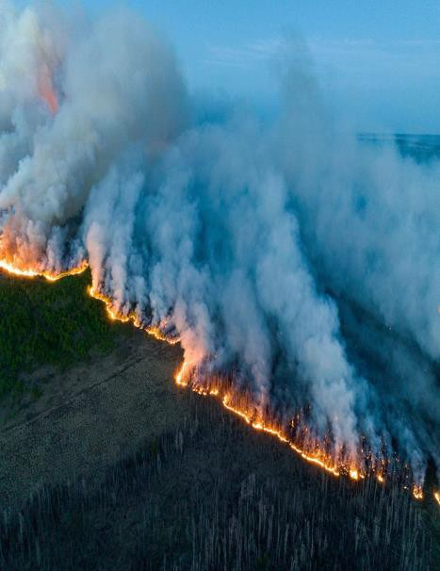
Projection Methods by Sector
Hold Constant: biogenics, fires, fertilizer, residential wood combustion, dust, others
Non-EGU point, oil & gas, nonpoint, locomotives, commercial marine vessels
Apply factors reflecting emissions activity
forecasts and impact of regulatory programs
Remove permanently closed point sources
Often done in the Control Strategy Tool (CoST)
Run MOVES: onroad and nonroad sectors
Run EGU forecast model (IPM or ERTAC)
All sectors include national rules, where applicable
Future Realizations
Analytic years for state implementation planning are a single realization designed to only quantify the impacts of anthropogenic emissions changes
Notes:
People need to understand that these data and the subsequent air quality modeling are just one part of a weight of evidence argument for or against a case that an area will meet NAAQS attainment goals. Relative to trends in observed air quality and emissions, emissions control programs, and other SIP elements, the air quality modeling gets a lot of attention from those of us developing/supporting SIPs due in larger part to the resource requirements

Slide 7
Electricity Generating Units (EGU)
U.S. EPA IPM and ERTAC EGU models
Different models to forecast emissions
Special considerations: Good Neighbor Plan, electric vehicle (EV) demand projections, 111d GHG Fossil Fuel rule
Integrated Planning Model (IPM)
Provides least-cost projections of capacity expansion, generation, and emission control strategies for meeting energy demand and environmental, transmission, dispatch, and reliability constraints.
Eastern Research Technical Advisory Committee EGU Model
Provides conservative generation and emissions projections appropriate for state air quality planning from hourly base year data and state-supplied information.

Slide 8
Industrial Point (NonEGU)
Projections in this sector incorporate growth factors derived from the Annual Energy Outlook (AEO) and state employment data
Projections based on value of shipments, energy use, and employment data by industry type
Regional data favored over national data
Growth caps of 2% per year
Federal and state controls
Known shutdowns

Slide 9
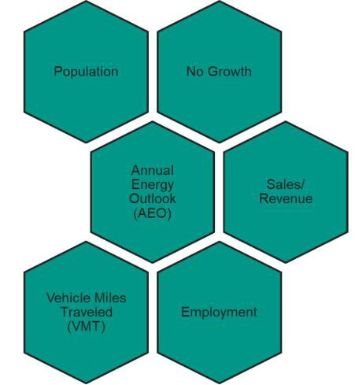
Nonpoint
The nonpoint data category is made up of a wide variety of emissions sources and projection methods can vary greatly between these different sources.
Many of the subsectors used the Annual Energy Outlook sector data; other data included population and VMT projections
A few subsectors (e.g., residential wood combustion and waste) used no growth
Review the platform documentation for details

Slide 10
Onroad and Nonroad Mobile
Onroad
2023 AEO used to project 2022 activity data to the analytic years
Some states provided VMT projections
EPA developed adjustment factors to account for recent onroad mobile source rules that are not reflected in MOVES4
Nonroad
MOVES4-nonroad used for 2026, 2032, and 2038 using 2022 meteorology
Notes:
we did carry forward the geographic redistribution for construction and agricultural SCCs that was implemented in the 2016 platforms

Slide 11
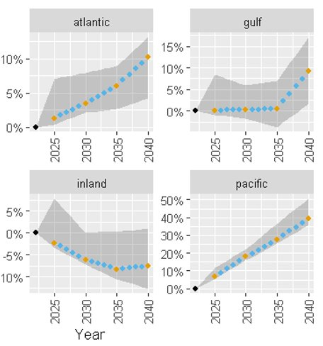
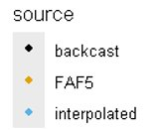
Marine, Airport, & Rail
Relative growth for bulk carriers by region (AK and HI also available)​
Marine
Adjustment factors by ship type and region were developed based on the Freight Analysis Framework version 5
A NOx adjustment was applied based on projected fleet turnover to cleaner engines​
Airports
Terminal Area Forecast (TAF) used to derive projection factors for each analytic year
Rail
Annual Energy Outlook (AEO) fuel use data used to derive factors to compute analytic year emissions

Slide 12
Oil and Gas
Production-related non-point and point sources​
Energy Information Administration (EIA) state historical production data for years 2022 and 2023​
Production forecasts from EIA's Annual Energy Outlook (AEO) 2023 Reference case​
Exploration-related non-point sources
3-year average of activity (2018, 2019, 2022)
Average activity used in the EPA Oil and Gas Tool to generate analytic year emissions
Transmissions-related point sources
EIAs AEO 2023 Reference Case production forecast
Controls applied to point and non-point sources
New Source Performance Standard (NSPS) Oil and Gas, Reciprocating Internal Combustion Engines, Natural Gas Turbines and Process Heaters

Slide 13
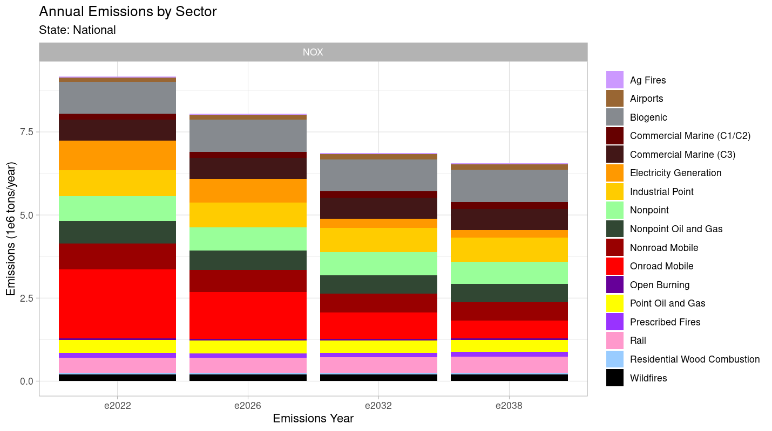
National Nitrogen Oxides Emissions
Notes:
NOx changes are driven by reductions in onroad mobile and EGU point, most of the other sectors are not forecasted the change much
Soil NOx is forecast to be the single largest source of NOx by 2032
Important future sources of NOx: C3 CMV, industrial point, nonpoint, oil and gas, nonroad mobile, rail

Slide 14
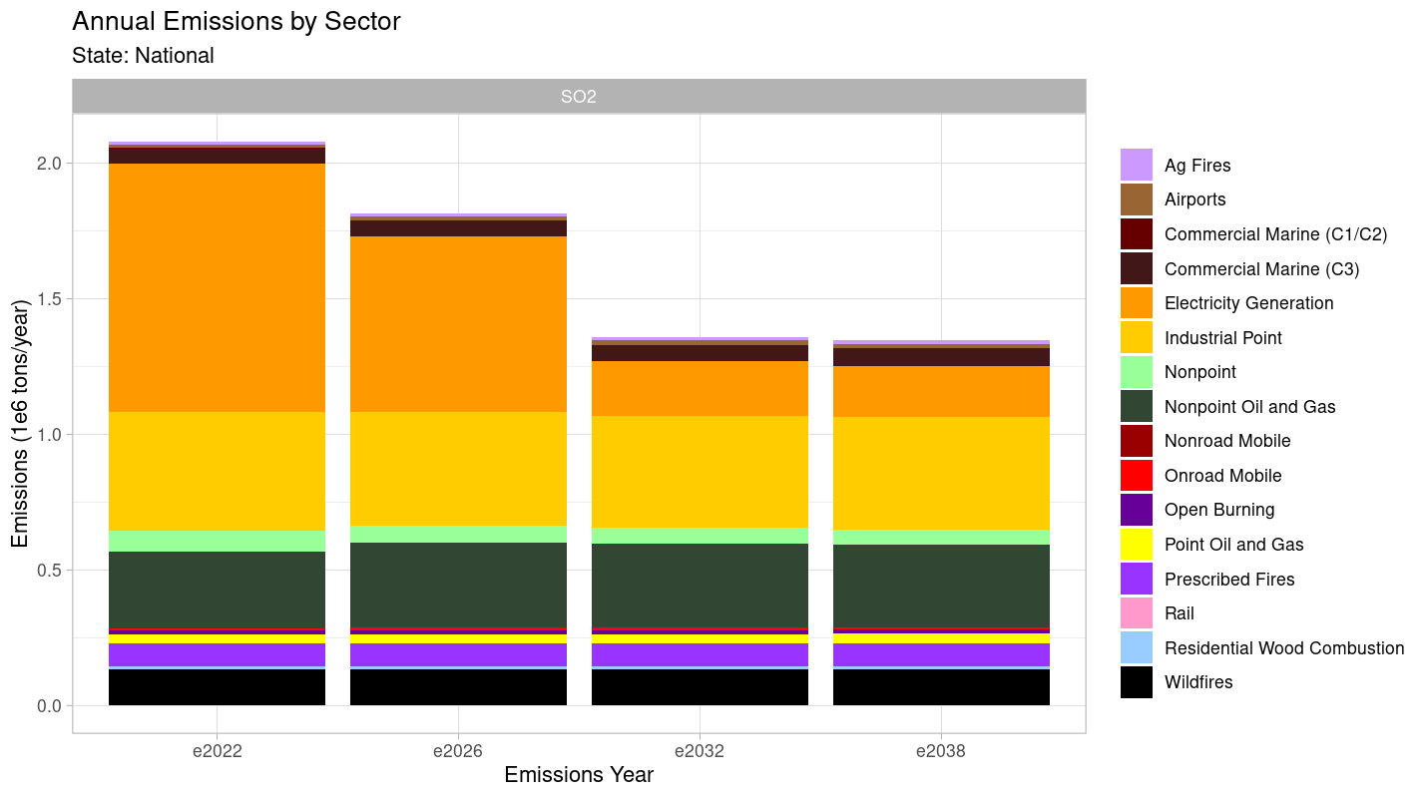
National Sulfur Dioxide Emissions
Notes:
Continued forecasts of dramatic changes to EGU SO2
Industrial point and nonpoint oil and gas are forecast to be the dominant sources by 2032

Slide 15
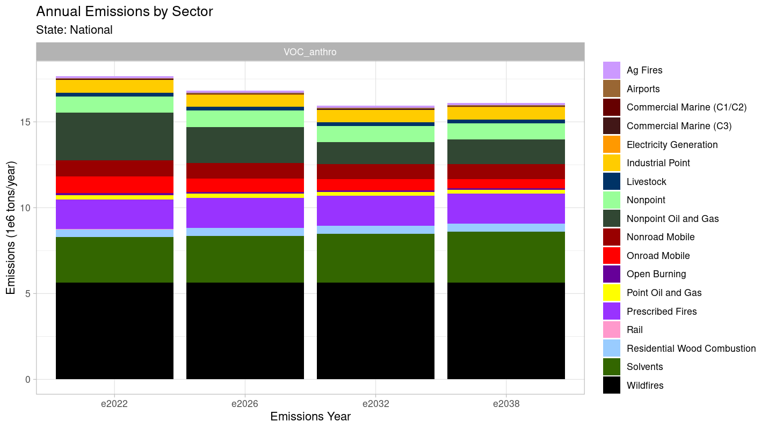
National Volatile Organic Compound* Emissions
* Anthropogenic Only

Slide 16
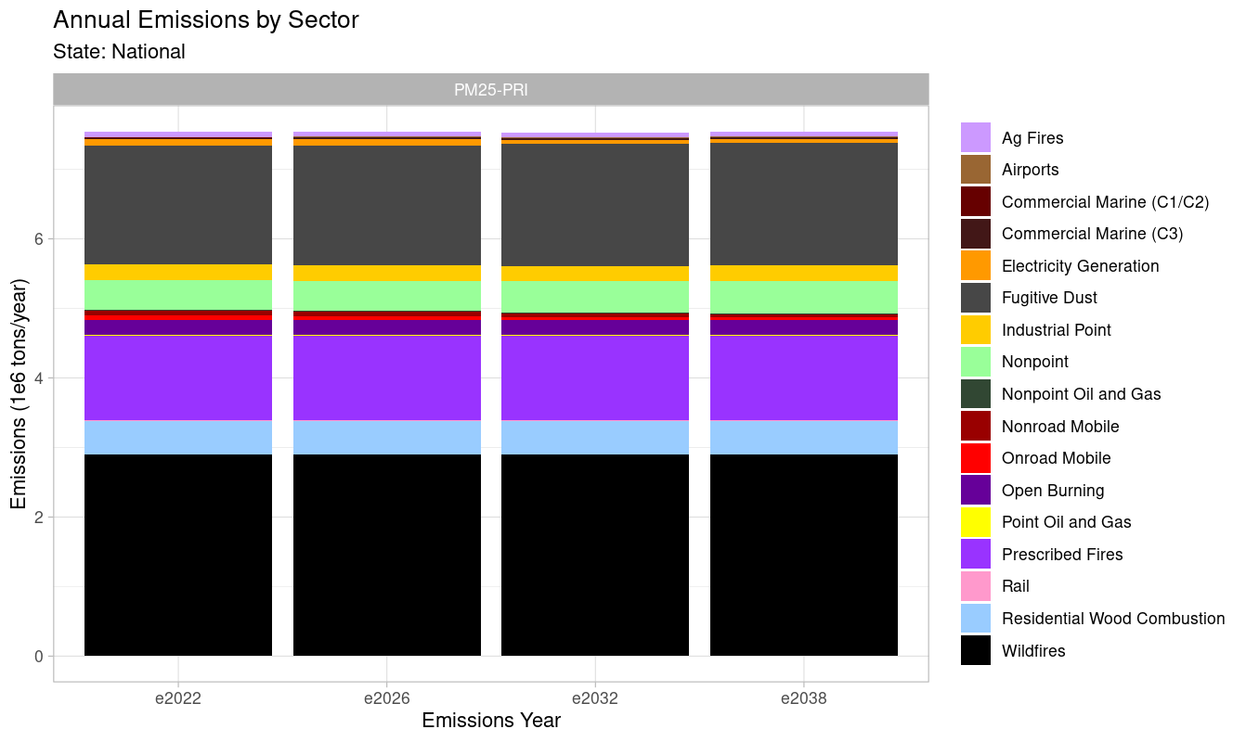
National Fine Particulate Emissions
Notes:
Fires are constant
Fugitive dust shown here is unadjusted

Slide 17
Next Steps
Analytic year emissions are open for comment through November 7, 2024
US EPA will review and incorporate comments
Final analytic emissions inventories will be available by the end of 2024
A 2022v2 platform will be developed in 2025 with updated projection methods/data for some sectors
2022v1 Emissions Modeling Platform @ US EPA

