Slide 1
Impacts of Chemical Mechanism Choice and Meteorology on Model Processes and Wintertime PM_{2.5} in the Western U.S.
Cam Phelan¹, Abi Lawal¹, William Vizuete², Jacob Boomsma³, Heather Holmes³, Cesunica Ivey¹
¹ University of California Berkeley Department of Civil & Environmental Engineering
² University of North Carolina Department of Environmental Sciences and Engineering
³ University of Utah Department of Chemical Engineering
23rd Annual CMAS Conference, October 23, 2024

Slide 2
Acknowledgements
AQMEL at UC Berkeley
Collaborators at University of Utah, University of North Carolina
Chi-Tsan Wang and anyone else who contributed to PyPERMM, PyPA
Funding from NIH NIEHS, R01ES032810
Savio supercomputer cluster from the Berkeley Research Computing program
Notes:
Speaker notes are for people who prepare what they say, so you’re in the clear obviously.

Slide 3
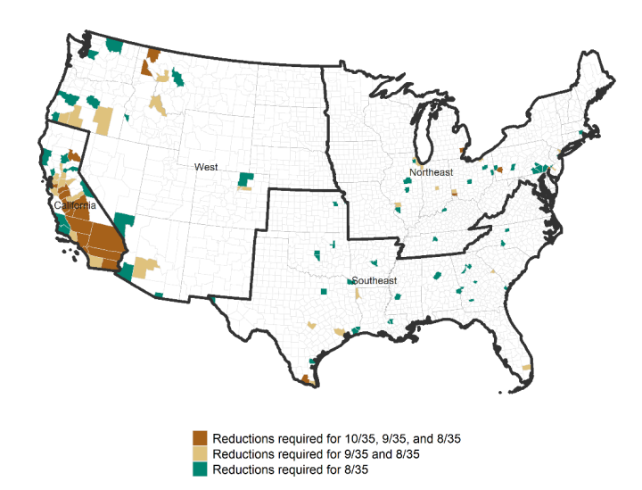
Chemical Mechanism Choice Impacts Simulated Pollution
This is not news
Lots of chemical mechanism choices!
Secondary aerosols, nighttime chemistry
No requirement or explicit guidance on mechanism choice for SIPs– good and bad
Final Regulatory Impact Analysis for Reconsideration of National Ambient Air Quality Standards for Particulate Matter, 2024

Slide 4
Reasons for poor model performance in Western US
Bountiful, UT
Grid scales common in CMAQ insufficient to capture flow, other meteorology around mountains
Persistent Cold Air Pools (PCAPs) poorly captured by meteorology models
Emissions inventory issues
Boise, ID
Salt Lake City, UT
Reno, NV
Denver, CO
Phelan et al., 2024, in review

Slide 5
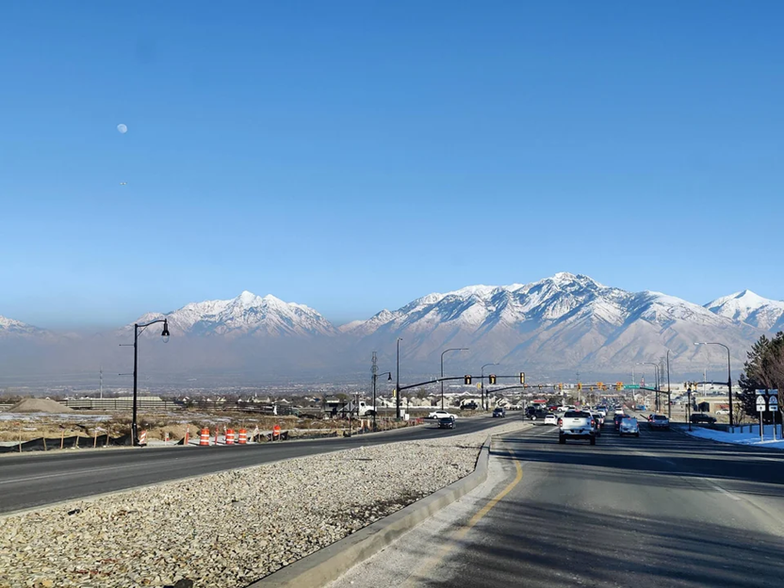
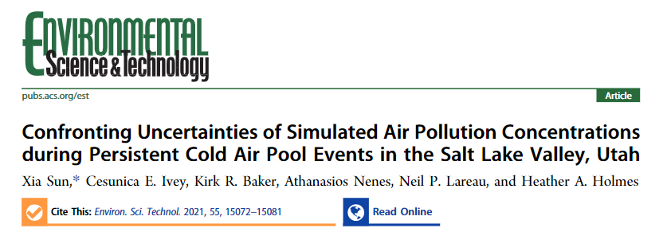
Persistent Cold Air Pools (PCAPs) make modeling in the western U.S. wintertime even more difficult
Image (R): Salt Lake Tribune

Slide 6
Questions
How do PM_{2.5} differences between mechanisms change with meteorology?
Which chemical species of PM_{2.5} have the most variability?
Which CMAQ processes are responsible for this variability?
Are there important gas-phase reactions that could also impact this situation?

Slide 7
Modeling Methods
AERO7
A
4 CMAQ 5.3.3 simulations, only varying chemical mechanism
A = cb6r3_ae7_aq
B = cb6r3_ae6_aq
C = racm2_ae6_aq
D = saprc07tc_ae6_aq
January 1-31, 2016 plus 2 weeks spinup time
IPR and full IRR at all grid cells and model layers
Cb6r3
B
AERO6
C
D
RACM2
SAPRC07tc

Slide 8
Model Specifications
Inputs and Model Versions | WRF Options | CMAQ Options
EQUATES emissions, boundary conditions for 2016 12_US1 WRF v4.3.3 MCIP 5.3.3 CMAQ 5.3.3 | ACM2 boundary layer PX LSM K-F Cumulus RRTM LW radiation Dudhia SW radiation Thompson microphysics Modified_IGBP_MODIS land use** | Inline dust turned on** pcSOA turned on for all nonfire sources M3dry deposition Bi-di NH₃ flux BEIS biogenics 12_US1 grid 35 vertical layers, 14 under 1 km

Slide 9
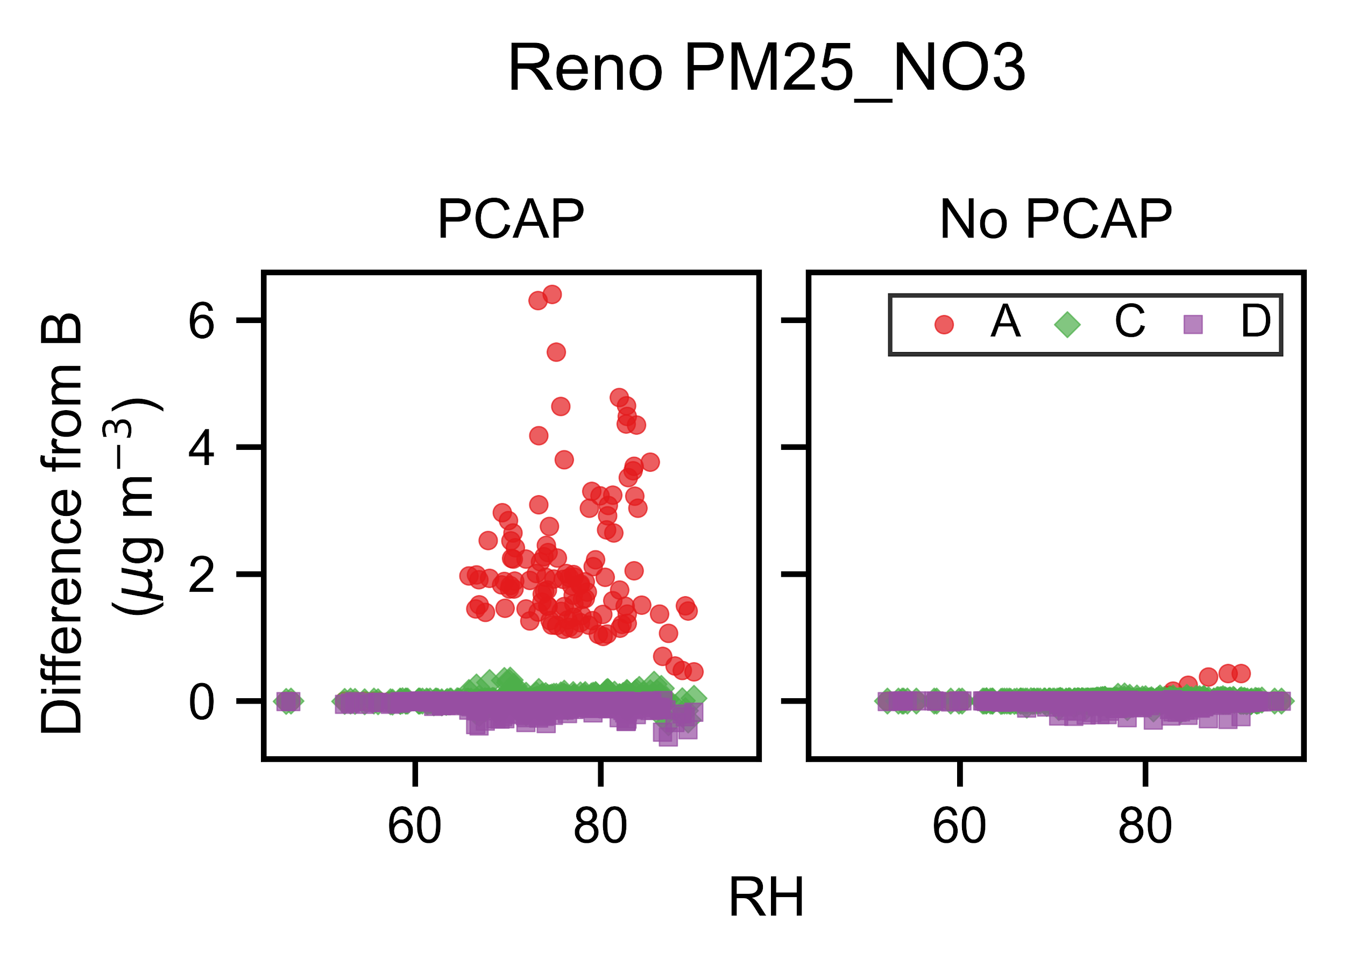
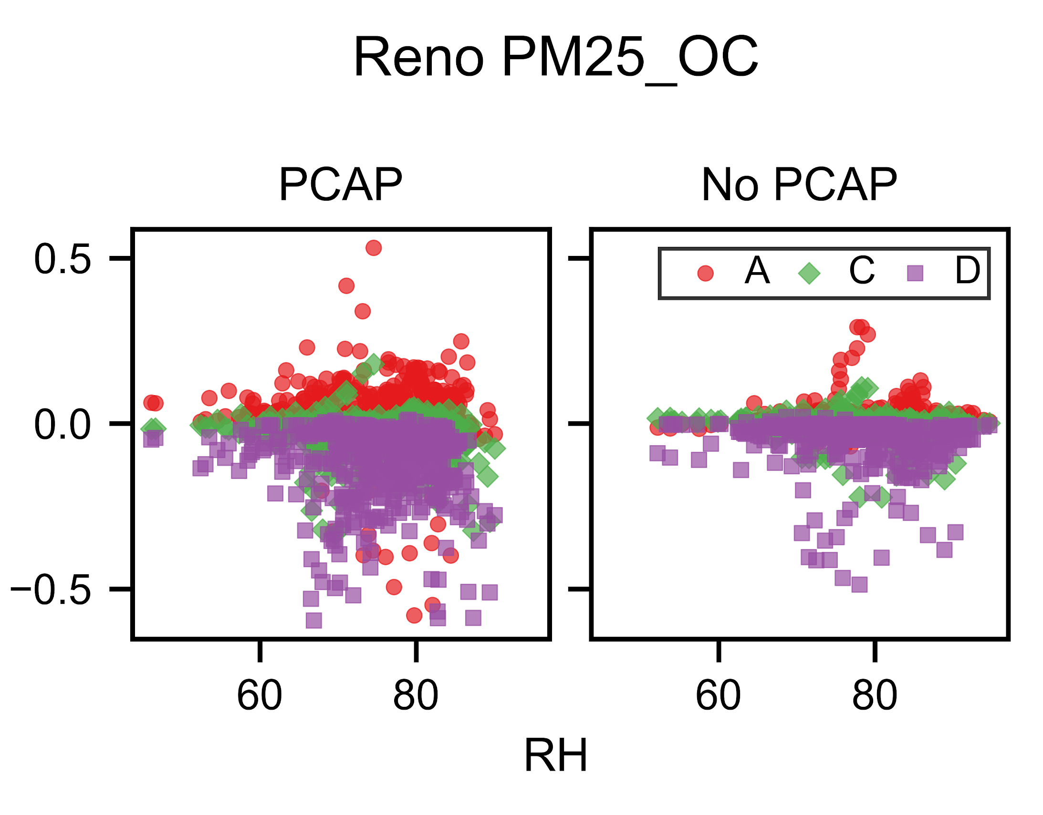
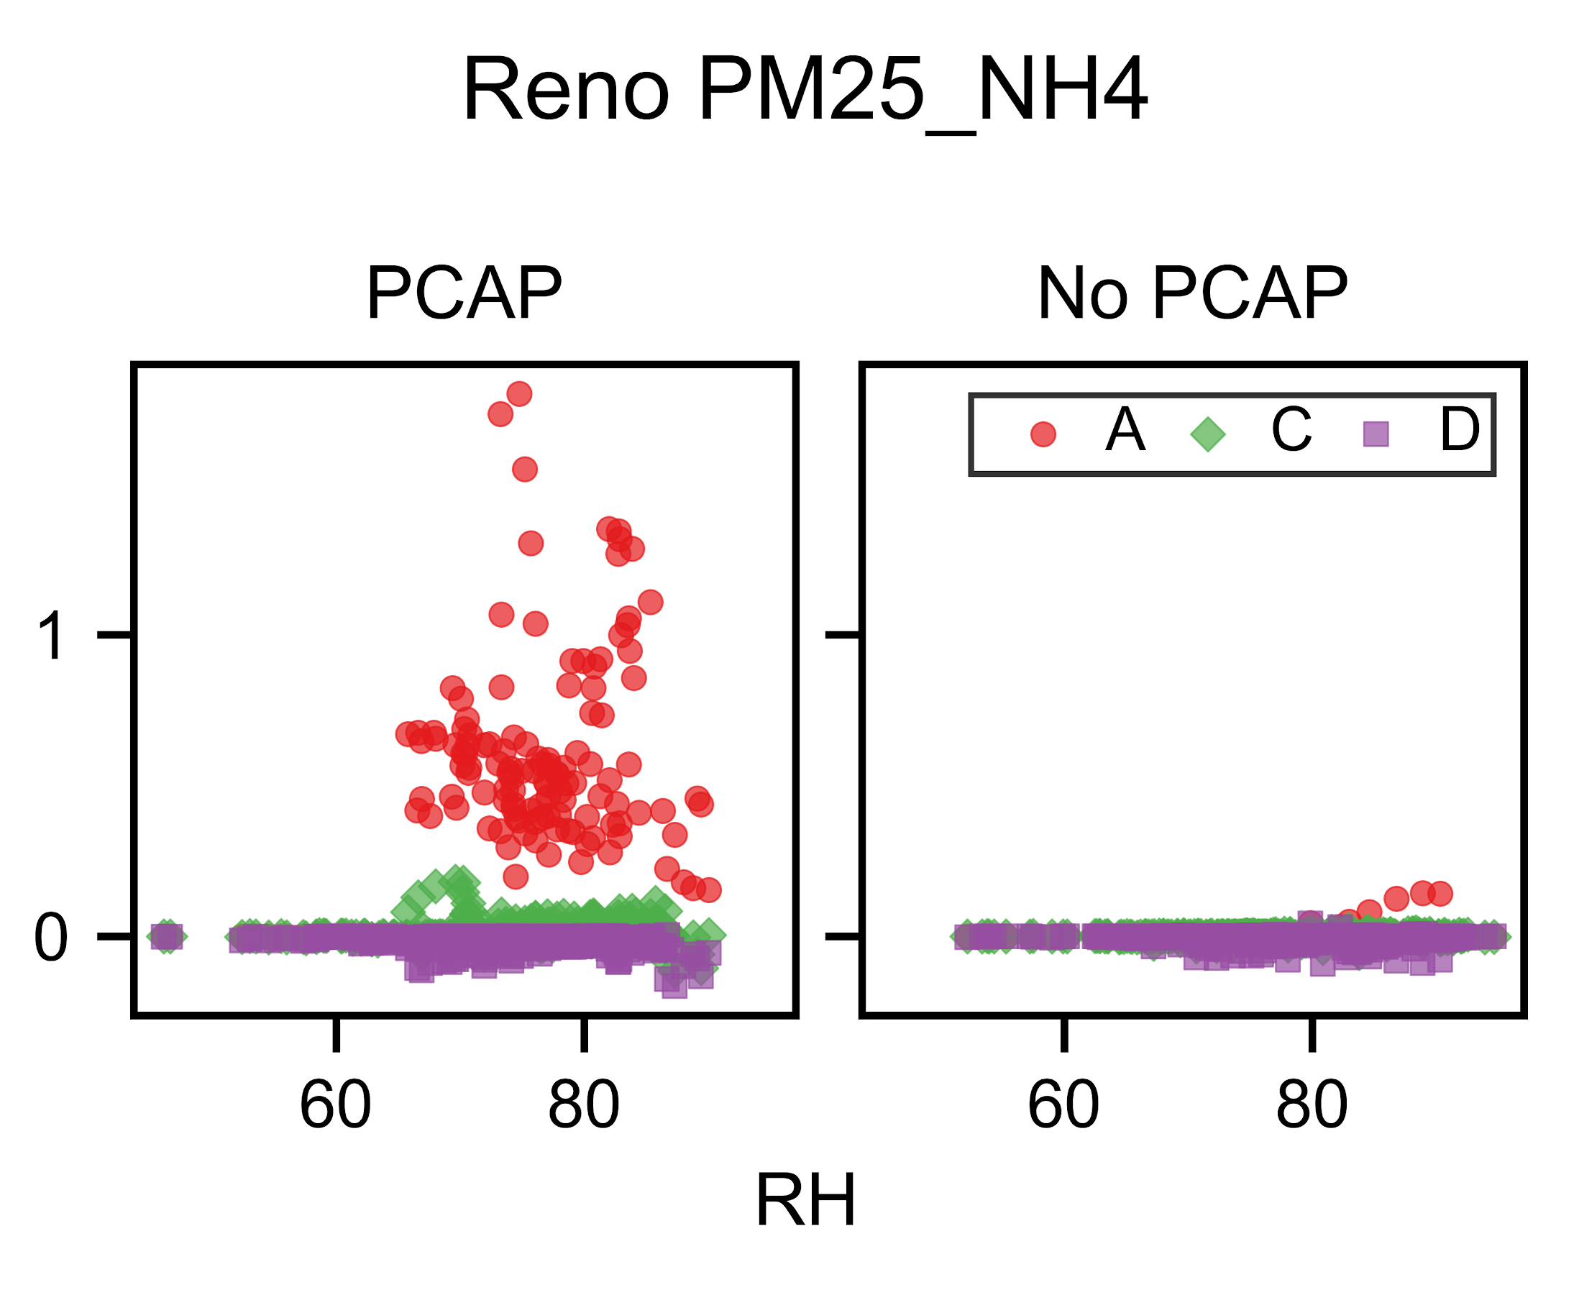
Chemical mechanism variability with humidity, PCAP strongest for nitrate, ammonium
Phelan et al., in prep

Slide 10
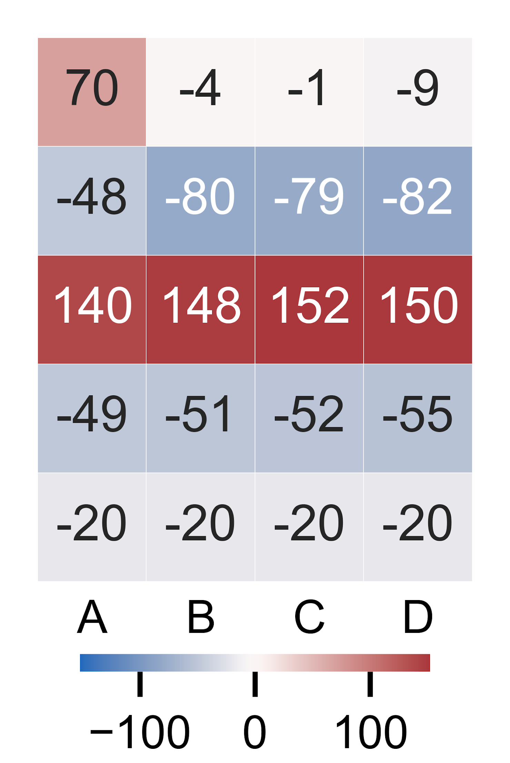
Poor performance for total and speciated PM_{2.5}
Reno, NV
NMB for total PM_{2.5} between -41% - -28% during PCAPs
NMB for total PM_{2.5} between -53% - -49% excluding PCAPs
Small sample size for CSN data, cannot compare PCAP speciated performance
Not a valid model for SIP applications!

Slide 11
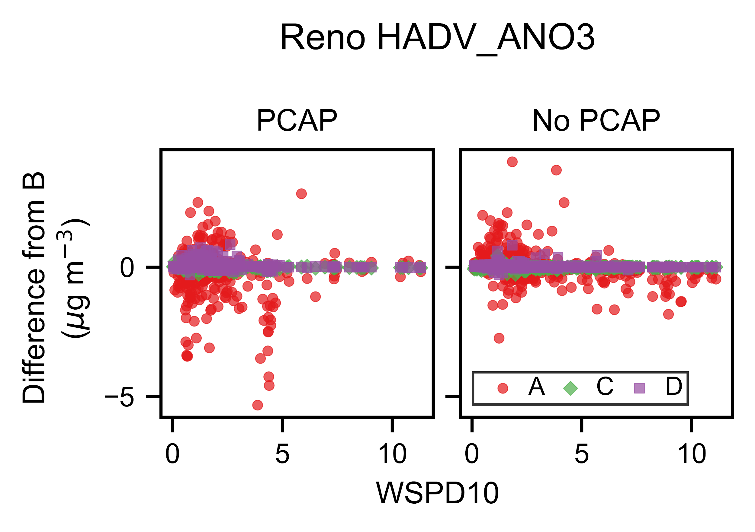
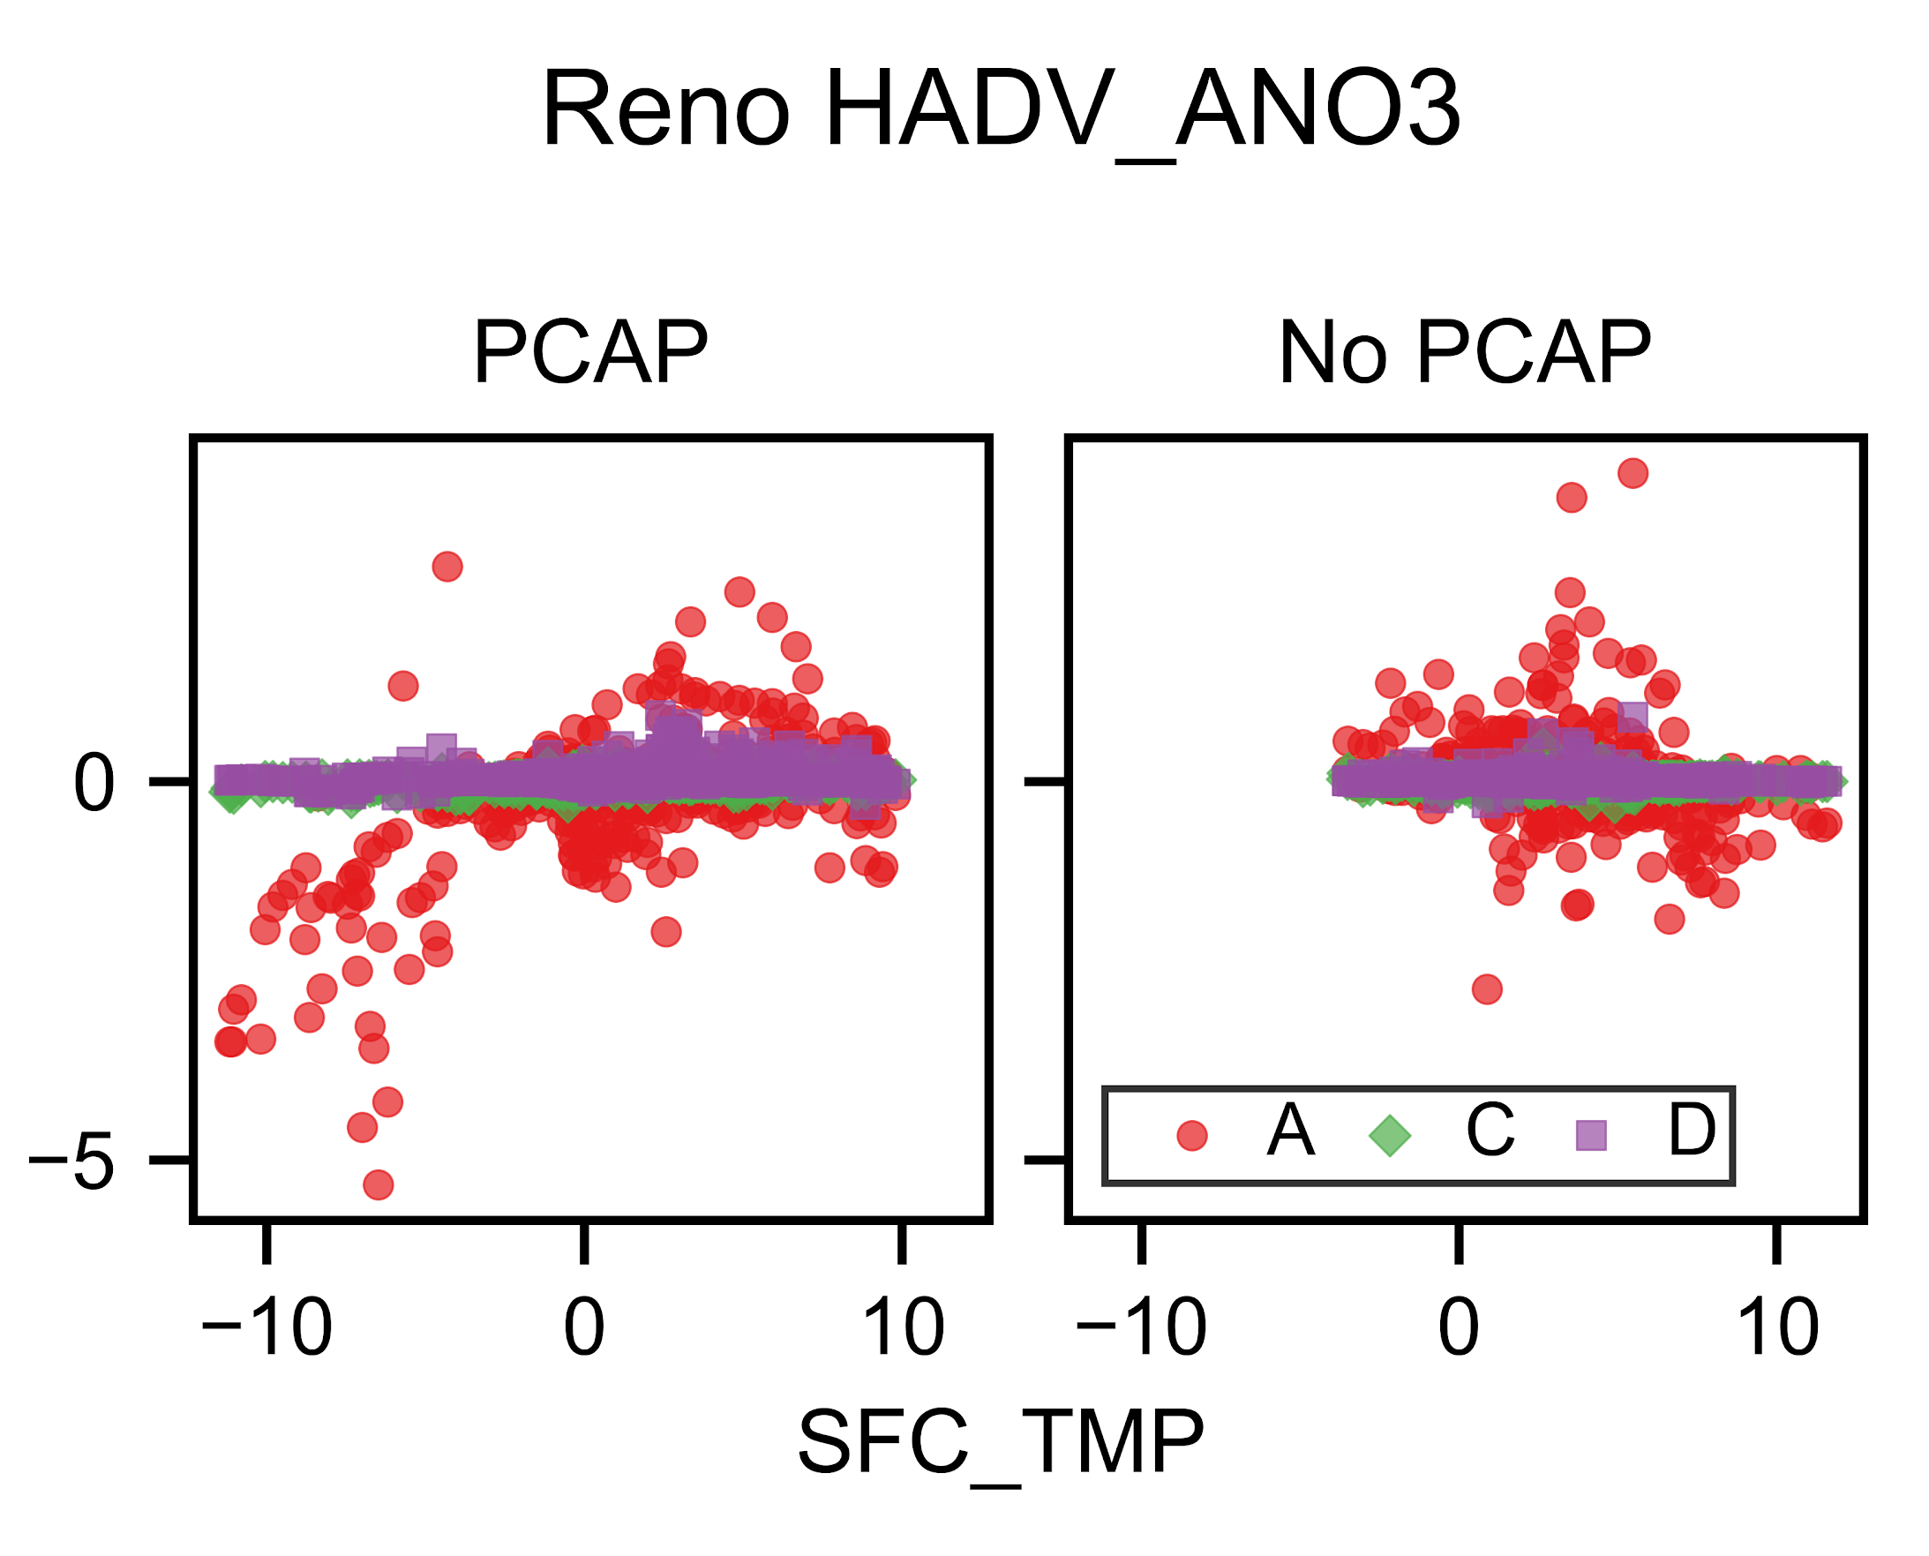
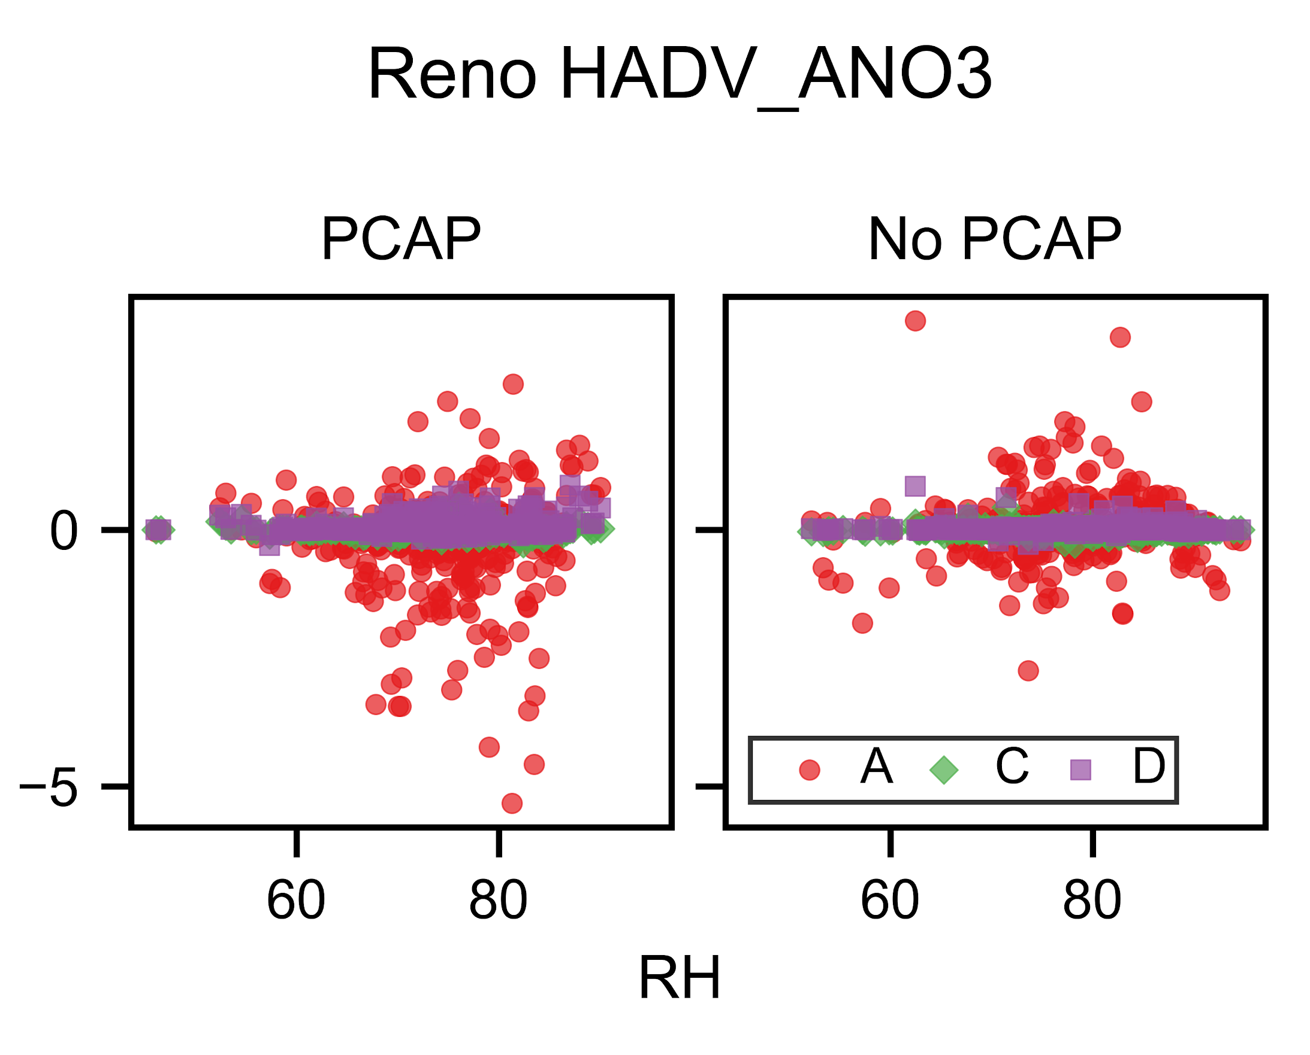
Process analysis shows larger horizontal advection than expected during PCAPs
Phelan et al., in prep

Slide 12
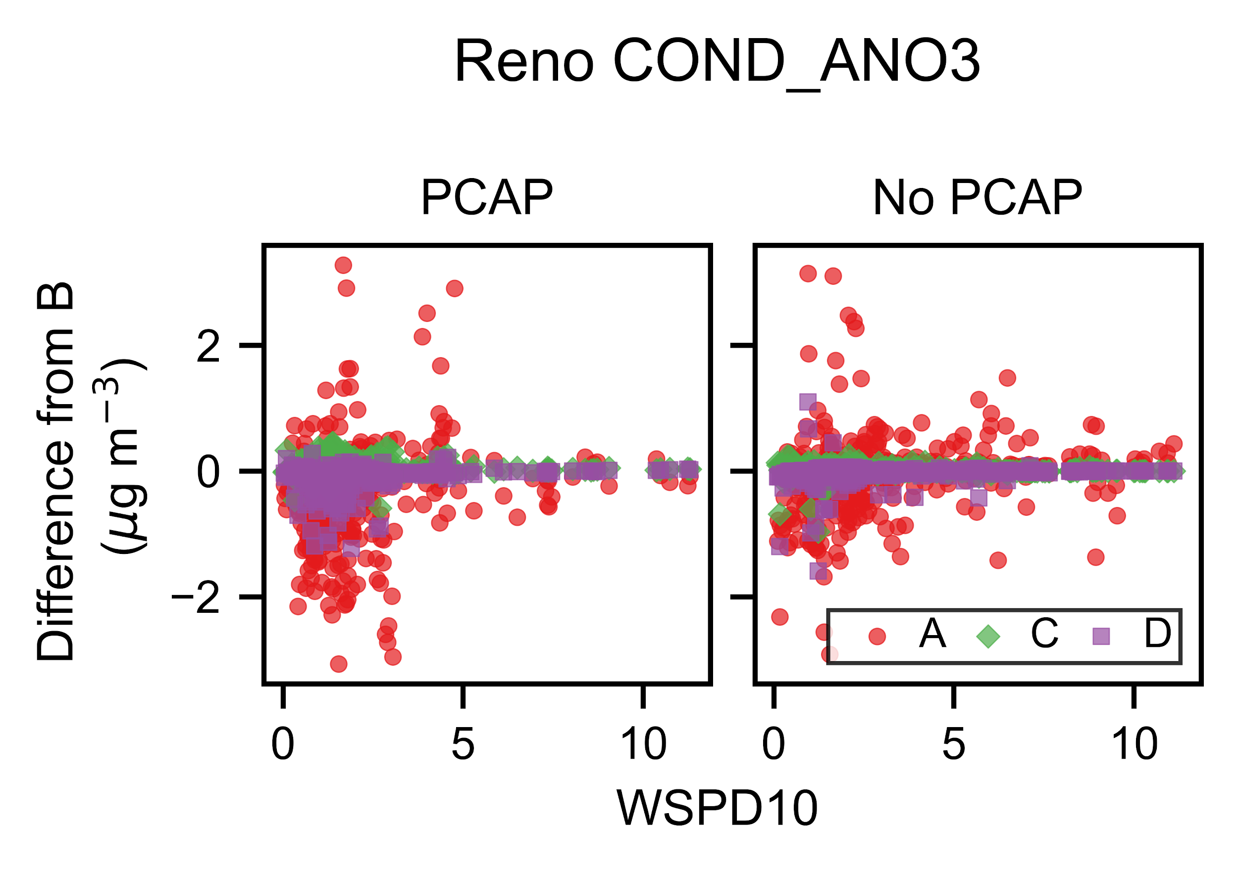
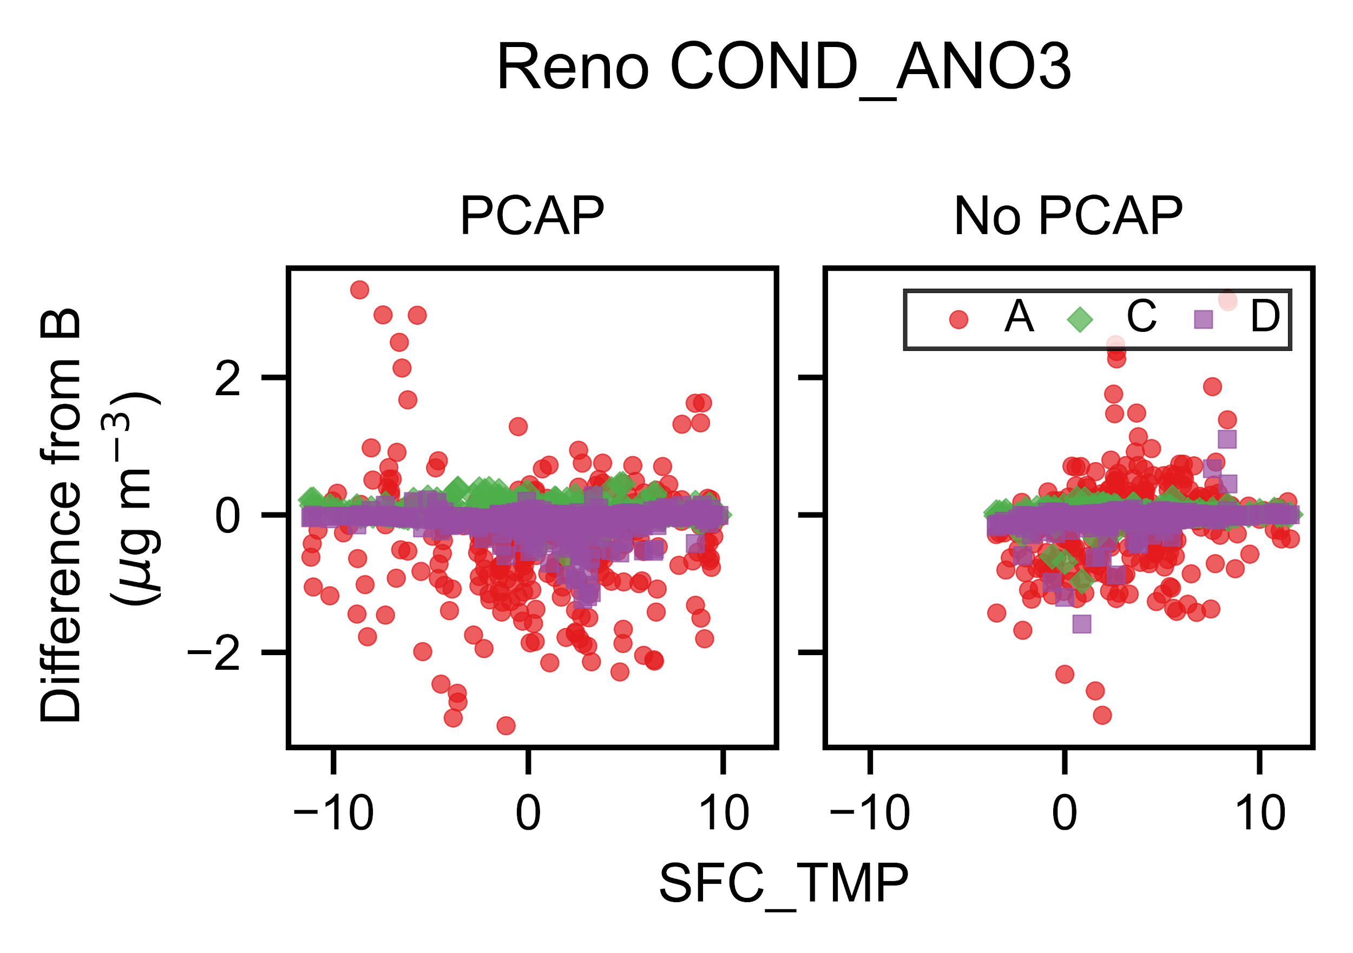
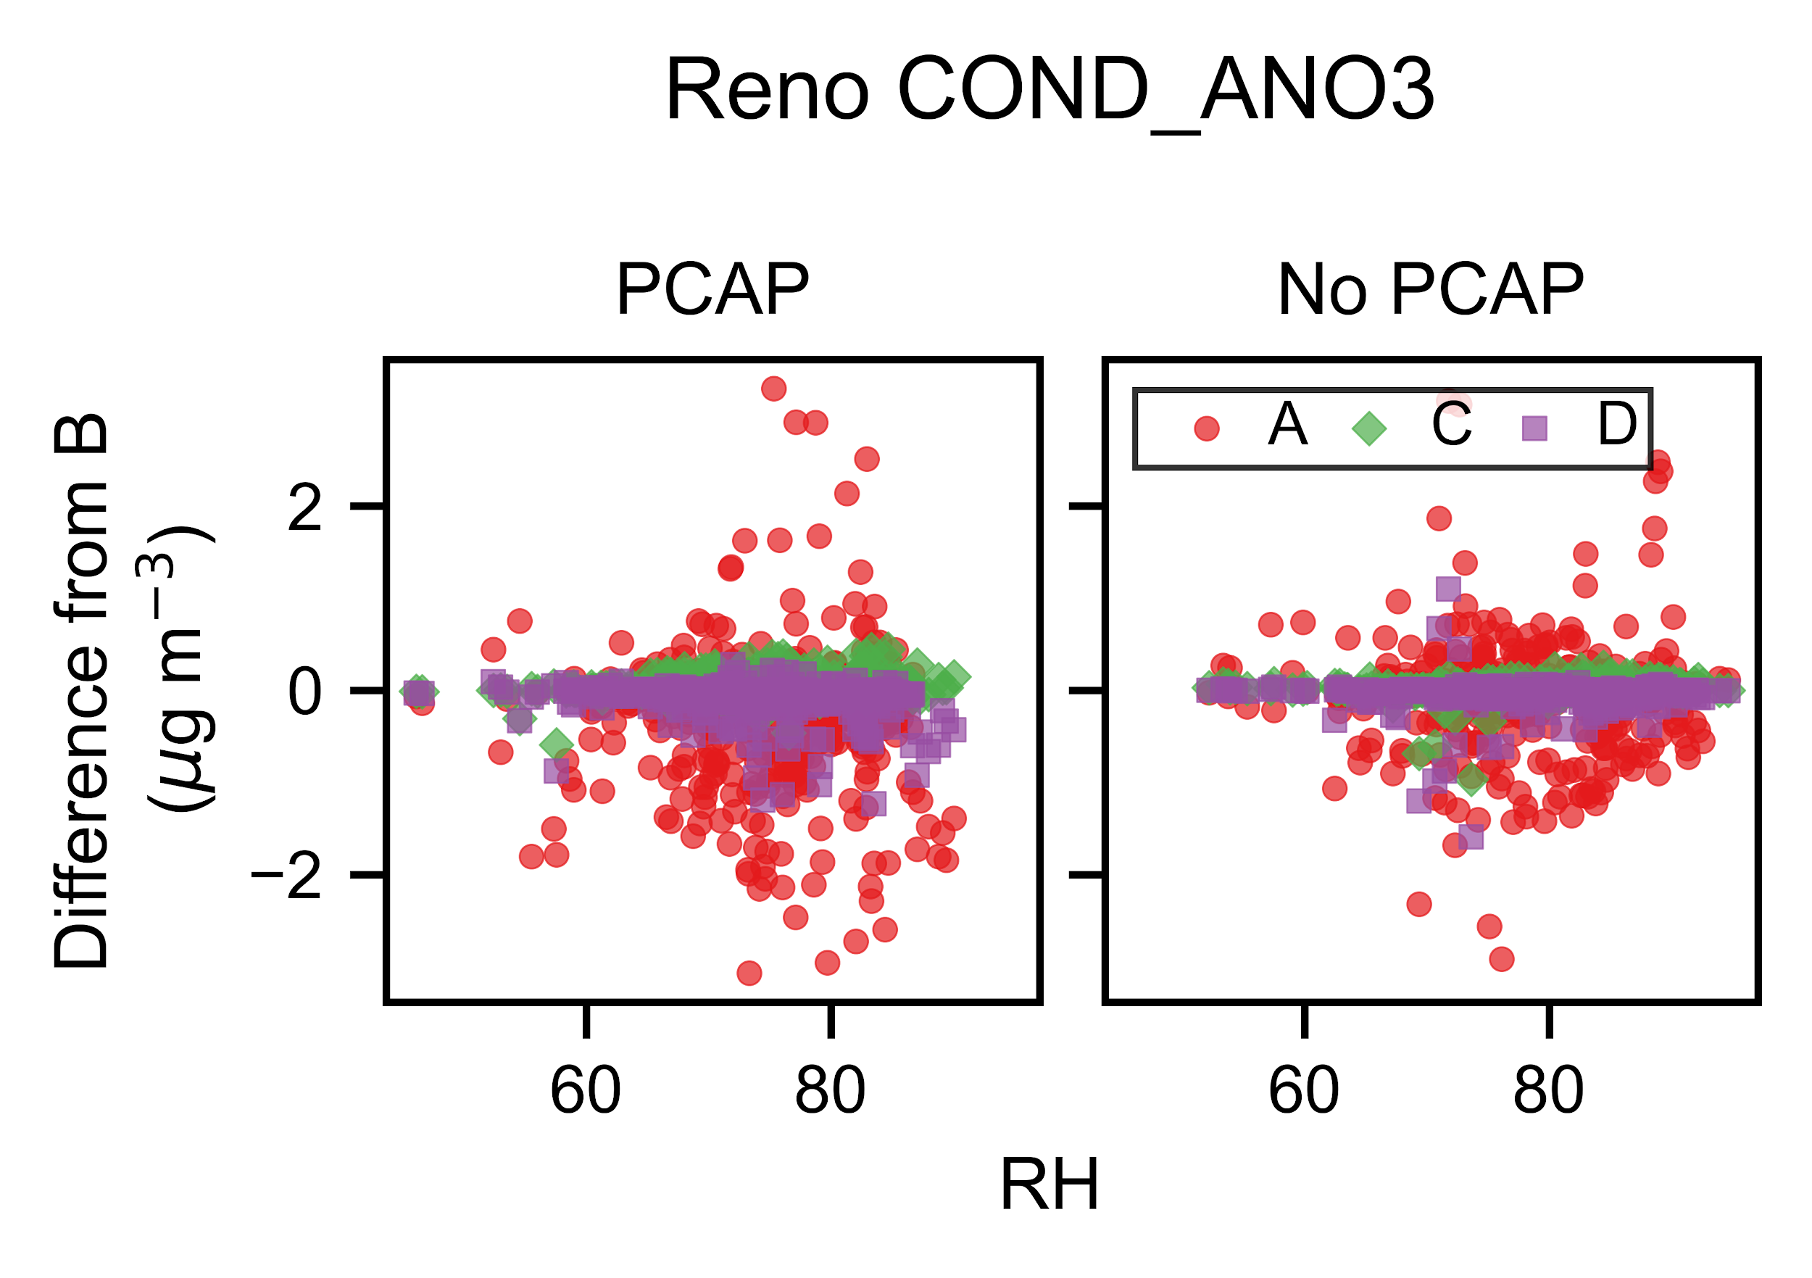
Condensation is the largest non-transport process, but does not fully explain nitrate PM_{2.5} variability
Phelan et al., in prep

Slide 13
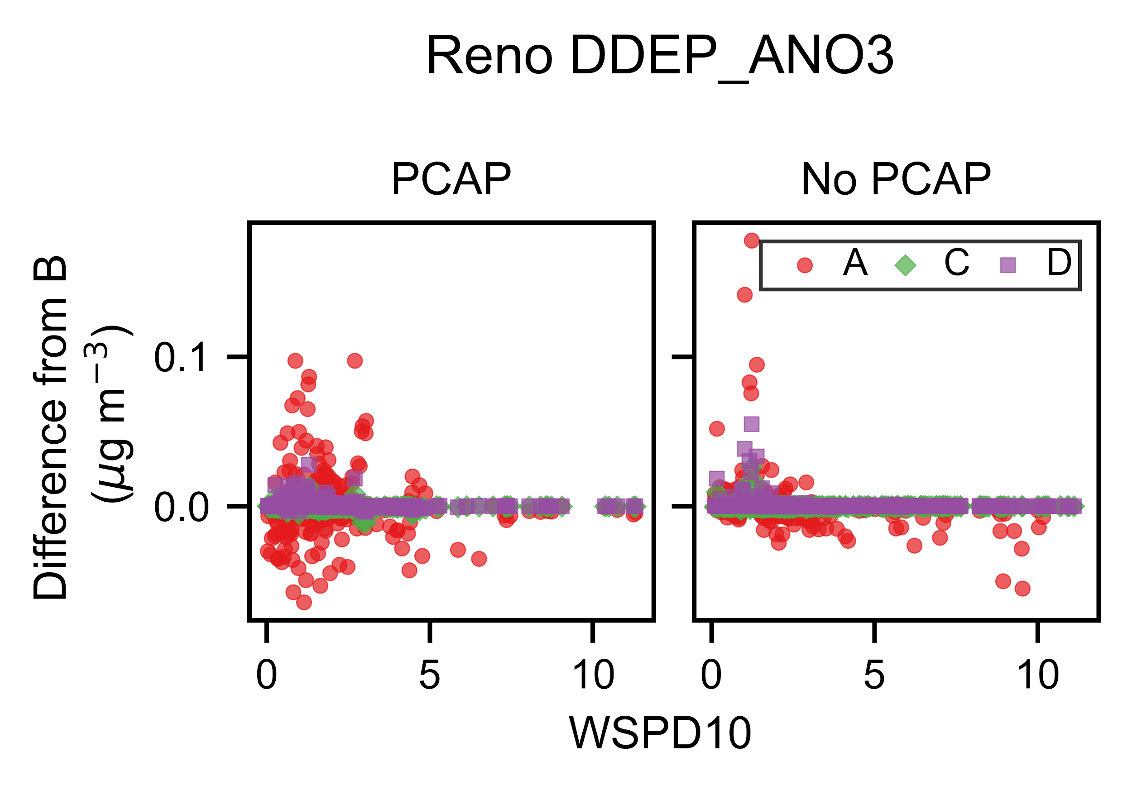
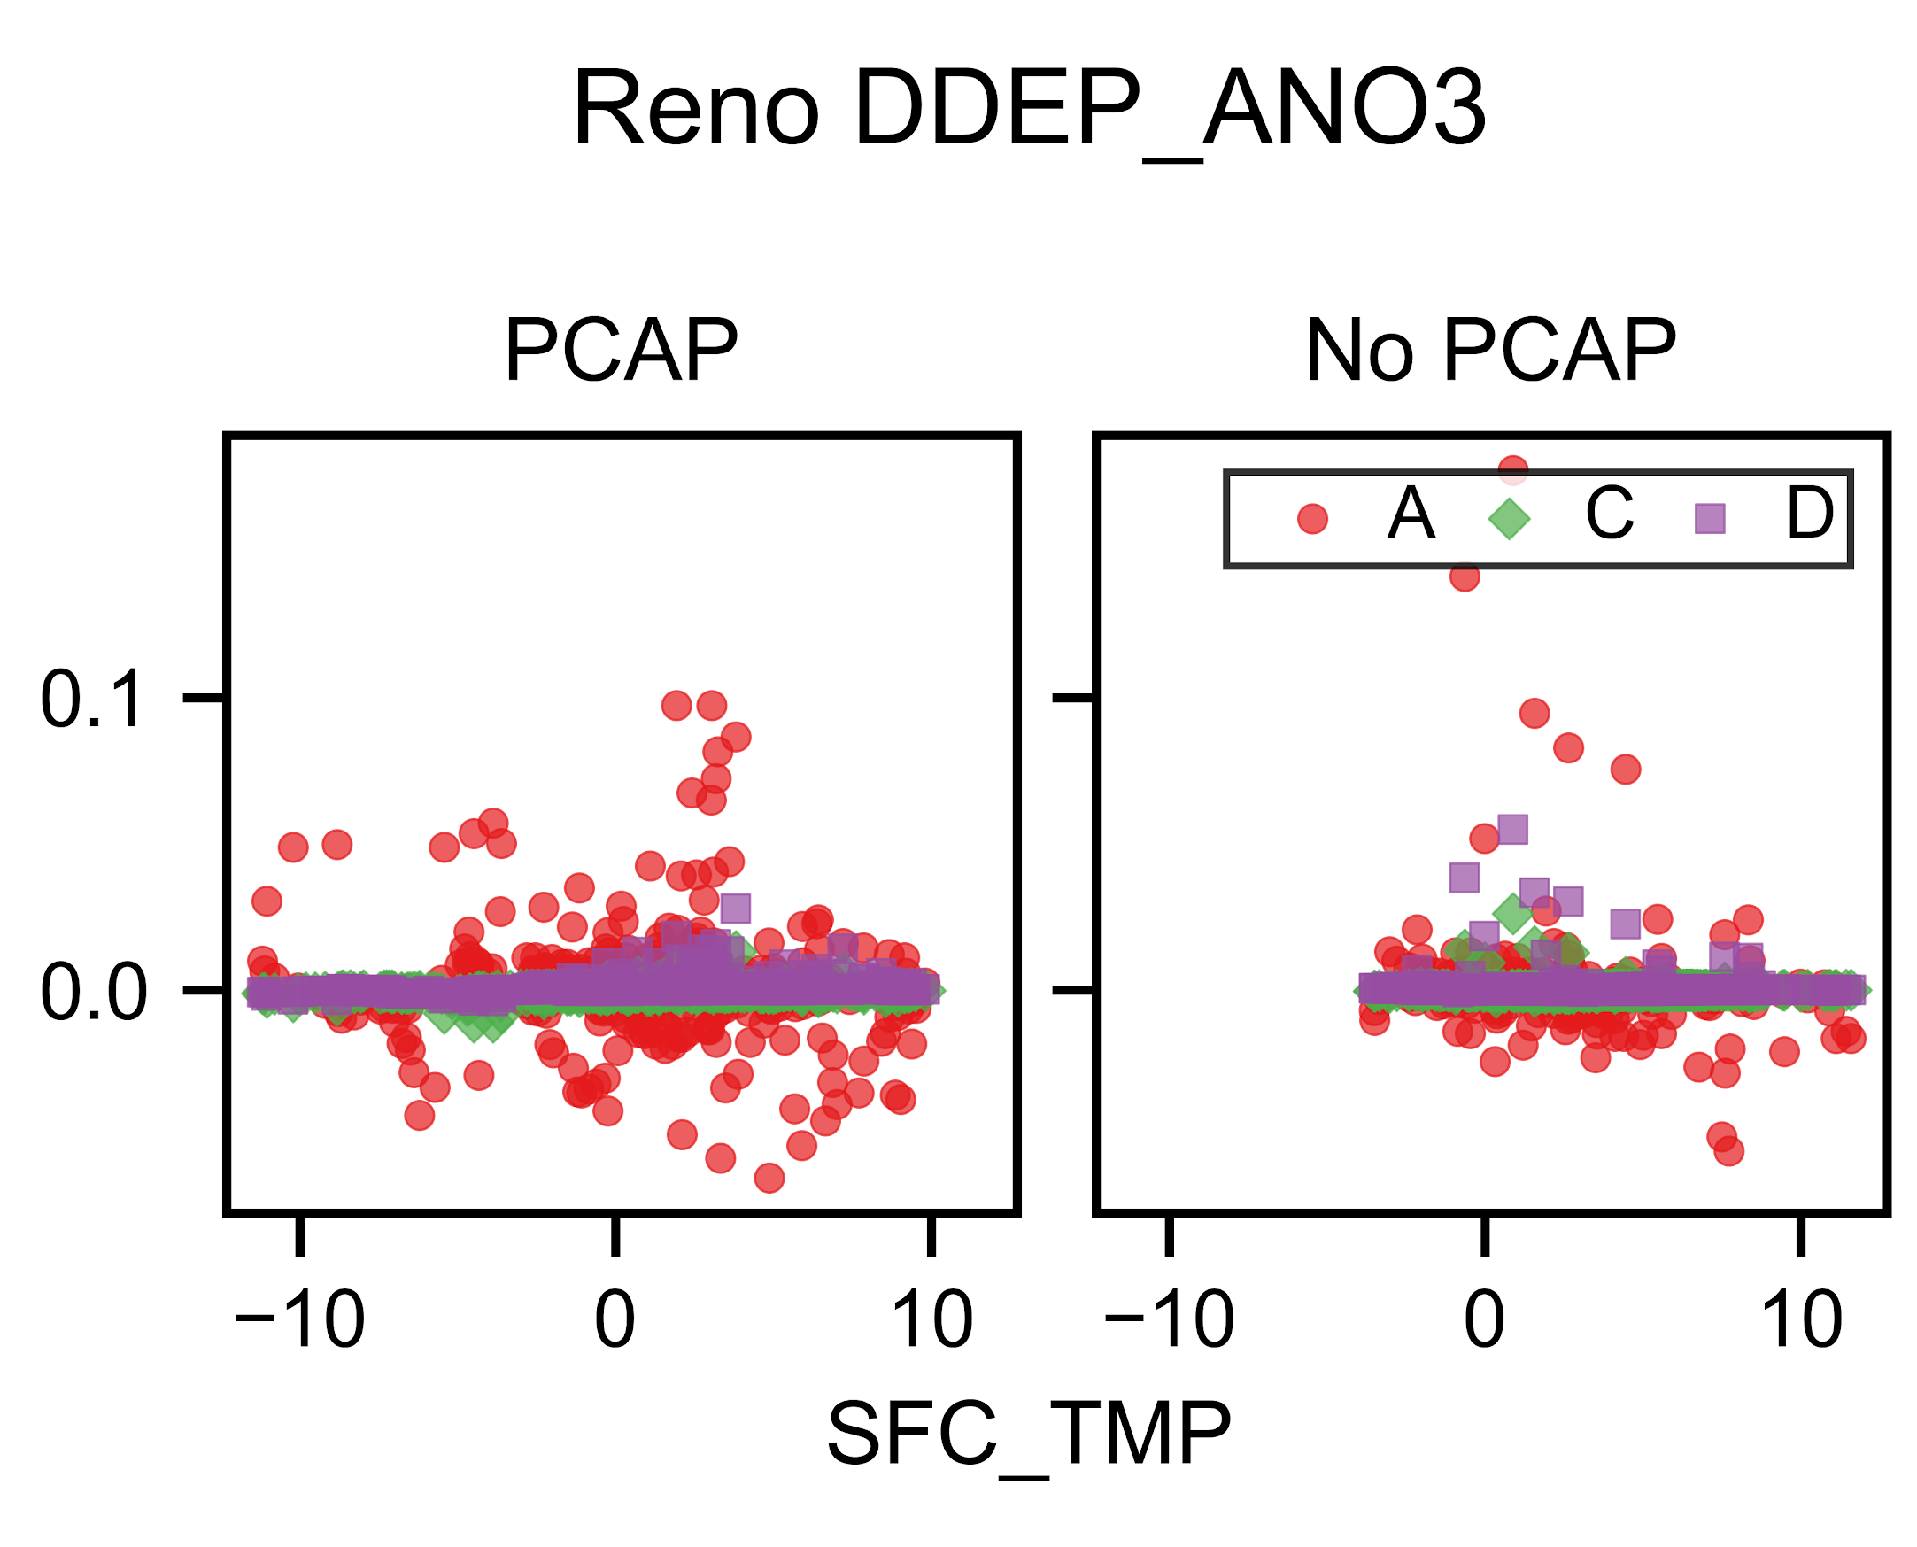
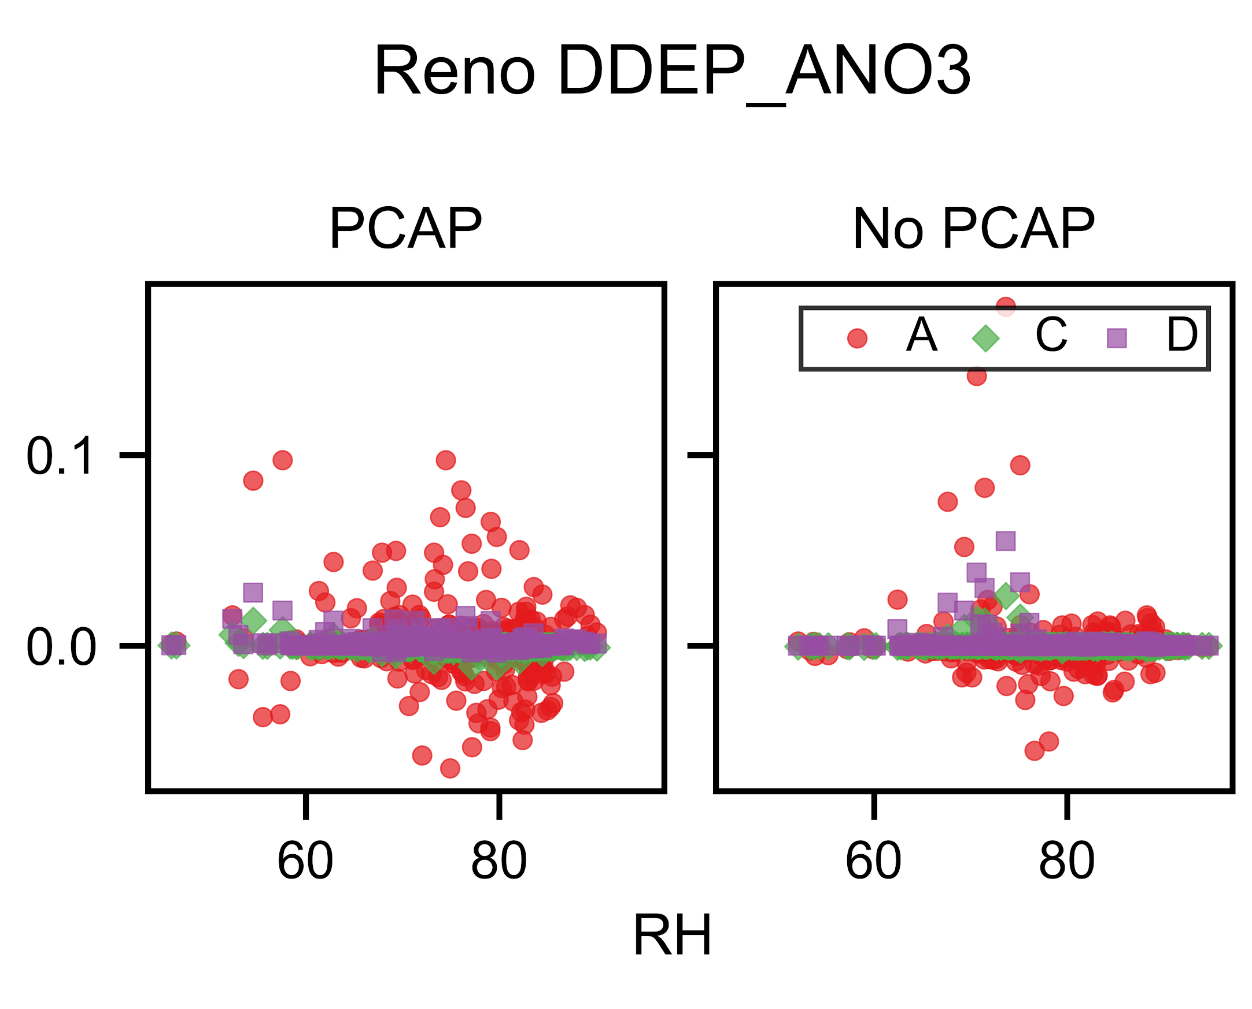
Dry deposition rates in A are more variable than B-D, reflecting the impact of aerosol treatment
Phelan et al., in prep

Slide 14
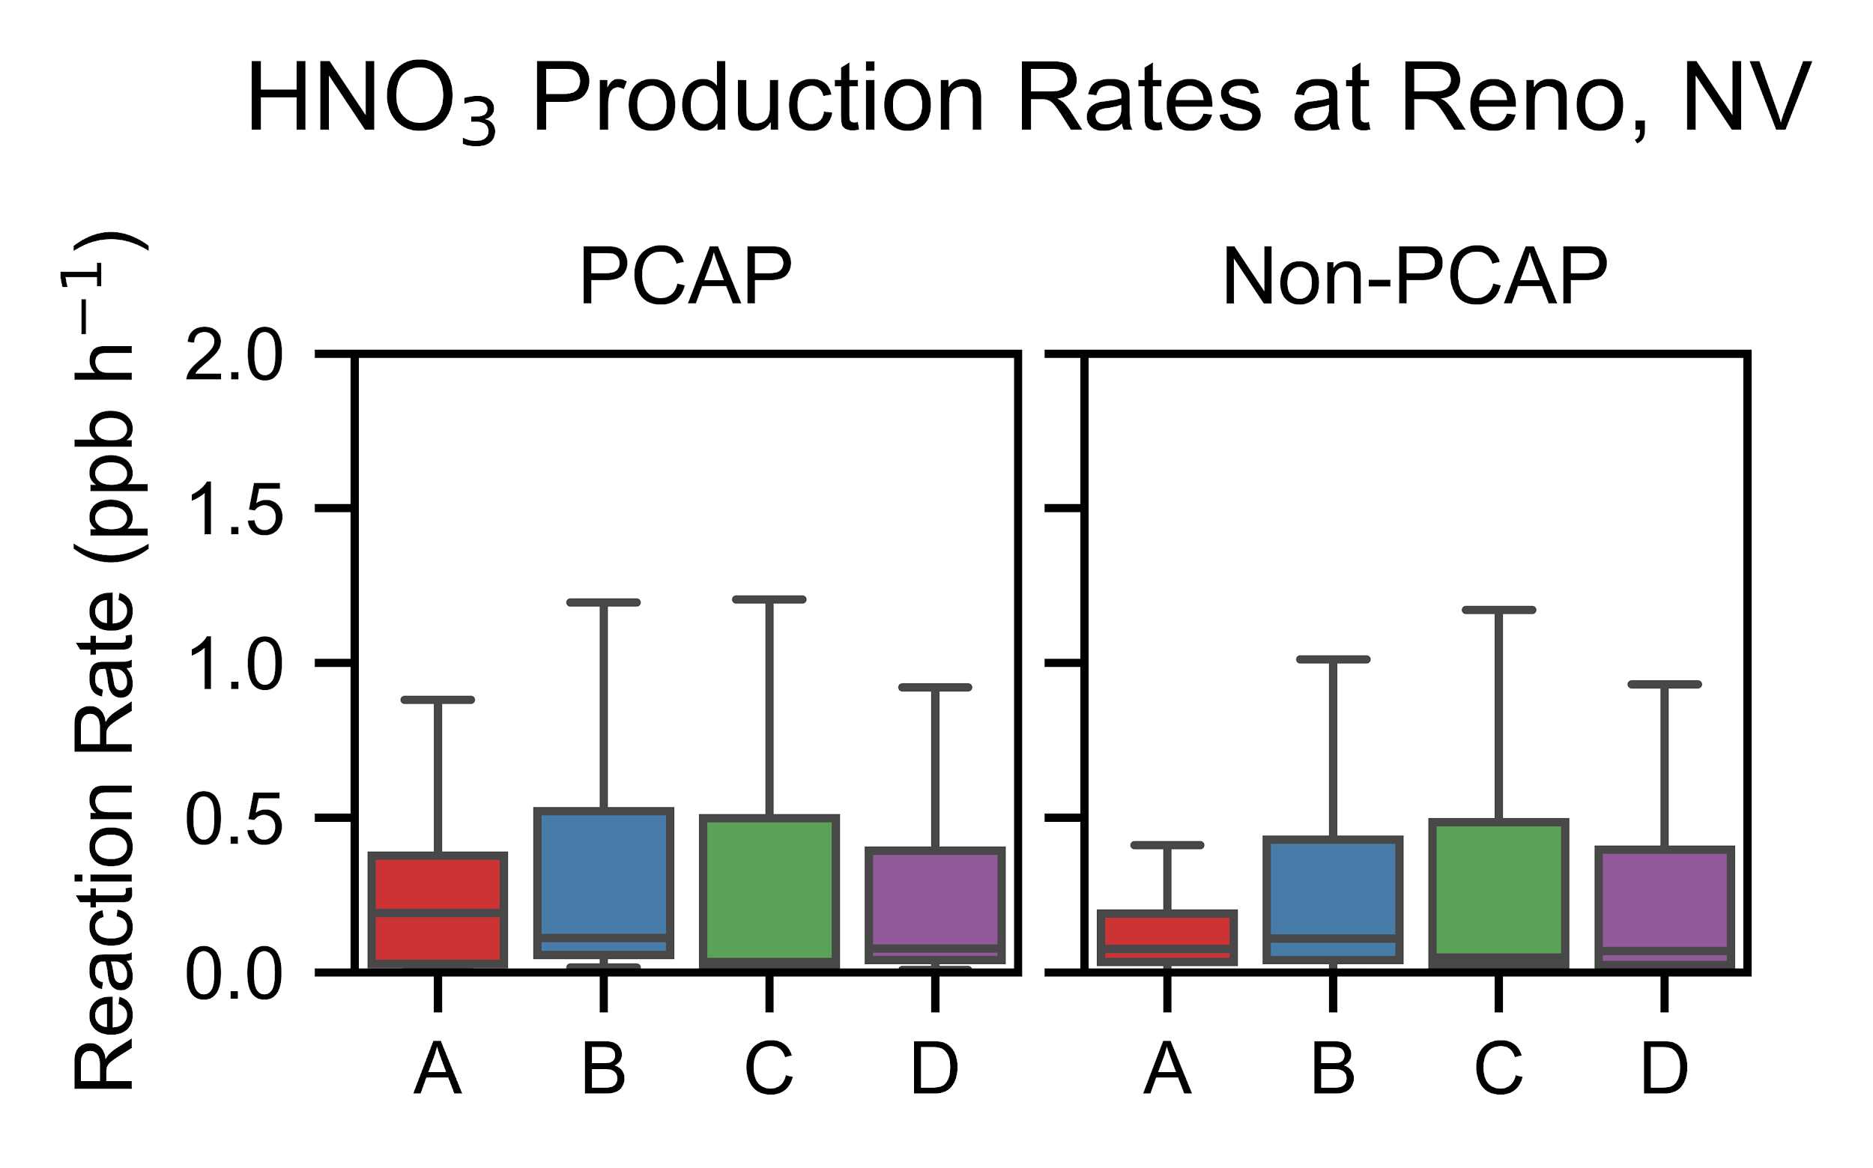
What reactions change with meteorology?
Using IRR to compare the consumption of explicit organic species
Alkene
VOC oxidation product
Isoprene
Gas-phase nitrogen chemistry in progress
No aqueous/multiphase chemistry (yet)

Slide 15
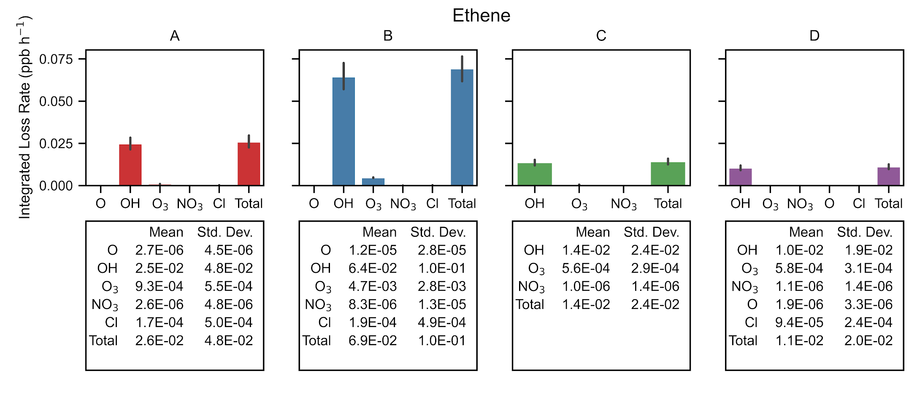
Ethene consumption by oxidant
cb6r3_ae7_aq cb6r3_ae6_aq racm2_ae6_aq saprc07tc_ae6_aq
Phelan et al., in prep

Slide 16
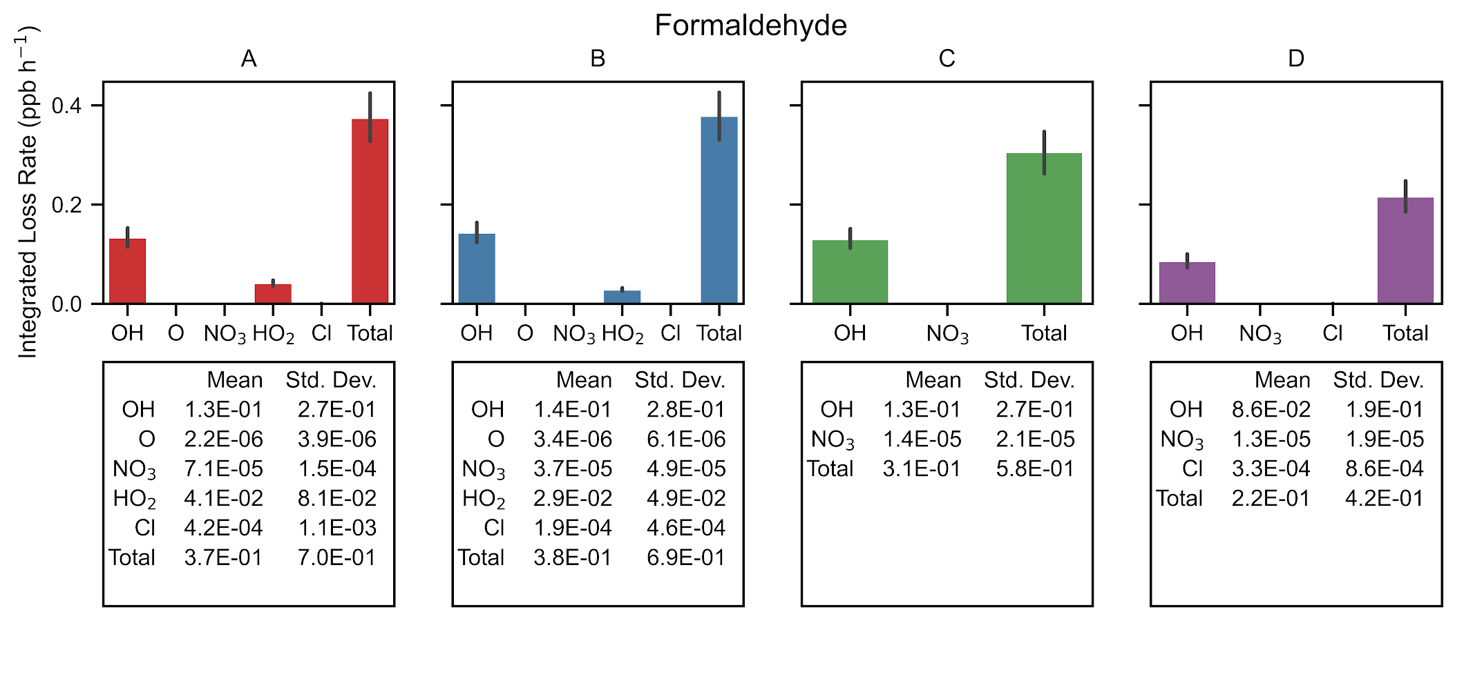
Formaldehyde consumption by oxidant
cb6r3_ae7_aq cb6r3_ae6_aq racm2_ae6_aq saprc07tc_ae6_aq
Phelan et al., in prep

Slide 17
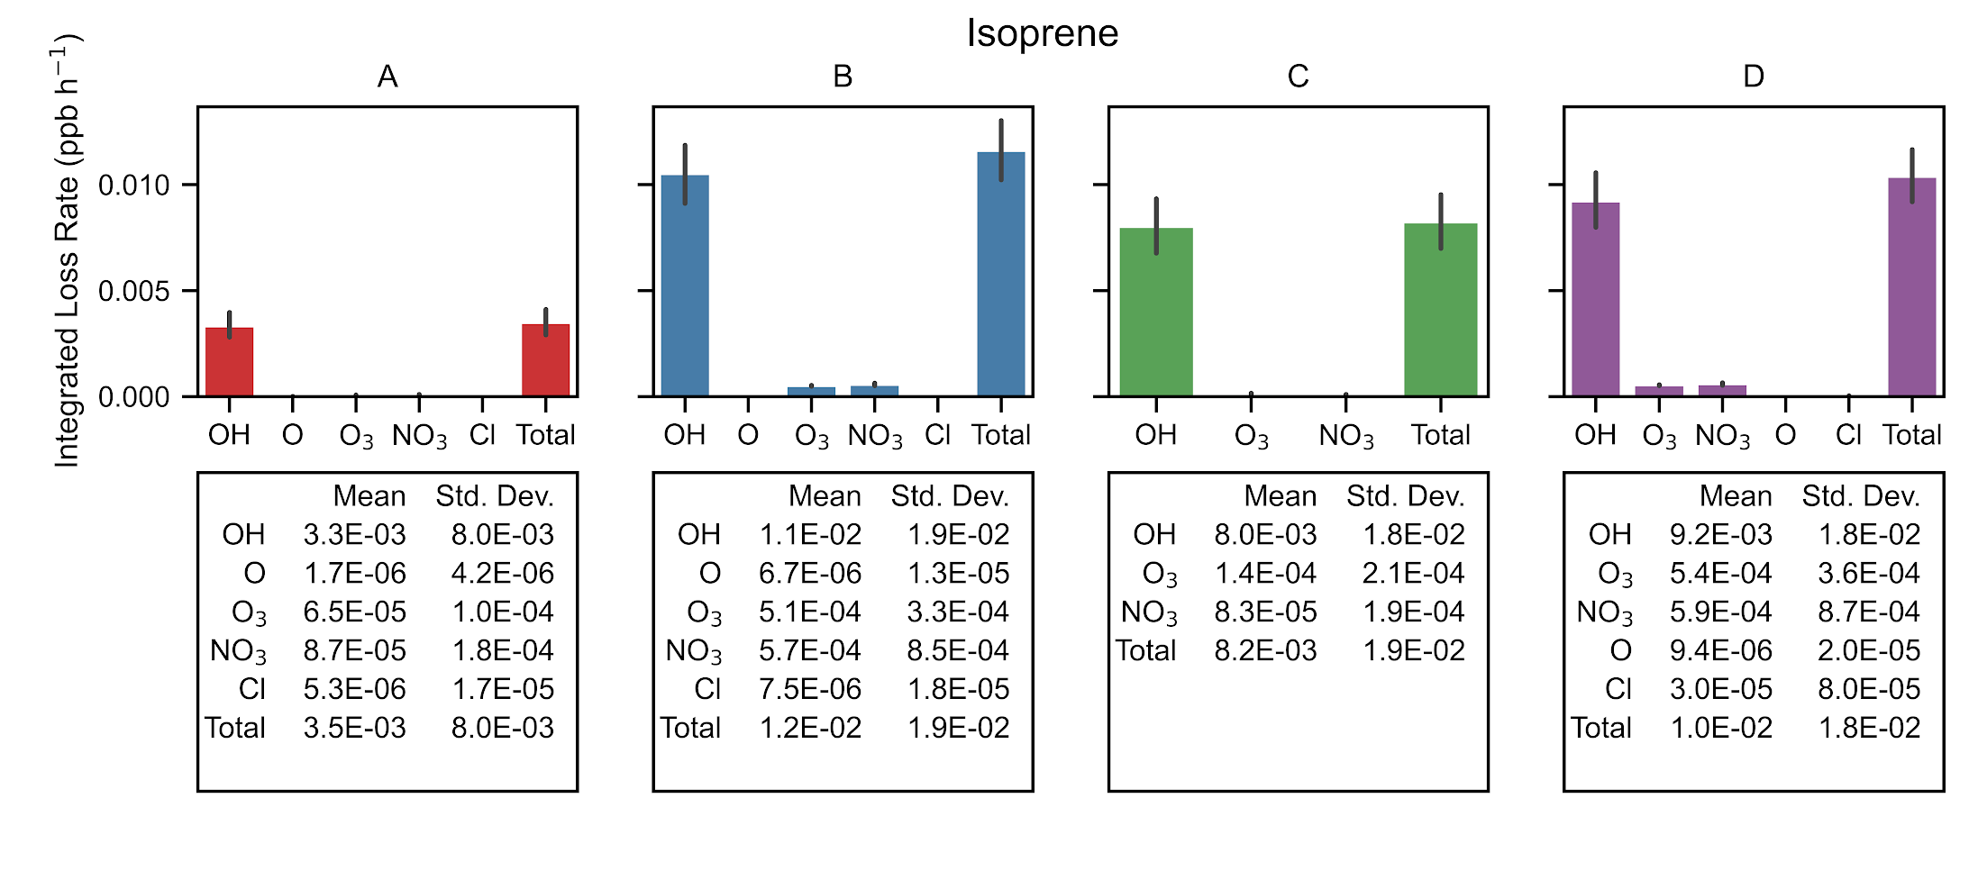
Isoprene consumption by oxidant
cb6r3_ae7_aq cb6r3_ae6_aq racm2_ae6_aq saprc07tc_ae6_aq
Phelan et al., in prep

Slide 18
Key Takeaways
Large differences in secondary PM_{2.5} between mechanisms, with meteorology
IPR magnitudes for aerosol nitrate does not reflect variability found in model outputs
Advection is likely oversimulated in the WRF model
Differences in modeled VOC oxidation do not propagate into OC PM_{2.5} variability
Upcoming Work
Replicate IPR and IRR analysis with Boise, Denver, & Salt Lake City
Compare gas-phase and aerosol nitrogen IPR
In-depth comparison of SLC processes and reactions with findings from Baasandorj et al, 2017
Interacting impacts of meteorology
Look into CMAQv5.4+, CRACMM
cam_phelan@berkeley.edu

Slide 19
Using Integrated Process Rate (IPR) outputs to understand model dynamics
ΔC_{adv}
ΔC_{diff}
ΔC_{emis}
ΔC_{gas}
Advection
Diffusion
Emissions
Gas-phase chemistry
Deposition
Aerosol processes
Plume in grid
Aqueous chemistry
ΔC_{dep}
ΔC_{aero}
ΔC_{plume}
ΔC_{cloud}
Driver
ΔC_{total} (x, y, z, t + Δt)

