Slide 1
Emissions Methods Improvements to support the NEI and emissions data to support the development of a modeling platform
Tesh Rao
EPA/OAQPS/Emissions Inventory and Analysis Group (EIAG)
October 23, 2024
2024 CMAS Conference

Slide 2
Other collaborators…
Jesse Bash, ORD
Amara Holder, ORD
Ingrid George, ORD
Havala Pye, ORD
James Beidler, ORD
George Pouliot, ORD
Kristen Foley, ORD
Nonpoint contractors (David Cooley, Hannah Derrick, Olivia Salmon)
Karl Seltzer, EIAG
Madeleine Strum, EIAG
Yijia Dietrich, EIAG
Rich Mason, EIAG
Lindsay Dayton, EIAG
Alison Eyth, EIAG
Jeff Vukovich, EIAG
Art Diem, EIAG
Jeff Vukovich, EIAG

Slide 3
Topics for Today
Teams in OAQPS’s Emissions Inventory and Analysis Group (EIAG)
Where does “Methods” and “Science” fit in?
A little background on the NEI
What does the Methods Team do?
What did the methods team accomplish for the 2020 NEI?
How do we use existing tools, data, and input to establish priorities for methods?
Plans for the 2023 NEI
Future work, beyond the 2023 NEI

Slide 4
Teams in EIAG
NEI (National Emissions Inventory) Team
Create triennial NEI and annual point source inventories
Develop new NEI emissions calculation methods & tools
Sector expertise
Documentation
Emission trends and int’l reporting
Emissions Modeling Team
Create emissions modeling platforms
Future year emissions projections
Develop emissions modeling software
SPECIATE
Biogenics and model-based emissions
Documentation
Methods Team
Climate Pollution Reduction Grant (CPRG) support
Website & data publishing
NEI Report
International reports and custom summaries
Establishing new methods and improvements to current methods for all sectors and emission trends for NEI and modeling
CAER (Combined Air Emissions Reporting) Team
Develop new CAER system and associated pieces (feed EIS/TRI)
Build connections with CEDRI, WebFIRE, and GHG reporting program needed for project
Implement any AERR revisions that needs CAERS (e.g., direct facility reporting)

Slide 5
Overview of National Emissions Inventory (NEI) and Related Programs
Emissions Estimation Methods
Emissions Calculation Tools
Emission Modeling Platforms
Emissions Data Collection Tools
Emission Inventories
Emission Trends

Slide 7
NEI Five Key Goals
Complete: All emissions to the atmosphere included, whether regulated or unregulated, for all counties/tribes including Puerto Rico and the Virgin Islands
Represents the year of the inventory
Uses best available information and the best possible science in EPA methods
Transparent - includes the emissions origin (who provided, factor, activity, method)
Timely
Notes:
Fast slide: summarize that v2 release comes down to “good enough” vs policy driver like NATA

Slide 8
Methods Team – Emission Inventory and Analysis Group
The Methods Team* within EIAG prioritizes areas of the NEI for methodological improvements.
Improvements can be scientific updates to existing emission sources or the addition of a new source type to the inventory.
Prioritization accounts for estimated contributions to NAAQS violations, key Hazardous Air Pollutant (HAP) sources, input from stakeholders, and new scientific work suggesting updates necessary for existing methods.
The Methods Team then leads, collaborates on, or incorporates outside work that improves the prioritized items within the inventory development process. This may include emission quantification, future projections, speciation, or temporal and spatial allocation.
Any work that gets published adds additional credibility to the NEI and downstream uses of NEI
* weblink: https://www.epa.gov/air-emissions-inventories/emissions-science-improvements-emission-sectors

Slide 9
Sample Emission Methods improvements completed for 2020 NEI
Nonpoint solvent utilization (Karl Seltzer and Havala Pye)
Complete update, including new emission methods and speciation
https://acp.copernicus.org/articles/21/5079/2021/
Nonpoint agricultural silage (Tesh Rao)
New VOC & HAP emissions source
About 600k tons of VOC nationwide, at cattle/dairy farms
Nonpoint hot-mix and warm-mix asphalt paving added, emulsified/cutback asphalts updated (Karl Seltzer)
About 85K tons of VOC added
https://pubs.rsc.org/en/content/articlelanding/2023/ea/d3ea00066d
VOC and PM_{2.5} speciation updates (Karl Seltzer, George Pouliot, Art Diem)
Released SPECIATE5.2
100 or so updated/improved VOC and PM profiles
Profile type updates and species property updates
Use of Bluesky Pipeline for wildland fire emissions (Jeff Vukovich, James Beidler, George Pouliot)
More modular approach to estimating emissions
Inclusion of lead (Pb) as a pollutant from wildland fires (Amara Holder and Tesh Rao)
About 3% of total Pb in the 2020 NEI, nationally. Can be as high as 12-15% in some states
https://www.sciencedirect.com/science/article/pii/S2590162123000291
Improvements to residential wood combustion PM2.5 emission factors (Madeleine Strum, Rich Mason, NP contractors)
Biogenic model updates (Jesse Bash, Jeff Vukovich)
Updated emissions factors
Use of gridded biomass data from USFS
Improved transition of seasons
https://gmd.copernicus.org/articles/9/2191/2016/
Use of EQUATES project to upgrade Criteria Air Pollutant Emission Trends (Kristin Foley, George Pouliot, Rich Mason, Alison Eyth, Tesh Rao, many others)
Established consistent methods over time for many key sectors (2002-2019)
EPA website: https://www.epa.gov/air-emissions-inventories/air-pollutant-emissions-trends-data
Manuscript: https://www.sciencedirect.com/science/article/pii/S2352340923001403?via%3Dihub
Find more details on each of these updates, either:
Via published manuscript
Or, via 2020 NEI TSD: https://www.epa.gov/air-emissions-inventories/2020-national-emissions-inventory-nei-technical-support-document-tsd

Slide 10
NEI Drivers - Uses by SLTs
NAAQS and Regional Haze Implementation
Starting point for State Implementation Plan (SIP) inventory requirements for O₃, PM_{2.5}, transport, and regional haze SIPS
Planning inventories
Modeling inventories
NAAQS Designations: emissions (along with monitoring data) are among the most important factors in designation tools used by SLTs (designating non-attainment areas)
NAAQS policy assessments and integrated science assessments (ORD)
EPA works with the SLTs to develop the NEI. We use data submitted by SLTs for all the sources supplemented with estimates that EPA develops

Slide 11
NEI Drivers - Uses by EPA and Others (1 of 2)
Air quality modeling
NAAQS Regulatory and Regional Haze: Transport rules, NAAQS Regulatory Impact Analysis (RIA), OTAQ RIAs, international transport
AirToxScreen – risk results used by SLTs
Technology Review (RTR): starting point
ORD air quality model development
Centers for Disease Control and Prevention (CDC) air quality analysis
Global modeling inventories used by international community
Emissions trends – national and state
Air trends report
ORD Report on the Environment
International agreements
Public and press requests
Notes:
International examples: (e.g., CLRTAP, US-Canada AQ Agreement, Arctic Monitoring and Assessment Programme (AMAP), Commission for Environmental Cooperation (CEC))

Slide 12
NEI Drivers - Uses by EPA and Others (2 of 2)
Monitoring: siting purposes
Public information via NEI website
NEI Report Story Map
NEI query tools, technical support documentation, submittal instructions, guidance, plan, instructions
Emissions processes for EPA’s air quality modeling
Data quality analysis
OECA Enforcement and Compliance History (ECHO) web tool for regulated facilities
TRI – missing or significant facility differences

Slide 13
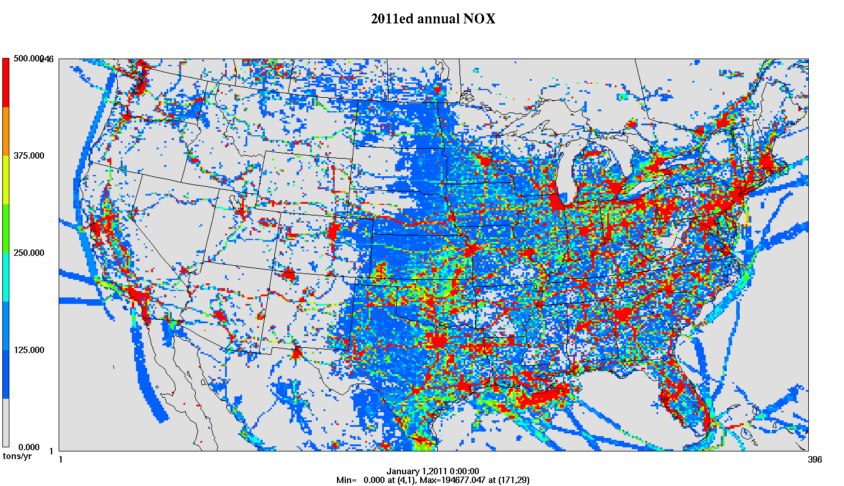
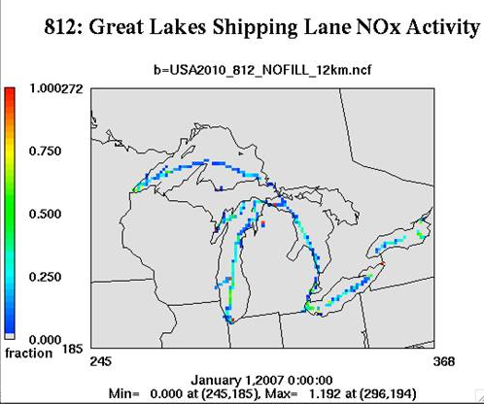
Example of a Key NEI Use: Allocating to hours, grid cells, and species for AQ modeling
NEI Data
Ancillary Data: profiles and cross references
SMOKE
SMOKE software system performs temporal allocation, speciation, and spatial allocation to create…
NEI
$$E(s,t,l)=f\left(A, EF, CF,M\right)$$
where:
s: sector ranges from broad to specific
t: time ranging from annual to hourly;
x: location ranging from state to point
A: activity data
EF: emission factor
CF: control factors
M: Meteorology
State-Tribe-Local supersedes EPA where available
Temporal Profiles
Base and Future Inventories (annual, monthly, daily, hourly)
Met. Data
Speciation Profiles
Final product: gridded, hourly, speciated emissions in a format for an air quality model
Spatial Surrogates
Notes:
NEI important to international community: methods/factors are often used as example for others

Slide 14
A few summaries of NEI data
2020 NEI and Trends

Slide 15
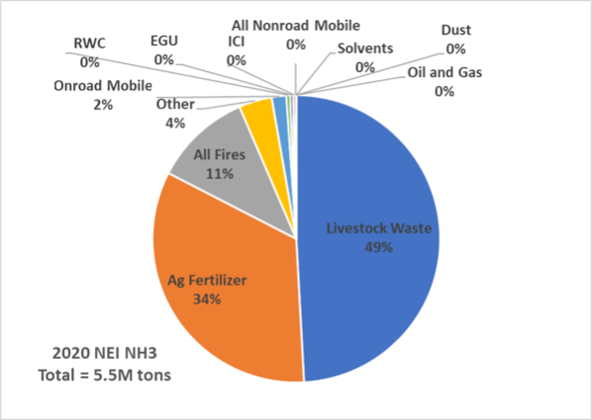
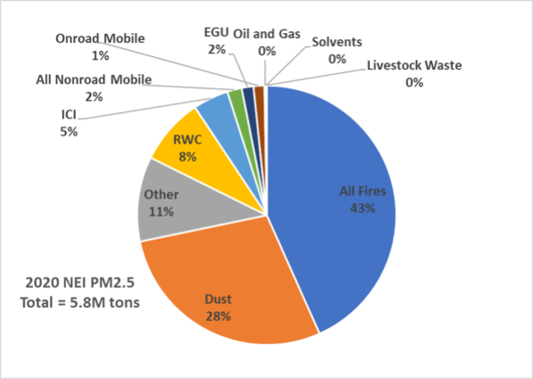
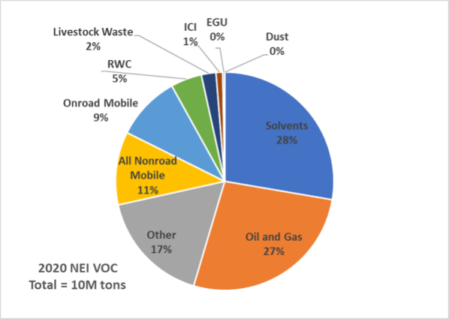
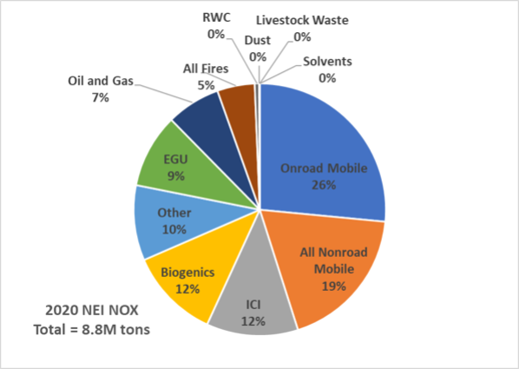

Slide 16
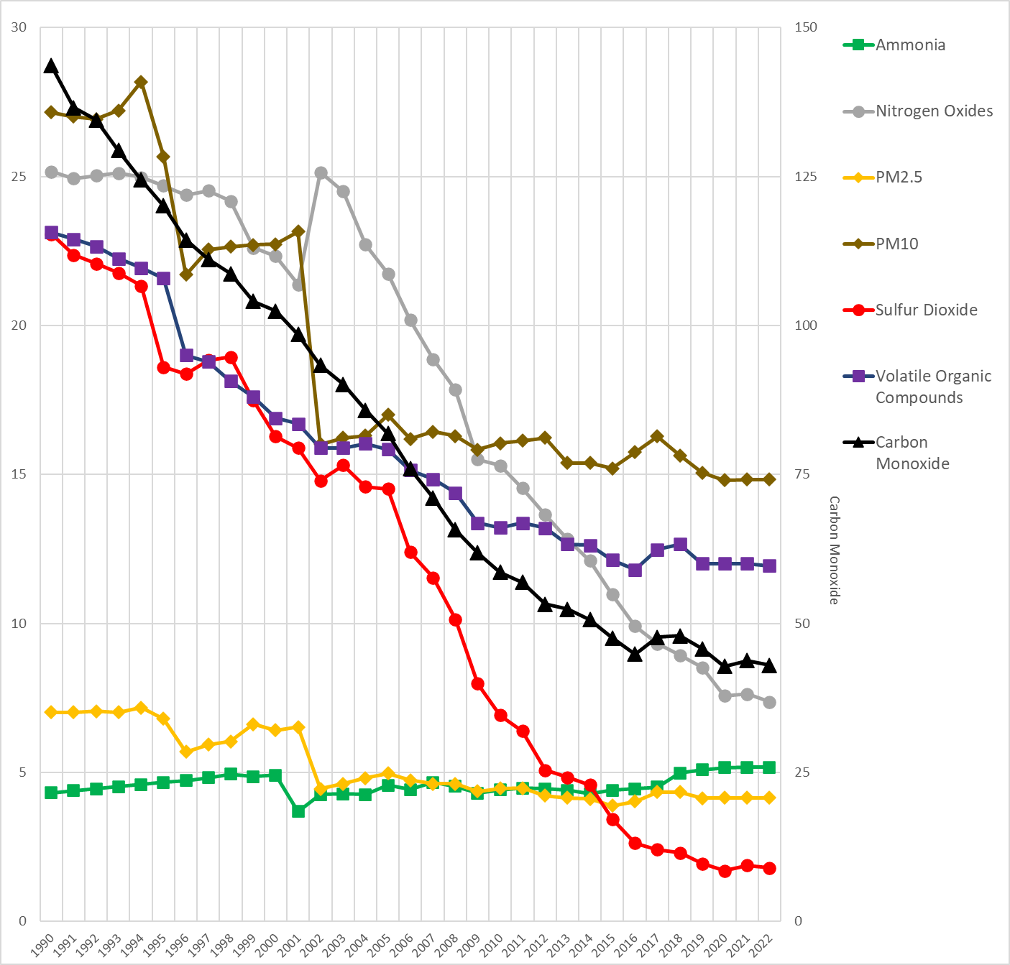
Items to note:
Methods update in 2020 NEI: From 2002-2019, these trends reflect EQUATES-based emissions data, which minimizes time series effects due to method changes
Stakeholders have indicated this to be a very helpful upgrade
More sectoral detail available at the national and state level to help explain national trends
Can isolate more emission sectors
Added BC and OC
PM2.5 shows static trends over time since 2002, POC shows similar trends
NH3 shows an increasing trend in recent years up to 2020
VOC flattening trends in recent years
Large point source SO2 reductions leading to other sectors playing a role (O&G contributes about 10%) in 2020
Wildfires Omitted
Y-axes represent “Million Tons”

Slide 17
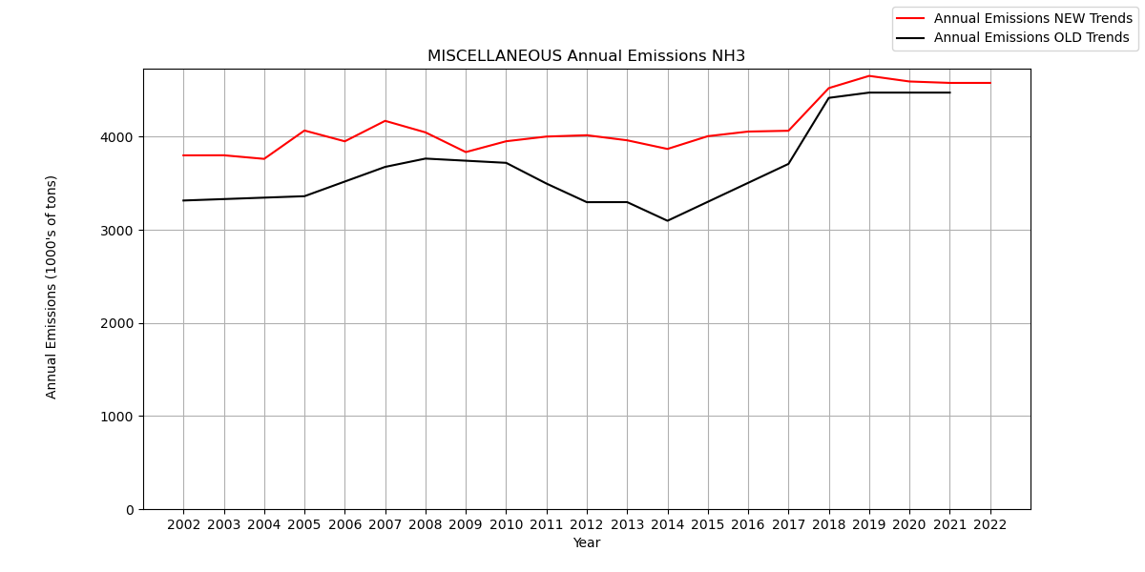
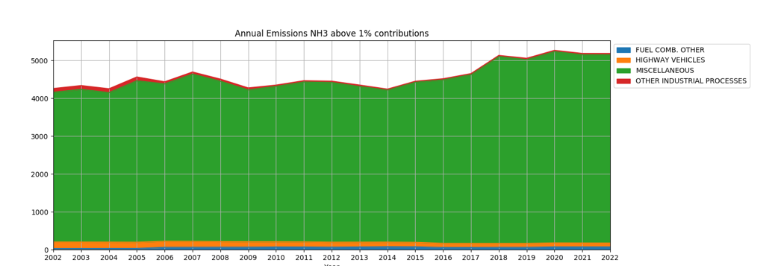
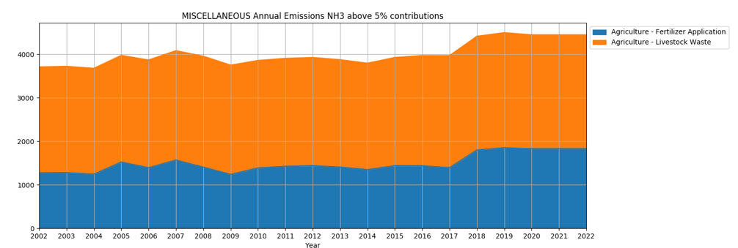
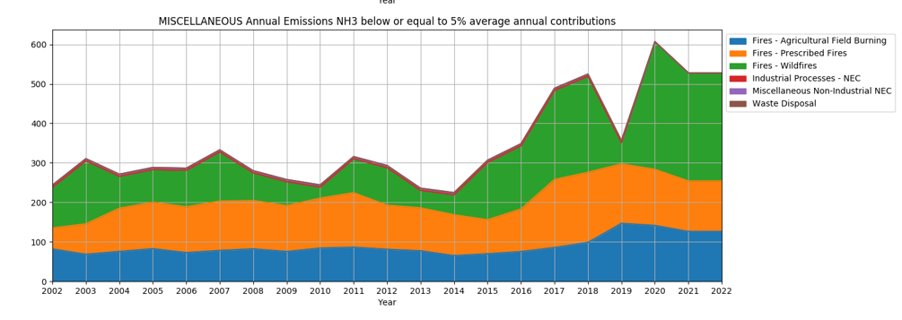
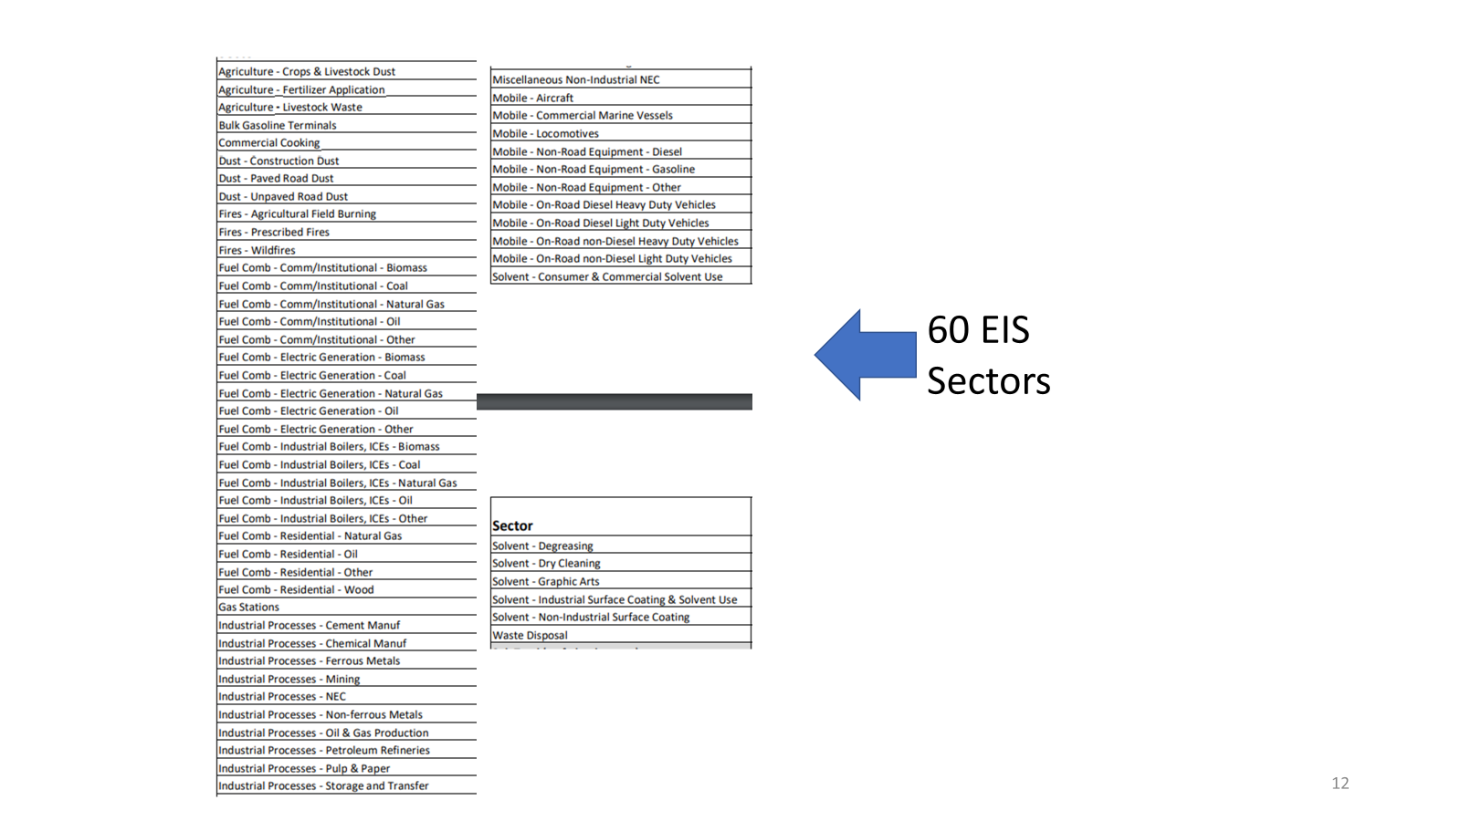
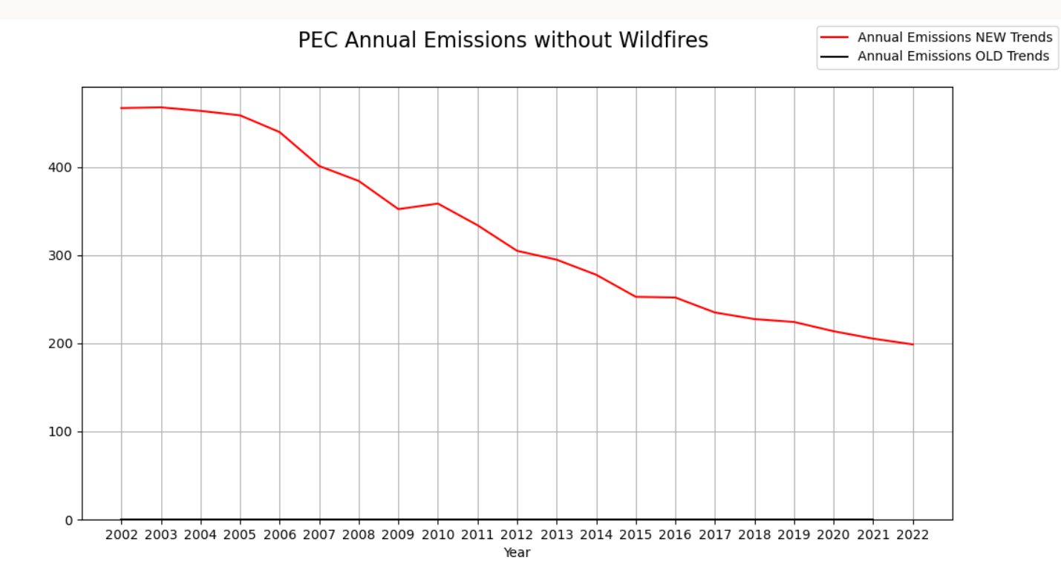
More things that can be done now with CAP trends with EQUATES-based updates

Slide 18
Example: PM2.5 and Residential Wood Combustion (RWC)
Improved methods to improve RWC (woodstove emissions) in the 2020 NEI, which led to a 44% increase in PM2.5 RWC emissions compared to the 2017 NEI

Slide 19
Current Methods Priorities List, for 2023 NEI
Roofing Asphalt Emissions (volatile organic pollutants (VOC), HAPs)
About 12k tons of VOC estimated in 2020 (Nationwide)
Improving commercial cooking emission methods and adding residential cooking (PM2.5, CO, VOC, HAPs)
Commercial: 330k tons PM2.5, 40k tons VOC, 150k tons CO (2020)
Residential: 13.5k tons PM2.5, 1.2k tons VOC, 171k tons CO (2020)
Abandoned oil and gas wells (VOC HAP)
About 174k tons VOC (and about 320k tons CH4) in 2020
NH3 emissions for non-Ag sources (human activities, pets, wild animals), mobile sources
Uses population and animal population activity data and in sum is nearly equal to what mobile source NH3 estimates are in urban areas
About 120k tons of NH3 added, mostly in urban areas
Use updated MOVES model, which will yield ~2x NH3 emissions for onroad
Introduction of structural/motor vehicle fires (CAP, HAP)
Together about 25k tons of PM2.5 and about 40k tons of VOC
Introduction of pile burn emissions (all pollutants)
Small amounts of emissions
Possibly Include dioxins/furan congeners for as many sources as possible
Continued improvements to residential wood combustion methods (activity, emission factors, speciation, SCC rearrangements)—(CAP, HAP)
Introduction of Campfire emissions (about 2-3% of RWC total PM2.5)
Potential addition of barrel stoves (“exempt” type appliances)
Continued spatial allocation improvements, temporal allocation improvements, speciation updates

Slide 20
Further “on the horizon” wish list
General improvements to existing sectors, including improvements to spatial allocation methods, temporal allocations, and VOC and PM speciation
Using top-down data to estimate emissions/improve current emissions
Estimation of emissions from O&G leaks, methane/VOCs
NH3 sectors
Solvent usage in O&G operations
Development of HAP emission trends
Other (new) sources
Dust from coal train open compartment rail operations
Improving dust estimates, and including wind-blown dust in the NEI
Fireworks
Working more with international community on emission methods and related items
Working to improve sectors that may play an important role in the new PM NAAQS
Understanding Woodstove emissions better
Improving Cooking emission estimates

Slide 21
The Future
We highly value collaborative improvements to the NEI!
When we say “NEI,” we mean many things: Emission quantification, projections, speciation, or temporal and spatial allocation (i.e., translating annual, county-level emissions to the gridded products we use in air quality models).
We would also like to pursue new avenues of research to build and evaluate inventories: using top-down methods to constrain, allocate or develop estimates of emissions, PMF/NMF analysis of measurements to understand source attribution, generation of “emission ratios” from field work to evaluate the inventory, etc.
Currently methods improvements and additions are geared towards an NEI process (every 3 years). We would like to see how to streamline this process for interim year inventories (such as modeling platforms)
Please contact us with ideas, data, and for collaborative opportunities
Tesh Rao (rao.Venkatesh@epa.gov)

