Slide 1
An Analysis of Uncertain Wind Impacts on Smoke Model Performance
Zongrun Li, Yongtao Hu, Susan M. O’Neill, Armistead G. Russell, M. Talat Odman
A project funded by
Notes:
Thanks for joining. Here is the topic for today. I would like to discuss how the uncertain wind impacts the smoke model, how we reduce the wind bias and evaluate the smoke models considering the wind bias.

Slide 2
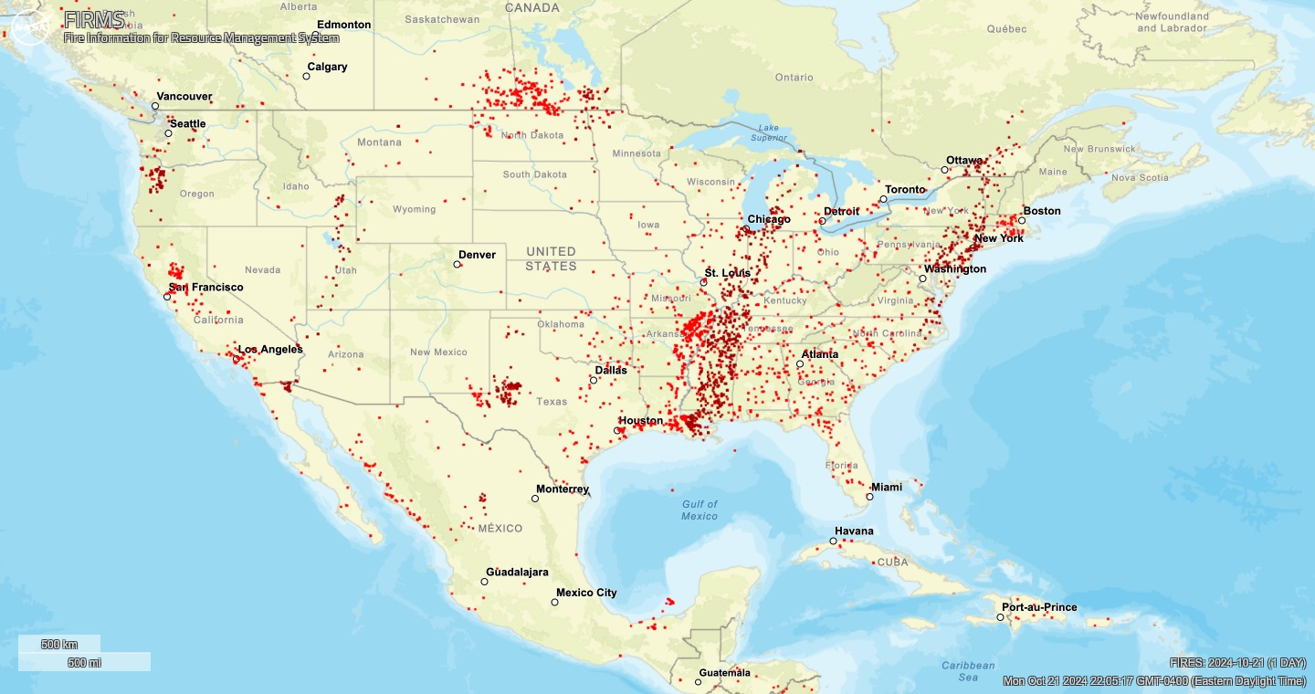
Wildland Fires
Wildfires and Prescribed Fires
Emit significant amount of PM which degrades the air quality.
Harmful to human health and wealth.
Simulations of Wildland Fires
Emissions
Intensity
Time profile
Vertical profile
Smoke Transport
Wind bias
Fire Radiative Power Detections from FIRMS, October 21st, 2024
Notes:
Wildland fire and its air quality impacts have become increasingly important topics. Fires, including prescribed burns and wildfires, emit significant amounts of PM, which can degrade air quality.
You might be curious about how frequently these fires occur. On the right, you can see fire radiative power detected by satellite. This was captured around the time the CMAS conference started. We see multiple fires in the southeastern U.S., primarily from prescribed burns. We can also see some fire detections in Canada.
How to simulate the wildland fires and its impacts is important. For improving model performance, there are two major components to consider: emissions and smoke transport.
A lot of research is focused on the fire emissions. For instance, how can we better estimate the intensity of emissions? And how do we make the time profile and vertical profile of emissions more realistic?
The other aspect is smoke transport. One issue is that meteorological models, like WRF, often have biases in wind simulation. This can have a big impact on how accurately we model smoke transport. In this presentation, we will focus on firstly, how to reduce the wind bias in the meteorological model. Second, how to evaluate smoke modeling considering the biased wind.

Slide 3
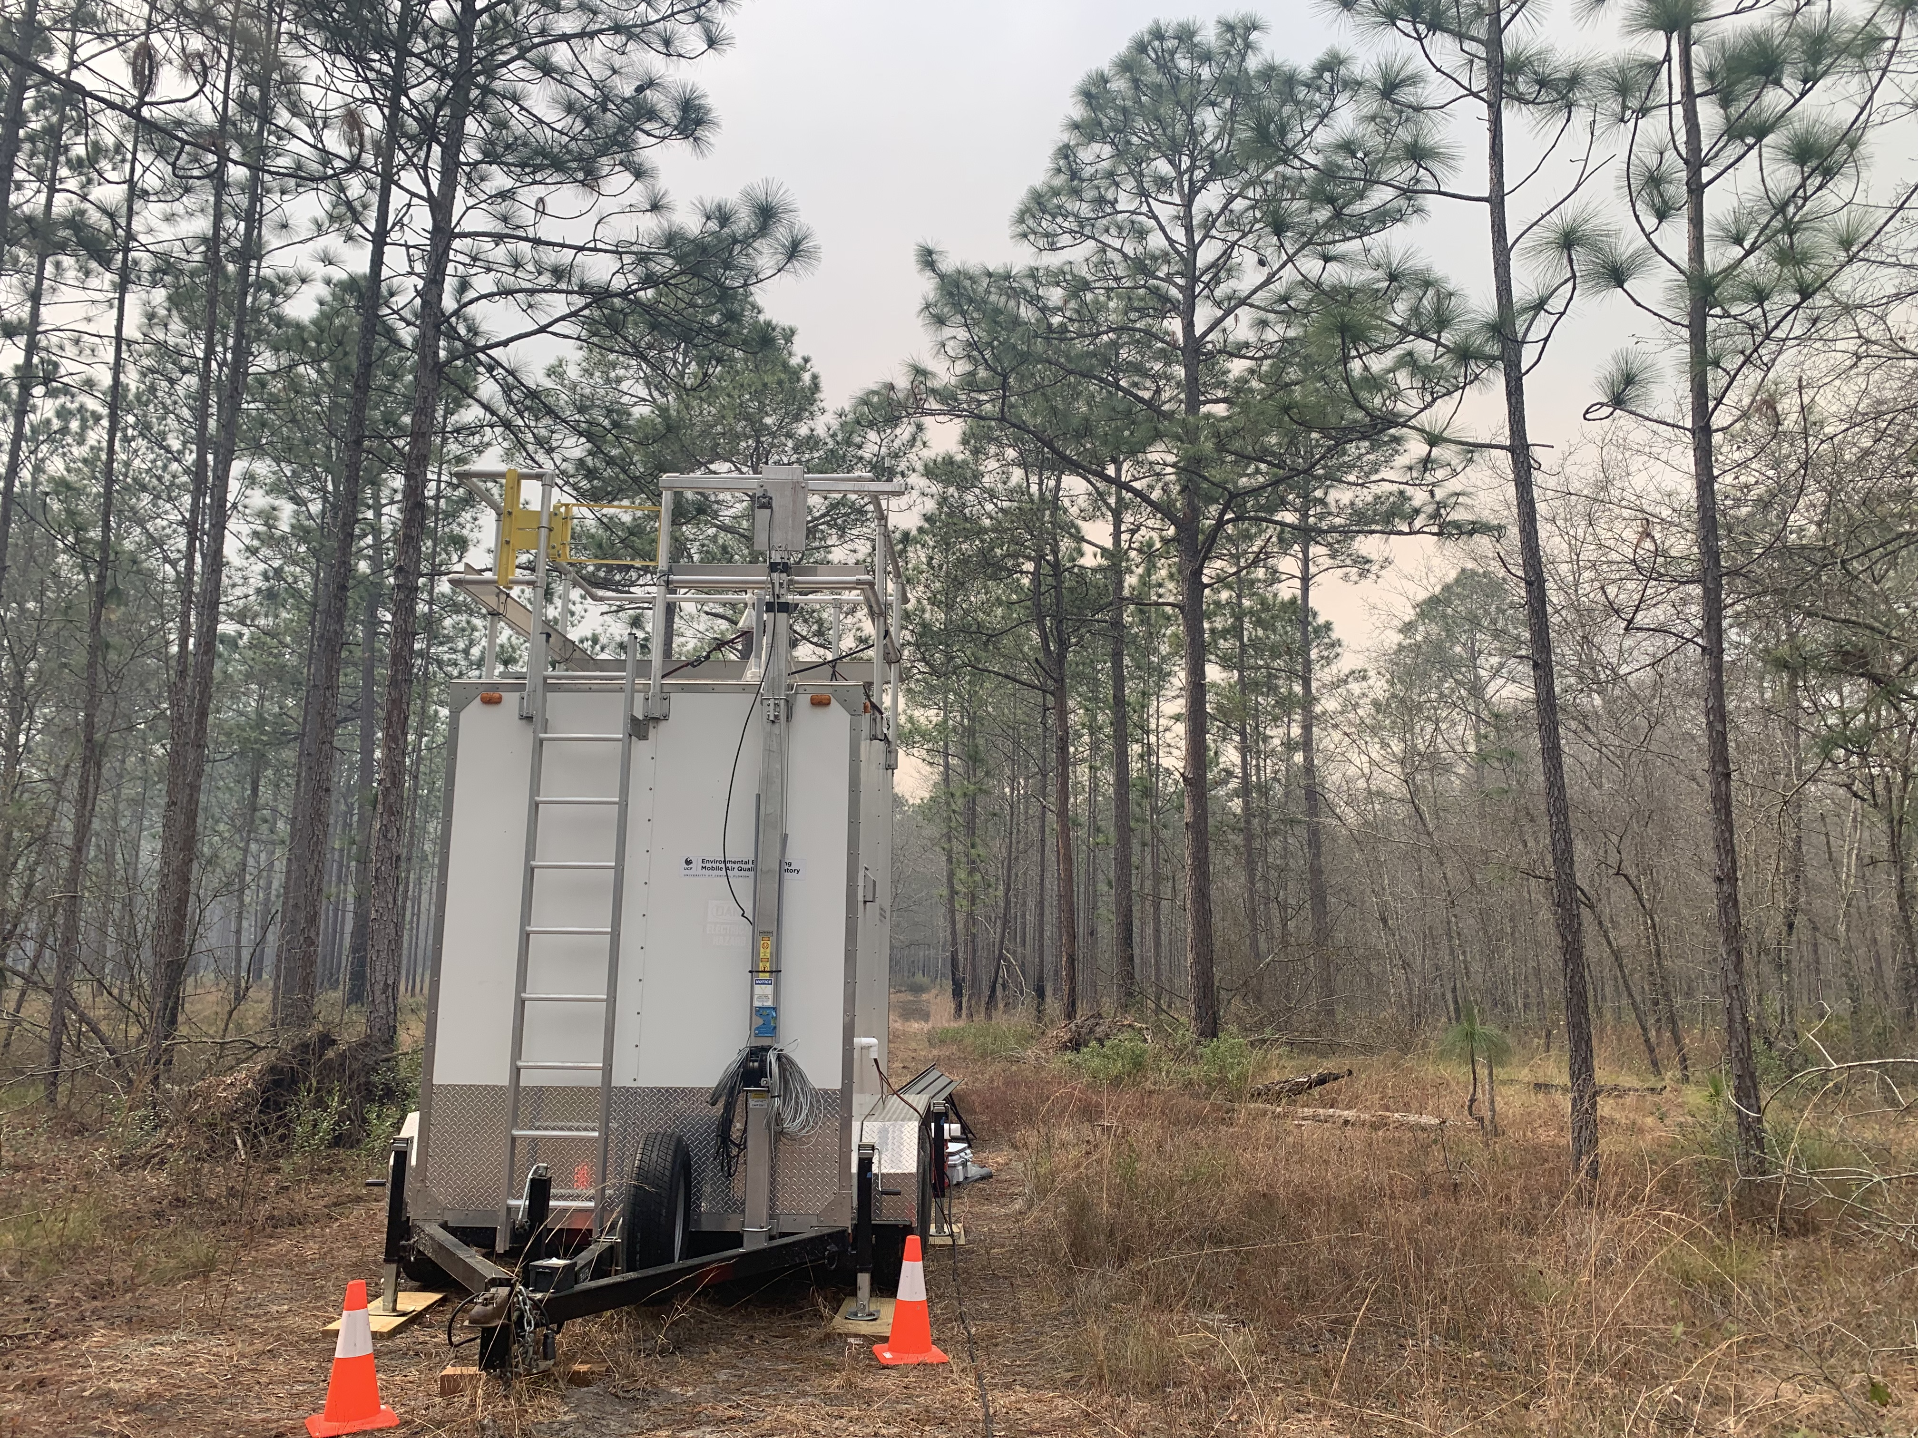
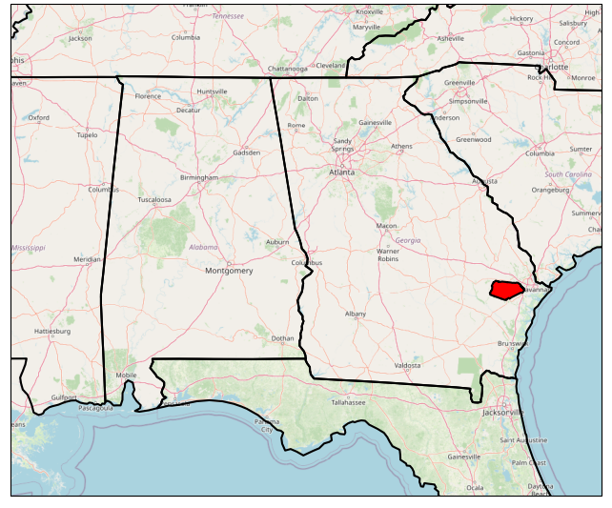
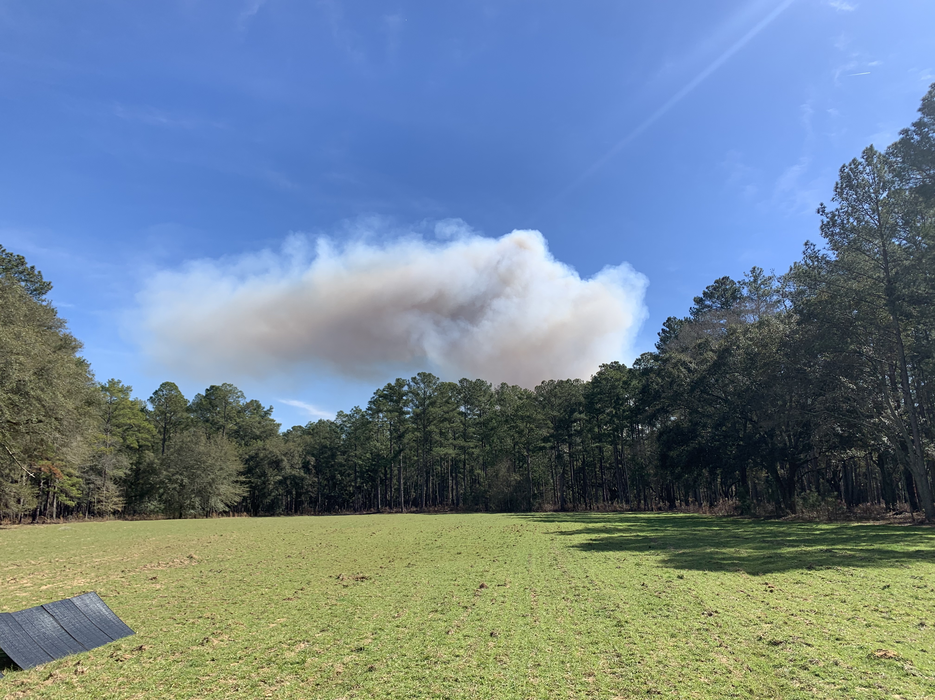
Measurements
Fort Stewart, 2022
Notes:
To start with our discussion, I will firstly introduce the fire events and modeling frameworks we want to use in the presentation. We did measurements on Fort Stewart which is a military base in eastern Georgia. We deployed some TEOM monitors in trailers so that we can relocate the monitors to measure the smoke at downwind. We also have several portable monitors EBAM to measure the PM.
So, here are some pictures we took during the prescribed burns. As you can see, the air is unclear near the trailer due to the smoke. And this is the smoke plume from the burns.

Slide 4
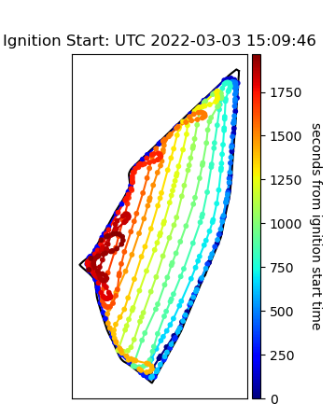
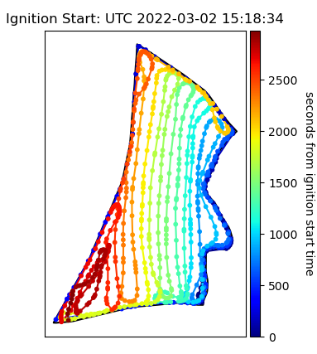
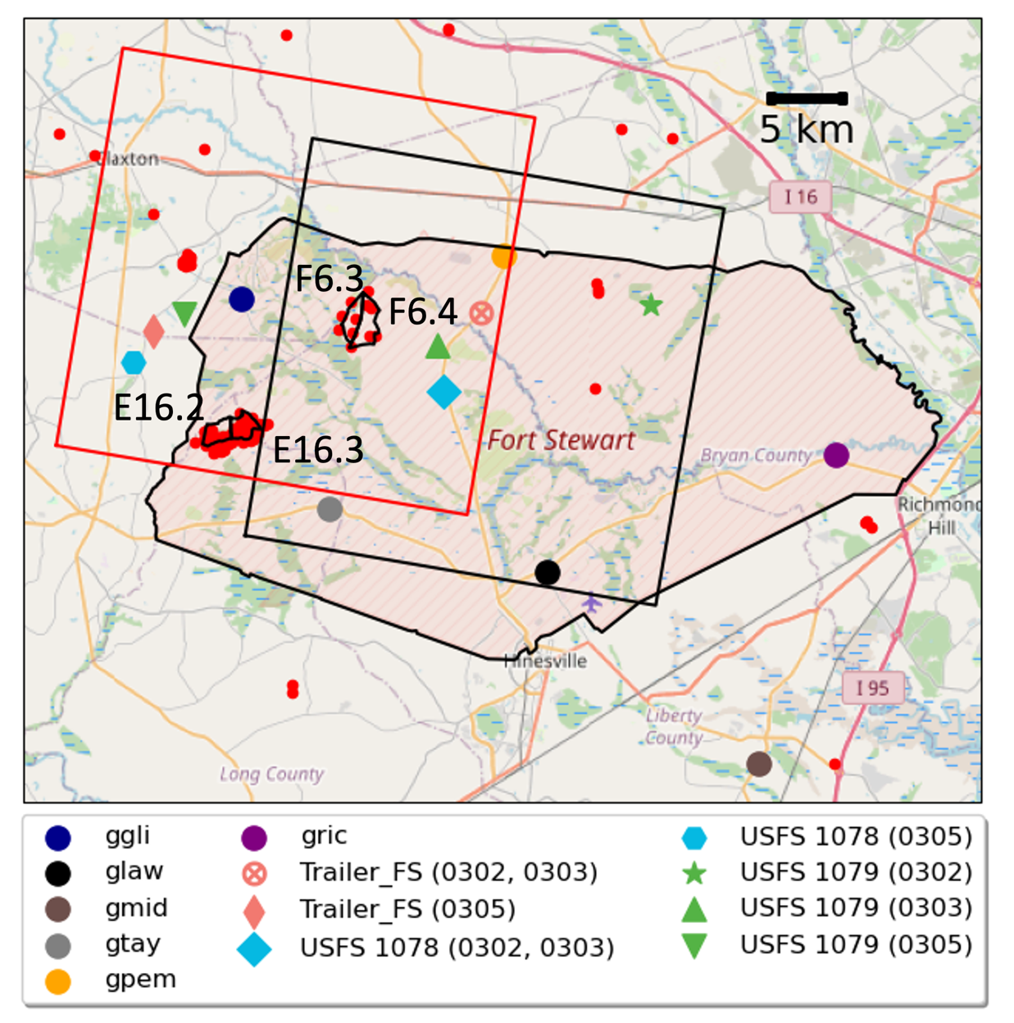
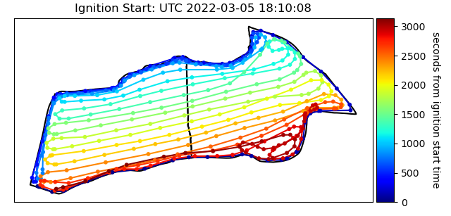
Modeling Frameworks
Model | WRF-SFIRE (v4.2)
Type of Model | Eulerian coupled fire-atmosphere model
Ignition Method | Aerial ignition (GPS recorded)
Resolution | 12km-4km-1km-200m 20 minutes time intervals
Fire Propogation | Rothermel formula.
Fire Emissions | Online calculated based on LANDFIRE fuel type. SERA emission factors for Southeastern U.S. Inert tracer for PM_{2.5}.
Plume Rise | Plume is lifted by buoyancy.
Notes:
To simulate the prescribed burns, we used WRF-SFIRE which is an eulerian coupled fire-atmosphere model. The model is included in WRF and it considers the fire and meteorological coupling effects.
The neat thing of the model is that it can do a really good job to simulate different ignition methods. For these burns, the fires were ignited by arial ignitions and the GPS in helicopter record the trajectory.
We used the same ignition method to start the WRF-SFIRE model.

Slide 5
Methods
Name | Description
Benchmarks (widely used in CTMs) | Benchmark (B): WRF-SFIRE with initial and boundary conditions (IC/BC) provided by 1-km resolution WRF
Nudging Benchmark (NB) | Nudging Benchmark (NB): WRF-SFIRE with nudging and IC/BC provided by 1-km resolution nudged WRF
Wind Bias Reduction Methods (reduce wind bias in WRF) | Augmentation Nudging (AN): WRF-SFIRE with nudging to observational data augmented by interpolation
Initial Condition and Boundary Condition (ICBC) | Initial Condition and Boundary Condition (ICBC): WRF-SFIRE with IC/BC from rotated wind direction and scaled wind speed based on wind bias
Smoke Model Evaluation Methods (post-analysis the concentration uncertainty with consideration of wind bias) | Rotation and Translation (RT): Rotate the monitor location with burn units as center and translate the distance between monitor location and burn units.
Equal Time Back/forward Trajectory (BFT) | Equal Time Back/forward Trajectory (BFT): Combining backward trajectory and forward trajectory under same time steps to find pseudo-monitor locations.
Equal Distance Back/forward Trajectory (BFT*) | Equal Distance Back/forward Trajectory (BFT*): Combining backward trajectory and forward trajectory under same distance to find pseudo-monitor locations.
Notes:
Here are the method we want to discuss today. There are mainly three parts. The first part is the benchmark. We selected two settings which are widely used when we run chemical transport model or WRF-SFIRE model. The meteorological conditions are directly provided by WRF or using the observations to do the data assimilation, which also as known as nudging.
The second part is we want to reduce the wind bias in WRF. We often found the wind bias in WRF simulation which affect the concentration simulation. We want to discuss how to make the WRF simulation performance better.
The third part is the smoke model evaluation methods. The WRF simulation even with the wind bias reduction methods, still have bias comparing to observations. In this section, we have several post-analysis methods which can be applied to the smoke model results. These method is dedicated to understand the concentration uncertainty with consideration of wind bias.

Slide 6
Wind Bias Reduction Methods
Observational Nudging: Observational nudging is a method to introduce artificial tendency terms in WRF simulations, which gradually nudge the model around the observation stations towards corresponding observations.
Included observations: RAWS monitors, NCEP ADP global surface and upper air observational weather data, and measurements from EBAM deployed in the Fort.
Augmentation Nudging (AN): using 1-km resolution wind field which is interpolated based on Kriging to augment the nudging process.
Initial Condition and Boundary Condition (ICBC): directly revise the initial and boundary condition of the wind for the fire domain based on wind bias.
Notes:
Firstly, we want to discuss can the nudging or augmented nudging help us to reduce the wind bias.
However, the wind monitors are sparse in the fire simulation domain. In the WRF-SFIRE domain, we only have two to four monitors during the measurement campaign.
To increase the nudging intensity and solve the problem on the sparse spatial distribution of met monitors, we interpolated the wind measurements based by Kriging interpolation. And we assume each grid cell has a monitor which observations are the interpolated wind.
Since for prescribed burn simulation period is short, typically the fire start after sunrise and end before sunset, we run the model with one day setting. The nudging duration is short and the impacts could be limited. Another is that if we increase the nudging intensity too much, the WRF results could be unrealistic. Nudging is somewhat a tradeoff between wind performance and realistic physics.
So, to address these issues, we directly revise the initial and boundary condition of the wind for the fire domain based on wind bias. If we have wind direction bias, we conducted solid body rotation on wind direction to reduce wind bias. If we have wind speed bias, we scaling the wind speed.

Slide 7
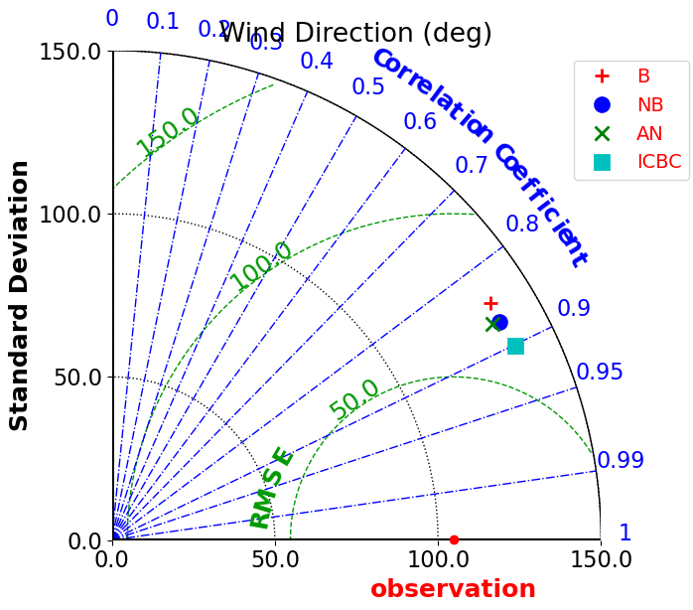
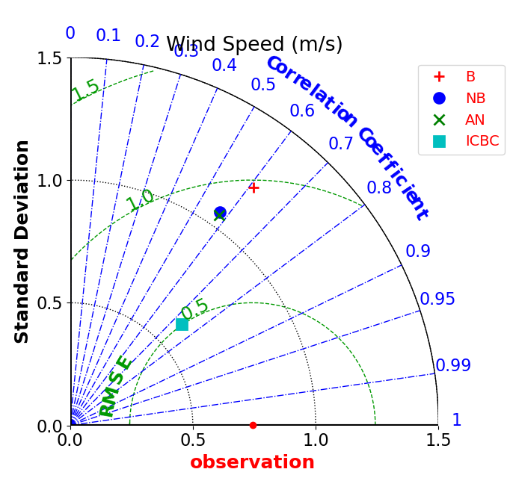
Results of Wind Bias Reduction Methods
Notes:
We used Taylor graph to compare different models’ performance. Taylor graph which can includes correlation, RMSE, standard deviation in one graph.

Slide 8
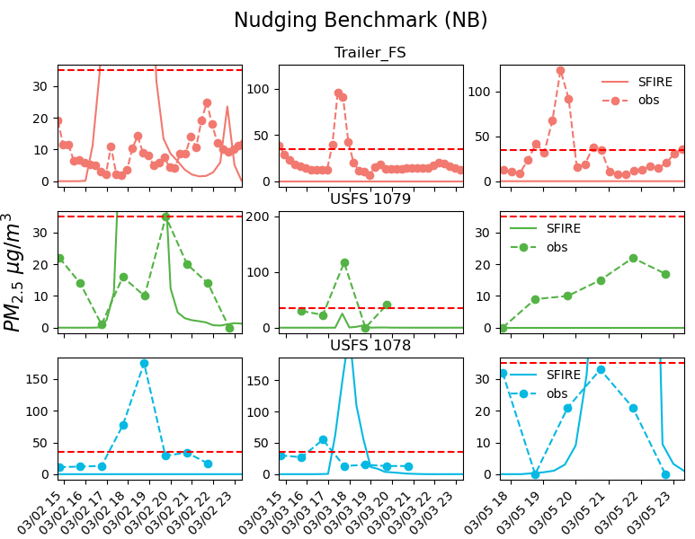
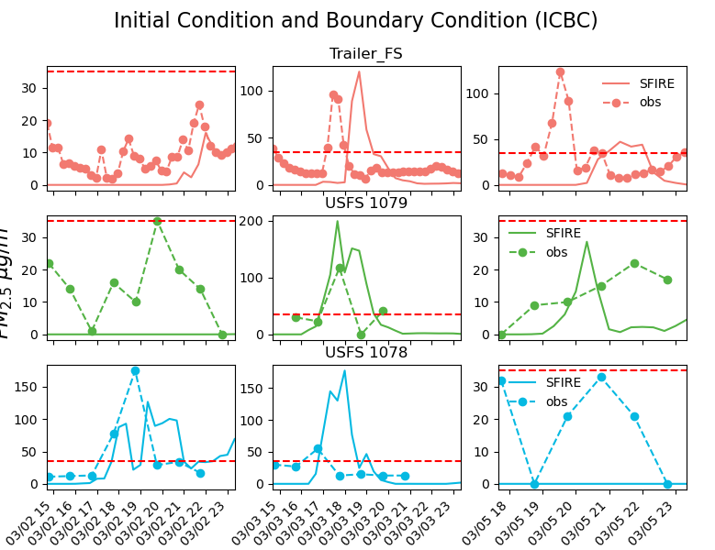
Smoke Simulation Evaluations

Slide 9
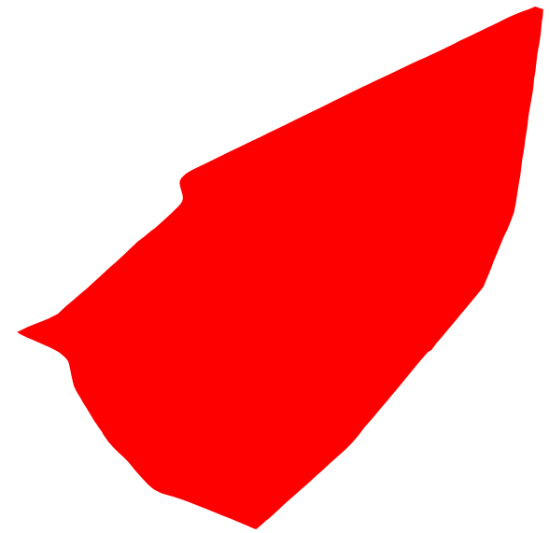
Smoke Evaluation Models
General Idea:
Pseudo Monitor: Projected
location of the monitor under the simulated wind
Modeled conc. at monitor
Modeled Wind
VS
Measurements
Monitor
Modeled conc. at pseudo monitor
$$θ$$
VS
Observed Wind
Measurements
Burn Unit
Notes:
But we still have wind bias even we used the ICBC method, and it is almost impossible to remove all the bias from the model. We considers to evaluate the concentration uncertainties due to the biased wind by designing smoke evaluation models.

Slide 10
Rotation and Translation
Pseudo Monitor Location
Wind Direction Bias: Rotate the monitor location using burn units as centroid.
Wind Speed Bias: Translate the distance between monitor location and burn unit to correct the smoke detection timing.
Uncertainty: Consider the wind bias at current hour and the previous hour.
Direction of Monitor Rotation
Monitor Location
$$θ$$
Burn Unit
$$\left[\min\left(σ_{dir}\left(t−1\right), σ_{dir}\left(t\right)\right),\max\left(σ_{dir}\left(t−1\right), σ_{dir}\left(t\right)\right)\right]×[\min\left(σ_{spd}\left(t−1\right), σ_{spd}\left(t\right)\right),\max{(σ_{spd}\left(t−1\right), σ_{spd}(t))}]$$
Notes:
We also want to consider some uncertainties during this process. For example, the smoke transport at time t not only be affected by the current hour wind, but also be affected by the previous hour.

Slide 11
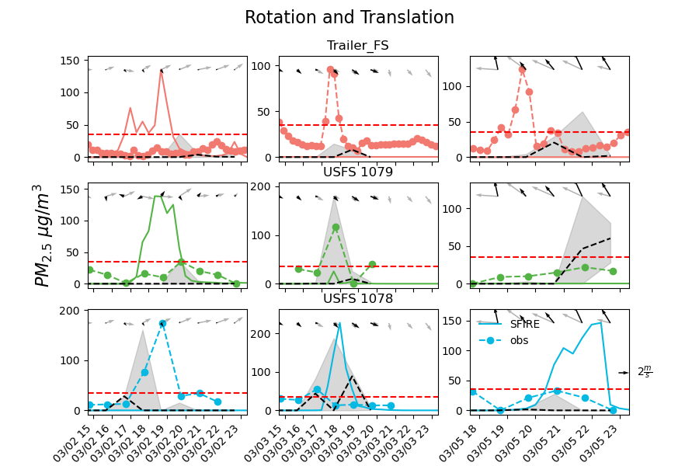
Results of Rotation and Translation
Notes:
The dashed black line is using the wind bias at the concentration hour to find the pseudo monitor location.
The shaded area considers the wind bias at the concentration hour and a previous hour to estimate the uncertainty.

Slide 12
Equal Time/Distance Backward-Forward Trajectory
Backward Trajectory: Backward trajectory from the monitor location to find the source of smoke detection.
Forward Trajectory: Forward from the source location using simulated wind field to find the destination of simulated smoke.
Uncertainty:
Spatial uncertainty along forward trajectories.
u_{obs}(t) ± σ_{u}(t)
v_{obs} (t) ± σ_{v}(t)
u_{obs} (t-1) ± σ_{u}(t-1)
v_{obs} (t-1) ± σ_{v}(t-1)
Backward trajectory
Burn Unit
Forward trajectory
u_{wrf} (x _{t+1}, y _{t+1}, t + 1)
v_{wrf} (x _{t+1}, y _{t+1}, t + 1)
u_{wrf} (x _{t-1}, y _{t-1}, t-1)
v_{wrf} (x _{t-1}, y _{t-1}, t-1)
u_{wrf} (x _{t}, y _{t}, t)
v_{wrf} (x _{t}, y _{t}, t)
BFT
BFT*
Notes:
The rotation translation method assumes the wind direction and bias impacts are independent. However, they should simultaneously impact the smoke transport. To address that, we considered the smoke trajectories.
The backward forward trajectory methods have two steps. We do the backward trajectory firstly from monitor location with observed wind to find the source of smoke detection. Then, we start from this source and do a forward trajectory. The destination of the forward trajectory is the pseudo monitor.
There are two ways for doing the forward trajectory:
One way is that we assume smoke parcel will transport same time as the backward trajectory process. However, it is a method to correct the wind bias on smoke transport but cannot address the wind bias impacts on smoke diffusion.
Another way is we found the pseudo monitor location which forward trajectory distance is equal to backward trajectory distance. And we may need to compare the concentration at different hours in modeling with current hour's measurements.
And we also want to consider the uncertainty in this process. During the backward trajectory, we do not know how the observed wind distribute along the trajectory. We assumed a Gaussian distribution with a standard deviation which is calculated by the spatial standard deviation among different metereological monitors in the study domain. We used Monte Carlo simulation to estimate the uncertainty.

Slide 13
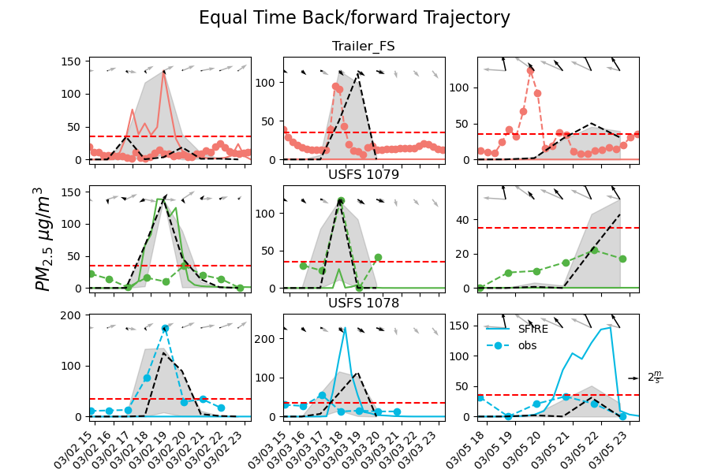
Results of BFT
Notes:
for BFT the black dashed line is using the observed wind at the monitor location to do the back/forward trajectory.
We assumed the Gaussian distribution of backward trajectory wind with considering the spatial variation from measured wind in the domain. We generate 1000 wind field for backward trajectory under such distribution and use Monte Carlo simulation to estimate this shaded area.

Slide 14
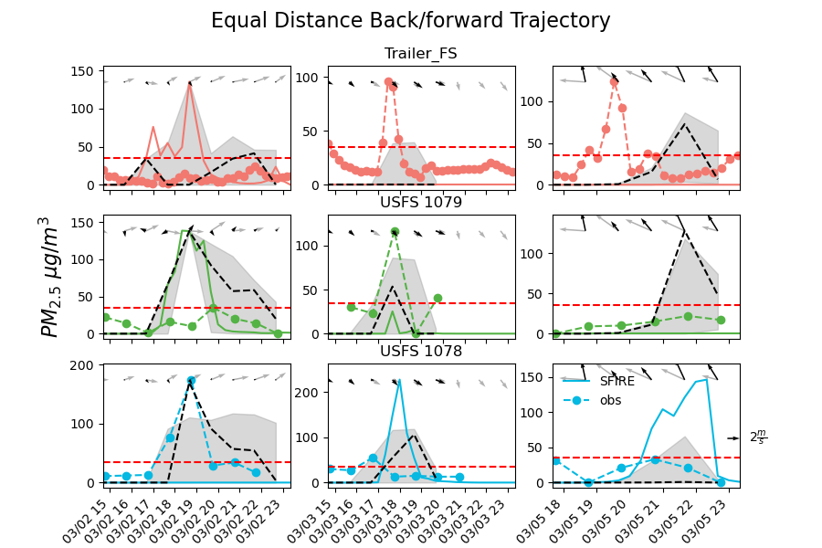
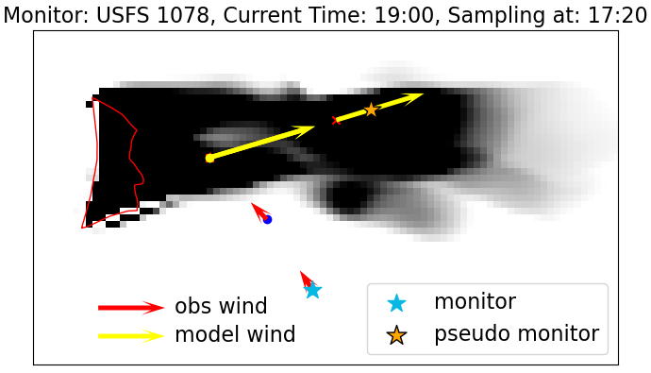
Results of BFT*

Slide 15
Conclusion
Wind simulation uncertainties significantly impacted the PM_{2.5} concentration fields in the WRF-SFIRE model.
While nudging reduced wind bias for the one-day prescribed burn simulations, its impact on performance was limited.
The ICBC method proved the most effective among wind bias reduction methods, improving concentration simulation accuracy.
Smoke model evaluation methods successfully captured smoke that was previously missed due to biased winds.
RT assumes wind direction and speed biases act independently, while BFT accounts for both simultaneously by correcting smoke transport through trajectory simulation. However, BFT does not account for diffusion effects caused by wind bias.
The BFT* method enhances smoke transport simulation by considering both diffusion and transport effects based on smoke transport distance.
Notes:
We used WRF-SFIRE as an example in this presentation but the methods we designed can be applied to other regional models such as CMAQ or WRF-Chem.

Slide 16
Thanks for Listening!
Email: zli867@gatech.edu

