Slide 1
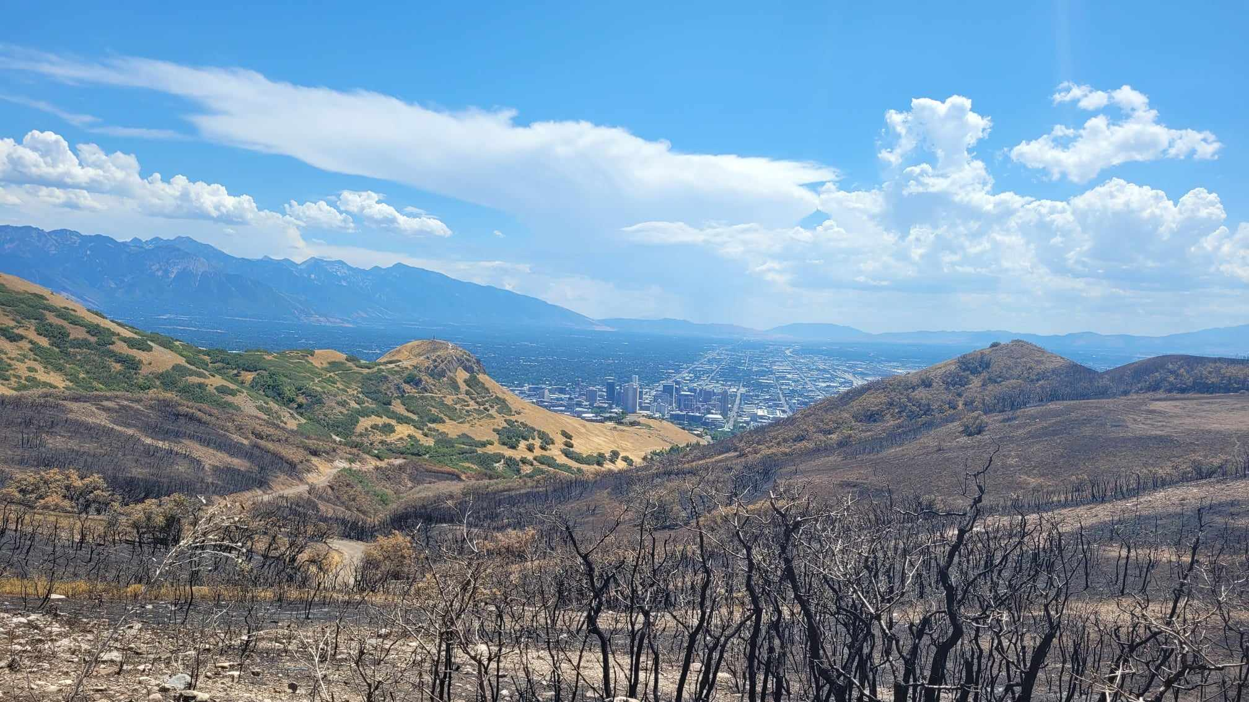
Improving numerical air quality forecasts in the western United States with an emphasis on wildfire smoke
Taylor Wilmot, Heather Holmes,
Derek Mallia, Kerry Kelly,
Ross Whitaker

Slide 2
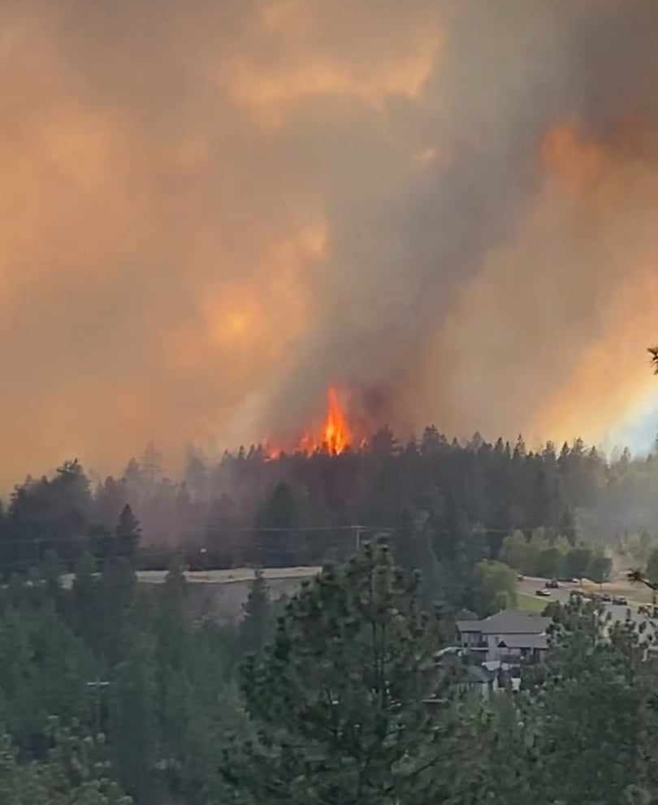
Outline
2
CREATE-AQI overview
Forecast model framework
Preliminary forecast evaluation
Future development

Slide 3
CREATE – AQI
3
An NSF CIVIC project to observe and predict Utah air quality
Objective: protect Utah children from outdoor air quality hazards
Combine air quality sensors and automated forecasts to inform decision makers
Wintertime inversions, windblown dust, and wildfire smoke are all present in Utah
CREATE-AQI Forecast model Preliminary evaluation Future development

Slide 4
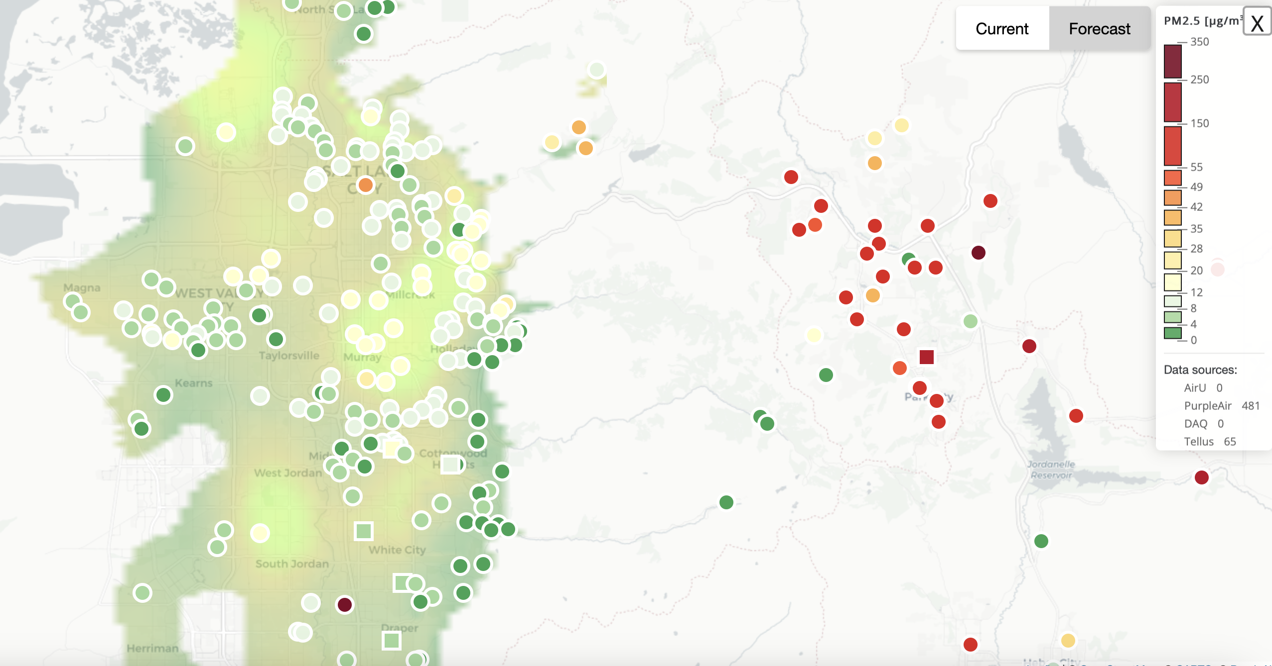
CREATE – AQI observations
4
Effectively a nowcasting tool
Installing sensors at high schools throughout the state
Employs ML to spatially interpolate
Long term: will be leveraged to improve forecasting outputs
CREATE-AQI Forecast model Preliminary evaluation Future development

Slide 5
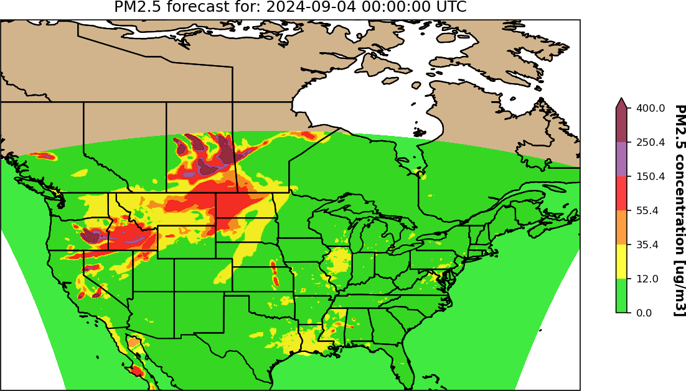
Forecast framework – air quality
5
National emissions inventory
Non-fire emissions
Whole atmosphere community climate model
Chem. initial/boundary conditions
SMOKE modeling system
Hourly, 3-D, wildfire emissions grids
Fire emissions prediction
Criteria pollutants
Heat fluxes, fire area
CMAQ – forecast
MCIP, ICON, BCON
WRF simulation
12km met. simulation
Freitas et al. plume rise
Plume top heights
Vertical distribution of smoke
CREATE-AQI Forecast model Preliminary evaluation Future development

Slide 6
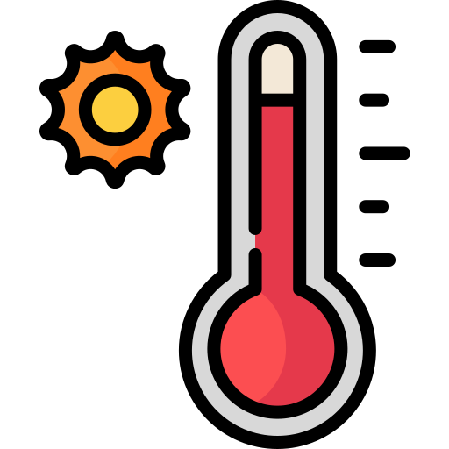
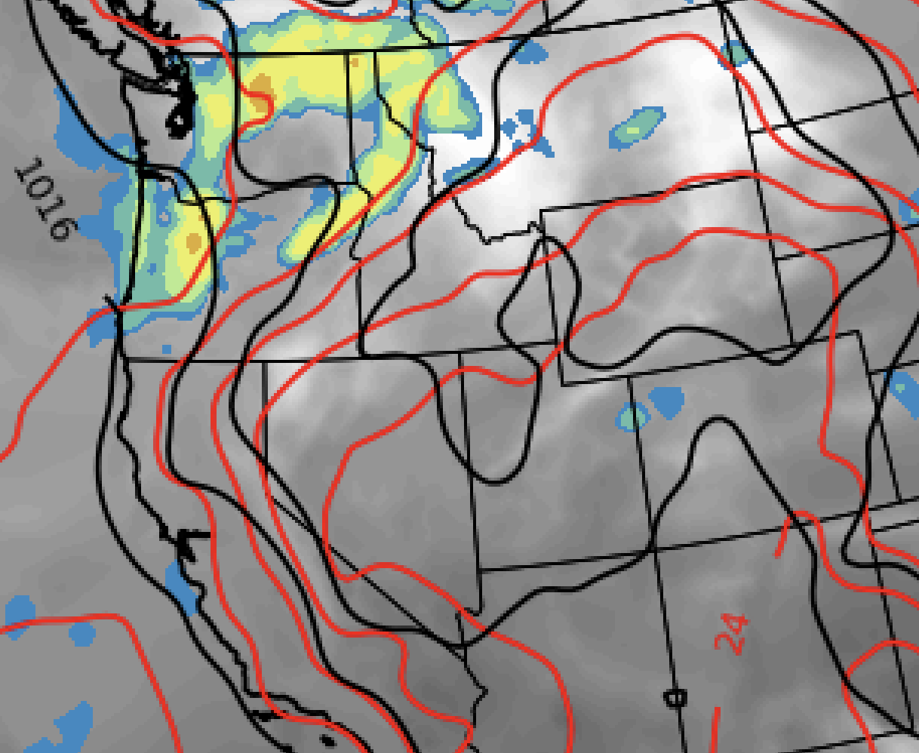
Forecast framework – wildfire emissions
Fire spin-up period
6
Fire forecast
GOES detection
VIIRS/MODIS detection
Fire activity forecast model
Satellite detections
MODIS and VIIRS for magnitude, normalized GOES used for scaling
Fire area
Vegetation data
Provides gridded fuel characteristic data from LANDFIRE
spin-up
Rate of spread
forecast
Rothermel et al. (1972) model used to scale heat fluxes and fire area up or down
Fire emissions prediction
ROS
Fuel moisture
Criteria pollutants, fire area, heat flux based on EFs
Model computes dead and live fuel moisture to initialize fuel consumption model
t
Meteorological forecasts
If its hotter, windier, and drier tomorrow, the model will scale up the fire area, heat flux and smoke emissions
WRF provides medium-resolution weather data
CREATE-AQI Forecast model Preliminary evaluation Future development

Slide 7
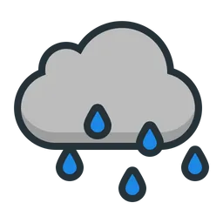
Forecast framework – wildfire emissions
Fire spin-up period
6
Fire forecast
GOES detection
VIIRS/MODIS detection
Fire activity forecast model
Satellite detections
MODIS and VIIRS for magnitude, normalized GOES used for scaling
Fire area
Vegetation data
Provides gridded fuel characteristic data from LANDFIRE
spin-up
Rate of spread
forecast
Rothermel et al. (1972) model used to scale heat fluxes and fire area up or down
Fire emissions prediction
ROS
Fuel moisture
Criteria pollutants, fire area, heat flux based on EFs
Model computes dead and live fuel moisture to initialize fuel consumption model
t
Meteorological forecasts
If it rains and is cooler tomorrow, the model will scale down the fire area, heat flux and smoke emissions
WRF provides medium-resolution weather data
CREATE-AQI Forecast model Preliminary evaluation Future development

Slide 8
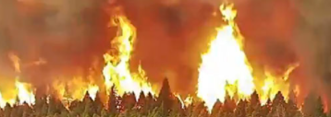
Forecast framework – wildfire plume rise
7
Stand alone version of Freitas et al. plume rise scheme
Ingests forecasted heat flux, fire area, and meteorological fields
Entrainment – mass conservation approach to predict vertical distribution
Flux_{Vertical, Out}
Detrainment
Entrainment
Flux_{Vertical, In}
CREATE-AQI Forecast model Preliminary evaluation Future development

Slide 9
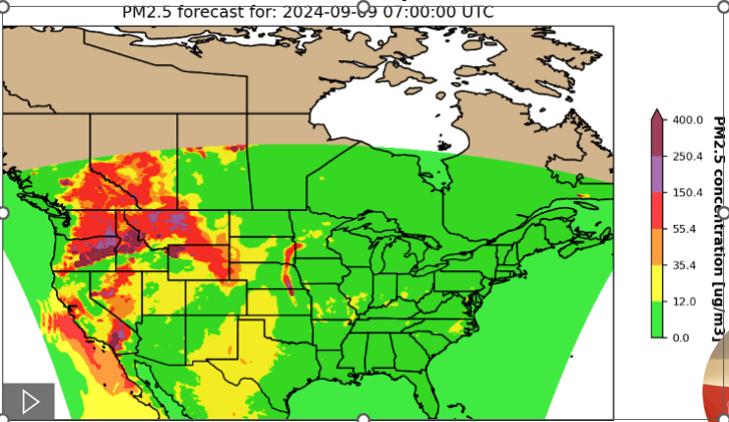
Forecast framework – outputs
8
CREATE-AQI Forecast model Preliminary evaluation Future development

Slide 10
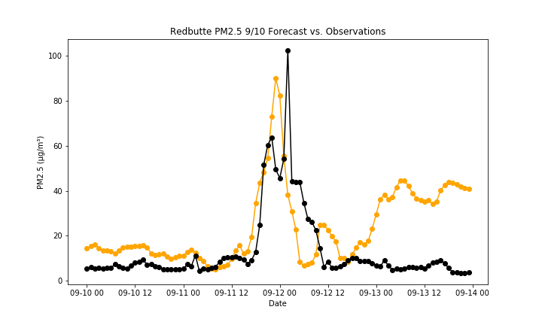
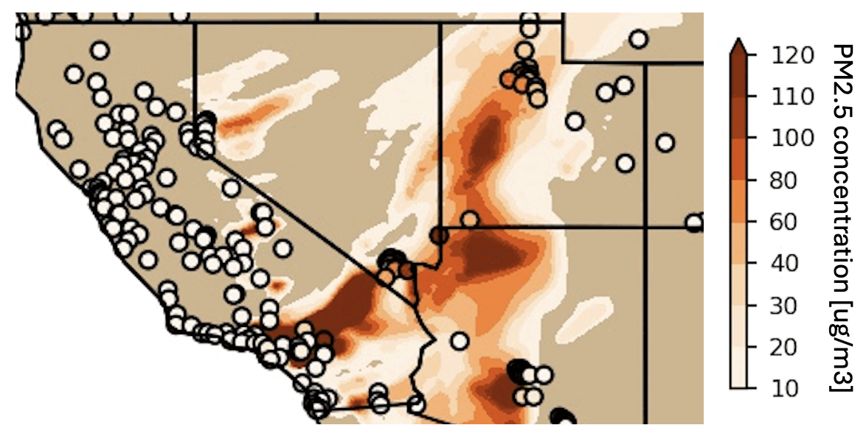
Preliminary evaluation – air quality
9
Performed well for largest smoke event in Salt Lake City this summer
Issues with smoke emissions from cloud blocked fires
Timing and shape of smoke plumes appear better forecasted than magnitude of smoke
Forecasted PM2.5 values are biased high
Forecast
Observations
CREATE-AQI Forecast model Preliminary evaluation Future development

Slide 11
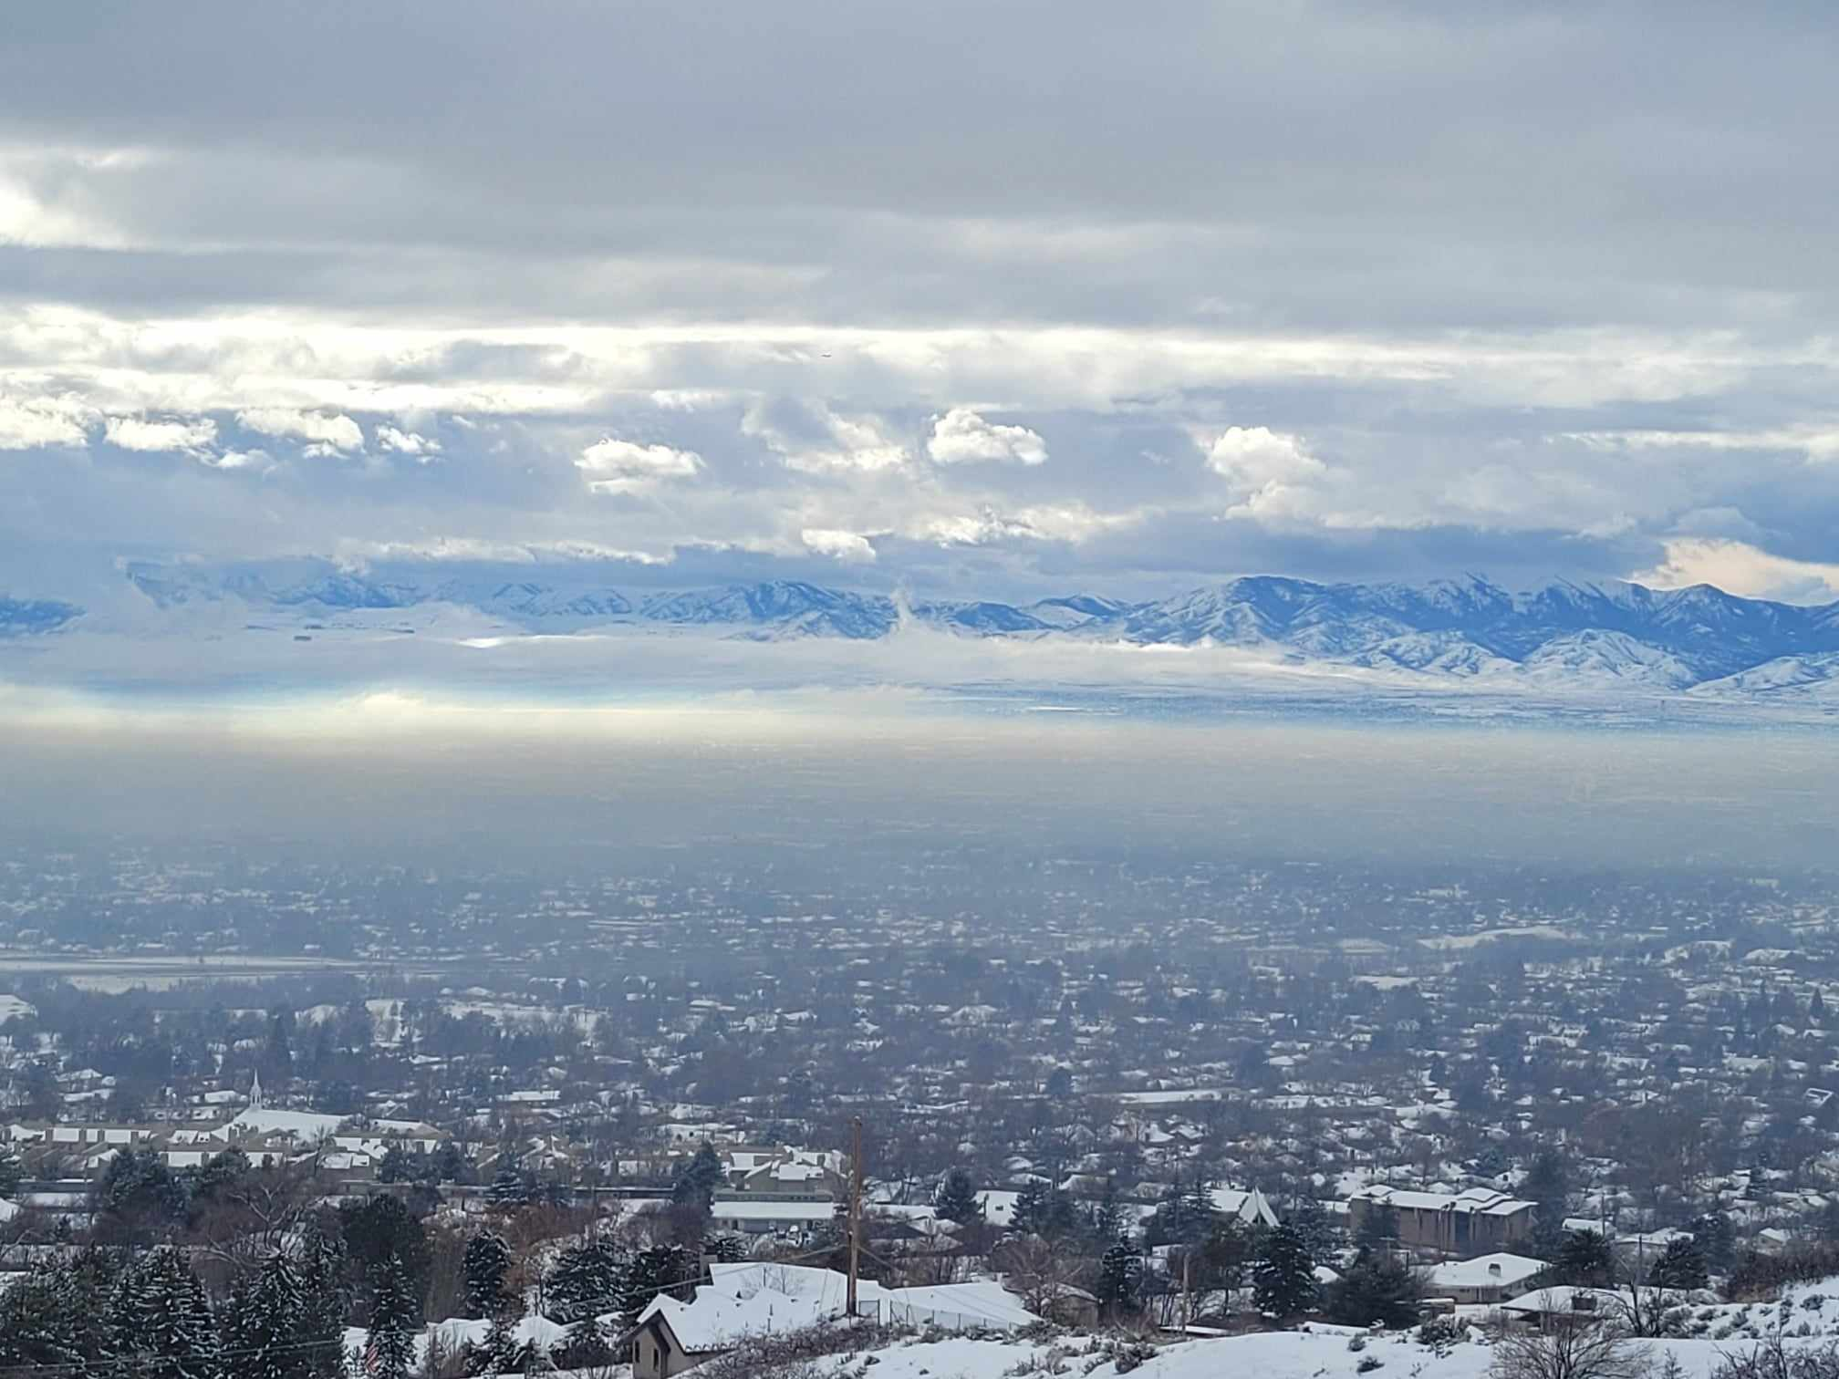
Future development
10
WRF-CMAQ:
4km nested domain
Two-way coupling
Wildfire emissions:
Number of possible development pathways (FOFEM, ML ingesting coupled models, etc.)
Wind blown dust:
Inclusion of exposed lakebed in playa land use category (important for Great Salt Lake)
Wintertime inversions:
Likely a statistical model that is initiated based on met conditions
Bias reduction scheme based on accompanying sensor observations
Questions: Kai.Wilmot@utah.edu
CREATE-AQI Forecast model Preliminary evaluation Future development

