Slide 1


Fine particulate matter and ozone variability with regional and local meteorology in Beijing, China
Shreya Guha¹, Ting Zhang¹, Patrick L. Kinney², Lucas R.F. Henneman¹
4
¹Department of Civil, Environmental and Infrastructural Engineering, George Mason University, Fairfax, VA
²Department of Environmental Health,
Boston University School of Public Health, Boston, MA

Slide 2
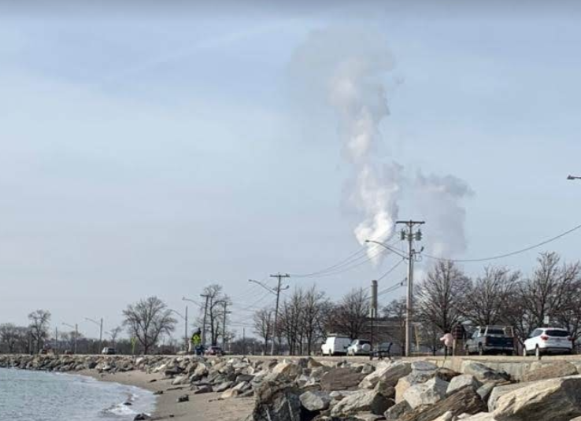
Introduction
Air pollution due to PM_{2.5} and Ozone: One of the most important eco-environmental problems in China (Nel 2005; Brauer et al. 2016)
Spatial distribution of and level of pollution determined by:
  Pollution sources, AND
  Meteorology situation due to
    Diffusion,
    Accumulation, and
    Transport of air pollutants
    (Jacob and Winner 2009; Pearce et al. 2011)
Notes:
Air pollution is linked to morbidity and mortality in humans
It is also linked to climate changes and global warming
It is important to separate out the influences of meteorology from anthropogenic behaviors on air pollutant concentrations to understand their behavior and thus build more effective policies.
My work focusses on China

Slide 3
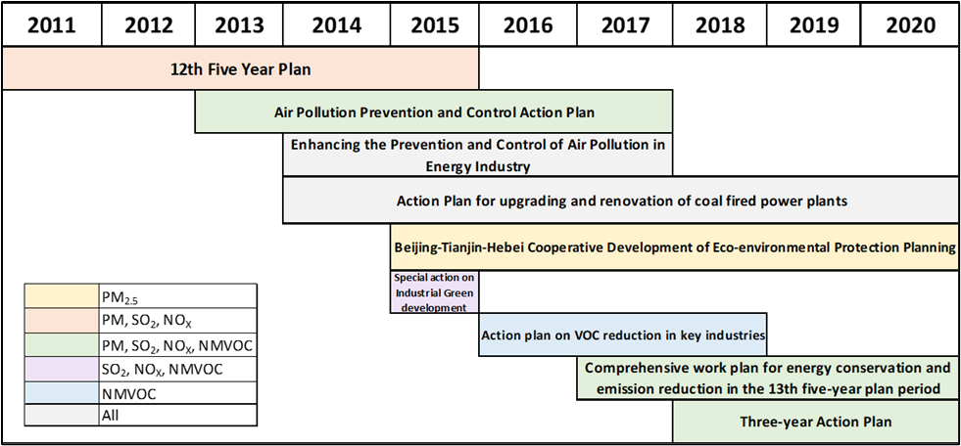
Background
Notes:
47 cities

Slide 4
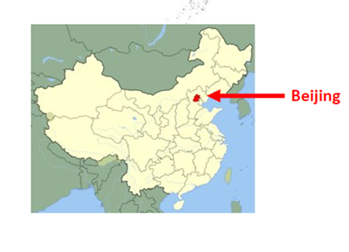
Background
In 2013, China launched the Air Pollution Prevention and Control Action Plan, to cut the PM_{2.5} source emissions

Slide 5
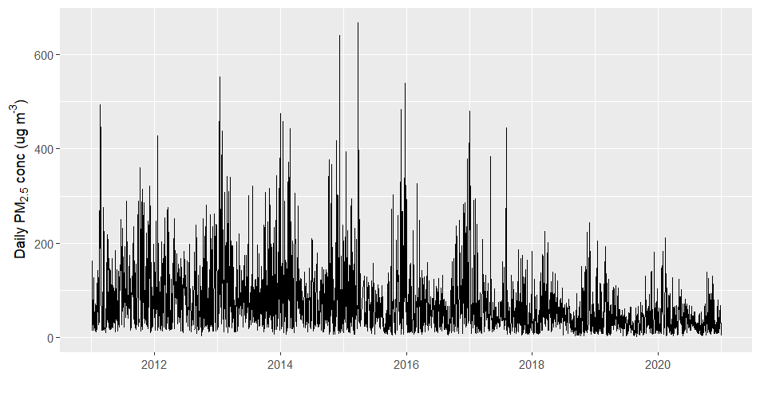
Background
In 2013, China launched the Air Pollution Prevention and Control Action Plan, to cut the PM_{2.5} source emissions
It helped in reducing PM_{2.5} concentration in Beijing

Slide 6
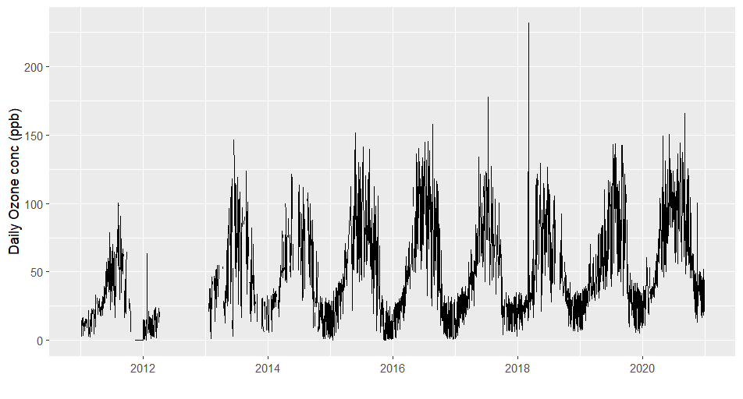
Background
In 2013, China launched the Air Pollution Prevention and Control Action Plan, to cut the PM_{2.5} source emissions
It helped in reducing PM_{2.5} concentration in Beijing
However, ozone concentrations increased since then

Slide 7
Objectives
How much of the pollutant concentrations are attributed to meteorology?
Which meteorological variable has more influence on the pollutant concentrations?
Which model performs better when it comes to predicting pollutant concentrations?

Slide 8
Methods
Data:
1. Pollutants:
  PM_{2.5}
  Ozone
2. Meteorology
Notes:
Short-term components of meteorological time series [ST_{met}(t)] are used to predict STM(t) by using models of varying complexity: linear model (LM), general additive model (GAM) and random forest (RF)

Slide 9
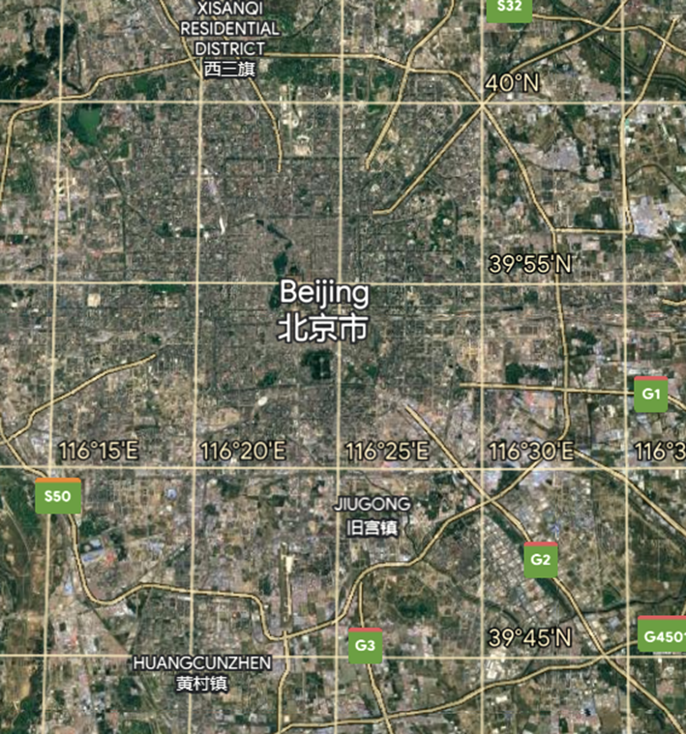
Local observed Data
Pollutant data:
  AirNow Beijing and
  China National Air Quality Monitoring Network
Variable | Number of Observations | Mean | Median | Standard Deviation | Min | Max
PM_{2.5} (μgm⁻³) | 3602 | 75 | 54 | 72 | 2.1 | 667
Ozone (ppb) | 2954 | 49 | 40 | 34 | 0 | 232
Meteorological data: China Meteorological Data Service Centre (CMDC)
  Temperature
  Wind Speed
  Wind direction
  Dew Point Temperature

Slide 10
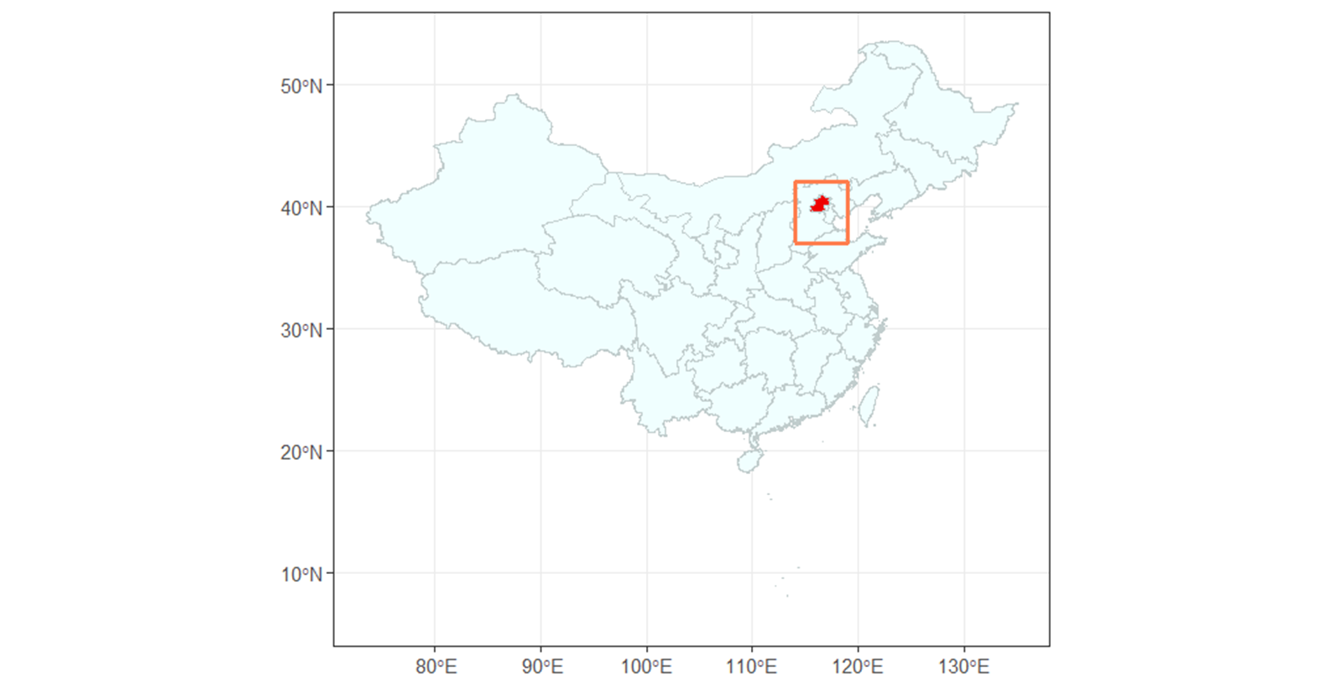
Regional Meteorological Reanalysis Data
NCEP Global Data Assimilation System (NCEP-GDAS​)
  Temperature
  Wind speed
  Wind direction
  Relative Humidity
  Surface Pressure
  Precipitation
European Centre for Medium-Range Weather Forecasts (ECMWF) Reanalysis v5 (ERA5)
  Solar radiation

Slide 11
Methods
Data:
1. Pollutants:
  PM_{2.5}
  Ozone
2. Meteorology
Short term components of these signals
KZ-filter
Notes:
Short-term components of meteorological time series [ST_{met}(t)] are used to predict STM(t) by using models of varying complexity: linear model (LM), general additive model (GAM) and random forest (RF)

Slide 12
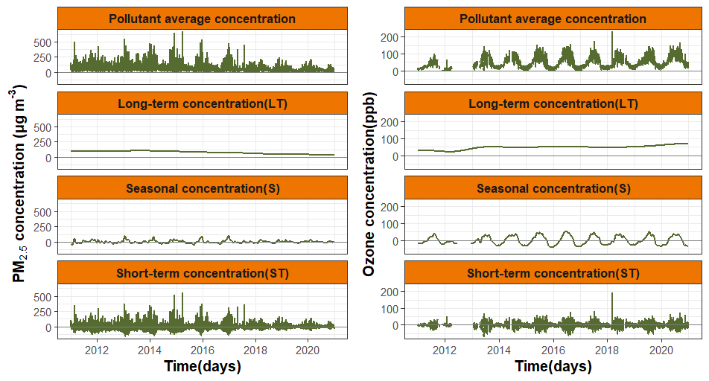
Meteorological Detrending using KZ-filter
Notes:
multiple-pass moving average filters of different averaging windows
Kz: series of iterations of a moving average filter of length m, where m is a positive, odd integer.
Can handle missing values
Previously, Done only locally
Other methods: ANN, FFT
Multiple KZ yields good results except sulfate
Combination with LM alone

Slide 13
Methods
Data:
1. Pollutants:
  PM_{2.5}
  Ozone
2. Meteorology
Short term components of these signals
Models:
Linear Model
General Additive Model
Random Forest
KZ-filter
Relationships between pollutants & meteorology
Notes:
Short-term components of meteorological time series [ST_{met}(t)] are used to predict STM(t) by using models of varying complexity: linear model (LM), general additive model (GAM) and random forest (RF)

Slide 14
Methods
Data:
1. Pollutants:
  PM_{2.5}
  Ozone
2. Meteorology
Short term components of these signals
Models:
Linear Model
General Additive Model
Random Forest
KZ-filter
Relationships between pollutants & meteorology
Local Variable
Regional Variable
Local & Regional Variable

Slide 15

Methods
Data:
1. Pollutants:
  PM_{2.5}
  Ozone
2. Meteorology
Short term components of these signals
Models:
Linear Model
General Additive Model
Random Forest
KZ-filter
Relationships between pollutants & meteorology
Evaluation
Local Variable
Regional Variable
Local & Regional Variable

Slide 16
Methods
Data:
1. Pollutants:
  PM_{2.5}
  Ozone
2. Meteorology
Short term components of these signals
Models:
Linear Model
General Additive Model
Random Forest
KZ-filter
Relationships between pollutants & meteorology
Evaluation

Slide 17
Methods
Data:
1. Pollutants:
  PM_{2.5}
  Ozone
2. Meteorology
Short term components of these signals
Models:
Linear Model
General Additive Model
Random Forest
KZ-filter
Relationships between pollutants & meteorology
Evaluation
Train 80%
Randomly Partition Data
Test 20%

Slide 18
Methods
Data:
1. Pollutants:
  PM_{2.5}
  Ozone
2. Meteorology
Short term components of these signals
Models:
Linear Model
General Additive Model
Random Forest
KZ-filter
Relationships between pollutants & meteorology
Evaluation
Train 80%
Randomly Partition Data
Test 20%
Holdout Analysis:
How much error?
How much correlation?

Slide 19
Methods
Data:
1. Pollutants:
  PM_{2.5}
  Ozone
2. Meteorology
Short term components of these signals
Models:
Linear Model
General Additive Model
Random Forest
KZ-filter
Relationships between pollutants & meteorology
Evaluation
Train 80%
Randomly Partition Data
Test 20%
Holdout Analysis:
How much error?
How much correlation?
Model Performance for single run

Slide 20
Methods
Data:
1. Pollutants:
  PM_{2.5}
  Ozone
2. Meteorology
Short term components of these signals
Models:
Linear Model
General Additive Model
Random Forest
KZ-filter
Relationships between pollutants & meteorology
Evaluation
Train 80%
Randomly Partition Data
Test 20%
Holdout Analysis:
How much error?
How much correlation?
Model Performance for single run
Repeat

Slide 21
Methods
Data:
1. Pollutants:
  PM_{2.5}
  Ozone
2. Meteorology
Short term components of these signals
Models:
Linear Model
General Additive Model
Random Forest
KZ-filter
Relationships between pollutants & meteorology
Evaluation
Train 80%
Randomly Partition Data
Test 20%
Holdout Analysis:
How much error?
How much correlation?
Model Performance for single run
100 times
Repeat

Slide 22
Methods
Data:
1. Pollutants:
  PM_{2.5}
  Ozone
2. Meteorology
Short term components of these signals
Models:
Linear Model
General Additive Model
Random Forest
Remove the variability from daily meteorology
KZ-filter
Relationships between pollutants & meteorology
Evaluation

Slide 23
Methods
Data:
1. Pollutants:
  PM_{2.5}
  Ozone
2. Meteorology
Short term components of these signals
Models:
Linear Model
General Additive Model
Random Forest
Remove the variability from daily meteorology
KZ-filter
Relationships between pollutants & meteorology
Evaluation
Result!!

Slide 24
Including regional variables in the models significantly improved the models’ performances
Notes:
Out of the 3 models, RF has the least error and the highest correlation, which can be attributed to its ability to handle higher dimensional spaces.
Fine-tuning the model, RF with 500 trees and 3 trees split at each variable performed best

Slide 25
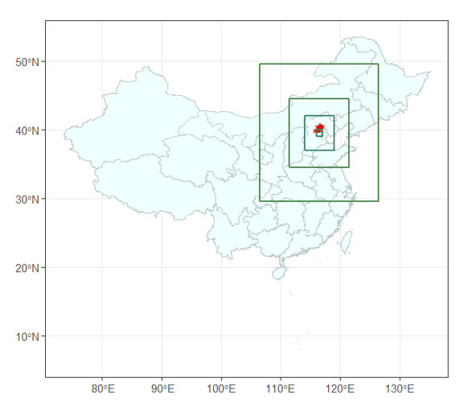
Model with regional variables averaged spatially across the 5°x5° box surrounding Beijing has better predictive performance
Notes:
5x5 aligns with the BTH area

Slide 26
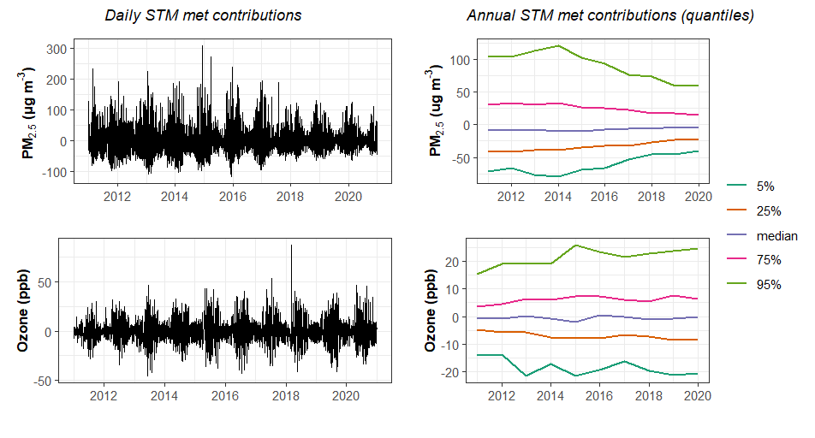
Daily & annual quantile summaries for STM met contributions show reduced met variability with decrease in emissions
Notes:
The reduced variability of meteorological contributions (STM) predicted by the combined RF model in PM2.5 is somewhat surprising given that the model does not contain markers for annual PM2.5 concentrations or any long-term proxy for the time trend
Neither emission magnitudes nor markers for time are included in the models.
None of the annual meteorological variable distributions show a noticeable trend across the study period
95th percentile of Annual STM met contribution to PM2.5 >100 µg m^{‑3} for 2011-2015, 5th percentiles in those < -50 µg m^{‑3}, highlighting the large influence meteorology had on daily PM_{2.5} concentrations before 2015

Slide 27
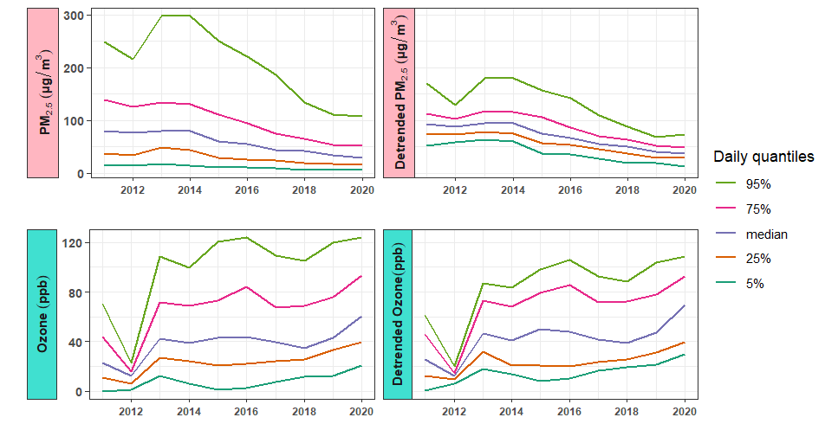
Raw observed data vs meteorological detrended helps in understanding influence of meteorology to daily pollutant concentrations
Notes:
Hence, although the decreasing trend in average PM2.5 concentrations is driven by human emissions, the annual variability of PM2.5 concentration is influenced by meteorological factors.
2012: not enough data for ozone

Slide 28
Meteorological Detrending using KZ-filter

Slide 29
Daily & annual quantile summaries for STM met contributions show reduced met variability with decrease in emissions

Slide 30
Subtracting the influence of meteorology leads to lower concentration variability
Notes:
Hence, although the decreasing trend in average PM2.5 concentrations is driven by human emissions, the annual variability of PM2.5 concentration is influenced by meteorological factors.
2012: not enough data for ozone

Slide 31

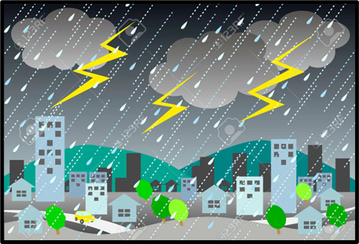
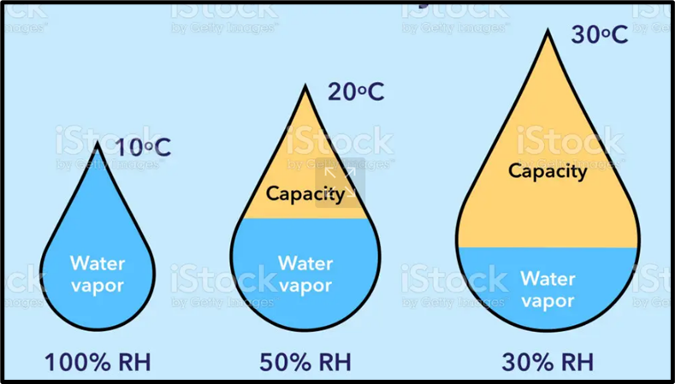
Variable importance ranks show that regional temperature is more important than local temperature for PM2.5, while the reverse is true for Ozone
Only top 6 out of 24 variables shown here
Notes:
Higher temperature -> Lesser environmental lapse rate (-dT/dz)
-> More stable atmosphere (ELR < DALR)
-> Increased concentrations of PM2.5
Also responsible for other photochemical activities associated with other pollutants like NOx, Ozone, smog episodes etc
Scavenging effect on particulate matters, improves visibility
More relative humidity -> atmosphere less stable
-> more mixing of pollutants
-> less concentration of PM2.5
regional wind from south-east and south-west are important for PM_{2.5} : pollution transport from the south relative to the less-populous, more mountainous north
RF not affected by multi-collinearity

Slide 32
Conclusions
Overall decrease in PM_{2.5} concentrations at Beijing at both long-term and short-term scales congruent with recent national and regional policy implementations
Meteorology accounts for 45% of PM_{2.5} concentrations and 40% of ozone concentrations in Beijing from 2011-2020
Regional meteorology (especially in the surrounding BTH area) as important as local meteorology in Beijing
Higher emissions result in higher meteorological contributions to the pollutant concentrations
Effective policies help curb anthropological emissions as well as the daily meteorological contributions to pollutant concentrations
Notes:
APPCAP, regional BTH Cooperative Development of Eco environmental Protection Planning (2015), national 13th five-year plan period (2017)
Emissions and the meteorological impacts on pollutant concentrations cannot be completely separated as one affects the other
This work highlights the effects of long-term policy implementations on the short-term pollutant concentrations

Slide 33


Thank you!

