Slide 1
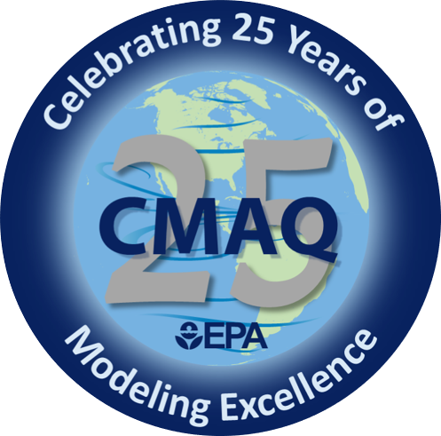
CRACMM chemistry and CMAQ: past, present, and future
Havala O. T. Pye, Rebecca Schwantes, Nash Skipper, Bryan Place, Golam Sarwar, Ben Murphy, Bill Hutzell, Emma D’Ambro, Rob Pinder, Forwood Wiser, Faye McNeill, Kathleen Fahey, Sara Farrell, Pietro Vannucci, Karl Seltzer, William Stockwell, and the CRACMM Team
EPA, ORISE, NOAA Chemical Sciences Laboratory, UT El Paso, and Columbia University
The views expressed in this presentation are those of the author and do not necessarily reflect the views or policies of the U.S. EPA.
Office of Research and Development
Center for Environmental Measurement and Modeling (CEMM)
CMAS Conference
21 October 2024
Notes:
25 minutes

Slide 2
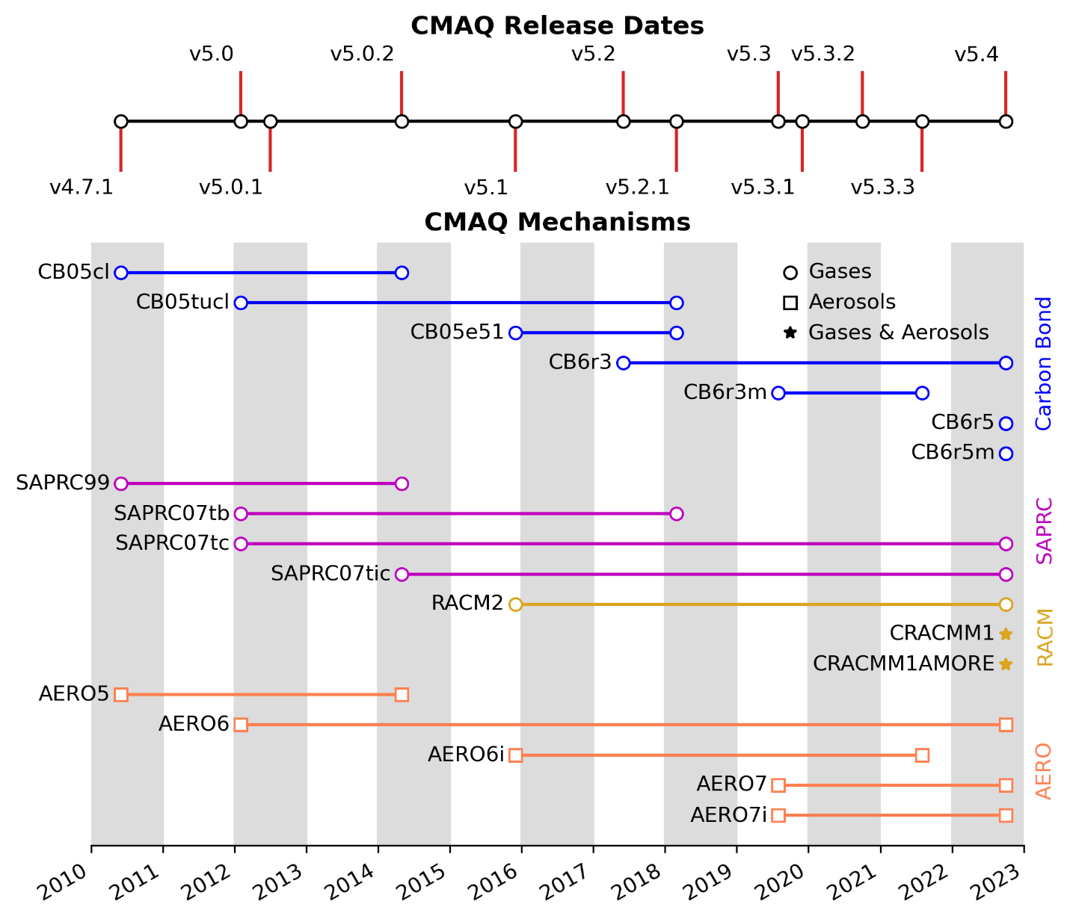
A History of Mechanisms in CMAQ
Mechanisms in CMAQ Public Releases Since 2010
Since 2010, EPA ORD has released >14 descriptions of atmospheric chemistry
Historically, gas-phase reactions leading to ozone are described in one set of reactions and aerosols are described in a different set
This has led to an emphasis on different species for different purposes
Pye et al., 2024 EM Magazine
Notes:
Since 2010, EPA ORD has released at least 14 descriptions of atmospheric chemistry known as chemical mechanisms.
And historically, gas-phase reaction leading to ozone are described in one set of reactions such as those from CB, SAPRC, or RACM;
and aerosol formation is described in a different set known as the “aero” module.
This has led to an emphasis on different species for different purposes.

Slide 3
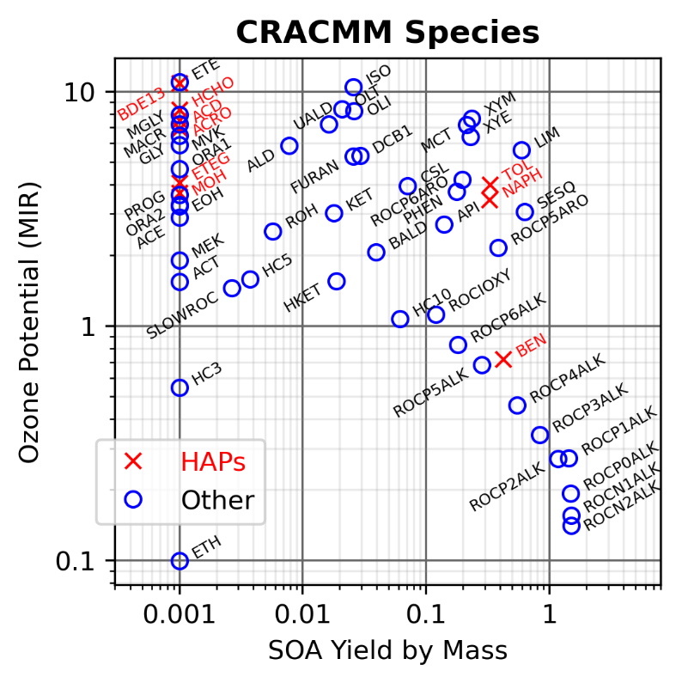
Ozone and PM (SOA) endpoints emphasize different species
Species with both SOA and ozone formation:
Traditionally represented in duplicate for gas vs aerosol purposes
Opportunities to better constrain these systems through coupling as SOA formation removes mass from the gas phase!
Species with high ozone formation but no SOA (included in traditional mechanisms)
#3 (HC3-propane) and #5 (ETH-ethane) species by emission abundance (excluding biogenics); little O₃ and no SOA; traditionally included
Semi and intermediate volatility species with high SOA formation and less contribution to ozone (excluded from traditional mechanisms)
Pye et al. 2024, EM Magazine
Notes:
This is illustrated if we look at the species and their potential to form ozone, indicated by MIR, and SOA through volatility pathways estimated by a simple yield.
Starting in the lower left, we have species like propane and ethane that are abundantly emitted and form a little bit of ozone. They are traditionally included in mechanisms designed for gas-phase endpoints.
In the upper left, we have species with high ozone formation but no SOA such as 1,3 butadiene, ethene, and formaldehyde. These species are included in traditional mechanisms focused on gas-phase endpoints.
In the lower right, we have species like semi and intermediate volatility compounds with high SOA formation but less contribution to ozone. These are not included in traditional mechanisms focused on ozone.
In the upper right, we have species with both SOA and ozone formation such as xylenes, toluene, limonene, and a-pinene. These systems are traditionally represented in duplicate for gas and SOA purposes. However, because we know the SOA formation should remove mass from the gas phase, there is an opportunity to further constrain these systems if we couple gas and aerosol endpoints.

Slide 4
Persistent challenge: atmospheric chemistry is complex & not fully known
Explicit schemes are not complete descriptions of atmospheric chemistry
MCM benzene chemistry based on characterization of 50% of the reacted carbon (newer studies reach 80%, Xu et al., 2020 ES&T)
Autoxidation not included
Producing simplified mechanisms is not straight forward, labor intensive, and depends on the endpoint of interest
As knowledge continues to grow and additional endpoints are necessary to predict, how do we synthesize this information?
Pye et al., 2024 EM Magazine
Notes:
A persistent challenge in building chemical mechanisms is that atmospheric chemistry is complex and not fully known.
In explicit or semi-explicit reaction schemes, we attempt to represent the chemistry in a high level of detail and we often consider these mechanisms to be a standard with which simplified mechanisms are compared.
For MCM, this results in over 10,000 reactions. For GECKO-A, just for one species, a-pinene, over a million reactions are required.
However, even these schemes are not complete descriptions of atmospheric chemistry.
For example, MCM benzene chemistry is based on characterization of 50% of the carbon and autoxidation is not included.
In models like CMAQ, we use simplified mechanisms which have less than 1,000 reactions and a couple hundred species.
How these mechanisms are created is not straight forward, labor intensive, and depends on the endpoint of interest.
So as knowledge continues to grow and additional endpoints are necessary to predict,
our challenge is how do we synthesize this information for use in models like CMAQ?

Slide 5
The Community Regional Atmospheric Chemistry Multiphase Mechanism aims to:
Improve the characterization of emissions and their chemistry
Build process-level representations of toxics, PM, and ozone
Remain computationally feasible for current operations
Leverage community knowledge
Notes:
The Community Regional Atmospheric Chemistry Multiphase Mechanism is our plan to
Improve the characterization of emissions and their chemistry
Build process-level representations of toxics, PM, and ozone
Remain computationally feasible for current operations
Leverage community knowledge
Our focus on the 3 endpoints of PM, ozone, and toxics are reflected in our logo designed by Chelsea Thompson at NOAA.
On the left, we have IEPOX which is an important precursor to secondary organic aerosol and PM.
In the middle we have ozone.
And on the right we have formaldehyde as a representative of toxic species.

Slide 6
Specific CRACMM Objectives
All emitted organic mass should go into model species as CRACMM includes a full range of reactivity and volatility
Formation of condensible gases (leading to SOA) must remove mass from the gas-phase
CRACMM aims to conserve mass: Loss/gain of C, N, etc is automatically calculated at the reaction level via CMAQ tools (CHEMMECH) and documented in mech.def
All species must have at least one example structure documented
Allows for automated emission mapping and greater dissemination
See trailing comments in namelist or CRACMM metadata in repo
Notes:
CRACMM has several specific objectives
We aim to conserve mass and to facilitate this, the loss and gain of carbon and other elements is automatically calculated by CMAQ tools and documented in the mechanism definition file. This can assist developers which debugging as it will highlight if a larger fraction of mass is being lost and over time, we aim to elimnate any artificial gas or loss of carbon.
We require that all species have at least one example structure documented. This allows us to use chemiinformatics tools to automatically parse information from structures which facilitates emission mapping as well as better communicating the meaning of species.

Slide 7
Scientific Advancements and Applications
Version 1 in CMAQv5.4 (2022) – coupling gas and PM, building emission infrastructure
Version 2 in CMAQv5.5 (2024) – improving formaldehyde via the chemistry of biogenic VOCs
Version 3 in CMAQv6.0 (2026) – adding heterogeneous chemistry and enabling more applications
Notes:
In this next section, I’ll cover results from the two versions of CRACMM that have already been released and the upcoming planned release for 2026.
Version 1 was released in CMAQv5.4 in 2022 and focused on coupling the gas and PM phases as well as building emission infrastructure.
Version 2 was released this month in v5.5 and we focused on improving formaldehyde
And version 3 will be released in v6.0 in 2026 and will add more heterogeneous chemistry and enable more applications.

Slide 8
SOA paths integrated with gas phase
Emission
Oxidation
Condensation
SOA in Aromatic Systems: from aromatic hydrocarbons, oxygenated aromatics and heterocyclic species, and others
Over half of gas-phase benzene (BEN) oxidation results in phenol (PHEN). The amount of benzene SOA from the phenol channel affects source apportionment.
Pye et al., 2023 ACP
Version 1-2 Development
Notes:
As part of version 1, we integrated SOA paths with the gas phase chemistry.
Here, I’m showing molar flows to organic aerosol in the aromatic systems with
includes species like toluene, xylenes, benzene, furan, phenol, furanone, cresol and other species.
Some of these species are only emitted (like benzene) but some are both emitted and produced, such as phenol.
In the case of benzene, over half of the oxidation of benzene produces phenol.
To represent SOA across both systems, we have to determine how much benzene SOA actually comes from further phenol oxidation.
The role of phenol in benzene SOA will affect source apportionment as benzene is primarily from anthropogenic combustion sources like cars
while phenol emissions are predominantly from biomass burning.

Slide 9
SOA paths integrated with gas phase
CRACMM OA Systems
System(s) | SOA Yield Basis | Driver | Autoxidation
Phenol and Cresols† | Literature | Volatility | No
Alkane-like S/IVOCs and ~C10-C8 VOC alkanes | GECKO + literature | Volatility | Yes
Aromatic IVOCs,† Benzene, Toluene, Xylenes | MCM + literature | Volatility | Yes
Sesquiterpenes | MCM + literature | Volatility | Yes
Secondary oxygenated S/IVOCs | Multigeneration 2-D VBS | Volatility | No
Isoprene epoxydiols | CMAQ AERO7 | Aqueous Rxn | No
Glyoxal + methylglyoxal | CMAQ AERO7 | Aqueous Rxn | No
α-pinene and limonene | Literature | Volatility | Yes
Terpene nitrate | Literature | Volatility & Hydrolysis* | No
Terpene aldehydes† | Literature | Volatility | Yes
Furanone† | Literature | Volatility | No
Long-lived species† | Simple estimate | Volatility | No
Emitted oxygenated IVOCs† | Simple estimate | Volatility | No
Small, volatile alkanes | Simple estimate | Volatility | No
Multifunctional isoprene oxidation products†* | AMOREv1.2 | Aqueous Rxn | No
Emission
Oxidation
Condensation
SOA in Aromatic Systems: from aromatic hydrocarbons, oxygenated aromatics and heterocyclic species, and others
Over half of gas-phase benzene (BEN) oxidation results in phenol (PHEN). The amount of benzene SOA from the phenol channel affects source apportionment.
Pye et al., 2023 ACP
†Not considered an SOA precursor in CMAQ AERO6/7
*New in CRACMM2 compared to CRACMM1 (Skipper et al., 2024 EGUSphere)
Version 1-2 Development
Notes:
We have integrated the SOA for a number of systems shown here on the right.
Some pathways are volatility based while others are aqueous, and a few include autooxidation.
These slides will be posted if you are interested in these details.

Slide 10
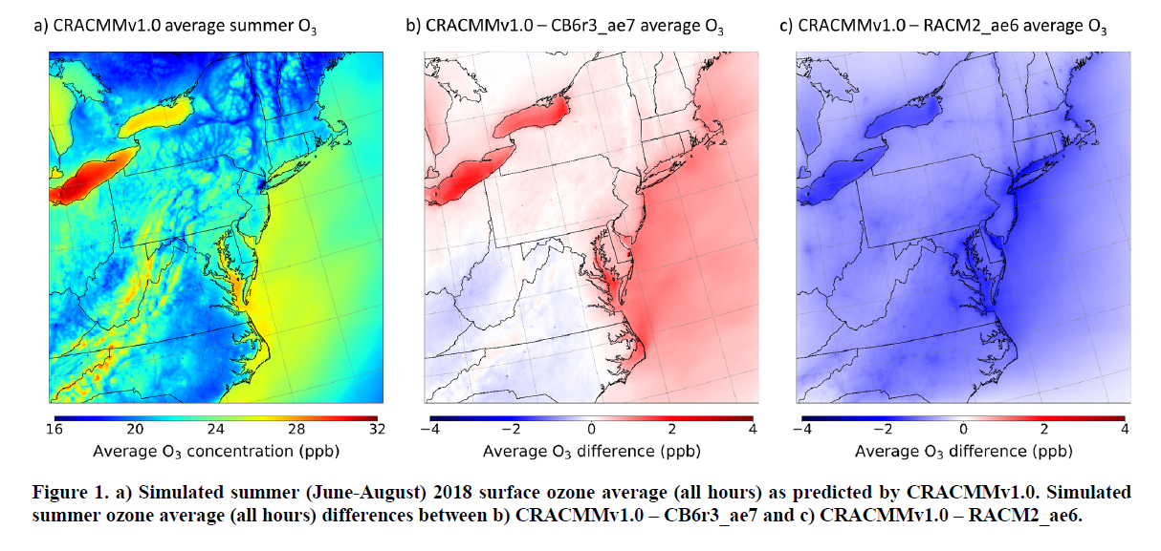
CRACMM1 ozone is similar to (but higher than) CB6
Place et al., 2023 ACP
Summer LISTOS 2018
Two drivers that decreased CRACMM1 ozone relative to RACM2:
Updates to inorganic rate constants
Monoterpene chemistry
CRACMM1 tends to be higher than CB6 at the higher end of the ozone distribution.
Version 1 Development and Application
Notes:
We have applied CRACMM to several domains. One of the first was the northeast US in summer 2018 which coincided with the LISTOS campaign.
Compared to CB6r3, CRACMM1 tended to be pretty similar or a big higher for ozone, especially at the higher end of the ozone distribution.
CRACMM is notable a bit lower in ozone than RACM2 which is what we built upon due to updates in the inorganic rate constants as well as
Updated to the monoterpene system which we further updated in CRACMM version 2.

Slide 11
PM and Temperature
Broad need for CMAQ to provide data relevant to health and climate (e.g., National Climate Assessment)
Southeast U.S. projected to experience greatest increase in number of PM_{2.5}-attributable deaths due to climate change at 2100 (Fann et al., 2021 JAMA NetOpen)
Notes:
In terms of a more specific example of how we are evaluating CMAQ with CRACMM, we can look at understanding the relationship of PM2.5 with temperature.
At EPA, we have a broad need to provide data relevant to health and climate. For example, CMAQ is used in NCA and other EPA projects to understand the impacts of climate change on PM2.5. In particular, CMAQ simulations using downscaled climate meteorology indicated the southeast US is projected to have the greatest regional increase in PM2.5-attributable deaths by the end of the century due to climate change.

Slide 12
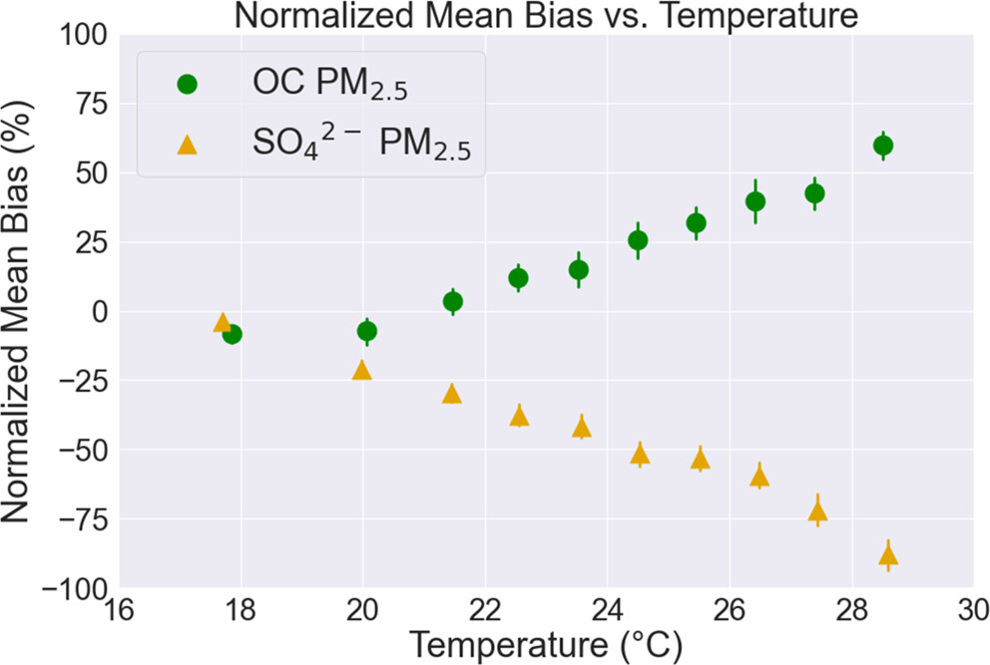
PM and Temperature
Vannucci et al., 2024 ACS ESC
Observed PM_{2.5} Relationship with T (Summer 2019)
Broad need for CMAQ to provide data relevant to health and climate (e.g., National Climate Assessment)
Southeast U.S. projected to experience greatest increase in number of PM_{2.5}-attributable deaths due to climate change at 2100 (Fann et al., 2021 JAMA NetOpen)
Can evaluation of PM variation with T in the present day indicate if processes are correctly represented?
Vannucci et al found:
Unbiased PM-T relationship, component-specific biases
Sulfate underestimates most likely related to low chemical conversion of SO₂
Sulfate and isoprene epoxy diol (IEPOX) SOA are highly connected and modulate the OC and sulfate–T sensitivities
CMAQ-CRACMM bias: -0.07 µg/m³/K
Eastern U.S. Summer
Version 1 Application, v5.5 CRACMM1 IEPOX rate fix impact
Notes:
In Pietro Vannucci’s work, we wanted to understand if PM variation with T was properly represented in the model and if it could provide insight into the behavior of model processes.
We found CRACMM reproduced the observations of PM vs T very well but found OC increased too much with increasing temperature and sulfate didn’t increase enough.
By testing specific interventions, we determined the sulfate underestimate was most likely related to low chemical conversion of SO2 and
the connection between sulfate and IEPOX SOA modulated the OC vs T sensitivity. And we do have plans to update the sulfate chemistry in CRACMM3.

Slide 13
FIREX-AQ indicates missing organics from wildland fires
Pye et al., ES&T in press
In C units: 1.25 ± 0.06 gC ROC/gC CO
Complete Estimate
Particle
Gas
Emission Ratio (g-reactive organic compounds/kg-CO)
*Indicates Emission Ratio inferred from ambient concentrations (Pye et al., 2024 submitted)
EPA 2019 Inventory Methods: Foley et al., 2023 DiB
Version 1 Application
Notes:
Since CRACMM was designed to represent the full pool of reactive organic carbon, we applied it to the FIREX-AQ campaign to understand if we had enough organic emissions from wildfires in our model.
Our base model and inventory indicated about 300 g/kgCO with most of the emission in the gas phase.
From the observations and a simulation in which we adjusted all known species,
we estimated closer to 700 or 800 g/kgCO indicating that both the total organics as well as the particulate organic emissions from fires were low.

Slide 14
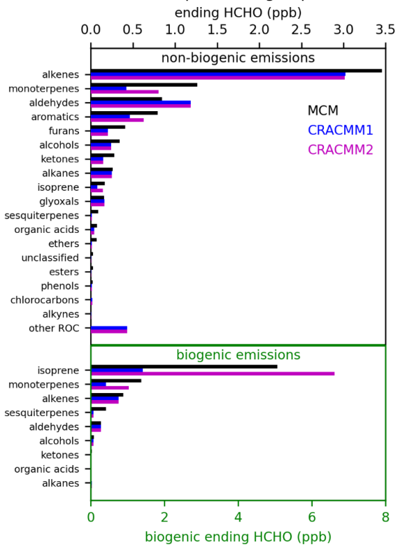
Formaldehyde chemistry improved
Skipper et al., 2024 EGUSphere
1. HCHO biased low in CRACMM1
2. MCM box modeling used to screen for potential chemistry errors
3. Chemistry updated and used to estimate inhalation risk from formaldehyde as well as the controllable fraction of risk
See Poster by Nash Skipper TODAY to see the full CRACMM2 evaluation and learn about controllable risk from formaldehyde
Version 2 Development and Application
Notes:
For CRACMM version 2, we focused on improving predictions of formaldehyde as it is the top driver of cancer risk from inhalation of ambient compounds for a broad portion of the U.S. and has significant secondary sources. We found CRACMM1 was biased low compared to ground observations, flight data, and TROPOMI satellite data.
To identify systems for update, we performed box model calculations with MCM and CRACMM1. Since we know MCM is not a complete or perfect representation of chemistry, we used differences between the two as a screening tool to identify systems for further update. Both isoprene and monoterpenes stood out as biased and were updated in CRACMM2.
We then used CRACMM to estimate the inhalation risk from formaldehyde as well as the controllable risk. See Nash’s poster TODAY for all the details and a full evaluation of CRACMM2.

Slide 15
Computational competitiveness for regional modeling
Target: CRACMM should remain within 30% of wall clock time of operational CMAQ (species count as proxy)
Pye et al., 2024 EM Magazine
Version 1
Notes:
As I mentioned in the introduction, CRACMM is meant to be computationally feasible for regional modeling. It’s intermediate in size between SAPRC and CB6, and much smaller than explicit mechanisms. We had a target to remain within 30% of the wall clock time required for current operations. One way we were able to remain computationally efficient was to use the AMORE technique shown here on the right which can condense isoprene chemistry with over 800 reactions into around 20 reactions and 12 species.

Slide 16
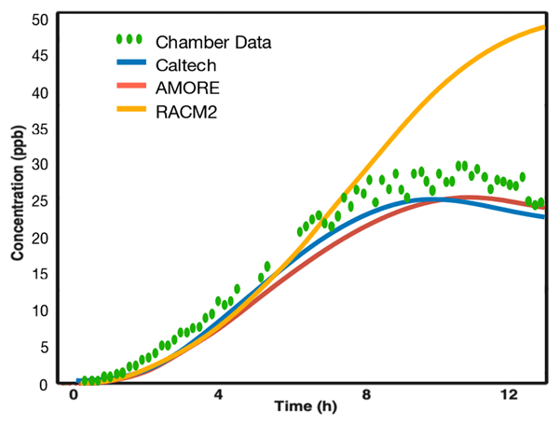
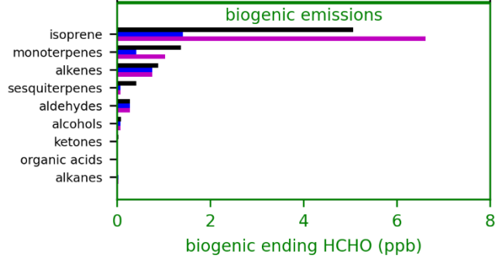
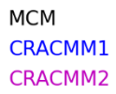
Remedy bias without slowdown
Graph theory representation of isoprene (AMORE technique) improves predictions of key PM and toxic species (without any meaningful runtime slowdown!)
AMORE v1.0 improves PM precursor, IEPOX
(Wiser et al., 2023 GMD)
AMORE v1.2 in CRACMM2 improves formaldehyde from isoprene
(Skipper et al., 2024 EGUSphere)
RACM2
( = CRACMM1)
AMORE v1.0
Version 1-2
Notes:
AMORE allowed us to remedy the bias in some key species. On the left, we have IEPOX…..
On the right, we show how formaldehyde was improved in CRACMM2 for the isoprene system.

Slide 17
CRACMM3 Versions for 2026 Release
Talk by Sarwar at 1:40PM TODAY
CRACMM3 HAP
Base + expanded set of toxic tracers, designed for applications like AirToxScreen and estimation of ambient air inhalation health risk
CRACMM3M
Marine version with detailed halogen and chlorine chemistry, recommended for hemispheric and global simulations
CRACMM3
Base, most highly curated and efficient, recommended for most CMAQ applications
Notes:
In the 2026 release of CMAQ, we will have 3 versions…

Slide 18
Updates to expect in the 2024-2026 Base Releases
Scientific Update | Impact | CMAQ Reference
Isoprene and monoterpene chemistry updated to state of science | Improved predictions of IEPOX abundance, new SOA from multifunctional isoprene products, improved formaldehyde, higher ozone; monoterpene chemistry tied to laboratory data | Available now in CRACMM2; Skipper et al. 2024 EGUSphere; Wiser et al. 2023 GMD
HO₂ uptake on particles | Reduced O₃ in locations of high PM (mostly external to U.S. or in historical U.S. atmosphere) | Available now in CRACMM2; Skipper et al. 2024 EGUSphere
Aerosol nitrate photolysis | Increased transport of ozone to U.S. (especially in spring and western U.S.) | Coming in CRACMM3; Sarwar et al. 2024 STOTEN
Sulfur oxidation on particles | Increased secondary sulfate (e.g., in Fairbanks, AK) leading to more total sulfate | Coming in CRACMM3; Farrell et al. 2024 EGUSphere
CRACMM2 Poster by Nash TODAY
Talk by Sarwar at 1:40PM TODAY
Notes:
Here are a couple updates to expect in the 2024 and 2026 releases. In CRACMM2, we have updated isoprene and monoterpene chemistry.

Slide 19
Do I need to update to CRACMM3?
Strongly consider updating if you are interested in:
Sulfate (e.g., Fairbanks, AK; China)
Formaldehyde (e.g., predictions of ambient cancer risk, TEMPO analysis)
Springtime ozone and role of background vs local sources
Organic aerosol and role of isoprene vs monoterpene vs heterocyclic systems
Aromatic chemistry (single ring aromatics and oxygenated aromatics)
Reactivity in wildfire smoke (e.g., furan chemistry)
Contributing model developments that become part of the official release
Notes:
Whether or not you update to CRACMM3 in 2026 will depend on a number of factors, but here are some reasons you may want to consider updating.
For example, if you are interested in…
In addition, if you are interested in contributing model developments that become part of the official release, Identifying and correcting errors in CRACMM can be particularly helpful

Slide 20
A community approach
If you use, develop, apply, evaluate, or support CRACMM—you are the community!
Notes:
CRACMM is a community mechanism and if you use, develop, apply, evaluate, or otherwise support CRACMM, you are part of that community.

Slide 21
Chemical mechanisms: Not just for modelers
Mechanisms require:
Characterization of individual reactions and systems
Synthesis across systems into a whole
Testing and evaluation against ambient data
Flow-tube & batch experiments
JPL/IUPAC assessments
Computational chemistry
Explicit reaction schemes
Box modeling
MCM, CRI, CB, RACM, SAPRC, GECKO-A,…
Field campaigns
Curation of metadata
Chemical transport modeling
Notes:
We see CRACMM as a mechanism that is not restricted to CMAQ users or even modelers. This is because mechanisms require a lot of information to be robust. For example, they require characterization of individual reactions and systems which can be accomplished through …..
Synthesis of systems into whole mechanisms which is done through…..
Testing and evaluation which includes….

Slide 22
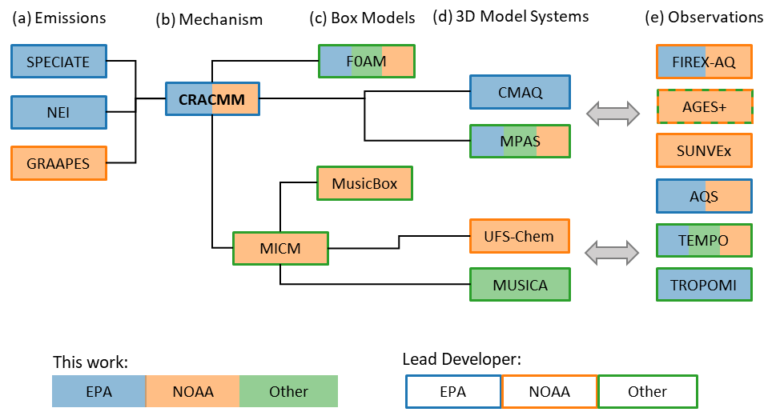
The CRACMM Collaborative Effort
Key partners:
EPA ORD Lead: Havala Pye
NOAA CSL Lead: Becky Schwantes
University Partners:
V. Faye McNeill, Columbia University
Kelvin Bates, University of Colorado
William R. Stockwell, University of Texas El Paso
Planned linkages under the CRACMM Collaborative Effort
White Paper at: www.epa.gov/cmaq/cracmm
Notes:
To facilitate CRACMM development, we have created the CRACMM collaborative effort which is a partnership between EPA ORD, NOAA CSL, and acadmics. Becky Schwantes is our NOAA CSL lead and we have 3 university partners. Our goal is to jointly develop the representation of chemistry in CRACMM. To do this, we use a number of emission inventories, box models, and 3-D models. As part of the NOAA effort, CRACMM will be integrated into MICM which provides an opportunity to use CRACMM in both NOAA and NCAR models.
Model-Independent Chemistry Module (MICM)

Slide 23
Process to contribute to official CRACMM versions
1. Scope Discussion
Form: Virtual meeting or email to provide early feedback on suitability of an update for CRACMM.
Outcome: Feedback; may include information on potential for duplication or partners for further development.
2. Science Proposal
Form: Virtual meeting in which developer presents update and suitability for CRACMM.
Outcome: Recommendation whether to proceed to next step and guidance on path to integration.
3. Code Review
Form: Initiated via Pull Request to CMAQ Repository.
Outcome: After successful review and integration, officially released by EPA in CMAQ and on github.com under USEPA/CRACMM.
OPTIONAL
REQUIRED
REQUIRED
Discussions will be documented on https://github.com/USEPA/CRACMM in future. See slides at end for more details on process.
All steps documented on github.com (currently in private repo with transition to public in future)
Notes:
As part of being a community mechanism, we have developed a process by which you can contribute development to the official release of CRACMM.
The first step is a scope discussion

Slide 24
Resources available
The official release of CMAQ and CRACMM’s main home (https://github.com/USEPA/CMAQ)
User guide, tutorials, documentation, etc
The CRACMM repo for CMAQ and non-CMAQ users (https://github.com/USEPA/CRACMM)
Metadata, box model inputs, and other information such as rules for emission mapping
SMOKE inputs and the SPECIATE to SMOKE Tool (https://github.com/USEPA/S2S-Tool)
S2S Tool output includes gspro and gscnv files for use in SMOKE
See 2022v1 OAQPS platform for CRACMM2 gspro, etc
The F0AM box model (https://github.com/AirChem/F0AM)
Includes official versions of CRACMM after publication in peer-reviewed literature (currently CRACMM1)
CMAQ website (www.epa.gov/cmaq/cracmm)
Fact Sheets with timeline of CMAQ model releases, CRACMM versions, and plans for other mechanisms
White paper describing collaborative effort with NOAA and academics
CMAQ-ready inputs using CRACMM
2018 12NE3 benchmark distributed with v5.5 (see Tutorials and link)
2018 12US1 (https://doi.org/10.15139/S3/9AV907)
2017 MPAS global (https://doi.org/10.15139/S3/PAHQFO)
2019 12US1 (coming Fall 2024)
Publications (see www.epa.gov/cmaq/cracmm and slide at end)
See poster TODAY by Ruby Tian of NY DEC

Slide 25
CRACMM Highlights
CRACMM was designed for the full range of reactivity and volatility of organic species, and characterizing this full suite is needed for accurate predictions of PM and other endpoints (e.g., wildland fire PM).
Process-level representations of species like PM_{2.5} and formaldehyde facilitate source attribution and build confidence in simulations that cannot be evaluated with measurements (e.g., future projections, counterfactuals such as no anthropogenic influence).
CRACMM2 is computationally competitive with operational CB6r5 in CMAQ.
CRACMM is available in CMAQ and F0AM and will be available in NOAA and NCAR models.
CRACMM is the only mechanism being updated by EPA ORD in CMAQ going forward.

Slide 26
Notes:
Not everything known
Original goal of ozone
Detailed mechanisms developed
Need to condense down
How you simplify depends on what you want to predict
Problem, how we’re solving problem
Knowledge continues to grow
Reactions ignored
Complete description intractable

Slide 27
Workflow for Updates to CRACMM
CRACMM Scope Discussion (optional)
For developers interested in getting early feedback on whether an update is likely a good fit for CRACMM, they can request an optional initial scope discussion with the CRACMM leads and/or CRACMM development team. Scope discussions may include information on potential duplication or partners for further development and are not decisions regarding approval or disapproval of a particular update. Science scope discussions will be documented on the CMAQ_Dev (eventually CRACMM) GitHub site as issues.
CRACMM Science Proposal Process
Updates to CRACMM must undergo a proposal stage prior to code submission. The CRACMM science proposal process will consist of a one-hour virtual meeting in which the developer presents their update and its suitability for incorporation in the official CRACMM. The developer should include information to discern:
the complexity of the update (for example: chemical systems considered, number of new species, number of new reactions, model processes needing update, etc),
underlying scientific basis (for example: data used for evaluation, simulations performed, impact on priority species, etc), and
the path to documentation in a peer-reviewed publication.
The meeting will be open to the entire EPA CRACMM development team with CRACMM leads at EPA and NOAA as mandatory attendees (see the CRACMM White Paper). The NOAA CRACMM lead may invite additional NOAA scientists. Other critical external scientists involved in the development of an update may also be invited to provide scientific information. Within one month of the proposal meeting, CRACMM lead(s) will synthesize meeting discussion with a goal of determining a consensus and provide feedback to the developer on whether the update is ready to proceed. The CRACMM science proposal discussion outcome and path to integration in the main CRACMM mechanism will be documented in a CMAQ_Dev (eventually CRACMM) GitHub Issue. The science proposal occurs before the Code Pull Request, but the exact timing is up to the developer.
CRACMM Code Review
All updates to CRACMM must go through the CMAQ Code Pull Request procedure (See the CMAQ SOP). Receiving positive support in a CRACMM Science Proposal meeting does not guarantee incorporation in the official CRACMM.

Slide 28
Farrell, S. L., Pye, H. O. T., Gilliam, R., Pouliot, G., Huff, D., Sarwar, G., Vizuete, W., Briggs, N. & Fahey, K. Predicted impacts of heterogeneous chemical pathways on particulate sulfur over Fairbanks, Alaska, the N. Hemisphere, and the Contiguous United States. EGUsphere 2024. preprint, 1–43. https://doi.org/10.5194/egusphere-2024-1550 (2024).
Heterogeneous sulfate pathways targeted for CRACMM3 (2026); CB6 model application to Fairbanks, AK and other domains
Murphy, B. N., Sonntag, D., Seltzer, K. M., Pye, H. O. T., Allen, C., Murray, E., Toro, C., Gentner, D. R., Huang, C., Jathar, S., Li, L., May, A. A. & Robinson, A. L. Reactive organic carbon air emissions from mobile sources in the United States. Atmos. Chem. Phys. 23, 13469–13483. https://doi.org/10.5194/acp-23-13469-2023 (2023).
Mobile emission inventory (recommended input for CRACMM)
Place, B. K., Hutzell, W. T., Appel, K. W., Farrell, S., Valin, L., Murphy, B. N., Seltzer, K. M., Sarwar, G., Allen, C., Piletic, I. R., D’Ambro, E. L., Saunders, E., Simon, H., Torres-Vasquez, A., Pleim, J., Schwantes, R. H., Coggon, M. M., Xu, L., Stockwell, W. R. & Pye, H. O. T. Sensitivity of northeastern US surface ozone predictions to the representation of atmospheric chemistry in the Community Regional Atmospheric Chemistry Multiphase Mechanism (CRACMMv1.0). Atmos. Chem. Phys. 23, 9173–9190. https://doi.org/10.5194/acp-23-9173-2023 (2023).
First CMAQ Implementation of CRACMM (version 1) applied to northeast US in summer 2018; focus on ozone evaluation
Pye, H. O. T., Place, B. K., Murphy, B. N., Seltzer, K. M., D’Ambro, E. L., Allen, C., Piletic, I. R., Farrell, S., Schwantes, R. H., Coggon, M. M., Saunders, E., Xu, L., Sarwar, G., Hutzell, W. T., Foley, K. M., Pouliot, G., Bash, J. & Stockwell, W. R. Linking gas, particulate, and toxic endpoints to air emissions in the Community Regional Atmospheric Chemistry Multiphase Mechanism (CRACMM). Atmos. Chem. Phys. 23, 5043–5099. https://doi.org/10.5194/acp-23-5043-2023 (2023).
CRACMM framework and documentation
Pye, H. O. T., Schwantes, R. H., Barsanti, K. C., McNeill, V. F. & Wolfe, G. M. Leveraging Scientific Community Knowledge for Air Quality Model Chemistry Parameterizations. EM Magazine. https://ntrs.nasa.gov/citations/20240000094 (2024).
Overview of CRACMM as a community effort and community data needs
Pye, H. O. T., Xu, L., Henderson, B., Pagonis, D., Campuzano-Jost, P., Guo, H., Jimenez, J. L., Allen, C., Skipper, T. N., Halliday, H. A., Murphy, B., D’Ambro, E. L., Wennberg, P. O., Place, B., Wiser, F., McNeill, V. F., Apel, E., Blake, D., Coggon, M. M., Crounse, J. D., Gilman, J., Gkatzelis, G., Hanisco, T. F., Huey, G., Katich, J. M., Lamplugh, A., Lindaas, J., Peischl, J., St. Clair, J. M., Warneke, C., Wolfe, G. & Womack, C. Evolution of reactive organic carbon and its potential health risk in wildfire smoke. Environ. Sci. Technol. https://doi.org/10.1021/acs.est.4c06187 (in press).
Application of CRACMM1AMORE to FIREX-AQ western US wildfires and characterization of reactive organic compounds
Sarwar, G., Hogrefe, C., Henderson, B. H., Mathur, R., Gilliam, R., Callaghan, A. B., Lee, J., & Carpenter, L. J. Impact of particulate nitrate photolysis on air quality over the Northern Hemisphere,
Sci.of The Tot. Env., https://doi.org/10.1016/j.scitotenv.2024.170406 (2024).
Aerosol nitrate photolysis targeted for CRACMM3
Seltzer, K. M., Rao, V., Pye, H. O. T., Murphy, B. N., Place, B. K., Khare, P., Gentner, D. R., Allen, C., Cooley, D., Mason, R. & Houyoux, M. Anthropogenic secondary organic aerosol and ozone production from asphalt-related emissions. Environmental Science: Atmospheres 3, 1221–1230. https://doi.org/10.1039/D3EA00066D (2023).
Application of CRACMM1 to understand role of asphalt paving in criteria pollutant formation
Skipper, T. N., D’Ambro, E. L., Wiser, F. C., McNeill, V. F., Schwantes, R. H., Henderson, B. H., Piletic, I. R., Baublitz, C. B., Bash, J. O., Whitehill, A. R., Valin, L. C., Mouat, A. P., Kaiser, J., Wolfe, G. M., St. Clair, J. M., Hanisco, T. F., Fried, A., Place, B. K. & Pye, H. O. T. Role of chemical production and depositional losses on formaldehyde in the Community Regional Atmospheric Chemistry Multiphase Mechanism (CRACMM). EGUsphere 2024. preprint, 1–34. https://doi.org/10.5194/egusphere-2024-1680 (2024). 84.
CRACMM2 development and application to ambient formaldehyde and its cancer risk; reference for CMAQv5.5 CRACMM2 (see SI for additional evaluation)
Vannucci, P. F., Foley, K., Murphy, B. N., Hogrefe, C., Cohen, R. C. & Pye, H. O. T. Temperature-Dependent Composition of Summertime PM2.5 in Observations and Model Predictions across the Eastern U.S. ACS Earth Space Chem. https://doi.org/10.1021/acsearthspacechem.3c00333 (2024).
CRACMM1 application to understanding PM_{2.5} vs temperature and evaluation of OC and sulfate systems; includes effect of CRACMM1 IEPOX rate constant fix in v5.5
Wiser, F., Place, B. K., Sen, S., Pye, H. O. T., Yang, B., Westervelt, D. M., Henze, D. K., Fiore, A. M. & McNeill, V. F. AMORE-Isoprene v1.0: a new reduced mechanism for gas-phase isoprene oxidation. Geosci. Model Dev. 16, 1801–1821. https://doi.org/10.5194/gmd-16-1801-2023 (2023).
AMORE condensation approach applied to isoprene, AMOREv1.2 isoprene included in base CRACMM2

