Slide 1
Improving CMAQ Representation of 2023 Wildfire Air Quality Impacts by Assimilating Satellite NO2 Data
Joshua Kumm^{1,2}, Barron Henderson³, Sergey Napelenok³, Heather Simon³, Zhen Qu²
1 ORISE Fellow at US EPA
2 NC State University
3 US EPA
2024 CMAS Conference, In-Person
The views expressed in this presentation are those of the author and do not necessarily reflect the views or policies of the U.S. EPA.

Slide 2
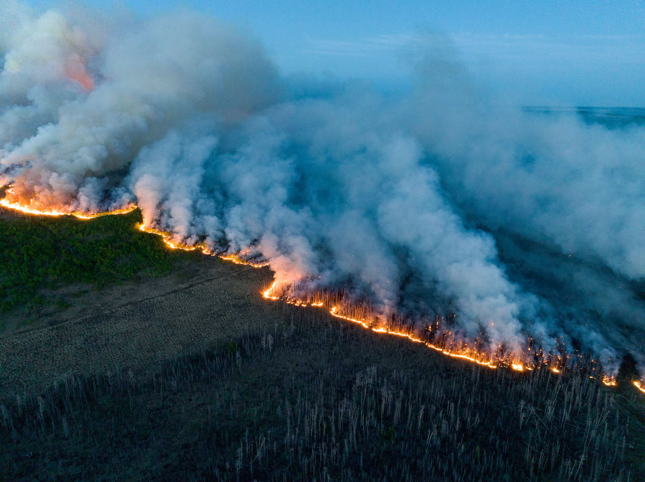
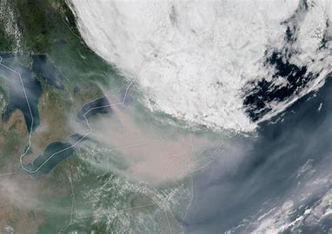
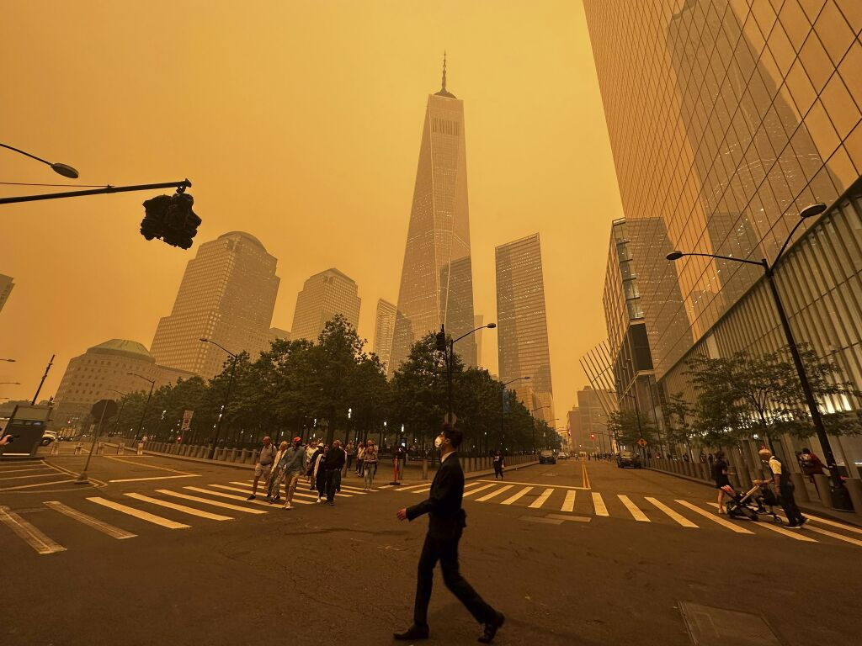
Motivation: the 2023 Canadian Wildfires
Last summer, wildfires raged across Canada at an unprecedented scale from May-October
18.5 million hectares burned (>2.5x previous record)
Frequent smoke plumes produced significant air quality problems across the US

Slide 3
Rapid Modeling of Fire Impacts
Accurate estimation of 2023 fire emissions crucial to understanding fire impacts to air quality, but not yet available
Rapid modeling efforts such as the Expedited Modeling of Burn Events Result (EMBER) underway at US EPA
Shown to reasonably capture fire plume extent and downwind ozone formation
However, high uncertainty remains…
How can we improve representation of the 2023 fires and reduce uncertainty in these modeling efforts?
Notes:
No up-to-date emissions inventories currently available
CMAQ v5.4 model
Fire emissions estimated from BlueSky pipeline
Reasonably captures fire plume extent and downwind ozone formation
However, high uncertainty remains…

Slide 4
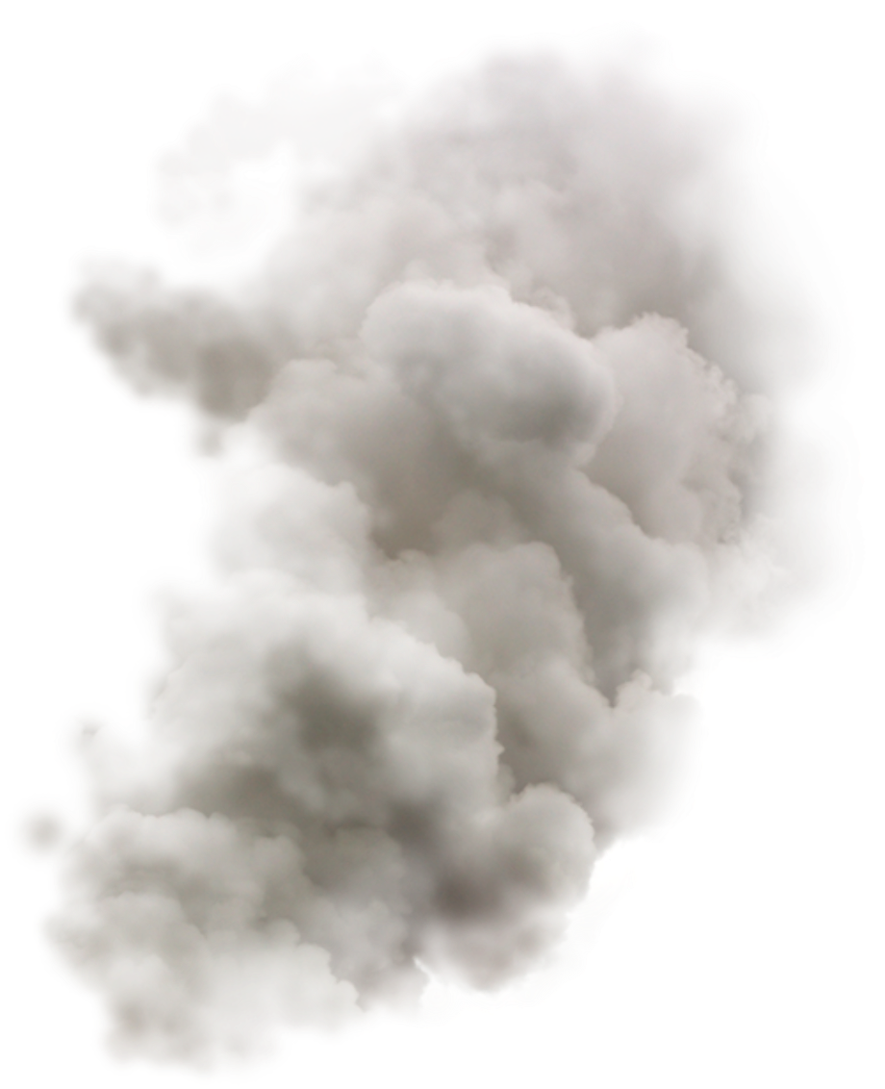
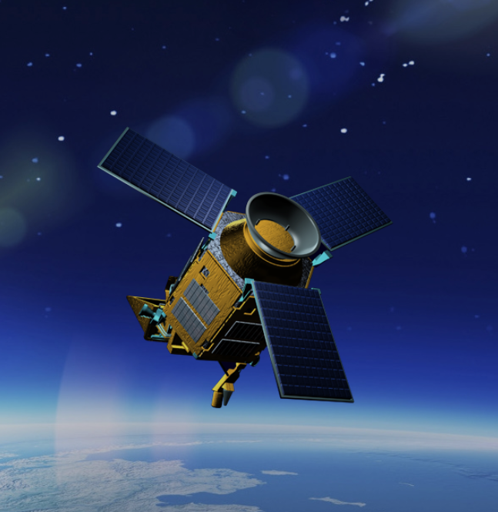
The Case for Assimilating Satellite NO₂
To gain a better understanding of ozone-related fire impacts, we need to start with NO₂ at the source
Fires release large quantities of NO_{x} (including NO₂)
NO_{x} carried via smoke plumes to distant locations, reacting photochemically to form ozone
NO₂ observations from the TROPOspheric Monitoring Instrument (TROPOMI) can refine modeled NO₂ and ozone concentrations
Higher spatiotemporal resolution (5.5 km x 3.5 km, 102 min)
Captures urban-scale air quality on subseasonal timeframe
Notes:
NO_{x} is among the major pollutants released in large quantities by wildfires
Transported long distances in smoke plumes
Reacts in the atmosphere to form ozone
Accurate estimation of fire NO_{x} crucial to understanding overall wildfire AQ impacts, but no up-to-date emissions inventories are currently available
Inventories time-intensive, often take years to develop
US EPA’s early modeling efforts successful, but have high uncertainty

Slide 5
Gridpoint Statistical Interpolation (GSI)
Gridpoint Statistical Interpolation (GSI) model assimilates satellite chemical data into CMAQ
Accounts for background error covariance, satellite uncertainty
Shown to improve agreement between satellite and model
For NO₂ assimilation, we introduce an online coupled CMAQ-GSI framework
GSI simulates ‘new’ NO₂ values using 3DVAR assimilation algorithm
Increment calculated as difference between original and new modeled NO₂ values
Updates NO₂ concentrations in CMAQ with increment for areas with available observations
Notes:
First, GSI pauses CMAQ run at top of hour to check for TROPOMI observations
GSI simulates ‘new’ NO₂ values using 3DVAR assimilation algorithm,
Calculates increment as difference between original and new modeled NO₂ values,
Updates NO₂ concentrations in CMAQ with increment
GSI process is complete, and CMAQ run resumes

Slide 6
NO₂ Assimilation Modeling Setup
Two CMAQ v5.4 model simulations are performed over the 2023 North American fire season: a ‘NOASSIM’ run, and an ‘ASSIM’ run
NOASSIM - base simulation
ASSIM - with GSI NO₂ data assimilation
Both model runs use 2023 EMBER inputs/specifications
April 11 - September 30, 2023 (10 day spinup)
36US3 domain, 35 vertical layers
NACC meteorology, NASA GEOS-CF IC/BCs
2018 avg anthropogenic, 2023 BlueSky preliminary fire emissions
Notes:
‘NOASSIM’: a base model run with CMAQ-GSI NO₂ data assimilation turned ‘off’,
‘ASSIM’: CMAQ-GSI NO₂ data assimilation turned ‘on’, occurring occasionally at hours with available obs

Slide 7
Case Study Overview
We sampled one ‘normal’ time period, and two multiday fire events to investigate:
Non-Fire Event: April 11-15, 2023
Fire Event #1: June 3-7, 2023
Fire Event #2: July 12-16, 2023
We use three metrics to evaluate model performance:
Comparison of TROPOMI and CMAQ NOASSIM NO₂ Vertical Column Densities (VCDs)
NOASSIM and ASSIM model-simulated NO₂ Differences at lower, mid, and upper levels
NOASSIM and ASSIM model-simulated O₃ Differences at lower, mid, and upper levels

Slide 8
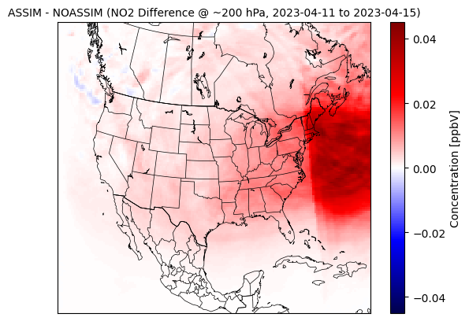
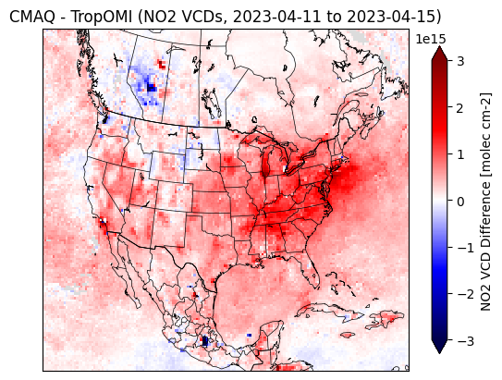
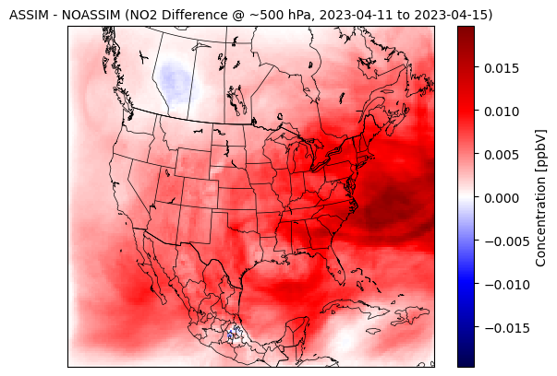
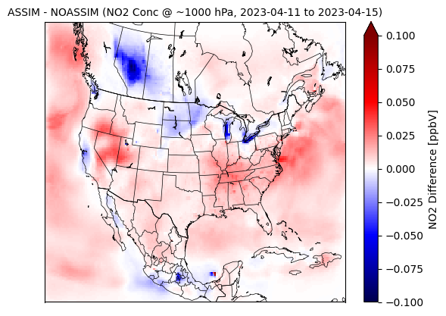
Non-Fire Event: April 11-15, 2023
Left: TropOMI vs CMAQ NO₂ Vertical Column Densities (VCDs)
Right: ASSIM vs. NOASSIM NO₂ Differences at 1000, 500, and 200 mb
TropOMI - CMAQ
Notes:
-Spatial structure of NO2 changes in the model correlates to the absolute differences we saw between TROPOMI and NOASSIM CMAQ
-Magnitude
-Broad ozone increases in areas where NO2 was raised

Slide 9
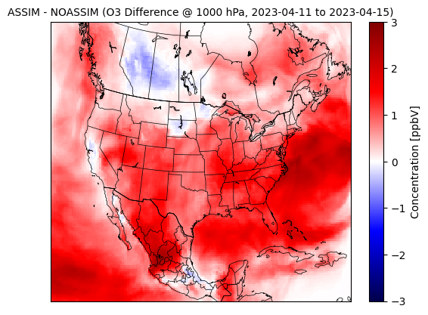
Non-Fire Event: April 11-15, 2023
ASSIM vs. NOASSIM Surface O₃ Differences
Notes:
-Spatial structure of NO2 changes in the model correlates to the absolute differences we saw between TROPOMI and NOASSIM CMAQ
-Magnitude
-Broad ozone increases in areas where NO2 was raised

Slide 10
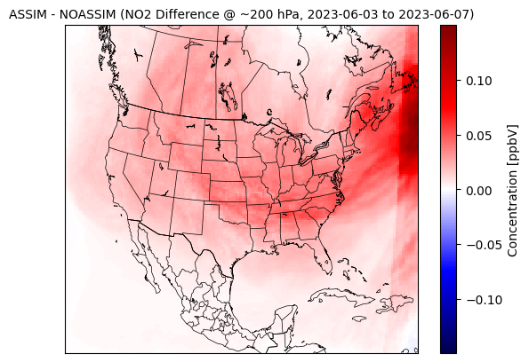
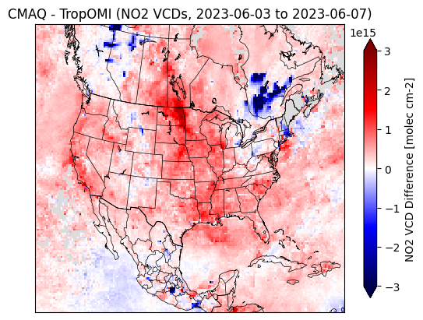
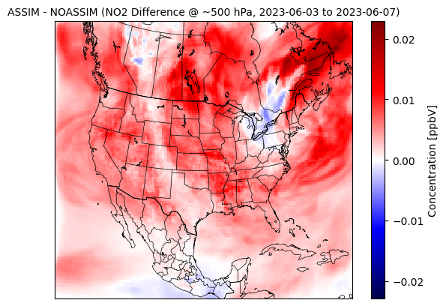
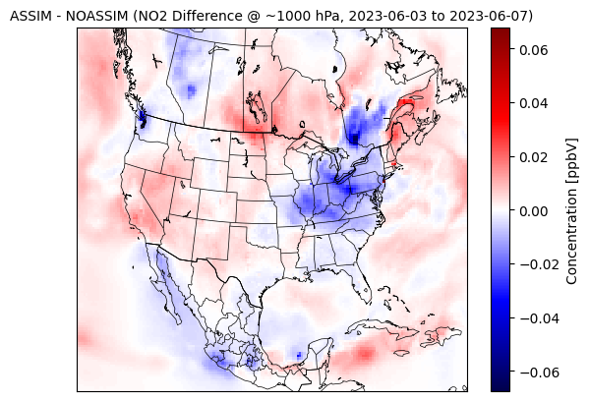
Fire Event #1: June 3-7, 2023
Left: TropOMI vs CMAQ NO₂ Vertical Column Densities (VCDs)
Right: ASSIM vs. NOASSIM NO₂ Differences at 1000, 500, and 200 mb
TropOMI - CMAQ
Notes:
-Spatial structure of NO2 changes in the model correlates to the absolute differences we saw between TROPOMI and NOASSIM CMAQ
-Magnitude
-Broad ozone increases in areas where NO2 was raised

Slide 11
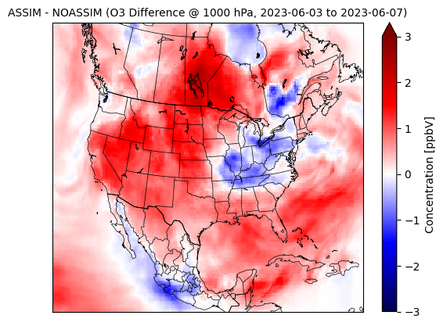
Fire Event #1: June 3-7, 2023
ASSIM vs. NOASSIM Surface O₃ Differences
Notes:
-Spatial structure of NO2 changes in the model correlates to the absolute differences we saw between TROPOMI and NOASSIM CMAQ
-Magnitude
-Broad ozone increases in areas where NO2 was raised

Slide 12
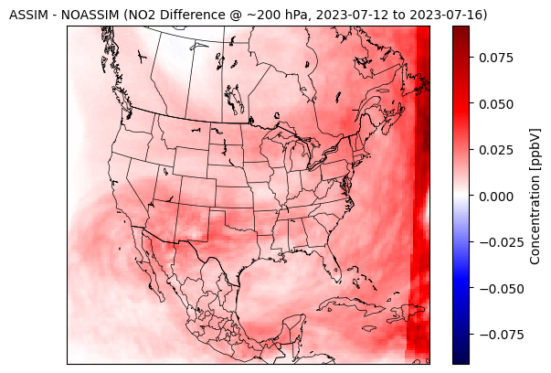
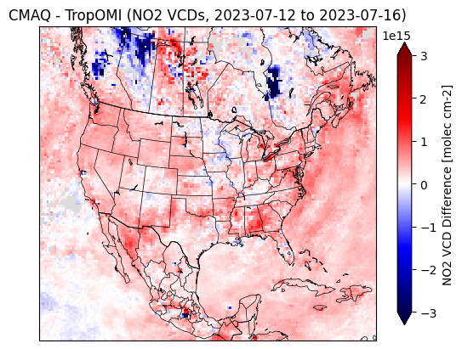
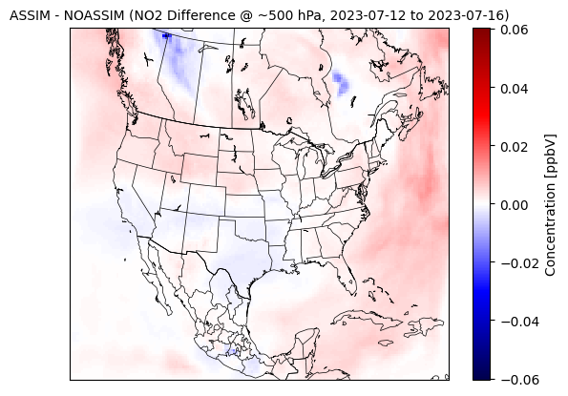
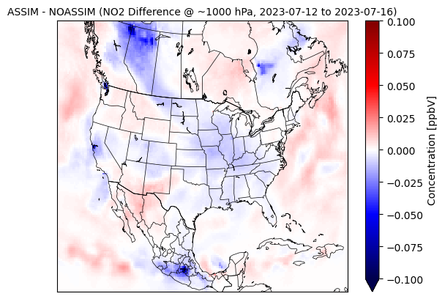
Fire Event #2: July 12-16, 2023
Left: TropOMI vs CMAQ NO₂ Vertical Column Densities (VCDs)
Right: ASSIM vs. NOASSIM NO₂ Differences at 1000, 500, and 200 mb
TropOMI - CMAQ
Notes:
-Spatial structure of NO2 changes in the model correlates to the absolute differences we saw between TROPOMI and NOASSIM CMAQ
-Magnitude
-Broad ozone increases in areas where NO2 was raised

Slide 13
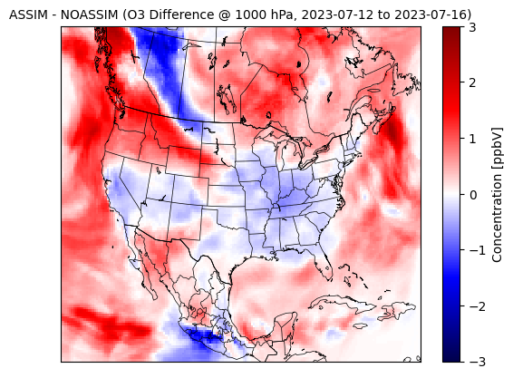
Fire Event #2: July 12-16, 2023
ASSIM vs. NOASSIM Surface O₃ Differences
Notes:
-Spatial structure of NO2 changes in the model correlates to the absolute differences we saw between TROPOMI and NOASSIM CMAQ
-Magnitude
-Broad ozone increases in areas where NO2 was raised

Slide 14
Conclusions
TROPOMI retrieved NO₂ columns are significantly lower than CMAQ at fire plume locations
In areas not experiencing wildfire impacts, broad areas exist where TROPOMI > CMAQ, indicating CMAQ EMBER anthropogenic NO_{x} emissions may be low
Inter-run comparison shows that GSI improves agreement between CMAQ and TROPOMI NO₂
Indicates validity of CMAQ-GSI system
GSI implementation has direct impact on CMAQ representation of ozone
Note: this claim has yet to be independently verified
Notes:
Present in both case studies
Reflected in NOASSIM and ASSIM run comparison
Valdiity - assimilations are “in the right direction”
Explain TROPOMI senesitivty issue - in areas of thick smoke, TROPOMI top-down measurements cannot properly see the surface, which can result in improper column approximation, i.e., “lower” values interpolated than we would expect based on limited info

Slide 15
Next Steps
Further investigation of near-fire discrepancies in TROPOMI and CMAQ NO₂
Currently unclear whether this is a TROPOMI sensitivity issue, CMAQ overestimation of fire emissions, or something else
Looking into possible artifacts within the near fire retrievals
Evaluation of model performance with respect to in situ observations
Compare NOASSIM/ASSIM CMAQ performance to available AQS data for O₃
Perform quantitative analysis and compute revealing statistics
Determine whether the assimilation induced changes are in line with other observations
With this work, we seek to inform 2023 rapid modeling efforts, and inspire policy action!

