Slide 1
Inferring Global Ground-level Ozone Concentrations Through Data Fusion of Chemical Reanalysis, Ozonesondes, and Lowermost Tropospheric Satellite Observations
Hantao Wang, Marc Serre, Kazuyuki Miyazaki, Juan Cuesta, J. Jason West

Slide 2
Motivation
Satellite observations have been widely used to monitor the global distribution of tropospheric ozone, but ground-level ozone is difficult to detect.
IASI+GOME2 offers a unique satellite product as an indicator of ozone in the lowermost troposphere (0-3 km)
Satellite observations provide information in regions that are sparse in ground-based monitoring stations.
Objective
Estimate global ground-level ozone concentrations based on IASI+GOME2 lowermost tropospheric ozone measurements, using a chemical reanalysis and ozonesonde observations to correct to ground-level concentrations.

Slide 3
Data
Dataset | Time resolution | Record time | Spatial resolution | Year | Type
IASI-GOME2 | Monthly average | 9:30am local time | 1°*1° | 2017 | Satellite observation
TCR-2 | Monthly average | 9am-11am | 1.125°*1.125° | 2017 | Chemical reanalysis
Ozonesonde | Monthly mean fit | Random | 43 locations | 2017 | Ozone vertical profile
This study aims to produce
Global monthly average DMA8 ground-level ozone map at 1° *1°
Performance evaluated with TOAR-II monthly DMA8
Notes:
Explain the IASI+GOME2 briefly. The IASI+GOME-2 approach combines infrared spectroscopy and UV/vis spectrometry to retrieve ozone profiles with enhanced sensitivity and regional detail. The approach has been validated against ozonesondes and shows good agreement. IASI+GOME-2 provides clear observations of ozone plumes below 3 km LMT, making it a major advancement in remote sensing of lowermost tropospheric ozone and its applications for air quality studies.

Slide 4
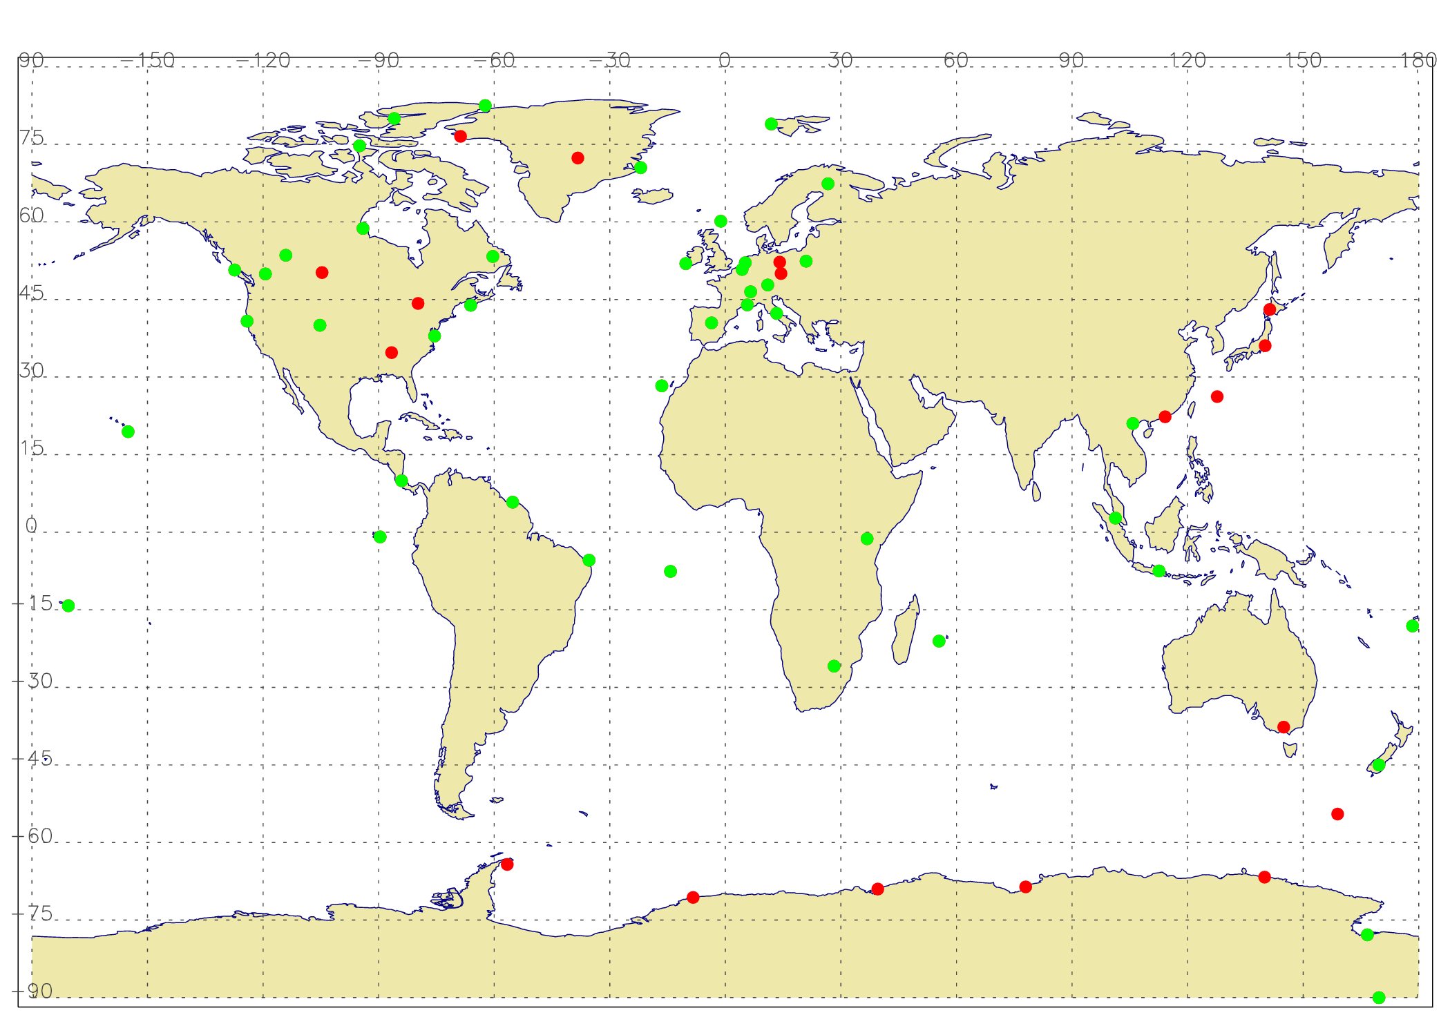
Ozonesonde observations at 43 sites
Apart from three sites in Western Europe that launch ozonesondes three times a week (Uccle in Belgium, Hohenpeissenberg in Germany, Payerne in Switzerland), all other ozonesonde launches occur weekly.
Notes:
All dots are the ozonsonde location we have over the world. Green dots are the 43 ozonesonde location included in this study. Ozonesondes are very accurate sources of ozone vertical profile data.

Slide 5
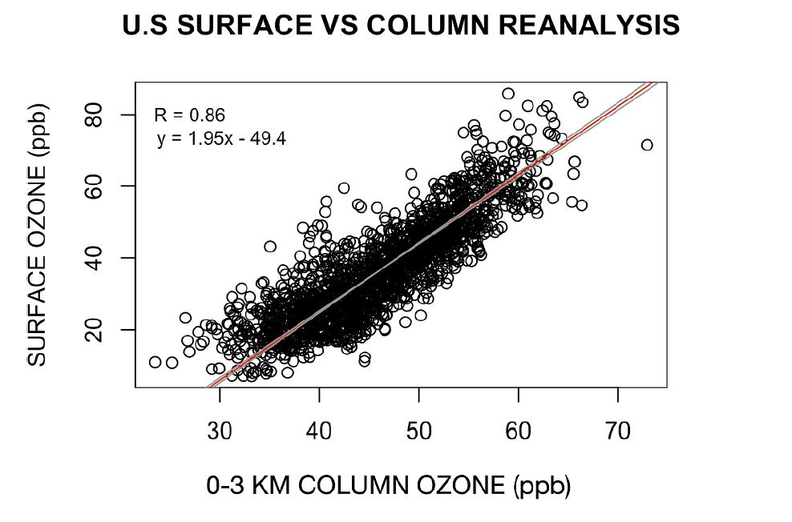
Previous method using satellite observations
$Surface Ozone \left(satellite\right)=0 to 3 km Ozone (satellite)×\frac{Surface Ozone \left(reanalysis\right)}{0 to 3 km Ozone \left(reanalysis\right)}$
Columbi et al 2021
Coverage: summertime daily data at satellite over pass time from 2005-2009 in the Eastern U.S., Western U.S., and China (2° *2°) (~7000 total)
Method: correct the reanalysis 0 to 3 km ozone by ozonesonde (23 in the US, and 1 in China) and reanalysis surface ozone by TOAR at satellite over pass time
Bias correction: subtracted the average bias from observation data at all grid points within each regions
Limitations:
The output for ground-level ozone is sparse, covering three regions in summer and does not represent DMA8
The ratio calculation has inconsistencies due to different correction sources
The uniform bias correction across regions fails to account for spatial variability
Columbi et al 2021

Slide 6
Method in this study
$Surface Ozone \left(satellite\right)=0 to 3 km Ozone (satellite)×\frac{Surface Ozone \left(reanalysis\right) (9−11am)}{0 to 3 km Ozone \left(reanalysis\right) (9−11am)}$
Generate Monthly Ozonesonde LMT 0-3km dataset
Provides global coverage with monthly data across all seasons at a finer spatial resolution (1° x 1°)
Corrects the 0 to 3 km satellite ozone data using ozonesonde and reanalysis ratio by ozonesonde ratio, offering a more consistent correction.
Uses the BME (Bayesian Maximum Entropy) method for spatial bias correction
Correct the ratio from TCR2 by ozonesonde ratio with spatial only BME
Correct the satellite 0-3km by ozonesonde with spatial only BME
Multiply the ratio with corrected LMT ozone
Get ground-level monthly DMA8 ozone

Slide 7
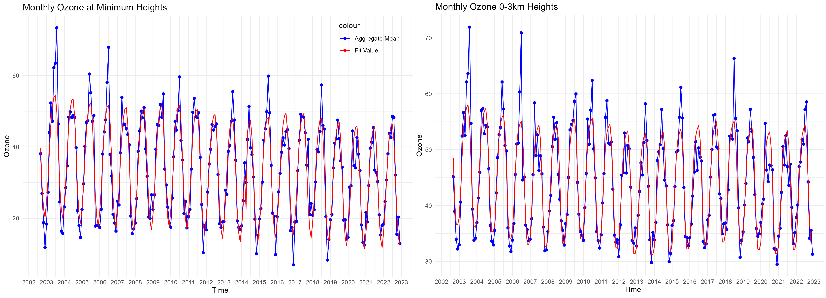
Ozonesonde monthly values were represented using a GAM, with Duchon splines (thin plate splines) fitted altitude, month, and a time index (1, ..., 12 * Nyear)
Payerne station Surface height: 491m Lat: 46.81 Lon: 6.94
Notes:
An attempt to approximate the monthly average MDA8 ozone (30 days x 8 hours = 240 hours of sampling) using 4 surface ozone measurements from ozonesondes (with only a few seconds of surface sampling time each) results in a bias of about 4 ppb (10%). Chang et al 2024

Slide 8
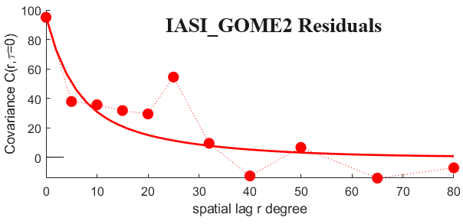
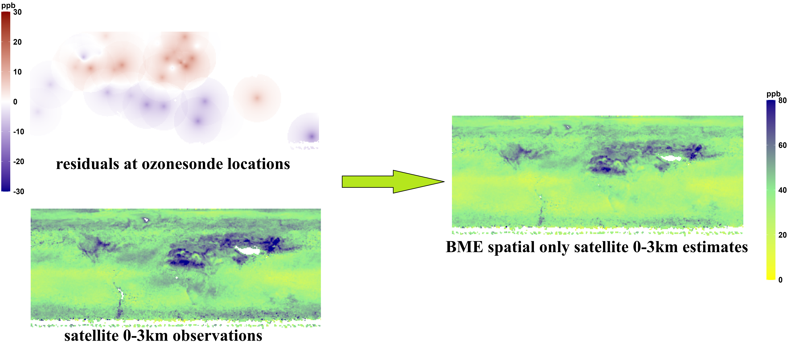
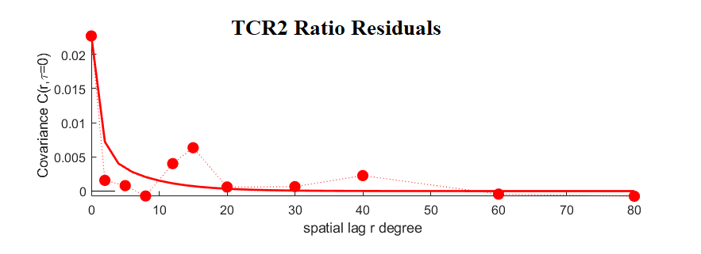
Covariance on residuals
Spatial only BME method
Bayesian Maximum Entropy (BME) : a data fusion framework used to correct bias by combining biased model estimates (global offsets) with unbiased observations
Covariance of Residuals: the covariance function models the spatial correlation of residuals between global offsets and observations across locations, capturing how residuals vary with distance
Notes:
$${0.6e}^{−\frac{3r}{15}}+0.4e^{−\frac{3r}{60}}$$
$${0.7e}^{−\frac{3r}{3}}+0.3e^{−\frac{3r}{20}}$$

Slide 9
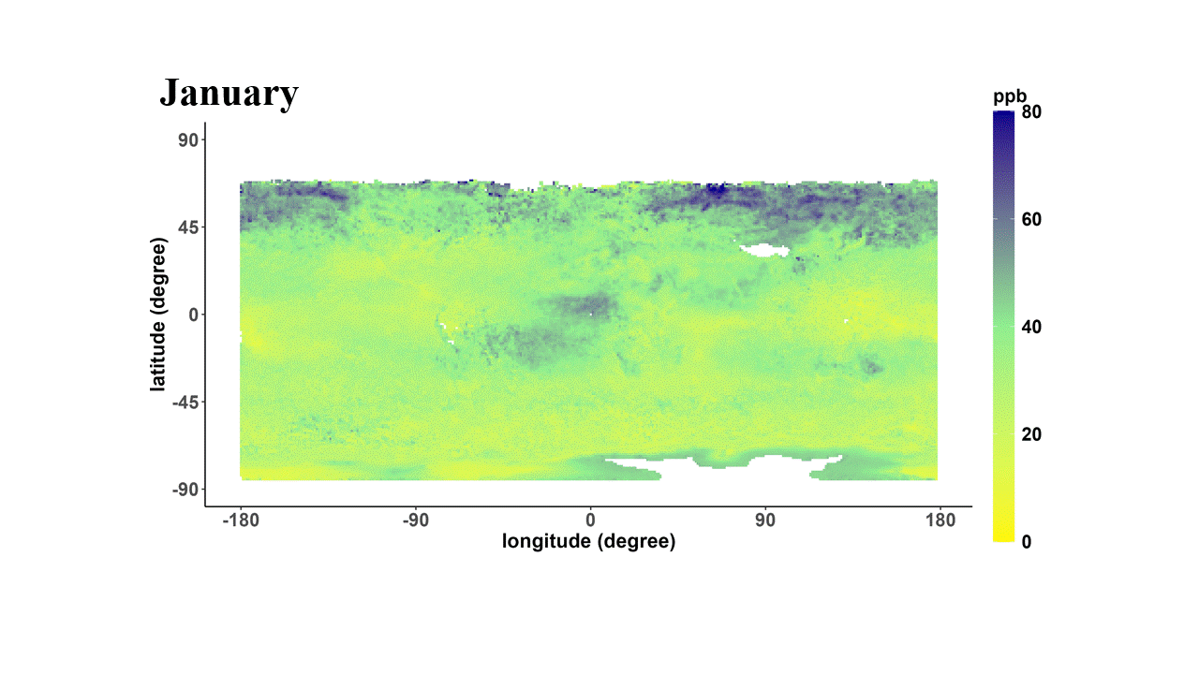
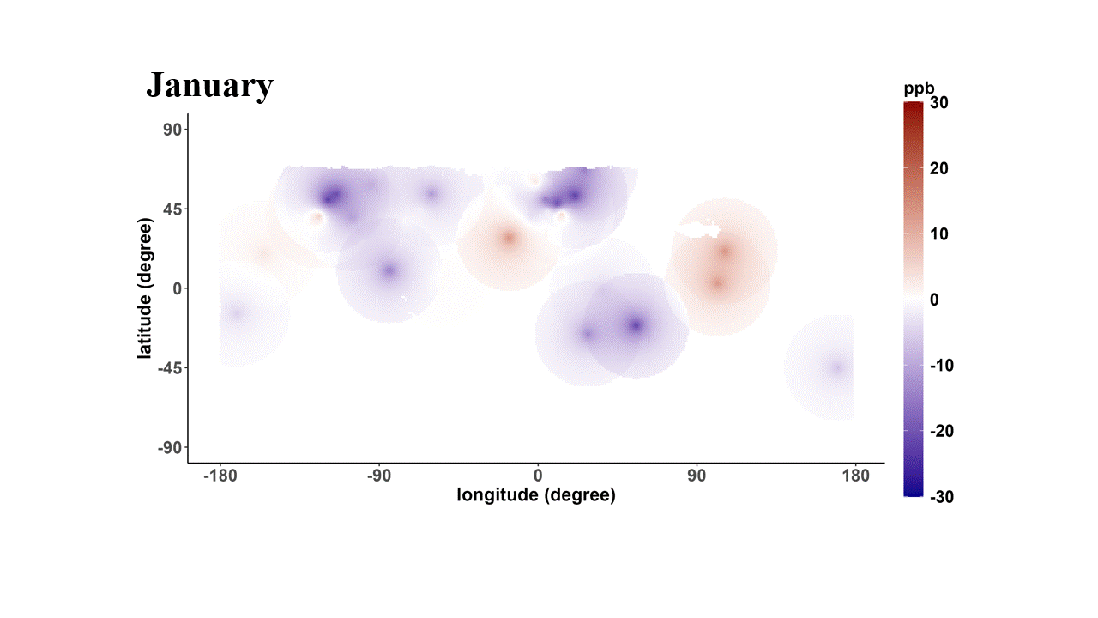
$Surface Ozone \left(satellite\right)=0 to 3 km Ozone (satellite)×\frac{Surface Ozone (reanalysis)}{0 to 3 km Ozone (reanalysis)}$
IASI-GOME2 0-3km ozone corrected by ozonesonde observations using BME in 2017
Difference of IASI+GOME2 0-3km ozone from BME (with correction minus without)

Slide 10
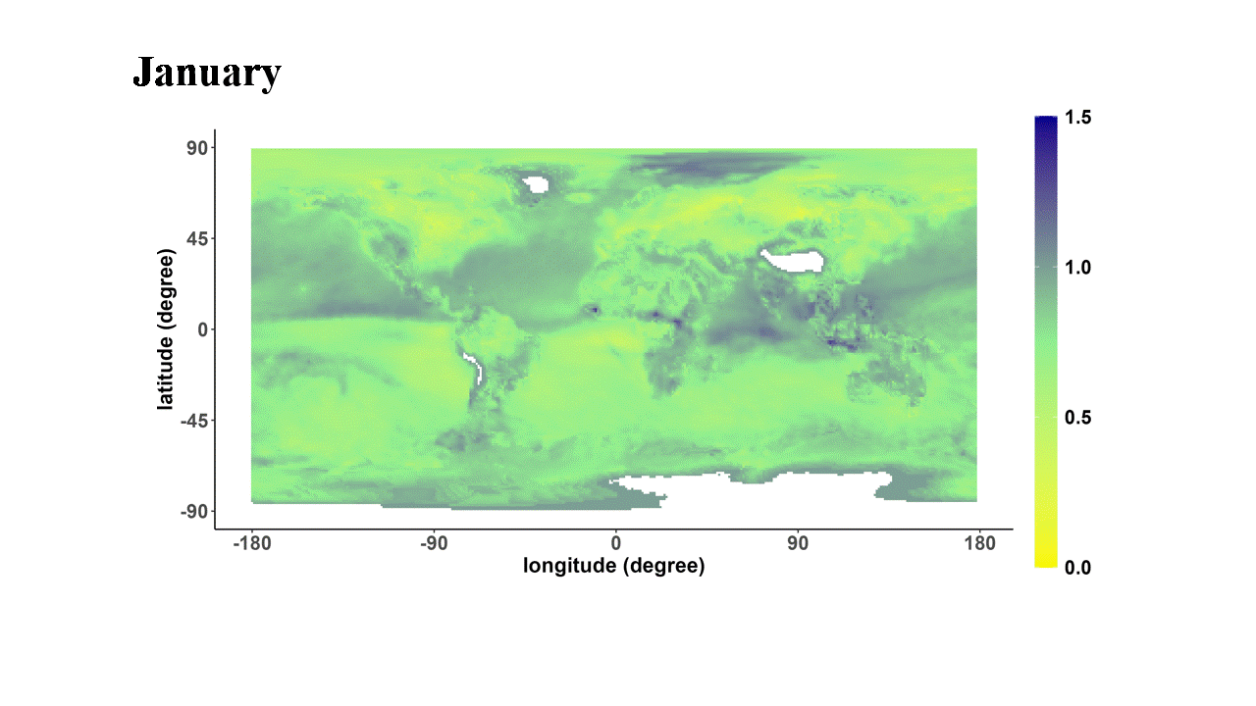
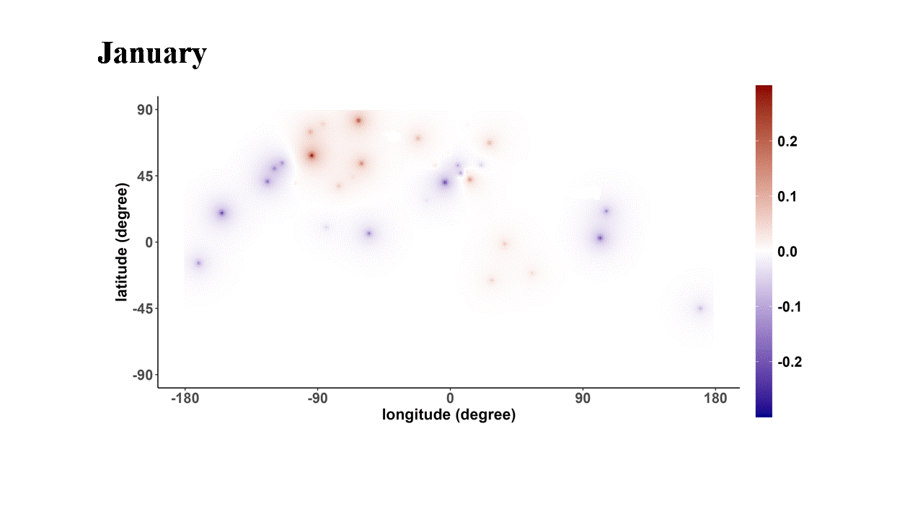
TCR2 ratio corrected by ozonsonde observations using BME in 2017
$Surface Ozone \left(satellite\right)=0 to 3 km Ozone (satellite)×\frac{Surface Ozone (reanalysis)}{0 to 3 km Ozone (reanalysis)}$
Difference of ratio from BME (with correction minus without)

Slide 11
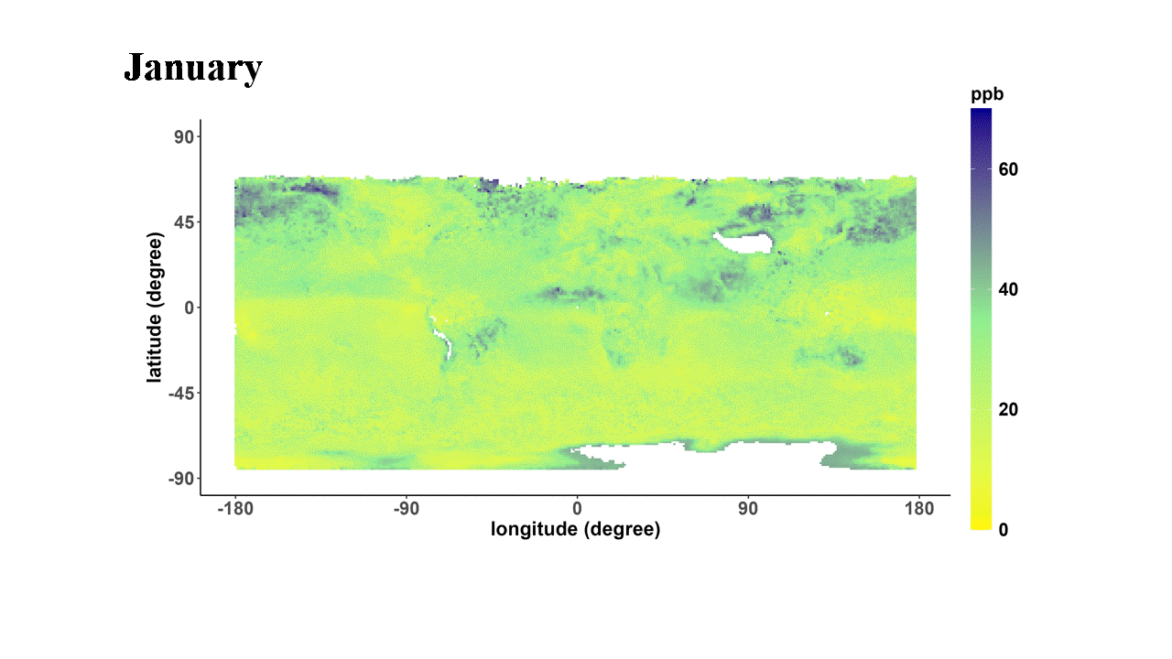
2017 surface ozone by corrected ratio and corrected 0 to 3km satellite ozone
$Surface Ozone \left(satellite\right)=0 to 3 km Ozone (satellite)×\frac{Surface Ozone (reanalysis)}{0 to 3 km Ozone (reanalysis)}$

Slide 12
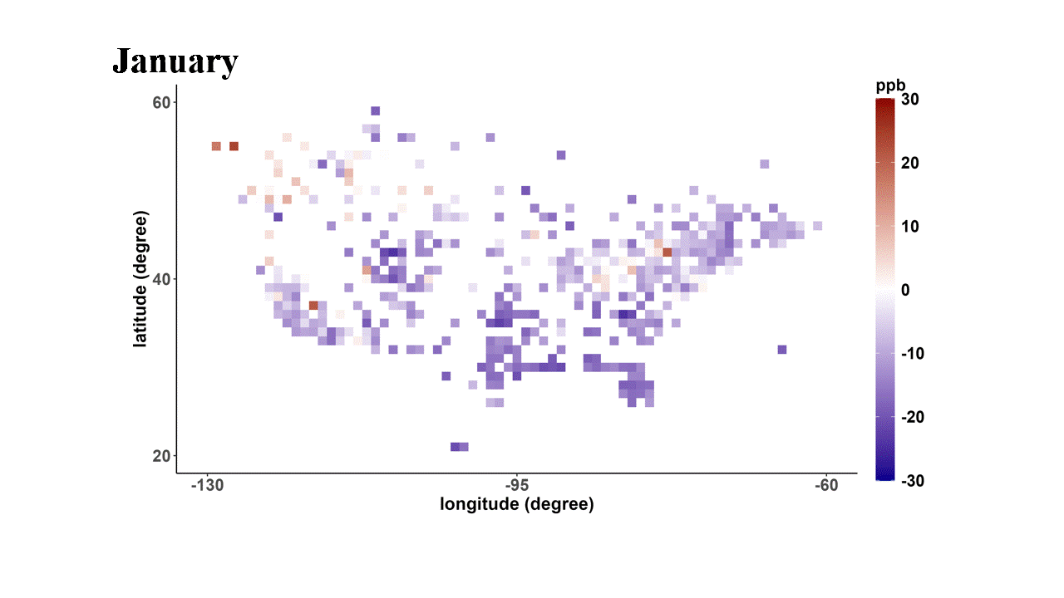
Surface error US map (Estimate - TOAR-II monthly DMA8)

Slide 13
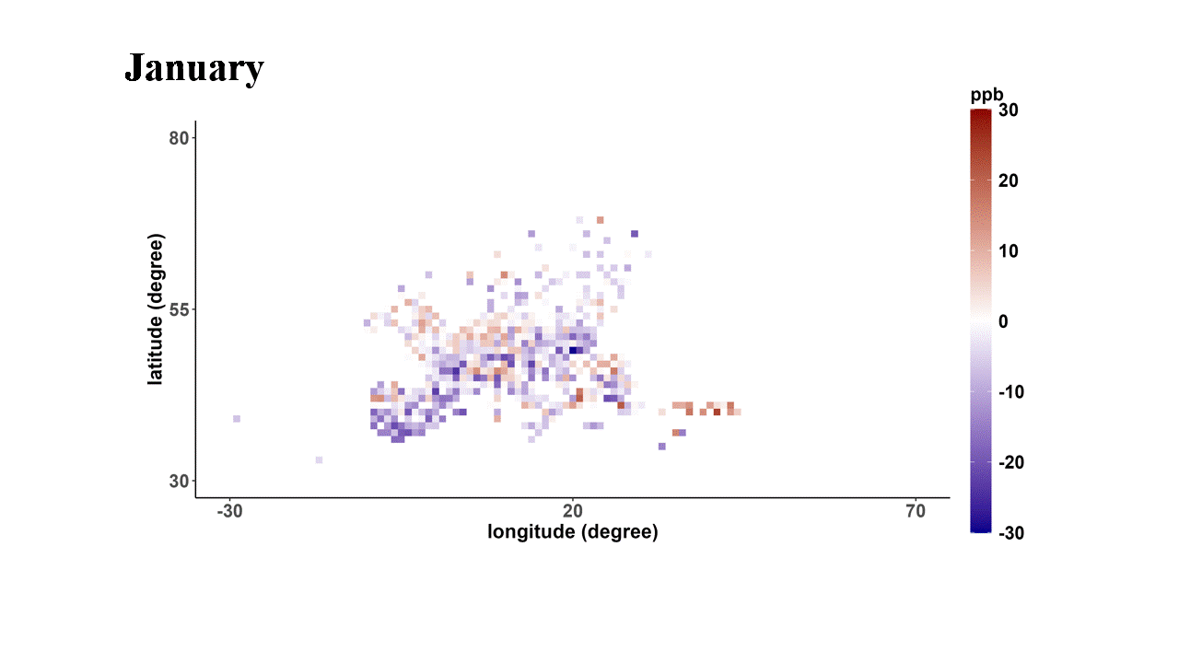
Surface error EU map (Estimate - TOAR-II monthly DMA8)

Slide 14
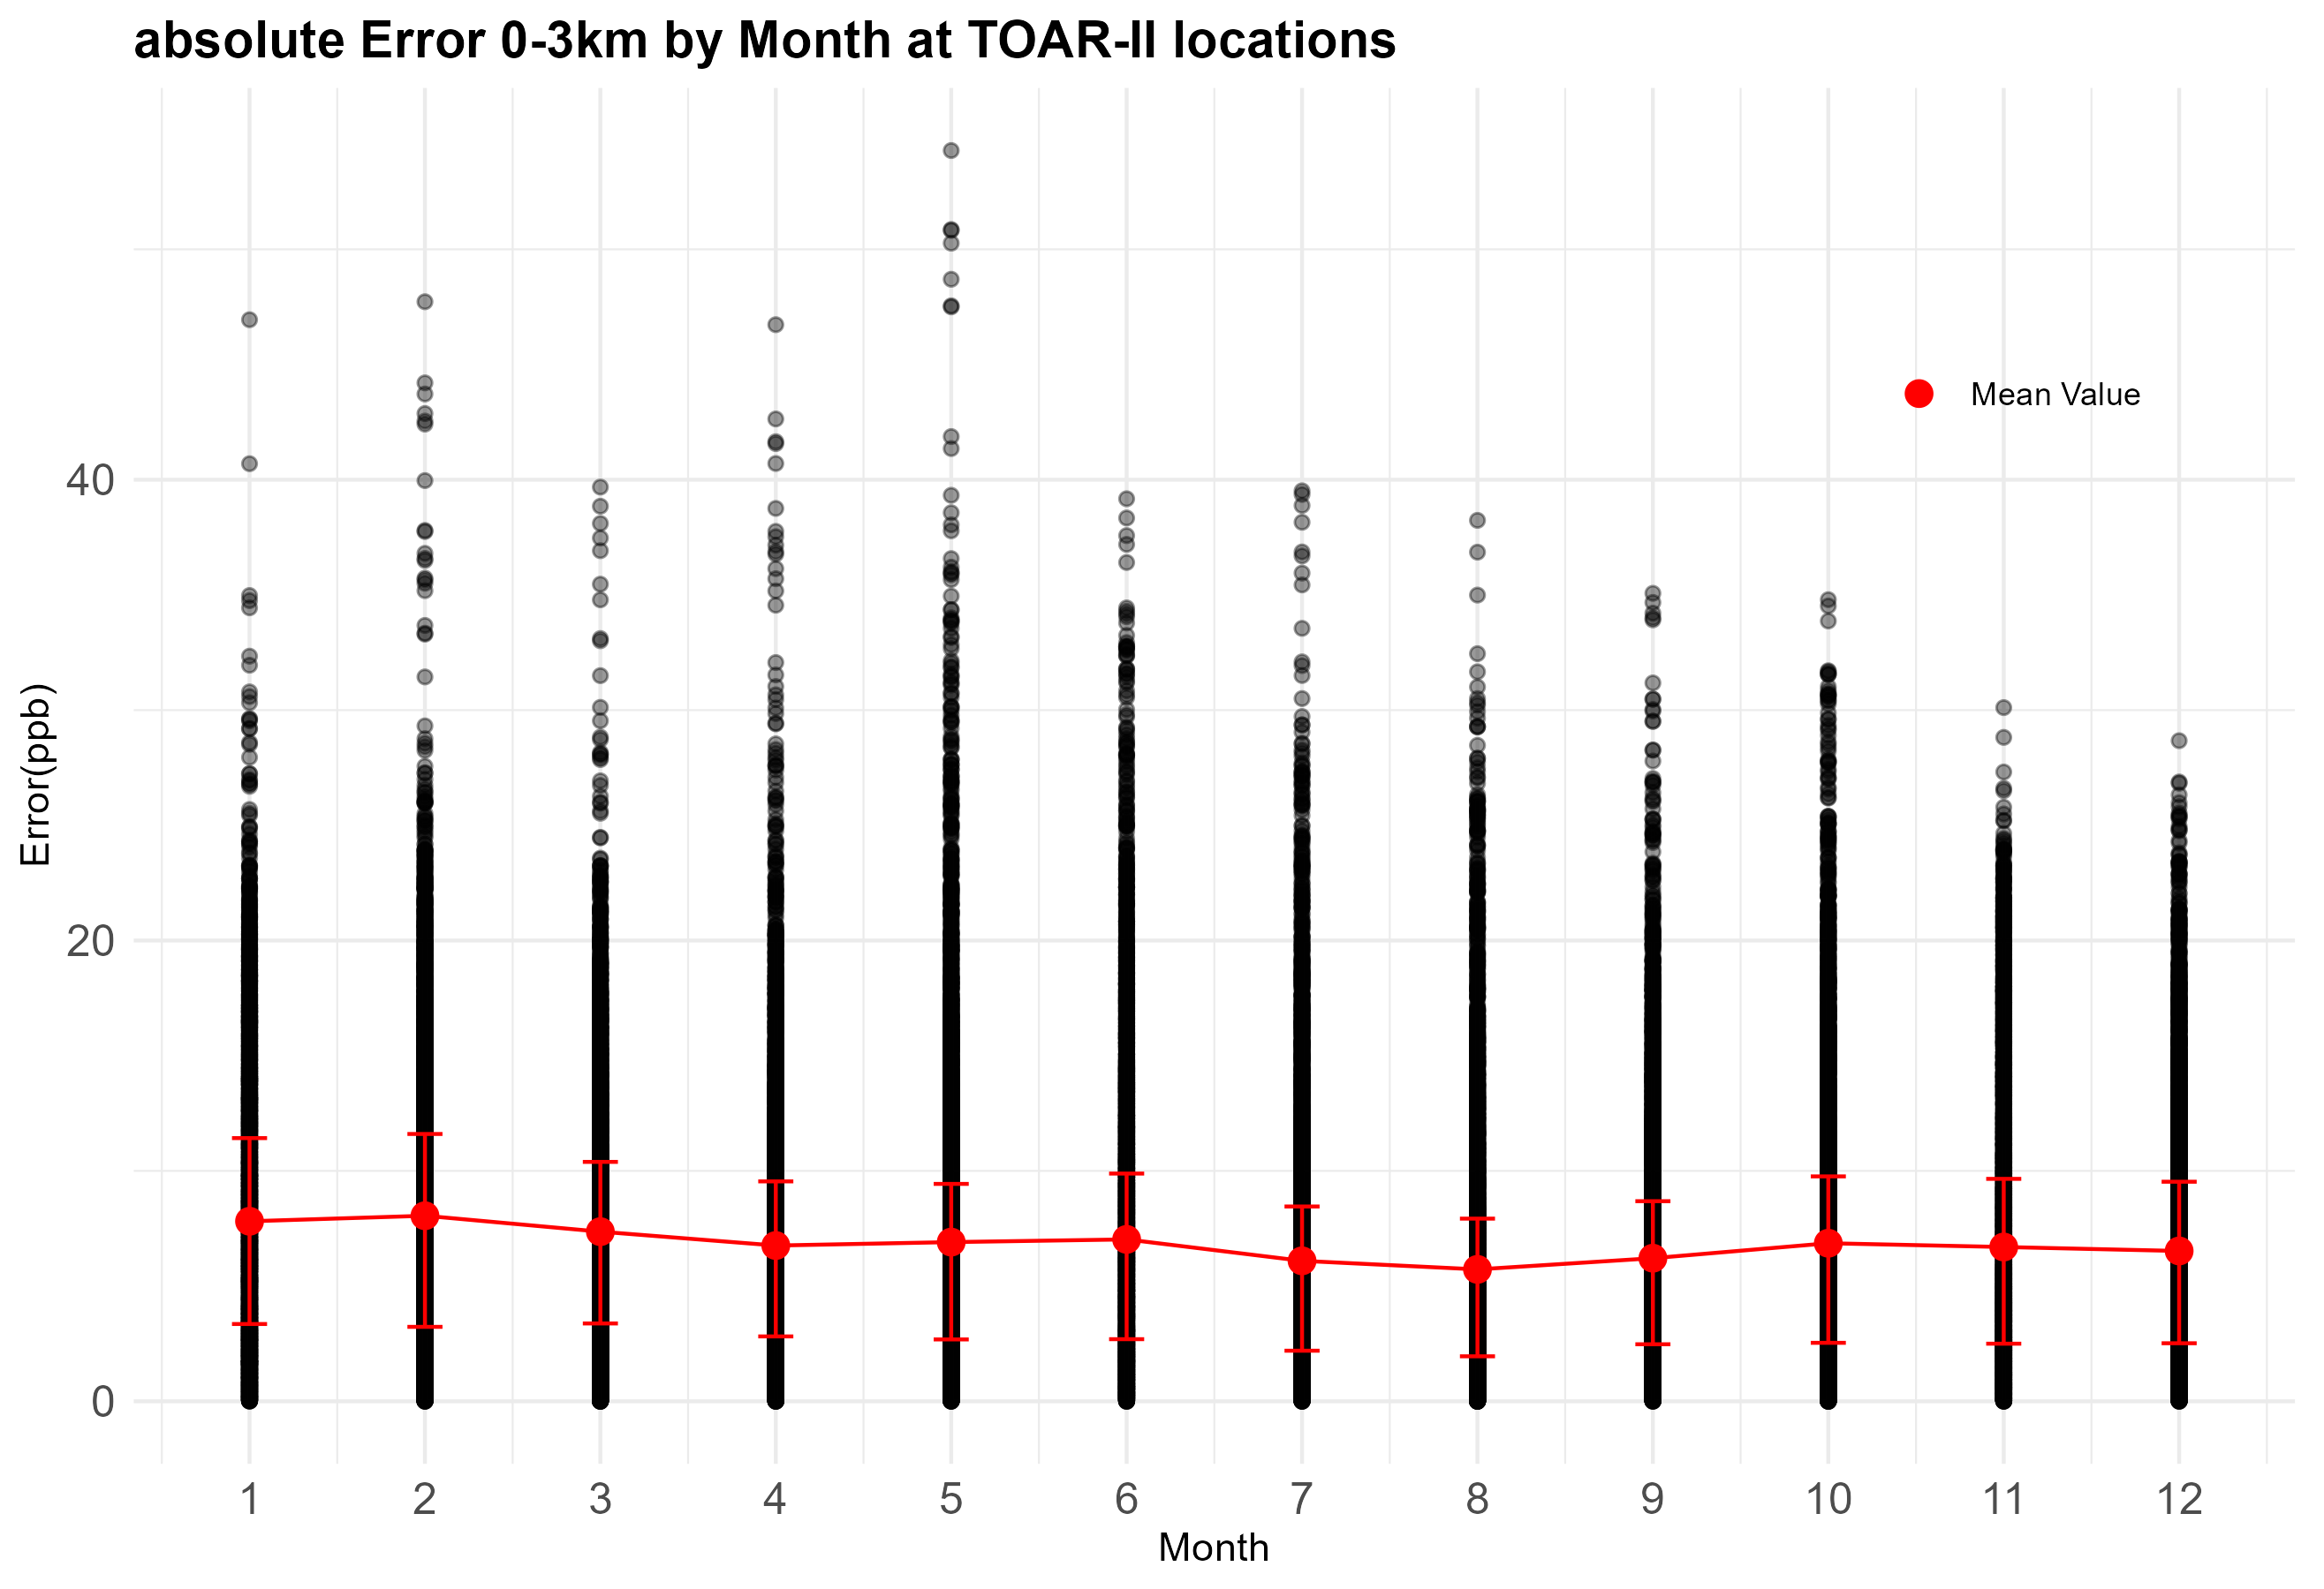

Slide 15
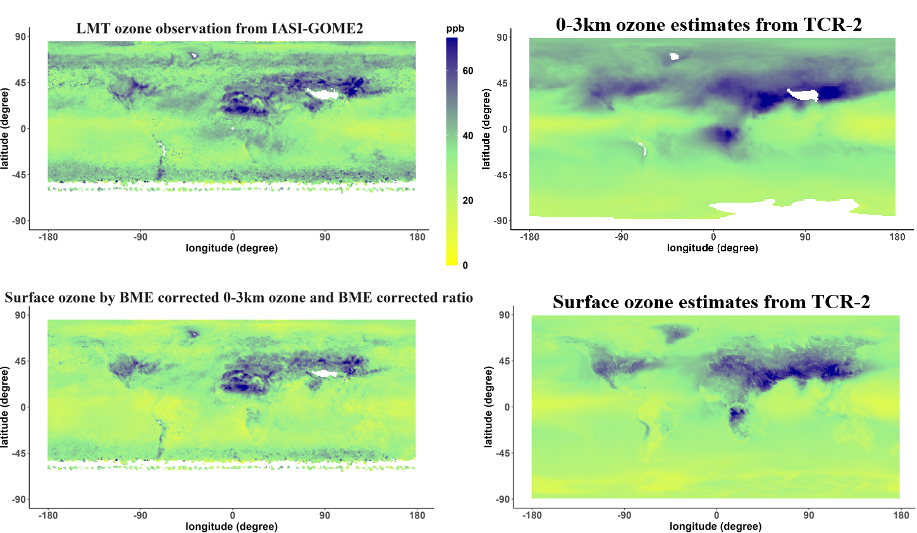
2017 June ozone maps
$Surface Ozone \left(satellite\right)=0 to 3 km Ozone (satellite)×\frac{Surface Ozone (reanalysis)}{0 to 3 km Ozone (reanalysis)}$

Slide 16
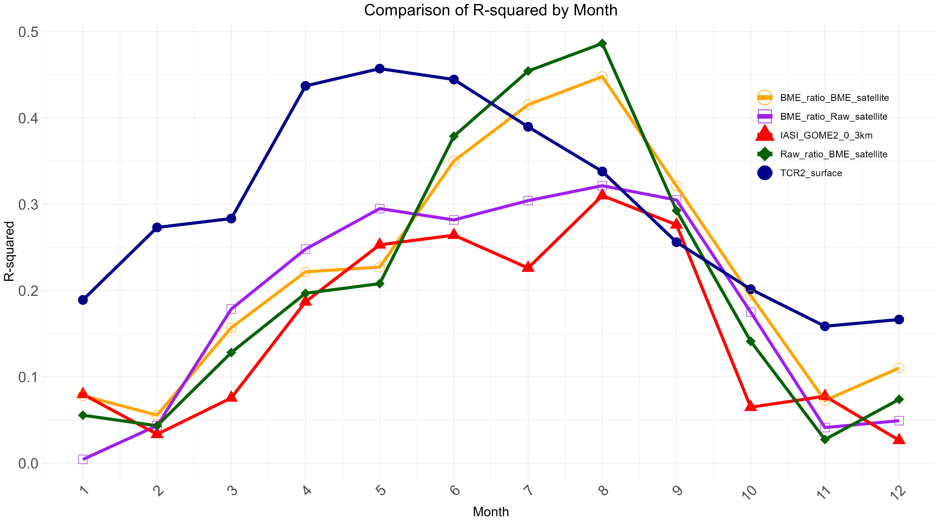

Slide 17
RMSE and R² for 2017 year (n = 62744)
final product
Data | TCR2_surface | IASI_GOME2_LMT
R² | 0.539 | 0.208
RMSE | 8.517 | 10.166
Only BME ratio | Only BME sate | BME ratio and sate
0.411 | 0.492 | 0.503
10.077 | 8.654 | 8.833
RMSE and R² for 2017 summer (June-Aug) (n = 15663)
Data | TCR2_surface | IASI_GOME2_LMT
R² | 0.410 | 0.295
RMSE | 10.612 | 9.231
Only BME ratio | Only BME sate | BME ratio and sate
0.324 | 0.459 | 0.423
9.652 | 8.198 | 8.385
Against TOAR-II monthly DMA8 (2024.7 version)

Slide 18
Results
Spatial autocorrelation of 0-3 km ozone from ozonesonde exists over 15° range.
This derived surface ozone significantly outperformed the satellite LMT observations
When focusing on TOAR-II stations during the summer (June to August), the derived ozone map provided more accurate results than both satellite LMT observations and chemical reanalysis.
Next steps
Use a fine resolution global model to refine the ozone maps to fine spatial resolution
Apply the method to 2013-2023 IASI+GOME2 0-3km ozone data.

Slide 19
Thank you! and any questions?

