Slide 1
Modeling the effects of energy system scenarios on air quality and deposition
Chris Nolte, Dan Loughlin, Ben Murphy, Jesse Bash, Uma Shankar
U.S. EPA Office of Research and Development, Research Triangle Park, NC
The views expressed in this presentation are those of the authors and do not necessarily reflect the views or policies of the US EPA
Office of Research and Development
23rd Annual CMAS Conference
22 October 2024

Slide 2
Modeling Framework
Notes:
Here is a schematic of the modeling framework we are using.

Slide 3
GCAM
Global Change Analysis Model
Scenario
assumptions
Scenario
assumptions
End points
Energy
Energy
Agriculture
Technology penetrations
Population
growth
Fuel use and prices
Economic growth
Economic
Policy cost
Resource
availability
Economy
Climate
Cost of energy services
Land and food prices
Climate change
Climate
Technology development
GHG emissions
Water
Land use
Global mean temperature
Behavior and preferences
Environmental
Air pollutant emissions
Policies
Water use
Simulates the co-evolution of these systems through time
Health impacts
GCAM documentation: http://jgcri.github.io/gcam-doc/
Notes:
We use the Global Change Analysis Model, or GCAM. GCAM is a member of a class of models known as integrated assessment models, or human-earth system models, and is one of the models that create the scenarios that are simulated by global climate models in IPCC assessment reports.
(click)
GCAM takes as its inputs scenario assumptions, including population and GDP, as well as resource availability, technology characteristics, and any policies such as carbon taxes or other emissions constraints.
(click)
The model simulates the Energy, Economy, Water, Agriculture, Land Use, and Climate systems, and (click) particularly the interactions between these components over time.
(click)
The model's outputs are the mix of technologies and market shares meeting end-use demands, as well as the prices for all modeled markets and the associated emissions of GHGs and air pollutants – the air pollutant emissions are the primary outputs we care about.

Slide 4
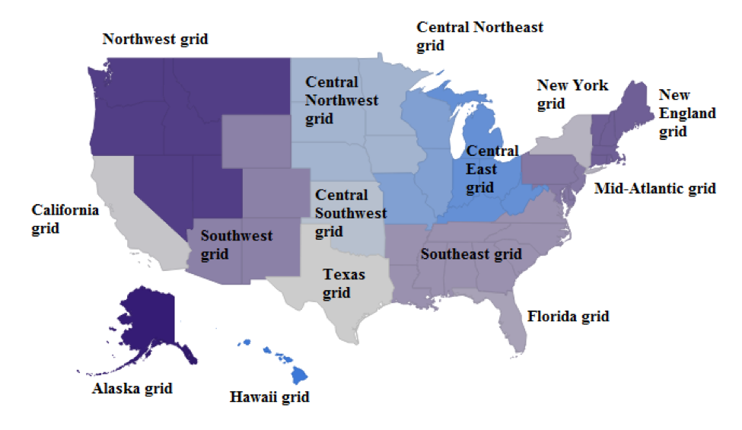
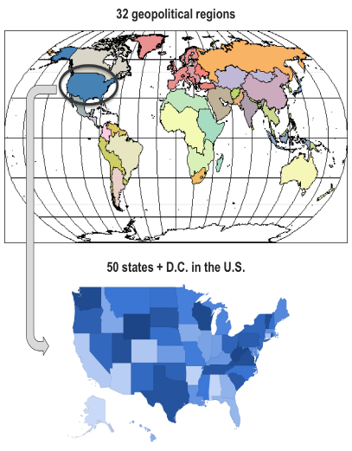
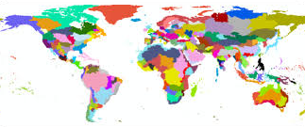
GCAM-USA spatial resolution
Electric grid regions
Socio-economic and energy regions
Land regions and water supply basins
GCAM documentation: http://jgcri.github.io/gcam-doc/
Notes:
GCAM is developed by the Joint Global Change Research Institute, a consortium between the Pacific Northwest National Laboratory and the University of Maryland on their College Park campus.
There are a few variants of GCAM, depending on its input data. The core model currently divides the world into the 32 global regions shown in the upper left, where the U.S. and China are their own regions, while smaller and/or similar countries are aggregated like "EU-15" and "Africa_Eastern".
We primarily work with GCAM-USA, in which the US is disaggregated into the 50 states plus the District of Columbia. Each GCAM-USA simulation includes the other 31 global regions. This allows us to examine the effect of state-level policies within the context of a global scenario. It's important to note that GCAM has subnational representation of physical geography, such as land classification and water basins, though I won't be talking about those aspects of the model.
I will often just say “GCAM” in this talk, but all simulations I am presenting use GCAM-USA.

Slide 5
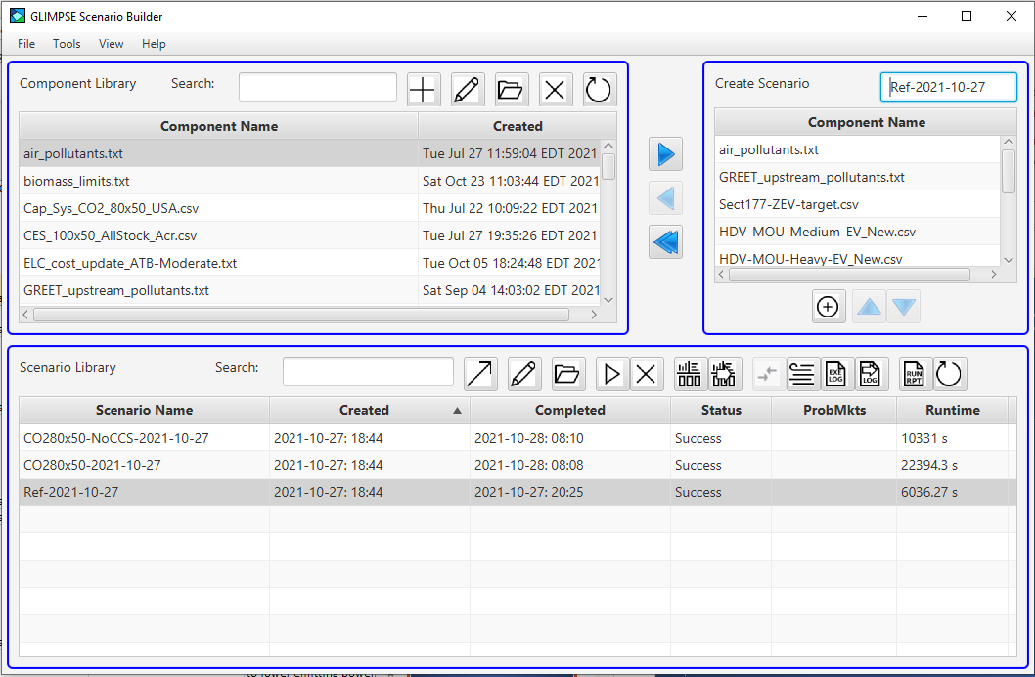
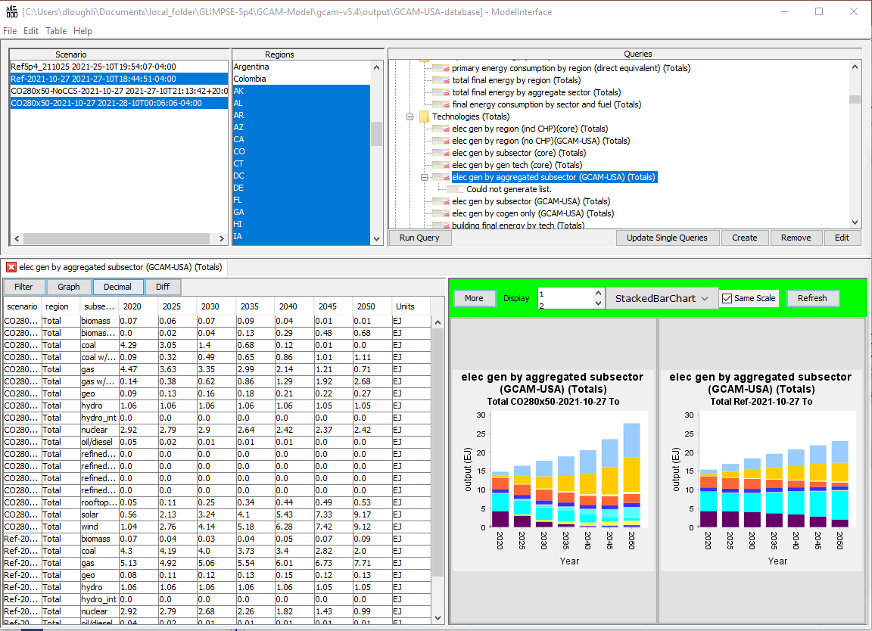
EPA GLIMPSE Project
GLIMPSE: GCAM Long-term Interactive Multi-Pollutant Scenario Evaluator
Decision support system
GLIMPSE graphical user interface for GCAM
Supports exploratory analyses
Constructing scenarios
Managing GCAM execution
Visualizing results
Facilitates policy evaluation
Technology market share targets
Technology and fuel subsidies or taxes
Pollutant taxes and caps
Technology availability
Operational modes
Test specific policy or scenario
Outline goals; GCAM identifies strategy
https://www.epa.gov/glimpse
Notes:
We've been working with GCAM for about 9 years. One major aspect of that project has been to integrate GCAM into a decision support system Dan has developed known as GLIMPSE, or the GCAM Long-term Interactive Multipollutant Scenario Evaluator. GLIMPSE is a Java graphical user interface for GCAM, and helps develop scenario components, construct scenarios out of those components, as well as facilitate management and archival of model configurations.
All our GCAM simulations are conducted using the GLIMPSE framework.
GLIMPSE has been released and is available upon request. We’re working on getting it distributed via GitHub, hopefully later this year.

Slide 6
Scenario “levers” supported by GLIMPSE
Policy levers
Non-policy levers
Emissions:
- tax
- reduction target or cap
Fuel prices:
coal, natural gas, oil, and biomass
Technology attributes:
availability
cost
efficiency
lifetime
Technologies:
- subsidy
- market share targets:
+ Renewable Portfolio Standards
+ EV market share targets
+ High efficiency technologies
+ Biofuels
- specific output targets
+ e.g. offshore wind
Behavior and choice:
technology preference or bias
(via shareweights)
Notes:
Like any model, you get different outputs from GCAM by providing it different inputs. The scenario "levers" supported by GLIMPSE can be loosely classed into policy levers and non-policy levers. (click)
Policy levers include emissions taxes or caps, technology subsidies and minimum market share targets, or specific output targets, such as a specified number of exajoules of electricity produced by offshore wind.
(click)
Non-policy levers include things like fuel prices, technology attributes, such as their cost, efficiency, and their availability. We can model the system behavior if battery costs plummet or a cheap new carbon capture technology is discovered, or we can model a policy that limits or forbids a certain technology, such as new nuclear plants. (that’s why I said this grouping between policy and non-policy levers is loose)
GCAM models the market share of competing technologies based principally on their cost differences, but also on parameters known as shareweights. Shareweights are not themselves market shares, but instead represent persistence or friction, or consumer aversion to change. We can relax or enhance those shareweights to make the system more or less responsive to price differences.

Slide 7
Scenario Design
GLIMPSE v1.1 / GCAM v7.0
Reference Scenario includes provisions of Inflation Reduction Act
Production Tax Credit (PTC) and Investment Tax Credit (ITC)
Biofuel, hydrogen (H2), and carbon capture and sequestration (CCS) subsidies
Residential and commercial energy efficiency credits
High efficiency electric home rebates
Passenger and commercial electric vehicle credits
Methane reduction program (incl. agricultural)
Net-Zero Scenario
Layers on national Net-Zero CO2 emissions by 2050 target
Direct Air Capture (DAC) of CO2 is available
Barriers to electric vehicle adoption are addressed 5 years earlier
Alternative Net-Zero Scenarios with one of the following:
Limited role for bio-energy
Limited role for nuclear power
Increased role for nuclear power
No availability of CCS and DAC
“Electrify everything” applied to transportation and buildings
Using outputs from 2035 and 2050 to scale emissions for CMAQ modeling
Notes:
For research looking at the effects of proposed policies, the results are always highly dependent on what is in the baseline or reference scenario.
Here, our Reference scenario includes relatively limited GHG mitigation and no additional air pollution control requirements beyond regulations that are already on the books, like Tier 3 Motor Vehicle and Fuel standards and current New Source Performance Standards. However, it does include representation of provisions of the Inflation Reduction Act
GCAM is relatively computationally inexpensive, taking about 1 to 5 hours to run out to 2050. This facilitates exploration of a wide range of scenarios and iterative refinement of a smaller set of scenarios for investigation with downstream models like CMAQ, which take more than a week on our high-performance computing system to conduct an annual simulation.

Slide 8
Scenario Emissions
Notes:
Note that CO2 emissions do not reach 0 in 2050 – they are Net Zero, accounting for a land sink of ~220 MTC

Slide 9
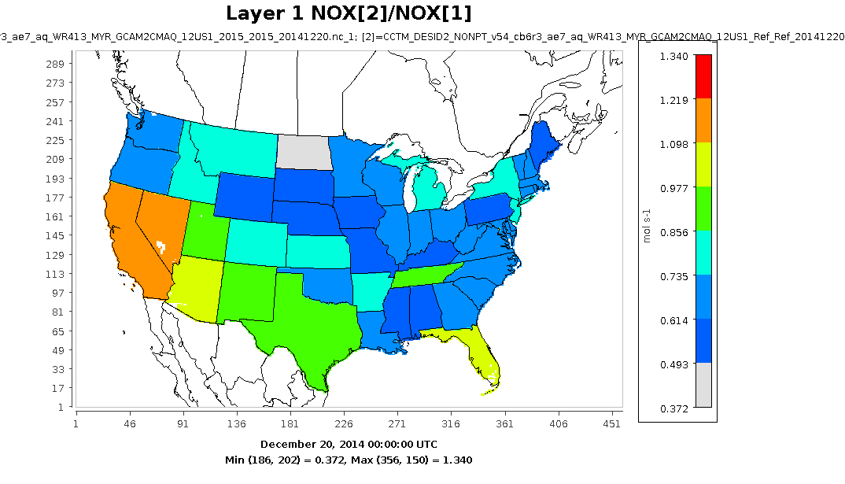
Linking GCAM to CMAQ
Use DESID module to scale EQUATES emissions from base year 2016
Apply regional (state level) and sectoral scaling factors for NOx, SO2, primary PM25, VOCs, and NH3
applied to sources modeled by GCAM, i.e., those related to energy system. While GCAM has an ag sector, we are not linking changes in cropland simulated by GCAM to changes in fertilizer application
Ratio of NOx NONPT (area) emissions, future to base year.
Scaling factors follow state boundaries, as specified via instructions given to CMAQ based on GCAM simulations
We are applying scaling factors like this for 11 emissions sectors
Notes:
GCAM gives us the change in emissions. We use CMAQ to model the resulting impacts on air quality.
To bridge GCAM and CMAQ, we calculate ratios of GCAM emissions in the future, either 2035 or 2050, to the base year 2016, and apply those as scaling factors to the CMAQ emissions. These scaling factors vary by state, sector, and pollutant species for NOx, SO2, primary PM25, VOCs, and NH3, and we’re applying scaling factors for 11 different emissions sectors.
Ratio of NOx emissions in diagnostic file for NONPT (area sources), GCAM Reference case (2050) to 2015.

Slide 10
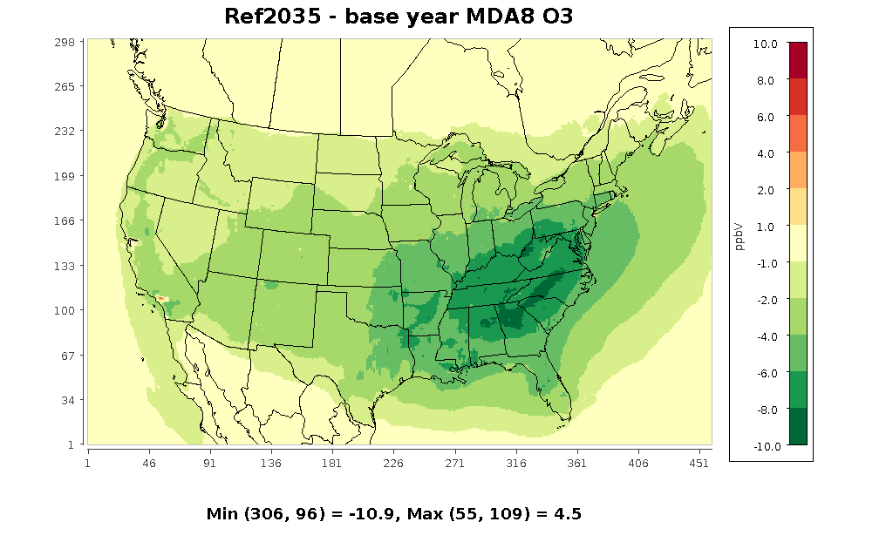
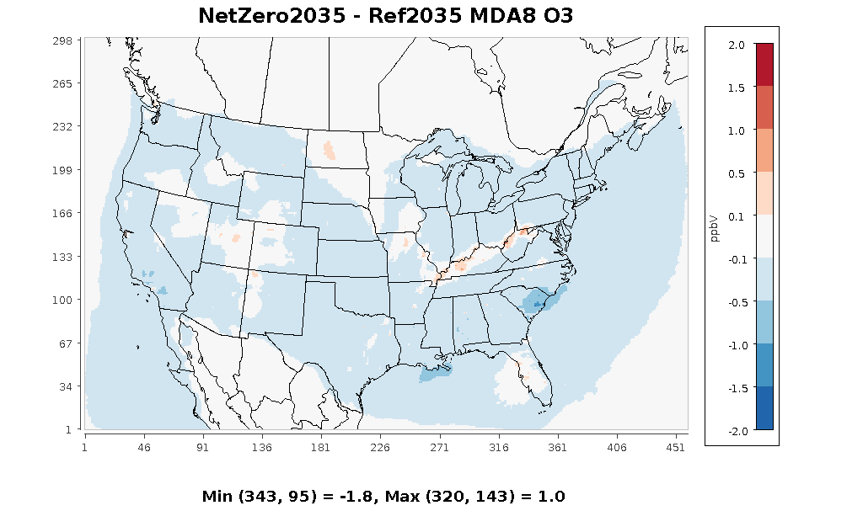
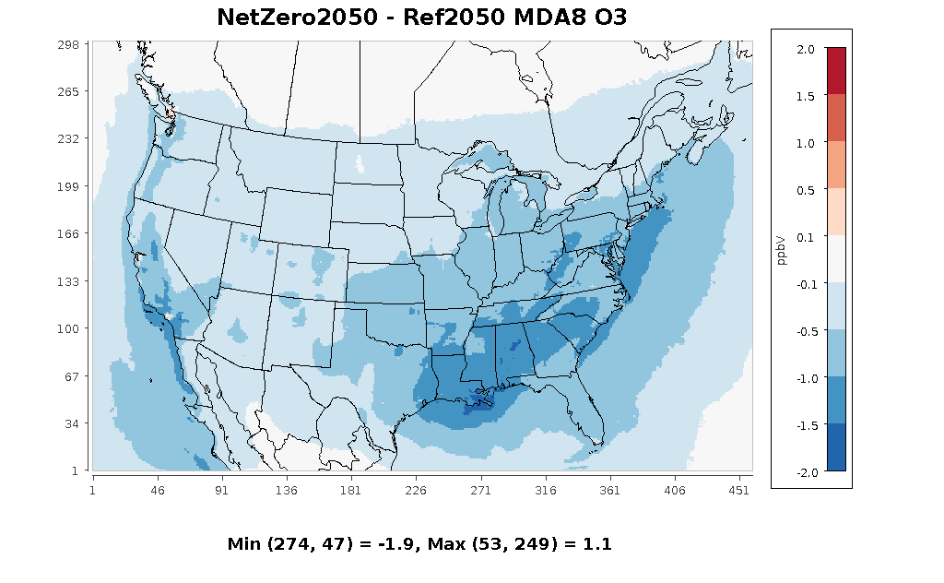
Changes in May-Sept MDA8 Ozone
2035
2050
±10
±10
Ref − 2016
±2
±2
O3 Co-Benefits of NetZero Scenario
NetZero − Ref
Notes:
Reference scenario, 2035: decrease of at least 1 ppb essentially everywhere in the CONUS, more than 4 ppb decrease over most of eastern US, and over 10 ppb in parts of the Southeast
Reference scenario, 2050: slight increase relative to 2035, in line with fact that NOx emissions are higher
NetZero scenario: co-benefit of 0.1 - 0.5 ppb over most of the U.S. in 2035. Strong co-benefit of 0.5-1.9 ppb in EUS and SoCal in 2050 due to decreases in both NOx and VOCs

Slide 11
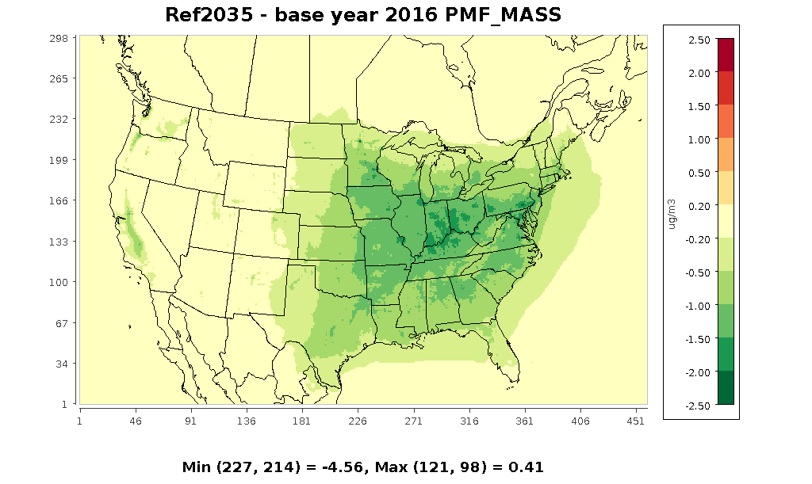
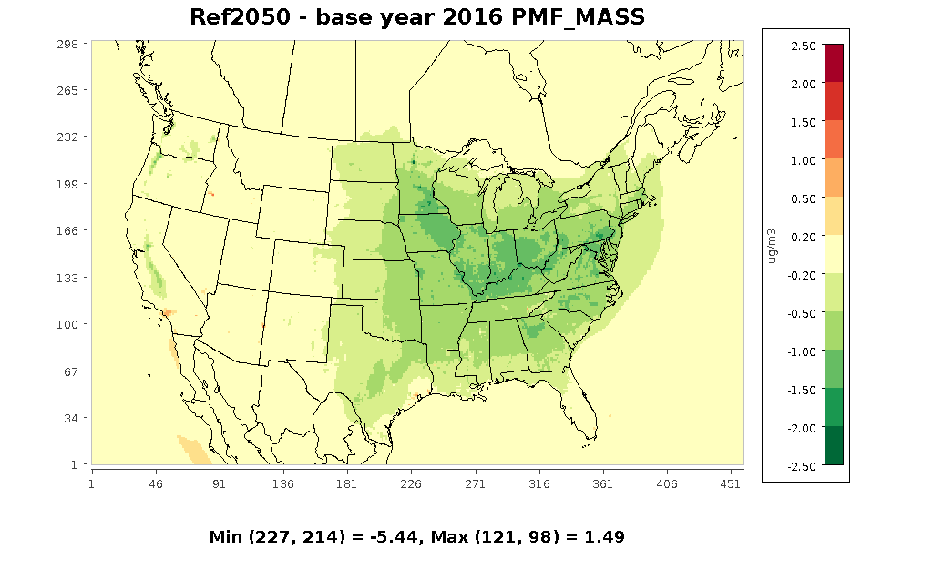
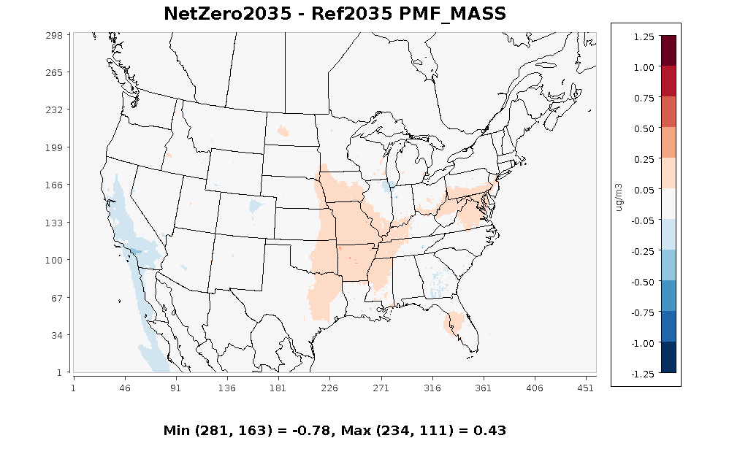
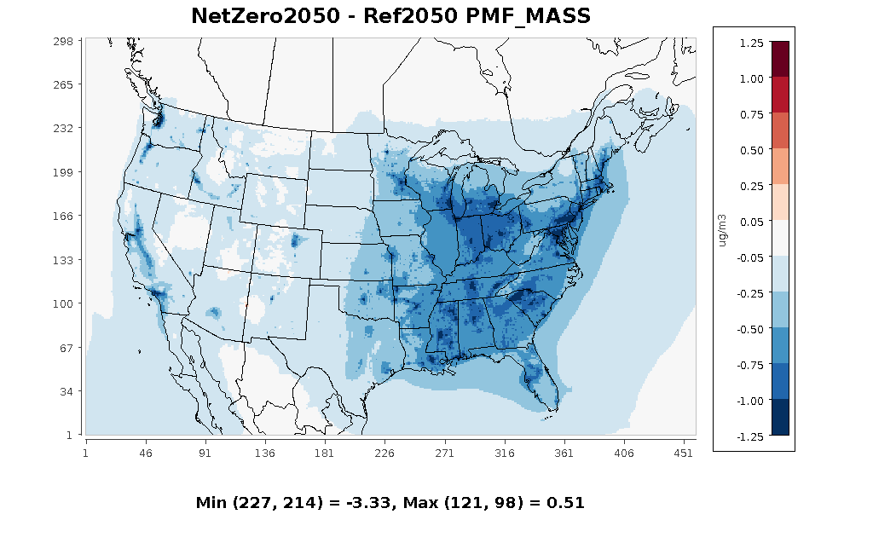
Changes in Annual Average PM2.5
2035
2050
±2.5
±2.5
Ref − 2016
±1.25
±1.25
PM_{2.5} Co-Benefits of NetZero Scenario
NetZero − Ref
Notes:
Reference scenario, 2035: decrease of at least 0.5 ug/m3 over most of EUS, exceeding 1 ug/m3 in several states and 1.5 ug/m3 in Ohio River Valley. Slight increase (smaller decrease) in 2050, and even a small absolute increase in SoCal
NetZero scenario, 2035: little impact on PM2.5, with small decrease in California and small increase in Central US
NetZero scenario, 2050: large co-benefit, with PM decrease of 0.5-1.0 ug/m3 over most of EUS and parts of California

Slide 12
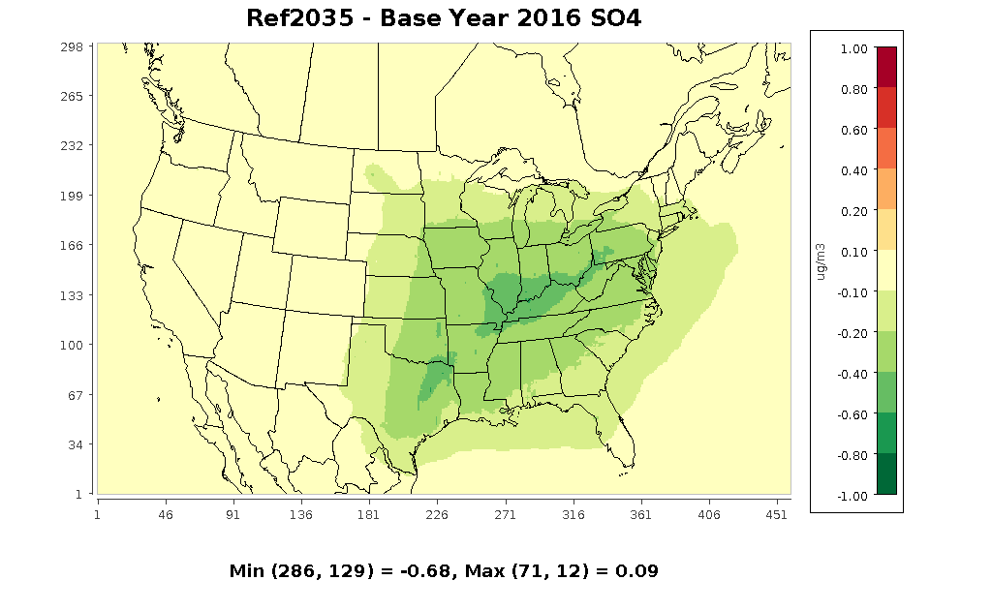
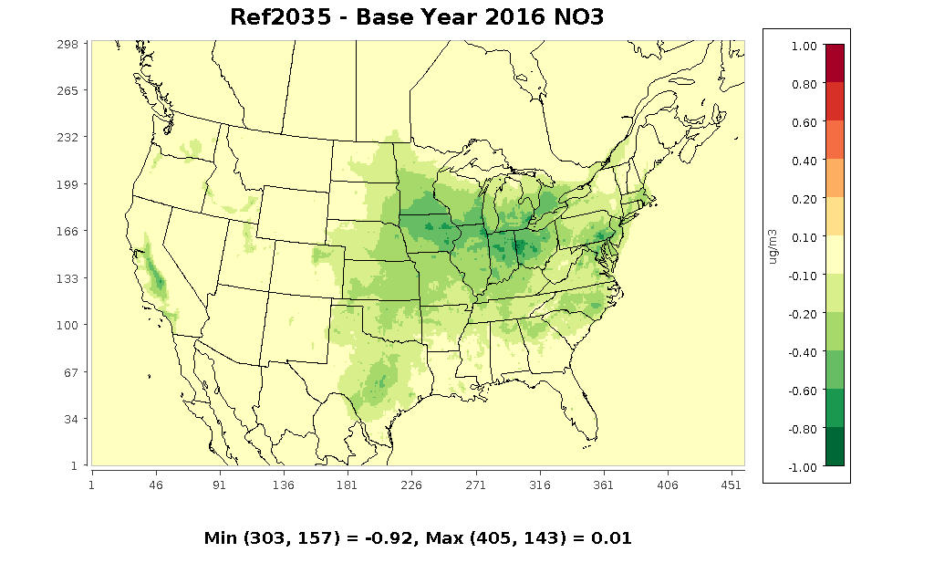
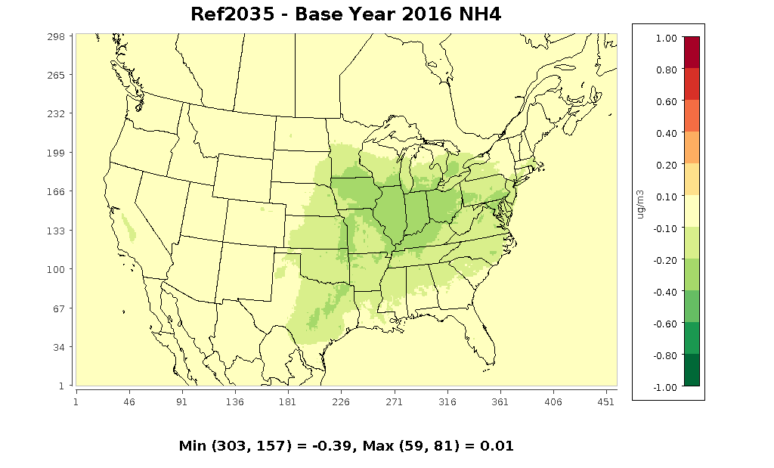
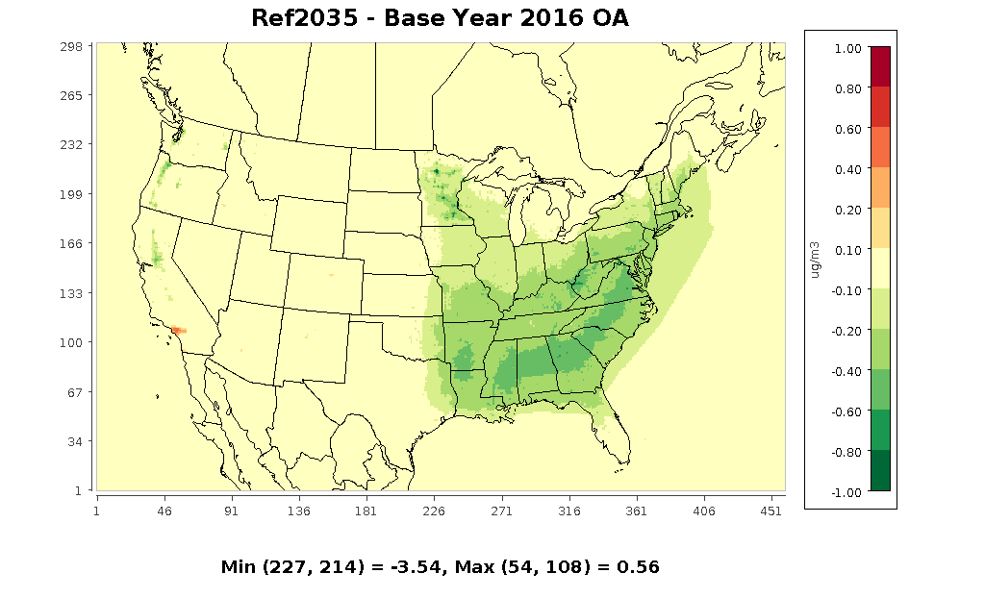
Changes in PM2.5 Components: 2035 − Base Year
all 4 panels ±1.0
Notes:
The inset plot is again the change in total PM2.5.
The other panels, on a smaller scale, are all differences in specific PM components between the Reference scenario in 2035 and the base year of 2016.
Decreases of around 0.2-0.6 ug/m3 SO4 in most of the EUS, slightly larger decrease in NO3 further to the north, smaller decrease in NH4.
Decrease in organic aerosol in EUS, particularly SE.

Slide 13
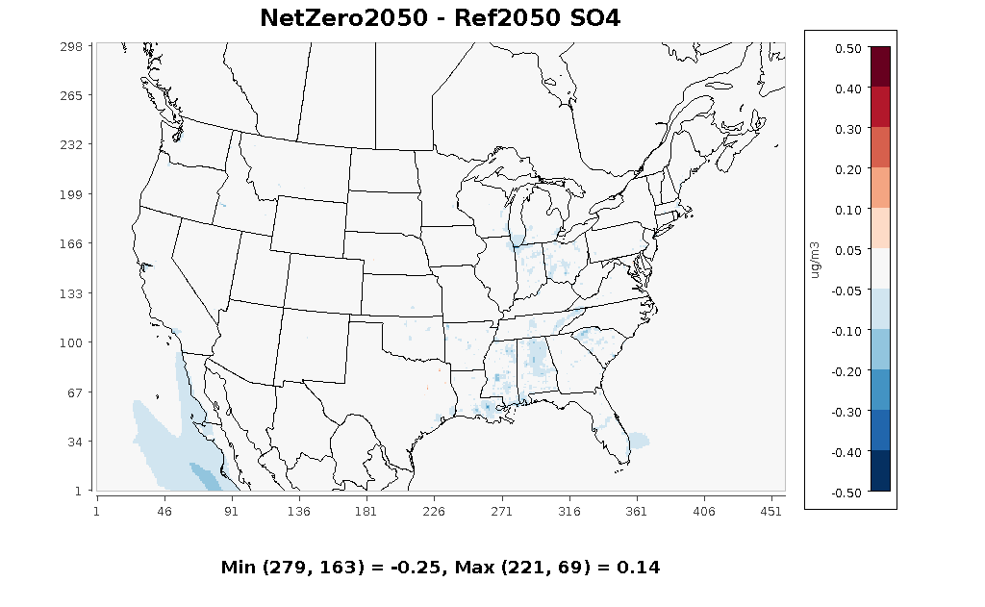
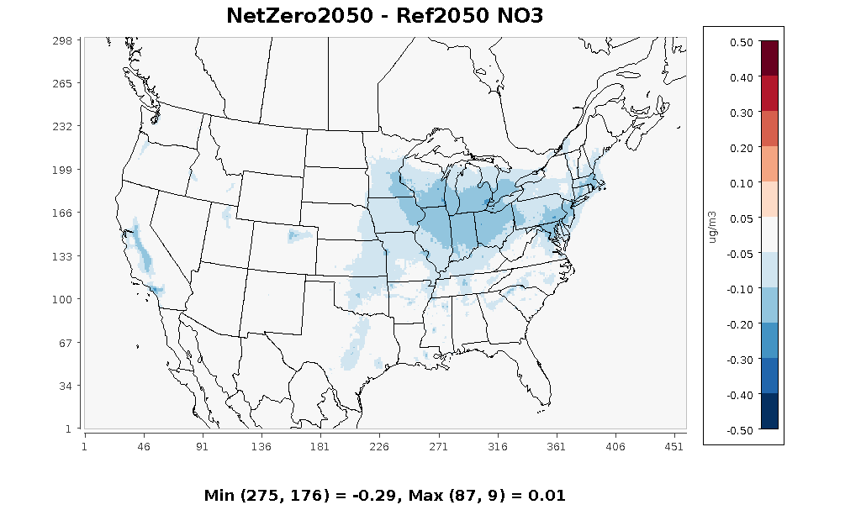
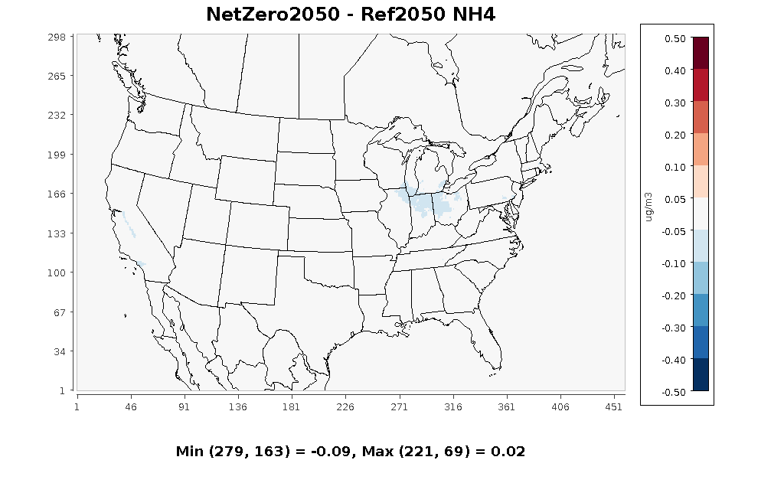
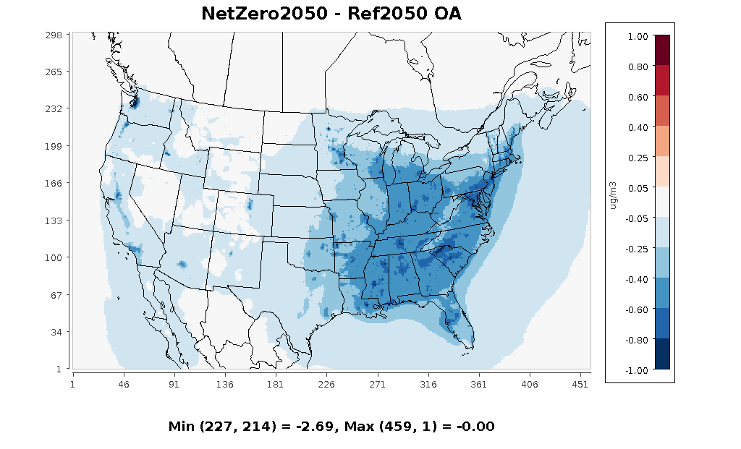
PM_{2.5} Co-Benefits by Component in 2050
±0.5
±0.5
±0.5
±1.0
Notes:
The inset plot is again the co-benefit in 2050, the difference between NetZero and Reference scenarios.
There is essentially no difference in SO4 between the NetZero and the Reference scenario, likely because most coal-fired power plants are already retired in the Reference scenario.
Also little change in NH4 – most NH3 emissions are from agriculture, which we are not varying in these scenarios.
The main drivers of the changes in PM2.5 are organic aerosols (shown here) and primary PM2.5 (recall slide 8).

Slide 14
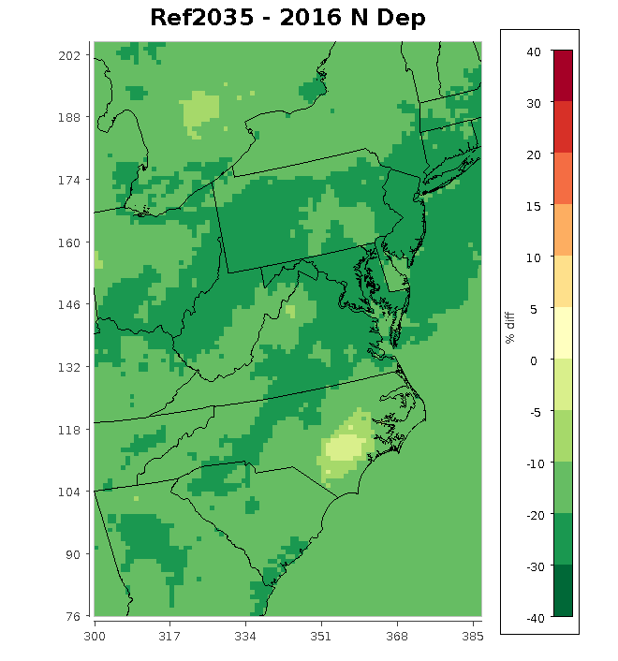
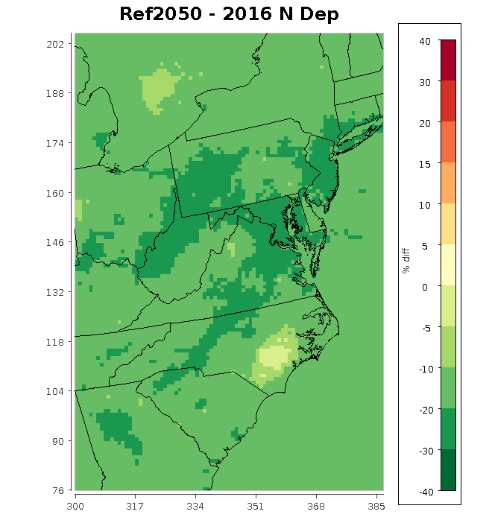
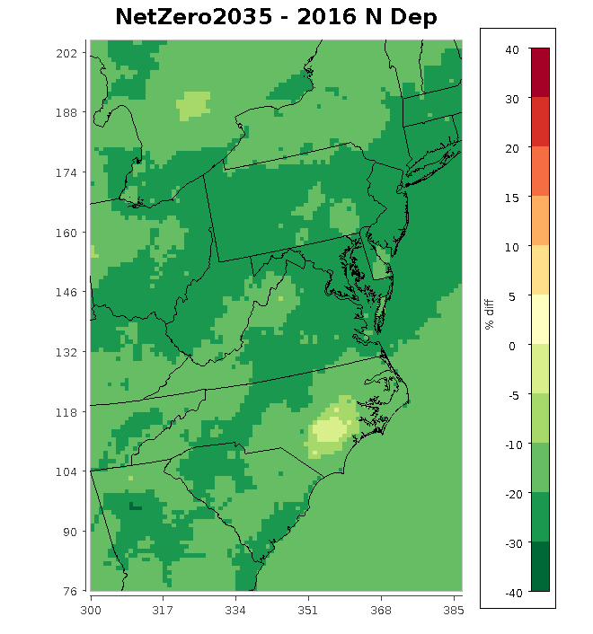
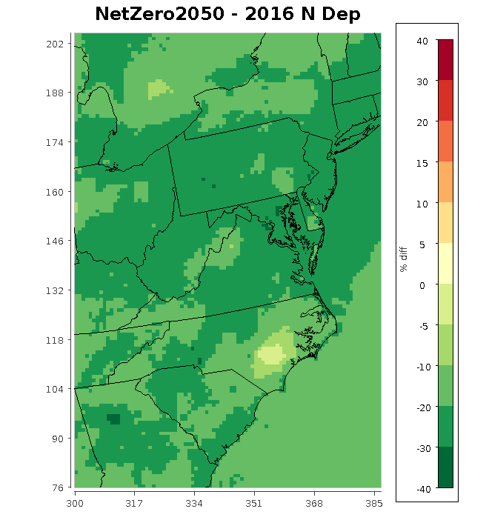
Relative Changes in Annual Total N Deposition to Chesapeake Bay Watershed
10-30% decrease in N deposition in Reference scenario in 2035 relative to 2016
N deposition increases slightly in Reference scenario in 2050
Little to no difference between Reference and NetZero scenarios in 2035
NetZero scenario results in further decreases in N deposition in 2050

Slide 15
Summary
Reference scenario results in strong decrease in MDA8 O₃ (1-10 ppb) in 2035 due to lower NOx emissions.
Reference scenario leads to decrease in PM_{2.5} of 0.5-2.0 μg m⁻³ in much of the Eastern US
Relatively little difference between Reference and NetZero scenarios at 2035, but large difference in 2050
Further decreases of 0.5-1.9 ppb O₃ and 0.5-1.0 μg m⁻³ PM_{2.5} over much of the Eastern U.S.
Total N deposition decreases 10-30% in Chesapeake Bay watershed in 2035; further reductions in NetZero scenario in 2050
Future Work
Examine impacts of additional scenarios with greater differences in 2035 and/or 2050
Analyze Integrated Source Apportionment Model (CMAQ-ISAM) results to estimate sectoral contributions to changes in deposition

