Slide 1
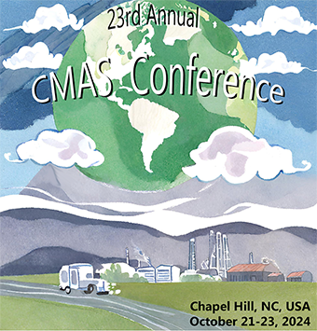
Enhancing Meteorological and Air Quality Prediction Accuracy Through High-Resolution Data Assimilation Using Deep Learning
Hossein Alizadeh , Ali Azimi , Seyed Hamid Delbari , Vahid Hosseini
School of Sustainable Energy Engineering, Simon Fraser University, British Columbia, Canada

Slide 2
Outline
01
Motivation and Background
02
Study Area
03
Methodology-Data Assimilation in WRF
04
Methodology-AI Integration
05
AI Results
06
WRF Results
07
CMAQ Results
08
Conclusion

Slide 3
Motivations
Improve WRF Performance
Reduce bias errors with specific attention to extreme weather conditions in Edmonton, Alberta
Enhance Long-term Prediction Accuracy
Nudging the model output for long-duration modelling
Refine Local Forecast
Improve the surface-level meteorological parameters where small-scale weather phenomena are important
Enhance AQ Prediction
Analyze the impact on CMAQ outputs
Leverage Deep Leaning Downscaling
Incorporate a novel AI downscaling method to reconstruct the grid analysis

Slide 4
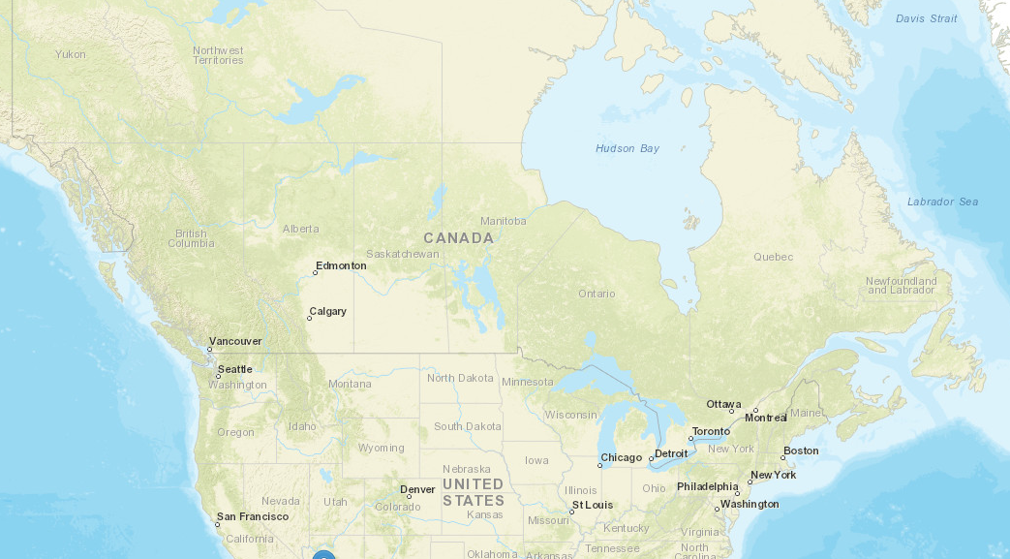
Study Area
Edmonton is the capital of Alberta and is recognized as the fifth-largest city in Canada. Its population is approximately 1 million.
Edmonton's primary industrial activities include advanced technology, energy, and tourism. It is located in South Alberta, near Canada’s oil and gas reserves and industries.
References:
www.alberta.ca

Slide 5
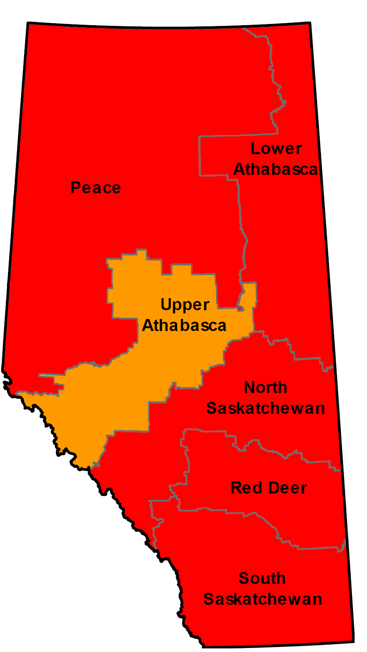
Local Air Quality Regulations
Canadian Ambient Air Quality Standards (CAAQS)
In terms of federal limits, all Alberta’s air zones have exceeded the 2020 NO₂ CAAQS. Most of them are categorized in red management level.
An updated standards for NO₂ concentration will be in effect starting 2025, in which annual average NO₂ threshold will be reduced from 17 ppb to 12 ppb.
CAAQS Status
References:
https://www.casahome.org/attachments/CAAQS%20and%20NO2%202018-08-09.pdf

Slide 6
WRF Data Assimilation
(WRF Data Assimilation)
Variables to Nudge
Nudging Coeff.
NCEP NAM
12 km
GFS
1 degree
MET Files
Apply Weightings
(AI Model)
Compute Nudging Tendency
Field Variables Processing
Encoder
Decoder
Update Model
WRF Output
Advance to next time step
High-Res. Field
1.3 km
NCEP: National Centers For Environmental Prediction
NAM: North American Mesoscale Forecast System
GFS: Global Forecast System
Notes:
The Output of AI model includes field variables such as pressure, temperature, wind components, and moisture variables, which are structured in a way that WRF can efficiently read and process.
There is a Quality control procedure that involve gross error checks to identify and eliminate observations that fall outside the plausible range of meteorological variables, buddy checks to compare each observation with neighboring observations to detect inconsistencies or anomalies, and cross-validation against a background field to identify and discard data that significantly deviate from expected values.
The timing of applying nudges to the model defines the interval between the updates of nudging tendency terms and the assimilation of new observations.
The fundamental concept in observation nudging is the calculation of innovations, which represent the differences between observed values and the model's corresponding variables at the observation locations.
The weightings in nudging process ensures observations influence the model state appropriately in space and time. The overall nudging incorporates temporal, vertical, and horizontal weighting functions. Vertical weighting functions vary based on the observation type and the structure of the planetary boundary layer, and horizontal weighting involves calculating a radius of influence and applying a distance-based weighting function to modulate the influence.
Once the nudging tendencies are computed using innovations and weighting functions, these tendencies are added to the model's prognostic equations as additional forcing terms. This process gradually adjusts the model variables toward the observed values without abrupt changes that could destabilize the model.

Slide 7
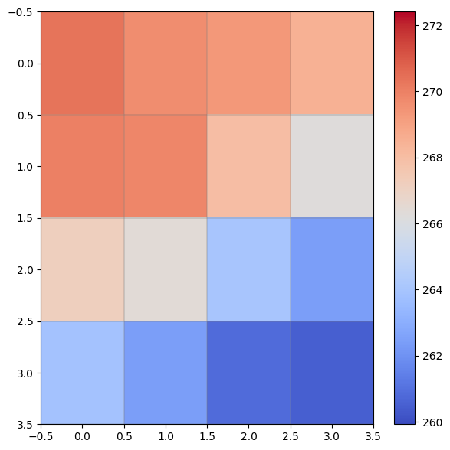
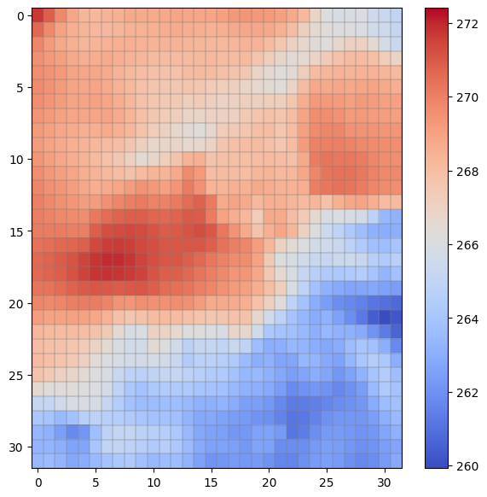
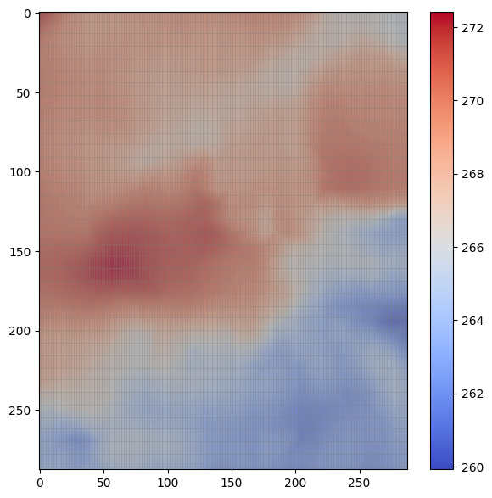
Methodology-Data Assimilation in WRF
108km
12km
Stage 1:
Train the model using data from 108 km to 12 km resolution
Deep Learning
Framework
Stage 2:
Use the same trained model to downscale from 12 km to 1.33 km resolution
12km
1.3km
Trained Model
Notes:
As mentioned, in order to improve the accuracy of the WRF model, we need high-resolution climate data as input for its data assimilation process.
Such data is often unavailable, especially at finer scales like 1 km. So we tried to come up with a deep learning framework that could generate this high-resolution data by downscaling coarser inputs.
The model operates in two stages:
Stage 1: We train the model using data from 108 km to 12 km resolution.
Stage 2: The same model is then used to downscale from 12 km to 1.33 km.

Slide 8
Methodology-AI Flow Chart
Challenge:
The relationship between coarse (108 km) and medium (12 km) resolutions is different from the relationship between 12 km and 1.33 km
Model Architecture:
Residual Encoder-Decoder with Attention Mechanism
Residual Learning helps by allowing the model to focus on refining the errors from an initial interpolation, rather than predicting the full high-resolution output.
Model predicts residuals (corrections to bilinear interpolation), refining finer details to improve output resolution
$$f^{−1}\left(X\right)=\hat{f^{−1}}{\left(X\right)}_{\text{bilinear} \text{interpolation}}+r{\left(\hat{f^{−1}}\left(X\right)\right)}_{\text{residual}}$$
$${\hat{f}}^{−1}(x)$$
$$r\left({\hat{f}}^{−1}\left(x\right)\right)$$
Input
Output
Encoder
Bottleneck
Decoder
Notes:
The challenge is that the relationship between coarse (108 km) and medium (12 km) resolutions is different from the relationship between 12 km and 1.33 km. This makes it difficult for the model to learn general features that apply well across both scales.
To address this, we developed a Residual Encoder-Decoder with Attention Mechanism.
Residual Learning helps us by allowing the model to focus on refining the errors from an initial interpolation, rather than predicting the full high-resolution output. Which at this case, makes the learning process more efficient and accurate. Additionally, we used an Attention Mechanism which ensures the model focuses on the most important spatial features during downscaling, which results in capturing finer details that are crucial for improving WRF's performance.
So, we want to predict f^-1 which is the final high-resolution.
The bilinear interpolation is the initial estimate,
And finally the residual 𝑟 ( 𝑓 ^ − 1 ( 𝑋 ) ) is the correction the model learns to apply,

Slide 9
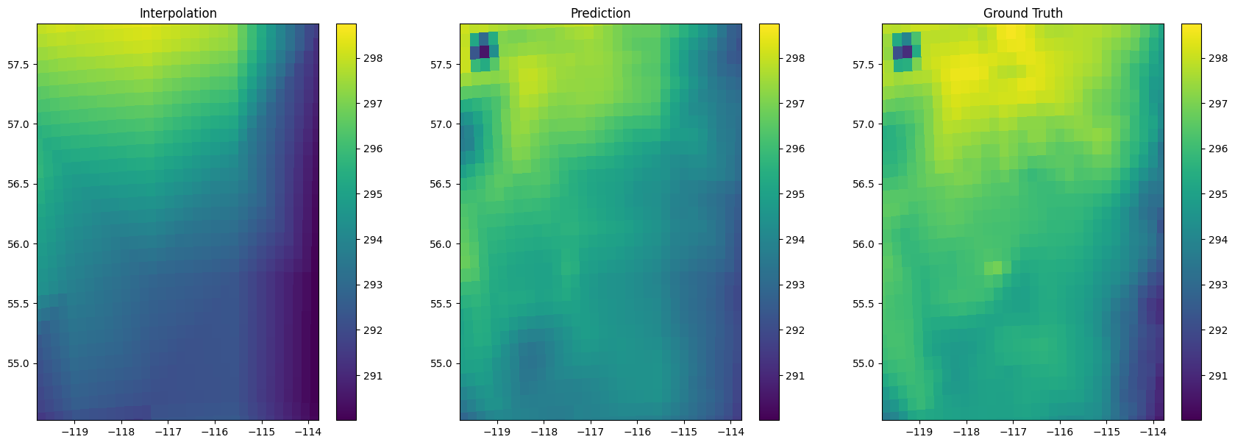
Results – Temperature (K)
Results from Stage 1: Downscaling from 108 km to 12 km
Comparing the model's temperature prediction to the ground truth using statistical indicators
Mean Absolute Error | Root Mean Square Error | R² Score
0.94 | 1.24 | 98.4%

Slide 10
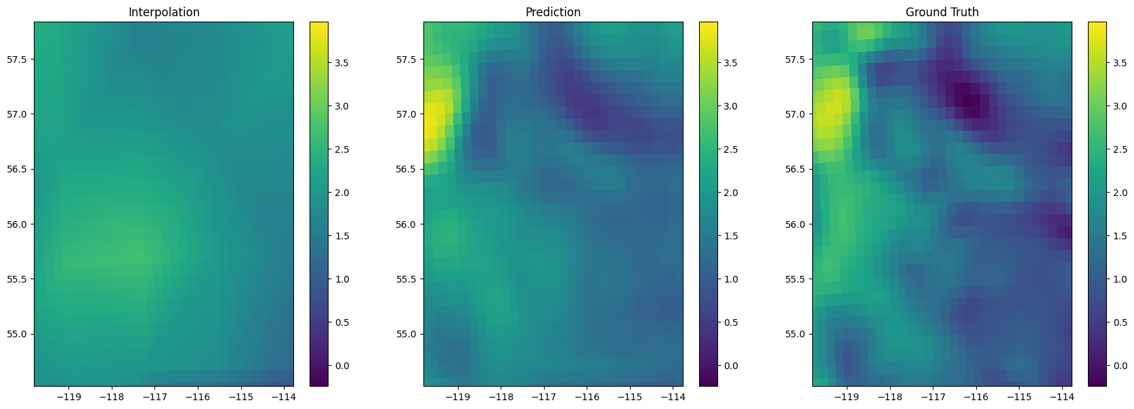
U - component of the velocity field
Results from Stage 1: Downscaling from 108 km to 12 km
Comparing the model’s U-component velocity prediction to the ground truth using statistical indicators
Mean Absolute Error | Root Mean Square Error | R² Score
0.34 | 0.58 | 93.1%

Slide 11
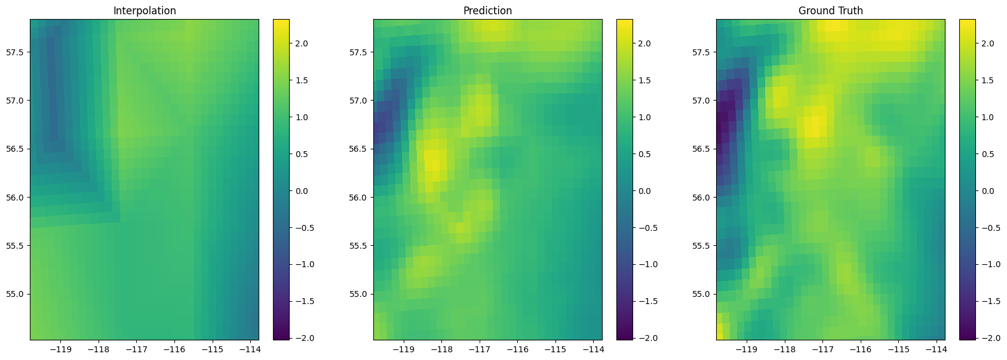
V - component of the velocity field
Results from Stage 1: Downscaling from 108 km to 12 km
Comparing the model’s V-component velocity prediction to the ground truth using statistical indicators
Mean Absolute Error | Root Mean Square Error | R^2 Score
0.44 | 0.65 | 91.8%

Slide 12
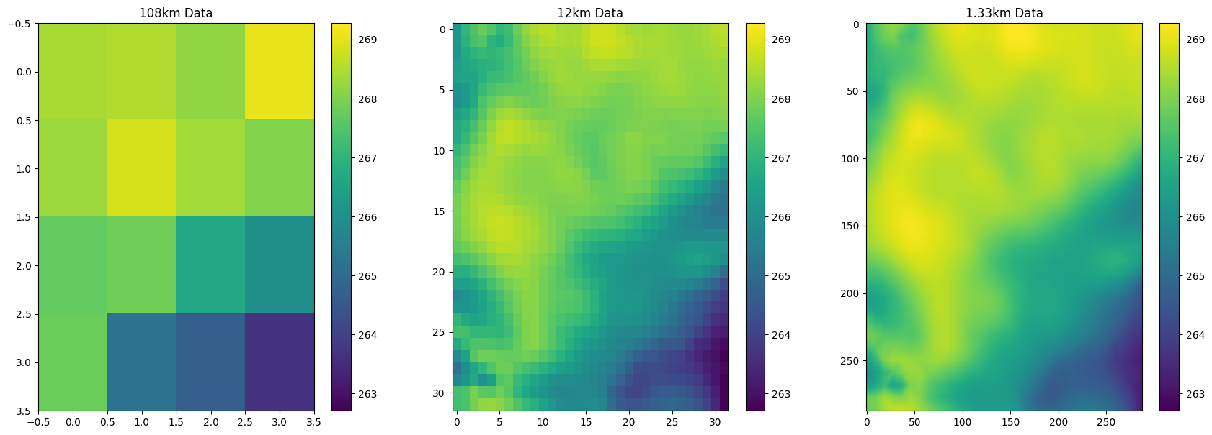
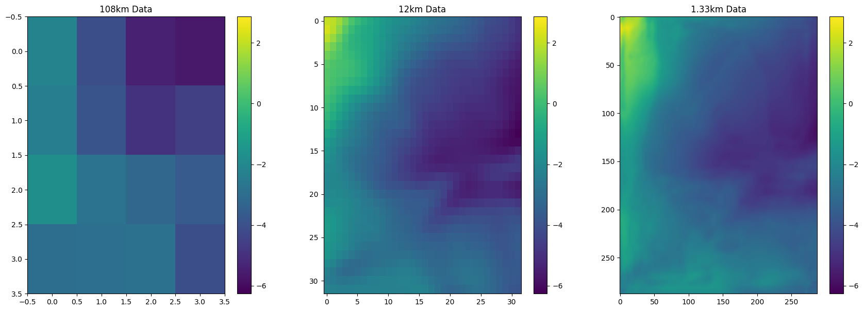
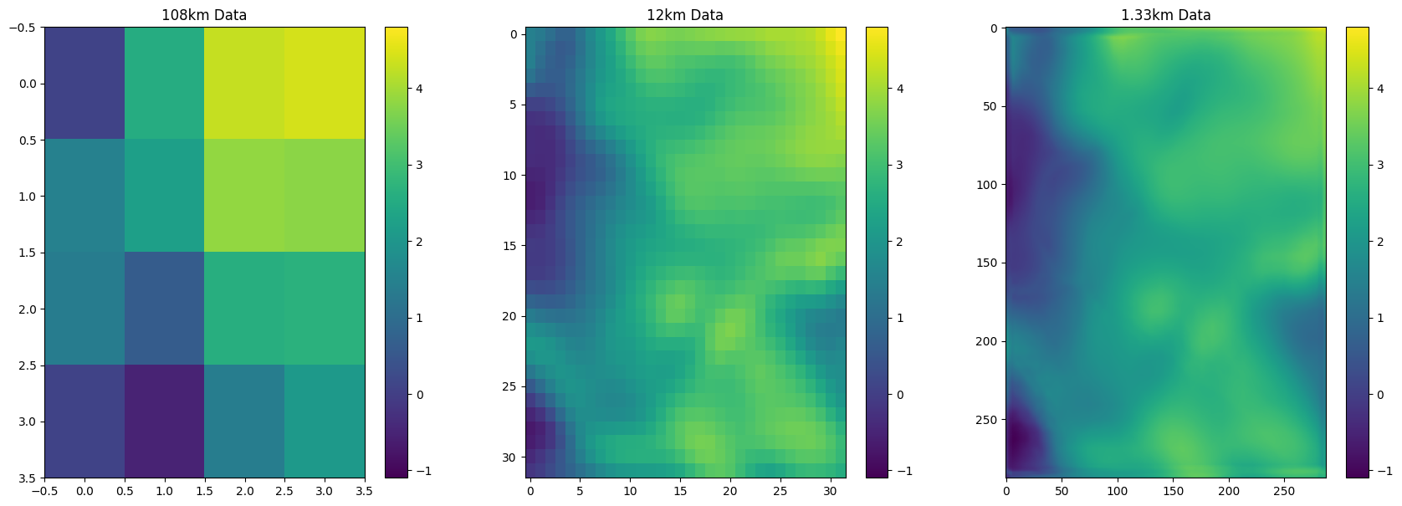
Downscaling Outputs with the AI model
108 km
12 km
1.3 km
Coarse to Fine Resolution:
108 km: Coarse patterns with minimal detail.
12 km: Intermediate resolution revealing more structure.
1.3 km: High-resolution output capturing fine-scale spatial variability critical for localized weather predictions.
Temperature
U velocity component
V velocity component

Slide 13
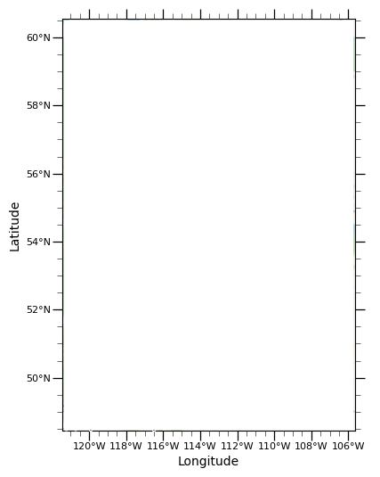
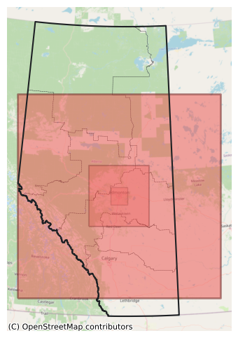
Methodology-Domain Specifications
D1
D2
D3
Domain | Lat_ref | Long_ref | Resolution (km)
Domain 1 | 49.48 | -120.73 | 9
Domain 2 | 52.37 | -115.51 | 3
Domain 3 | 53.21 | -114.06 | 1

Slide 14
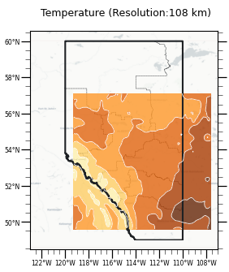
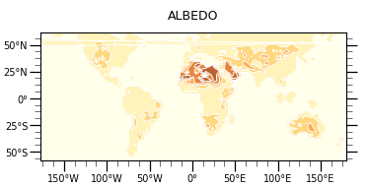
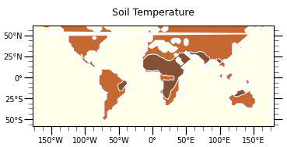
Methodology-WRF Model Flow Chart
Land-use and topography data
Data preparation and conversion
Interpolation of data to the WRF domain
Initial/Boundary condition identification
WRF model
Atmospheric and Land-soil variables
Simulation Episode:
12 Jul. – 24 Jul. 2019

Slide 15
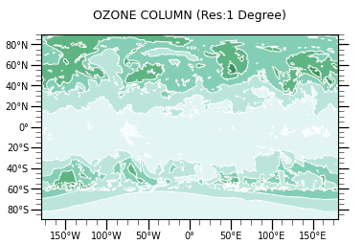
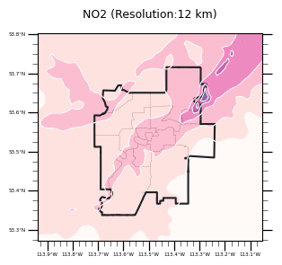
Methodology-CMAQ Model Flow Chart
Anthropogenic emission
SMOKE Model
Canada National Emission Inventory (2015)
WRF Model
Biogenic emission
BEIS Model
BELD4 Canada Land Use
Meteorology Chemistry Interface processor
Emissions Chemistry Interface processor
Clear-Sky photolysis rates
Chemical Mechanism
Carbon Bond 6 version r3 with aero7 treatment of SOA
3-D Advection Scheme
WRF_CONS [7]
CMAQ model
Initial/Boundary Conditions
Vertical Diffusion
ACM2 Model [8]
Dry Deposition
M3DRY Model [9]

Slide 16
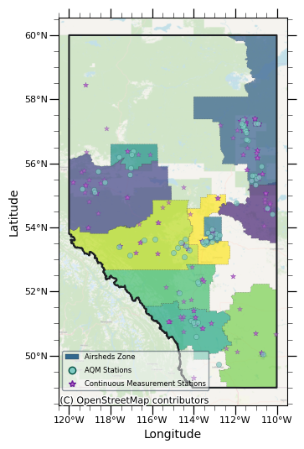
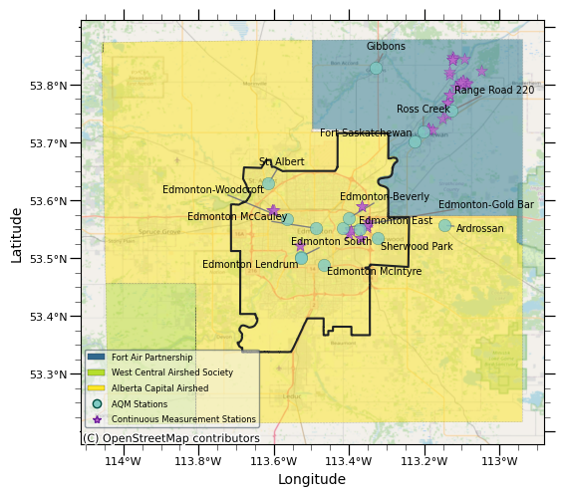
Methodology-Validation Process
Hourly observation data from 12 air quality monitoring stations operated by Alberta Capital Airshed was collected.
Ground-level hourly averaged model results were compared to the observation results.

Slide 17
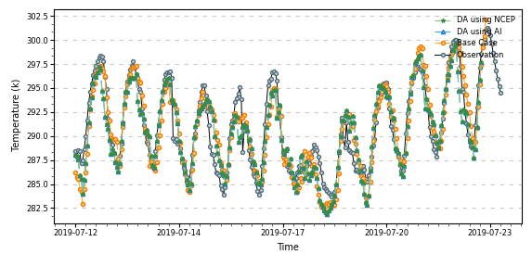
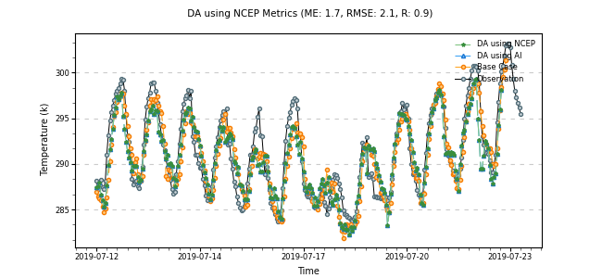
WRF Results – Temperature
St. Albert Station
Model | ME | RMSE | R
 | $$\sum{\left(\frac{\left|M_{i}−O_{i}\right|}{N}\right)}$$ | $${\left[\frac{1}{N}\sum{{\left(\hat{M_{i}}−O_{i}\right)}^{2}}\right]}^{\frac{1}{2}}$$ | $$\frac{\sum{\left(M_{i}−\overline{M}\right)\left(O_{i}−\overline{O}\right)}}{σ_{M}σ_{O}}$$
Base Case | 1.51 | 1.87 | 0.92
DA with AI | 1.37 | 1.75 | 0.92
DA with NCEP | 1.43 | 1.79 | 0.92
Edmonton East Station
Model | ME | RMSE | R
 | $$\sum{\left(\frac{\left|M_{i}−O_{i}\right|}{N}\right)}$$ | $${\left[\frac{1}{N}\sum{{\left(\hat{M_{i}}−O_{i}\right)}^{2}}\right]}^{\frac{1}{2}}$$ | $$\frac{\sum{\left(M_{i}−\overline{M}\right)\left(O_{i}−\overline{O}\right)}}{σ_{M}σ_{O}}$$
Base Case | 1.78 | 2.12 | 0.93
DA with AI | 1.73 | 2.05 | 0.93
DA with NCEP | 1.81 | 2.11 | 0.93

Slide 18
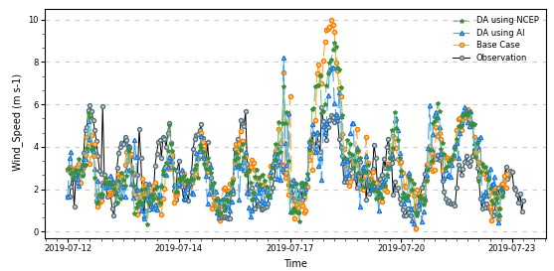
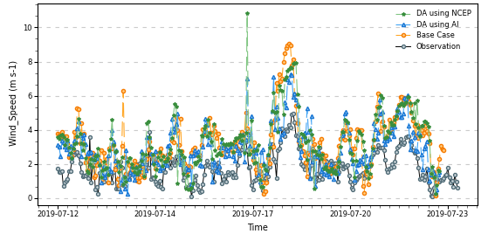
WRF Results – Wind Speed
St. Albert Station
Model | ME | RMSE | R
 | $$\sum{\left(\frac{\left|M_{i}−O_{i}\right|}{N}\right)}$$ | $${\left[\frac{1}{N}\sum{{\left(\hat{M_{i}}−O_{i}\right)}^{2}}\right]}^{\frac{1}{2}}$$ | $$\frac{\sum{\left(M_{i}−\overline{M}\right)\left(O_{i}−\overline{O}\right)}}{σ_{M}σ_{O}}$$
Base Case | 1.21 | 1.65 | 0.58
DA with AI | 1.05 | 1.36 | 0.57
DA with NCEP | 1.13 | 1.45 | 0.61
Edmonton East Station
Model | ME | RMSE | R
 | $$\sum{\left(\frac{\left|M_{i}−O_{i}\right|}{N}\right)}$$ | $${\left[\frac{1}{N}\sum{{\left(\hat{M_{i}}−O_{i}\right)}^{2}}\right]}^{\frac{1}{2}}$$ | $$\frac{\sum{\left(M_{i}−\overline{M}\right)\left(O_{i}−\overline{O}\right)}}{σ_{M}σ_{O}}$$
Base Case | 1.47 | 1.85 | 0.68
DA with AI | 1.27 | 1.56 | 0.63
DA with NCEP | 1.41 | 1.81 | 0.69

Slide 19
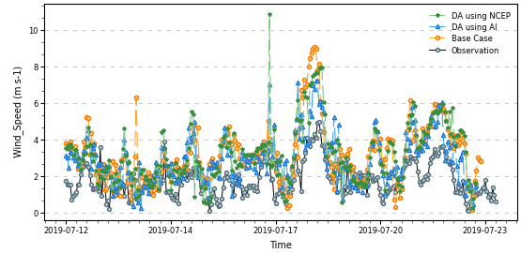
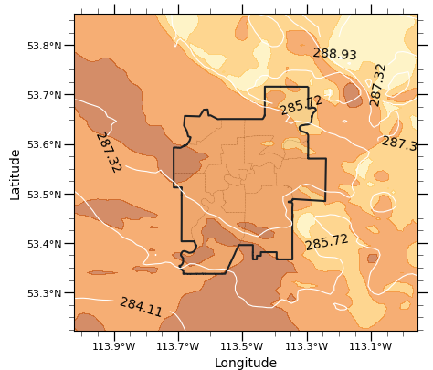
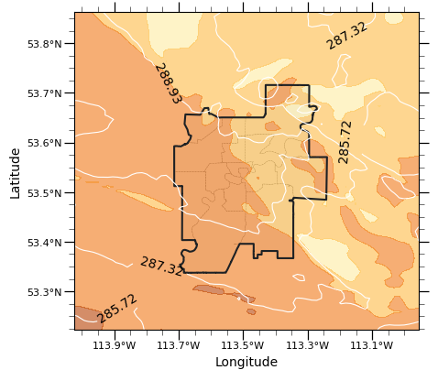
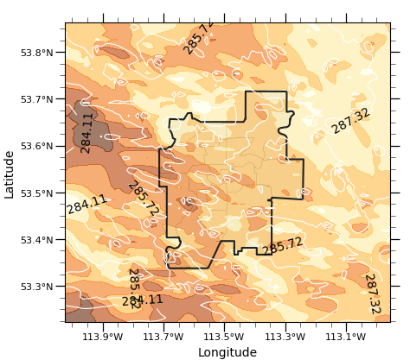
WRF Results
Base Case
Data Assimilation Using NCEP NAM
Data Assimilation Using AI Results
Line Contour of Temperature (k)
Contour of Wind Speed (m/s)

Slide 20
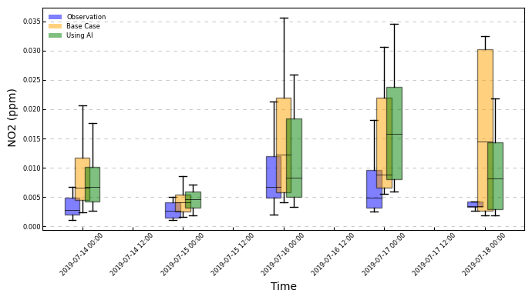
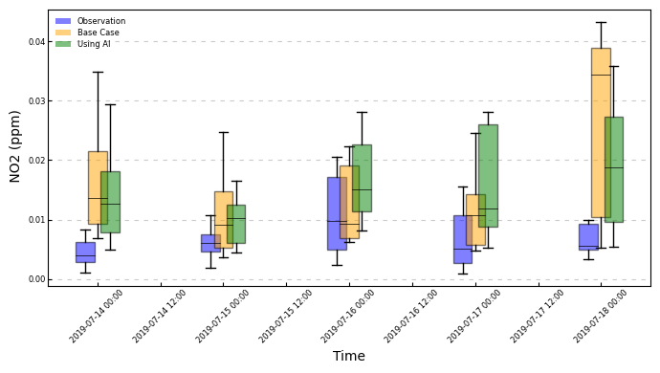
CMAQ Results – NO₂
St. Albert Station
Model | MAPE | RMSE | IOA
 | $$\frac{100}{N}\sum{\left(\frac{\left|M_{i}−O_{i}\right|}{O_{i}}\right)}$$ | $${\left[\frac{1}{N}\sum{{\left(\hat{M_{i}}−O_{i}\right)}^{2}}\right]}^{\frac{1}{2}}$$ | $$1−\frac{\sum{{\left(M_{i}−O_{i}\right)}^{2}}}{\sum{{\left(\left|M_{i}−\overline{O}\right|+\left|O_{i}−\overline{O}\right|\right)}^{2}}}$$
Base Case | 0.81 | 0.01 | 0.52
With DA using AI | 0.75 | 0.008 | 0.58
Edmonton East Station
Model | MAPE | RMSE | IOA
 | $$\frac{100}{N}\sum{\left(\frac{\left|M_{i}−O_{i}\right|}{O_{i}}\right)}$$ | $${\left[\frac{1}{N}\sum{{\left(\hat{M_{i}}−O_{i}\right)}^{2}}\right]}^{\frac{1}{2}}$$ | $$1−\frac{\sum{{\left(M_{i}−O_{i}\right)}^{2}}}{\sum{{\left(\left|M_{i}−\overline{O}\right|+\left|O_{i}−\overline{O}\right|\right)}^{2}}}$$
Base Case | 0.68 | 0.009 | 0.45
With DA using AI | 0.71 | 0.009 | 0.49

Slide 21
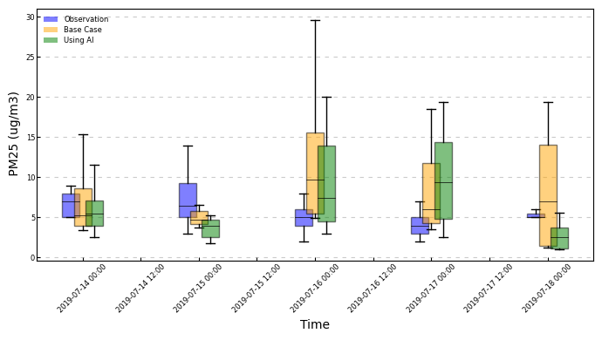
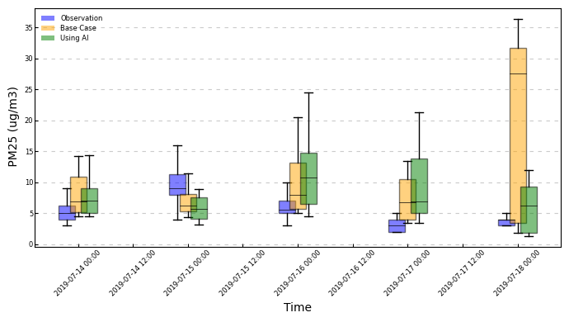
CMAQ Results – PM 2.5
St. Albert Station
Model | MAPE | RMSE | IOA
 | $$\frac{100}{N}\sum{\left(\frac{\left|M_{i}−O_{i}\right|}{O_{i}}\right)}$$ | $${\left[\frac{1}{N}\sum{{\left(\hat{M_{i}}−O_{i}\right)}^{2}}\right]}^{\frac{1}{2}}$$ | $$1−\frac{\sum{{\left(M_{i}−O_{i}\right)}^{2}}}{\sum{{\left(\left|M_{i}−\overline{O}\right|+\left|O_{i}−\overline{O}\right|\right)}^{2}}}$$
Base Case | 0.47 | 7.7 | 0.40
With DA using AI | 0.42 | 5.8 | 0.62
Edmonton East Station
Model | MAPE | RMSE | IOA
 | $$\frac{100}{N}\sum{\left(\frac{\left|M_{i}−O_{i}\right|}{O_{i}}\right)}$$ | $${\left[\frac{1}{N}\sum{{\left(\hat{M_{i}}−O_{i}\right)}^{2}}\right]}^{\frac{1}{2}}$$ | $$1−\frac{\sum{{\left(M_{i}−O_{i}\right)}^{2}}}{\sum{{\left(\left|M_{i}−\overline{O}\right|+\left|O_{i}−\overline{O}\right|\right)}^{2}}}$$
Base Case | 0.45 | 7.7 | 0.33
With DA using AI | 0.43 | 6.2 | 0.55

Slide 22
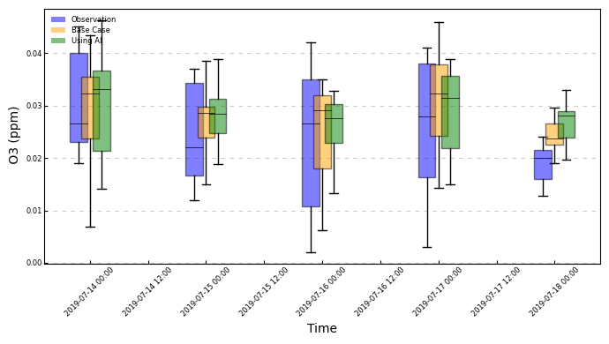
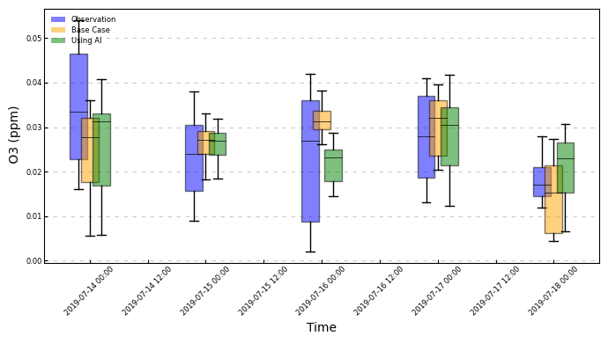
CMAQ Results – O3
St. Albert Station
Model | MAPE | RMSE | IOA
 | $$\frac{100}{N}\sum{\left(\frac{\left|M_{i}−O_{i}\right|}{O_{i}}\right)}$$ | $${\left[\frac{1}{N}\sum{{\left(\hat{M_{i}}−O_{i}\right)}^{2}}\right]}^{\frac{1}{2}}$$ | $$1−\frac{\sum{{\left(M_{i}−O_{i}\right)}^{2}}}{\sum{{\left(\left|M_{i}−\overline{O}\right|+\left|O_{i}−\overline{O}\right|\right)}^{2}}}$$
Base Case | 0.15 | 0.0076 | 0.82
With DA using AI | 0.14 | 0.0071 | 0.83
Edmonton East Station
Model | MAPE | RMSE | IOA
 | $$\frac{100}{N}\sum{\left(\frac{\left|M_{i}−O_{i}\right|}{O_{i}}\right)}$$ | $${\left[\frac{1}{N}\sum{{\left(\hat{M_{i}}−O_{i}\right)}^{2}}\right]}^{\frac{1}{2}}$$ | $$1−\frac{\sum{{\left(M_{i}−O_{i}\right)}^{2}}}{\sum{{\left(\left|M_{i}−\overline{O}\right|+\left|O_{i}−\overline{O}\right|\right)}^{2}}}$$
Base Case | 0.18 | 0.009 | 0.71
With DA using AI | 0.16 | 0.008 | 0.75

Slide 23
Conclusion
01
An encoder-decoder AI-based algorithm is used to nudge the WRF’s temperature and velocity fields into high-resolution, urban community-scale outputs.
02
Using the data assimilation method increased the accuracy of the model and reduced the errors of the WRF model. It utilizes the benefits of both mesoscale and local models by including the effects of a global model in a local model.
03
Comparing the results of data assimilation using a high-resolution field for data assimilation increases the accuracy by reducing the mean error by 9%, while using a low-resolution field (NCEP) increases the accuracy by 4%.
04
The results of CMAQ indicated that while using more accurate meteorology data can enhance the accuracy of the model at specific times, other inputs, such as emission inventory, need to be dealt with separately.

Slide 24
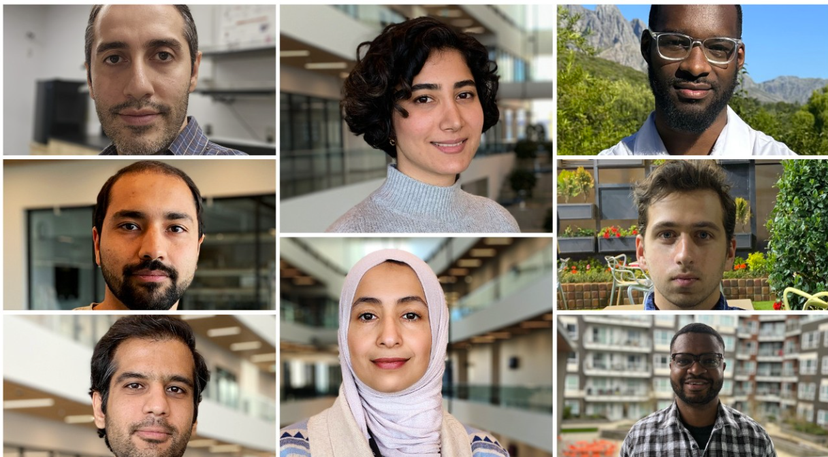
Acknowledgment
Environment and Climate Change Canada (ECCC), Climate Action Awareness Fund (CAAF)—Advancing Climate Change Science & Technology, provides the funding for the project “Urban Transportation Emissions and GHGs; Technologies and Behavioral Shifts.”
Research collaborators at the University of Alberta, Prof. Bob Koch and Prof. Mahdi Shahbakhti.
Project partners, such as the Government of Alberta, the City of Edmonton, Clean Air Strategic Alliance, and Alberta Airshed Council.
Research students at the CREATE lab, School of Sustainable Energy Engineering, Simon Fraser University, Metro Vancouver, Canada
Collaborative Research on Energy, Air Pollution, Transportation and Environment

Slide 25
Thank You for Your Attention
Email
Haa59@sfu.ca

Slide 26
Back up slides – CMAQ time series

Slide 27
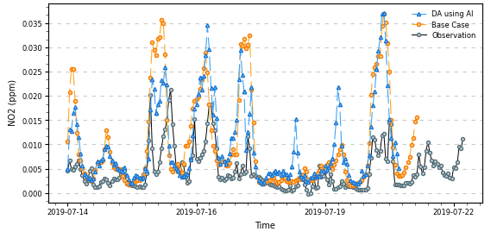
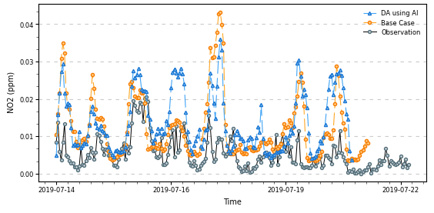
CMAQ Results – NO₂
St. Albert Station
Model | MAPE | RMSE | IOA
 | $$\frac{100}{N}\sum{\left(\frac{\left|M_{i}−O_{i}\right|}{O_{i}}\right)}$$ | $${\left[\frac{1}{N}\sum{{\left(\hat{M_{i}}−O_{i}\right)}^{2}}\right]}^{\frac{1}{2}}$$ | $$1−\frac{\sum{{\left(M_{i}−O_{i}\right)}^{2}}}{\sum{{\left(\left|M_{i}−\overline{O}\right|+\left|O_{i}−\overline{O}\right|\right)}^{2}}}$$
Base Case | 0.81 | 0.01 | 0.52
With DA using AI | 0.75 | 0.008 | 0.58
Edmonton East Station
Model | MAPE | RMSE | IOA
 | $$\frac{100}{N}\sum{\left(\frac{\left|M_{i}−O_{i}\right|}{O_{i}}\right)}$$ | $${\left[\frac{1}{N}\sum{{\left(\hat{M_{i}}−O_{i}\right)}^{2}}\right]}^{\frac{1}{2}}$$ | $$1−\frac{\sum{{\left(M_{i}−O_{i}\right)}^{2}}}{\sum{{\left(\left|M_{i}−\overline{O}\right|+\left|O_{i}−\overline{O}\right|\right)}^{2}}}$$
Base Case | 0.68 | 0.009 | 0.45
With DA using AI | 0.71 | 0.009 | 0.49

Slide 28
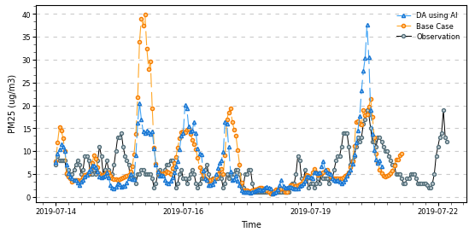
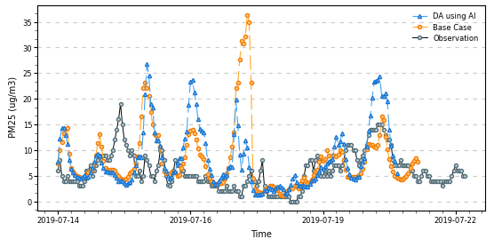
CMAQ Results – PM 2.5
St. Albert Station
Model | MAPE | RMSE | IOA
 | $$\frac{100}{N}\sum{\left(\frac{\left|M_{i}−O_{i}\right|}{O_{i}}\right)}$$ | $${\left[\frac{1}{N}\sum{{\left(\hat{M_{i}}−O_{i}\right)}^{2}}\right]}^{\frac{1}{2}}$$ | $$1−\frac{\sum{{\left(M_{i}−O_{i}\right)}^{2}}}{\sum{{\left(\left|M_{i}−\overline{O}\right|+\left|O_{i}−\overline{O}\right|\right)}^{2}}}$$
Base Case | 0.47 | 7.7 | 0.40
With DA using AI | 0.42 | 5.8 | 0.62
Edmonton East Station
Model | MAPE | RMSE | IOA
 | $$\frac{100}{N}\sum{\left(\frac{\left|M_{i}−O_{i}\right|}{O_{i}}\right)}$$ | $${\left[\frac{1}{N}\sum{{\left(\hat{M_{i}}−O_{i}\right)}^{2}}\right]}^{\frac{1}{2}}$$ | $$1−\frac{\sum{{\left(M_{i}−O_{i}\right)}^{2}}}{\sum{{\left(\left|M_{i}−\overline{O}\right|+\left|O_{i}−\overline{O}\right|\right)}^{2}}}$$
Base Case | 0.45 | 7.7 | 0.33
With DA using AI | 0.43 | 6.2 | 0.55

Slide 29
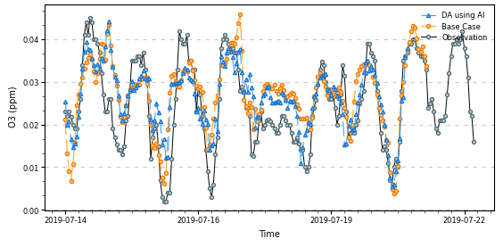
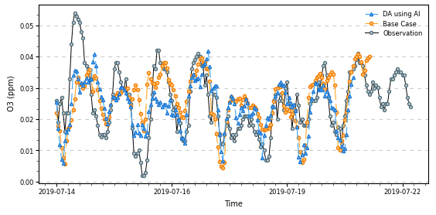
CMAQ Results – O3
St. Albert Station
Model | MAPE | RMSE | IOA
 | $$\frac{100}{N}\sum{\left(\frac{\left|M_{i}−O_{i}\right|}{O_{i}}\right)}$$ | $${\left[\frac{1}{N}\sum{{\left(\hat{M_{i}}−O_{i}\right)}^{2}}\right]}^{\frac{1}{2}}$$ | $$1−\frac{\sum{{\left(M_{i}−O_{i}\right)}^{2}}}{\sum{{\left(\left|M_{i}−\overline{O}\right|+\left|O_{i}−\overline{O}\right|\right)}^{2}}}$$
Base Case | 0.15 | 0.0076 | 0.82
With DA using AI | 0.14 | 0.0071 | 0.83
Edmonton East Station
Model | MAPE | RMSE | IOA
 | $$\frac{100}{N}\sum{\left(\frac{\left|M_{i}−O_{i}\right|}{O_{i}}\right)}$$ | $${\left[\frac{1}{N}\sum{{\left(\hat{M_{i}}−O_{i}\right)}^{2}}\right]}^{\frac{1}{2}}$$ | $$1−\frac{\sum{{\left(M_{i}−O_{i}\right)}^{2}}}{\sum{{\left(\left|M_{i}−\overline{O}\right|+\left|O_{i}−\overline{O}\right|\right)}^{2}}}$$
Base Case | 0.18 | 0.009 | 0.71
With DA using AI | 0.16 | 0.008 | 0.75

