Slide 1
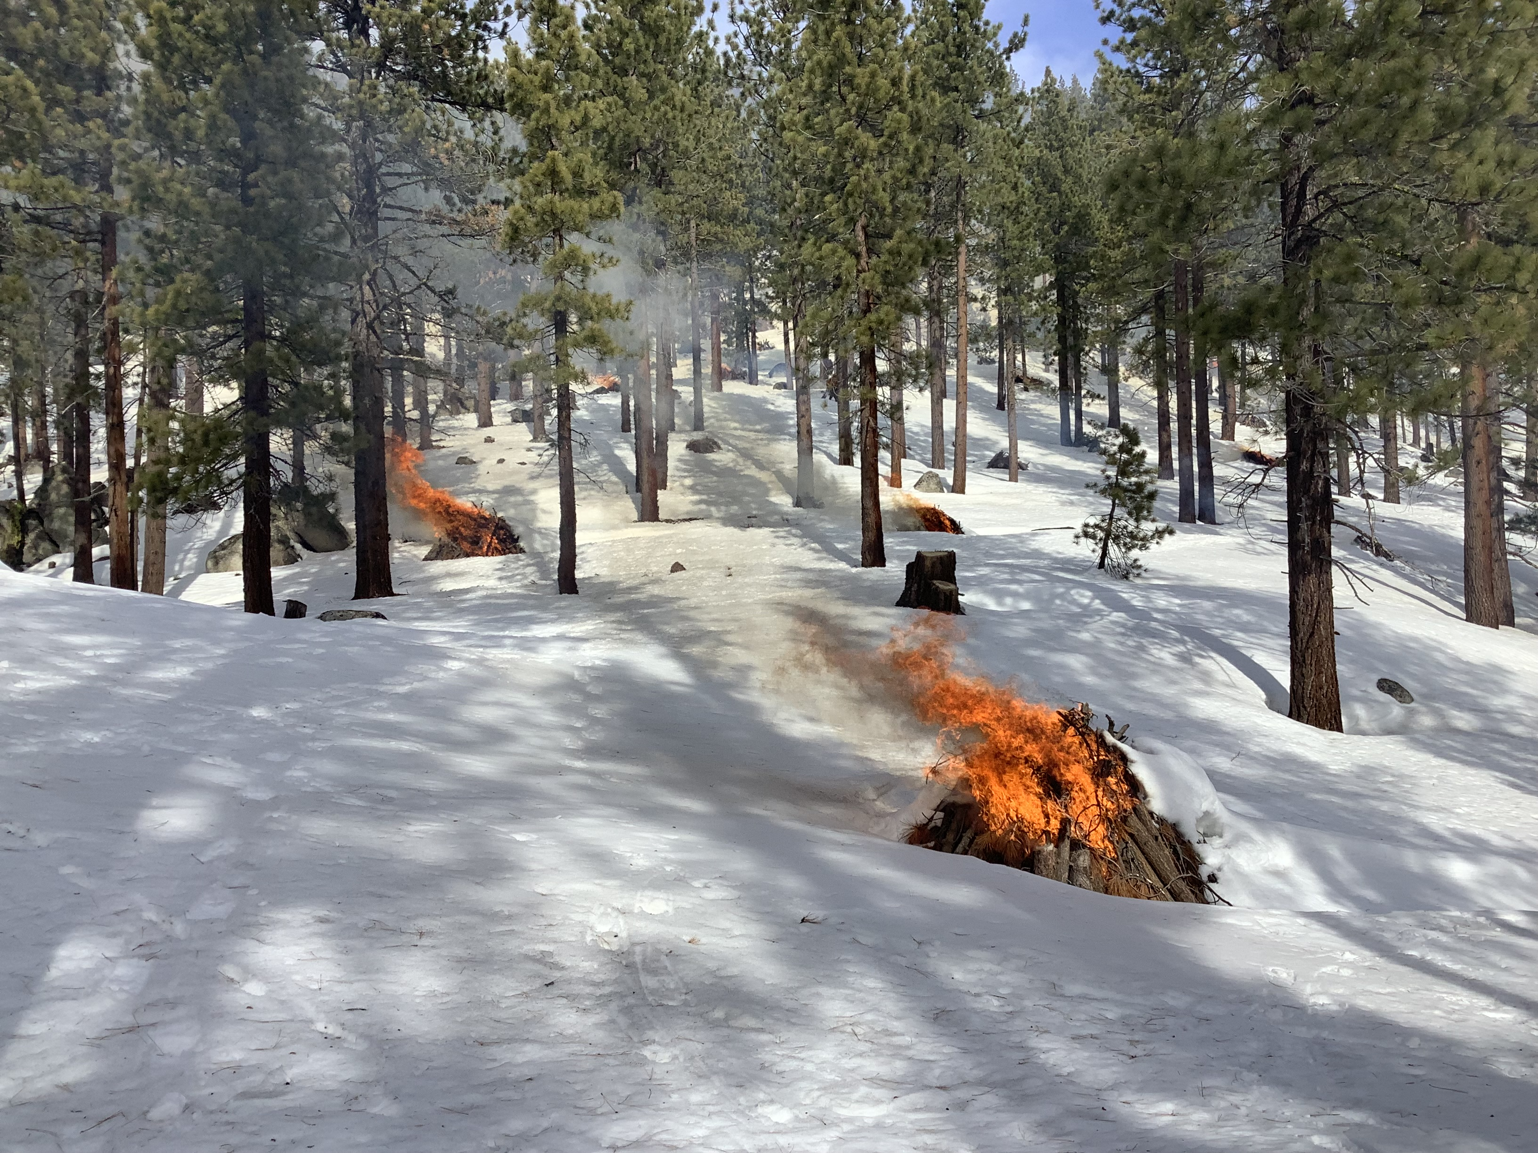
Pile Burning Estimates in the 2022 Emissions Modeling Platform
Source: https://forestry.nv.gov/uploads/hero-backgrounds/Spooner_Rx_Burn_-_202220220115_0021.JPG
James Beidler ¹, Jeff Vukovich ², George Pouliot ¹, Venkatesh Rao ²
¹ Office of Research and Design, US EPA; ² Office of Air and Radiation, US EPA
2024 CMAS Conference, Chapel Hill, NC

Slide 2
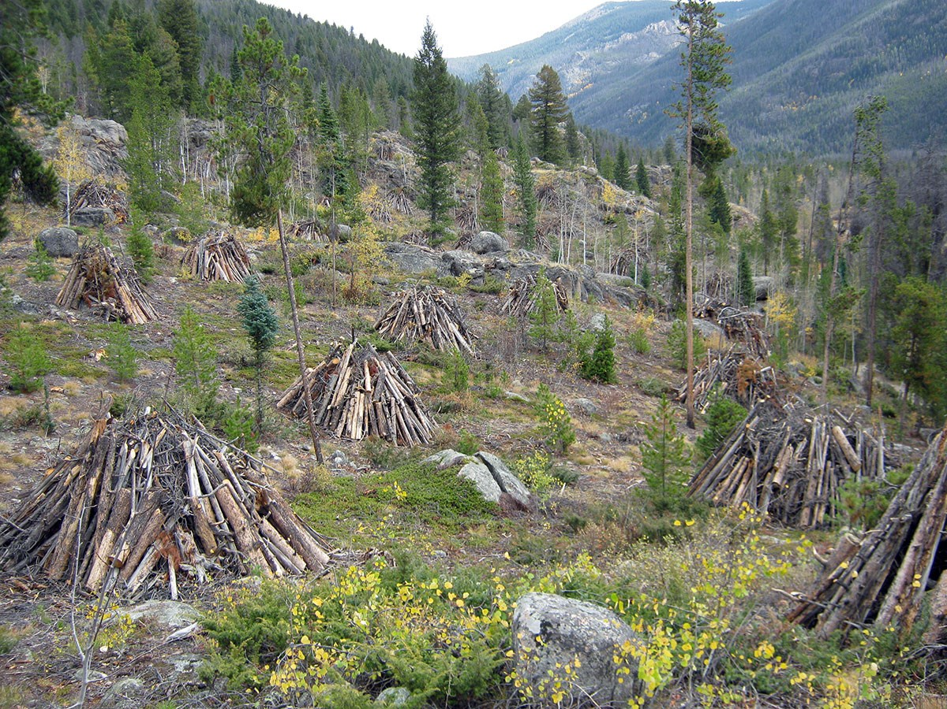
What is a Pile Burn?
Piles may sit until wood is dry and conditions are right for ignition
Thinned or downed woody
biomass are placed into piles
Piles can be stacked by hand or machine in a variety of geometries and sizes
Piles in Rocky Mountain National Park
Image source: https://www.nps.gov/subjects/fire/images/12_co_romo_FireAdaptedCommunities.jpg

Slide 3
Why are pile burns important?
Pile burn (PB) emissions estimates not included in 2020 NEI methods
Rx Fire a large contributor to PM in CONUS
2020 NEI misclassed pile burns as area prescribed burns (e.g. broadcast and underburn)
~75-90% of area treated with fire in Oregon each year are in the form of pile burns.
Source: Oregon Department of Forestry 2022 Oregon Smoke Management Report

Slide 4
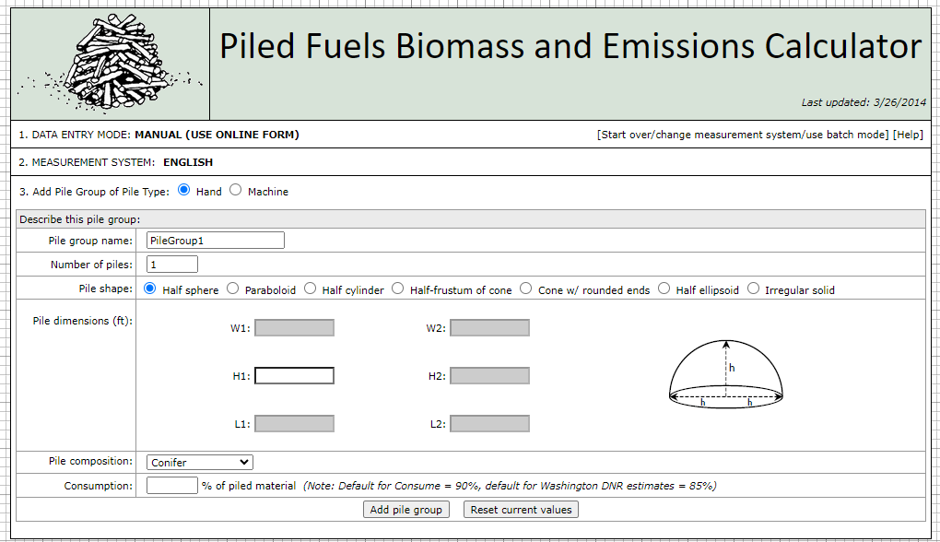
Land Manager Tools for Pile Burn Emissions
The US Forest Service (USFS) and University of Washington (UW) maintains a pile burn calculator based on methods in CONSUME and Hardy 1996.
https://depts.washington.edu/nwfire/piles/

Slide 5
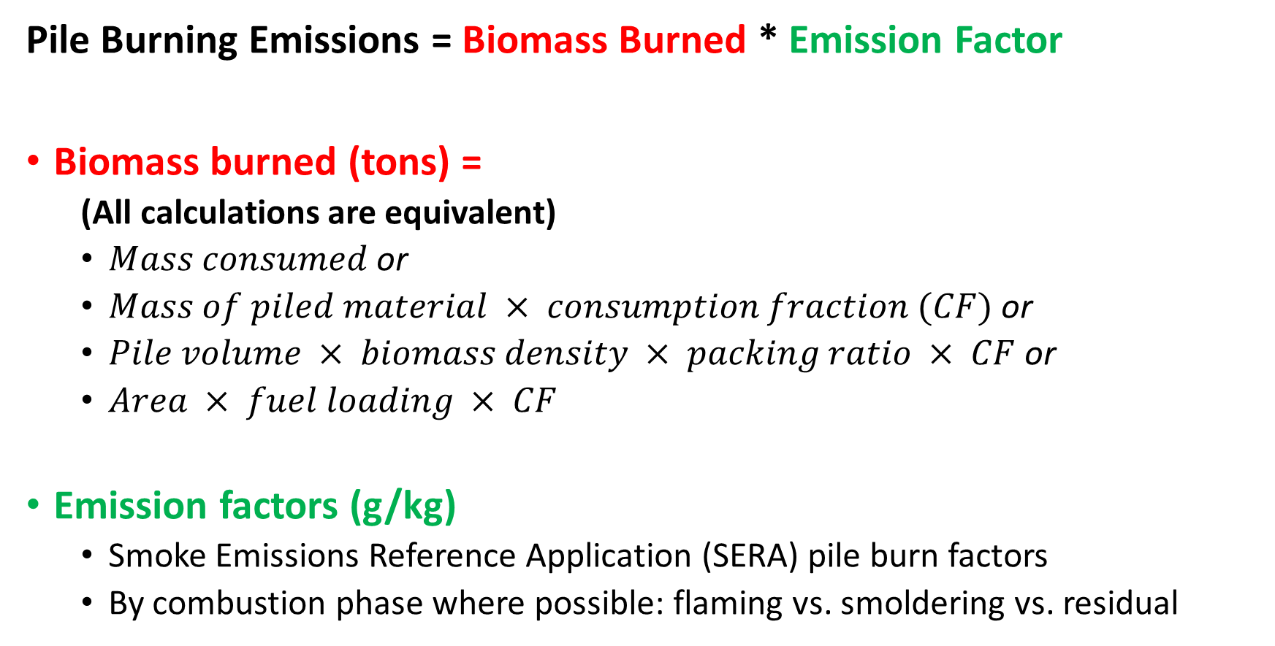
Estimating Pile Burn Emissions
Pile Burning Emissions = Biomass Burned * Emission Factor
Biomass burned (tons) =
  (All calculations are equivalent)
  $Mass consumed$or
  $Mass of piled material × consumption fraction (CF)$or
  $Pile volume × biomass density × packing ratio × CF$or
  $Area × fuel loading × CF$
Emission factors (g/kg)
  Smoke Emissions Reference Application (SERA) pile burn factors
  By combustion phase where possible: flaming vs. smoldering vs. residual

Slide 6




Estimating Biomass Burned From Activity
Activity supplied as a mass
  If it is burned or consumed – great! Nothing more to do.
  If it is total mass in pile – apply the consumption fraction (75-95% Hardy 1996) (90-95% Wright 2019)
Activity supplied as a pile volume
  Determine packing ratio to calculate effective volume (0.1-0.3 Hardy 1996/CONSUME v3) for machine piles
  Determine wood species to calculate mass using biomass density (Miles 2009) or regression formula (Wright 2010)
Activity supplied as a geometry
  Determine best volume formula to calculate pile volume
  Follow the pile volume method above
Image source: Hardy 1996

Slide 7
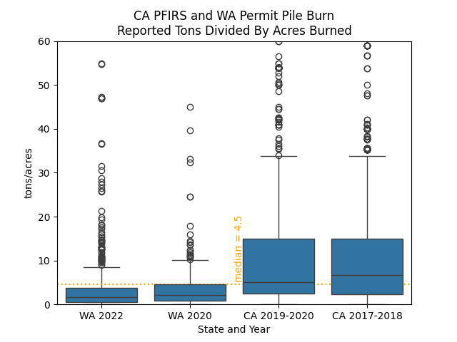
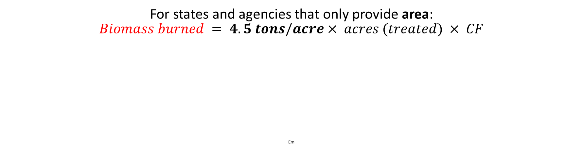
Estimating Biomass Burned from Area
4.5 tons/acre median value derived from CA and WA permit data
Em
For states and agencies that only provide area:
$$Biomass burned = 4.5 tons/acre× acres (treated) × CF$$
Em

Slide 8
2022 Pile Burn Activity
EPA received pile burn activity from
  13 States
  2 Federal Agencies
  1 Tribe
Permit and other activity critical to emissions estimates
Each record may represent multiple piles

Slide 9
2022 Pile Burn Workflow
Pile Burn (PB) activity removed from wildfire (WF) and prescribed fire (Rx) workflow
8% of PB permits reconcile spatially and temporally with satellite fire detections (HMS)
ICS-209(WF)
WFIGS (WF)
FACTS(WF/Rx/PB)
DOI (Rx/PB)
Non-ag and grassland satellite detects
State/Local/Tribe (Rx and PB)
Python Modified SmartFire2
Pile Burn Emissions
BlueSky
Pipeline
Pile Burn
Processor
WF/Rx
Day-specific Fire lat-lon, Type and Acres Burned
PB

Slide 10
2022 National PM2.5 for All Wildland Fires

Slide 11
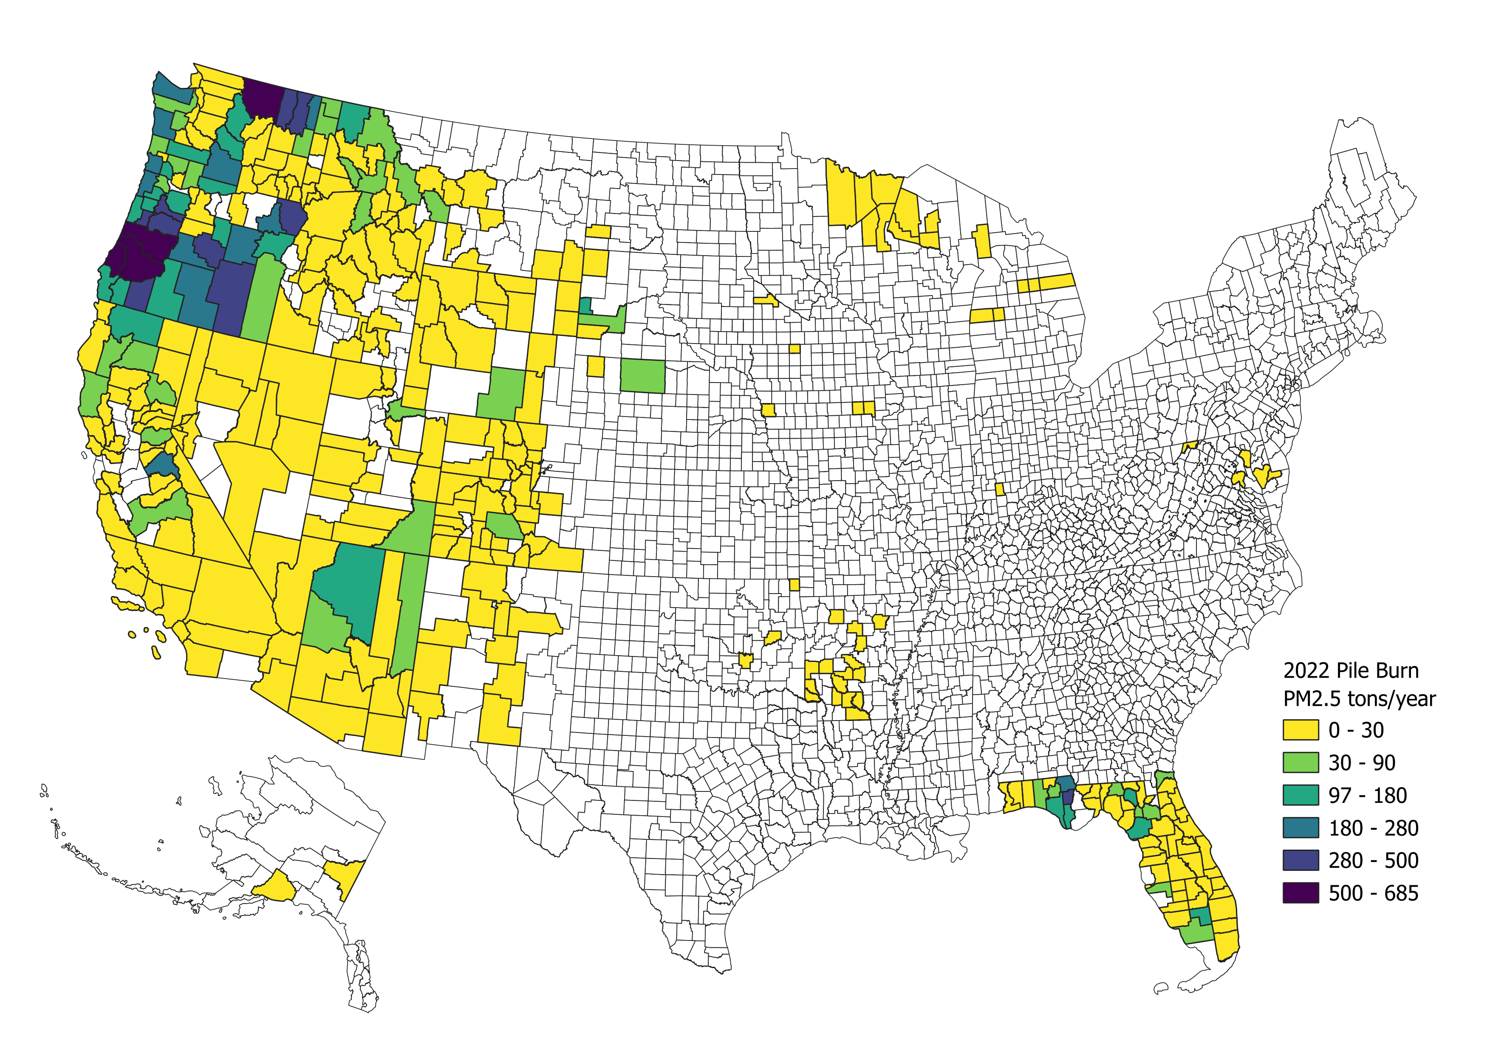
2022 Pile Burn PM2.5 By County

Slide 12
Impact on PM2.5: PB vs Broadcast Rx
2022 USFS FACTS Pile Burn Activity Associated with HMS Detects
Broadcast Rx Processed through BlueSky as Rx Area Burns
PB Processed as piles using the draft pile burn method
Area treated is equivalent between methods
86% Reduction in PM2.5

Slide 13
Conclusions
PM emitted per acre burned is ~85% lower when modeled as a pile burn instead of a broadcast burn for detected fires
  Suggests historical overestimates of emissions from Rx fires in 2020NEI if treated area is equivalent
  Permit data is largely in excess of what was previously detected by satellites, resulting in PM increases for some areas
It all starts with activity: state/local/tribal permit data is crucial
Pile burn practices vary resulting in large tons/acre differences

Slide 14
Modeling and Future Work for 2023 NEI
Temporal factors by combustion phase if possible, currently using broadcast burn profiles
  Pile burns may occur over snow and can have long smoldering tails
Plume rise method – heat output from a single representative pile
  Estimates using SMOKE/CMAQ Briggs approach show most in lowest layers
HAPs and pile-specific speciation profiles
Pile Burns included in 2023 NEI request for data

Slide 15
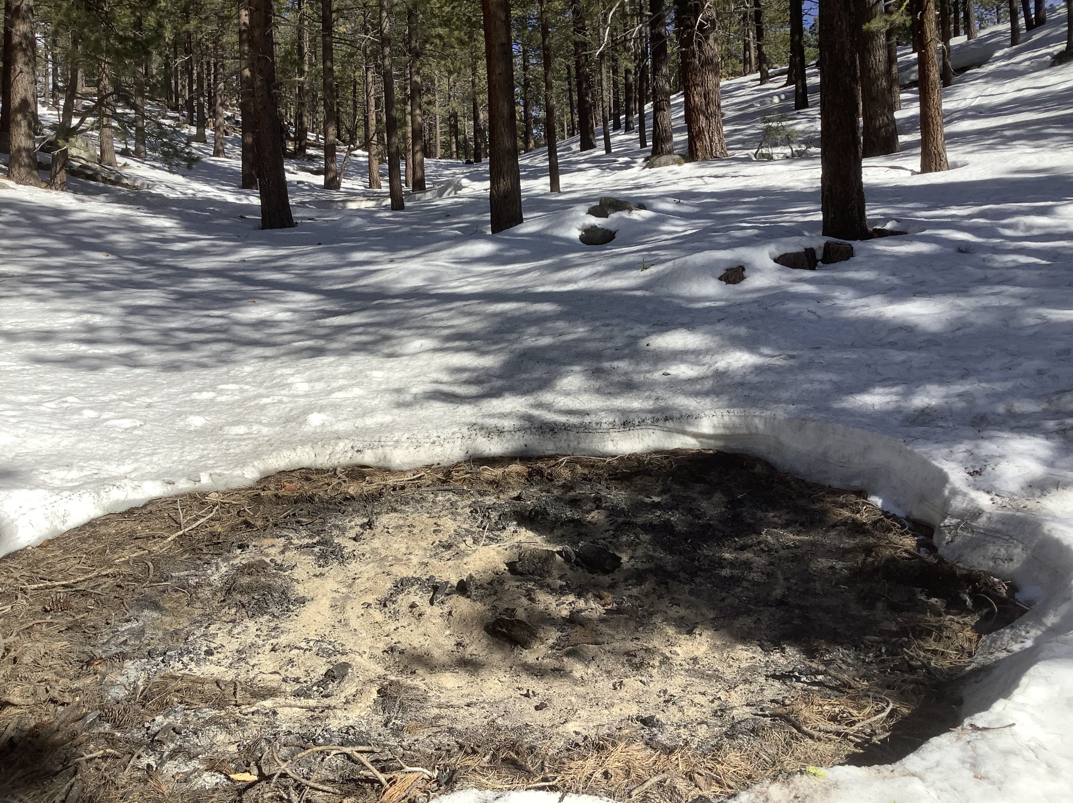
Contact: James Beidler Beidler.James@epa.gov
The views expressed in this presentation are those of the author(s) and do not necessarily represent the views or the policies of the U.S. Environmental Protection Agency.
https://forestry.nv.gov/uploads/missions/Spooner_Rx_Burn_-_202220220220_0012.JPG

