Slide 1
https://epa.gov/glimpse
Air quality and environmental justice implications of deep decarbonization pathways
Dan Loughlin, Chris Nolte, Joyce Kim, and Trinity White (ORISE)
U.S. EPA Office of Research and Development
Air Quality, Climate, and Energy Session, 2024 CMAS Conference, Chapel Hill, NC, Oct. 21-23rd

Slide 2
Foreword
Current GLIMPSE Team and Major Contributors
EPA: Dan Loughlin (co-lead), Chris Nolte (co-lead), Joyce Kim, Kate Crowley, Jia Shi, Uma Shankar, Joe Bronstein (ORISE), Trinity White (ORISE), Heidi Paulsen, Jeff Cole, Julien Isnard, Shannon Koplitz, Colby Tucker, Jia Shi, and Matthew Zwerling
EPA Collaborators: Shutsu Wong, Bob McConnell, Alex Macpherson, and others
PNNL: Steve Smith, Maridee Weber, and Rachel Hoesly, and Nathan Wiens
ARA: Aaron Parks and Yadong Xu
Objectives of this Presentation
Provide an overview of GLIMPSE and its capabilities to support development of state Comprehensive Climate Action Plans (CCAPs) under EPA’s Climate Pollution Reduction Grant (CPRG) program
Disclaimers
The views expressed in this presentation are those of the author and do not necessarily represent the views or policies of the U.S. Environmental Protection Agency.
Model results are provided for illustrative purposes only.

Slide 3
Context
Inflation Reduction Act of 2022
Climate Pollution Reduction Grant Program (CPRG) administered by EPA
CPRG provides funds for:
Climate planning
Priority Climate Action Plans PCAP (early 2024)
Comprehensive Climate Action Plans (mid-to-late 2025)
Implementation of mitigation measures

Slide 4
How can GLIMPSE support a CCAP?
Capabilities relevant to climate planning:
1. Estimating a GHG inventory
2. Projecting that inventory into the future
3. Estimating the GHG impacts of a single measure or package of measures
4. Identifying strategies for achieving GHG reduction goals
5. Estimating co-reductions of air pollutants
6. Pairing with tools to estimate air quality and health benefits
Notes:
SPEAKER: Andrea

Slide 5
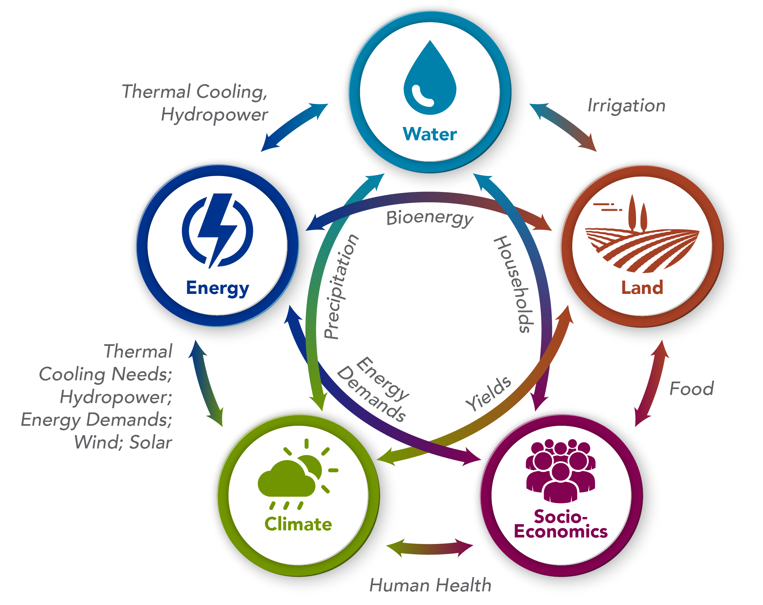
Global Change Analysis Model (GCAM)
Type:
human-Earth systems simulation model
state-level resolution (GCAM-USA)
Attributes:
Open source, freely available
Operates on Windows, Mac, Unix
Runtime of 30 minutes to several hours
Sectoral coverage:
energy supply and demand, electricity, refining, industry, buildings, transportation, agriculture
Temporal coverage:
2015 to 2050 in 5-year increments
Lead developer:
Pacific Northwest National Laboratory (PNNL)
GCAM has approximately 40 years of development and hundreds of published applications
Graphic developed by PNNL

Slide 6
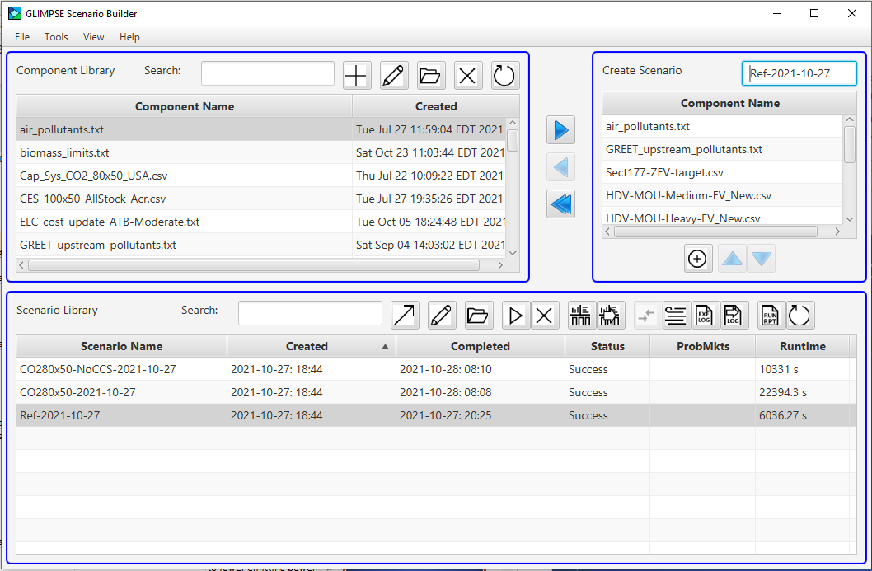
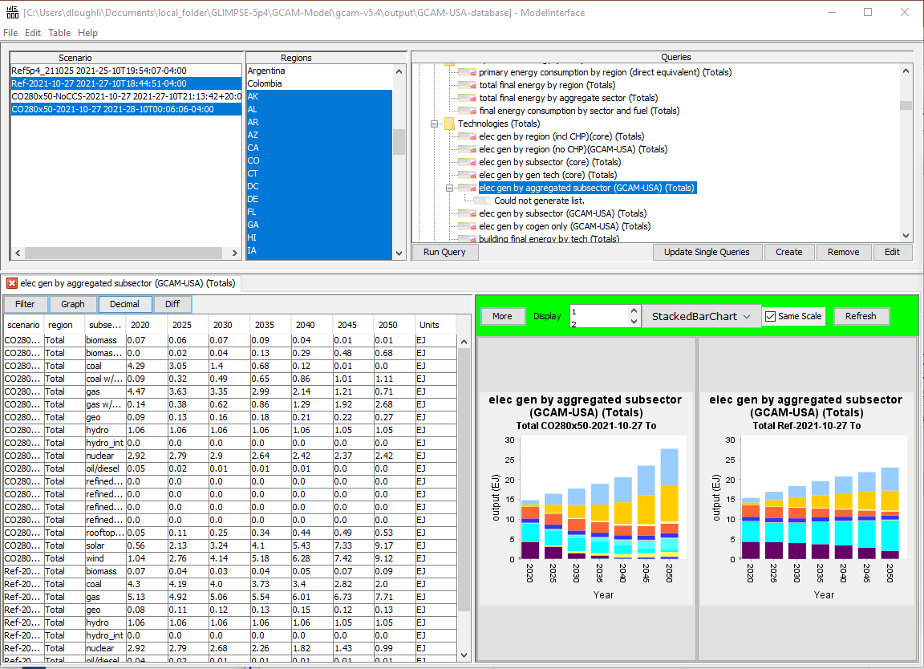
GLIMPSE Software
Developed by EPA
Graphical User Interface for GCAM
Addresses usability barriers
Facilitates:
Representing policies and measures
Constructing scenarios
Executing GCAM
Visualizing and analyzing results
Archiving and repeatability
Can be linked to other tools/models to estimate air quality and health impacts
GCAM Long-term Interactive Multi-Pollutant Scenario Evaluator

Slide 7
Developing a GHG inventory
GLIMPSE represents economic activity and tracks GHG emissions
GHG emissions
CO2:
Based upon fuel-based carbon content
Non-CO2 GHGs:
Included
Methane (CH4)
Nitrous oxide (N2O)
Hydrofluorocarbon gases (HFC)
Sources of EFs
International Energy Agency
Emis. Database for Global Atmos. Res.
Community Emissions Data System
GHG emissions by species, 2020
CO2 emissions by sector, 2020

Slide 8
Projecting GHGs into the future
GLIMPSE simulates evolution of these systems through time
Considerations in making projections:
Population growth and migration
Economic growth and transformation
Climate change
Technology change
Competition for energy, biomass, land and water resources
Other interactions across sectors
Policies that impact these factors
Onroad-Passenger
Onroad-Freight
Air-Locomotive-Marine
Industry
Fuels
Electric

Slide 9
Evaluating specific reduction measures
GLIMPSE has specific “levers” for many GHG reduction measures
GHG reduction measures supported directly in GLIMPSE
Technology subsidies (e.g., for EVs or heat pumps)
Fuel subsidies (e.g., for hydrogen or biofuels)
Technology requirements (e.g., LED bulbs)
Technology capacity (e.g., rooftop solar, offshore wind)
Energy efficiency target for vehicle classes (e.g., MPG target)
Market share targets (e.g., RPS, CES, EVs)
Others that can be simulated in GCAM-USA
Building shell standard improvements
Examples of measures not directly supported in GLIMPSE or GCAM*
Electric distribution grid improvements
Charging infrastructure investments
Other efficiency standards
Cap and trade program (e.g., Regional Greenhouse Gas Initiative)
* Through share weights, we can simulate changes in bias (e.g., range anxiety)
Notes:
SPEAKER: Andrea

Slide 10
Evaluating packages of reduction measures
Methodology
Scenario design
Reference case
“Current legislation” assumptions
Incorporates many major provisions of the IRA (e.g., technology subsidies)
Measures case
Adds set of GHG reduction measures
(see next slide for descriptions)
Goal case
Adds CO2 reduction target to Measures
Reflects Net Zero target from the recent Energy Modeling Forum 37 study
Modeling approach
Conduct steps relevant for climate planning
Assess emission reductions from Measures relative to Reference
Evaluate reductions from each measure individually
Identify additional opportunities for emission reductions to reach the Net Zero CO2 reduction target in the Goal case
Estimate co-emitted air pollutant reductions associated with Measures
Translate these air pollutant emission changes into air quality and health benefits
Notes:
SPEAKER: Andrea

Slide 11
Evaluating packages of reduction measures
The Measures case includes the following:
Power Sector
80% RPS by 2050
Rooftop solar output grows to 1 exajoules (EJ) by 2050
Offshore wind output grows to 3 EJ by 2050
Alternative Fuels Production
IRA hydrogen subsidies are extended through 2050
Buildings
From 2025, all new building appliances are high-efficiency, electric
Onroad Transportation
Light duty: electric sales share grows to 80% by 2050
Freight: electric sales share grows to 50% by 2050
Buses: 100% hybrid or electric sales in 2030, 100% electric from 2035

Slide 12
Evaluating packages of reduction measures
The Measures case includes the following:
Power Sector
80% RPS by 2050
Rooftop solar output grows to 1 exajoules (EJ) by 2050
Offshore wind output grows to 3 EJ by 2050
Alternative Fuels Production
IRA hydrogen subsidies are extended through 2050
Buildings
From 2025, all new building appliances are high-efficiency, electric
Onroad Transportation
Light duty: electric sales share grows to 80% by 2050
Freight: electric sales share grows to 50% by 2050
Buses: 100% hybrid or electric sales in 2030, 100% electric from 2035

Slide 13
Evaluating packages of reduction measures
The Measures case includes the following:
Power Sector
80% RPS by 2050
Rooftop solar output grows to 1 exajoules (EJ) by 2050
Offshore wind output grows to 3 EJ by 2050
Alternative Fuels Production
IRA hydrogen subsidies are extended through 2050
Buildings
From 2025, all new building appliances are high-efficiency, electric
Onroad Transportation
Light duty: electric sales share grows to 80% by 2050
Freight: electric sales share grows to 50% by 2050
Buses: 100% hybrid or electric sales in 2030, 100% electric from 2035

Slide 14
Evaluating packages of reduction measures
The Measures case includes the following:
Power Sector
80% RPS by 2050
Rooftop solar output grows to 1 exajoules (EJ) by 2050
Offshore wind output grows to 3 EJ by 2050
Alternative Fuels Production
IRA hydrogen subsidies are extended through 2050
Buildings
From 2025, all new building appliances are high-efficiency, electric
Onroad Transportation
Light duty: electric sales share grows to 80% by 2050
Freight: electric sales share grows to 50% by 2050
Buses: 100% hybrid or electric sales in 2030, 100% electric from 2035

Slide 15
Evaluating packages of reduction measures
Simulation of CO2 emission trajectories for Reference and Measures

Slide 16
Evaluating packages of reduction measures
Simulation of CO2 emission trajectories for Reference and Measures
CO2 emission reductions from Measures relative to Reference:
2025: 3%
2030: 6%
2040: 17%
2050: 30%
Cumulative additional emission reductions from Measures through 2050:
16,400 MTCO2

Slide 17
Evaluating packages of mitigation measures
Results can be decomposed by sector and measure
Building
electrification
Onroad-
Freight
EV Target
Onroad-
Passenger
EV target
Calculated by removing each specific measure from bundle
As tested, other measures had limited impact at national level

Slide 18
Identifying strategies for achieving goal
Comparison of results with Net Zero target in Goal
The modeled measures achieve approximately 45% of targeted reductions
GLIMPSE can be used to gain insights about measures to close the gap
Steps:
Add declining CO2 cap to scenario
Allow GLIMPSE to identify strategy for achieving cap
Assess incremental reductions
Reference
Measures
Goal

Slide 19
Identifying strategies for achieving goal
Reduction opportunities identified by GLMPSE to fill gap to goal:
Strategies
Sector | Short-term (through 2035) | Long-term (post 2035)
Power | Additional wind and solar | Additional wind, solar, nuclear, biomass, CCS
Buildings | Accelerated transition to high-efficiency | Demand reductions
Industry | Application of CCS and biomass-fueled cogeneration | Widespread use of direct air capture and CCS
Onroad transportation | Earlier transition to electric and hydrogen | Expanded use of hydrogen
Nonroad transportation | Earlier transition to electric and hydrogen | Expanded transition to electric, demand reductions
Note: CDR represents carbon removal technologies, including direct air capture (DAC)

Slide 20
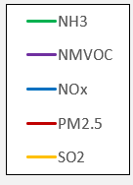
Estimating air pollutant co-reductions
GLIMPSE also outputs air pollutants by state and source category
Air pollutants output by GLIMPSE by state, technology, and pollutant:
Ammonia (NH3)
Carbon monoxide (CO)
Nitrogen oxides (NOx)
Sulfur dioxide (SO2)
Fine particulate matter (PM2.5)
Non-methane volatile organic compounds (NVMOCs)
Sources of air pollutant emission factors:
EPA National Emission Inventory
EPA MOVES and IPM models
Various NSPSs
From these results, we can produce emission change factors for use with:
EPA’s Community Multiscale Air Quality model (CMAQ)
EPA’s COBRA air quality and health screening tool
Solid: Reference

Slide 21
Estimating air pollutant co-reductions
GLIMPSE also outputs air pollutants by state and source category
Air pollutants output by GLIMPSE by state, technology, and pollutant:
Ammonia (NH3)
Carbon monoxide (CO)
Nitrogen oxides (NOx)
Sulfur dioxide (SO2)
Fine particulate matter (PM2.5)
Non-methane volatile organic compounds (NVMOCs)
Sources of air pollutant emission factors:
EPA National Emission Inventory
EPA MOVES and IPM models
Various NSPSs
From these results, we can produce emission change factors for use with:
EPA’s Community Multiscale Air Quality model (CMAQ)
EPA’s COBRA air quality and health screening tool
Solid: Reference
Dash: Measures

Slide 22
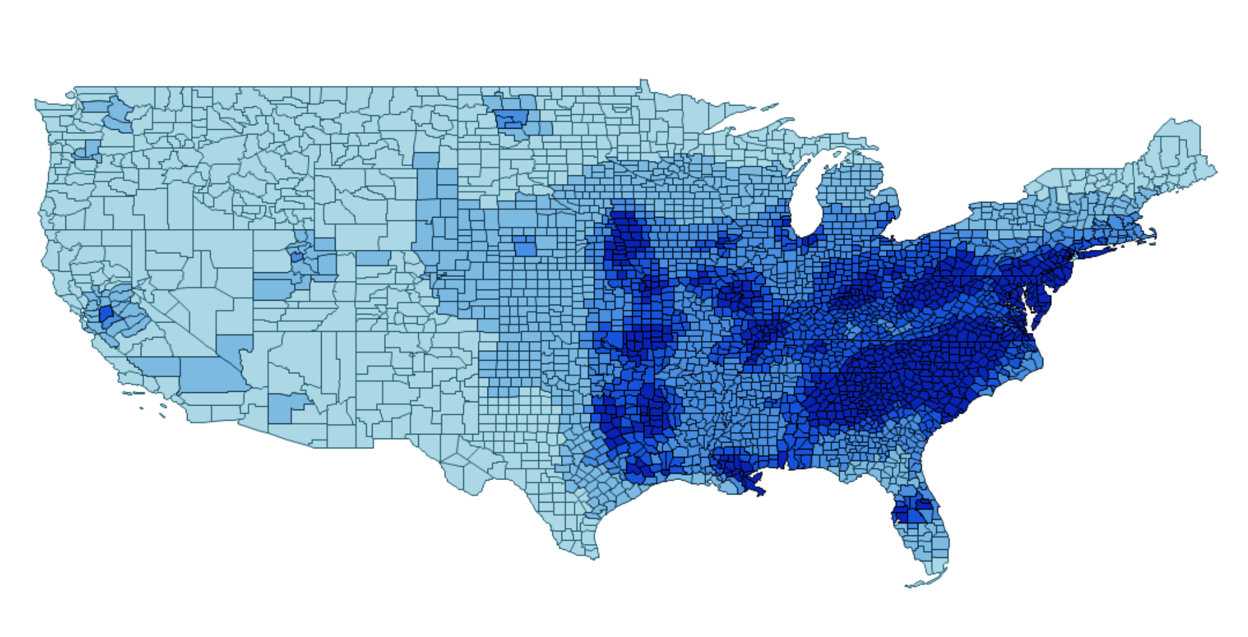
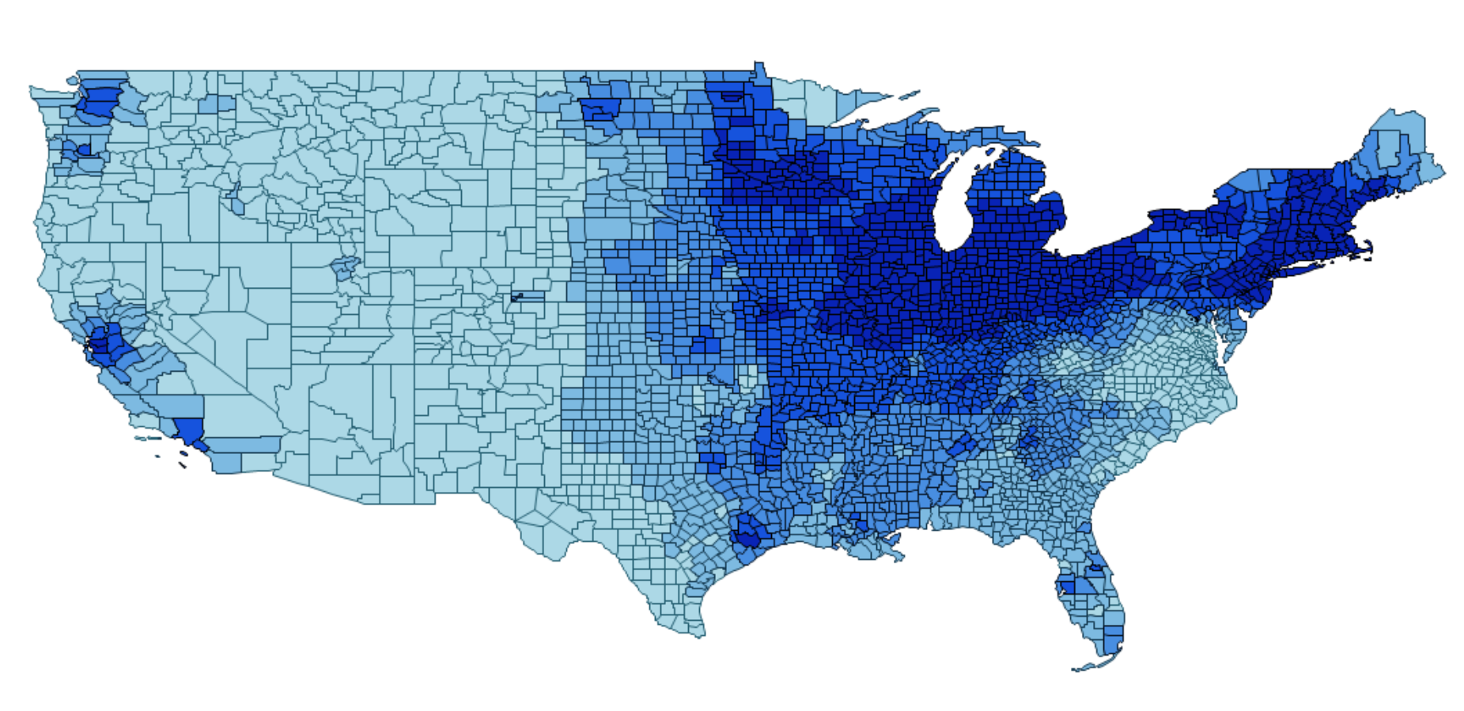
Evaluating air quality and health benefits
Change in O3 concentration (ppbV), 2050
Using EPA’s COBRA screening tool
https://epa.gov/cobra
Air quality and health impacts of Measures relative to Reference
 | Population-weighted change in concentration |  | Monetized benefits (2023$s @ 2% discount rate)
Pollutant | 2035 | 2050 | 2035 | 2050
Ozone (MDA8 ppbV) | -6% | -10% | $89 billion to $130 billion | $210 billion to $300 billion
PM2.5 (μg/m³) | -2% | -5%
> - 0.81
-0.81 to -1.3
-1.3 to -1.6
-1.6 to -1.8
< -1.8
Change in PM2.5 concentration (μg/m³), 2050
> - 0.07
-0.07 to -0.13
-0.13 to -0.19
-0.19 to -0.30
< -0.30
Notes:
* MDA8 represents the maximum daily 8-hour average ozone concentration, a metric that is used in determining attainment status
** “Low and High values represent differences in the methods used to estimate some of the health impacts in COBRA.” – COBRA Users’ Guide

Slide 23
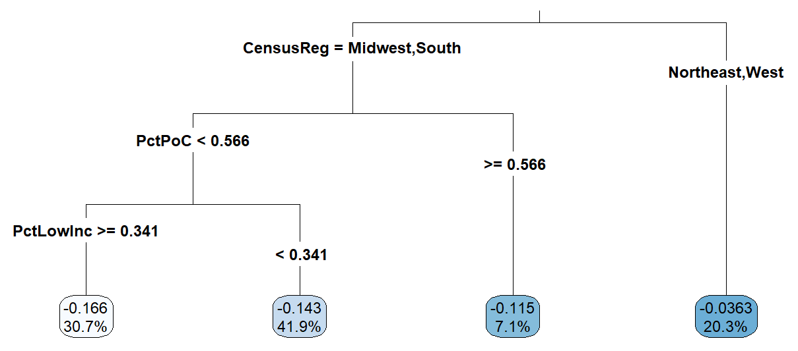
Investigating environmental justice
Where are these benefits occurring and who is affected?
Combine air quality changes by county with county-level demographic data from EJScreen, the Census, and other data sources.
Factors:
- Percent low income
- Percent people of color
- Land use type (metro, urban, rural)
- Region of country
Use machine-learning approaches such as CART and Random Forest to develop insights.
CART analysis of changes in PM concentrations, 2035
Insights:
PM reductions most sensitive to part of country, with South, then Midwest seeing greatest reductions
In the South and Midwest, the greatest PM reductions tended to be in areas with < 57% people of color, but > 34% low income
Trinity White starting to explore these methods
Note: We are very early in adding these capabilities to our team but are excited about the insights they can provide.

Slide 24
Take home thoughts
GCAM-USA has the potential to be an important tool in state climate planning
GLIMPSE addresses many of the barriers to running GCAM-USA
GLIMPSE is not a “turnkey” modeling system
Applications are often an iterative process involving experimentation, learning, and refining assumptions
Understanding how GCAM works is critical in interpreting results. This requires a commitment of time and effort needed for experimentation
Insights can be gained from big-picture dynamics, but it is always advisable to explore small-scale dynamics
Why did the model get the result that it did?
Was this response reasonable?
Are there real-world factors that were not modeled but which could impact this response?

Slide 25
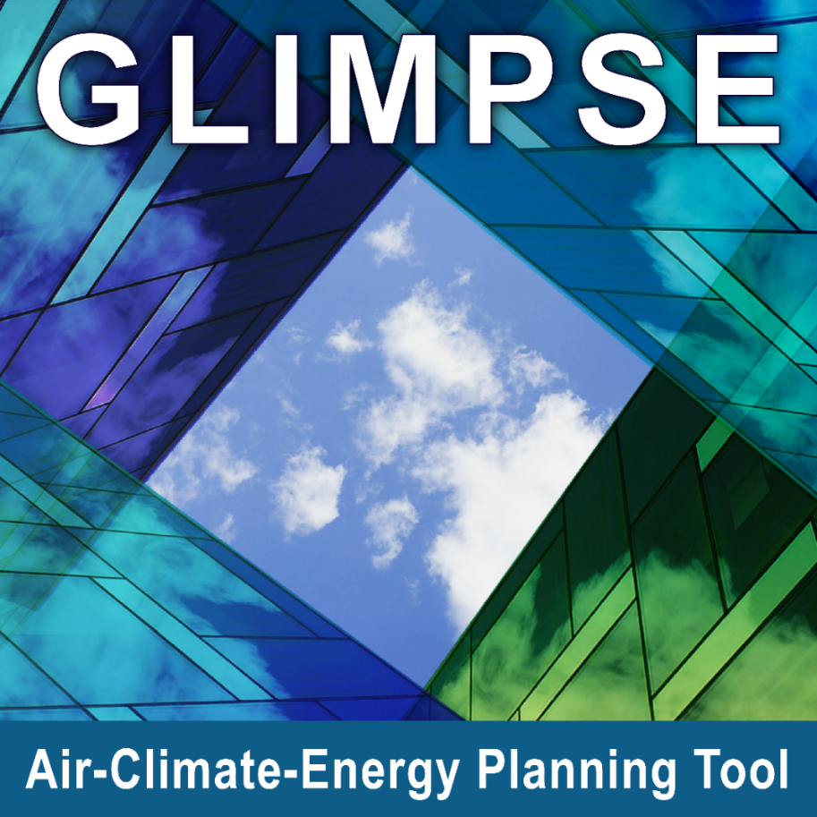
Questions?
Contact:
Loughlin.Dan@epa.gov
glimpse@epa.gov
To keep up with GLIMPSE developments:
Visit https://epa.gov/glimpse
Announcements
Users’ Guide
Links to training videos
Sign up for listserv by emailing glimpse-news-subscribe@lists.epa.gov

Slide 26
Outline
What is GCAM? What is GLIMPSE?
How can GLIMPSE be used in developing a CCAP?
Developing a GHG Inventory
Projecting GHG emissions into the future
Evaluating impacts of specific GHG mitigation measures
Identifying additional measures to meet a GHG reduction goal
Estimating air pollutant emission co-reductions
Estimating air quality and health benefits
What are the strengths and limitations of using GLIMPSE?
Where to get additional information?

Slide 27
Evaluating specific reduction measures
Example of dynamics captured in GCAM-USA:
System-wide impacts of vehicle electrification
Quaternary (price-induced)
Tertiary (supply)
Δ buildings emissions
Overall?
Δ coal mining emissions
Secondary (fuel production)
Δ industrial emissions
Δ power
emissions
Δ oil & gas emissions
Primary
Δ refinery
emissions
Δ biomass production emissions
Δ onroad
emissions
Δ other transportation emissions
Δ bio-refinery
emissions
Measure:
EV subsidy

