Slide 1


Long-term criteria and toxic pollutants trends in air quality and community exposures over the Marcellus Shale region in the US
Chi-Tsan Wang, B.H. Baek, Jia Xing, Yunyao Li, Charles Chang, and Daniel Tong
Research support by Health Effects Institute (HEI)

Slide 2
Outline
Research Background
Objectives
Methods
Results
Conclusions and Future Works

Slide 3
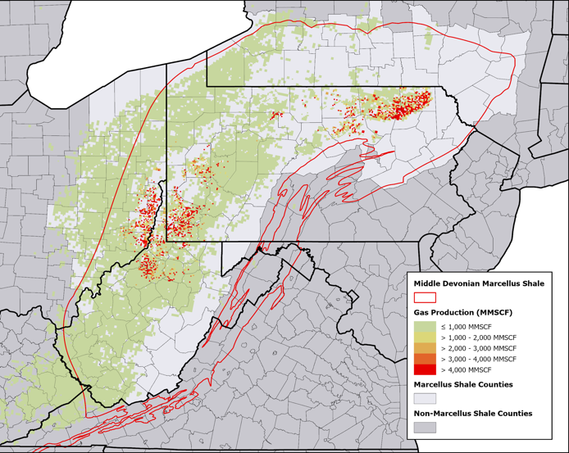
Research background 1: Oil and Gas production in Marcellus Shale region
The oil and gas sector is crucial to the U.S. economy but poses significant environmental challenges, especially for local/regional air quality and under-represented counties nearby.
The fracking method has been applied in the Marcellus Shale region in the early 2000s and gained its momentum around 2007-2008.
Since January 2008, approximately, 15,939 wells have been drilled and fracked at 5,674 sites across these shales. (Jacquet et al., 2018)
Long-term impacts of these pollutants, including hazardous air pollutants (HAPs) and criteria air pollutants (NOx, ozone, PM2.5), in areas with unconventional oil and gas development (UOGD), are not well understood, particularly in the Marcellus Shale.
Gas wells map over Marcellus Shale (2021)
Oil and gas production and exploration from West Virginia from 2001 to 2021.

Slide 4
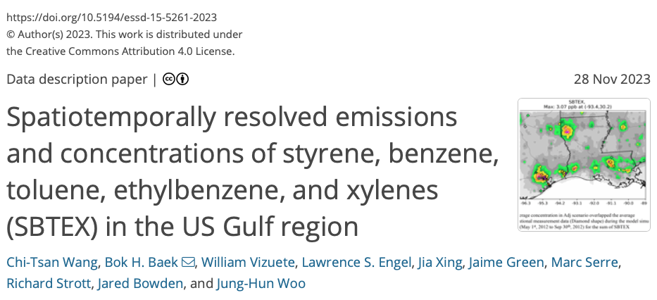
Research background 2:
Previous studies for hazardous air pollutants for the US Gulf region
One of our BTEX exposure studies over the GULF region indicated that the Benzene and Ethylbenzene concentrations in blood show the increase of association with central nervous system (CNS) symptoms. (Werder et. al., 2020)
Recent study applied the CAMx model with reactive tracer method to simulate the individual HAPs concentration for 2011-2016 to support epidemiological exposure study. (Wang et al., 2023)
Sensitive populations, including children, elderly, and historically disadvantaged communities, are disproportionately affected by these emissions.
https://essd.copernicus.org/articles/15/5261/2023/

Slide 5
Objectives
To investigate the long-term impacts of unconventional oil and gas development (UOGD) emissions on air quality trends and community exposures in the Marcellus Shale region, covering the period from 2002 to 2021.
The research focuses on criteria air pollutants (such as NO₂, O₃, and PM_{2.5}) and hazardous air pollutants (HAPs), including Benzene, Toluene, Ethylbenzene, Xylenes (BTEX), and other harmful chemicals (e.g., Naphthalene, 1,3 Butadiene,,,,)
It incorporates advanced chemical transport modeling (CTM) and Deep-learning Machine Learning system (DeepCTM) to estimate the levels of pollutants and to optimize control strategies for improving air quality and reducing health risks.

Slide 6
Research method scheme
Emission and Meteorology
CAMx model simulation
Machine Learning Model training and simulation (DeepCTM)
HAPs data imputation for model states for all years by HAPI tool (Wang et al, 2023).
Prepare all 20 year CTM ready emission data by SMOKE and meteorology by WRF.
Prepare CAMx emission input data by CAMQ2CAMx.
Prepare individual HAPs chemical and physical parameters
Run CAMx + Reactive Tracer for 2008,2014,2019
Run emission sensitivity test for NOx, VOC, and HAPs
Prepare the CAMx input and output data to 4x4km domain by flex-nesting method.
Training the DeepCTM by CAMx model input and output.
Estimate other years (2002-2021) air pollutant concentration

Slide 7
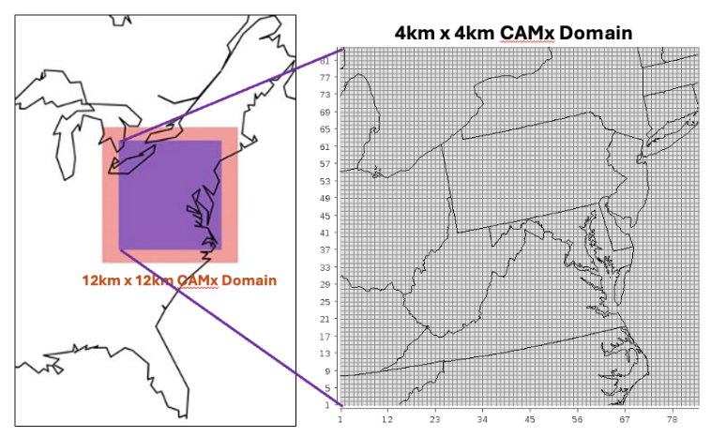
Methods: CAMx model configuration
Model | Descriptions
CTM model | CAMx model 7.0
Model Domain/Res. | 12km x 12km with flex-nesting to 4km x 4km nrow = 197, ncol =197
Simulation period | 2008, 2014 & 2019 entire years
Meteorology | WRF model result with WRFCAMx process
Emissions | 2008 & 2014: EQUATE data, 2019: NEI 2019ge emission model platform
BC | 2000-2022 GMU North America Chemical Reanalysis (NACR) data (hourly O3, NOx…)
Chemical mechanism | CB6r4 and HAPs Reactive tracer individual reactions for HAPs oxidation decay by OH, NO3 and Ozone.
Simulation cases | 2008, 2014, 2019, and 2019 HAPs emission x 3 and x 0.1
CAMx model 2-layer nesting model domain, 12km x 12 km and 4km x 4km.
Notes:
NO Horizonal wind speed reduced? Or this already considered in CMAQ? Summarize two tables. 5.3.1.
Put the simulation period, simulation scenario.
Mothed :

Slide 8
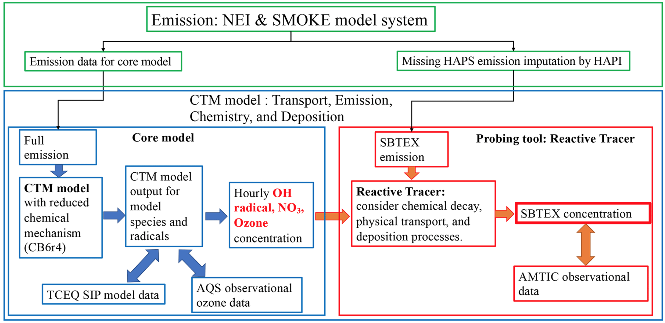
Emission and CAMx model RTRAC

Slide 9
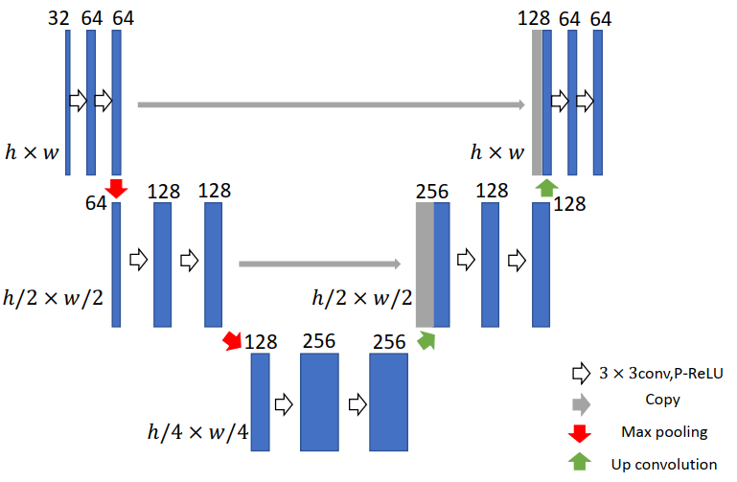
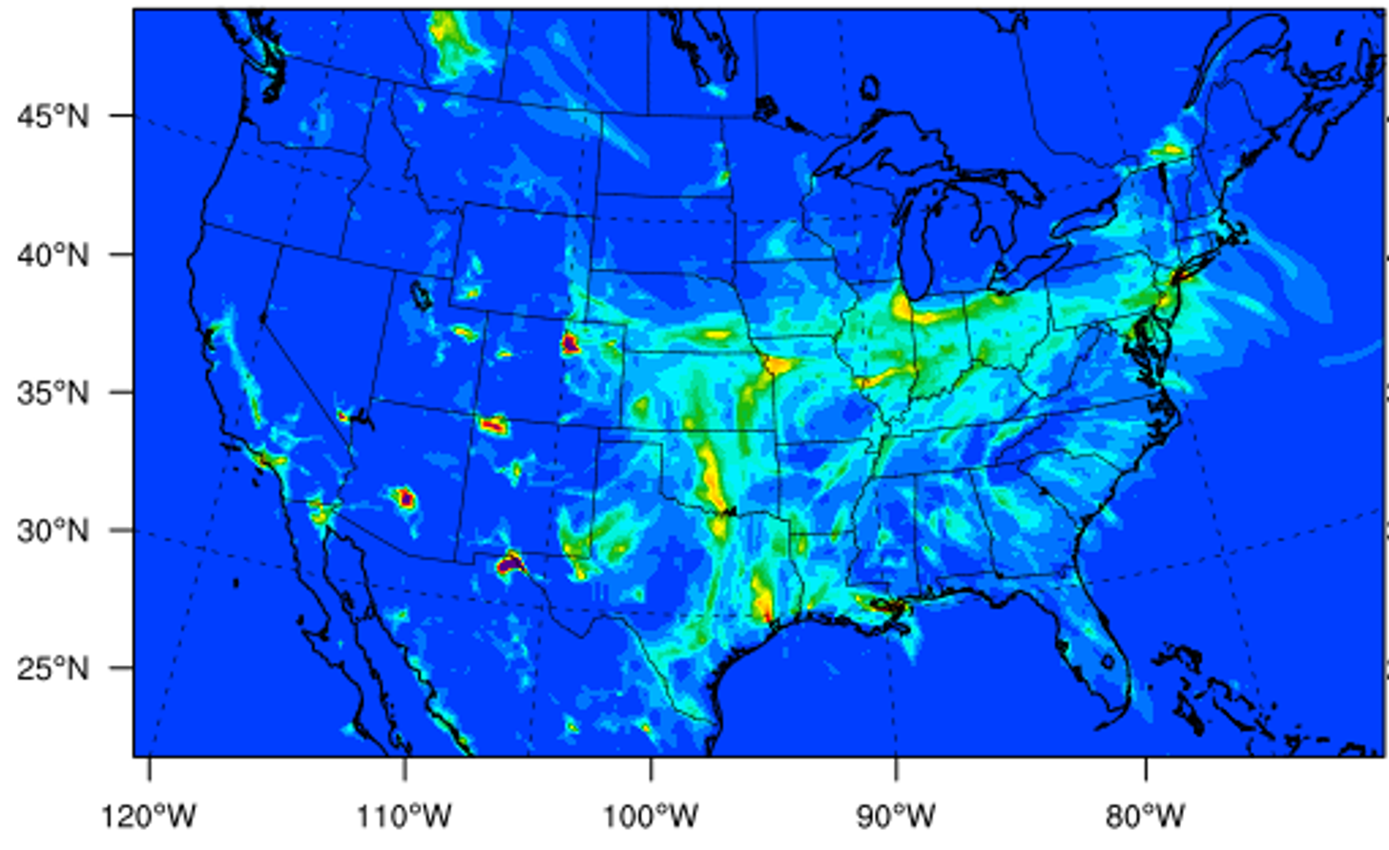
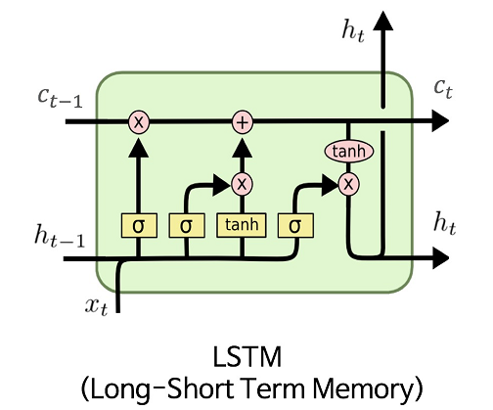
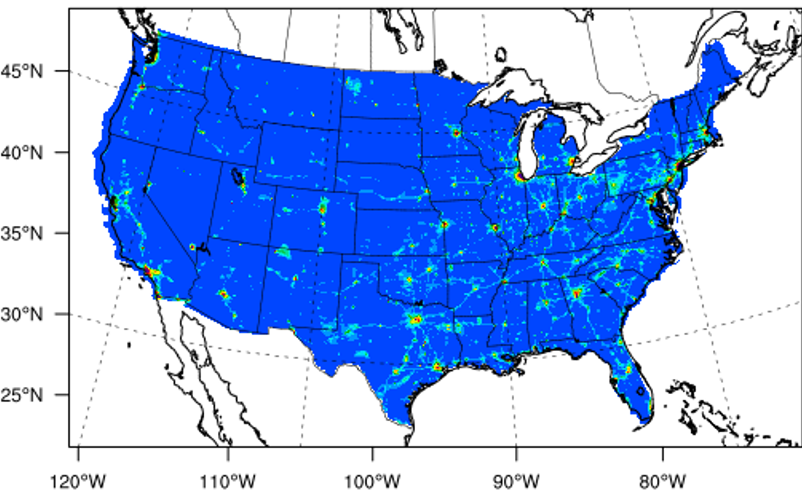
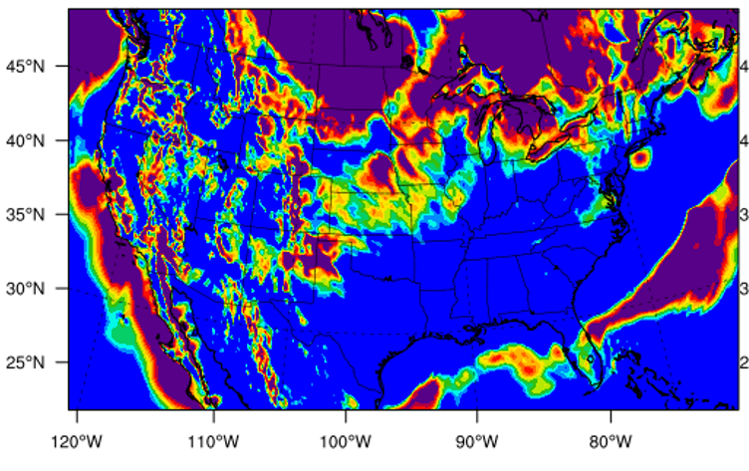
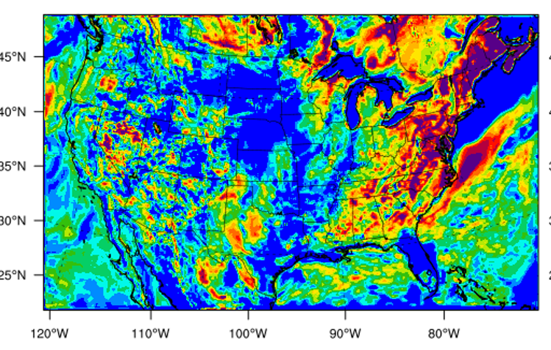
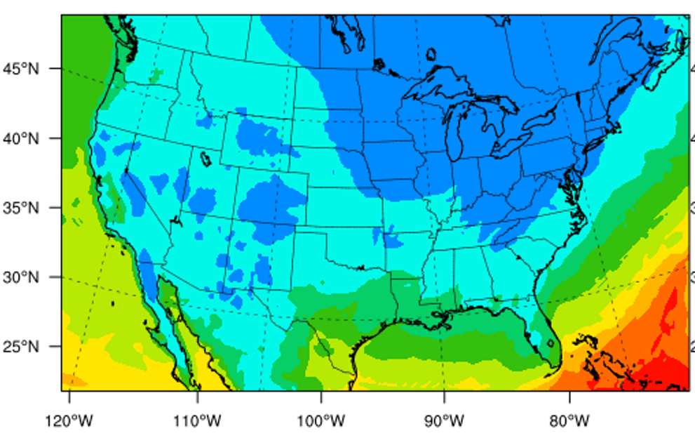
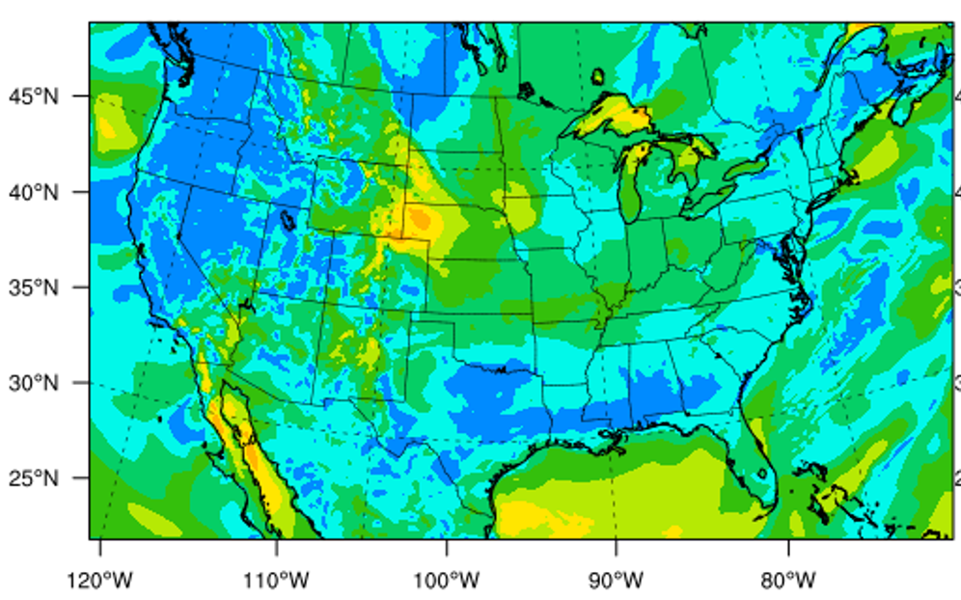
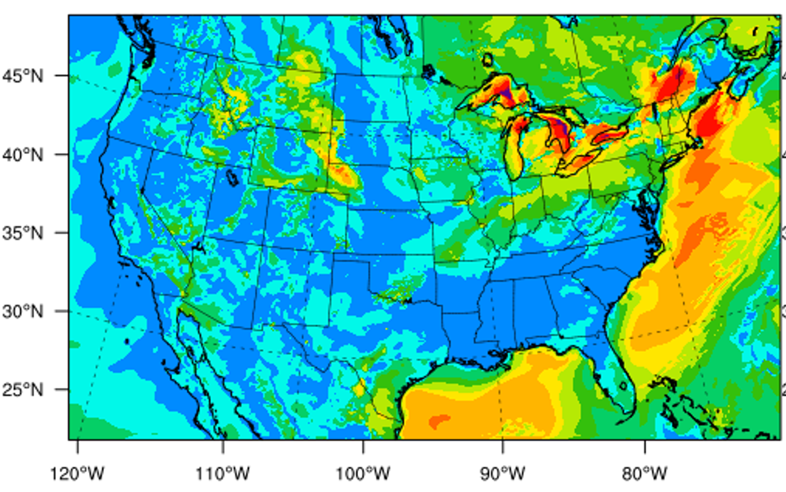
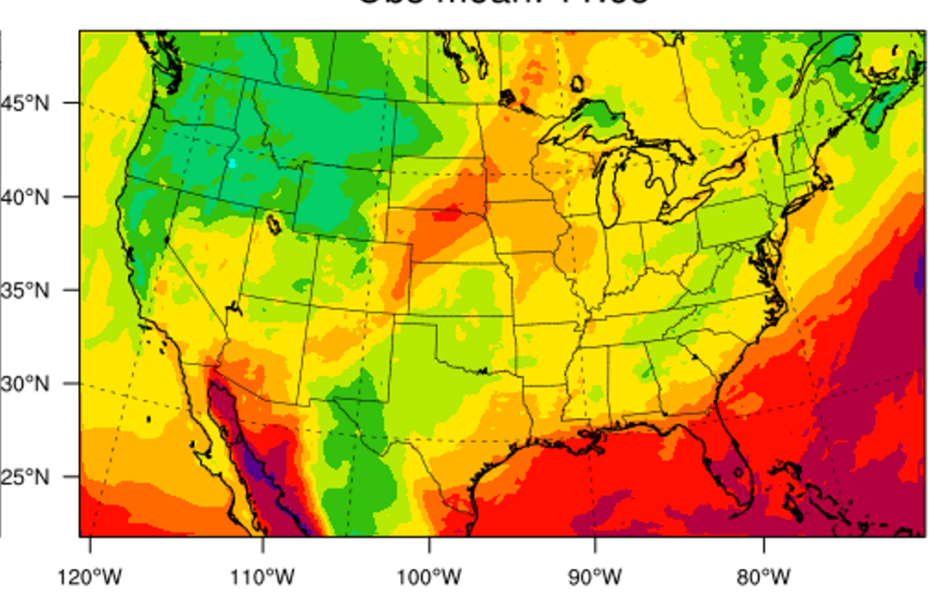
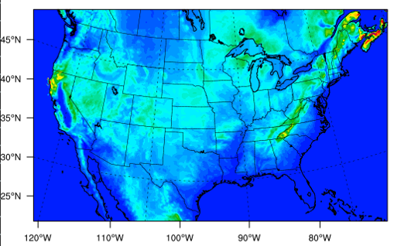
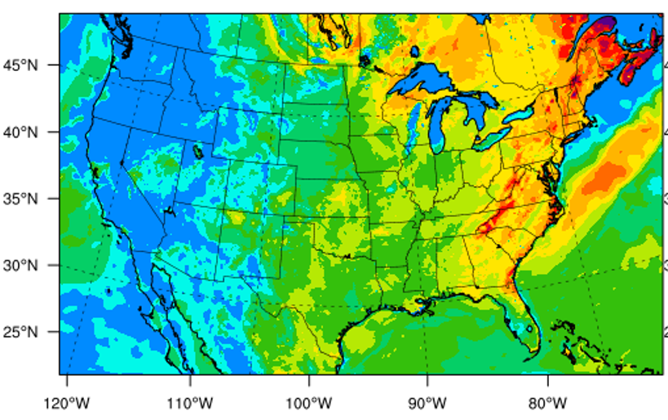
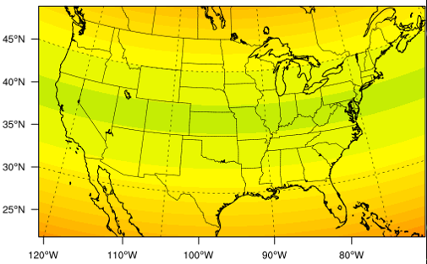
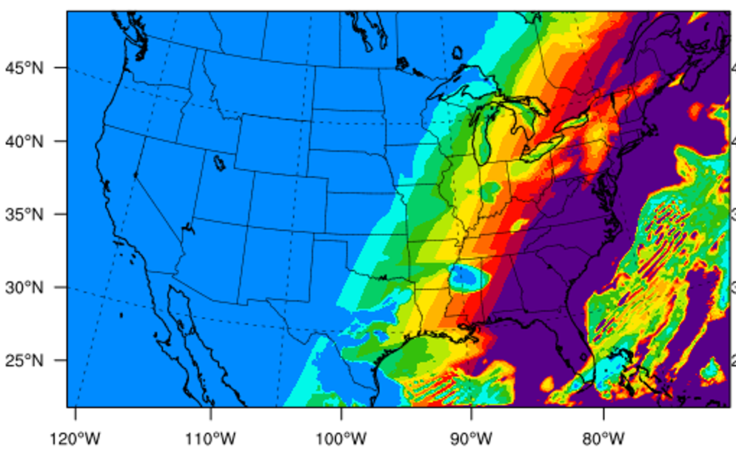









Methods: DeepCTM model training
Model structure
Output: C_{Conc}= 1
MLP
UNet: capture the cross-space interaction
CNN
U-Net
pReLU
Concatenate
CNN
$$h_{t−23}$$
$$h_{t−22}$$
$$h_{t−1}$$
$$h_{t}$$
Input: C_{iconc}= 1
LSTM: capture the temporal variation
pReLU
LSTM
LSTM
$$…$$
LSTM
LSTM
Input: C_{emis.}= 1
CNN
$$x_{t−23}$$
$$x_{t−22}$$
$$x_{t−1}$$
$$x_{t}$$
Input: C_{geography}= 2,
C_{Meteorology}= 11
Prep
VEG
LAI
V wind
U wind
humidity
daily mean
PBL height
Wind speed
DeepCTM
terrain height
grid area scale
convective velocity scale
2-meter temperature
Short-wave radiation
CNN: convolution network; LSTM: long short term memory; U-Net structure (2-layers): a u-shaped architecture with a down sample function (max pooling) and a deconvolution function (up convolution); MLP: multiple layers of perceptrons with threshold activation; pReLU: the parametric rectified linear unit is used as the activation function

Slide 10
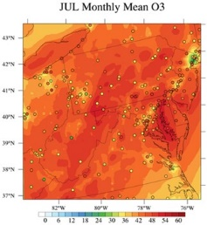
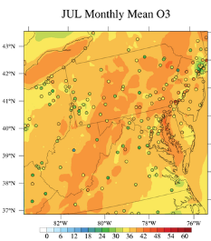
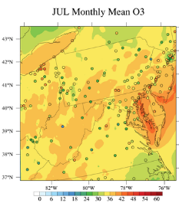
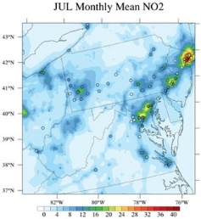
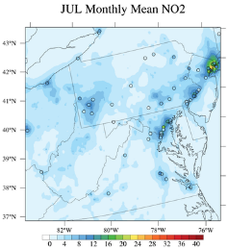
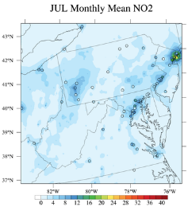
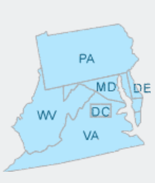
Result 1:CAMx monthly ozone and NO₂ concentrations
2008
2014
2019
JUL
O3
JUL
NO2

Slide 11
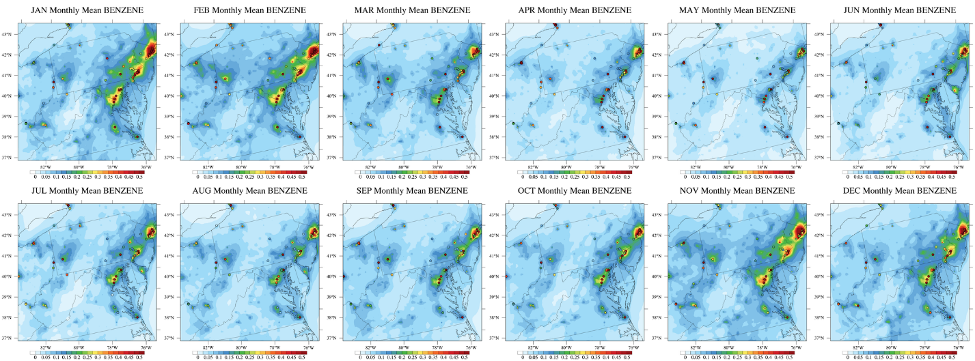
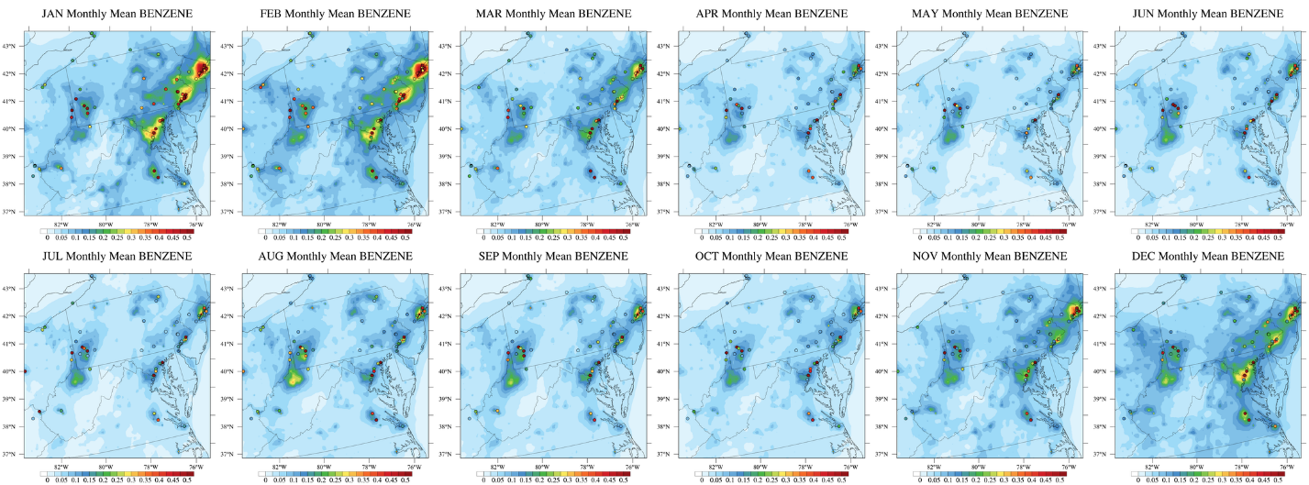
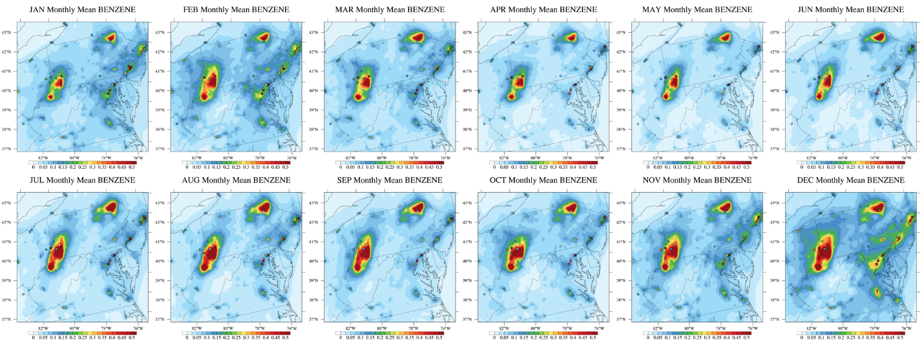
Result 2: CAMx RTRAC results for Benzene monthly average
2008
2014
2019
JUL
DEC
Notes:
Please point out the under-estimations of bezene and other HAPs in earlier years like 2008 and 2014 due to the under-estimates of HAPs inventory over the Marcellus region. In 2019, the CMAx performance has improved with the enhanced HAPs inventory

Slide 12
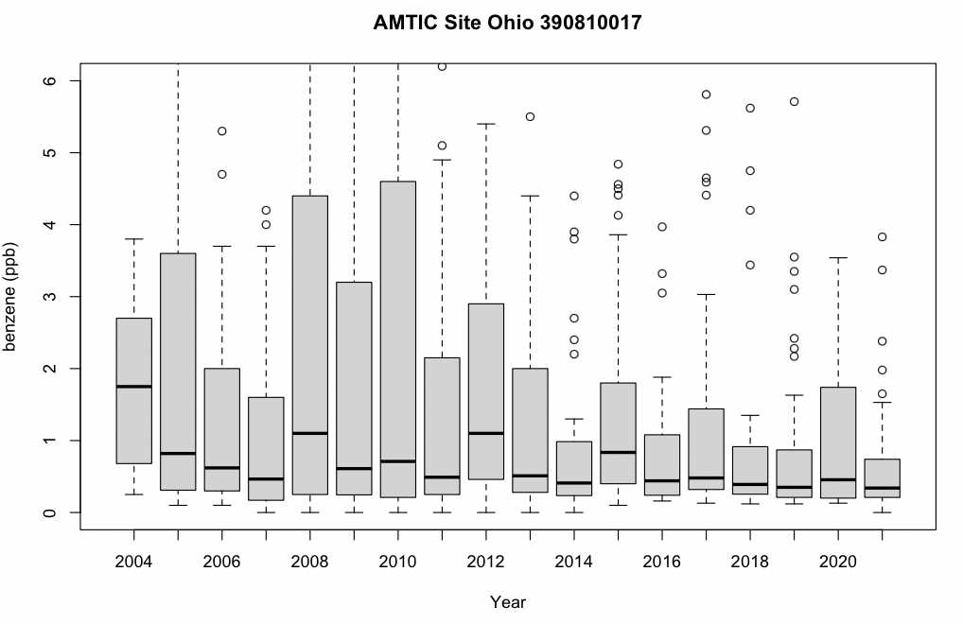
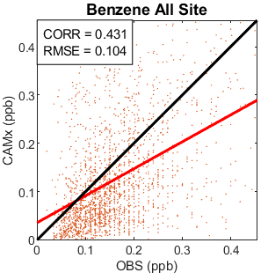
Result 3: Benzene Daily Observation Ohio Steubenville
2019

Slide 13
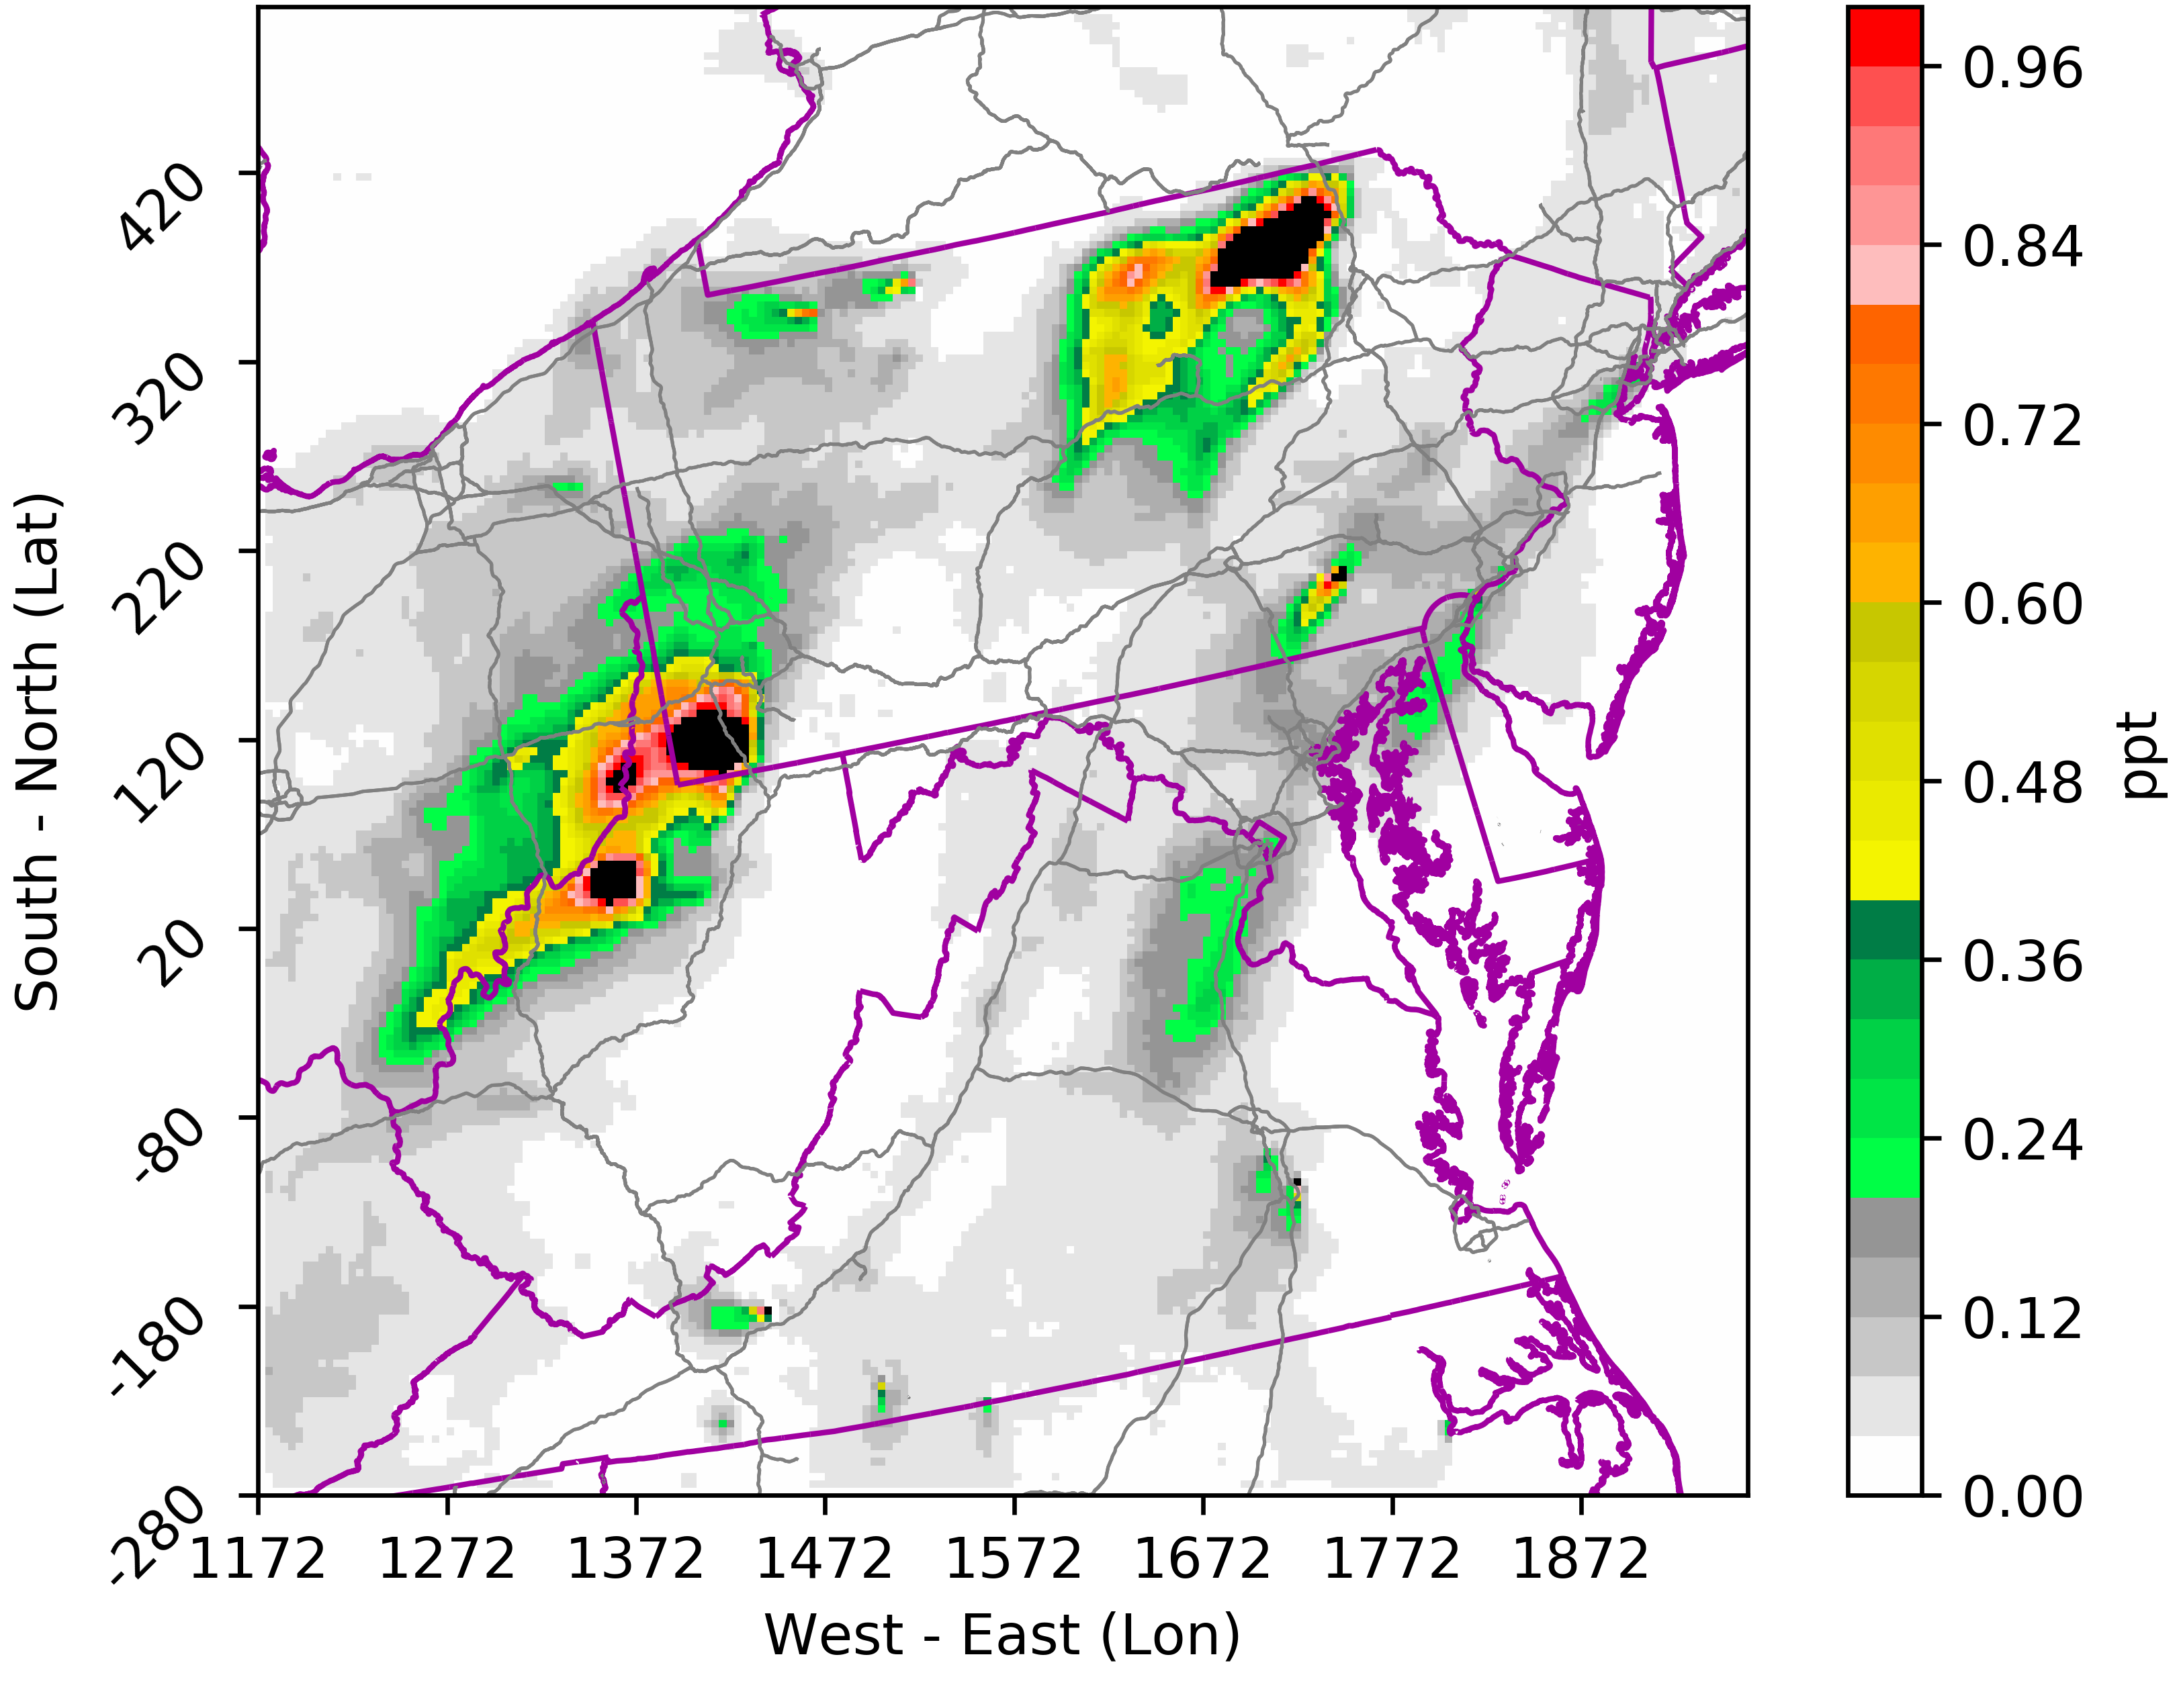
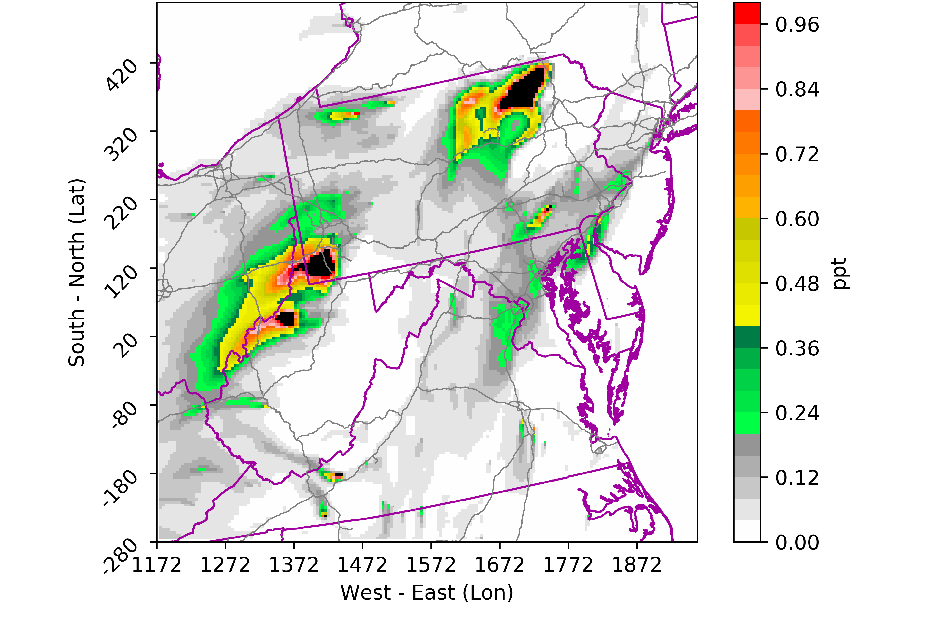
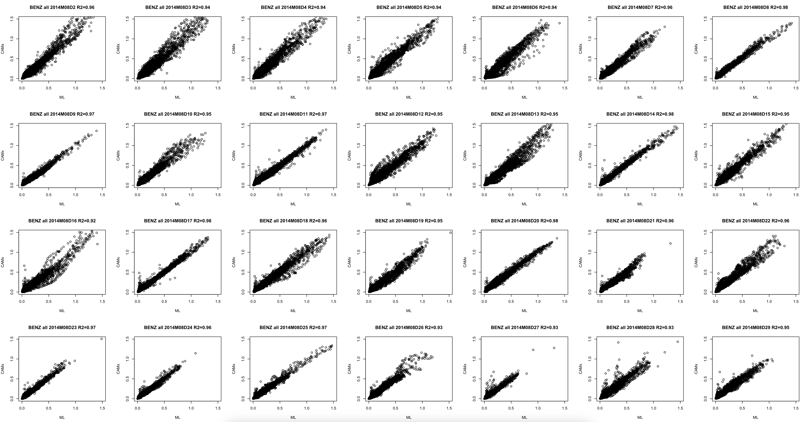
Result 4: ML model HAPs result: Benzene
2014/08/25 LT 05:00-6:00
ML
CAMx
R² = 0.97

Slide 14
Conclusions and Future Work:
Model result shows that Ozone and NO₂ concentration reduction in the model domain, but the NEI HAPs emission are increases in Marcellus Shale region.
The HAPs observational data in Marcellus Shale hotspot sites and other near sites shows decrease by year, but the model HAPs result is underestimate. 2019 emission was improved and better represent the HAPs concentration.
The well-trained DeepCTM model can produce one day hourly HAPs concentration data in 30 seconds and the hourly R-square (ML & CAMx) is > 0.9; Daily average R-square is > 0.97. The CAMx model simulation takes 1.5 - 2 hours for generating one day result.
NOx and VOCs sensitivity cases will be applied to train the DeepCTM model for Ozone and PM25.
Compare the ML model result with observational data for HAPs and CAPs.

Slide 15
Thank you and Questions?
Chi-Tsan Wang: cwang48@gmu.edu

