Slide 1
Impacts of Major Updates to Canadian On-road Emissions Inventory and Spatial Surrogates on Regional Air Quality Model Predictions
Junhua Zhang, Qiong Zheng, and Ali Katal
Air Quality Research Division, Environment and Climate Change Canada,
4905 Dufferin Street, Toronto, ON, M3H 5T4, Canada
junhua.zhang@ec.gc.ca
Laurent Bruneau Cossette
Air Quality Policy-Issue Response Section, MSC, Environment and Climate Change Canada
2121 Rte Transcanadienne, Montreal, QC, H9P 1J3, Canada
2024 CMAS, Oct. 21st – 23rd, 2024, Chapel Hill, NC,USA

Slide 2
outline
Issue with summertime NO₂ overestimation for Canada for the current Canadian RAQDPS modelling system
Investigation and updates to spatial surrogates for on-road emissions
Major methodology changes for estimating Canadian on-road and off-road emissions
Impacts of the new surrogates and updated inventory on model prediction of NO₂ concentration for Canadian regions and large cities
Discussions and summary remarks

Slide 3
Issue with Summertime NO₂ Prediction
RAQDPS = Regional Air Quality Deterministic Prediction System, based ECCC’s GEM-MACH in-line chemical transport model
Key predictands are surface O₃, NO₂, and PM_{2.5}
Summertime NO₂ concentration was overpredicted for Canada, particularly for most of the large cities
On-road emission was identified as one of the main reasons for the overestimation
Summer 2022 Average Hourly NO₂ (ppb) – Canada
Summer 2022 hourly NO₂ (ppb) – Montreal

Slide 4
spatial surrogates for on-road emissions (1)
Canadian on-road emission inventory is at provincial level
Spatial surrogates were created based on the Canadian National Road Network (NRN) shapefile (National Road Network - NRN - GeoBase Series - Open Government Portal (canada.ca)) for distributing provincial on-road emissions to each model grid cell
NRN shapefile is a collection of provincial shapefiles
Road classification for some provincial road shapefiles are not consistent
Complex and difficult to build a homogeneous national road network shapefile for whole Canada

Slide 5
spatial surrogates for on-road emissions (2)
Current road network shapefile for generating on-road spatial surrogates built in 2012
Newer version of the provincial road network shapefile become available
Issues identified with the current road network shapefile
Updates using the latest version of the shapefiles
Province / Territory | Edition | Release Date | Validity Date | Number of kilometers
British Columbia | 8.0 | 2011-03 | 2011-02 | 82,901
Alberta | 8.0 | 2011-04 | 2011-02 | 233,147
Saskatchewan | 5.0 | 2011-08 | 2011-03 | 250,810
Manitoba | 4.2 | 2011-08 | 2008-04 | 87,960
Ontario | 7.0 | 2011-08 | 2011-05 | 278,784
Quebec | 5.0 | 2011-12 | 2011-03 | 153,413
New Brunswick | 2.1 | 2010-10 | 2003-06 | 31,830
Prince Edward Island | 10.0 | 2011-03 | 2010-12 | 6,821
Nova Scotia | 9.0 | 2011-04 | 2011-01 | 48,267
Newfoundland and Labrador | 6.0 | 2009-08 | 2009-07 | 21,504
Yukon | 9.0 | 2011-04 | 2011-03 | 6,152
Northwest Territories | 7.0 | 2011-03 | 2011-01 | 5,404
Nunavut | 5.0 | 2010-07 | 2009 | 1,195
Province / Territory | Code | Edition | Release Date | Validity Date | Number of Kilometers
Alberta | AB | 15 | Apr-22 | Apr-22 | 237,821
British Columbia | BC | 14 | May-17 | Mar-17 | 93,961
Manitoba | MB | 6 | Apr-13 | Apr-12 | 89,003
New Brunswick | NB | 12 | Jun-22 | Jun-22 | 35,830
Newfoundland and Labrador | NL | 7 | Apr-13 | Sep-12 | 23,026
Northwest Territories | NT | 13.1 | Jun-22 | Apr-22 | 7,812
Nova Scotia | NS | 15 | Oct-22 | Oct-22 | 51,985
Nunavut | NU | 10 | May-22 | May-22 | 927
Ontario | ON | 15 | Jul-22 | Jul-22 | 262,863
Prince Edward Island | PE | 20.1 | Aug-21 | Aug-21 | 6,988
Quebec | QC | 9 | Aug-16 | Feb-16 | 162,768
Saskatchewan | SK | 12.1 | Dec-22 | Nov-22 | 250,122
Yukon | YT | 17 | May-22 | May-22 | 6,406

Slide 6
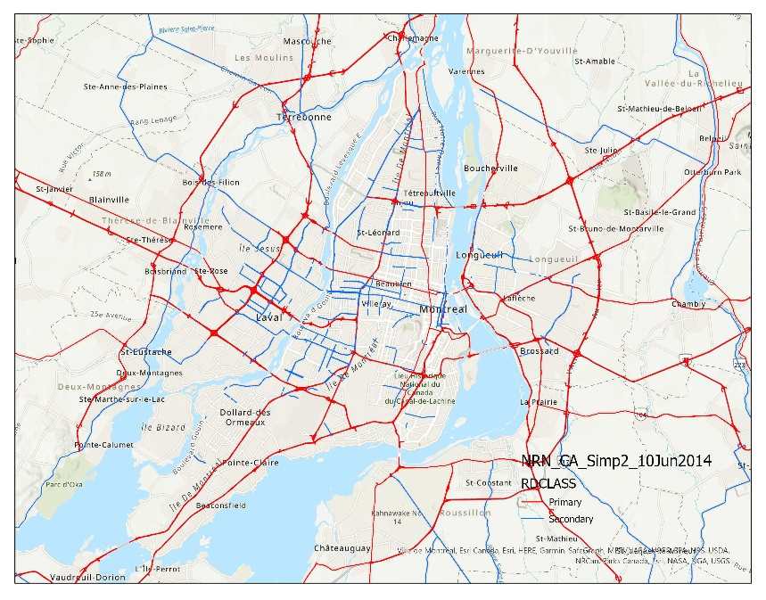
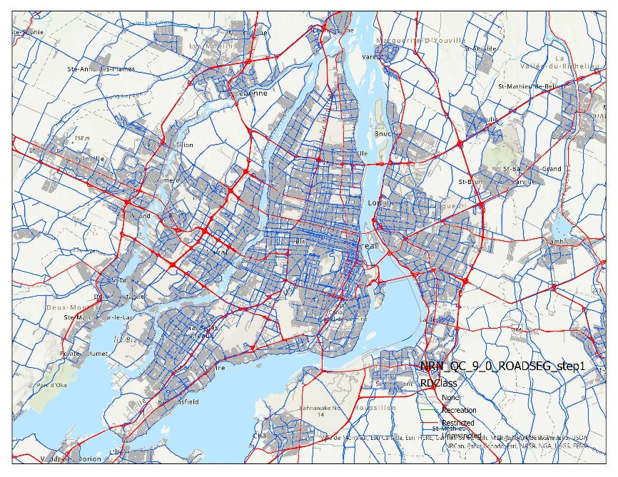
Updates to ON-road spatial surrogates Example 1
Current
Updated
Inventory Road Type
Off-network
Off-Network Idling
Rural Restricted Access
Rural Unrestricted Access
Urban Restricted Access
Urban Unrestricted Access
Montreal
Montreal
For Quebec, currently only arterial road (blue lines) is classified as Unrestricted Road surrogate
Unreasonable small number of Unrestricted Roads within the downtown area and almost no Unrestricted Roads outside the city
Collectors is added for Unrestricted Road surrogate, large increase of unrestricted road for downtown Montreal, but also adding new unrestricted roads to suburban and smaller cities/towns
Notes:
Arterial: A major thoroughfare with medium to large traffic capacity
Collector: A minor thoroughfare mainly used to access properties and to feed traffic with right of way

Slide 7
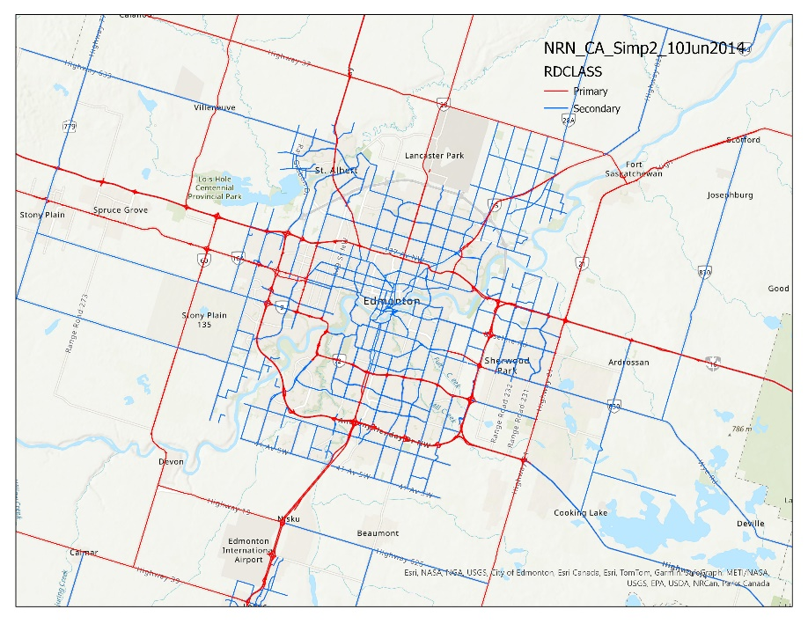
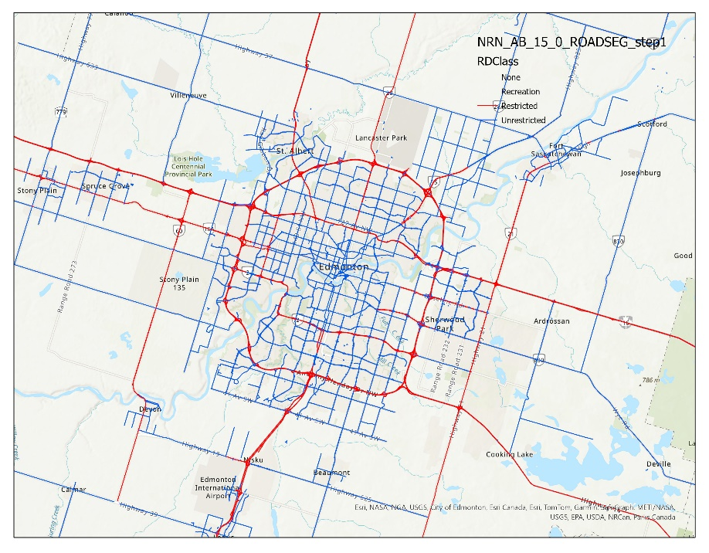
Updates to ON-road spatial surrogates Example 2
Current
Updated
Inventory Road Type
Off-network
Off-Network Idling
Rural Restricted Access
Rural Unrestricted Access
Urban Restricted Access
Urban Unrestricted Access
Edmonton
Edmonton
For Alberta, currently collectors are only added for a few large cities, such as Calgary and Edmonton, for Unrestricted Road surrogate
Most of the Urban Unrestricted Road emission is allocated to those large cities
As an update, collectors are added for smaller towns for Unrestricted Road surrogate
Notes:
Arterial: A major thoroughfare with medium to large traffic capacity
Collector: A minor thoroughfare mainly used to access properties and to feed traffic with right of way

Slide 8
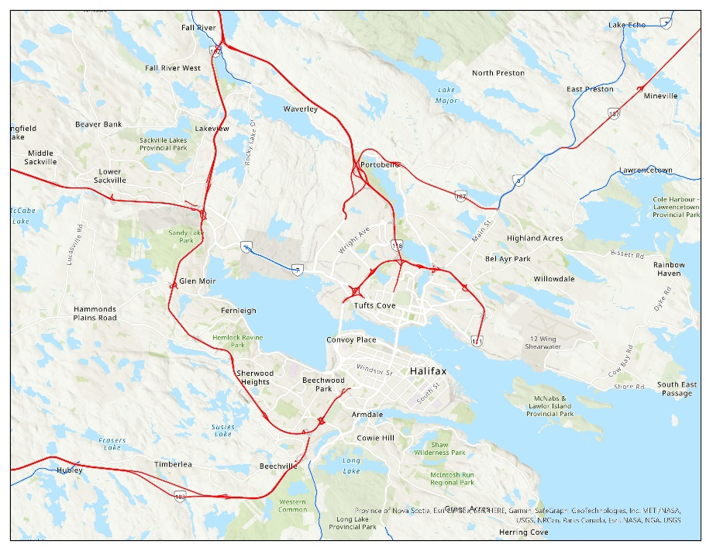
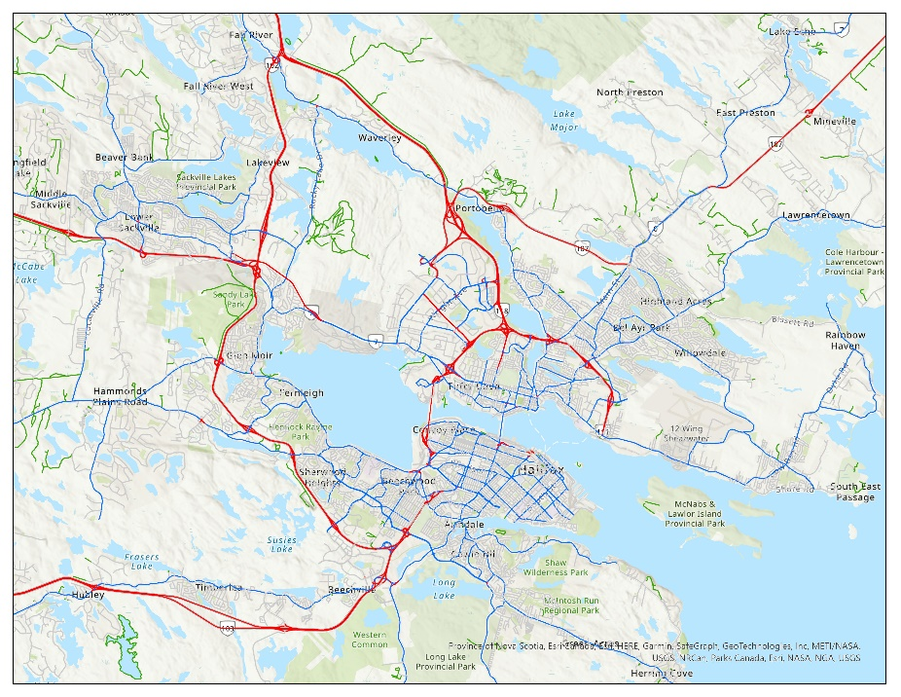
Updates to ON-road spatial surrogates Example 3
Current
Updated
Currently almost no Unrestricted Roads for the city of Halifax and NO₂ is underpredicted
Most of the urban unrestricted roads were defined as unknown road for Nova Scotia
Missing unrestricted roads were added
Halifax
Halifax
NO2
Notes:
Arterial: A major thoroughfare with medium to large traffic capacity
Collector: A minor thoroughfare mainly used to access properties and to feed traffic with right of way

Slide 9
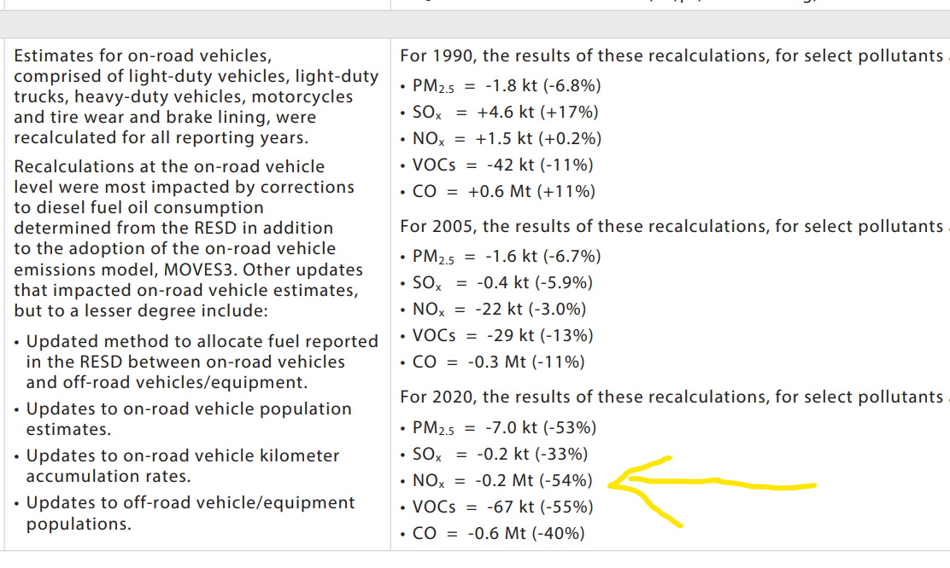
Major update to Canadian onroad emissions
A major update in 2023 for estimating Canadian onroad emissions for the Canadian Air Pollutant Emissions Inventory (APEI)
Compared to previous methodology, onroad NOx emission was reduced by more than 50%. Emissions for other pollutants were reduced at similar magnitude
The reduction is mainly due to two main reasons: 1) corrections to diesel fuel consumption determined from the Report on Energy Supply and Demand (RESD) in Canada, and 2) upgrade of the MOtor Vehicle Emission Simulator (MOVES) model from MOVES2014 to MOVES3 with updated activity data, such as updates to vehicle population and vehicle kilometer traveled (see, Table A3–4 of https://publications.gc.ca/collections/collection_2023/eccc/En81-30-2021-eng.pdf)

Slide 10
update to Canadian off-road emissions
Due to 1) corrections to diesel fuel oil consumption determined from the Report on Energy Supply and Demand (RESD) in Canada, and 2) updated method to allocate fuel reported in the RESD between on-road and off-road vehicles/equipment, off-road NOx emission increased by 13% for year 2020
Increase of off-road NOx emission is only about 10% decrease of on-road NOx emissions (+22 kt vs -0.2 Mt), resulting in overall large decrease of NOx emission

Slide 11
Impacts on model predictions (1)
Emission inventories for the current Canadian RAQDPS (BASE):
1) projected 2023 US and MEX
2) old-version-APEI-based projected 2023 Canadian emissions
TEST set of emissions using 2021 Canadian emission inventory based on the new methodologies and new on-road surrogates
Comparisons between RAQDPS and the test run are shown for Canada, Eastern Canada, Western Canada, and large cities

Slide 12
Impacts on model predictions (2)
Summer 2022 - Canada and Regions
CANADA
BASE TEST
New version of the emissions and surrogates significantly reduce summer positive NO2 and negative O3 bias for entire Canada, Western and Eastern Canada
Negative PM2.5 bias slightly worse
WESTERN CANADA
EASTERN CANADA
BASE TEST
BASE TEST

Slide 13
Impacts on model predictions (3)
Summer 2022 - Large Cities
Vancouver
Calgary
BASE TEST
BASE TEST
Vancouver Time Series
Calgary Time Series

Slide 14
Impacts on model predictions (4)
Summer 2022 - Large Cities
Toronto
Montreal
BASE TEST
BASE TEST
Toronto Time Series
Montreal Time Series

Slide 15
Discussions and Summary
Current Canadian RAQDPS modelling system overpredicts summer NO₂ concentration for Canada, particularly for large cities
On-road spatial surrogates were carefully checked and updated to allocate more emissions from large cities to smaller communities
Recent major methodology change for estimating Canadian on-road emissions resulting in 50% reduction of on-road NOx emissions
Model results show significant improvement for summertime NO₂ prediction for Canadian regions and most of the large cities
Updated emissions inventory and on-road spatial surrogates make the underprediction of wintertime NO₂ concentration worse (results not shown), further investigation is needed

Slide 16
Thank You for Your Attention!

Slide 17
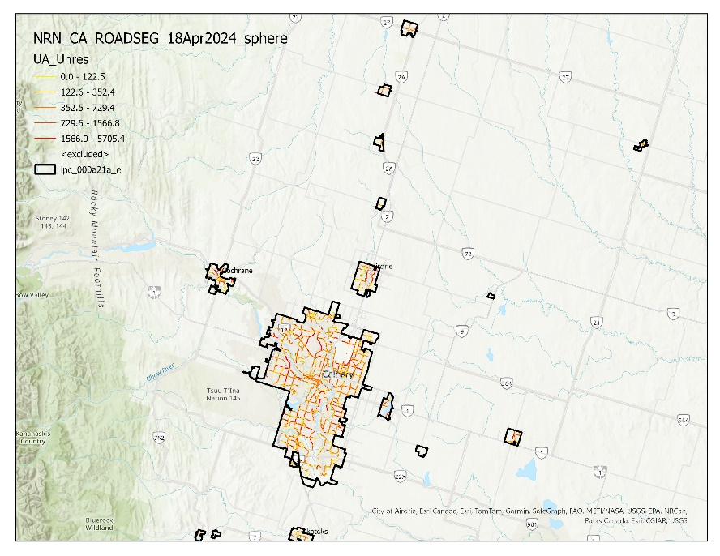
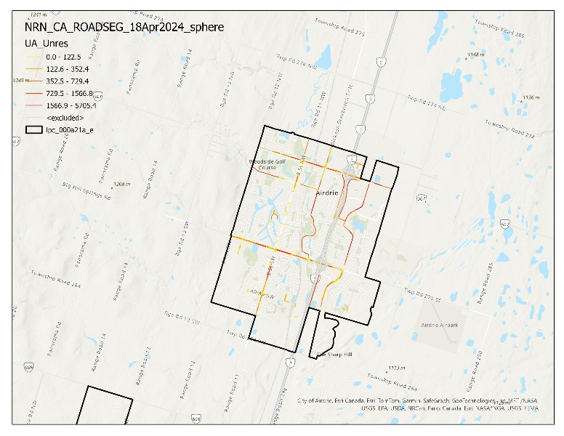
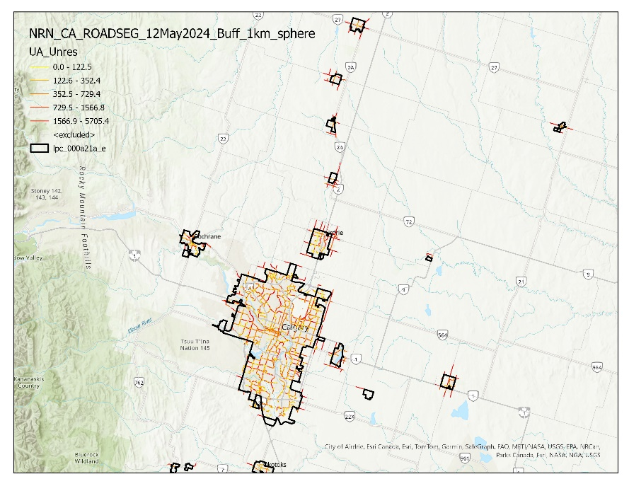
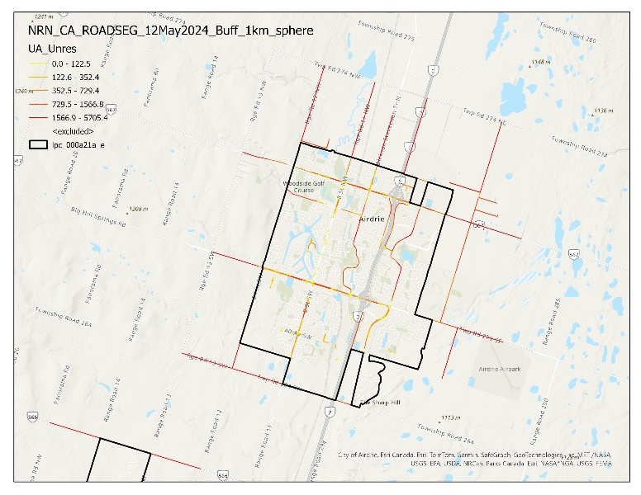
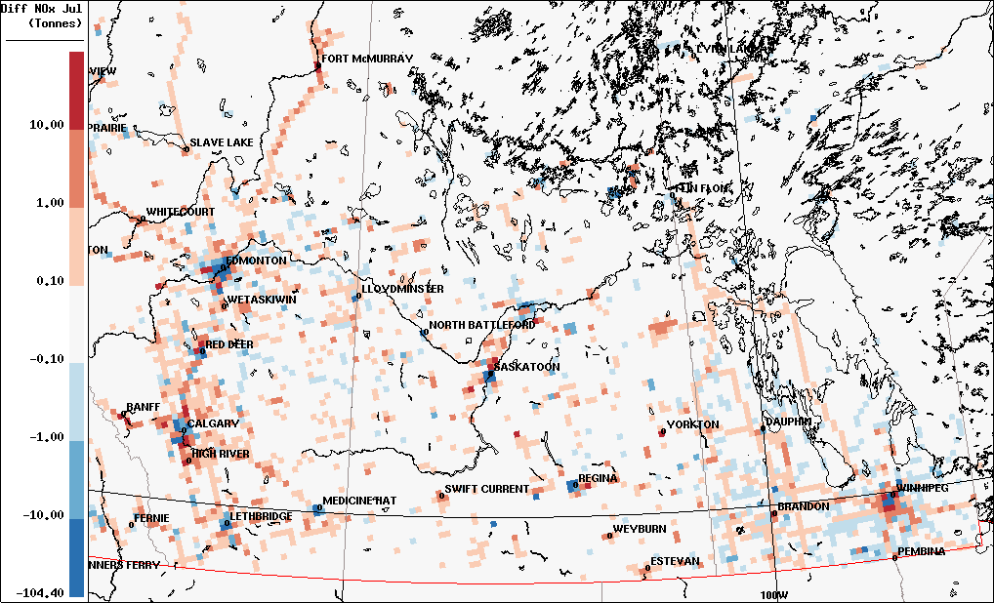
Updates to ON-road spatial surrogates Example 4
One Possible Update
2021 Population Center (PC) boundary shapefile was used to separate urban/rural roads
Considering the transportation range can be larger than the dwelling area, one kilometre buffer is added around the Population Center boundary
More weight added to small towns than large cities, resulting in smaller emissions for large cities
Change of NOx emission

Slide 18
Impacts on model predictions (3)
Summer 2022 - Provinces and Territories
British Colombia
Alberta
BASE TEST
BASE TEST
Saskatchewan
Manitoba
BASE TEST
BASE TEST

Slide 19
Impacts on model predictions (4)
Summer 2022 - Provinces and Territories
Ontario
Quebec
BASE TEST
BASE TEST
New Brunswick
Nova Scotia
BASE TEST
BASE TEST

Slide 20
Impacts on model predictions (5)
Summer 2022 - Provinces and Territories
Prince Edward Island
Newfoundland and Labrador
BASE TEST
BASE TEST
Northwest Territory
Yukon Territory
BASE TEST
BASE TEST

