Slide 1
A physically constrained deep-learning fusion method for retrieving surface NO₂ concentration from satellite and ground monitors
Jia Xing^{1,2}, Bok H. Baek¹, Siwei Li³, Chi-Tsan Wang¹, Ge Song³, Siqi Ma¹, Daniel Tong¹ , Joshua S. Fu²
¹George Mason University
²University of Tennessee-Knoxville
³Wuhan University

Slide 2
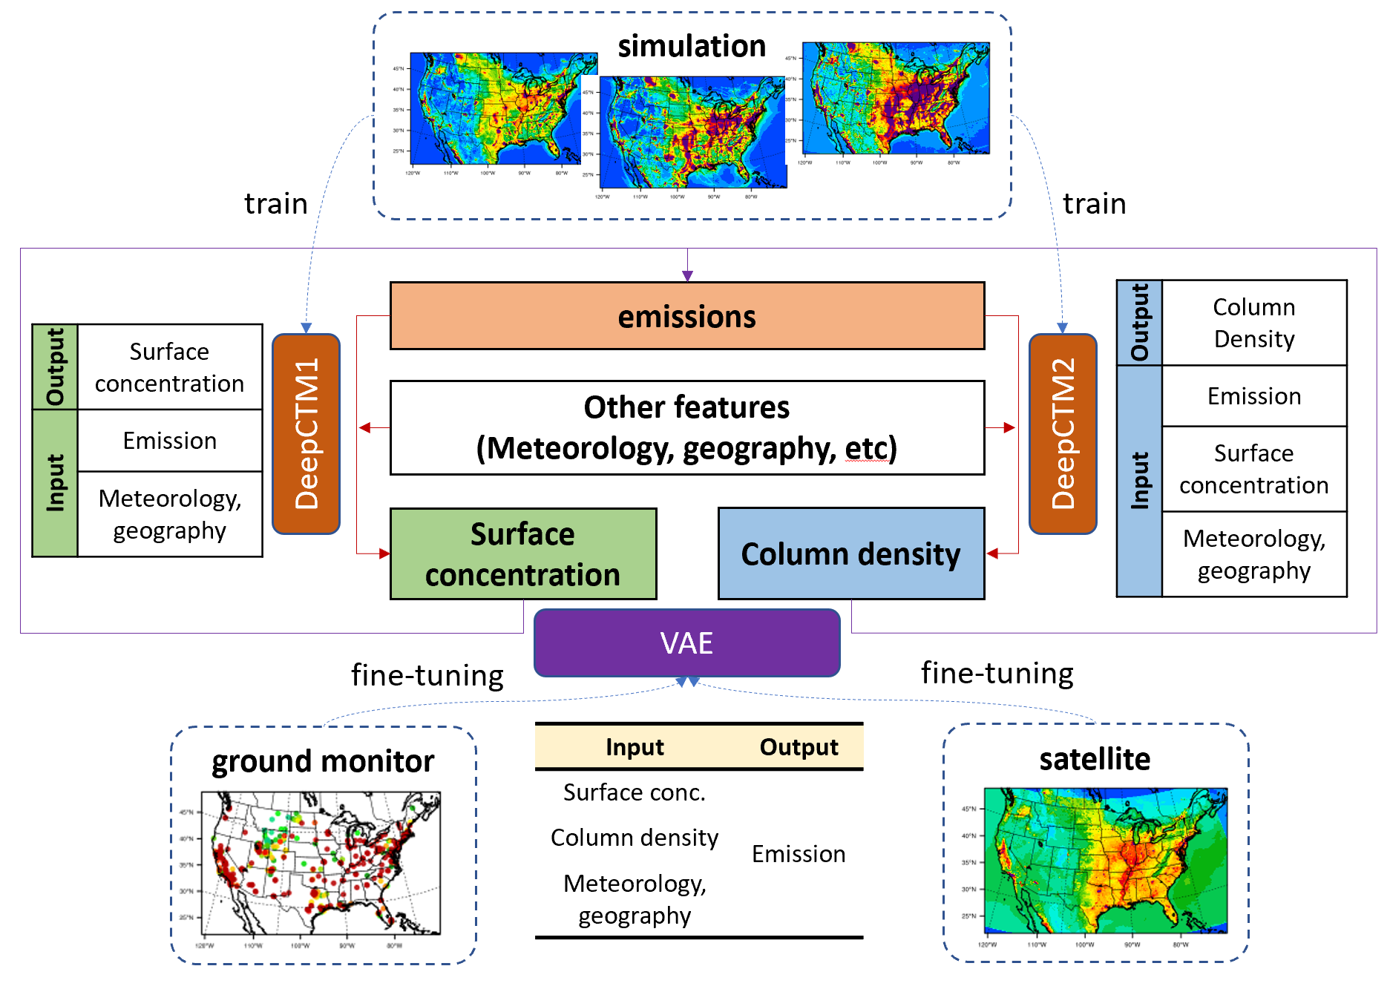
DeepMMF—Deep-learning Measurement-Model Fusion
Aims to
Effective fusing satellite and ground measurements
Address sample-imbalance issue
Provide near real-time update
Overview of DeepMMF

Slide 3
Three advantages of DeepMMF
(1) Physically constrained by atmospheric processes informed by CTM
Emission (24 hour average)
forward
backward
……
DeepCTM1
surface conc.
……
VAE
DeepCTM2
column density
hour 1
hour 2
hour 25
Scenario | Emission | Meteorology
Baseline | base | 2019
Hypo-1 | base | 2020
Hypo-2 | zero | 2020
Hypo-3 | double | 2019
12km CMAQ simulation data used for training

Slide 4











DeepCTMs
(forward module)
Output: NO₂ concentration
Initial condition
$$y_{0}$$
$$y_{1}$$
$$y_{2}$$
…
$$y_{t}$$
…
$$y_{23}$$
$$y_{24}$$
Conv2d
Conv2d
Conv2d
Conv2d
Conv2d
Role 1: as a baseline
…
…
CONV
CONV
CONV
CONV
CONV
ConvLSTM: four layers with channel numbers of 256, 128, 64, and 64, with a 3×3 kernel size
h4, c4
…
…
—provide real-time predictions of surface concentration and column density
LSTM
LSTM
LSTM
LSTM
LSTM
CONV
CONV
CONV
CONV
CONV
h3, c3
LSTM
LSTM
…
LSTM
…
LSTM
LSTM
CONV
CONV
CONV
CONV
CONV
h2, c2
LSTM
LSTM
…
LSTM
…
LSTM
LSTM
CONV
CONV
CONV
CONV
CONV
h1, c1
…
…
Role 2: participates in atmospheric processes
LSTM
LSTM
LSTM
LSTM
LSTM
…
…
$$x_{1}$$
$$x_{2}$$
…
$$x_{t}$$
…
$$x_{23}$$
$$x_{24}$$
Input: meteorological, emission, and geographical features

Slide 5
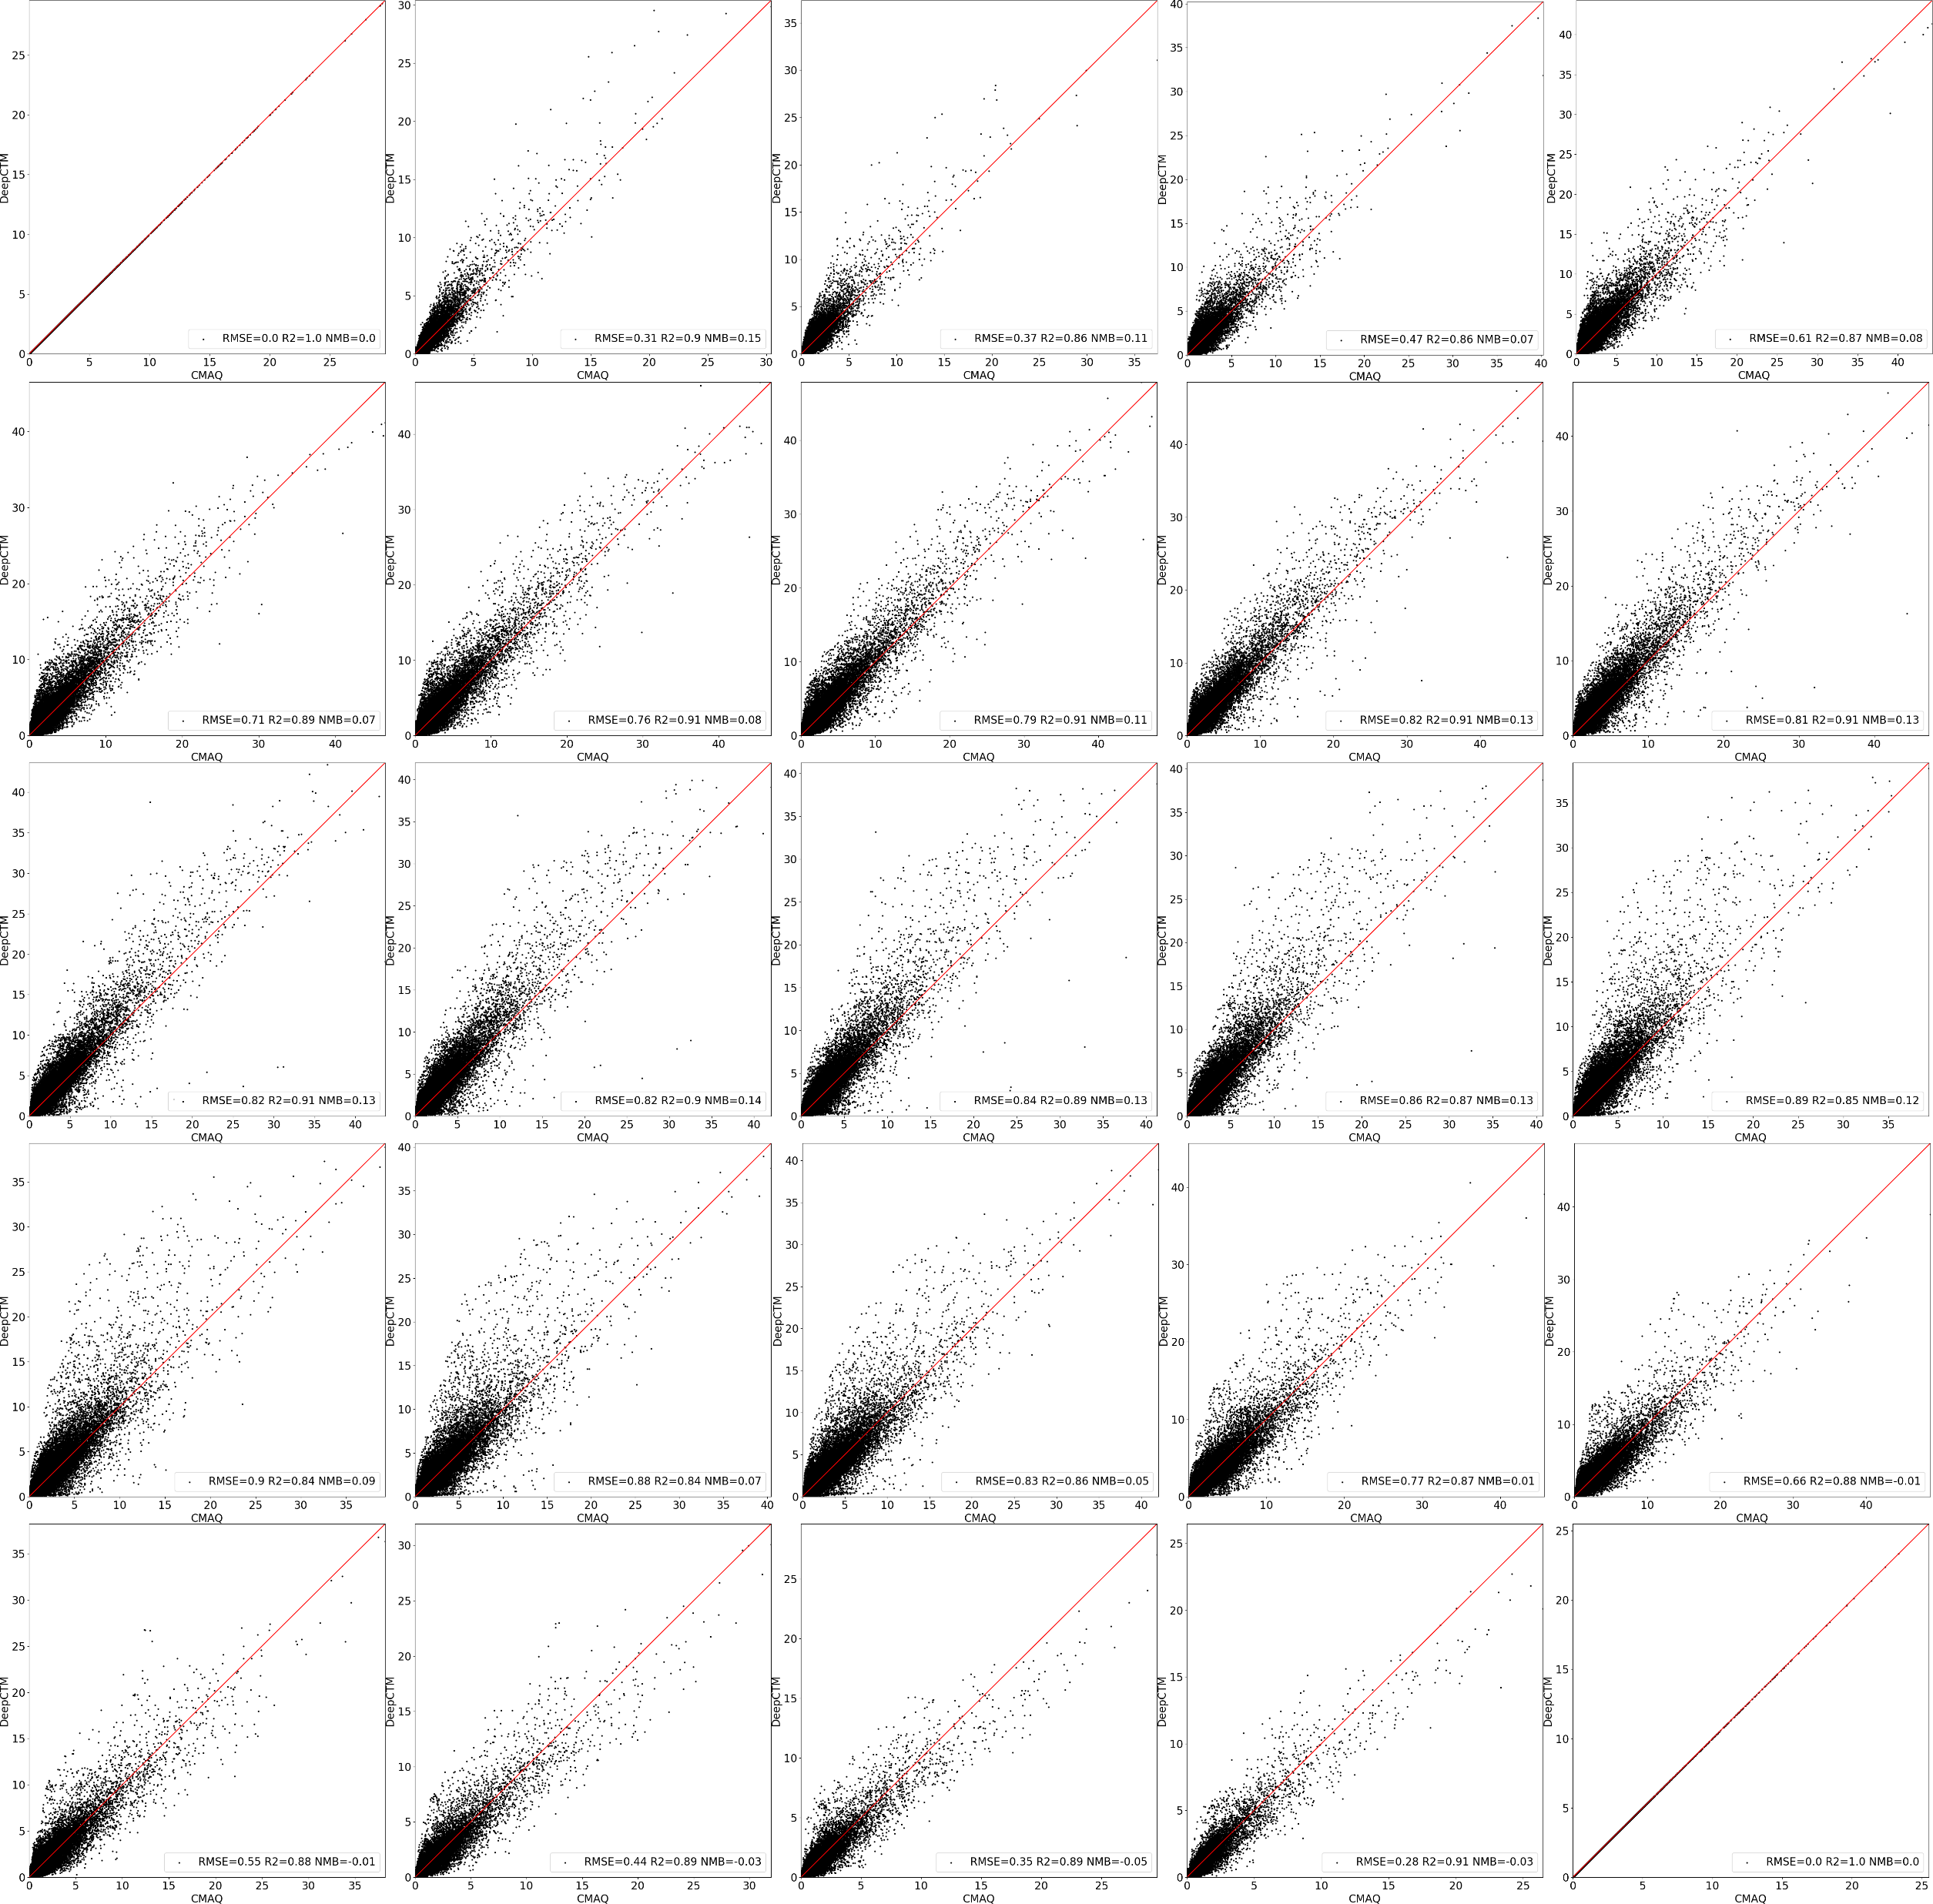
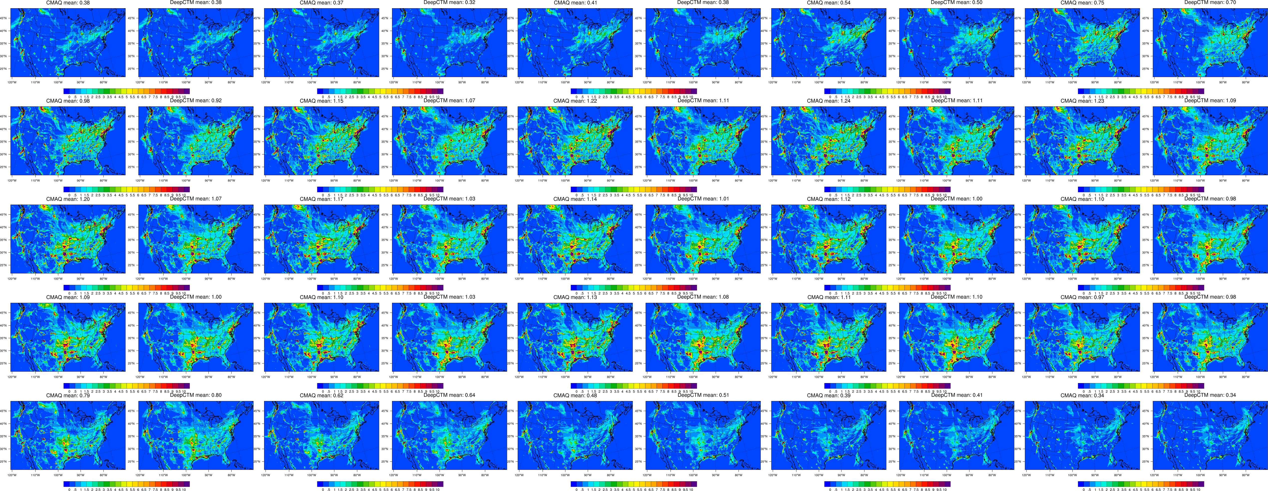
Performance of DeepCTM in estimating surface NO₂
hour 0
hour 1
hour 2
hour 3
hour 4
hour 20
hour 21
hour 22
hour 23
hour 24
a test example (January 26, 0 – 24 hour)

Slide 6
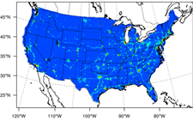
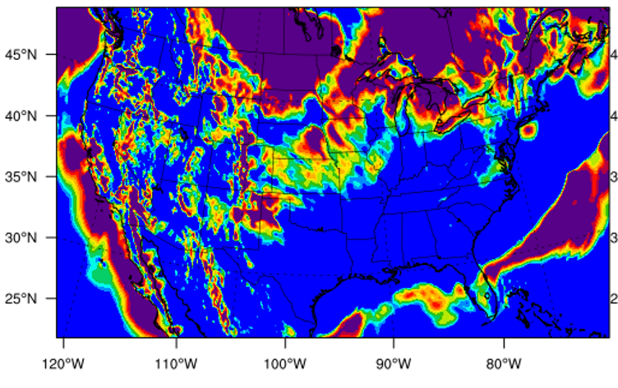
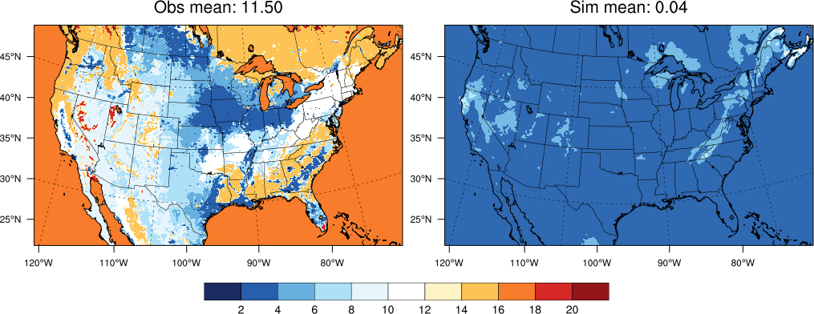
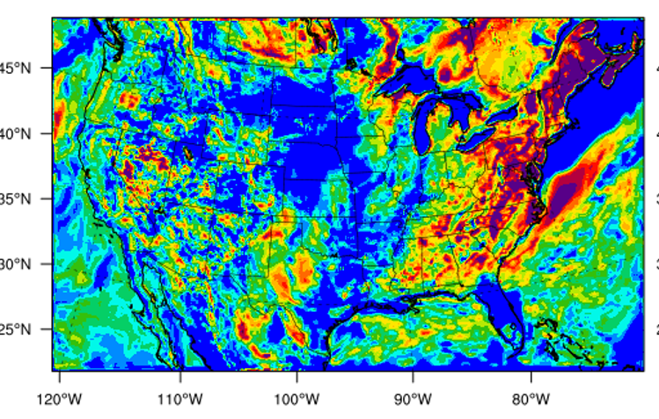
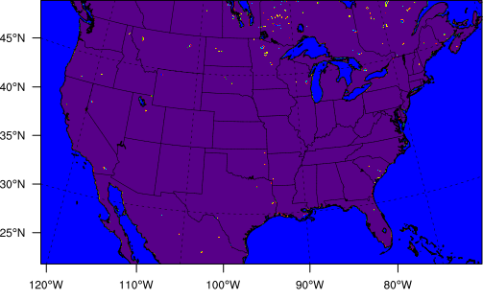
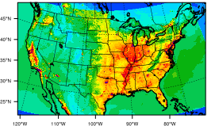
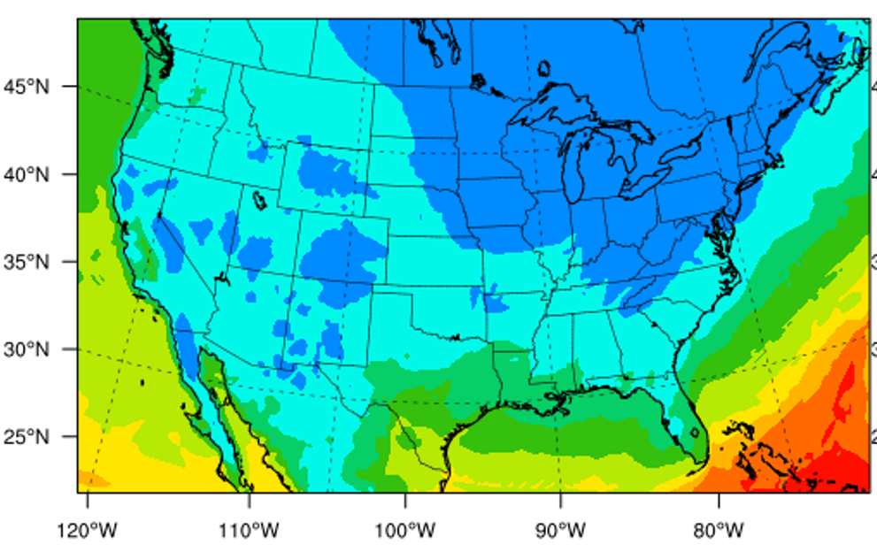

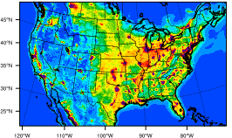
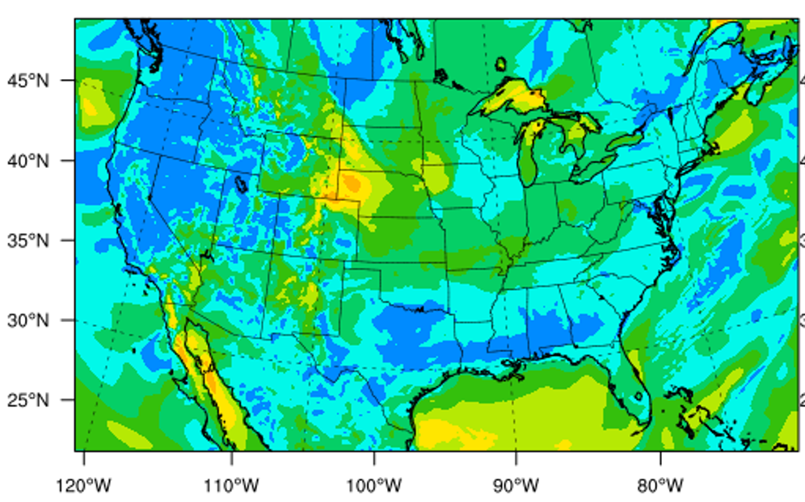
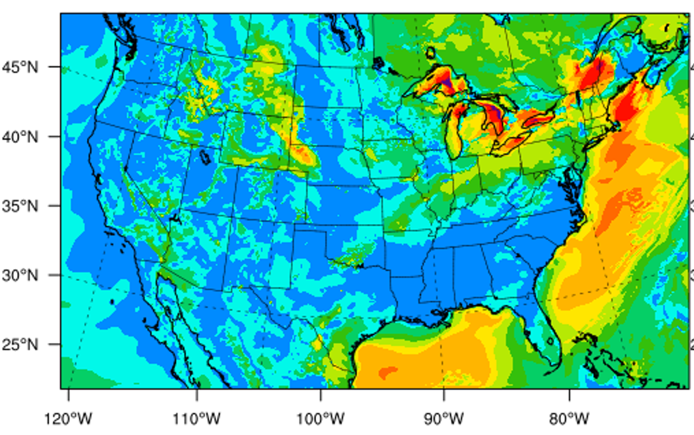
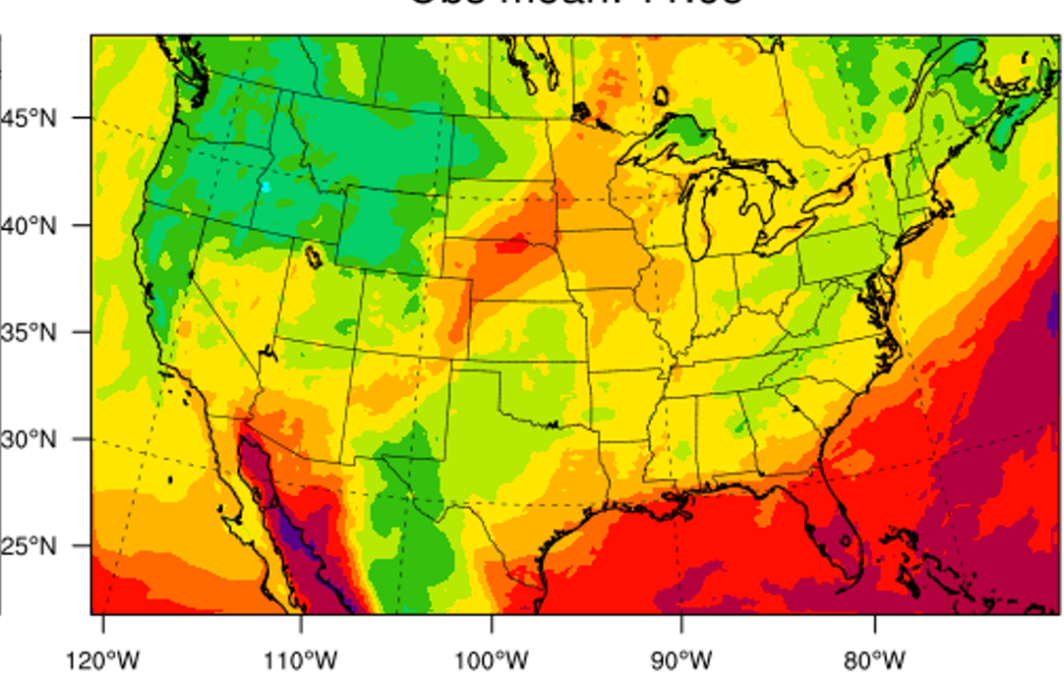
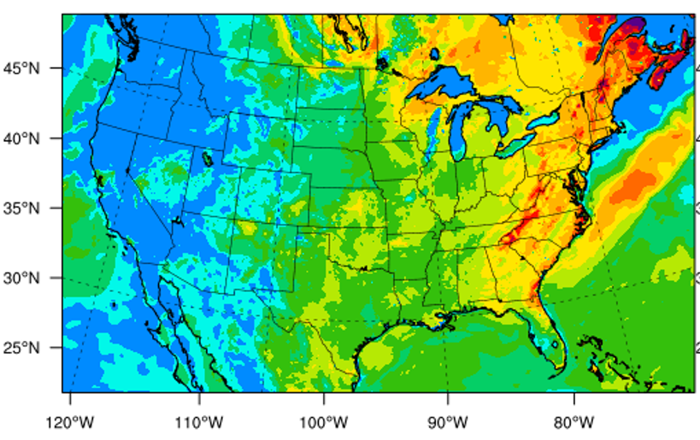
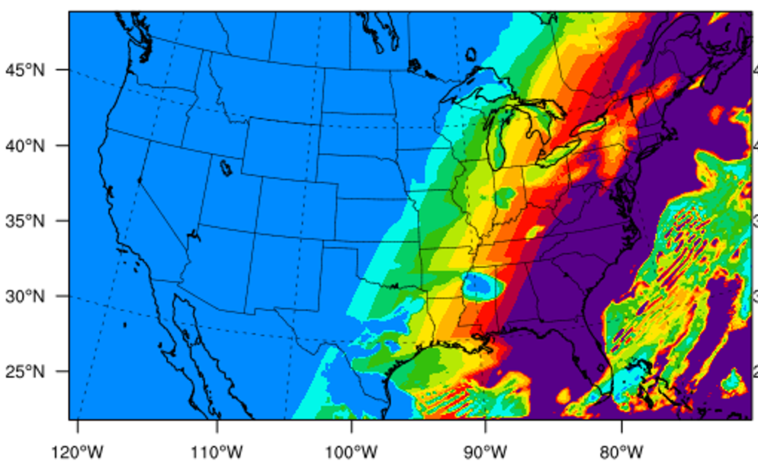











VAE
(backward module)
$$E_{NOx}$$
C_{nox emiss}= 1
MLP
CNN
CNN
U-Net
pReLU
pReLU
Concatenate
—optimize the emissions based on observation
CNN
CNN
$$h_{1}$$
$$h_{2}$$
$$h_{t}$$
$$h_{24}$$
pReLU
pReLU
LSTM
LSTM
$$…$$
LSTM
$$…$$
LSTM
CNN
CNN
$$y_{0, 24}$$
$$x_{1}$$
$$x_{2}$$
$$x_{t}$$
$$x_{24}$$
Concatenate
C_{geography}= 4
C_{EMsector}= 10
C_{NO2 column density}= 2
C_{NO2 conc}= 1
C_{Meteorology}= 9
V wind
Terrain height
U wind
Land-water
humidity
map-scale factor
PBL height
Land use type
Wind speed
convective velocity scale
2-meter temperature
Short-wave radiation

Slide 7
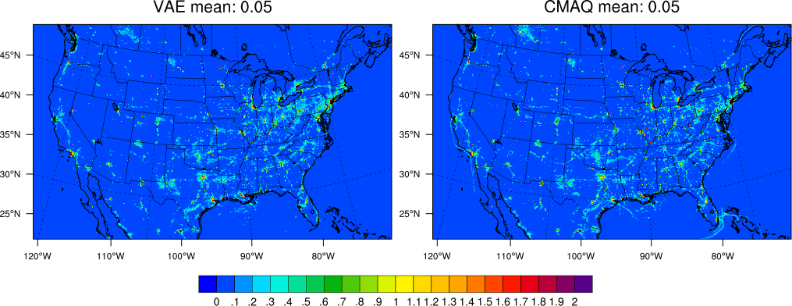
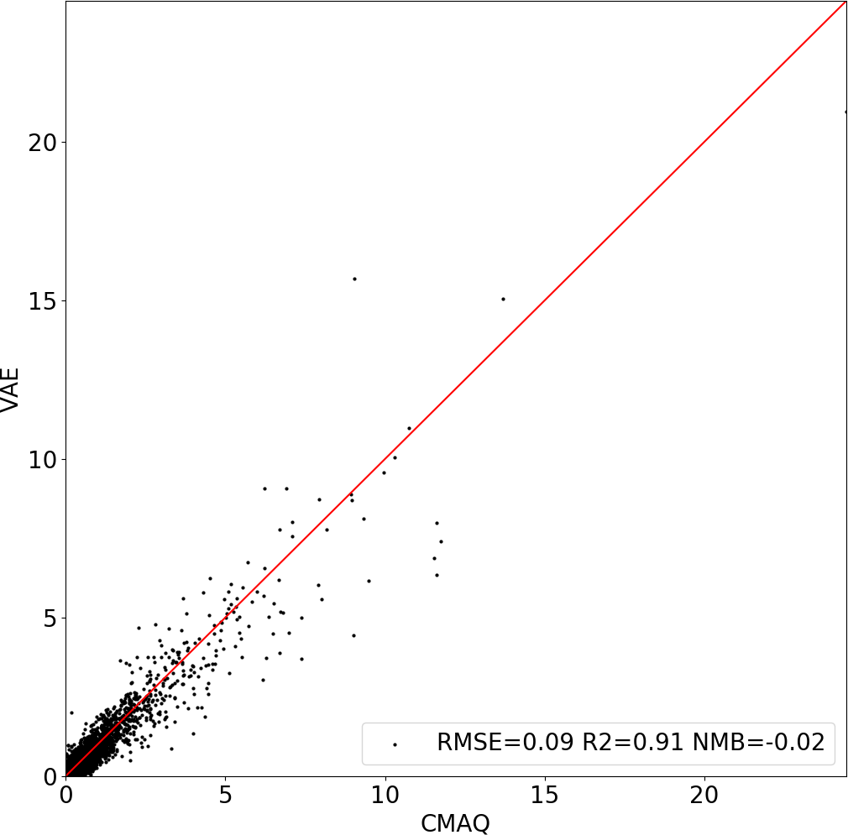
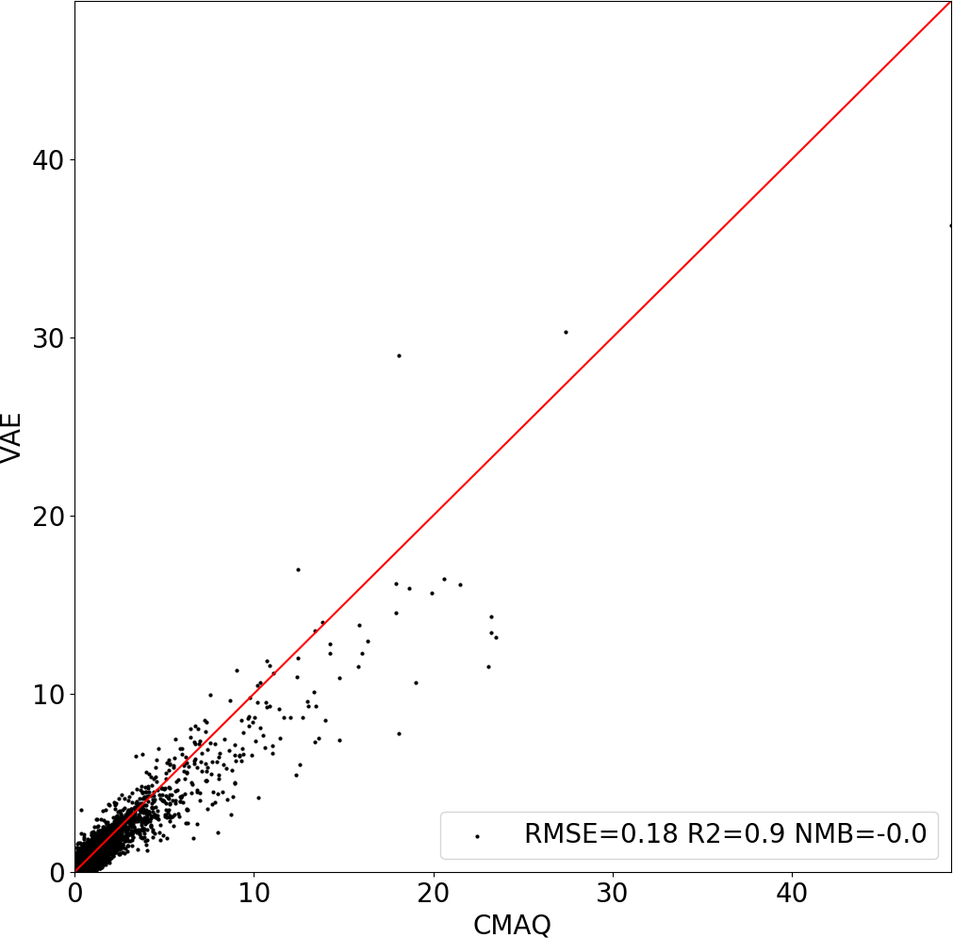
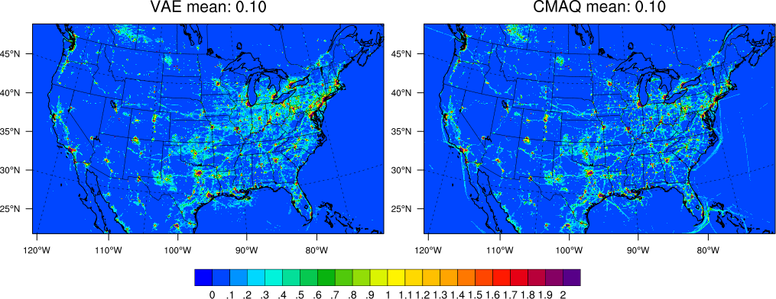
Performance of VAE in estimating total NOx emission
Baseline
double emission
one test example (January 26, 2019)

Slide 8
Three advantages of DeepMMF
Emission (24 hour average)
forward
backward
……
DeepCTM1
surface conc.
……
VAE
DeepCTM2
column density
hour 1
hour 2
hour 25

Slide 9
Three advantages of DeepMMF
(2) fine-tune on a well pre-trained model (no sample imbalance issue)
Emission (24 hour average)
②
Fine-tuning with observed dataset
……
DeepCTM1
surface conc.
……
VAE
DeepCTM2
column density
hour 1
hour 2
hour 25
Year | Source | Frequency
2019 | ground | selected grids
 | satellite | specific hour
2020 | ground | selected grids
 | satellite | specific hour
AQS/ TROPOMI data used for fine-tune

Slide 10
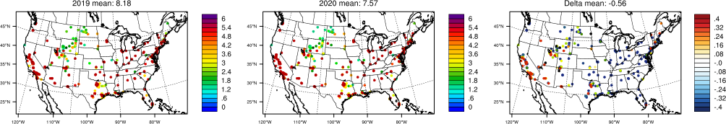
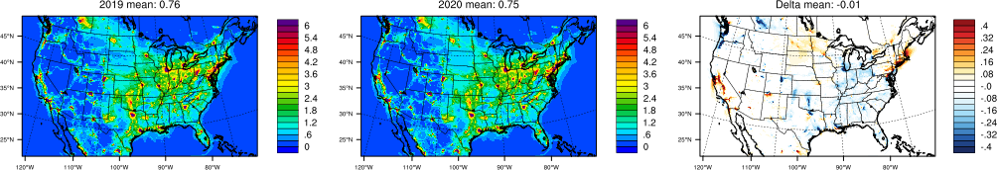
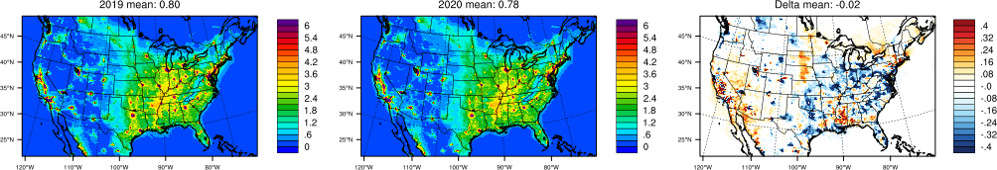
Comparison of observed, simulated, and fused surface NO₂
2019
2020
∆ (2020-2019)
AQS
CMAQ
(only change met.)
no change in emission
DeepMMF
DeepMMF successfully reflected high concentration and significant reduction

Slide 11
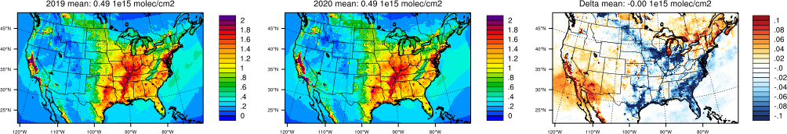
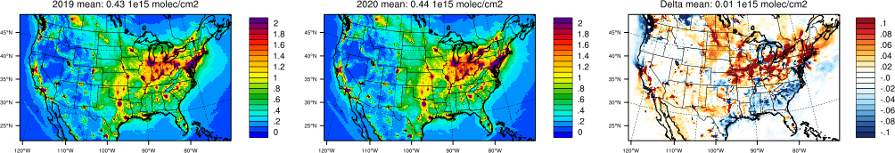
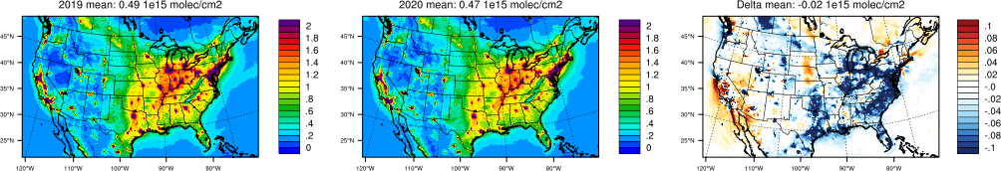
Comparison of observed, simulated, and fused NO₂ column
2019
2020
∆ (2020-2019)
TROPOMI
CMAQ
(only change met.)
no change in emission
DeepMMF
high NO2 column
significant reduction

Slide 12
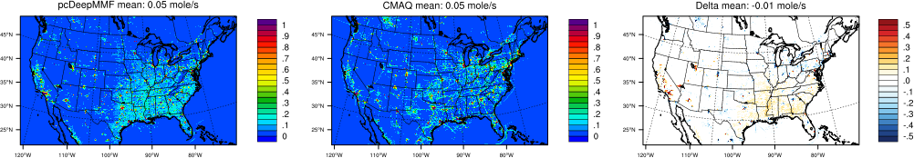
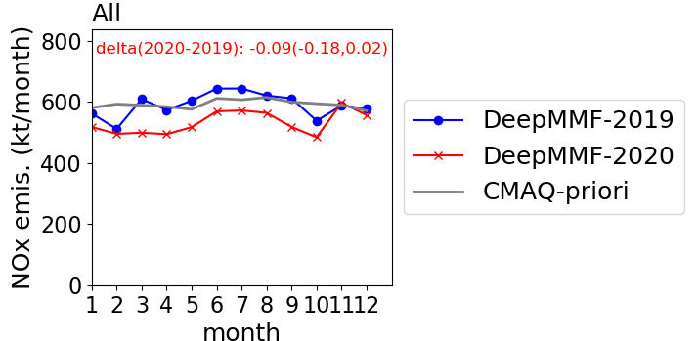
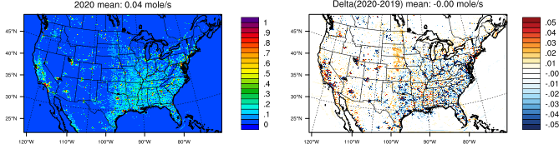
DeepMMF predicts the changes in NOx emission from 2019 to 2020
DeepMMF-2019
CMAQ-priori
∆ (DeepMMF – CMAQ)
DeepMMF-2020
∆ DeepMMF (2020 – 2019)
increase due to the wildfire
reduction due to the pandemic

Slide 13
Three advantages of DeepMMF
Emission (24 hour average)
Pre-trained with simulated dataset
Fine-tuning with observed dataset
……
surface conc.
……
③
column density
testbed
hour 1
hour 2
hour 25
Two-stage optimization
$$ω^{∗}=\arg{\min_{}{\sum{L1\left({Emis}^{posteriori},{βEmis}^{priori}\right)+αL2\left({Conc}^{pred},{Conc}^{obs}\right)}}}$$
(3) Dynamic selection of prior emissions avoids the “nudging effect”

Slide 14


Using Testbed to optimize the strategy
$$ω^{∗}=\arg{\min_{}{\sum{L1\left({Emis}^{posteriori},{βEmis}^{priori}\right)+αL2\left({Conc}^{pred},{Conc}^{obs}\right)}}}$$
Stage1: determine the $α$
Stage2: determine the $β$
L-curve to pick up
the optimized point
Case 1 (using lower prior emission)
prior emission ratio to the baseline emission:
fixed prior (1)
optimized prior (with least biases from concentration)
Case 2 (using higher prior emissions)
%: normalized bias of concentration

Slide 15
Comparison of emission changes retrieved by DeepMMF with NEI
with fix prior resulted in underestimation of emission changes

Slide 16
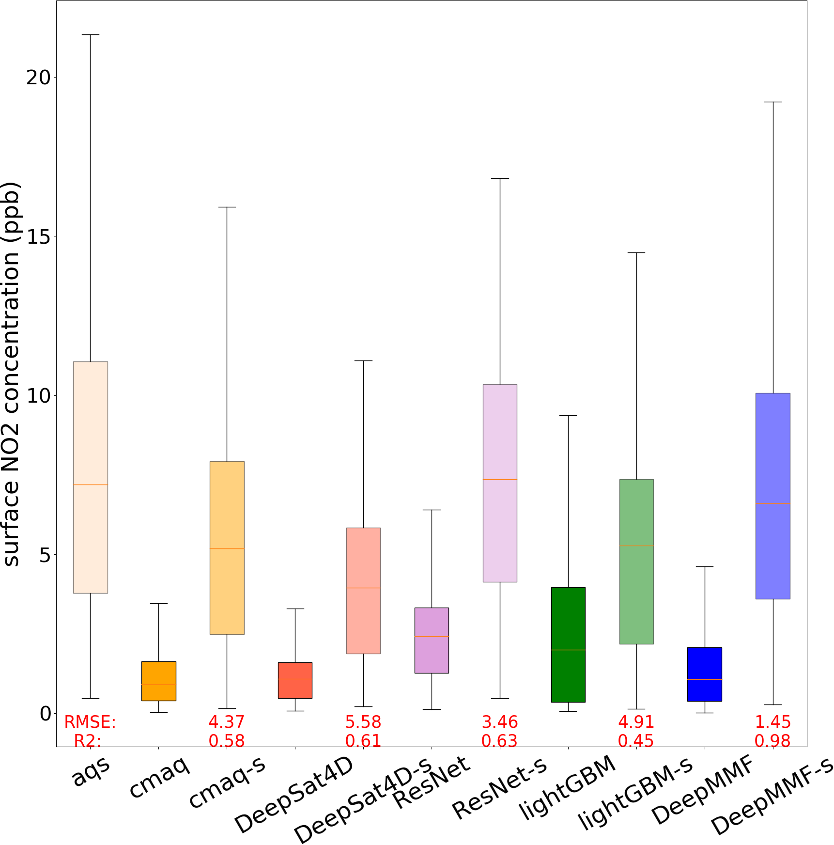
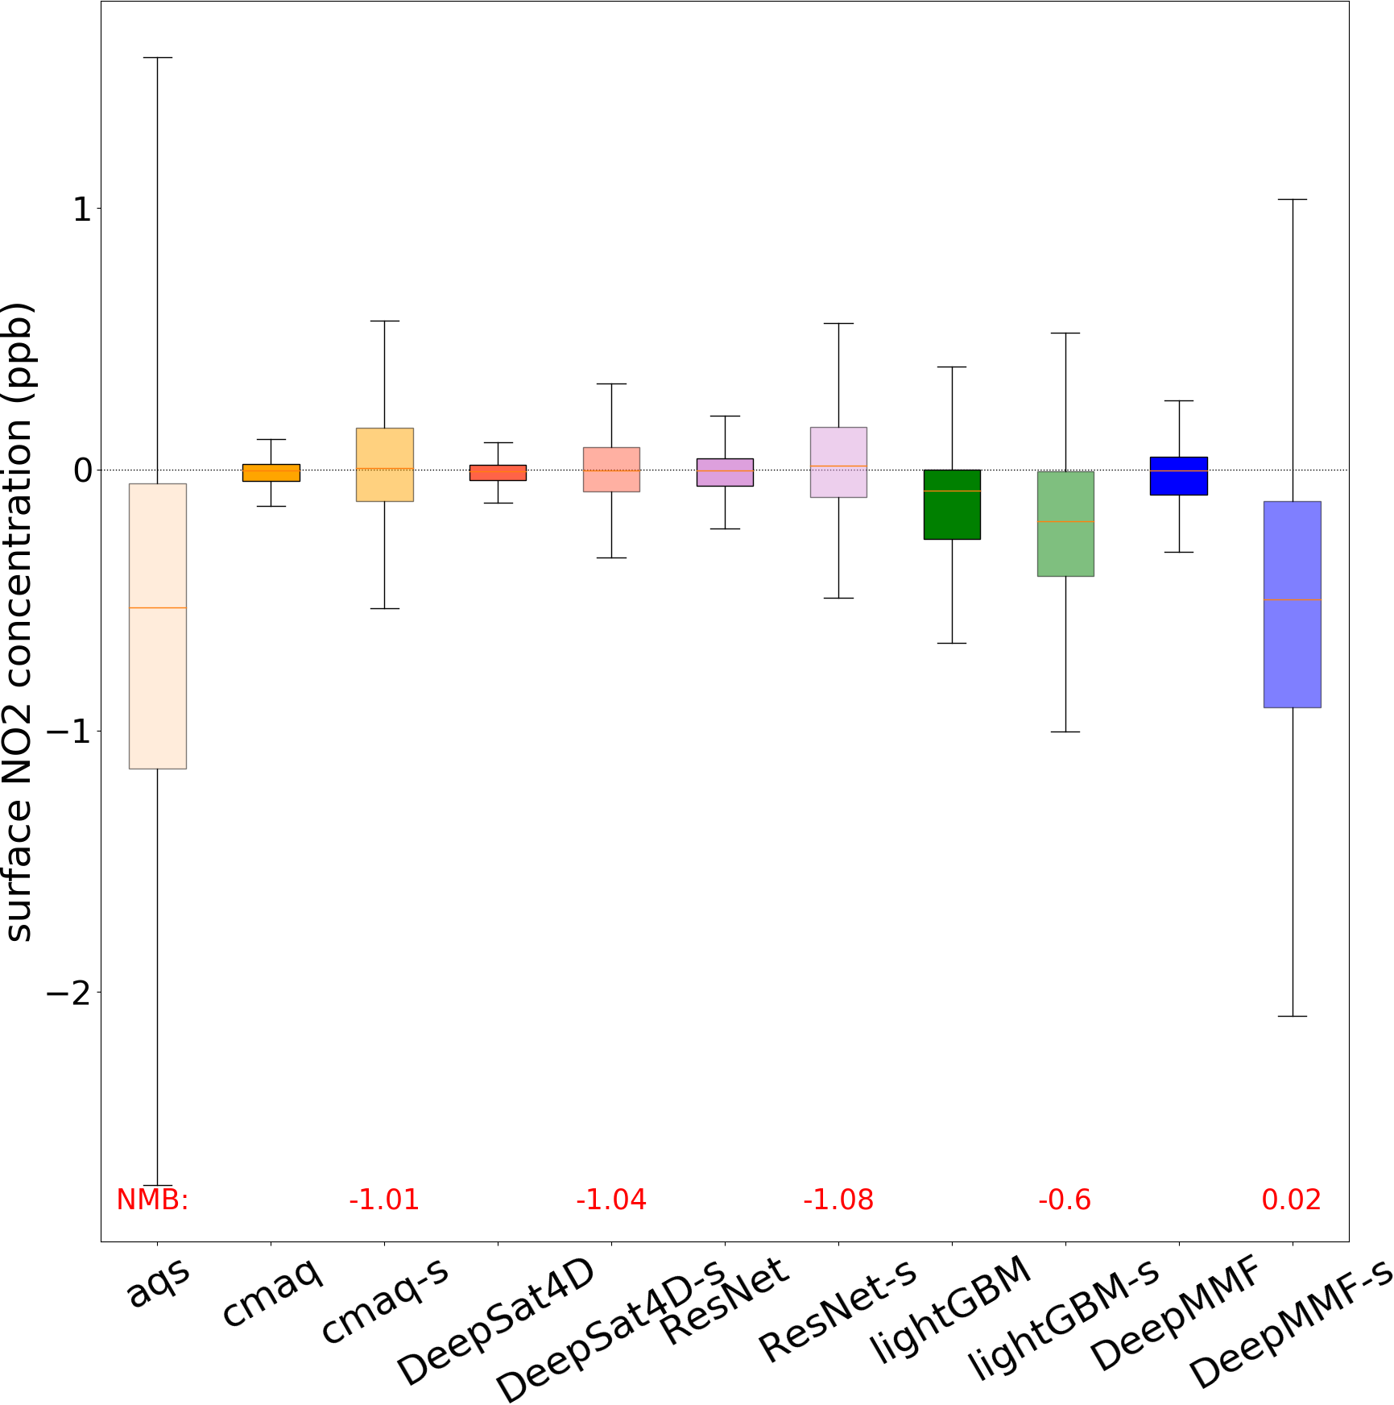
Comparison of fused concentration using different methods
Surface NO2 concentration in 2019
Change of NO2 concentration during 2019-2020
well reflect the changes in NO2
the model with “-s” represents that only selecting the grids that match with the AQS sites

Slide 17
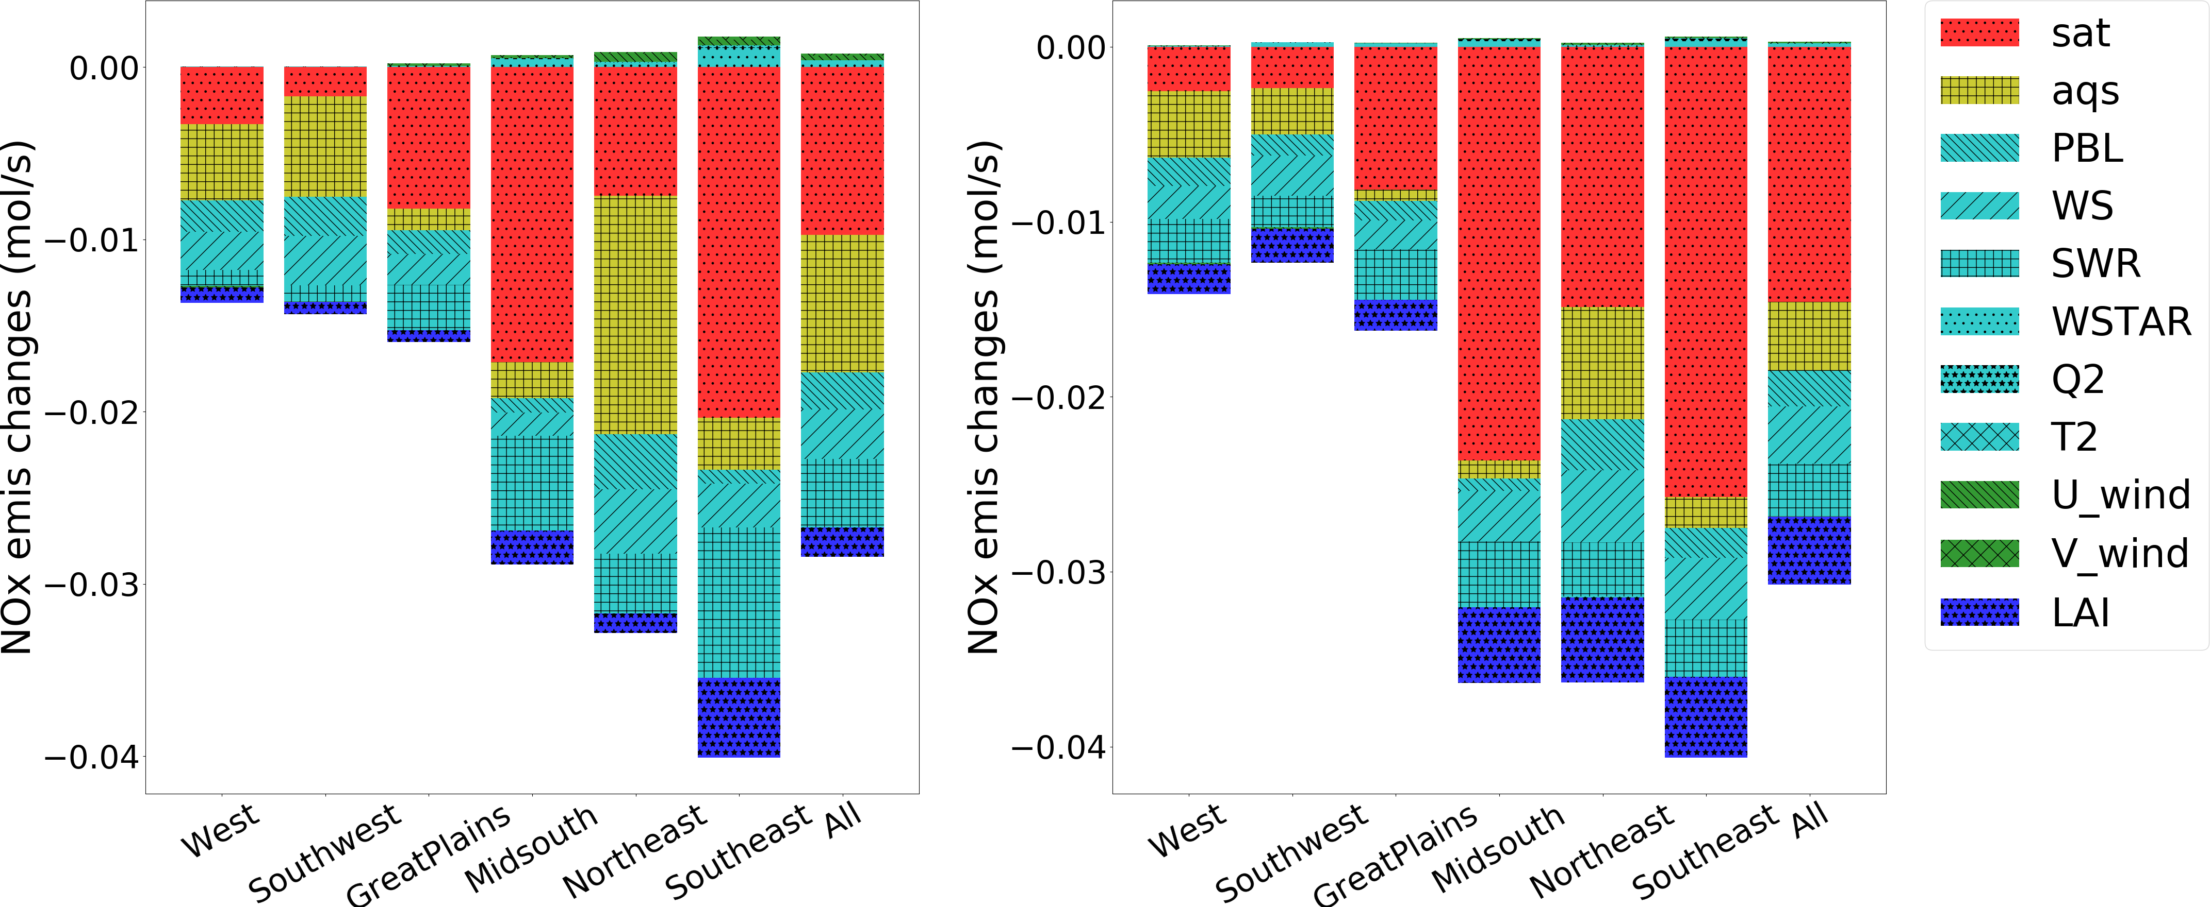
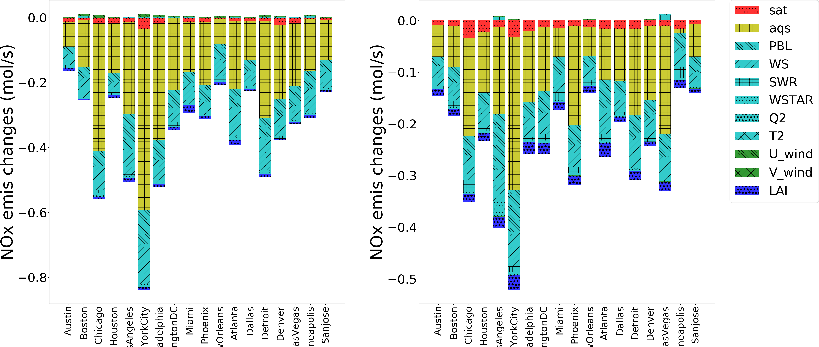
Sensitivity analysis for the importance in features (monthly average)
January
July
by reducing each input by 20% and taking the difference from the baseline
Region-level
(average of all grid cells within the region)
satellite observations play a more important role on a regional scale, while AQS is more important at city grid cells
City-level
(proximate to the city area to represent the urban environment)

Slide 18
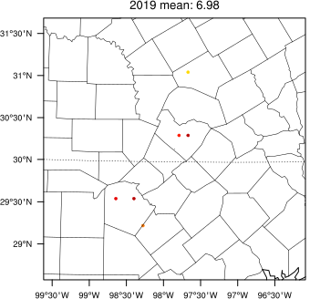
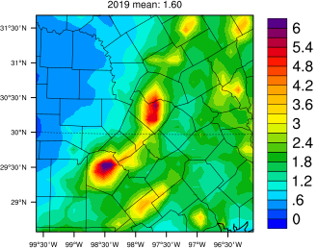
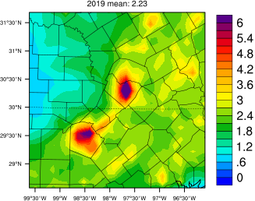
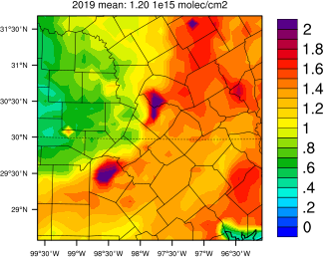
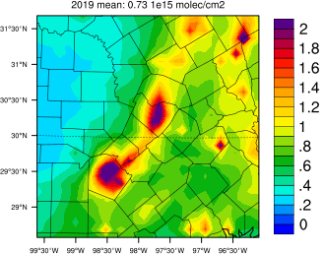
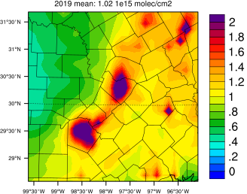
Zoom in city level
AQS
CMAQ
DeepMMF
Ground concentration
TROPOMI
CMAQ
DeepMMF
column density
ground measurement is limited even at urban scale
an example in Austin

Slide 19
Limitations and Future work
Sectoral level emission adjustment (wildfire, shipping, etc)
High temporal satellite like TEMPO
Extra-fine scale (1 km or higher) spatial resolution
For other species like PM2.5 and O3 for health studies

Slide 20
Thank you for your attention!

Slide 21
Correlation between the discrepancy in posterior and prior emissions and that in predicted concentrations in 2019 and 2020 retrievals
Stage1
Stage2
2019
the points was labeled by the weighting value
2020

Slide 22
State-level Comparison (unit: % of emission change)

