Slide 1


Integrating Fire Behavior Models and Chemical Transport Models: A case study of Coupling WRF-SFIRE with CMAQ
Zongrun Li, M. Talat Odman, Yongtao Hu,
Armistead G. Russell
School of Civil and Environmental Engineering,
Georgia Institute of Technology
A project funded by
Notes:
Integrate the fire behavior model and chemical transport model to build a model that can focus on prescribed fire air quality impact prediction. In this presentation, I will take WRF-SFIRE and CMAQ as a case. But I hope our method has generality and can be applied to integrate other fire behavior models with air quality models

Slide 2

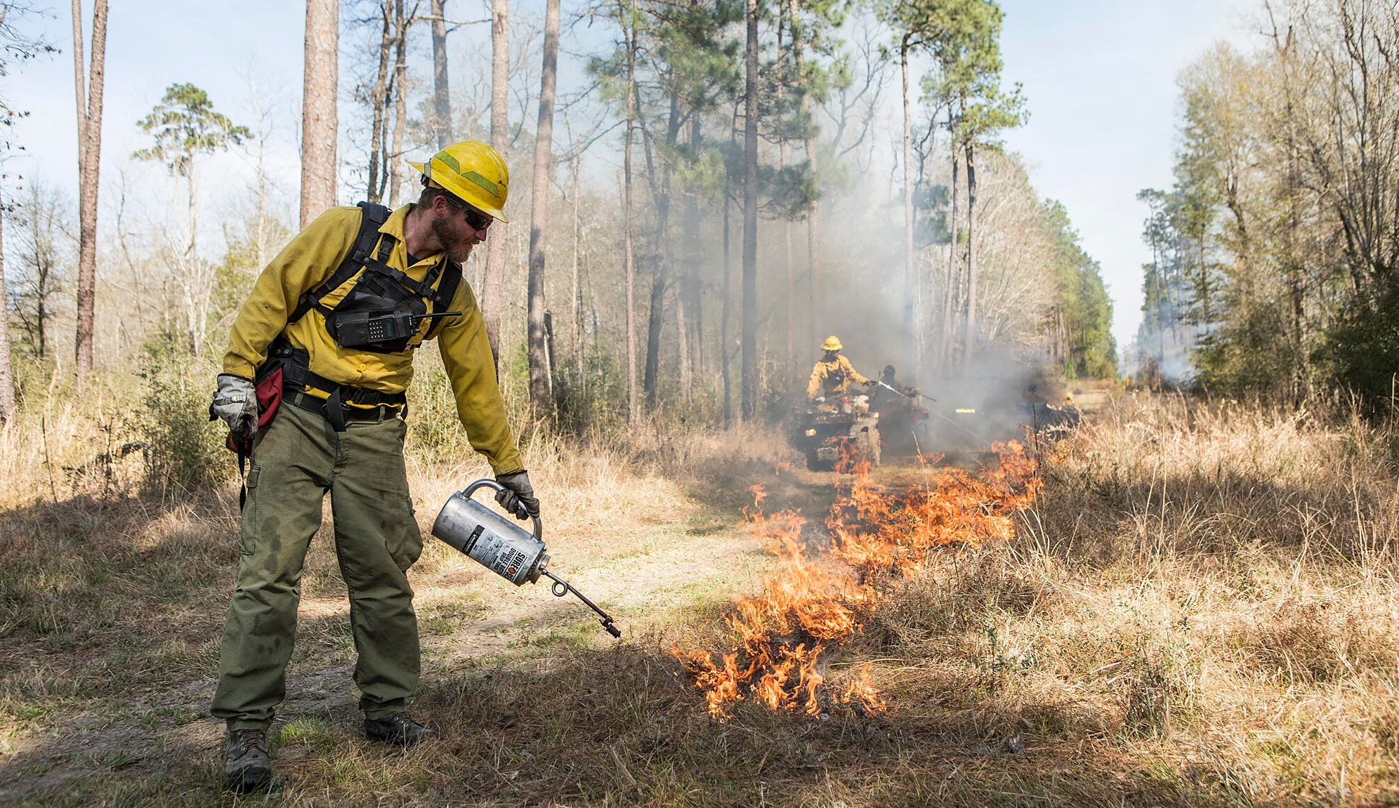
Background
Prescribed fires:
  Prevent wildfires
  Minimizes the spread of pest insects and diseases;
  Removes unwanted species that threaten species native to an ecosystem;
Why investigate?
  Improve PM_{2.5} prediction and modeling.
  Advise the fire management practices (how to minimize the air quality impacts)
Source: https://wildfiretoday.com/2021/11/06/congress-appropriates-3-3-billion-for-wildland-fire/
https://www.nature.org/en-us/about-us/where-we-work/united-states/texas/stories-in-texas/prescribed-fire-texas/
Notes:
Firstly, why do we focus on prescribed fires?
Wildland fire issues are important in the US.
Biden committed 500 million dollars for prescribed fire use over the next 10 years. The reason for spending a lot of money on prescribed fires because prescribed fires have many benefits.
Currently, there are some models to simulate prescribed burnings but the project is targeted to improve the modeling. We also want to integrate ignition patterns in the prescribed fire simulation tools.

Slide 3
Smoke Plumes in Models
Global CTMs:
GEOS-Chem (public version):
inject smoke into PBL.
Regional CTMs:
CMAQ (BlueSky):
  Briggs
  FEPS
  Sofiev (FRP)
WRF-Chem
  Freitas
Fire Behavior Models
WRF-SFIRE
  The fire propagates based on the Rothermel formula.
Wildland Fire Dynamics Simulator (WFDS)
  Physics-based model: particle model and boundary fuel model
  Level-set method model: Rothermel formula.
QUIC-FIRE
  Agent-based model: cellular automata
Fire Behavior Models
Plume rise models
QUIC-FIRE
WRF-SFIRE
WFDS (Physics-based)
Simple
Physics Complexity
Complex
Efficient
Computational Efficiency
Intensive
Notes:
The physics behind the fire is complex . There are mainly two types of approaches for smoke vertical structure and time profile estimations. One is based on simple assumptions or has simple physics, and one considers more processes.
WRF-SFIRE: Eulerian coupled fire-atmosphere model; considers atmosphere and fire interactions.
WFDS: Physics-based model: assuming vegetation as particles (particle model) or porous solid (boundary fuel model); computationally intensive
Level-set method model: similar to WRF-SFIRE; the fire front propagates based on the Rothermel formula.
QUIC-FIRE
Agent-based model: using cellular automata which regulates several rules on how the grid’s states will be evolved based on neighborhood states.
Computational efficiency and aimed at prescribed fire simulations.

Slide 4
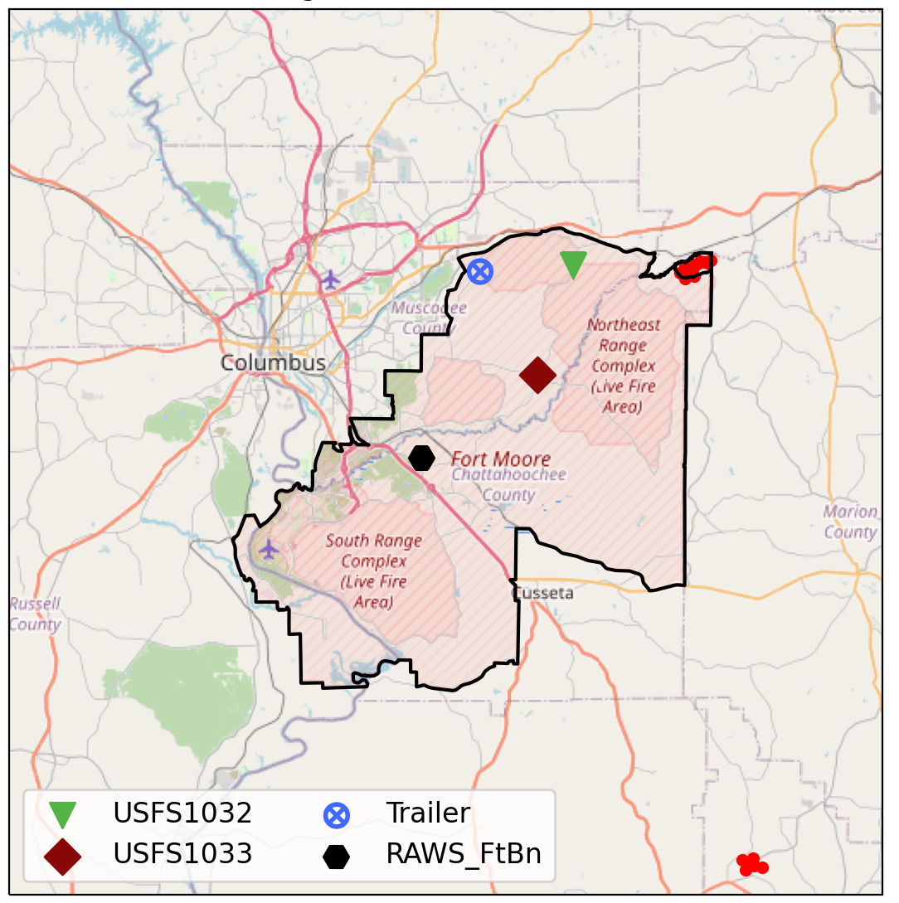
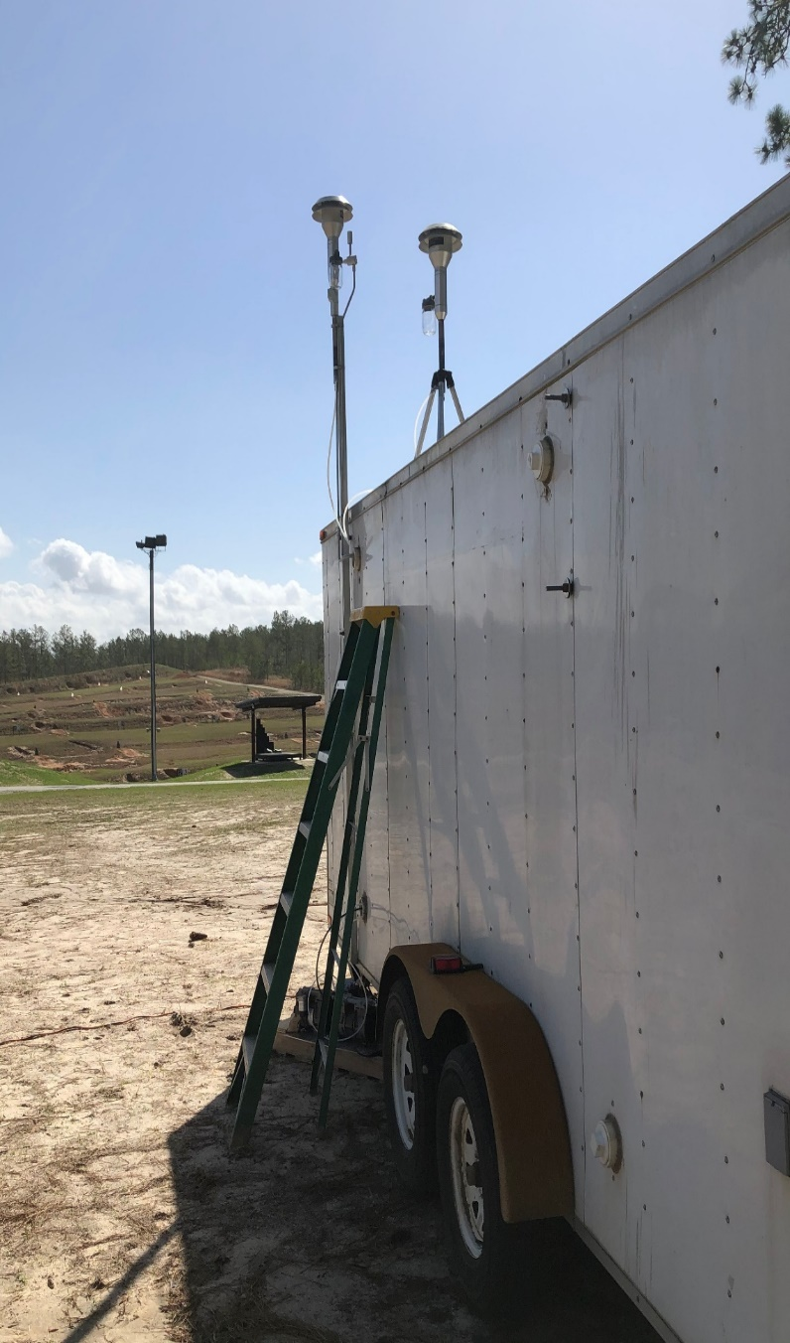
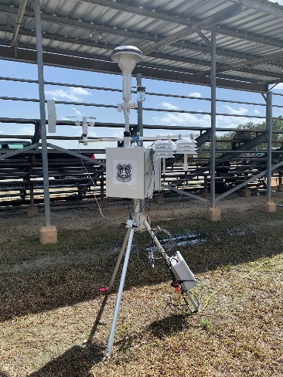
Method: Observations at Ft. Benning (GA)
Selected Burn Date: 2021-03-20
Deployed instruments: 1 Trailer and 2 E-BAMs
E-BAMs and Trailer measure PM_{2.5} mass
E-BAM
Averaged Wind Direction
Trailer
Notes:
To start discussing and evaluating our method for coupling WRF-SFIRE and CMAQ, I will use a case in Fort Benning.

Slide 5
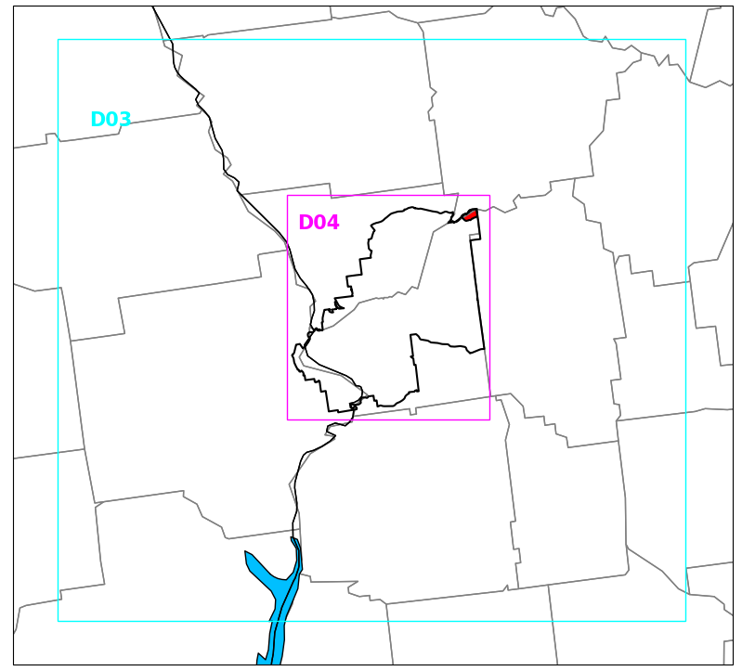
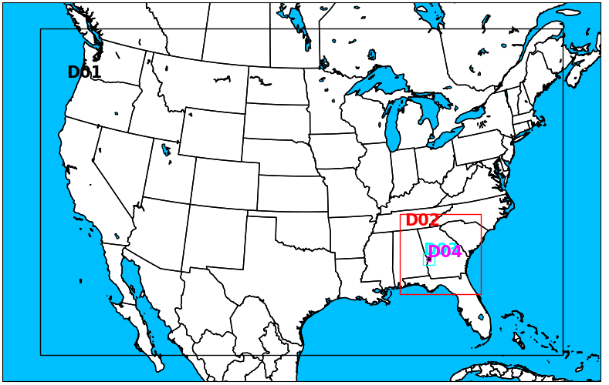
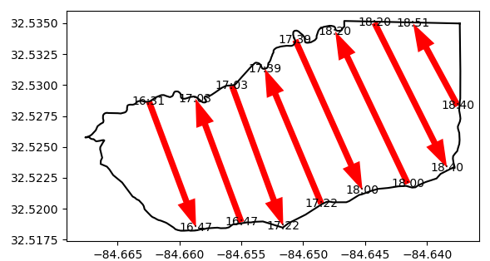
Model Setups
Resolution: 12km-4km-1km-200m
  WRF-SFire simulates fires in 200m domain
  CMAQ uses 1km meteorology.
Ignition pattern (drip torch):
  Ignition start time: from GOES-16
  Ignition speed: walk speed ~1.2m/s
Notes:
Fort Stewart

Slide 6
Coupling Fire Behavior Model with CTM
Methodology
Reduce Dimensions
WRF-SFIRE 3D smoke tracer field
2D plume heights in grid columns
Sampling
1D plume height in center of plume
Loss function
Optimization
CMAQ
Emission flux on coupling surface
Coupling surface
Regridding
Species Mapping

Slide 7
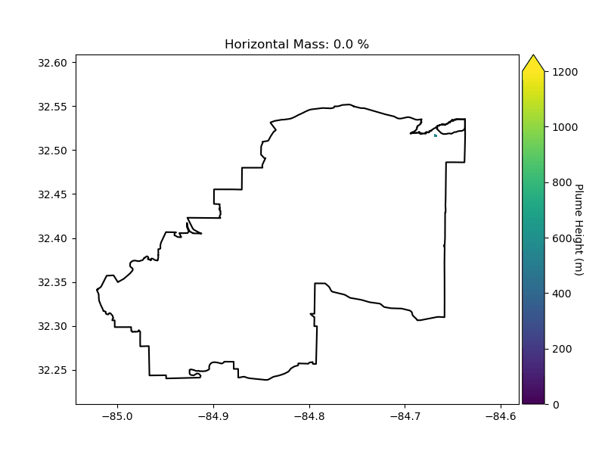
Plume Structure Simplification (3D to 2D)
Sort the horizontal grid cell by mass from high to low.
Start to include the grid cell with the highest mass until the total mass has reached a certain value (90% of total mass)
Plume height
Plume height
90% mass of total column
Notes:
We define plume height as the altitude at which 90% of the total mass within the vertical column is contained.

Slide 8
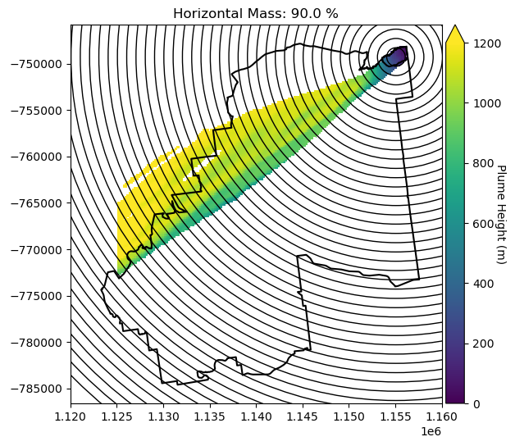
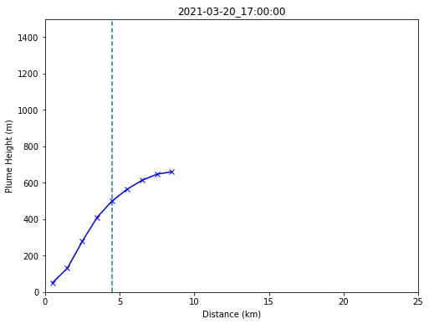
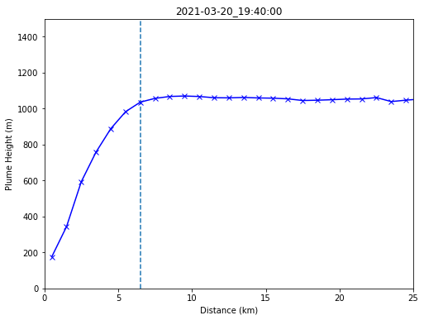
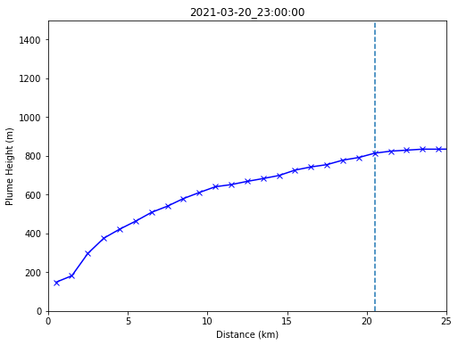
Plume Structure Simplification (2D to 1D)
Sampling method:
Start from the centroid of the burn unit
Calculate mean values of reduced plume height in each sampling ring (1km intervals)
Beginning of Fire
Fire Spread
End of Fire
Plume Height (m)
Distance (km)
Notes:
gentle slope

Slide 9
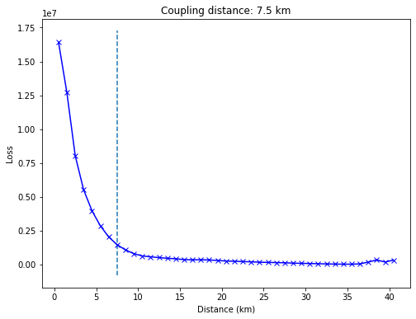
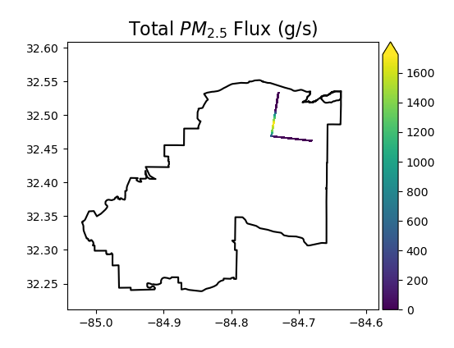
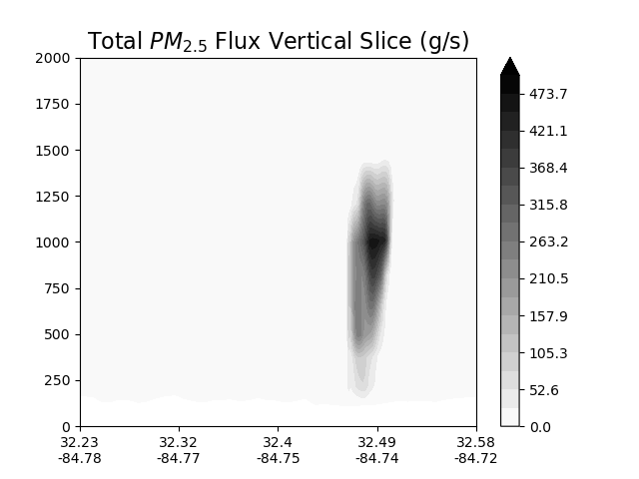
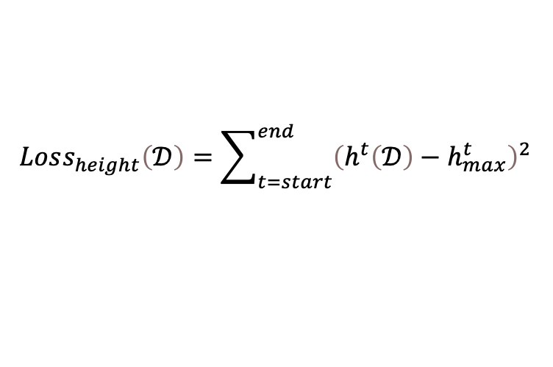
Coupling Surface and Emission Flux
$$Loss_{height}\left(𝒟\right)=\sum_{t=start}^{end}{{\left(h^{t}\left(𝒟\right)−h_{max}^{t}\right)}^{2}}$$
If we truncate at distance D, how much of plume height do we lose compared to the max. height?
The “elbow”: trade-off between the coupling distance to the source and coupling plume height accuracy

Slide 10
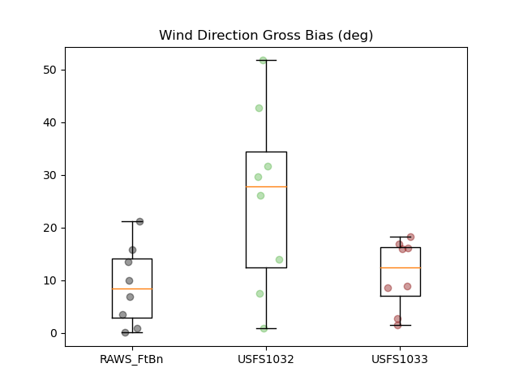
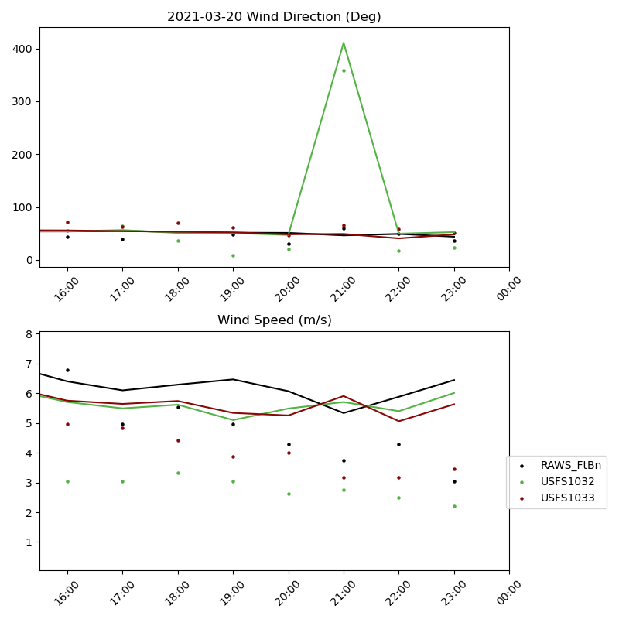
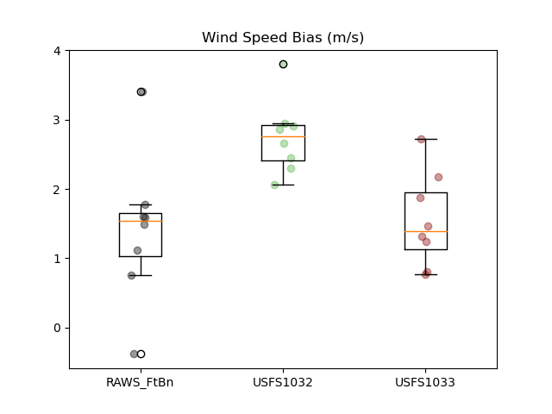
Results: Meteorological Modeling with WRF
Wind Bias (burning times from GOES-16) = WRF – OBS (16:00-23:00 UTC)
Bias = WRF-OBS
Notes:
We evaluate the meteorological simulation performance. The wind bias is relatively low at Remote Automated Weather Station and E-BAM 1033

Slide 11
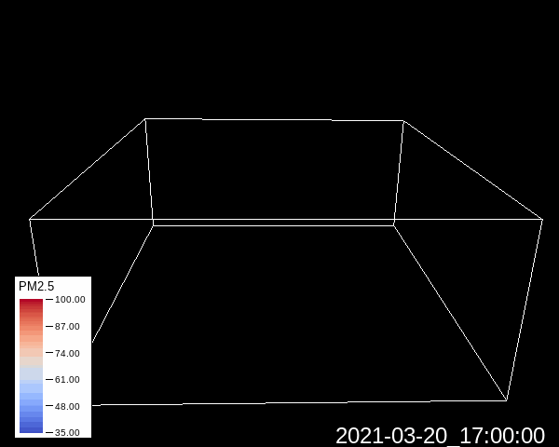
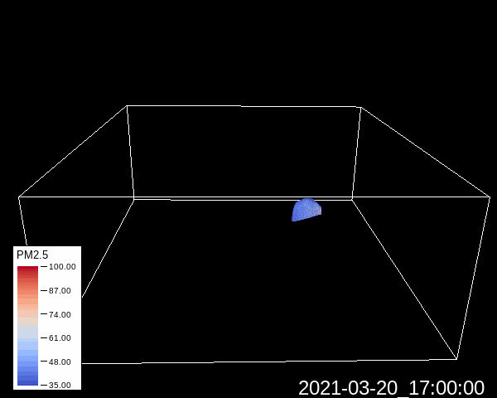
3D Structure of PM_{2.5}
WRF-SFIRE CMAQ
PM_{2.5} TOT (μg/m³)
WRF-SFIRE
PM_{2.5} tracer (μg/m³)
Notes:
We visualize the 3D structure of PM2.5 by Vapor software. As we can see, these two method shows similar pattern after the coupling surface. It indicates that we successfully extracted the WRF-SFIRE information and put it into CMAQ.

Slide 12
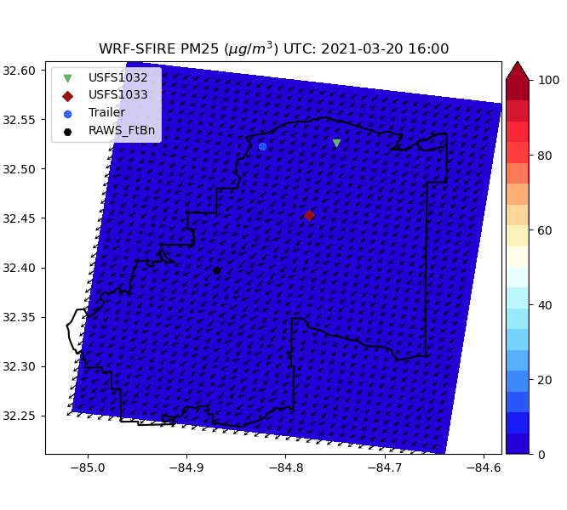
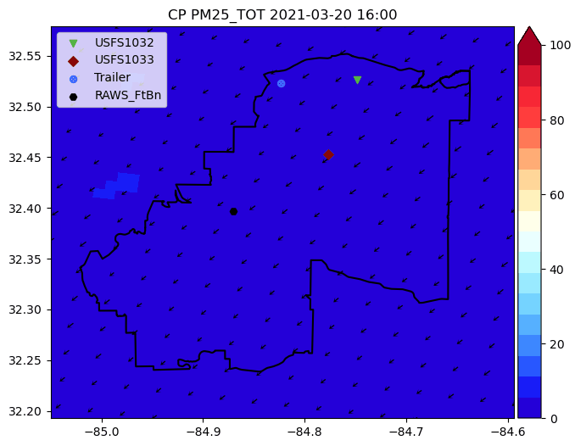
Ground Concentration Comparison

Slide 13
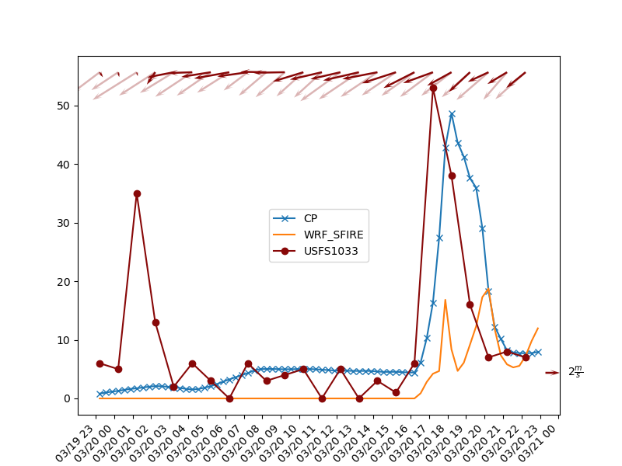
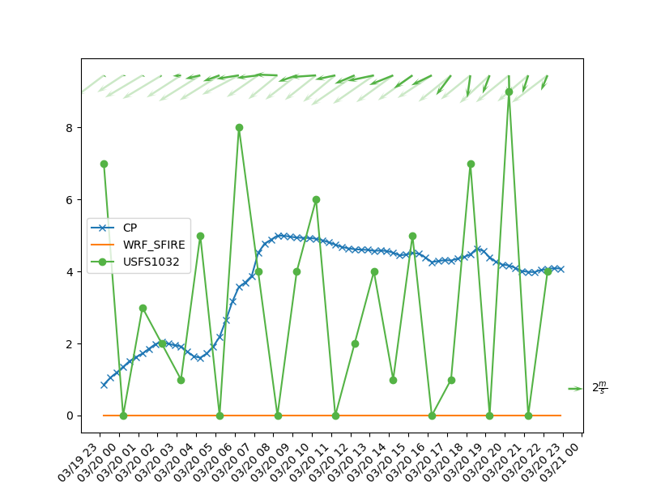
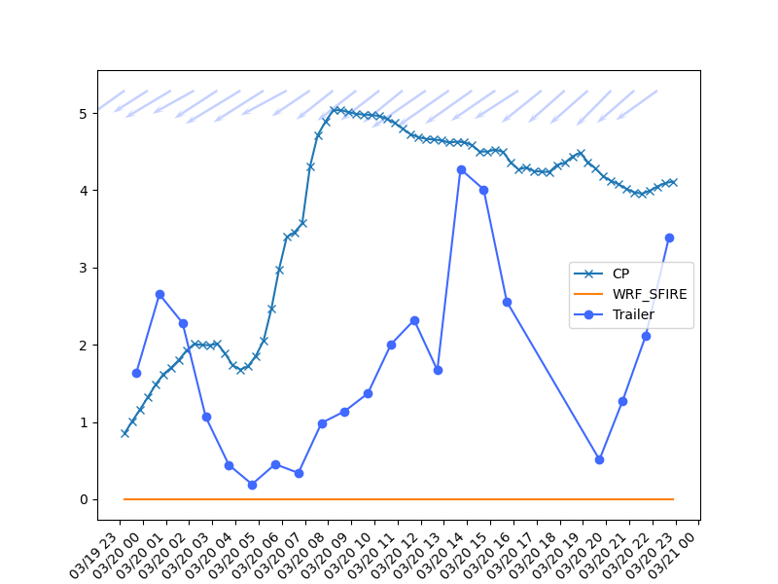
Results: Comparisons with Measurements
Downwind
Upwind
Upwind

Slide 14
Conclusion & Future Work
The coupling method shows a promising performance in the case we have evaluated.
Include the BlueSky framework to improve emission estimations.
Investigate differences between WRF-SFIRE and coupled WRF-SFIRE-CMAQ (resolutions, chemistry, etc.). Consider WRF-SFIRE-Chem.
Construct the concentration fields between the centroid of burn units and the coupling surface (box model).
Couple other fire behavior models by using the method we presented (e.g., QUIC-FIRE)
Notes:
Does the chemistry play an important role?
Couples other fire behavior model by using the method we presented (QUIC-FIRE)

Slide 15
Thanks for Listening!
Notes:
Thanks for listening.

Slide 16
Supplementary Materials
Species Mapping
CMAQ AERO7 | WRF-SFIRE | CMAQ AERO7 | WRF-SFIRE
PMC | 0.248 PM_{2.5} | PNA | 0.00135 PM_{2.5}
PAL | 4.6e-4 PM_{2.5} | PNCOM | 0.3513 PM_{2.5}
PCA | 7.2e-4 PM_{2.5} | PNH4 | 0.0034 PM_{2.5}
PCL | 0.0024 PM_{2.5} | PNO3 | 0.011 PM_{2.5}
PEC | 0.1093 PM_{2.5} | POC | 0.5019 PM_{2.5}
PFE | 4.45e-4 PM_{2.5} | PSI | 1e-4 PM_{2.5}
PK | 0.00135 PM_{2.5} | PSO4 | 0.0033 PM_{2.5}
PMN | 1.1e-4 PM_{2.5} | PTI | 6.7e-4 PM_{2.5}
PMOTHR | 0.0125 PM_{2.5}
Notes:
AERO6

Slide 17
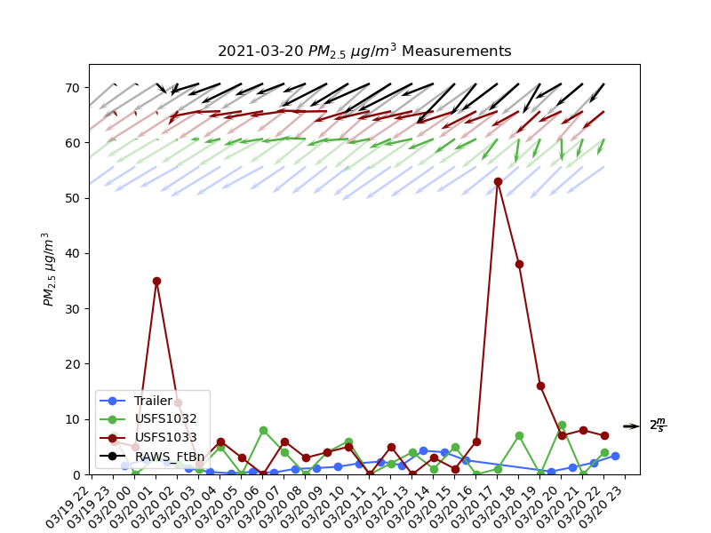
Measurements

Slide 18
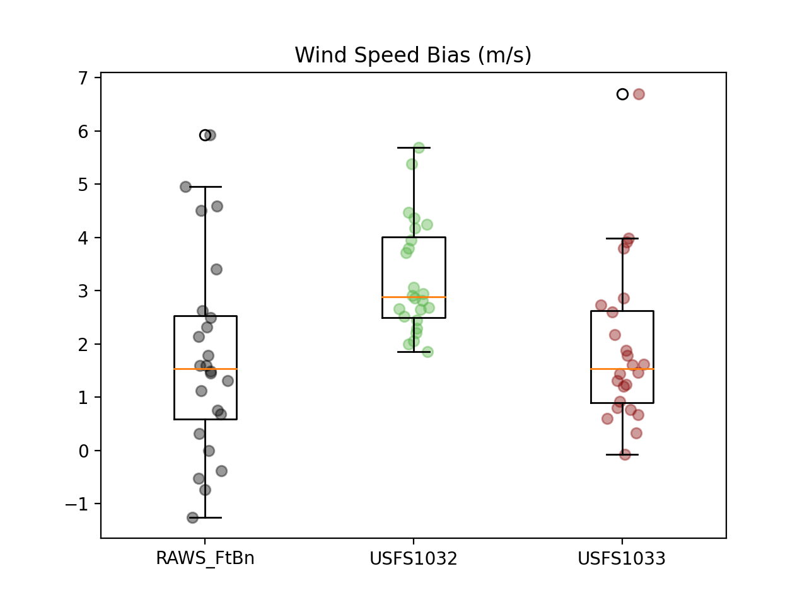
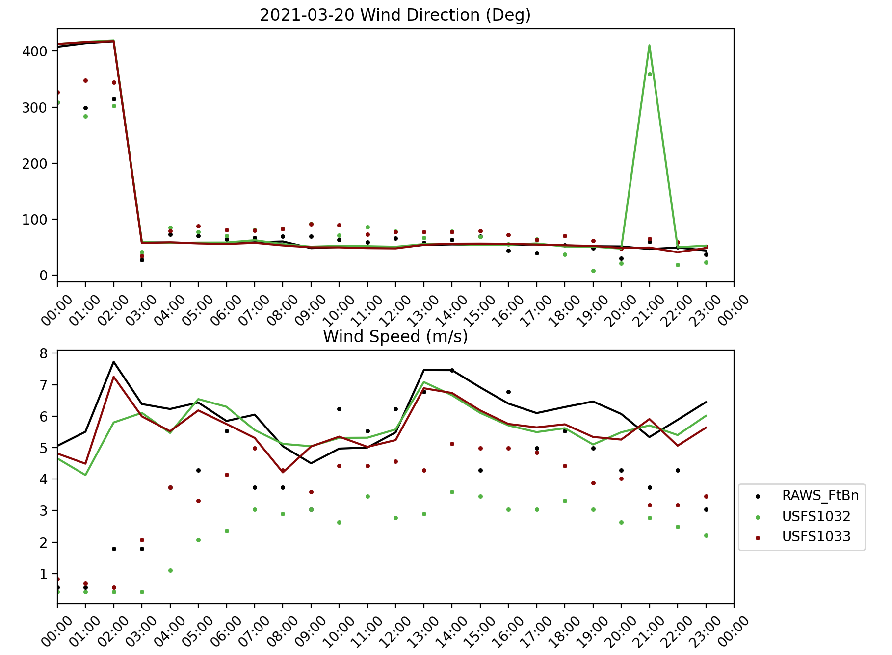
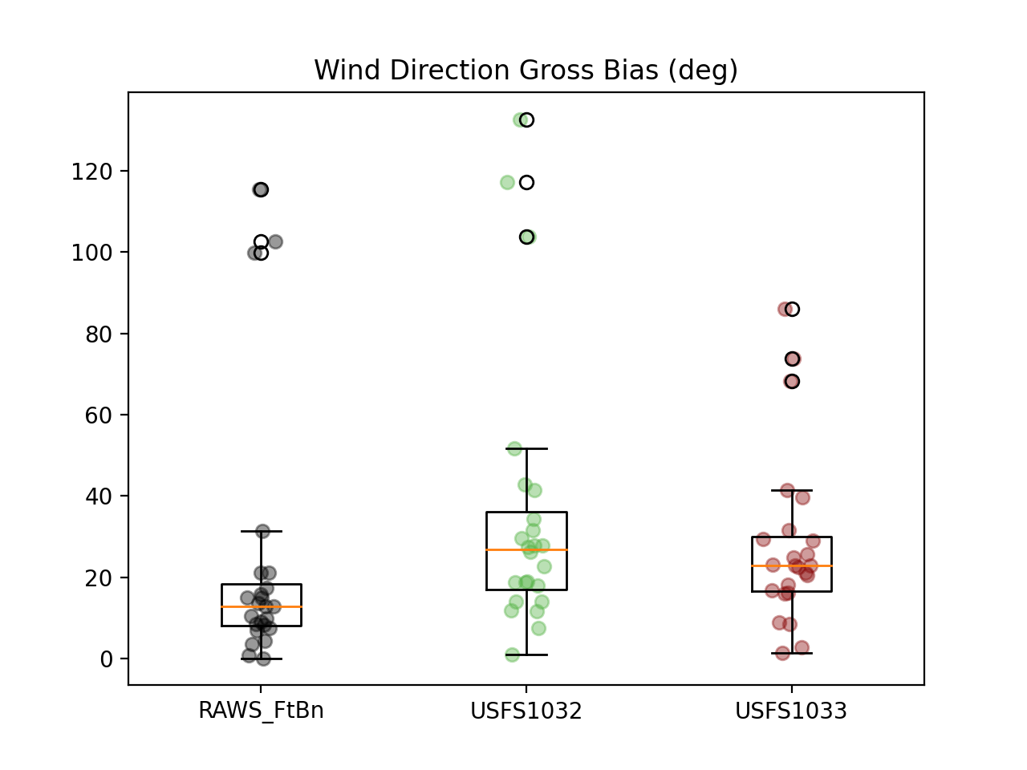
Wind Evaluation

Slide 19
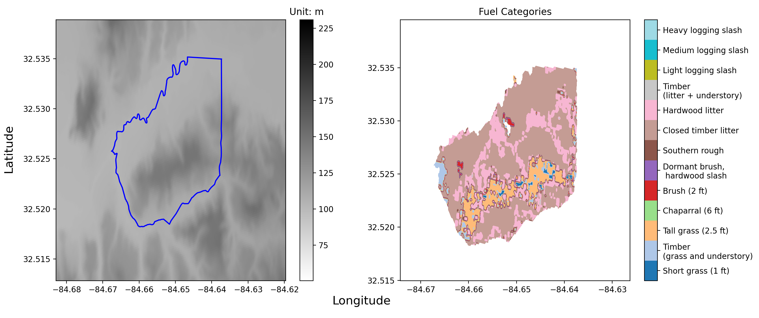
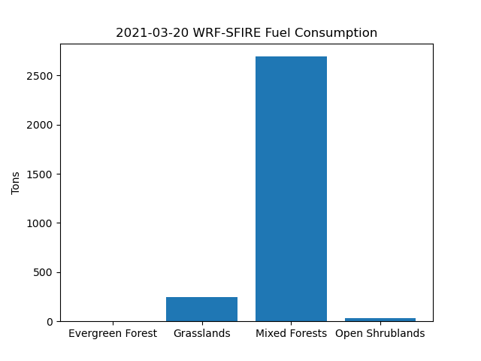
Emissions & Consumption

Slide 20
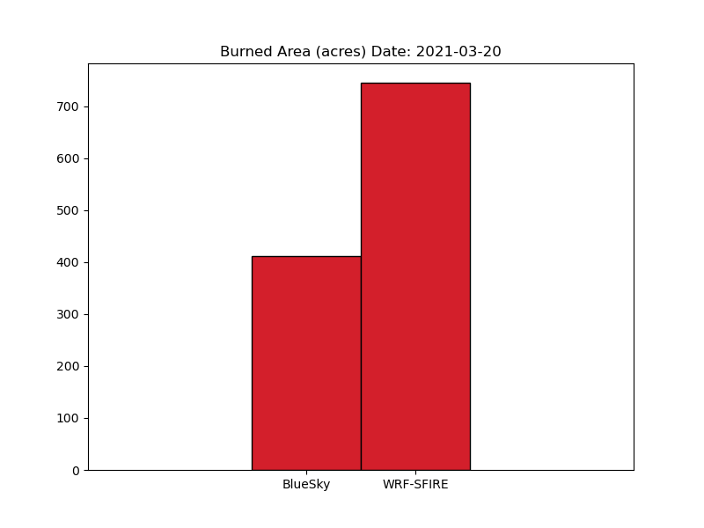
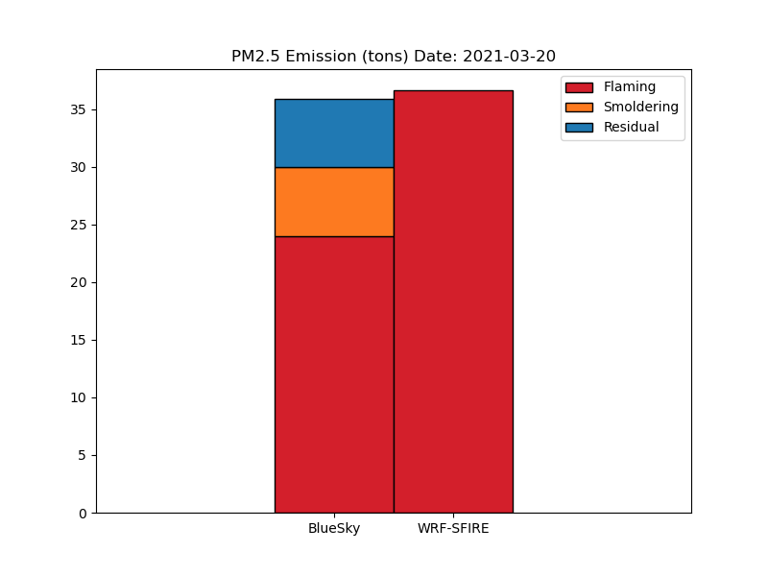
Comparisons with BlueSky Emissions
BlueSky burned area is exactly based on ground records.
WRF-SFIRE burned more than the records, but the emissions are comparable with the BlueSky

Slide 21
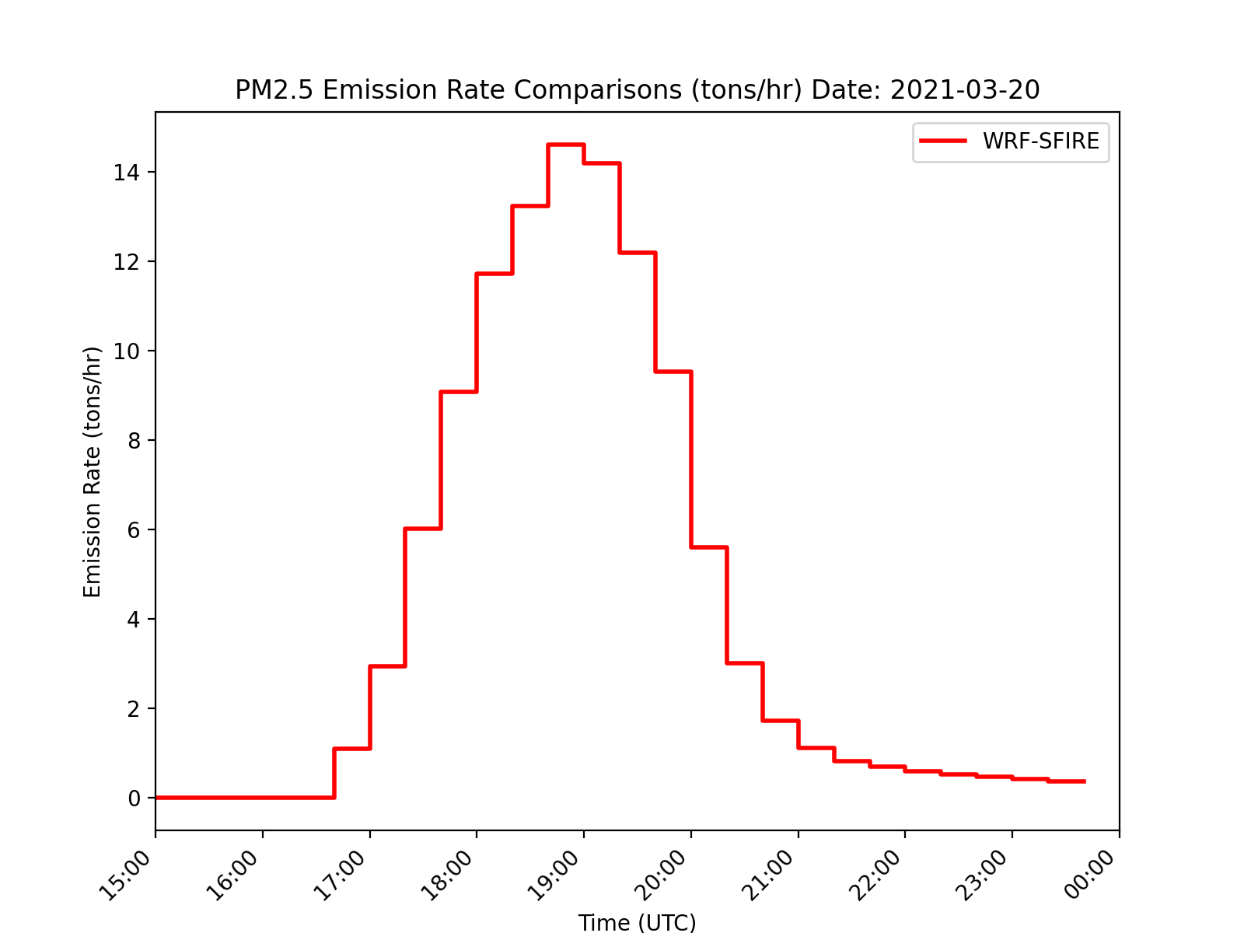
Emissions
Total Burned Area (acres) | 745.20
Total PM2.5 Emissions (tons) | 36.64

