Slide 1
Evaluating the Ability of Statistical and Photochemical Models to Capture the Impacts of Biomass Burning Smoke on Urban Air Quality in Texas
Matt Alvarado, Jennifer Hegarty,
Chase Calkins, John Henderson,
and Richard Pernak
Atmospheric and Environmental Research Lexington, MA
October 17, 2023

Slide 2
Acknowledgements
This research presentation was supported by funding from the Texas Commission on Environmental Quality (TCEQ). The findings, opinions, or conclusions expressed do not necessarily represent those of the TCEQ.
Disclaimer: The information contained in this report or deliverable has not been evaluated by EPA for this specific application.

Slide 3
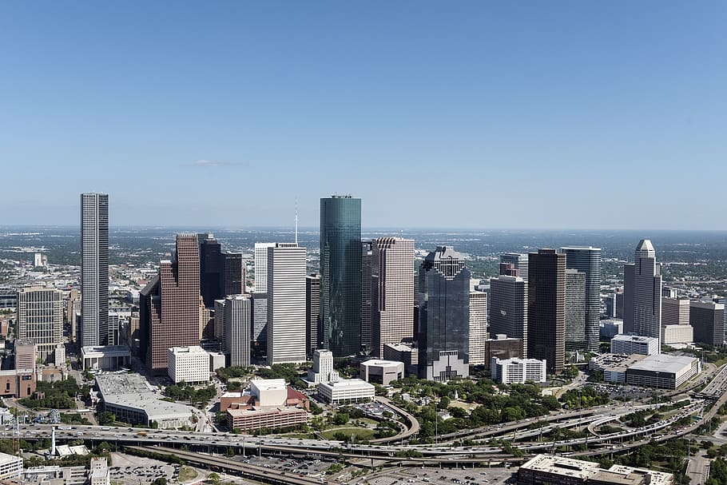
Three Chemical Stages of Smoke Ozone (O₃) Formation
Mixing with Urban Air
Near-Source Chemistry
(0-6 hr)
Long-range Transport
(6-48 hr)
Rapid O₃ formation
Depletion of initial NO_{x} and HRVOCs
Net O₃ formation settles to ~ 0.2 dO₃/dCO
Mixing of smoke organics with fresh NO_{x} from the fires can increase urban O₃ formation
Alvarado et al., Smoke Chemistry, in Peterson, D. L., McCaffrey, S. M., & Patel-Weynand, T. (2022). Wildland Fire Smoke in the United States: A Scientific Assessment (p. 341). Springer Nature.

Slide 4
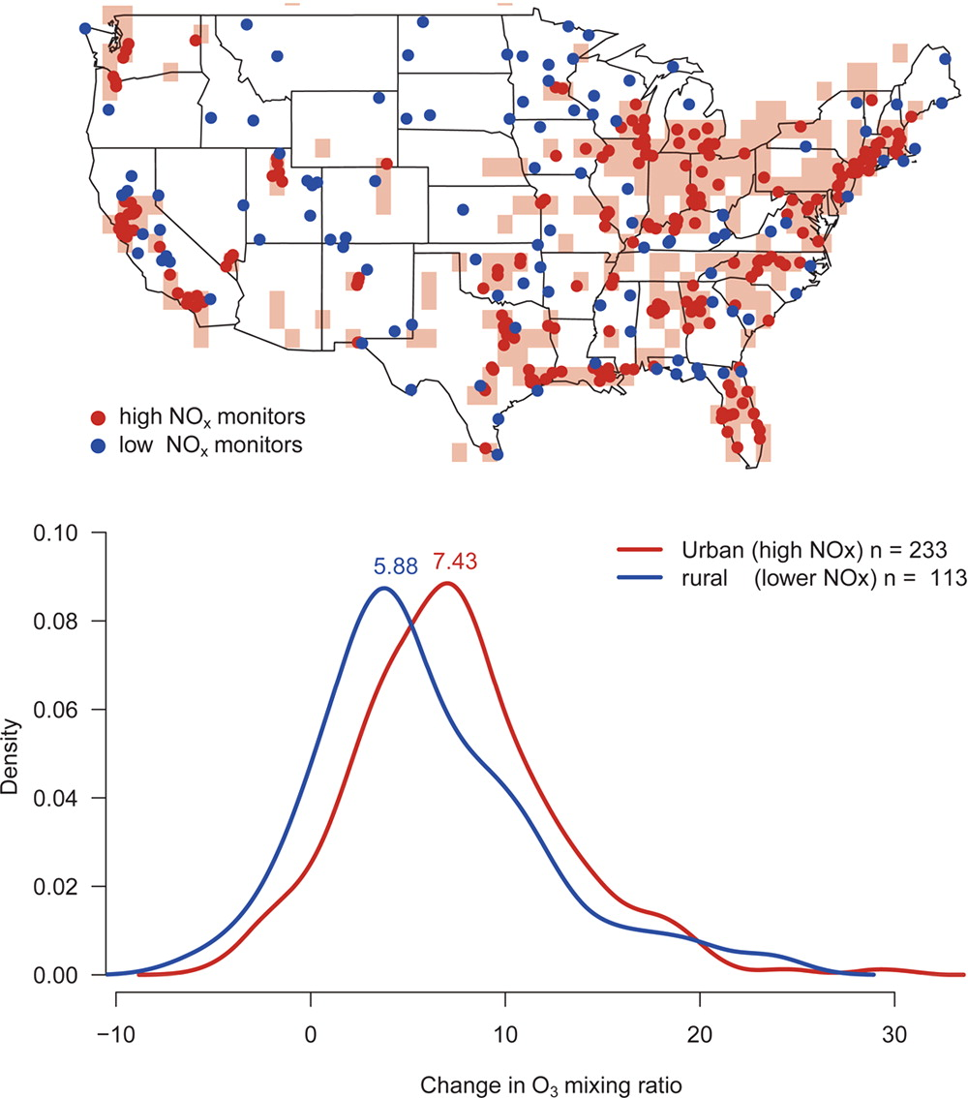
Estimates of the increase in O₃ when smoke mixes with urban emissions (Brey and Fischer, ES&T) 2016

Slide 5
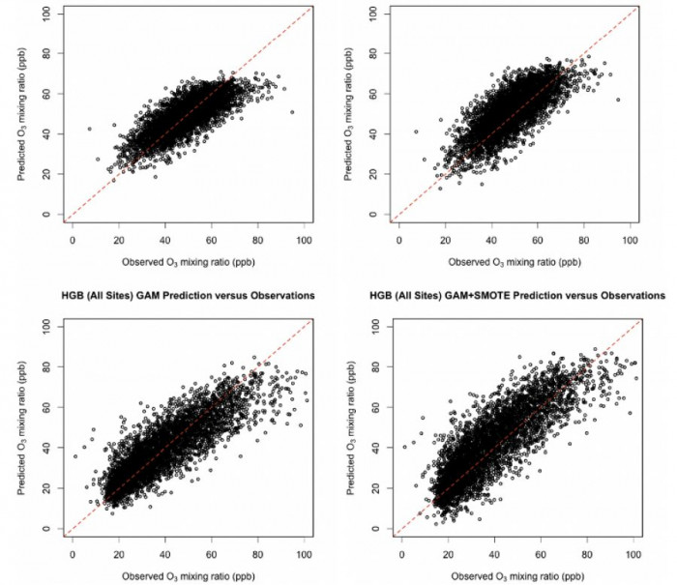
Our Previous Statistical Studies of O₃ Formation in Texas
Original
With Synthetic Data
El Paso
Houston
Austin-Round Rock
Smooth Functions
R² 0.76, Std. Dev. 6.6 ppbv
Pernak et al., AAQR, 2019.
https://doi.org/10.4209/aaqr.2018.12.0464
Brown-Steiner et al., AAQR, 2021. https://doi.org/10.4209/aaqr.210077

Slide 6
Objectives
Use generalized additive models (GAMs) driven with satellite and surface observations to examine the impact of fires on background and total O₃ and PM_{2.5} in two Texas urban areas (Houston and El Paso).
Examine the ability of CAMx photochemical model to simulate these fire impacts by applying similar statistical methods to the CAMx results.

Slide 7
Generalized Additive Models
GAMs are extensions of multiple linear regression models that fit unknown non-linear functions of predictors
In this study, all meteorological and fire predictors (except HMS smoke flag) were simulated as smooth functions using cubic spline basis set, with periodic splines used to account for the effects of the day of year and HYSPLIT bearing.
Year, day of week, and the HMS smoke flag were included as factor variables.
The models predict the natural logarithm of MDA8 O₃

Slide 8
Air Quality and CAMx Data
Surface air quality data from Texas Air Monitoring Information System (TAMIS)
Sites separated into background (for sites on the outskirts of the city) and urban (for sites near the city core)
Background: Minimum MDA8 O₃ from background sites
Maximum: Maximum concentrations in each city (including background sites)
TCEQ generated CAMx output for the Houston (4 km horizontal resolution) and El Paso (12 km resolution) for the year 2019
MDA8 O₃ values calculated based on the CAMx grid box
New CAMx-based values for the maximum MDA8 O₃ and background MDA8 O₃ value were calculated using the same methods used for the ambient data.

Slide 9
Meteorological Predictors (Pernak et al., 2019)
Afternoon mean temperature (ºC, afternoon_mean_T, 1-4 PM CST)
Diurnal temperature change (ºC, diurnal_T)
Daily average wind speed (m/s, daily_ws)
Daily average wind direction (degrees clockwise from North, daily_wd)
Daily average water vapor density (g/m³, SWVP)
Morning surface temperature difference (1200 UTC) (temperature at 925 or 700 mb–temperature at surface at 1200 UTC) (ºC, T_dif_925mb or T_dif_700mb)
Transport direction (degrees clockwise from North, HYSPLIT_Bearing)
Transport distance (m, HYSPLIT_dist)
Variables 1-5 were calculated from the surface meteorological data in the Texas Air Monitoring Information System (TAMIS).
Variable 6 was calculated from the the Integrated Global Radiosonde Archive (IGRA Version 2).
Variables 7 and 8 were calculated from 24-hour HYSPLIT back-trajectories (300 m AGL, start at local solar noon) driven with 12 km NAM data.

Slide 10
NOAA HMS Smoke Flag
The smoke flag files were generated from NOAA Hazard Mapping System (HMS) smoke polygons for 2012 – 2021 that were converted to the GOES CONUS grid for colocation with the urban area.

Slide 11
FINN Fire Counts and Emissions
Large-scale
Used Fire Inventory from NCAR (FINN v2.5, Wiedinmyer et al., 2011, McDonald-Buller et al., 2015, 1 km resolution)
Determined fire counts within different distances from the city center (0.5, 1.0, 2.5, 5.0, 10.0, and 25.0 degrees (lat/lon) from the city).
Geographic
Sum fire counts, area, biomass burned, and species emissions for Mexico (MEX), Yucatan (YUCATAN), states bordering Texas (NM, AR, OK, LA) and California (CA)

Slide 12
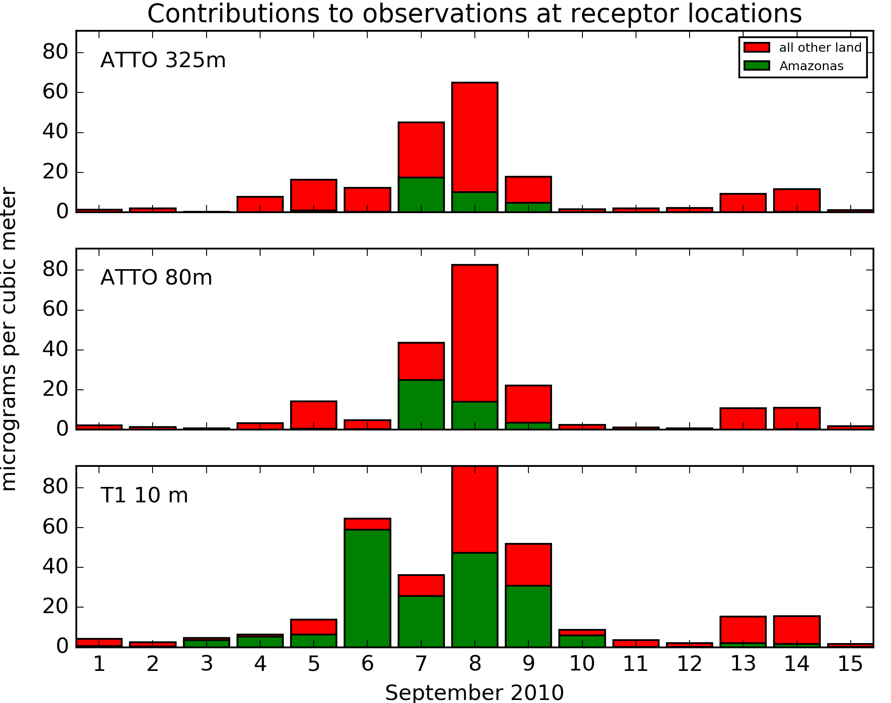
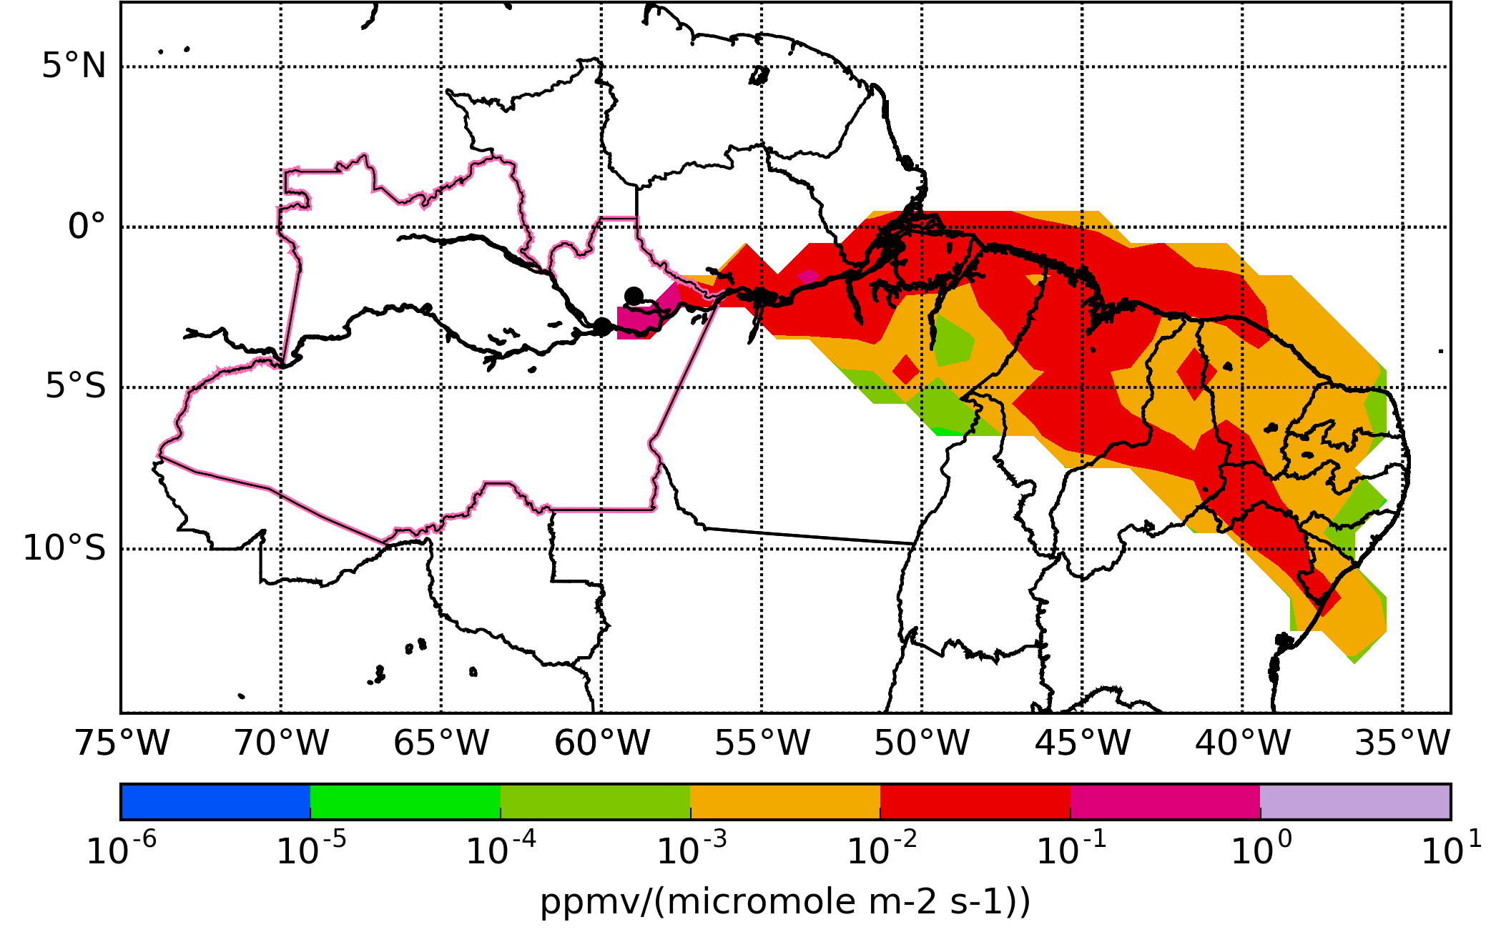
WRF-STILT Footprints
WRF-STILT traces 500 stochastic particle back-trajectories to determine the sensitivity of observed concentrations to emissions upwind (i.e., the footprint, left).
Convolved 3-day WRF-STILT footprints with 0.1x0.1 degree FINN v2.5 fire emissions for NO, NO₂, CO, and CO₂ to get estimates of fire emissions impact.
Results were very similar regardless of species, so focused on NO.
Accumulated “footprint” estimating impact of fire emissions on PM_{2.5} concentrations at Manaus.
Modeled fire PM_{2.5} levels at different locations and heights in Manaus in Sept. 2010. Green is from fires in Amazonas, red from all other fires.

Slide 13
Objective 1: Impact of fires on urban AQ in Texas

Slide 14
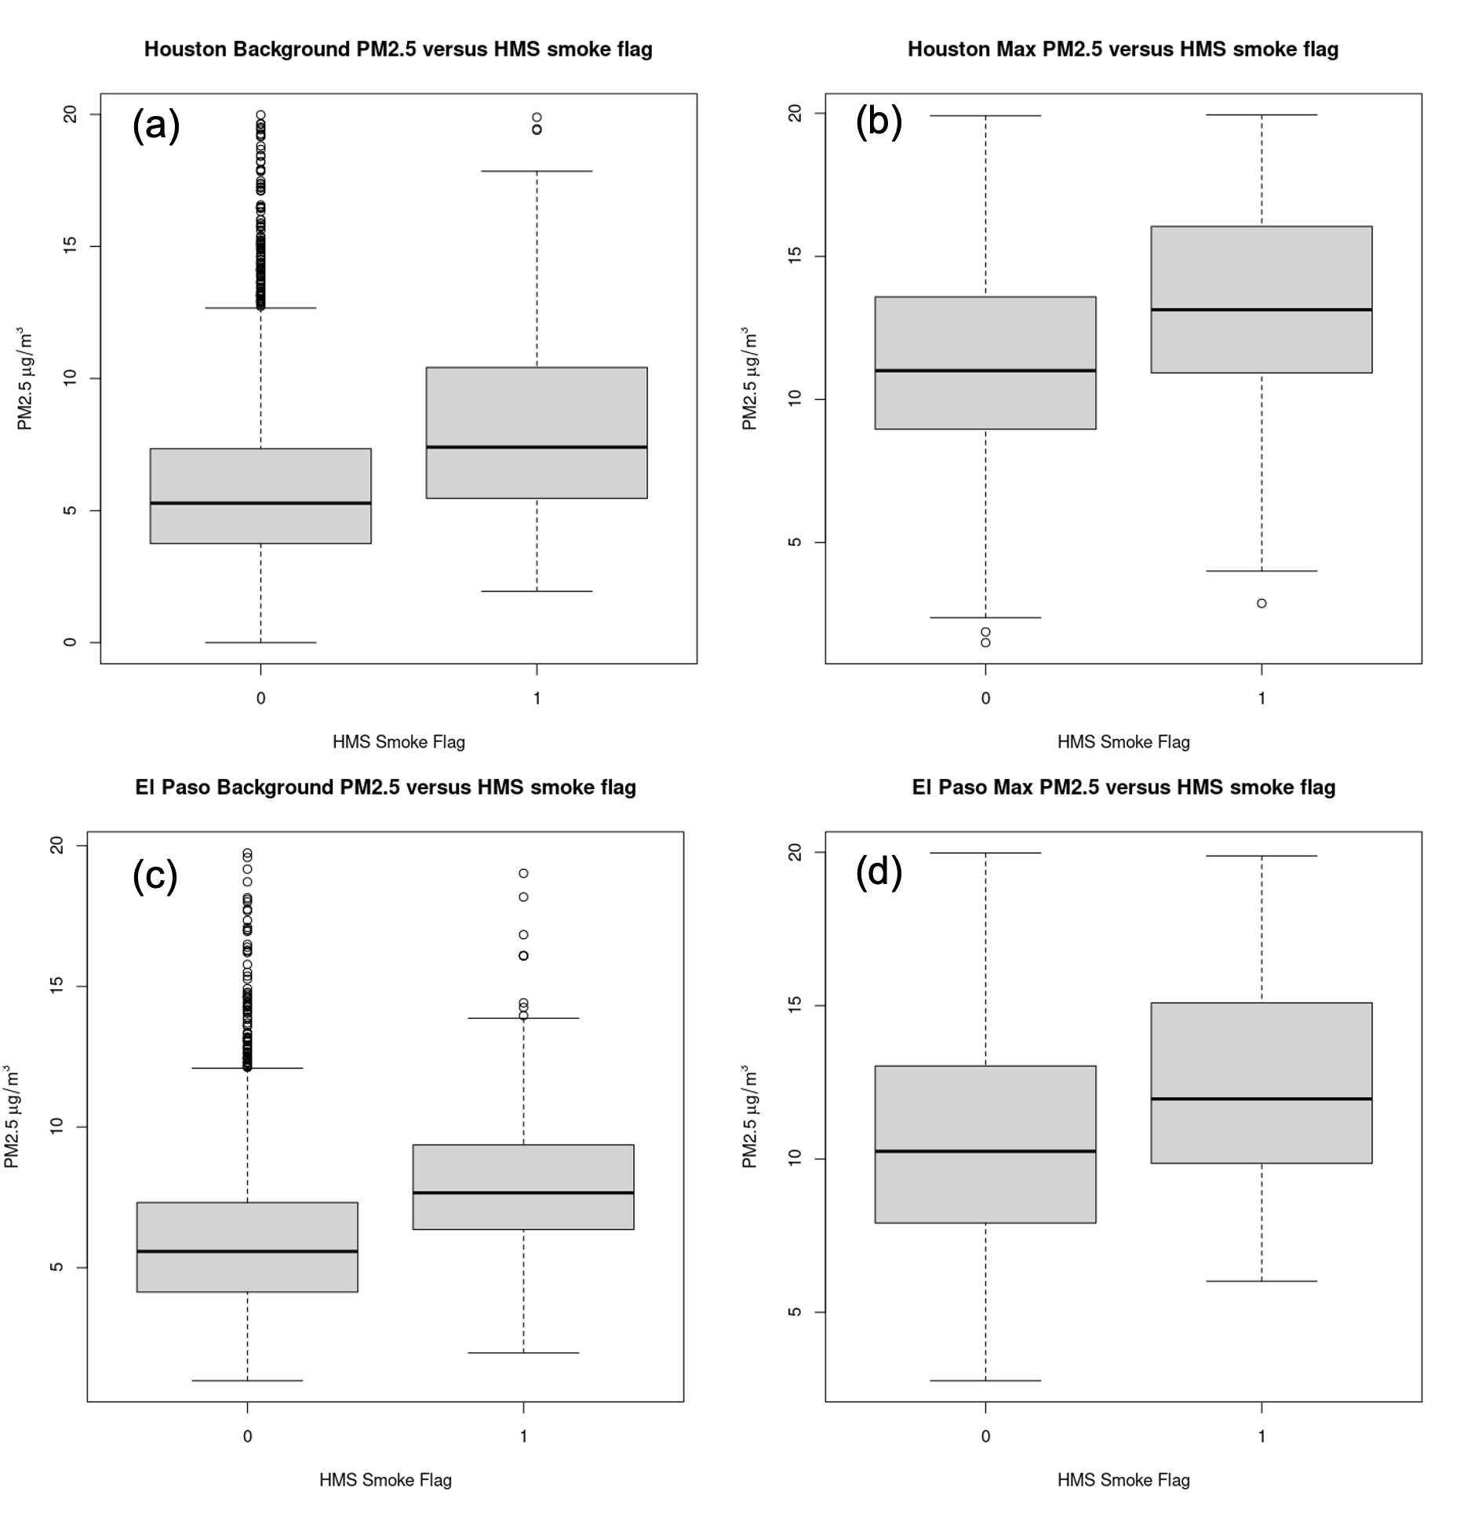
Smoke Flag Tests: Daily Average PM_{2.5} Impacts
Background
Maximum
Houston
Houston PM_{2.5} Background: 1.9-2.6 µg/m³
Houston PM_{2.5} Max: 1.5-2.3 µg/m³
El Paso PM_{2.5} Background: 1.7-2.5 µg/m³
El Paso PM_{2.5} Max: 1.5-2.6 µg/m³
El Paso

Slide 15
FINN Large-Scale Fire Count Tests: Max O₃ Fits
 | Houston Max MDA8 O₃ |  |  | El Paso Max MDA8 O₃
 | Dev. Exp. (%) | GCV | p | Dev. Exp. (%) | GCV | p
0.5 degrees | 67.5 | 83.019 | <0.001 | 53.9 | 46.927 | 0.75
1.0 degrees | 67.7 | 82.492 | <0.001 | 53.9 | 46.899 | 0.21
2.5 degrees | 68.4 | 80.655 | <0.001 | 54.1 | 46.741 | <0.01
5.0 degrees | 68.7 | 79.895 | <0.001 | 54.2 | 46.608 | <0.001
10 degrees | 69.0 | 79.214 | <0.001 | 54.1 | 46.859 | 0.08
25 degrees | 67.5 | 82.795 | <0.001 | 54.9 | 45.988 | <0.001
Best + HMS smoke flag | 69.1 | 79.025 | <0.001 | 55.1 | 45.959 | <0.001

Slide 16
FINN Geographic: El Paso Maximum O₃
AR was removed, but all other variables kept as significant predictors.
Total deviance explained was 57.1% with a GCV of 44.43, which is a better fit than the large-scale FINN fire count.
Only the Mexico predictor had a large increase in O₃ and saturated quickly.

Slide 17
Ambient Fit Summary
 | Houston MDA8 O₃ |  | El Paso MDA8 O₃
 | Bkgrd (ppbv) | Max (ppbv) | Bkgrd (ppbv) | Max (ppbv)
Smoke flag only | 2.4 | 2.6 | 2.4 | 1.9
+ large-scale fire counts | 7.8 | 13.8 | 6.1 | 4.5
+ geographic fire variables (best fit) | 8.0 | 7.1 | 7.2 | 7.0
+ WRF-STILT footprints | 4.5 | 6.7 | 2.7 | 2.0
Houston
Mean background MDA8 O₃ is increased 2.4 to 8.0 ppbv by smoke
Change in O₃ impact as the smoke enters the city -0.9 ppbv to +6.0 ppbv
El Paso
Mean background MDA8 O₃ is increased 2.4 to 7.2 ppbv by smoke
Change in O₃ impact as the smoke enters the city -1.6 ppbv to -0.5 ppbv.

Slide 18
Objective 2: Ability of CAMx to simulate fire impacts

Slide 19
Methods
Use the FINN large scale predictors and the smoke flag
Houston: FINN fire counts within 10 degrees
El Paso: FINN fire counts within 25 degrees
Include Is_Model variable in the fit as a factor
If Is_Model is statistically significant, the CAMx simulation is different from the ambient data
Determine source of difference
Examine smooth fits and factor coefficients for differences
Look at difference in GAM predictions for 2019 for different O₃ levels
Look at differences in predicted smoke impacts

Slide 20
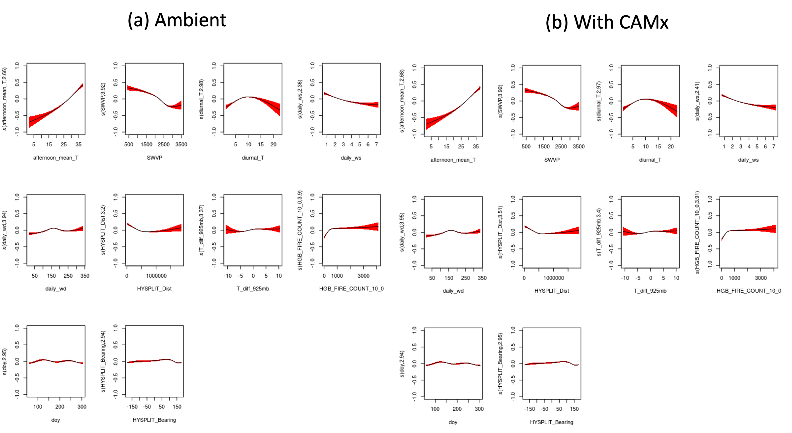
Houston Maximum MDA8 O₃
Is_Model variable NOT significant
Fits are similar
Smoke_flag coefficients similar (0.033 ambient, 0.034 CAMx)

Slide 21
Houston Maximum MDA8 O₃: Total O₃ Predictions
 | Ambient (ppbv) (Is_Model = 0) | CAMx (ppbv) (Is_Model = 1) | % Difference
Minimum | 27.7 | 28.2 | 2%
25th Percentile | 42.7 | 43.7 | 2%
Median | 50.2 | 51.2 | 2%
Mean | 52.4 | 53.9 | 3%
75th percentile | 61.3 | 62.5 | 2%
Max | 82.9 | 84.1 | 1%
Std. Dev. | 12.5 | 12.6
CAMx has small (2%) overestimates in Houston, constant through distribution

Slide 22
Houston Maximum MDA8 O₃: Smoke O₃ Predictions
 | Ambient (ppbv) | CAMx (ppbv)
Minimum | 9.4 | 11.0
25th Percentile | 12.7 | 12.9
Median | 15.3 | 15.6
Mean | 15.6 | 15.8
75th percentile | 18.3 | 18.1
Max | 21.5 | 21.8
Std. Dev. | 3.4 | 3.3
Estimated smoke impacts are very similar in ambient data and CAMx simulations (within 0.3 ppbv except for minimum), suggesting CAMx does a reasonable job

Slide 23
Houston Background MDA8 O₃
Is_Model variable highly significant
But fits are similar
Smoke_flag coefficients similar (0.058 ambient, 0.063 CAMx)

Slide 24
Houston Background MDA8 O₃: Total O₃ Predictions
 | Ambient (ppbv) (Is_Model = 0) | CAMx (ppbv) (Is_Model = 1) | % Difference
Minimum | 16.4 | 20.2 | 23%
25th Percentile | 23.9 | 28.9 | 21%
Median | 28.9 | 35.5 | 23%
Mean | 31.0 | 37.6 | 21%
75th percentile | 37.2 | 45.4 | 22%
Max | 57.6 | 67.0 | 16%
Std. Dev. | 9.1 | 11.0
CAMx has large overestimates of background O₃ in Houston, causing the Is_Model variable to be significant

Slide 25
Houston Background MDA8 O₃: Smoke O₃ Predictions
 | Ambient (ppbv) | CAMx (ppbv)
Minimum | 5.6 | 8.4
25th Percentile | 8.1 | 10.1
Median | 9.2 | 11.1
Mean | 9.7 | 11.6
75th percentile | 10.9 | 13.0
Max | 16.1 | 18.1
Std. Dev. | 2.4 | 2.3
CAMx predicts 2 ppbv more background O₃ impact of smoke in Houston than in ambient data
CAMx suggests a net O₃ increase of 4 ppbv when the smoke enters the city, ambient data suggests 6 ppbv

Slide 26
El Paso Maximum MDA8 O₃: Smoke O₃ Predictions
 | Ambient (ppbv) | CAMx (ppbv)
Minimum | 2.8 | 2.5
25th Percentile | 4.0 | 3.7
Median | 4.2 | 3.9
Mean | 4.3 | 4.0
75th percentile | 4.7 | 4.4
Max | 5.6 | 5.2
Std. Dev. | 0.8 | 0.8
Estimated smoke impacts are very similar in ambient data and CAMx simulations (within 0.4 ppbv)
This, plus similarity of the smooth function fits and the smoke_flag coefficient, suggest CAMx does a reasonable job modeling the impact of smoke on maximum O₃ in El Paso, even while underestimating the absolute values

Slide 27
El Paso Background MDA8 O₃: Smoke O₃ Predictions
 | Ambient (ppbv) | CAMx (ppbv)
Minimum | 4.6 | 4.4
25th Percentile | 6.3 | 6.0
Median | 6.5 | 6.1
Mean | 6.4 | 6.0
75th percentile | 6.6 | 6.3
Max | 7.6 | 7.2
Std. Dev. | 0.8 | 0.8
As with maximum, estimated smoke impacts are very similar in ambient data and CAMx simulations (within 0.4 ppbv), suggesting CAMx does a reasonable job
Both suggest a ~ 2 ppbv loss of O₃ when smoke enters El Paso

Slide 28
Conclusions
The results depend strongly on which set of fire predictors is used.
For Houston, the change in O₃ impact as the smoke enters the city varies from -0.9 ppbv to +6.0 ppbv.
In El Paso, the change in mean O₃ impact as the smoke enters the city varies from -1.6 ppbv to -0.5 ppbv.
For El Paso, our CAMx analysis suggested that there were statistically significant differences between CAMx and the ambient data, but further analysis showed that the predicted impacts of fires in both cases were very similar.
For Houston, the differences between CAMx and the ambient data fits were not statistically significant for maximum O₃, but the CAMx data strongly overestimates the background O₃ for Houston on both smoky and non-smoky days and overestimates the smoke impact on background O₃ by 2 ppbv.

Slide 29
For more information, please contact
Matthew Alvarado
Principal Scientist and VP, R&D
malvarad@aer.com
781-761-2330

Slide 30
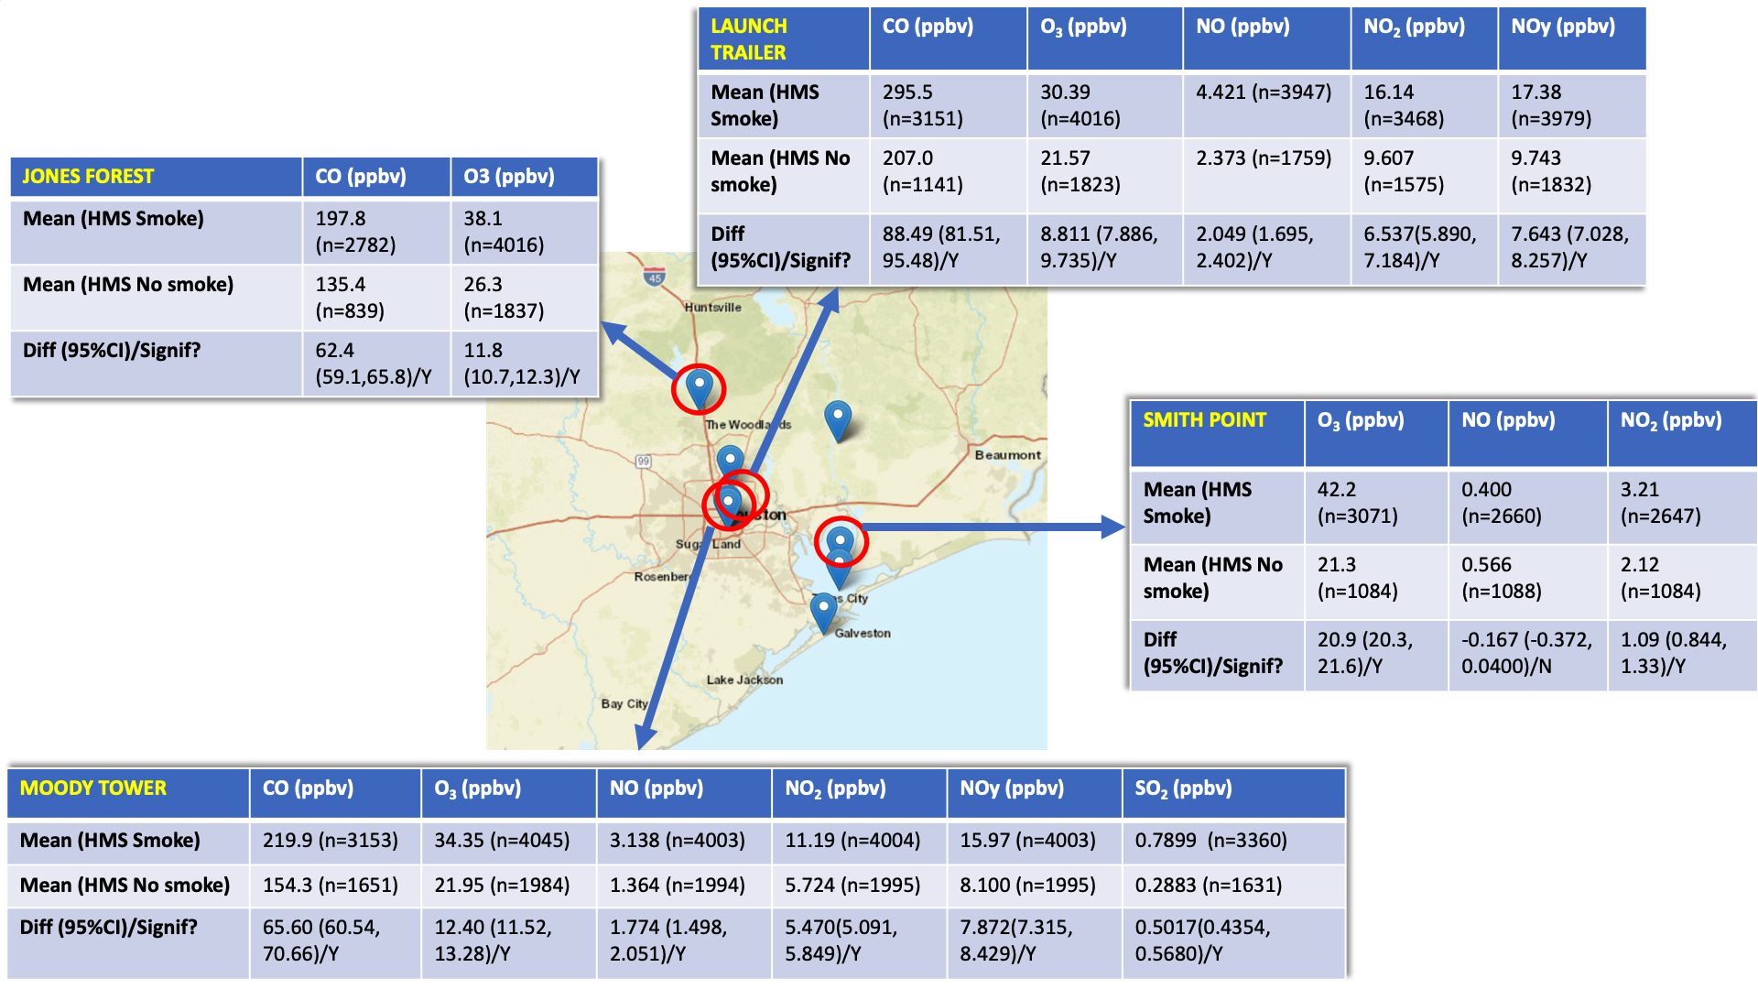
Our Previous Work on Smoke Influences on O₃ in Houston
Impacts of 8-20 ppbv O₃!

Slide 31
FINN Large-Scale Fire Count Tests: Bkgrd O₃ Fits
 | Houston Bkgrd MDA8 O₃ |  |  | El Paso Bkgrd MDA8 O₃
 | Dev. Exp. (%) | GCV | p | Dev. Exp. (%) | GCV | p
0.5 degrees | 63.5 | 60.402 | 0.05 | 51.0 | 40.737 | 0.76
1.0 degrees | 63.7 | 60.14 | 0.001 | 51.0 | 40.739 | 0.69
2.5 degrees | 64.1 | 59.389 | <0.001 | 51.2 | 40.619 | 0.01
5.0 degrees | 64.4 | 58.959 | <0.001 | 51.2 | 40.621 | 0.04
10 degrees | 64.4 | 59.072 | <0.001 | 51.3 | 40.619 | 0.01
25 degrees | 64.0 | 59.671 | <0.001 | 52.3 | 39.788 | <0.001
Best + HMS smoke flag | 64.6 | 58.890 | <0.001 | 52.6 | 39.641 | <0.001

Slide 32
FINN Geographic Predictor Tests: Best variables
Region | Houston |  | El Paso
 | Maximum MDA8 O₃ | Background MDA8 O₃ | Maximum MDA8 O₃ | Background MDA8 O₃
MEX | Biomass burned (BMASS) | Non-methane hydrocarbon (NMHC) emissions | BMASS | Xylene emissions
YUC | Fire Area | Fire Count | Fire Area | Fire Area
OK | Fire Count | BMASS | Fire Count | Fire Count
NM | Fire Count | Fire Count | Fire Count | Fire Count
LA | Fire Count | Fire Count | Hydroxyacetone (HYAC) emissions | CH₃CN emissions
AR | Fire Count | NMHC emissions | Fire Count | Fire Count
CA | NO_{x} emissions as NO | Glycoladehyde (GLYALD) emissions | NO_{x} emissions as NO | Fire Area

Slide 33
Smoke Flag Tests: MDA8 O₃ Impacts
 | Houston MDA8 O₃ |  | El Paso MDA8 O₃
 | Bkgrd (ppbv) | Max (ppbv) | Bkgrd (ppbv) | Max (ppbv)
Minimum | 1.2 | 1.5 | 1.7 | 1.4
25th Percentile | 1.9 | 2.1 | 2.2 | 1.8
Median | 2.3 | 2.5 | 2.4 | 1.9
Mean | 2.4 | 2.6 | 2.4 | 1.9
75th percentile | 2.8 | 3.0 | 2.5 | 2.0
Max | 4.7 | 4.8 | 2.9 | 2.4
Std. Dev. | 0.6 | 0.6 | 0.2 | 0.2
O₃ is increased by 1.2-4.8 ppbv when HMS says there is smoke over the city
Less than impact of smoke inferred when not controlling for meteorology.
Small increase in impact when smoke enters Houston, small decrease in El Paso

Slide 34
FINN Large-Scale Fire Count Tests: MDA8 O₃ Impacts
 | Houston MDA8 O₃ |  | El Paso MDA8 O₃
 | Bkgrd (ppbv) | Max (ppbv) | Bkgrd (ppbv) | Max (ppbv)
Minimum | 1.3 | 2.4 | 2.7 | 1.9
25th Percentile | 5.8 | 11.3 | 5.3 | 3.3
Median | 7.9 | 13.6 | 6.1 | 4.3
Mean | 7.8 | 13.8 | 6.1 | 4.5
75th percentile | 9.6 | 16.9 | 6.9 | 5.7
Max | 18.4 | 28.2 | 9.4 | 8.8
Std. Dev. | 3.0 | 4.3 | 1.4 | 1.4
Adding FINN fire counts greatly increases the estimated impact of smoke on O₃, more in line with uncorrected BC2 estimates from previous work
Large increase in impact when smoke enters Houston, small decrease in El Paso

Slide 35
FINN Geographic: El Paso Maximum O₃
AR was removed, but all other variables kept as significant predictors.
Total deviance explained was 57.1% with a GCV of 44.43, which is a better fit than the large-scale FINN fire count.
Only the Mexico predictor had a large increase in O₃ and saturated quickly.

Slide 36
FINN Geographic Variables
 | Houston MDA8 O₃ |  | El Paso MDA8 O₃
 | Bkgrd (ppbv) | Max (ppbv) | Bkgrd (ppbv) | Max (ppbv)
Minimum | 1.0 | 2.0 | 1.6 | 0.3
25th Percentile | 5.6 | 5.3 | 5.5 | 5.4
Median | 7.7 | 7.0 | 7.4 | 7.2
Mean | 8.0 | 7.1 | 7.2 | 7.0
75th percentile | 9.8 | 8.4 | 8.7 | 8.5
Max | 23.2 | 20.5 | 13.0 | 12.6
Std. Dev. | 3.7 | 2.8 | 2.1 | 2.3
Gives best fit with data of tested predictors
Significant smoke impacts (mean 7-8 ppbv)
Small decrease in impact when smoke enters Houston, small decrease in El Paso

Slide 37
WRF-STILT Footprint Tests
 | Houston MDA8 O₃ |  | El Paso MDA8 O₃
 | Bkgrd (ppbv) | Max (ppbv) | Bkgrd (ppbv) | Max (ppbv)
Minimum | -2.9 | 1.2 | 1.6 | 1.2
25th Percentile | 3.4 | 5.4 | 2.3 | 1.7
Median | 4.7 | 6.6 | 2.6 | 1.9
Mean | 4.5 | 6.7 | 2.7 | 2.0
75th percentile | 5.8 | 8.3 | 3.1 | 2.1
Max | 10.22 | 13.3 | 4.7 | 5.8
Std. Dev. | 1.9 | 2.4 | 0.6 | 0.6
Lower impacts than FINN fits, but poorer fit
Shape of response similar to Mexican FINN variables
Significant smoke impacts (mean 7-8 ppbv)
Large increase in impact when smoke enters Houston, small decrease in El Paso

Slide 38
Houston Maximum O₃
Only MEX, AR, and NM kept as significant predictors.
Total deviance explained was 68.2% with a GCV of 81.6, which is a better fit than the large-scale FINN fire counts.
Increases in Mexican biomass burned and Arkansas fire counts were associated with increased O3 but saturated at relatively low values, while NM fire counts slightly decreased O₃

Slide 39
Houston Background O₃
All variables were kept as significant predictors.
Total deviance explained was 65.5% with a GCV of 57.9, which is a better fit than the large-scale FINN fire count fit.
All fire impacts were positive except for NM, with MEX and AR showing the largest impacts (Figure 4).

Slide 40
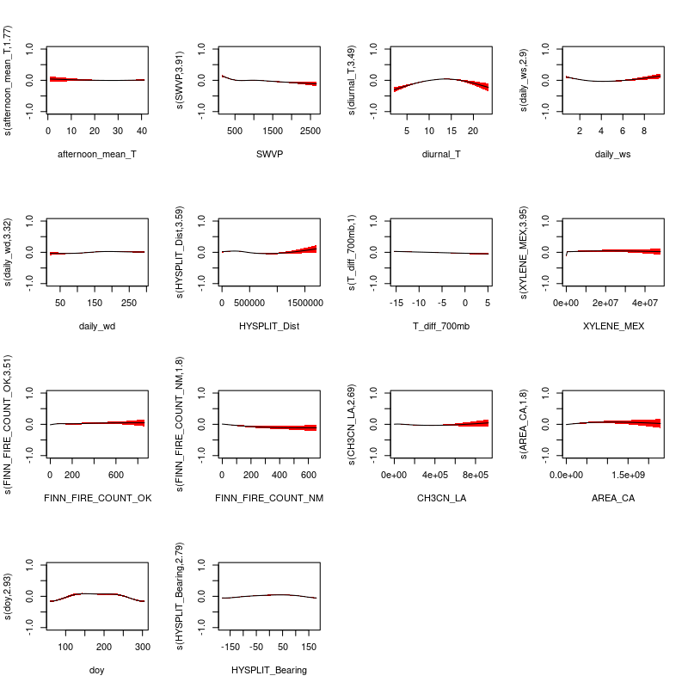
El Paso Background O₃
AR was removed, but all other variables kept as significant predictors.
Total deviance explained was 54.4% with a GCV of 38.57, which is a better fit than the large-scale FINN fire count fit from Section 4.1.2.
Mexico tended to increase O₃ while NM decreased it.

Slide 41
WRF-STILT Footprint Tests
The convolved footprints were highly significant predictors (p << 0.001) in Houston, but surprisingly were not significant predictors for El Paso.
The deviance explained and GCV statistics for each fit were:
Houston Maximum – Deviance explained 67.9%, GCV 81.9
Houston Background – Deviance explained 64.2%, GCV 59.4
El Paso Maximum – Deviance explained 54.2%, GCV 46.1
El Paso Background – Deviance explained 51.8%, GCV 39.8
These fit statistics are generally worse than those using the FINN fire count variables, suggesting that the WRF-STILT footprints may not correctly represent the transport of biomass burning emissions to these urban areas.

Slide 42
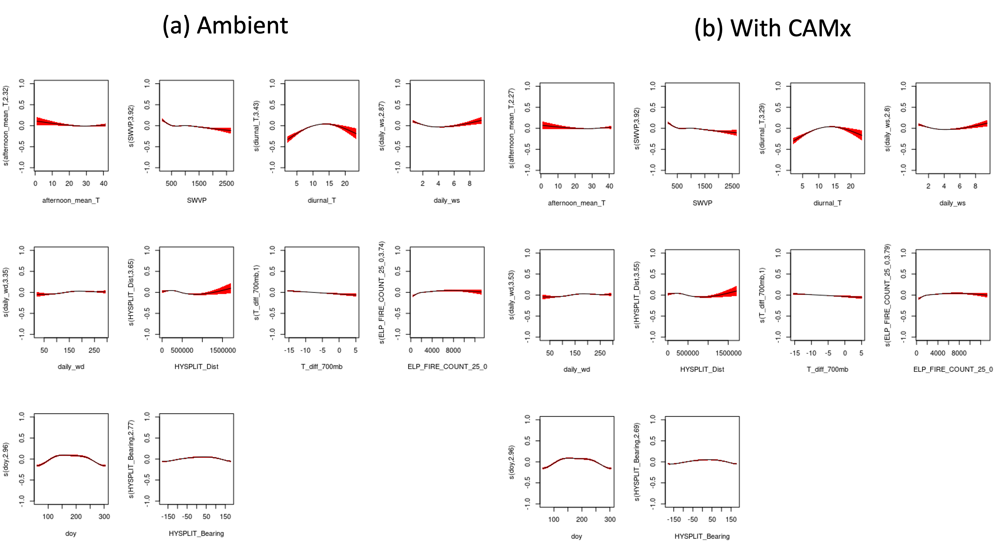
El Paso Background MDA8 O₃
Is_Model variable highly significant
But fits are similar
Smoke_flag coefficients similar (0.036 ambient, 0.031 CAMx)

Slide 43
El Paso Background MDA8 O₃: Total O₃ Predictions
 | Ambient (ppbv) (Is_Model = 0) | CAMx (ppbv) (Is_Model = 1) | % Difference
Minimum | 33.7 | 32.1 | -5%
25th Percentile | 42.3 | 42.0 | -1%
Median | 48.2 | 46.2 | -4%
Mean | 47.6 | 45.9 | -4%
75th percentile | 52.5 | 50.6 | -4%
Max | 61.4 | 58.1 | -5%
Std. Dev. | 6.3 | 5.9
CAMx underestimates background O₃ in El Paso, but percentage underestimate is relatively constant

Slide 44
CAMx Summary
Only Houston Maximum MDA8 O₃ shows no significant difference between ambient and CAMx data when evaluated with the GAMs
Only Houston Background MDA8 O₃ shows significant (> 1 ppbv) differences between smoke impacts
Houston Background MDA8 O₃ is strongly (> 20%) overestimated in CAMx
El Paso Maximum MDA8 O₃ is underestimated by CAMx, with a more severe underestimate at high O₃ levels (-10%).

