Slide 1
Direct and indirect exposures to fires in the wildland-urban interface of California
Miriam E. Marlier (UCLA), Rachel Connolly (UCLA), Jihoon Jung (UNC), Claire Schoellart (UW), Eimy Bonilla (HU), Osinachi Ajoku (HU), & Joseph Wilkins (HU)

Slide 2
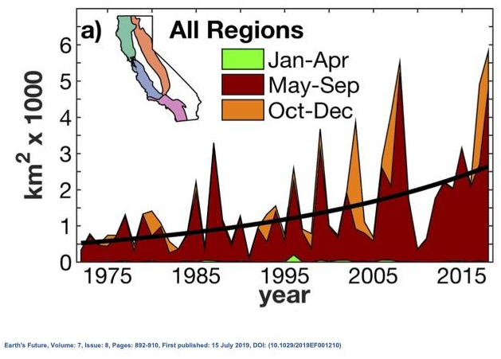
Wildland fire is increasing in California
California’s annual forest fire burned area increased fivefold from 1972-2018
Interactions among climate, fuel management, and development
California’s burned area could increase by 80% by end of century
Williams et al. (2019), Westerling et al. (2018)

Slide 3
Community impacts through multiple pathways
Direct threats
Public safety
Infrastructure
Indirect threats
Air pollution
Existing work shows vulnerable communities located in central and northern California
Community Health Vulnerability Index
Jung et al. (In Press)

Slide 4
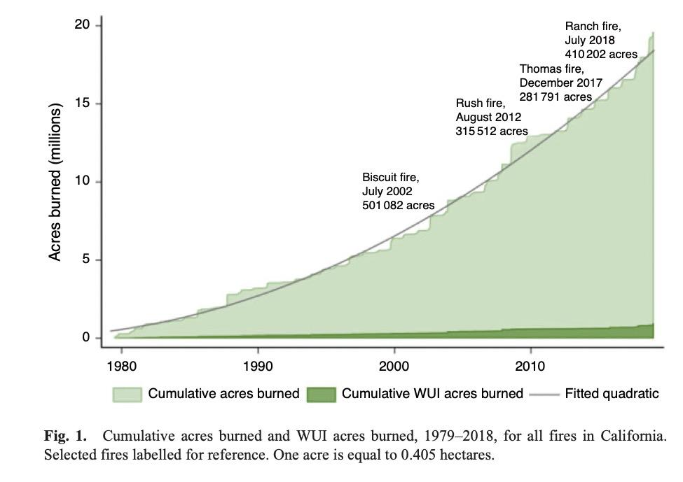
WUI-specific exposures and vulnerability
WUI burned area is small proportion of total burned area in California but overlaps with communities
We lack exposure maps of direct and indirect wildland fire threats in WUI areas
Who is exposed?
How has this changed over space and time?
Buechi et al. (2021)

Slide 5
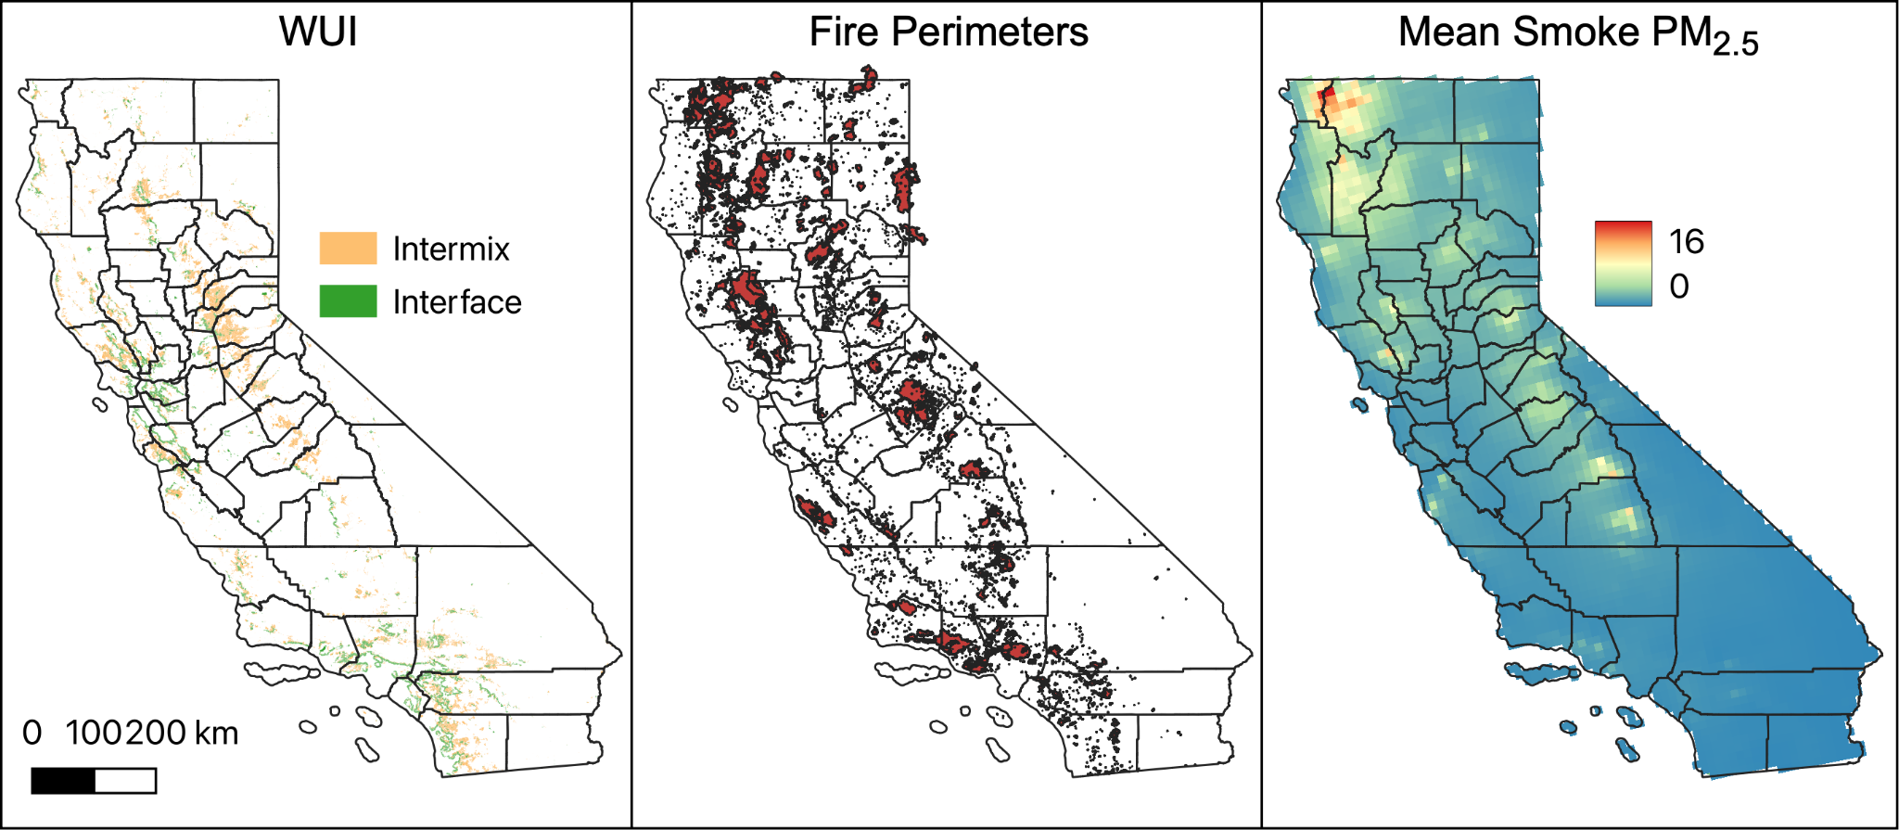
Data and methods
Radeloff et al. (2018), Cal Fire (2023), Wilkins et al. (2018)
Notes:
-We use geospatial data to map the WUI, direct fire threats, and smoke pollution exposure.
-First map WUI areas in California using previously published data according to ownership status.
-Then evaluate direct fire threats through burned area perimeters and building damage.
-Finally consider indirect threats through the contribution of wildland fires to air pollution.
-The next few slides provide more details on each of these datasets.

Slide 6
Data and methods
Radeloff et al. (2018), Cal Fire (2023), Wilkins et al. (2018)

Slide 7
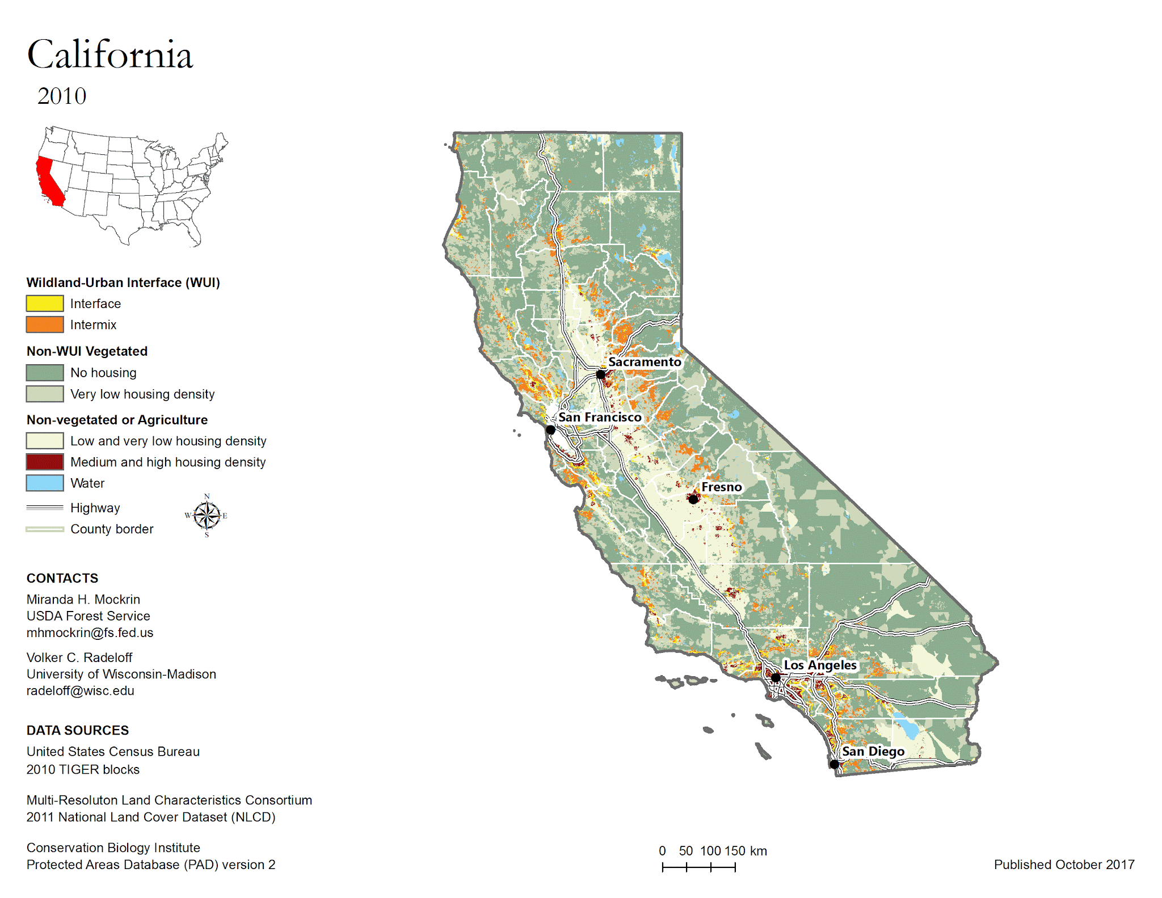
Mapping WUI areas in California
WUI definition:
Interface: housing neighbors wildland vegetation
Intermix: housing and vegetation intermingle.
Underlying datasets:
Housing density (U.S. census)
Vegetation cover (National Land Cover Database, NLCD)
WUI covers 6.6% of California’s land area and includes 35.5% of California’s housing
Radeloff et al. (2018)
Notes:
-Radeloff dataset maps WUI on a decadal basis since 1990.
-WUI has been fairly stable in California over last decade (27,999 km2 in 2010 and 27,796 km2 in 2020).
-Additional approaches to mapping the WUI, but the spatial unit of the Radeloff dataset aligns with population metrics that we use to define vulnerability.
-This dataset also allows us to look at WUI changes over time.

Slide 8
Data and methods
Radeloff et al. (2018), Cal Fire (2023), Wilkins et al. (2018)

Slide 9
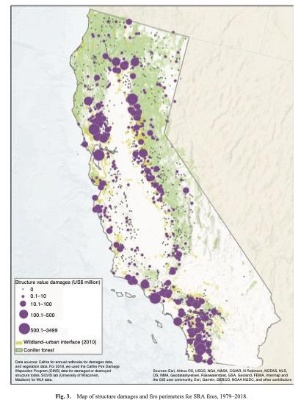
Direct fire exposures
Burned area perimeters from CalFire Fire and Resource Assessment Program (FRAP)
Includes forest fires > 10 acres, brush fires > 50 acres, and grass fires > 300 acres.
Building damage from CalFire Wildfire Activity Statistics
Annual reports of structural damages in State Responsibility Areas (following Buechi et al. 2021)
Buechi et al. (2021)
Notes:
We use two metrics of direct fire exposure.
Burned area from Cal Fire FRAP program. This is the focus for the presentation today.
We are also working to digitize building damage data from annual Cal Fire reports, but this is still in progress

Slide 10
Data and methods
Radeloff et al. (2018), Cal Fire (2023), Wilkins et al. (2018)

Slide 11
Indirect exposures: Smoke PM_{2.5}
CMAQ model simulations with and without inclusion of wildland fire emissions
Wildland fires include wildfires, managed fires, agricultural burns, and prescribed fires
Simulations produce 2008-2018, daily surface level fire-contributed fine particulate matter (“smoke PM_{2.5}”)
Wilkins et al. (2018)

Slide 12
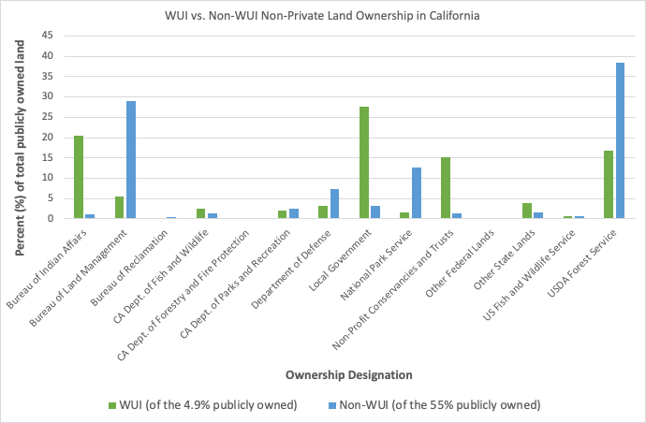
WUI ownership
CalFire, Radeloff et al. (2018)
Notes:
Notable:
WUI ownership (only 5% of WUI that is publicly owned): Bureau of Indian affairs, local government dominate, with USDA forest service as well. For non-WUI, BLM and USDA dominate. Implications for land management

Slide 13
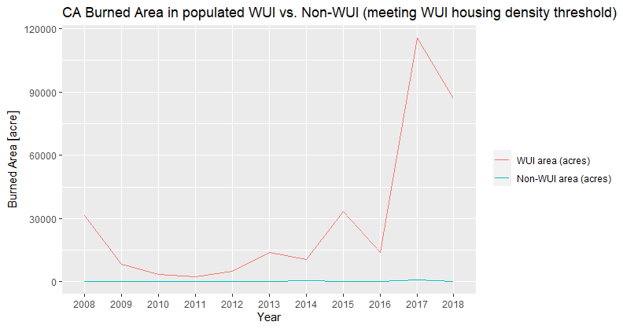
Direct exposures to burned area
CalFire, Radeloff et al. (2018)
Notes:
When we do not adjust for the WUI housing density threshold, this chart looks very different (can see google doc: https://docs.google.com/document/d/1uauMq9qZ0e4YFWc5KfPOQWhuDmDeEFTgS-TzBu4s6y0/edit)
When we do adjust for housing density, burned area in the populated areas of WUI significantly exceeds burned area in populated areas of Non-WUI across the state.
WUI density threshold is 6.17 units/sq km (chart looks very different if we do not adjust for housing density - much more burned for non-WUI than WUI)
https://esajournals.onlinelibrary.wiley.com/doi/10.1002/eap.2597

Slide 14
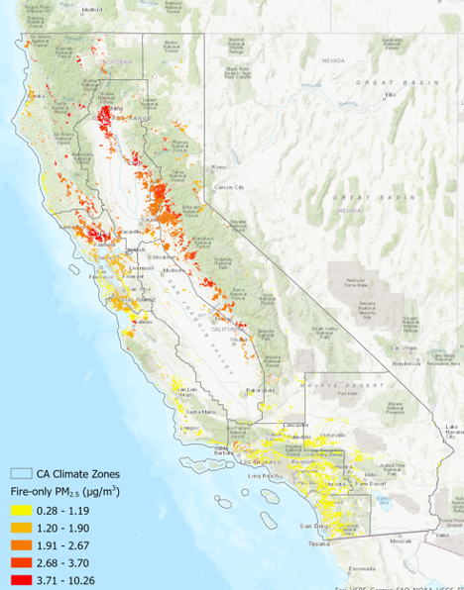
Table: Fire-Only PM_{2.5}
(areas with housing density exceeding WUI threshold)
Indirect exposures to smoke PM_{2.5}
Year | WUI Fire-only PM_{2.5} (µg/m³) | Non-WUI Fire-only PM_{2.5} (µg/m³)
2008 | 3.12 | 2.59
2009 | 0.59 | 0.56
2010 | 0.3 | 0.28
2011 | 0.41 | 0.38
2012 | 0.48 | 0.4
2013 | 0.98 | 0.78
2014 | 0.66 | 0.48
2015 | 1.02 | 0.75
2016 | 0.98 | 1.08
2017 | 3.42 | 2.74
2018 | 3.25 | 2.8
Map: WUI Fire-Only PM_{2.5}
(Average, 2008-2018)
Notes:
Map shows fire-only PM2.5 in the WUI over the eleven year period - can see differences by climate zone here, with significant impacts in northern CA.
Table shows fire-only PM2.5 for areas meeting the WUI threshold for housing density, to ensure we are analyzing actual population exposures. Can see more distinct differences in the high fire years, with WUI concentrations exceeding non-WUI distinctly for 2008, 2017, and 2018.

Slide 15
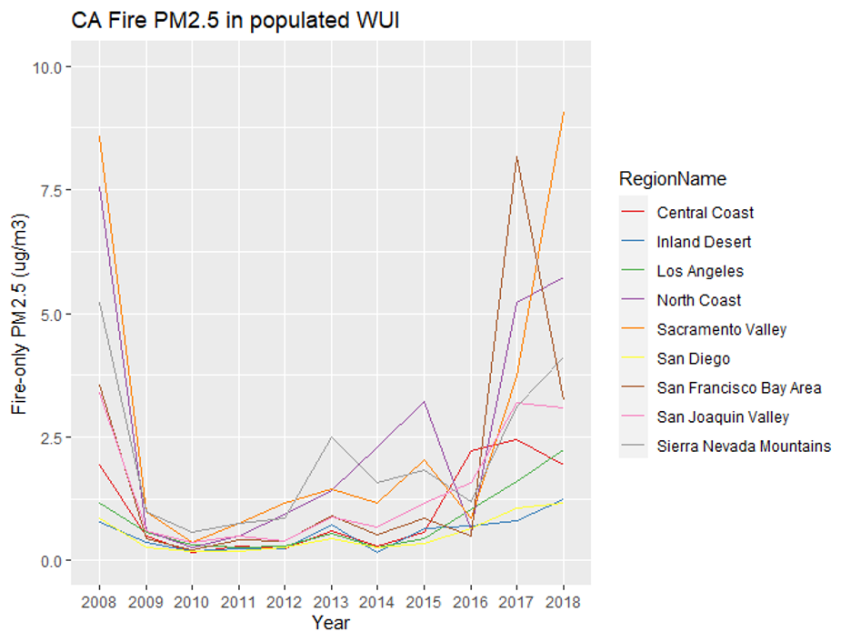
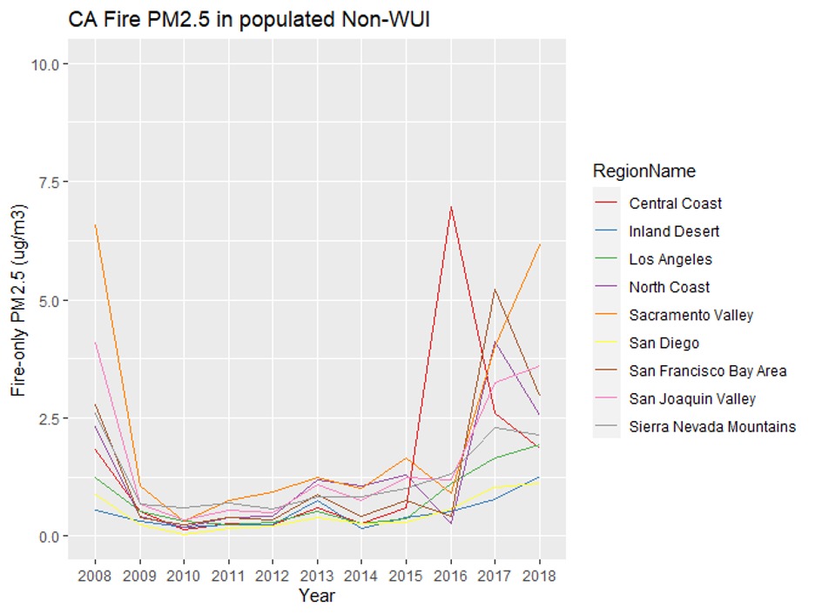
Indirect Exposures: CA Climate Change Assessment Regions
Notes:
These are also limited by the WUI housing density threshold (so the non-wui only represents places people are actually living instead of remote areas).
In WUI, can see high concentrations in the North Coast, Sacramento Valley and SF Bay Area (the latter for 2017 fires).
In non-WUI, Central coast peaks for 2016 fires, and otherwise higher estimates for north coast, sacramento, and SF bay area in recent high fire years (though dips in 2018 for SF and NC).
More variation in the WUI during low fire years as well.

Slide 16
Conclusions and next steps
Key takeaway:
Identify high-risk WUI communities
Inform strategies to protect public health and safety
Next steps:
Consider exposure to prescribed fire smoke separately from wildfire smoke
Include structural damage in direct fire threats

Slide 17
This work was funded by NASA grants 80NSSC22K1684 and 80NSSC22K1480.
Contact: mmarlier@ucla.edu and joseph.wilkins@howard.edu

