Slide 1
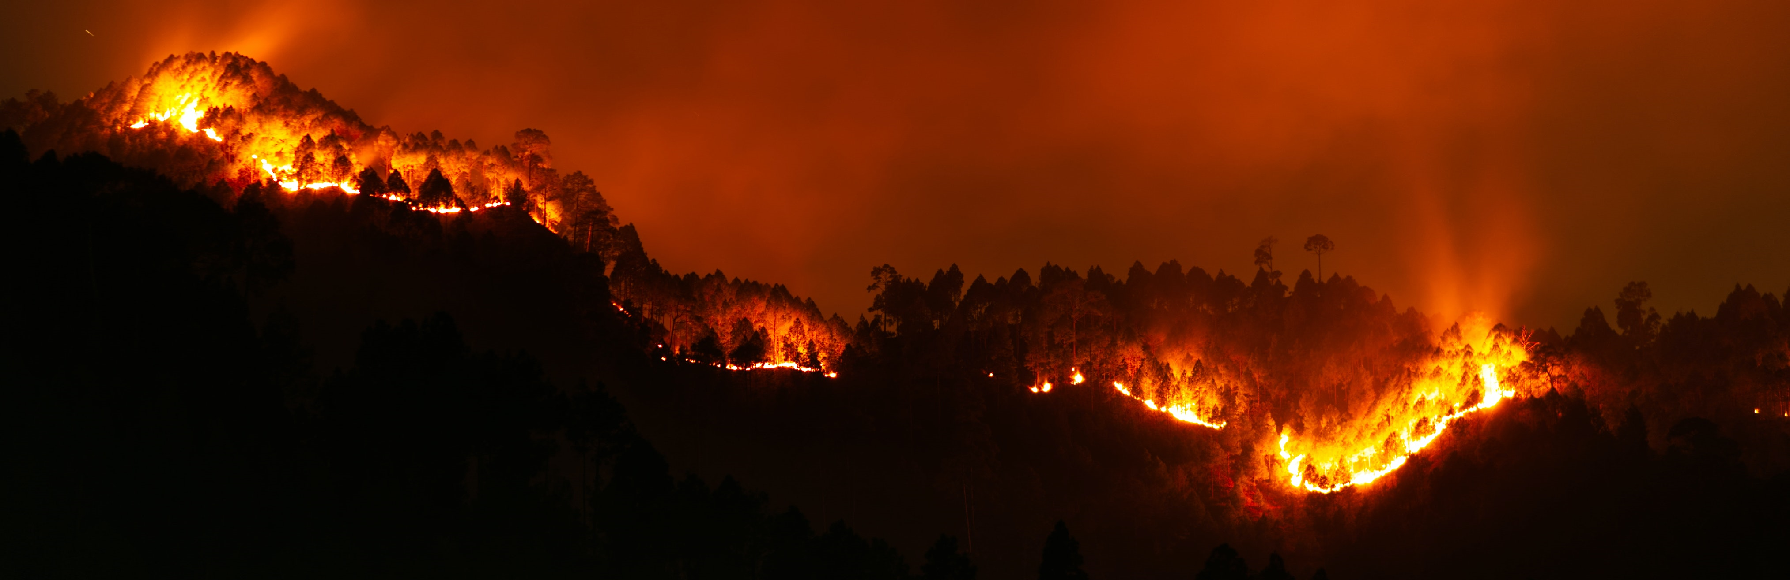

Fire Emissions Inventory Comparison and Processor Development
Jeremiah Johnson¹, Pradeepa Vennam¹, Fiona Jiang¹, Ben Yusuf²
¹Ramboll
²Texas Commission on Environmental Quality

Slide 2
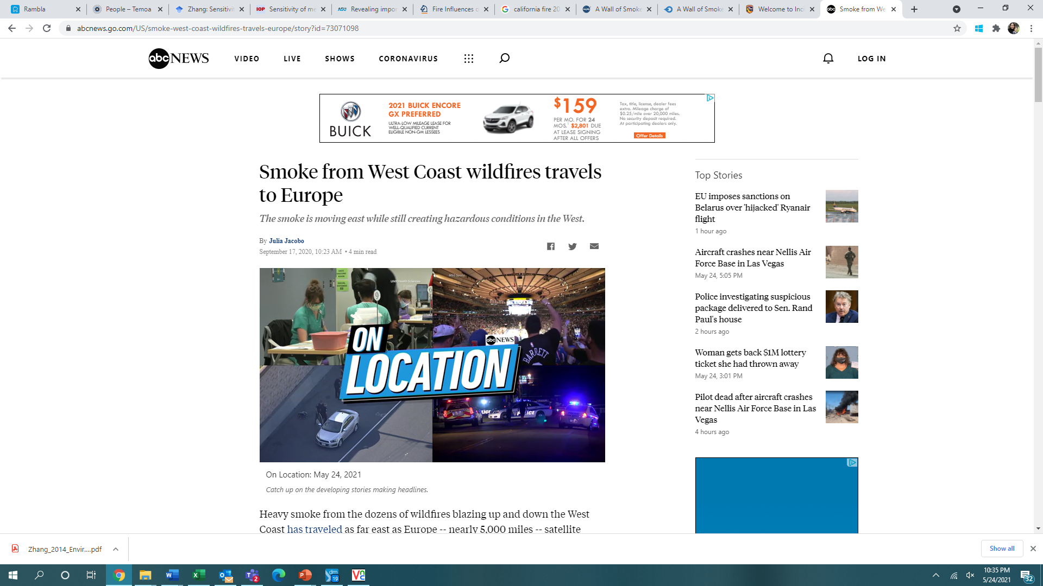
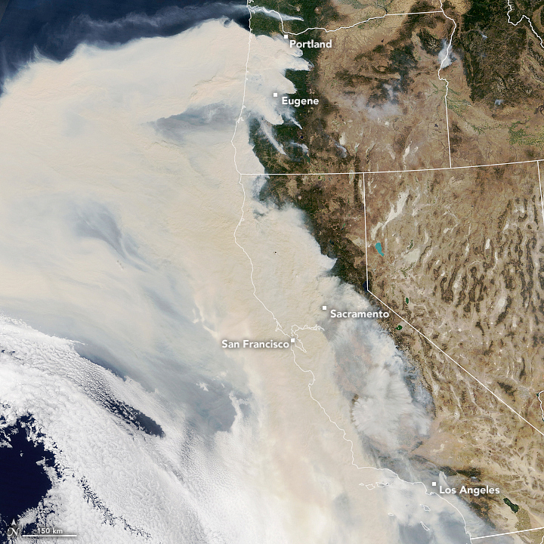
Motivation
Fires are large emission sources and Fire Emission Inventories (FEIs) are uncertain
Accurate FEIs needed for Exceptional Event (EE) analyses and State Implementation Plan (SIP) modeling for ozone/PM_{2.5}/regional haze
Processing tools can limit choice of FEI and different processing methods can introduce or exacerbate uncertainties
Source: ABC News, October 3, 2020

Slide 3

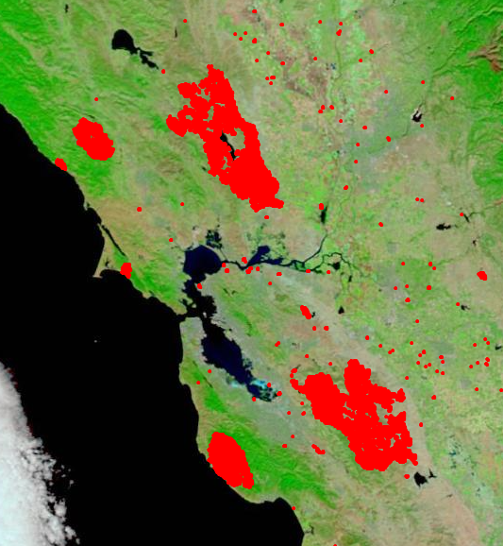
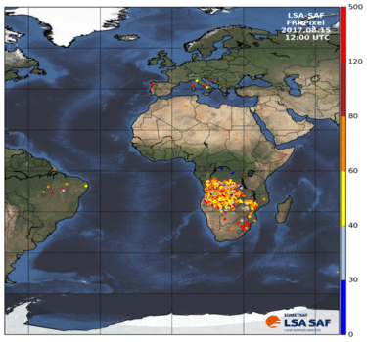
Available Fire Inventories
Burned areas
Fire Radiative Power
Source: NASA Disasters Mapping Portal
Source: https://wildfire.geog.kcl.ac.uk/products-and-data/
Area burned
LC-specific biomass loading and EFs
Thermal anomalies
LC-specific dry matter
combustion rates and EFs
FINN, GFED, BlueSky
GFAS, QFED, FEER, RAVE, FLAMBE, GBBEPx, IS4FIRES

Slide 4
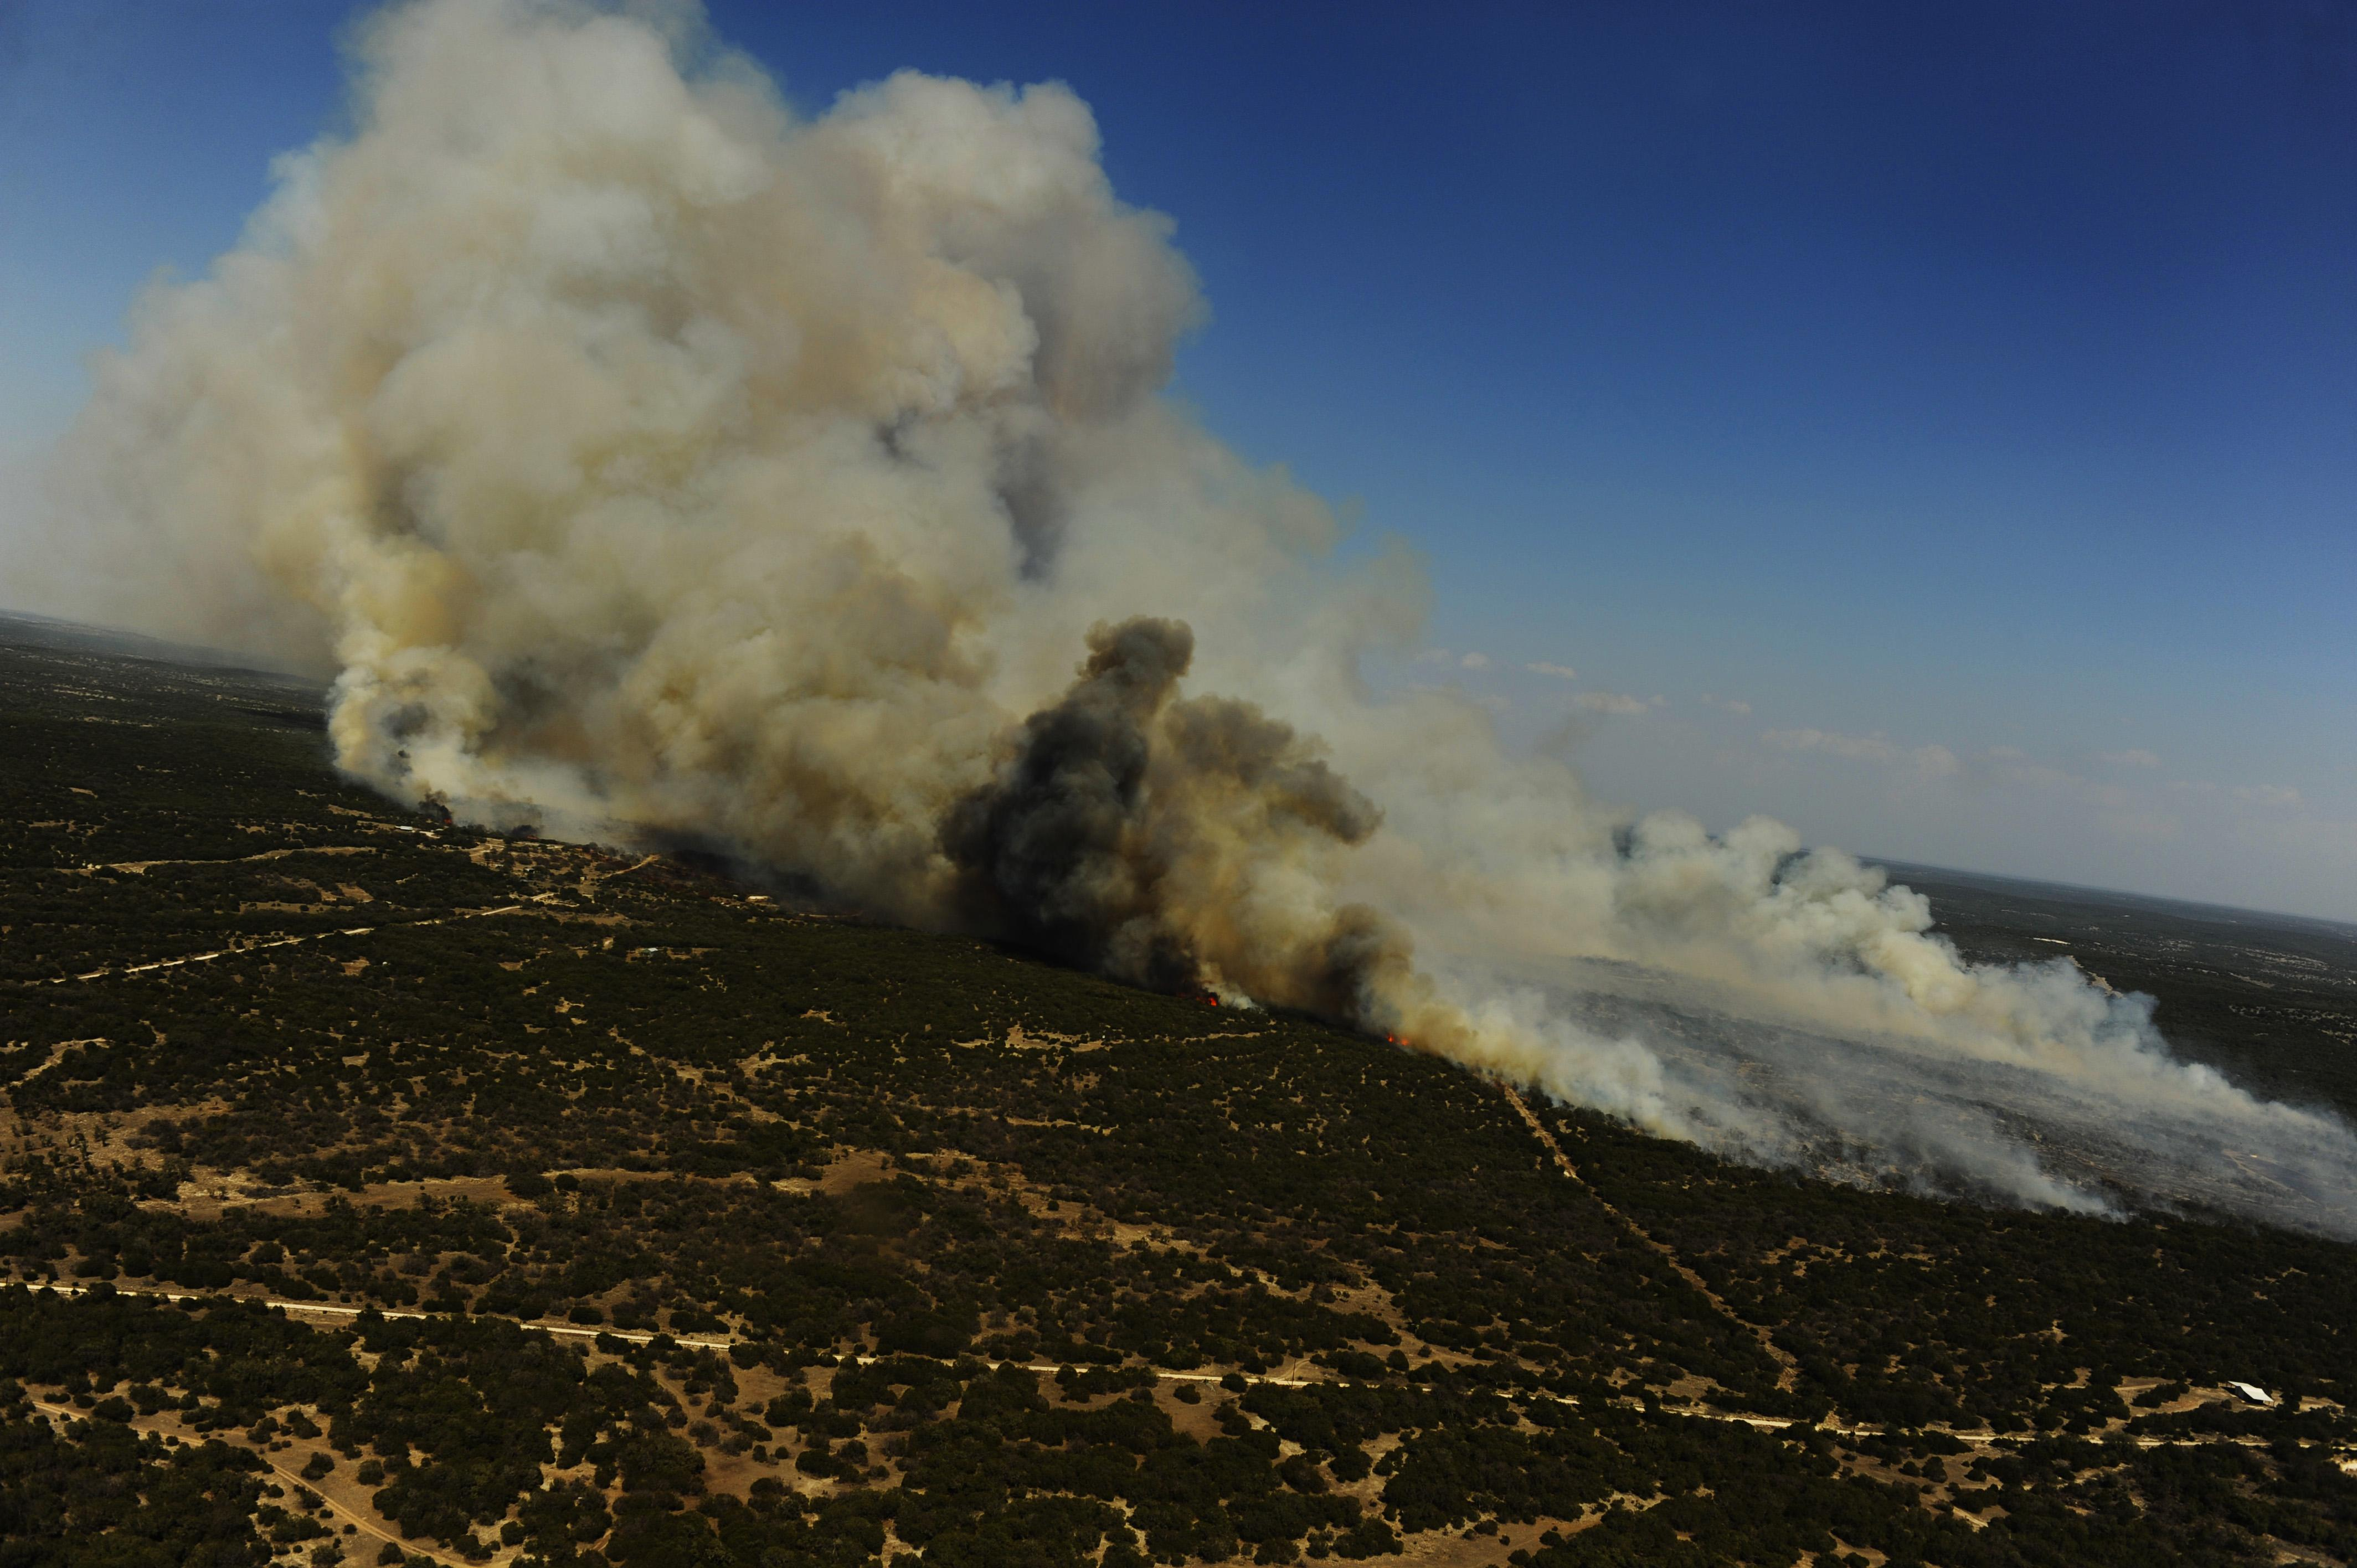
Ramboll’s FEI Processor
A Python-based tool that:
  Re-grids emissions to target modeling domain projection/resolution
  Speciates for CB6 or CB7 chemistry mechanisms
  Temporally and vertically allocates emissions
Implemented for four global FEIs
Other global FEIs can be added in the future
Output formatted as netCDF-4 w/ compression for efficiency (CAMx only for now)
By U.S. Department of Defense Current Photos - 110426-F-RM405-451,
Public Domain, https://commons.wikimedia.org/w/index.php?curid=51091038

Slide 5
Updates to FEI Processor in 2023
In 2023, Ramboll expanded the FEI tool
  Added 4th fire inventory (FINN2.5, GFAS1.2, QFED2.5 and FEER1.0)
  Added alternative temporal distribution (Default and RAVE landcover)
  Added alternative plume rise (PBL500 and Sofiev)
  Tested 4 fire inventories in CAMx using Texas 2019 episode
    TCEQ CAMx modeling showed large, frequent ozone overpredictions across Texas using FINN
    FRP-based FEIs (GFAS, QFED, and FEER) all showed substantially better ozone and PM performance compared to FINN
Current work includes
  Adding 5th fire inventory (RAVE1.0)

Slide 6
FEI Processing Diagram
Python FEI Tool
GIS
Intersect CAMx grid with FEI grid
Regridding
Extract N. America subregion
Speciation
NCO tools
netCDF reformatting
Temporal
Vertical Allocation
FINN2.5
GFAS1.2
FEER1.0
QFED2.4
RAVE1.0
CAMx-ready 3-D netCDF files
CAMx

Slide 7
Temporal Allocation
Default Diurnal Profile
Diurnal behavior specific to fire type and environment
Gridded FEIs do not discern fire type
Two options
  Default (top): Smoothly varying profile for all fires
  New (bottom): landcover-dependent profiles from RAVE team
RAVE Landcover Diurnal Profiles
Notes:
Higher injection height will typically reduce near‐field downwind concentrations
Reference: Lareau, N.P. and Clements, C.B., 2017. The mean and turbulent properties of a wildfire convective plume. Journal of Applied Meteorology and Climatology, 56(8), pp.2289-2299.

Slide 8

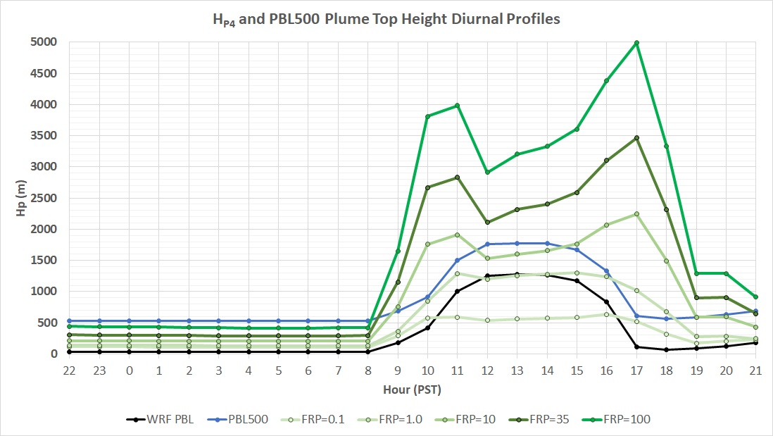
Vertical Allocation of Fire Emissions
Sofiev Plume Rise Algorithm
Plume rise accounts for fire intensity
Plume injection height and vertical allocation play a vital role in downwind pollutant dispersion
FEI tool has 2 options:
  PBL500: WRF PBL + 500 m
  (Wilkins et al., 2022)
  Sofiev (new): from Sofiev et al. (2012)
Both use SMOKE/Briggs-like vertical allocation below plume injection height
Plume Top Heights and WRF PBL
Notes:
Wilkins, J. L., Pouliot, G., Pierce, T., Soja, A., Choi, H., Gargulinski, E., Gilliam, R., Vukovich, J., Landis, M. S. 2022. An evaluation of empirical and statistically based smoke plume injection height parametrisations used within air quality models. International Journal of Wildland Fire 31, 193-211. https://doi.org/10.1071/WF20140

Slide 9
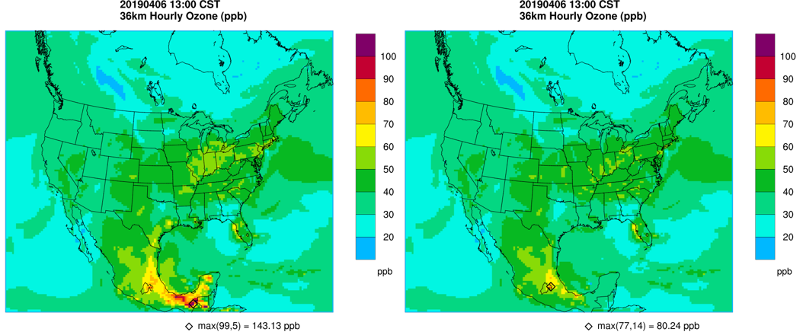
Testing Four FEIs
Three Fire Radiative Power (FRP) FEI’s produced better ozone and PM_{2.5} model performance than FINN
GFAS1.2 performed best and used to evaluate temporal and vertical allocation options
  Most fires occur in Mexico/Central America
  These fires can impact Texas AQ, but plume rise and temporal distribution are less important to Texas
FINN2.5
GFAS1.2

Slide 10
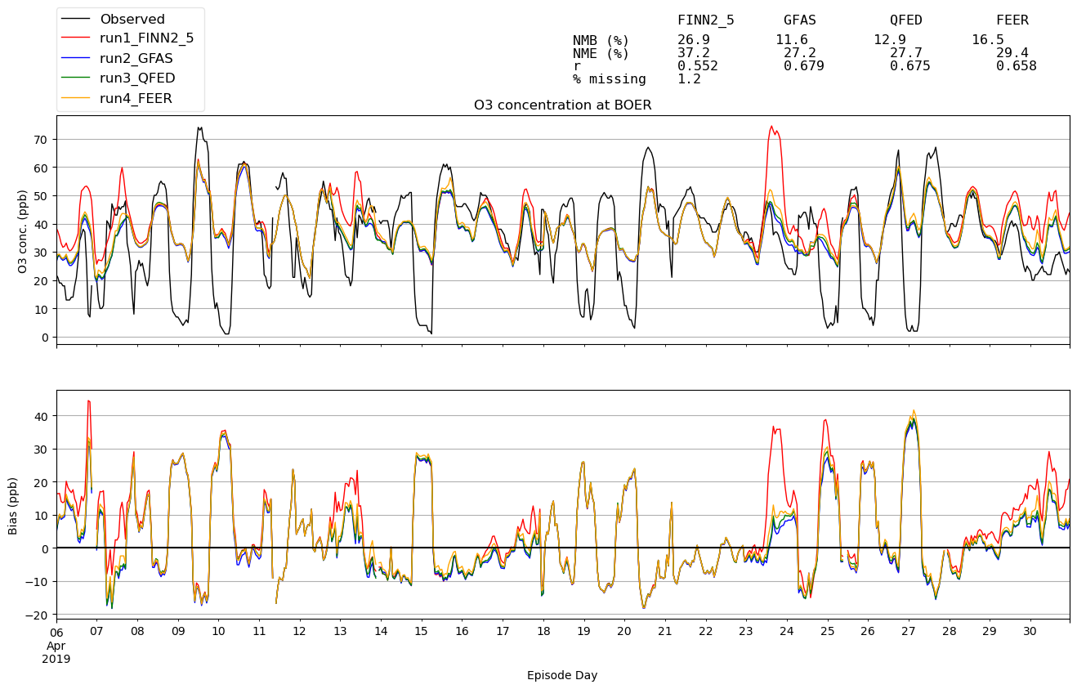
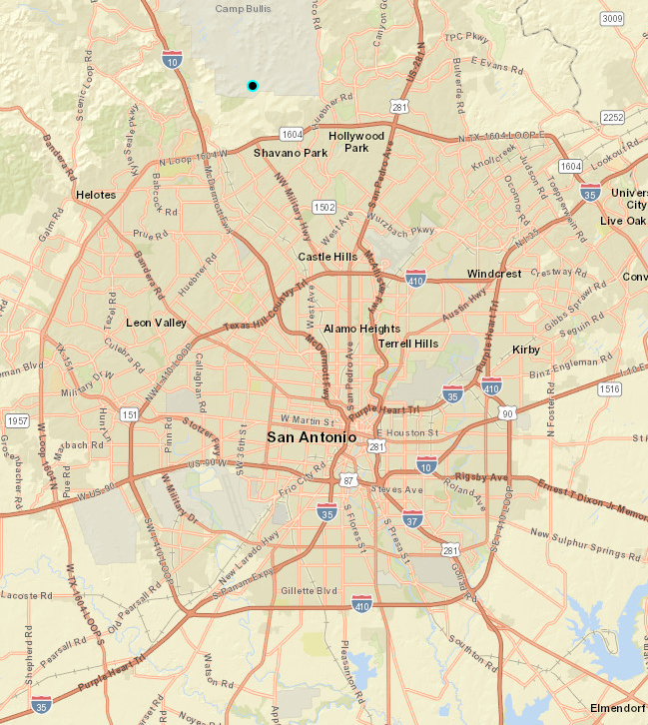
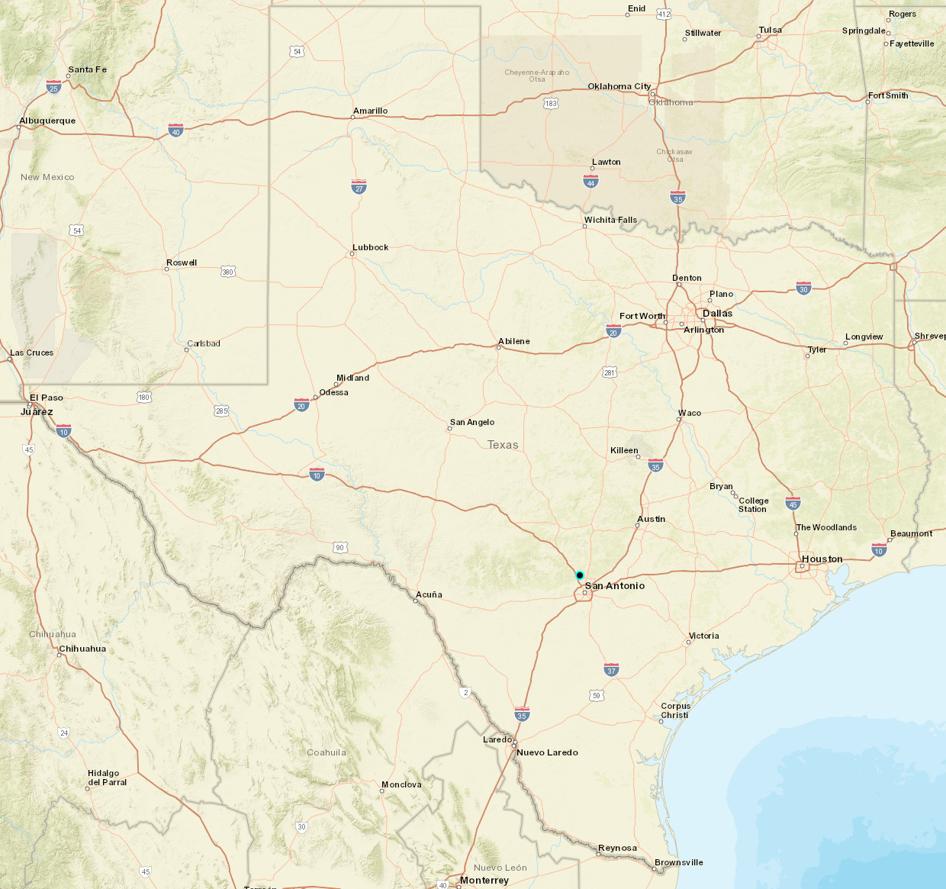
April 2019 CAMx Ozone Time Series at Camp Bullis
Key dates
(FINN over-predicts in TCEQ’s modeling):
Apr 6-7,13,23
Camp Bullis
(BOER)

Slide 11
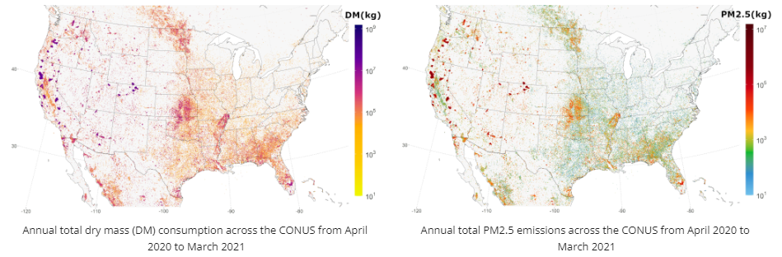
Next Steps
Model additional seasons and years using all available FEIs
Investigate performance of vertical plume rise and temporal allocation schemes for fires near monitors
Ramboll is continuing development of FEI processor
  Annual 2021 simulation focused on Western U.S.
  Updates to incorporate new RAVE FEI
  CAMx updates to treat semi-volatility of primary PM_{2.5} emissions from fires
Source: https://sites.google.com/view/rave-emission/about

Slide 12
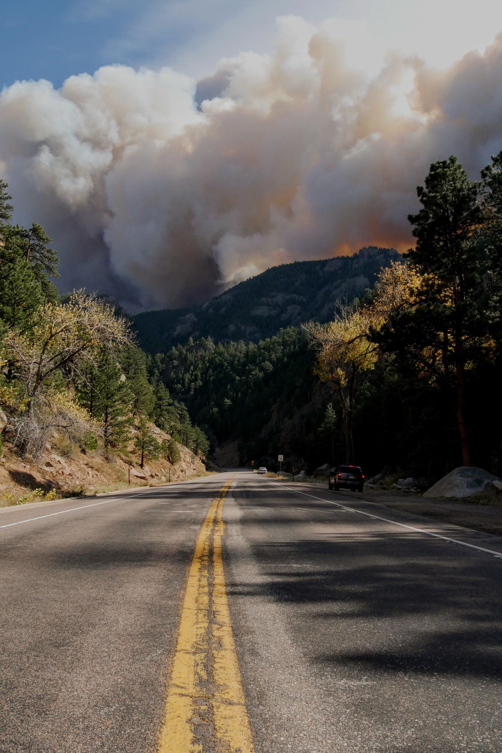
Questions?
Contact:
Jeremiah Johnson JJohnson@ramboll.com
Notes:
Photo by Malachi Brooks on Unsplash

Slide 13
Extra Slides

Slide 14
FEI Comparison
FEI | Horizontal Resolution | Timeframe | Frequency | Approach | Burned Area/FRP Methodology | Emissions Species | Modeling Applications
FINN2.5 | 1 km² (text product) and 0.1°×0.1° (gridded product) | 2002–2021 | Daily through 2021; previous calendar year available each July | Burned area | Estimated by active MODIS and VIIRS fire counts: 0.75 km² for savanna at each fire pixel, 1 km² for other types | NOx, VOC, CO, SO2, NH3, OC, PM_{2.5} | FINN1.0: TCEQ NRTEEM (2017-2020); WACCM real time forecasts FINN2.2: TCEQ 2019 SIP modeling platform
GFAS1.2 | 0.1°×0.1° | 2003–present | Daily with 24-hour lag | FRP | MODIS | NOx, VOC, CO, SO2, NH3, OC, BC, PM_{2.5} | CAMS C-IFS
QFED2.5 | 0.1°×0.1° | 2000–Present | Daily with 1-month lag | FRP | MODIS | NOx, VOC, CO, SO2, OC, BC, PM_{2.5} | GEOS-Chem; CAM-chem
FEER1.0 | 0.1°×0.1° | 2003–Present | Daily with 1-month lag | FRP | From GFASv1.2 (Kaiser et al., 2012) | NOx, VOC, CO, SO2, NH3, OC, BC, PM_{2.5} | Fire research; climate impacts; Northern Sub-Saharan research
RAVE1.0 | 0.03°×0.03° over North America | 2021–Present | Hourly with 24-hour lag | FRP | GOES, VIIRS | NOx, total VOC, CO, SO2, NH3, OC, BC, PM_{2.5} | HRRR-Smoke; CMAQ; WRF-Chem
BlueSky via EPA | Data source dependent | Every year through 2020 | Hourly | Burned area | MODIS, HMS, other | NOx, VOC, CO, SO2, NH3, OC, BC, PM_{2.5} | EPA NEI modeling platform
Notes:
SMARTFIRE/BlueSky contain a menu of choices regarding fire activity datasets, weights, algorithms (SMARTFIREv2) as well as fuels, total consumption, time rate and emissions factors (BlueSky). Therefore, the SMARTFIREv2/BlueSky approach does not yield a consistent emissions product that can be easily evaluated against the other FEIs

Slide 15
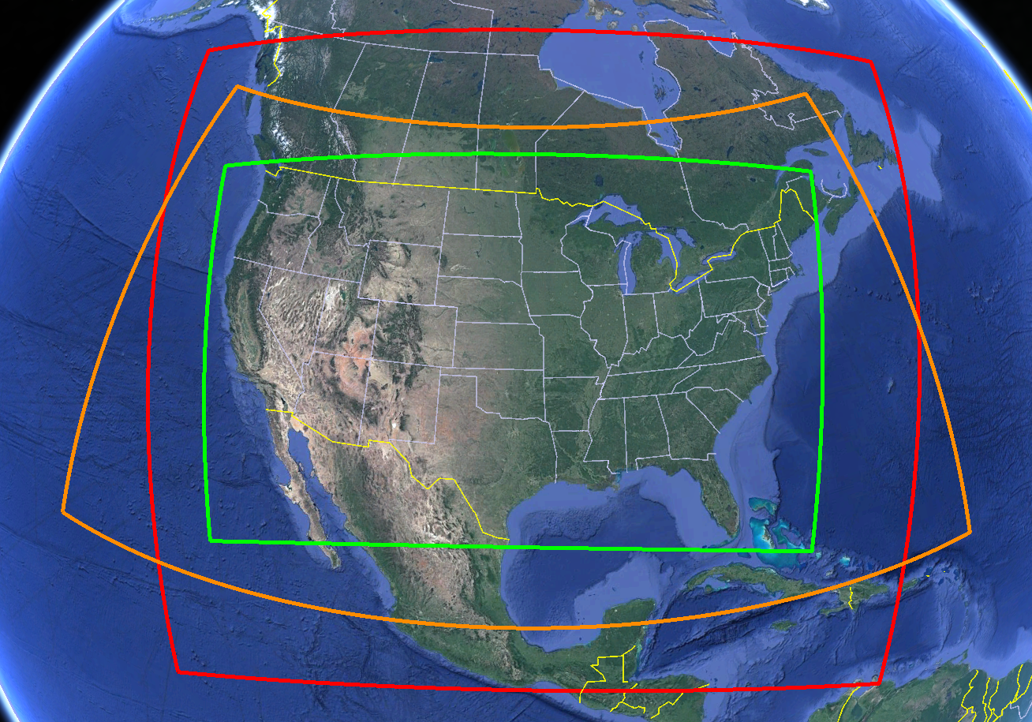
RAVE FEI Details
Substantial increase in spatial (0.03° vs. 0.1°) and temporal (hourly vs. daily) resolution compared to other FEIs
Inclusion of 5-min GOES FRP should help better capture diurnal variation in fire intensity/emissions
RAVE extent does not include entirety of EPA 36US3 domain
  Need to “stitch” emissions from another FEI
No individual VOC species provided
  Landcover-dependent VOC split factors available from FINN
12US2
RAVE FEI
36US3

