Slide 1
Impacts on a Wildland Emissions Inventory when using the Smoke Emissions Reference Application (SERA) emissions factors: Year 2021 Case Study
J VUKOVICH, USEPA/OAQPS/EIAG OCT 18, 2023
2023 CMAS CONFERENCE ChaPEL HILL, NC
ACKNOWLEDGE: JAMES BEIDLER (ORD), GEORGE POULIOT (ORD), Christine Allen (GDIT)

Slide 2
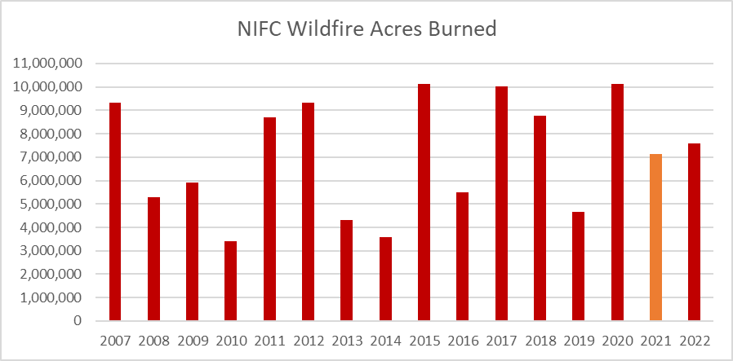
2021 Wildfire season: 7.125M acres
Annual average for period = 7.11M acres
NIFC = National Interagency Fire Center

Slide 3
2021 Wildfire season: Top fires
NIFC totals from http://nifc.gov

Slide 4
Key features of 2021 inventory compilation
and comparison
Produced day-specific emissions for prescribed burns and wildfires
Emissions include Criteria Air Pollutants (CAPs) and Hazard Air Pollutants (HAPs)
Used available national/federal activity databases with satellite detects from Hazard Mapping System (HMS) (from NOAA/NESDIS¹)
Used Smartfire2 to reconcile detects with all activity databases to produce daily acres burn by fire type (wildfire and prescribed only)
Used US Forest Service’s Bluesky Pipeline to estimate emissions
  One run with Fire Emission Production Simulator (FEPSv2) emissions factors (used in last 4 NEI cycles)
  One run with Smoke Emissions Reference Application (SERA) emissions factors
Flint Hills grassland prescribed fires handled outside of Bluesky Pipeline
  Not using FEPSv2 so not covered in this presentation
Emissions are provided for both flaming and smoldering combustion phases
¹ National Oceanic and Atmospheric Administration/National Environmental Satellite, Data, and Information Service

Slide 5
Bluesky Pipeline (BSP)
US Forest Service has significantly updated the Bluesky Framework and named the new system “Bluesky Pipeline”
It is open source at https://github.com/pnwairfire/bluesky
Currently, BSP version 4.2.13 used at EPA
EPA has applied BSP for various other years and projects
  2020 NEI Wildland fire emissions (FEPSv2)
  EQUATES time series (FEPSv2) (https://www.epa.gov/cmaq/equates#emissions_modeling )
BSP has both SERA and FEPSv2 emissions factors available
FEPSv2 factors vary by combustion phase only, limited pollutants
SERA factors can vary by phase, fire type, region, fuel type and more pollutants

Slide 6
Smoke Emissions Reference Application (SERA)
SERA is a searchable online database coordinated by the US Forest Service and University of Washington
Consists of existing peer-reviewed emission factors (EFs) of 276 known air pollutants
EF records include modified combustion efficiency, fuel type, study type, measurement platform (ground, tower or air-based), geographic location and source reference.
Database enables the analysis and summaries of existing EFs, and creation of average EFs to be used in decision support tools for smoke management, including BSP
SERA was designed to provide a synthesis of existing EFs and summary values for emissions modelling that can facilitate more rapid incorporation of EFs

Slide 7
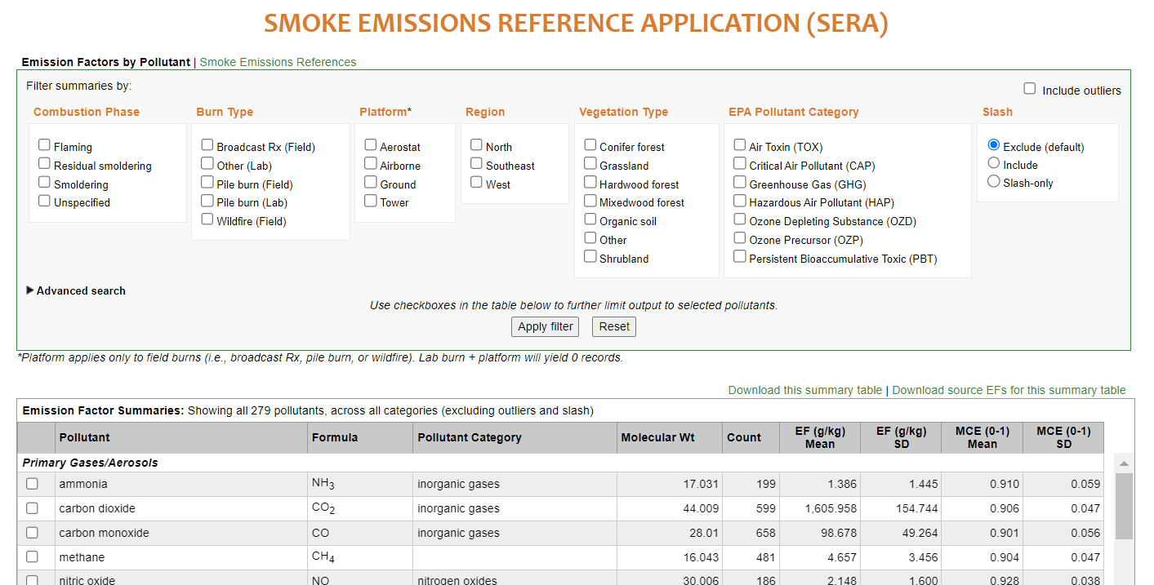
https://depts.washington.edu/nwfire/sera/index.php

Slide 8
Smartfire2 and Agriculture burn processing for 2021
ICS-209(WF)
NIFS (WF)
FACTS(WF/Rx)
WF = Wildfire
Rx = Prescribed burn
NOAA Hazard Mapping System (HMS) Detects
USDA Cropland Data Layer (CDL) + FCCS combined
Ag land detects
Non-ag and grassland detects
Crop residue burning fire methodology (USEPA)
SmartFire2
NATIONAL AND FEDERAL DATA
Day-specific Ag burn Fire location, Acres Burned and Emissions
Day-specific Fire lat-lon, Type and Acres Burned

Slide 9
S
Fuels
(FCCSv3: Landfire v2)
Proportional Fuels
Fire Location
(lat-lon and geoJSON)
Consumption
(Consume v5)
Dates
Fire Type
Emissions Factors (FEPSv2)
Fire Size
Day-Specific Emissions
SmartFire2 Output
Bluesky Pipeline
FCCS = Fuel Characteristic Classification System FEPS = Fire Emission Production Simulator

Slide 10
S
Fuels
(FCCSv3: Landfire v2)
Proportional Fuels
Fire Location
(lat-lon and geoJSON)
Consumption
(Consume v5)
Dates
Fire Type
Emissions Factors (SERA)
Fire Size
Day-Specific Emissions
SmartFire2 Output
Bluesky Pipeline
FCCS = Fuel Characteristic Classification System SERA=Smoke Emissions Reference Application

Slide 11
CONUS Wildland Criteria Air Pollutant Emissions Totals (tons)

Slide 12
CONUS Emissions Totals (tons) by fire type
NIFC Wildfire acres burned = 7.125M

Slide 13
CONUS Emissions Totals (tons) by phase type

Slide 14
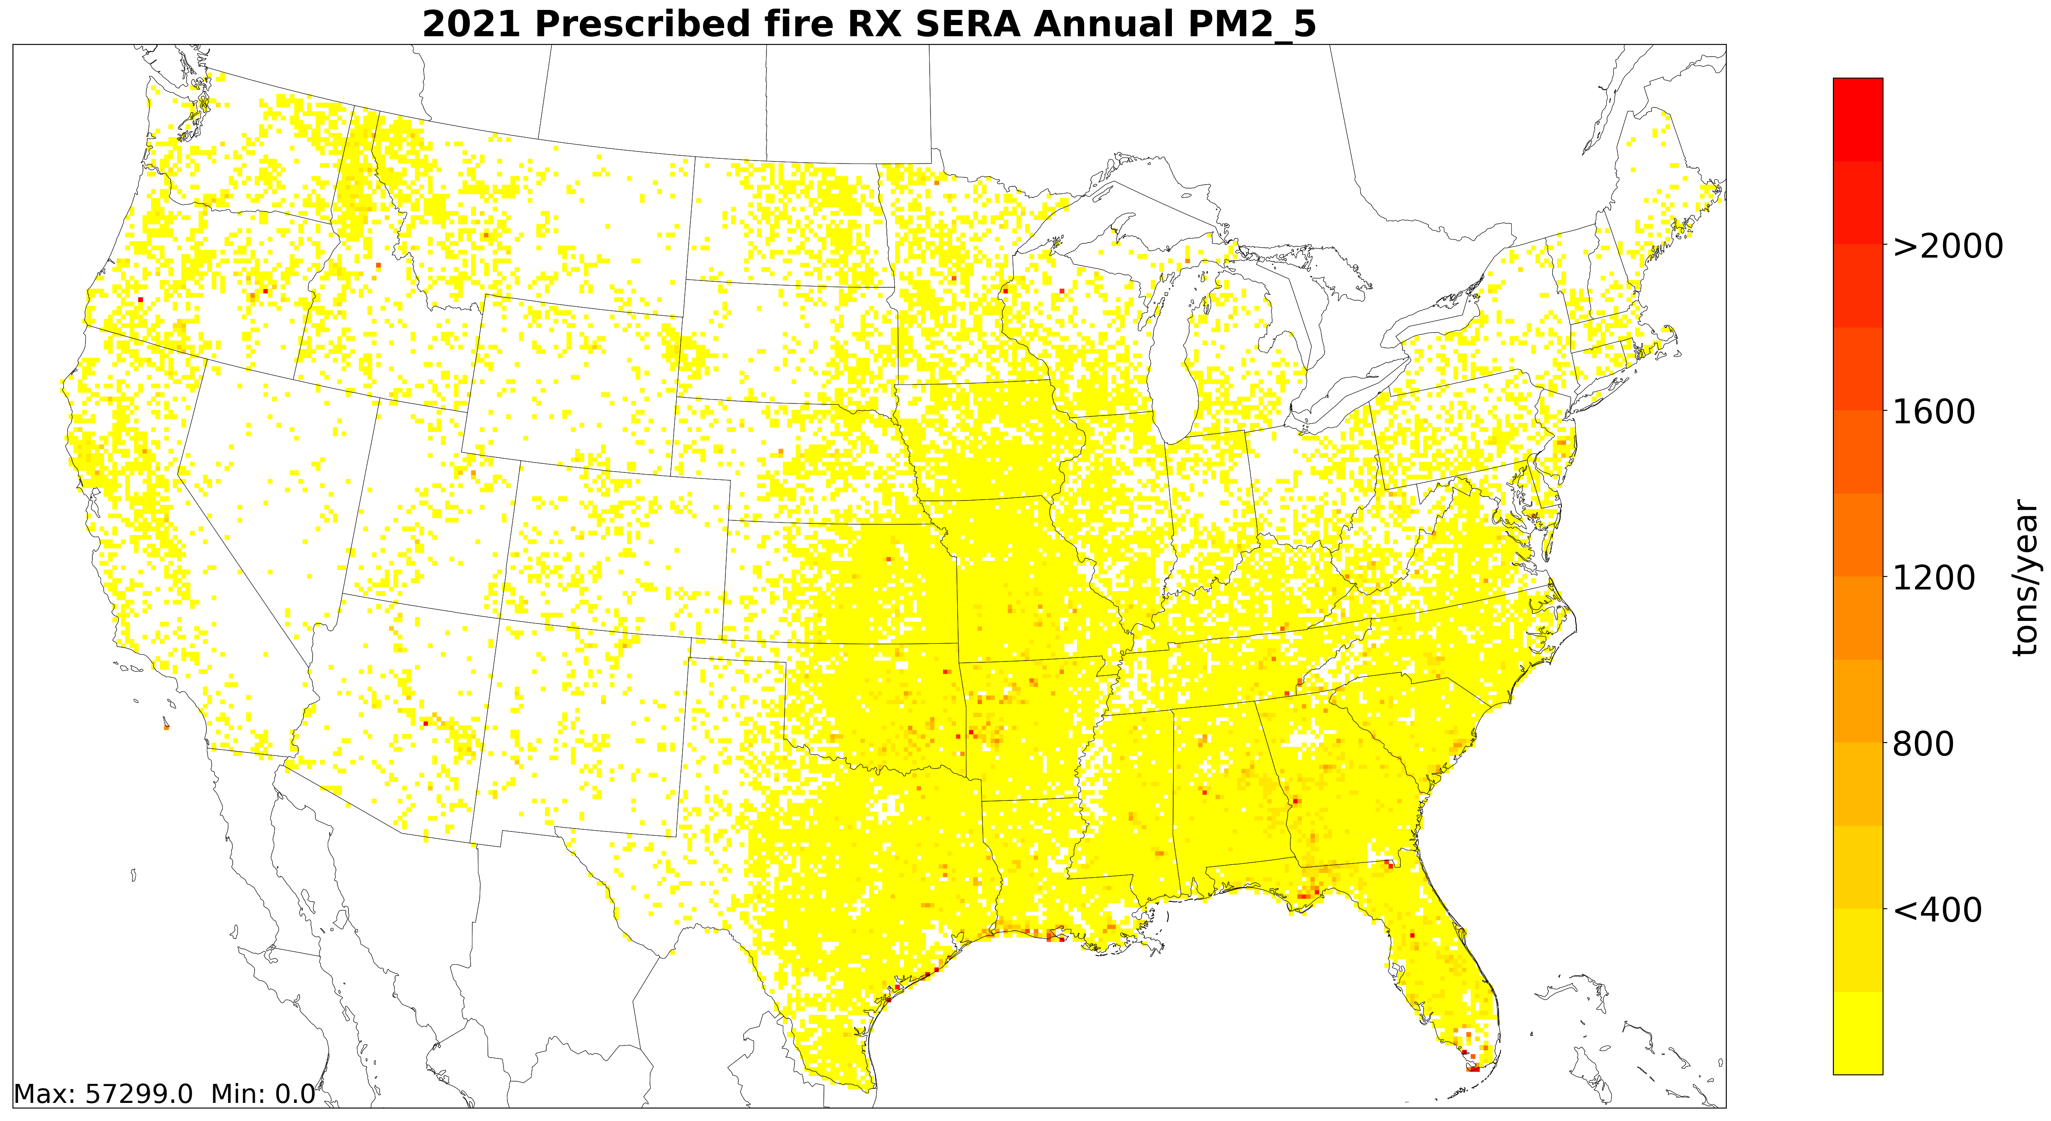

Slide 15
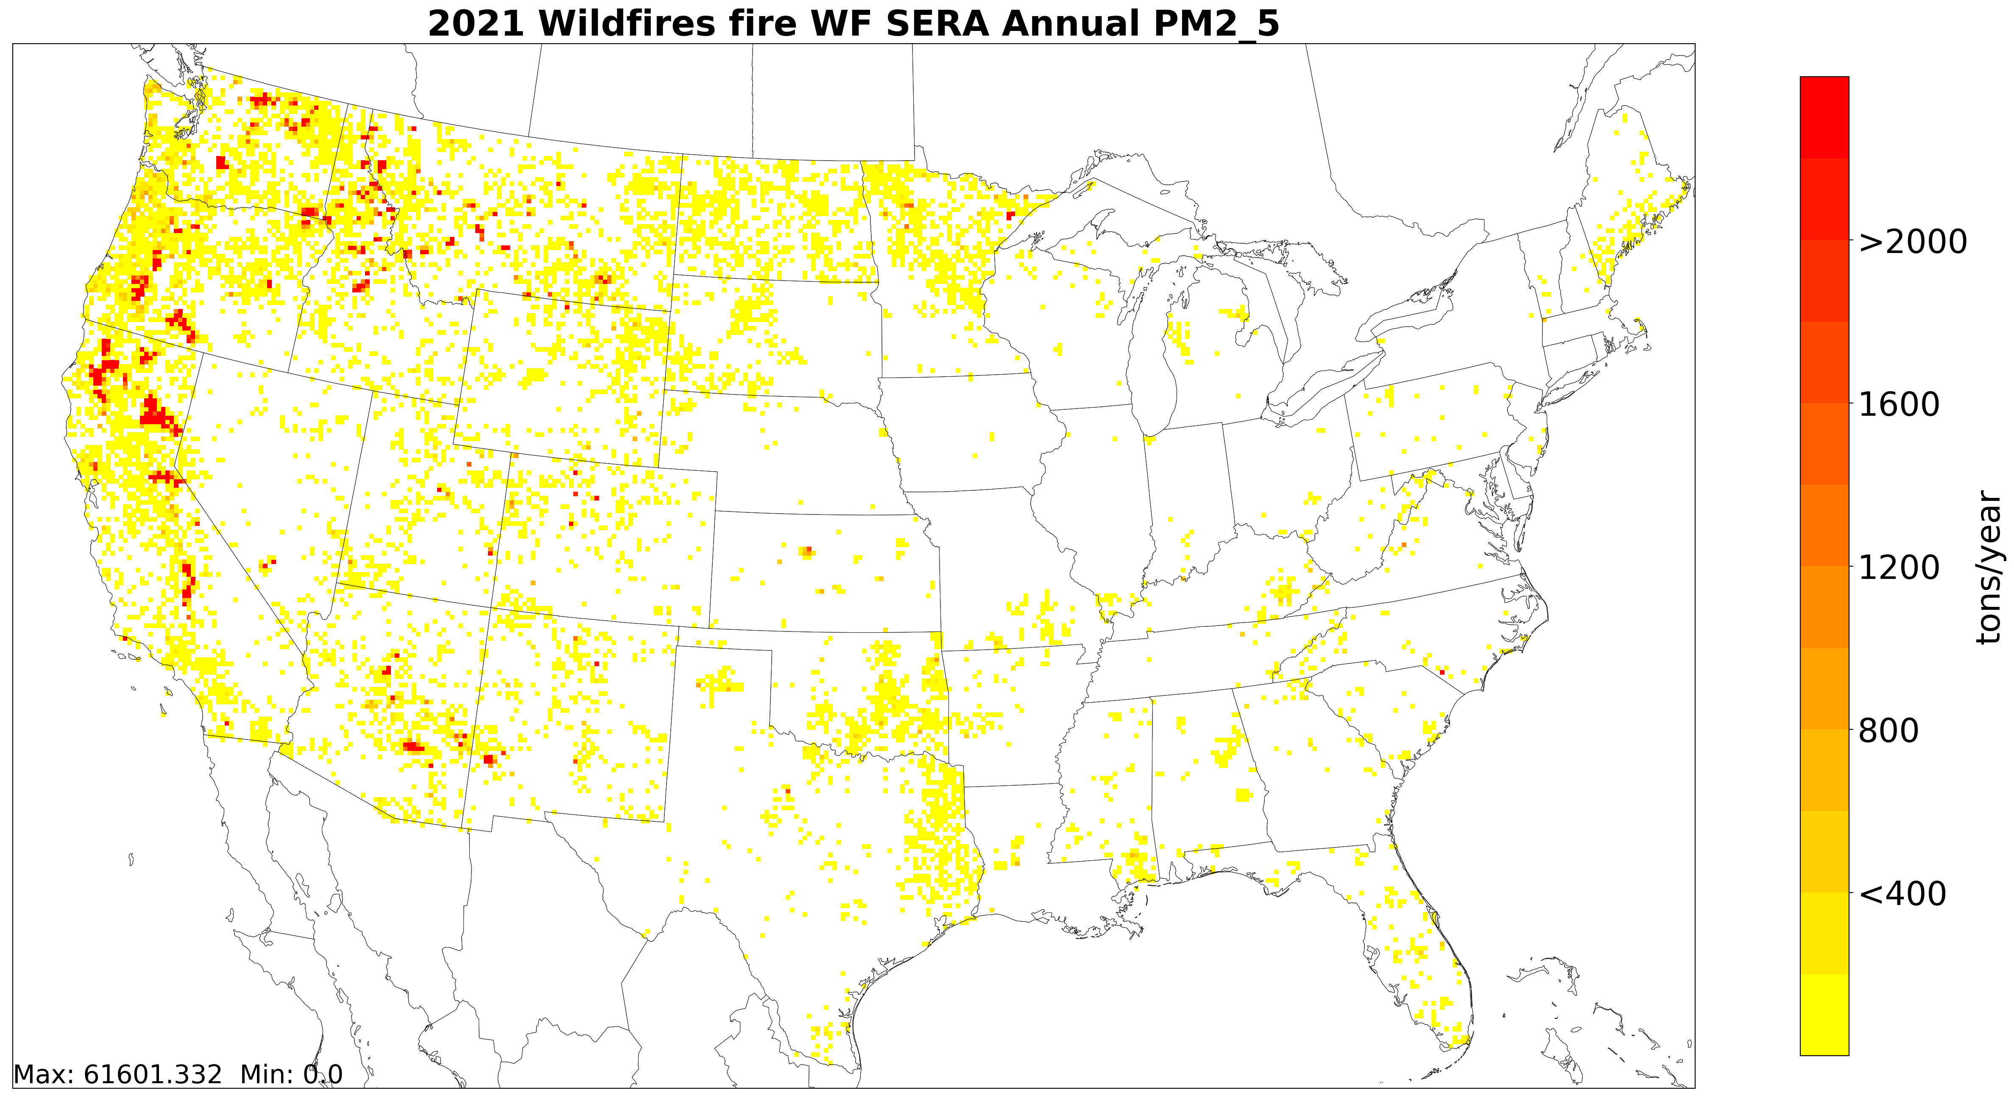

Slide 16
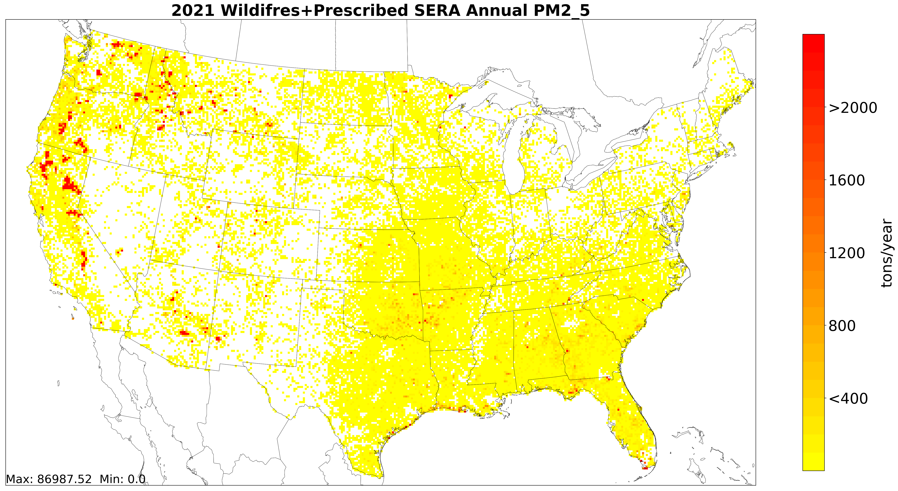

Slide 17
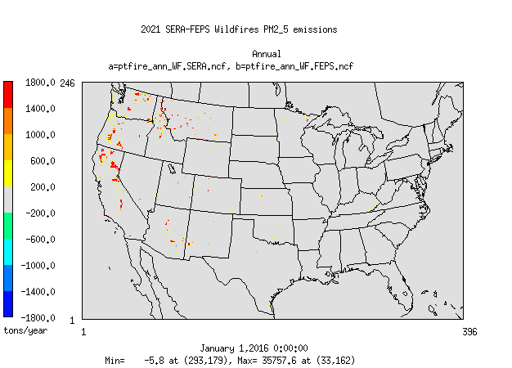
PM2.5 Wildfire emissions difference: SERA minus FEPS

Slide 18
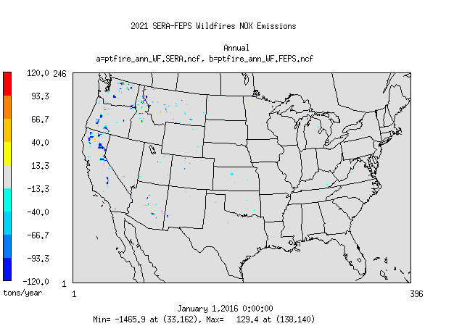
NOx Wildfire emissions difference: SERA minus FEPS

Slide 19
Top Wildfires emissions changes (tons) by state

Slide 20
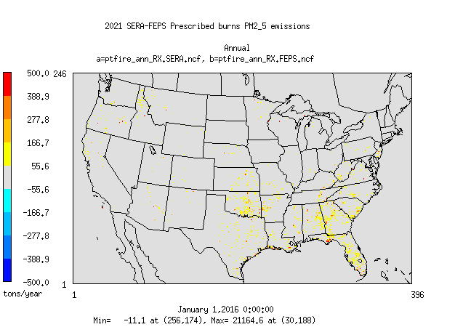
PM2.5 Prescribed burn emissions difference:
SERA minus FEPS

Slide 21
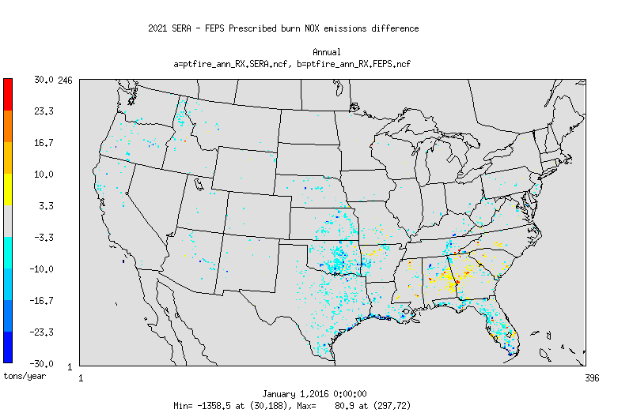
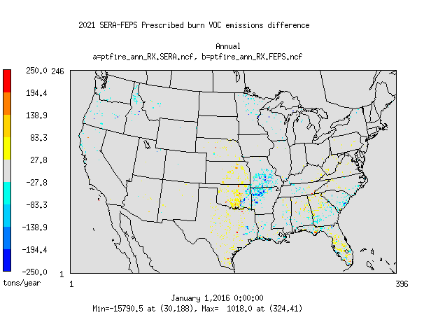
NOx
Prescribed burn emissions
difference: SERA minus FEPS
VOC

Slide 22
Top Prescribed burn emissions changes (tons) by state

Slide 23
Top PM2_5
Emitting Acres
Burned-Fuels
In 2021 for
Wildfires
Top PM2_5
Emitting Acres
Burned-Fuels
In 2021 for
Prescribed
burns

Slide 24
PM2.5 Emissions Budget:
2020NEI Anthropogenic + 2021 CONUS Wildland fires
FEPS
SERA
Doesn’t include Flint Hills prescribed fires or Alaska wildfires

Slide 25
Conclusions and Plans
SERA database enables the analysis and summaries of existing EFs, and creation of average EFs now available in BSP
Unlike the FEPSv2 factors that only vary by phase the SERA factors can vary by phase, fire type, region, fuel type and more pollutants
In this year 2021 case, the CONUS PM2.5 wildland emissions doubled using the SERA EFs vs the old FEPSv2 EFs; NOX emissions dropped ~23%
EPA to conduct air quality model simulation with year 2021 emissions soon
EPA plans to use the SERA factors in BlueSky Pipeline in upcoming emissions inventory/modeling platforms including year 2022 Collaboration and the 2023NEI

Slide 26
Any questions about 2020 NEI fires please contact Vukovich.Jeffrey@epa.gov

Slide 27
THE END
BUT
EXTRA SLIDES: FYI

Slide 28
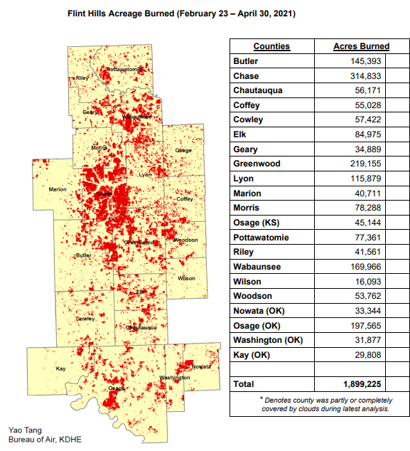
Estimating Area Burned Flint Hills Prescribed Burning Spring 2021
Use all “Grass” HMS detects in these counties for the time of the prescribed Burning
Use SMOKE EMISSIONS REFERENCE APPLICATION (SERA) grass emission factors to estimate pollutants except PM2.5
PM2.5 from measurements in Flint Hills Amara Holder (EPA-ORD): 12.68 g/kg

Slide 29
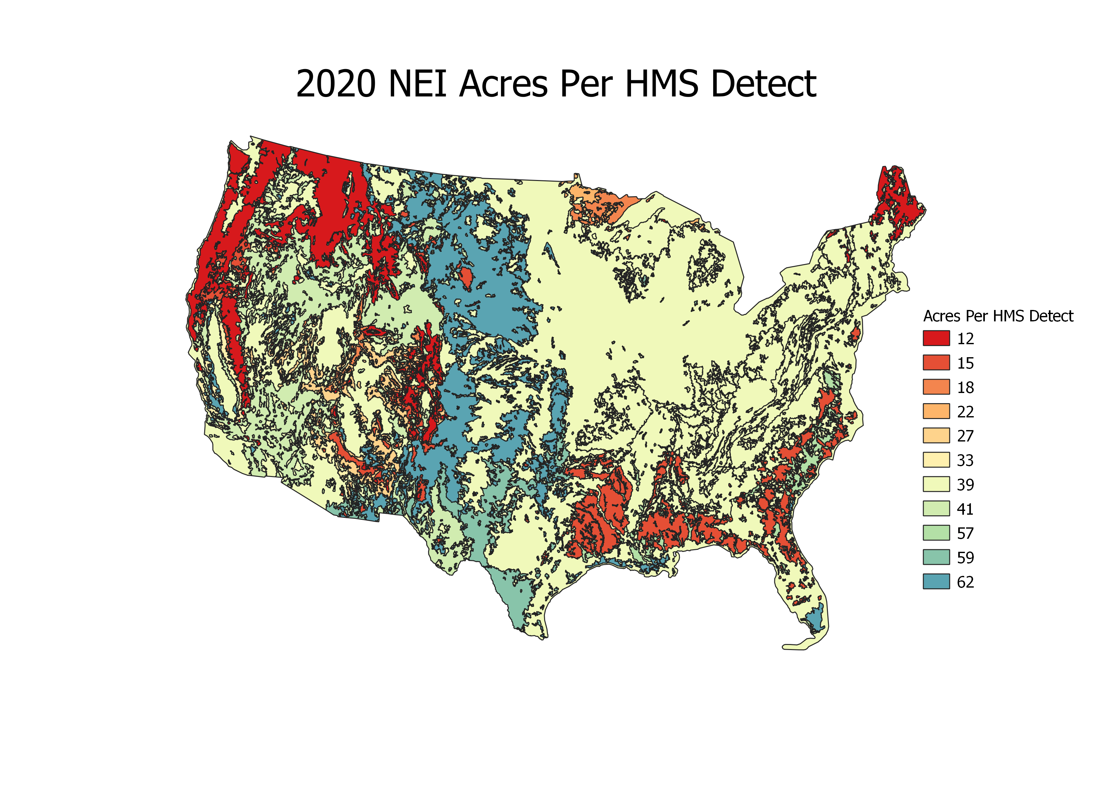

Slide 30
