Slide 1
WUDAPT
Objectives
Acquire information on aspects of form and functions of cities relevant to climate studies.
Store the data in a geographic framework that is searchable and widely accessible.
Build portal tools to extract urban canopy parameters (UCPs) and analyse urban properties for cross-urban comparison and model building.
WUDAPT was created as a community initiative and has no central organizing committee. Its direction is encouraged by Ching & Mills but the research is driven by diverse research groups.

Slide 2
 | Questions on climate relevant urban data
Q1. | Is WUDAPT a useful resource for the urban AQ community?
Q2. | What urban data is needed to improve urban AQ models that is difficult to get?
Q3. | How precise does this data have to be in terms of spatial/temporal resolution?
Q4. | How sensitive are current models to variation in urban inputs?
Q5. | Can global urban data of sufficient quality be gathered to run current AQ models?
Q6. | Which data gathering effort should be prioritized?
Q7. | How should the value of these produces be tested?
Q8. | Should these data gathering and testing efforts be coordinated and centralized? Does WUDAPT need a formal structure?

Slide 3
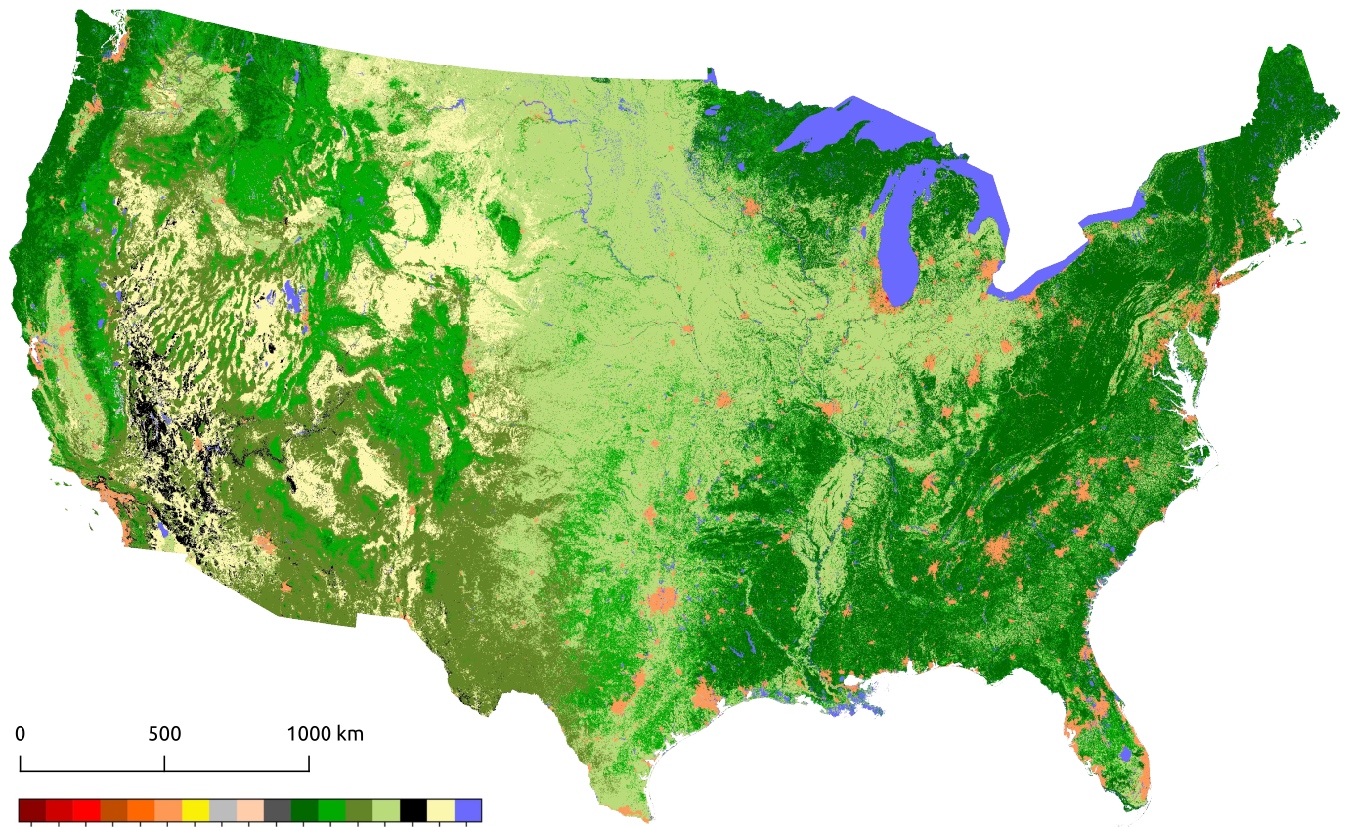
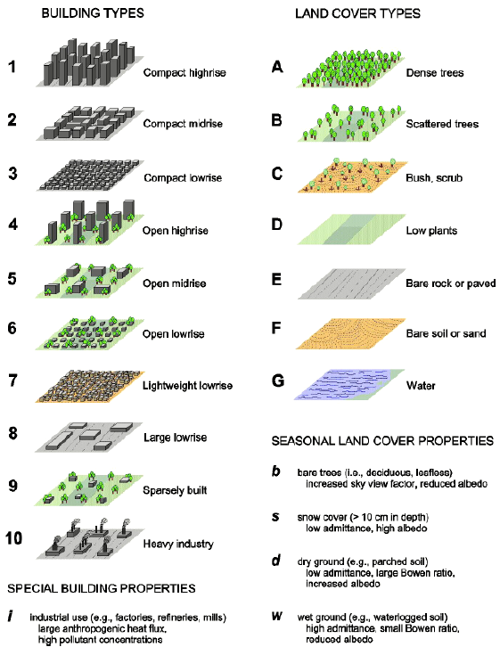
Global LCZ Map
https://lcz-generator.rub.de/

Slide 4
WUDAPT panel
This panel was originally organised by Jason Ching and his original idea drew upon the opportunity provided by multiple urban projects in the US and beyond that were conducting city-based research on multi-scale modelling, including air quality outcomes. He described these existing projects as providing potential testbeds as possible platforms for specific CMAS community collaborative engagements.
The context for this panel is the inclusion WUDAPT data in models such as Weather Research Forecasting (WRF) and the Community Earth System Model (CESM) and the potential for incorporating these data into AQ models.
Moderator Gerald Mills (UCD, Ireland)
Panel:
Jon Pleim (USEPA)
Taciana Albuquerque (The Federal University of Minas Gerais, Brazil)
Sarav Arunachalam (UNC Institute for the Environment)
Yang Zhang (Northeastern University)

Slide 5
The objective of the panel is to discuss what the priorities for WUDAPT should be in terms of data acquisition and processing to support climate/AQ models.
The panel conversation would be structured around the issues that are relevant for the current/next generation models.
The types of models that need information at a scale ≤1km².
The urban data demands:
Information on the urban physical landscape (spatial morphology/thermal/radiative properties) and
on the urban anthropogenic contributions (time/space varying). This would include sub-km emissions of heat/vapour and pollutants.
Do the models agree on the urban data needed?
Are there ways of acquiring useful urban data consistently and globally?
What data acquisition and processing should be prioritised?
A second objective is the testing of these data in an urban model case-study where there are observations to evaluate model outputs.

Slide 6
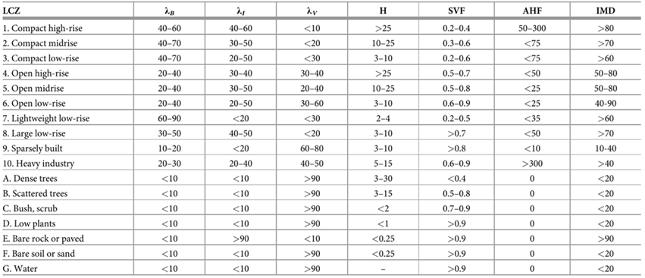
LCZ based urban canopy parameter ranges
Built fraction, Impervious ground fraction, Vegetative fraction, Mean building height, Sky view factor, Anthropogenic Heat flux, Impermeable surface cover.
In climate/weather models the 10 urban classes and their UCP values are substituted for the existing urban classes. The natural classes are not used.

Slide 7
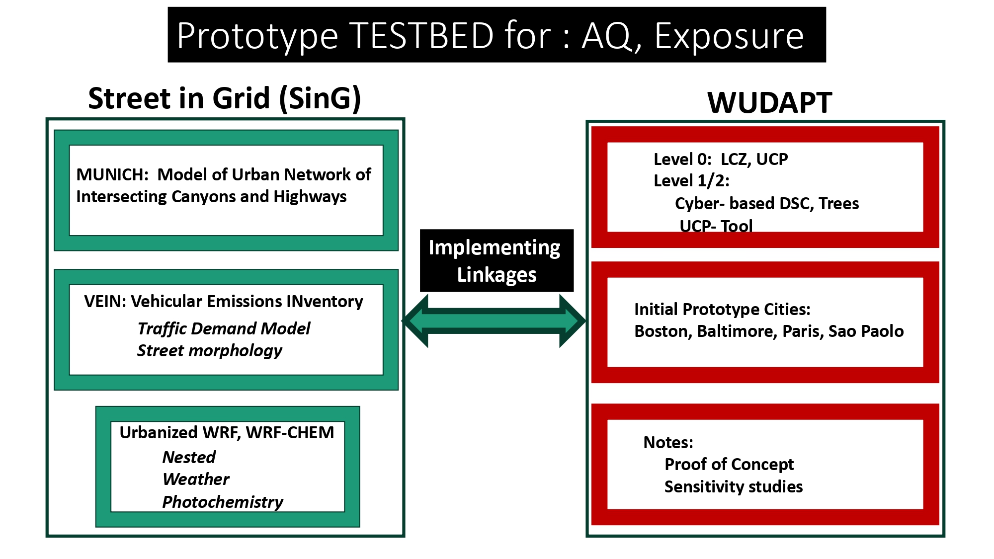
Example testbed linking WUDAPT data to MUNICH

Slide 8
 | Questions on climate relevant urban data
Q1. | Is WUDAPT a useful resource for the urban AQ community?
Q2. | What urban data is needed to improve urban AQ models that is difficult to get?
Q3. | How precise does this data have to be in terms of spatial/temporal resolution?
Q4. | How sensitive are current models to variation in urban inputs?
Q5. | Can global urban data of sufficient quality be gathered to run current AQ models?
Q6. | Which data gathering effort should be prioritized?
Q7. | How should the value of these produces be tested?
Q8. | Should these data gathering and testing efforts be coordinated and centralized? Does WUDAPT need a formal structure?

