Slide 1
Evaluating Meteorological Effects of GSLA Growth Using Urban Canopy Modeling
Corey L. Smithson, Bradley R. Adams
Brigham Young University
Air Quality Research Lab
2023 CMAS Conference
October 16-18, 2023

Slide 2

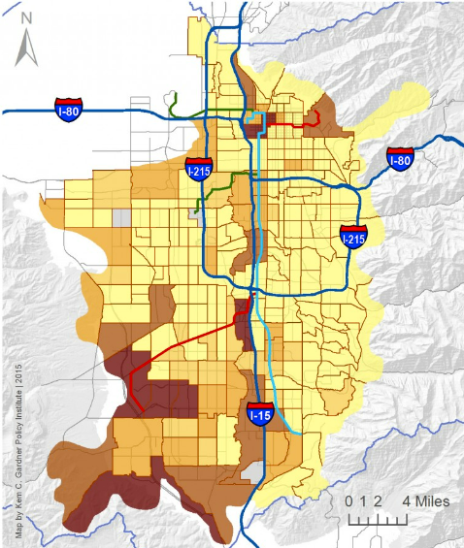


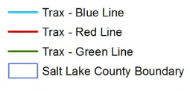
Introduction
Greater Salt Lake City Area (GSLA) continues to experienced significant urban growth
Increases potential for meteorological impacts via increased urban structures and heating (urban canopy)
Objectives:
  Predict effects of urban growth on local met conditions (2-m air temp, RH, 10-m wind speed)
  Document modeling approach
    “User Guide for Urban Canopy Modeling in WRF” (https://doi.org/10.26067/NMYT-4Z93)
Percent Change 2010-2014
Source: Kem C Gardner
Policy Institute
University of Utah
Notes:
higher temperatures can increase energy consumption and induce negative health effects

Slide 3
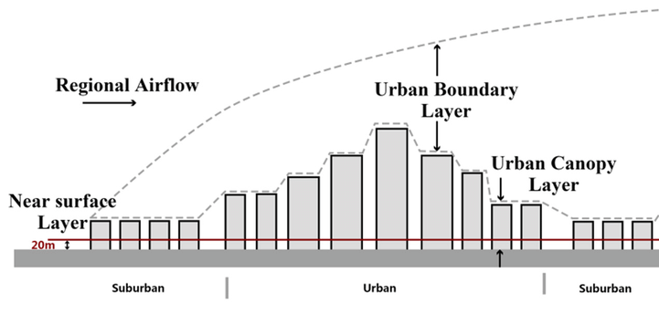
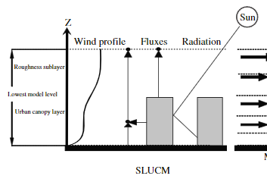
Urban Canopy Models (UCM)
Urban canopy refers to effects of building profiles, varying land surface properties and anthropogenic heating on local meteorological conditions
Three UCM options to represent canopy behavior:
  Slab UCM represents urban areas with surface roughness adjustment based on gross surface albedo and heat capacity
  Single-layer UCM includes effects of street canyons, roofs, roads, vegetation fraction
  Multi-layer UCM adds increased spatial refinement, but requires more detailed inputs and computational time
    WRF v4.5 simplifies urban property specification
Single Layer UCM
Notes:
Noah default is Slab UCM
The single-layer UCM represents urban areas by including estimations of street canyons, roofs, and roads [10]. S-L considers only one orientation of two-dimensional approximation of streets and evaluates urban classes with different thermal properties. Provides accurate estimation of sensible heat fluxes by assuming wind distribution in canopy, where horizontal wind is presumed distributed vertically as combination of logarithmic and exponential functions. S-L also takes into account radiation trapping effects due to multi-reflections in urban geometry and considers fraction of albedo and vegetation on roofs, walls, and grounds. Anthropogenic heat is estimated as a fixed temporal profile added to sensible heat flux from street canyon.

Slide 4
WRF-UCM Modeling Approach
Model Parameters
Meteorological Data
Static Surface Data
LCZs map refined urban/rural properties into WRF land use categories
LSMs simulate interaction between surface processes and atmosphere
  Default 5-layer thermal diffusion LSM does not allow layered UCMs
UCMs use refined urban definitions to improve exchange between surface and atmosphere
Modeling Approach:
  Develop GSLA baseline model w/LSM, UCM, LCZ
  Modify LCZs to assess urban growth scenarios
WPS
(WRF Preprocessing System)
Geogrid
Ungrib
Metgrid
Local Climate Zones
(LCZs)
WRF (v4.3)
(Weather Research and Forecasting Model)
Land Surface Model, Urban Canopy Model
Meteorological Output (T, RH, V)
Notes:
LSMs help define surface roughness which affects viscous force which is included in F source terms in momentum eqs. LSMs also contribute to Q source term in energy equation via heat fluxes and radiation and defined surface temperature.
UCMs use bulk urban characteristics to determine effects of urban canopy [15]. UCMs incorporated into WRF model as sub-grid parameterization scheme [23]. UCM models exchange of energy, momentum, and mass between urban surface and overlying atmosphere. Provides lower BCs for main WRF atmospheric model

Slide 5
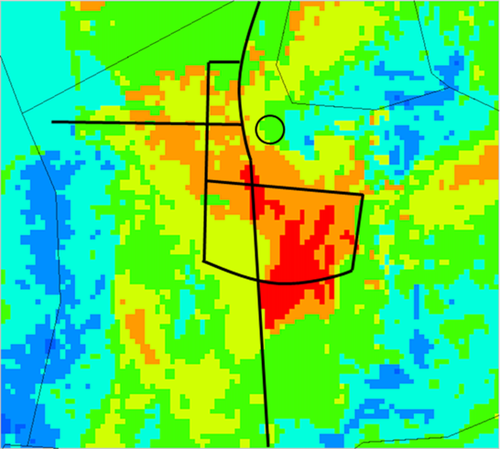
Land Surface Model Comparisons
7/30/2019 3:00 am MDT
Predicted and measured 2-m temperatures near SLC downtown (Gateway station) over a 1-week period
2-m temperature differences between 5-layer diffusion (default) and Noah models. Positive differences indicate Noah predicted higher temperatures.
Significant nighttime differences in mixed-use areas
Minimal daytime differences
Noah predictions more closely match diurnal temperatures
Noah-MP 2-4°C cooler temps, better RH, 2X runtimes

Slide 6
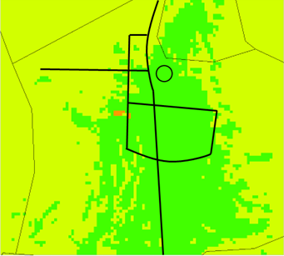
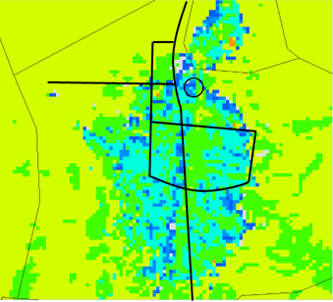
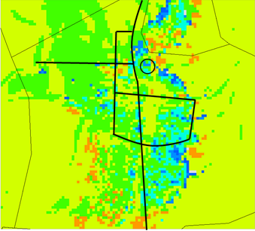
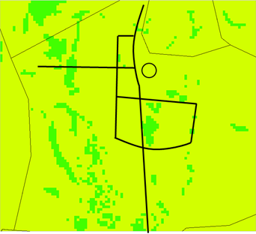
Urban Canopy Model Comparison
7/28/2019 6:00 PM MDT
9:00 PM MDT
3:00 AM MDT
9:00 AM MDT
Predicted and measured 2-m temperatures approximately 2 miles southeast of SLC downtown (Hawthorne Elementary)
Largest differences between 9:00 pm and 6:00 am MDT, reflects gradual decrease in anthropogenic heat rates
Decreased temps in more vegetative areas, consistent with [Nehkron et al., 2013] study
Noah single-layer UCM more accurate than Noah slab
2-m temperature differences between single-layer and slab UCMs. Positive differences indicate single-layer predicted warmer temperatures.
Notes:
cooler temperatures predicted using the single-layer UCM are initially surprising, but simply mean that the Noah LSM discussed previously already accounts for much of the heating and vegetation effects of the urban areas.
Nehkron et al., saw similar trends in their study and theorized that the decrease was due to the change from a single urban classification to low density urban classification that included a lower surface emissivity.

Slide 7
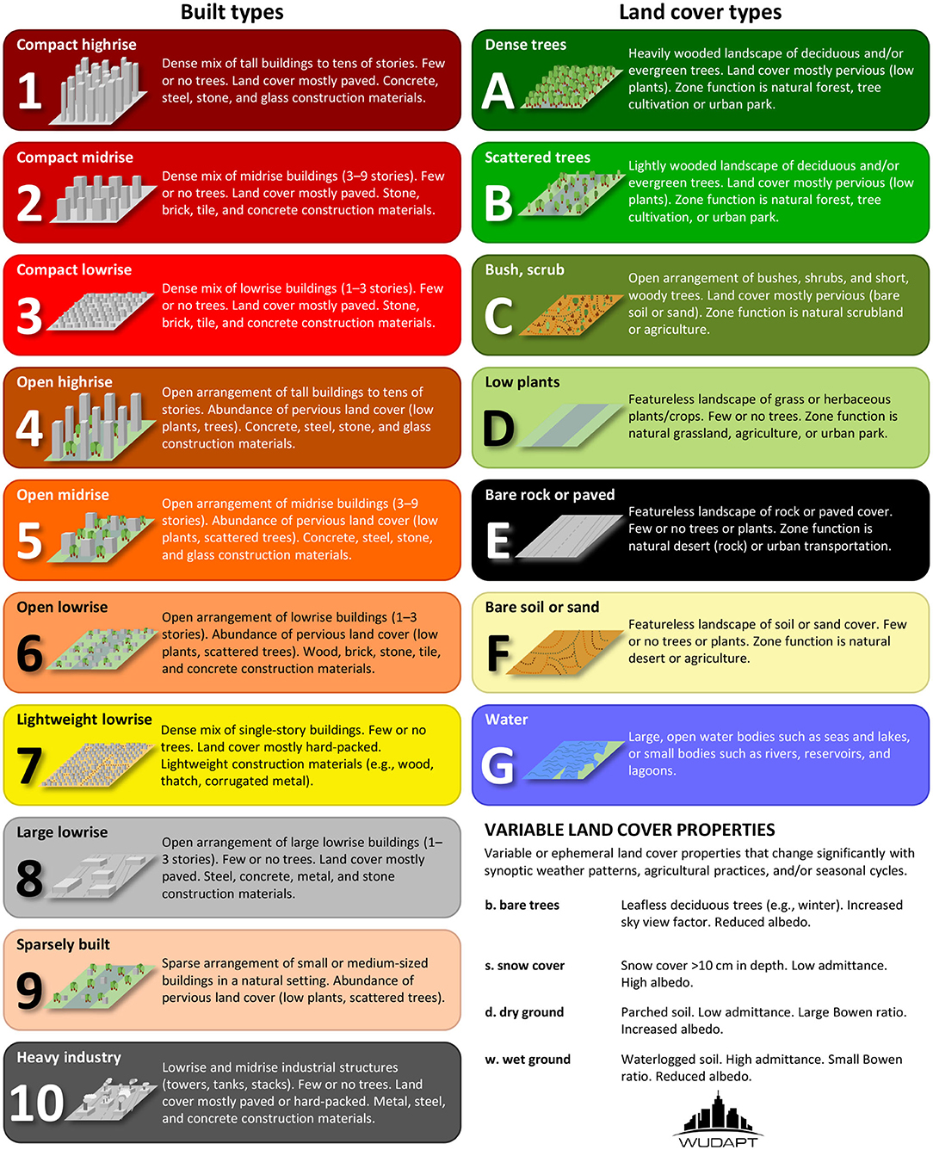
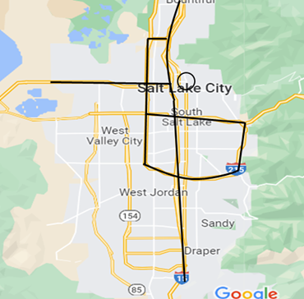
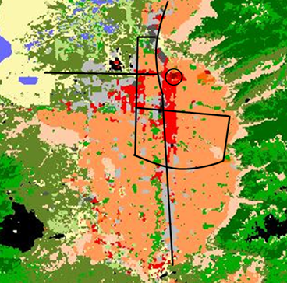
Local Climate Zones (LCZs)
WUDAPT LCZs map urban and rural areas into land use categories used by WRF (10 built types, 7 land cover types)
Categories represent different geoms, AH rates, veg. frac.
WRF-UCM default is 3 urban categories (NUDAPT), no shrub
LCZ maps edited to represent growth scenarios

Slide 8
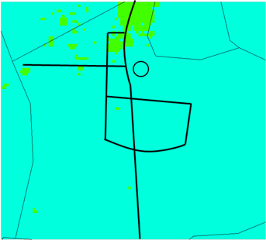
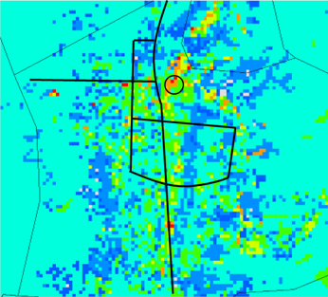
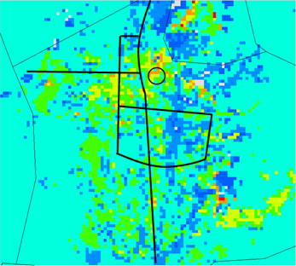
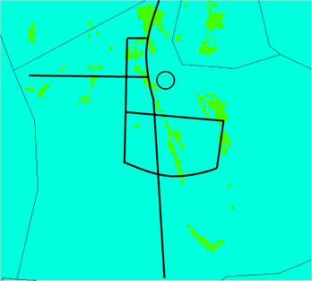
LCZ Effects
7/28/2019 6:00 PM MDT
9:00 PM MDT
Differences most pronounced during nighttime hours
LCZs produced 5-10°C higher temperatures in more urban areas
LCZs 4-6°C lower temperatures in more suburban/rural areas
Consistent with LCZs more refined heating descriptions
3:00 AM MDT
9:00 AM MDT
2-m temperature differences with WUDAPT LCZs vs. NUDAPT. Positive values indicate LCZs predicted warmer temperatures.

Slide 9
Baseline Model Summary
3-nested grid with inner domain of 500m (tested 1000, 500, 300m)
Noah LSM better captures diurnal patterns and enables layered UCMs
Single-layer UCM predicts more accurate 2-m temperatures than slab model
WUDAPT LCZs resulted in greater spatial variation in temperatures
  Urban areas have higher temperatures
  Suburban/rural areas have lower temperatures
Predicted temperatures sensitive to Anthropogenic Heating rates during nighttime hours

Slide 10
Baseline Model Validation
10-meter Wind Speeds
Predicted and measured conditions at Hawthorne Elementary, 7/28/19 – 8/5/19
Baseline model matched trends
Temperature most accurate; wind most challenging
2-meter Temperature
2-meter Relative Humidity

Slide 11
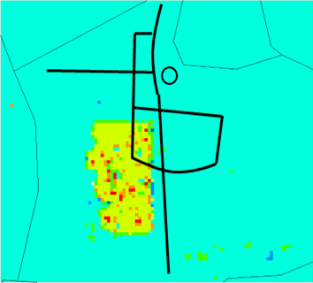
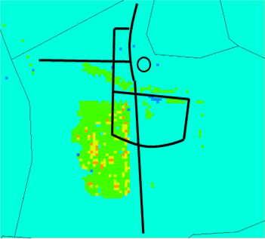
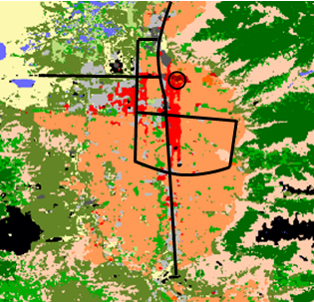
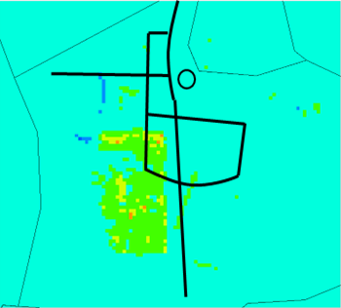
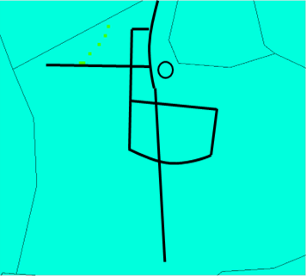
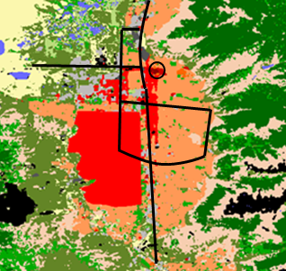
Urbanized Western Side of Valley
7/28/19 9:00 PM MDT
12:00 AM MDT
LCZ change - western side changed from Open Lowrise to Compact Lowrise
Nighttime temperatures increased by 3-6°C across modified region with local increases up to 11°C
Consistent with increased anthropogenic heating
Insolation dominates in daytime
6:00 AM MDT
9:00 AM MDT
6:00 AM MDT
2-m temperature differences. Positive values indicate urbanized case had warmer temperatures

Slide 12
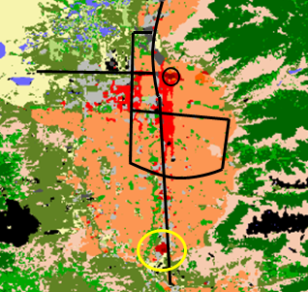
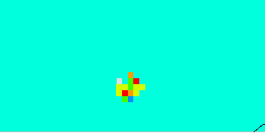
Development of Southern “Downtown”
LCZ change - Former prison site from Large Lowrise to Compact Highrise and Compact Midrise
Predicted nighttime temperatures increased locally by 3-10°C
Predicted relative humidity and wind speeds lower with urban development
Changes did not “drift” into adjacent regions
2-m Relative Humidity
10-m Wind Speed
2-m temperature differences at 9:00 pm. Positive values indicate urbanized case predicted warmer temperatures

Slide 13
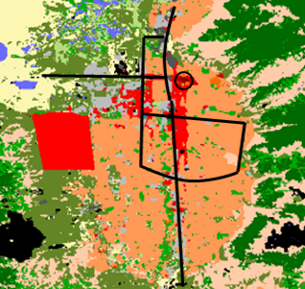
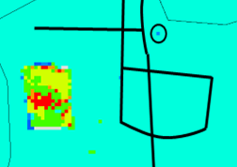
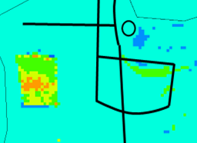
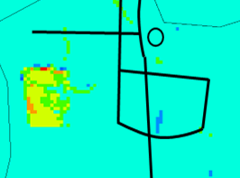
Urbanized Far Western Edge of Valley
Three regions of Open Lowrise, Sparsely Built, and Bush/Shrubland all transformed to Compact Lowrise
Largest differences occurred in region transformed from Sparsely Built to Compact Lowrise (5 W/m² AH & 0.3 urban frac vs 30 W/m² & 1.0)
Change from Bush/Shrubland to Compact Lowrise behaved differently due to no WRF UCM for non-urban category vs UCM for urban
7/28/19 9:00 PM MDT
12:00 AM MDT
6:00 AM MDT
2-m temperature differences. Positive values indicate urbanized case had warmer temperatures.
Notes:
Open lowrise – orange, Sparsely built – tan, Bush – olive green
Bush and Shrubland classification is not an urban category, thus WRF does not use a UCM when processing that region for the baseline case. WRF does use a UCM for the Compact Lowrise classification though, and as seen in the UCM sensitivity study, using a single-layer UCM can sometimes predict lower temperatures for some regions compared to using only the Noah LSM with no UCM
5 vs 10 vs 30

Slide 14
Conclusions
WRF-UCM framework developed, validated and documented
  500-m inner grid, Noah LSM, Single-layer UCM, WUDAPT LCZs
All GSLA urban growth scenarios increased local nighttime temperatures 5-10°C
  Driven by anthropogenic heating rates and urban fractions
Growth scenarios did not affect daytime temperatures
Increased urbanization affected local temperatures, but did not appear to have “downwind” effects
Increased urbanization decreased relative humidity
Effects on 10-meter wind speed were mixed

Slide 15
Acknowledgments
Funding for this research was provided by the Utah Division of Air Quality Science for Solutions, Contract #200762
High performance computing resources were provided by the BYU Office of Research Computing
Undergraduate researchers in the AQR Lab provided valuable assistance: Eric Monson (software scripts), Hans Klomp and Natalie White (simulations and post-processing), Joseph Cannon (LCZs), and Ariel Cable (WRF preprocessing)

Slide 17
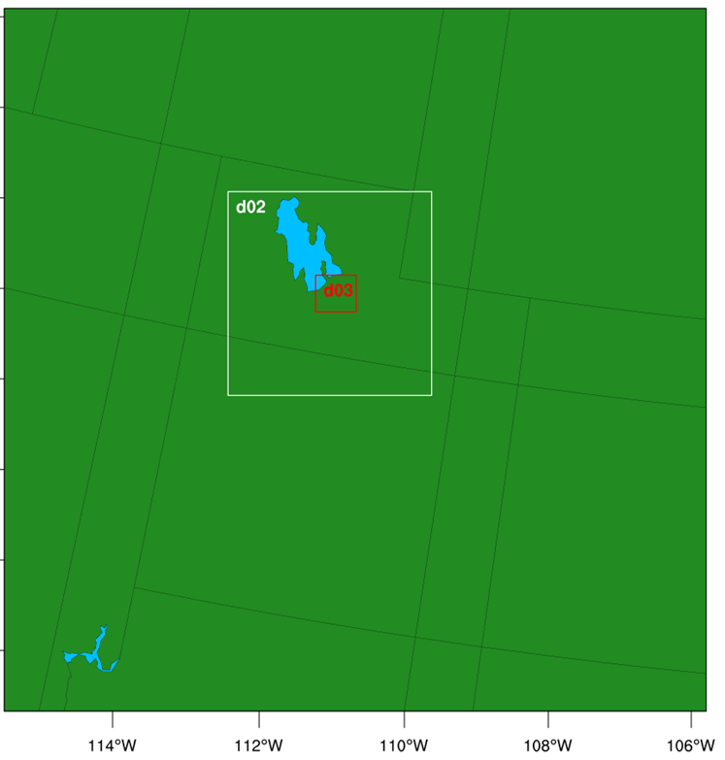
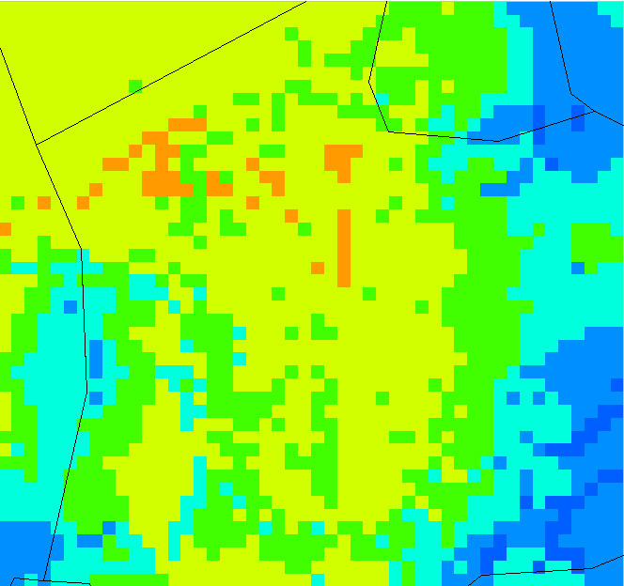
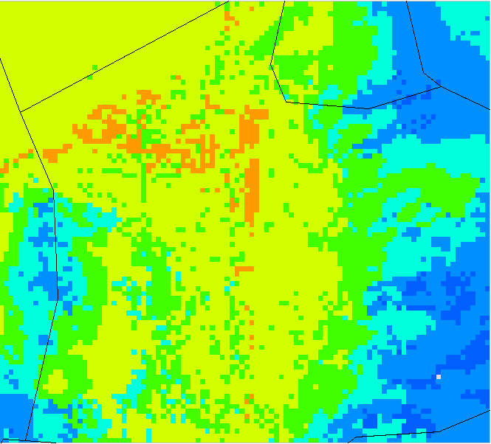
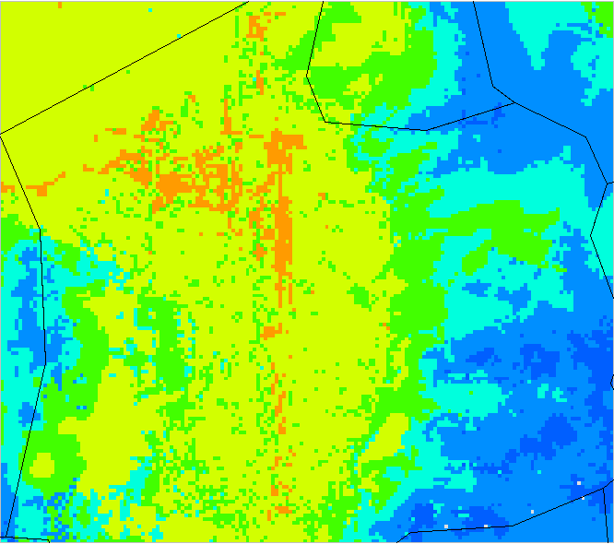
Mesh Resolution Effects
Inner Domain Grid: 1000m
Inner Domain Grid: 500m
Inner Domain Grid: 300m
3 nested domains
2-meter temperatures (°C)
Simulation Time Period:
July 28 – August 5, 2019
1.2km typical for inner domain grid spacing
500m determined to be satisfactory
Domain size and boundary location had little effect on results
Notes:
What date/time for Verdi plots?

Slide 18
LSMs

Slide 19
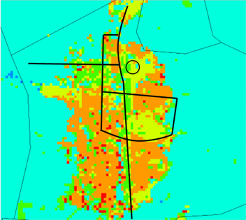
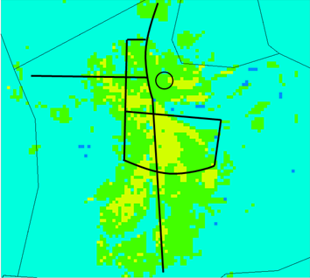
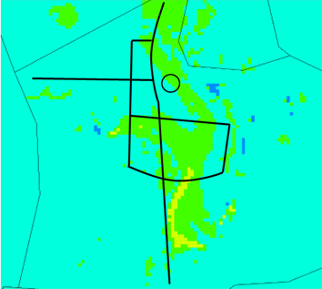
Anthropogenic Heating Effects
7/28/2019 9:00 PM MDT
12:00 AM MDT
6:00 AM MDT
(Rate = AH_{const} * MF)
2-m temperature differences between default and high AH cases
Hourly Multiplication Factor applied to anthropogenic heating constant
Increased AH has large effect in early nighttime
Effect diminishes as night progresses as AH rates decrease (AHI behavior)
Little to no effect during daytime because insolation dominates

