Slide 1

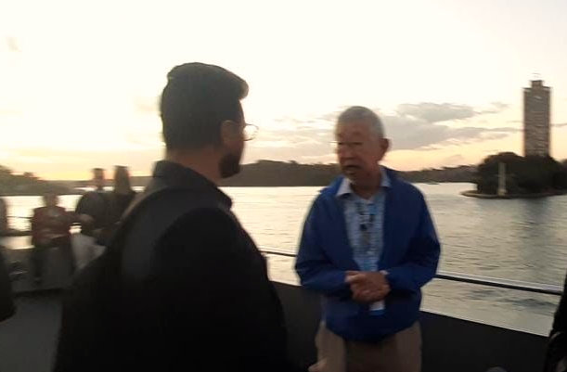




22nd Annual CMAS Conference 2023
World Urban Database and Access Portal Tool (WUDAPT),
special session in honor of Jason Ching
Multi-scale modeling of urban carbon emissions: Integrating WRF and MUNICH models in Dublin, Ireland
Authors
Ankur Prabhat Sati & Gerald Mills
School of Geography, University College of Dublin Ireland

Slide 2
Contents
The main objective of the present work is the estimation of urban greenhouse emissions using
WRF-chem over Ireland with a final focus on the capital city, Dublin using MUNICH model
WRF-chem Model set-up
Local Climate Zones (LCZs) in WRF Model
Vegetation Photosynthesis and Respiration Model (VPRM)
Model performance evaluation
Model of Urban Network of Intersecting Canyons and Highways (MUNICH)
Conclusions

Slide 3

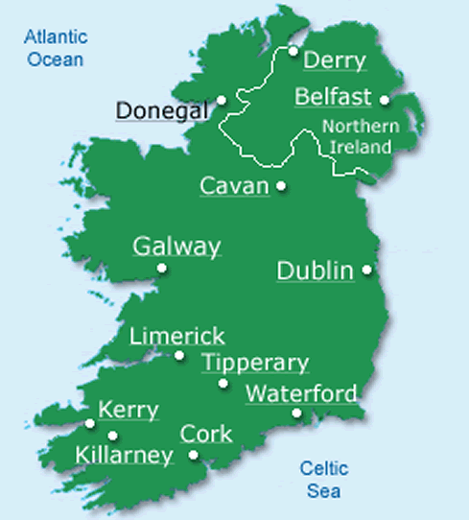
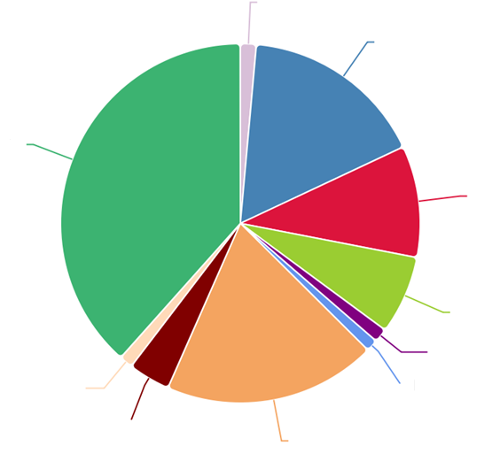
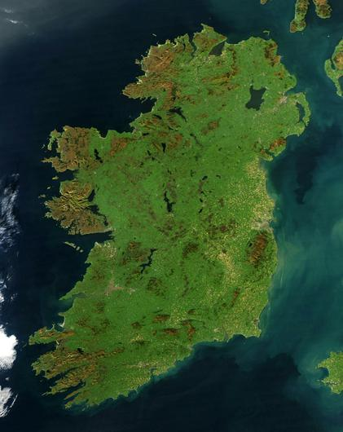
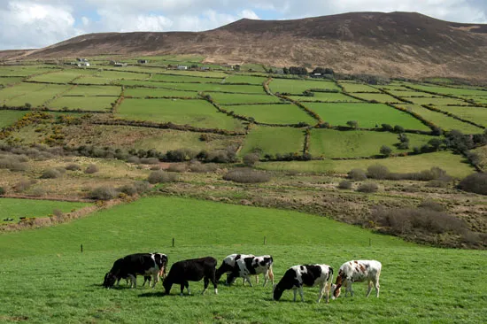
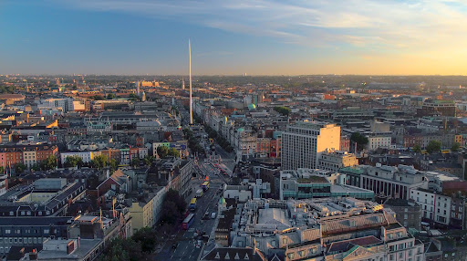
Ireland and Greenhouse gas emissions
 | Ireland | N Carolina | US
Area (sq km) | 70,273 | 139,390 | 9,833,520
Population (million) | 5.1 | 10.6 | 331
Largest city Pop (Million) | Dublin 1.26 | Charlotte 1.38 | New York 19.4
Waste 1.4
Energy Industries 16.6
Agriculture 38.4
Residential 10.0
Manufacturing Combustion 7.1
Commercial services 1.3
F-gases 1.2
Public Services 1.1
Industrial Process 3.8
Transport 19.1
% share in GHG emissions 2022, https://www.epa.ie/
Ireland has an objective of climate neutrality by 2050 with an interim target of a 51% reduction in GHG emissions by 2030 relative to a baseline of 2018.

Slide 4
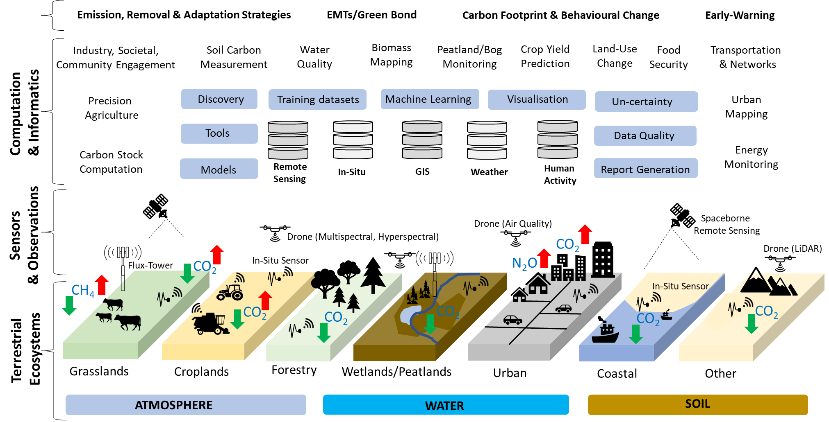
Greenhouse gas studies in Ireland
Terrain AI: Understanding of GHG exchange across landscapes viz., farms, forests, peatlands, and urban spaces.
Multidisciplinary: AI and computational methodologies for the collection, modeling, and fusion of multi-thematic data
https://terrainai.com/
NEXSYS: Innovative solutions across different scales of the urban landscape including neighborhood scales, collectives of large municipal buildings, new and retrofit housing and data centres

Slide 5
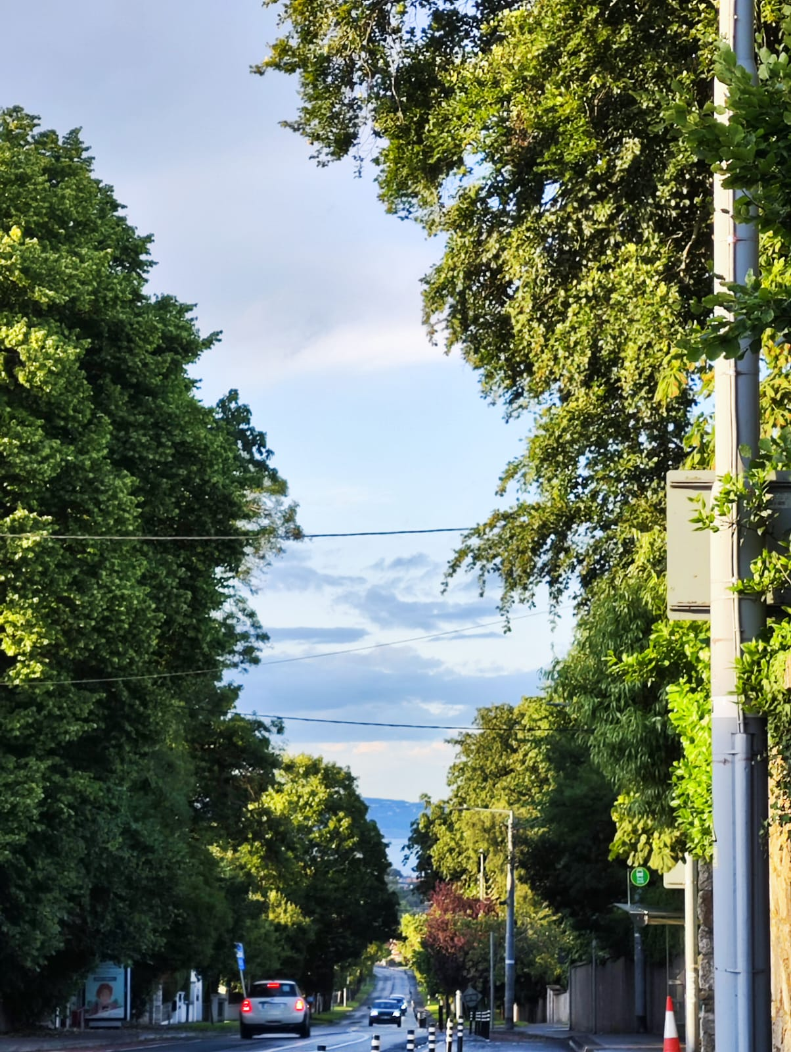
Emissions in Urban Areas
Various studies focus on anthropogenic emissions for urban areas. Mitigation policies include reducing emissions in various sectors eg., transport, energy (powerplants), residential uses etc
The Climate action plans of every city include greening of cities. We need a comprehensive framework to assess the combined impact of reducing anthropogenic emissions and greening towards becoming “Carbon-Neutral” cities.
A very few studies deal with CO₂ sequestration by urban vegetation. An uptake of
1.4 ton km⁻² day⁻¹ was estimated for an urban neighborhood in Singapore (Velasco et al., 2013)
We intend to use modeling techniques to understand the role of vegetation, initially trees, on CO₂ emissions in an urban landscape.

Slide 6
Model setup (WRF-LCZ-GHG)
The work involves updating various datasets for the model over the study region
Meteorology: ERA5 Reanalysis
Chemistry: Greenhouse gases Mode
Landuse - CORINE
Urban Form - LCZs
Biogenic Emissions -VPRM
Anthropogenic- EDGAR V6.0
Domain Setup
Land Use
Meteorological data
geogrid
ungrib
metgrid
WPS
Chem
Biogenic Emissions
VPRM
Real Data
Boundary Conditions
CMAS Reanalysis
WRF chem
Anthropogenic Emissions EDGAR
Convert_emiss
Model Output and Visualization

Slide 7
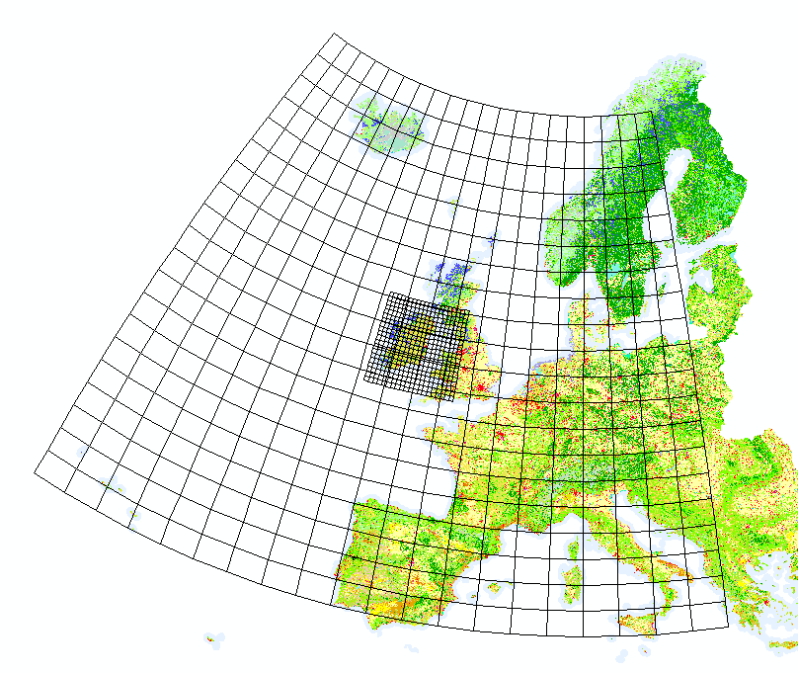
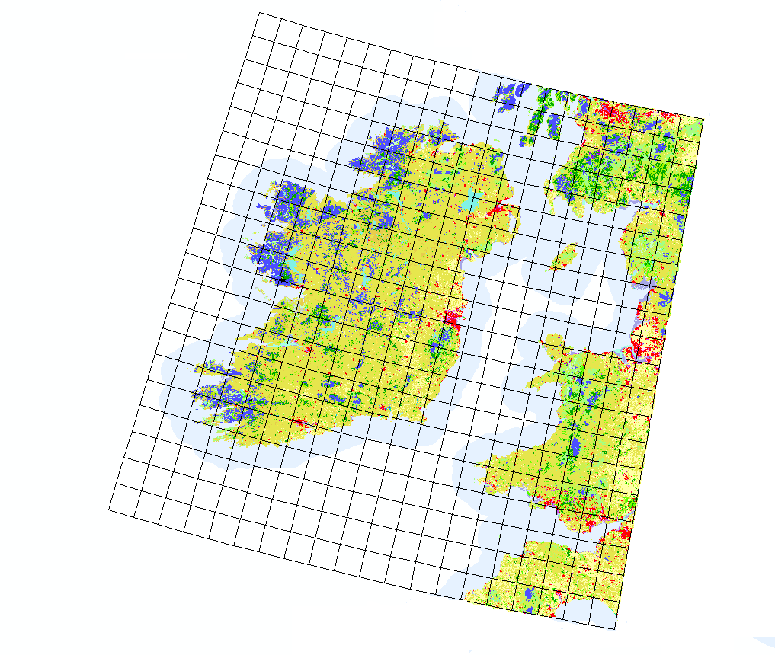
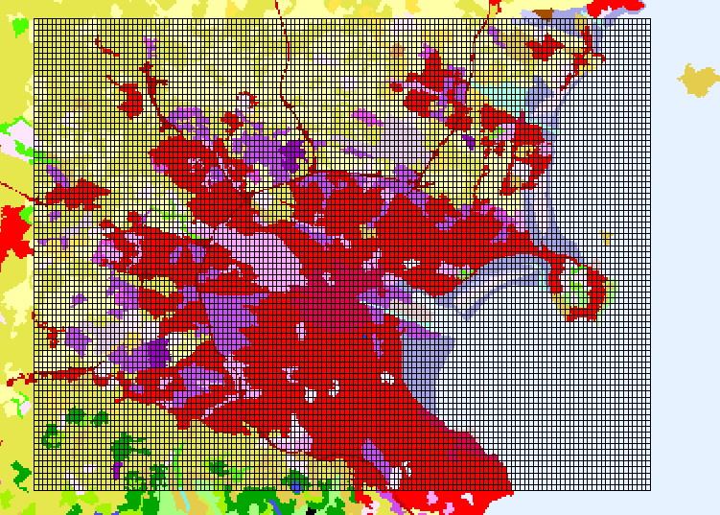
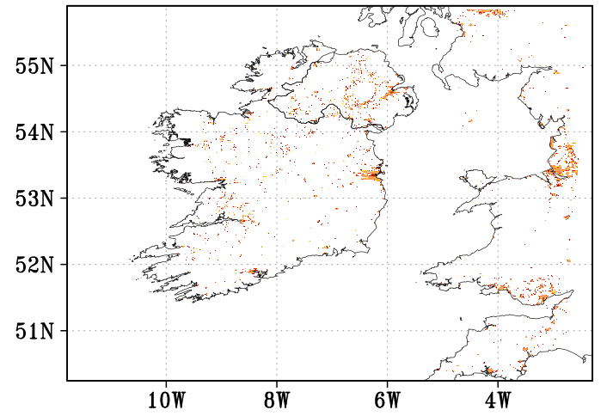
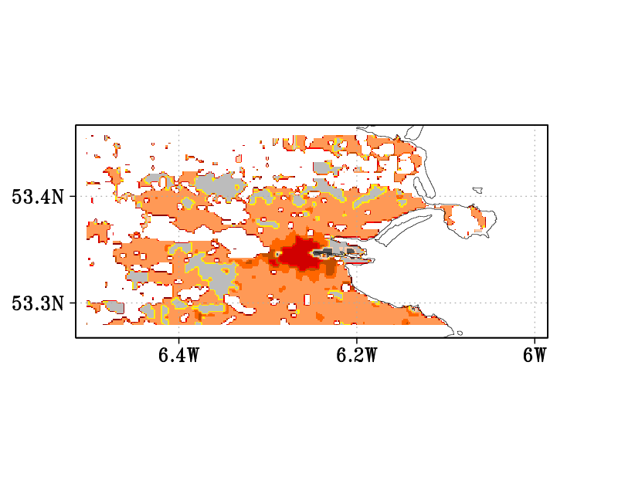
Triple nested domain setup covering Ireland and Dublin city
A WUDAPT-to-WRF python tool that injects WUDAPT's Local Climate Zone information into WRF.
(Demuzere et al., 2021)
Domain | Resolution (km) | Grids | Expanse (km²)
1- Outer | 10 | 252 × 345 | 8,694,000
2- Middle | 1 | 551 × 611 | 336,661
3- Inner | 0.25 | 137 × 81 | 694
Simulation Period:
May 2020 (Summer Period)
(a) Ireland at 1km (b) Dublin city area
LCZs around Dublin show presence of LCZ 6 (Open low-rise), LCZ 4 (Open high-rise) and LCZ 2 (Compact midrise in the city center}.

Slide 8
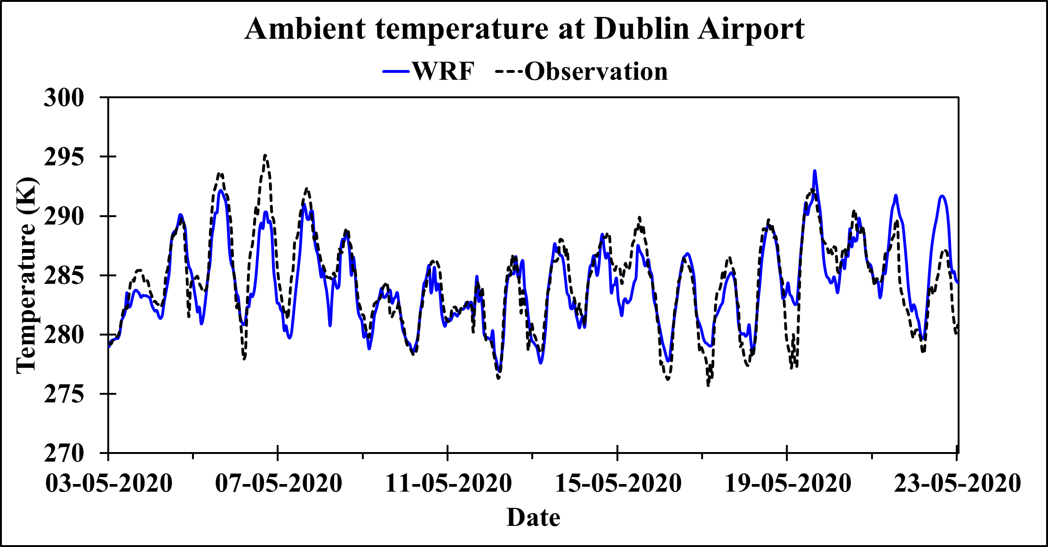
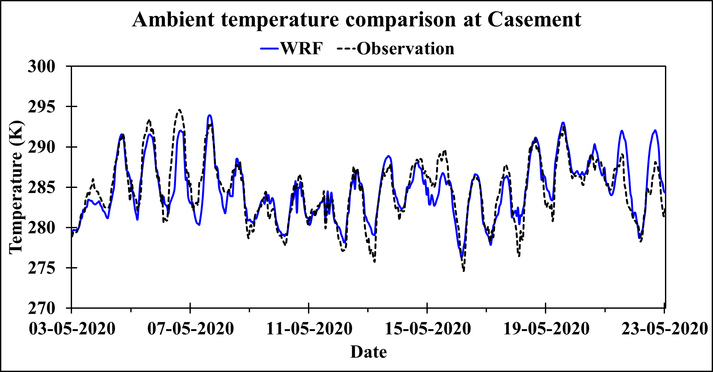
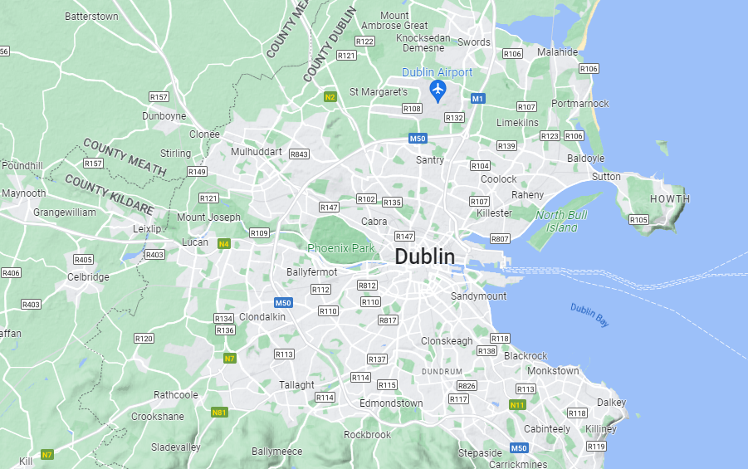
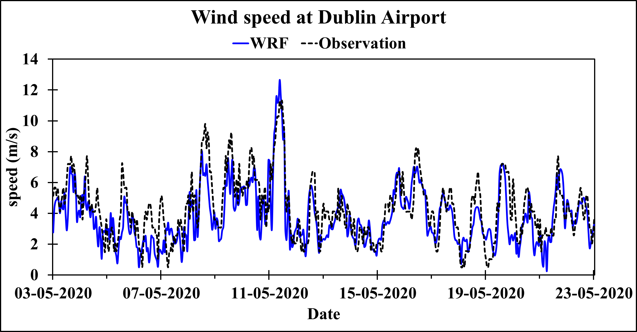
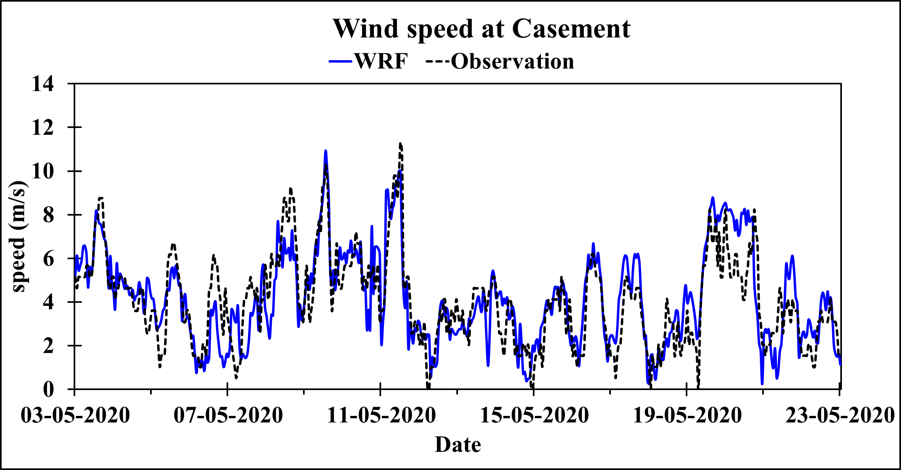
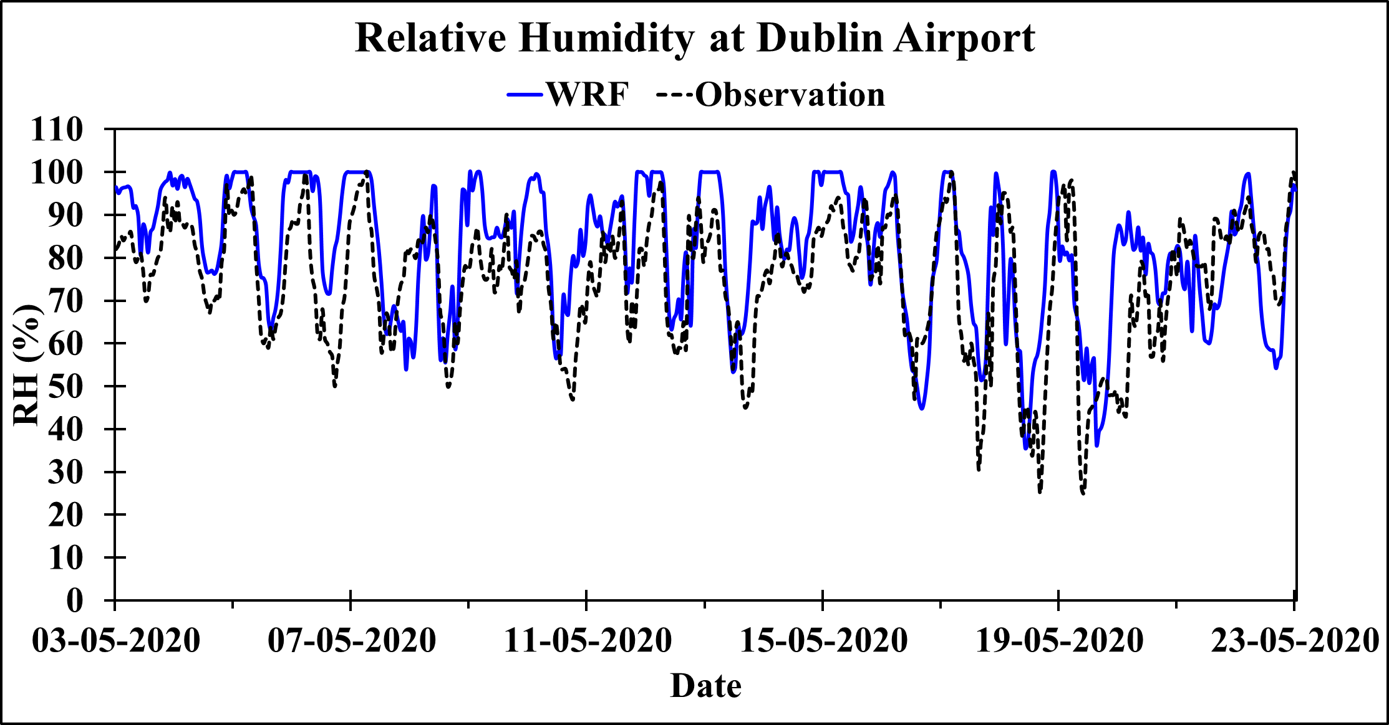
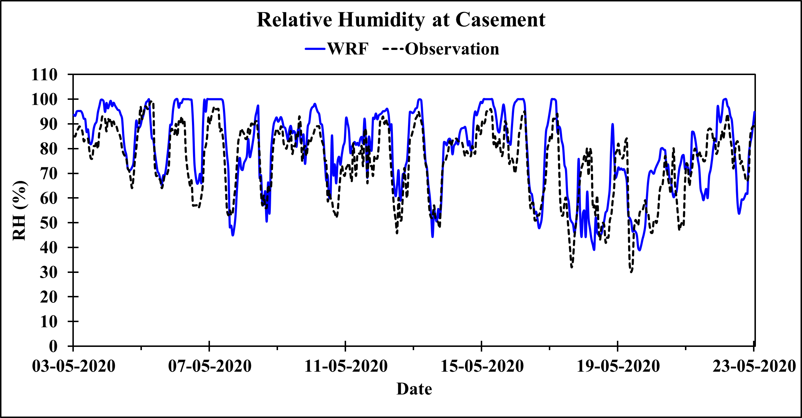
WRF simulated meteorology at two stations around Dublin
Model: WRF+LCZ
Resolution: 250 m
Period: May 2020
Dublin Airport
Casement
RMSE units: Temp-K, wind speed-m/s, RH- %

Slide 9
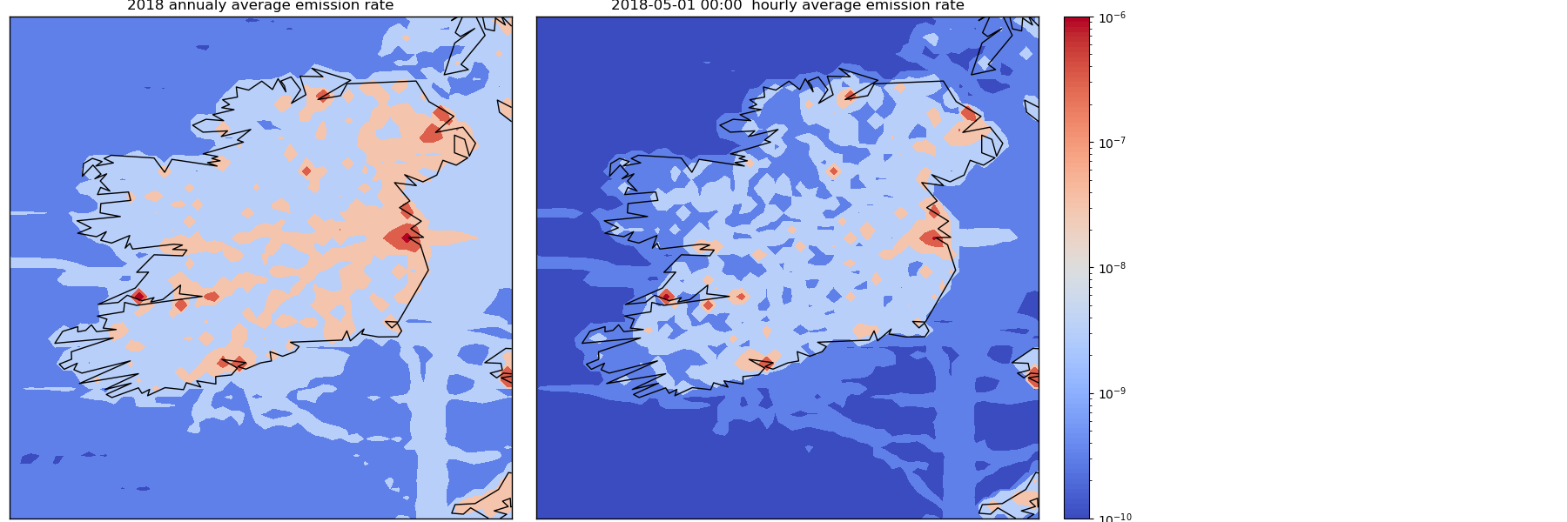
Anthropogenic emissions
EDGAR v6.0 provides emissions of the three main greenhouse gases (CO₂, CH₄, N₂O) and fluorinated gases per sector and country.
CO₂ emissions include all fossil CO₂ sources, such as
fossil fuel combustion,
non-metallic mineral processes (e.g. cement production),
metal (ferrous and non-ferrous) production processes,
urea production,
agricultural liming and solvents use.
Large scale sources and sinks from Land-use, Land-use Changes and Forestry (LULUCF) are excluded.
Average emission rates for CO₂ (kg m-2 s-1)

Slide 10
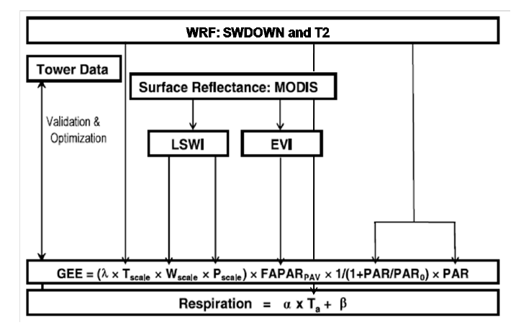
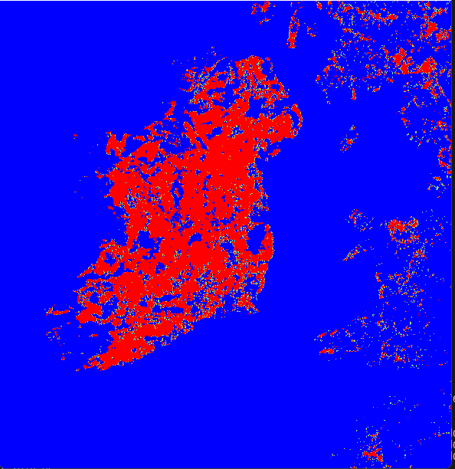
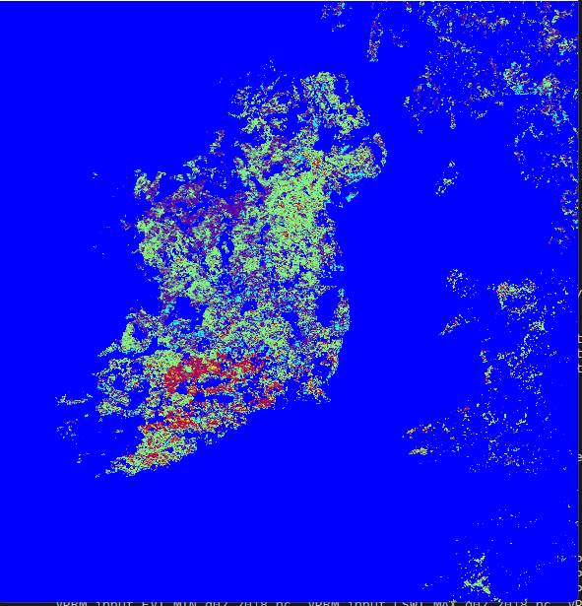
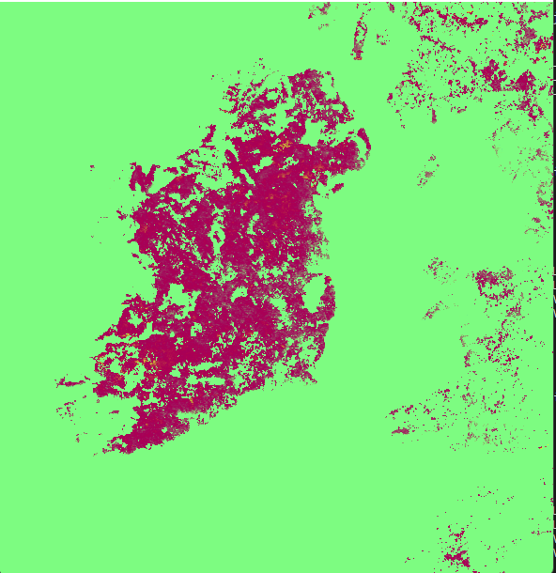
Biogenic CO2 Fluxes - VPRM model
VEGFRA, EVI and LSWI for the major vegetation class ‘grasslands’ across inner domain.
The parameters T_{scale} , P_{scale} and W_{scale} account for the temperature sensitivity of photosynthesis, effects of leaf age on canopy photosynthesis, and the effect of water stress on GEE
The VPRM preprocessor generates: Vegetation Fraction (VEGFRA), MODIS Land Surface Water Index (LSWI) and Enhanced Vegetation Index (EVI)

Slide 11
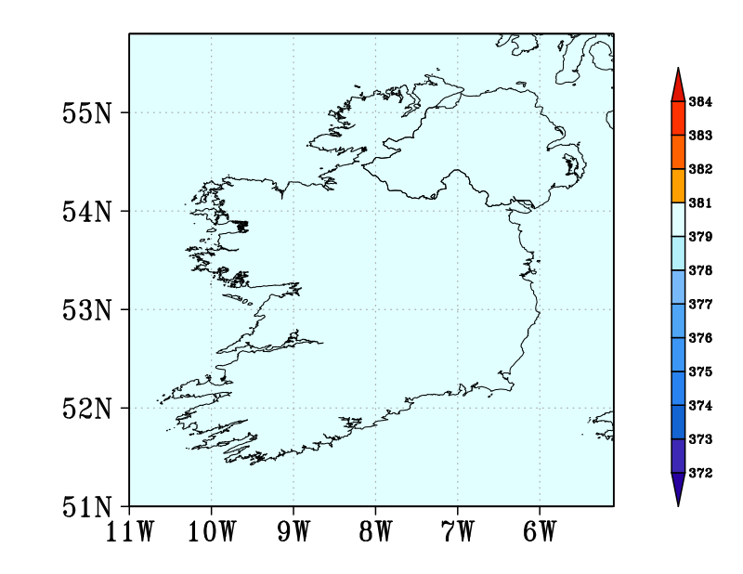
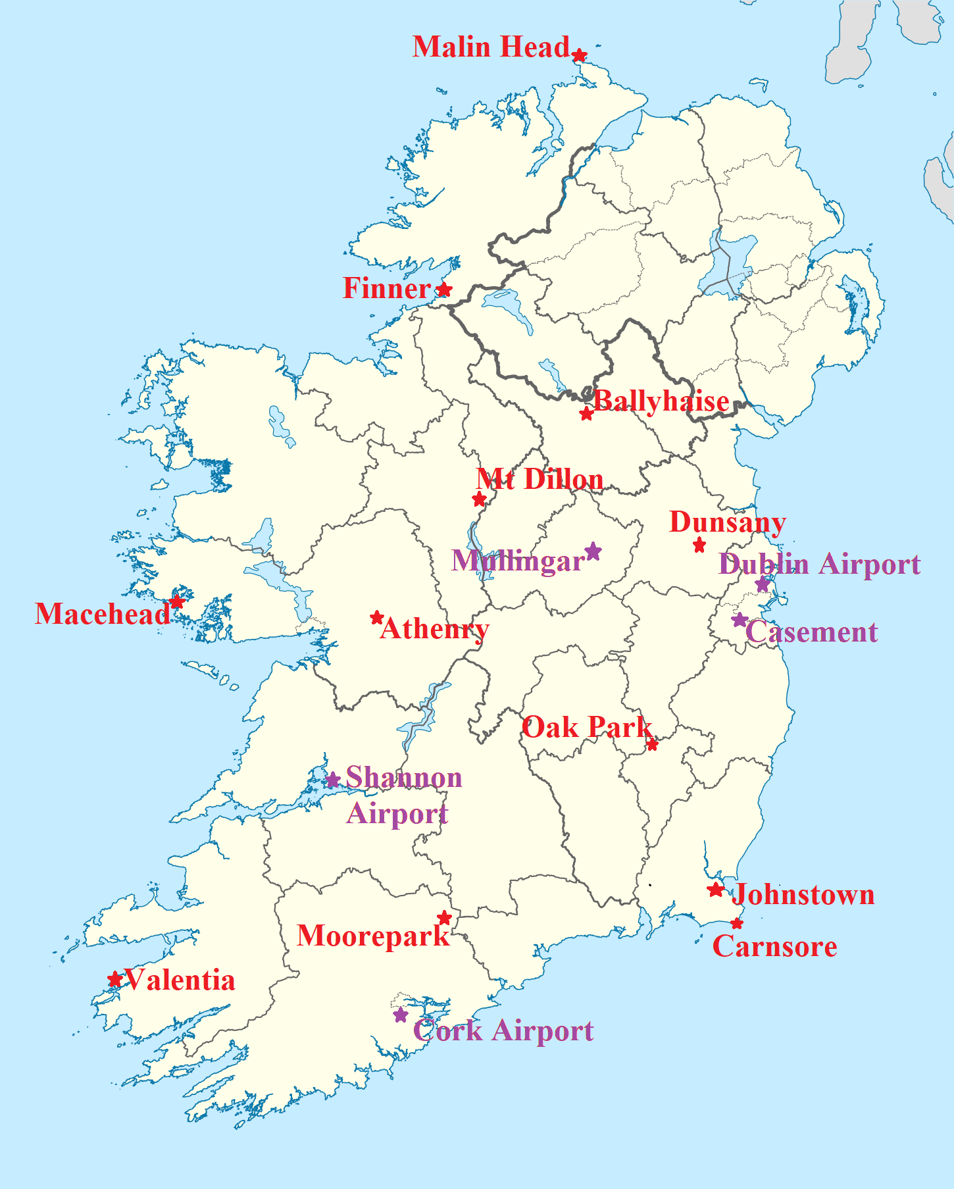
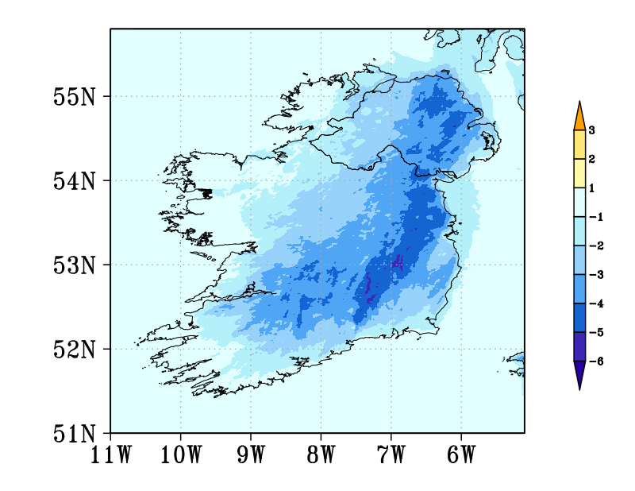
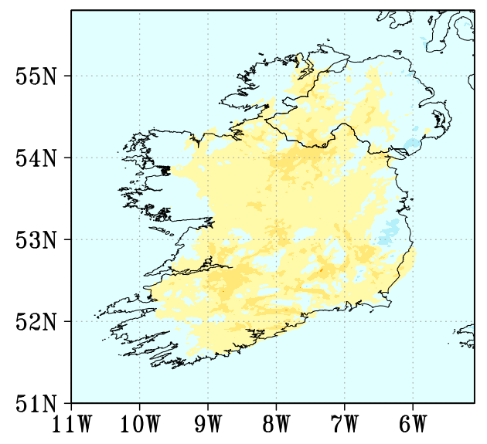
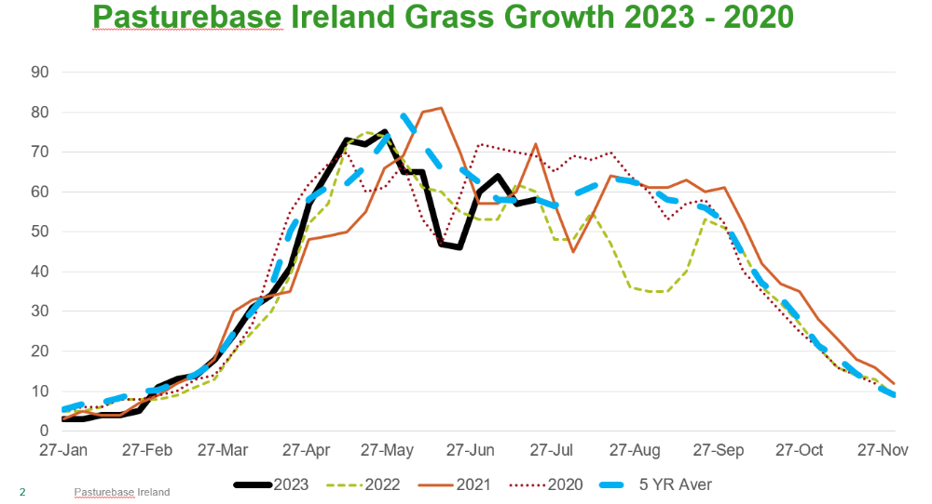
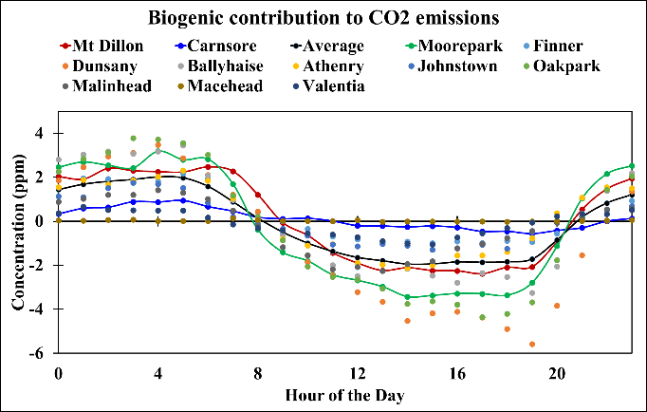
WRF-Chem (VPRM) generated Biogenic CO₂ emissions
CO₂
Day
15 h
Pasture-based grass growth Ireland 2020-2023
Night01 h
WRF-chem simulated contribution of biogenic CO₂ (ppm) for day and night-time.
https://www.teagasc.ie/
The vegetation utilizes CO₂ during daytime (around 3-4 ppm)
Slight increase in biogenic CO₂ during night owing to respiration

Slide 12
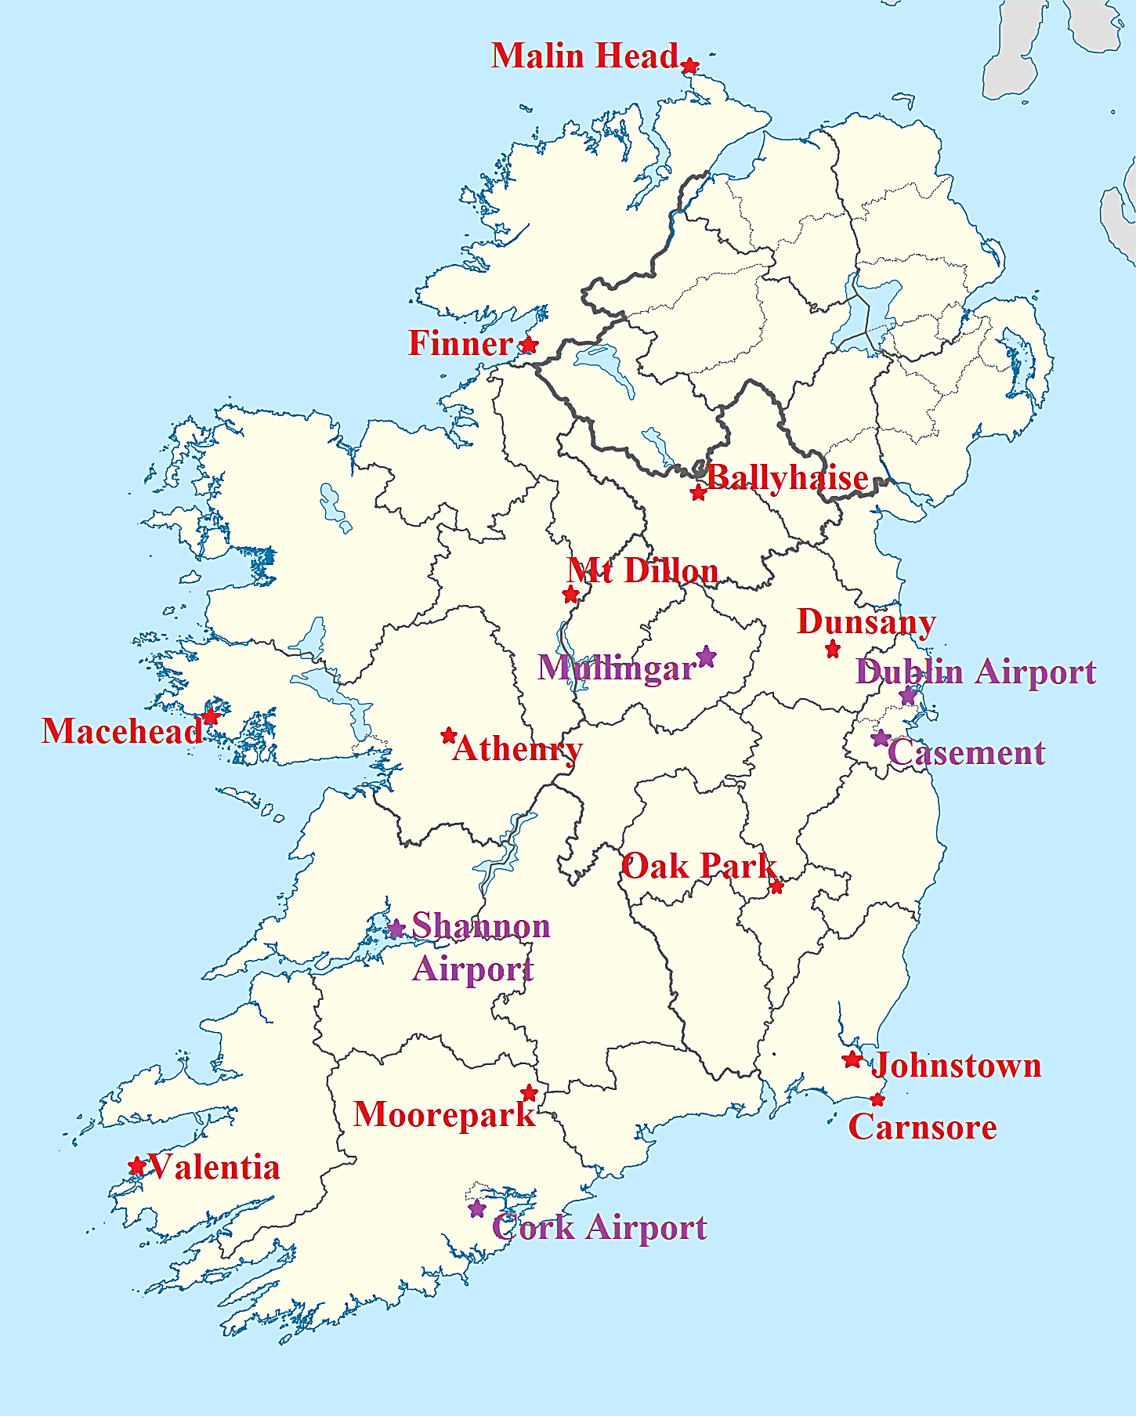
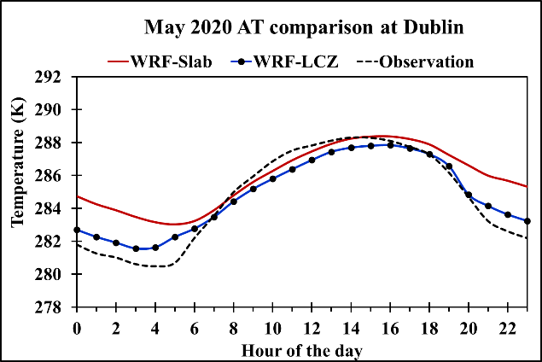
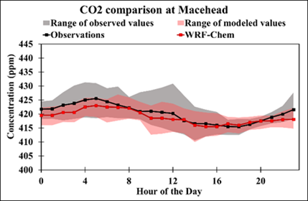
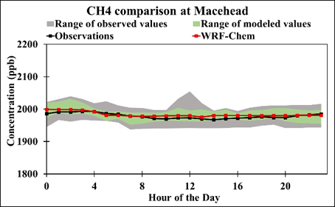
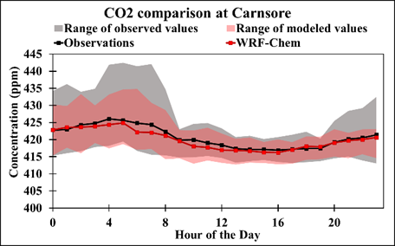
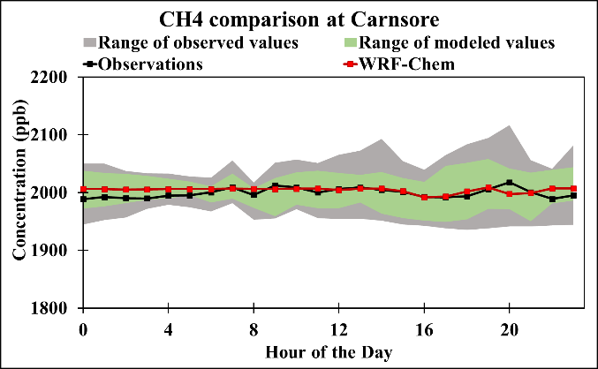
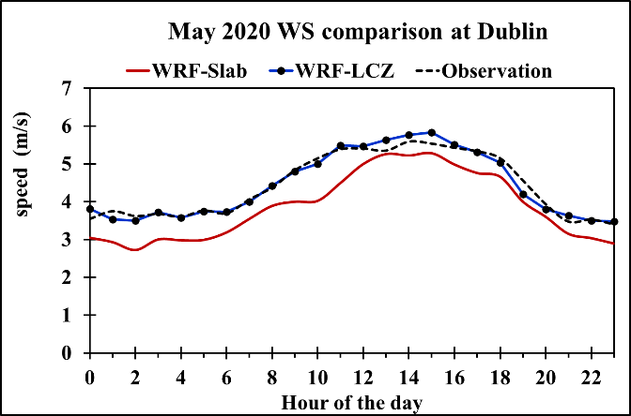
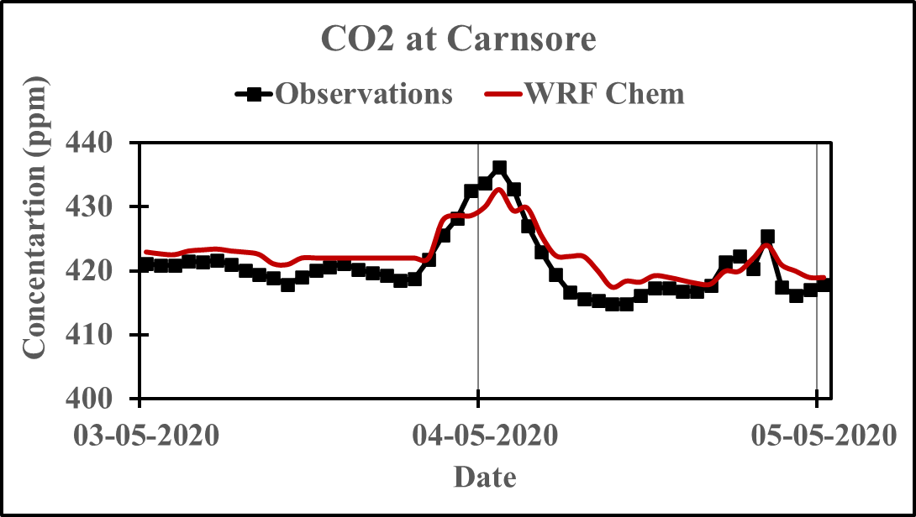
Model Performance Evaluation
Met Evaluation at Dublin
CO₂ Evaluation
CH₄ Evaluation
Averaged stats for urban stations
 | MBE |  | RMSE |  | r (unitless)
 | Slab | LCZ | Slab | LCZ | Slab | LCZ
Temperature (K) | -0.26 | -0.03 | 2.11 | 1.45 | 0.88 | 0.90
Wind speed (m/s) | -0.45 | 0.01 | 0.85 | 0.69 | 0.80 | 0.80
Improvement in meteorology after inclusion of LCZs
Model simulates the averaged and peak GHG values
The diurnal trend of meteorology and GHGs is captured

Slide 13
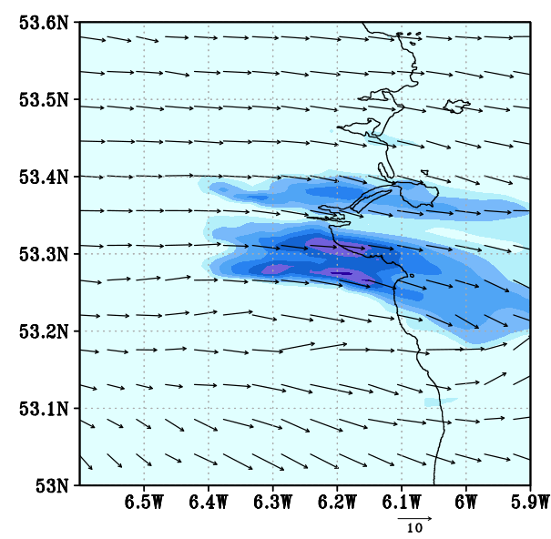
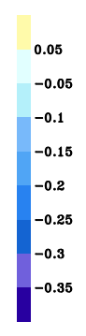
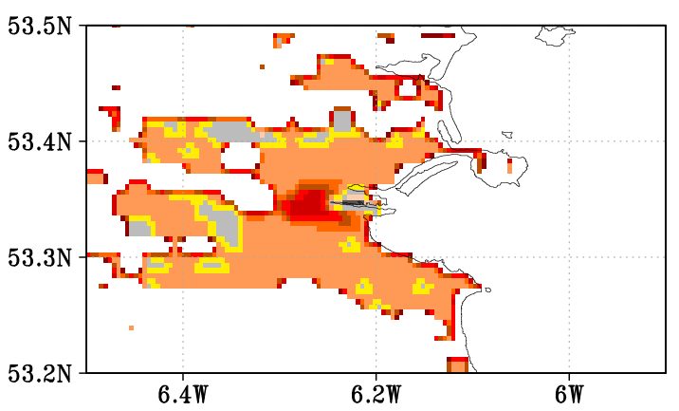
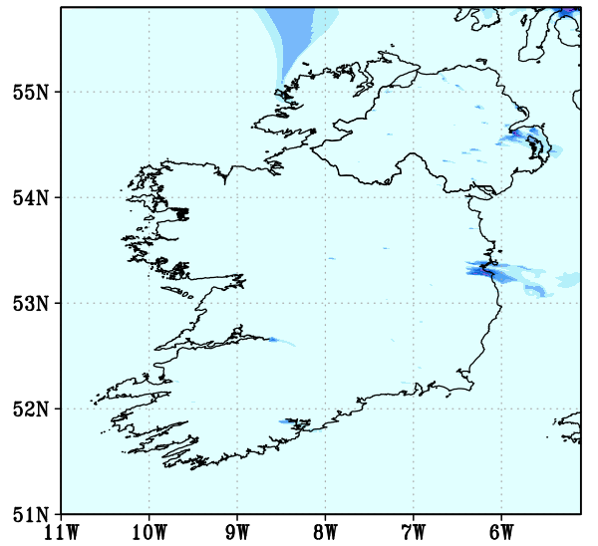
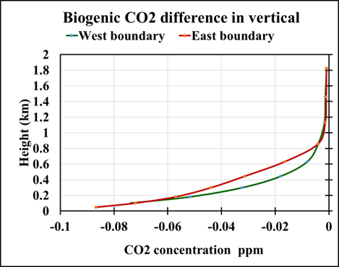
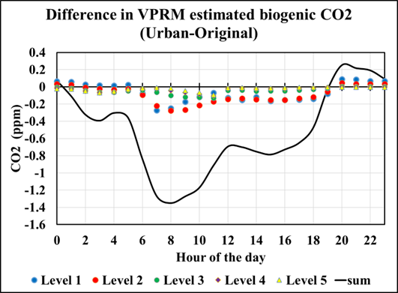
Urban VPRM
In order to calculate the biogenic emissions over urban areas, the “others” category is further subdivided into “urban” and “non-urban non-vegetated (NUNV)” areas (snow, barren, sand, water, etc).
Following Hardiman et al., (2017), the dominant vegetation in urban areas is treated as deciduous trees
Urban-VPRM estimated CO₂ contribution (ppm)
Contribution of 7x11 km urban area in Dublin City
Inclusion of trees leads to enhanced sequestration of CO₂ during daytime and minor addition in nighttime values owing to respiration
The cumulative daily impact of including trees in the urban area equals 12.30 ppm of CO₂ sequestered which is around 24 tonnes of CO₂ per day

Slide 14
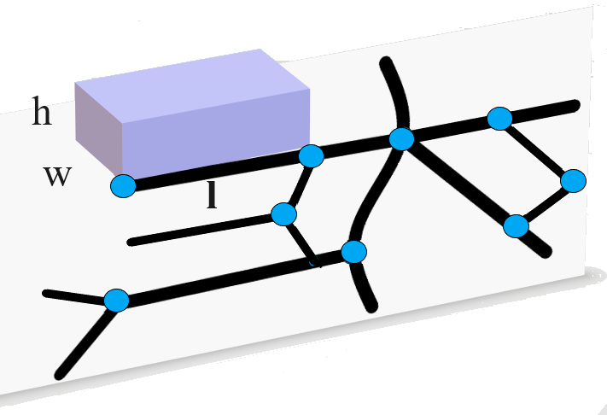
Model of Urban Network of Intersecting Canyons and Highways (MUNICH)
Simulate subgrid concentrations in the urban canopy
MUNICH consists of two main components:
  Street-canyon - represents the atmospheric processes in the volume of a street.
  Street-intersection - represent the exchange of pollutants between streets.
Traffic flow, speed,
vehicle categories, etc
Geographical Data
Street width and length,
building height
Meteorological Data
Emission Data
Background concentration
Photolysis Rate
MUNICH
WRF simulated wind speed and direction, PBL, etc
In-street hourly concentrations
Source: Kim et al., 2018

Slide 15
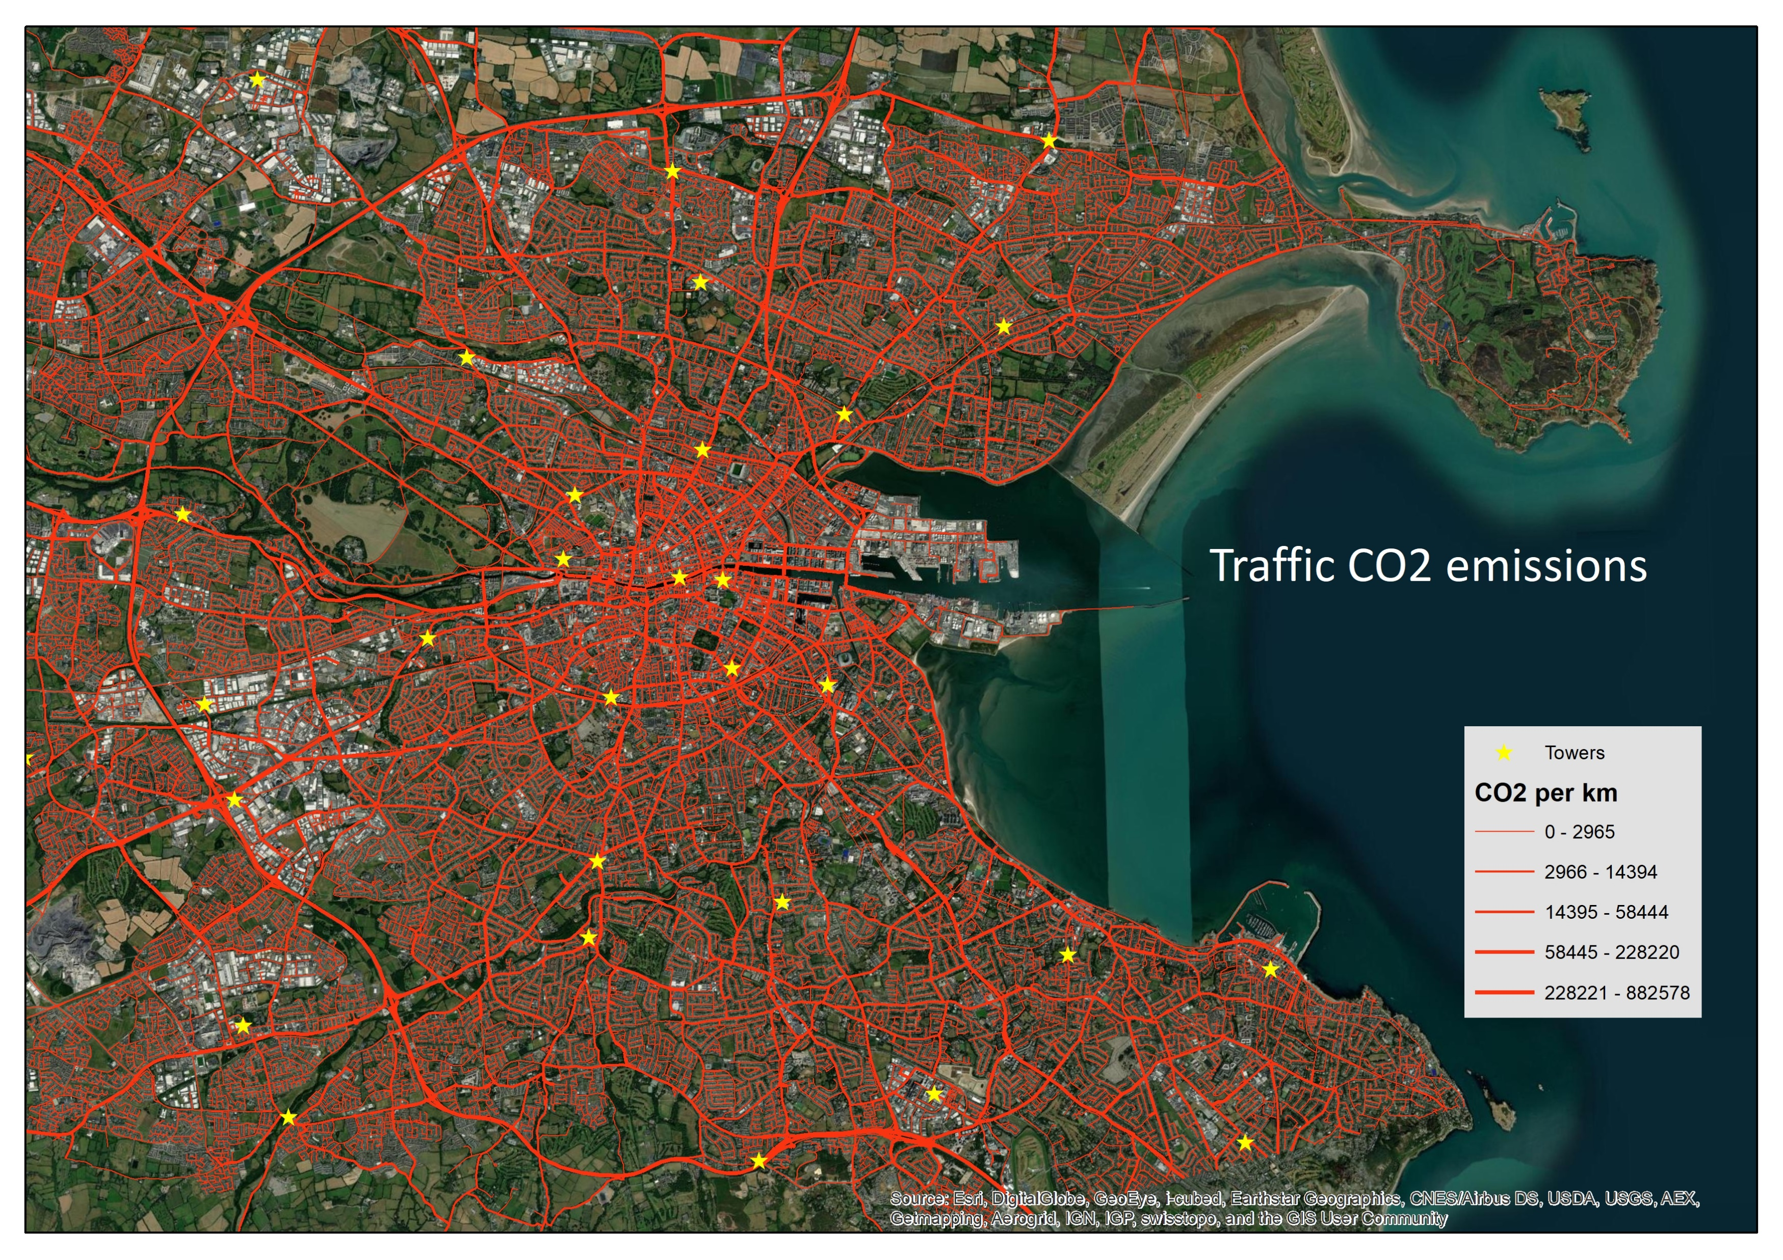
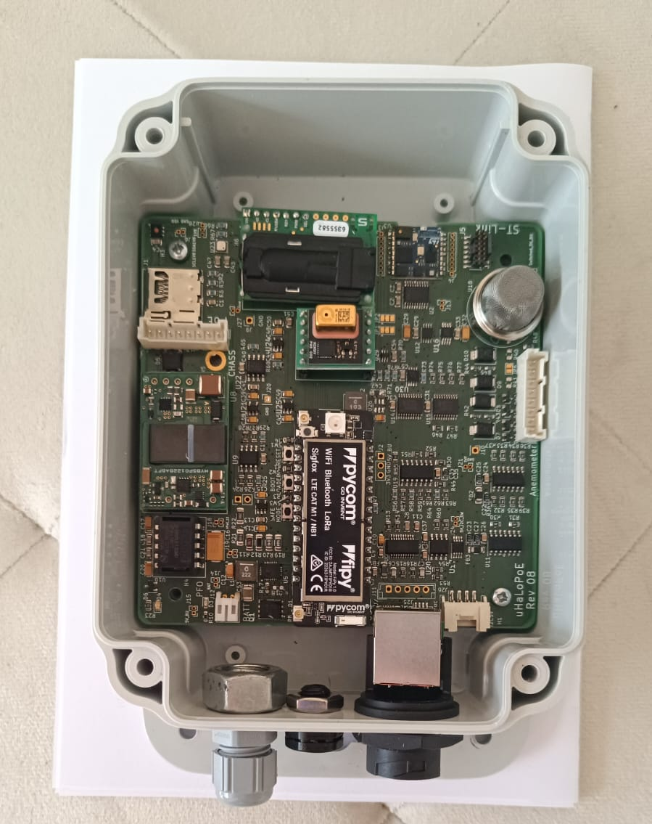
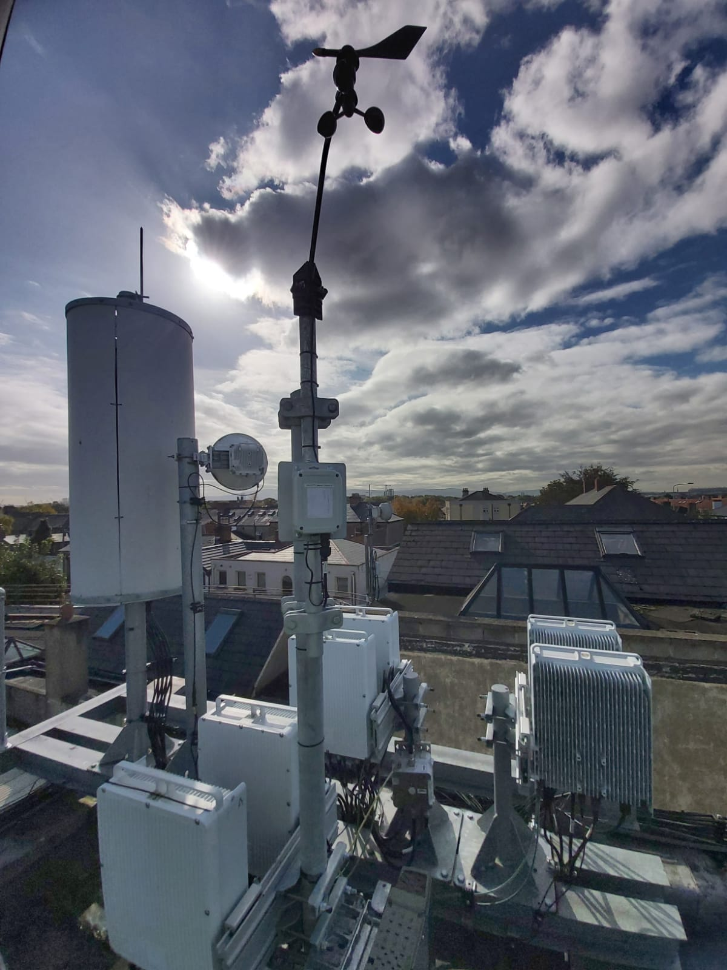


Monitoring and Evaluation
Gas monitoring unit
https://edgeliot.com/
Station installation across Dublin city
Plan for an urban network of inexpensive GHG monitors to evaluate model simulations and assess zero-carbon policies.
Network to be collocated with existing mobile phone masts and use LoRaWAN to provide real-time data availability.

Slide 16
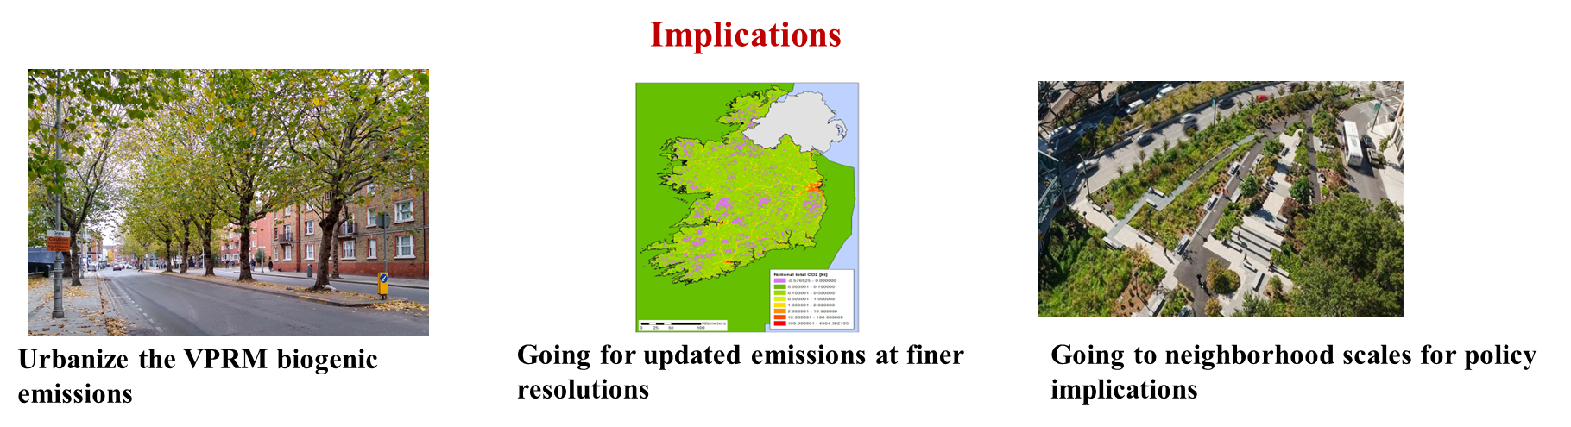
Conclusions
High resolution WRF-chem setup with updated datasets at Island scale
Improvement in model simulated meteorology after inclusion of LCZs
WRF-chem captures contribution of biogenic GHGs across Ireland
Implications
Updated emissions at finer resolution
Monitoring and Evaluation
Neighborhood scale analysis for policy implications

Slide 17


THANK YOU
https://terrainai.com/
https://www.nexsys-energy.ie/
References
Stewart, I. D. and Oke, T. R.(2012): Local Climate Zones for Urban Temperature Studies, B. Am. Meteorol. Soc., 93, 1879–1900,
Demuzere et al. (2021). LCZ Generator: A Web Application to Create Local Climate Zone Maps. Front. Environ. Sci., 9, 637455, https://doi.org/10.3389/fenvs.2021.637455
Demuzere et al. (2022). A global map of local climate zones to support earth system modelling and urban-scale environmental science. Earth Syst. Sci. Data, 14, 3835–3873, 2022
Mahadevan, et al, 2008: A satellite-based biosphere parametrization for net ecosystem CO2 exchange: Vegetation Photosynthesis and Respiration Model (VPRM) Global Biogeochem. Cycles., 22, GB2005,
Beck, V., T. Koch, R. Kretschmer, J. Marshall, R. Ahmadov, C. Gerbig, D. Pillai, and M. Heimann, 2011: The WRF Greenhouse Gas Model (WRF-GHG) Technical Report No. 25, Max Planck Institute for Biogeochemistry, Jena, Germany
Kim, Y., Wu, Y., Seigneur, C., and Roustan, Y.: Multi-scale modeling of urban air pollution: development and application of a Street-in-Grid model (v1.0) by coupling MUNICH (v1.0) and Polair3D (v1.8.1), Geosci. Model Dev., 11, 611-629, https://doi.org/10.5194/gmd-11-611-2018, 2018.

