Slide 1


Fusing Surface Monitors, Satellites and Forecasts for Near-real-time Air Quality
Barron H. Henderson
22nd Annual CMAS Conference - 2023-10-18
Co-authors: Pawan Gupta, Shobha Kondragunta, Phil Dickerson, Alqamah Sayeed, Hai Zhang, Janica Gordon, Halil Cakir, Brett Gantt, Benjamin Wells, and HAQAST AirNow Team
Disclaimer: The views expressed in this presentation are those of the authors and do not necessarily reflect the views or policies of the U.S. Environmental Protection Agency.

Slide 2
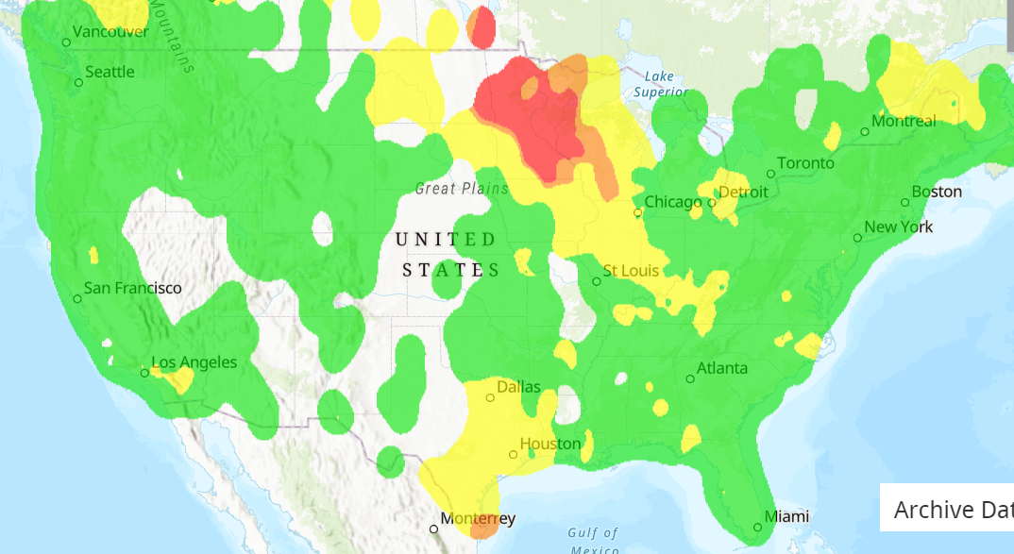

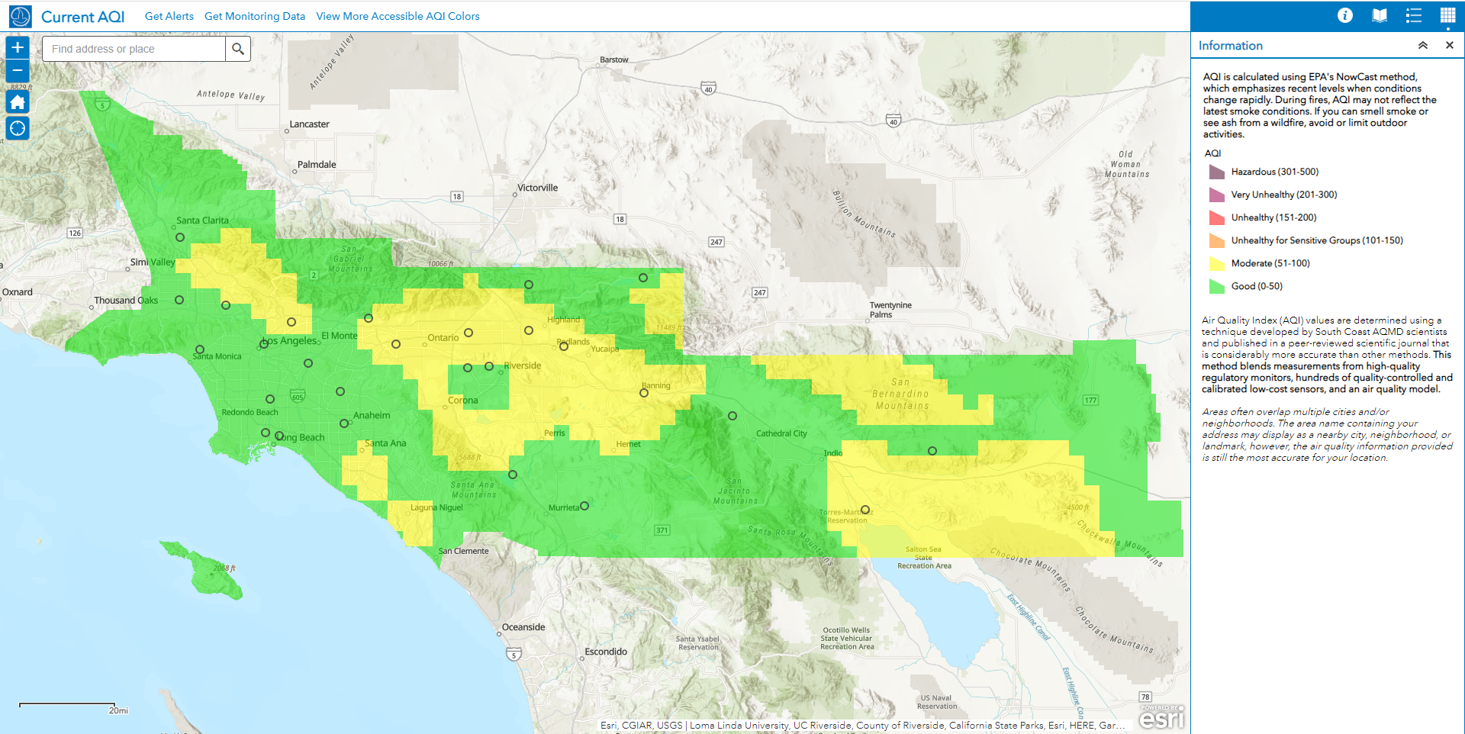
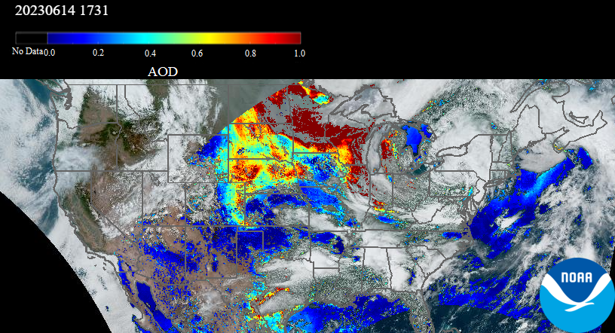

Motivation
Example Day in AirNow and Aerosol Watch
AirNow communicates air quality in real time
  Millions of visitors per day during fire seasons
  Simple distance (d⁻⁵) contours monitors only
4x more PurpleAir sensors than monitors
  Increased the spatial coverage of monitored particulate matter.
  Spoiler alert: sensor data improves predictions.
Near-real-time satellite observations
  Recent development by NOAA/NESDIS/STAR
  NASA HAQAST project connecting AirNow to NOAA geostationary satellite data
What about fusing AirNow, PurpleAir and satellites?
Yellow in between green monitors must be from fusion.
2023-06-14 11:53

Slide 3
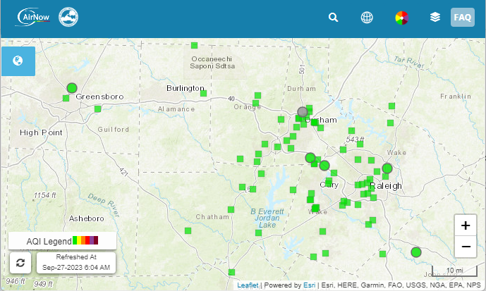
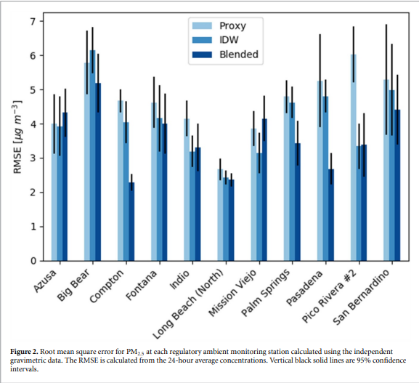
Monitors and PurpleAir sensors
Fire and Smoke Map
Way more in RTP
Many agencies report monitor data to AirNow
  ~1000 reporting monitors per hour
  Publicly available thru AirNowAPI
Schulte et al (2020) using PurpleAir
  Residual Kriging with both AirNow and PurpleAir
    NOAA Forecast model
    Model Correction : Y = M_{n} - Krig(M_{n} – O_{n})
  Improved performance of PM2.5 in leave-one-out validation and compared to Federal Reference Monitors
We use corrected PurpleAir low-cost sensors
  Barkjohn et al. 2021 developed a national correction
  Extended correction via RSIG
2x in Greensboro
Better RMSE in Los Angeles
Schulte et al 2020 (10.1088/1748-9326/abb62b)
Notes:
EPA Fire and Smoke Map

Slide 4
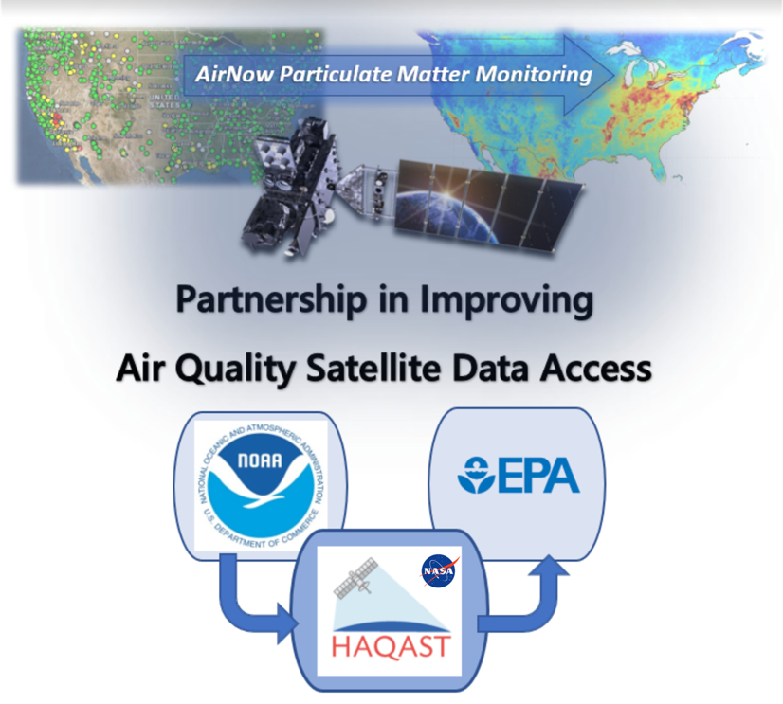
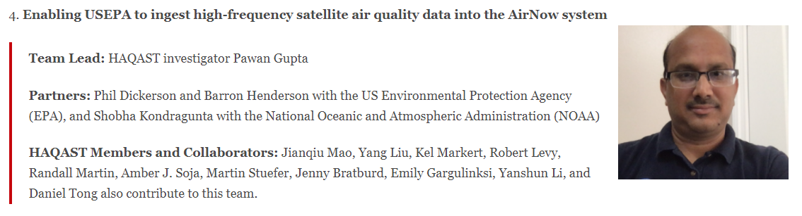
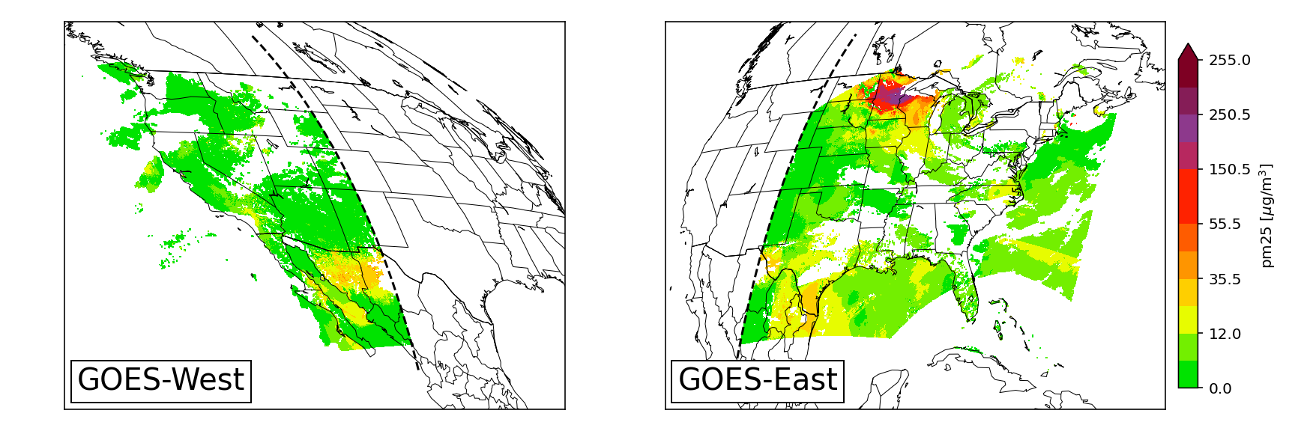
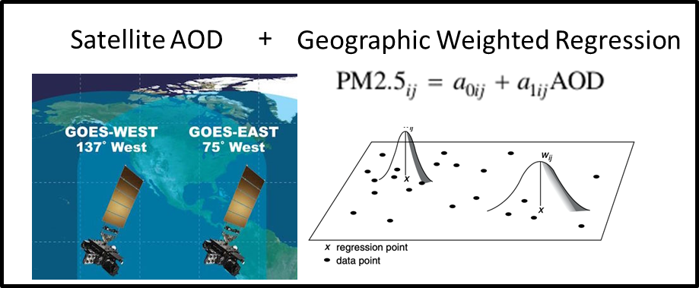
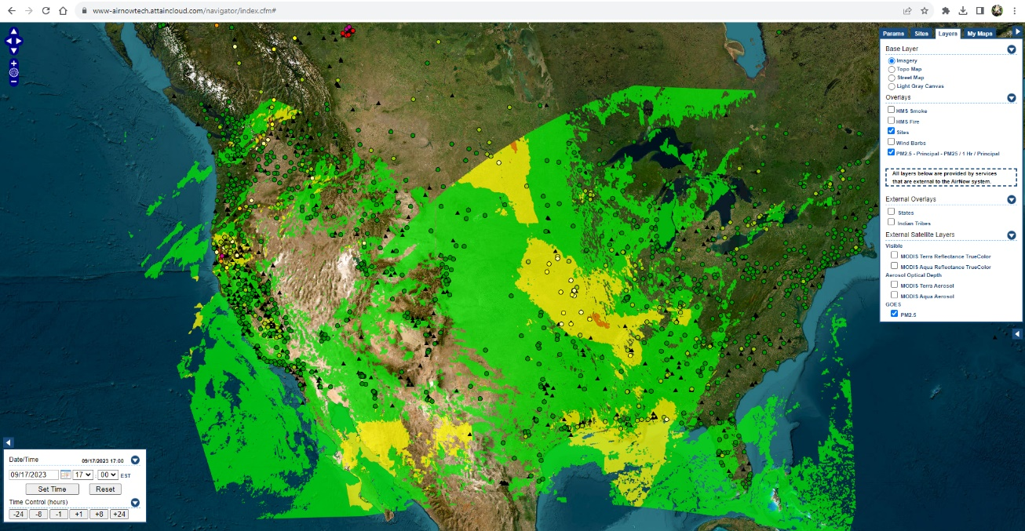
GOES-PM25
https://haqast.org/tiger-teams/#2021-tiger-teams
Sayeed et al: Deep Neural Network bias corrections.
O'Dell et al.: Public Health Benefits from Improved Identification of Severe Air Pollution Events with Geostationary Satellite Data, submitted to GeoHealth, 2023.
Zhang et al.: Nowcasting Applications of Geostationary Satellite Hourly Surface PM2.5 Data. Weather and Forecasting, 37(12), 2313-2329, 2022. doi: 10.1175/WAF-D-22-0114.1
Bratburd et al.: Air Quality Data When You Need It: Incorporating Satellite Data Updates into AirNow, EM Plus, 2022.
Zhang and Kondragunta.: Daily and Hourly Surface PM2.5 Estimation From Satellite AOD, Earth Space Sci, 8, doi: 10.1029/2020EA001599, 2021.
Notes:
Geostationary satellites are home bodies while polar satellites are globe trotters.
Geostationary Operational Environmental Satellites (GOES) stare at the US all day long.
Not like polar satellites passing once at 10am and once at 2pm (if you have two satellites)
From an US perspective, GOES satellites view the western US from the pacific and the eastern US from the atlantic.
Shobha Kondragunta and Hai Zhang fused with AirNow monitors by a geographic weighted regression.
Pawan led a tiger team to connect that data back to EPA.
There are a lot of technical details, but the upshot is simple.
We extensively evaluated the data, applied machine learning corrections, and we’re putting that data into various airnow systems like AirNowTech.
This is a great idea: federal agencies working together to provide tangible benefits to the American people from satellite data.
This project is taking that data a step further.
We’re going to bring the satellite data

Slide 5
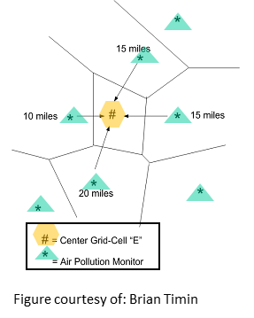
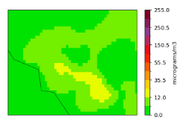
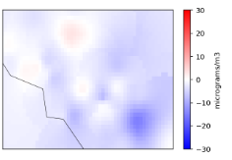
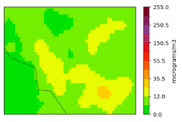
Hourly National-scale Fusion Ensemble
Interpolating bias to “correct” the forecast model*
  NOAA’s Forecast Model (NAQFC) as mediating layer
  VNA Bias = sum(d_{n}⁻² (m_{n} - o_{n})) / sum(d_{n}⁻²) ● n = Voronoi Neighbor
  Y_{i} = NAQFC – VNA Bias_{i}
One layer from AirNow (Y_{AN}) observations:
  mostly regulatory grade hourly observations
  paired with collocated grid cell.
NAQFC
VNA Bias
*A multiplicative corrector of this type is called extended VNA (eVNA)
**Piece-wise regression as in Fire and Smoke Map
Bias Corrected
Notes:
NAQFC

Slide 6
Hourly National-scale Fusion Ensemble
Interpolating bias to “correct” the forecast model*
  NOAA’s Forecast Model (NAQFC) as mediating layer
  VNA Bias = sum(d_{n}⁻² (m_{n} - o_{n})) / sum(d_{n}⁻²) ● n = Voronoi Neighbor
  Y_{i} = NAQFC – VNA Bias_{i}
One layer from AirNow (Y_{AN}) observations:
  mostly regulatory grade hourly observations
  paired with collocated grid cell.
One layer from PurpleAir (Y_{PA}) observations:
  low-cost sensor hourly observations with calibration**
  Aggregated within grid cells to create a pseudo-observation
NAQFC
VNA Bias
*A multiplicative corrector of this type is called extended VNA (eVNA)
**Piece-wise regression as in Fire and Smoke Map
Bias Corrected
Notes:
NAQFC

Slide 7
Hourly National-scale Fusion Ensemble
Interpolating bias to “correct” the forecast model*
  NOAA’s Forecast Model (NAQFC) as mediating layer
  VNA Bias = sum(d_{n}⁻² (m_{n} - o_{n})) / sum(d_{n}⁻²) ● n = Voronoi Neighbor
  Y_{i} = NAQFC – VNA Bias_{i}
One layer from AirNow (Y_{AN}) observations:
  mostly regulatory grade hourly observations
  paired with collocated grid cell.
One layer from PurpleAir (Y_{PA}) observations:
  low-cost sensor hourly observations with calibration**
  Aggregated within grid cells to create a pseudo-observation
One layer from GOES-PM25 (Y_{GOES}) “observations”
  Geostationary Operational Environmental Satellite (GOES)
  Aerosol Optical Depth from the GOES Advanced Baseline Imager
  Geographic Weighted Regression (GWR) against AirNow
  Deep Neural Network Corrected (Sayeed et al in prep)
NAQFC
VNA Bias
*A multiplicative corrector of this type is called extended VNA (eVNA)
**Piece-wise regression as in Fire and Smoke Map
Bias Corrected
Notes:
NAQFC

Slide 8
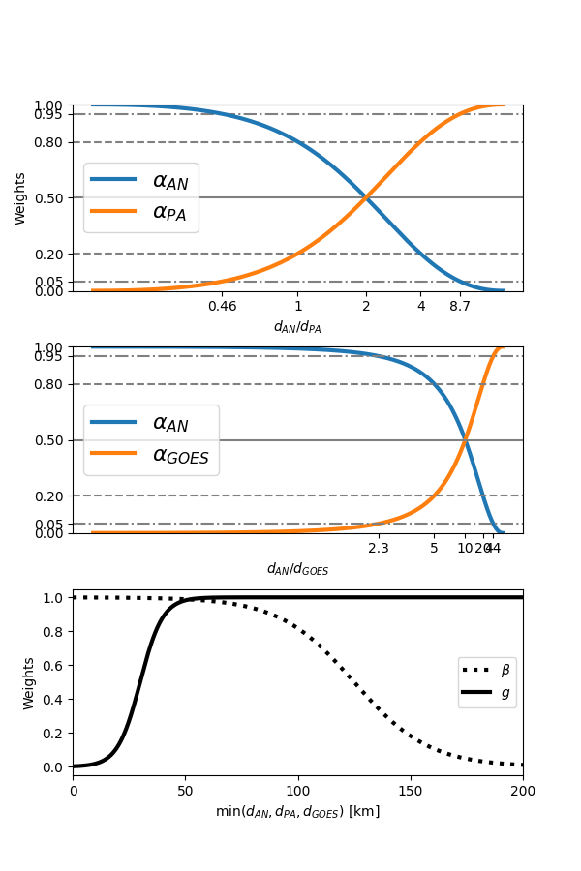
Ensemble Averaging Method
Simple fusion of bias corrected surfaces
  NAQFC, AirNow, PurpleAir, GOES-PM25
  Fuse the surfaces based on distance
  Apply different weights to ensembles
Y_{AN,PA,GOES} = α_{AN}Y_{AN} + α_{PA}Y_{PA} + α_{GOES}Y_{GOES}
  α'_{AN} = (1 x d_{AN})⁻²
  α'_{PA} = (2 x d_{PA})⁻²
  α'_{GOES} = (10 x d_{GOES})⁻²
  α'_{tot}= α'_{AN} + α'_{PA}+ α'_{GOES}
  Normalize them all: α_{i} = α'_{i} / α'_{tot}
Y_{AN,PA,GOES} = β x Y_{AN,PA,GOES} + (1 - β) x Y_{NAQFC}

Slide 9
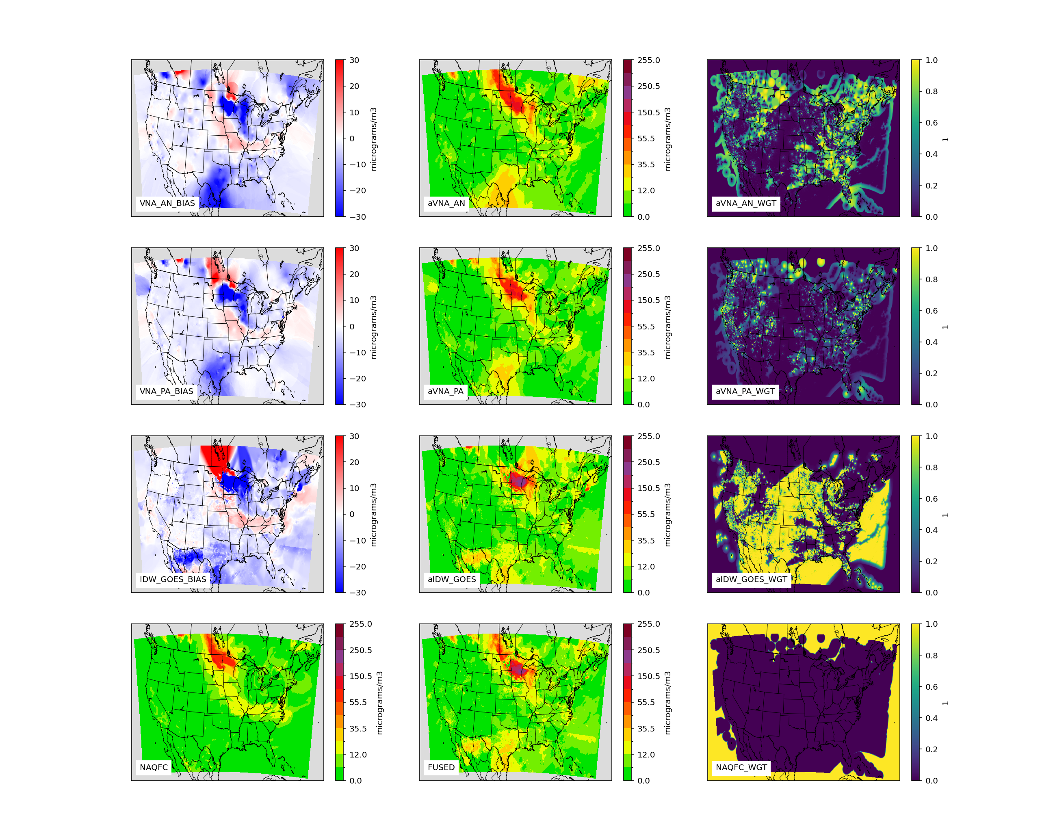
Case Study
2023-06-14T17Z
Interpolated Bias
Bias Corrected
Weights
Monitors
Fairly typical day June day in the south western domain.
Large fire contributions in Canada and sweeping down through Minnesota, Wisconsin and further
4 data sources
  AirNow Monitors (top)
  PurpleAir sensors
  GOES PM25
  NAQFC (bottom)
Estimates
Bias Corrections
Full fusion
PurpleAir
GOES PM25
NAQFC
Full fusion
Notes:
There is a lot going on here, so we’re going step thru it bit by bit.
We start in the lower corner with the NAQFC.
We then calculate bias at all observational points and interpolate to the model grid.
We then subtract the interpolated bias from the original model. This gives us the bias corrected surfaces.
Based on the distance to observations in each type, we calculate the weights.
Finally, we multiply each bias corrected surface by its weight and sum to get the “full” fusion.
It is hard to see some of the differences without zooming in.

Slide 10
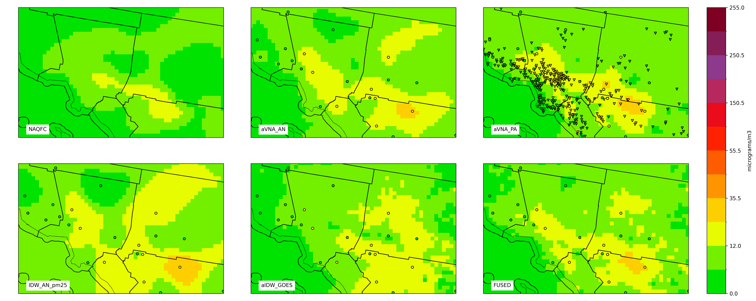
Los Angeles: 2023-06-14T17Z
NAQFC
y_{AN}
y_{PA}
IDW(AN)
y_{GOES}
y_{FUSED}
Notes:
I’ve looked at a bunch of these maps, and I the agreement between approaches is fairly typical.
The monitor data is being interpolated or extrapolated relatively long distances.
The PurpleAir data seems to miss it entirely.
The satellite data suggests that the extension should be in different directios.
The final fused product preserves the high concentration at the monitor, extends it to the northeast, but defers to the PurpleAir by curtailing it to a much smaller area.

Slide 11
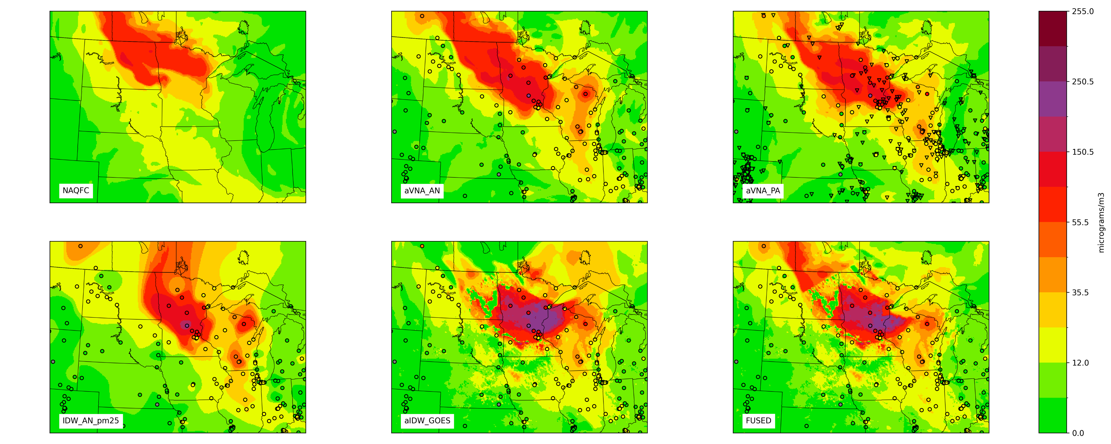
Canadian Wildfires: 2023-06-14T17Z
NAQFC
y_{AN}
y_{PA}
IDW(AN)
y_{GOES}
y_{FUSED}
Notes:
We don’t need annotations here, our eyes are drawn to the plume.
Recall that the monitors strengthened the modeled plume to the northwest and weakened it to the southwest.
The PurpleAir data largely agree.
Both AirNow and PurpleAir show few values greater than 150 (hidden under the dots) monitored value of 153 at the St. Cloud monitor.
The GOES GWR by contrast has a large area of very high air pollution

Slide 12

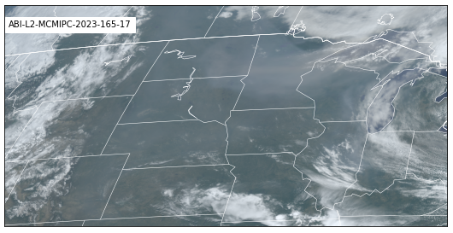
Canadian Wildfires: 2023-06-14T17Z
NAQFC
y_{AN}
y_{PA}
IDW(AN)
y_{GOES}
y_{FUSED}
Notes:
The high values are clearly associated with a smoke plume.
We don’t even need aerosol optical depth, we see it in the true color imagery.
We also see that strong relationship between the strength of the plume and the high concentrations.
However, the PurpleAir don’t see the high concentrations in the downwind plume.
This might be a decoupled leading edge of the plume.
The high bias in that case would be driven by a strong relationship at monitors behind.

Slide 13
Canadian Wildfires: 2023-06-14T17Z
NAQFC
y_{AN}
y_{PA}
IDW(AN)
y_{GOES}
y_{FUSED}
Notes:
The last thing I want to point out is the discontinuity.
GOES measures AOD, but it is screened out of northwest North Dakota.
The screening is because of viewing angle. This causes an abrupt lack of “observations” and a strong switch to AirNow and PurpleAir

Slide 14
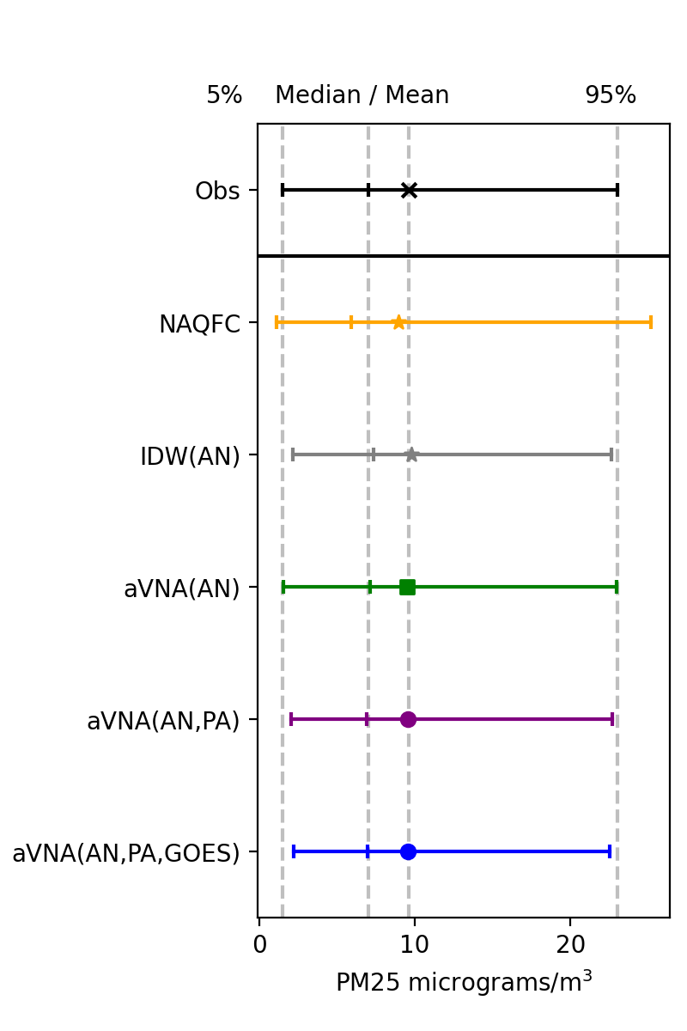
Evaluating the approach
That was just one hour…
Applied daylight from Jun 2023 to Sept 2023
  IDW as in AirNow (*)
  NAQFC from NOAA (*)
  Corrected w/ AirNow: AN
  Correction w/ AN and PurpleAir: AN+PA
  Correction w/ AN, PA and GOES: AN+PA+GOES
Predicted each AirNow monitor without that monitor in the fusion
  n=1.3M = 12 h/d * 30 d/m * 3.75m * 1000 /h
Statistics: Normalized Mean Bias, Normalized Mean Error, RMSE, Correlation.
Notes:
12 x 1000 x 31 x 3 = ~1M

Slide 15
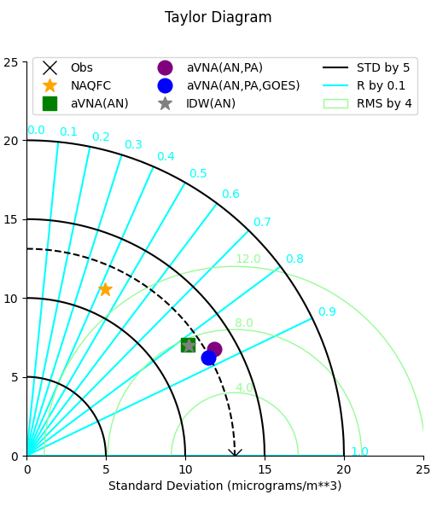
Performance Summary: June-Sept 2023 (daylight hours; n=1.3M)
Multiple statistics matter
  Pearson correlation (y-axis)
  centered Root Mean Squared Error (x-axis)
  Reproduction of standard deviation
The NAQFC has the lowest correlation, the highest RMSE, and the worst standard deviation.
The AirNow and IDW have similar correlation, AirNow has better standard deviation.
The fusion with PurpleAir improves standard deviation, correlation, and root mean squared error.
The fusion with GOES is even better.

Slide 16
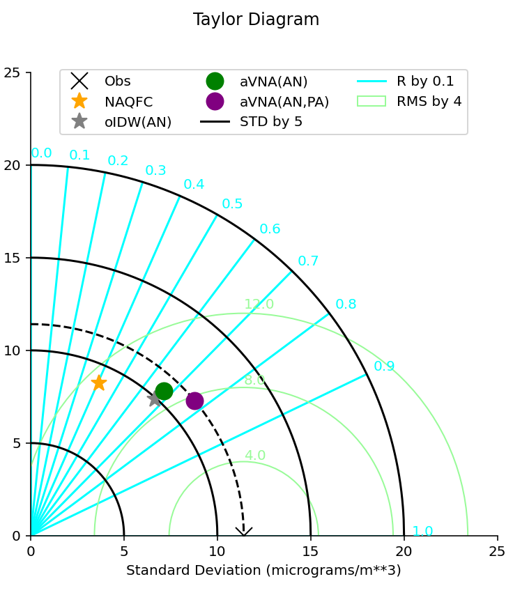
Performance Summary: June 2021-June 2022 (All hours; n=8M)
Multiple statistics matter
  Pearson correlation (y-axis)
  centered Root Mean Squared Error (x-axis)
  Reproduction of standard deviation
The NAQFC has the lowest correlation, the highest RMSE, and the worst standard deviation.
The AirNow and IDW have similar correlation, AirNow has better standard deviation.
The fusion with PurpleAir improves standard deviation, correlation, and root mean squared error.
Is the story more complex? When does one fail and the other succeeds?

Slide 17
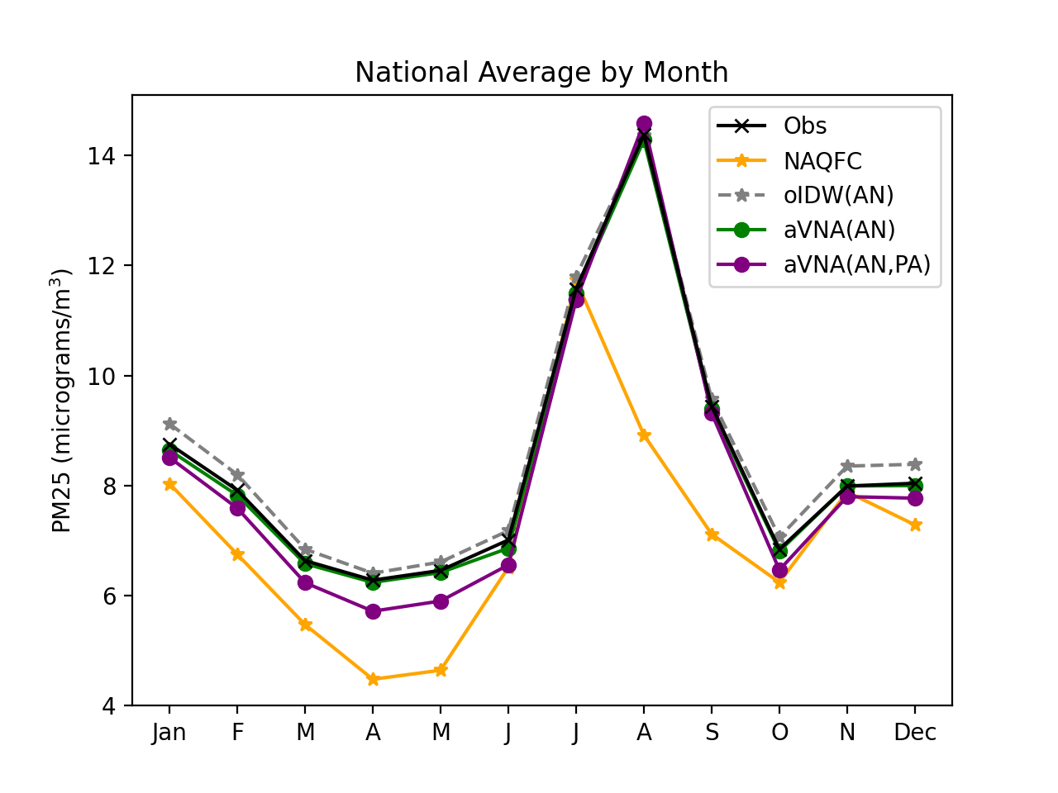
Leave-1-out Validation: National Average of Predictions
This figure summarizes the concentration of PM2.5 over the months of the year by method.
All methods peak during the fire season with the NAQFC peaking during July.
Whereas the observations and other methods all peak during August.
Remember, this is validation. In application, the prediction at the monitor is equal to the monitor.

Slide 18
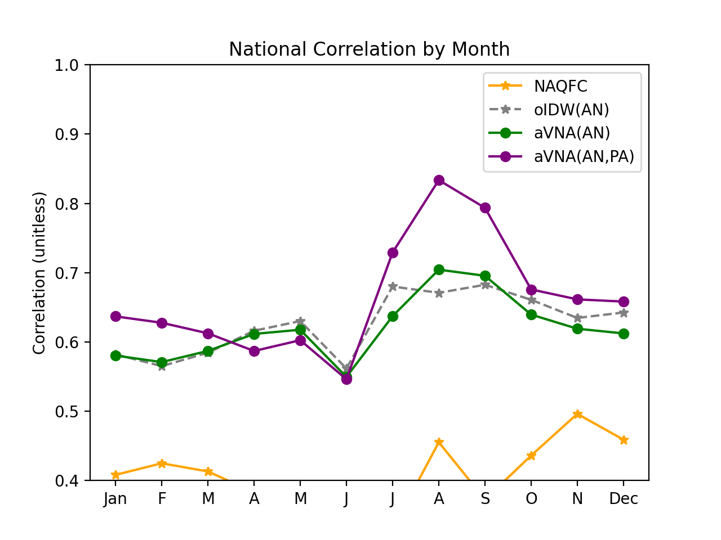
Leave-1-out Validation: National Correlation
Incorporating PA improves the correlation especially during the fire season.
aVNA(AN) has lowest correlation overall.
aVNA(AN,PA) improves the correlation over the time of day.
Remember, this is validation. In application, the prediction at the monitor is equal to the monitor.

Slide 19
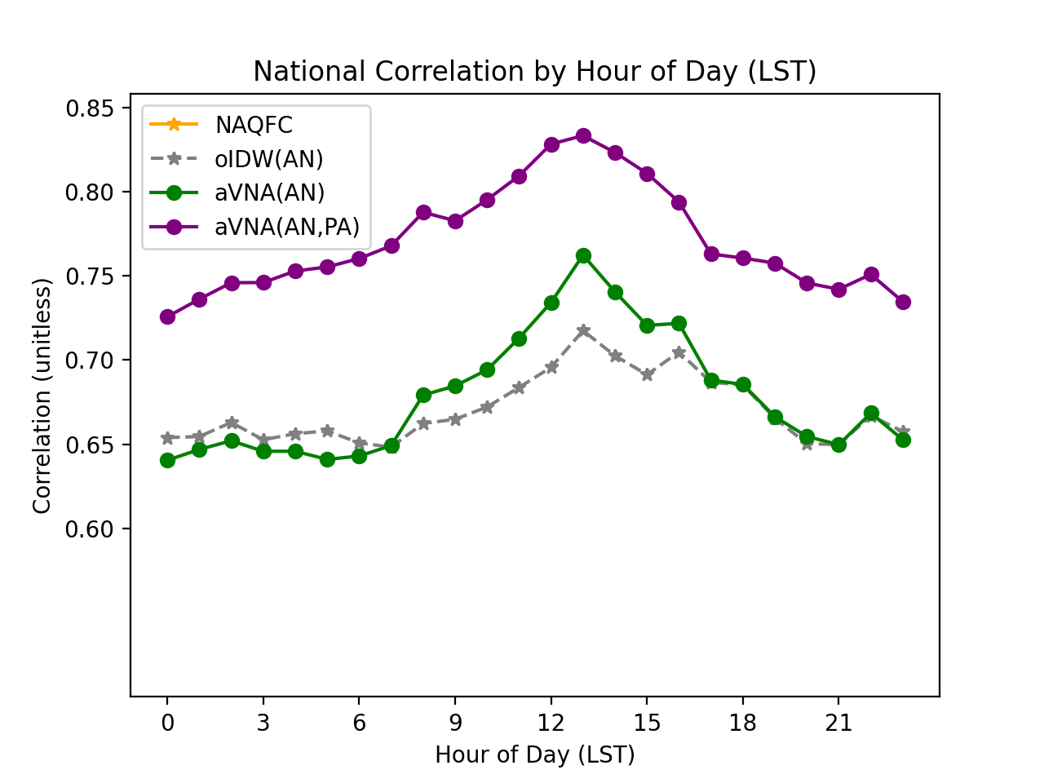
Leave-1-out Validation: National Correlation
Incorporating PA improves the correlation especially during the fire season.
aVNA(AN) has lowest correlation overall.
aVNA(AN,PA) improves the correlation over the time of day.
Remember, this is validation. In application, the prediction at the monitor is equal to the monitor.

Slide 20
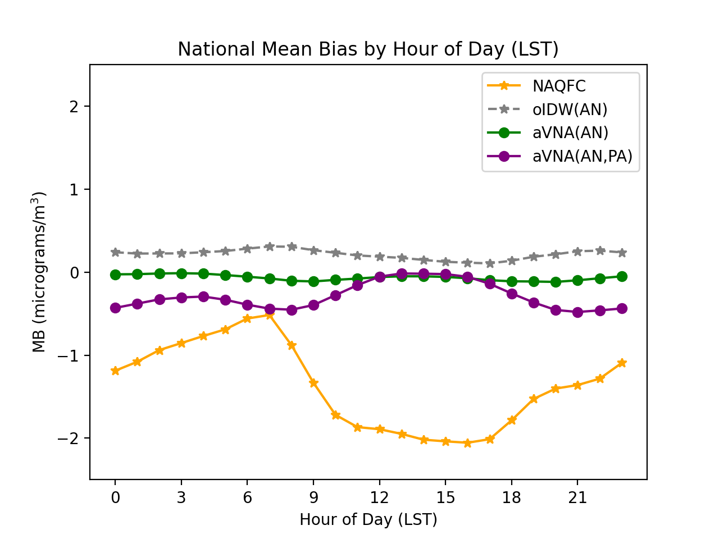
Leave-1-out Validation: National Mean Bias
oIDW and aVNA(AN) have the most consistent bias.
aVNA(AN,PA) has highest bias at night but is still quite good.
  Currently, we use a single bias correction for PurpleAir.
  Humidity varies with time of day and may need more complex correction.
  Also, FEM technologies are evaluated most strictly for daily average concentration.
Remember, this is validation. In application, the prediction at the monitor is equal to the monitor.

Slide 21
Summary
AirNow needs an updated interpolation method.
  EPA has long used models and statistical fusion to fill gaps with regulatory but has not incorporated these methods into AirNow.
  Schulte et al. demonstrated including models and PurpleAir improved on simple interpolations and applied it in an AirNow-like system.
  HAQAST Tiger Team evaluated GOES PM25 for real-time-applications.
Fusion with PurpleAir is ready.
  Discontinuities are less stark because datasets are more spatially consistent.
  Value of PurpleAir is obvious because they are dense near monitors.
Fusion with GOES PM25 ongoing work
  HAQAST Tiger Team 2021 (Gupta) – now 2023 (Yang Liu)
  Conceptually, the satellite value is highest away from monitors and sensors… making it hard to evaluate
  ~5% of monitors are further than 30km from their nearest withheld monitor…

Slide 22
Questions?
henderson.barron@epa.gov

Slide 23
Extra Slides
henderson.barron@epa.gov

Slide 24
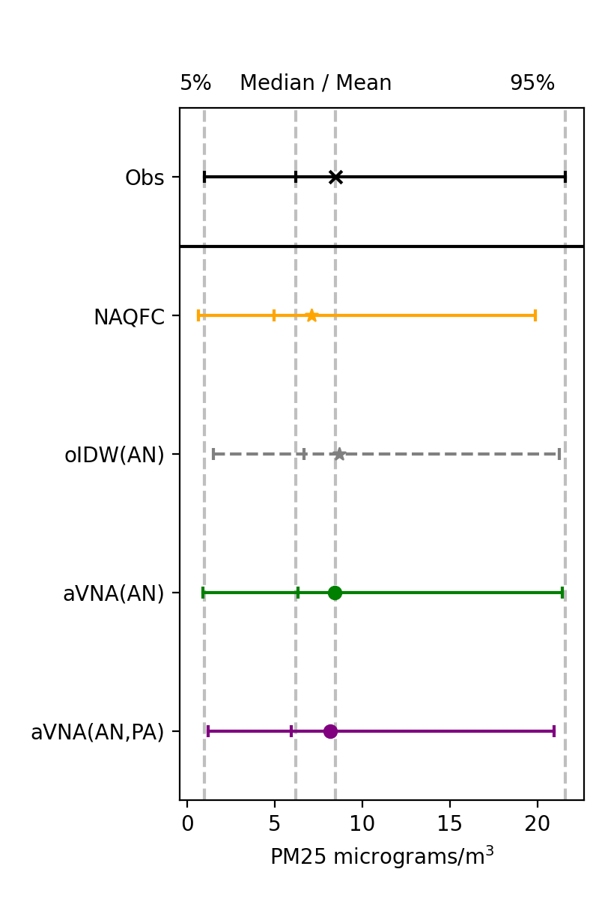
Evaluating the approach
That was just one hour…
Applied hourly data from Jun 2021 to Jun 2022
  IDW as in AirNow (*)
  NAQFC from NOAA (*)
  Corrected w/ AirNow: AN
  Correction w/ AN and PurpleAir: AN+PA
  Correction w/ AN, PA and GOES: AN+PA+GOES
Predicted each AirNow monitor without that monitor in the fusion
  n=8M = 8760 h/y * 1000 /h
Statistics: Normalized Mean Bias, Normalized Mean Error, RMSE, Correlation.
Notes:
Additive (aVNA

Slide 25
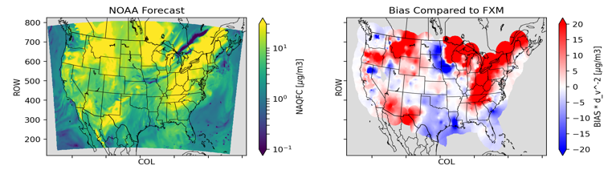
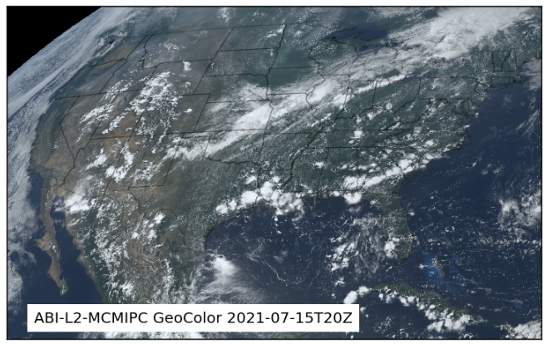
Fires are challenge any method
IDW miss fires between stations.
NAQFC had “persistent” fire emissions.
  A fire continues to emit until it is observed to have stopped.
  Not great at fires in the first place.
Satellite imagery shows some smoke over high biased reasons.

Slide 26
EPA National-scale Approaches
AirNow application at the national scale requires a speed, accuracy, and simplicity
EPA has several techniques like residual kriging used by South Coast’s.
  Voronoi Neighbor Averaging (VNA), Extended VNA (eVNA)
  Today, there will be a focus on a variation of eVNA that is additive VNA (aVNA)
Equation and Applications | Pros | Cons
IDW = sum(O_{n} x w_{n}) - AirNow | Super Fast and Easy Equals monitor! | No causal mechanism.
Downscaler = f(M, O, N) - REA and CDC PHASE | Rigor Confidence intervals | Too slow for this application
eVNA = M x sum(O_{n} / M_{n} x w_{n}) - SIPs and RIA | Fast Equals monitor! | Requires model* Ratio can become unstable
aVNA = M - sum((M_{n} - O_{n}) x w_{n}) - new, like Residual Kriging | Fast Equals monitor! | Require model* Can result in negative values
*Our NOAA colleagues make hourly forecasts twice a day!
Figure courtesy of: Brian Timin
• n = neighbors (AirNow=10-nearest; Otherwise=Voronoi) • w_{n} = d_{n}^{p} / sum(d_{n}^{p}) : p = -2 or -5 in AirNow

Slide 27
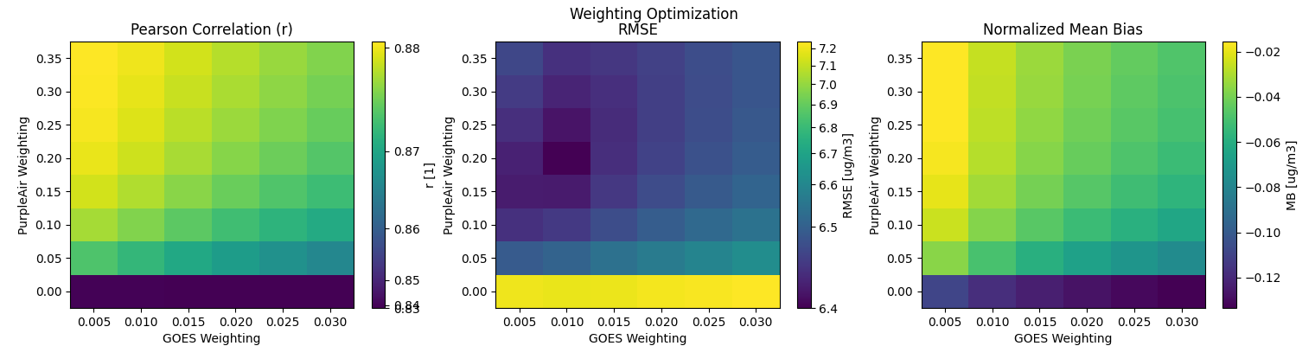
Preliminary weighting figure.

Slide 28
Alternative Ensemble Weighting Approaches
We need a method to synthesize the products:
  At this point, we have a potential of 4 fusion products
  2 bias correction methods (aVNA, eVNA), 2 data sources (AirNow, PurpleAir)
Geographically Varying Weights (GVW)
  Similar to Requia[1], but implemented like Skipper[2]
  Y_{fused} = Σ_{i}α_{i}Y_{i} ● α_{i} = c_{i} + β_{i,0}x + β_{i,1}y + β_{i,2}d_{PA} + β_{i,2}d_{AN}
  c_{i} and all β are fit using least squares regression
Random Forest Regression (RF)
  Features: x, y, d_{PA}, d_{AN}, Y_{i} estimates from leave-one-out cross-validation
  Configuration: Minimum 20 features for a split; 100 trees.
Not Shown: Few day tests show
  Both GVW and RF have better correlation than current approach; RF best.
  But…. Current approach has better standard deviation than either
This will likely need to be revisited when bringing in the GOES-PM25.
[1] Requia et al. https://pubs.acs.org/doi/10.1021/acs.est.0c01791
[2] Skipper et al. https://doi.org/10.1021/acs.est.0c08625

Slide 29
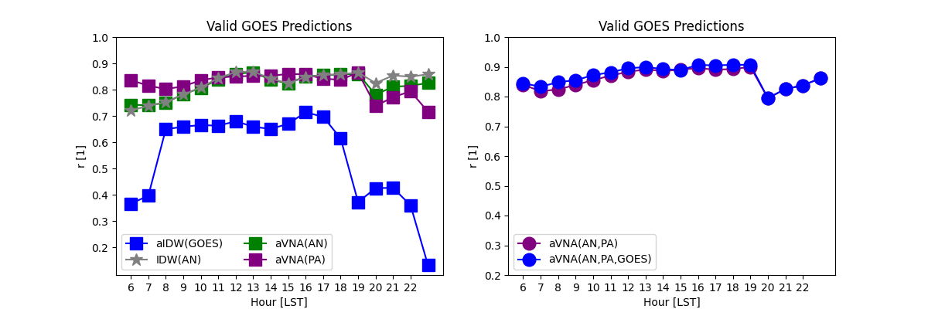
Leave-1-out Validation: National Mean Bias
GOES shows structure in the bias that is associated with long-distance extrapolation…
The fusion actually doesn’t use those cells (too far away)
Remember, this is validation. In application, the prediction at the monitor is equal to the monitor.

Slide 30
Supplement on eVNA

Slide 31
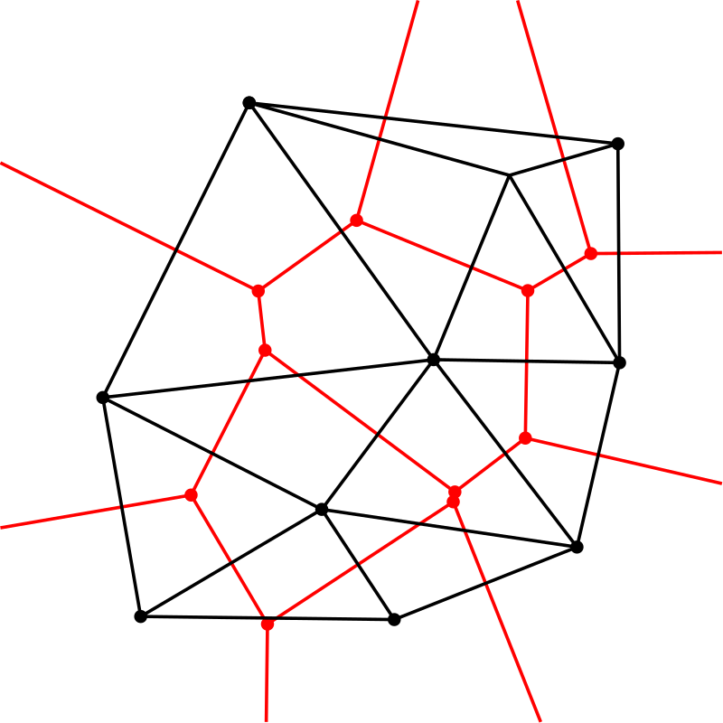
What is a Voronoi diagram and how does it relate to a Delaunay Tessellation?
The Voronoi Diagram is show in red while the Delaunay Tessellation is in black
  Red polygons show area where black lines delimit closest neighbor relationships
  Black triangles are made by vertices where no triangle includes another’s vertices
Voronoi Diagram
  Extend a radius in all directions from each black vertex.
  When two vertices meet, stop.
  This is the extent of the “area of influence”

Slide 32
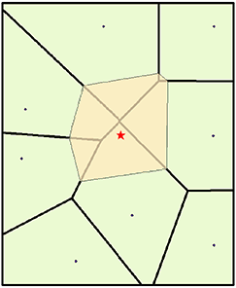
Natural Neighbor Interpolation
Sibson published a method in 1981
Create a complete Voronoi Diagram shown in black lines with green faces
Add a point and redevelop a local polygon (yellow)
Contribution Weights:
  Sibson weights: The area intersection between old polygons and the new polygon are the weights.
  Laplace weights: The neighbor’s shared face length (green line) divided by the distance to the neighbor (blue line).
  All normalized to 1.
Sibson and Laplace weights use elements of the Voronoi polygon.
Sibson, R. "A Brief Description of Natural Neighbor Interpolation," chapter 2 in Interpolating Multivariate Data. New York: John Wiley & Sons, 1981. 21–36.

Slide 33
VNA is NNA without the Voronoi diagram
First published in MATS User Guide (2007)
Timin, Wesson, Thurman (2010)
VNA in EPA Tools
  Create a complete Voronoi Diagram shown in green and yellow
  weights: distance to the neighbor (blue line)
So, VNA does not use any element of the Voronoi polygon… at all.
  This is actually the Delaunay neighbor average weighed by f(distance)
  Constructing a Delaunay diagram is twice as fast as Voronoi diagram.
Abt, MATS User Guide, 2007.. (2010).
Timin, Wesson, Thurman, Chapter 2.12 of Air pollution modeling and its application XX. (Eds. Steyn, D. G., & Rao, S. T.) Dordrecht: Springer Verlag.

Slide 34
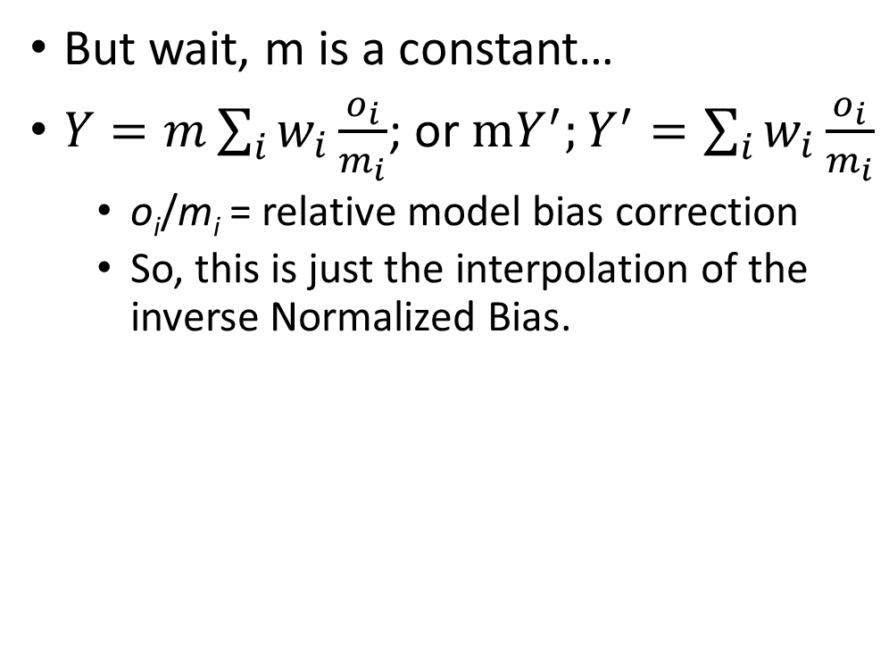
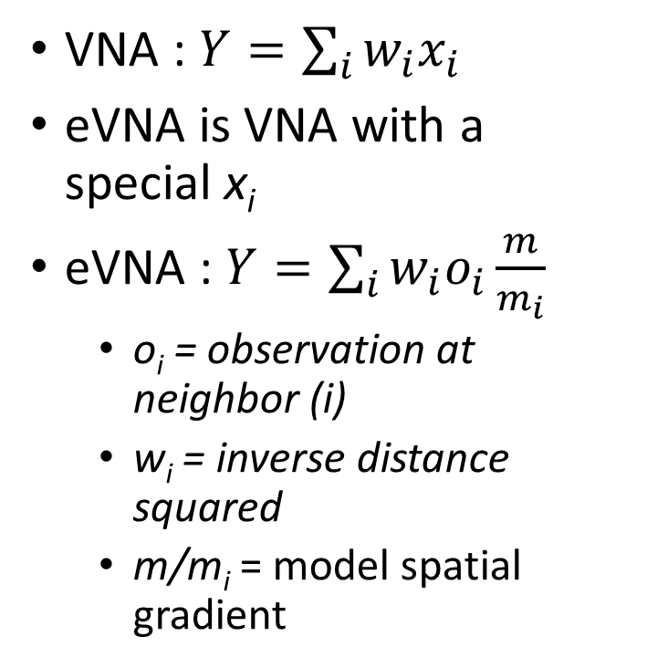
What is extended VNA?
VNA : $Y=\sum_{i}{w_{i}x_{i}}$
eVNA is VNA with a special x_{i}
eVNA : $Y=\sum_{i}{w_{i}o_{i}\frac{m}{m_{i}}}$
  o_{i} = observation at neighbor (i)
  w_{i} = inverse distance squared
  m/m_{i} = model spatial gradient
But wait, m is a constant…
$Y=m\sum_{i}{w_{i}\frac{o_{i}}{m_{i}}}$; or $mY^{′};Y^{′}=\sum_{i}{w_{i}\frac{o_{i}}{m_{i}}}$
  o_{i}/m_{i} = relative model bias correction
  So, this is just the interpolation of the inverse Normalized Bias.

