Slide 1
The views expressed in this presentation are those of the authors
and do not necessarily reflect the views or policies of the U.S. EPA.
Cooking Emissions and Their Chemical Characterization in the United States
Karl Seltzer,¹ Venkatesh Rao,¹ Rich Mason,¹ Jennifer Snyder,¹
Brandy Albertson,² Andrew Bollman,³ Susan McCusker⁴
¹Office of Air and Radiation, US Environmental Protection Agency, ²Oregon Department of Environmental Quality,
³North Carolina Department of Environmental Quality, ⁴Mid-Atlantic Regional Air Management Association, Inc.
United States Environmental Protection Agency
Office of Air and Radiation
October 17, 2023
Presentation to: CMAS Conference

Slide 2
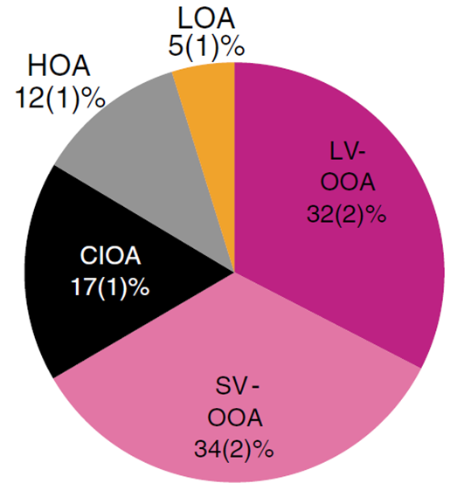
Cooking Results in Emissions & PM_{2.5} Exposure
Cooking results in gaseous and particulate emissions.
Gases include a substantial contribution from aldehydes and semi-volatiles (Schauer et al., 1999; Klein et al., 2016); particulates are predominantly organic (McDonald et al., 2003).
Positive matrix factorization of AMS observations suggests cooking emissions contribute ~5-10% of total ambient PM_{2.5} and ~15-20% of organic aerosol in cities (Hayes et al., 2013; Sun et al., 2011).
Land-use regression modeling suggests cooking contributes a nationwide, population-weighted organic aerosol exposure of ~0.4 µg m⁻³ (Saha et al., 2022).
Source Contributions to Organic Aerosol in Los Angeles
“Cooking Influenced” Organic Aerosol
Hayes et al., 2013

Slide 3
Cooking Emissions in the 2020 NEI
Cooking contributed ~200,000 tons of primary PM_{2.5} emissions, which is greater than all onroad and nonroad primary PM_{2.5} emissions.
7% of the nonpoint emissions, excluding fires, and scales with population.
Emissions are estimated for commercial cooking and residential grilling → mostly PM_{2.5}, CO, and VOC.
All commercial cooking emissions are assigned to appliance-specific Source Classification Codes (e.g., under fired charbroiler, flat griddle, etc.).
Emissions are not estimated for non-backyard grilling residential cooking or food trucks.

Slide 4
Current Emission Estimation Methods
Emissions are a function of the county-specific estimated mass of meat cooked, by meat type and appliance type. This is the activity data, and it varies for each NEI-cycle based on restaurant count statistics.
$${County Meat Mass}_{a,m}=\sum_{r}{\left({Restaurant Count}_{r}×\%_{r,a}×{Appliance Count}_{r,a}\right)×{Mass/year}_{r,a,m}}$$
Where: r is the index for restaurant-type, a is the index for appliance-type, m is the index for meat-type.
%r,a is the percent of restaurant-type r with appliance-type a.
Appliance Count_{r,a} is the number of appliance-type a at restaurant-type r.
Mass/year_{r,a,m} is the amount of meat-type m cooked on appliance-type a per year.
All red variables do not annually vary. Only Restaurant Count_{r} annually varies.
%_{r,a}, Appliance Count_{r}, and Mass/year_{r,a,m} are from the 2001 CARB report.

Slide 5
Meat Consumption Statistics
The USDA maintains annual statistics on production, imports, exports, beginning stocks, carcass mass, retail mass, and boneless mass of beef, veal, lamb, pork, chicken, turkey, and fresh/canned/cured fish/shellfish.
Consumption Dataset | Steak | Hamburger | Poultry | Pork | Seafood | Other
NEI Methods [tons] | 10,629,477 | 21,257,150 | 25,705,019 | 5,285,493 | 9,484,562 | 10,037,655
USDA [tons] | 9,513,398 |  | 15,735,308 | 8,531,215 | 2,006,500 | 8,751,896
Sizeable differences in estimated meat consumption using existing methods and data from the USDA. Note that “NEI Methods” are only meant to capture consumption at commercial establishments.
According to USDA statistics, ~65% of protein is consumed at home, ~35% is consumed away from home (e.g., restaurant, school, fast food, other).

Slide 6
PM_{2.5} Emissions Factors
A compilation of 7 studies that include 41 individual PM_{2.5} emissions factors suggest emissions can substantially vary; ~3 orders-of-magnitude.
Studies vary based on cooking device, type of meat cooked, and setting (e.g., commercial vs. residential). EFs tend to have larger inter-study, not intra-study, variability.

Slide 7
Total Cooking Emissions Estimates
Emissions vary substantially when combining consumption statistics from the USDA with emissions factors from literature yield.
PM_{2.5}
200k tons in 2020 NEI
100k – 575k, depending on EF selection.
VOC
34k tons in 2020 NEI
2k – 202k, depending on EF selection.
CO
175k tons in 2020 NEI
76k – 420k, depending on EF selection.

Slide 8
Hazardous Air Pollutant Emissions
Dominated by small aldehydes; can reach up to >25k tons of directly emitted HCHO.

Slide 9
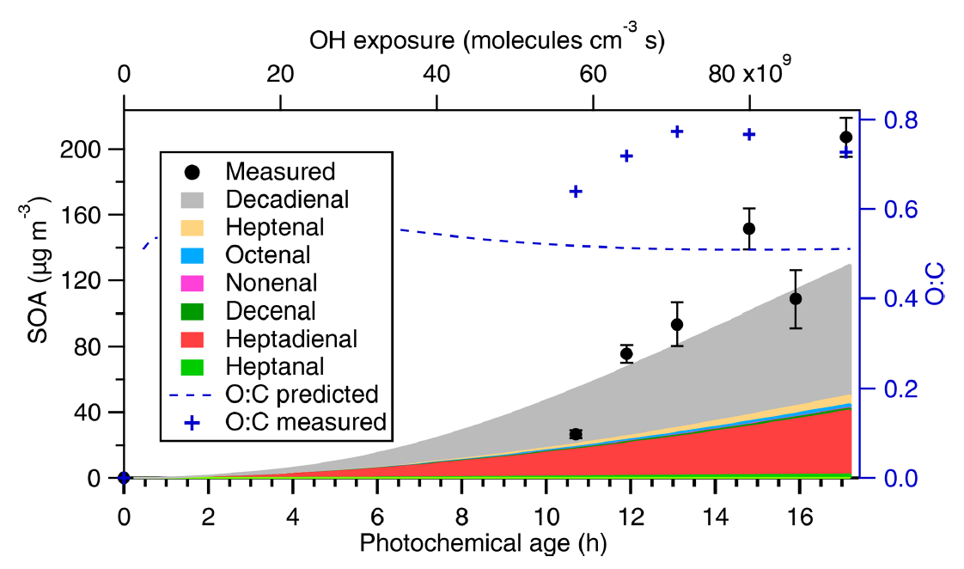
Organic Cooking Emissions are Semi-Volatile & SOA Precursors
Measure of volatility
Takhar et al., 2019
Takhar et al., 2021
Primary organic aerosol emissions from cooking are semi-volatile and a non-negligible portion would evaporate under standard ambient conditions (≤ 10 µg m⁻³ OA).
Aldehydes contribute to a large fraction of cooking SOA and cooking SOA is highly oxygenated.

Slide 10
Conclusions
Cooking emissions are predominantly PM_{2.5} and CO in the 2020 NEI. Emissions are calculated using appliance-specific meat consumption estimates.
Current methods overestimate total meat consumption, which has a direct impact on emissions estimates.
Reported emissions factors feature substantial variability, resulting in PM_{2.5} emission estimates that span 100k – 300k tons. Continued work needed to constrain this value or create a composite, more representative emissions factor.
VOC emissions from cooking are rich in formaldehyde, acetaldehyde, and propionaldehyde, all of which are hazardous air pollutants. VOC emissions also include SOA precursors; are there appropriate SOA formation pathways in existing chemical mechanisms to capture this chemistry?

Slide 11
Contact:
seltzer.karl@epa.gov

