Slide 1
The Well-tempered deposition algorithm
Colin Lee*¹, Paul Makar ¹, Kenjiro Toyota ¹, Christian Hogrefe², Olivia Clifton^{3,4}, Mhairi Coyle⁵, Erick Fredj⁶, Orestis Gazetas^{7,8}, Ignacio Goded⁷, László Horváth⁹, Qian Li¹⁰, Ivan Mammarella¹¹, Giovanni Manca⁷, J. William Munger¹², Ralf Staebler¹, Eran Tas¹⁰, Timo Vesala^{11,13}, Tamás Weidinger¹⁴, Zhiyong Wu¹⁵, Leiming Zhang¹
Oct 17
CMAS 2023
¹ Air Quality Research Division, Environment and Climate Change Canada
² United States Environmental Protection Agency, Office of Research and Development
³ NASA Goddard Institute for Space Studies
⁴ Center for Climate Systems Research, Columbia Climate School, Columbia University
⁵ United Kingdom Centre for Ecology and Hydrology
⁶ Department of Computer Science, The Jerusalem College of Technology
⁷ European Commission, Joint Research Centre (JRC)
⁸ Scottish Universities Environmental Research Centre (SUERC)
⁹ Department of Optics and Quantum Electronics, ELKH-SZTE Photoacoustic Research Group
¹⁰ The Institute of Environmental Sciences, The Robert H. Smith Faculty of Agriculture, Food and Environment, The Hebrew University of Jerusalem
¹¹ Institute for Atmospheric and Earth System Research/Physics, University of Helsinki
¹² School of Engineering and Applied Sciences and Department of Earth and Planetary Sciences, Harvard University
¹³ Institute for Atmospheric and Earth System Research/Forest Sciences, University of Helsinki
¹⁴ Department of Meteorology, Institute of Geography and Earth Sciences, Eötvös Loránd University
¹⁵ ORISE Fellow at Center for Environmental Measurement and Modeling

Slide 2
Ozone dry deposition
Ozone dry deposition is an important driver of ozone concentrations
Most implementations based on Wesely 1989
Including in ECCC’s coupled weather and air quality model, the Global Environmental Multiscale—Modelling Air Quality and Chemistry (GEM-MACH)
Long-term deposition observations* are rare
Require tower measurements for gradient (several heights) or eddy flux (high-time resolution concentration + vertical wind)

Slide 3
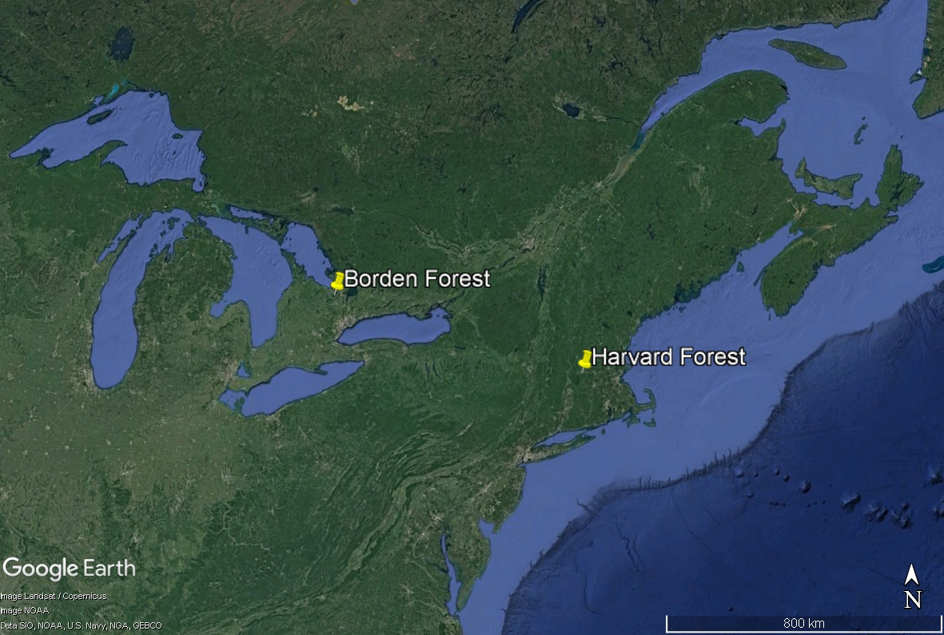
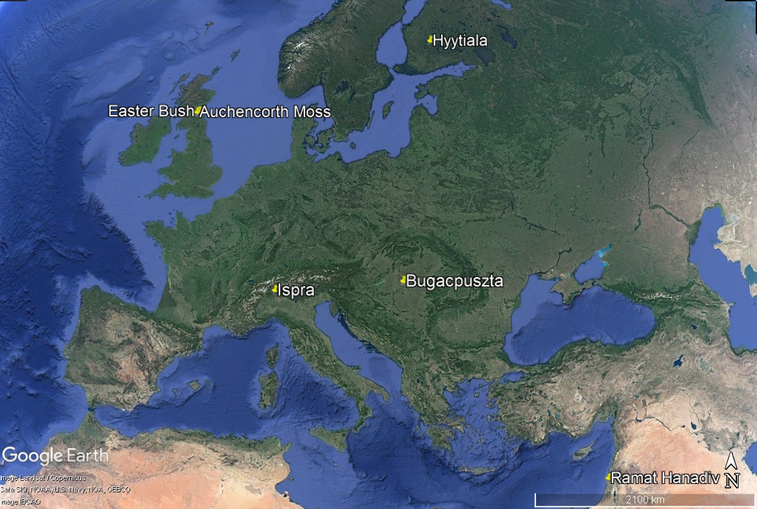
AQMEII4 o3 tower site data
8 sites with tower measurements covering 5 land types over 3-12 years with ~35 met variables

Slide 4
Machine learning is popular
Recent developments in machine learning (ML) and artificial intelligence (AI) have created an explosion of applications
This dataset is a great candidate for ML
Many input variables (~30 common to all sites)
Almost 100,000 valid observations in total
Number one fear: machine learning is “not interpretable”
Especially deep neural networks
Great recent work on “explainable AI”
Another approach: Physics-Informed AI
Build physical constraints into your model or loss function

Slide 5
Goal: physics informed deep resistance model
Most deposition algorithms use “resistance model” with different deposition pathways represented as resistors in parallel or in series
Can we use the input variables related to each pathway to train a neural network (NN) to predict the resistance components and then add these up in parallel?

Slide 6
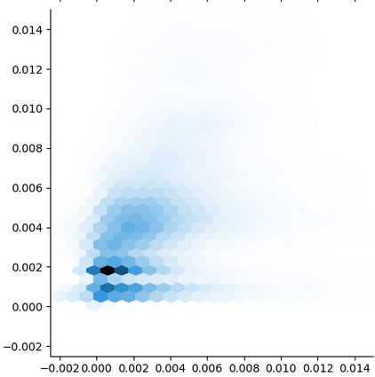
How well does our physical model do?
Comparing GEM-MACH implementation against observations:
R $=0.37$
RMSE $=1.62×{10}^{−5}$
GEM-MACH V_{d} (m/s)
Observed V_{d} (m/s)

Slide 7
Detour: abusing tensorflow
TensorFlow is a mature and powerful machine learning platform in Python
TensorFlow operations are differentiable
TensorFlow has built-in optimisation routines
Part of the physics-informed NN development process involved translating the Fortran dry deposition code into TensorFlow operations
I was therefore able to use TensorFlow to optimise the tunable parameters in our implementation of the Wesely scheme
This is not recommended, I mostly did it to see what would happen

Slide 8
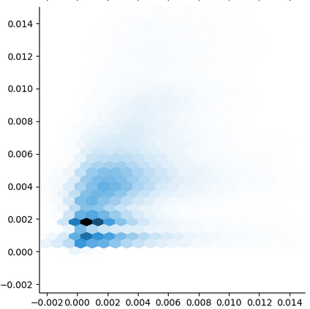
Tensorflow-tuned parameters
Comparing GEM-MACH algorithm with parameters tuned to observations
R $=0.43$
RMSE $=1.05×{10}^{−5}$
Some improvement over baseline, but not huge
GEM-MACH V_{d} (m/s)
Observed V_{d} (m/s)

Slide 9
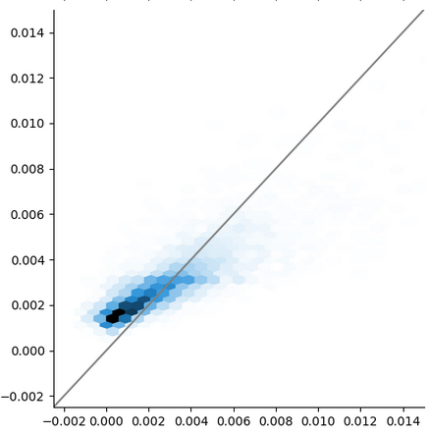
Question 1: is there enough information?
Method: train traditional fully-connected neural network (black box) on all the observational data
Result: R $= 0.83$
RMSE $= 3.59×{10}^{−6}$
Bias $= −2.12×{10}^{−7}$
There is information here!
But this is still a black box
On to physics-informed NN
Neural Network V_{d} (m/s)
Observed V_{d} (m/s)

Slide 10
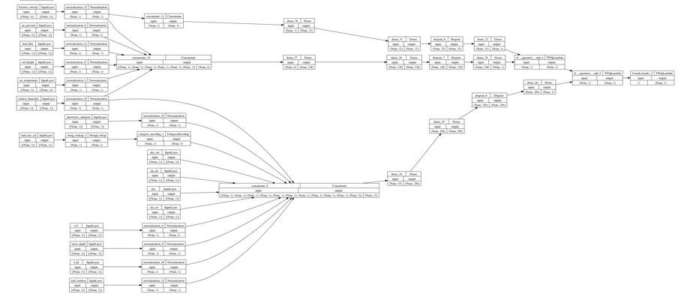
Physics informed network setup
Structure:
3 neural networks for diffusion, aerodynamic and surface resistance terms
Each takes only the inputs our physical algorithm uses, e.g. r_{diff} only uses friction velocity, no other inputs
Output: $v_{d}= \frac{1}{r_{diff}+r_{aero}+r_{surf} }$

Slide 11
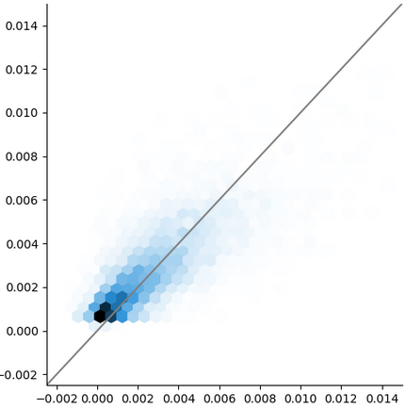
Physics-informed results
Result: R $= 0.78$
RMSE $= 3.68×{10}^{−6}$
Bias $= −1.85×{10}^{−5}$
Almost as good as the black box, except now we have information about what the model is “thinking”
Neural Network V_{d} (m/s)
Observed V_{d} (m/s)

Slide 12
Conclusions and future work
We can use the physics-informed model to learn improve the physical model
E.g., can easily change which variables go into each resistance
Physics-informed model can be taken further: break surface resistance down into soil, canopy, stomatal components instead of one large network
Test it out in regional model
I expect it to fail spectacularly, but we will learn a lot
How do we handle un-represented land types?
The views expressed in this presentation are those of the authors and do not necessarily reflect the views or policies of the U.S. EPA.

