Slide 1
Estimating ZIP Code-Level Air Quality and Health Risks of New York City’s Transportation Decarbonization Pathways using COMET and ZAPPA
Ozge Kaplan¹, Catherine Seppanen² and Sarav Arunachalam²
U.S. Environmental Protection Agency, Office of Research and Development
University of North Carolina, Gillings School of Global Public Health
22nd Annual CMAS Conference 2023, 16-18 October 2023
Disclaimer: The views expressed in this presentation are those of the authors and do not necessarily represent the views or policies of the U.S. Environmental Protection Agency.

Slide 2
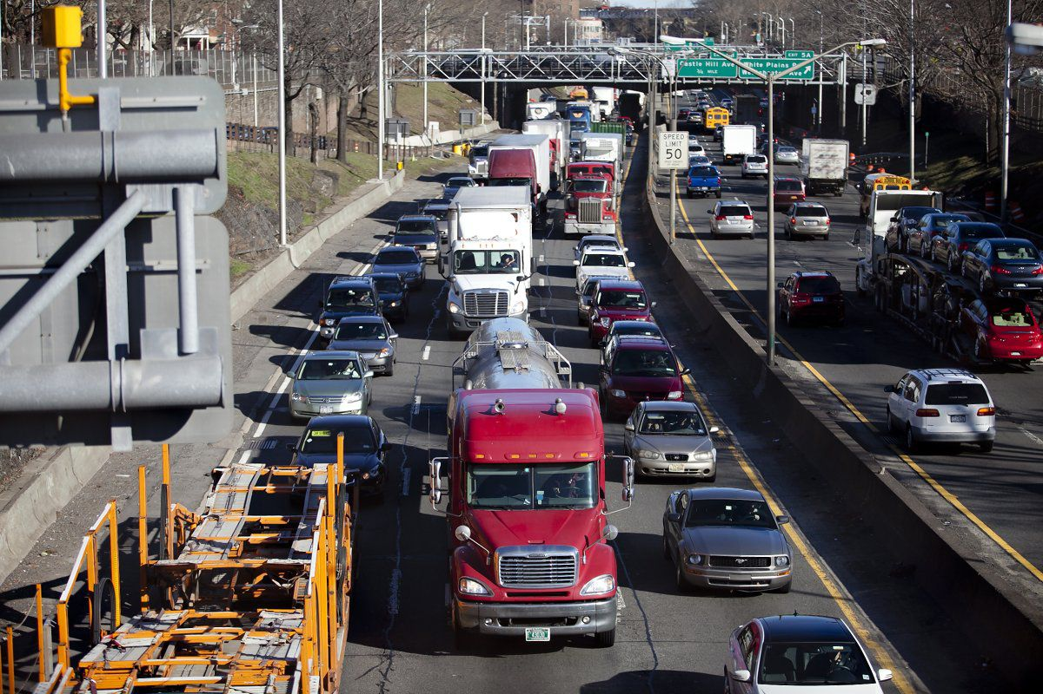
Air, Climate, and Energy Linkages
In the U.S., 5.1 million children and 20 million adults have asthma.
Major pollutants include nitrogen dioxides – triggering ozone formation – and PM2.5 (or fine particles)
Air pollution leads to asthma attacks and cause a range of other health issues such as heart attacks, strokes, lung cancer and even early death
Air quality standards helped achieve clean air in many communities, though still nearly half of Americans breathe unhealthy air.
The burden is unevenly shared specifically low-income communities and communities of color impacted disproportionately
Transportation sector is one of the biggest contributors to air pollution.

Slide 3
Research Question
NYC is already a leader in combating climate change.
In 2014, a goal of reducing NYC’s greenhouse gas (GHG) emissions 80% by 2050 was established.
NYC has enacted multiple strategies to meet its energy and climate goals:
State & City Electricity Technology Targets
Clean Energy Standard: 70% Renewable Electricity by 2030
Clean Vehicle Deployment Targets
Federal Fuel Economy Standards
What technology pathways could achieve transportation CO2 reductions?
What would be the resulting air emission → air quality → health co-benefits?
What would be the distribution of benefits at local level?

Slide 4
COMET and ZAPPA Soft-Link
COMET - NYC
OUTPUTS (Sector and Borough)
Technology portfolio Fuel use Emissions (NO_{x}, SO₂, PM₁₀, PM_{2.5}, CO, VOC, CO₂, CH₄) Prices Total system cost
Emission changes from base year to future year per borough per emission category
Scenario – a
Scenario – b
Scenario – c…
ZAPPA - NYC
ZCTA level user-defined emission change
COMET: City-based Optimization Model for Energy Technologies
ZAPPA: Zipcode Air Pollution Policy Assessment Tool

Slide 5
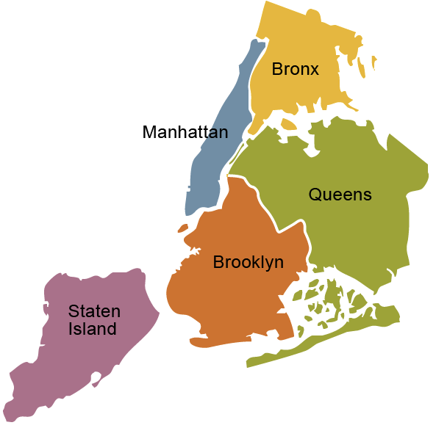
A scenario framework evaluated New York City’s transportation decarbonization policies with a focus on air emissions
Characterized the two most important uncertainties that can impact how cities could attain decarbonization goals
Scenarios | Description
STEADY STATE | Least cost optimization with embedded technology turnover due to age and existing regulations, no carbon reduction
DEPENDENCE | The CO2 intensity of electricity levels follow BAU trends
REVOLUTION | The CO2 intensity of electricity levels follow State’s goals on achieving electricity generation from renewables. “Clean Energy Standard”
Speed of the grid decarbonization
Speed of the end-use demand technology decarbonization
Isik, M., Dodder, R. & Kaplan, P.O. Transportation emissions scenarios for New York City under different carbon intensities of electricity and electric vehicle adoption rates. Nat Energy (2021). https://doi.org/10.1038/s41560-020-00740-2

Slide 6
City-based Optimization Model for Energy Technologies
COMET is an analytical peer-reviewed technology evaluation tool for cities and states that can provide
alternatives for long-term evolution of energy systems
multipollutant and multi-media impacts, unintended consequences of the evolution of energy systems.
COMET is built to be used within an energy-environment-economic optimization framework developed by Energy Technology Systems Analysis Programme (ETSAP) of the International Energy Agency
TIMES (The Integrated MARKAL-EFOM System)
MARKAL/TIMES has been used internationally since 1978 and supported by the International Energy Agency.

Slide 7
COMET - a partial-equilibrium, technology rich, optimization model

Slide 8
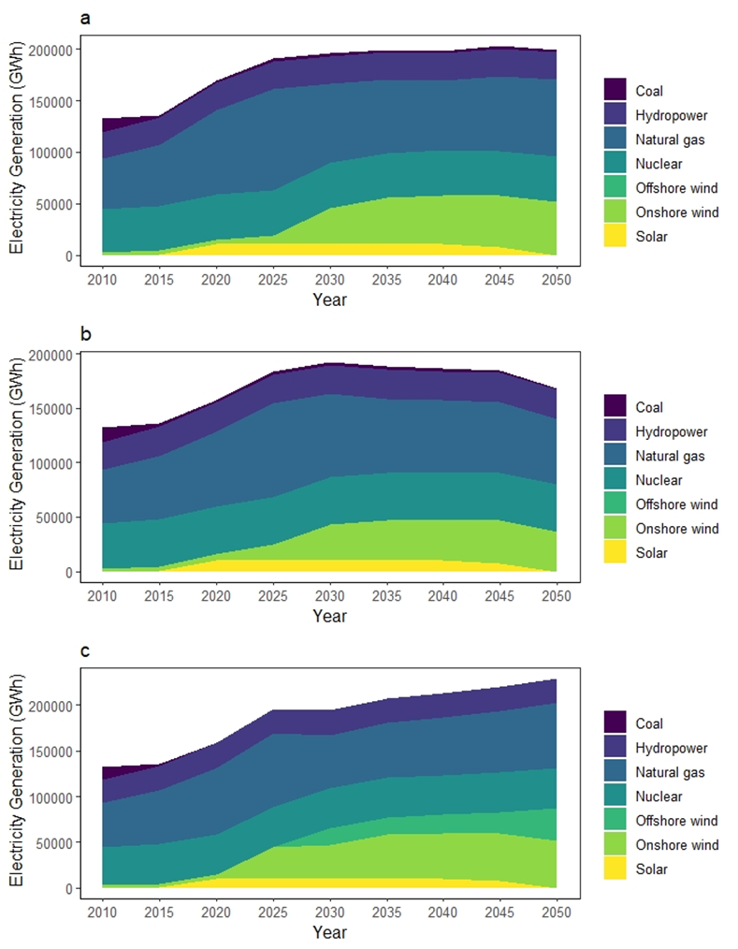
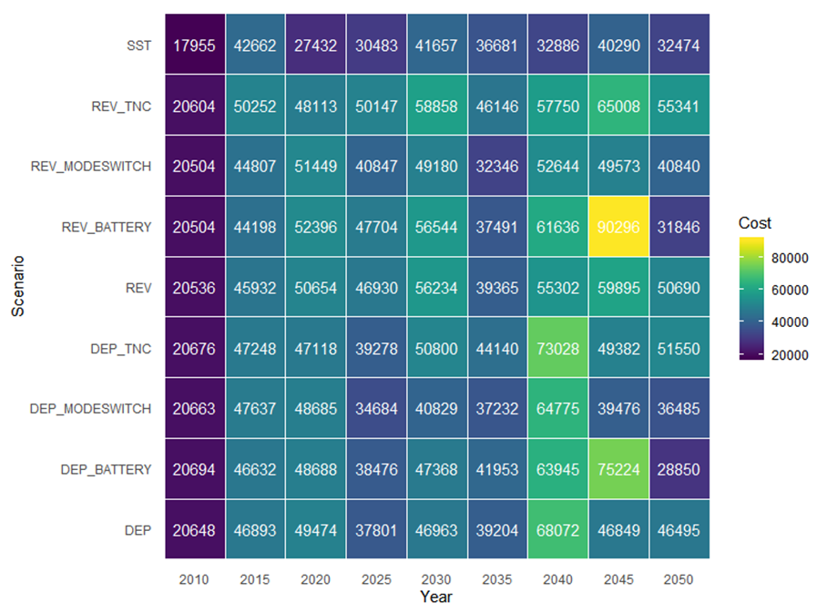
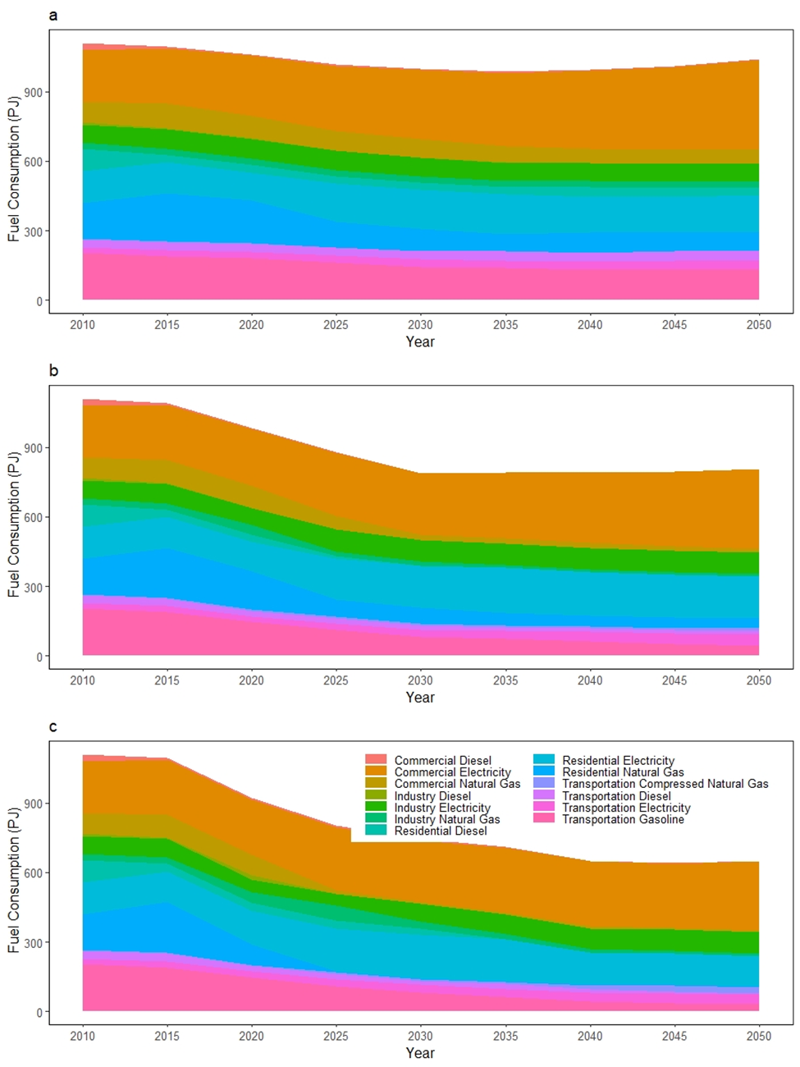
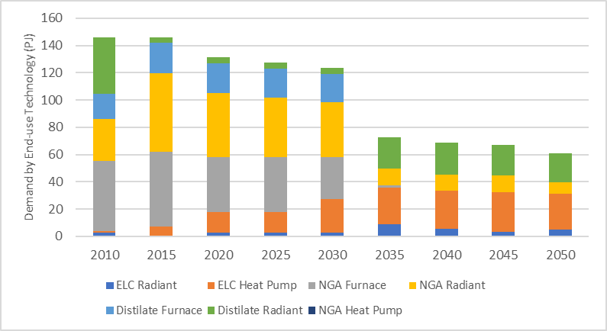
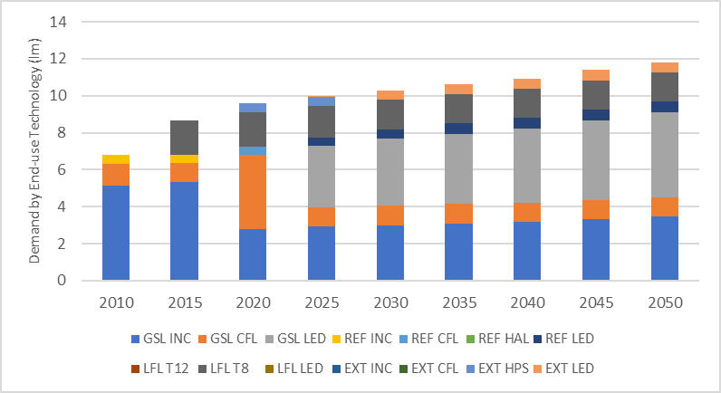
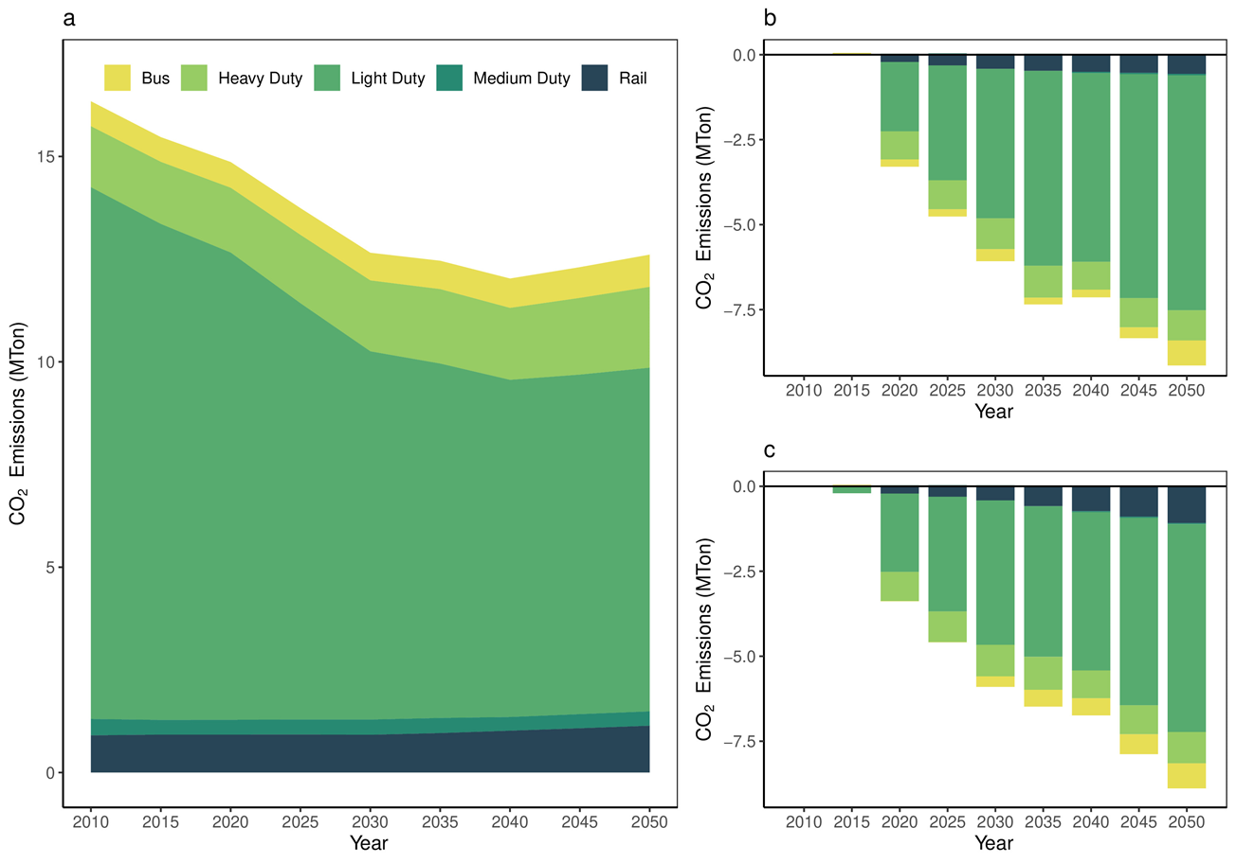
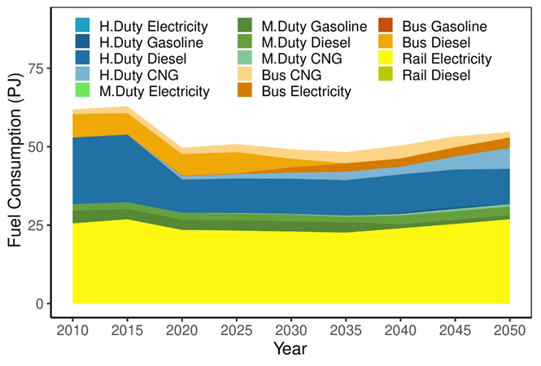
Variety of outputs from COMET (Illustrative)
End-use Demand
Technology Portfolio
Electricity Generation Mix
Investment Costs
Sectoral Fuel
Consumption
Space Heating
2005 $US Million
Lighting
Emission Implications
Beyond light-duty vehicles mix

Slide 9
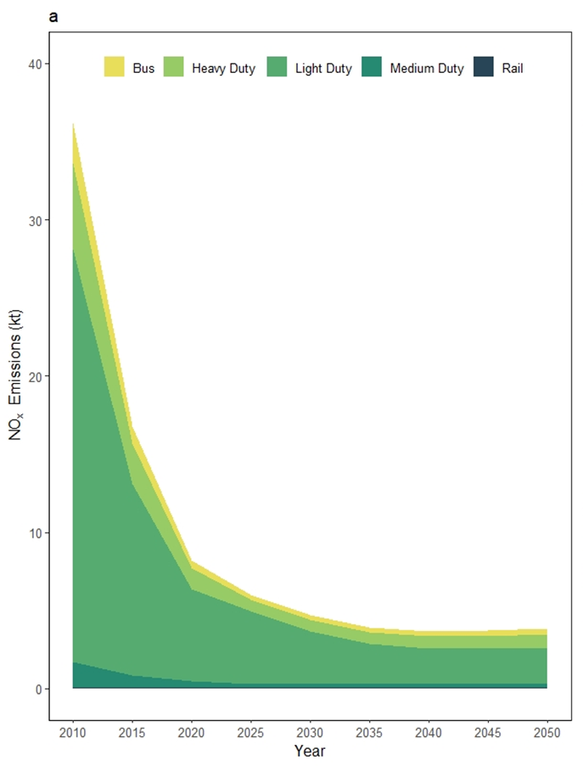
Fuel consumption and transport related CO2 and NOx emissions
Tier 3, CAFE standards contribute to reductions in Steady-State
In 2015, majority of gasoline consumption is in light-duty sector, whereas diesel consumption is happening in the medium- and heavy-duty sectors.
NYC already has significant use of electricity in their transport system due to use of subways trains.
STEADY STATE carbon dioxide (left) and NOx emissions (right) reduce due to implementation of emission and fuel efficiency standards along with standard turnover of the fleet

Slide 10
Light duty fuel consumption
STEADY STATE
DEPENDENCE
REVOLUTION
By 2050, we see higher investment in energy efficiency in light-duty fleet rather than boosting the electrification
STEADY STATE light-duty vehicle fleet continues to rely on gasoline despite standard fuel efficiency improvements
36% reduction in 2050 compared to 2010
Gasoline consumption decreases by 79% and 83% in REVOLUTION and DEPENDENCE compared to STEADY STATE
No investment in hydrogen-fueled vehicles were observed.
High electrification of light-duty vehicles in both REVOLUTION and DEPENDENCE

Slide 11
Heavy duty and other transportation fuel consumption
DEPENDENCE scenario converts more heavy-duty short-haul trucks from diesel to CNG while electrifying some portion of the bus fleet earlier
STEADY STATE
DEPENDENCE
REVOLUTION
New York City already has substantial electricity consumption due to subway system
STEADY-STATE heavy-duty sector continues to rely on diesel.
Electricity consumption increases by 33% and 26% for REVOLUTION and DEPENDENCE.
DEPENDENCE consumes more electricity in the transportation sector than other scenarios in the near term

Slide 12
Transportation CO₂ emissions in Mton
STEADY-STATE
DEPENDENCE
Most of these reductions were observed in the light-duty sector followed by short haul heavy-duty trucks.
Both DEPENDENCE and REVOLUTION resulted in deeper cumulative reductions in CO2 emissions
Majority of the near-term savings are coming from switching to newer vehicles with improved fuel efficiency
We observe deepest reduction in a sensitivity scenario where light-duty sector is electrification is intensified (DEP_BATTERY)
REVOLUTON

Slide 13
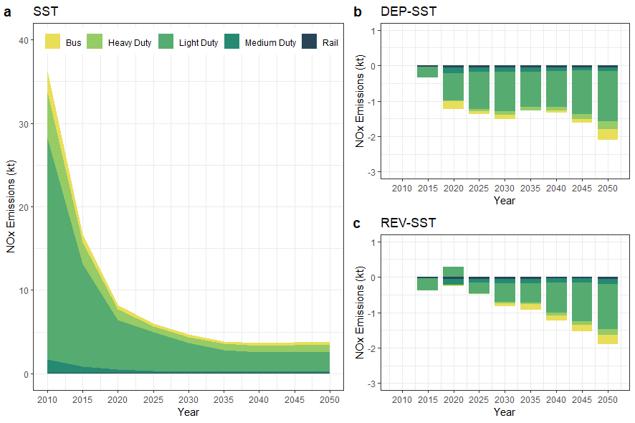
Transportation NO_{x} and PM10 emissions in kton
Key Insight: The fuel switching, especially buses and short haul freight modes, from diesel to CNG resulted in further reductions in NOx and PM10 emissions
Key Insight: The scenario with intense electrification of LDV fleet (i.e., all new LDV purchases to be 100% starting 2030) resulted in more NOx savings than the scenario where the passenger demand is reduced and replaced by public transit, walk and bike modes
Key Insight: However, in the decarbonization scenarios, we observed more PM benefits when the LDV demand is reduced and switched to public transit, walk and bike modes.
Given the transit modes were moving towards clean fuels and electrification.
Key Insight: Grid carbon intensity highly influenced the resultant NOx emissions
the deepest transport air emissions reductions were in the scenario, where the grid had higher carbon intensity

Slide 14
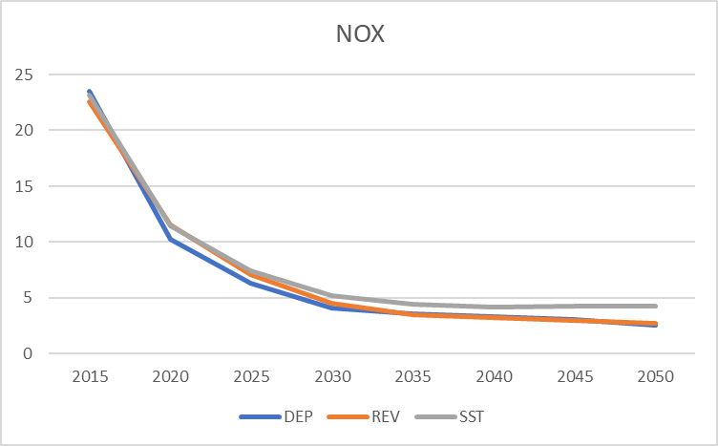
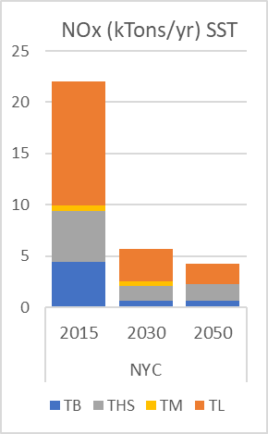
Variations in localized emissions
Gathered new data to reflect city-driving conditions, and run MOVES at county-level
Updated the transport emission factors – originally based on census region averages
Resultant total emissions using updated emission factors yielded close figures compared to scenarios utilizing regional emissions factors
However, there are instances of over- and underestimation of local emissions per mode type

Slide 15
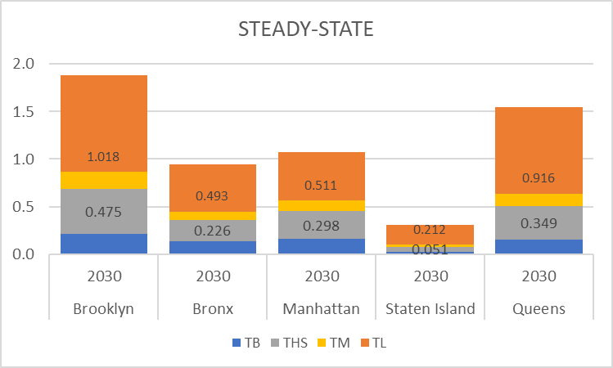
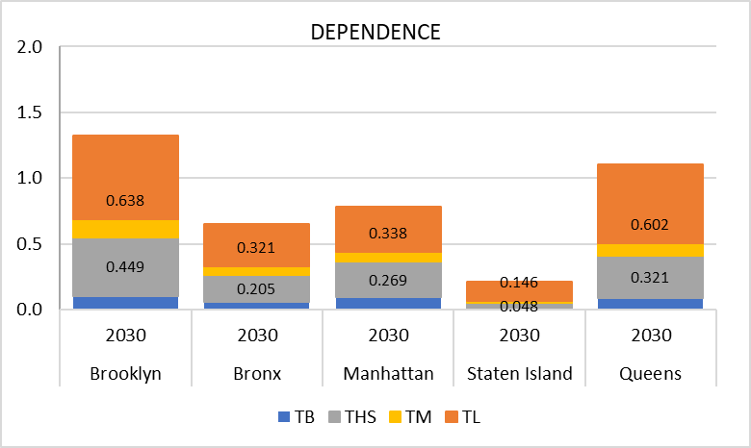
Although total emissions in 2050 were close to each other in decarbonization scenarios, pathways to the decarbonization mattered more at a local level.
To analyze the impact of this transition we linked these scenarios and corresponding emission reductions with reduced form air quality models

Slide 16
ZAPPA-NYC: Zipcode Air Pollution Policy Assessment Tool
Integrate COBRA and C-TOOLS (two reduced-form models)
COBRA can explore how changes in air pollution from clean energy policies and programs, including energy efficiency and renewable energy, can affect human health at the county, state, regional, or national levels.
C-Tools are suite of local scale air quality screening tools.
Incorporate custom higher resolution input datasets for emissions, health incidences and population for New York City to:
allow for a finer-grained, more localized analysis (zip-code level rather than county level) of the health benefits from air quality management decisions, and
perform rapid evaluation of various policy options
Inputs
Process National Emissions Inventories from NEI 2016 v3 to create ZIP code level emissions for area sources, onroad and ship-in-transit sources modeled as line sources
Meteorology from La Guardia processed through AERMET
Average of 10 receptors in each ZIPcode used in health impacts
Changes in air pollution translated to primary and secondary PM2.5 concentrations
COBRA provides health risk for mortality + 11 other end-points

Slide 17
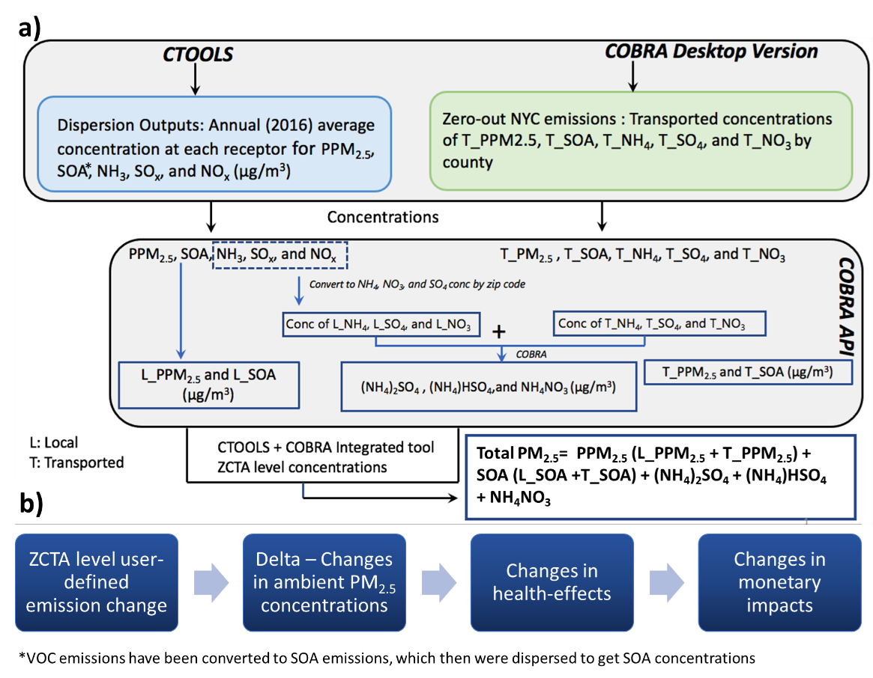
ZAPPA Framework
Current version of ZAPPA is limited to simulating health-effect changes related to primary and secondary PM_{2.5} formation.
Results are translated into monetary impacts through quantifying changes in health-effects.
Shukla et al, ES&T 2022

Slide 18
COMET and ZAPPA Soft-Link
COMET - NYC
OUTPUTS (Sector and Borough)
Technology portfolio Fuel use Emissions (NO_{x}, SO₂, PM₁₀, PM_{2.5}, CO, VOC, CO₂, CH₄) Prices Total system cost
Emission changes from base year (2015) to future year (2030) per borough per category
Scenario – SST
Scenario – REV
Scenario – DEP
ZAPPA - NYC
ZCTA level user-defined emission change

Slide 19
Soft-linking COMET and ZAPPA
ZAPPA doesn't allow a change to its baseline concentrations when calculating health impacts from the modeled scenario.
Estimated the health impacts for a scenario against a future-year baseline through a two-step process.
Run ZAPPA with emissions changes from the ZAPPA baseline (2016) to the future year. This will calculate health impacts due to the year change – “SST2015 - SST2030”
Run ZAPPA with emissions changes between the ZAPPA baseline and the future-year scenario – “SST2015 - REV2030”
Subtract the health impacts calculated in step 1 from the step 2 results to estimate impacts solely due to the scenario in a future year – “SST2030 - REV2030”
“Assumed ZAPPA's 2016 base data approximates to the SST 2015 base emissions.”
Preliminary runs use NOx emission changes

Slide 20
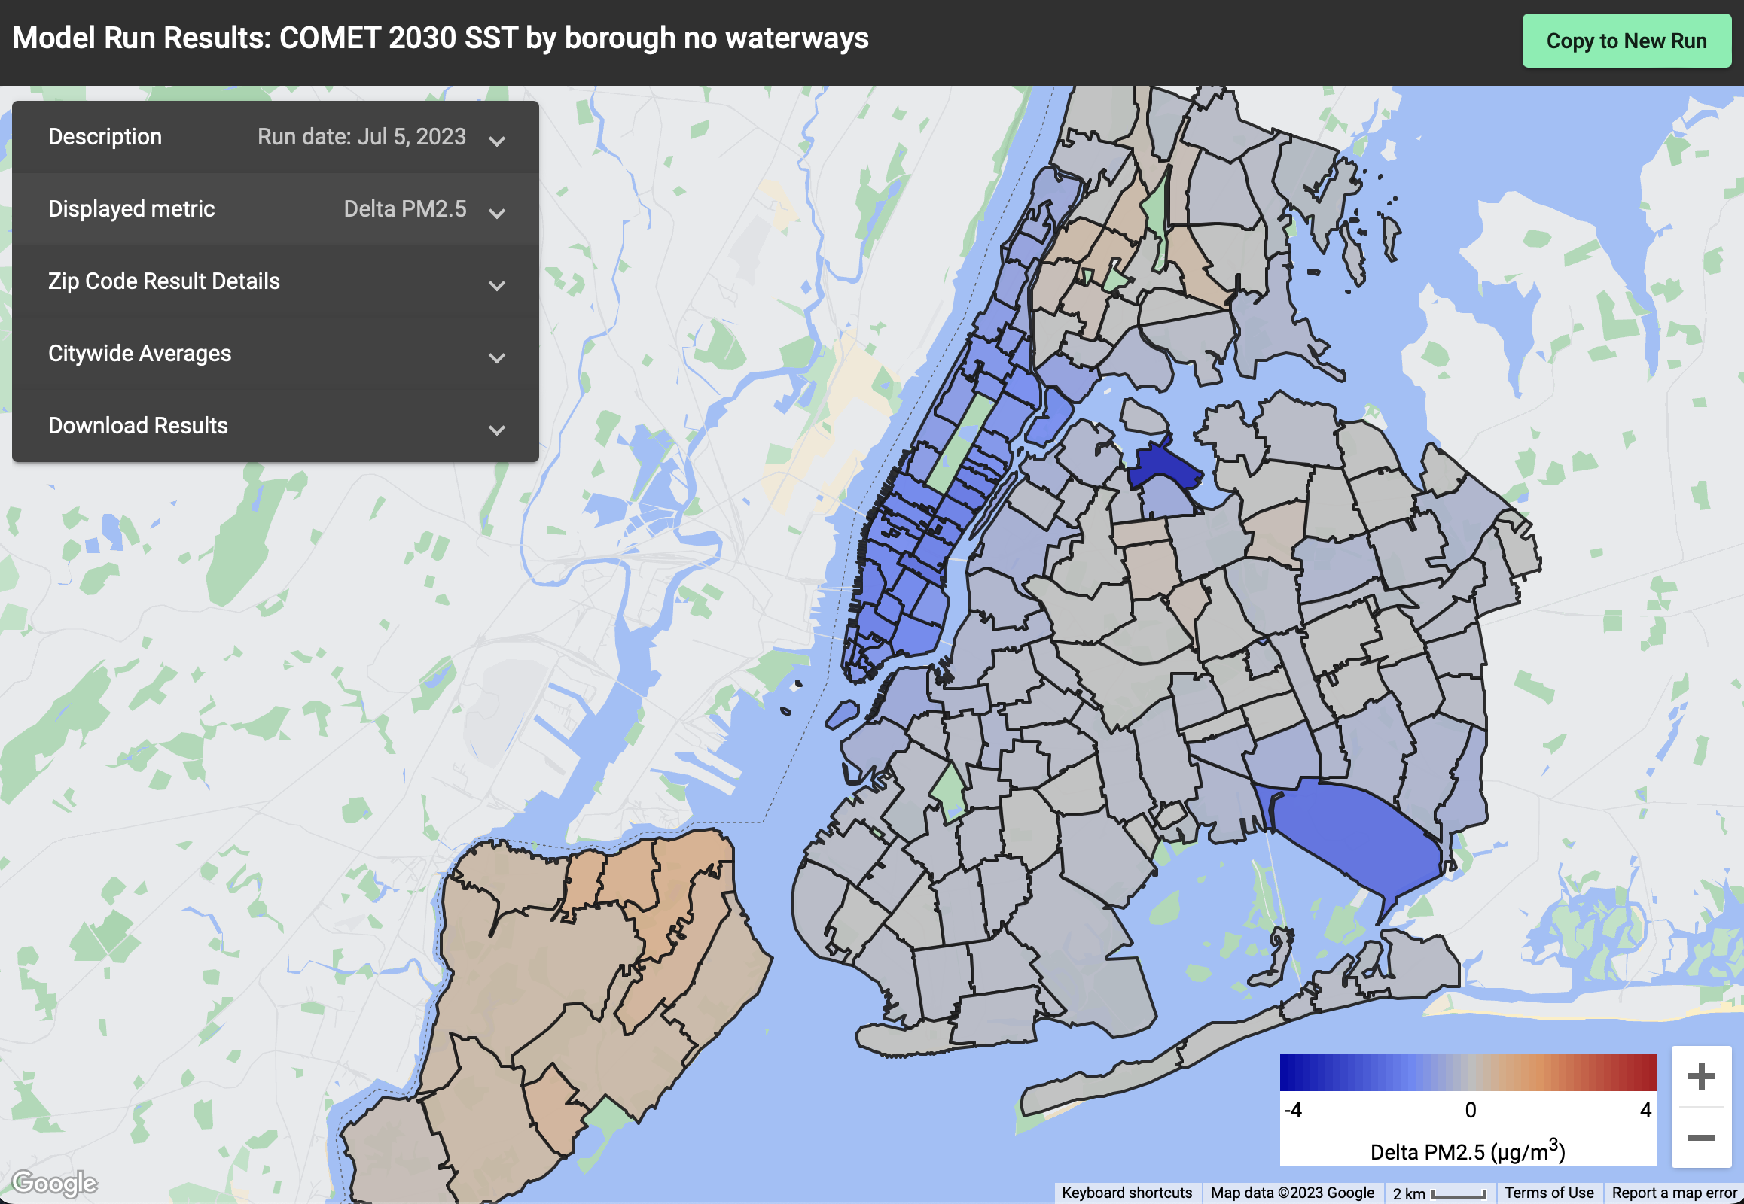
Changes in PM2.5 Concentrations
Showing resulting concentration changes from SST 2015 to SST 2030 resulting from NOx emission changes by borough by source category
Observed increase in PM2.5 concentrations in some parts of the city due to changes in emissions from 2015 to 2030 in SST scenario

Slide 21
Changes in PM2.5 Concentration
Showing PM2.5 concentration change from SST2015 to REV2030 scenario resulting from NOx emission changes by borough by source category
REV scenario shows increased electrification and fuel efficiency in later model years
This yields decrease in air pollutants resulting in decreased PM2.5 concentrations in nearly all parts of the city.

Slide 22
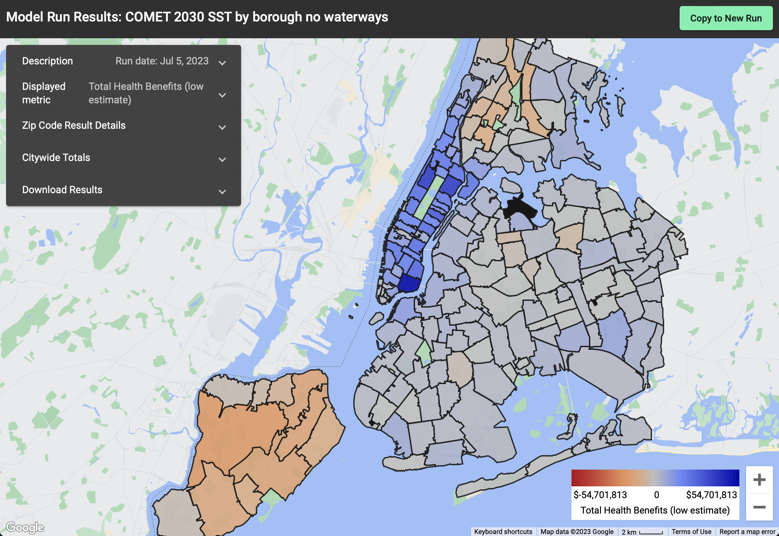
Business as usual – SST scenario continues to result in health impacts (negative) in some parts of the city SST does not include any CO2 policy, although the model captures standard turnover of technologies, older equipment results in increase in concentrations.

Slide 23
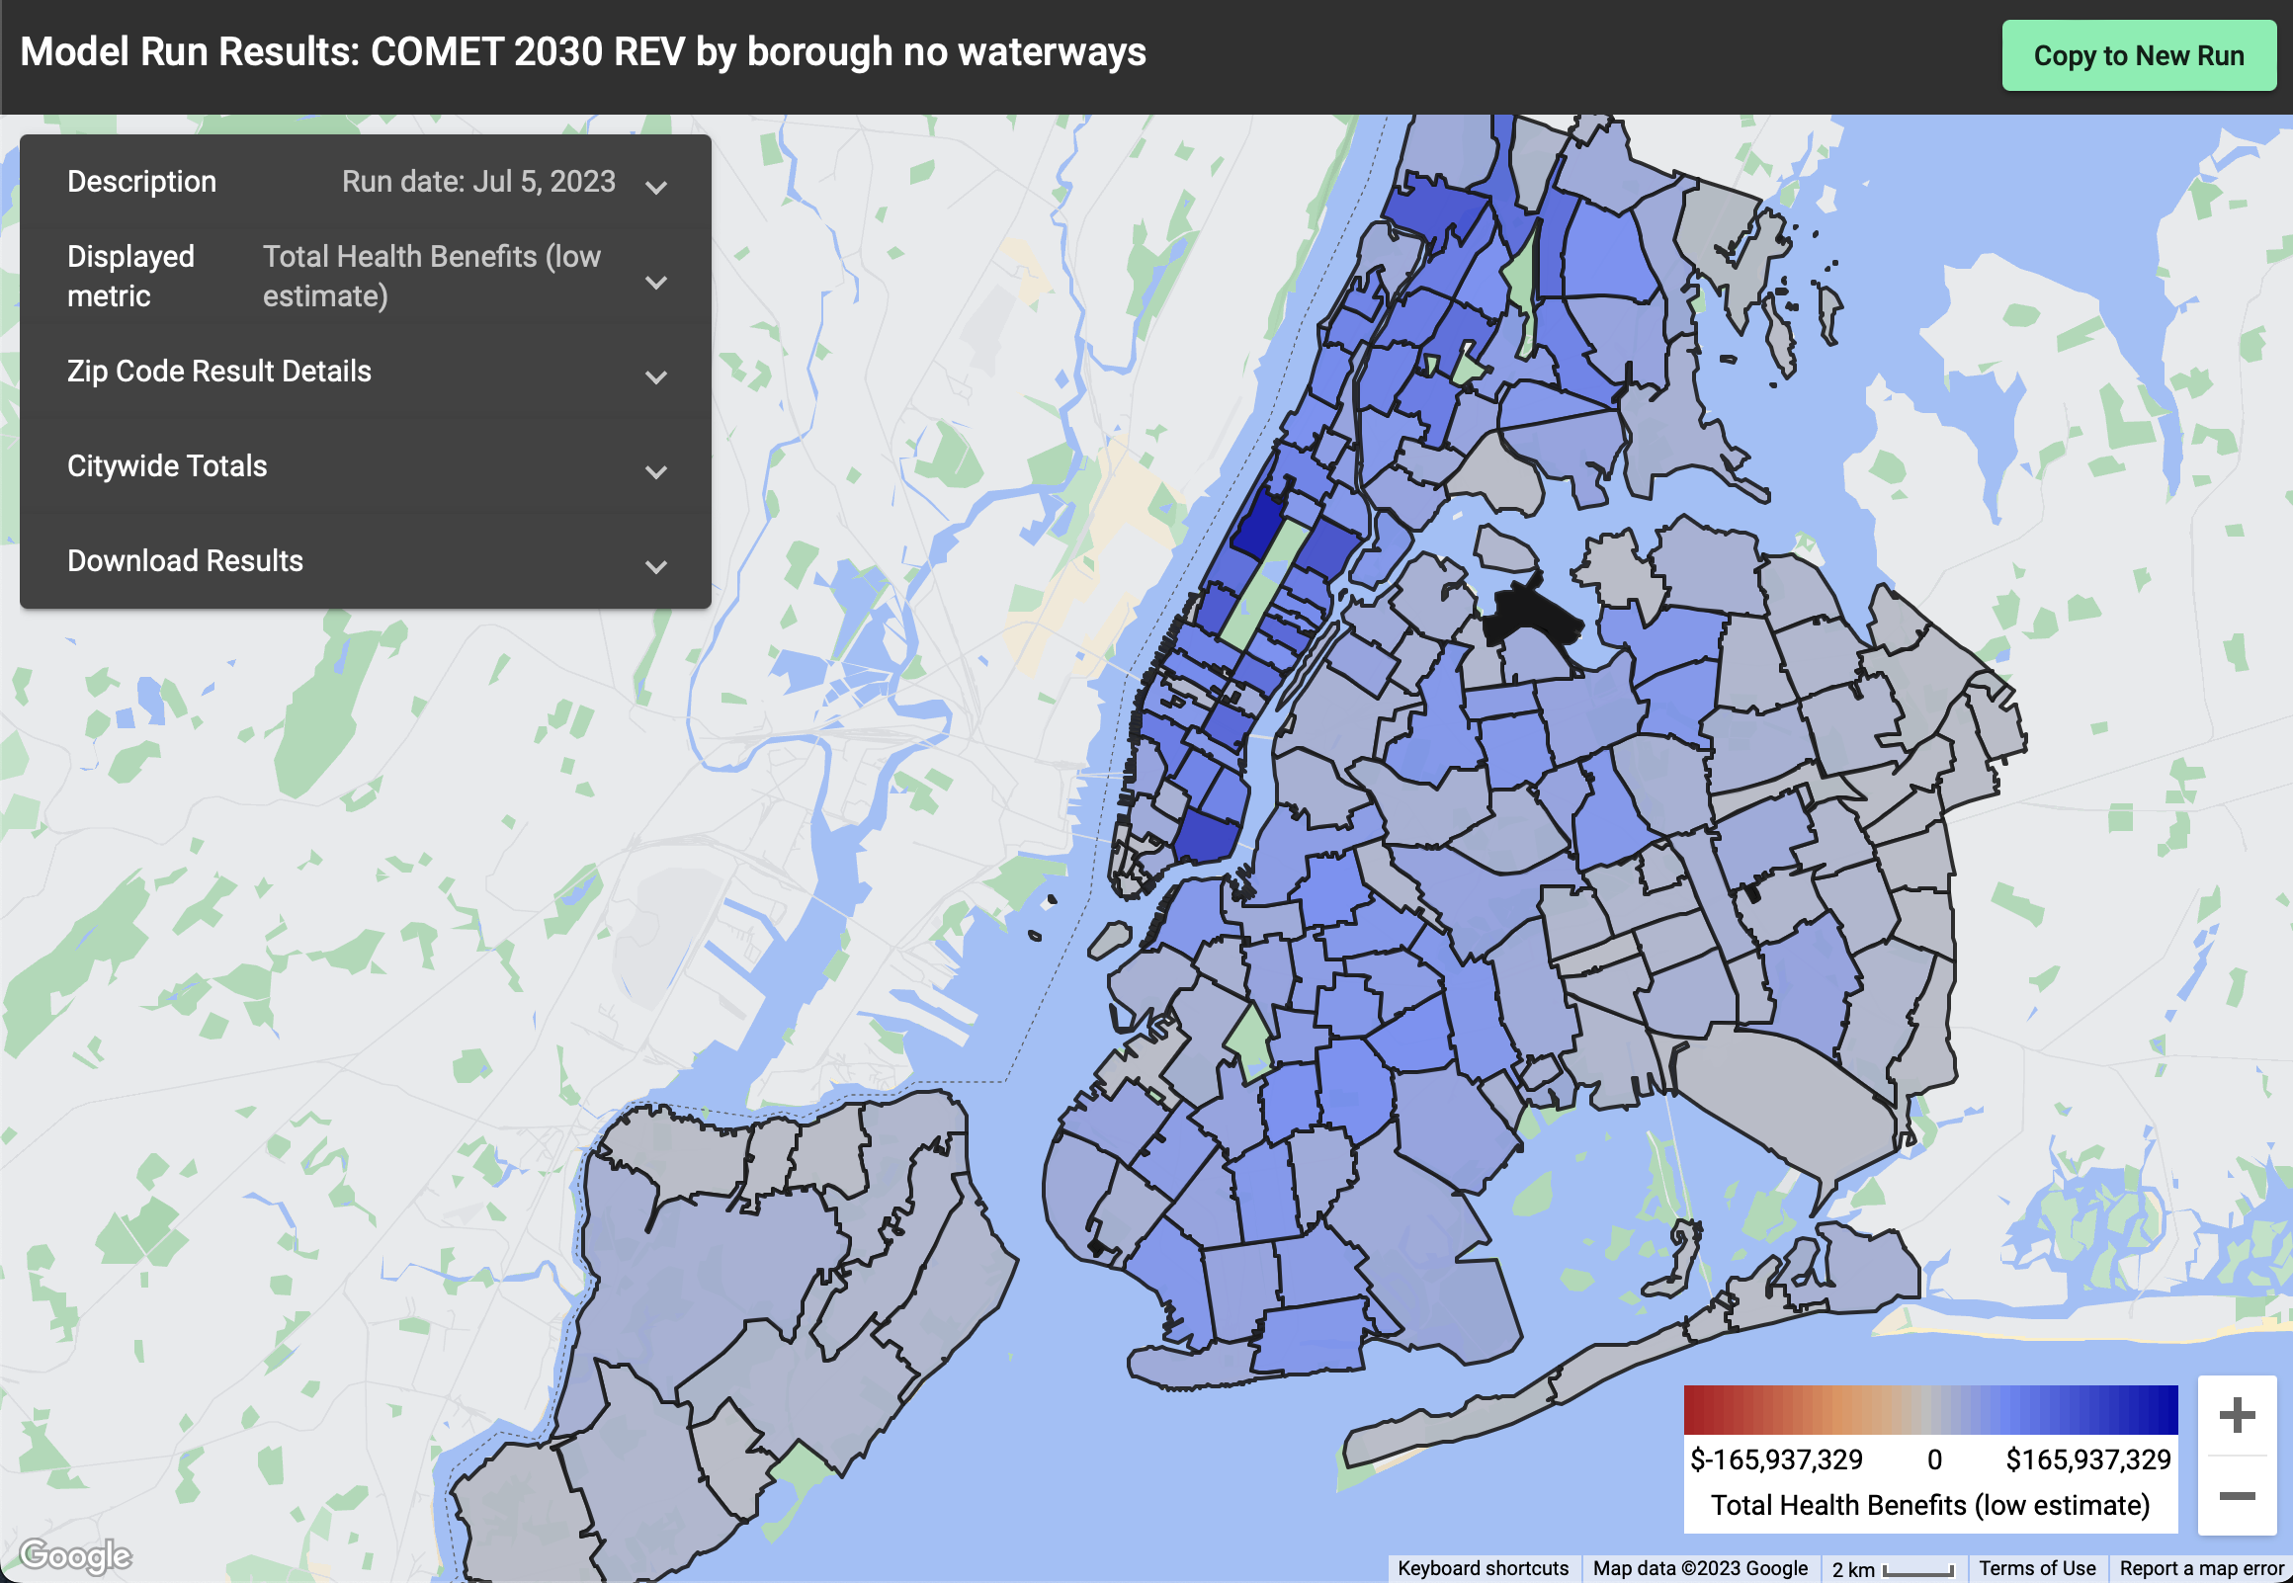
REV Scenario results in all net health benefits across the city due to electrification of fleets and turnover to more efficient vehicles

Slide 24
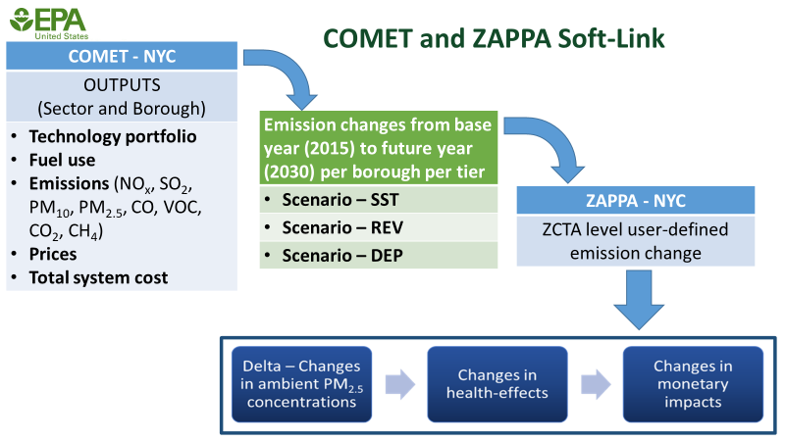
Preliminary Health Benefits and Future Directions
 |  | Citywide |  |  | Borough Specific
 |  | SST '15 to SST '30 | SST '15 to REV '30 | SST '30 to REV '30 | SST '15 to SST '30 | SST '15 to REV '30 | SST '30 to REV '30
Avg. Δ PM2.5 ug/m³ |  | -0.28 | -0.37 | -0.09 | -0.30 | -0.35 | -0.05
Deaths Avoided | Low | 72 | 95 | 23 | 76 | 93 | 17
Total Health Benefits (high) | High | 163 | 215 | 52 | 171 | 210 | 39
Total Health Benefits | Low | $785 M | $1,035 M | $250 M | $825 M | $1,011 M | $186 M
Total Health Benefits (high) | High | $1,764 M | $2,325 M | $560 M | $1,855 M | $2,272 M | $418 M
Apply the same procedure used for NOX emissions to calculate percent changes for SO2 and PM10.
Use the PM10 percent change values to adjust PM2.5 emissions in ZAPPA.
Apply changes to all three pollutants in a single ZAPPA run.
Conduct ZAPPA run for DEP scenario

Slide 25
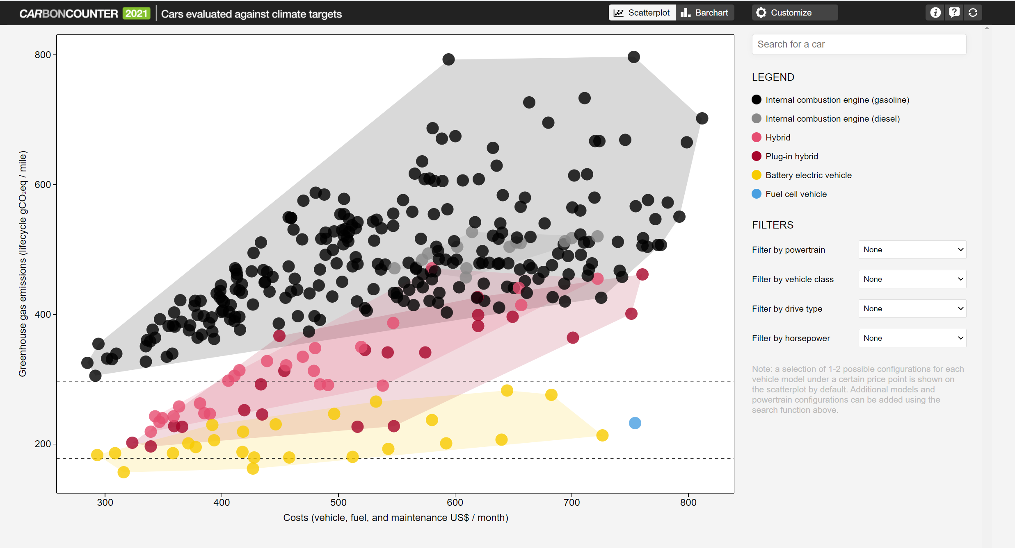
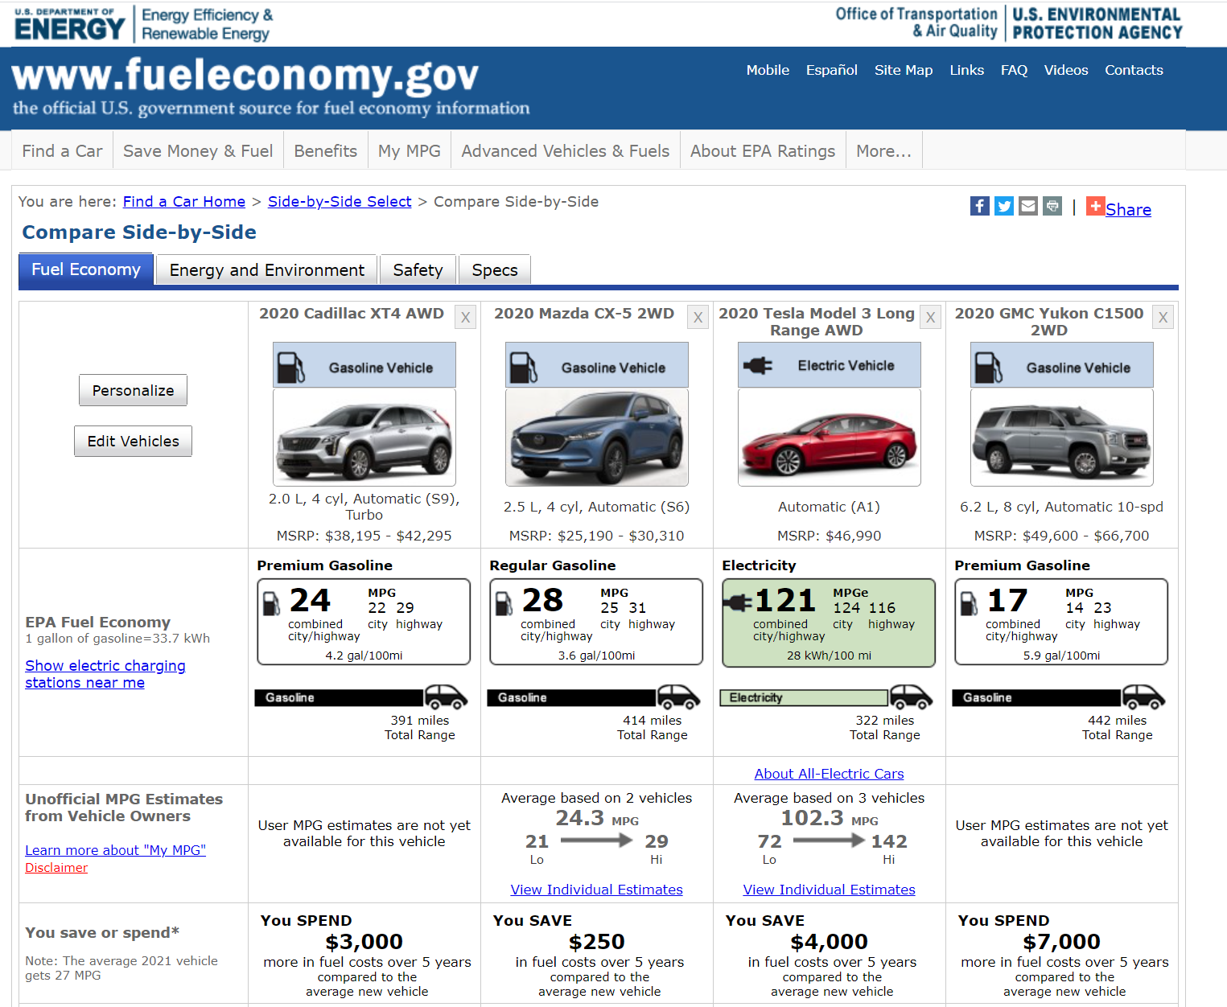
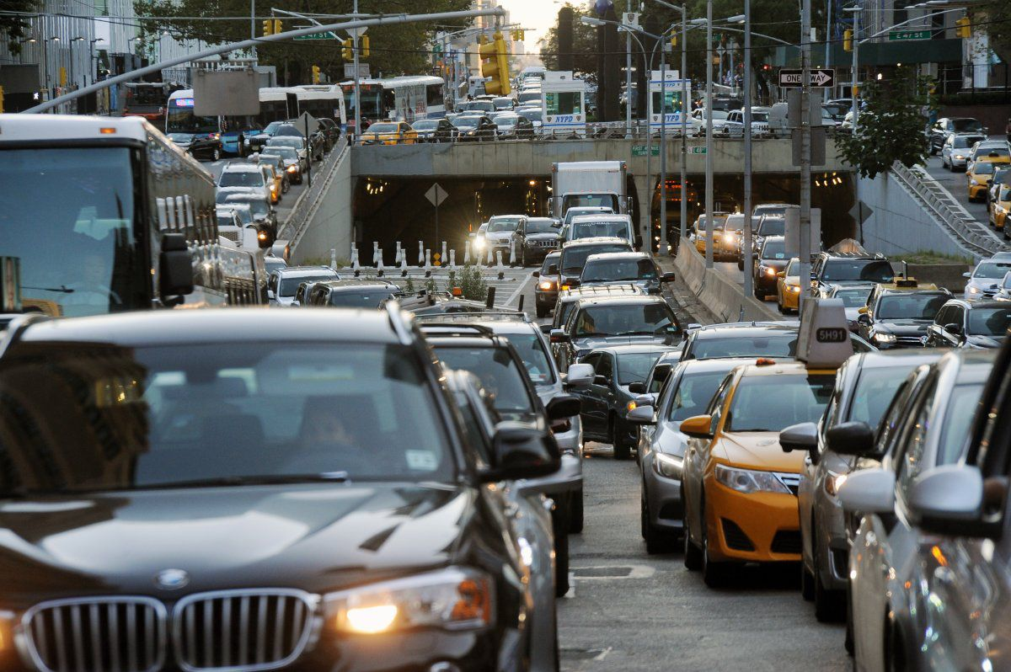
How can we reduce transportation emissions?
Clean fuels
Vehicle efficiency
How we move people and goods
Hard to decarbonize sectors - air, rail, freight
Implementing technological breakthroughs
How we build our cities
Better planning to reduce demand therefore yielding reduction in emissions
Encouraging use of public transit, walking and biking

Slide 26
Thank you for your interest
Ozge Kaplan, PhD (PI)
Kaplan.Ozge@epa.gov
919-541-5069
Bibliography
Isik, M., Dodder, R. & Kaplan, P.O. (2021) “Transportation emissions scenarios for New York City under different carbon intensities of electricity and electric vehicle adoption rates, “ Nature Energy 6, 92–104. https://doi.org/10.1038/s41560-020-00740-2
Kaplan, P.O. and Isik, M. (2020) “City-based Optimization Model for Energy Technologies: COMET- New York City Documentation” EPA/600/R-19/124 https://cfpub.epa.gov/si/si_public_record_report.cfm?Lab=CEMM&dirEntryId=348535
COMET Website: https://www.epa.gov/air-research/city-based-optimization-model-energy-technologies-comet

