Slide 1
CMAS Conference 2023
Impacts of Greenhouse Gas and Air Pollutant Mitigation Policies
in Northeast Asia on the Future Air Quality of Korea
Youjung Jang¹, Jung-Hun Woo^{1*}, Bomi Kim¹, Younha Kim², Jinseok Kim¹, Hyejung Hu¹, Meongdo Jang¹
¹Konkuk University, Seoul, Korea
²IIASA, Laxenburg, Austria
Notes:
Hello, my name is Youjung from Konkuk University.
My presentation title is 'Impacts of Greenhouse Gas and Air Pollutant Mitigation Policies in Northeast Asia on the Future Air Quality of Korea.'

Slide 2
Index
Introduction & Objective
Methodology
Results
Summary & Future Works
Notes:
Here is an overview of my presentation.
Introduction and Objective
Methodology
Results
Summary and Future Works

Slide 3

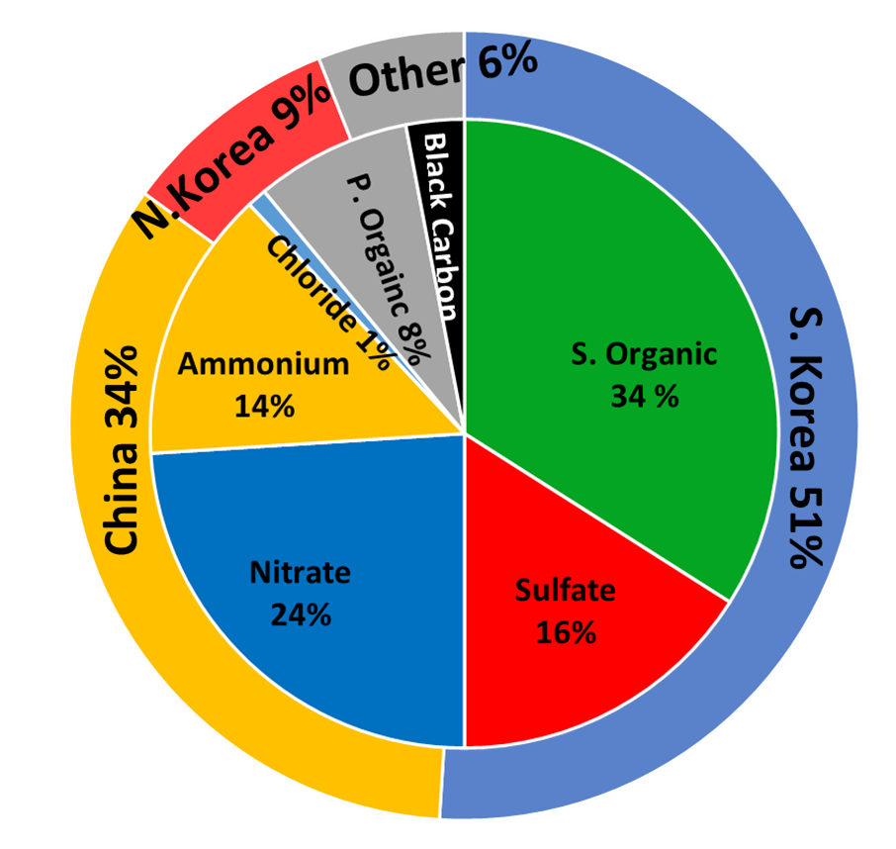
1. Introduction & Objective
CMAS Conference 17-10-2023
Factors Affecting Fine Particle Pollution in Korea
Korea's air quality is affected by China, contributing 34% of fine particles in Korea (RSSR, 2017).
The growing elderly population increases the health impact of air pollutants.
Aging
Aging and Health Impact
Emissions Change
(China)
Emissions Change
(Seoul Metro, Korea)
Composition of Fine Particles
NASA KORUS-AQ (RSSR, 2017)
Bo et al., 2016
HEI, 2015; World Bank 2017
Research Objective
Examining Korea’s future air quality changes in response to Northeast Asian countries’ air policies.
Exploring how aging influences health impacts related to air quality.
Notes:
Korea is located in the far east of the Eurasian continent where many industrial countries are located.
NASA KORUS-AQ research shows that transboundary of China account for 34 % of fine particle concentration over the Seoul Metropolitan Area(SMA) in Korea.
China has a significant influence on Korea’s air quality, so China’s emission reduction is expected to have a positive impact on Korea’s air quality improvement.
Furthermore, as Korea's population ages, it is expected that the sensitivity to health impacts caused by PM2.5 pollution will increase in the country.
We are exploring two questions:
How does Korea's future air quality change in response to Northeast Asian countries' air policies?
How does aging influence health impacts related to air quality?

Slide 4
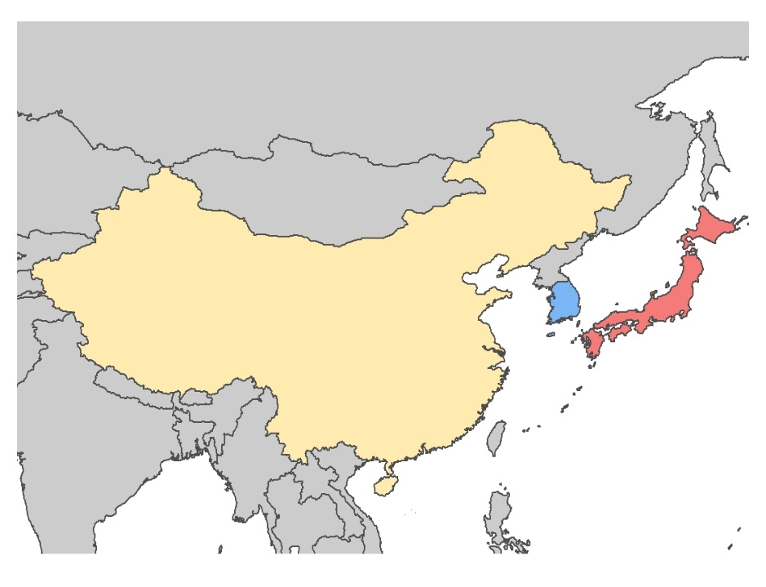
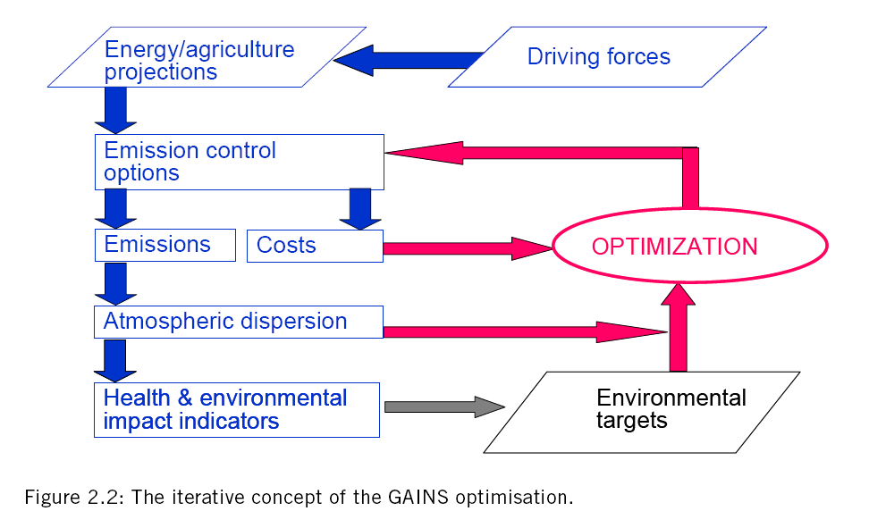
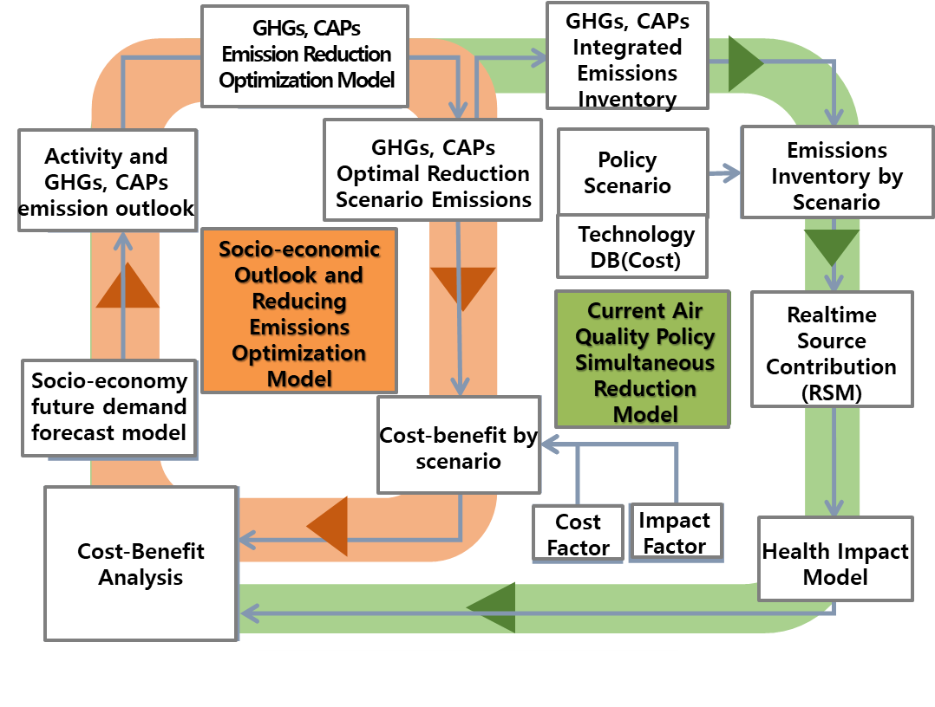
2. Methodology
CMAS Conference 17-10-2023
Integrate Assessment Models(IAMs)
Research Framework
 | Korea | China
Periods | 2015 ~ 2050
IAMs | GUIDE-Korea¹ | GAINS-Global²
Emission inventory | CREATE³ | ECLIPSE_v6b⁴
Air Quality modeling | WRF-SMOKE-CMAQ⁵ RSM⁶
Health Impact Analysis | BenMAP⁷ health impact function
GAINS-Global
+ ECLIPSE_v6b
(China)
GUIDE-Korea
+ CREATE
(South Korea)
GHGs and air pollutants Unified Information Design system-Korea
Greenhouse Gas and Air Pollution Interactions and Synergy-Global
Comprehensive Regional Emissions inventory for Atmospheric Transport Experiment
Evaluating the Climate and Air Quality Impacts of Short-Lived Pollutants
Weather Research and Forecasting model / Sparse Matrix Operator Kernel Emissions / Community Multiscale Air Quality Model
Responds Surface model
Benefits Mapping and Analysis Program
< GAINS-Global>
< GUIDE-Korea>
Source: Amann et al. , GAINS-Asia Methodology, 2008 ; http://gains.iiasa.ac.at/gains
Source: Woo et al., KEITI, 2020
Notes:
In this study, we constructed future emission scenarios for Korea and China based on their 2015 emissions data.
We assessed the impact of these future emission scenarios on Korea's future PM2.5 concentrations and explored the resulting health impact. The framework we used is as follows:
Our research covers the period from 2015 to 2050.
We utilized integrated assessment models: GUIDE-Korea in Korea and GAINS-Global in China.
For emissions inventory, we applied CREATE in Korea and ECLIPSE in China.
Additionally, our air quality modeling utilized WRF-SMOKE-CMAQ and RSM,
while health impact analysis was conducted using the BenMAP health impact function.

Slide 5
2. Methodology
CMAS Conference 17-10-2023
Scenarios
Two scenarios (Baseline and Control) were developed.
Each scenario was created through a combination of energy pathway and air pollution control.
- Policies from both Korea and China were incorporated to reflect each country's own policies.
Scenario |  | Energy pathway |  | Air Pollution control
Baseline |  | BAU | No Further policy scenario | No Control | No Further Control (NFC) scenario
Control | Korea | NetZero | Carbon-Neutrality scenario | CLE | Current Legislation (CLE) scenario
 | China | Low-SDS | Low Sustainable Development (SDS) Scenario | MFR | Maximum Feasible Reduction (MFR) scenario
① Baseline
Emissions
② Control
2015
2050
  → Control 시나리오에, 한국은 탄소중립 정책을 반영하였으나, 중국은 IEA의 Low-SDS 시나리오를 반영함
Notes:
We developed both Baseline and Control scenarios.
Each scenario was developed by combining a specific energy strategy with country-specific approaches to air pollution control.
The Baseline scenario represents a scenario without additional control measures,
while the Control scenario incorporates each country's specific policies.
You can find detailed explanations of the future energy pathway and air quality policies for each scenario in the presentation slides.

Slide 6
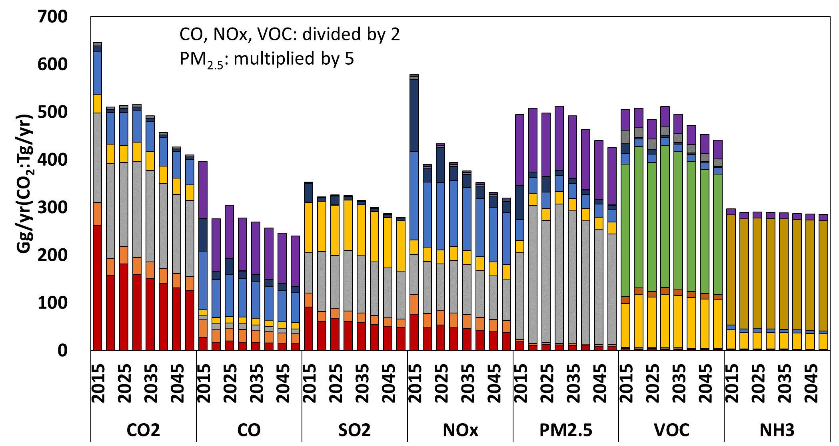
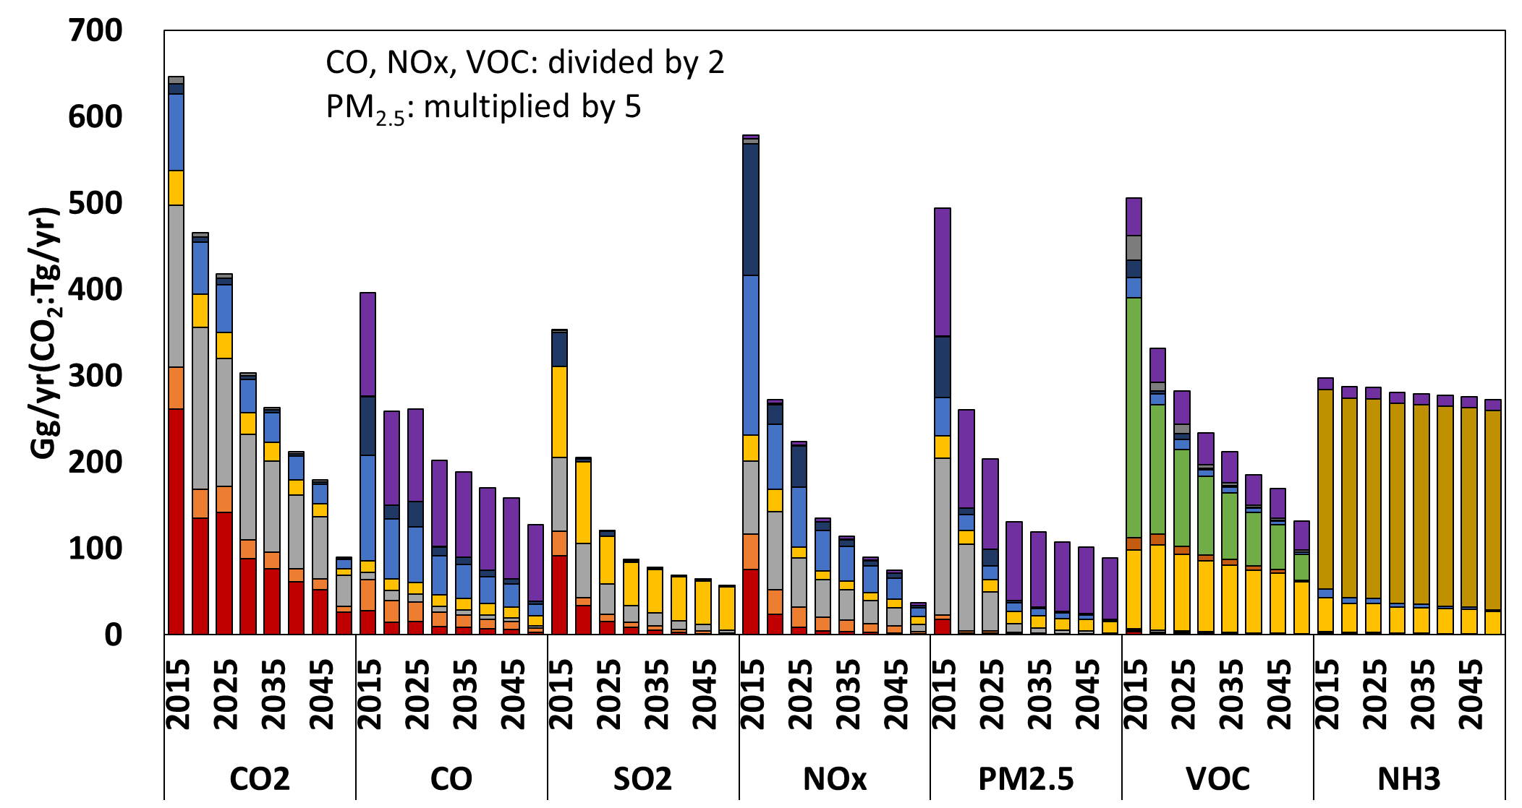
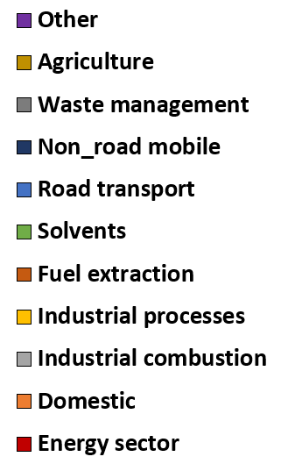
3. Results
CMAS Conference 17-10-2023
Future Emissions Inventory (2015~2050)
Korea
  Applied Net-Zero (Carbon neutrality) energy policies and enhanced air quality policies for the Control scenario.
  Compared to 2015, emissions reductions by 2050 range from 4.0% (NH₃) to 44.8% (NO_{x}) in the Baseline scenario and from 8.3% (NH₃) to 93.6% (NO_{x}) in the Control scenario.
Baseline
Control
Notes:
Based on our findings, we implemented Net-Zero (Carbon neutrality) energy policies and enhanced air quality regulations within the Control scenario in Korea. As a result, by 2050, the emissions in the Baseline scenario showed a decrease ranging from 4.0% (NH3) to a substantial 44.8% (NOx) in comparison to the 2015 emission.
In contrast, the Control scenario showed even more reductions, ranging from 8.3% (NH3) to a remarkable 93.6% (NOx).

Slide 7
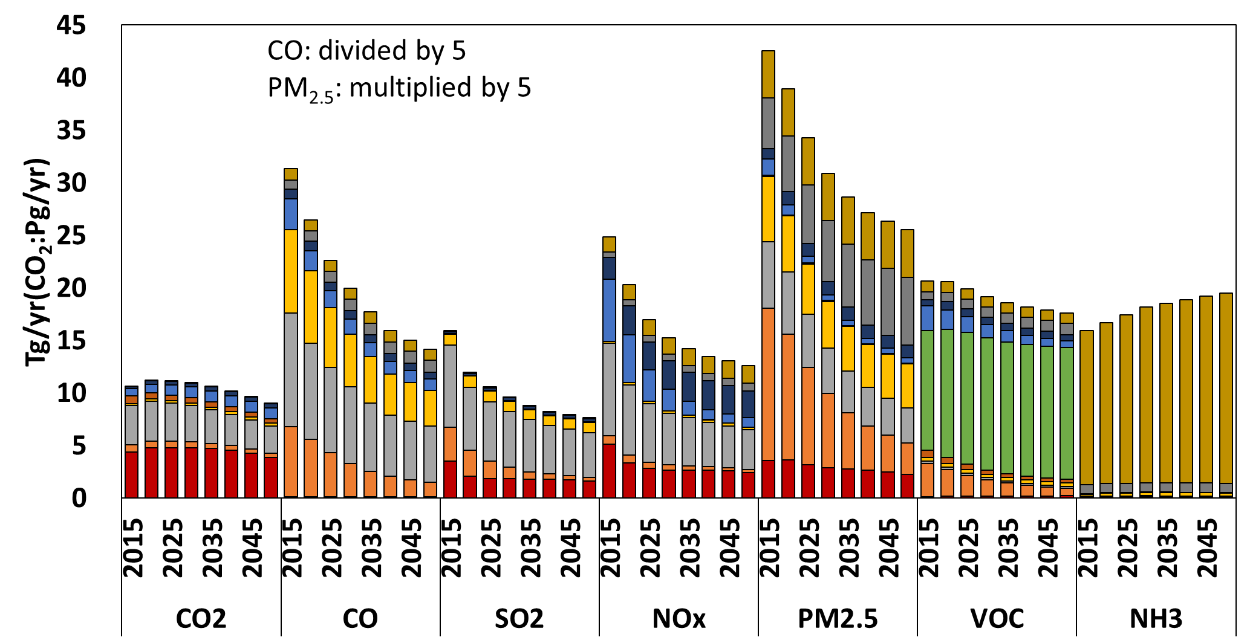
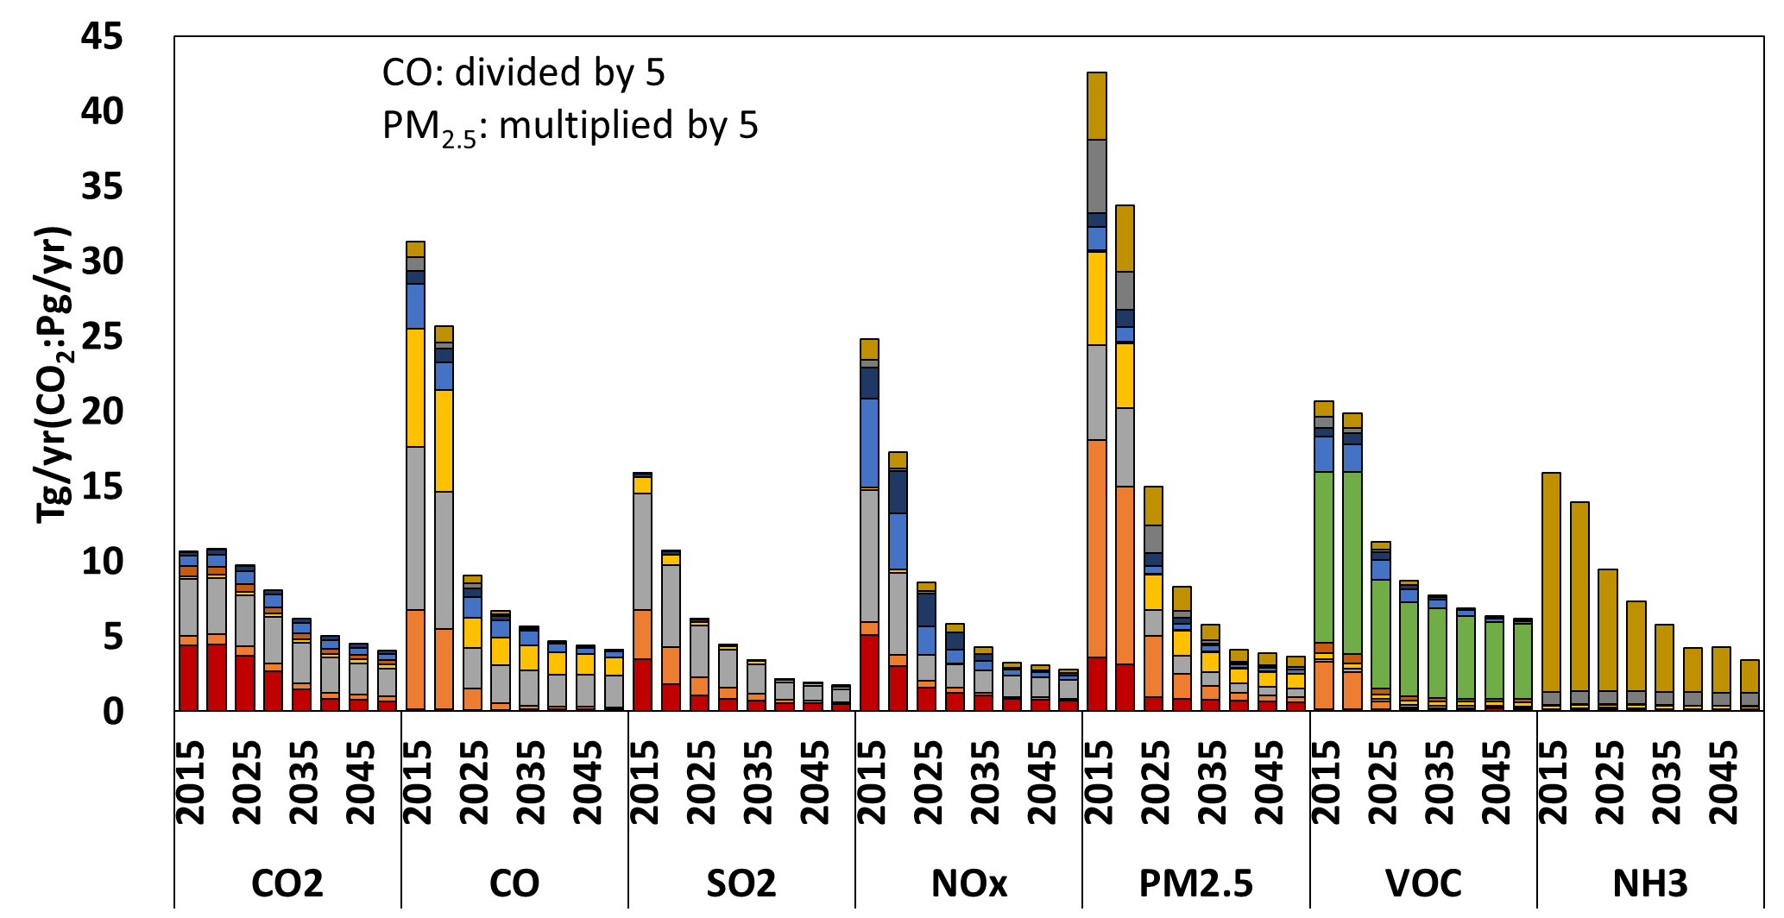
3. Results
CMAS Conference 17-10-2023
Future Emissions Inventory (2015~2050)
China
  Applied Low-SDS and MFR to the energy pathway and air quality policies for the Control scenario.
  Compared to 2015, emissions reductions by 2050 range from 14.8% (VOC) to 54.7% (CO) in the Baseline scenario, and from 61.6% (CO₂) to 91.4% (PM_{2.5}) in the Control scenario.
Baseline
Control
Notes:
Examining China's future emissions inventory, we applied the Low-SDS and MFR strategies for energy pathways and air quality policies in the Control scenario.
Comparing to the year 2015, we noticed significant emissions reductions by 2050.
In the Baseline scenario, these reductions ranged from 14.8% (VOC) to 54.7% (CO),
However, in the Control scenario, the reductions were even more remarkable, with numbers spanning from 61.6% (CO2) to an outstanding 91.4% (PM2.5).

Slide 8
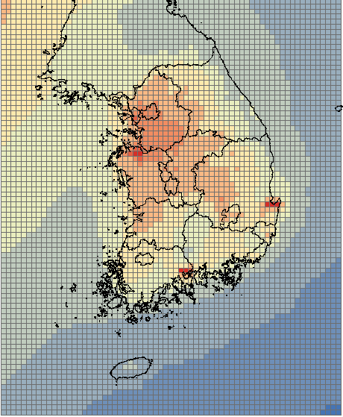
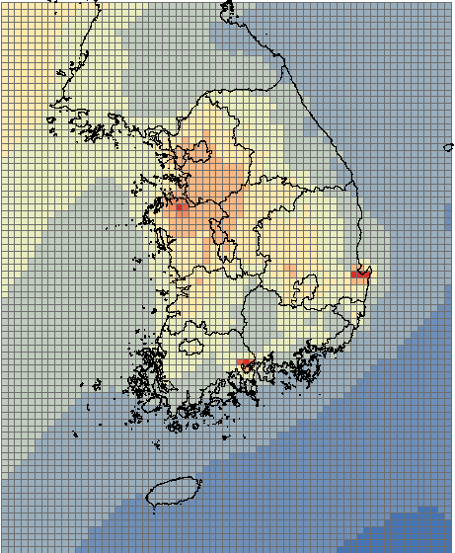
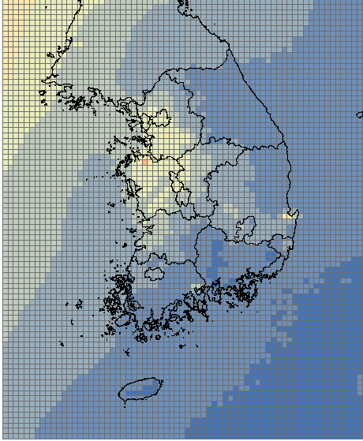
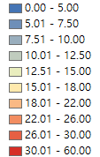
3. Results
CMAS Conference 17-10-2023
Future PM_{2.5} Air Quality in Korea
PM_{2.5} concentration by scenario in Korea
  The application of control policies led to a decrease in PM_{2.5} concentration.
  In Control scenario (2050), most of Korea stays below 15 ㎍/㎥ (Korean air quality standard) for PM_{2.5}.
Baseyear (yr2015)
Baseline (yr2050)
Control (yr2050)
PM_{2.5} Conc.
[㎍/㎥]
Average : 18.7 ㎍/㎥
14.0 ㎍/㎥
8.5 ㎍/㎥
Source : Woo et al., AQNEA project(2022)
Notes:
Shifting our focus to the future PM2.5 air quality forecasts for Korea,
We noticed a decrease in PM2.5 concentrations as a result of the implementation of control policies.
In the Control scenario for 2050, the majority of areas in Korea maintained PM2.5 concentration below the Korean air quality standard of 15 ㎍/㎥.

Slide 9
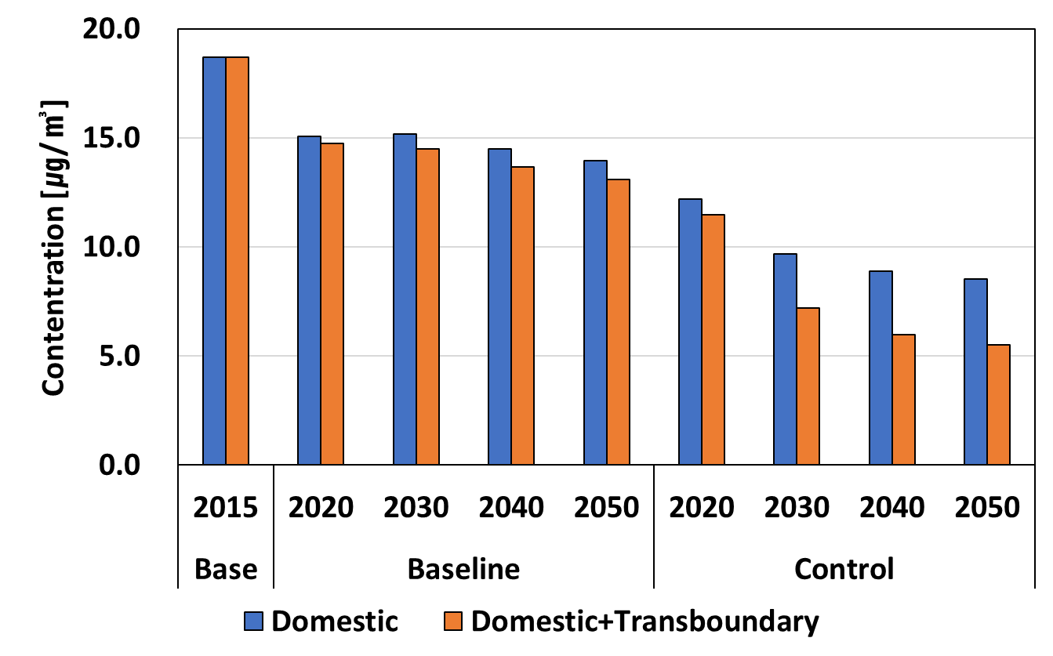
3. Results
CMAS Conference 17-10-2023
Future PM_{2.5} Air Quality in Korea
PM_{2.5} concentration by scenario with transboundary
  Considering the transboundary effect of China's air quality policies, we can anticipate more than a 16.2% additional improvement in air quality in the Control scenario in 2050.
18.7
- 30.0%
Korea Air Quality Standard
14.0
13.1
- 54.4%
8.5
- 70.6%
5.5
WHO Guidance
Notes:
In the baseyear, Korea had a PM2.5 concentration of 18.7 ㎍/㎥.
Implementing the control scenario exclusively in Korea resulted in a significant 54.4% improvement, reducing it to 8.5 ㎍/㎥.
However, with the applied of control scenarios in both countries, the concentration further dropped to 5.5 ㎍/㎥,
marking a remarkable 70.6% overall improvement.
It's worth noting that 16.2% of this improvement can be attributed to transboundary effects.

Slide 10
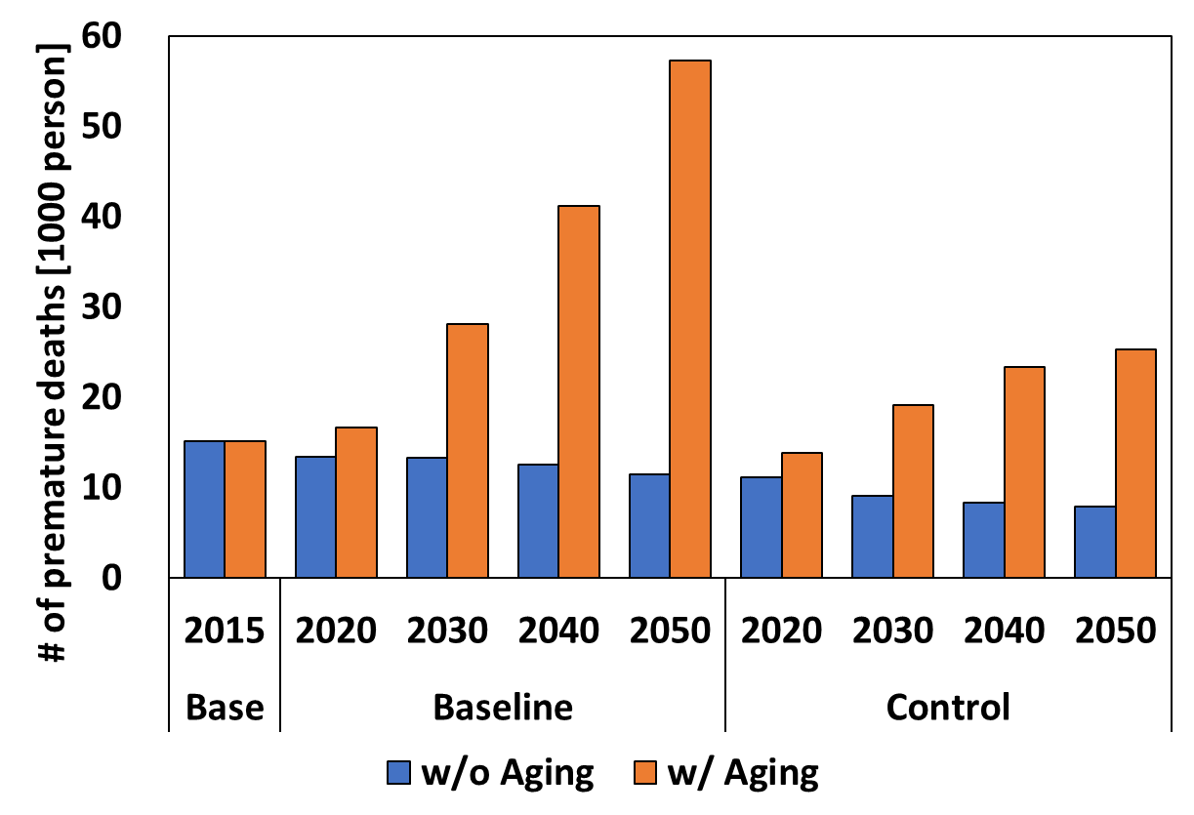
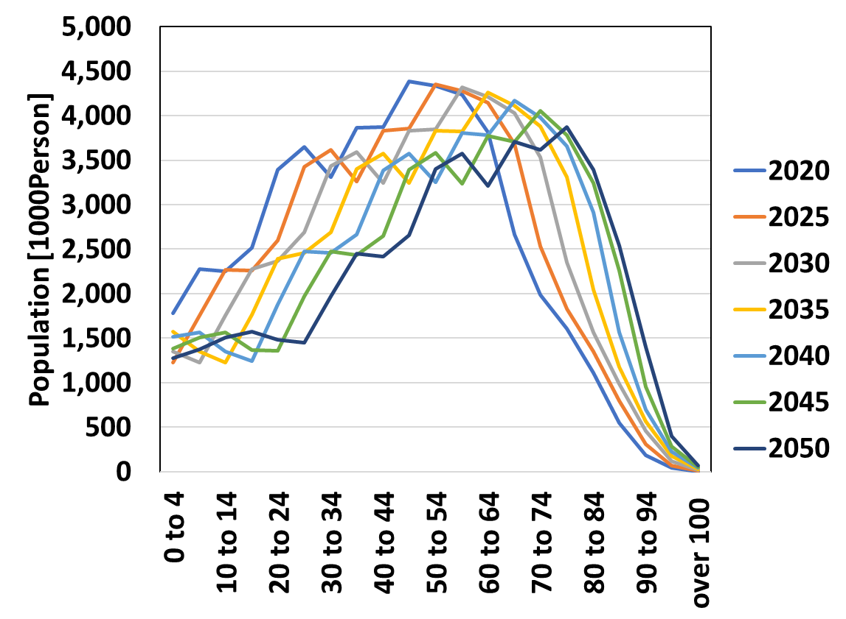
3. Results
CMAS Conference 17-10-2023
Future PM_{2.5} pollution changes by scenario in Korea
Concentration-Based Health Impact
  Premature death changes related to PM_{2.5} concentration in Korea were analyzed, considering and not considering the aging population trend.
  When aging population trend is considered, the difference is more than twice as high as when it is not considered.
< Distribution by Population Age >
44
59
79
w/ Aging
w/ Aging
w/o Aging
25,232
w/o Aging
15,075
Aging
7,925
Source : KOSIS, 2022
Notes:
We have estimated the population distribution by age in Korea.
In the year 2020, the peak age was 44, in 2030, it shifted to 59, and by 2050, the peak age had risen to 79.
This indicates an increasing trend in the peak age, showing that the population is aging.
In the base year, there were about 15 thousands premature deaths.
Under the control scenario, this number decreased by 47.4% to about 8 thousands without considering aging.
However, when accounting for population aging, the number of premature deaths increased by 67.4% compared to the base year, reaching around 25 thousands per year.
Considering the aging population trend, this difference more than doubles in comparison to when aging is not taken into account.
This highlights the need for even greater improvements in the future.

Slide 11
4. Summary & Future Works
CMAS Conference 17-10-2023
Summary
In this study, we developed future emission scenarios for Korea and China based on their 2015 emissions, considering energy outlook and air quality policies.
In the Control scenario, both Korea and China saw emissions decrease, resulting in a reduction of 8.3% (NH₃) to 93.6% (NO_{x}) in Korea by 2050.
In 2050, PM_{2.5} concentrations in Korea were projected to decrease by 54.4%, with a 16.2% additional decrease when considering transboundary effects of China's air quality policies.
Health impacts related to PM_{2.5} concentrations indicated potential reductions. However, when factoring in aging population, premature deaths show an increasing trend.
For future research, we will incorporate recent air quality policies from both Korea and China, including China's NetZero policy
Notes:
Now, This is my summary.
In this study, we developed future emission scenarios for both Korea and China, taking into account their 2015 emission
and considering energy pathway and air quality policies.
Within the Control scenario, we observed emissions reductions in both Korea and China,
resulting in a substantial decline ranging from 8.3% (NH3) to 93.6% (NOx) in Korea by the year 2050.
For the year 2050, our projections indicated a 54.4% decrease in PM2.5 concentrations in Korea.
Notably, when we factored in the transboundary effects of China's air quality policies, there was an additional 16.2% decrease.
Our analysis of health impacts associated with PM2.5 concentrations suggested potential reductions.
However, when we considered the aging population, we noted a rising trend in premature deaths.
In our future research, we plan to integrate recent air quality policies from both Korea and China, including China's NetZero policy.

Slide 12
Thank you

