Slide 1
Assessing Impacts of Oil and Gas activities in the Permian Basin to Ozone Nonattainment at Carlsbad, New Mexico
Huy Tran¹, Grace Smith², Saravanan Arunachalam¹
¹Institute for the Environment, The University of North Carolina at Chapel Hill, NC, USA
²Environmental Defense Fund, Washington DC, USA
Presented at
The CMAS 2023 Conference, Chapel Hill, NC
Acknowledgments:
Environmental Defense Fund (EDF)
Data provided from U.S. EPA, New Mexico and Texas environmental agencies

Slide 2
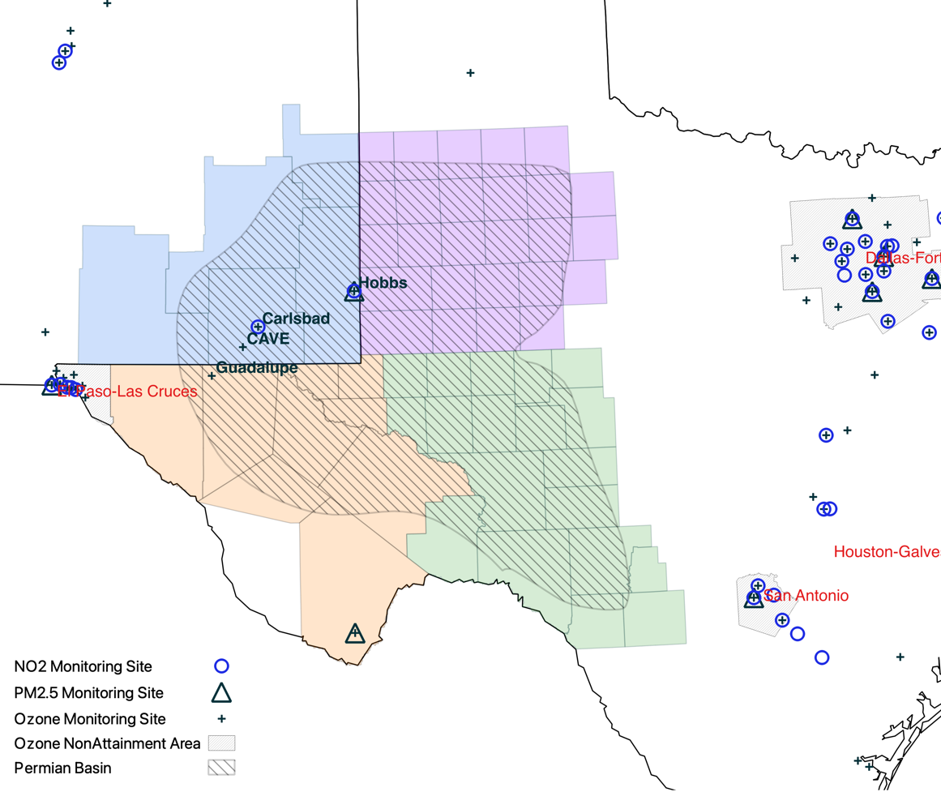
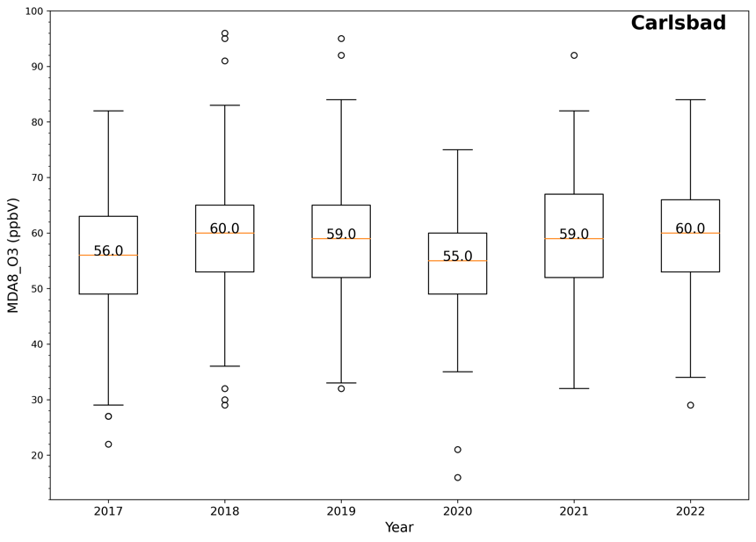
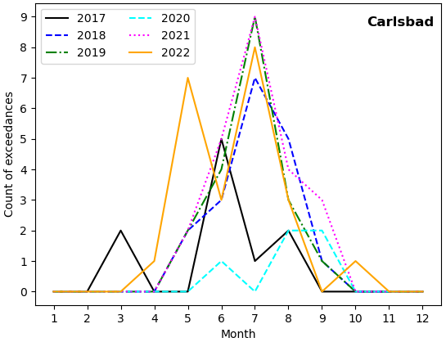
Introduction
Background:
The Carlsbad and other ozone monitor sites in the region frequently observed MDA8O3 exceedances in recent years. MDA8O3 exceedances were mainly observed in the region during summer months (May – September)
Emissions from oil and gas activities in the Permian basin (PMB) have been implicated for contributing to high ozone levels in the Texas and New Mexico region
Objective:
Perform HYSPLIT back-trajectory modeling and emissions inventory analyses to assess if emissions from the PMB contributed to ozone nonattainment at specific monitors in New Mexico
Notes:
On the New Mexico side of the Permian basin, besides Carlsbad and CAVE, ozone exceedances were also commonly observed at Hobbs in Lea county.
Guadalupe, Culberson county is the only ozone monitoring site on the Texas side of the Permian basin and observed ozone exceedances during 2019-2021
There is lack of additional ozone monitoring in Texas counties of the Permian basin where ozone exceedances are likely to be seen.
Existing O3 nonattainment area (San Antonio, Dallas Forth Worth) often observed MDA8O3 exceedances

Slide 3
HYSPLIT Model Configurations (v5.2.3)
The MDA8_O3 above 70 ppb threshold is used as the criterion to determine high and low ozone days
For each of the above exceeding MDA8O3 values, the eight hours based on which the 8HO3 was determined from (base hours) are identified
HYSPLIT is then applied to simulate 48-hour back trajectories starting from each of the eight identified base hours for four elevation levels above Carlsbad: 100, 200, 500 and 1,000 meters
Meteorology inputs: High-Resolution Rapid Refresh (HRRR) meteorological model, hourly inputs at 3 km x 3 km in horizontal resolution; Vertical motion extracted directly from HRRR
Number of base-hours for HYSPLIT back trajectory simulations
 |  | 2017 | 2018 | 2019 | 2020¹ | 2021 | 2022² | Total
Low Ozone days | MDA8O3 < 46 ppb (10th pctl) | 26 | 13 | 13 | 15 | 17 | 3 | 87
 | # of base-hours (trajectories) | 208 | 104 | 101 | 115 | 136 | 24 | 688
High Ozone days | MDA8O3 > 70 ppb (90th pctl) | 10 | 18 | 19 | 5 | 23 | 10 | 83
 | # of base-hours (trajectories) | 64 | 144 | 132 | 32 | 184 | 80 | 636
¹ Ozone data for 2020 is incomplete due to technical issues in monitoring equipment
² At the time of conducting HYSPLIT back trajectory analyses, ozone data in 2022 was not completed
Notes:
Hybrid Single-Particle Lagrangian Integrated Trajectory (HYSPLIT)
HYSPLIT models simulate the dispersion and trajectory of substances transported and dispersed through our atmosphere, over local to global scales. HYSPLIT is a complete system for computing simple air parcel trajectories, as well as complex transport, dispersion, chemical transformation, and deposition simulations

Slide 4
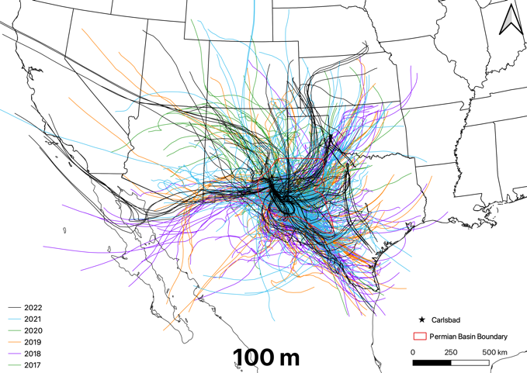
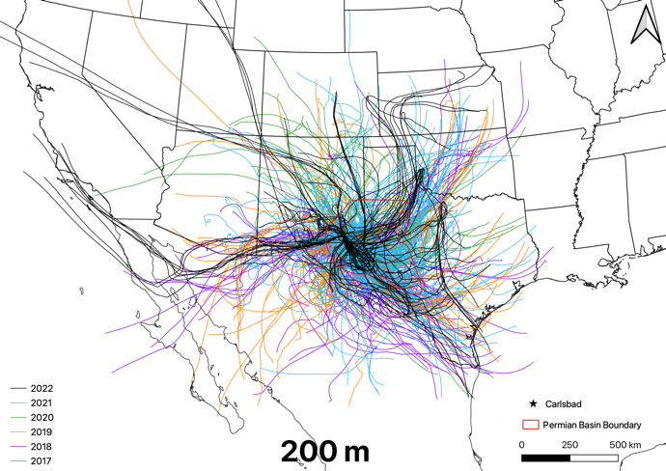
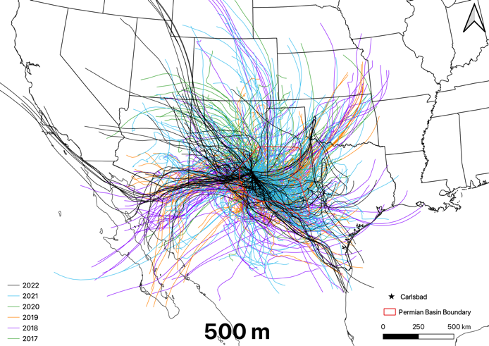
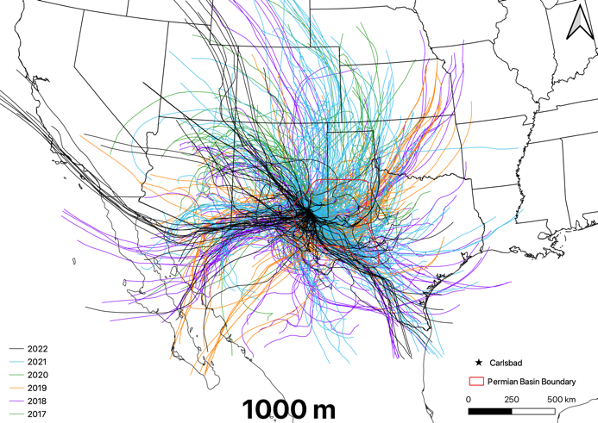
HYSPLIT trajectories are fairly consistent throughout 2017 - 2022
HYSPLIT 48-hour back trajectories
Trajectories ending at 100 m and 200 m above Carlsbad often pass through the counties located east and southeast of Carlsbad
Trajectories passing through counties located northeast and southwest of Carlsbad are found more frequently among those that ended at 500 m and 1000 m above
Notes:
Trajectory patterns consistent throughout 2017 – 2022
Trajectories ending at 100 m and 200 m above Carlsbad often passing through the counties located in east and southeast of Carlsbad
Trajectories passing through counties located in northeast and southwest of Carlsbad are found more frequently among those ended at 500 m and 1000 m above Carlsbad.
Heatmap value of each 3km x 3km grid-cell (within 1,200 km x 1,200 km domain) represents number of trajectory passages over that grid-cell and divided by total number of trajectories (in other word, % of trajectories) during a defined period and under specific condition

Slide 5
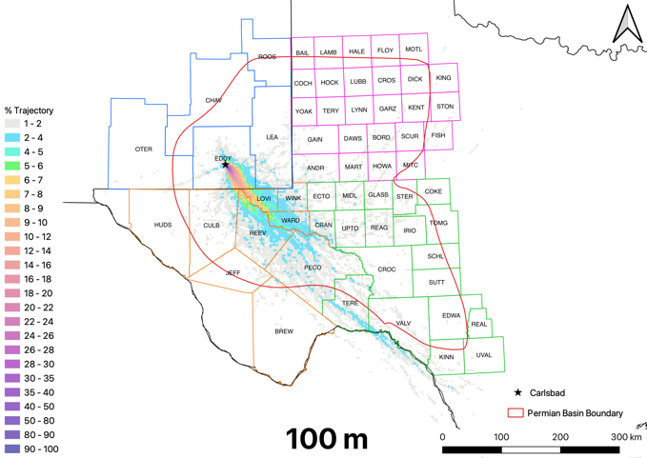
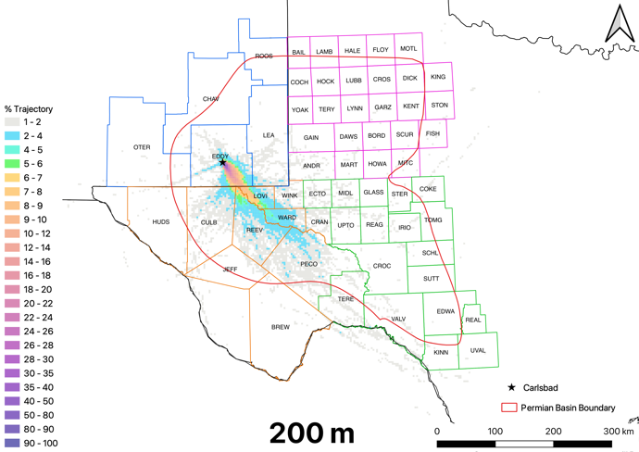
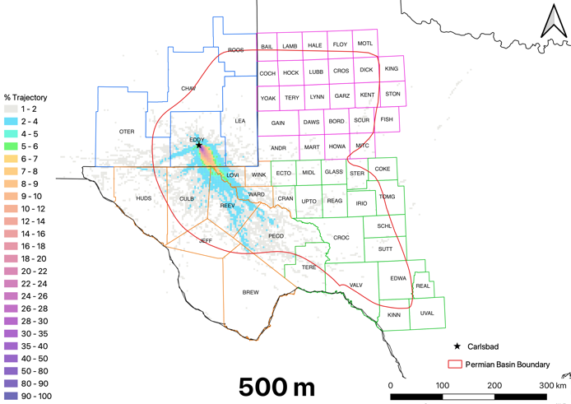
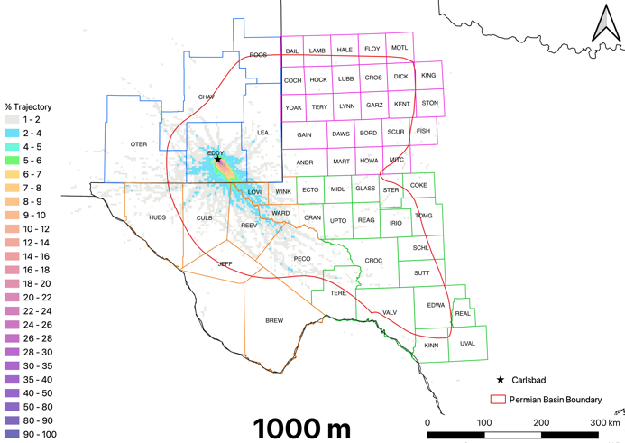
On high ozone days, trajectories typically passed through southeast of PMB
Heatmap Value (%) = $\frac{\text{Number} \text{of} \text{trajectory} \text{passages} \text{over} \text{a} \text{grid}\text{−}\text{cell}}{\text{total} \text{number} \text{of} \text{trajectories}}$
During high ozone days:
High heatmap value (> 4%) found in southwest and southeast PMB counties
Low heatmap value (< 2%) in northwest and northeast PMB counties
Strong implications of impacts on Carlsbad of emissions from southwest and southeast PMB counties
High Ozone Days
(MDA8O3 > 70 ppb)
Notes:
Heatmap value of each 3km x 3km grid-cell (within 1,200 km x 1,200 km domain) represents number of trajectory passages over that grid-cell and divided by total number of trajectories (in other word, % of trajectories) during a defined period and under specific condition
There are several aspects to be noted in our heatmap analyses:
Because all trajectories arrive at the grid-cell where Carlsbad site is in, the heatmap value for this cell is 100%.
Consequentially, top heatmap values are also found for grid-cells in Eddy county (EDDY) as they are on the dominant path of trajectories.
Furthermore, the farther away a grid-cell is from Carlsbad, the more likely that its heatmap value decreases.
As shown in this figure, greater than 4% of trajectories passing through the SW and SE regions (counties Loving-TX (LOVI), Ward-TX (WARD), Reeves-TX (REEV), Pecos-TX (PECO)) of PMB. Meanwhile, fewer number of trajectories (below 2%) passed through NW and NE regions of PMB implying rather insignificant impact of emissions sources located within these regions on Carlsbad (Figure 4).

Slide 6
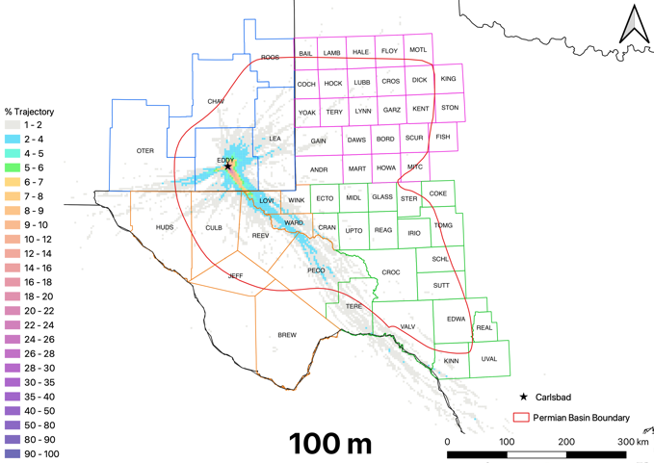
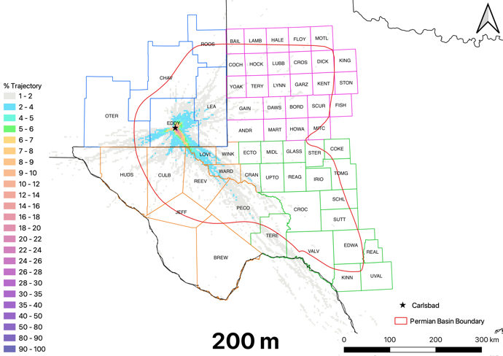
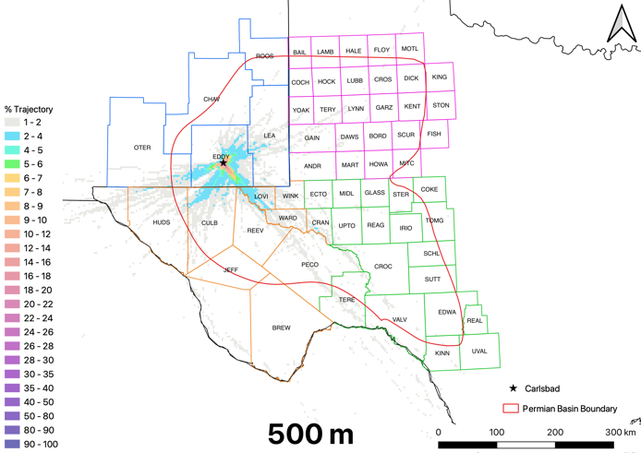
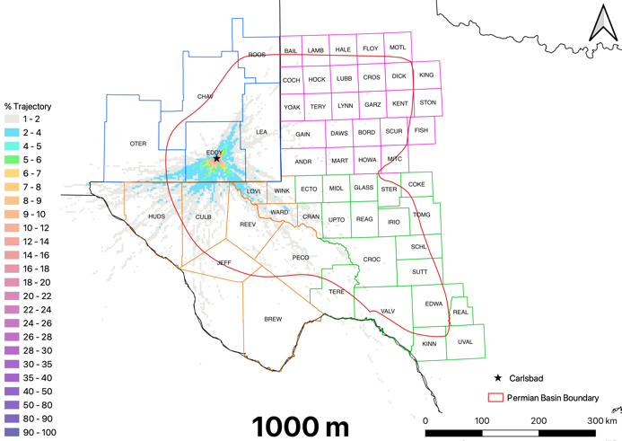
Trajectories passing through counties in northeast and west of PMB typically associated with low ozone
Distinctive difference in trajectory heatmap in High vs. Low Ozone days
During Low ozone days:
High heatmap value (> 5%) found northeast and west PMB counties
Low Ozone Days
(MDA8O3 < 46 ppb)
Trajectories passing though southeast PMB counties could either cause high or low ozone. But on high ozone days, it’s more likely that the trajectories passed through southeast PMB counties

Slide 7
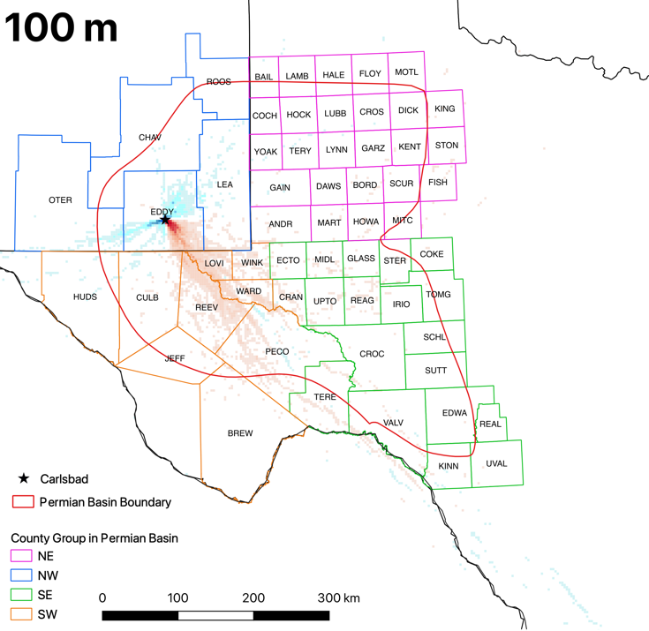
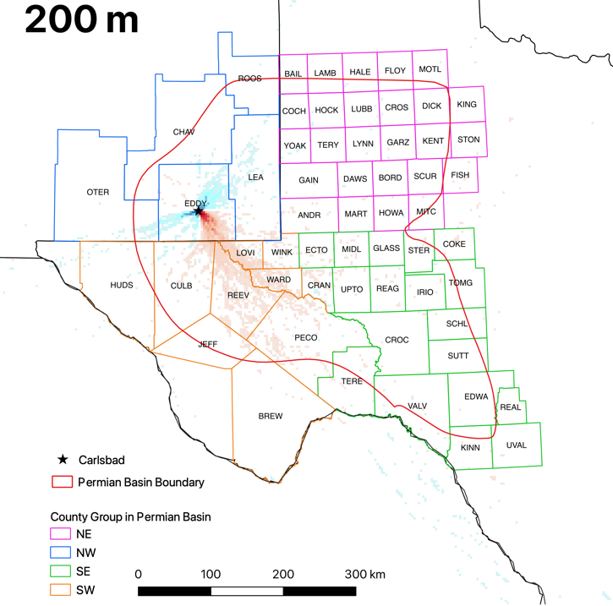
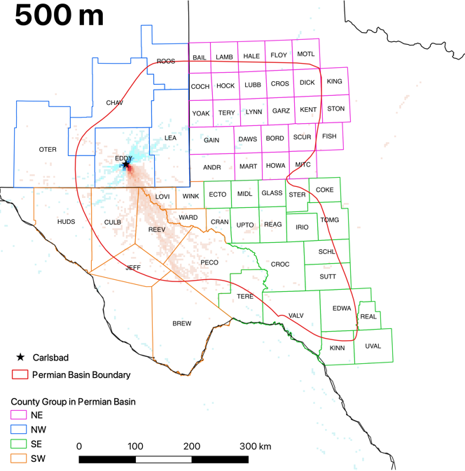
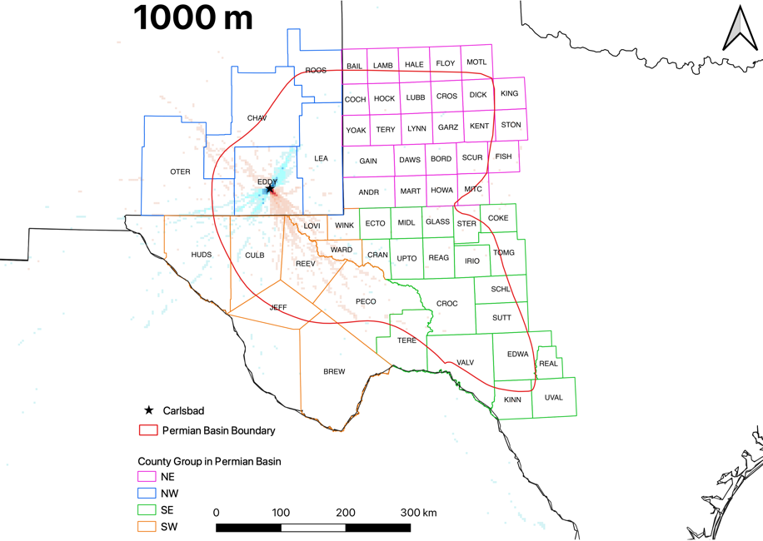
Distinctive difference in trajectory heatmap during High vs. Low Ozone days
Two groups of sources regions: the source regions between east and south of Carlsbad are often associated with high ozone days; the source regions toward northeast and southwest of Carlsbad are often associated with low ozone days

Slide 8
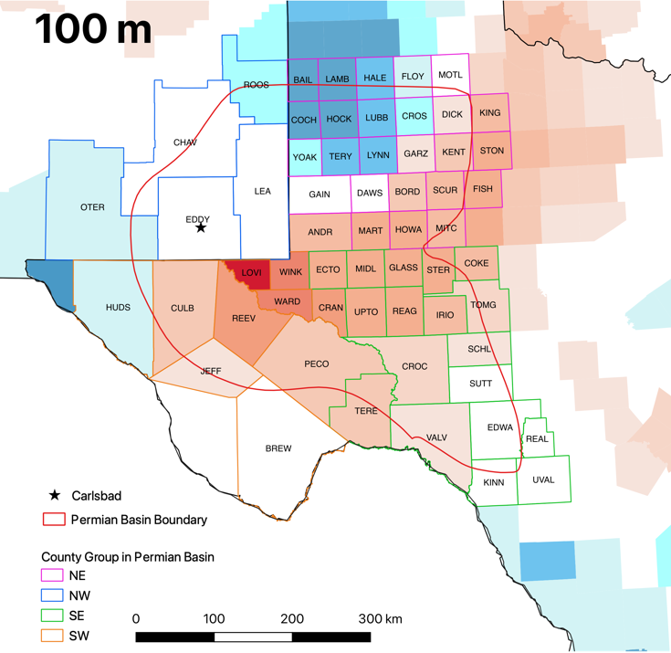
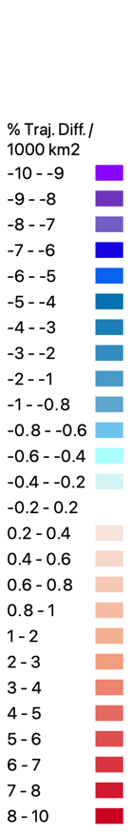
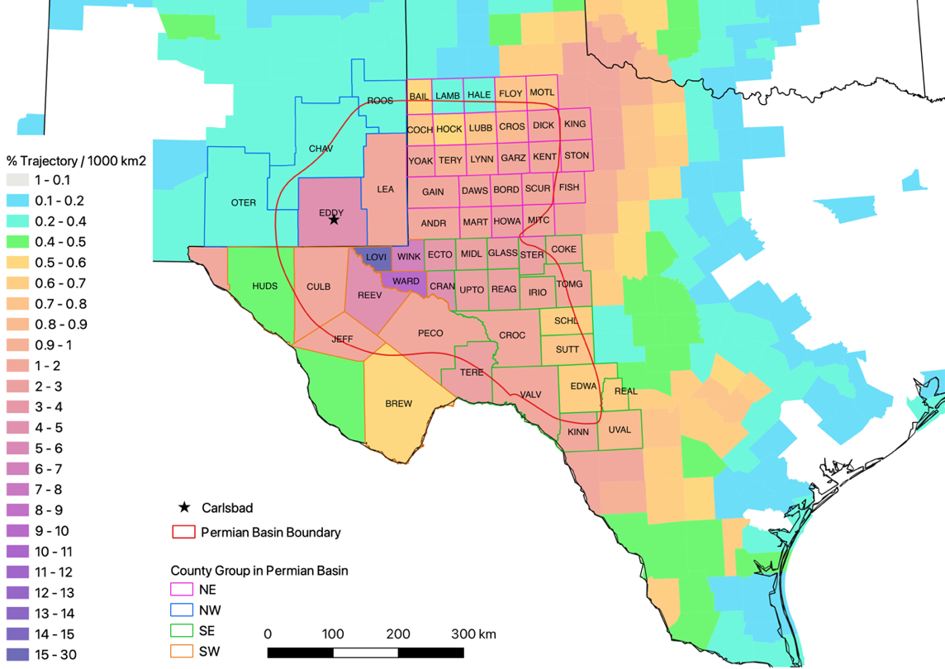
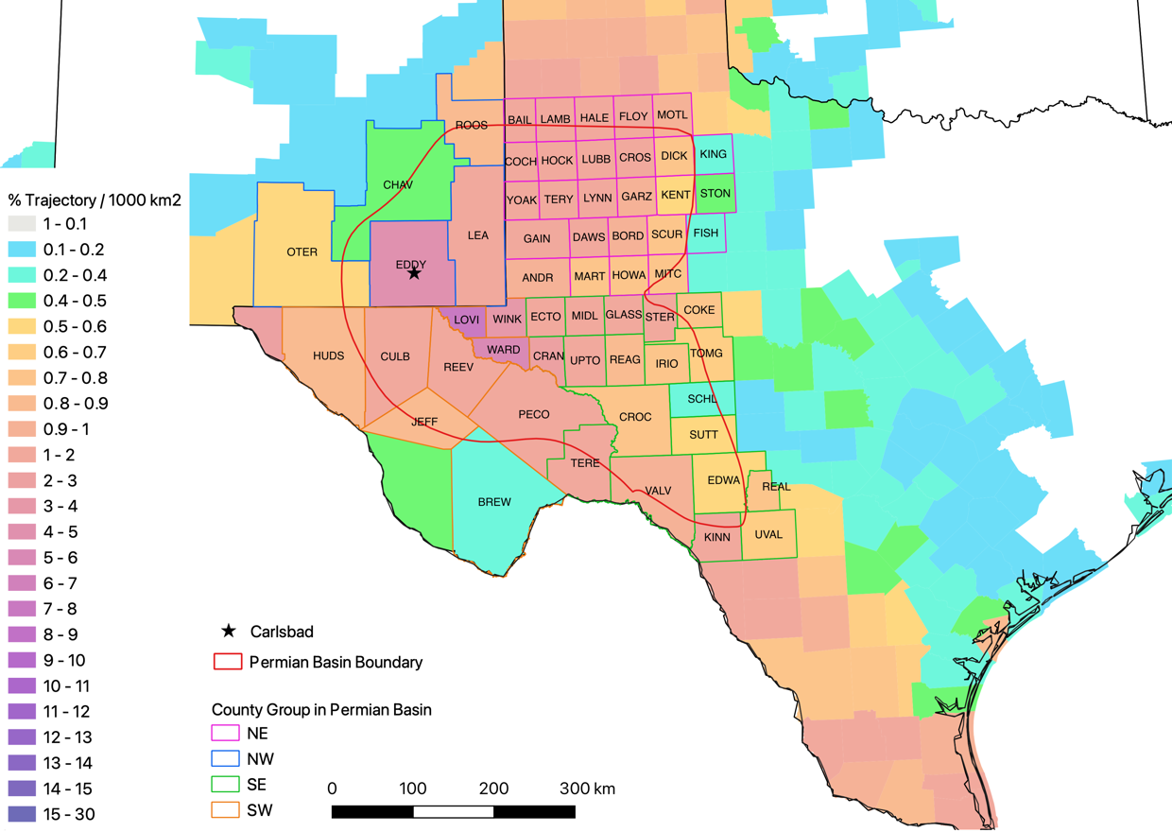
Normalized Trajectories at county-level
High minus Low
High Ozone Days
(MDA8O3 > 70 ppb)
Highest heatmap during high ozone days found in Loving, Ward, Winkler and Crane counties in Texas
Low Ozone Days
(MDA8O3 < 46 ppb)

Slide 9
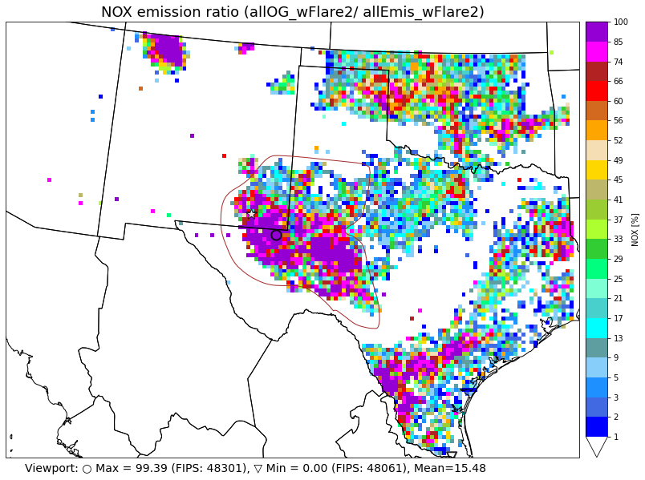
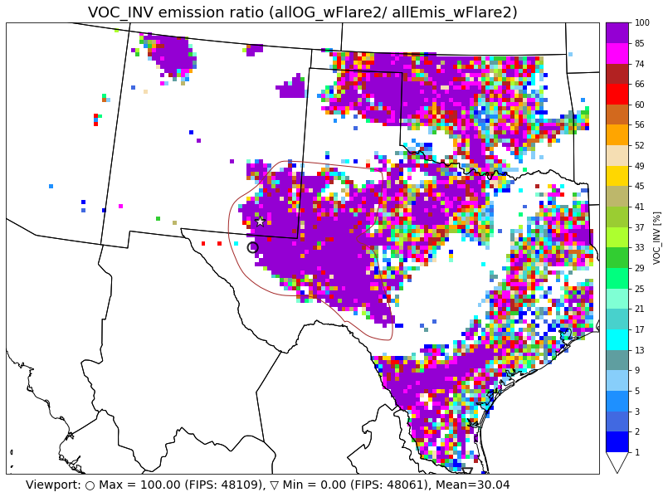
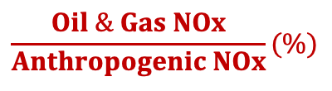
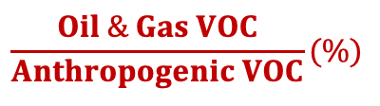
HYSPLIT Trajectories show strong indications of Impact of O&G emissions on Carlsbad O₃
High minus Low
$$\frac{Oil \& Gas NOx}{Anthropogenic NOx}(\%)$$
$$\frac{Oil \& Gas VOC}{Anthropogenic VOC}(\%)$$

Slide 10
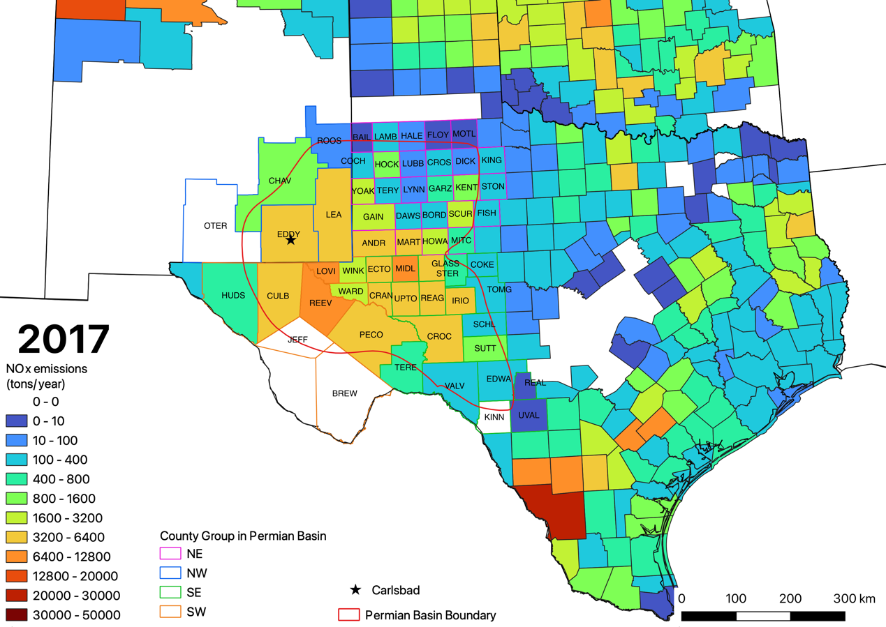
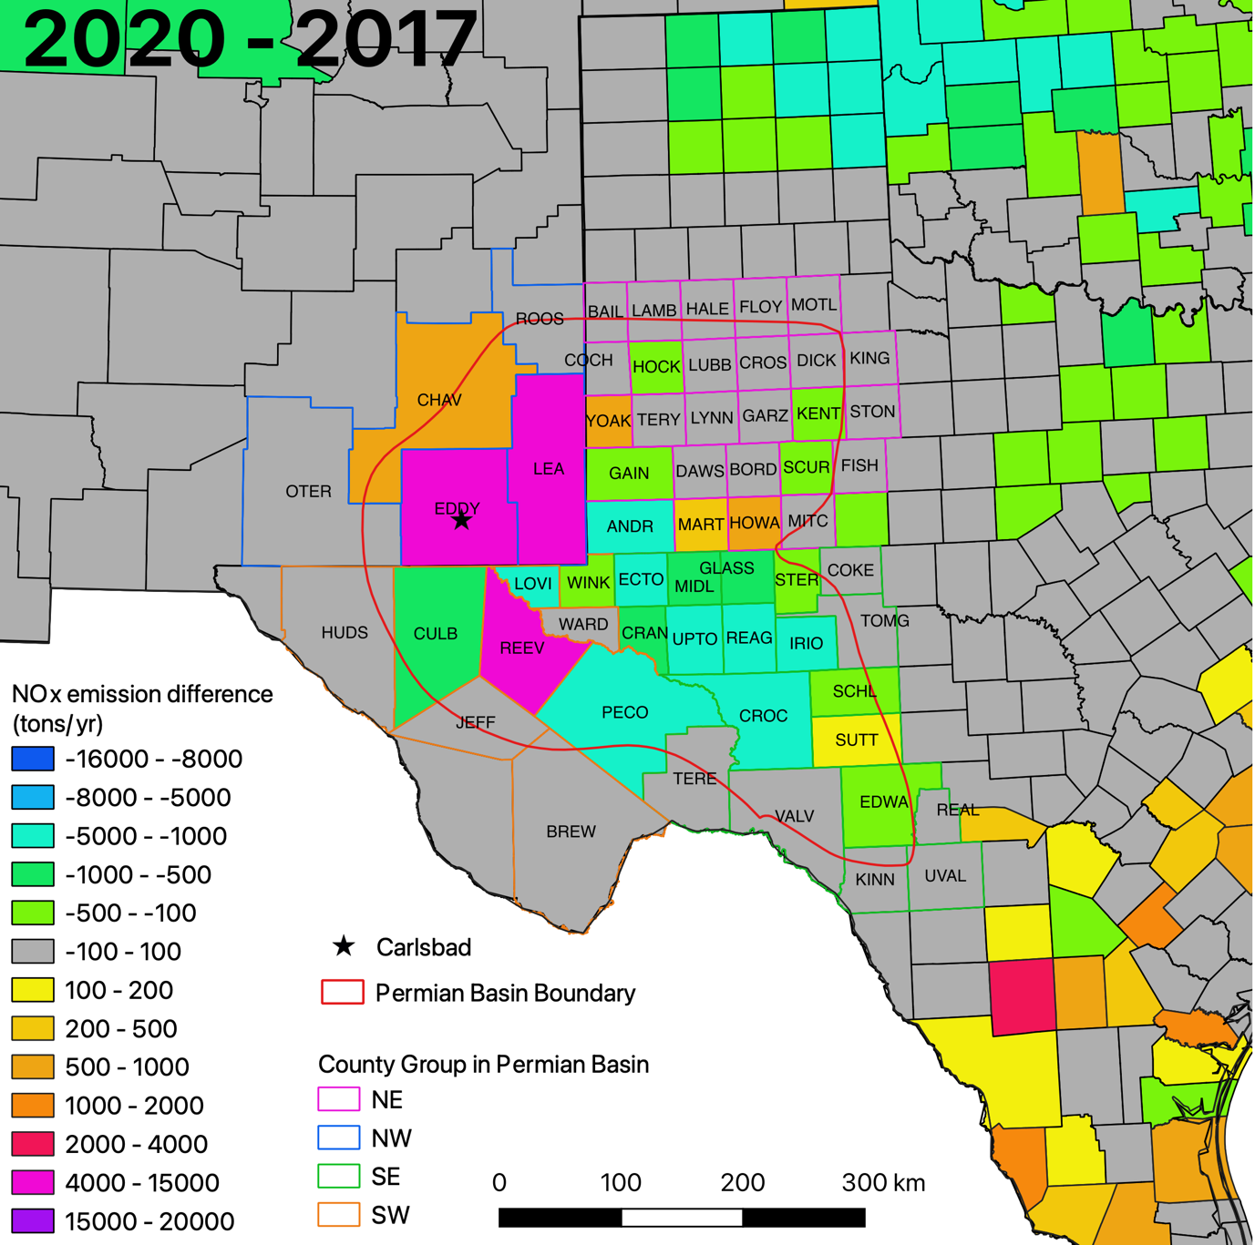
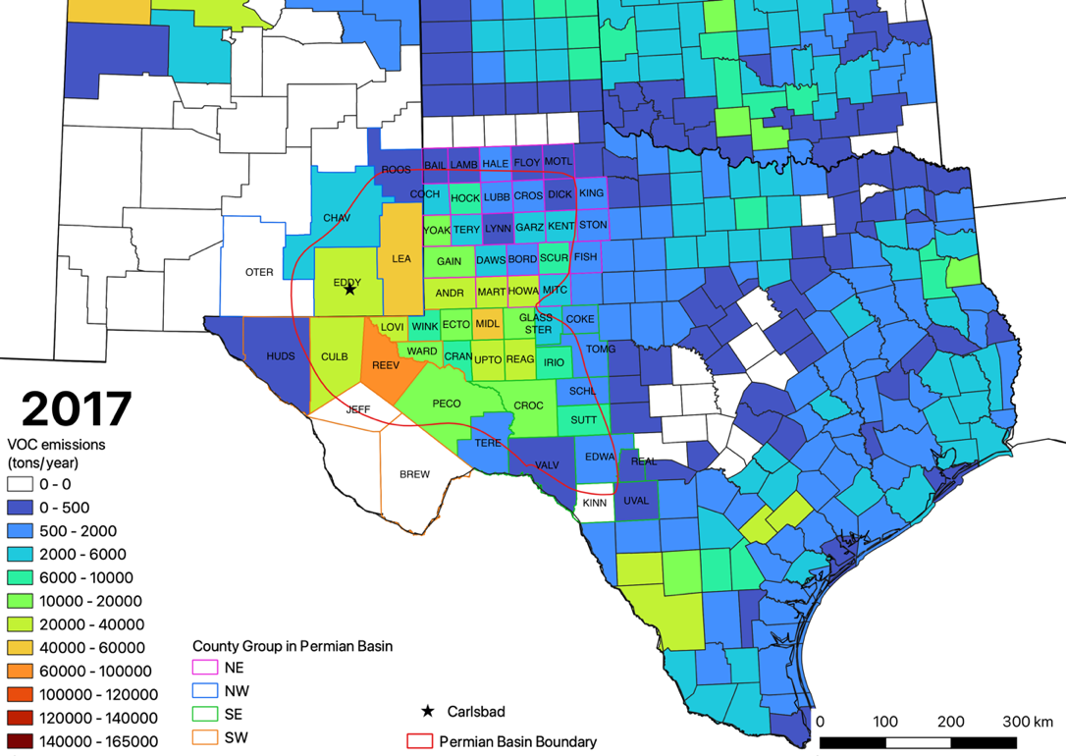
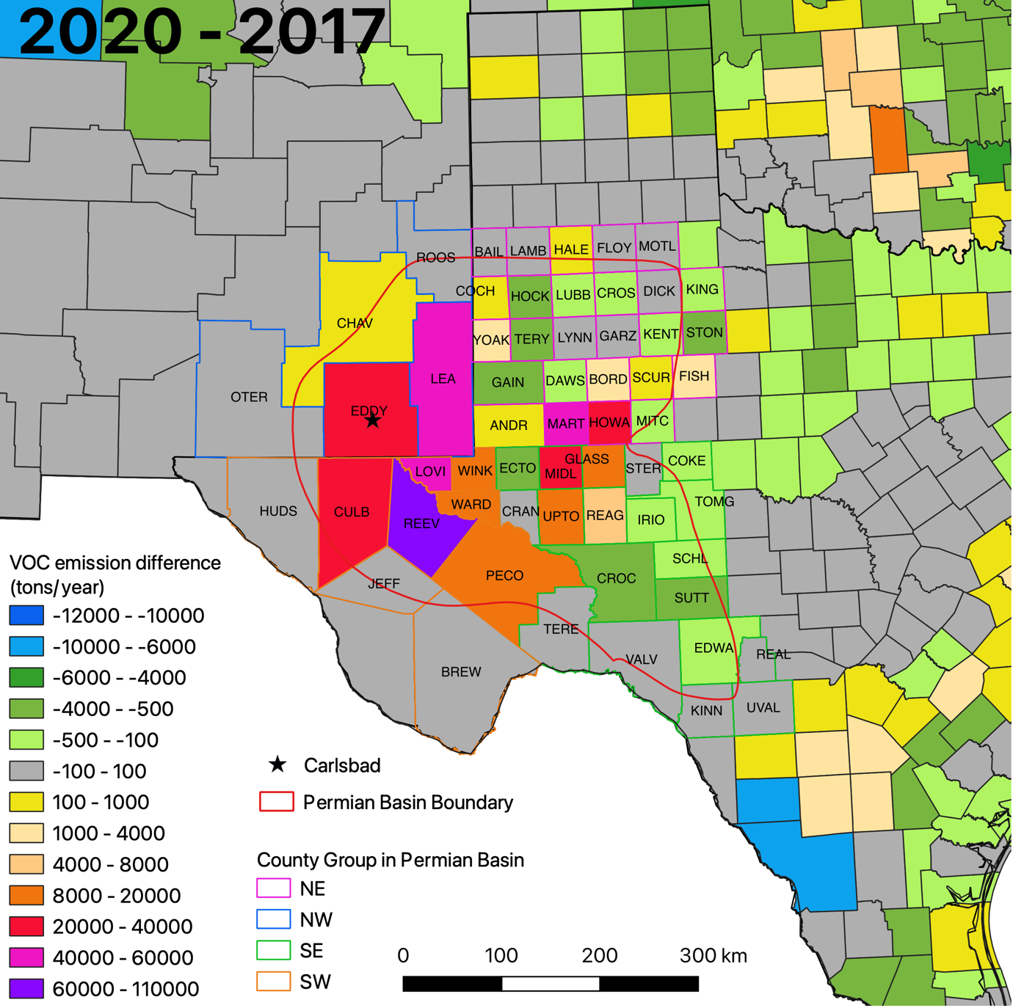
Oil & Gas NOx and VOC emissions increased in 2020 especially in counties in northwest PMB
O&G NOx emissions decreased in 2020 in most but in some PMB counties such as Eddy, Lea, Chaves (NM), Reeves (TX)
Oil & Gas NO_{X}
O&G VOC emissions increased in 2020 in most PMB counties especially those associated with high ozone days
Oil & Gas VOC
Notes:
In 2020 and in comparison to 2017, at the state level, emissions of NOx increase by 19%, and VOC increased by 45% from O&G in New Mexico
NOx slightly decrease by -1% whereas VOC increased 33% respectively in Texas
Changes in VOC emissions are much stronger than changes in NOx emissions

Slide 11
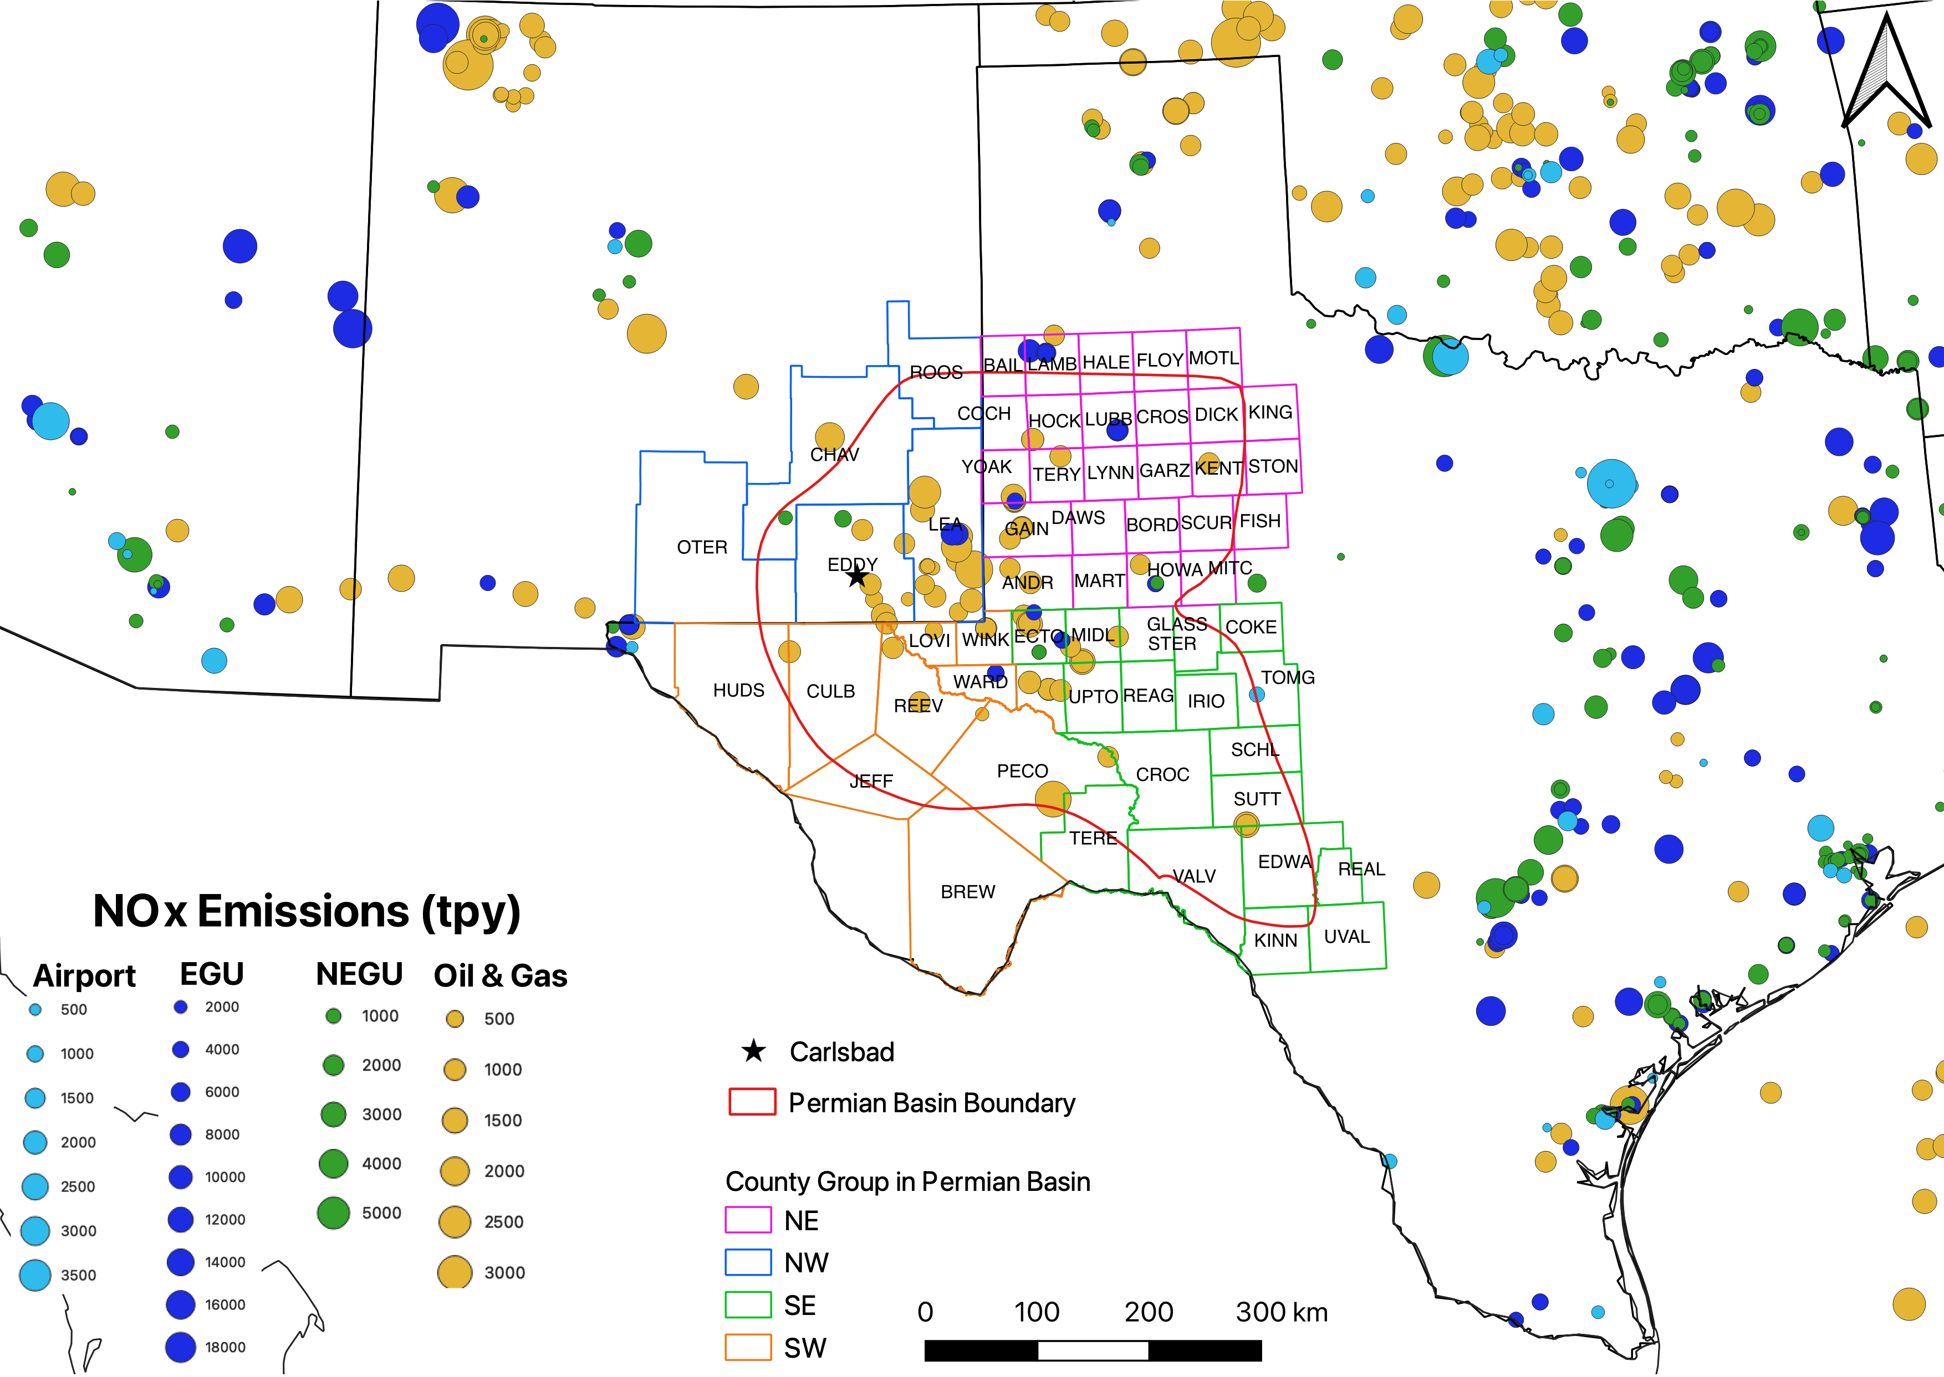
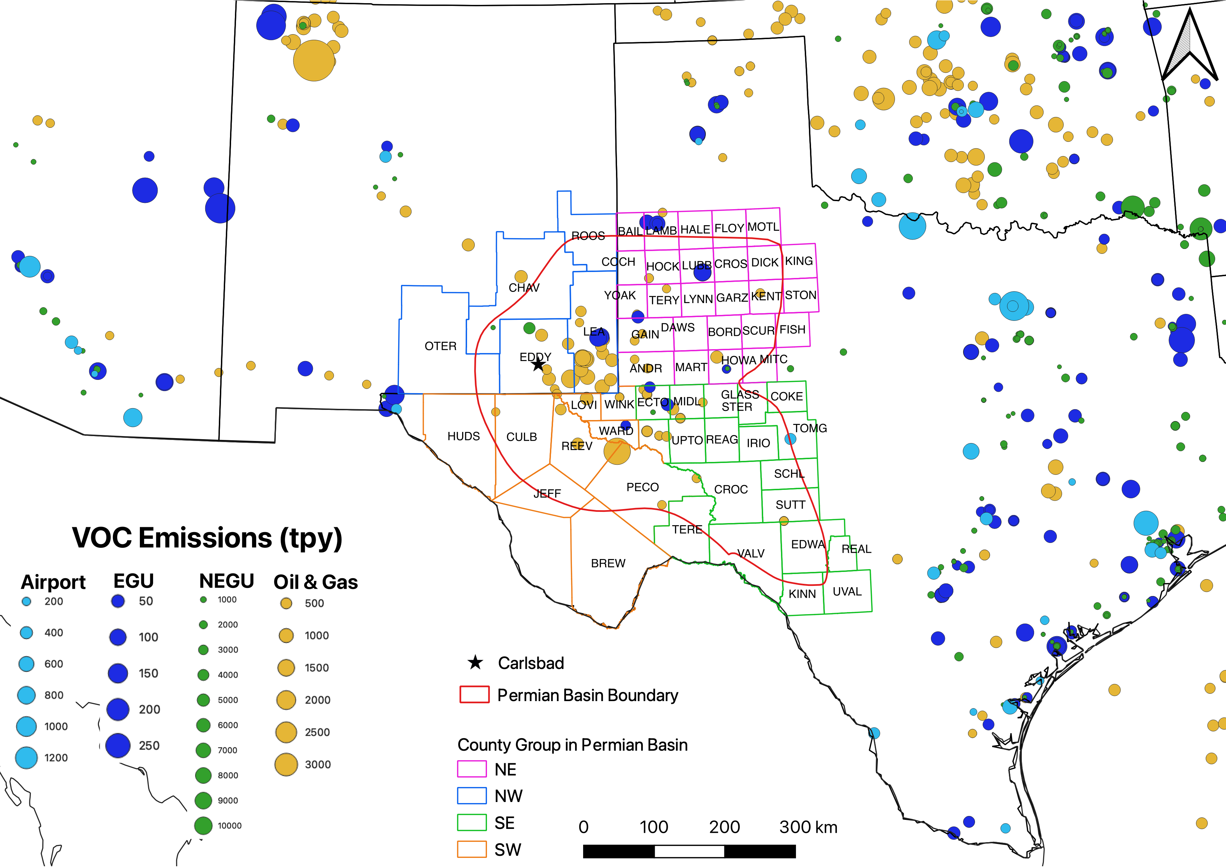
Oil & Gas emissions in PMB are the major contributor to Ozone at Carlsbad
Major point sources ( emissions > 100 tons/yr) are either well within or far away from PMB → impact of point sources outside PMB on Carlsbad are likely to be insignificant

Slide 12
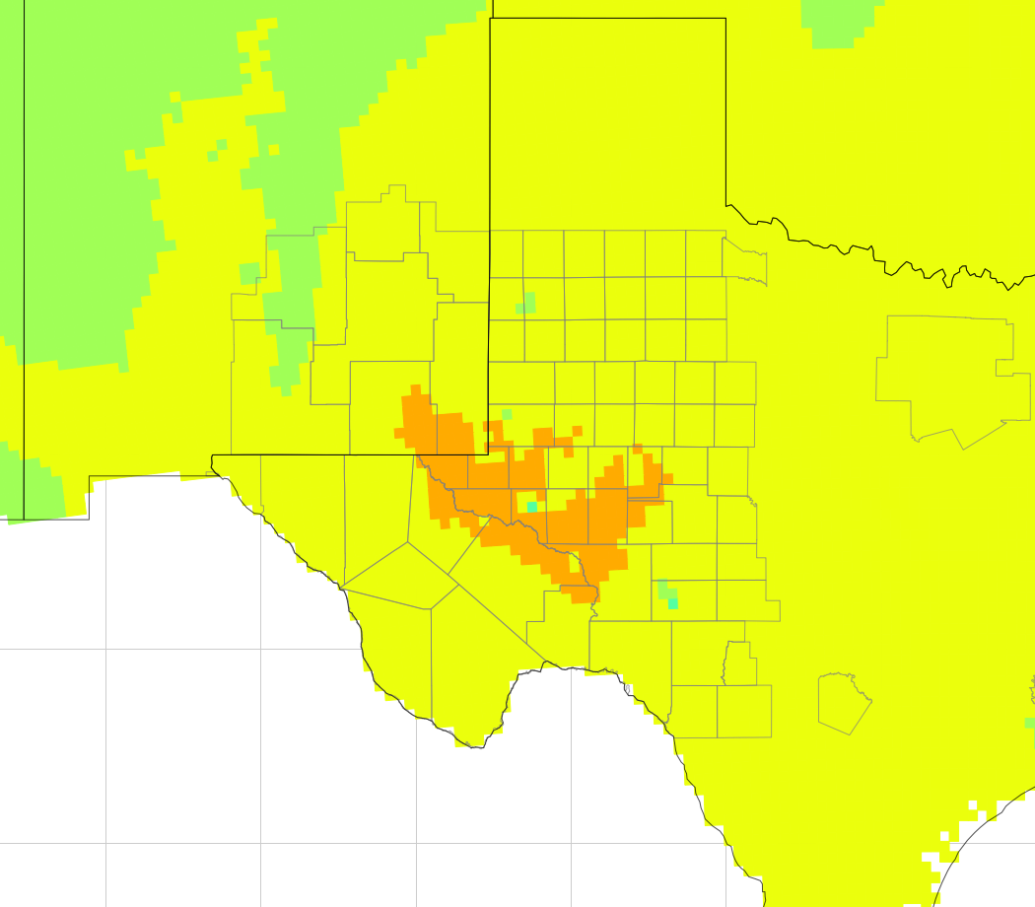
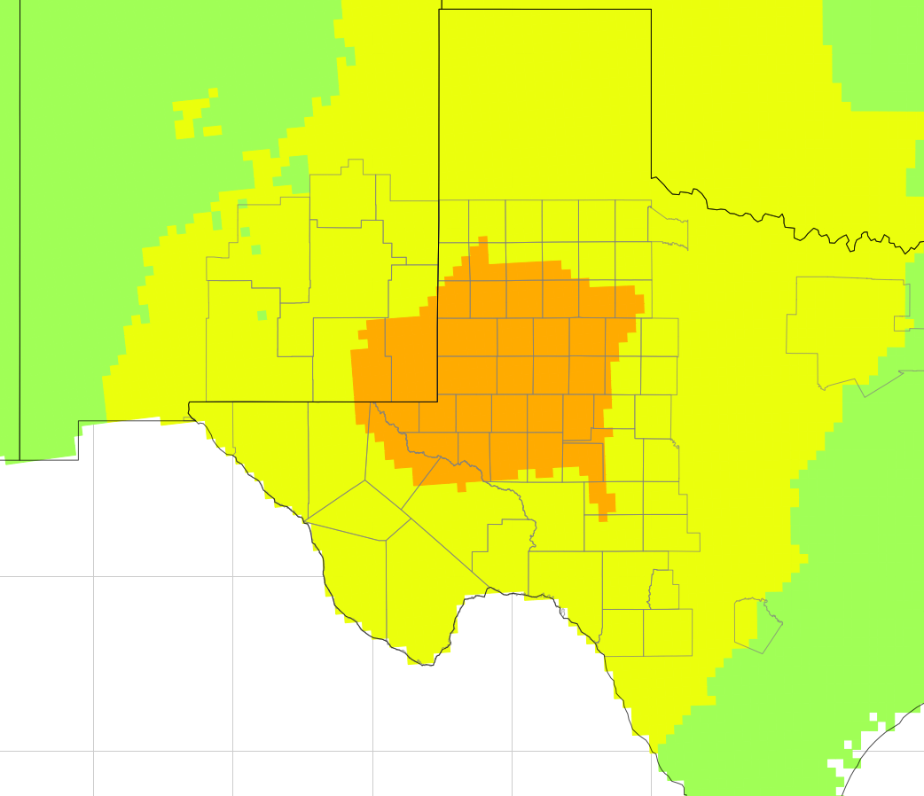
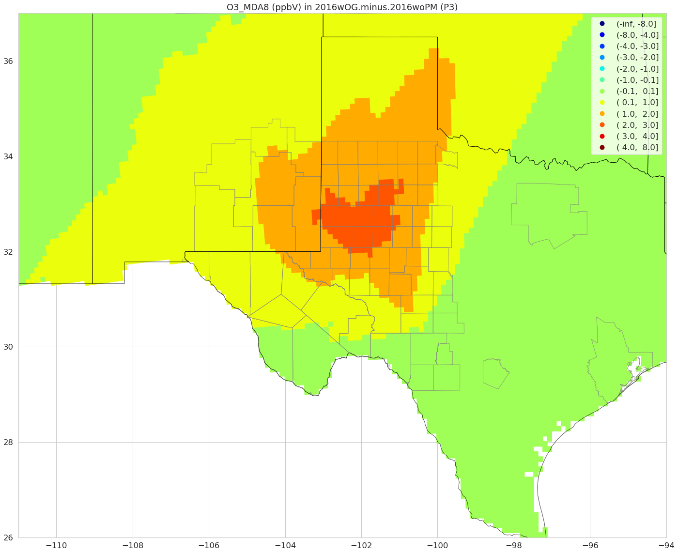
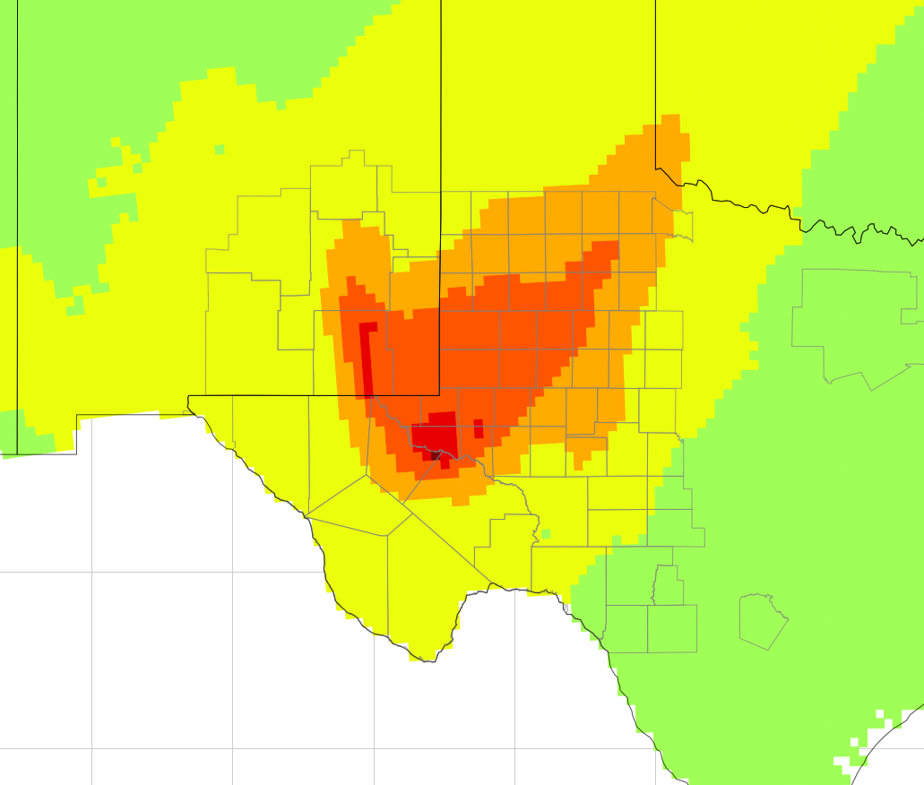
CMAQ simulations suggested that Carlsbad is not where highest ozone impact from Oil & Gas emission is modeled
CMAQ configurations: 12 km x 12 km, NEI 2016, base year 2016 with and without PMB O&G emissions
January
April
Highest MDA8O3 impact typically observed in southeast and southwest PMB counties (southeast of Carlsbad)
Ozone at Carlsbad is not only locally formed by transported from
Additional ozone monitoring sites in PMB counties in Texas are needed
Carlsbad: 0.9 ppb
PMB max = 1.5 ppb
Carlsbad: 1.1 ppb
PMB max = 1.87 ppb
July
October
Carlsbad: 1.4 ppb
PMB max = 2.5 ppb
Carlsbad: 2.9 ppb
PMB max = 4.7 ppb
Monthly-average MDA8O3 contributed by PMB O&G (ppb)
Highest MDA8O3 impact in any day: 22 ppb
Notes:
O&G emissions in the Permian Basin contributed to 10 of the total 24 MDA8O3 exceedances simulated in the Basin during four months in 2016.
The southeast region of Permian Basin showed the highest modeled ozone impact (upto 22 ppb of MDA8O3).
This also implies that ozone at Carlsbad is not only locally formed but transported from southeast (most likely) of PMB.
This finding also signifies the needs for additional ozone monitoring sites in the Basin to identify hotspots which may affect public health through ozone exposures.

Slide 13
Summary
Majority of airmass trajectories associated with high ozone days (MDA8O3 > 70 ppb) passed through counties in the Permian basin (PMB) that are east and southeast of Carlsbad. These counties are associated with high magnitudes of oil and gas emissions
Trajectories passing through counties in the PMB that are west, southwest, and northeast of the Carlsbad are often associated with low ozone days (MDA8O3 < 43 ppb)
HYSPLIT modeling demonstrates strong indication of impact of Oil & Gas emissions from PMB to ozone at Carlsbad
Significant increases in VOC emissions from Oil & Gas in 2020 in comparison to 2017 (45% for New Mexico, 33% for Texas, state-wide) in most counties in the PBM
Changes in O&G NOx emissions are to a relatively lesser extent (19% in New Mexico and -1% in Texas, state-wide) but there are significant increases in some counties in PMB (e.g., Eddy, Lea, Reeves) that are in the immediate vicinity of Carlsbad
Needs for additional ozone monitoring sites in the PMB to identify modeled hotspots which may affect public health through ozone exposures
Additional analyses (topography effect, source apportionment) to help identify the boundary of potential Carlsbad ozone nonattainment area and to quantify impacts of PMB emissions to Carlsbad ozone
Notes:
Changes in O&G emissions in these counties and in PMB in recent years have significant implications on ozone at Carlsbad.
EPA’s 5-factor approach: the relationship between meteorological conditions (e.g., temperature, wind speed and wind direction, barometric pressure) and ozone level at Carlsbad; geography and topography analysis to understand mountain ranges or other physical features that may influence transport of emissions of ozone precursors to Carlsbad.

Slide 14
Thank you

Slide 15
Backup Slides

Slide 16
Changes in Oil & Gas emissions throughout 2017-2020 (State total)

Slide 17
Impact of PMB Oil & Gas emissions on Ozone exceedances
Contribution of O&G emissions in Permian Basin (PMOG) to Ozone and MDA8O3 exceedances in 2016
Regions | w/o PMOG |  | With PMOG
 | MDA8O3* > 70 ppb | O3 > 70 ppb | MDA8O3 > 70 ppb | O3 > 70 ppb
Dallas-Forth Worth | 48 | 844 | + 0 | + 5
San Antonio | 26 | 310 | + 0 | + 0
El Paso-Las Cruse | 4 | 43 | + 0 | + 0
Permian Basin | 14 | 595 | + 10 | + 205
Northeast PMB | 0 | 0 | + 0 | + 0
Southeast PMB | 14 | 497 | + 8 | + 141
Southwest PMB | 0 | 79 | + 2 | + 47
Northwest PMB | 0 | 15 | + 0 | + 2
*There are 3,155 gridcells x 123 days = 388,065 chances that MDA8O3 exceedances could occur in the Permian Basin.

Slide 18
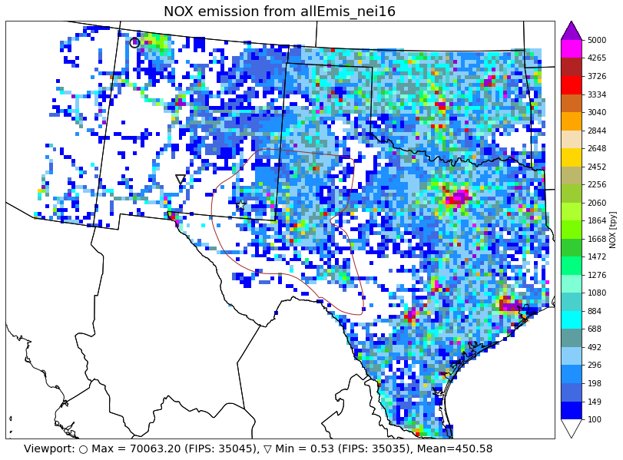
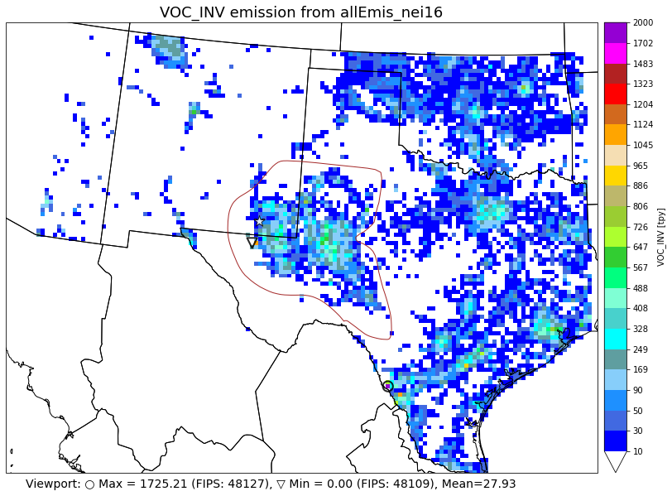
NEI2016 Anthropogenic emissions in Texas and New Mexico

Slide 19
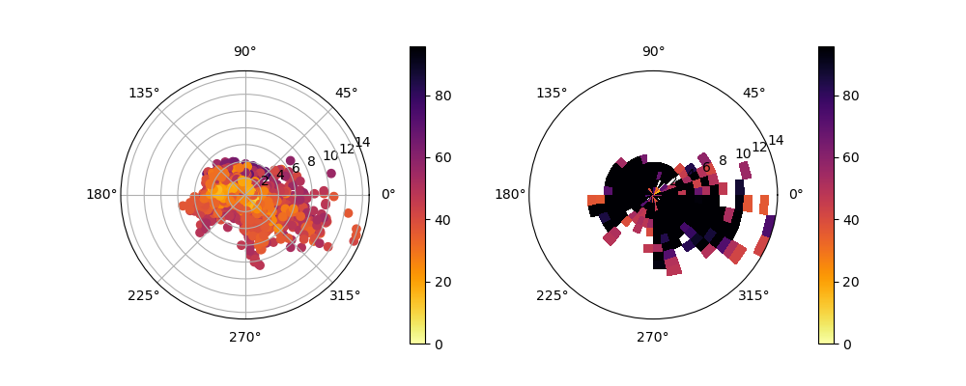
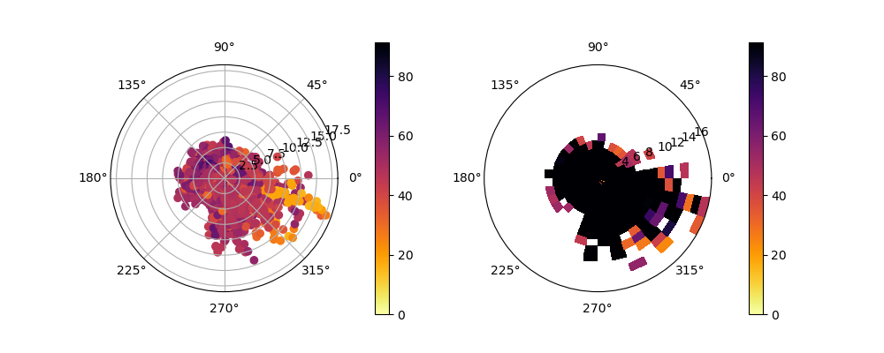
Concentration Rose at Carlsbad Caverns
2019
2020

