Slide 1
The Future of EPA’s Air QUAlity TimE Series
George Pouliot¹, Kristen Foley¹,Alison Eyth ², Jeff Vukovich ² ,Tesh Rao ², Caroline Farkas ², Janice Godfrey ²
EQUATES Team:
Norm Possiel², Michael Aldridge², Christine Allen³, Wyat Appel¹,
Jesse Bash¹, Megan Beardsley², Sarah Benish², James Beidler¹,
David Choi², Brian Eder ⁴, Caroline Farkas², Rob Gilliam¹,
Barron Henderson², Christian Hogrefe¹, Shannon Koplitz², Rich Mason², Rohit Mathur¹, Chris Misenis², Havala Pye¹, Lara Reynolds³, Matthew Roark³, Sarah Roberts², Donna Schwede ⁴, Karl Seltzer², Darrell Sonntag², Kevin Talgo³, Claudia Toro²
¹US EPA, Office of Research and Development
²US EPA, Office of Air and Radiation
³General Dynamics Information Technology
⁴ Retired
CMAS Conference
October 16-18, 2023

Slide 2
Outline
EQUATES project background and overview
Applications of EQUATES data and Publications
Ideas for EQUATES version 2.0
Office of Research and Development
Center for Environmental Measurement & Modeling

Slide 3
Why did we model past air quality?
Modeling data supplement measurements, providing a more complete picture of the air pollutant concentrations.
Decadal CMAQ simulations have been used to quantify trends in concentration and deposition of air pollutants.
These modeled timeseries are also a valuable resource for evaluating CMAQ’s ability to quantify the impact of changing emissions and meteorology on air quality.
Air quality measurement sites are expensive and not uniformly distributed across the country.
Modeled data provides information at all locations.
3

Slide 4
We’ve used CMAQ to estimate air quality trends before Why did we model everything again?
Past projects of decadal CMAQ simulations:
Only cover 1990-2010 or 2002-2014
Use outdated or inconsistent methods for modeling air quality from outside the US (‘boundary conditions’)
Use outdated methods for modeling meteorology (WRF 3.x)
Use inconsistent approaches for modeling air emissions from different sources (e.g.,
mobile, oil/gas, each NEI year used different methods)
Use outdated methods for modeling atmospheric chemistry, transport, and deposition, e.g., past projects used CMAQv5.0.2 (released 2014) for most years
4

Slide 5
EQUATES Overview
Weather conditions from a numerical weather model
Air emissions from various sources, e.g., vehicles, fertilizer, fires
Extends past projects by modeling 2002-2019
Uses consistent methods for modeling air quality from within and outside the US
New meteorology inputs to the air quality model based on state-of-the science simulations of the Weather Research and Forecasting Model version 4.1.1
New emissions inputs to the air quality model developed using consistent methods across years to avoid artificial step changes
New air quality modeling using the latest version of CMAQ
Air Quality Modeling
5

Slide 6
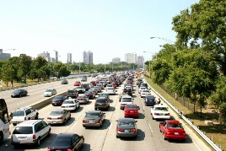
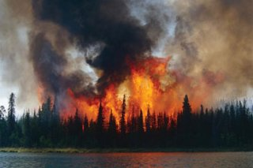
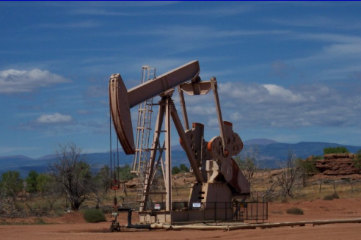
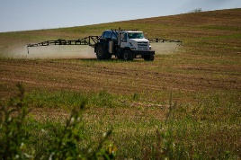
EQUATES Emissions Modeling for 2002-2019
The 2017 NEI was treated as a base year. To extrapolate to previous years, we
Developed new methods for consistent emissions for all years, e.g., vehicle, fires, oil & gas, volatile chemical products, crop fertilizer
Applied scale factors based on activity relative to 2017, e.g., shipping, rail, construction dust
Used existing emissions data for earlier years (e.g., CEMs data from EGUs)
Left emissions flat at 2017 NEI levels (e.g., waste disposal, bulk gasoline terminals)
6

Slide 7
Current and Future Applications from EQUATES
7

Slide 8
Trends in Criteria Pollutants such as (NO_{X}) emissions (EPA Trends)
Long-term regional trends of nitrogen and sulfur deposition in the United States
Long term estimates of particulate matter and ozone, including observed + model data “fusion”, for epidemiological studies
Deposition estimates from NADP’s Total Deposition Measurement Model Fusion product for assessing ecosystem health
Comparison with satellite observations
8

Slide 9
Measurement campaigns comparison (e.g. WINTER)
Incorporation of inventories into a global emission inventory in support to Hemispheric Transport of Air Pollution (HTAP v3)
Trends in HAPs
Trends for the Bureau of Economic Analysis
CMAQ-ISAM source apportionment studies and evaluation
Analysis of Prescribed fires and wildfires patterns
Development of the new Reactive Organic Carbon mobile source emission dataset
9

Slide 10
Example: Trends in EQUATES Emissions
10

Slide 11
Annual Total NO_{X} Emissions from Human Activities
Some of the changes in previous emissions datasets are due to how the emissions were estimated.
EQUATES trends are smoother than the previous emissions data, reflecting more consistent methods.
– EQUATES
– Previous Emissions Data
11

Slide 12
Annual Total NO_{X} Emissions from Petroleum and Related Industries
A 2013 EPA report found oil and gas sources were missing or underestimated in the 2008 (and prior) NEIs for many states.
EQUATES uses estimates from the latest version of the EPA’s Oil and Gas Tool for all years, improving consistency in emissions trends.
Year-to-year changes in EQUATES estimates are real, reflecting variability due to weather and energy pricing.
– EQUATES
– Previous Emissions Data
12

Slide 13
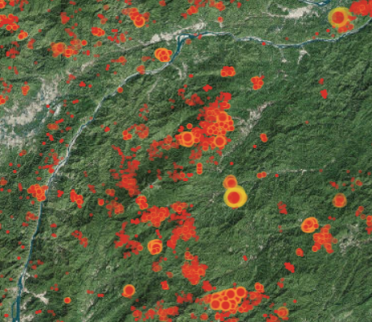
Ideas for Version 2.0
Significant Updates to Emission Methods: Wildfires (new satellites and methods(Smartfire, Bluesky Pipeline, SERA)

Slide 14
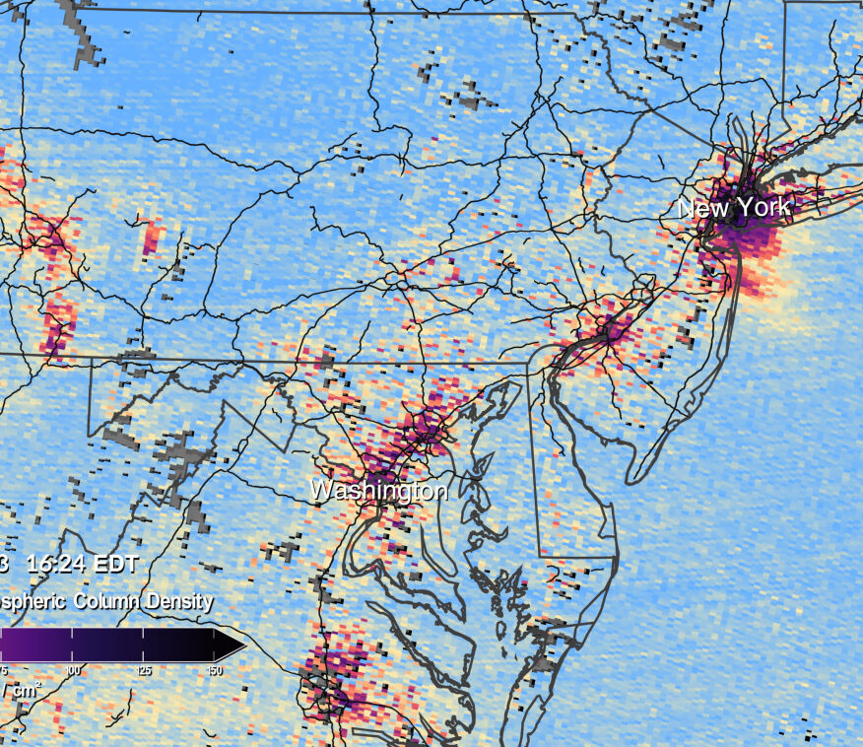
Ideas for Version 2.0
Incorporate new information about temporal, spatial allocation based on TEMPO measurements

Slide 15
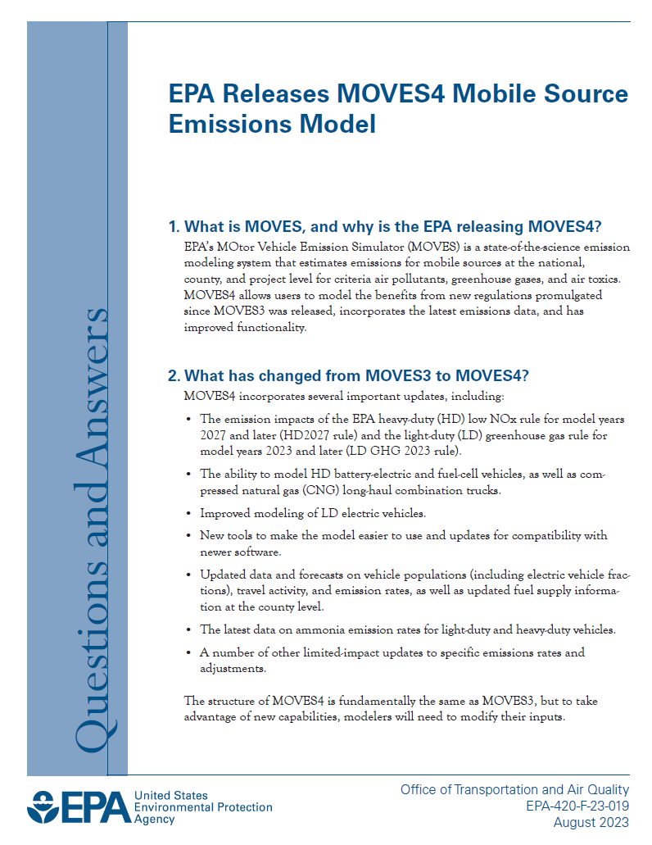
Ideas for Version 2.0
Mobile Sources (MOVES4)
Accounts for new and changed emission rules.
Includes improved emission rates and emission adjustments.
Updates modeling of electric vehicles, data and projections for vehicle populations & activity, and default data and projections for fuel properties.

Slide 16
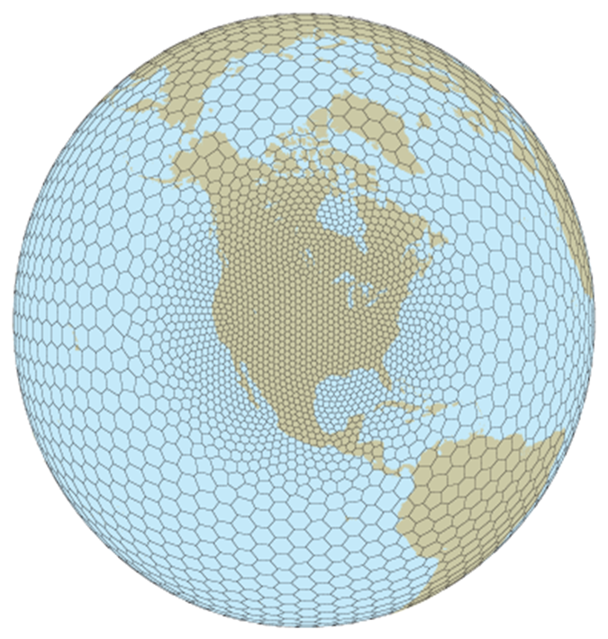
More Ideas for Version 2.0
Decadal time series for the 2020s and rerun 2002-2019?
Improve methods for estimating trends in hazardous air pollutants (HAPS) by using consistent emission factors for HAP inventories and speciation profiles across all sectors.
New versions of meteorological models (e.g., Model for Prediction Across Scales (MPAS).
New version of CMAQ with the new Community Regional Atmospheric Chemistry Multiphase Mechanism (CRACCM).

Slide 17
More Ideas for Version 2.0
Revised wood burning Emission Factors and speciation profiles.
Reanalysis of the multidecadal inventory of residential wood combustion with possible restructure of Source Classification Codes.
New Activity data methods.

Slide 18
Additional Information
EQUATES website: www.epa.gov/cmaq/equates
Emissions, meteorology, and CMAQ datasets are available to download through the CMAS Data Warehouse Google Drive
https://doi.org/10.15139/S3/F2KJSK
EPA Trends: https://www.epa.gov/air-emissions-inventories/air-pollutant-emissions-trends-data

Slide 19
Publications
Foley, K. M., Pouliot, G. A., Eyth, A., Aldridge, M. F., Allen, C., Appel, K. W., ... & Adams, E. (2023). 2002–2017 anthropogenic emissions data for air quality modeling over the United States. Data in Brief, 47, 109022.
Benish, S. E., Bash, J. O., Foley, K. M., Appel, K. W., Hogrefe, C., Gilliam, R., & Pouliot, G. (2022). Long-term regional trends of nitrogen and sulfur deposition in the United States from 2002 to 2017. Atmospheric Chemistry and Physics, 22(19), 12749-12767.
Crippa, M., Guizzardi, D., Butler, T., Keating, T., Wu, R., Kaminski, J., Kuenen, J., Kurokawa, J., et al. (2023). The HTAP_v3 emission mosaic: merging regional and global monthly emissions (2000–2018) to support air quality modelling and policies. Earth System Science Data 15 (6) 2667-2694. 10.5194/essd-15-2667-2023.

Slide 20
For more information on the slides in this presentation, please contact:
George Pouliot George.Pouliot@epa.gov
Kristen Foley Foley.Kristen@epa.gov
Disclaimer: The views expressed in this presentation are those of the authors and do not necessarily reflect the views or policies of the U.S. EPA.
Office of Research and Development
Center for Environmental Measurement & Modeling

