Slide 1
Development of a 2020 Emissions Modeling Platform
A. Eyth, J. Vukovich, C. Farkas, J. Godfrey, K. Seltzer, R. Mason, A. Diem (US EPA OAQPS)
S. Roberts (US EPA OTAQ)
C. Allen (General Dynamics Information Technology)
October 17, 2023

Slide 2
Origins of the 2020 Modeling Platform
Purpose
Support modeling done collaboratively with the Centers for Disease Control and Prevention (CDC) each year for the past 18 years
Fused air quality surface data using downscaling files on EPA's RSIG site
CDC National Environmental Public Heath Tracking Indicators and Data
Support AirToxScreen - EPA's screening tool to provide communities with information about health risks from air toxics
Review air quality model performance for the year 2020
Basis for Emission Inventories
The 2020 platform is based on the 2020 National Emissions Inventory (NEI) released in spring 2023
https://www.epa.gov/air-emissions-inventories/2020-national-emissions-inventory-nei-data

Slide 3
The National Emissions Inventory (NEI)
Data are submitted by state, local, and tribal agencies (S/L/T) and by EPA into the Emissions Inventory System (EIS)
NEI data categories
Point (and Facility) Inventory (lat-lon locations): electricity generating units (EGUs), point oil and gas sources, commercial and industrial facilities, airports, rail yards
Nonpoint (county-based): fugitive dust, agricultural, residential, solvents, locomotives, gas stations, fuel combustion, nonpoint oil & gas, residential wood combustion (RWC), biogenic, fires*, commercial marine vessels (CMV)*
Onroad mobile sources (county): vehicles driving on roads
Nonroad mobile sources (county): other mobile sources not on roads including tractors, recreational marine vessels, construction equipment, lawn and garden equipment
* These are in the nonpoint data category, but more detailed locations are available
US EPA OAQPS, Emission Inventory and Analysis Group
Notes:
The NEI data categories are illustrated by the pictures at the bottom of the page.

Slide 4
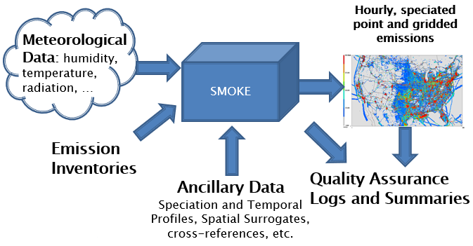
Preparing Emissions for Air Quality Modeling
The Sparse Matrix Operator Kernel Emissions (SMOKE) modeling system is used to prepare emissions data for air quality models
Performs speciation, temporal and spatial allocation, vertical distribution
The CMAS Center released SMOKE version 5.0 in June 2023
FUN FACT:
The SMOKE prototype
was released in 1998,
which makes 2023 the
25th anniversary of SMOKE!
https://www.cmascenter.org/download/ release_calendar.cfm
NEI, etc.

Slide 5
Emissions Method Updates in 2020 NEI
Improved estimates for industrial and commercial/institutional (ICI) fuel combustion (see R. Mason presentation)
Updated residential wood combustion emission factors and fuel consumption estimates
Updated methods to compute emissions from solvents and commercial cooking including more complete activity data
Added Volatile Organic Compounds (VOC) from agricultural silage and for additional asphalt paving processes
Updated data and methods used to compute biogenic emissions
Updated activity data for most types of emissions sources
Moved fires to nonpoint data category (although these are still treated as day-specific point sources for modeling)

Slide 6
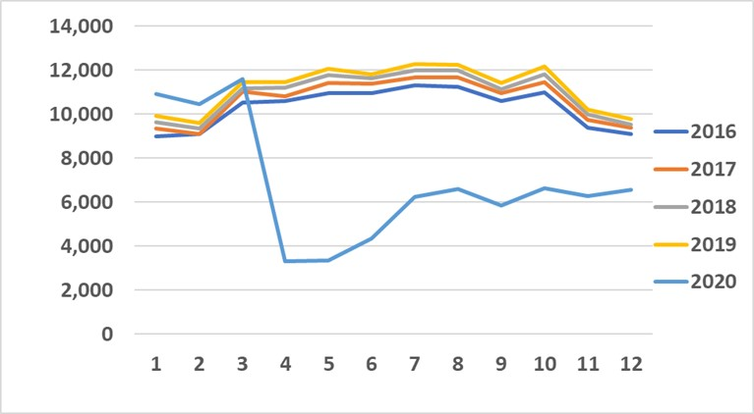
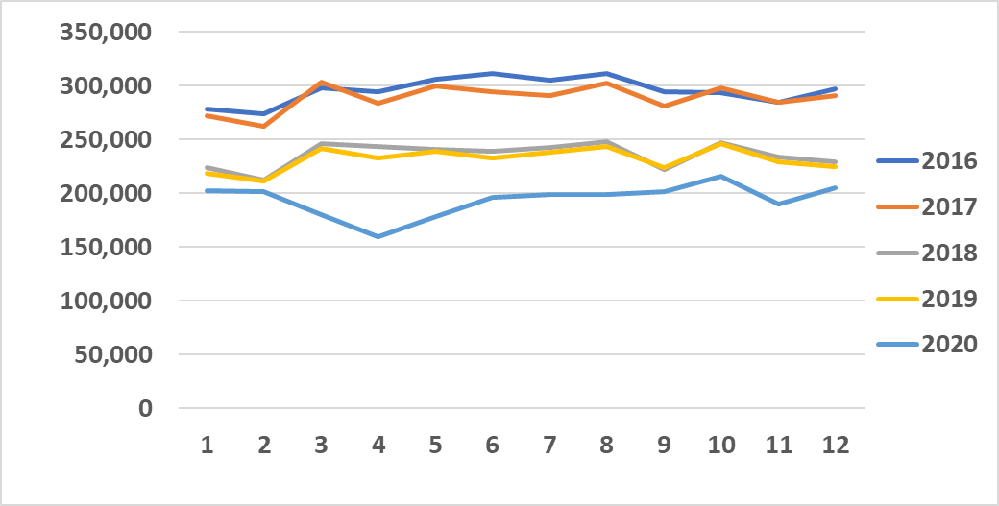
How is the 2020 pandemic reflected?
2016-2020 Airport NO_{x}
Point source emissions reflect actual 2020 emissions – including Continuous Emissions Monitoring System (CEMS) data for EGUs
Airport emissions are based on 2020-specific temporal patterns, landing and takeoff data, and aircraft types
Onroad mobile source emissions were computed with 2020-specific vehicle population, vehicle miles traveled
GPS-based telematics data were used to develop temporal and speed profiles
tons
2016-2020 Onroad mobile source NO_{x}
tons
Notes:
Emissions from airports and onroad are lower in April

Slide 7
Spatial Surrogate Improvements
2019 National Land Cover Database (NLCD) was updated from 2011
2020 American Community Survey (ACS) / census data (e.g., population, housing units) were updated from 2016
2020 oil and gas well and production data were used
OpenStreetMap was used to develop spatial surrogates for unpaved road dust, stage 1 refueling and asphalt paving
Residential wood emissions were spatially allocated based on detached housing units
Livestock waste emissions were allocated using animal-specific surrogates and in some states point discharge permit data

Slide 8
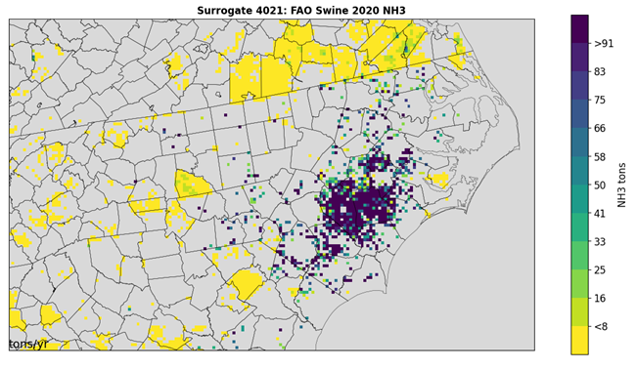
Example Maps of Ammonia Emissions using Updated Agricultural Surrogates
2020 NEI Beef Cattle NH₃ with new Surrogate
2020 NEI Swine NH₃ with new Surrogate

Slide 9
Speciation Improvements
Speciation profiles and cross references use SPECIATE 5.2
VOC and Total Organic Gas (TOG) profiles were updated for wildfires and nonpoint solvents
Profiles were assigned for the new agricultural silage and nonpoint asphalt paving processes
PM2.5 profiles were defined for grass fires
Speciation profiles were assigned for any new Source Classification Codes (SCCs) in 2020 NEI
Onroad speciation of VOC and was updated to be performed in SMOKE instead of in the MOtor Vehicle Emissions Simulator (MOVES) to support more chemical mechanisms (e.g., CRACMM)

Slide 10
2016-2020 Anthropogenic Emissions
tons / year
Emissions shown here are for the contiguous U.S. and are from EPA’s emissions modeling platforms for the respective years.

Slide 11
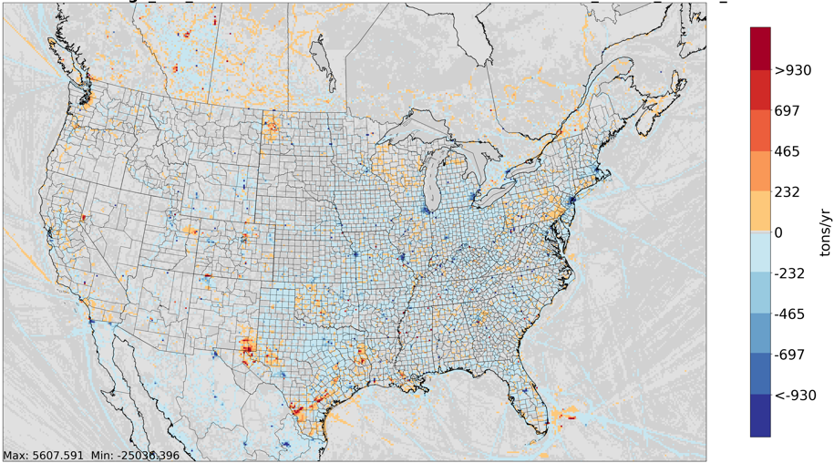
2020 Anthropogenic NOx and 2020-2019
NOx emissions are lower in 2020 in most areas because of decreases in mobile sources and stationary point sources due to the pandemic and controls being added
Increases in some areas are primarily due to oil and gas production

Slide 12
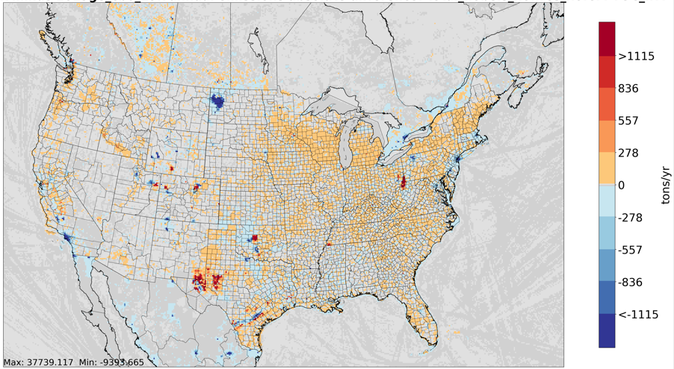
2020 Anthropogenic VOC and 2020-2019
VOC emissions are higher in 2020 than in 2019 due to 2020 NEI including new processes and increased estimates for solvents, plus there are increases and decreases in oil and gas production activity in some areas

Slide 13
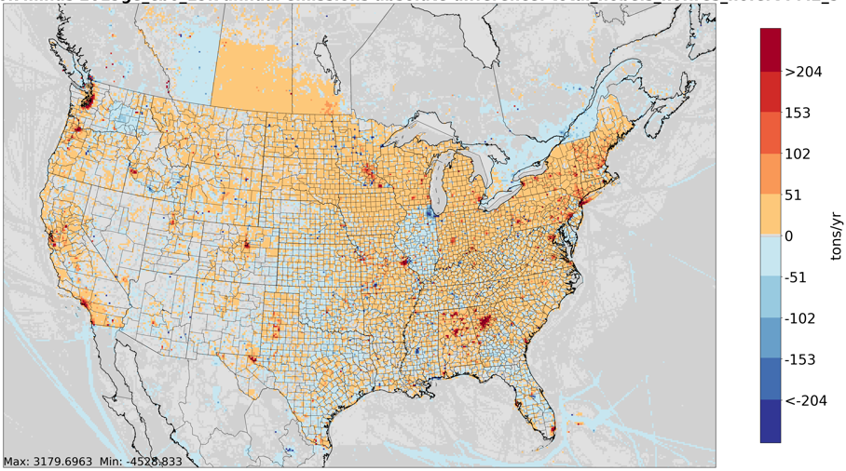
2020 Anthropogenic PM_{2.5} and 2020-2019
PM_{2.5} emissions are higher in 2020 due to improved estimation methods for residential wood combustion and other nonpoint sources

Slide 14
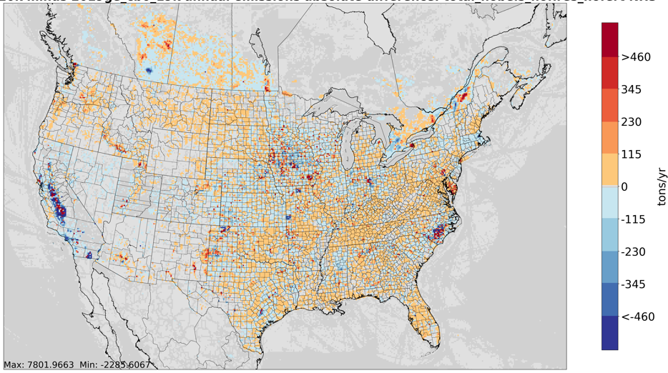
2020 Anthropogenic NH₃ and 2020-2019
Anthropogenic NH₃ including fertilizer
2020-2019 NH₃ (not including fertilizer)
NH₃ emissions are higher in 2020 due fertilizer, livestock, and waste disposal.
Changes due to updated livestock inventory and spatial surrogates are noticeable

Slide 15
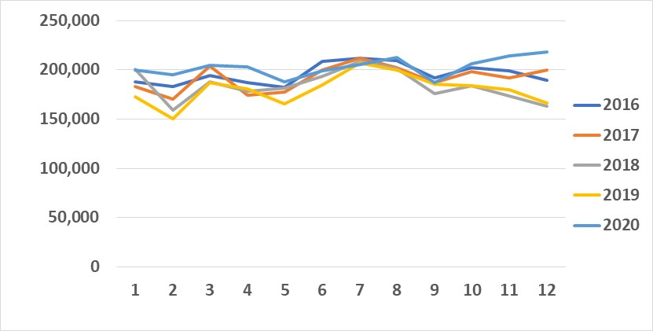
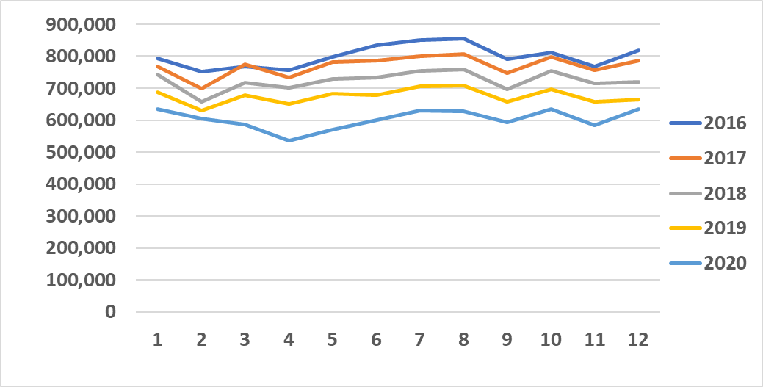
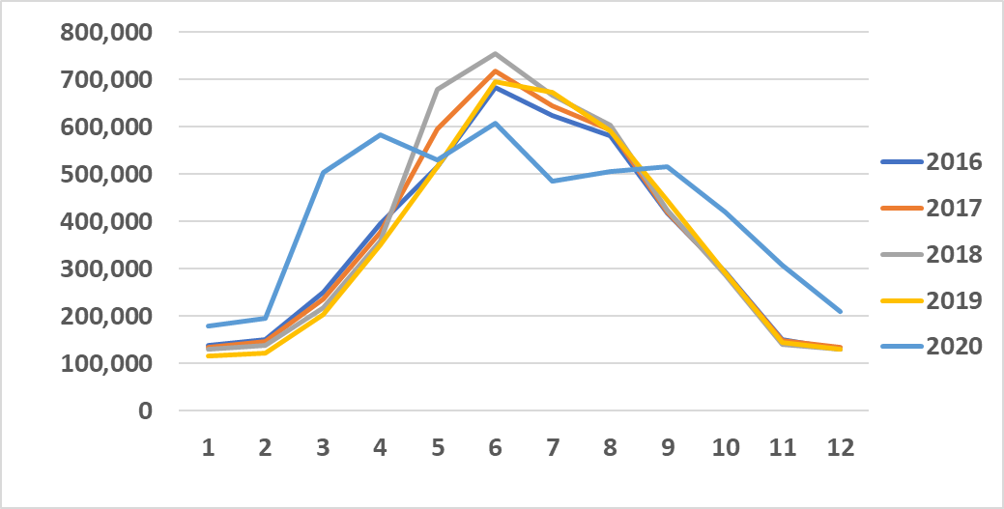
Anthropogenic Emissions by Month and Year
SO₂
PM_{2.5}
tons
tons
NOx
NH₃
tons
tons
month
month
Notes:
SO2 and NOx are steadily decreasing. PM is relatively flat and possibly increasing. NH3 is also increasing. The monthly patterns vary by pollutant.

Slide 16
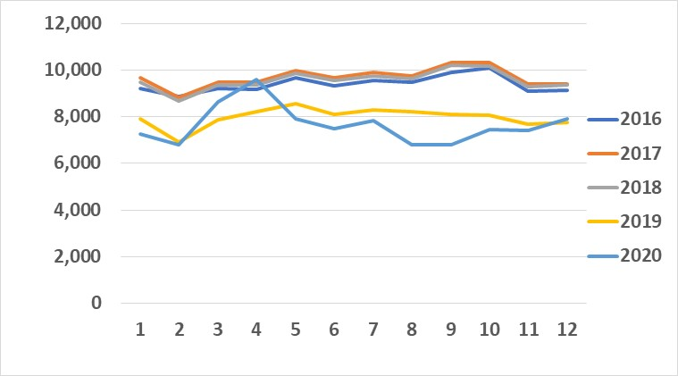
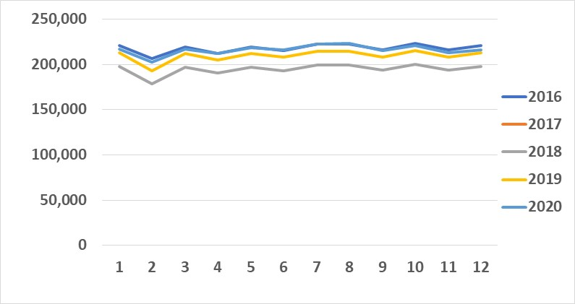
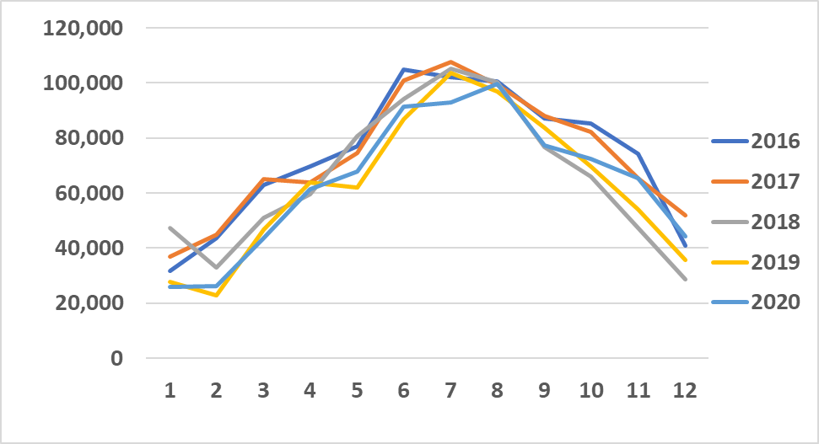
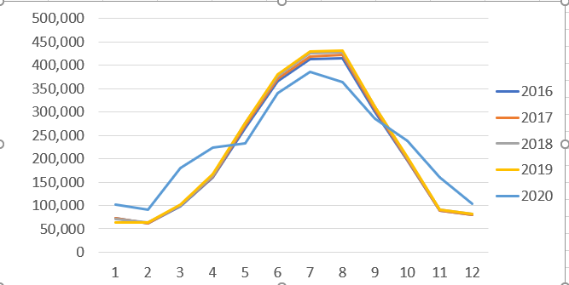
Emissions by Month and Year for Selected Sectors
EGU SO₂
C3 Commercial Marine Vessel NOx
tons
tons
Note: 2016, 2017, and 2018 are all based on 2017 NEI data; 2019 and 2020 use year-specific activity
Solvents VOC
Fugitive Dust PM₁₀
Livestock NH₃
tons
tons
tons
Notes:
The sectors are mostly selected due to their contributions to the emissions for the pollutant. The drop in EGU SO2 is significant. Emissions are highest in winter and summer and lower in spring and fall. 2020 CMV emissions show an interesting pattern – higher in March/April and lower for much of the rest of 2020. 2016-2018 wee all based on 2017 NEI.

Slide 17
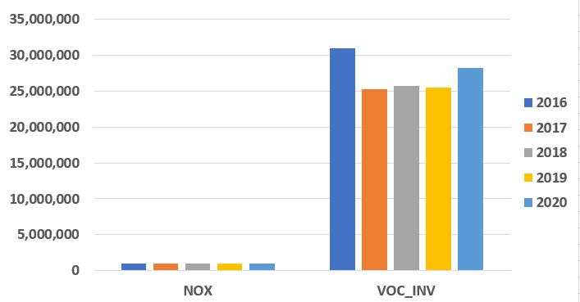
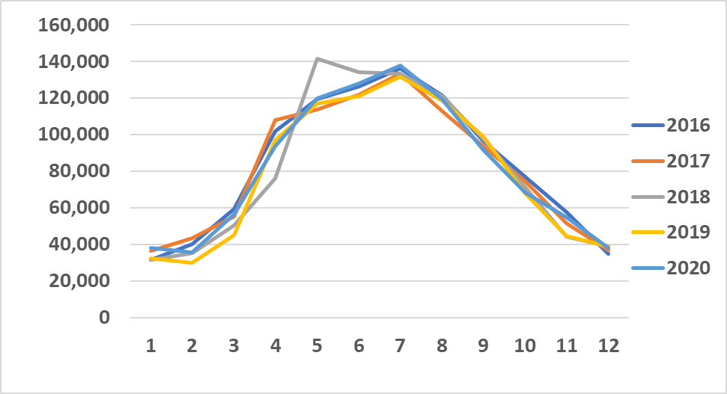
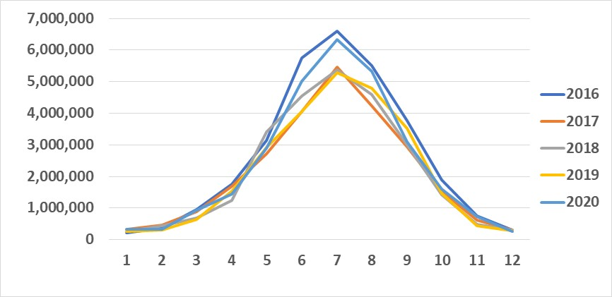
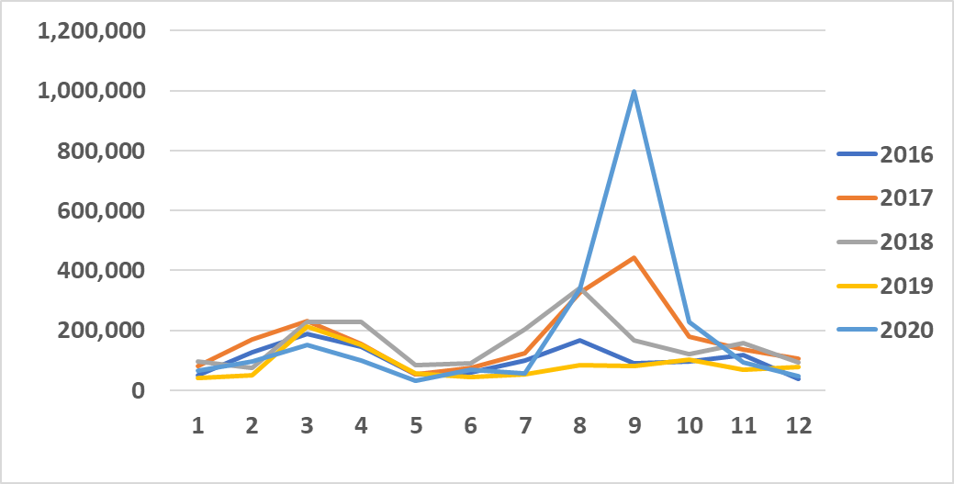
Fire and Biogenic Emissions by Year and Month
Biogenic
Wild and prescribed fires
tons/yr
tons/yr
BEIS NOx
BEIS VOC
Wild and Prescribed Fires PM_{2.5}
tons
tons
tons
Notes:
Fire emissions are CONUS. BEIS NOx and VOC have a different shape of the peak although July is highest for both. Fires have peaks in spring (prescribed / grassland) and in late summer for wildfires.

Slide 18
Acknowledgements and Finding Data
Development of the 2020 NEI and the associated modeling platform included contributions from many EPA and state, local, and tribal agency staff
Persons involved in development national NEI emissions data sets not listed as co-authors include:
EPA: Jesse Bash, George Pouliot, James Beidler, Michael Aldridge, Daniel Bizer-Cox, Ron Ryan, Jennifer Snyder, Lindsay Dayton, Venkatesh Rao
Non-EPA: Mark Janssen (LADCO), Matt Harrell (IL), many S/L/T staff
EPA’s Air Emissions Modeling Website at provides input data for and scripts to run SMOKE, plus detailed Technical Support Documents for EPA platforms, including the 2020 platform
https://www.epa.gov/air-emissions-modeling/emissions-modeling-platforms

