Slide 1
Machine Learning with Spatial Interpolation Techniques for Constructing 2D Ozone Concentrations in Southern California during the COVID-19 Shutdown
Khanh Do^{1,3}, Arash Kashfi Yeganeh¹, Ziqi Gao²,
Yang Zhang³, and Cesunica E. Ivey^{1,4}
22nd CMAS Conference, Chapel Hill, NC, October 17, 2023
¹Department of Chemical and Environmental Engineering, University of California, Riverside, CA
²Department of Civil and Environmental Engineering, Georgia Institute of Technology, Atlanta, GA, USA
³Department of Civil and Environmental Engineering, Northeastern University, Boston, MA
⁴Department of Civil and Environmental Engineering, University of California, Berkeley, CA
Notes:
14’

Slide 2
Objectives
Evaluate the deterministic and machine learning (ML) models under rapid changes in emissions and meteorology
Investigate ozone (O₃) concentrations during the lockdown
Why ML and what’s new?
Increase computational efficiency
Fill the sparse air monitoring network
Investigate if the pattern that have occurred in the past
Enable the use of historical data for prediction anywhere with the hybrid model (ML + spatial interpolation)
Notes:
1:45’

Slide 3
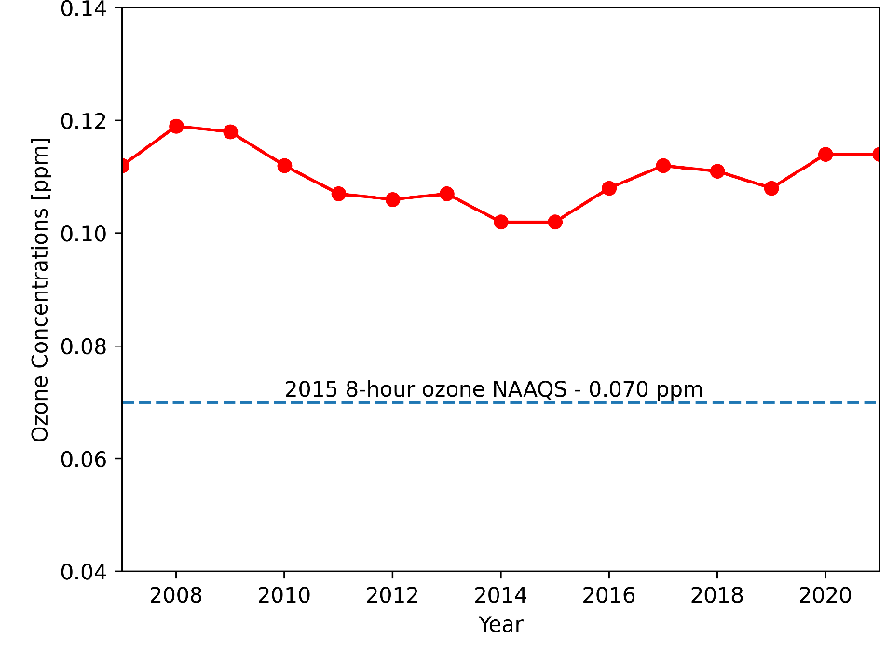
NO_{x} and O₃ Trends in Southern California
25 years of historical data of mean annual NO_{x}
O₃ design values for the South Coast
Significant NO_{x} decrease as a result of the emissions control programs implemented
The 8-hour O₃ design value for SoCAB marginally increased since 2014
What caused O₃ increase in recent years?
Notes:
2:27’

Slide 4
Machine Learning Methods
ML model
Step 1: use Random Forest Regression (RFR) to predict O₃ concentrations at 15 air monitoring sites
Step 2: apply three different spatial interpolation methods (ordinary kriging, inverse distance weighting (IDW), and bicubic interpolation)
Step 3: evaluate interpolated results with 12 additional sites
ML model training
Training features: NO₂, NO, temperature (T), relative humidity (RH), wind speed (WS), wind direction (WD), O₃
Training year: 2009, 2010, 2016, 2017, 2019; and evaluation year: 2020
Prediction at 15 sites using ML, and a 2-D O₃ data constructed using interpolation
Notes:
5:21’

Slide 5
Interpolation Methods
IWD
Consider distances between interpolating points
Have more significant influence from neighbor points
$$Z\left(x\right)=\frac{\sum_{i=1}^{n}{\frac{Z_{i}}{d{\left(x,x_{i}\right)}^{p}}}}{\sum_{i=1}^{n}{\frac{1}{d{\left(x,x_{i}\right)}^{p}}}}$$
Ordinary Kriging
Consider distances between interpolating points
Predict the optimum value $Z$ by linear combining the known values$Z_{i}$ and its weight $λ_{i}$, variogram
$$Z\left(x\right)=\sum_{i=1}^{n}{λ_{i}Z_{i}}$$
Bicubic Interpolation
Based on third-degree polynomial
Data interpolate on a rectangular grid with even distribution
$$Z\left(x,y\right)=\sum_{i=0}^{3}{\sum_{j=0}^{3}{a_{ij}x^{i}y^{j}}}$$
Notes:
5:55’

Slide 6
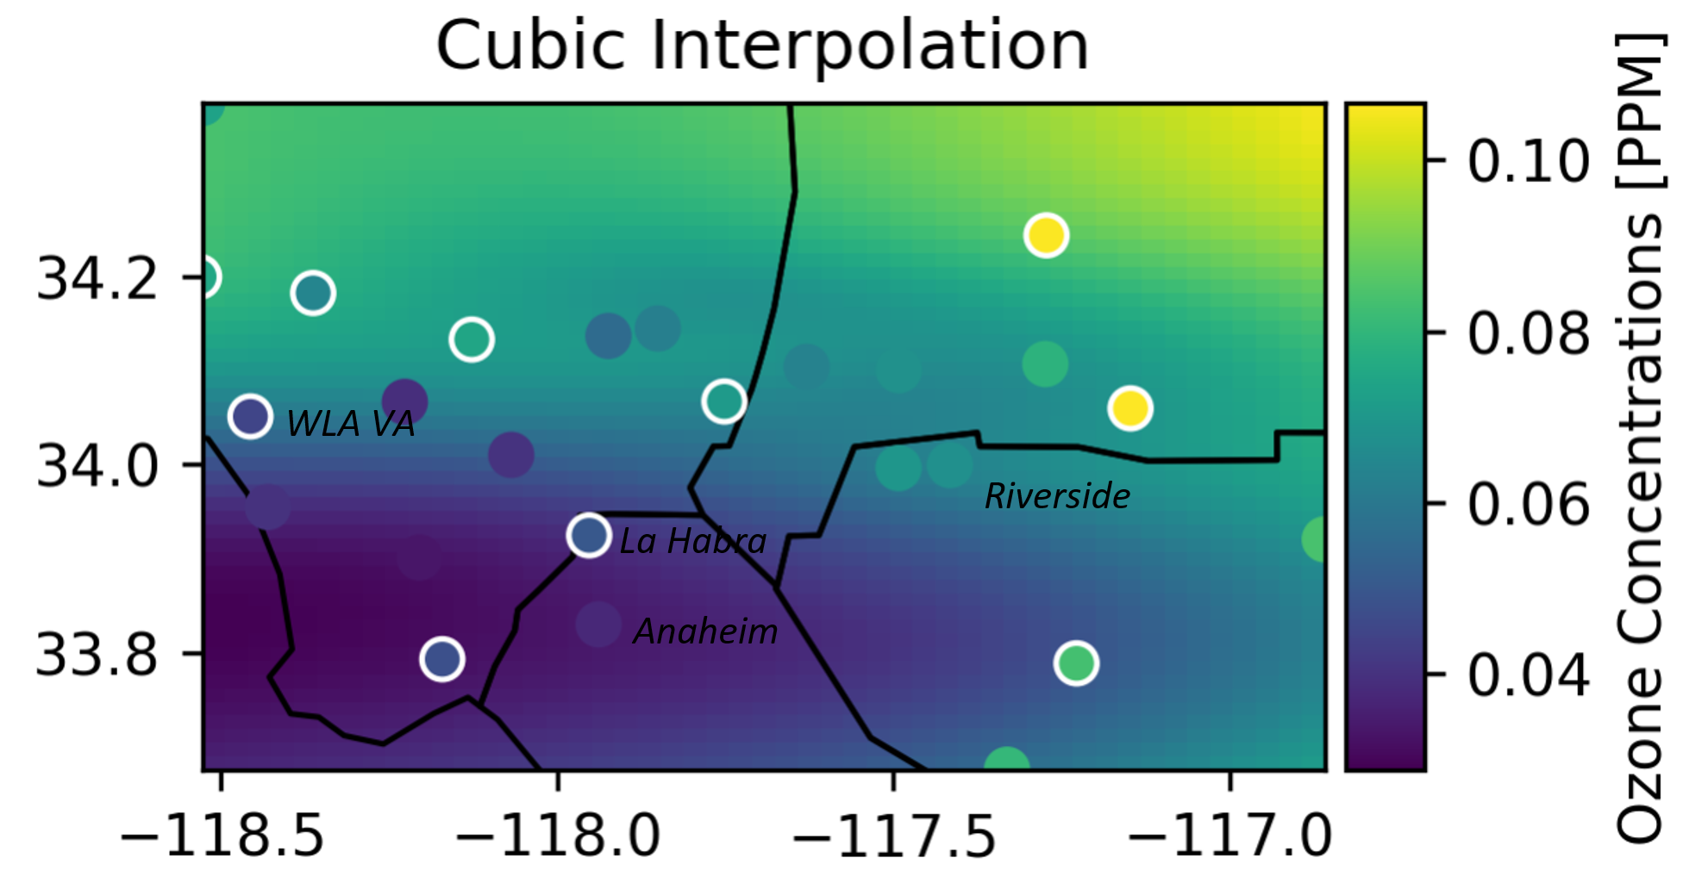
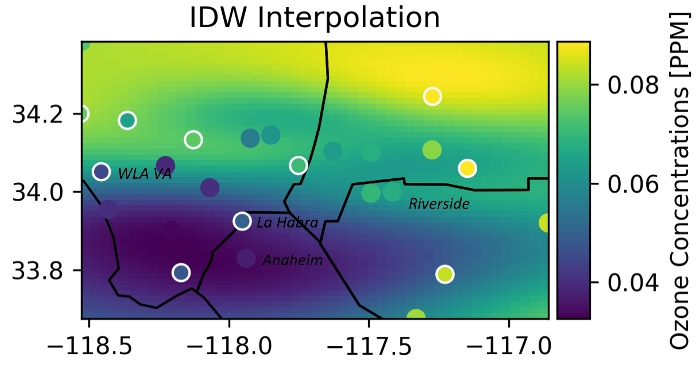
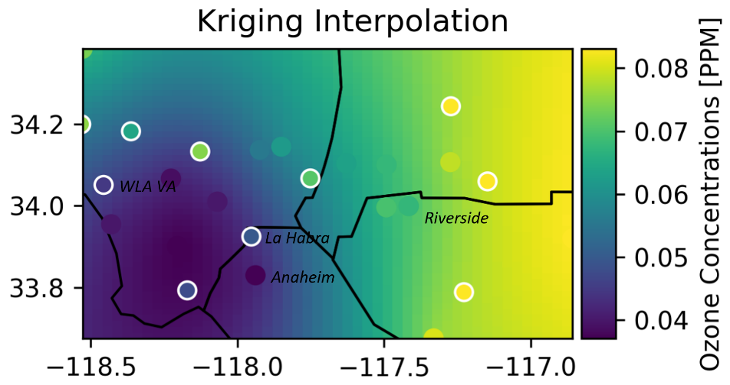
Snapshots of Interpolation
2-D hourly O₃ (16:00 on 06/22/2020). Evaluation sites: dots with white borders; ML sites: dots without borders
Kriging interpolation captures the O₃ trend in Southern California
Low O₃ levels observed in the southwest
High O₃ levels in Inland Empire
All interpolation methods perform well in low O₃ regions
Bicubic and IDW struggle to capture high O₃ regions
Notes:
6:43’

Slide 7
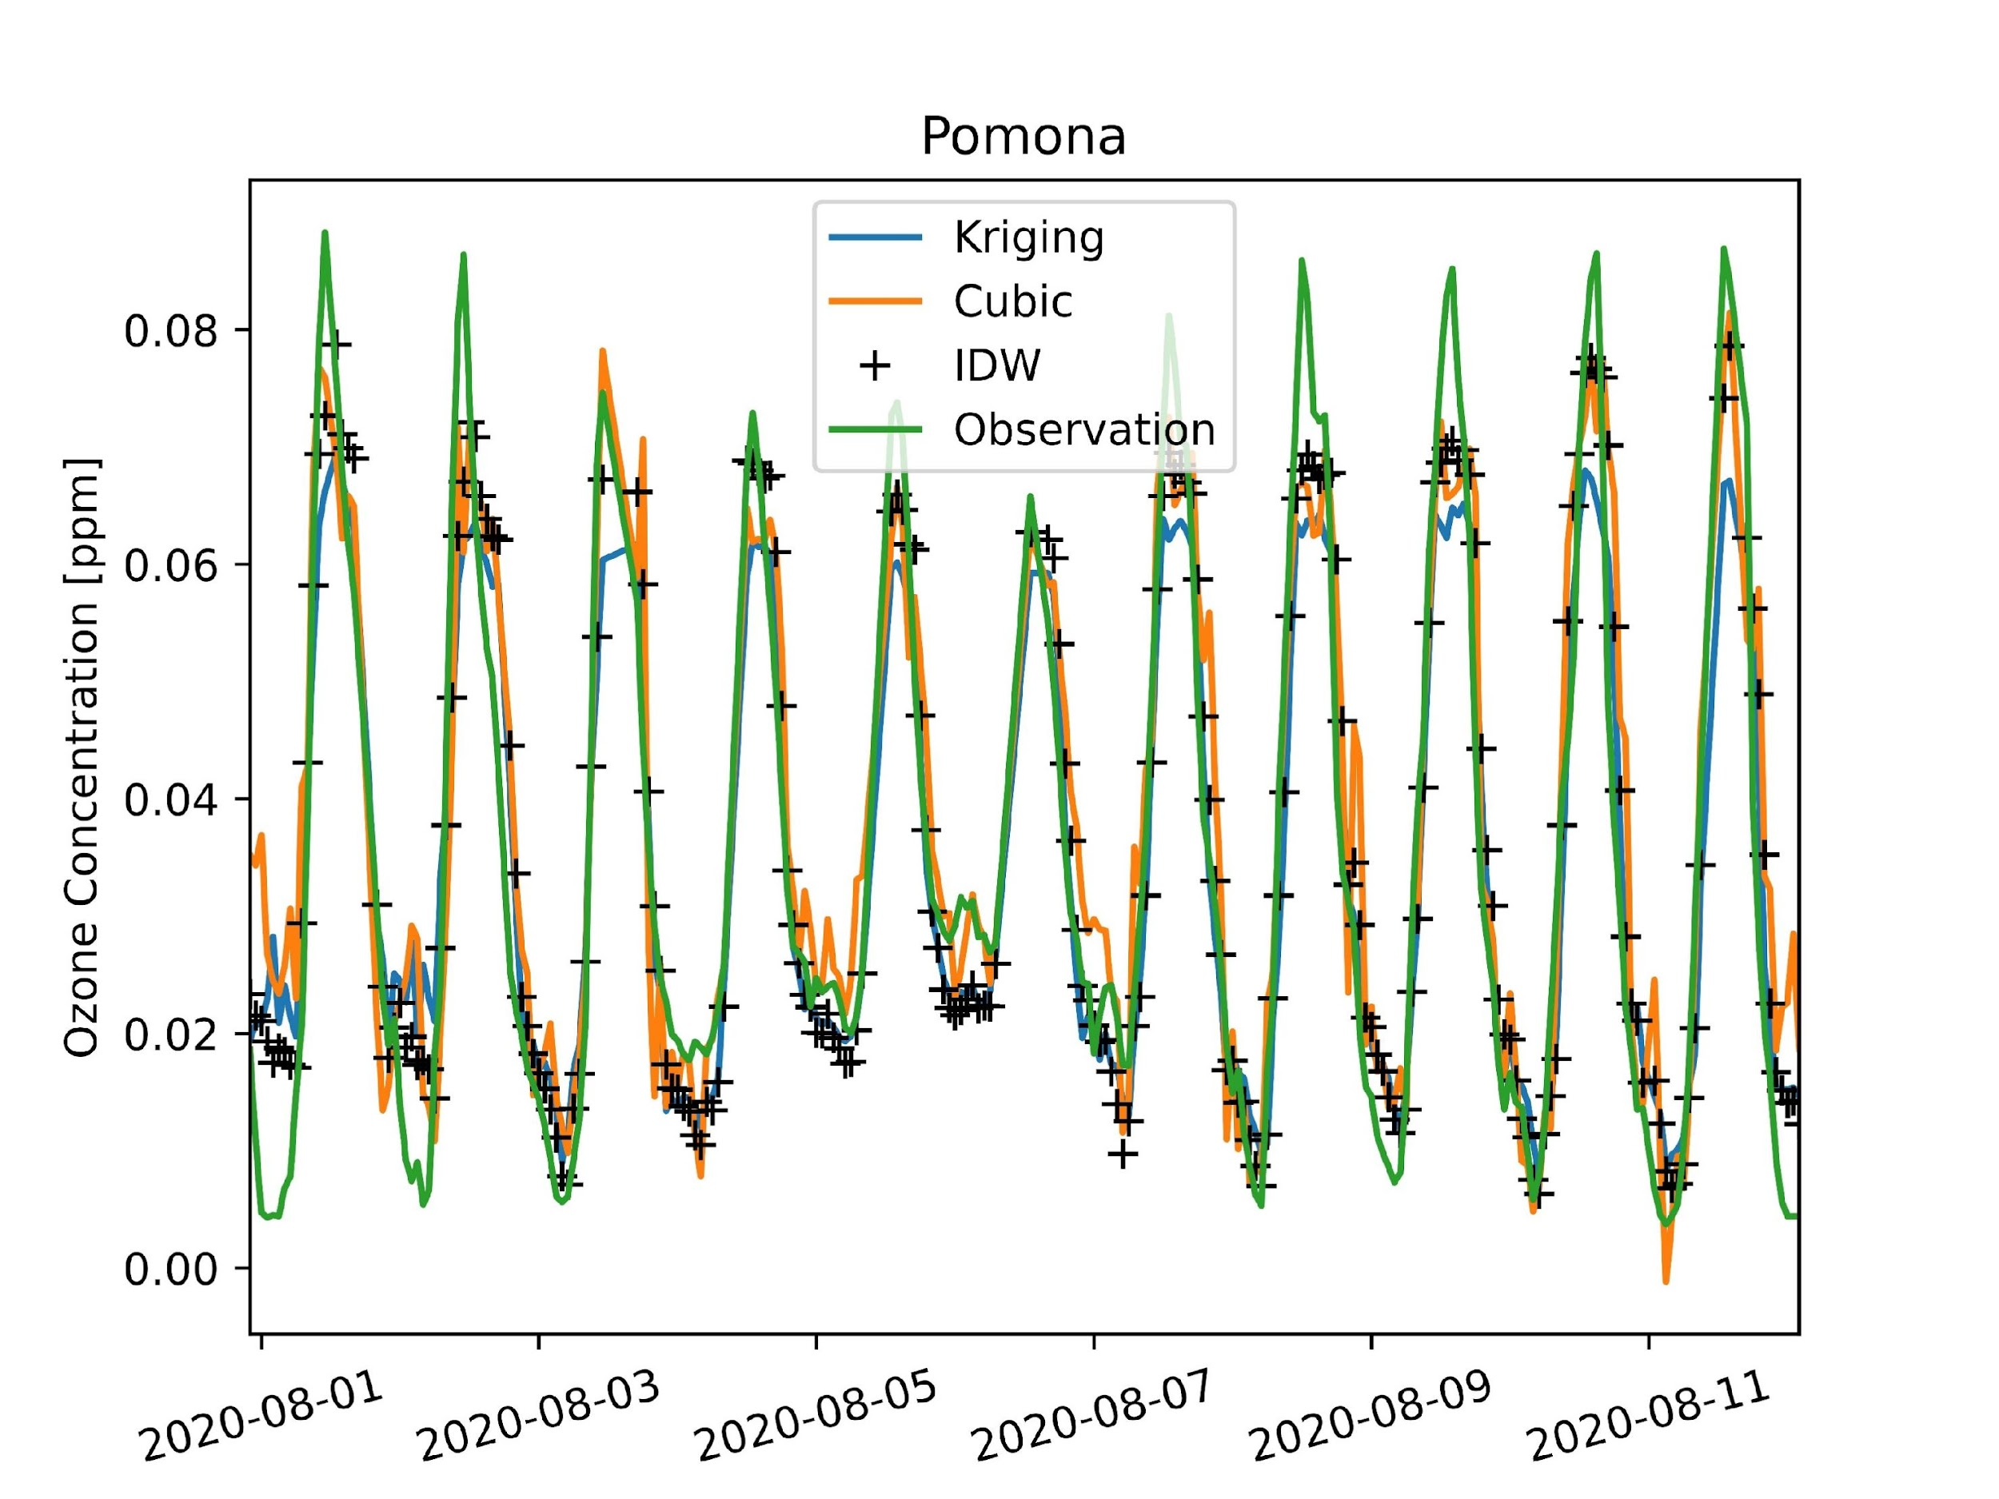
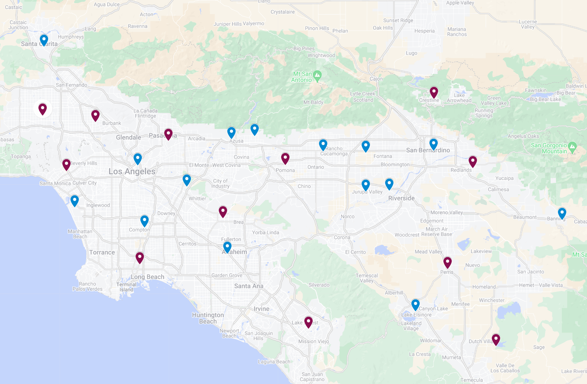
Temporal Evaluation (hourly)
The map shows 27 air monitoring sites in the SoCAB
Pomona
All three methods capture the O₃ trends in Southern California
They underestimate the peaks due to ensemble learning from RFR
Notes:
7:48’

Slide 8
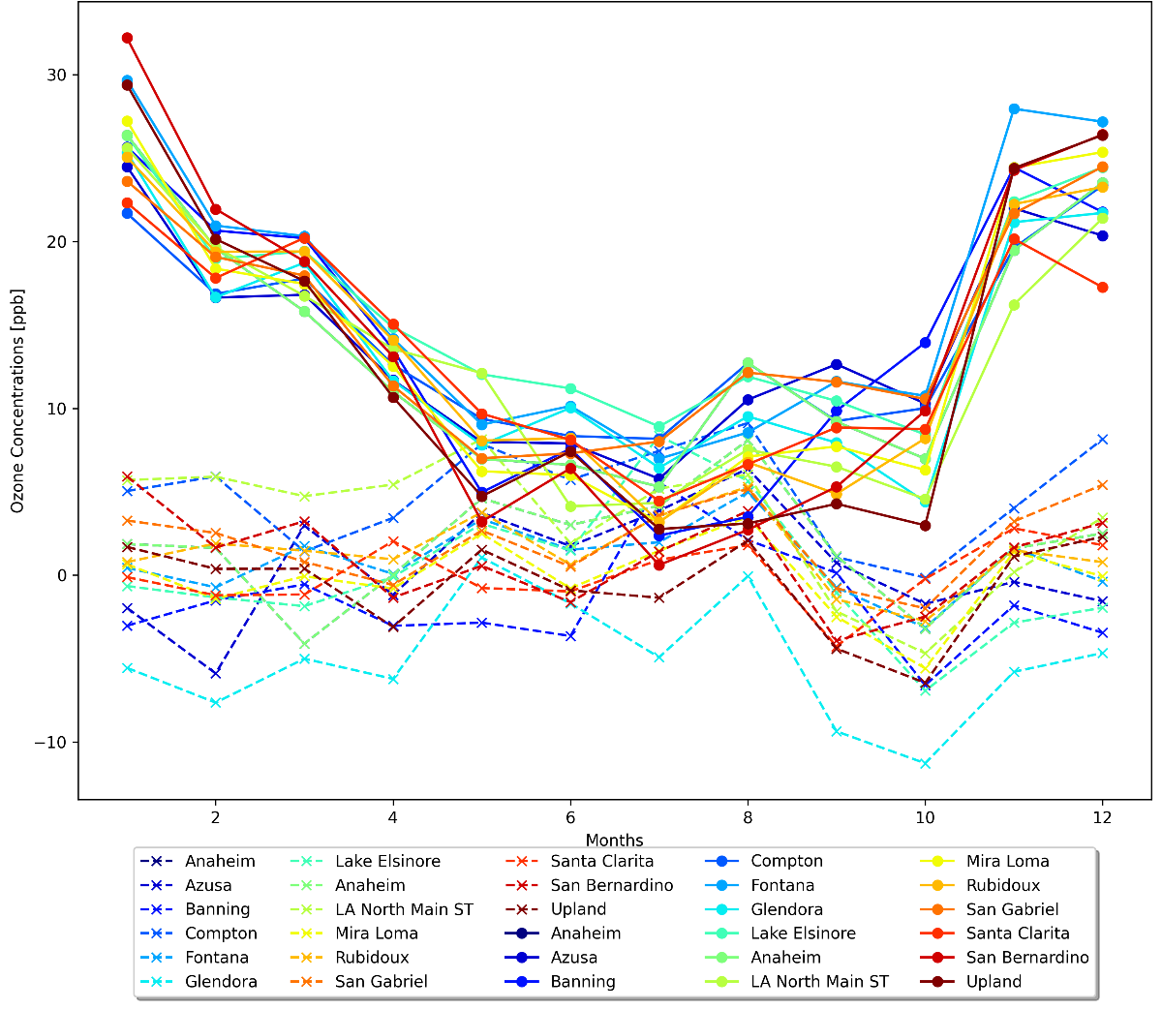
Temporal Evaluation (monthly)
Monthly mean bias computed at 15 sites for 2020. The kriging interpolation method: dash lines; CMAQ simulation: solid lines
MB for kriging interpolation centering around zero
CMAQ simulation overestimated the ozone levels
Seasonal variation has not well represented in CMAQ
O₃ concentrations in the SoCAB
Highest during the summer
Lowest in the winter
Poor CMAQ results could come from the emissions
Notes:
8:38’

Slide 9
Statistical Evaluation
Bicubic R² indicates the poorest performance among the three methods
IDW shows a significant improvement from bicubic interpolation
IDW accounts for the distances between the interpolation points and the data points
Kriging results in the best interpolation method
Accounts for the distance
Considers the variability of data by computing the variance
CMAQ has poor predictions at Los Angeles International Airport (LAX) and Crestline locations
LAX is situated near the the Pacific Ocean
Crestline is 1406 meters above sea level
Sites | Bicubic | IDW | Kriging | CMAQ
LAX | 0.31 | 0.48 | 0.65 | 0.25
Glendora | 0.46 | 0.53 | 0.72 | 0.52
Lake Elsinore | 0.52 | 0.70 | 0.79 | 0.56
San Gabriel | 0.53 | 0.77 | 0.81 | 0.62
Rubidoux | 0.46 | 0.65 | 0.86 | 0.68
Fontana | 0.88 | 0.89 | 0.87 | 0.59
Daily average R² values of 2020 were evaluated at 6 selected sites
Notes:
9:44’

Slide 10
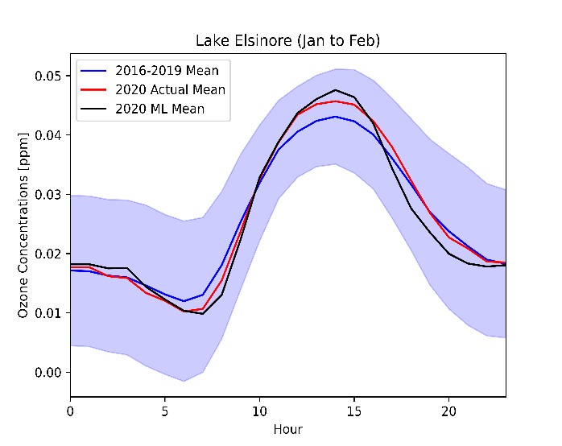
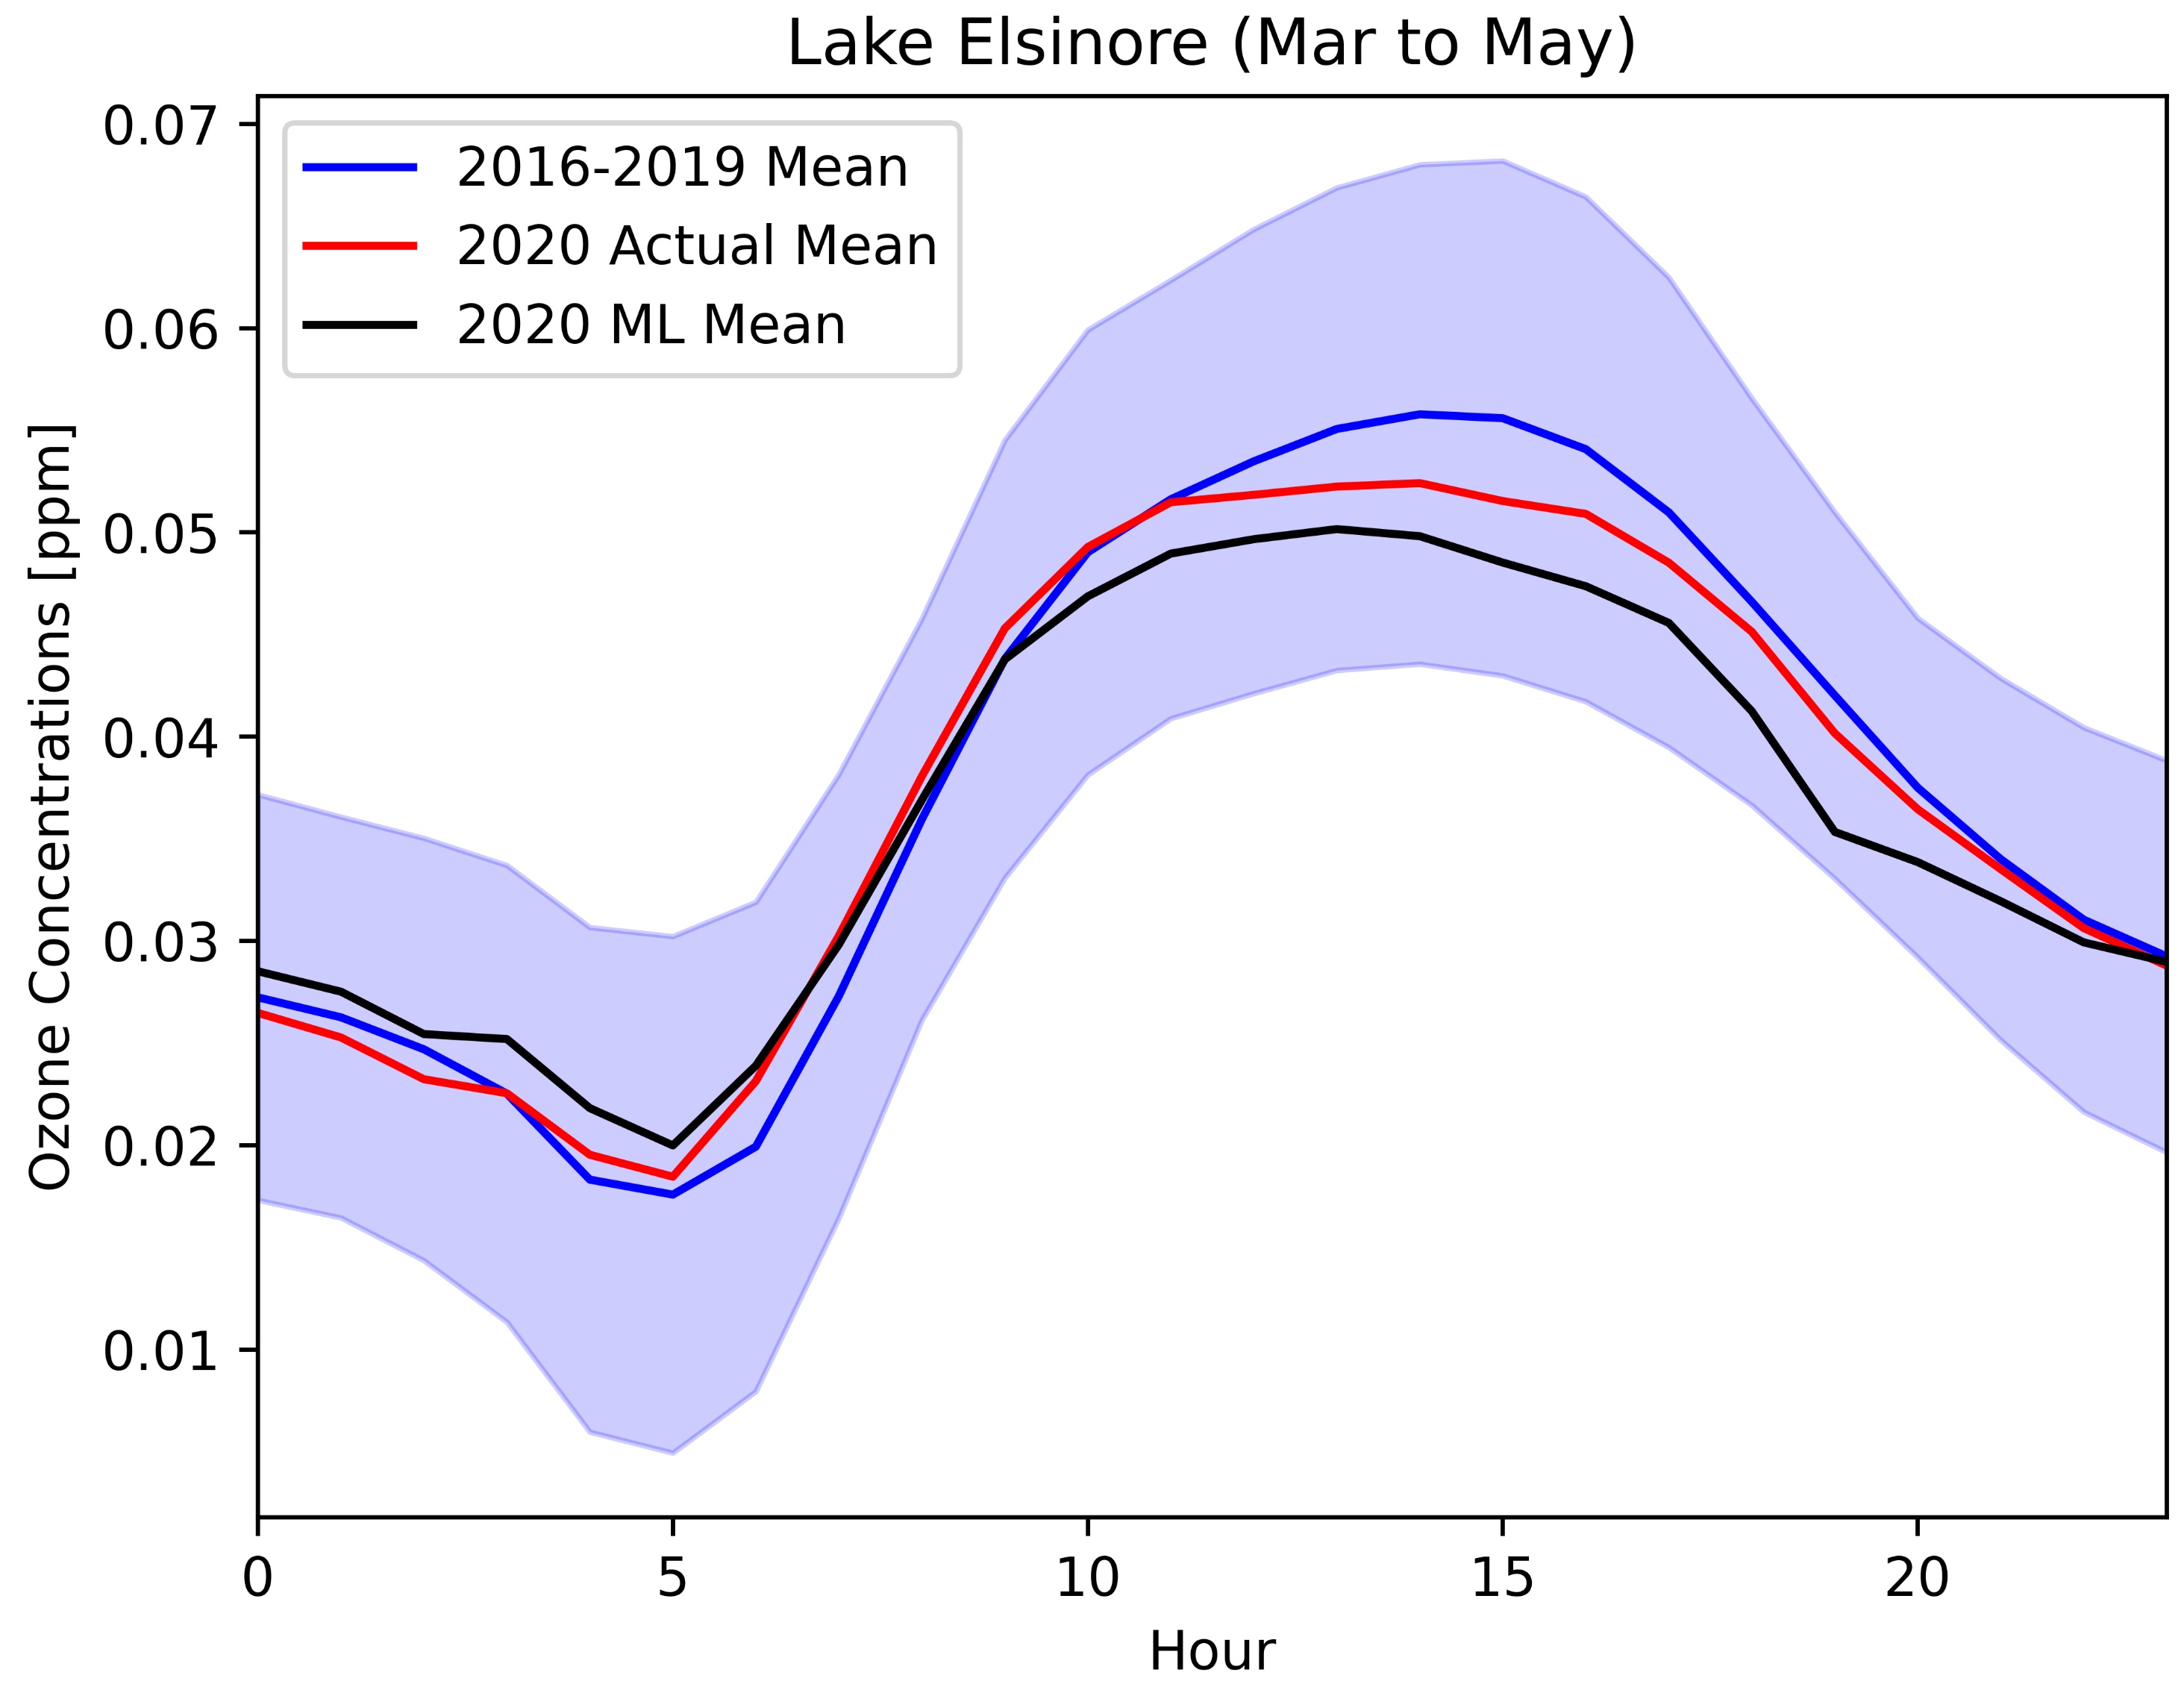
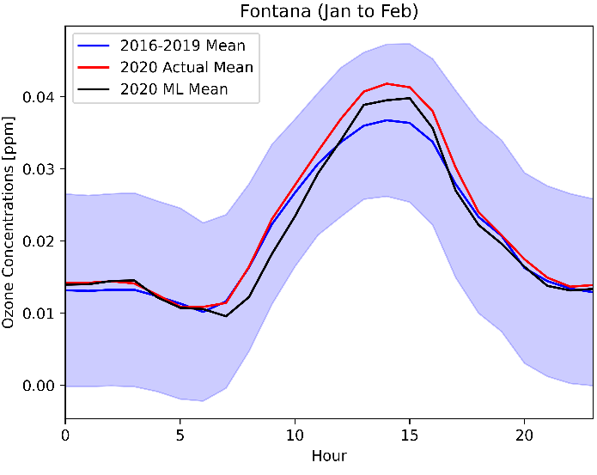
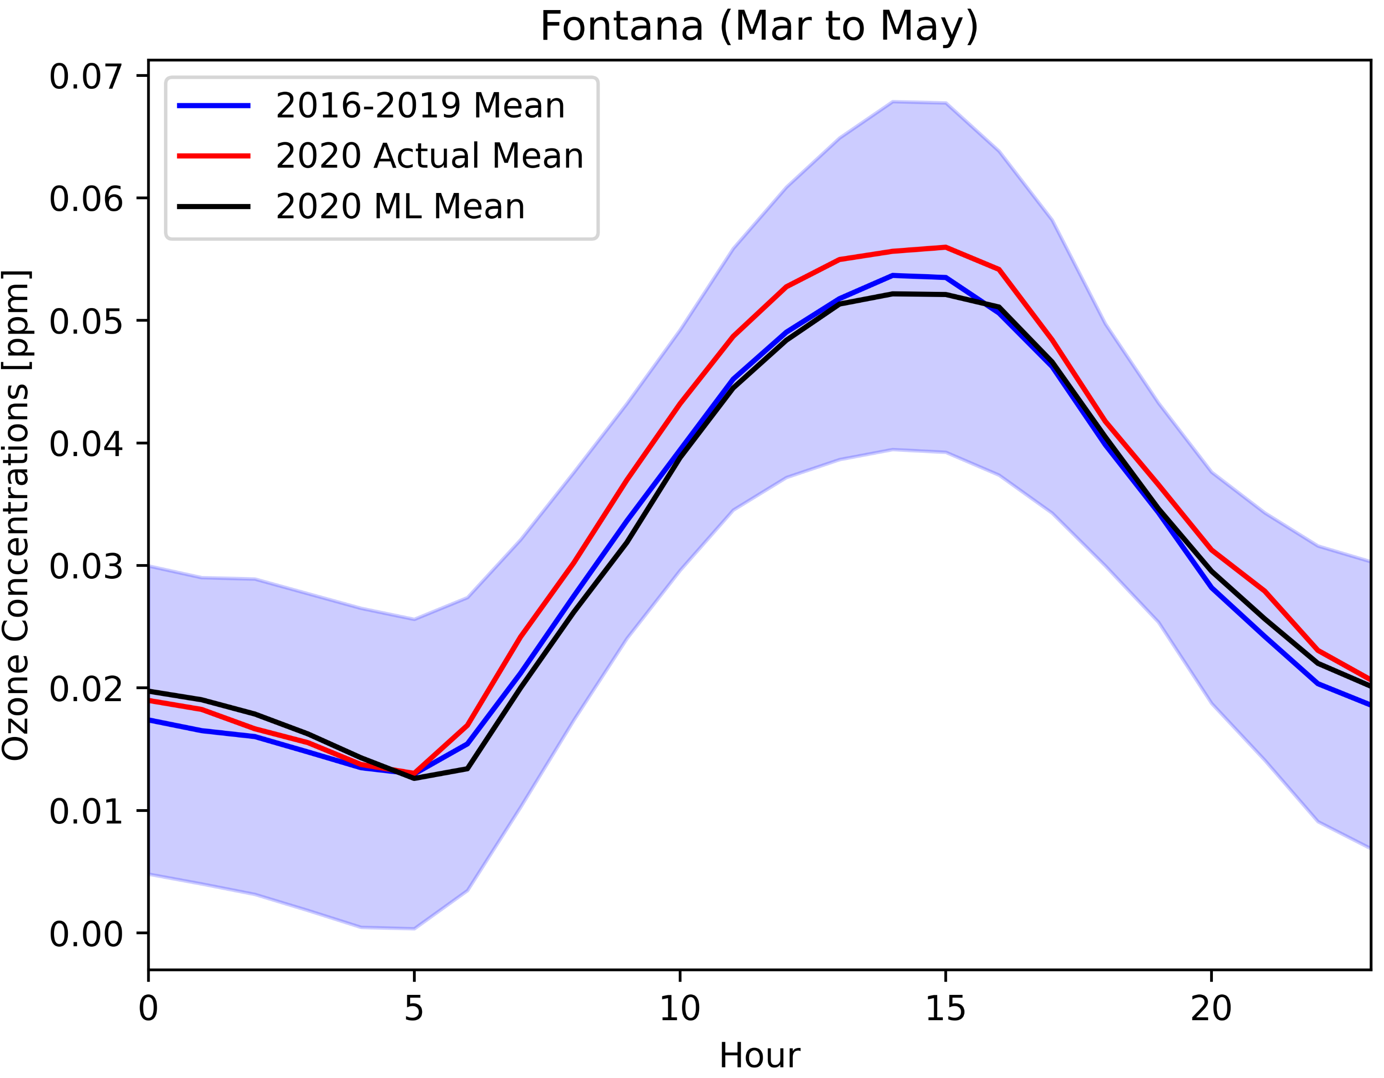
ML Performance during the Lockdown
O₃ Diurnal Profile
Pre-lockdown
During the Lockdown
Lake Elsinore
ML captures the O₃ trends throughout the periods
Lake Elsinore is in a remote area
The results indicate NO_{x}-limited regime
Fontana
ML does not capture O₃ trends during the lockdown
Fontana is an urban site
The results indicate VOC-limited regime
a
c
b
d
Notes:
12:07’

Slide 11
ML or Air Quality Models?
AQMs and ML models serve different purposes
ML with spatial interpolation
Offer a fast and cost-effective approach for sensitivity tests
Focus only for one species
Require quality of data and relevant features
Predict based on historical data
AQMs
Project future O₃ predictions in response to emission controls
Enable greater spatial resolution
Provide simulation data over a large domain
Simulate multiple air pollutant species
Notes:
14:09’

Slide 12
Conclusions
The ML model performs well before and after the lockdown
The ML model struggles to predict O₃ concentrations during the lockdown
There is not a similar pattern in air quality during the lockdown
Train the model with VOC data will improve the results
Policy implications
Fast visualization about NO_{x}- and VOC-limited regimes
Effective control strategies for emission reductions
Complement and support regulatory AQMs
Notes:
15:15’

Slide 13
Acknowledgments
South Coast Air Quality Management District (SCAQMD)
Dr. Armistead G. Russell for supporting the project
Dr. Sang-Mi Lee for supervising the project
Graduate Assistant in Areas of Need (GAANN)

Slide 14
Backup slides

Slide 15
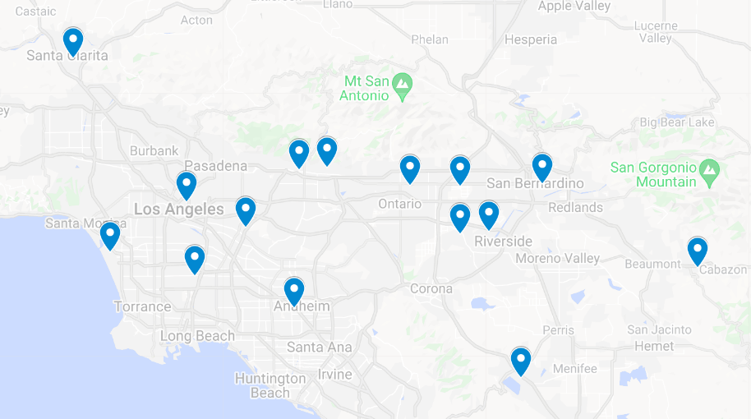
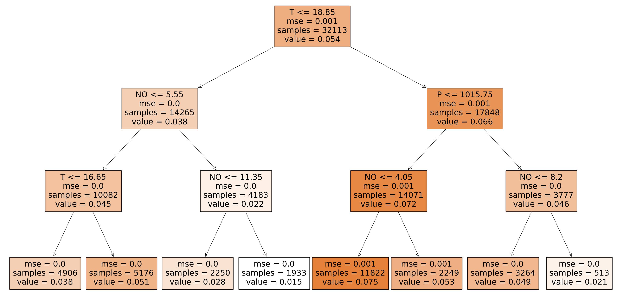
Methods
2-D ozone concentrations
Step 1: used Random Forest Regression (RFR) to predict ozone concentrations at each air monitoring location (15 sites)
Step 2: applied three different spatial interpolation methods (ordinary kriging, inverse distance weighting (IDW), and bicubic interpolation)
Step 3: evaluated interpolated results with 12 additional sites
Figure 3. Data from 15 air monitoring stations (Anaheim, Azusa, Banning, Compton, Fontana, Glendora, Lake Elsinore, LAX, LA North Main Street, Mira Loma, Rubidoux, San Gabriel, Santa Clarita, San Bernardino, Upland) were used for ML model predictions of ozone concentrations.
Figure 4. Three node decision trees based on air quality and meteorological input. The meteorology data is from LAX, and air quality data is from Fontana. The predictions were made based on 12:00 noon to 5:00 PM training data.
Background/
Objective
Methods
Results
Conclusion

Slide 16
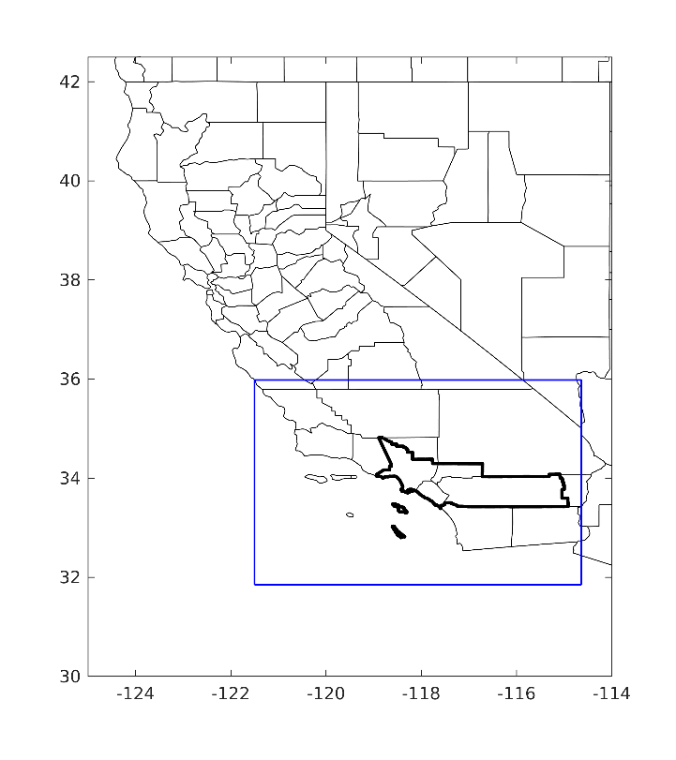
Methods
CMAQ Configurations
North American Mesoscale Forecast System (NAM) with high-resolution SST
4km resolution
2020 emissions were carried out with two-step corrections
2020 emissions were obtained based on 2019 emissions with the AQMD emission projection
$$linear correction factor=\frac{2020 emis−2019 emis}{2019 emis}$$
Correction for traffic reduction due to the pandemic lockdown based on weekly traffic change in 2020 provided from the UCR emission group from Jan 1st to Sep 30th of 2020. Using 2991 observed traffic locations in Southern California to interpolate the emission profiles.
Figure 5: The finest domain (blue lines) with 4 km horizontal resolution covered the entire SCAQMD region (thick black lines).
Background/
Objective
Methods
Results
Conclusion

Slide 17
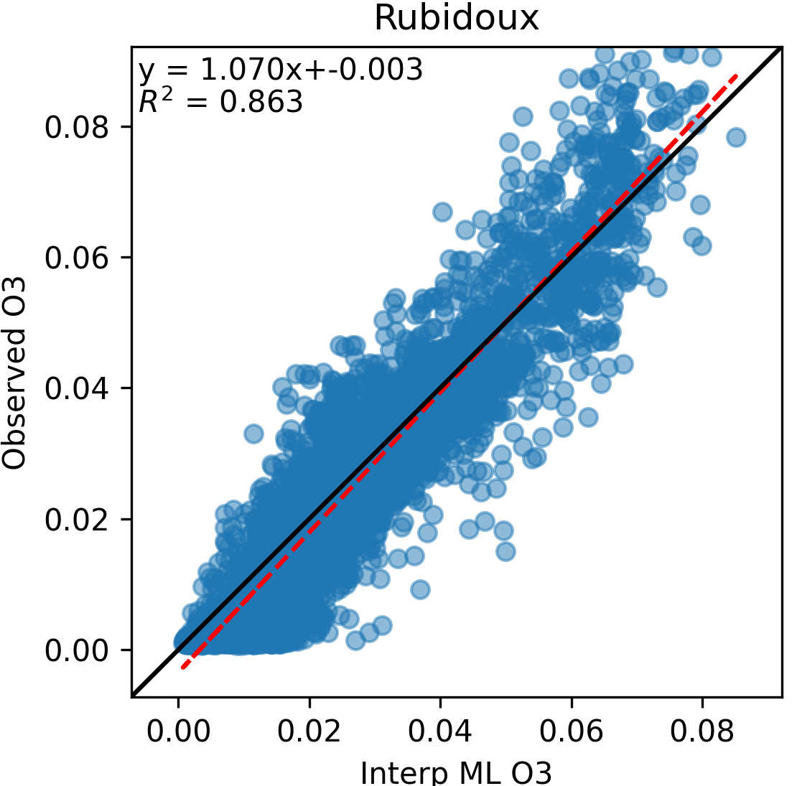
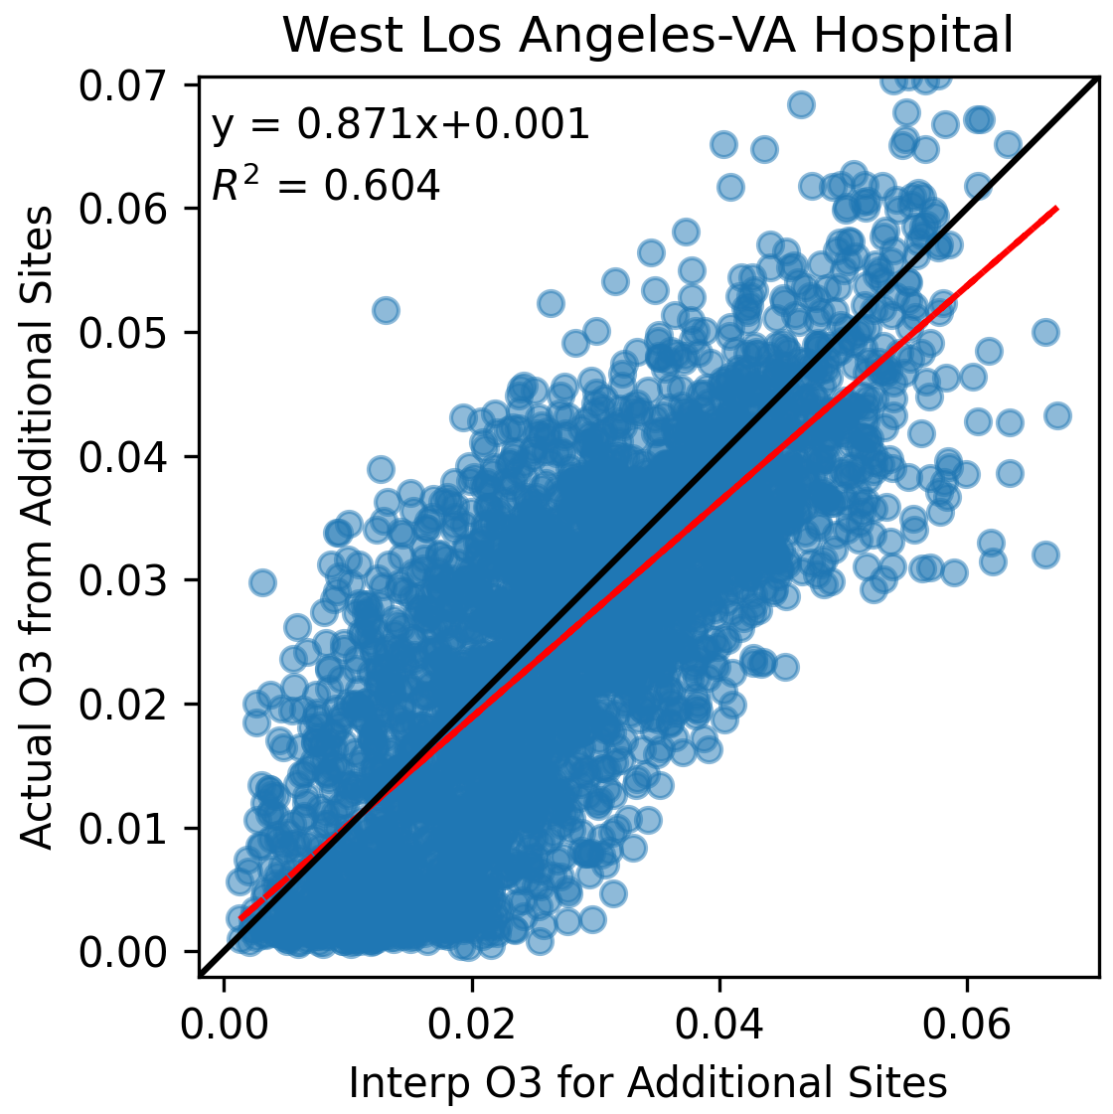
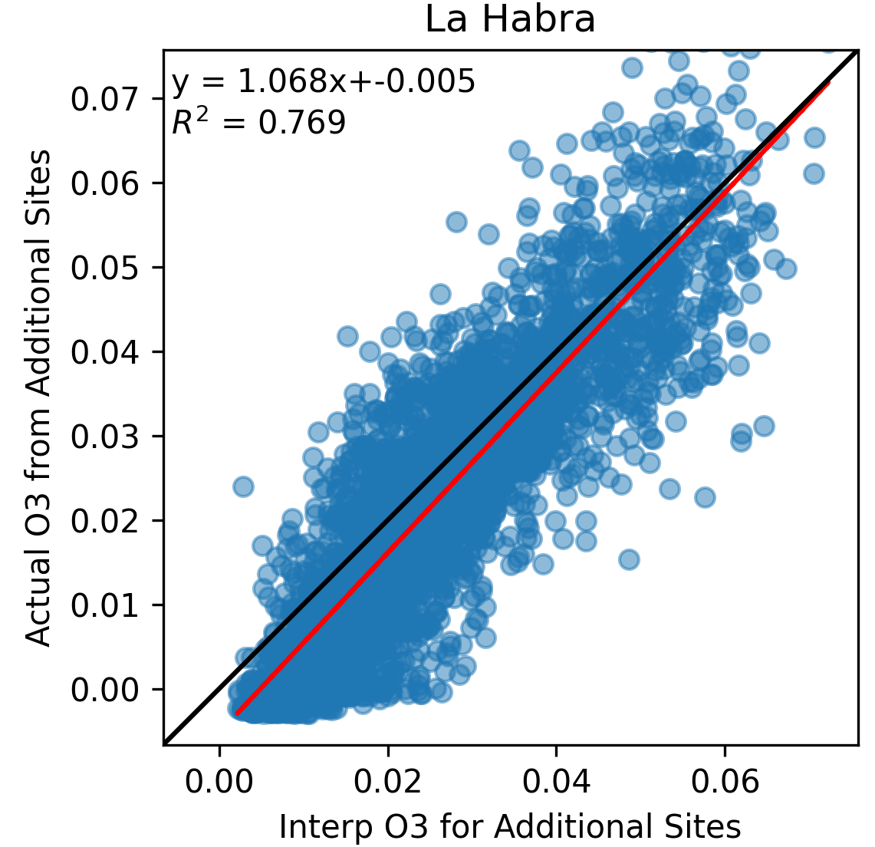
Results and Model Evaluation
Building Sites
Evaluating Sites
Evaluation metrics
15 building sites and 12 evaluation sites
Model performance increases from the West to the East
Predict poorly for Crestline site
LAX is not a function of meteorology
M.B. indicates
Overestimating the building sites
Underestimating the evaluation sites
Evaluation Sites | C.C. | M.B. | R.M.S.E.
Crestline | 0.64 | -0.0122 | 0.020
La Habra | 0.87 | 0.0033 | 0.008
Long Beach | 0.75 | -0.0006 | 0.009
Mission Viejo | 0.69 | -0.0040 | 0.011
North Hollywood | 0.88 | 0.0003 | 0.009
Pasadena | 0.88 | -0.0016 | 0.009
Perris | 0.89 | 0.0031 | 0.009
Pomona | 0.91 | 0.0020 | 0.009
Redlands | 0.84 | -0.0070 | 0.013
Reseda | 0.84 | -0.0042 | 0.011
West LA | 0.77 | 0.0022 | 0.009
Winchester | 0.62 | -0.0051 | 0.013
Building Sites | C.C. | M.B. | R.M.S.E.
Anaheim | 0.85 | 0.0025 | 0.008
Azusa | 0.87 | 0.0007 | 0.009
Banning | 0.85 | -0.0018 | 0.009
Compton | 0.87 | 0.0053 | 0.008
Fontana | 0.93 | 0.0011 | 0.007
Glendora | 0.84 | -0.0045 | 0.010
Lake Elsinore | 0.89 | 0.0002 | 0.007
LAX | 0.80 | 0.0033 | 0.008
LA North Main | 0.88 | 0.0031 | 0.008
Mira Loma | 0.92 | 0.0000 | 0.008
Rubidoux | 0.92 | 0.0014 | 0.007
San Gabriel | 0.89 | 0.0022 | 0.008
Santa Clarita | 0.91 | 0.0003 | 0.008
San Bernardino | 0.92 | 0.0010 | 0.009
Upland | 0.92 | -0.0003 | 0.008
Table 1: Evaluation metrics for 12 evaluation sites.
Table 2: Evaluation metrics for 15 building sites.
Figure 10: Scatter plots for building sites
Figure 11: Scatter plots for evaluation sites
Notes:
To evaluate the model, we computed different evaluation metrics for 15 building sites and 12 evaluation sites. Figure 6 and 7 are scatter plots plotting the predicted ozone concentrations and observation for 4 different locations resulting the high r-square and the slops are closed to 1.
The model performance increases from the West to the East and predicted poorly for Crestline site. Ozone at LAX is not a function of meteorology. From the mean bias, the model was overestimating the ozone concentration for the building sites and underestimating for the evaluation sites.

Slide 18
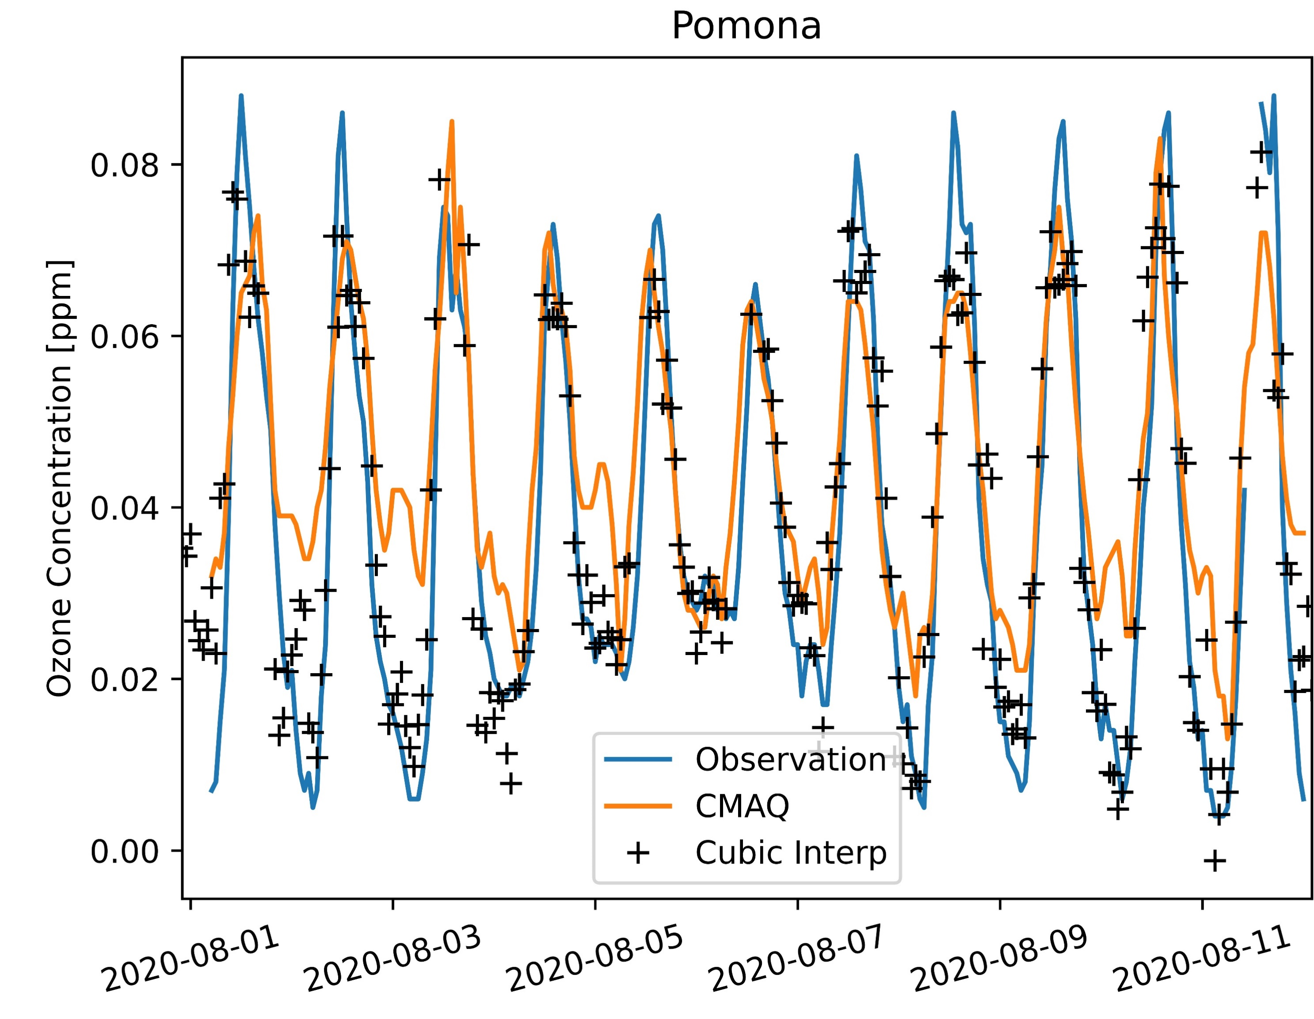
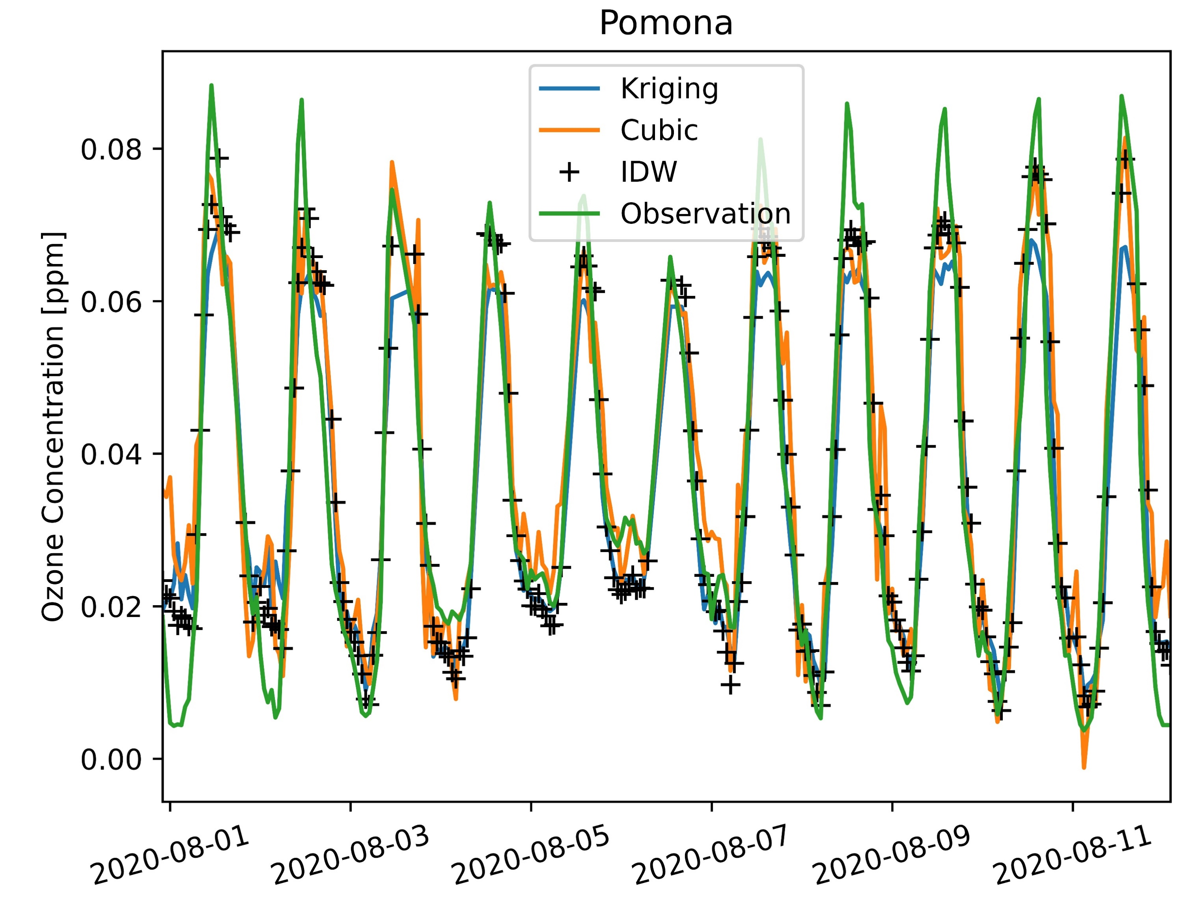
Results and Model Evaluation
2-D interpolation reduced simulation time and provided a high-resolution details of air pollution maps
Cubic interpolation captured extreme peaks of ozone
IDW is localized, significantly influenced by the nearest neighbors
Kriging has better overall performance from statistical benchmark
ML is more consistent than CMAQ
Provide accurate results over the entire simulation period
Capture air quality trends
Figure 12: Time series plotting ozone concentrations for CMAQ model, cubic interpolation, and observation
Figure 13: Time series plotting ozone concentrations for three different interpolation methods (kriging, cubic, and IDW) with observation
WLA VA
WLA VA
WLA VA
Riverside
La Habra
Riverside
La Habra
Riverside
La Habra
Anaheim
Anaheim
Anaheim
Figure 14: Hourly ozone heatmap (@16pm June 22, 2020) using kriging interpolation
Figure 15: Hourly ozone heatmap (@16pm June 22, 2020) using cubic interpolation
Figure 16: Hourly ozone heatmap (@16pm June 22, 2020) using IDW interpolation
Notes:
This slide compares different interpolation methods. Figure 7 is the time series plotting the ozone concentrations for CMAQ (orange line), cubic interpolation (black marker), and observation (blue line). By observation, cubic interpolation performed better. Figure 7 comparing three different interpolation methods, kriging, cubic, and IDW.
Figure 9, 10, 11 show the heatmap generated by interpolation. Cubic was able to capture the extreme peaks of air pollution. IDW is localized and significantly influenced by the nearest neighbors. Kriging has better overall performance from statistical benchmark.

Slide 19
Statistical evaluation
Sites | Bicubic | IDW | Kriging | CMAQ
Anaheim | 0.66 | 0.67 | 0.74 | 0.41
Azusa | 0.52 | 0.64 | 0.77 | 0.59
Banning | 0.17 | 0.46 | 0.73 | 0.26
Compton | 0.65 | 0.67 | 0.77 | 0.48
Fontana | 0.88 | 0.89 | 0.87 | 0.59
Glendora | 0.46 | 0.53 | 0.72 | 0.52
Lake Elsinore | 0.52 | 0.70 | 0.79 | 0.56
LA North Main ST | 0.36 | 0.67 | 0.78 | 0.48
LAX | 0.31 | 0.48 | 0.65 | 0.25
Mira Loma | 0.56 | 0.71 | 0.86 | 0.67
Rubidoux | 0.46 | 0.65 | 0.86 | 0.68
San Bernardino | 0.68 | 0.85 | 0.86 | 0.67
San Gabriel | 0.53 | 0.77 | 0.81 | 0.62
Santa Clarita | 0.27 | 0.72 | 0.84 | 0.61
Upland | 0.76 | 0.80 | 0.86 | 0.61
Bicubic R² indicates the poorest performance between the three interpolation methods
IDW shows a significant improvement from bicubic interpolation. Since IDW accounts for the distances between the interpolation points and the data points
Kriging resulted in the best interpolation method. Kriging accounts for the distance and considers the variability of data by computing the variance.
CMAQ gave poor predictions on LAX and Crestline locations. LAX is influenced by the Pacific Ocean and Crestline is 1406 meters above sea level.
Daily average R² values of 2020 were evaluated at 15 sites used for interpolation points for three interpolation methods. The R² for CMAQ was computed using the five highest ozone months from May to September 2020.

Slide 20
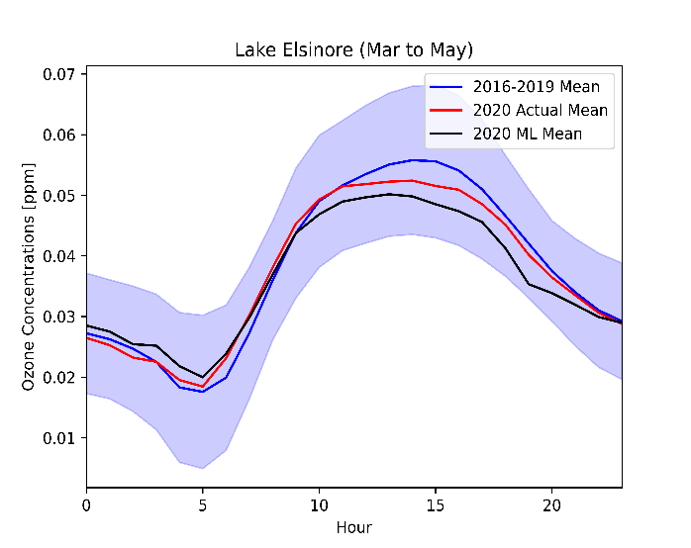
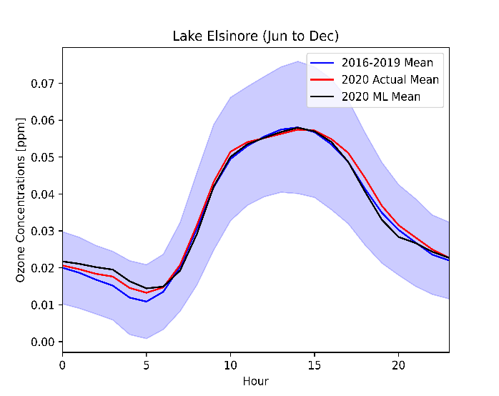
Results
a
b
c
Averaged diurnal profiles of 2016 - 2019 (blue), actual 2020 (red), and ML predicted 2020 (black) ozone concentrations (ppm) at Lake Elsinore for three different periods: (a) pre-lockdown (Jan to Feb), (b) lockdown (Mar to May), and (c) post-lockdown (after May). The shaded area is the standard deviation of the 2016 - 2019 measurements.
Ozone concentrations at Lake Elsinore were lower during the lockdown and back to normal after the lockdown
ML captured the ozone trends throughout the periods
Lake Elsinore is from remote area
The results indicate NOx limited regime
Background/
Objective
Methods
Results
Conclusion

Slide 21
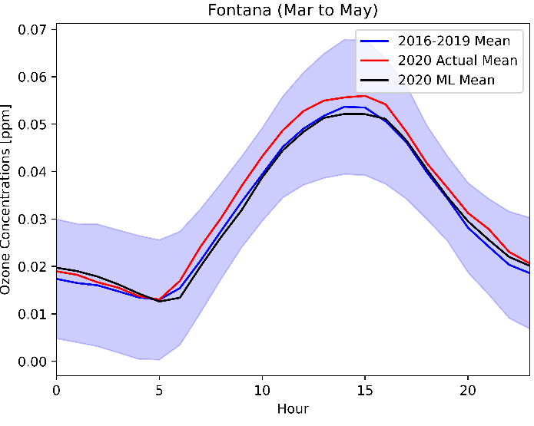
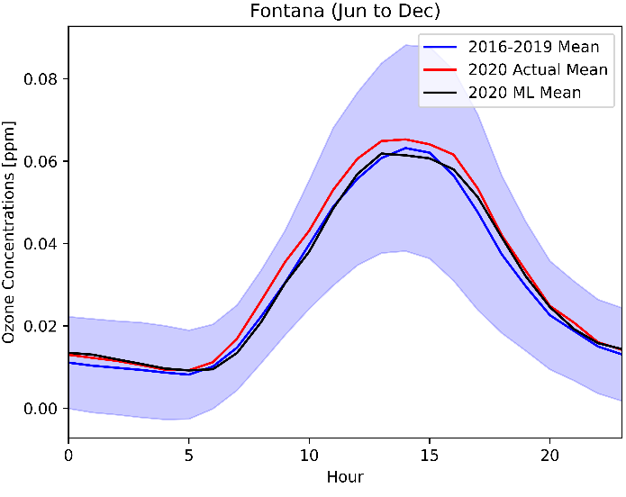
Results
a
b
c
Averaged diurnal profiles of 2016 - 2019 (blue), actual 2020 (red), and ML predicted 2020 (black) ozone concentrations (ppm) at Fontana for three different periods: (a) pre-lockdown (Jan to Feb), (b) lockdown (Mar to May), and (c) post-lockdown (after May). The shaded area is the standard deviation of the 2016 - 2019 measurements.
Ozone concentrations at Fontana were higher during the lockdown and did not back to normal after the lockdown
ML did not capture the ozone trends during and after the lockdown periods
Fontana site is an urban site
The results indicate VOC limited regime
Background/
Objective
Methods
Results
Conclusion

Slide 22
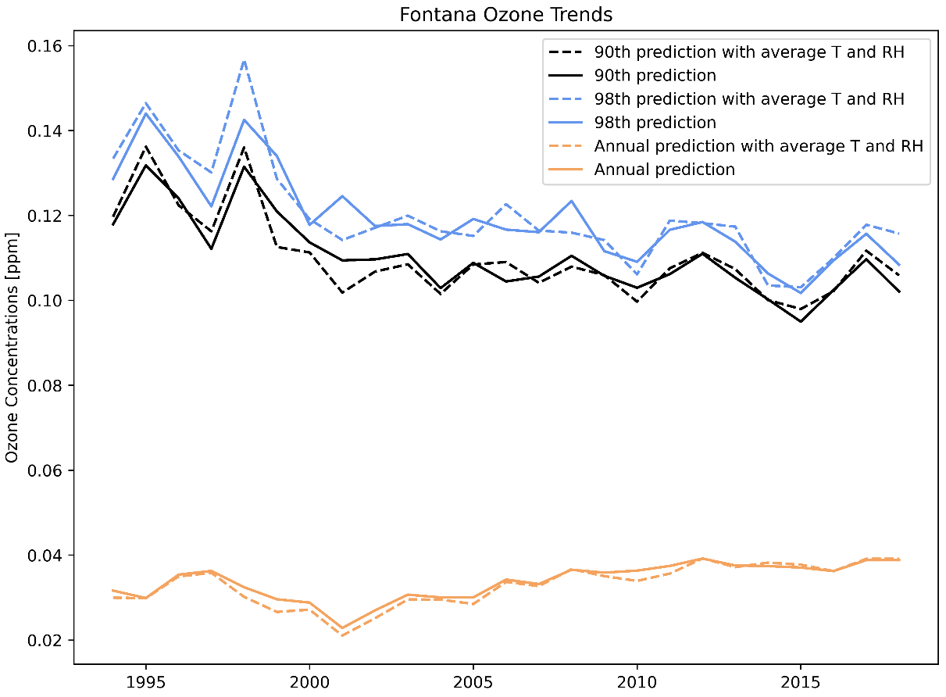
Effects of Meteorology
ML model easily predicts changes of the target (ozone) label with a perturbation of input features
Minimizing the effects of heat waves or foggy days by averaging T and RH from 1994 to 2018
Adjusted line shows a strong downward ozone trend from 1994 to 2010 but resisting further decrease
Meteorology has a minor effect on the annual average
Fontana ozone trends for 90th (black), 98th (blue) percentile, and annual average (orange). The dash lines were predicted with hourly average temperature and RH from 1994 to 2018. The solid lines were predicted with actual values. (Do et al., Environmental Science: Atmospheres, Under Revision)

Slide 23
Machine learning methods
NO₂, NO, temperature, RH, wind speed, wind direction, ozone
Training years from 2009 – 2019 and evaluating year is 2020
15 sites were predicted using ML, and a 2-D ozone heat map was constructed using interpolation based on 15 ML sites
Training sites | Anaheim, Azusa, Banning, Compton, Fontana, Glendora, Lake Elsinore, LAX, LA North Main Street, Mira Loma, Rubidoux, San Gabriel, Santa Clarita, San Bernardino, Upland
Features | NO₂, NO, temperature, relative humidity, wind speed, wind direction
Label | Ozone
Data sources | EPA AQS data mart, CARB AQMIS
Training years | 2009, 2010, 2016, 2017, 2018, 2019
Evaluation year | 2020
Data summary for machine learning modeling

