Slide 1
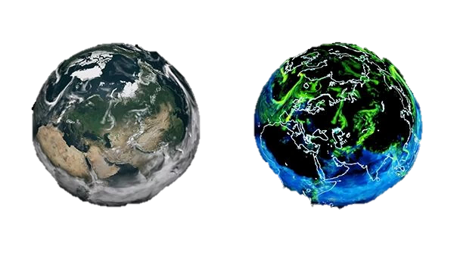
Deep Learning based Digital Twin for Simulating CMAQ surface NO₂ Levels over the CONUS Ahmed K. Salman, Yunsoo Choi, Jincheol Park, Seyedali Mousavinezhad, Mahsa Payami, Mahmoudreza Momeni, Masoud Ghahremanloo University of Houston

Slide 2
Introduction to Digital Twin
Objective of Digital Twin is to simulate CMAQ NO₂ concentration across CONUS
Accelerate simulation of CMAQ NO₂ surface concentration
Derive emission sensitivities from Digital Twin in order of CMAQ DDM
Accelerate Inverse modeling of emission inventory

Slide 3
Sub-set of CMAQ Input for Digital Twin
Category | Abbreviation | Variable name | Unit
SMOKE | NO | Nitric oxide emission | moles/s
SMOKE | NO2 | Nitrogen dioxide emission | moles/s
SMOKE | HONO | Nitrous acid emission | moles/s
SMOKE | VOC_INV | Total volatile organic compounds emission | moles/s
MCIP | PRSFC | Surface pressure | pascal
MCIP | TEMP2 | 2-m Temperature | K
MCIP | WSPD10 | 10-m wind speed | m/s
MCIP | WDIR10 | 10-m wind direction | degrees
MCIP | RGRND | Solar radiation reaching the surface | watts/m²
MCIP | Q2 | Mixing ratio At 2-m | kg/kg
MCIP | PBL | Planetary boundary level height | m
MCIP | RN | Nonconvective Pcpn per Met Tstep | cm
MCIP | RC | Convective Pcpn Per Met Tstep | cm
LULC | HGT_M | Terrain elevation | m
LULC | URBANDEV | Urban development | -
LULC | ALBEDO12M | Surface albedo | -
LULC | GREENFRAC | Green fraction | -
LULC | LANDMASK | Land-water mask | -
Total 18 channels of inputs are fed to Digital Twin

Slide 4
Digital Twin grid-discretization
Discretized CONUS grid into 768 x 768 km² sub-grids
Addresses GPU memory allocation issue while training Digital Twin
Augments the training data and prevents model overfitting
Spatial resolution: 12 km Temporal resolution: 1 hour

Slide 5
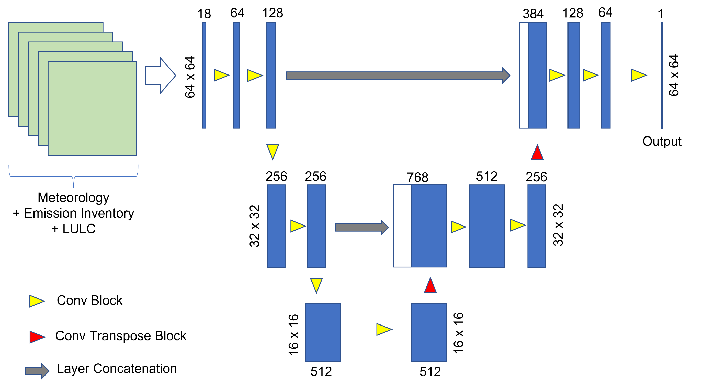
Digital Twin U-Net architecture
Train period: Summer 2011 & 2014
Test period: Summer 2017

Slide 6
Digital Twin 3-fold monthly cross-validation (NO₂ estimation)
Train period (2011, 2014, 2017) | Test period (2011, 2014, 2017) | Correlation | IOA | MAE (ppb) | SMAE
July & August | June | 0.979 | 0.989 | 0.22 | 0.151
June & August | July | 0.981 | 0.99 | 0.214 | 0.147
June & July | August | 0.978 | 0.988 | 0.22 | 0.151
 |  | 0.979 | 0.989 | 0.218 | 0.15
Digital Twin performance on our Test-case
Train period (Summer) | Test period (Summer) | Correlation | IOA | MAE (ppb) | SMAE
2011 & 2014 | 2017 | 0.949 | 0.974 | 0.228 | 0.211
Performance of model is higher when test period is closer to the training period
Evaluating model on a test dataset with a gap of 3 years is challenging (data shift)

Slide 7
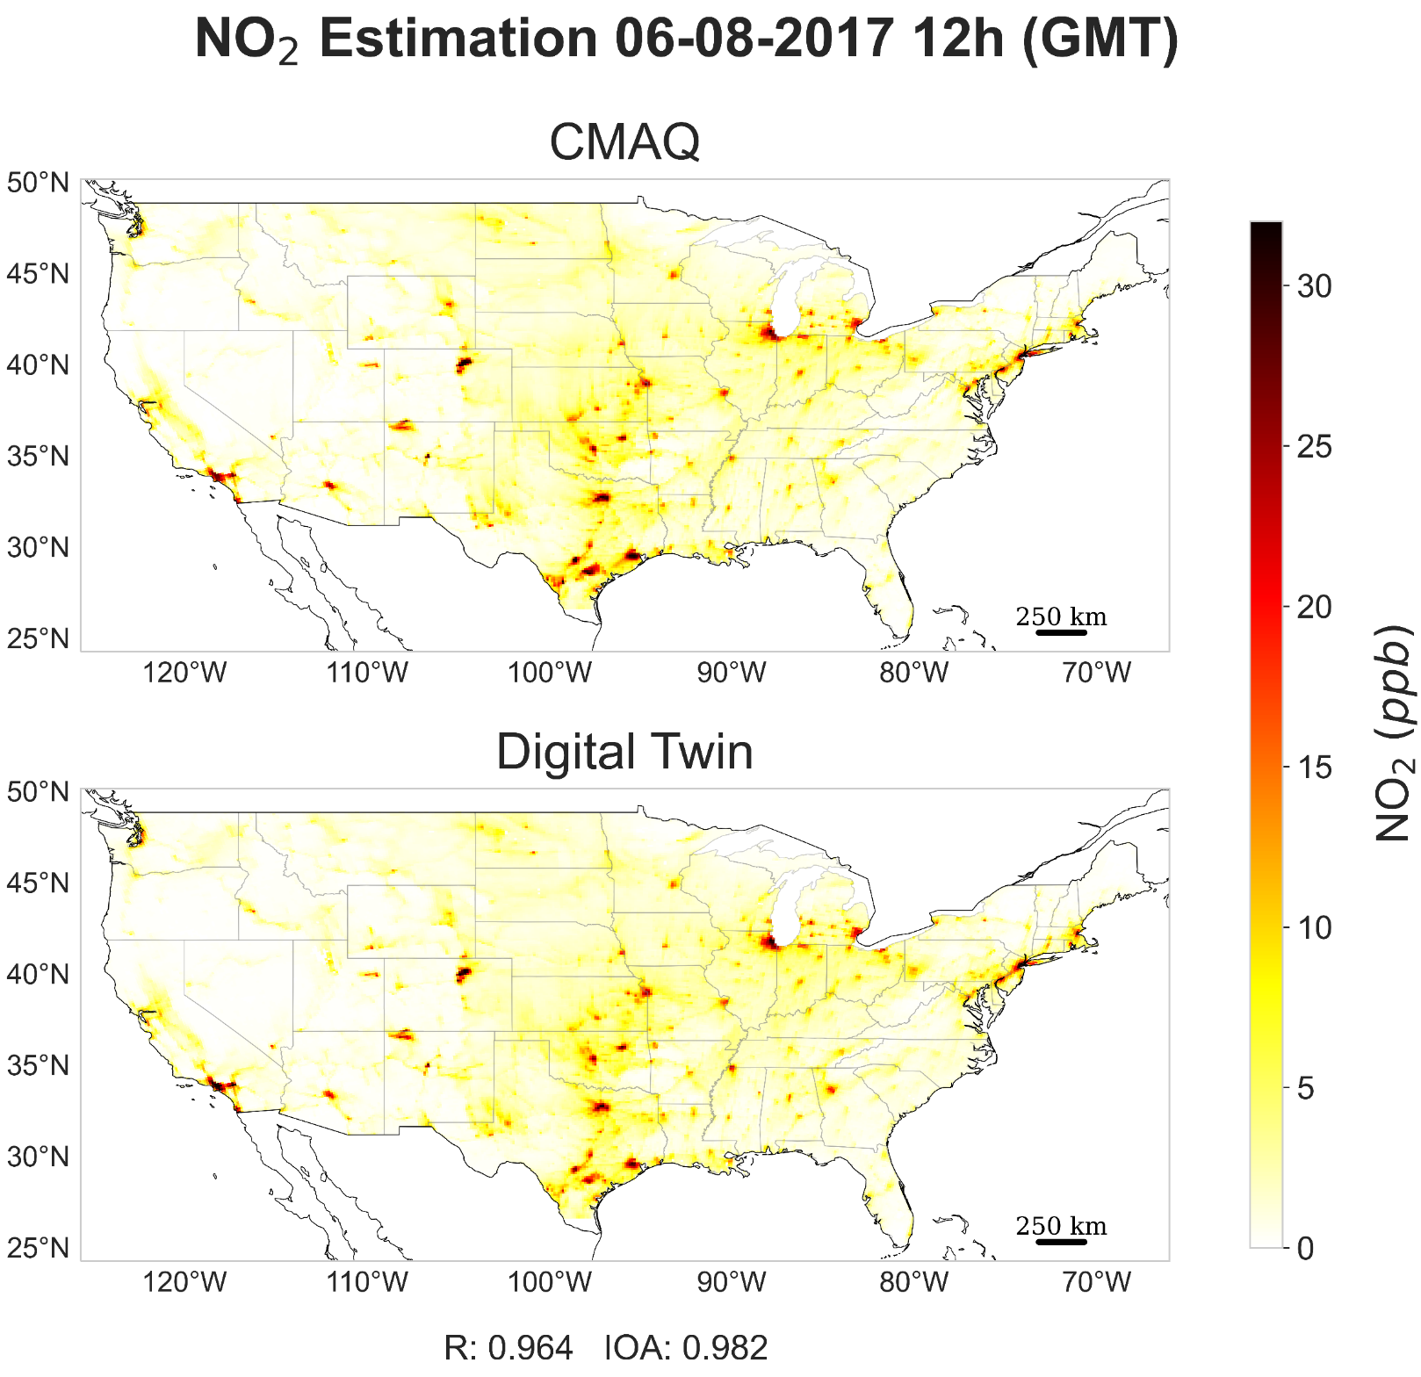
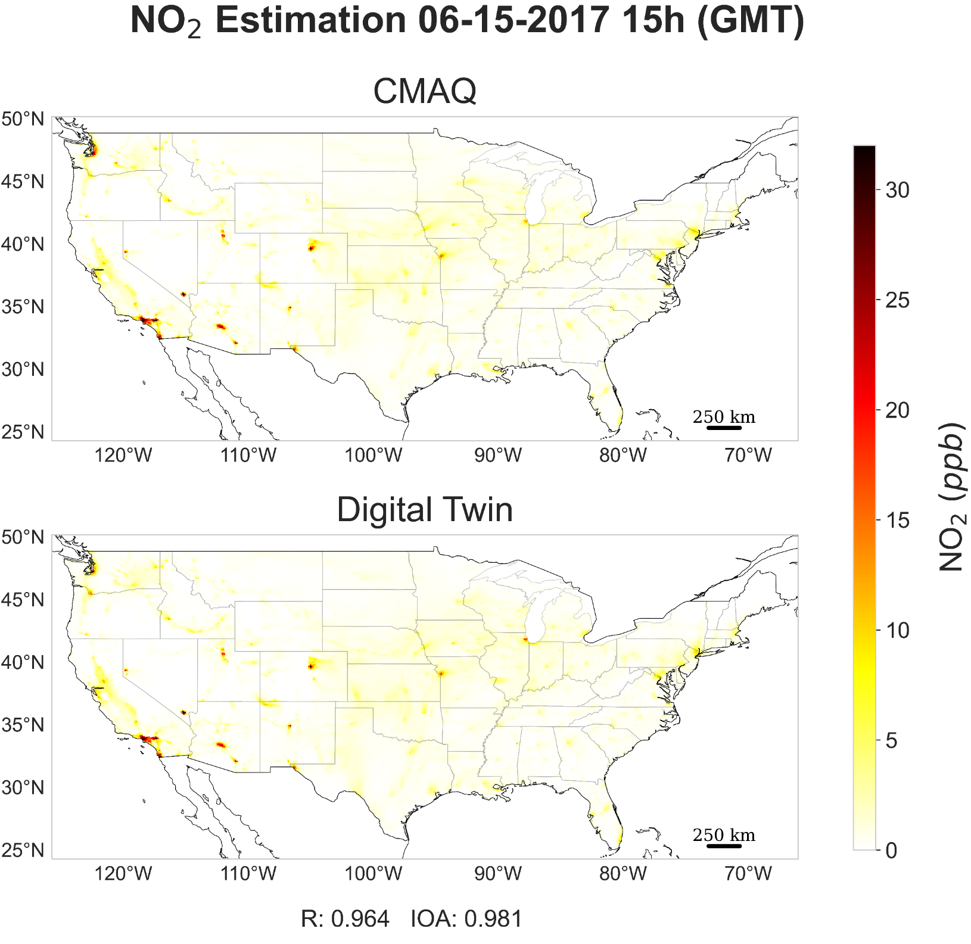
Sample Digital Twin estimation across US

Slide 8
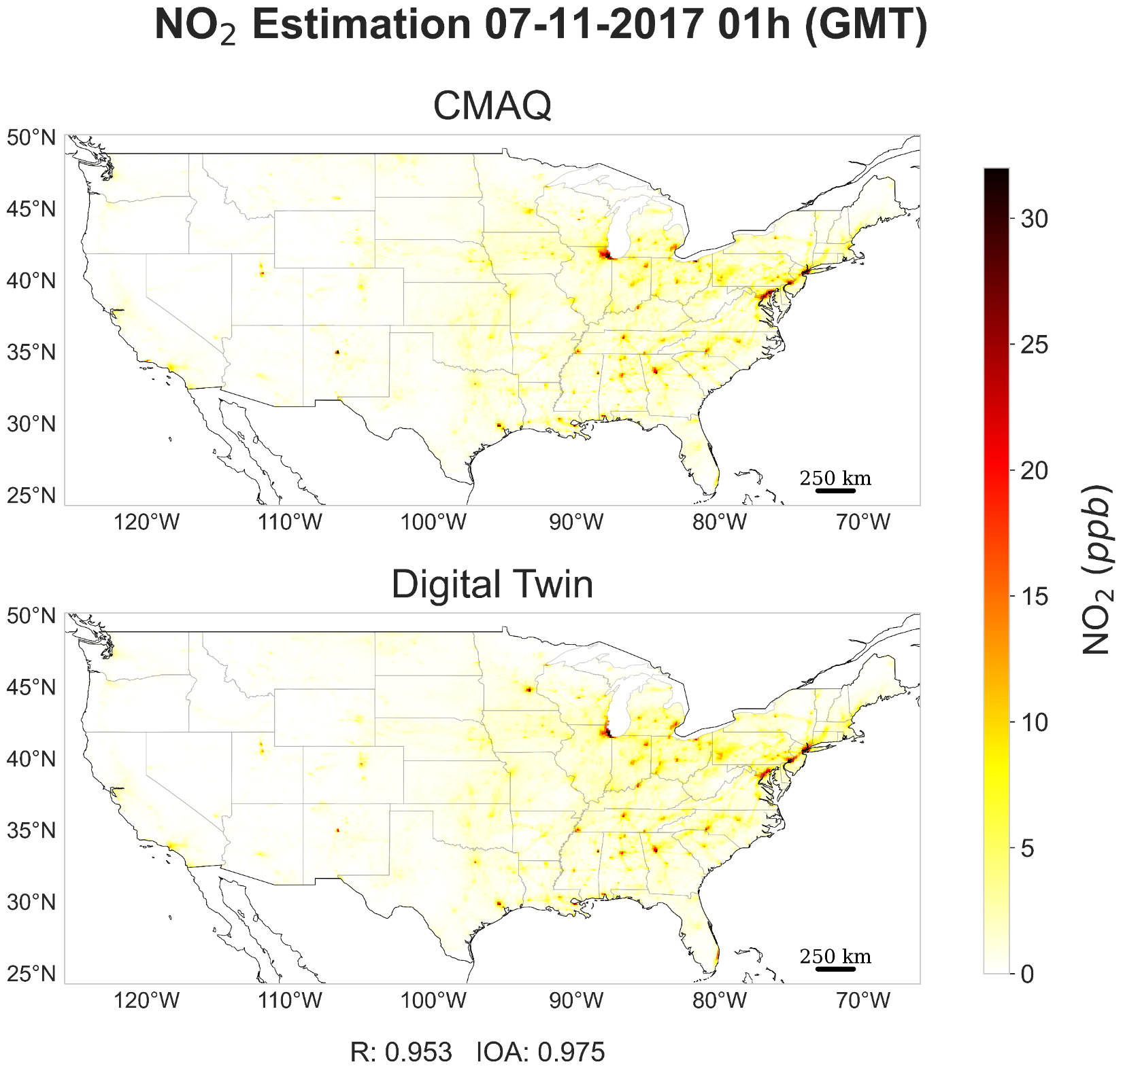
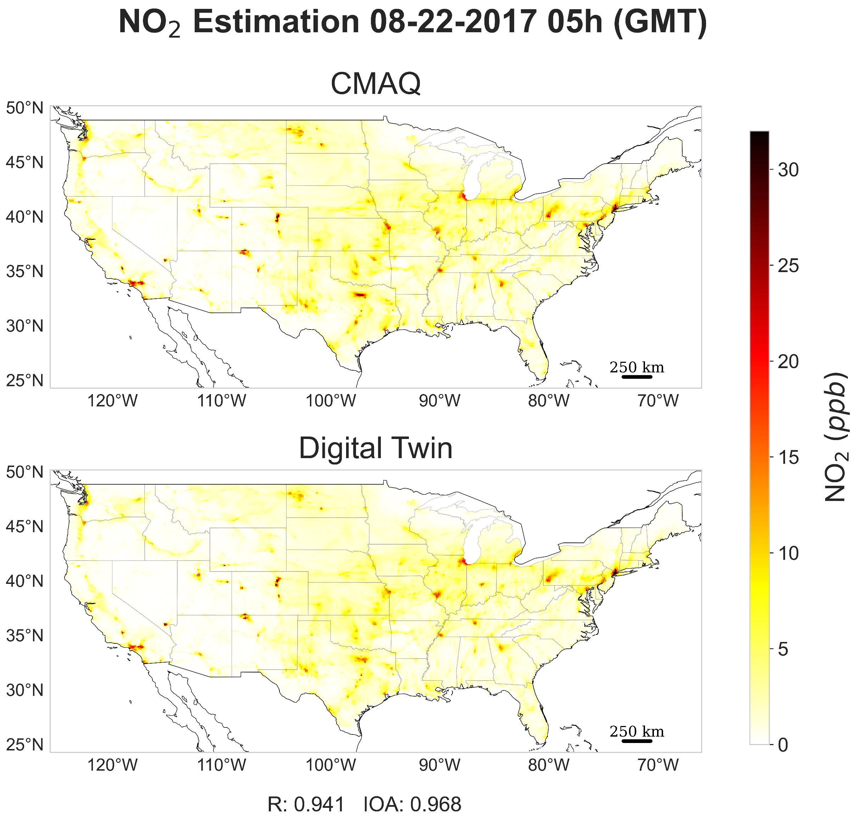
Sample Digital Twin estimation across US

Slide 9
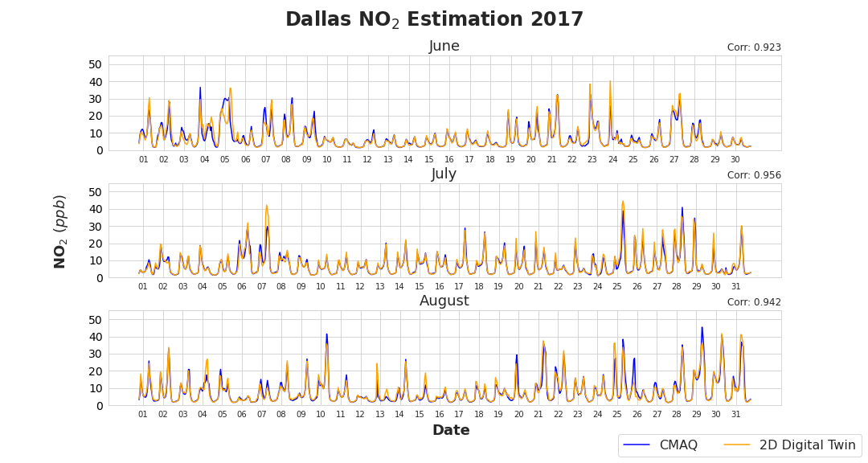
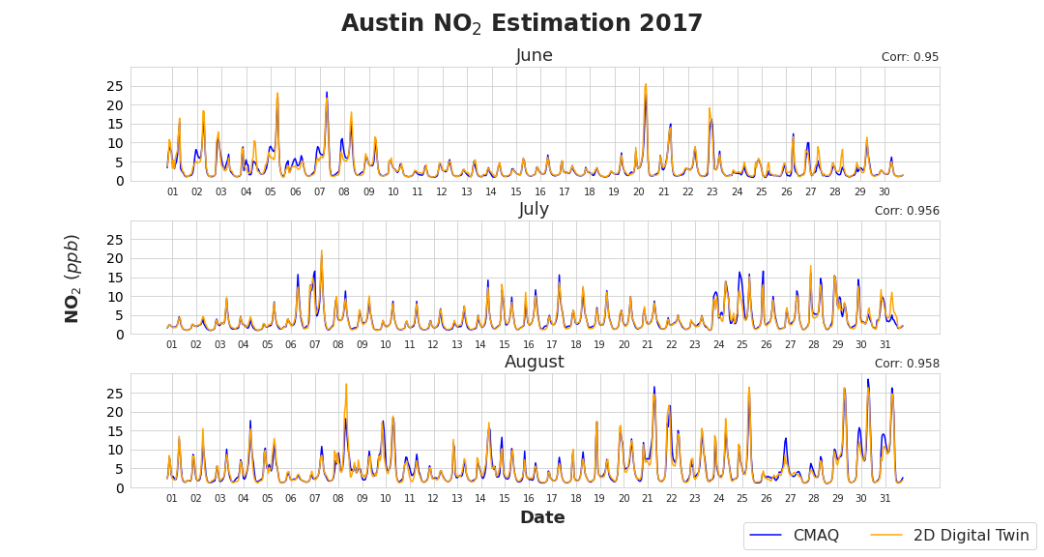
Sample Hourly NO₂ time-series

Slide 10
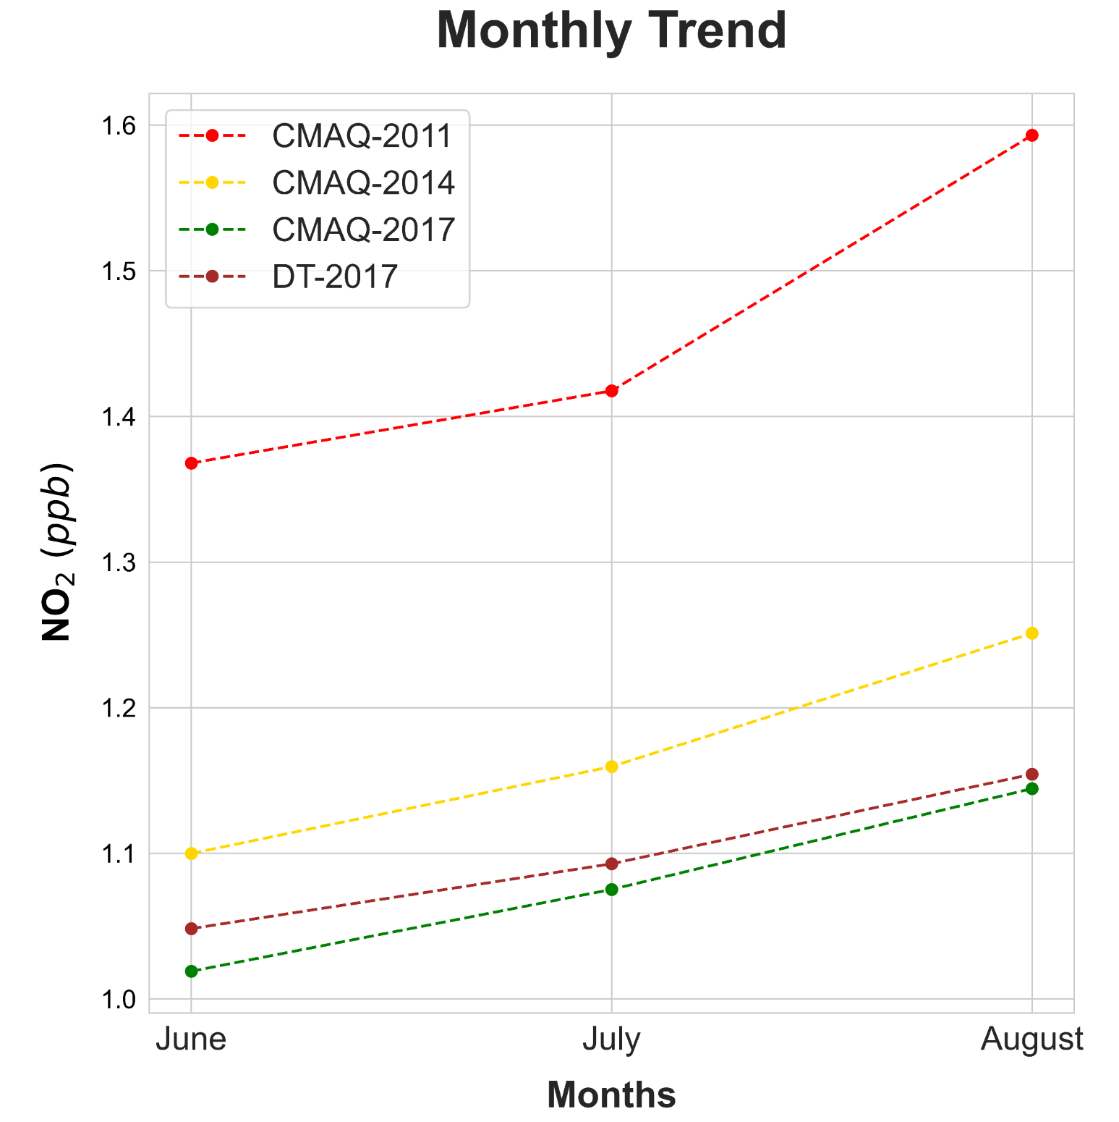
Digital Twin Monthly Performance
2017 | CMAQ STD (ppb) | Mean Bias (ppb) | MAE (ppb) | NMAE
June | 1.651 | 0.029 | 0.218 | 0.214
July | 1.643 | 0.018 | 0.22 | 0.205
August | 1.816 | 0.01 | 0.245 | 0.214
NO₂ conc. reduced from 2011 to 2017
Digital Twin generally overestimates, inherited bias from training data
MAE in August is relatively higher due to higher variance in NO₂ conc.

Slide 11
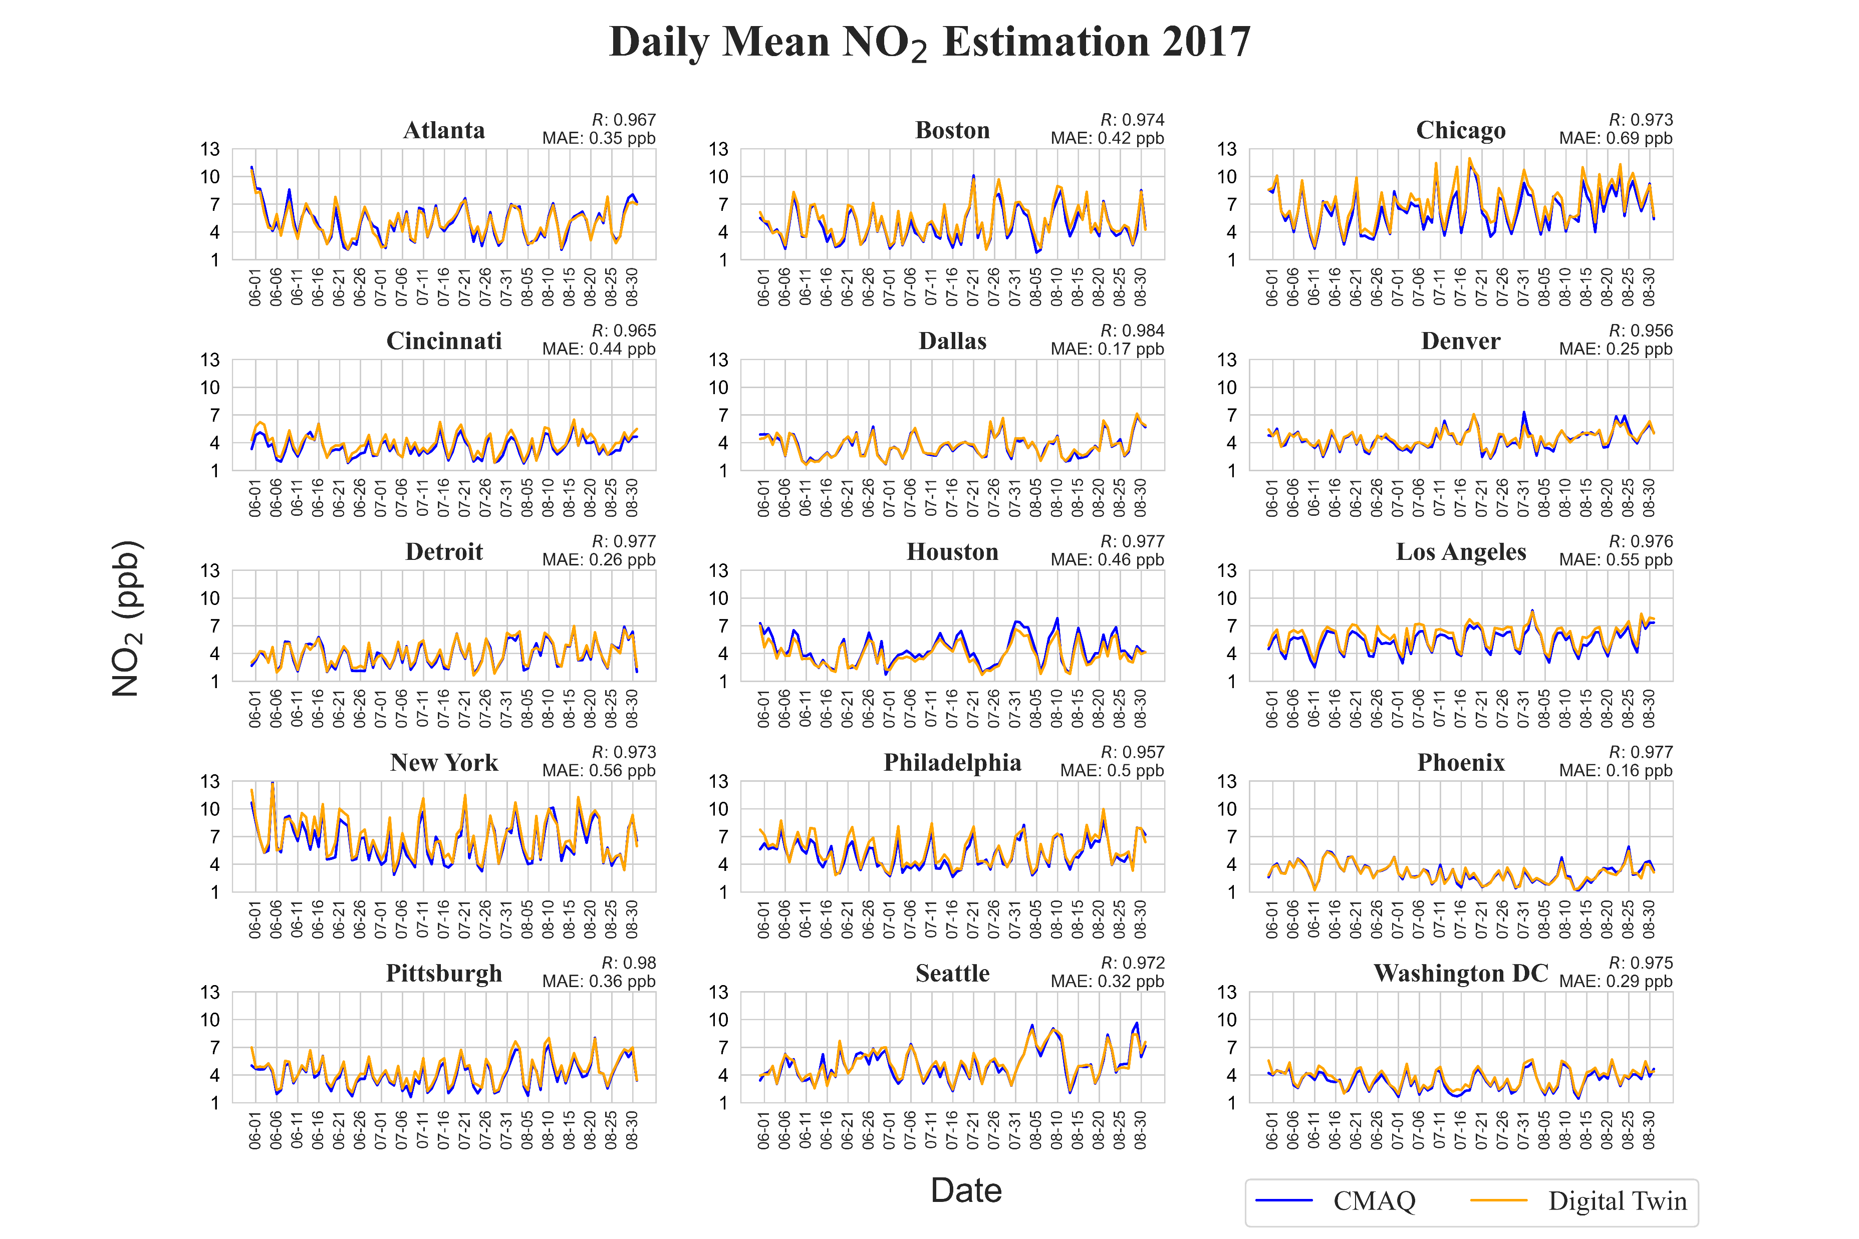

Slide 12
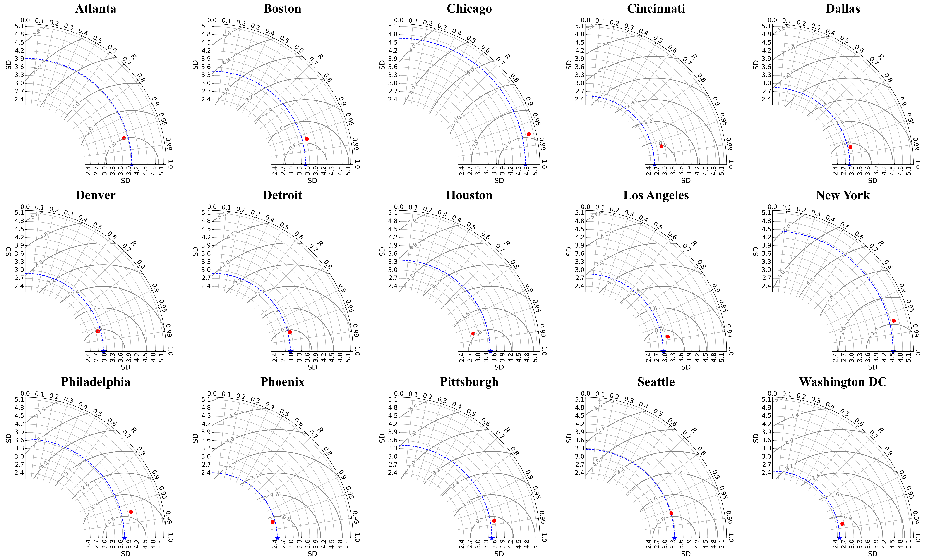
Taylor Diagram of Simulated Hourly NO₂ Spatially Averaged across Cities

Slide 13
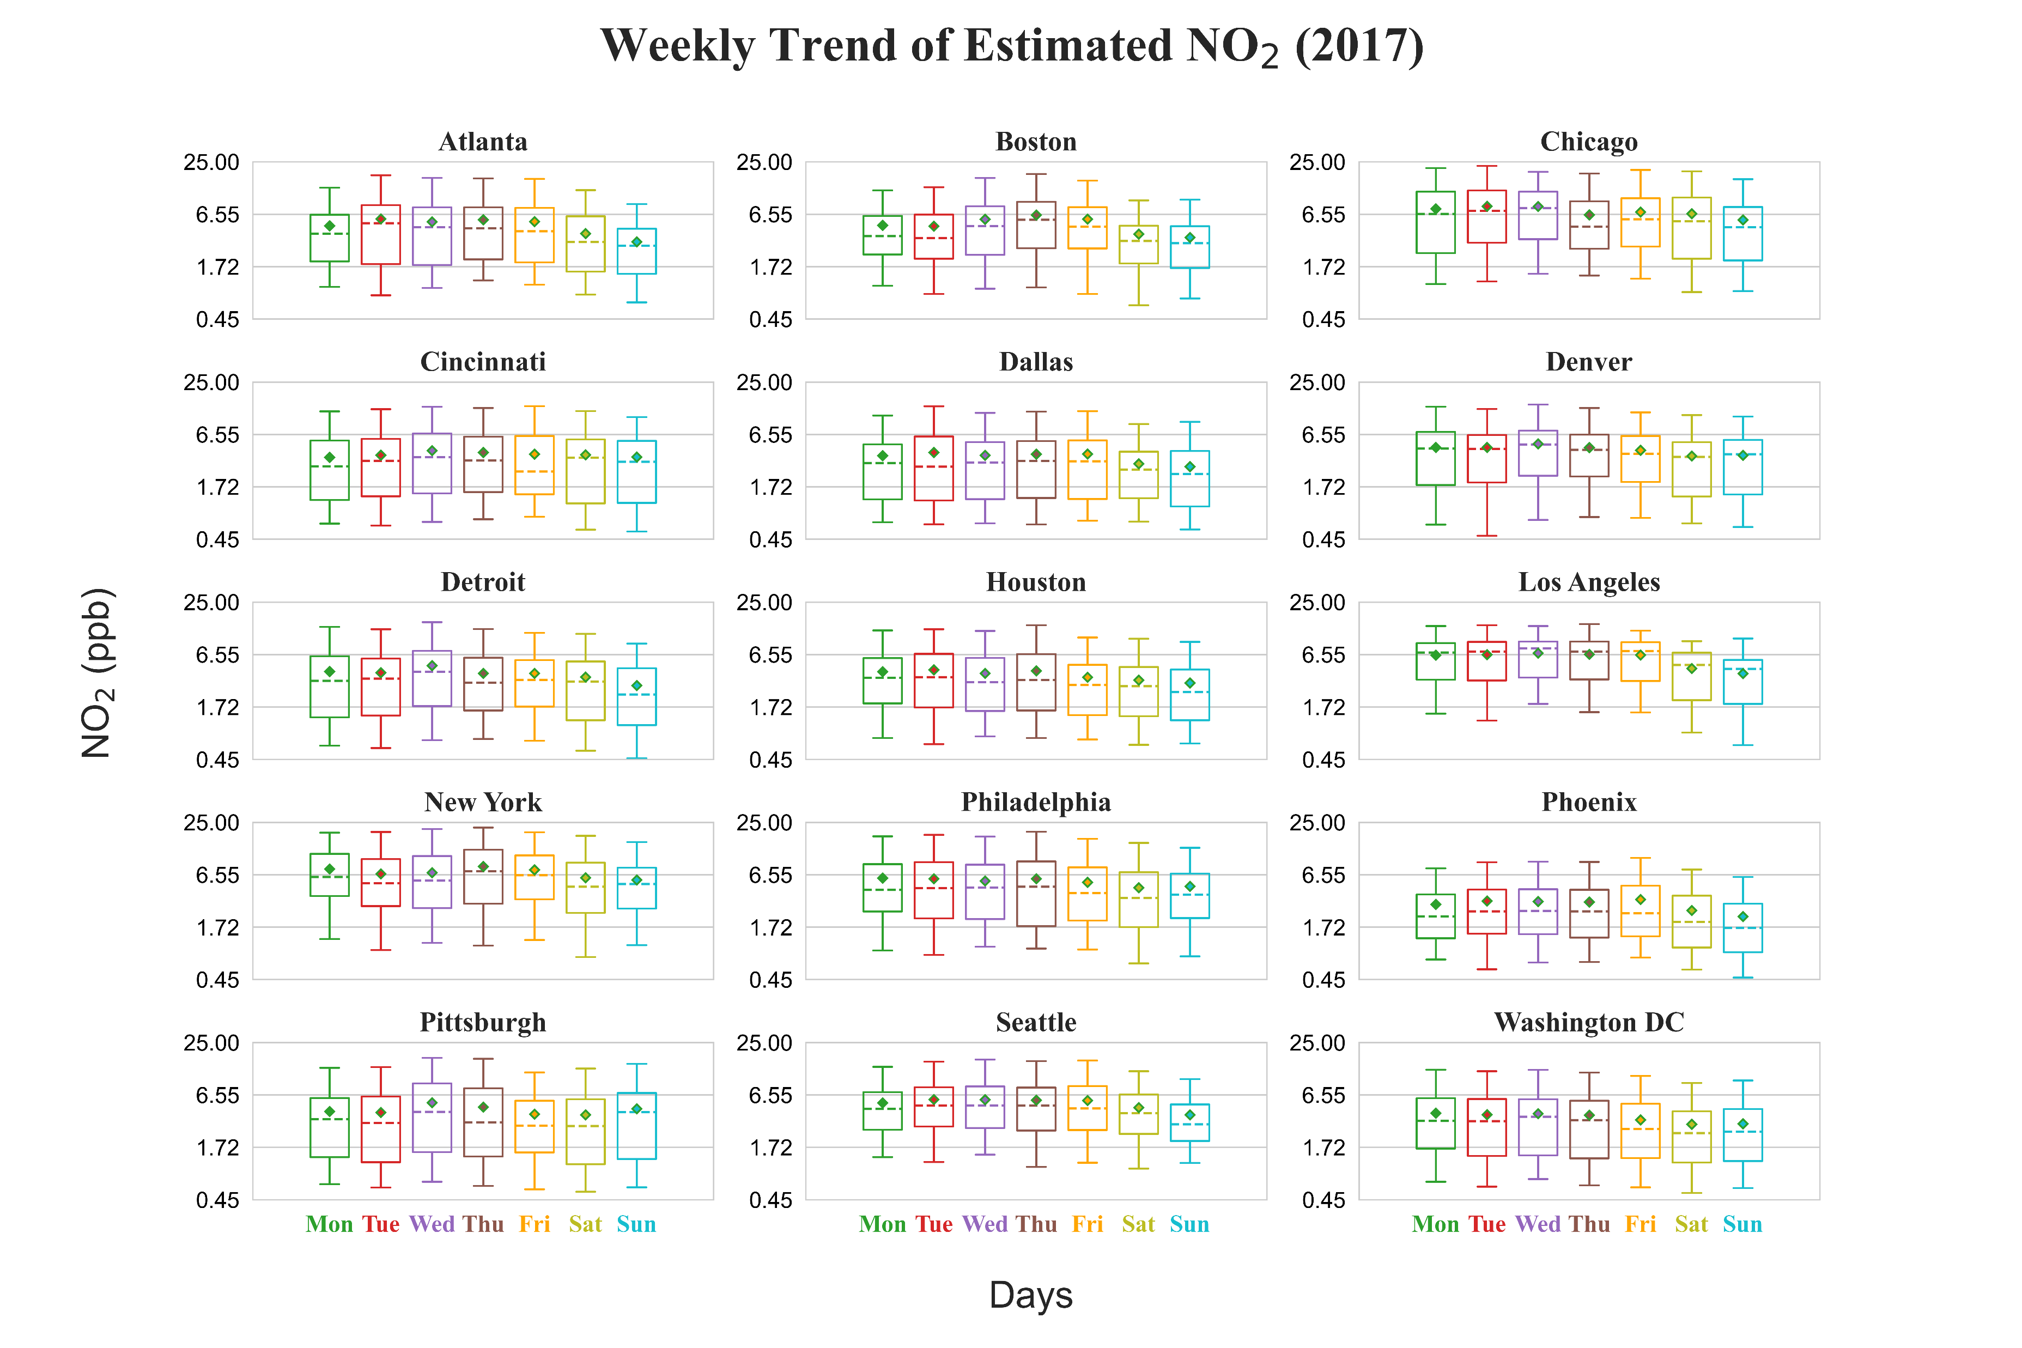

Slide 14
NO_{x} emissions to NO­₂ concentration sensitivity
Derived semi-normalized NOx sensitivity using the Mass Balance approach
$$\frac{∆E}{E} = β\frac{∆Ω}{Ω}$$
$Ω:$ NO₂ concentration
$E:$ NO_{x} emissions
$β:$ Initial sensitivity coefficient
Compared Digital Twin based sensitivity with CMAQ DDM for validation

Slide 15
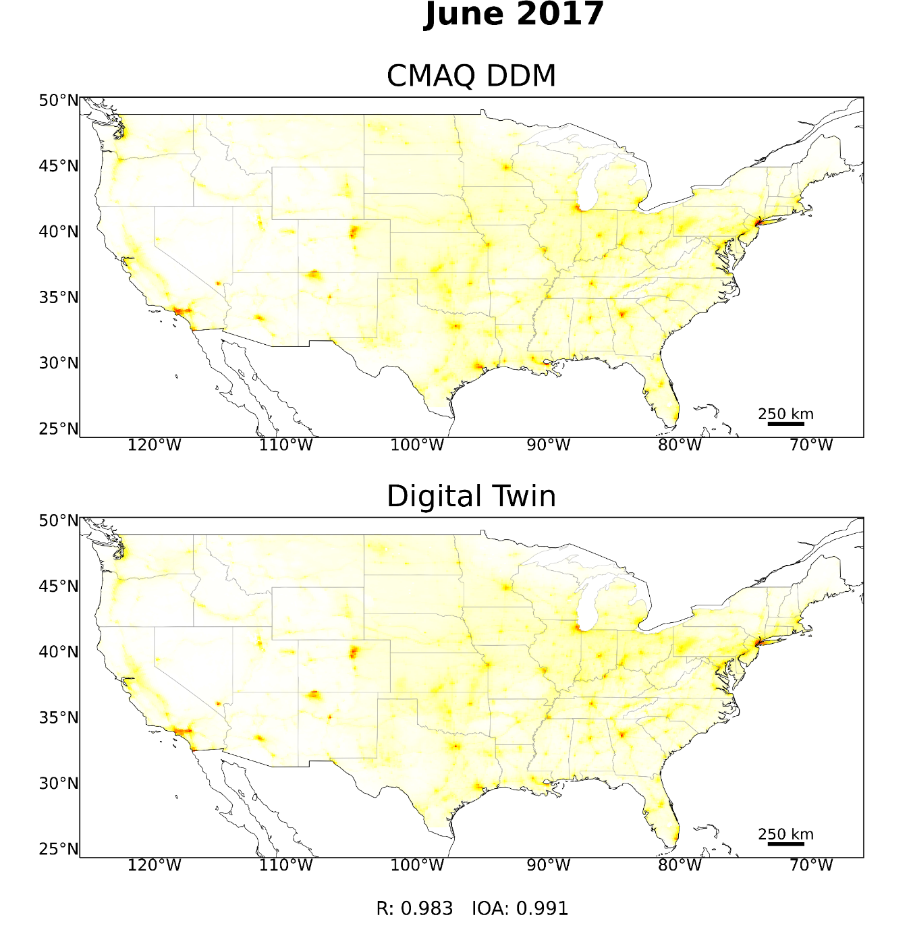
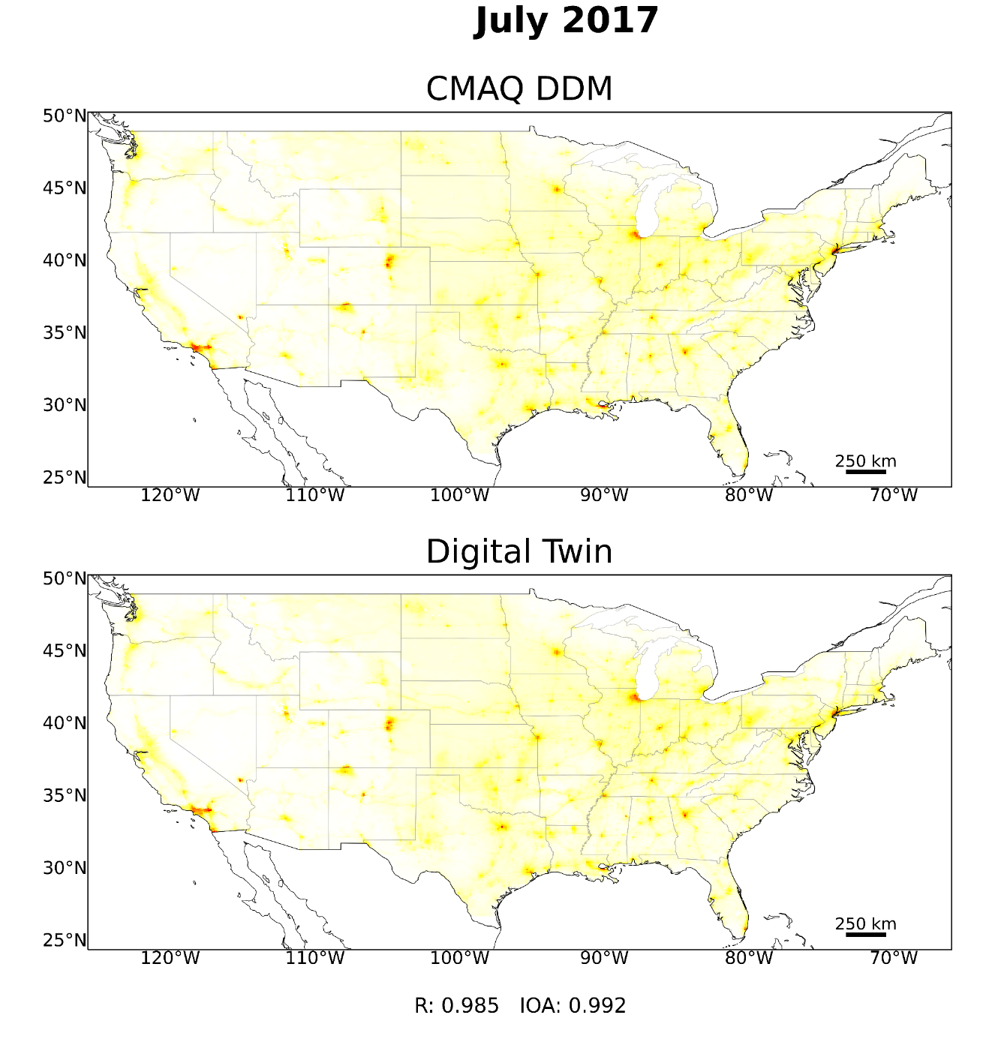
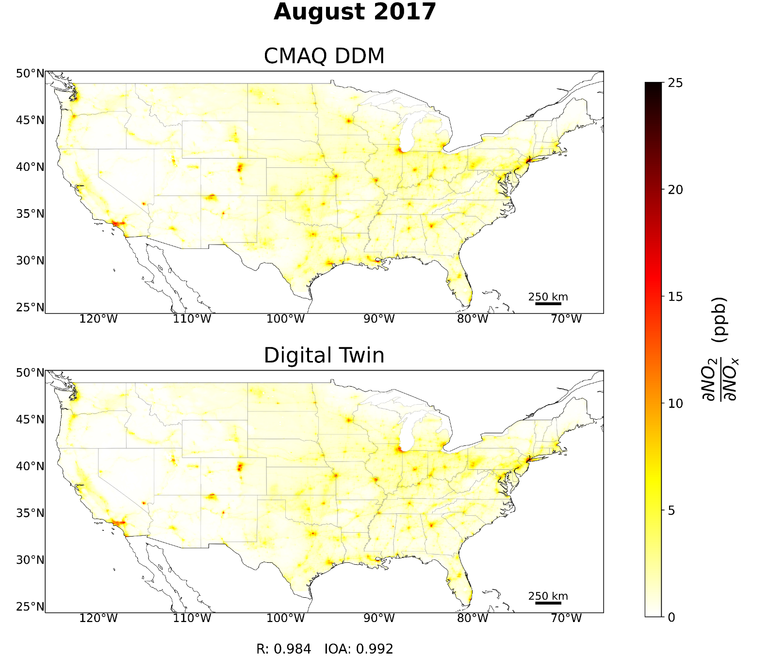
Monthly average sensitivity comparison

Slide 16
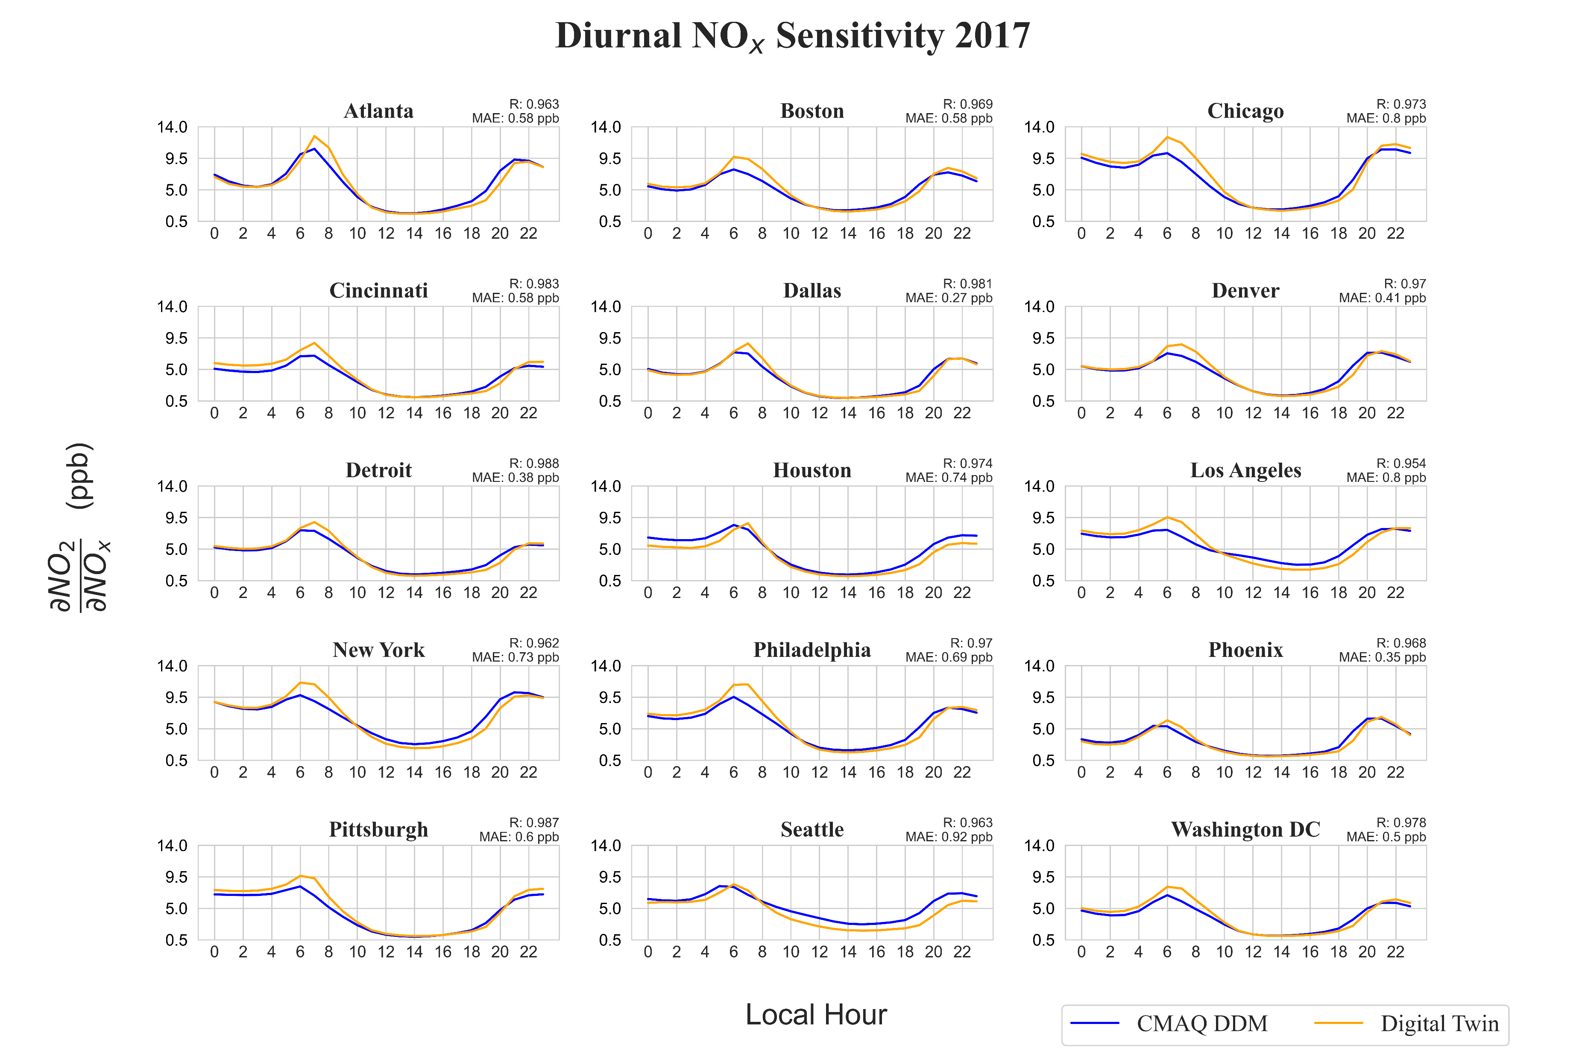

Slide 17
Computational Performance
1-hour NO₂ simulation over CMAQ-US grid
Model | Resources | Compute Time
CMAQ | 1 CPU | 71.75 (mins)
CMAQ | 28 CPUs | 4.08 (mins)
Digital Twin | 1 CPU | 10.5 (sec)
Digital Twin | 28 CPUs | 3.71 (sec)
Digital Twin | 1 GPU, 1 CPU | 6.83 (sec)
Digital Twin | 1 GPU, 28 CPUs | 2.15 (sec)
With 1 CPU, Digital Twin is more than 400 times faster than CMAQ
With 1 CPU and 1 GPU, Digital Twin is more than 600 times faster than CMAQ
Efficient programming and multi-GPU processing can further reduce computational time
CPU: Intel(R) Xeon(R) Gold 6252; GPU: NVIDIA A30 (24 GB)

Slide 18
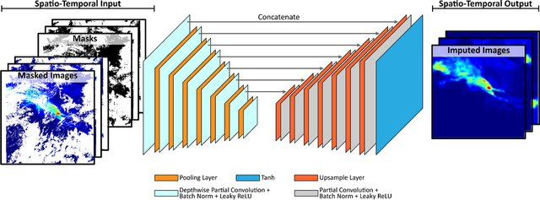
Future direction
Use PCNN to impute missing observation data across CONUS
Apply iterative Finite Difference Mass Balance (iFDMB) approach on Digital Twin to update emission inventory across CONUS
Feed optimized emission inventory to CMAQ to improve NO₂ concentration accuracy
$$E_{t}=E_{a}\left(1+\frac{1}{β}\frac{Ω_{o}−Ω_{a}}{Ω_{a}}\right)$$

Slide 19
Acknowldgements
NASA's Aura Science Team Grant (NNH19ZDA001N-AURAST).
UH high research priority funding

