Slide 1
Transport of soil nutrients to key Utah watersheds via dust events
Ty Hosler, Bradley Adams
Brigham Young University
Air Quality Research Lab
CMAS Conference
October 17, 2023

Slide 2
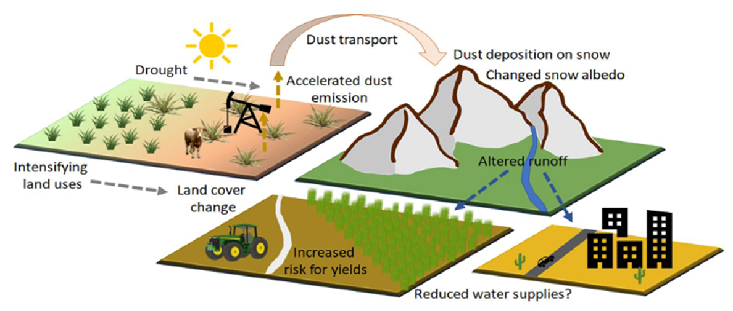
Overview
Dust modeling process
Illustrate deposition process (2020 event)
Watershed study (2023 spring season)
Current and Future work
Conclusions
BYU

Slide 3
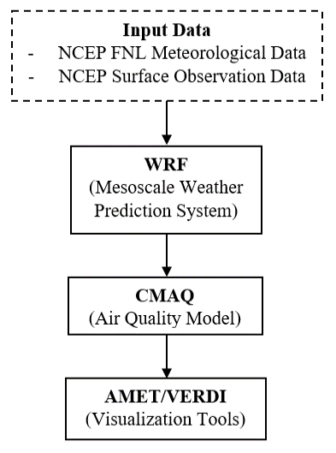
Dust Modeling Overview
Meteorological and land use inputs taken from national databases (NCEP FNL, NLCD, MODIS)
WRF 4.2.1 calculates met data, land use, soil type
Surface conditions updated with OBSGRID
CMAQ 5.3.1 calculates dust emission, transport, deposition
Dust Modeling Guide: https://doi.org/10.26067/FACPUB/5515
BYU

Slide 4
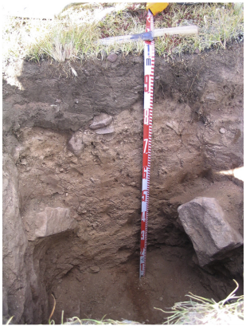
Deposition Overview
Dry and wet mechanisms
Transient for events; cumulative for periods/seasons
State-wide, local point, or watershed resolution
Speciated mineral elements
Soil nutrients: Na, P, K, Mg, . . .
Other: Ca, Al, Fe, Pb, carbonates, nitrates, . . .
Dust results feed water quality studies
Dry Deposition
Wet Deposition
Turbulent diffusion, sedimentation
In-cloud and below-cloud scavenging
Dust-rich soils
Glacial till
Photo by J. Munroe
Bedrock
BYU
Notes:
Dust inputs can alter soil fertility significantly and thus affect many ecosystem properties, including plant-community composition and productivity. As soils age, the supply of soil nutrients from minerals declines unless replaced by other inputs, such as dust (42). Dust may contain not only many plant-essential nutrients (e.g., Na, P, K, and Mg), but also substances that affect the availability of these nutrients (e.g., carbonates).

Slide 5
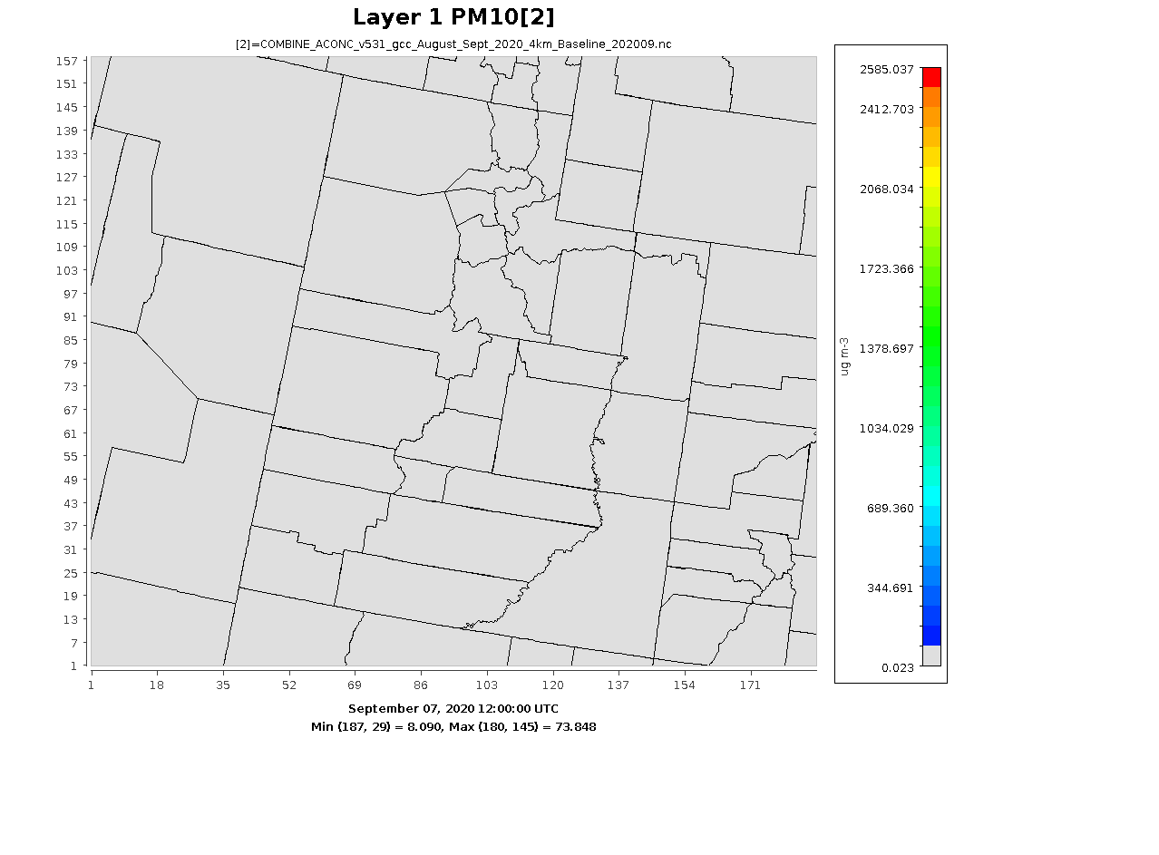
Speciated Dry Deposition
Na Volumetric Emission Rate
Na Concentration
Sep 7-9 2020 Dust Event
PM10 Concentration
9/8/20
6:00 UTC
9/8/20
6:00 UTC
Na Dry Deposition Flux
9/8/20
6:00 UTC
9/8/20
8:00 UTC
BYU
Notes:
Emission rate consistent with early PM10, concentration shows to-date accum; local deposits and carryover; time shift
Dry misses lower over mountains

Slide 6
Speciated Wet Deposition
Rainfall
Na Wet Deposition Flux
Na Concentration – 9/8/20
6:00 UTC
6:00 UTC
6:00 UTC
8:00 UTC
8:00 UTC
BYU
Notes:
Dry correlates with highest conc; wet correlates with rainfall, removes from atmospheric concentration
Dry and wet same magnitude but different locations; time step

Slide 7
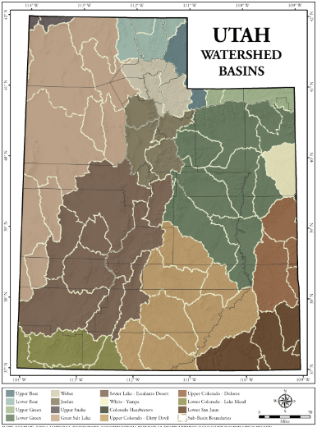
Deposition by Watershed
Cumulative Na Dry Deposition Flux Sep 1-9
Cumulative Na Wet Deposition Flux Sep 1-9
Curlew Valley
Upper Weber
Spanish Fork
Tule Valley
San Pitch
Sevier Lake
BYU
Notes:
Cumulative results show effects of north and mid-state emissions/dry deposits
Dry and wet same scale; results can be combined

Slide 8
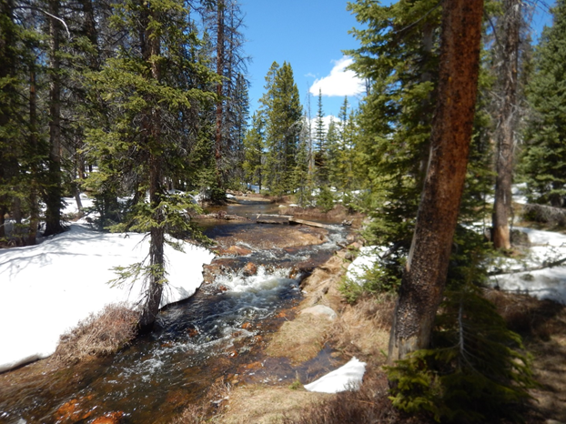
2023 Watershed Study
Research Question: What does the Utah Spring dust season (March – May, 2023) deposition in key watersheds look like?
Total seasonal deposition (i.e., Dry + Wet deposition)?
Relative contributions of Dry vs Wet deposition?
Location of major dust sources?
Location of major dust sinks?
BYU

Slide 9
Key Utah Watersheds
Key Watersheds:
Utah Lake
Jordan
Lower Weber
Upper Weber
Provo
Spanish Fork
Wasatch Front water supply
Water quality impacts
Drain to the Great Salt Lake
BYU
Notes:
90% of Utah’s water comes from Snowpack and 80+% of Utah’s population live along the Wasatch front.

Slide 10
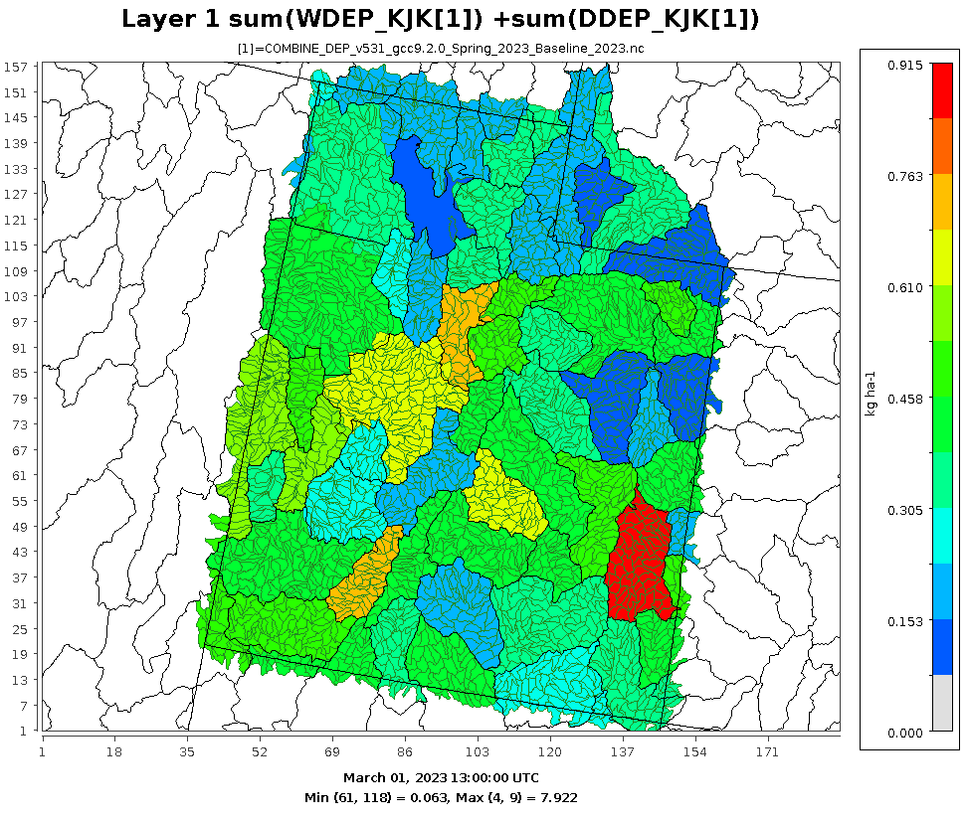
Total Deposition by Watershed
Total accumulated deposition of K for Spring 2023
Utah Lake the most, Upper Weber the least
Average: 0.44 Kg/ha
Historical comparisons in future work
Total Deposition Flux
Utah Lake
Upper Sevier
Upper Colorado-Kane Springs
BYU

Slide 11
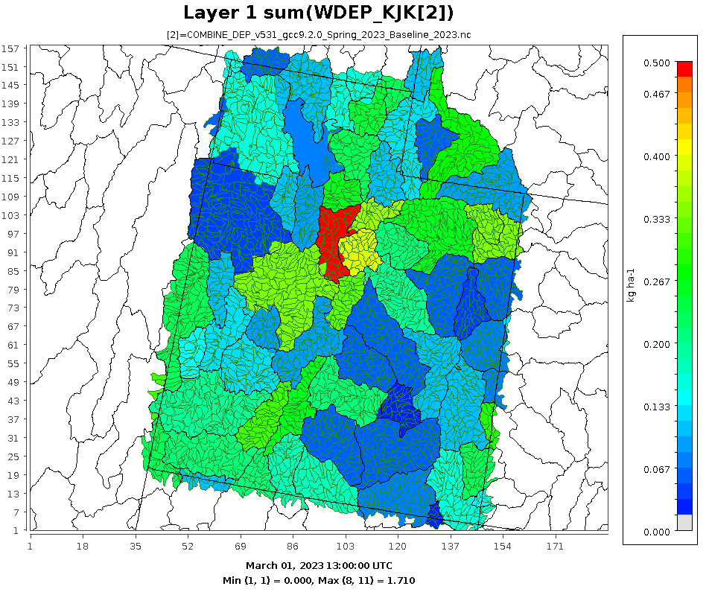
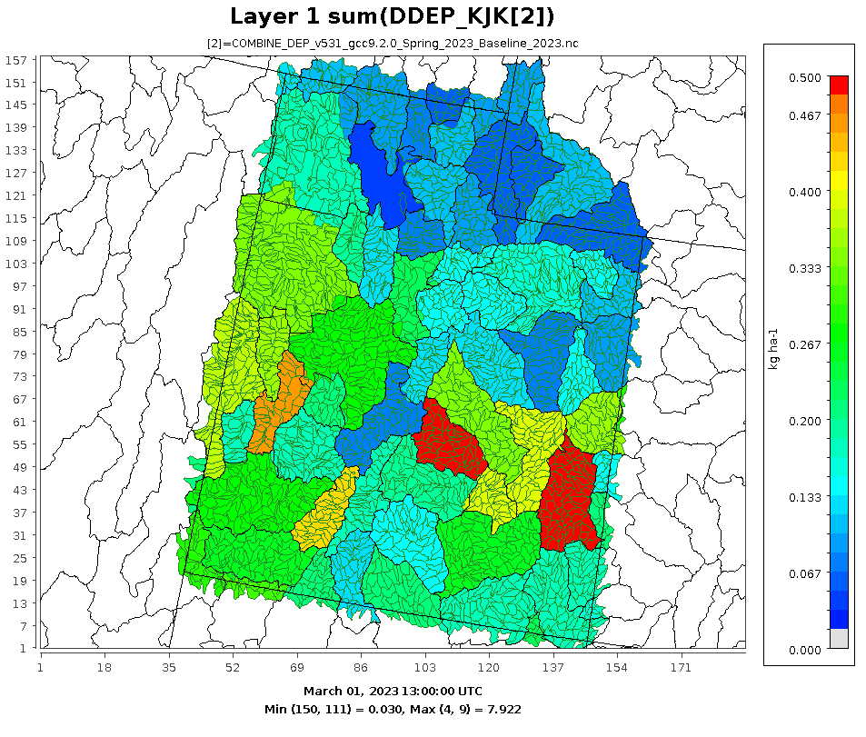
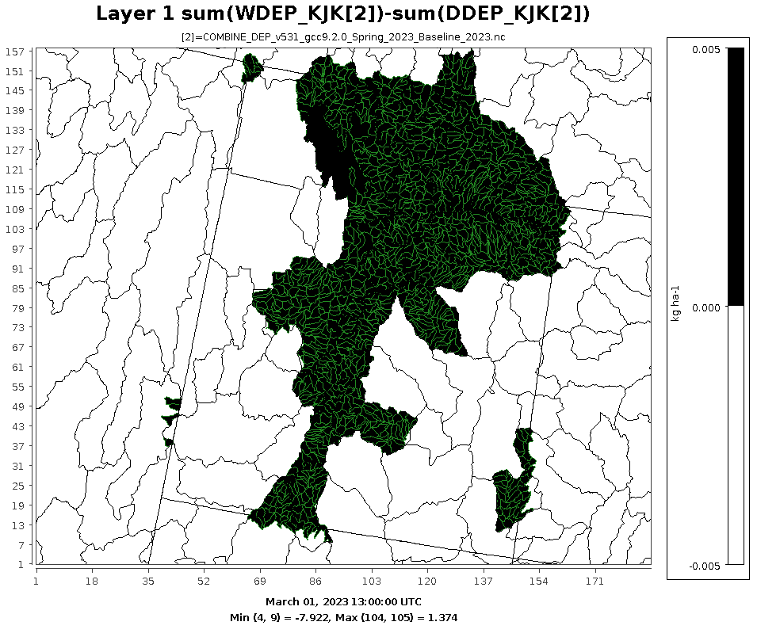
Dry vs Wet Deposition by Watershed
Wet Deposition Flux
Dry Deposition Flux
(Wet – Dry) Deposition Flux
BYU
Notes:
Dry deposition aligns well with the desert regions of Utah, suggesting a large portion of dust is emitted and redeposited close to its origin.
Wet deposition aligns well with the mountainous regions of Utah. The far right plot illustrates the different regions where each deposition mechanism dominates. The black (mountainous regions) are majority wet deposition, while the white regions are majority dry deposition

Slide 12
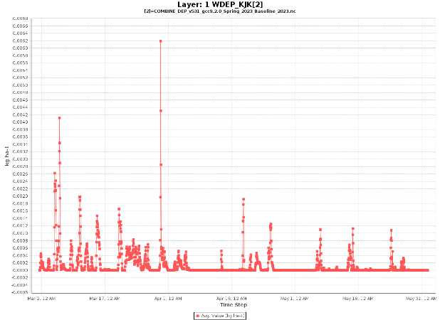
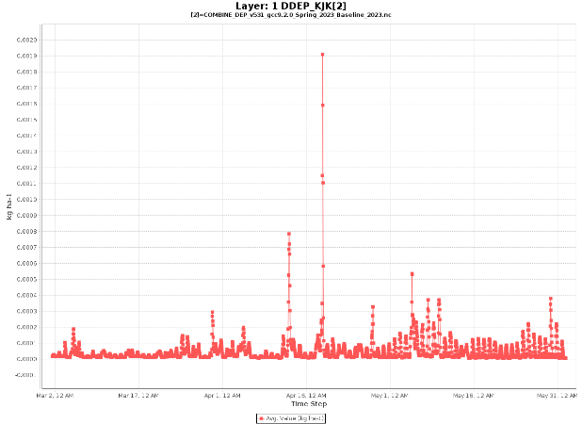
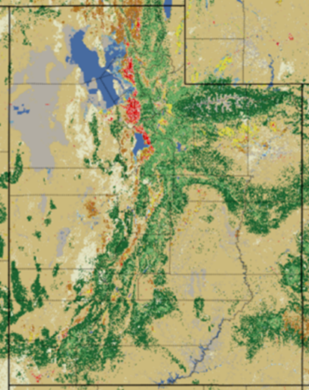
Time-Dependent Deposition
Spring 2023 Wet Deposition
Spring 2023 Dry Deposition
BYU
Notes:
Why does wet deposition the majority in the mountainous regions of Utah? --->A timeseries of WDEP events in the key watersheds reveals that the majority of wet deposition occurs during the tail end of winter in Utah (i.e., active snow season, March) ---> Prefrontal winds kick up dust and transport it to the mountains, then the snow brings it out of the atmosphere as it falls down. Timing of Dry deposition events was later in the spring (April), these events have been shown in recent studies to deposit dust on top of the snow and accelerate the spring snowmelt.

Slide 13
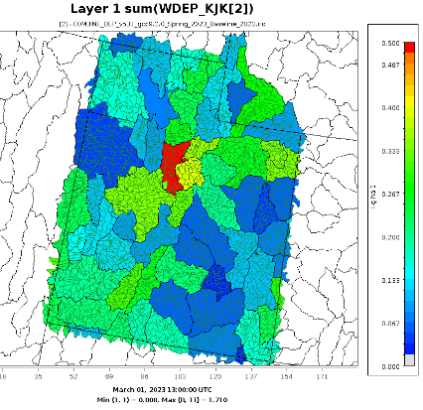
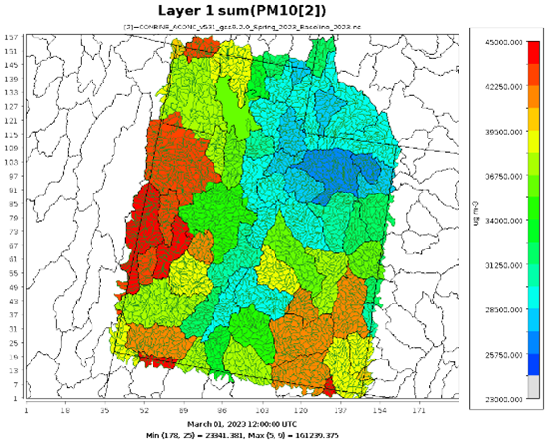
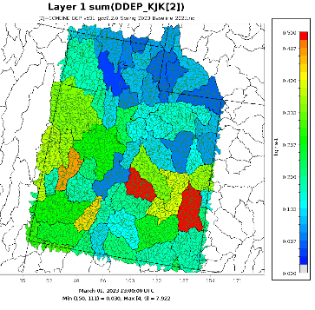
Source vs Sink Distributions
Wet Deposition Flux
Major sources: GSL desert, West desert, and Sevier Dry Lake
Dust sinks a function of emissions proximity and deposition mechanisms
PM 10 Concentration
Wet + Dry Cumulative Deposition Flux
GSL Desert
Dry Deposition Flux
Tule Valley
Sevier Lake
BYU

Slide 14
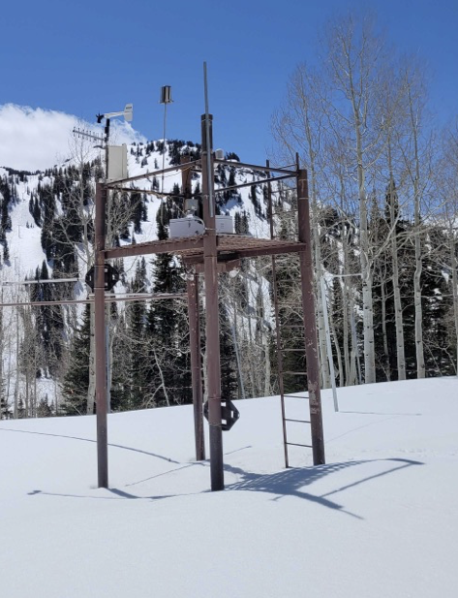
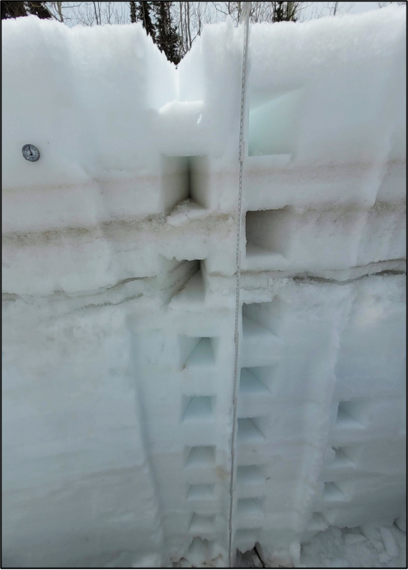
Current and Future Work
Atwater Study Plot, Alta, UT
Comparison with Atwater data
Historical variation in dust loading
Is there a trend?
Impact of dust loading on water quality
Seasonal variation in dust loading (Fall vs Spring)
BYU
Skiles, et al., 2018

Slide 15
Conclusions
CMAQ-based model used to track dry and wet deposition
Spring 2023 Watershed study showed:
Total deposition of elemental K in key watersheds
Highest in Utah Lake, lowest in Upper Weber
Wet deposition majority source for key watersheds
Dust scrubbed from atmosphere by late winter snowstorms
GSL, West Deserts, are major dust sources for Spring season
Deposition sinks dependent on source proximity and deposition mechanism
BYU

Slide 16
Acknowledgments
NSF Award # 000530-00001, Dust in the Critical Zone from the Great Basin to the Rocky Mountains
BYU office of Research Computing
BYU
Notes:
Cumulative results show effects of north and mid-state emissions/dry deposits
Dry and wet same scale; results can be combined

