Slide 1

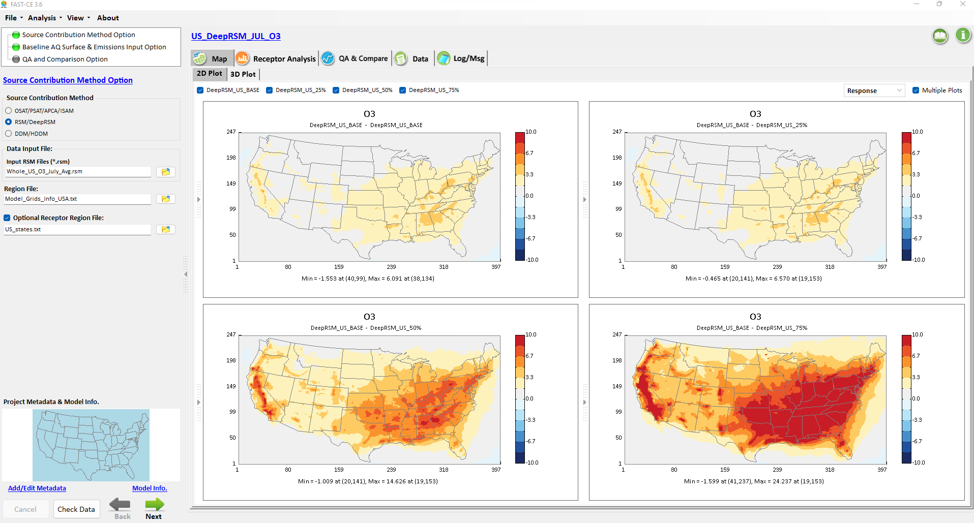

Pilot Application of Deep Learning Response Surface Model (DeepRSM)
Joey(Jiaoyan) Huang^{1,*}, Carey Jang¹, Jim Kelly¹, Jinying Li², Shicheng Long², Yun Zhu², Jia Xing³
1: Office of Air Quality Planning and Standards, U.S. EPA
2: School of Environment and Energy, South China University of Technology
3: Department of Civil and Environmental Engineering, the University of Tennessee
CMAS at Chapel Hill, NC
Oct 2023
NOx 25% reduction
VOC/NOx/SO2/NH3 25% reduction
VOC/NOx/SO2/NH3 50% reduction
VOC/NOx/SO2/NH3 75% reduction
Disclaimer: The views expressed in this presentation are those of the authors and do not necessarily reflect the views or policies of the U.S. Environmental Protection Agency.

Slide 2
Outline
  Overview of Source Attribution & Control/Response Modeling Methods
  Development & Evolution of Response Surface Modeling (RSM)
  Original RSM → Extended RSM (E-RSM) → Polynomial Function RSM (pf-RSM)
  → “Deep Machine Learning” RSM (DeepRSM)
  Ongoing and Recent RSM Applications/Comparisons & Publications
  DeepRSM: 2018 CMAQ pilot case for CONUS domain & 10 climate regions
  Summary & Next Steps

Slide 3
Emission-based “Reduced Form Modeling”:
Source Attribution & Control/Response Modeling Methods
“Source Attribution Modeling (Chem. regime: Baseline case)
  “Source Apportionment Modeling” (Chem. approximation)
    CAMx’s OSAT/PSAT/APCA, CMAQ’s ISAM &TSSA, etc.
  “Source/Receptor Sensitivity Modeling” (Math. approximation)
    Decoupled Direct method (DDM/HDDM), Adjoint method, etc.
“Control/Response” Modeling (Chem. regime: Control & Baseline case)
  “Brute Force” (BF) Modeling (e.g., “zero-out” pollutant/region/sector)
  “Response Surface Modeling” (RSM): Instant AQ responses of emissions control
    Previous USA applications: REMSAD (PM2.5):2008, CAMx (O3):2009, CMAQ (EGU-RSM): 2011 (Math./Stat. approximation)
    Original RSM → Extended RSM (E-RSM): 2015 → Polynomial Functions RSM (pf-RSM): 2019 → Deep Machine Learning RSM (DeepRSM): 2022 (Math. & Chem. approximation)
3

Slide 4
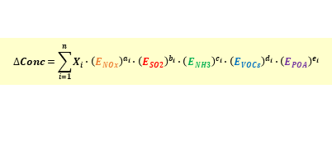
Evolution and Development of RSM
Region A
Pollutant A (PM)
How to further reduce number of model runs required in RSM?
Pollutant A (PM)
Air
Air
Air
Pollutant A (PM)
pollutant
pollutant
Region B
Pollutant B (O3)
Pollutant B (O3)
Pollutant B (O3)
•
Chemistry
RSM w/
Temporal
Polynomial
Functions
•
Transport
•
Indirect
Instant AQ responses
to emissions change
Instant AQ responses
Multi-pollutant responses
Single scenario
(brute-force)
to multi-region sources
based on polynomial functions
Region A
$$∆Conc=\sum_{i=1}^{n}{X_{i}∙{\left(E_{NOx}\right)}^{a_{i}}∙{\left(E_{SO2}\right)}^{b_{i}}∙{\left(E_{NH3}\right)}^{c_{i}}∙{\left(E_{VOCs}\right)}^{d_{i}}∙{\left(E_{POA}\right)}^{e_{i}}}$$
Emissions
Emissions
Change
Region B
NO_{x}
NH₃
POA
SO₂
VOC
Region C
AQM
RSM
E-RSM
pf-RSM
Deep-RSM
CMAQ, CAMx, etc.
via Brute-force runs
Wang et al., ES&T, 2011
Zhao et al., GMD, 2015
Xing et al., ACP, 2018
Li et al., JEM, 2022
Xing et al., ES&T, 2020
Xing et al., Atm. Res., 2022
Xing et al., ACP, 2011
Zhao et al., ACP, 2017
Xing et al., ES&T, 2017
2 (Base & Control)
Model runs required: > 1000s >100s >20
4

Slide 5
Deep Machine Learning “DeepRSM”
DeepRSM: “Deep Learning” pf-RSM
Combine
pf-RSM
and
Deep Learning CNN
to predict
Nonlinear PM2.5 & O3 responses to emissions control
# of model runs needed for maintaining RSM accuracy in predicting control responses （* for each selected control region or sector）
Traditional RSM | “pf-RSM” | “DeepRSM”
>100s | 20~30* | 1*
5
Xing et. al., ES&T, 2020 (Further details please see Appendix B)

Slide 6
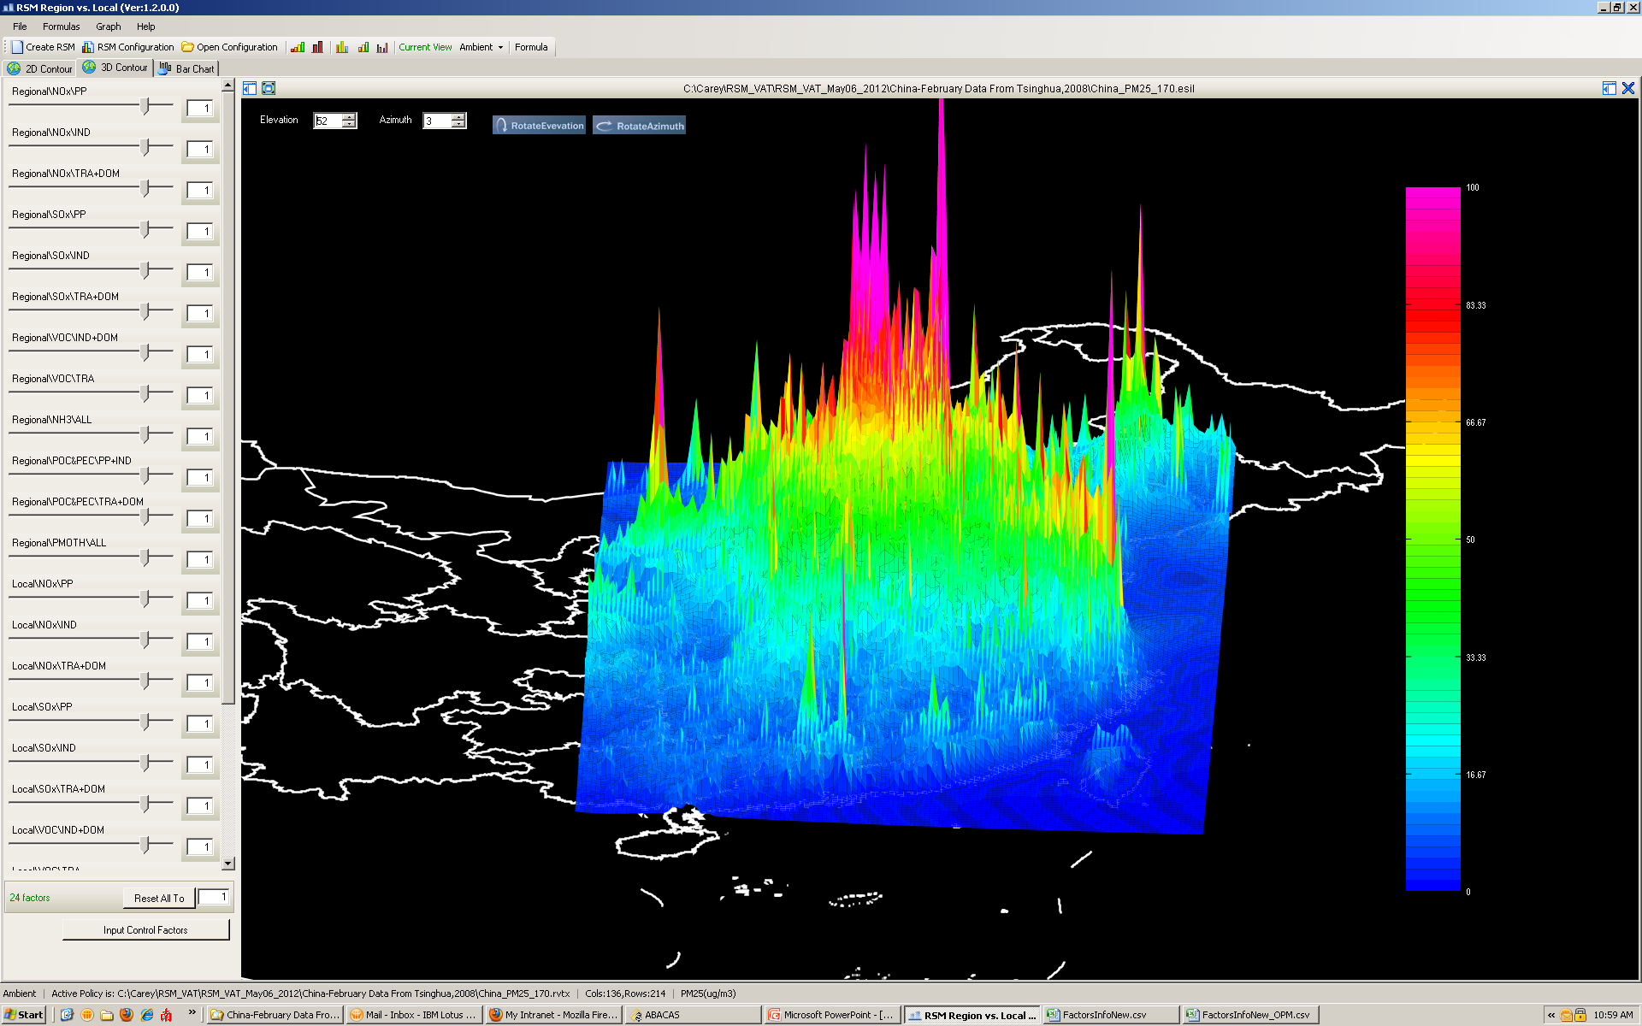
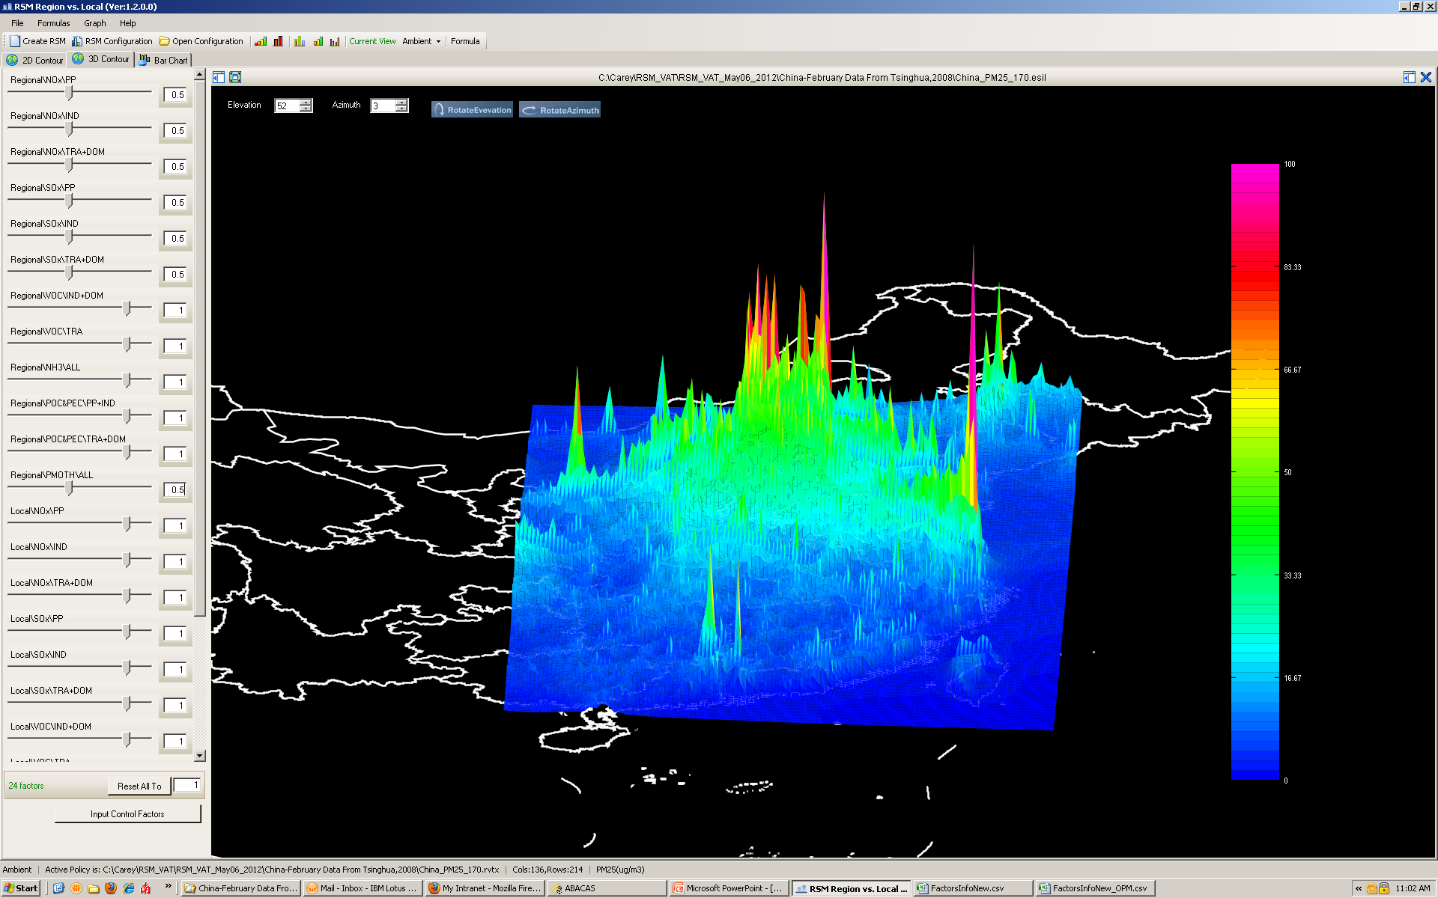
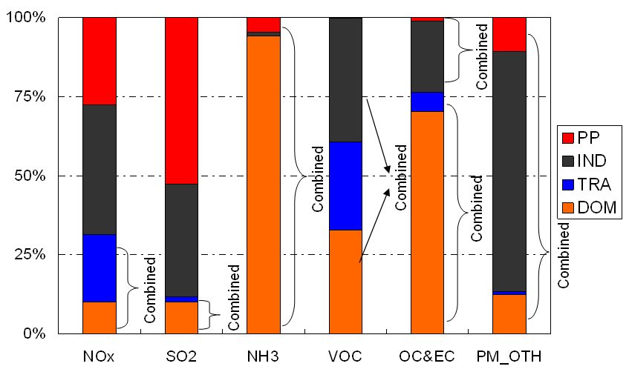
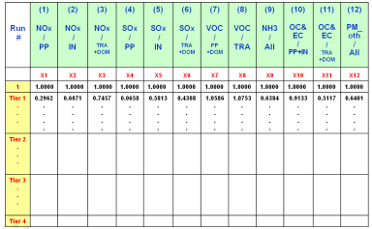
“4S” Steps in RSM (Original RSM)
Policy Factors
(Emission Factors)
Air quality
RSM
Instant AQ
Response Surface
1.Selection
Control
Base
“Pollutant/Region
/Sector” Factors
Source A- Local NOx
Source B- Regional VOC
Source C- Area NOx
…
4.Statistic
Create RSM
2.Sampling
Source C
Empirical Best Linear Unbiased Predictors (EBLUPs)
Control Matrix
Source B
Source A
Latin Hypercube Sample (LHS)
Hammersley quasi-random Sequence Sample (HSS)
3.Simulation
Multi-case CMAQ simulations
6
Experimental Design
Resource-intensive

Slide 7
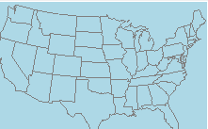
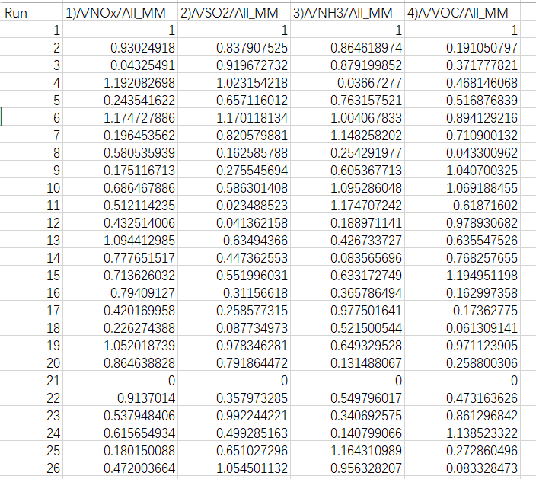
CMAQ/DeepRSM Model Configuration & Setup (CONUS domain)
CMAQ Configuration:
Control Matrix Design for Entire US domain 2018 (to create training cases):
CMAQ Version: CMAQ5.3.2
Model domain grids: 396 * 246
Grid resolution：12km * 12km
Chemical mechanism: cb6r3_ae7_aq
Simulation Period: Entire year of 2018
1 Region: USA
4 Pollutants: NOx, SO₂, NH₃, VOCs
1 Sector: All manmade(ALL_MM)
4 factors = 4 pollutants * 1 region * 1 sector
26 CMAQ simulation cases (training & OSS cases): 1 base case, 19 cases created by HSS method (0-1.2) for non-linear factors, 1 clean boundary conditions, 5 cases for “out of sample” (OOS) performance evaluation & QA
Training and OSS cases for DeepRSM test:
Training cases: 21 US 2018 daily cases from January to December of 2018
（#1 - #21：21 cases * 12 months = 252 monthly runs）
OOS cases: 5 US 2018 daily cases from January to December of 2018
（#22 - #26：5 cases *12 months = 60 monthly runs）
1-21： training cases
CONUS domain
22-26： Out of sample validation
Control Matrix

Slide 8
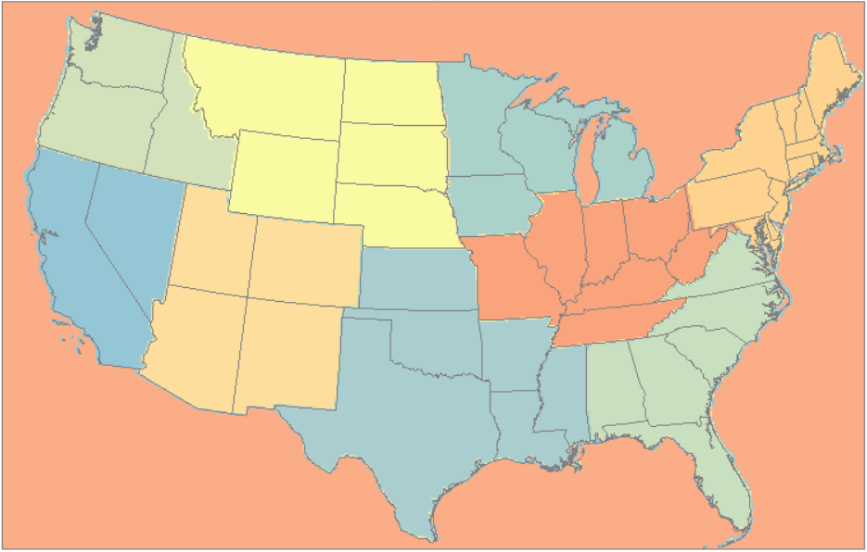
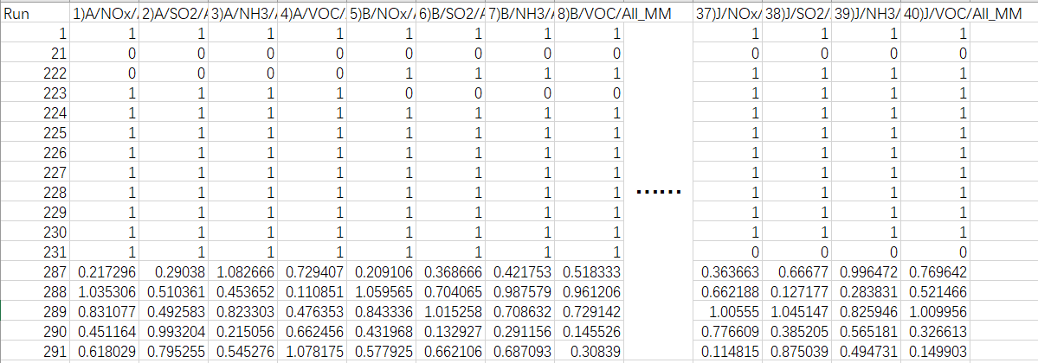
CMAQ/DeepRSM Model Configuration & Setup (10 Climate Regions)
CMAQ Configuration:
Additional runs for building “10 Climate-region” DeepRSM:
CMAQ Version: CMAQ5.3.2
Model domain grids: 396 * 246
Grid resolution：12km * 12km
Chemical mechanism: cb6r3_ae7_aq
Simulation Period: July 20181
DeepRSM Model: obtained from US 2018 daily cases of training (January to December, not divided into regions, treating the entire United States as a single region)
Building multi-region RSM cases: 11 cases in July(1 control case, 1 clean boundary conditions per region)
OOS cases: 5 “out-of-sample” cases for QA in July
10 NOAA Climate Regions:
The continental United States was divided into 10 regions based on climate zones:
10 Regions: CEN_CR, NE_CR, NPR_CR, NW_CR, S_CR, SE_CR, SW_CR, UPMW_CR, W_CR, OTHER
NW_CR
NPR_CR
1,222-231: used to build climate-region RSM
UPMW_CR
NE_CR
W_CR
CEN_CR
SW_CR
S_CR
SE_CR
OTHER
287-291: Out of sample validation
Control Matrix
Model domain: 10 NOAA Climate regions

Slide 9
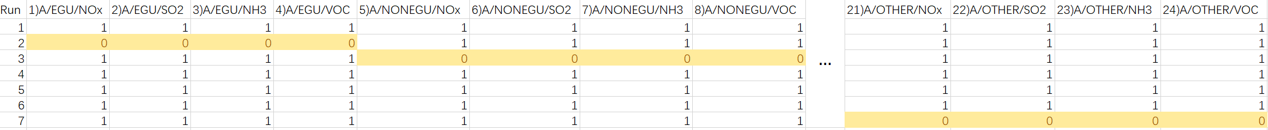
CMAQ/DeepRSM Model Configuration & Setup (5 sectors)
CMAQ Configuration:
Additional runs for building “5 sectors” DeepRSM:
CMAQ Version: CMAQ5.3.2
Model domain grids: 396 * 246
Grid resolution：12km * 12km
Chemical mechanism: cb6r3_ae7_aq
Simulation Period: July 2018
Sub-sectoral cases: 7 cases
1 base case, 5 clean boundary conditions per sectors, 1 clean boundary conditions for remaining sectors (OTHER)
The simulation timeframe is July 2018, not divided into regions, treating the entire United States as a single region)
5 sectors + other:
PT_EGU
PT_NONEGU
PT_OILGAS
FRIE (PT_RXFIRES, PT_FIRES, PT_AGFIRES)
GR_RWC (GR_RES_FIRES)
OTHER (PT_CMV_C1C2, PT_CMV_C3, PT_OTHFIRES, PT_OTHER, GRIDDED_EMIS)
CONUS domain
Control Matrix

Slide 10
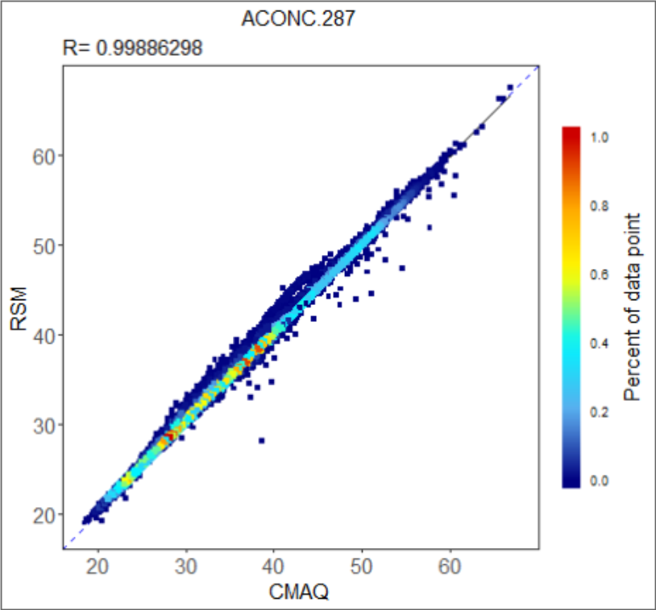
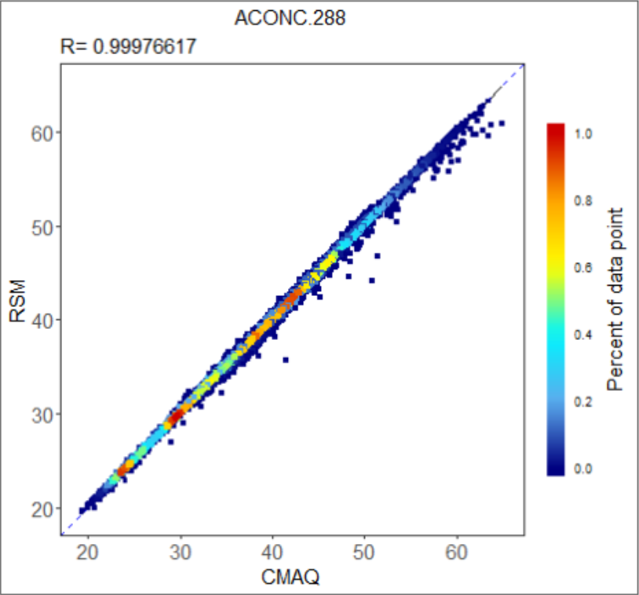
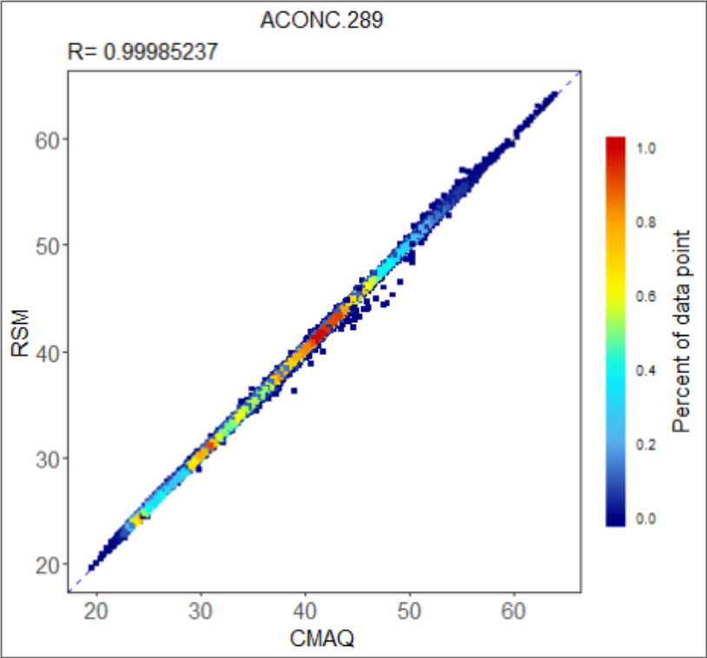
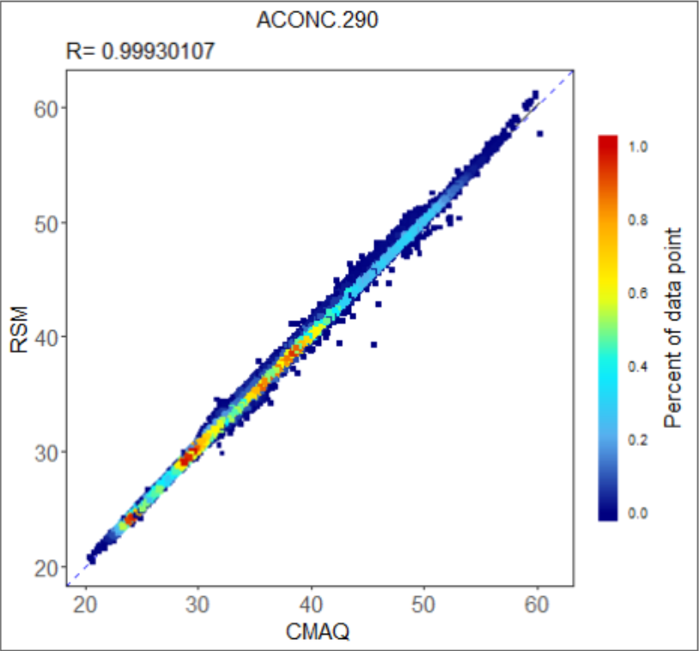
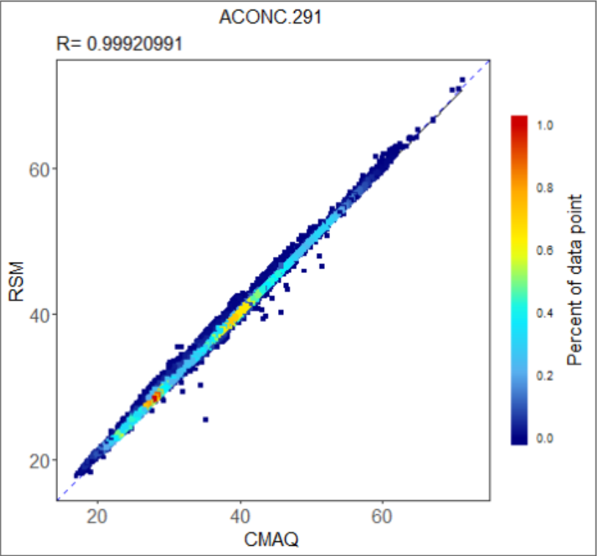
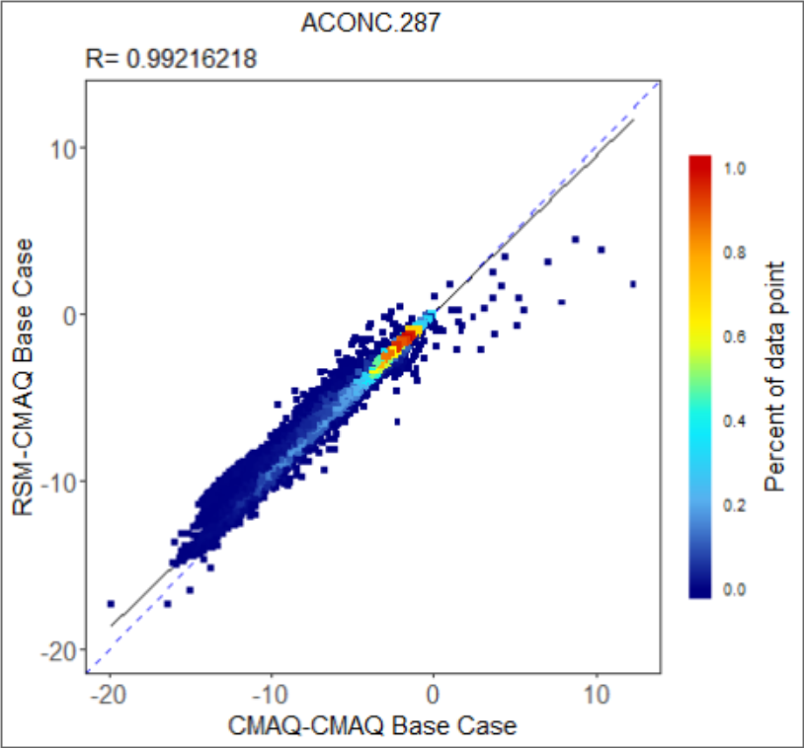
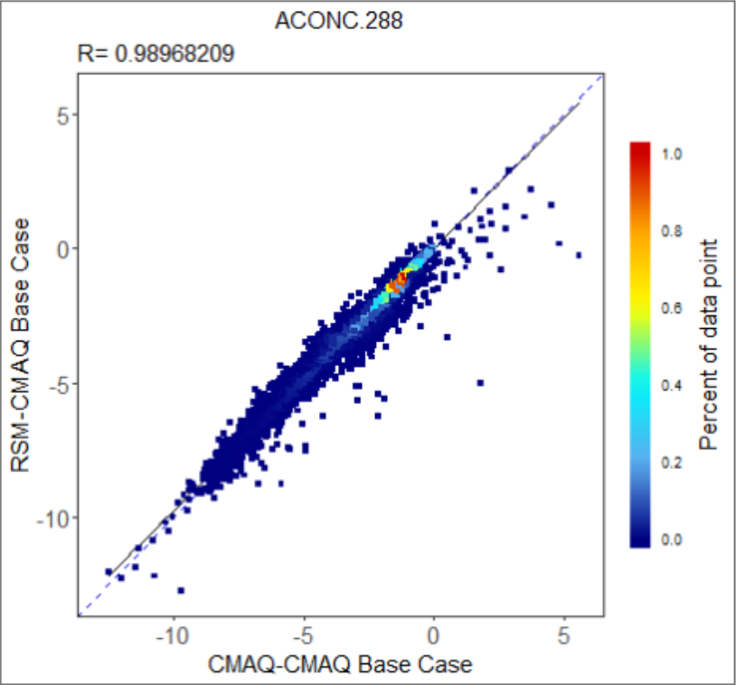
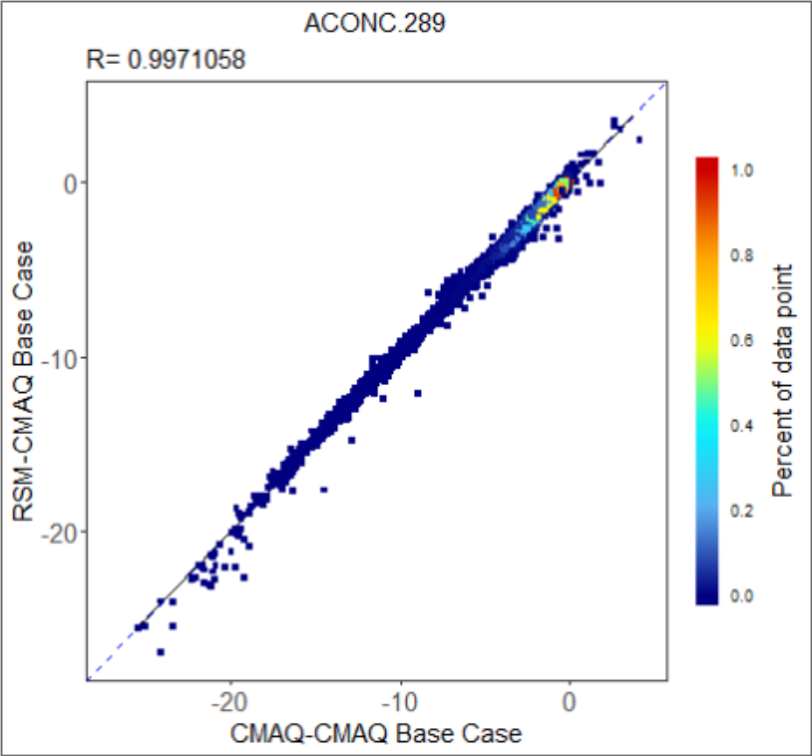
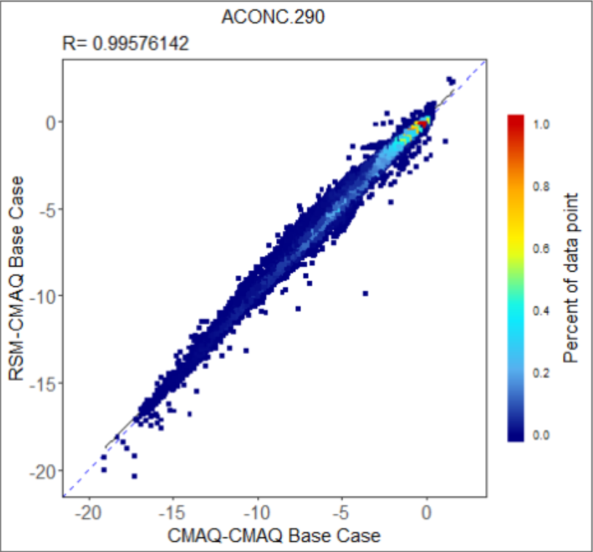
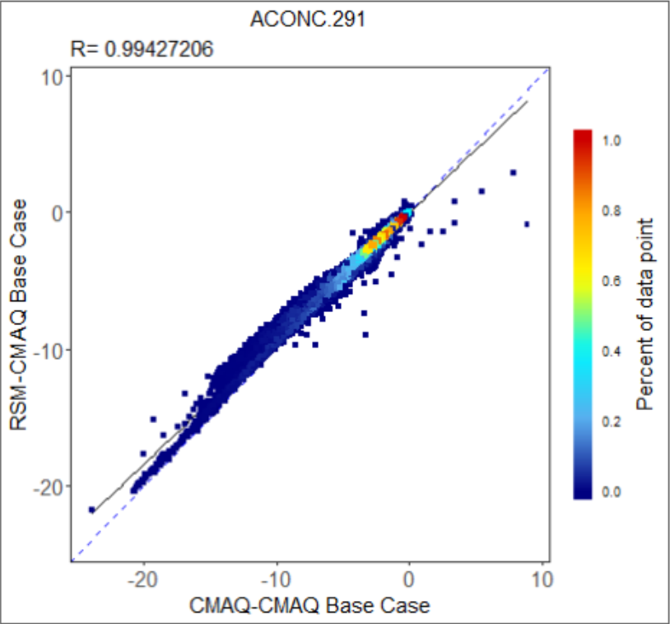
O₃ Performance Evaluation: DeepRSM vs. CMAQ
O₃ MDA8 monthly average (July 2018, US Climate Regions)
DeepRSM vs. CMAQ (Concentration):
DeepRSM vs. CMAQ (Response):

Slide 11
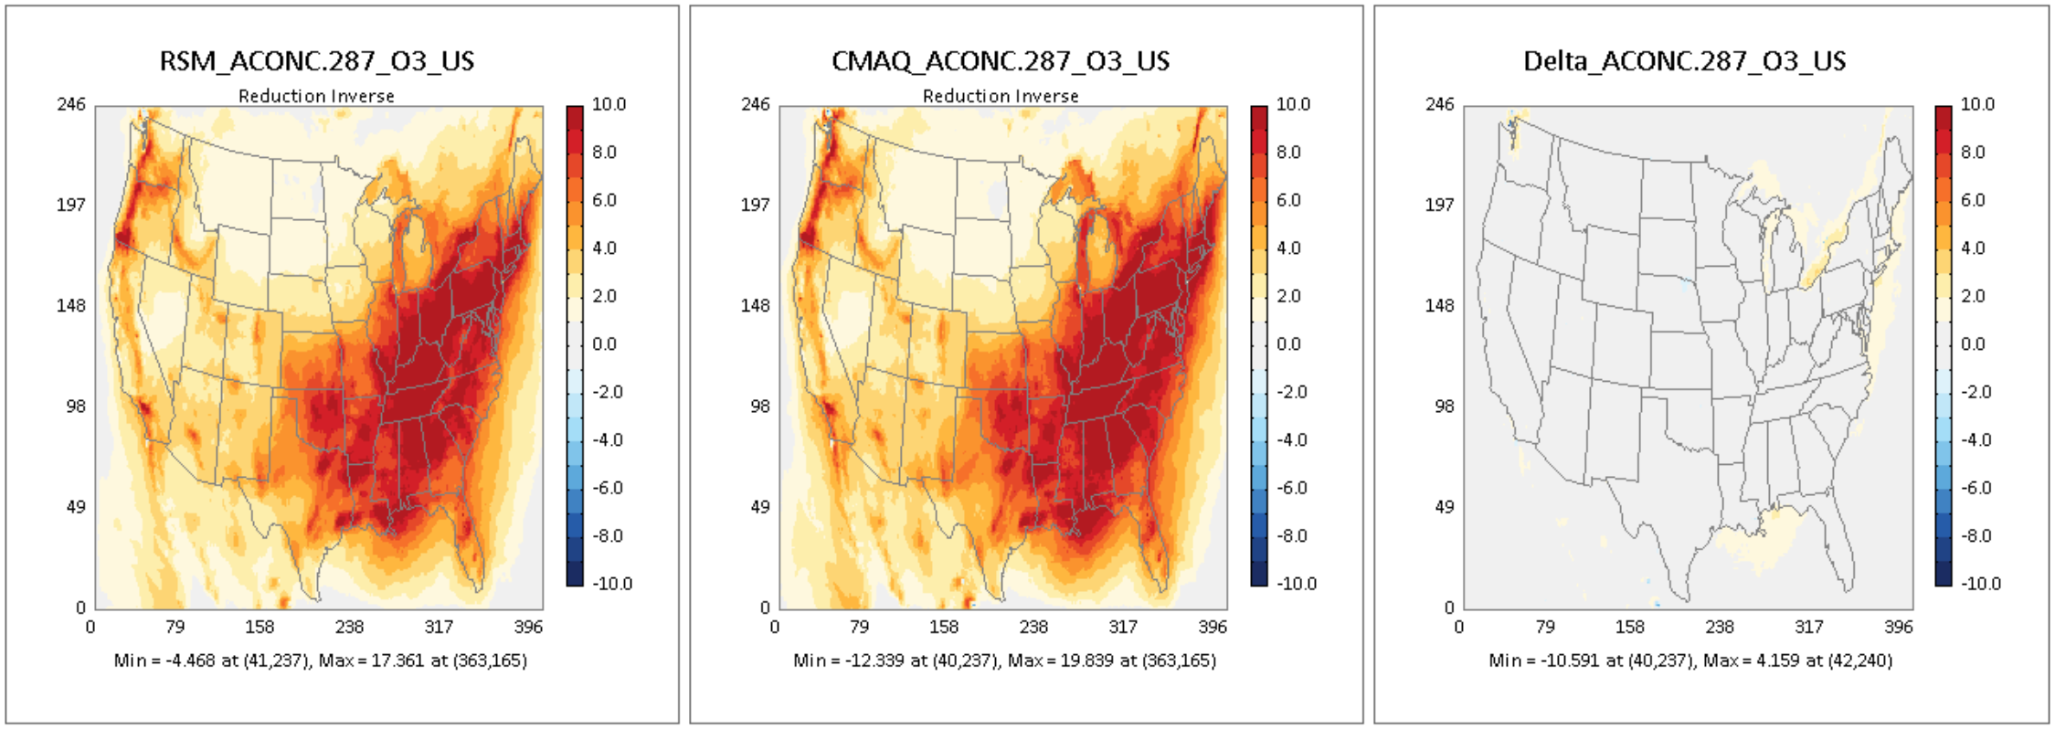
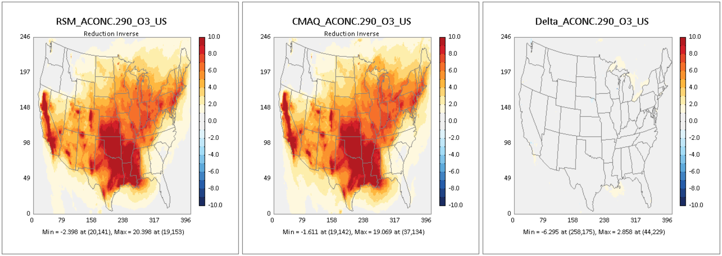
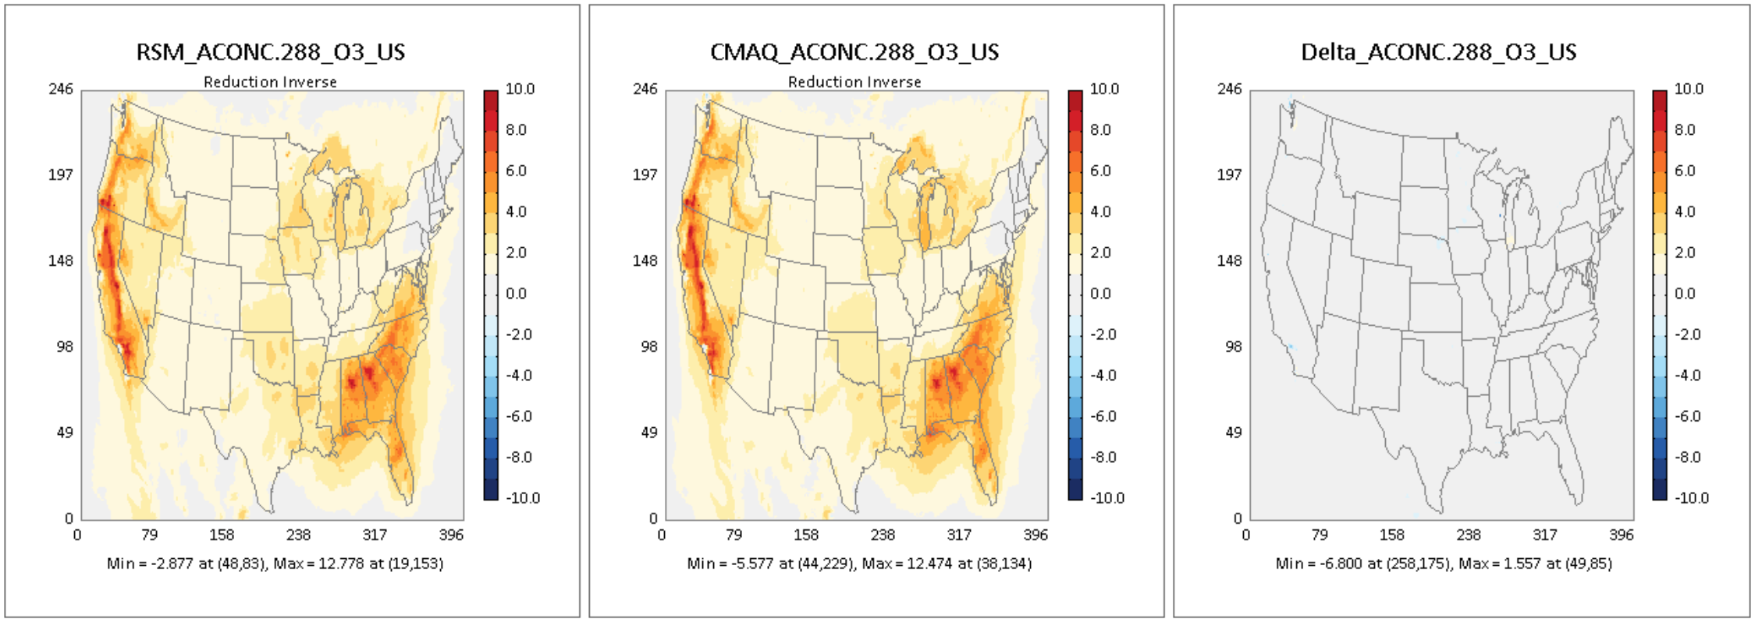
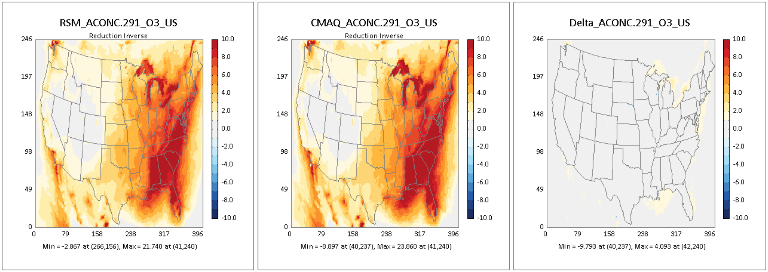
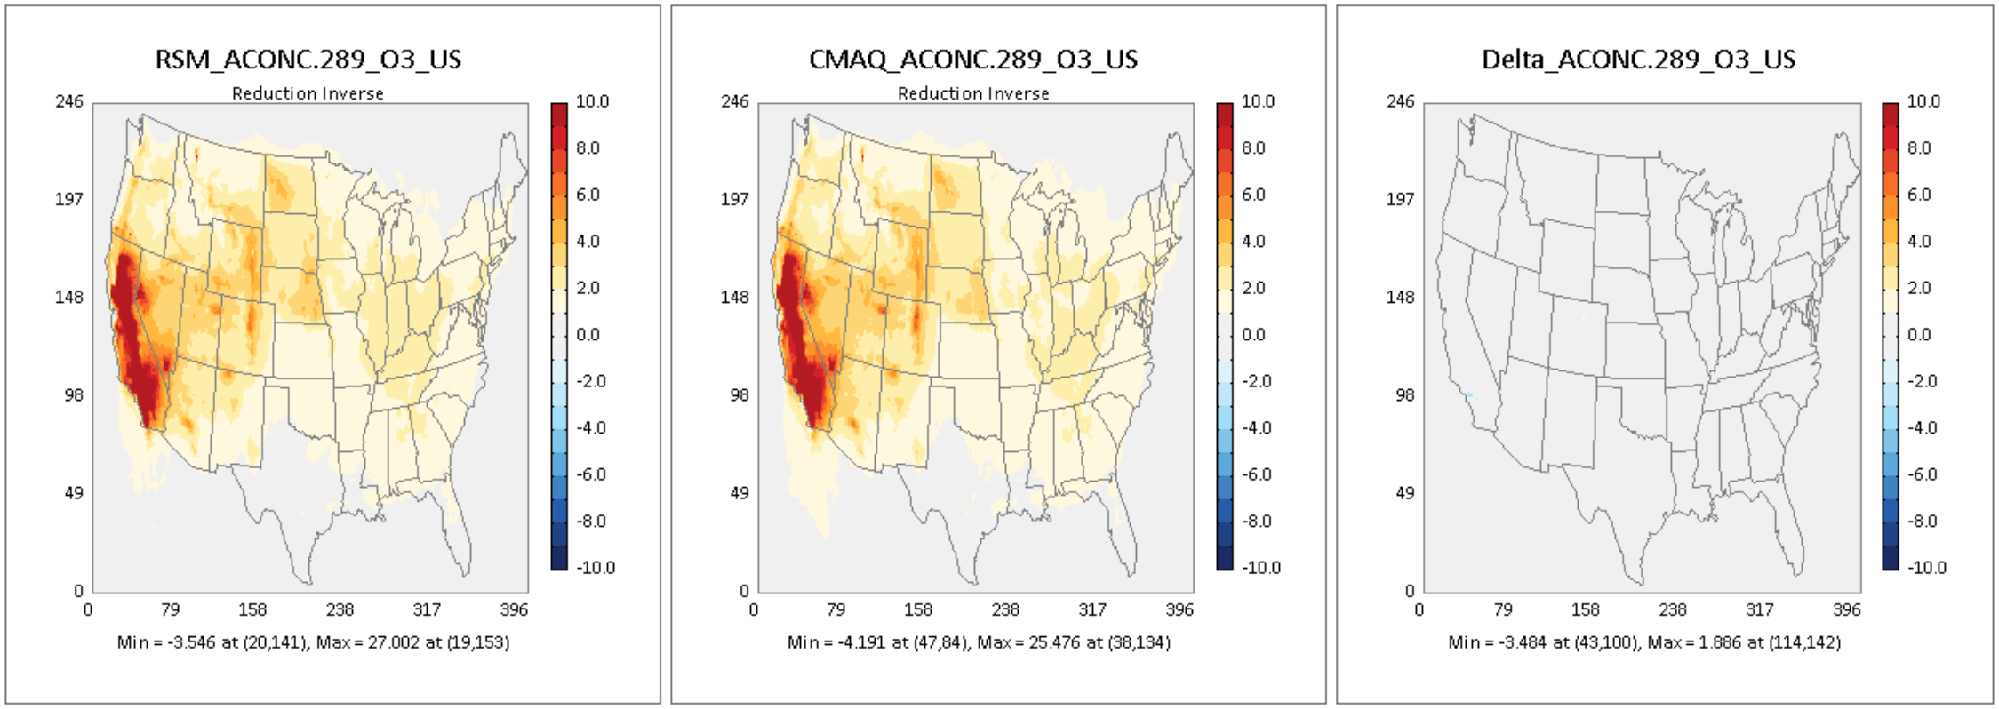
O₃ Performance Evaluation: DeepRSM vs. CMAQ
Response: O₃ MDA8 monthly average (July 2018, US Climate Regions)
ACONC.287
ACONC.290
ACONC.288
Δ (CMAQ-RSM)
ACONC.291
Δ (CMAQ-RSM)
ACONC.289
Δ (CMAQ-RSM)
Note: Blue (negative) indicates higher DeepRSM response, Red (positive) indicates higher CMAQ response
in Δ (CMAQ-RSM)
Notes:
Response： The difference between the baseline scenario and the control scenario

Slide 12
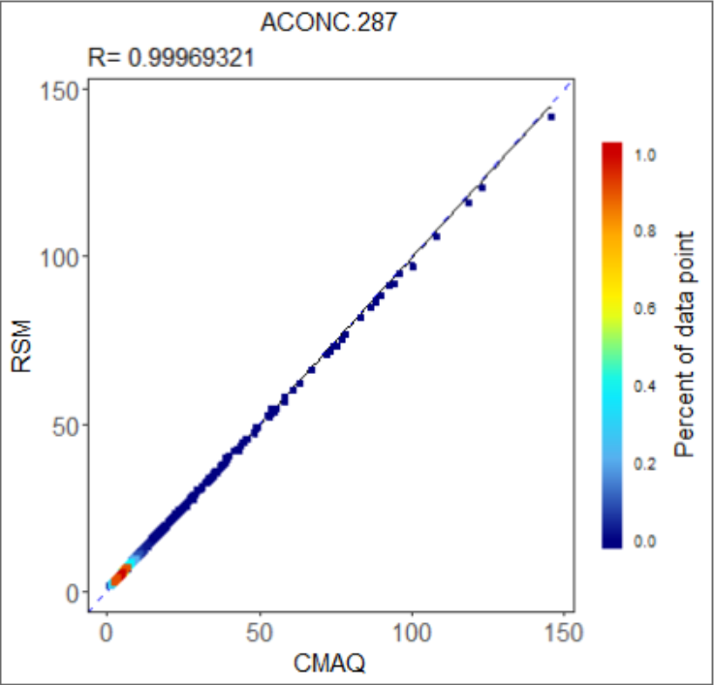
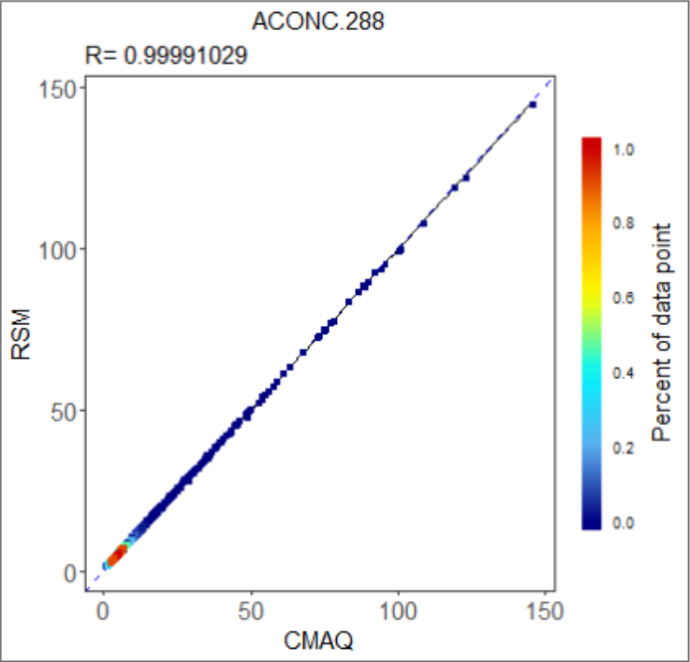

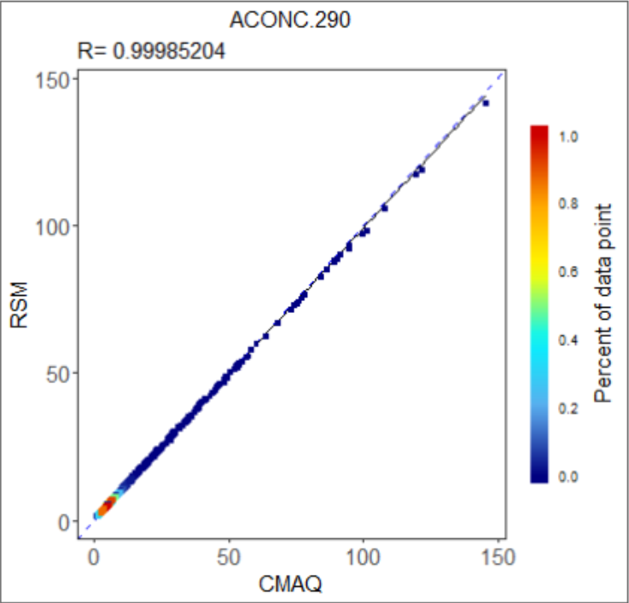
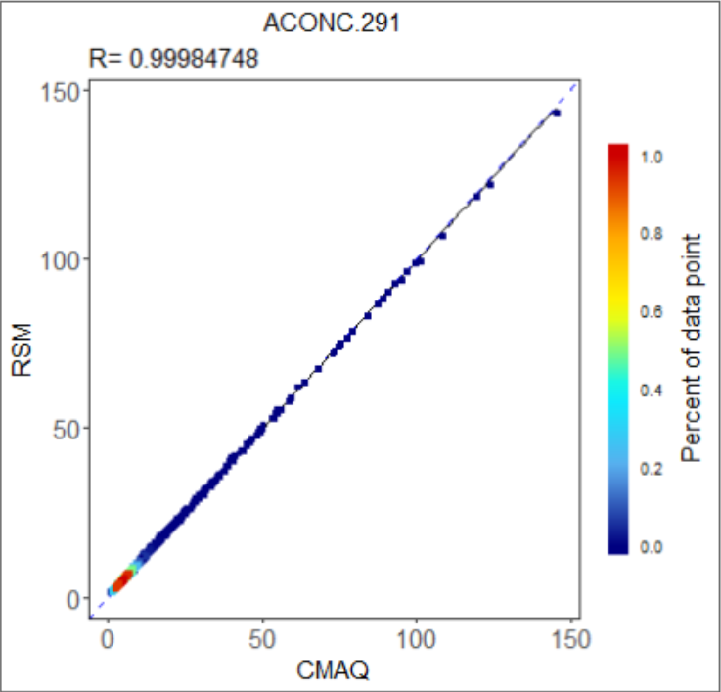
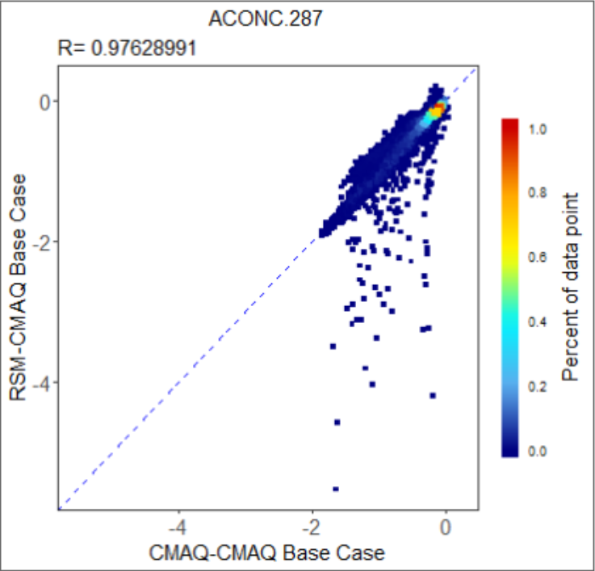
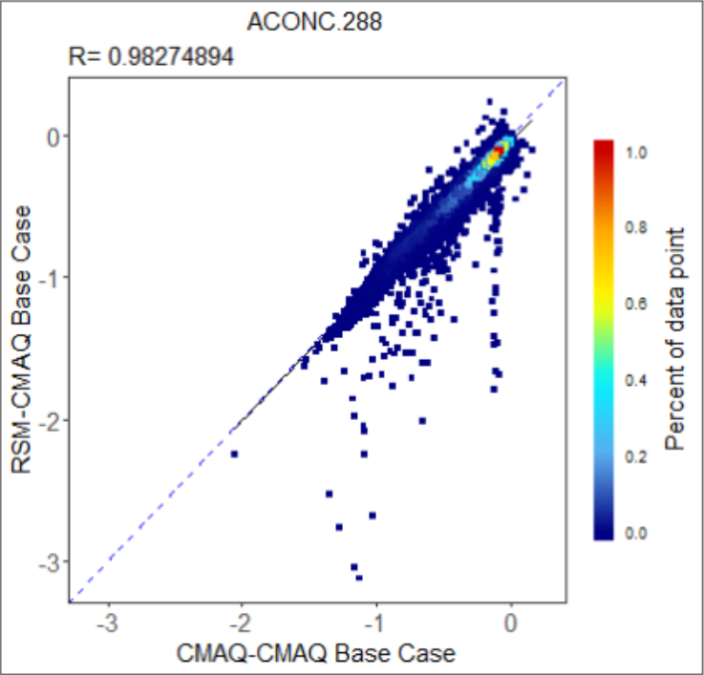
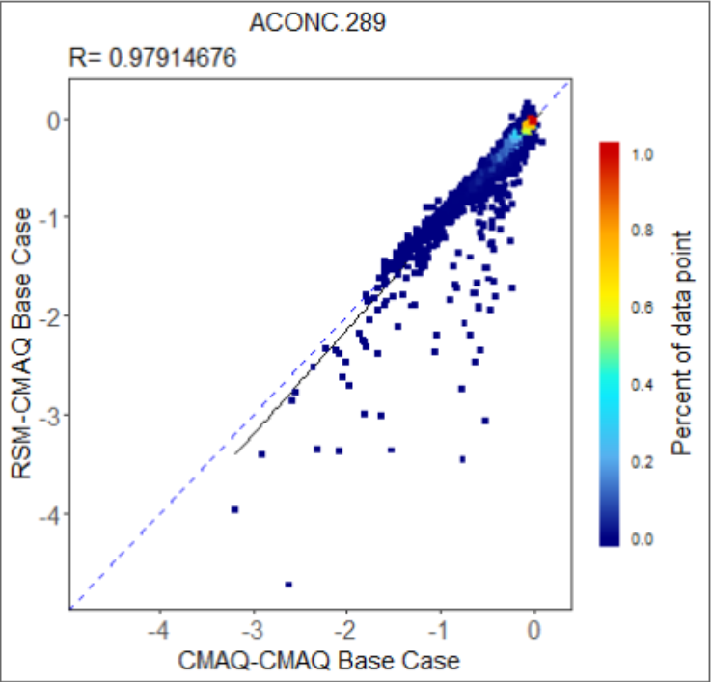
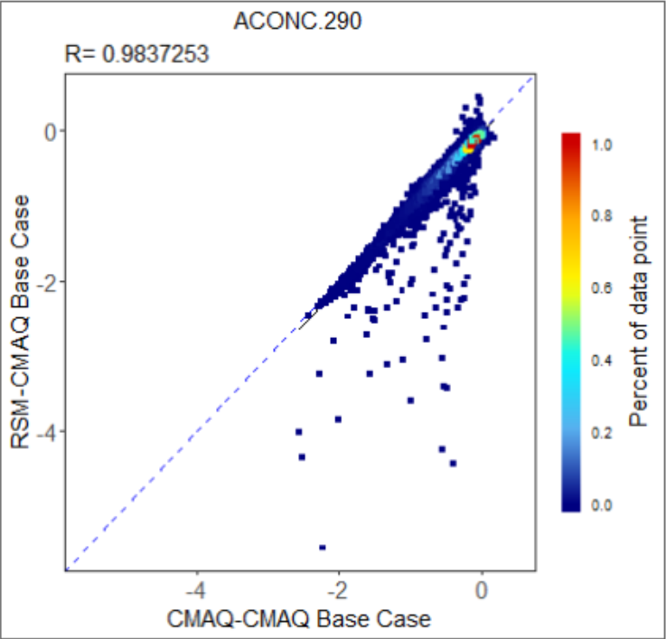
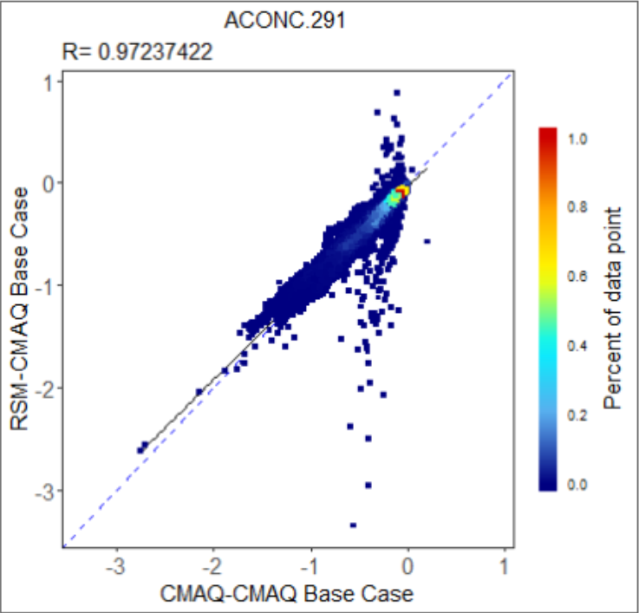
PM_{2.5} Performance Evaluation: DeepRSM vs. CMAQ
PM_{2.5} monthly average (July 2018, US Climate Regions)
DeepRSM vs. CMAQ (Concentration):
DeepRSM vs. CMAQ (Response):

Slide 13
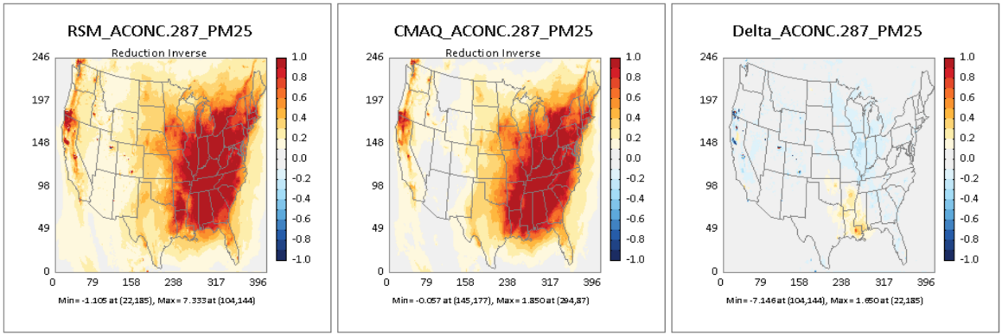
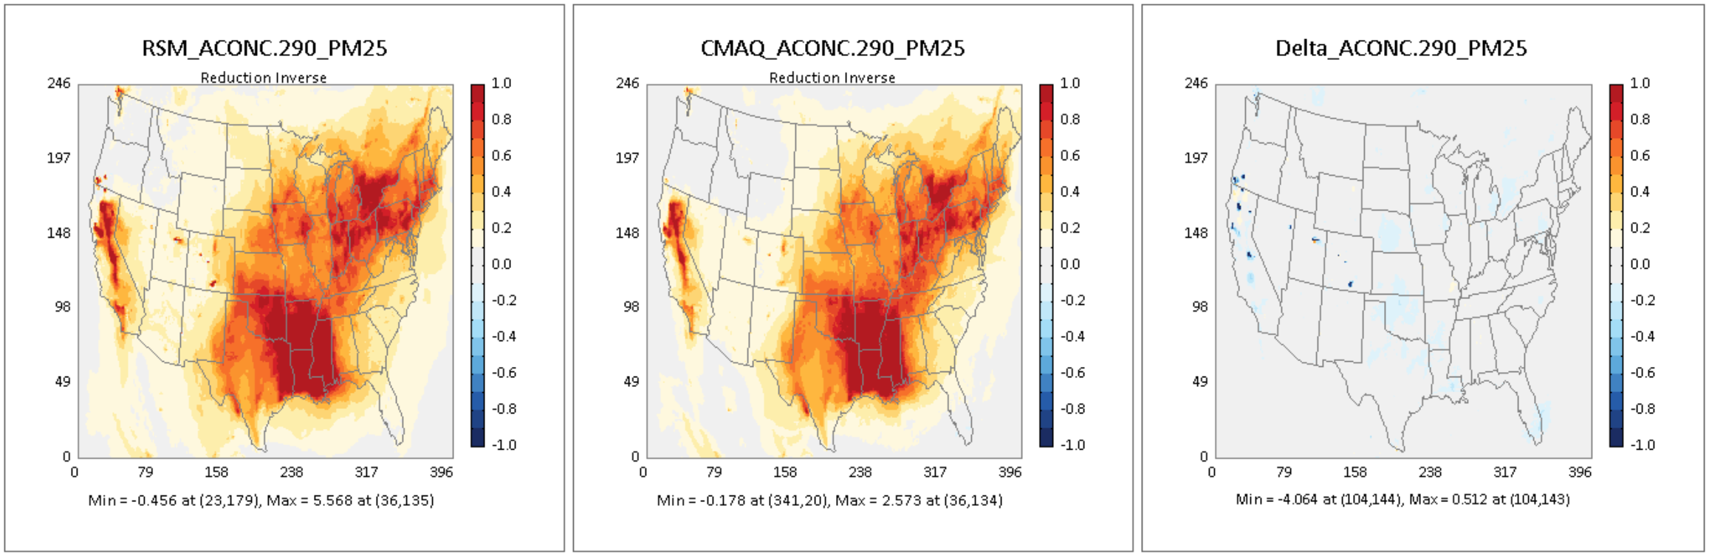
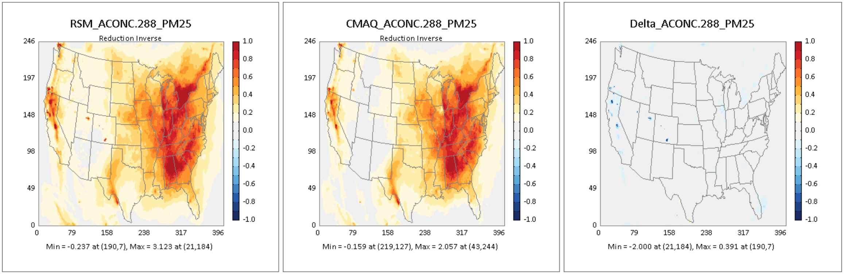
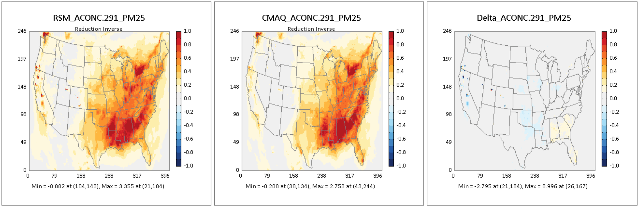
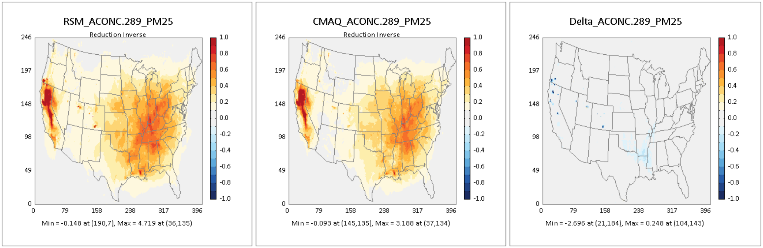
PM_{2.5} Performance Evaluation: DeepRSM vs. CMAQ
Response : PM_{2.5} monthly average (July 2018, US Climate Regions)
ACONC.287
ACONC.290
ACONC.288
Δ (CMAQ-RSM)
ACONC.291
Δ (CMAQ-RSM)
ACONC.289
Δ (CMAQ-RSM)
Note: Blue (negative) indicates higher DeepRSM response, Red (positive) indicates higher CMAQ response
in Δ (CMAQ-RSM)
Notes:
Response： The difference between the baseline scenario and the control scenario

Slide 14
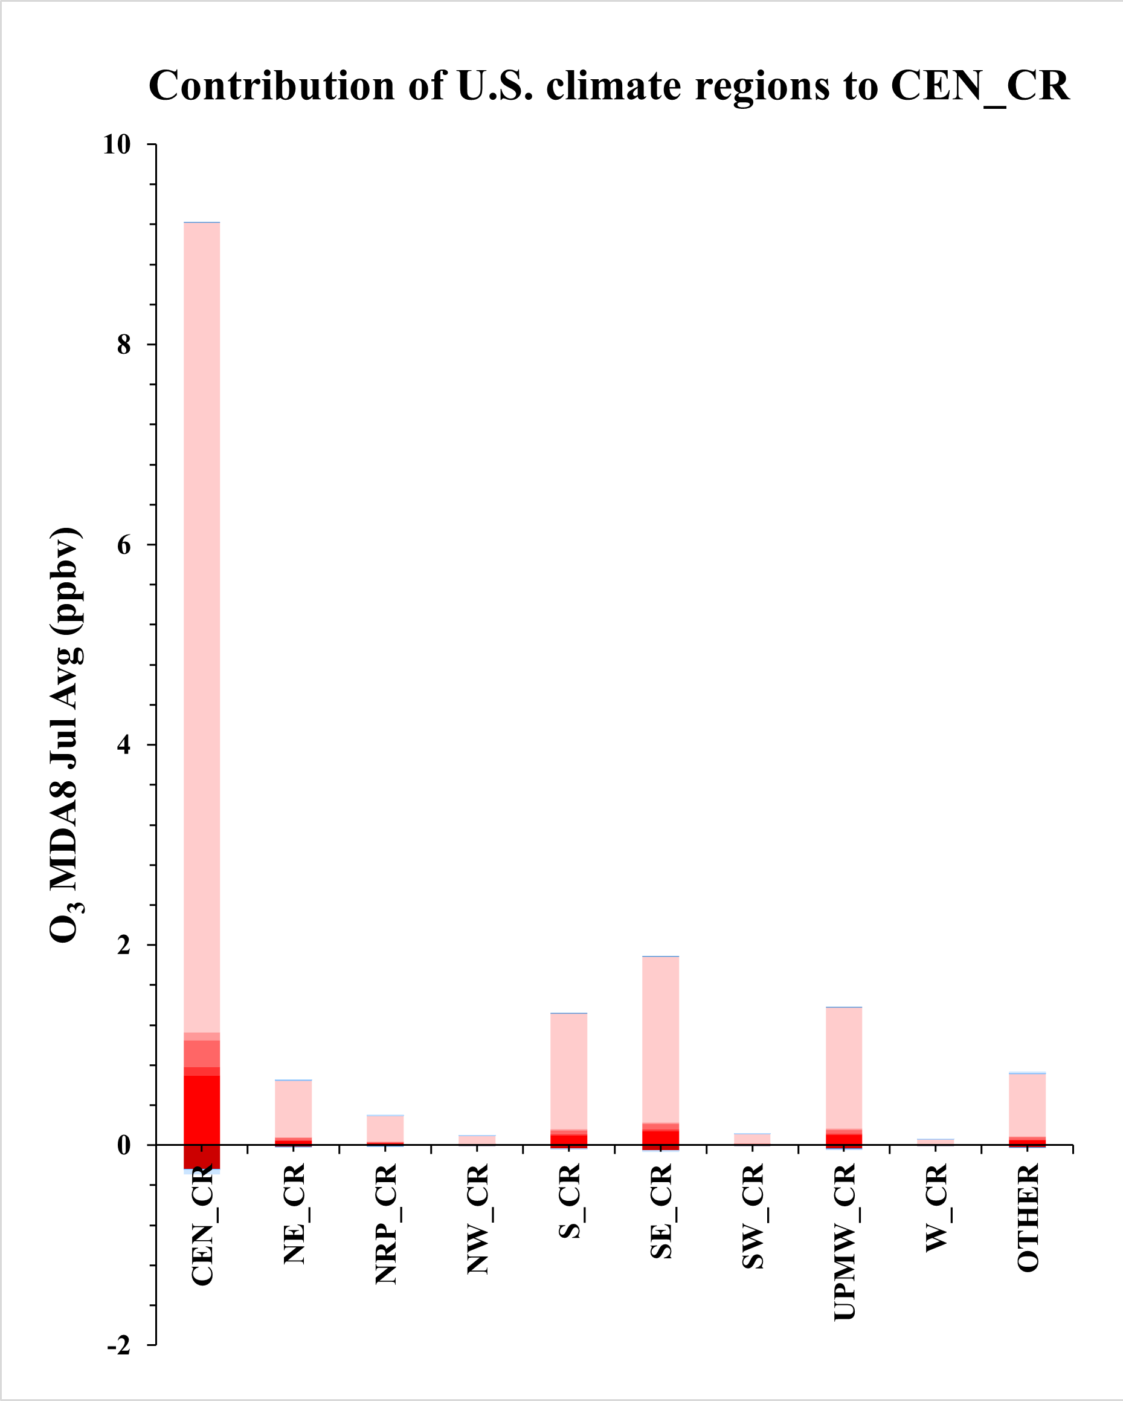
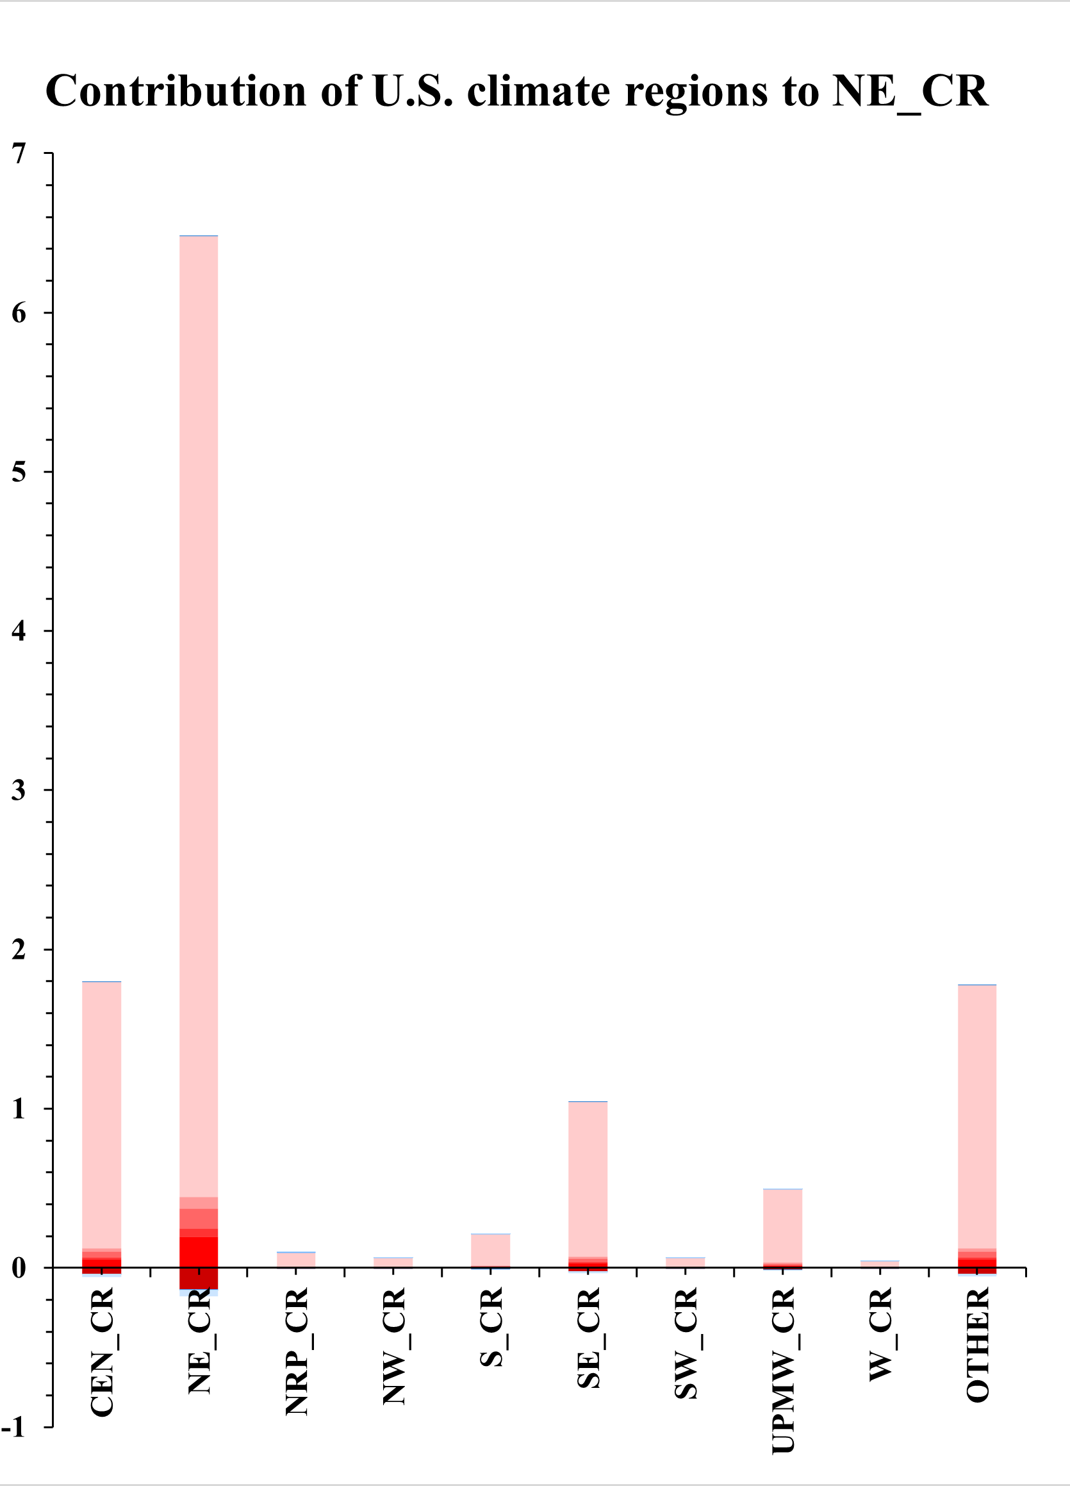
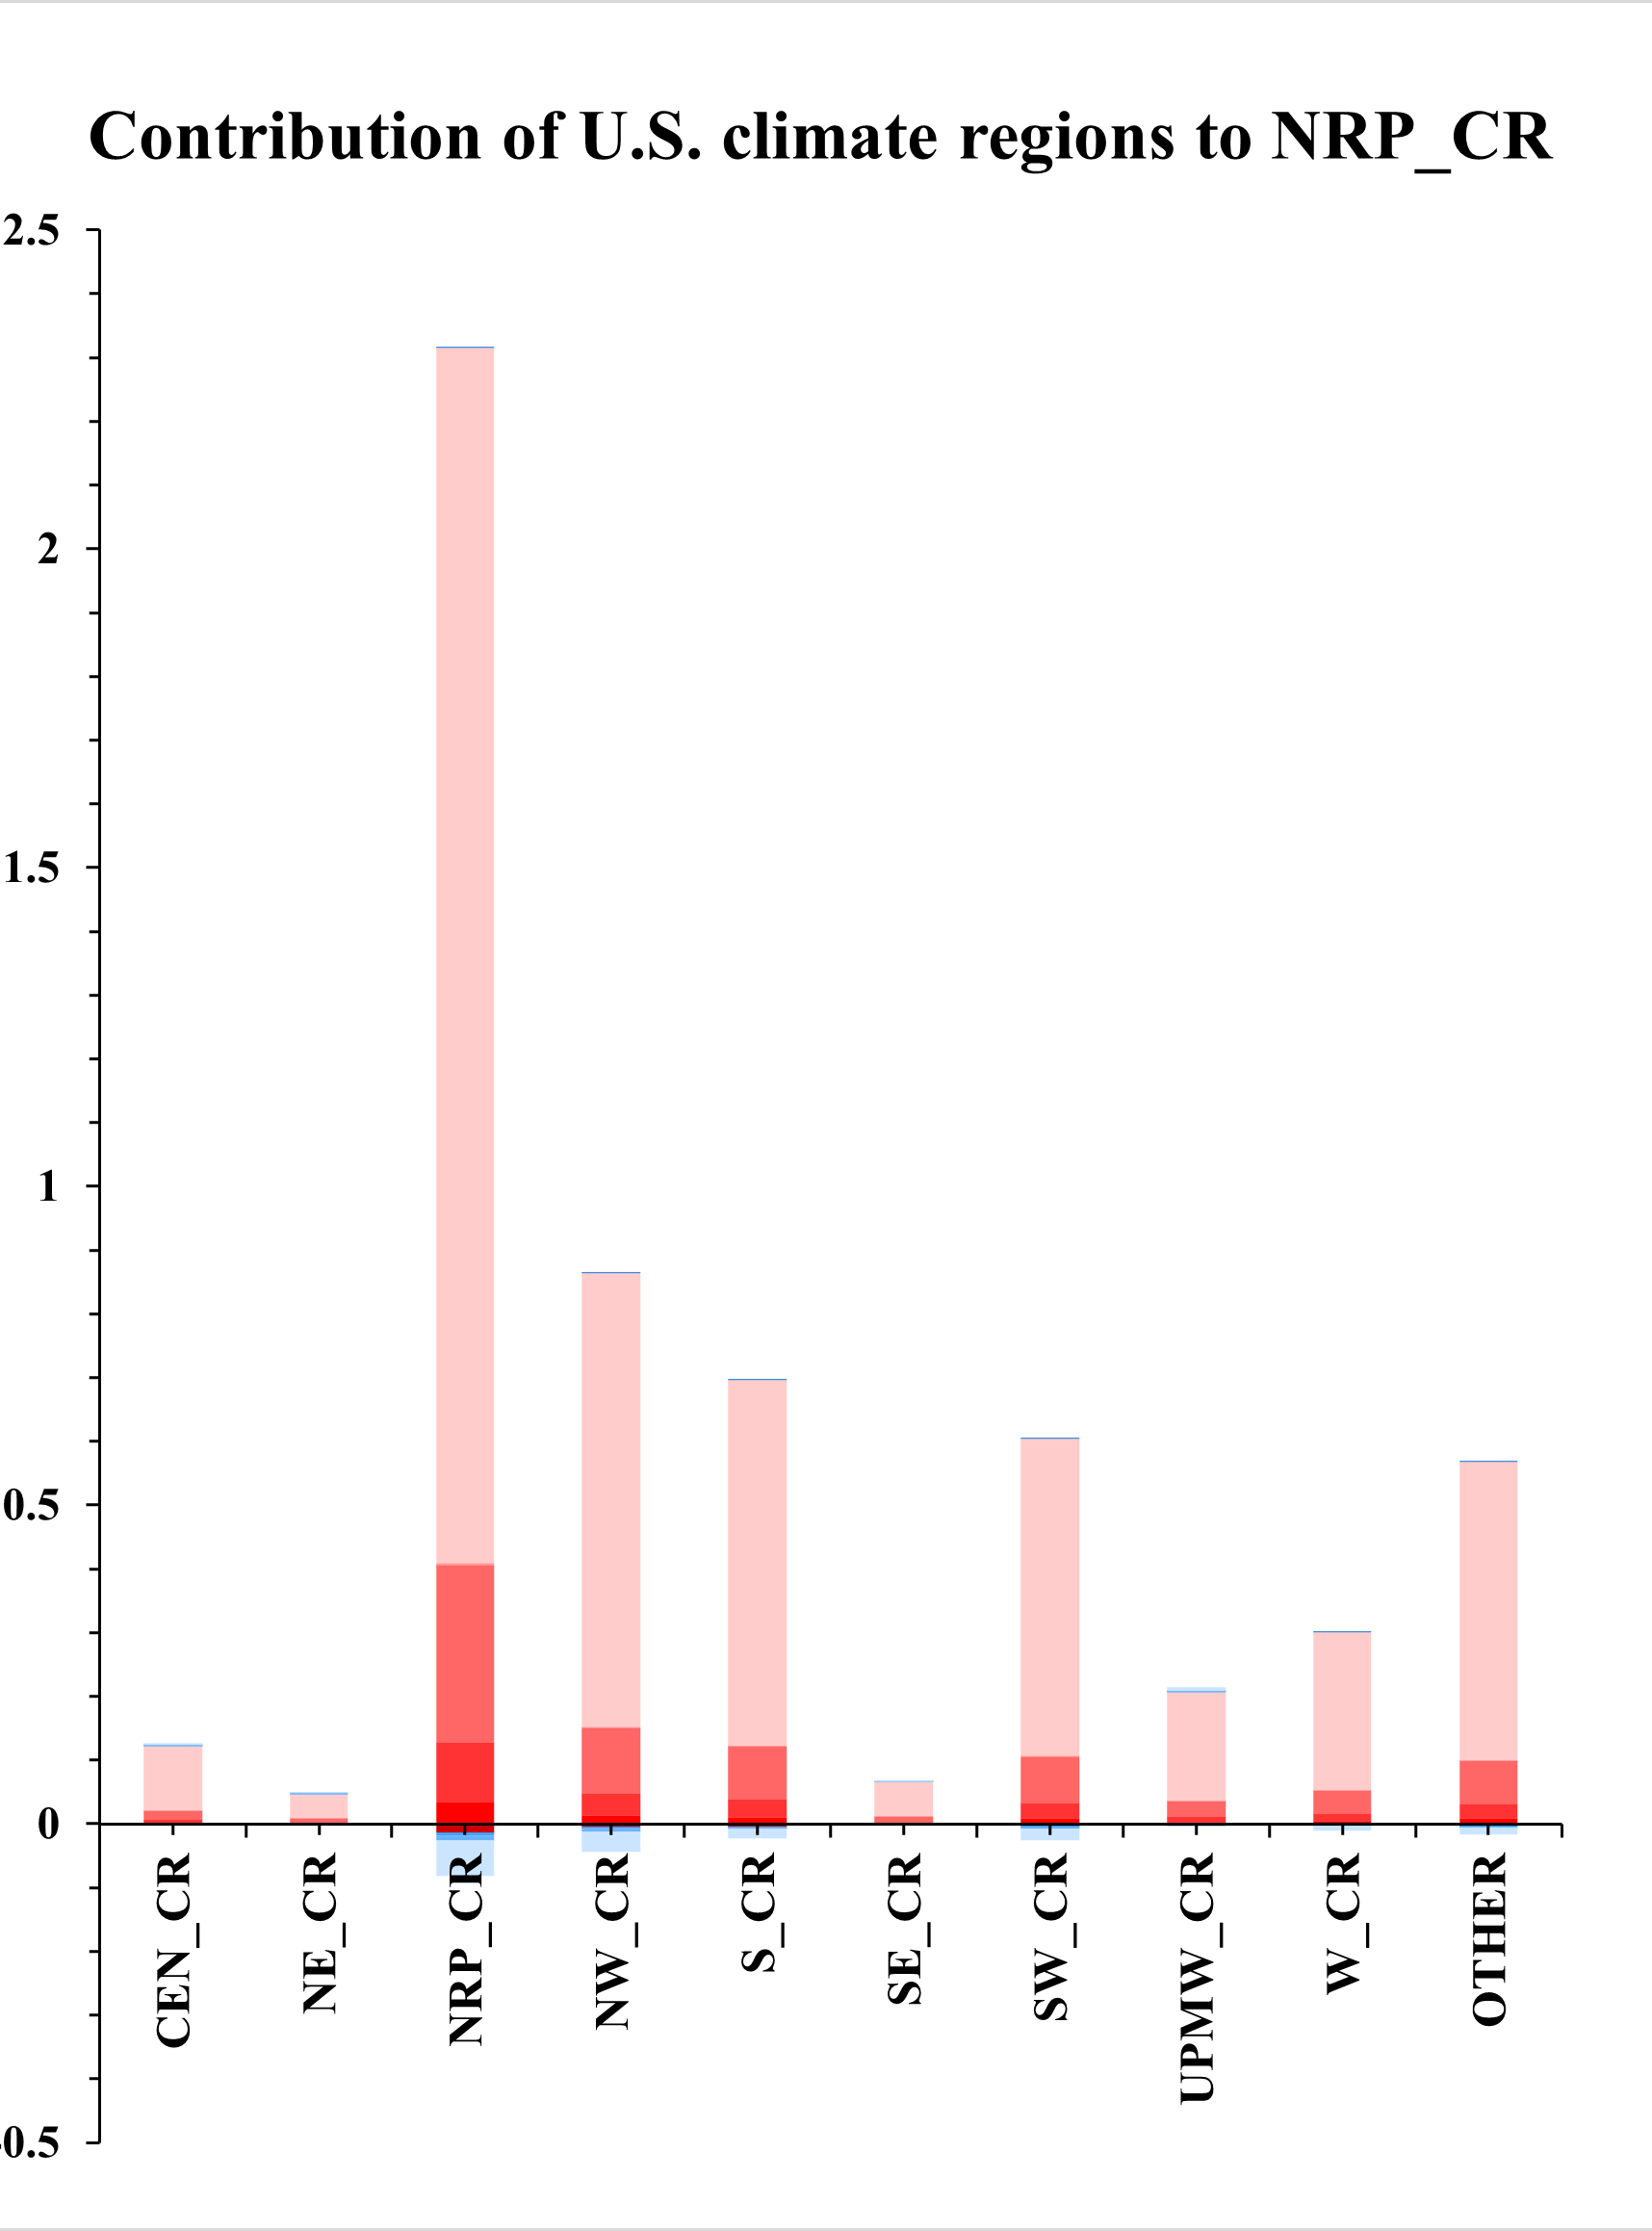
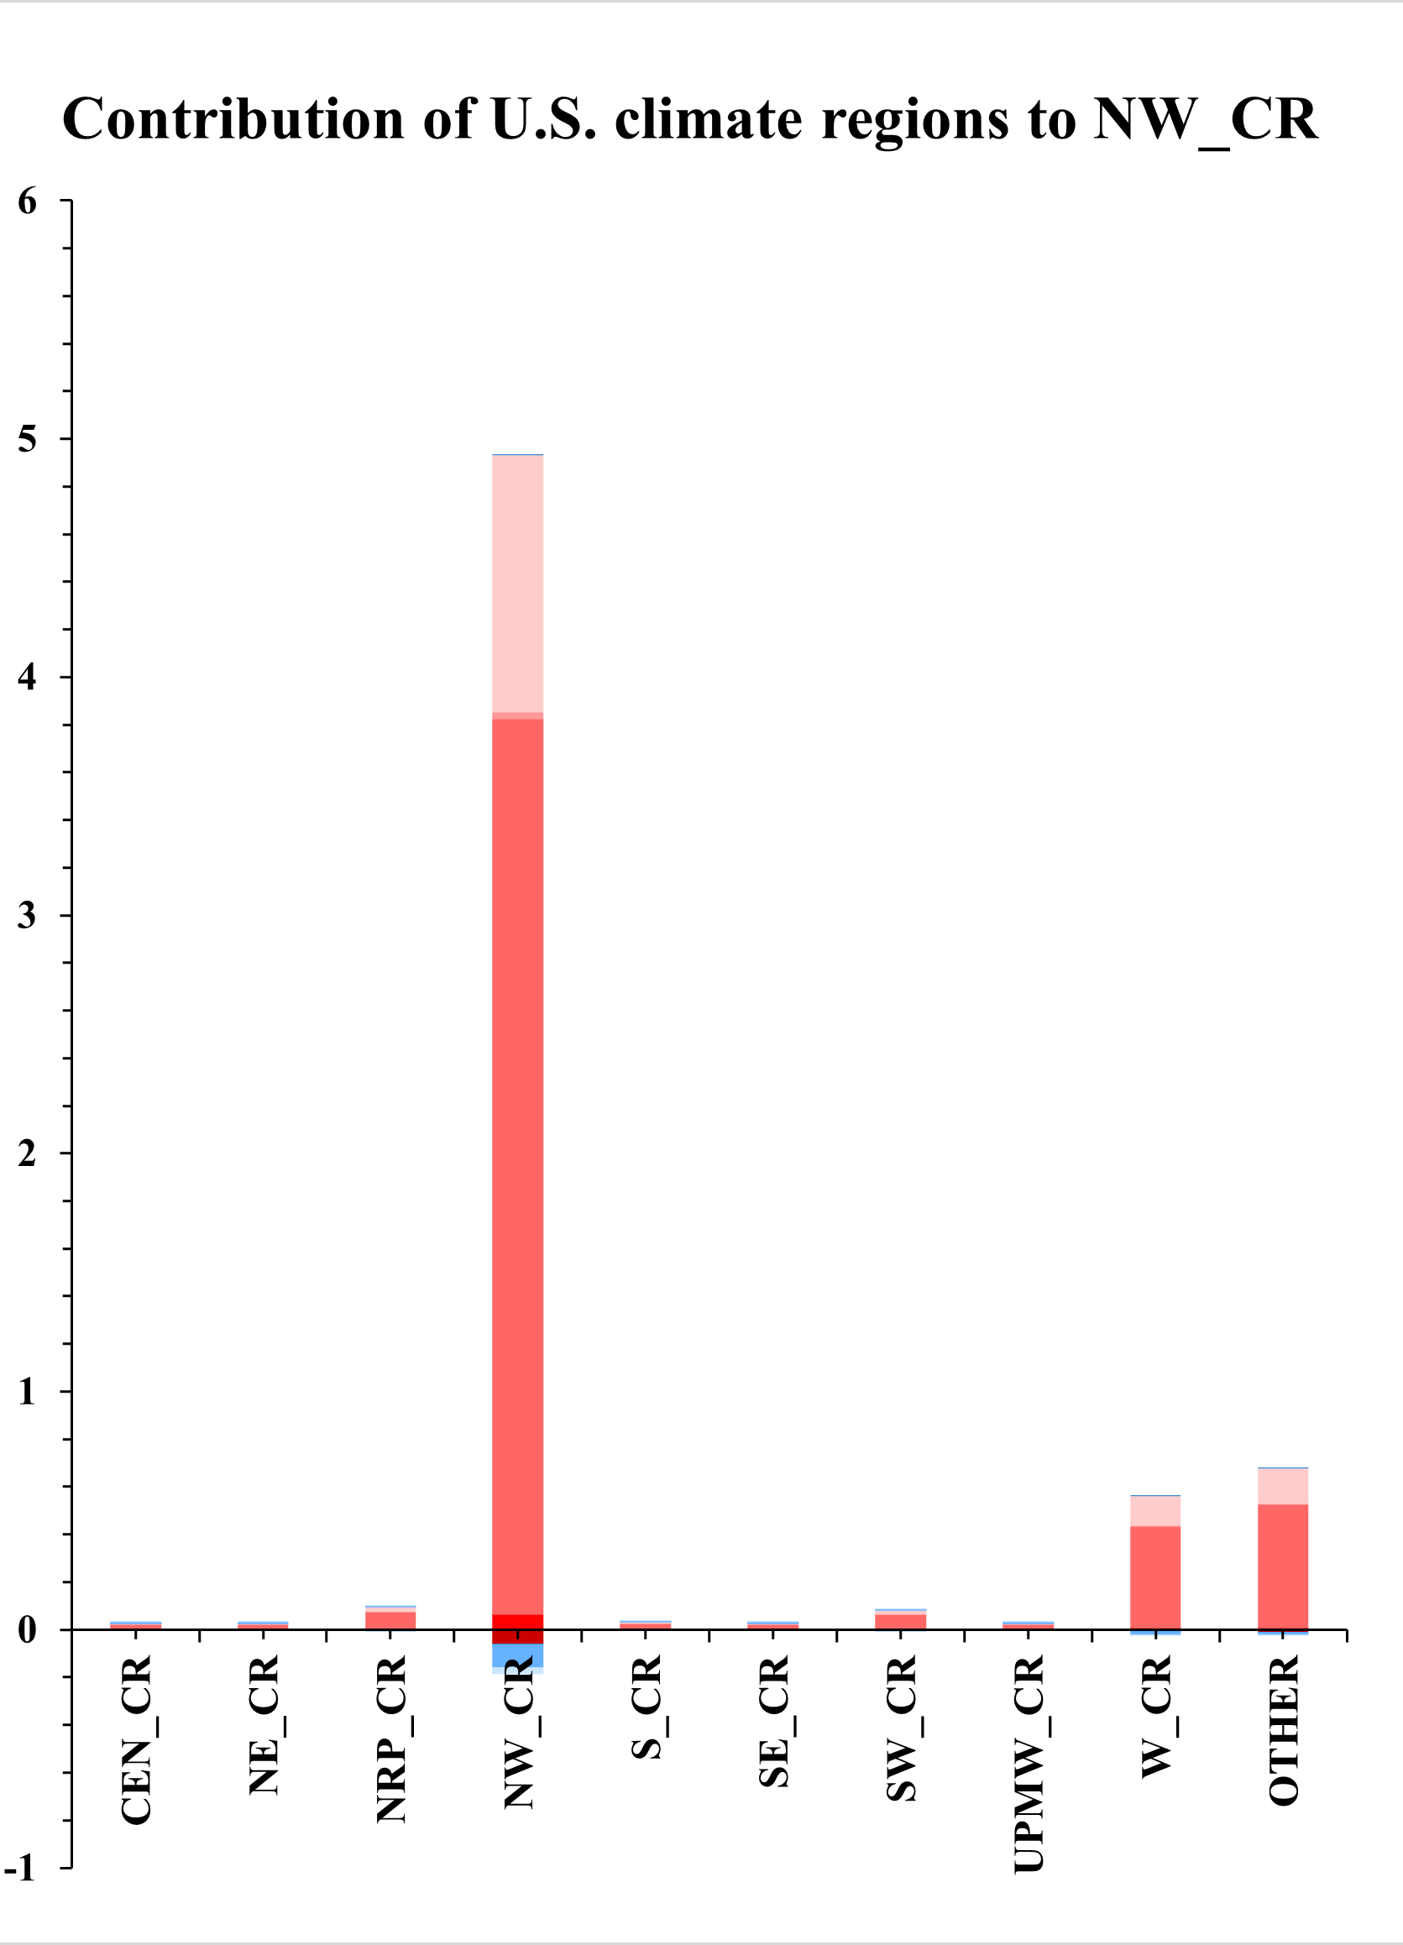
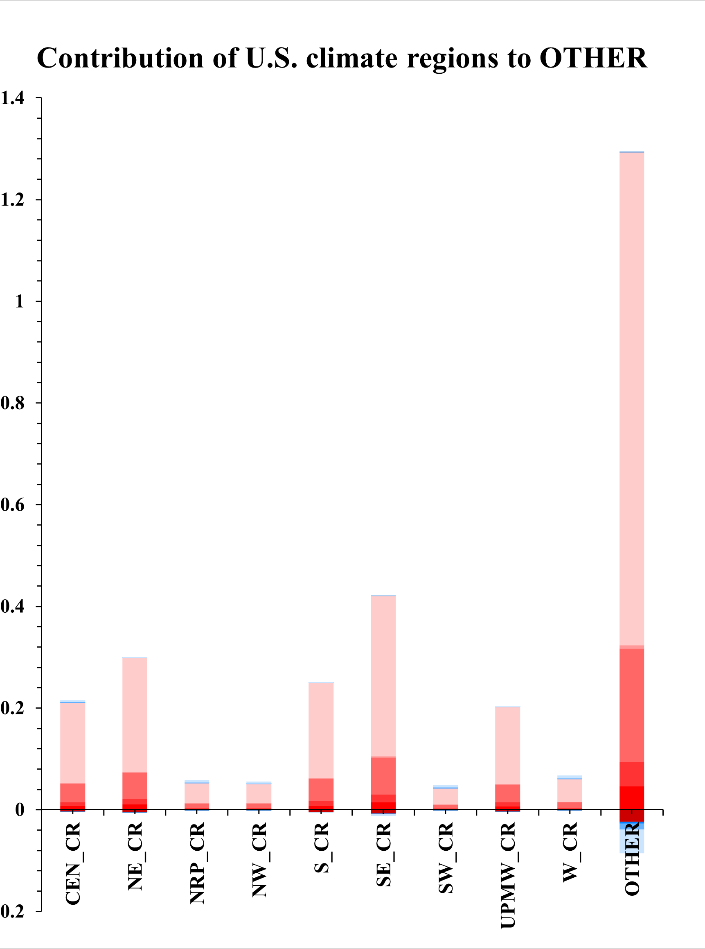
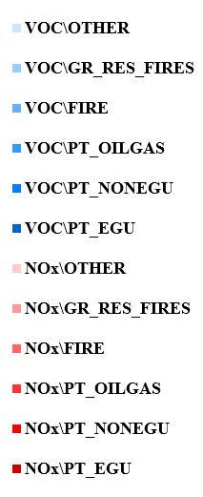
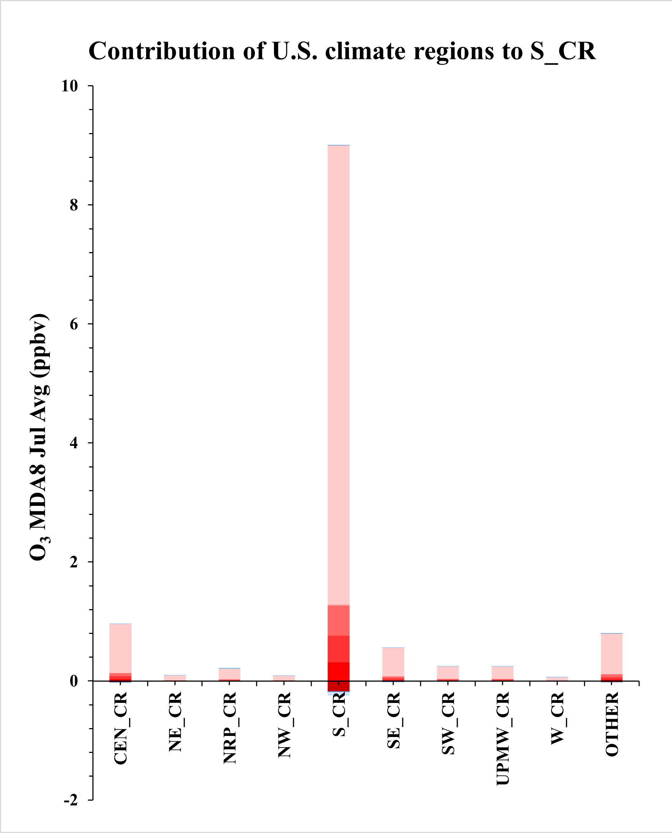
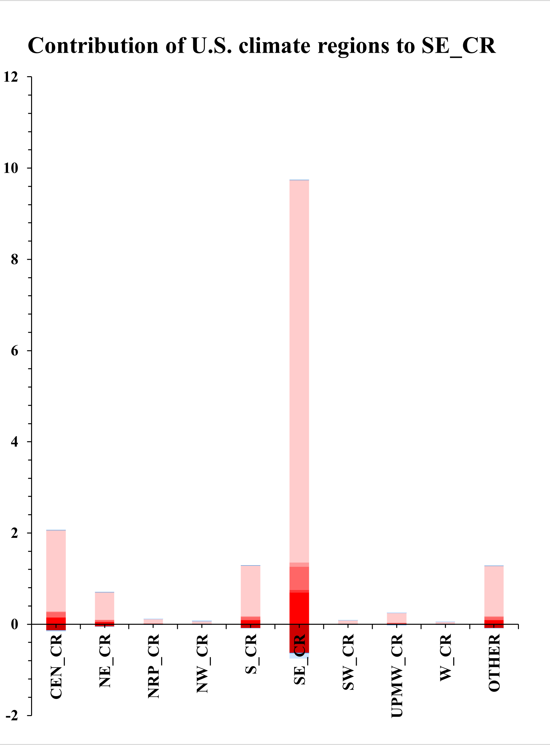
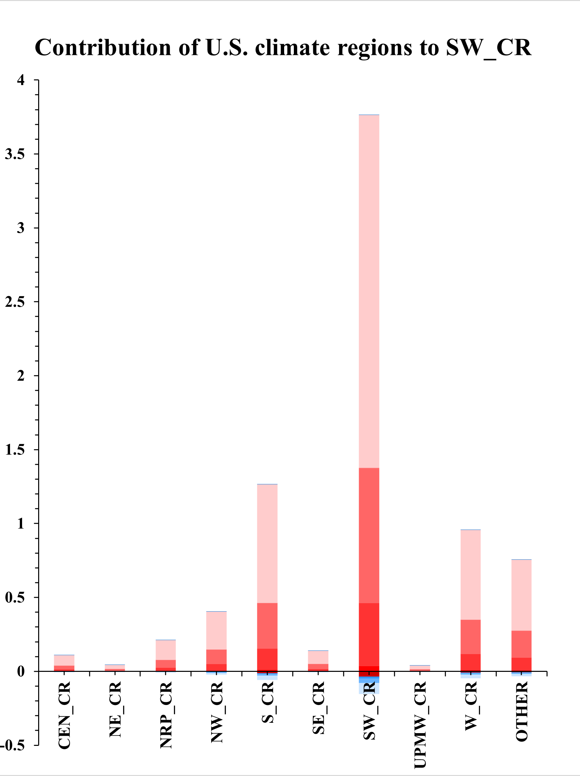
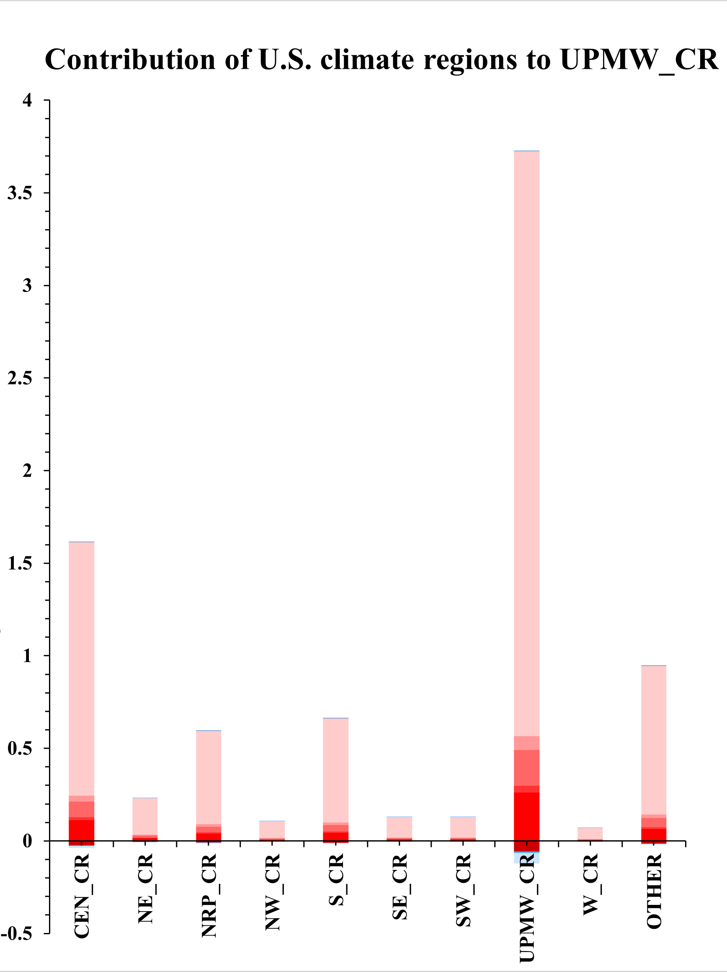

10 Climate Regions and 5 emission sectors (O₃)

Slide 15











10 Climate Regions and 5 emission sectors (PM_{2.5})

Slide 16
Summary of Source Attribution & Control/Response Modeling Methods
Modeling Techniques | Strengths | Limitations
Brute Force (BF) Method | Conceptually simple and easy to implement Traditionally served as baseline for AQ control response & impact assessment | Computationally expensive Not practical for multiple-source attribution
OSAT/PSAT/APCA (CAMx) & ISAM (CMAQ) | Computationally efficient Well documented and broadly applied Effective for multi-source (region/sector) apportionment assessment | Treatment of nonlinear chemistry Predict only positive contributions so could not treat nonlinear disbenefit issue (e.g., NOx disbenefit to O3 & PM2.5) Each precursor contributing only to a single PM2.5 species (e.g., NOx/SO2/NH3 only to PM-NO3⁻/ PM-SO4²⁻/PM-NH4⁺, respectively), and no species interactions nor SOA attribution
DDM/HDDM | Computationally efficient Well documented and broadly applied Can be used other than region/sector analysis (e.g., VOCs reactivities: “IR” ) | Limitations in predicting large emission reductions (e.g., > 50% cut) PM2.5 applications not supported yet
RSM & pf-RSM | Instant AQ response to emissions control Can replicate BFM effectively Well documented and applied | Computationally intensive Limited applications in USA May not be suitable for source apportionment
DeepRSM | Effective for control/response and multi-source contribution assessment Deep Learning “DeepRSM” is very promising in computational efficiency and accuracy | Need further performance evaluation & applications in USA
16

Slide 17
Take Home Messages & Next Steps
  “No one best tool to fit for all”:
    Each modeling technique has its own strengths & limitations
    Selecting a “best-fit” technique is depending upon policy analysis objectives
  “Source Attribution” vs. “Control/Response” modeling:
    They seem similar but somewhat different modeling assessment techniques
      Source Attribution: Chemistry regime based on “Baseline” case
      Control Response: Chemistry regime based on “Control & Baseline” case
  Suggested Work Plan & Next steps:
  Complete “2018 CMAQ” pilot case study for O3 & PM2.5 (species) and DeepRSM implementation on “FAST-CE” & “RSM-VAT”
    Evaluate/QA & compare “DeepRSM” vs. CMAQ-BF, ISAM (O3 & PM2.5) & HDDM (O3)
    Initiate pilot applications of “DeepRSM” to support regulatory modeling analysis
17

Slide 18






O₃ & PM_{2.5}: Comparisons of Source Contribution Methods
Comparisons of Source Attribution Methods (July 2018 case)
The responses of “DeepRSM” and “pf-RSM” are consistent with those of “CMAQ-BF Total”, indicating good performance of RSM, but higher (100%) reduction of VOCs shows a slight negative contribution, which may warrantee further improvements (e.g., increase the training cases).
Entire USA Domain O₃ Source Contribution Analysis
Entire USA Domain PM_{2.5} Source Contribution Analysis
CMAQ BF: NOx or VOC
Opf-RSM BF: NOx or VOC
DeepRSM BF: NOx or VOC
pf-RSM
DeepRSM
HDDM
CMAQ BF: Total
pf-RSM BF
DeepRSM BF
pf-RSM
DeepRSM
CMAQ BF: NOx or VOC
Opf-RSM BF: NOx or VOC
DeepRSM BF: NOx or VOC
pf-RSM
DeepRSM
HDDM
CMAQ BF: Total
pf-RSM BF
DeepRSM BF
pf-RSM
DeepRSM
CMAQ BF: NOx or VOC
Opf-RSM BF: NOx or VOC
DeepRSM BF: NOx or VOC
pf-RSM
DeepRSM
HDDM
CMAQ BF: Total
pf-RSM BF
DeepRSM BF
pf-RSM
DeepRSM
CMAQ BF: NOx or VOC
Opf-RSM BF: NOx or VOC
DeepRSM BF: NOx or VOC
Opf-RSM
DeepRSM
HDDM
ISAM
CMAQ BF: Total
pf-RSM BF
DeepRSM BF
Opf-RSM
DeepRSM
CMAQ BF
(NOx and VOC)
O₃ MDA8 Jul Avg (ppbv)
PM_{2.5} Jul Avg (μg/m³)
Note: “Total” indicates the difference between the base case and the control case with reduction of NO_{x} and VOC.
Note : “BF” refers to control separately for NO_{x}, VOC, NH₃ , SO₂ or PM_{2.5}

Slide 19


FAST-CE applications
Results of O₃ source contribution analysis for the US climate region using FAST-CE
Results of PM_{2.5} source contribution analysis for the US climate region using FAST-CE

