Slide 1
Updating Utah dust emission predictions using local soil and land cover conditions
Ty Hosler, Bradley Adams
Brigham Young University
Air Quality Research Lab
CMAS Conference
October 17, 2023

Slide 2
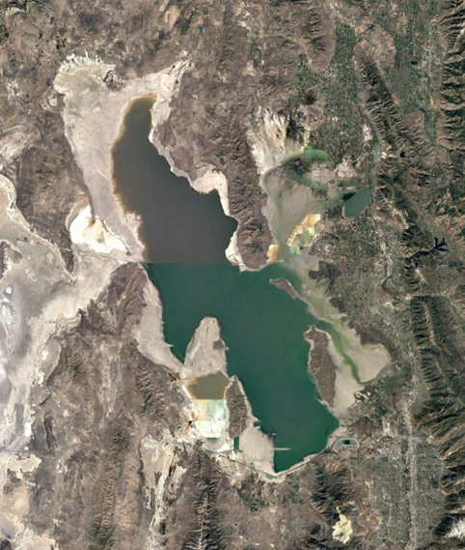

Outline
Dust modeling approach
Dust emission mechanisms
Utah soil texture effects
CMAQ model results
Impact of environmental factors
Conclusions
BYU

Slide 3
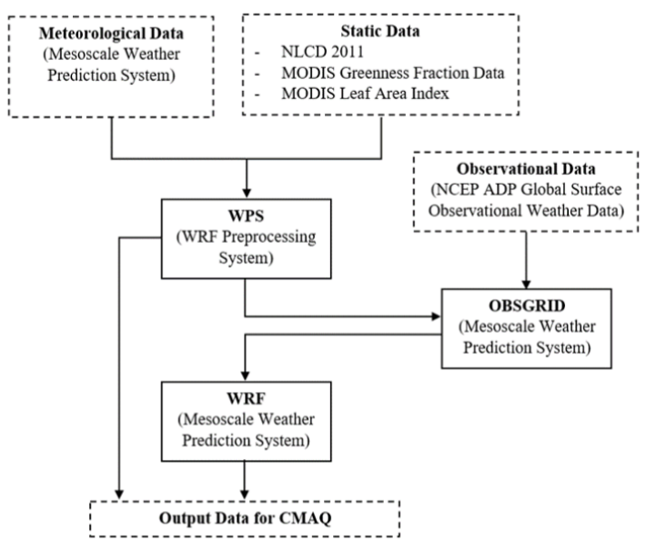
Software Overview
Meteorological and land use inputs taken from national databases (NCEP FNL, NLCD, MODIS)
WRF 4.2.1 calculates met data, land use, soil type
  Surface conditions updated with OBSGRID
CMAQ 5.3.1 calculates dust emission, transport, deposition
User Guide: https://doi.org/10.26067/FACPUB/5515
BYU
Notes:
Visualization with VERDI

Slide 4
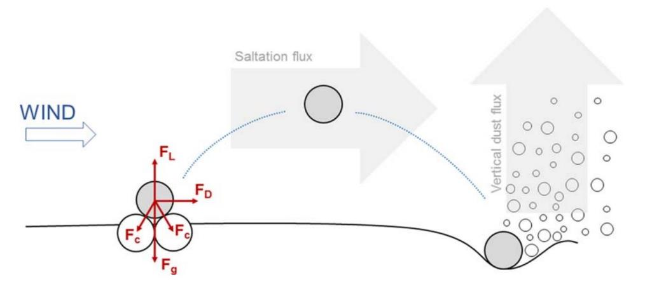

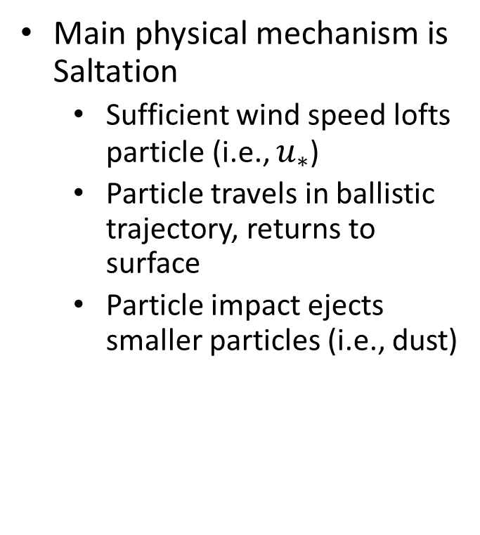
Dust Emission: Mechanisms
Main physical mechanism is Saltation
  Sufficient wind speed lofts particle (i.e., $u_{∗}$)
  Particle travels in ballistic trajectory, returns to surface
  Particle impact ejects smaller particles (i.e., dust)
From Foroutan et al. (2017)
Notes:
Lift and Drag forces must exceed interparticle cohesive forces (van der waal’s, water capillary forces) and gravity force on particle for it to be lofted
After impact we get a vertical flux representative of dust emission

Slide 5
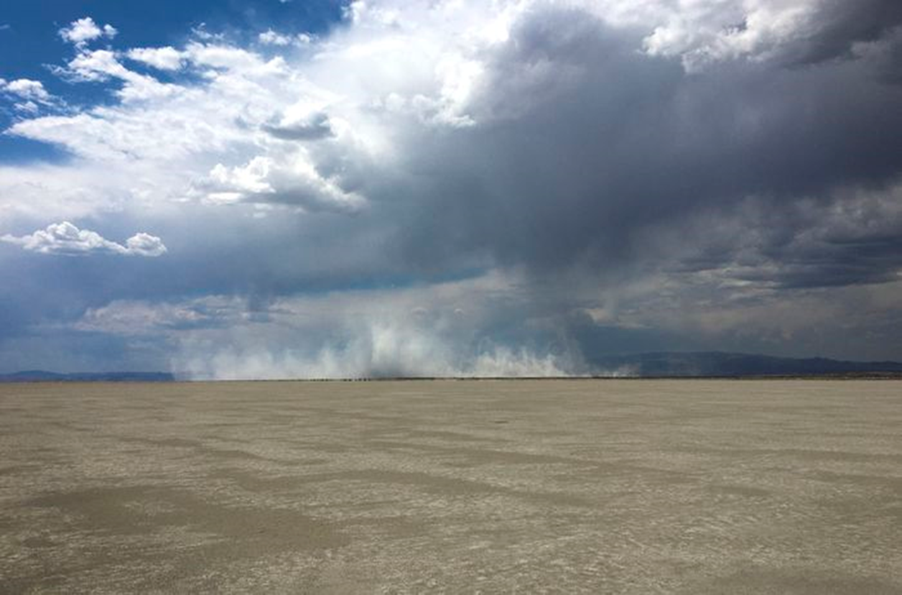

Dust Emission: Modeling
For dust to be emitted $u_{∗}$ > $u_{∗,t}$
$$u_{∗,t}=u_{∗,t0}f_{m}f_{r}$$
$$f_{m}\left(w\right)=\left\{\begin{aligned}1.0, &w<w^{′} \\ {(1.0+1.21{\left(w−w^{′}\right)}^{0.68})}^{0.5}, &w≥w^{′}\end{aligned}\right.$$
$$w^{′}=0.0014{(\%Clay)}^{2}+0.17(\%Clay)$$
Soil texture affects PSD and Soil moisture factor
From Fecan et al. (1999)
Notes:
Where $u_{∗,t0}$ is the ideal threshold friction velocity on a flat, smooth , dry surface.
f_m is the correction factor for soil moisture, while f_r is the correction factor for surface roughness
Increases in soil moisture and surface roughness protect the surface from erosion
$f_{sc}f_{c}$ set to 1 due to lack of information regarding them (salt concentration and crust)

Slide 6
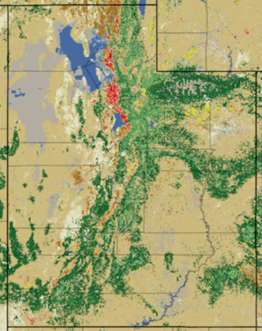
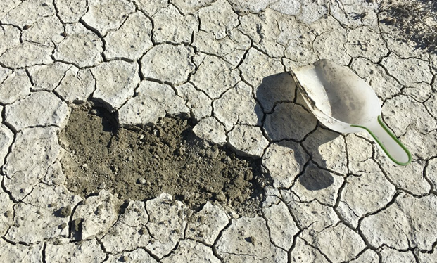
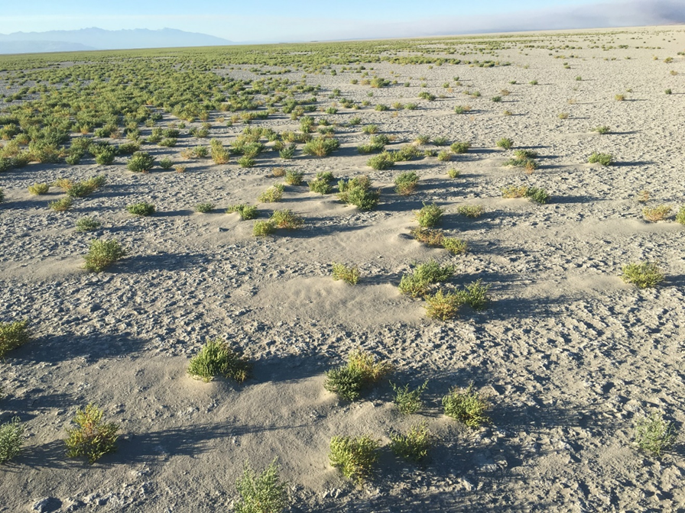
Motivation
Dust emission, transport, and deposition are important in Utah
  Public health
  Economics
  Environment
Improved emissions = improved transport and deposition
Default CMAQ properties not reflective of Utah
  Soil texture
  Snow cover
  Vegetation
  Crust
Receding shoreline
Great Salt Lake Desert
Sevier Dry Lake
Notes:
As we became more familiar with the CMAQ model, we began to suspect that its default properties were not reflective of Utah properties

Slide 7
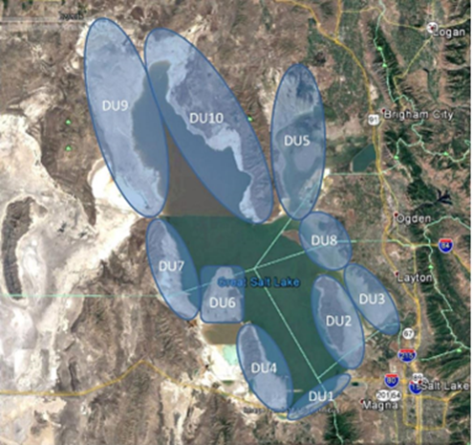
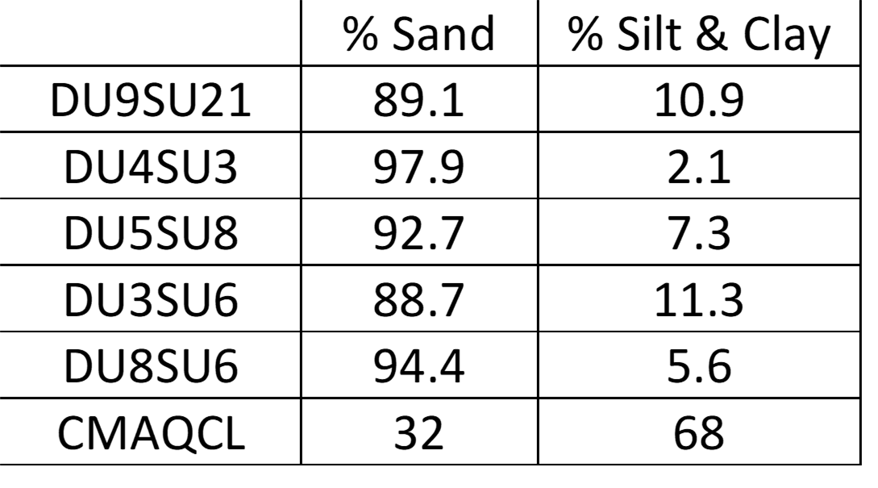

Effect of updated soil texture vs default
Soil composition changes influence dust emission in the following ways:
  Potential saltators
  Potential dust particles
  Threshold friction velocity ($u_{∗,t}$)
Suggests dust emission is overpredicted with default properties
From Perry et al. (2019)
Notes:
Perry et al took over 5000 samples, and measured many properties, among which was soil composition.
Saltating particles – for example, decreasing silt and clay % increases the number of possible saltators, but reduces the possible number of smaller particles that can be emitted as dust
These properties seem to be a reasonable approximation of other Utah playas

Slide 8
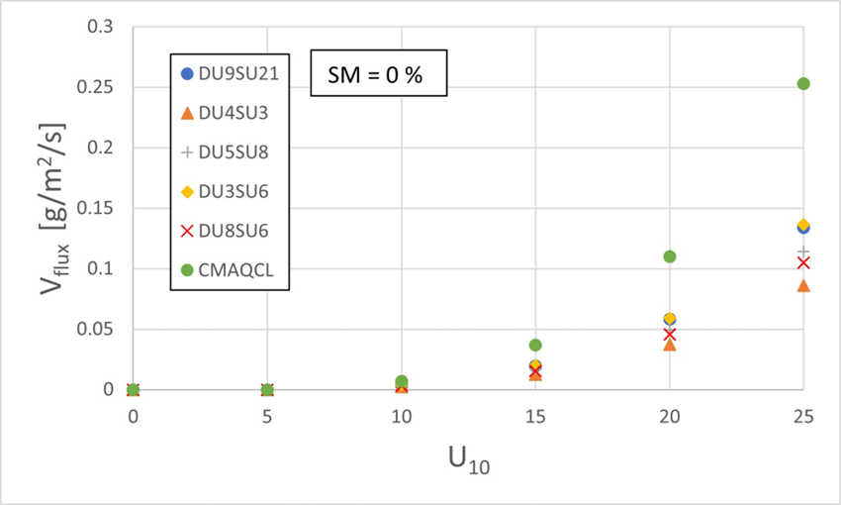
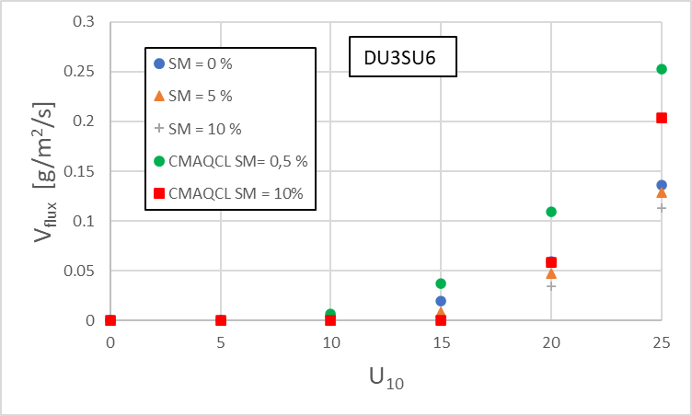
Effect of updated soil texture vs default
Standalone emission model
Effect of texture/PSD
Effect of soil moisture
CMAQCL w’ = 7.394 %
DU3SU6 w’ = 1.005 %
Notes:
Reduced clay and silt = reduced vertical flux upwards of 40-50% over the U10 velocities explored here (0% SM)
This plot demonstrates two effects:
Soil moisture threshold
Once the threshold exceeded CMAQCL still emits more

Slide 9
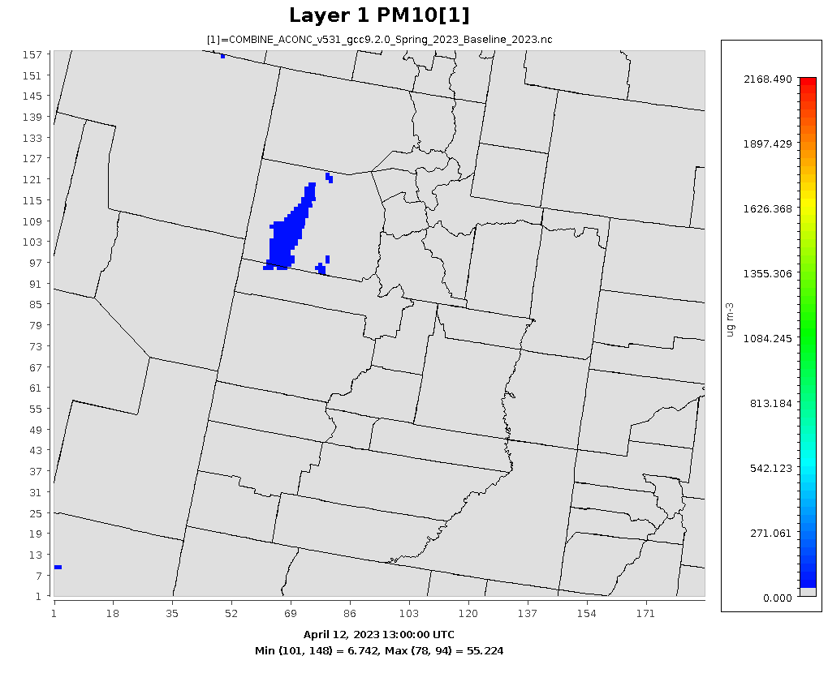
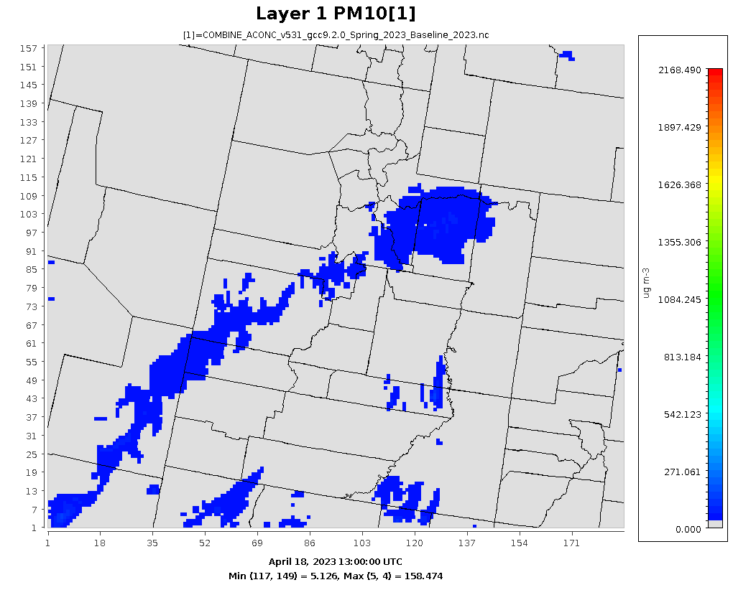
Effect of updated soil texture for two Utah meteorological events
PM10 Concentration
PM10 Concentration
4/12/23
4/18/23
April 12, 2023 Event
  Winds from the Southwest to Northeast
  Dust transport mostly from GSL Desert and Sevier Dry lake to the Wasatch Front
April 18, 2023 Event
  Winds from the West to East
  Dust from Great Salt Lake Desert transported to the Wasatch Front and deep into the Wasatch and Uinta ranges

Slide 10
Dust Events: April 12 & April 18, 2023
PM10 % Difference
PM10 % Difference
PM10 Cumulative % Difference
4/2 - 4/20
2023
4/12/23
00:00 UTC
4/19/23
00:00 UTC
Notes:
For both events, saw maximum PM10 concentration reductions of ~95%.
Compounding reduction due to soil texture change (i.e., significantly reduced potential dust particles) and reduced w’ below w for the events studied. This significantly increased the required threshold friction velocity for dust emission to occur.
The cumulative % difference plot is the difference between the sum of PM10 concentrations in each cell over the entire simulation timespan for the default and updated soil textures. It acts as a tracer for the areas which emitted less dust

Slide 11
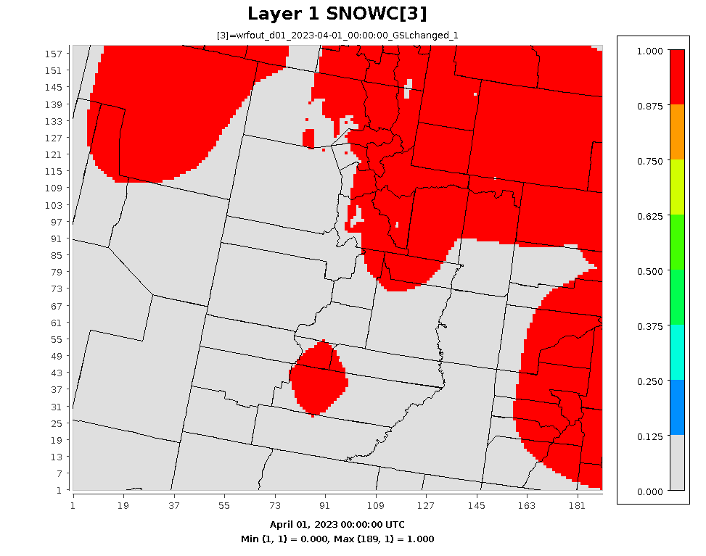
Snow cover
Accounting for snow in Utah’s Spring dust season is critical
2023 was a record snow year for Utah
Snow cover can vary drastically throughout spring
  Use OBSGRID to more accurately account for snow cover
Snow Cover (April 1 – April 7, 2023)
BYU
Notes:
Obsgrid updates the multi-year average “best guess” with local observations to better represent the actual snow cover on the ground.
On dry years this is especially important otherwise the model says there is far less dust emission than what actually occurs.

Slide 12
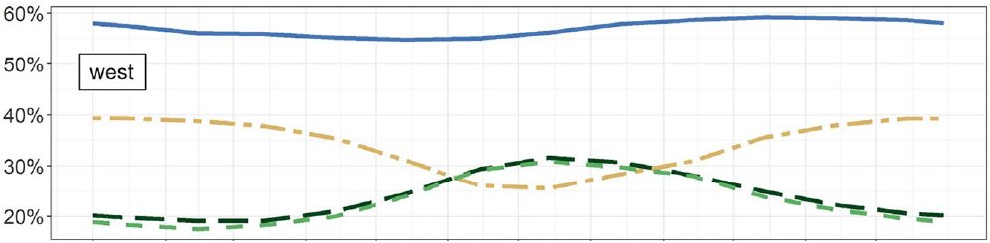

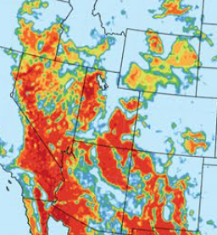
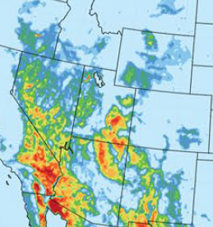

Non-photosynthetic vegetation
Current: Added non-photosynthetic (brown) vegetation fraction (NPV)
  Developed by Foroutan and Huang
  NPV reduces amount of erodible land
  NPV reduces wind drag
Future: Develop crust model
Future: Weighted averaging of properties
2016 averaged vegetation fractions in western US
Fraction of vegetation-free erodible lands (2016 spring)
PV Only
PV + NPV
From Huang and Foroutan (2022) JGR: Atmospheres,
doi.org/10.1029/2021JDo35243
BYU
Notes:
PV – photosynthetic (green) veg fraction; NPV – non-photosynthetic (brown) veg fraction;
PV only – MOD15A2GFS – FPAR; NPV – MODIS Nadir BRDF-Adjusted Reflectance with spectral mixture analysis
FPAR is fraction of photosynthetically active radiation (400-700 nm) absorbed by green vegetation.

Slide 13
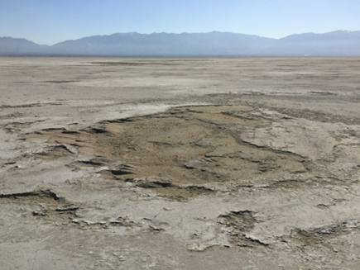
Conclusions
Default CMAQ properties overpredict Utah emissions:
  Soil moisture is tied to soil texture:
    As % Silt and Clay is reduced, w’ is reduced as well
    Compounding emission reduction with reduced silt and clay
  OBSGRID required to accurately account for Snow cover in Utah
  Non-photosynthetic vegetation:
    Reduces erodible land fraction
    Reduces wind drag
  Soil crust needs to be considered for many Utah dust sources:
    GSL shoreline
    GSL desert
    Sevier Dry Lake

Slide 14
Acknowledgments
NSF Award # 000530-00001, Dust in the Critical Zone from the Great Basin to the Rocky Mountains
Kevin Perry, University of Utah
Xinyue Huang & Hosein Foroutan, Virginia Tech
BYU office of Research Computing

