Slide 1
22nd Annual
CMAS Conference
^{October 16-18, 2023}
Quantifying Aircraft Emissions with Inverse Modeling: A Case Study at the Los Angeles International Airport
Gavendra Pandey and Saravanan Arunachalam
Institute for the Environment, University of North Carolina at Chapel Hill

Slide 2
Aircraft Dispersion Modelling (Background)
Aircraft emissions from an airport are a significant source of total emissions that have an impact on air quality in the airport vicinity (Arunachalam et al, 2011).
Aircraft activities at airports produce CO₂ and H₂O emissions that affect climate as well as other pollutants (NO_{x}, SO_{x}, and PM_{2.5}) that impact local air quality (Woody et al, 2011; 2015; 2016, Stettler et al., 2011; Levy et al, 2012; Ashok et al, 2017).
Aircraft sources are unique due to the transient nature of the emissions from each source, as well as the buoyant exhaust.
These sources emit the pollutants in short bursts, especially during landing and takeoff operations (LTO) and it is difficult to quantify these short bursts of emissions and model the governing processes.
Added complexity occurs when
when the airport is situated near a shoreline where meteorological conditions are far from being spatially uniform.

Slide 3
Quantifying Aircraft Emissions with Inverse Modeling: A Case Study at the Los Angeles International Airport (LAX)
Motivation
Airports need a dispersion modeling system that incorporates all physical and chemical processes related to LAQ (Local Air Quality) around airports
For the LAX study, we have seen that current regulatory model AERMOD underpredicts daytime concentrations even during hours with high emissions
Known limitations in AERMOD (Arunachalam et al, 2017; ACRP Report 179)
Identified issues related to:
Source representation: area vs. volume vs. line
Lack of plume rise for hot buoyant plumes
Limited treatment of chemistry
Time Scale – Sub-Hourly Approach
Shoreline effects to account for marine boundary layer
Objective
To quantify aircraft emissions at a large airport using inverse modeling approach and compare those with existing emissions estimates
(Pandey et al., 2023 (Under Review)
(Pandey et al., Atmos. Environ. 2023)
(Pandey et al., Atmos. Environ. 2022)

Slide 4
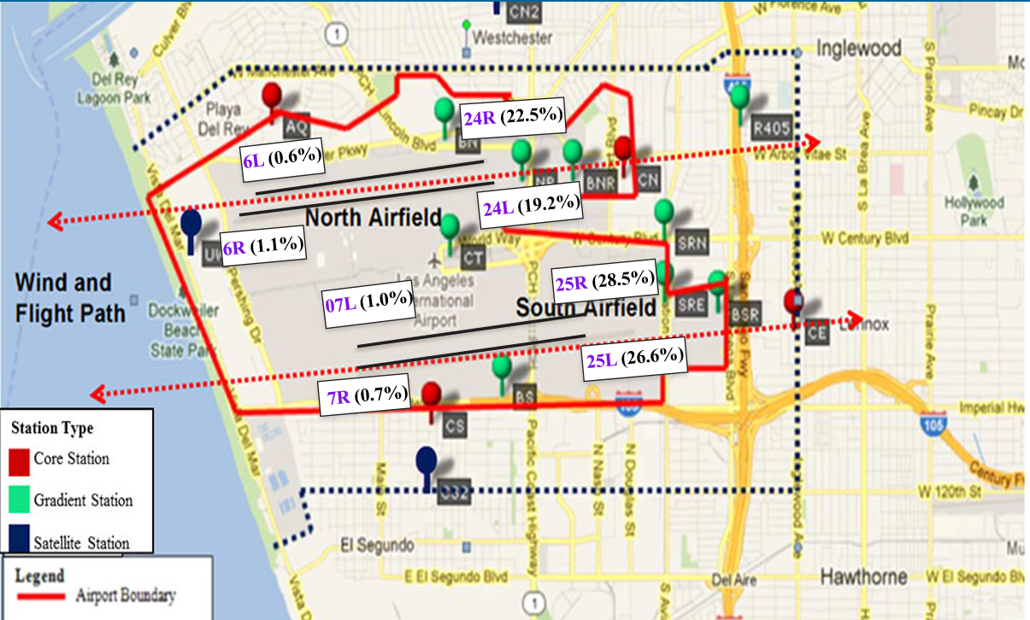
Model Evaluation with LAWA Study Data
SO₂ concentrations in the vicinity of the airport are dominated by aircraft emissions (given fuel Sulfur content)
Winter (Jan 31 – Mar 13, 2012)
Summer (Jul 18 – Aug 28, 2012)
17 Locations: 4 “core”, 4 “satellite”, 9 “gradient”
Over 400 compounds measured
AERMOD is evaluated with
SO₂ measurements from LAWA study conducted during winter and summer of 2012 at the AQ, CN, CS, and CE monitors shown in the figure
using 2 sets of meteorology:
Original Meteorology generated by AERMET and
Modified Meteorology based on region-specific modifications of AERMET outputs
Pandey et al, Atmos. Environ., 2022
LAWA: Los Angeles World Airports

Slide 5
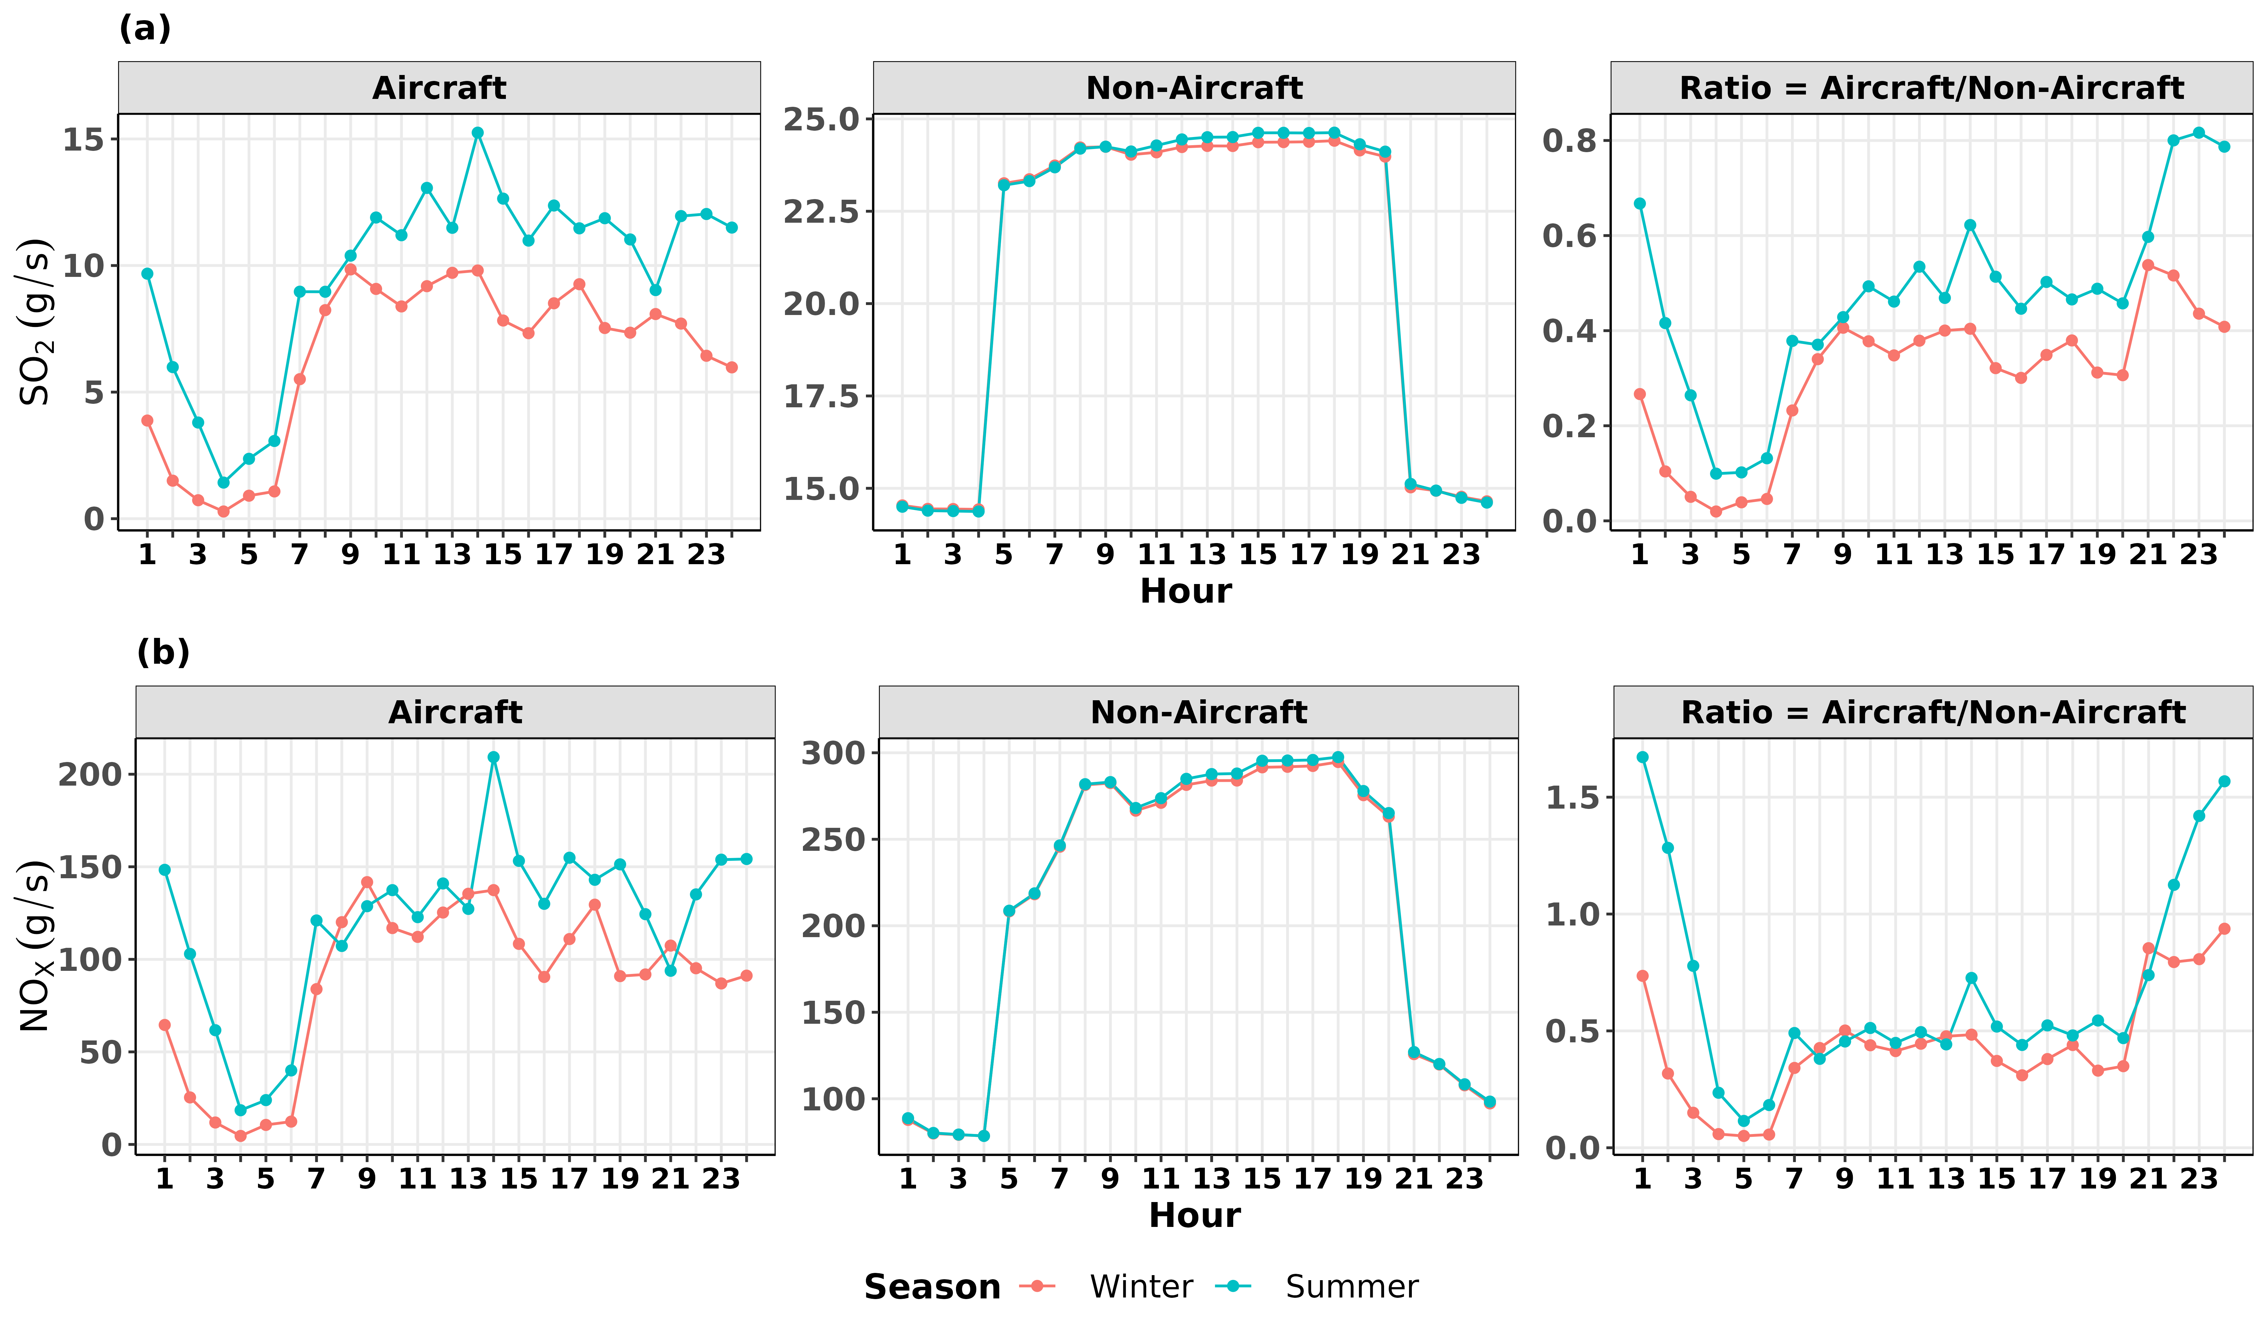
Emissions (Aircraft: AEDT, Non-Aircraft: LAX-AQSAS)
Comparison of hourly averaged aircraft and non-aircraft SO₂ and NO_{X} emissions during the winter and summer field studies.
Aircraft SO₂ and NOx emissions close to 50% of non-aircraft emissions in both seasons during 7-19 hours.
AEDT: Aviation Environmental Design Tool
LAX-AQSAS: Los Angeles Airport - Air Quality and Source Apportionment Study

Slide 6
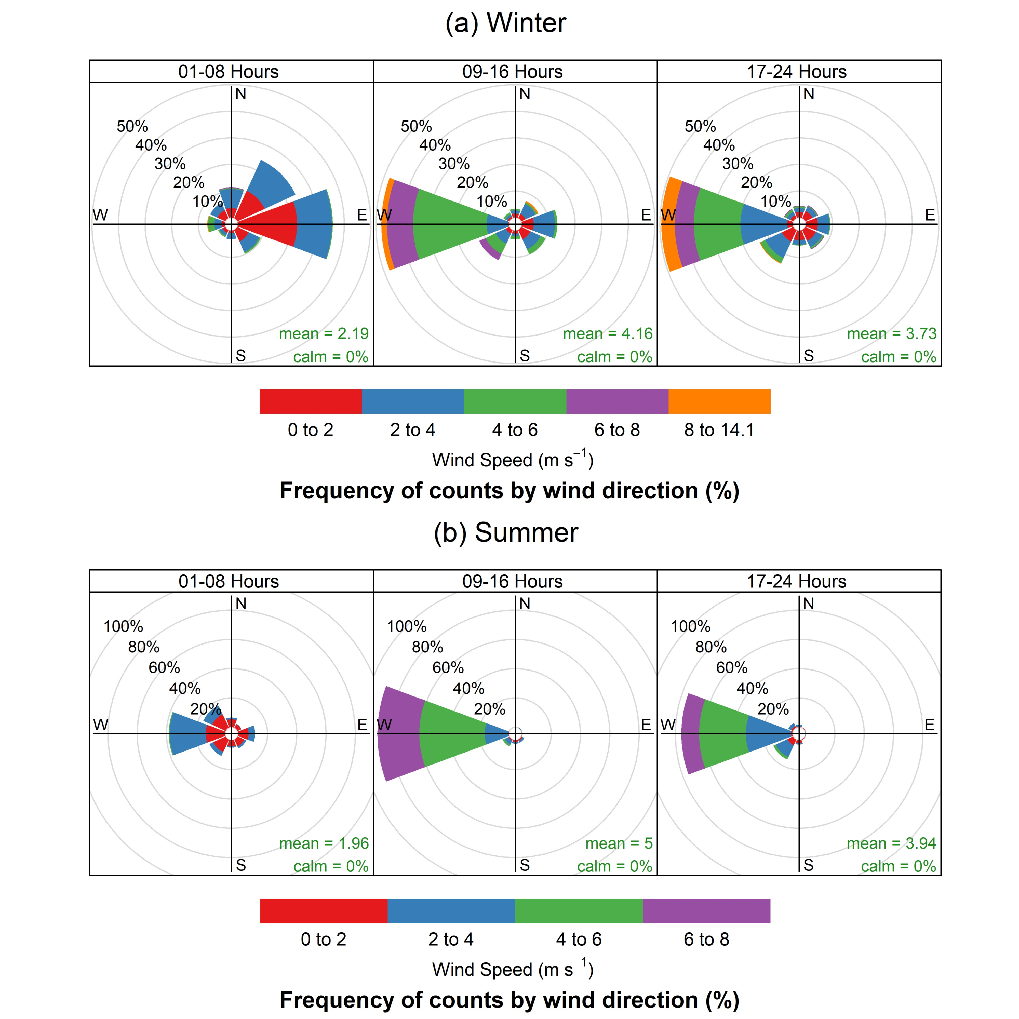
Modified Meteorological Conditions in AERMOD
to account for the formation of the internal boundary layer that is formed when stable air from the ocean flows onto the warmer land surface of the airport,
urban roughness effects on winds flowing from Los Angeles, east of the airport.
Source: Google
Modified Meteorology

Slide 7
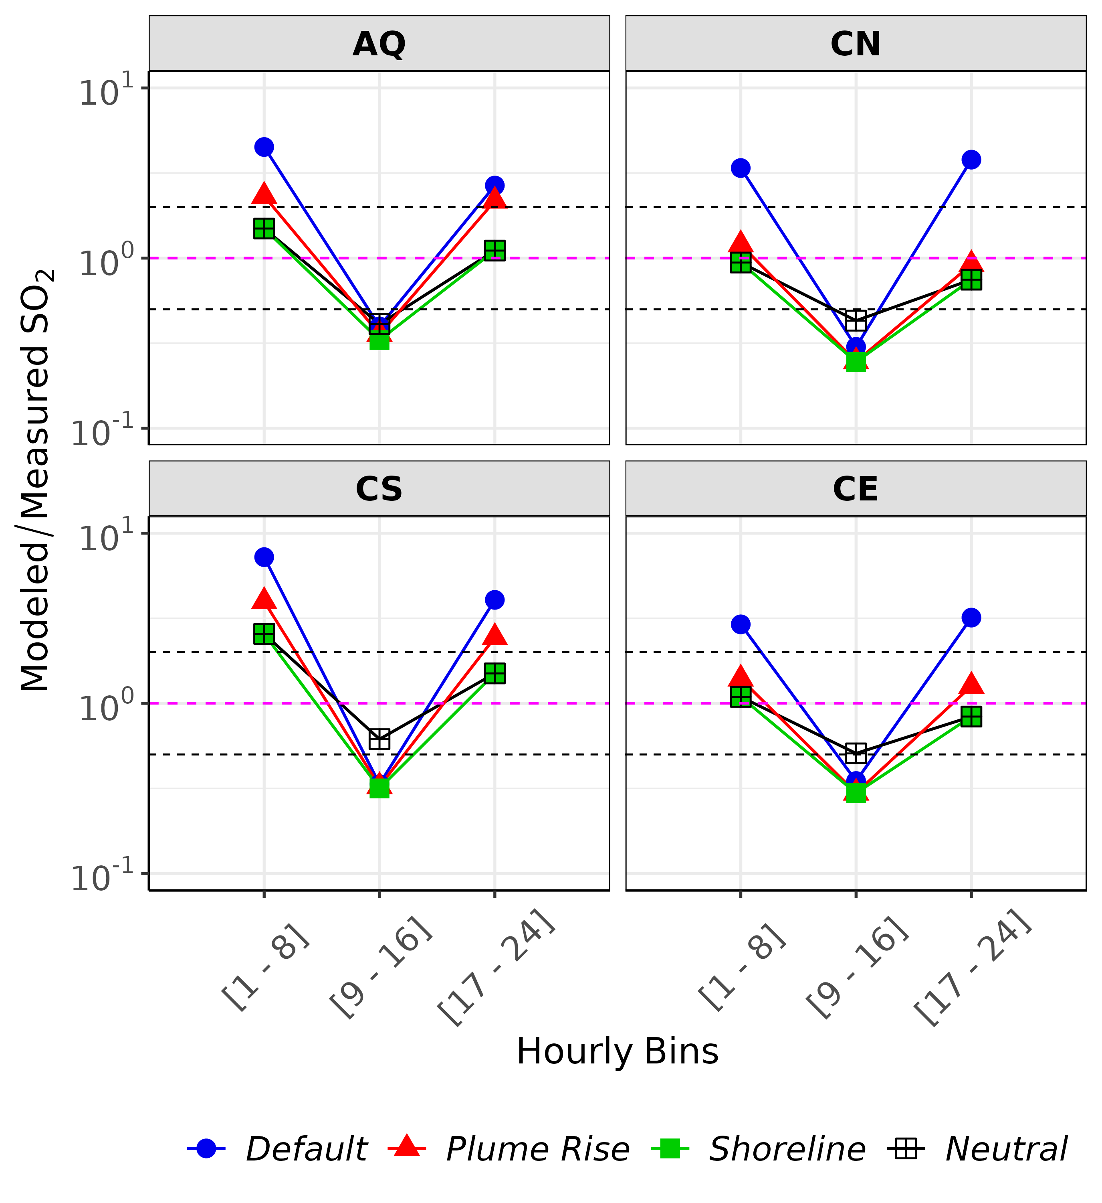
Implementation of Plume Rise and Shoreline Meteorology Results
Other issues for daytime underpredictions remain, and hence we are resorting to inversion to see if there is a problem with emissions locations/magnitudes.
AERMOD model performance significantly improved after adding plume rise and met modify.
Modeled/Measured mean SO₂ concentrations averaged over hourly bins at the four core sites (summer 2012)
Default – AERMOD base model
Plume Rise – AERMOD with aircraft plume rise,
Shoreline – AERMOD with PR and modified met,
Neutral – Westerly wind daytime hours convert to neutral
Pandey et al., Atmos. Environ. 2022 and 2023
Ratio of Modeled/Measured mean concentrations improved with plume rise and modified met during early morning and late night (when the base model had poor performance) hourly bins
Regulatory update to the EPA’s Guideline on Air Quality Models - Appendix W with updated AERMOD for aircraft exhaust modeling
(EPA tested code submission and plans to include in next AERMOD release by Nov 2023)

Slide 8
Inverse Modeling
A reverse of the forward problem becomes more important if the concentration measurements are known at given positions and times, mathematically it is known as an inverse problem.
Inverse problems are dealt within a classical parametric estimation framework (Data Assimilation).
Forward Modeling
S1
R
R
R
S2
R
R
Sources
Receptors
S3
S4
R
R
R
S - Source, R - Receptor
Inverse Modeling

Slide 9
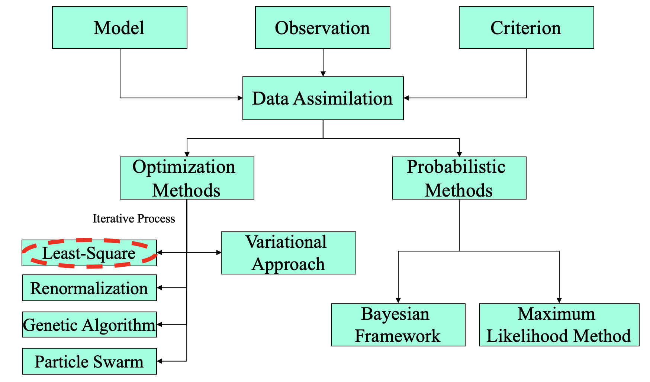
Data Assimilation / Inverse Modeling
Concentration Measurements
Source-Receptor Relationship
Inversion Technique
Data for Validation
Primary Requirements
Reference: Lewis, J. M., Lakshmivarahan, S., Dhall, S., Dynamic Data Assimilation: A Least Square approach., Cambridge University Press.

Slide 10
Classical Least Squares Formulation
For m sources, there will be total 3m unknowns, 2m will be locations, and m intensities.
For two point sources, source-receptor relationship is
Objective function is
Classical optimization will not work
A new technique is proposed
For fixed x₁ and x₂ ,
Reference: Singh et al., 2013. Inverse Modelling for Identification of Multiple-Point Releases from Atmospheric Concentration Measurements. BLM 146, 277–295.

Slide 11
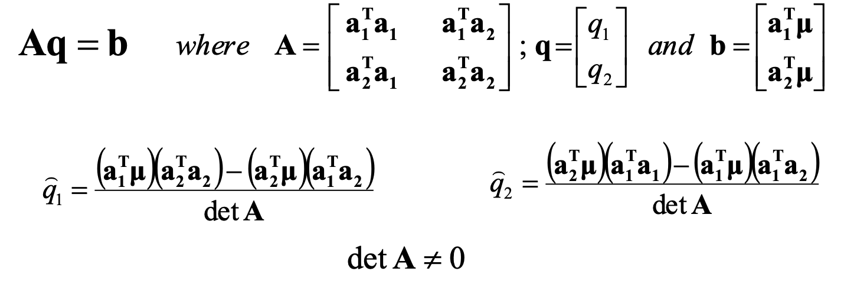
Classical Least Squares Formulation
Critical points lead to system of equations
The Hessian matrix of second order partial derivatives
If Hessian matrix will be positive definite, estimate of q₁ and q₂ ensure minimum of J.
Reference: Singh et al., 2013. Inverse Modelling for Identification of Multiple-Point Releases from Atmospheric Concentration Measurements. BLM 146, 277–295.

Slide 12
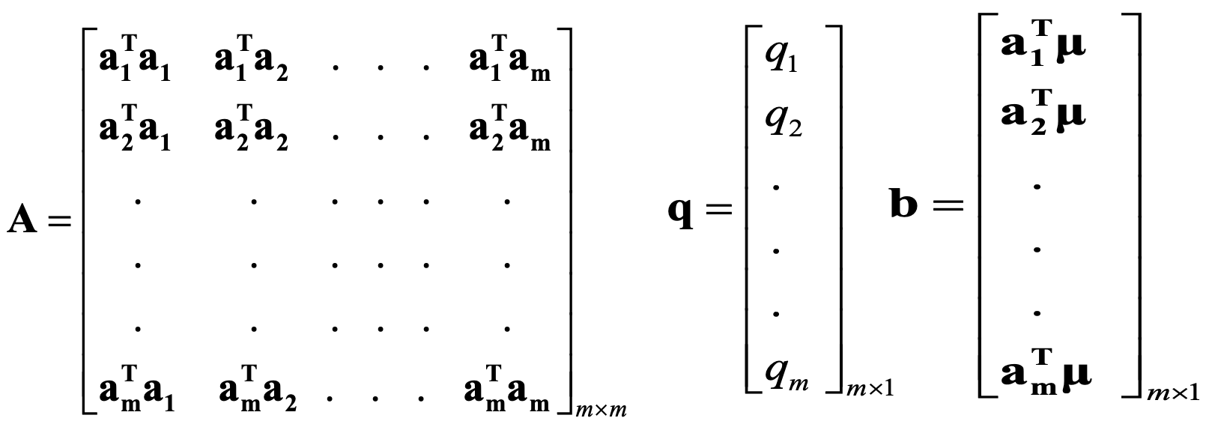
Classical Least Squares Formulation
Formulation for multiple point sources
Minimize objective function
Critical points lead to system of equations Aq = b
If Hessian matrix will be positive definite, estimate of q_{i} ’s ensure minimum of J.
Reference: Singh et al., 2013. Inverse Modelling for Identification of Multiple-Point Releases from Atmospheric Concentration Measurements. BLM 146, 277–295.

Slide 13
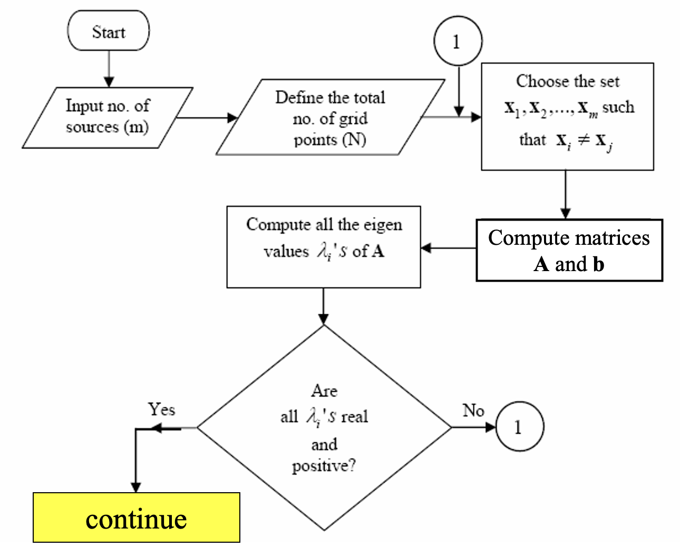
Proposed Methodology
Reference: Singh et al., 2013. Inverse Modelling for Identification of Multiple-Point Releases from Atmospheric Concentration Measurements. BLM 146, 277–295.

Slide 14
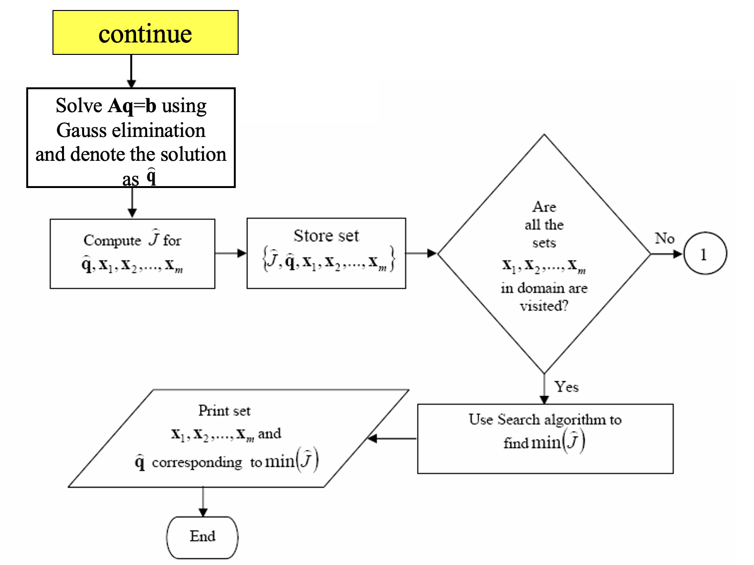
Proposed Methodology
Inverse modeling is performed for non-reactive tracer gases
Number of sources are assumed a priori
Vertical and temporal dimensions are not taken into account
Limitations
Reference: Singh et al., 2013. Inverse Modelling for Identification of Multiple-Point Releases from Atmospheric Concentration Measurements. BLM 146, 277–295.

Slide 15
Implementation of proposed methodology at LAX airport
SO₂ concentration measurements, $μ$
(from four LAX-AQSAS core sites 10 min averaged concentration, total 24 measurements in one hour)
Source-Receptor Relationship, $A$
(Adjoint as Gaussian Plume Model (by rotating wind direction 180 degrees))
Inversion Technique
(Least Squares inversion methodology)
Data for Validation
(Emission locations/magnitudes data from AEDT)
Domain Size: $10 km × 10 km$
Discretized Domain: $999 × 999 cells$
Mesh Size: $10 m × 10 m$
AEDT: Aviation Environmental Design Tool
LAX-AQSAS: Los Angeles Airport - Air Quality and Source Apportionment Study

Slide 16
Discussion
AERMOD doesn’t account for aircraft plume dynamics in area/volume source treatment
Proposed plume rise formulation for aircraft emissions modeled with AERMOD
Forward modeling results demonstrate improved model performance after incorporating plume rise and modified meteorology
AERMOD underpredicts during daytime hours even after applying above modifications
Resort to inverse modeling to assess potential problem with emissions locations/magnitudes
Use the adjoint of a standard Gaussian dispersion model and least squares as an inversion technique
Use SO₂ concentration measurements from the LAX-AQSAS for evaluation and comparison
Quantify the aircraft emissions locations/magnitudes using this complex approach
Ongoing work, and hope to share results soon

Slide 17
Acknowledgements
This work was funded by the U.S. Federal Aviation Administration Office of Environment and Energy through ASCENT, the FAA Center of Excellence for Alternative Jet Fuels and the Environment, project 19 through FAA Award Number 13-C-AJFE-UNC under the supervision of Jeetendra Upadhyay. ASCENT (Aviation Sustainability Center) (http://ascent.aero) is a U.S. DOT-sponsored Center of Excellence.
We thank Jeetendra Upadhyay and Mohammed Majeed of the FAA for several helpful discussions.
The authors wish to gratefully acknowledge the Los Angeles World Authority (LAWA) and the U.S. DOT Volpe Center for providing datasets from the LAX AQSAS Study.
Opinions, findings, conclusions and recommendations expressed in this material are those of the author(s) and do not necessarily reflect the views of ASCENT sponsor organizations.

Slide 18
References
Arunachalam, S., A. Valencia, M. Woody, M. Snyder, J. Huang, J. Weil, P. Soucacos and S. Webb (2017). Dispersion Modeling Guidance for Airports Addressing Local Air Quality Concerns. Transportation Research Board Airport Cooperative Research Program (ACRP) Research Report 179, Washington, D.C. Available from: http://nap.edu/24881.
Arunachalam S., Woody M., Baek B.H., Shankar U., Levy J.I. (2011) An Investigation of the Impacts of Aviation Emissions on Future Air Quality and Health. In: Steyn D., Trini Castelli S. (eds) Air Pollution Modeling and its Application XXI. NATO Science for Peace and Security Series C: Environmental Security. Springer, Dordrecht.
Ashok, A., Balakrishnan, H., Barrett, S. R. H., 2017. Reducing the air quality and CO2 climate impacts of taxi and take-off operations at airports. Transportation Research Part D 54, 287-303.
Lewis, J. M., Lakshmivarahan, S., Dhall, S., Dynamic Data Assimilation: A Least Square approach., Cambridge University Press.
Levy, J.I., Woody, M., Baek, B.H., Shankar, U., Arunachalam, S., 2012. Current and future particulate-matter-related mortality risks in the United States from aviation emissions during landing and takeoff. Risk Anal. 32 (2), 237-249.
Pandey, G., Venkatram, A., Arunachalam, S., 2022. Evaluating AERMOD with measurements from a major U.S. airport located on a shoreline. Atmos. Environ. 119506.
Pandey, G., Venkatram, A., Arunachalam, S., 2023. Accounting for plume rise of aircraft emissions in AERMOD. Atmos. Environ. 120106.
Singh, S.K., Sharan, M., Issartel, J.-P., 2013. Inverse Modelling for Identification of Multiple-Point Releases from Atmospheric Concentration Measurements. Boundary Layer Meteorol. 146, 277–295. https://doi.org/10.1007/s10546-012-9765-y.
Stettler, M., Eastham, S., Barrett, S., 2011. Air quality and public health impacts of UK airports. Part I Emiss. Atmos. Environ. 45 (31), 5415-5424.
Woody, M., Baek, B.H., Adelman, Z., Omary, M., Lam, Y.F., West, J.J., Arunachalam, S., 2011. An assessment of aviations contribution to current and future fine particulate matter in the United States. Atmos. Environ. 45 (20), 3424-3433.
Woody, M.,West, J., Jathar, S., Robinson, A., Arunachalam, S., 2015. Estimates of nontraditional secondary organic aerosols from aircraft SVOC and IVOC emissions using CMAQ. Atmos. Chem. Phys. 15 (12), 6929-6942.

