Slide 1
Spatiotemporal NH₃ Emissions using a Physically-guided Variational Autoencoder (VAE) with Remote-sensing Observations
B.H. Baek¹, Jia Xing¹, Mark Shepard², Siwei Li³, Chi-Tsan Wang¹, Jesse Bash³, Enrico Dammers⁴, Karen Cady-Pereira⁵, Daniel Tong¹
¹George Mason University; ²Environment and Climate Change Canada; Wuhan University³; ⁴U.S. EPA : ⁵TNO : ⁶AER
CMAS Conference 2023, Chapel Hill, NC | October 16~18, 2023

Slide 2
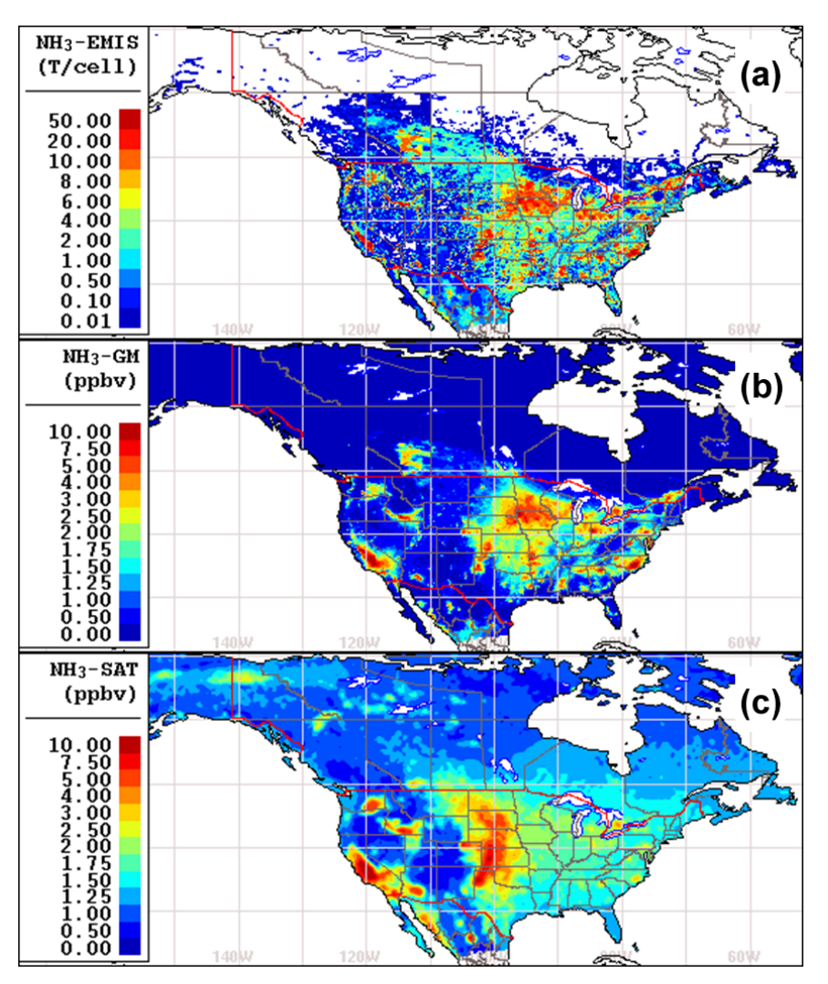
Motivation
NH₃ : Animal manure, production, and Application of fertilizers
Short lifetime of NH₃ (τ = 0.5-5 days or less)
Deposited to the surfaces near its source with relatively high dry deposition.
Ecosystem eutrophication
NH₄⁺ : Neutralization process of acid gases (H₂SO₄, HNO₃ and HCl) by NH₃ at the surface on PM_{fine} ≤ 2.5μm
NH₄HSO₄, [NH₄]₂SO_{4,} [NH₄]₃H[SO₄]₂, NH₄NO₃, NH₄Cl,,,,
Role of degradation of visibility in the local area
Longer lifetime of NH₄⁺ approximately 5~10 days
Ecosystem acidification from ammonium oxidation in the atmosphere
Sensitive spatiotemporal patterns by meteorology, events, and acid gases.
Top-down vs. Bottom-up NH₃ emissions are quite different
Swine NH₃ emissions from Iowa and NC relatively overestimated?
Beef NH₃ emissions from Texas, Kentucky, and Nebraska are the main NH₃ in Central US
(Shepard et al., 2020)
Notes:
Ammonia (NH3) is the most abundant alkaline gas in the atmosphere and has major impacts on air, soil, and water quality. Ammonia, in general, is relatively short-lived in the boundary layer, so its day-to-day atmospheric concentration levels over a region can vary greatly depending mainly on the meteorology (e.g. wind speed, temperature), episodic events (e.g. biomass burning, spreading of fertilizer), and concentration of reactant acid gases (e.g. nitric and sulfuric acid from NOx and SOx ) to produce a significant fraction (∼ 50 %) of the secondary fine particulate matter
Deposition of basic ammonia and ammonium-containing aerosols on land surfaces leads to acidification of the soil, when ammonium is oxidized (nitrified) to nitrate (NH+ 4 + 2O2 → NO−3 + 2H+ + H2O; Goulding, 2016). 2016). The protons generated from this reaction cause the acidification. Massive atmospheric deposition of NH3 adds reactive nitrogeninto water that can contribute to eutrophication.
NH3 observations in US are Ammonia Network Monitoring (AMoN) and several NH3 satellites products. AMoN is a great dataset but very sporatic and the satellite may not be accurate as AMoN but better spatial coverage.
Satellite observations of lower tropospheric ammonia have only been possible in the past decade through concurrent improvements in both the radiometric capabilities of infrared instruments on satellites and the radiative transfer forward modeling and inversion algorithms
CrIS is the newest of these operational satellites and has the lowest radiometric noise in the portion of the spectrum commonly used for ammonia retrievals over the glove
Comparing the model emission and GEM-MECH concentration fields would indicate that these differences are mainly due to the input emission fields
Another application of CrIS ammonia observations is emission estimates. Emission inventories are traditionally built from the bottom up, using emission factors and source locations to construct a complete inventory
Top-down satellite observations can be used to provide another source of emissions information and to supplement the inventories with more detailed information on hotspot locations and temporal variations (e.g. seasonal and inter-annual variations;

Slide 3
DeepCTM-VAE Applications with Observations
Objectives
Bottom-up NH₃ Emissions Comparison against Top-down NH₃ Emissions
Understand the differences and identify the solution to enhance the bottom-up Inventory
Deep-Learning Chemical Transport Model (Decorder)
Development of DeepCTM (forward) based on the CMAQ CONUS12 simulation to understand the non-linear relationship between emissions and air quality
Variational AutoEncoder (VAE) Applications with CrIS Remote-sensing and AQS Observations
Development of VAE (Backward) over the U.S.
Data Assimilation: Surface NH₃ concentrations based on the Crls remote-sensing and monitoring observations.
Development of top-down NH₃ emissions inventory over the U.S. and compare them against the bottom-up emissions (USEPA NEI)

Slide 4
Methodology
Chemical Transport Model (CTM) CMAQ Simulations based on the latest U.S.EPA 2017 NEI
All emission sectors including the agricultural (ag) sector with livestock waste and fertilizers
Deep-learning DeepCTM development based on CTM simulations
Forward (Decoder): Emissions → Concentrations
NASA/NOAA’s CrIS NH₃ Fast Physical Retrieval (CFPR) level-2 daily average (ppbv) over the U.S.
Applied globally to CrIs spectra from May 2012
Variational AutoEncoder (VAE) to estimate the top-down emissions based on the Crls NH₃
Backward (Encoder): Concentrations → Emissions
Based on the knowledge from the Decorder, VAE can estimate the physically-informed top-down emissions based on the observations (satellite Crls NH₃)
Comparison of the bottom-up and top-down emissions inventories
Quantitative comparisons between the NH₃ emissions over the U.S. domains
Sector-level NH₃ emissions corrections from Livestock wastes, Fertilizer, Wildfires, Onroad mobile sources, and so on
Notes:
Suomi National Polar-orbiting Partnership (S-NPP) satellite on 28 October 2011 and on the NOAA-20 satellite on 29 November 2017.

Slide 5
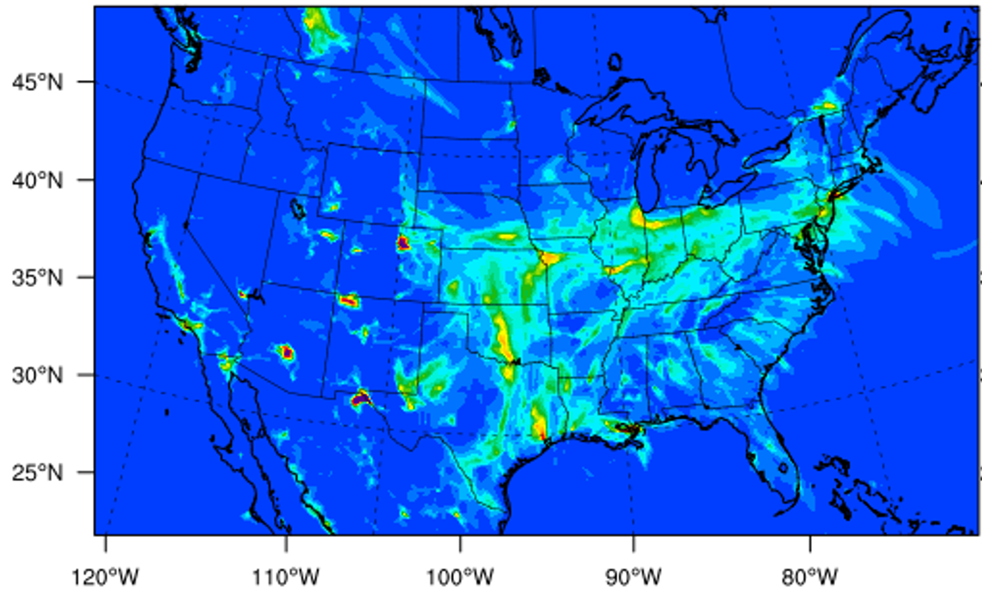
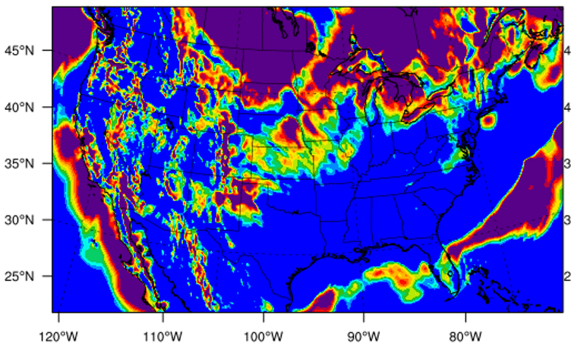
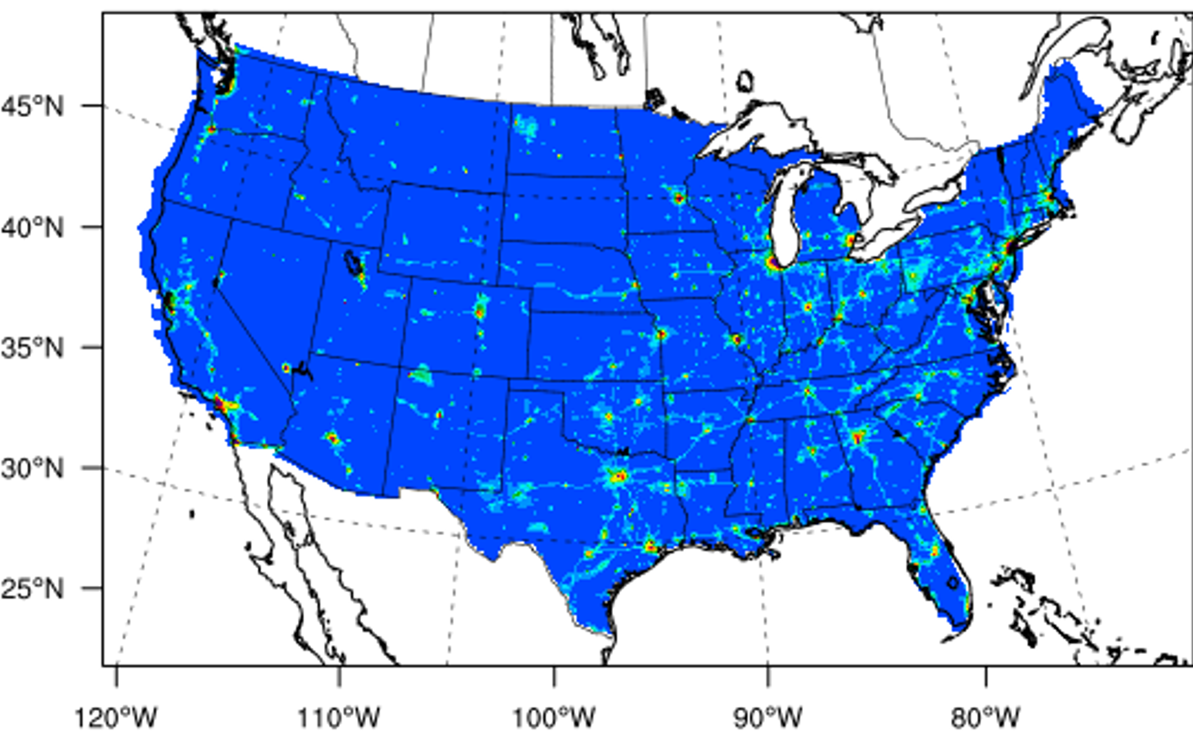
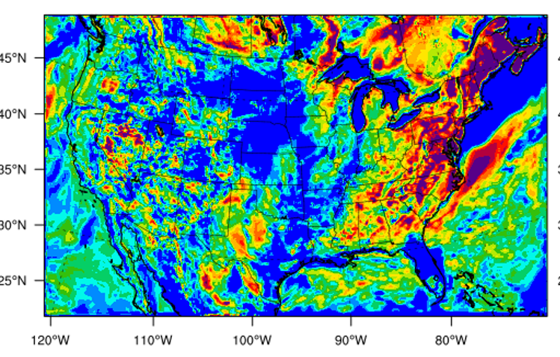
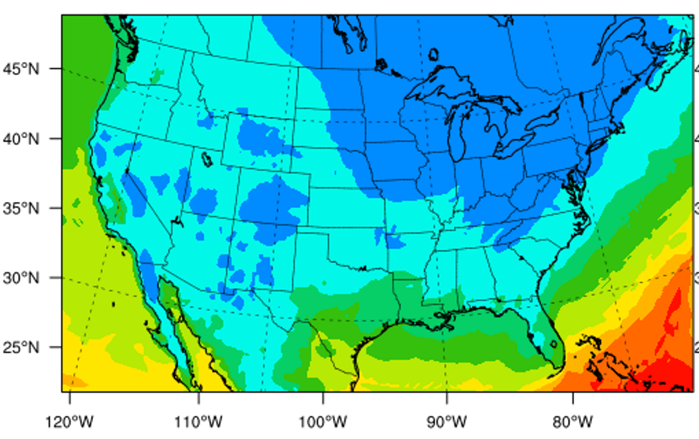
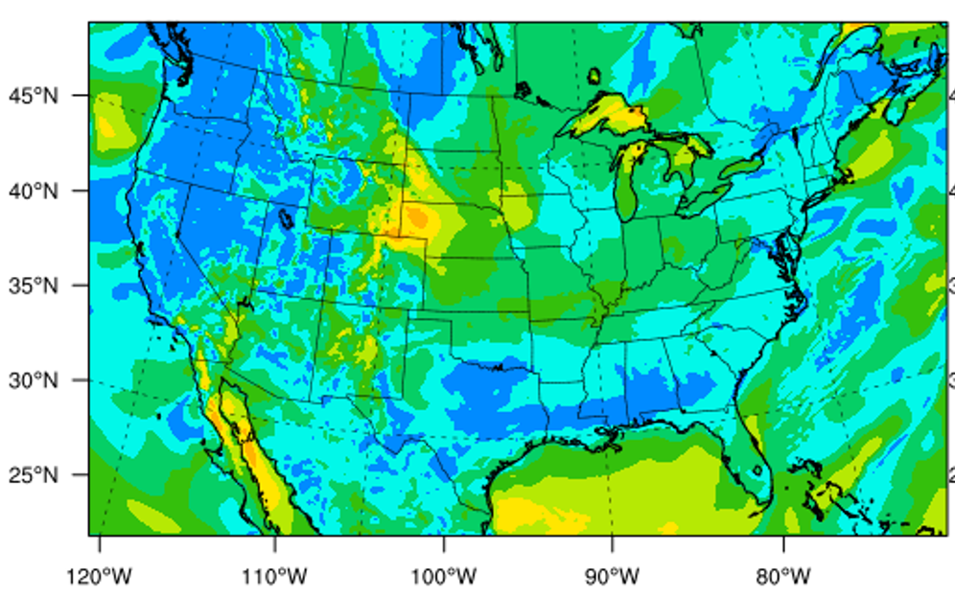
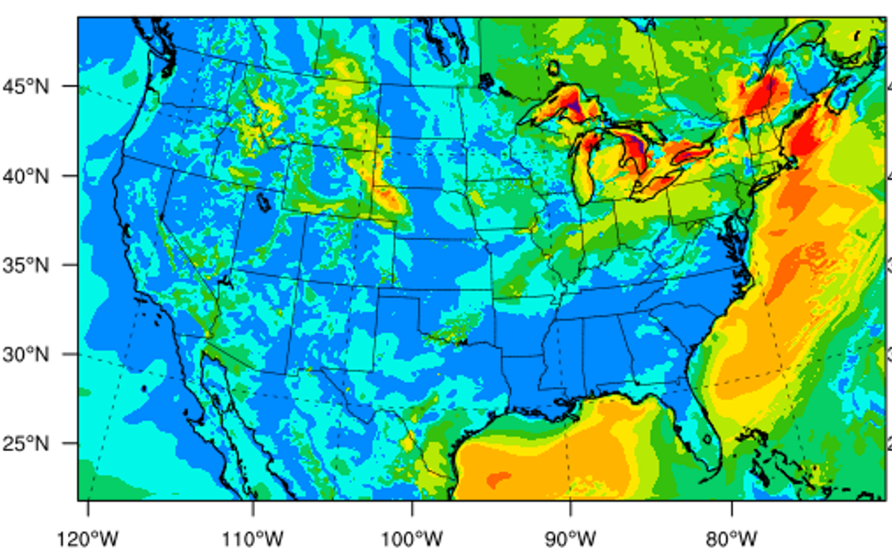
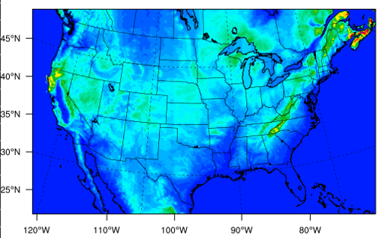
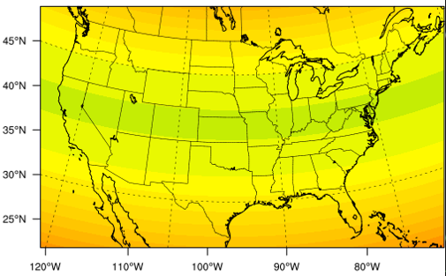
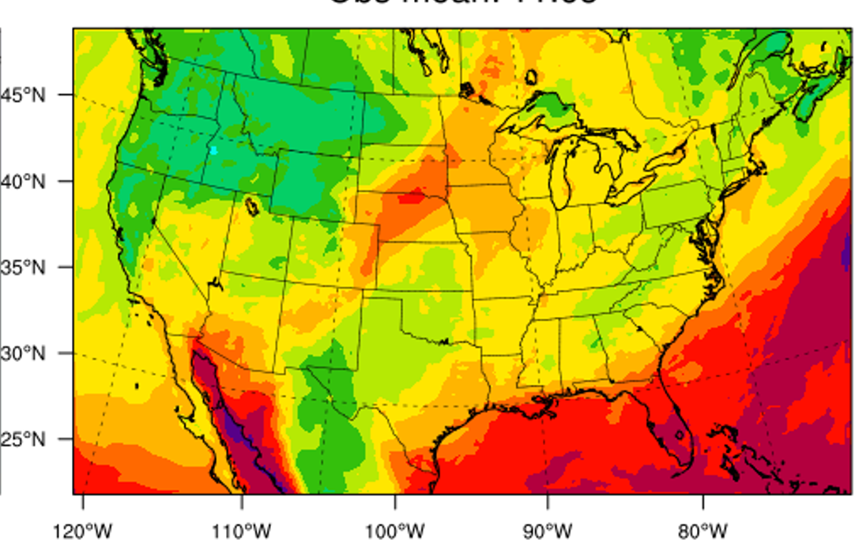
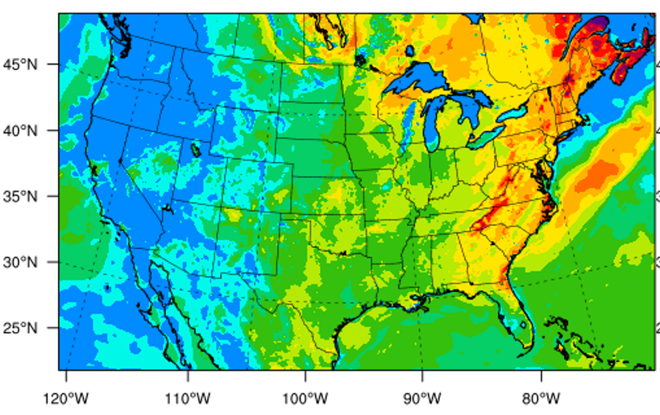
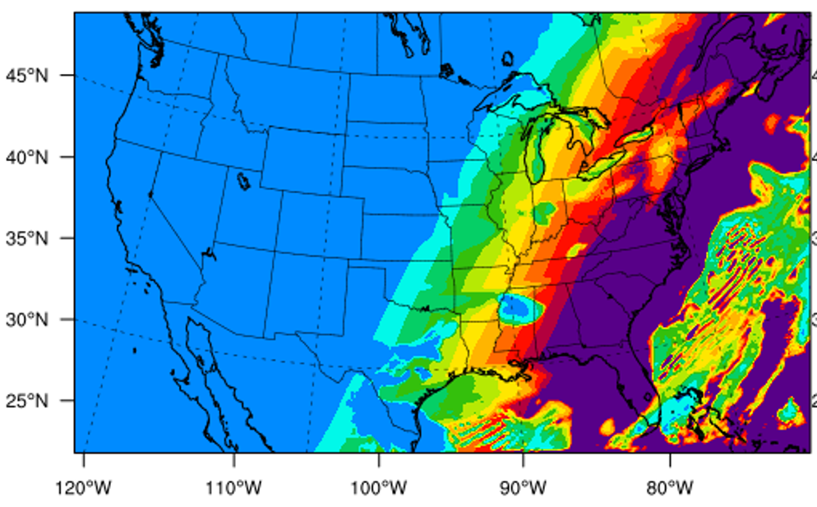
DeepCTM: Deep-Learning CTM
(Xing et al., ES&T, 2020)
MLP
Encoder
CNN
U-Net
C_{Conc}= 1
pReLU
Concatenate
CNN
$$h_{t−23}$$
$$h_{t−22}$$
$$h_{t−1}$$
$$h_{t}$$
pReLU
LSTM
LSTM
$$…$$
LSTM
LSTM
NH3 daily mean
CNN
$$x_{t−23}$$
$$x_{t−22}$$
$$x_{t−1}$$
$$x_{t}$$
C_{emis.}= 1
C_{geography}= 2
C_{Meteorology}= 11
Prep
VEG
LAI
V wind
U wind
humidity
NH3 daily mean
PBL height
terrain height
grid area scale
Wind speed
Study the impacts from the inputs (Emissions, Meteorology, Concentrations, and Time)
Computationally highly efficient (<2 minutes) to execute DeepCTM once the training of DeepCTM is complete
Decoder
2-meter temperature
convective velocity scale
Short-wave radiation
UNet: capture the cross-space interaction
LSTM: capture the temporal variation
Notes:
CNN: convolution network
LSTM: long short term memory
U-Net structure (2-layers): a u-shaped architecture with a downsample function (max pooling) and a deconvolution function (up convolution)
MLP: multiple layers of perceptrons with threshold activation
pReLU: the parametric rectified linear unit is used as the activation function
Machine learning shows its strong ability to reveal the complex atmospheric chemistry system
The efficiency of AQ forecasting can be enhanced with ML-built emission-concentration relationship
Exceptional computational advantages which allows users to perform CTM applications under various scenarios
The accuracy of AQ forecasting can be improved with ML-assimilated emissions and satellite observations
Instant responsive CTM with a rapid refreshed emissions under the national emergency responses.

Slide 6
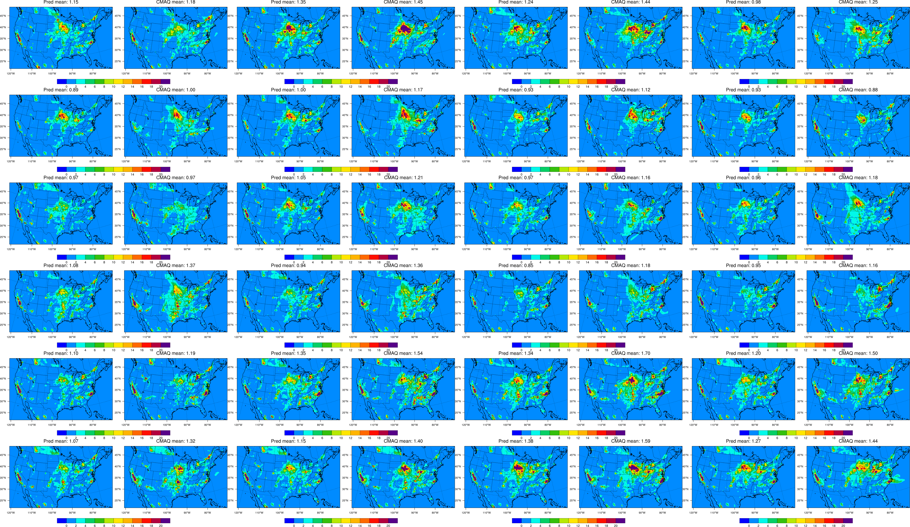
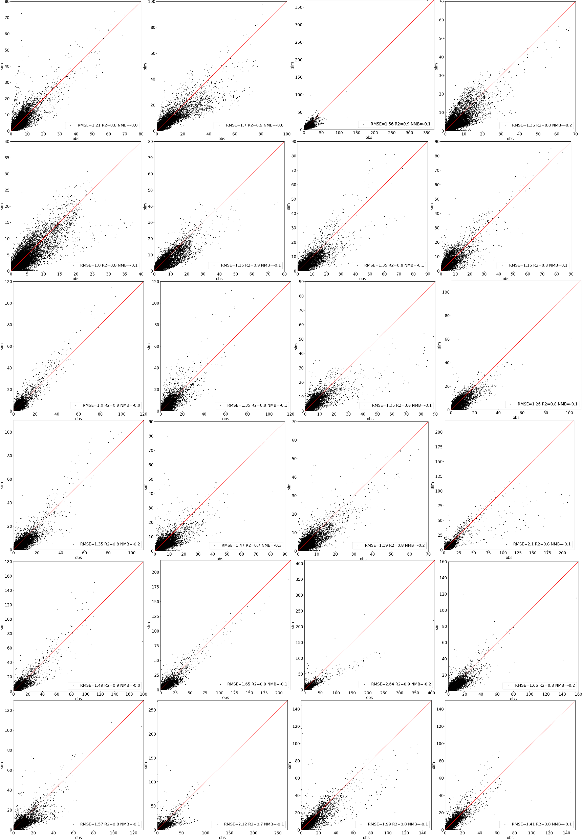
Performance of VAE-decoder (forward: emis->conc)
VAE-decoder
CMAQ
VAE-decoder
CMAQ
VAE-decoder
CMAQ
VAE-decoder
CMAQ
Daily NH₃ (ppb)
Day3
Day4
Day5
Day6
June 2020: Day 3-27
Day7
Day8
Day9
Day10
Day11
Day12
Day13
Day14
Day15
Day16
Day17
Day18
Day19
Day20
Day21
Day22
Day23
Day24
Day25
Day26
RMSE<3.0; R2>0.8

Slide 7
The Feature Impacts on NH₃ Concentrations
Monthly mean (2019)
modulating each feature one-by-one
T2：-2K
others：-20%
NH₃ concentration is contributed by NH₃ emissions (Enh3) and initial NH₃ condition (Inh3)
Met variables will modulate the NH3 concentration sensitivity to NH3 emissions
DeepCTM exhibits high efficiency in identifying the dominant factor to photochemical formation

Slide 8
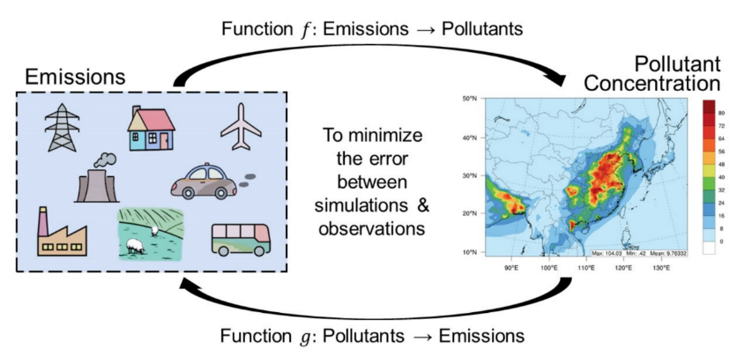
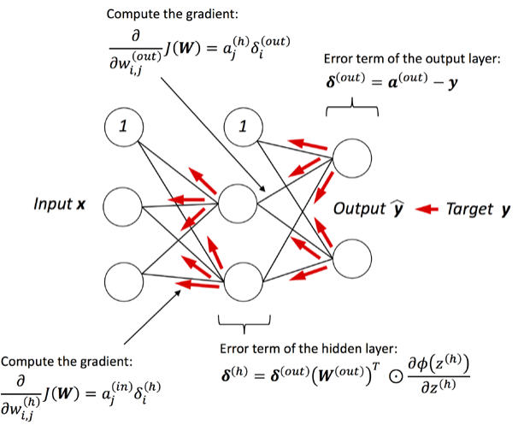
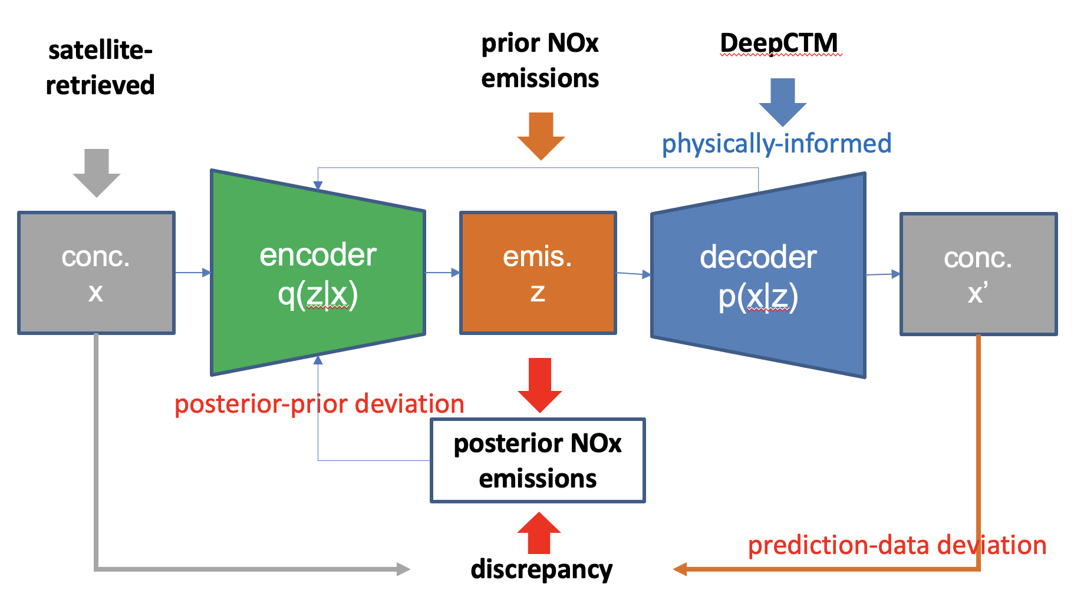
Variational AutoEncoder (VAE): Top-down Emissions
auto-grad
∆（Sim-Obs）
∆（Emis）
Variational AutoEncoder (VAE)
(Xing et al., ES&T, 2022)
back propagation
Based on emission-concentration relationship from DeepCTM, we can accurately estimate the differences of emissions
Because of the in-depth knowledge over various impactors (emissions, meteorology, initial conc.), we can proportionally correct the emissions only.

Slide 9
CrIS Fast Physical Retrieval (CFPR) Algorithm for NH₃
(Shepard et al., 2020)
 | Satellite | Spatial Resolution (km²) | Spatial Coverage | Temporal Coverage | Retrieved Quantity | Comments
NH₃ | Cross-track Infrared Sounder (CrIS) (2012-2038) | 14 (diameter) | Global | Twice a day CrIS-SNPP @ ~13:30 (day) ~1:30 (night) CrIS-NOAA20@ ~14:25 (day) 2:25 (night) | Profile level volume mixing ratio values (ppbv) | Limited vertical resolution Version 1.6 Shephard et al., ACPD, 2020 CFPR CrIS SNPP : May 2012 to May 2021 CFPR CrIS NOAA : March 2019 to present
CrIS is most sensitive to NH₃ between 950 and 700 mb (~0.5 to 3 km) with minimum 0.3 ppbv detectability
Not equally sensitive in the vertical and varies from profile-to-profile
Surface retrieved values are driven by sensitivity in the boundary layer
CFPR has been validated with U.S. AMoN (Ammonia Monitoring Network) and other ground–based FTIR (Fourier Transform Infrared) spectroscopy observations to determine the errors
AMoN: Crls ~15% higher with a good correlation of r ~ 0.8 and a slope of 1.02
FTIR: Crls ~30% higher (SD~40%)
Applications to data assimilations, data fusion and model-based emissions inversions for Confined Animal Feeding Operation (CAFO) facilities located remotely.
Notes:
cross-track infrared sounder (CrIS) is a satellite instrument with a Fourier-transform spectrometer onboard the Suomi National Polar-orbiting Partnership (NPP) satellite, which is part of the Joint Polar Satellite System (JPSS) program [30], launched in 2011. CrIS is in a sun-synchronous orbit, with mean local overpass times of 13:30 (ascending node) and 01:30 (descending node) [31–34]. CrIS has three bands in the infrared region (645–1095, 1210–1750, and 2155–2550 cm−1) with a 2200 km swath width and sets of three-by-three circular footprints, each approximately 14 km at the nadir [31–33]. The maximum sensitivity near the surface is typically ~1 ppbv [31].
We used daytime quality flag (less than 4), degrees-of-freedom-of-signal (less than or equal to 0.1) and χ2 measurements and removed low-quality data or outliers by applying the standard of (greater than or equal to 0.5).
These criteria were selected based on stronger correlation with Kangwha, on the western coast near the SMA.) with a range of 0.5 < R < 0.7.

Slide 10
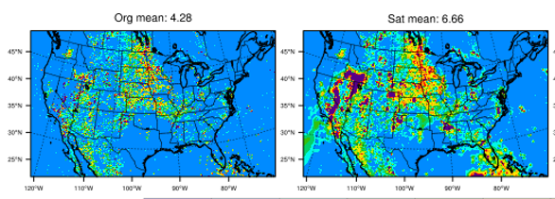
NH₃ CrIs CFPR Spatiotemporal Patterns
NOAA Satellites Surface NH₃ Measurements
SNPP
NOAA20
Combined
Interpolated
(Shepard et al., 2020)

Slide 11
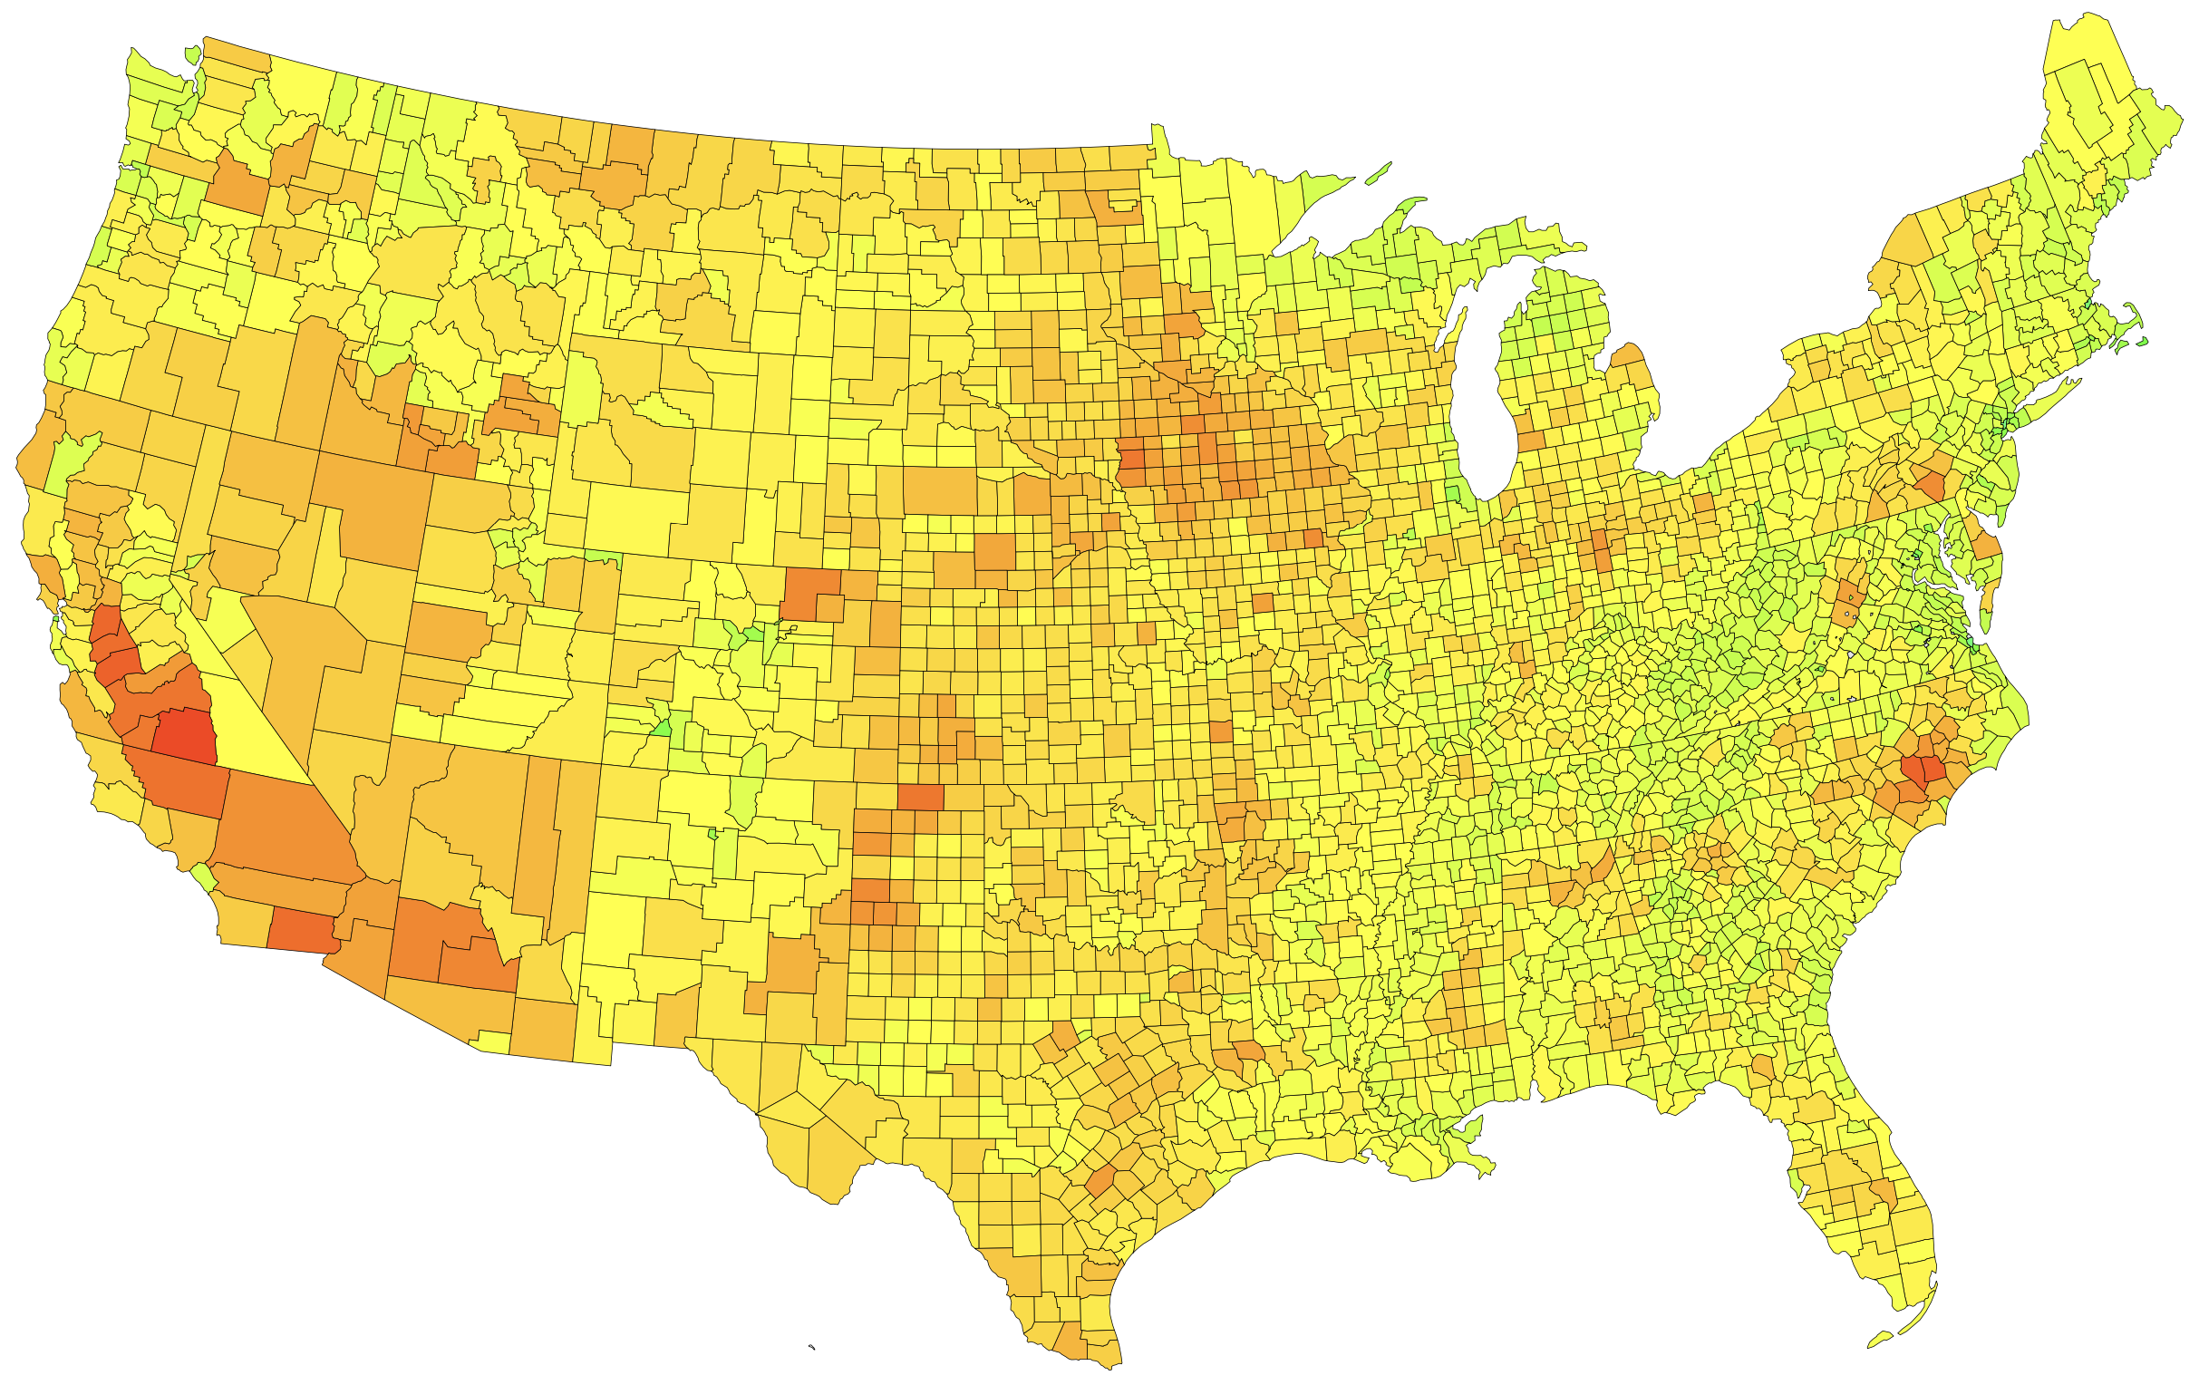
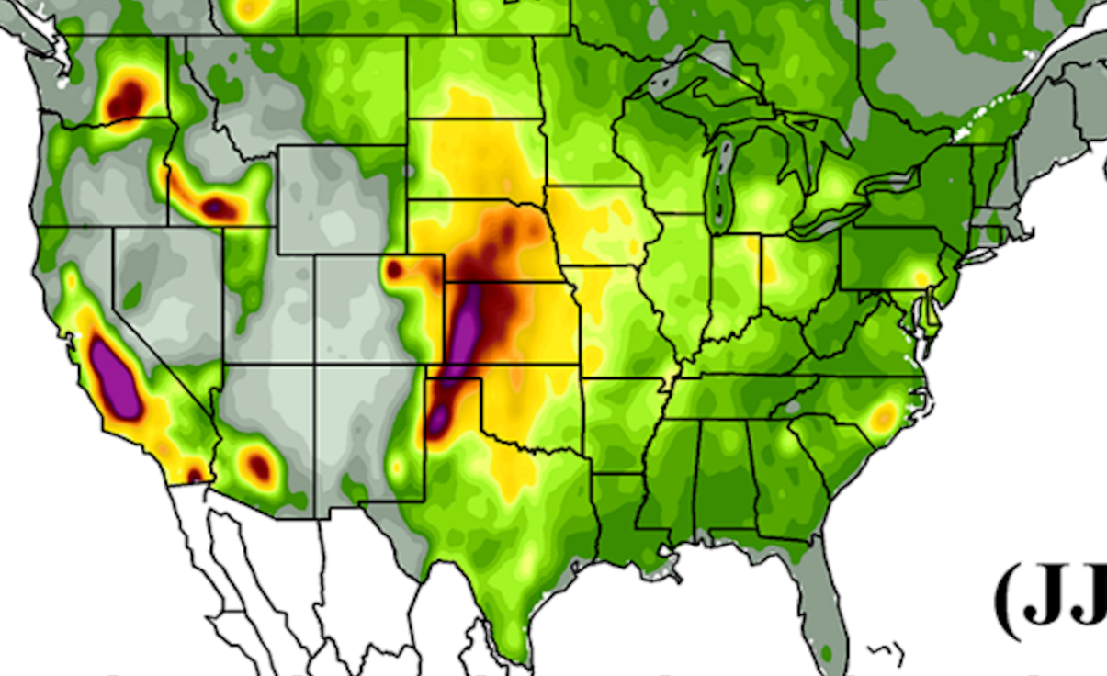
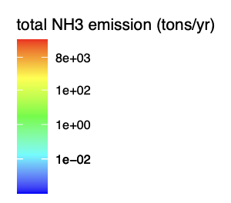
2017 NEI NH₃ Emissions from Agricultural Sector
Agricultural Sector: Fertilizer + Animals (Beef, Dairy, Swine, Broiler, Layers, Sheep, Horses, and Goats)

Slide 12
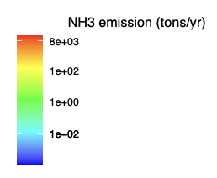
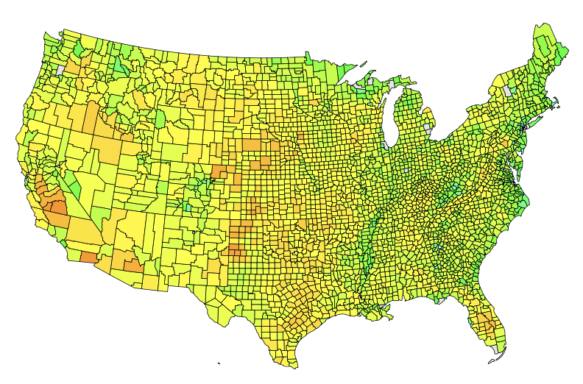
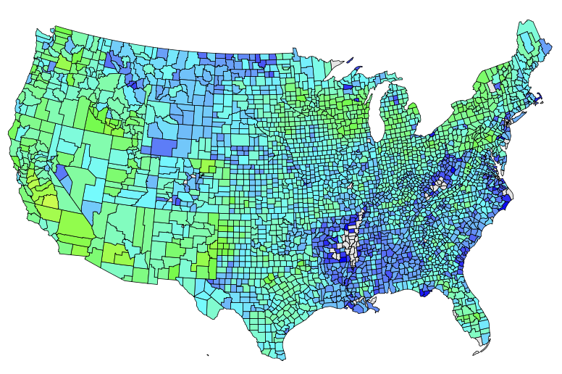
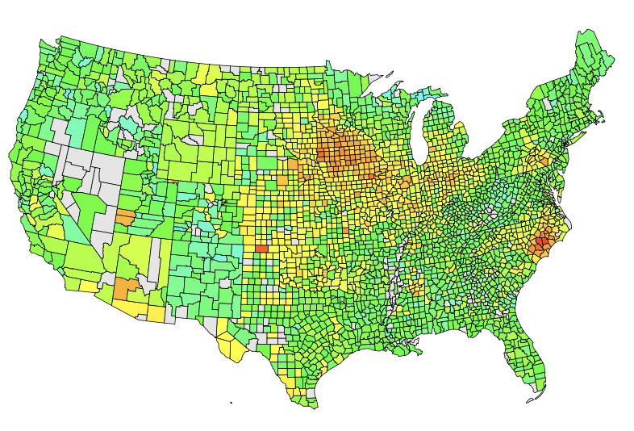
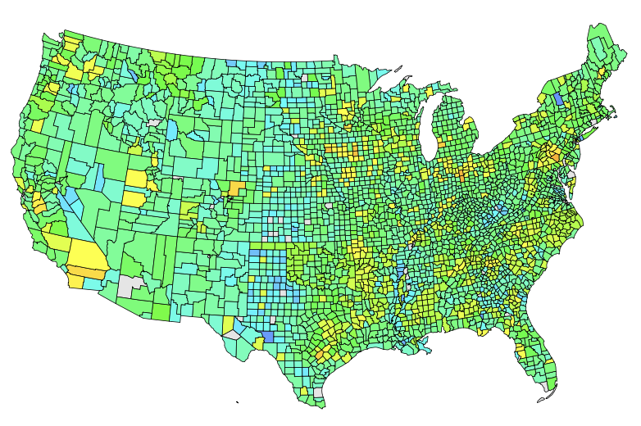
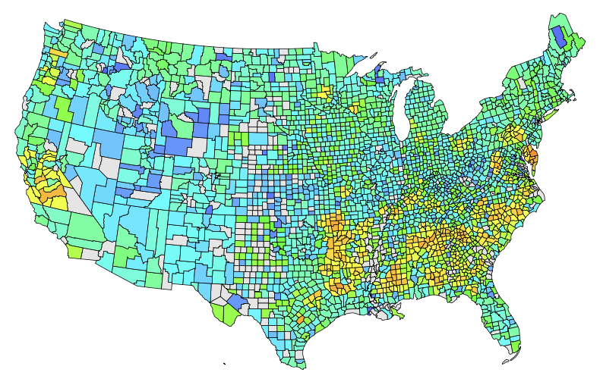
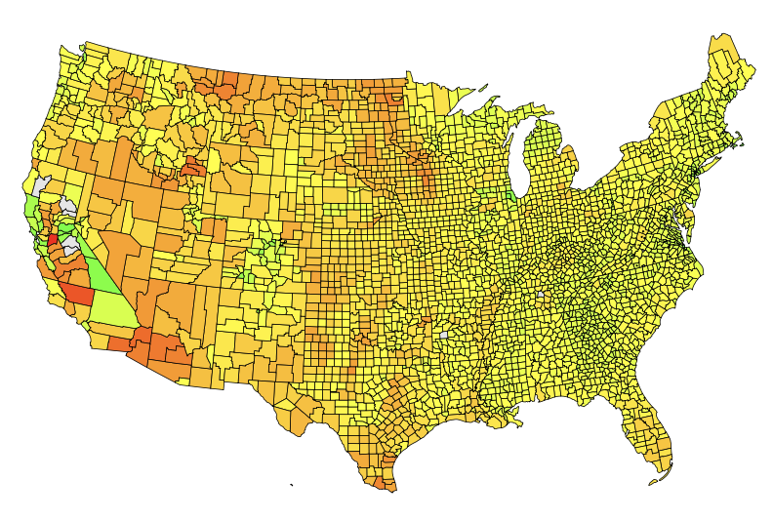
2017 NEI Ag NH₃ Emissions by Animals & Fertilizer (Summer)
Beef
Dairy
Swine
Layer
Broiler
Fertilizer

Slide 13
Performance of VAE-assimilation (2019)
CMAQ simulated
VAE assimilated
Satellite retrieved
Annual mean surface NH₃ concentration (2019)

Slide 14
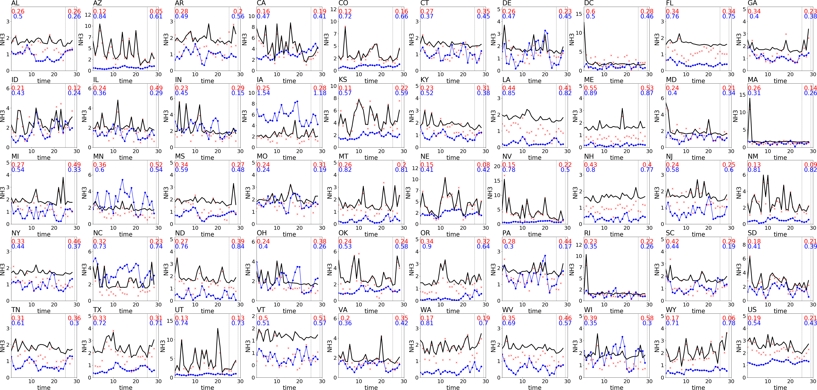
Performance of VAE-assimilation (June 2019)
Blue: CMAQ Simulation
Red: VAE-assimilation
Black: CFPR Satellite

Slide 15
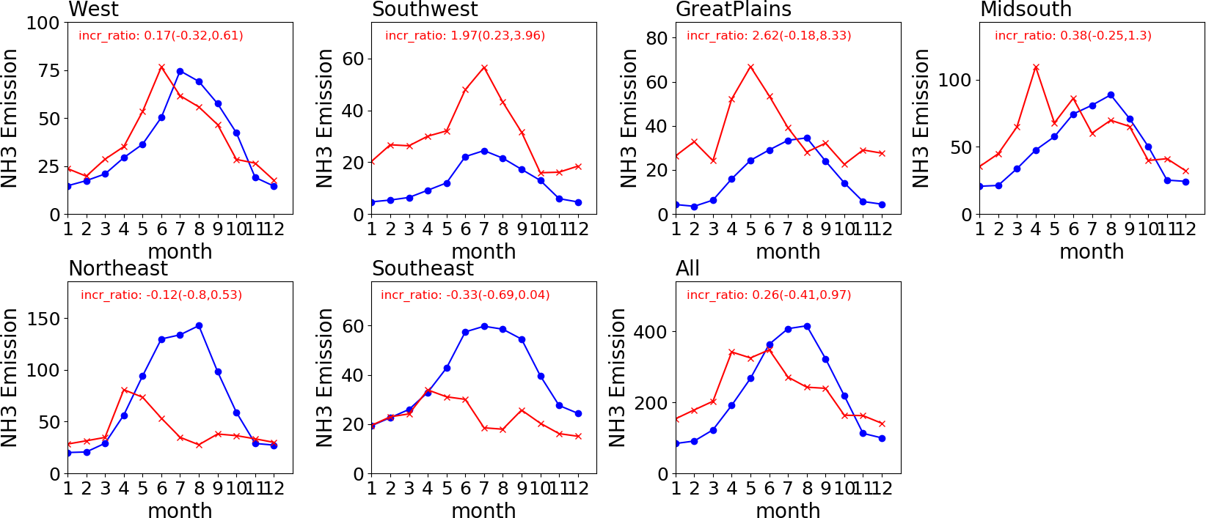
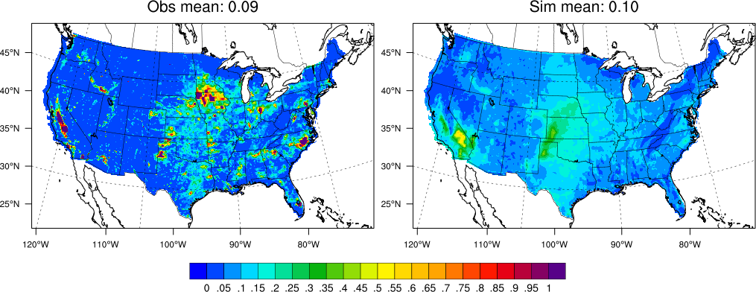
NH₃ Emissions Comparison (2019)
Indicating that the significant differences over the Great Plains and Southwest regions
Prior Emissions | Posterior Emissions
Important to utilize the spatial and temporal coverages from the CrIs NH₃
Relatively underestimated NH₃ from Beef vs overestimated NH₃ from Swine

Slide 16
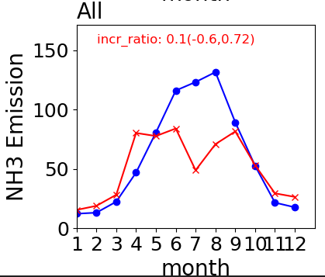
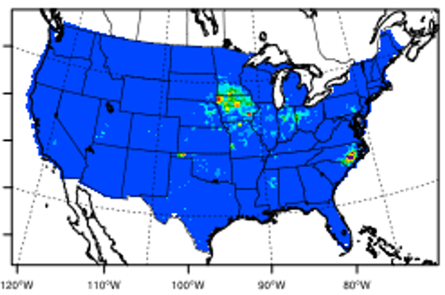
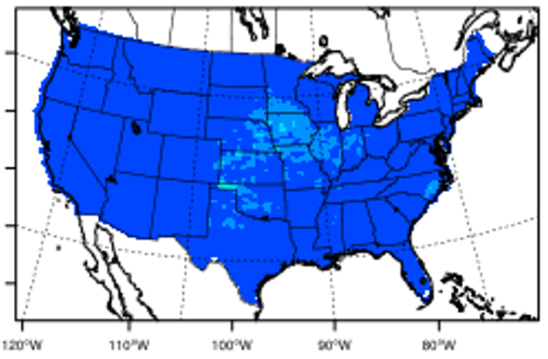
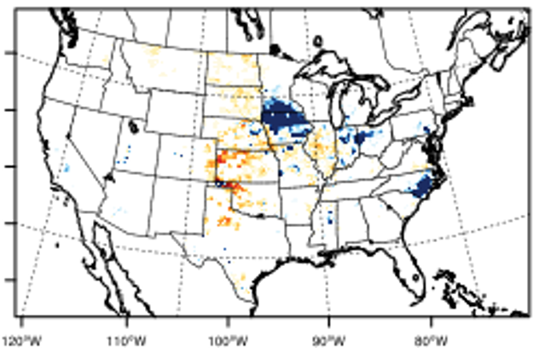
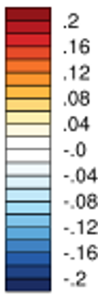
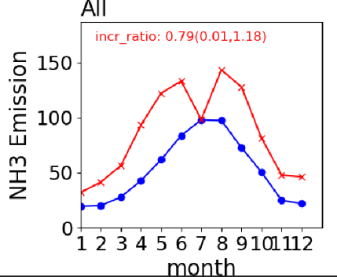
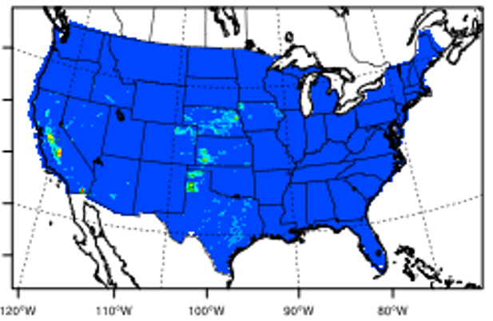
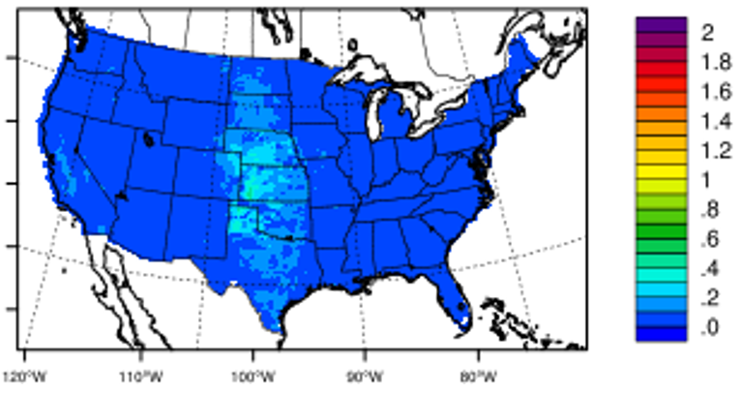
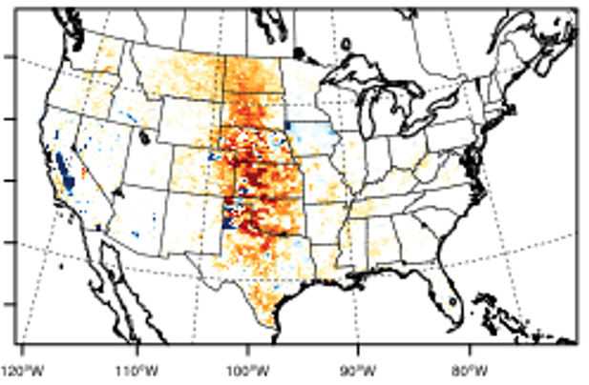
Sector-level NH₃ Emissions Comparison (2019)
Swine
Beef Cattle

Slide 17
Findings
A significant amount of surface NH₃ concentrations changes by location and time/dates
Requires a better spatiotemporal representation of NH₃ from livestock wastes
DeepCTM/VAE performed well in capturing the spatial and temporal differences of NEI Livestock Waste NH₃ against the observations
Identified the sector-level (anima-specific) NH₃ differences for the calibrations of animal-specific NEI Emissions from the Farm Emissions Model used in NEI development
Swine and Beef Cattle shows the lack of spatiotemporal representations
Swine: Overestimations of NH₃ over the areas in Iowa and NC (most swine-dense area)
Beef: Underestimation of NH₃ over the areas in TX, KY, CO, NE, SD, ND, and MT, while the overestimation occurred over CA.
Regional farm management practices input to the FEM need an update to address this issue.

Slide 18
Thank you!
ACKNOWLEDGEMENT
NOAA Atmospheric Chemistry, Carbon Cycle and Climate (AC4) [Grant# NA21OAR4310225]
USEPA
Korea National Institute of Environment Research

