Slide 1
Jia Xing^{1,2}, Bok H. Baek¹, Siwei Li³, Chi-Tsan Wang¹, Ge Song³, Siqi Ma¹, Daniel Tong¹
¹George Mason University
²University of Tennessee-Knoxville
³Wuhan University
Efficient Estimation of NOx Emission variation using a Physically-Guided Variational Autoencoder

Slide 2
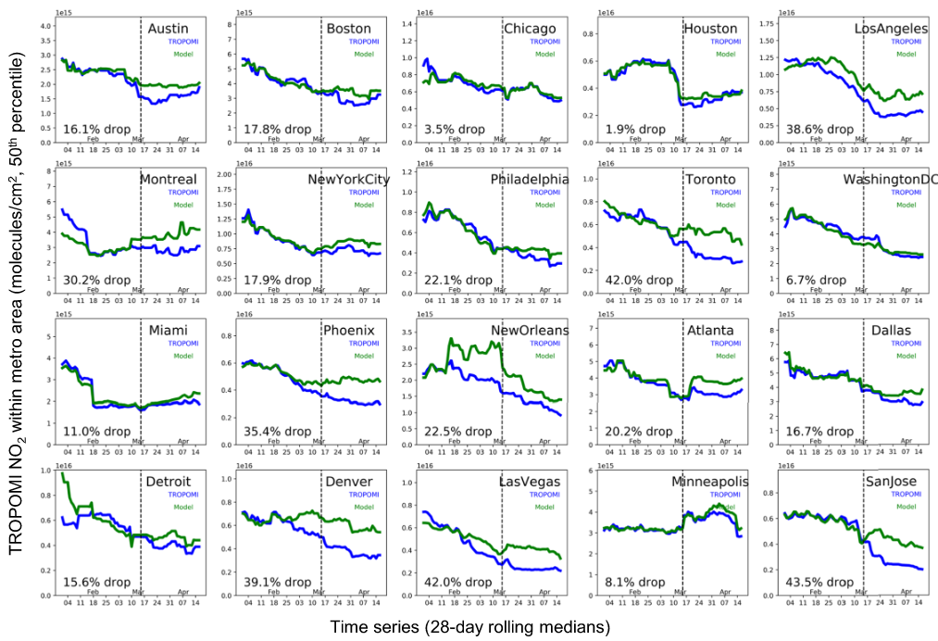
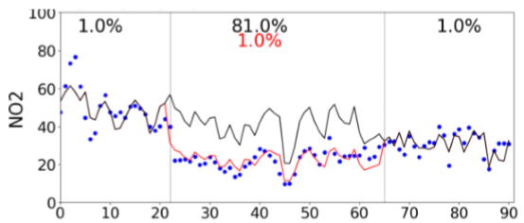
Motivation
Limitation of Chemistry Transport Modeling
Needs of Air Quality Forecasting
—combining multiple-observations for accurate prediction
large variations in emissions
Observation
Simulation with prior-emissions
Simulation with post-emissions
days from Jan 1st to Mar 31st 2020
NO2 conc. (ug/m³) in North China Plain (Xing et al., ACP, 2020)
TROPOMI satellite observations show NO2 decreases (9.2% - 43.4%) among 20 cities in North America during 2020 pandemic
Goldberg et al., GRL, 2020

Slide 3
Method-Variational Autoencoder (VAE)
satellite-retrieved NO₂ concentration
prior NOx emissions
Chemistry Transport Model
physically-informed
encoder
q(z|x)
decoder
p(x|z)
conc.
x
emis.
z
conc.
x’
posterior-prior deviation
posterior NOx emissions
prediction-data deviation
discrepancy
a deep-generative model from observations to emissions
Xing, et al., ES&T 2022

Slide 4
VAE framework
Step1: Pre-train decoder
Step2: Train encoder
Step3: Apply VAE
Hypothesize NOx emissions
Input
Adjusted NOx emissions
Input
Prior NOx emissions
VAE
Output
WRF-CMAQ
Train
decoder
encoder
Posterior NOx emissions
Meteorology’
Meteorology
Meteorology
Test
Train
Simulated NO₂ concentration
test
Input
Predicted NO₂ concentration
Observed NO₂ concentration
Label
Forward model
Backward model
Surface NO₂ concentration

Slide 5
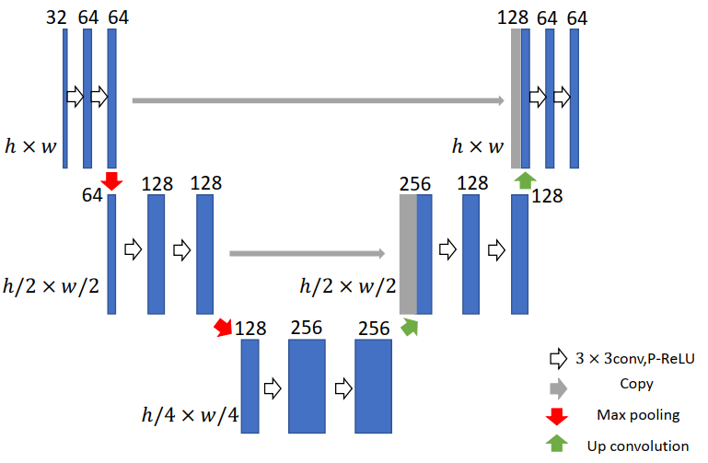
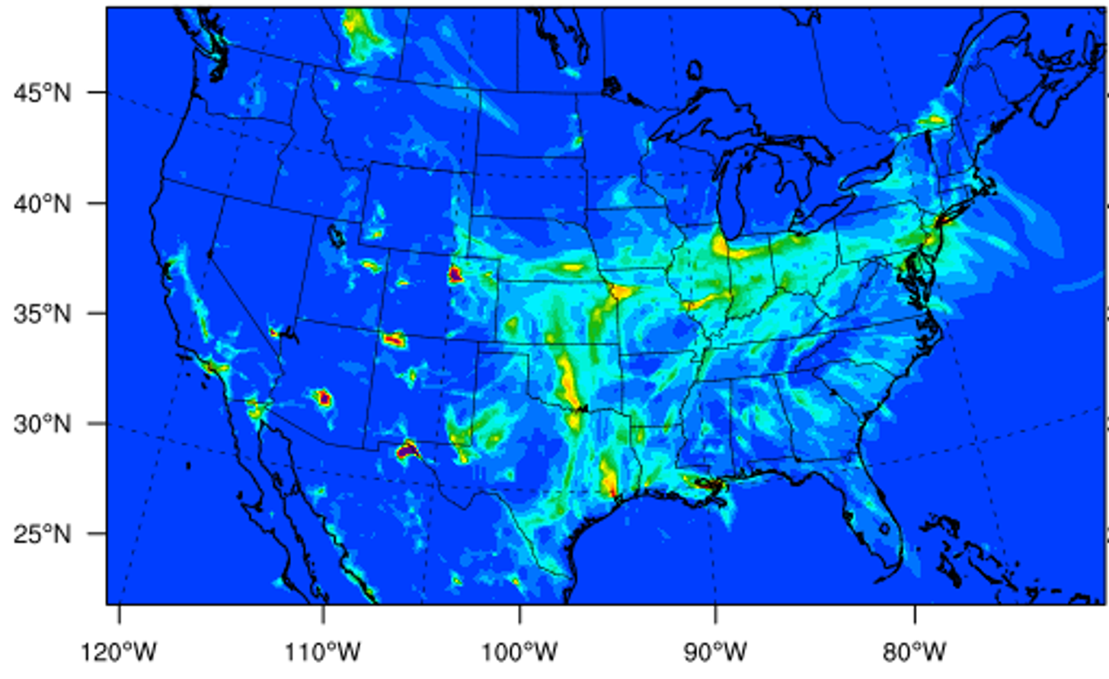
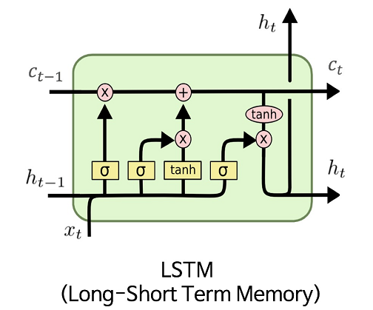
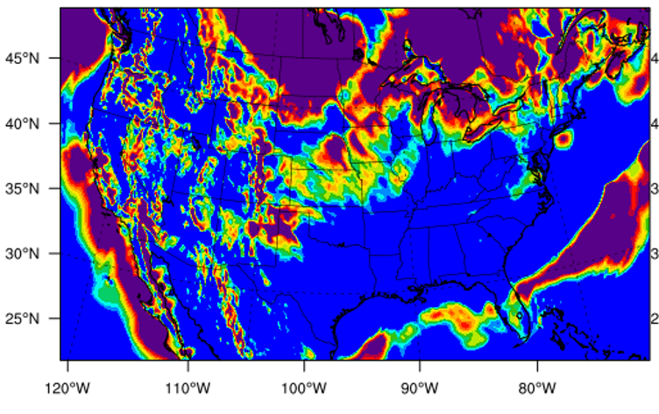
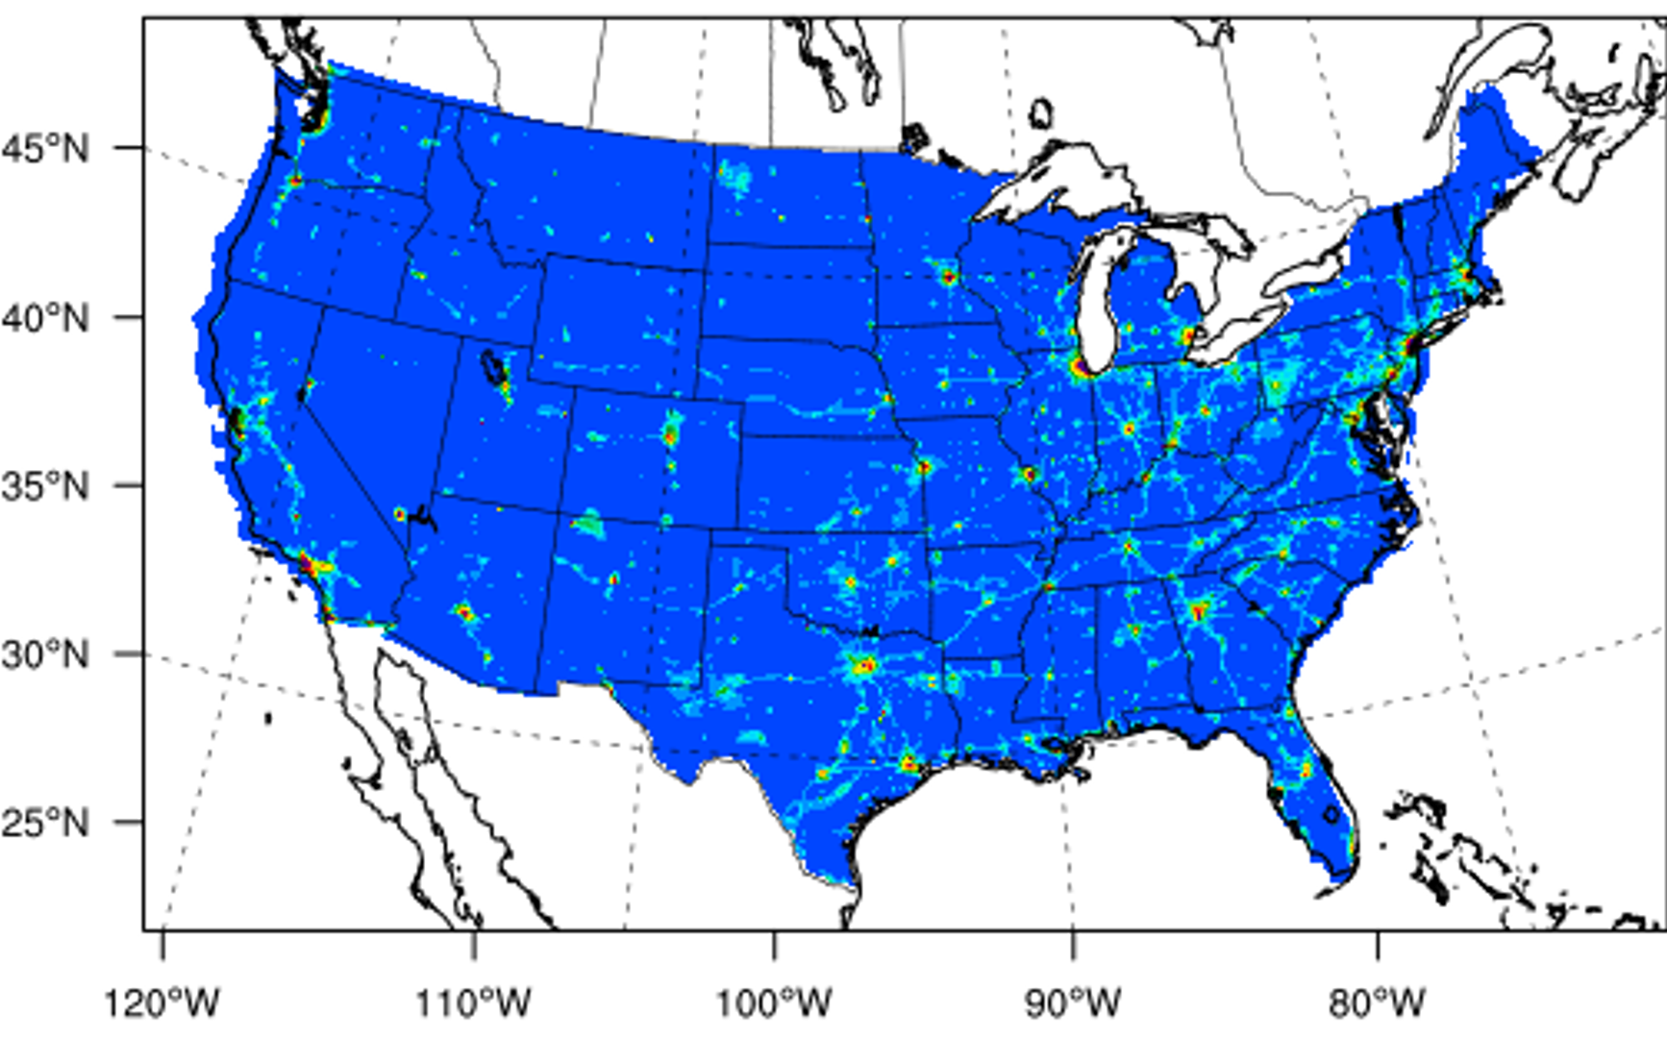
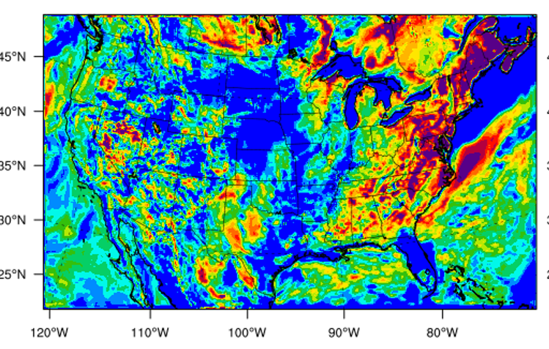
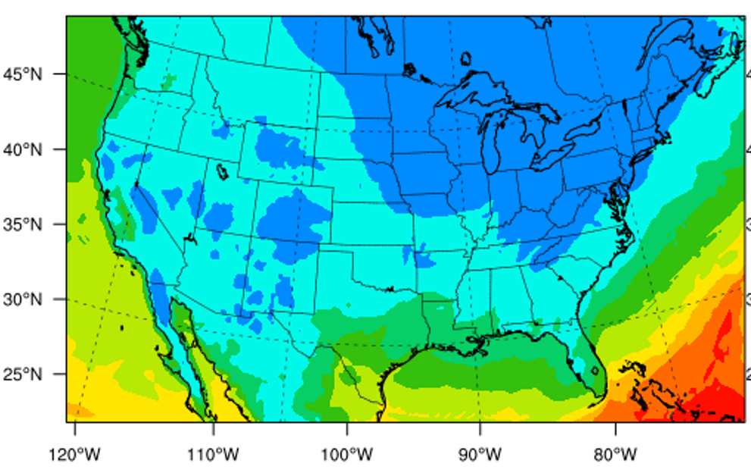
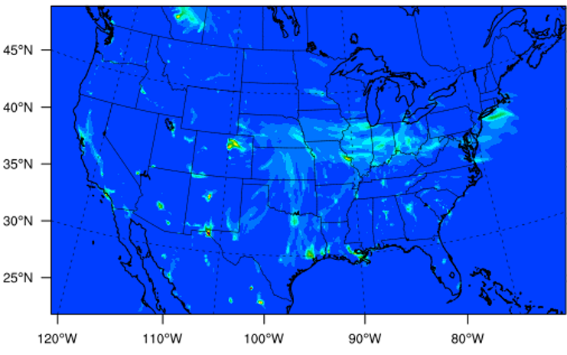
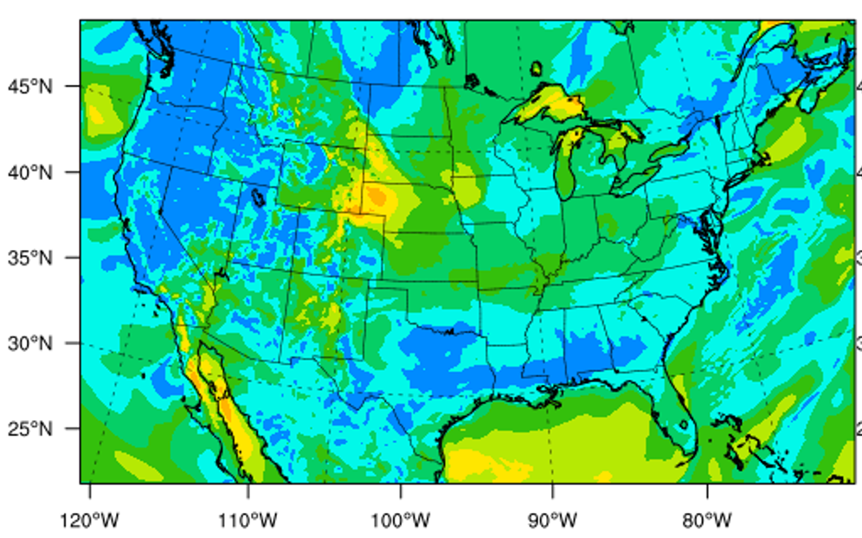
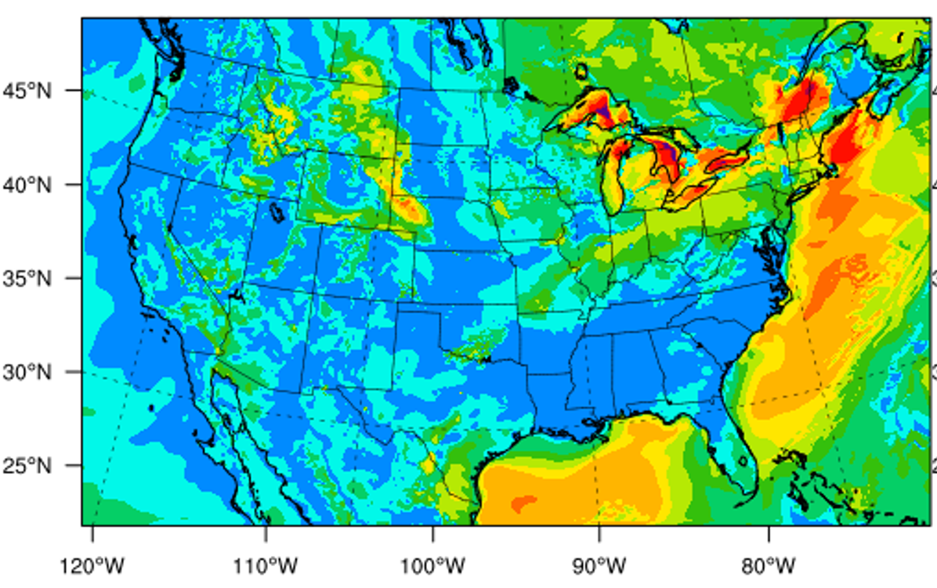
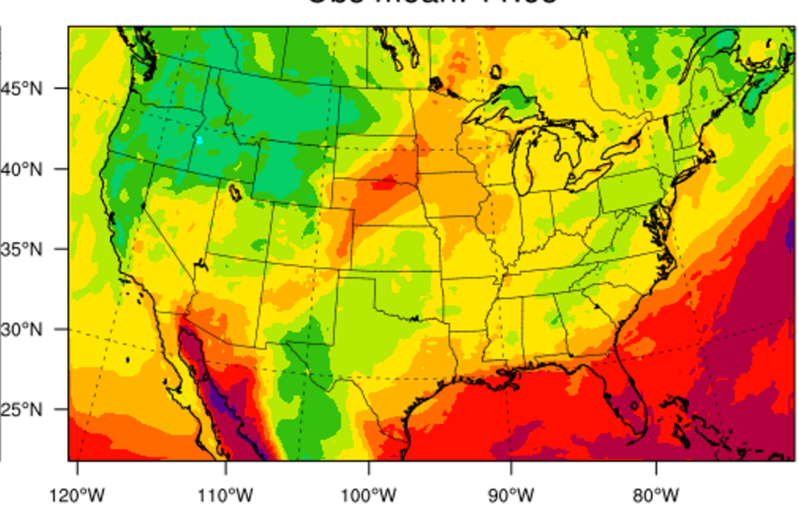
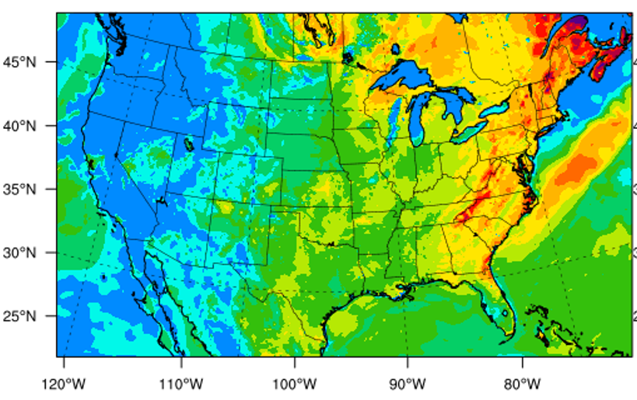
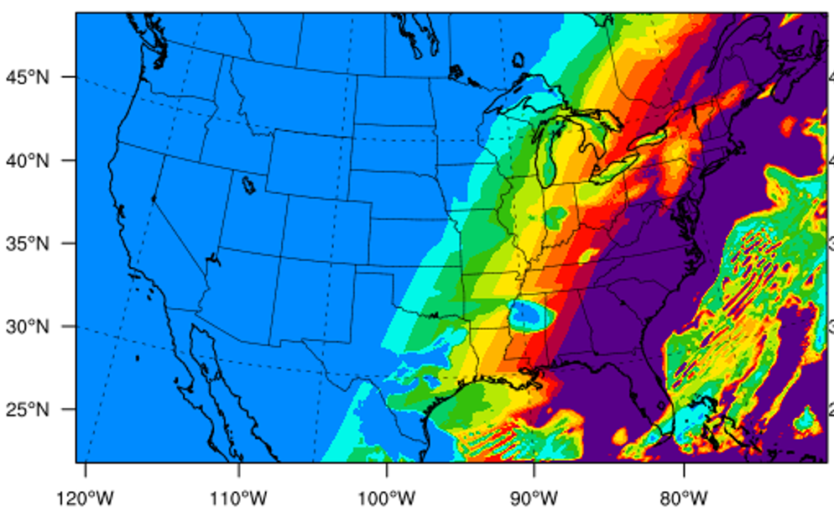









Model structure
UNet: capture the cross-space interaction
MLP
Encorder
CNN
U-Net
C_{Conc}= 1
pReLU
Concatenate
CNN
$$h_{t−23}$$
$$h_{t−22}$$
$$h_{t−1}$$
$$h_{t}$$
LSTM: capture the temporal variation
pReLU
LSTM
LSTM
$$…$$
LSTM
LSTM
NO₂
CNN
$$x_{t−23}$$
$$x_{t−22}$$
$$x_{t−1}$$
$$x_{t}$$
C_{emis.}= 1
C_{conc.}= 1
C_{Meteorology}= 8
V wind
U wind
humidity
NOx emission
PBL height
Wind speed
Decoder
Initial NO₂ concentration
convective velocity scale
2-meter temperature
Short-wave radiation
CNN: convolution network; LSTM: long short term memory; U-Net structure (2-layers): a u-shaped architecture with a down sample function (max pooling) and a deconvolution function (up convolution); MLP: multiple layers of perceptrons with threshold activation; pReLU: the parametric rectified linear unit is used as the activation function

Slide 6
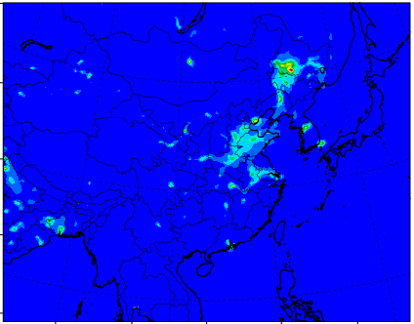
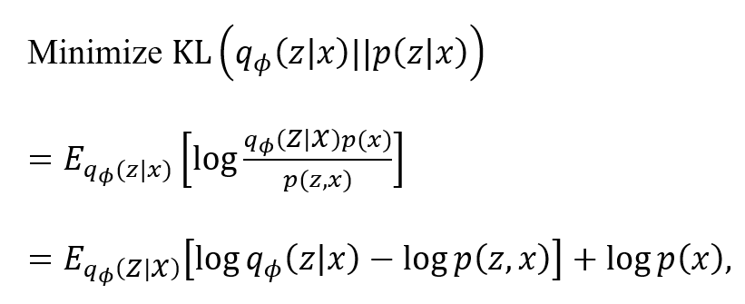
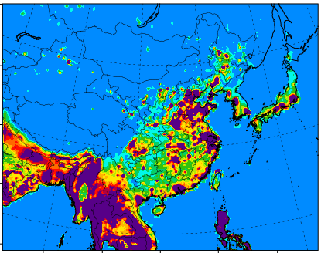
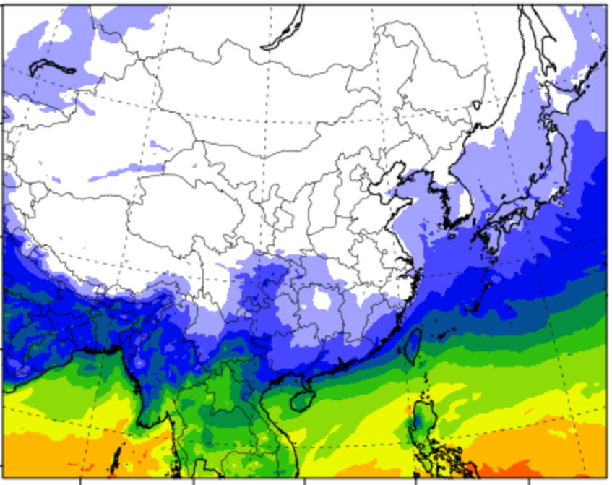
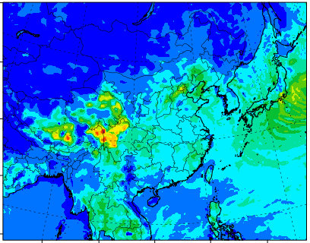
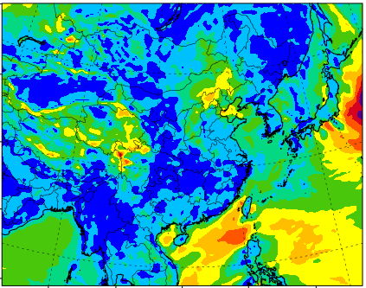
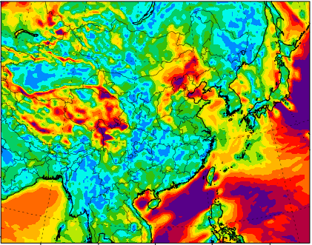
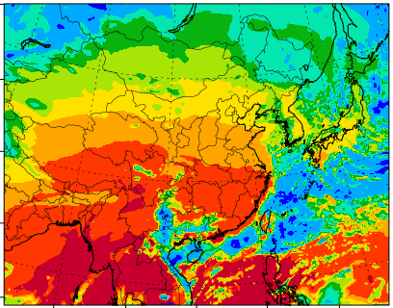
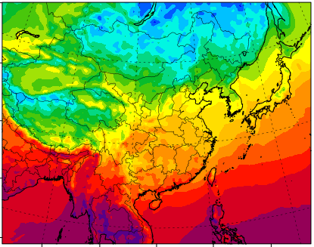




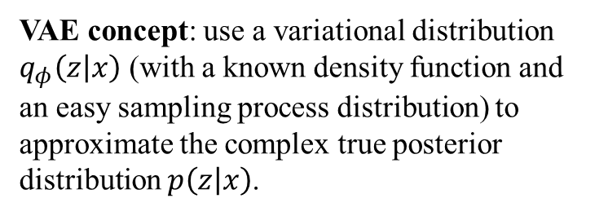





Model structure of VAE
VAE concept: use a variational distribution $q_{φ}\left(z | x\right)$ (with a known density function and an easy sampling process distribution) to approximate the complex true posterior distribution $p\left(z | x\right)$.
MLP
Encorder
CNN
U-Net
Objective function:
Kullback–Leibler divergence
C_{Conc}= 1
pReLU
Concatenate
CNN
$$h_{t−23}$$
$$h_{t−22}$$
$$h_{t−1}$$
$$h_{t}$$
pReLU
LSTM
LSTM
$$…$$
LSTM
LSTM
NO₂
CNN
$$x_{t−23}$$
$$x_{t−22}$$
$$x_{t−1}$$
$$x_{t}$$
C_{emis.}= 1
C_{conc.}= 1
C_{Meteorology}= 6
$$∝−{\left(g\left(f_{φ}\left(x\right)+εσ\right)−x\right)}^{⊤}∇_{z}g\left(z=f_{φ}\left(x\right)+εσ\right)∇_{φ}f_{φ}\left(x\right)$$
humidity
NOx emission
PBL height
Wind speed
posterior-prior deviation
prediction-data deviation
Decoder
Initial NO₂ concentration
Short-wave radiation
convective velocity scale
2-meter temperature
L-curve to determine the hyperparameter (noted as α) which balances these two

Slide 7
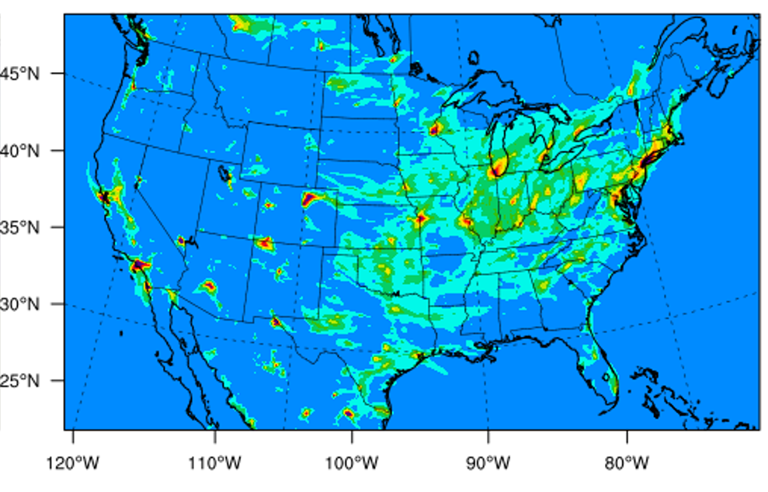
Dataset from WRF/CMAQ simulation
 | Decoder (pre-train) | Decoder | Encoder
Met. | Input | Input | Input
Emis. | Input | Input | Output
Conc | Output (CMAQ) | Output | Input (Satellite)
Conc-init | Input (CMAQ) | Input (Satellite) | Input (Satellite)
For decoder
Three scenarios:
  2019 baseline
  2019 double NOx emissions
  2020 meteorology with 2019 emissions
  2020 meteorology with no anthropogenic emissions
For encoder
2019/2020 baseline
2019/2020 satellite-retrieved surface NO₂ concentration (TROPOMI fused with AQS sites)
US 12km conus domain

Slide 8
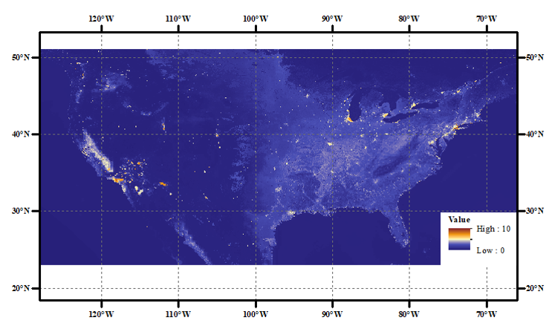
Dataset from observations
LightGBM (tree-based) model is used to derive the spatially continuous surface NO₂ concentration
NO2 column products from TROPOMI
Surface NO2 measurements from AQS (65% of total labels)
CMAQ modeled NO2 from rural data (35% of total labels)
Sample = 359456
R² = 0.9898
surface temperature
total precipitation
day of week
surface pressure
relative humidity
10m wind
$$Surface NO2=LightGBM(DOY, DOW, EL, ST, DT, SP, 10U, 10V, BLH, TP, TE, RH, xNO2 )$$
day of year
elevation
dewpoint
boundary layer height
satellite column
total evaporation
Satellite retrievals

Slide 9
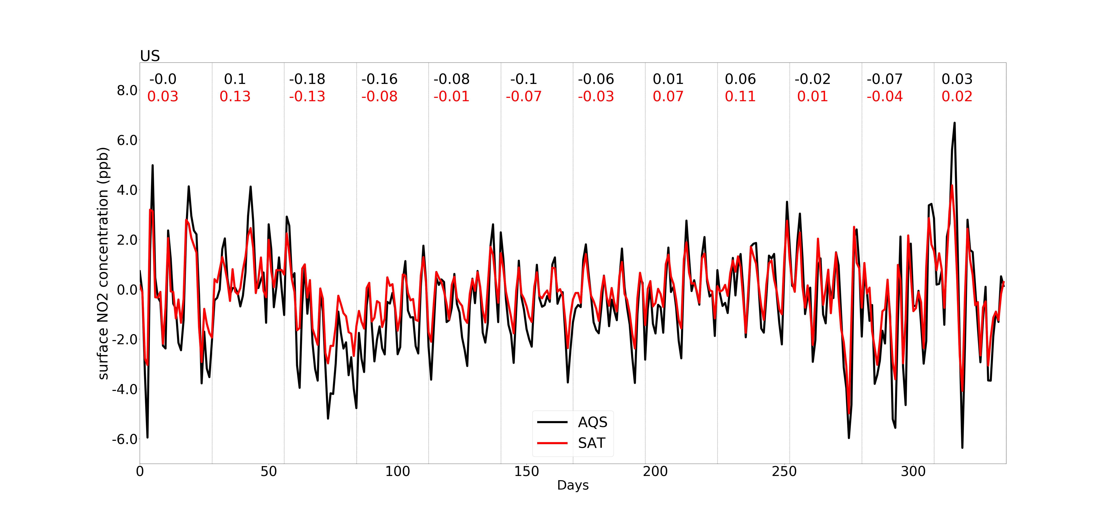
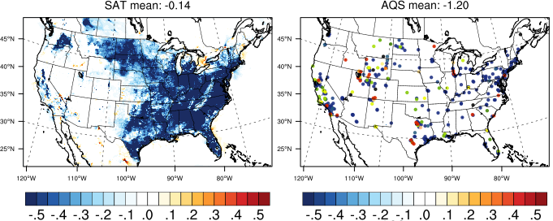
Observations
change ratio
daily-series for ∆NO2 (2020 - 2019)
NO₂ reduced significantly during March-April in 2020
Satellite retrieved surface-NO₂ concentrations present the similar reduction shown in AQS, but slightly lower compared to AQS
Spring (March-May)

Slide 10
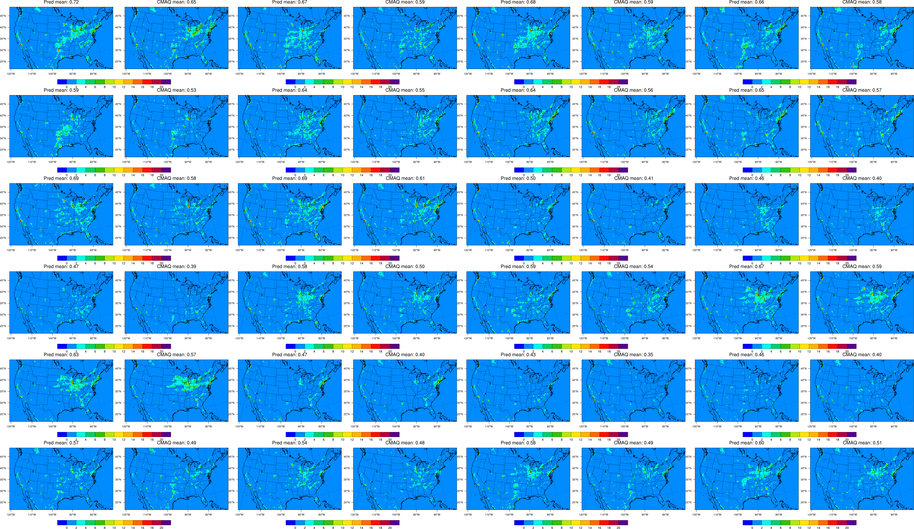
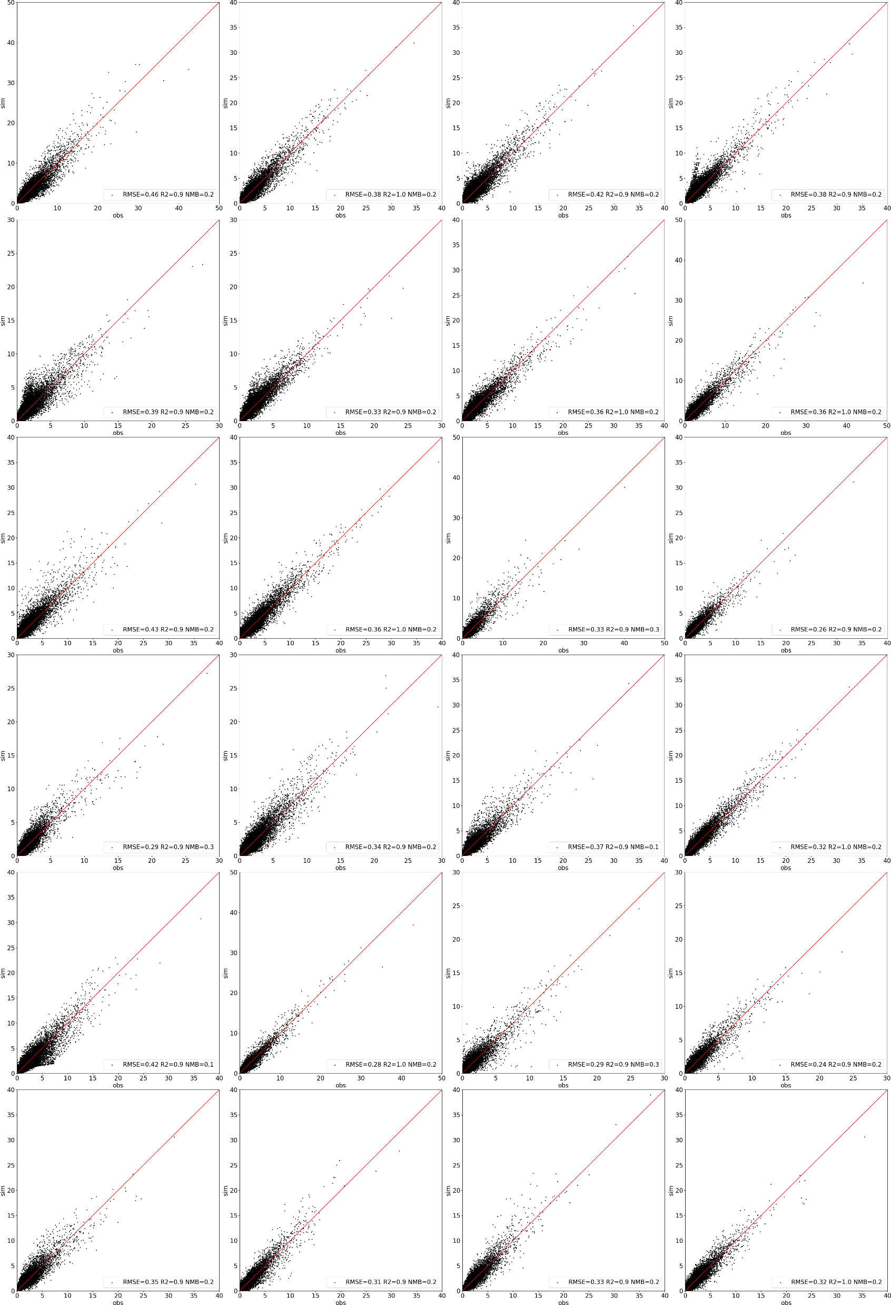
Performance of VAE-decoder (forward)
2020 March
VAE-decoder
CMAQ
VAE-decoder
CMAQ
VAE-decoder
CMAQ
VAE-decoder
CMAQ
Daily NO2 (ppb)
Day3
Day4
Day5
Day6
Day 3-26
Day7
Day8
Day9
Day10
Day11
Day12
Day13
Day14
Day15
Day16
Day17
Day18
Day19
Day20
Day21
Day22
Day23
Day24
Day25
Day26
RMSE<0.5; R2>0.9

Slide 11
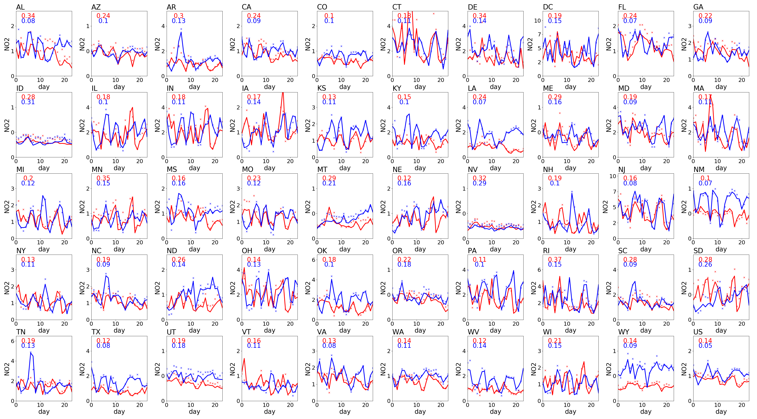
Performance of VAE-decoder (forward)
Daily NO₂ in March (ppb) by state
2019 base (train) NMB < 0.3
2020 base (test) NMB < 0.4
Performance in test dataset is worse than training, more training data will be helpful to improve the VAE-decoder performance

Slide 12
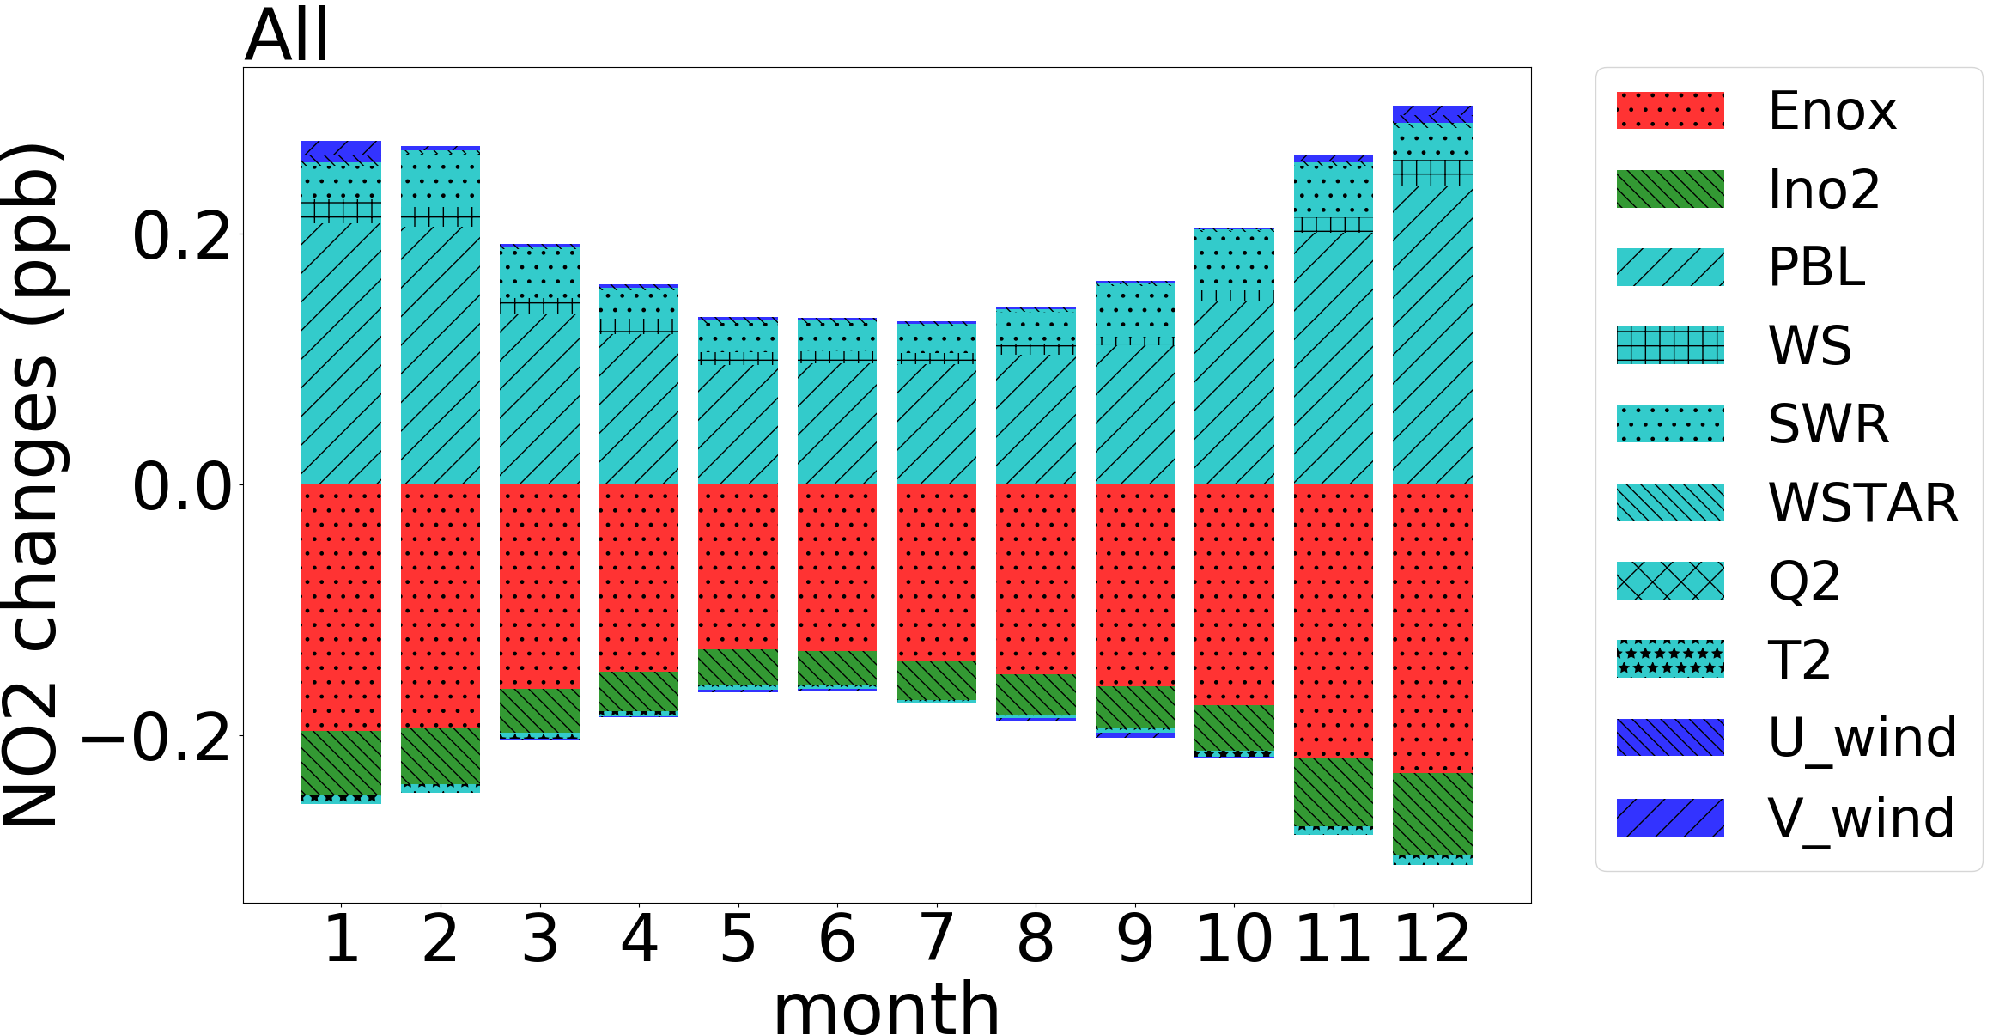
Understanding the feature impacts on NO₂ concentration
monthly mean (2019)
modulating each feature one-by-one
T2：-2K
others：-20%
NO2 concentration is contributed by NOx emissions (Enox) and initial NO2 condition (Ino2)
Met variables will modulate the NO2 concentration sensitivity to NOx emissions

Slide 13
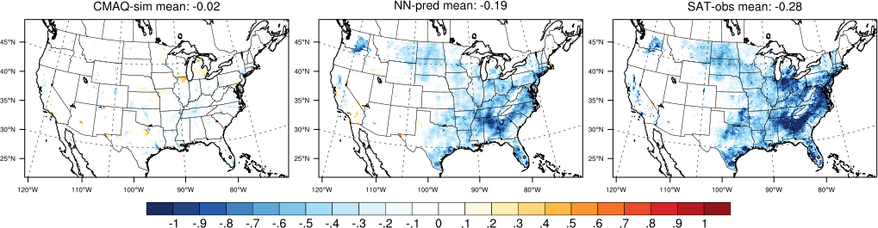
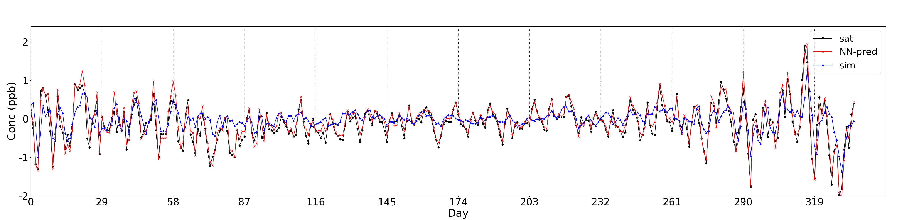
Performance of VAE-encoder (backward)
sim with no emission changes as 2019
VAE assimilated
Satellite retrieved
Spring ∆NO2 concentration (2020 – 2019)
VAE successfully assimilated surface NO2 concentration towards satellite
∆daily NO2 concentration between 2020 and 2019

Slide 14
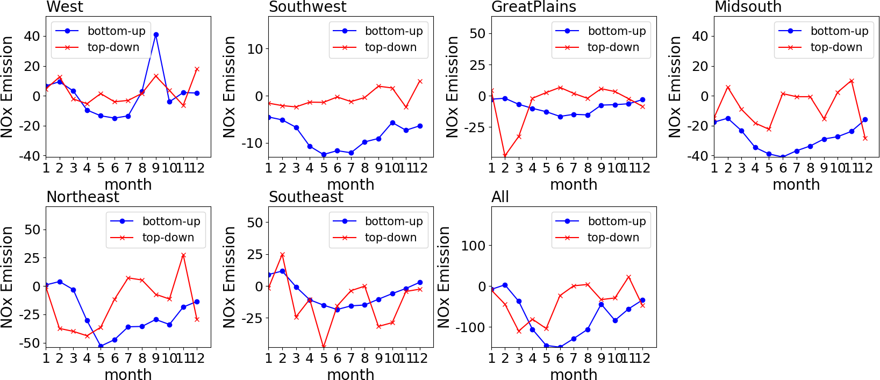
Comparing the VAE-adjusted (top-down) emissions with activity-based estimation (bottom-up)
∆NOx emissions (2020 – 2019)
kt/month
Both captured the NOx emission reduction in Spring

Slide 15
Adjusted emissions
West
Southwest
Great Plains
Mid-south
Northeast
Southeast
wild-fires

Slide 16
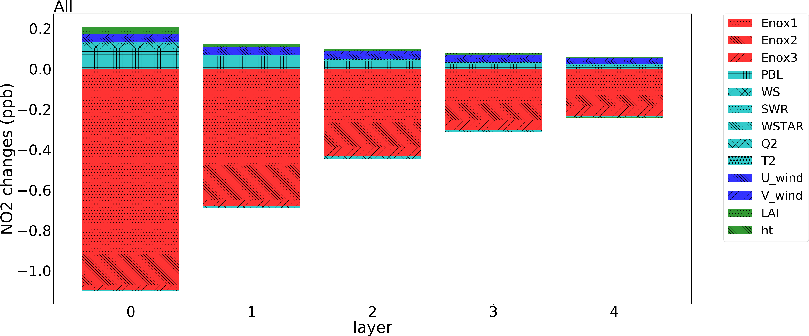
Emission impacts on concentration by vertical layers
based on sensitivity analysis using DeepCTM by reducing each feature by 20%
Enox1: surface
Enox2: layer 2-3
Enox3: layer >3
Sensitivity of upper emissions to NO2 concentration increases along with the height

Slide 17
Conclusion
VAE is suitable ML model to efficiently capture the emission variations from the observed concentrations
  VAE is easy to train and apply, with limited resources (CTM-free)
limitations still exist
  sector-level emissions, uncertainties from numerical model and observations

Slide 18
Acknowledgement: support from NOAA, NASA, WHO, US-EPA, NIEHS, KEITI, KCP
Thank you for your attention!

