Slide 1
A Technique to Estimate Nonpoint Industrial, Commercial, and Institutional (ICI) Fuel Consumption Rich Mason¹, David Cooley², Hannah Derrick² ¹Office of Air and Radiation, US Environmental Protection Agency ²Abt Associates, Inc.
22nd Annual CMAS Conference, Chapel Hill, NC October 17, 2023
Notes:
This presentation highlights a “half-measure” to partially correct double counting of ICI estimates when States/Locals do not provide nonpoint estimates or point inventory throughput data

Slide 2
Background of the Nonpoint ICI Calculations
Point source subtraction is needed to estimate nonpoint fuel consumption for the ICI sector
The EPA’s Wagon Wheel uses total fuel consumption by sector and fuel type from Energy Information Administration (EIA) State Energy Data System (SEDS)
The Wagon Wheel subtracts point source fuel consumption from the total fuel consumption to estimate nonpoint fuel consumption:
Nonpoint fuel consumption =
Total fuel consumption –
Point fuel consumption

Slide 3
Background: State/Local Process for submitting ICI Input Templates
 | Step 1: Choose ICI Input Template |  | Step 2: Identify ICI facilities |  | Step 3: Obtain Point Throughput Data |  | Step 4: Map Point SCCs to ICI Fuel Types |  | Step 5: QA Point ICI Through-puts |  | Step 6: Submit Template to SharePoint |  | Step 7: Complete Nonpoint Survey
Option A | ✓ |  | ✓ |  | ✓ |  |  |  | ✓ |  | ✓ |  | ✓
Option B | ✓ |  | ✓ |  | ✓ |  | ✓ |  | ✓ |  | ✓ |  | ✓
Option C | ✓ |  | ✓ |  | ✓ |  | ✓ |  | ✓ |  | ✓ |  | ✓
Option D | ✓ |  |  |  |  |  |  |  | ✓ |  | ✓ |  | ✓
Notes:
Why do States/Locals struggle to submit ICI throughput data? A background is provided here to illustrate the numerous steps required by S/Ls to submit an Input Template –and numerous places where assumptions can go wrong!

Slide 4
Problem Defined for 2020 NEI
While AERR historically has required submittal of all emissions (including nonpoint) and point source throughput data, this has not happened in reality
We have not enforced these requirements in the Emissions Inventory System (EIS)
This is changing in proposed AERR updates
Resulting QA issue: For State/Locals (S/L) that do not submit nonpoint ICI emissions or input templates (point inventory throughput data), two generally bad “easy” solutions have been historically applied:
1) “Do nothing” approach = Nonpoint ICI estimates (from EPA Wagon Wheel tool) are a double-count with Point inventory submittals, or,
2) “Hand-wave away” approach = Unavoidable underestimate in Nonpoint ICI by allowing S/Ls to zero out these nonpoint estimates via the EIS Nonpoint Survey
To be fair, option 2 is a reasonable approach for S/Ls with robust point inventories and fuel/sectors where any estimates would likely require permits (e.g., Industrial coal)

Slide 5
“Half-Measure” Solution Outlined –for 2020 NEI
Use S/L Point inventory fuel consumption input templates (submitted for 2020) and analyze vs EIA SEDS data by sector and fuel type
Compare the S/L-submitted fuel consumption (PT) vs carbon monoxide (CO) PT emissions and vs 2020 SEDS
Why CO?
Correspondence with SLTs at “NOMAD” (Nonpoint method advisory) committee meetings: Of the list of primary ICI pollutants submitted (CAPs), deemed least-likely to be impacted by (lack of) point inventory controls
CO2 would have been ideal, but it’s submittal by SLTs varies widely, and SCC assignments (required to tease out fuel type) were untenable for 2020 NEI

Slide 6
Using Point Inventory CO emissions vs S/L fuel consumption
A default approach required looking at all S/L sector/fuel input template submittals vs their point CO emissions. Computed median thruput/CO emissions ratios. Complications:
2020 SEDS = 0 for several state/sector/fuel types –despite S/L emissions > 0
S/L (point inventory) fuel consumption often > SEDS (represents both point & nonpoint)
Limiting analysis to SEDS > 0 and S/L fuel consumption > 1.5x SEDS was too restrictive
Ultimately used a “widest net” but did remove cases where S/L fuel consumption > 1.5x SEDS and S/L fuel consumption > 100 (UOM SEDS)
Found most of these were unit of measure errors, some of which were resolved

Slide 7
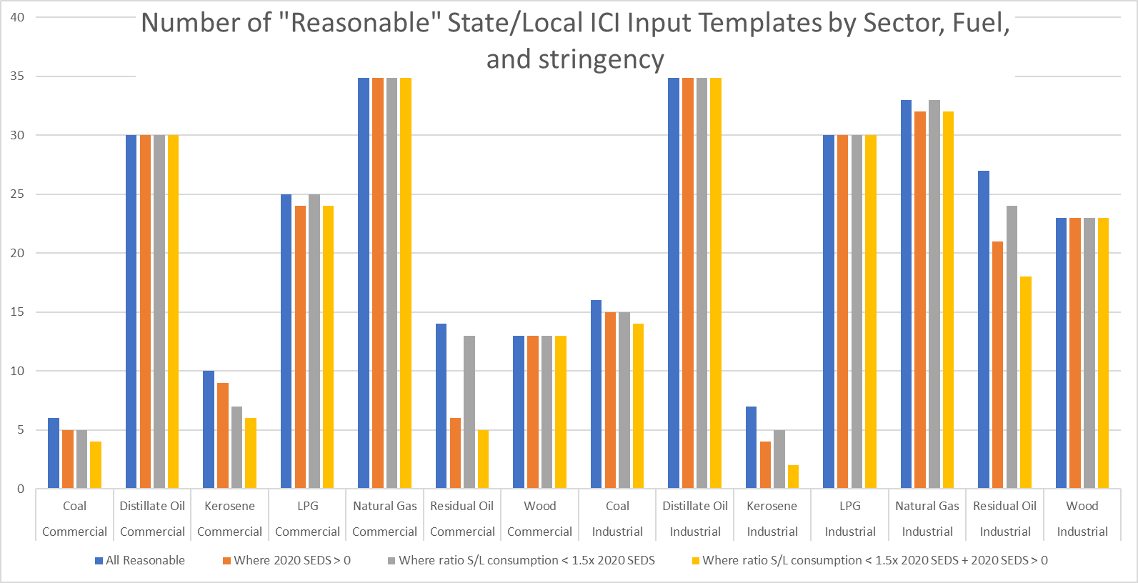
Notes:
34 States and 7 local agencies submitted an ICI Input Template for at least 1 sector/fuel type

Slide 8
Limitations
Could these median ratios be used for other years?
Short answer: won’t know until we receive year-2023 S/L inputs (via EIS)
2020 was a “different” year…cough…Covid…cough
A median ratio approach will have more uncertainty for states with point inventory most-different from “median” states:
Mix of sources and controls; this approach treats all sources -for a given sector/fuel- the same
Reporting thresholds: states that report a more-complete point inventory (submit smaller sources) would expect to have different ratio of fuel consumption to emissions vs those only reporting down to regulatory requirements
SEDS data 2020 vs 2017 mix of correlations
Strongest for Industrial distillate, natural gas, wood, and commercial natural gas
Poor correlation for ICI residual oil and commercial distillate and wood
Can’t necessarily ground truth based on SEDS (next slide)

Slide 9
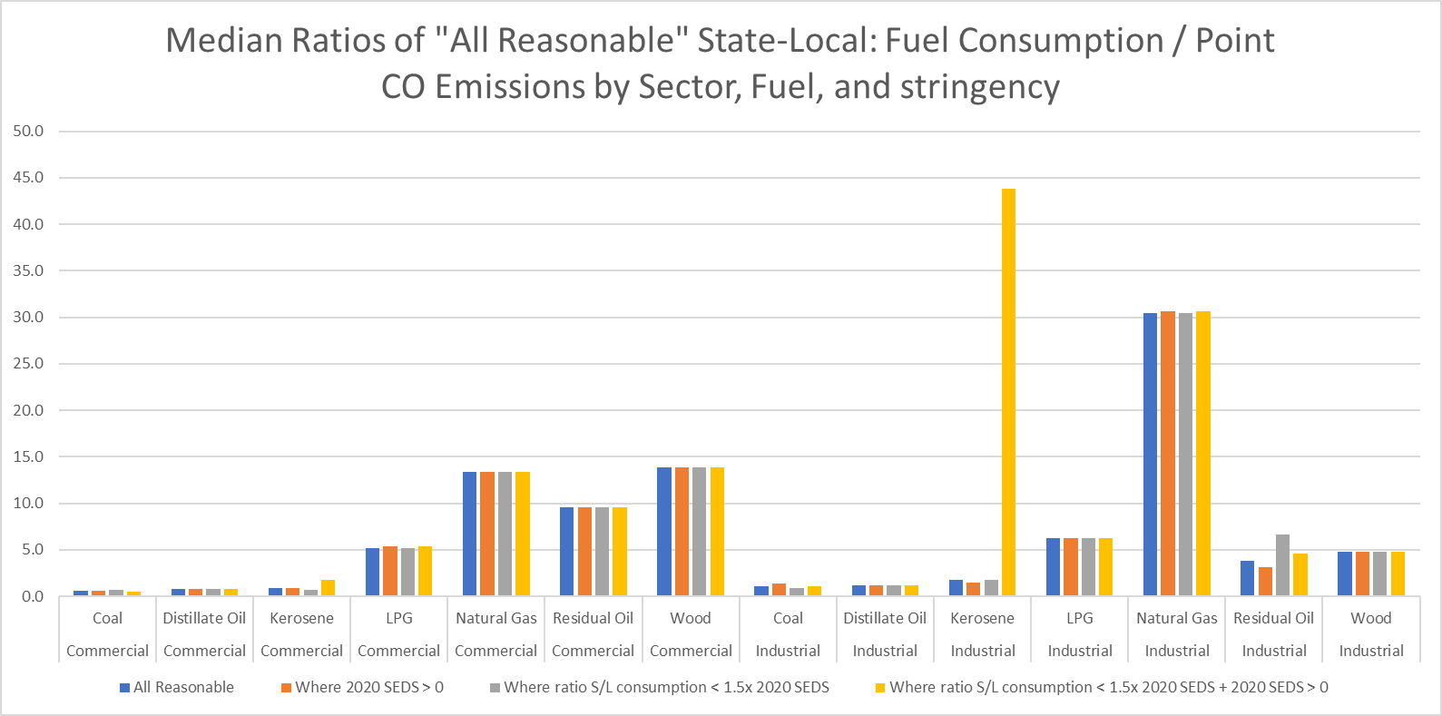
SEDS Limitations
Notes:
If SEDS is capturing all Industrial Kerosene (PT+NP), the Point inventory submittals (alone) are contradicting SEDS=0.

Slide 10
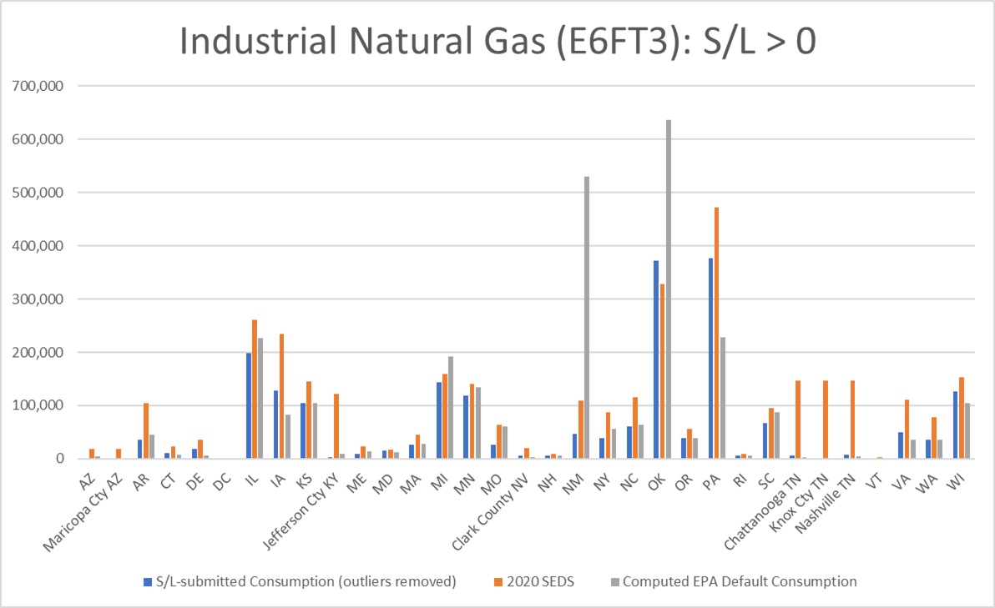
S/L vs SEDS fuel consumption relationships
Note: unless Point inventory includes ALL sources, would expect S/L-submitted fuel consumption (blue) to be less than SEDS (orange)

Slide 11
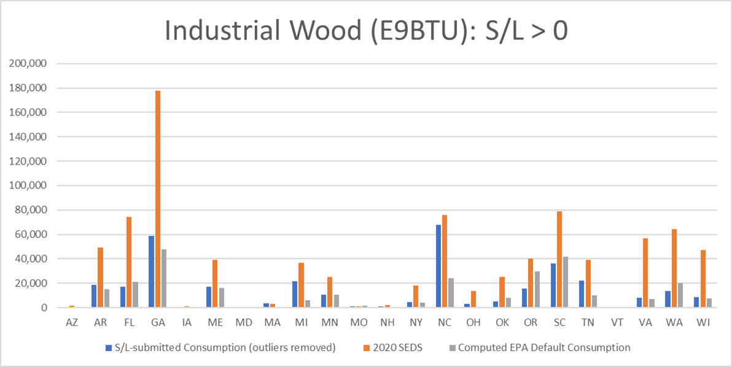
S/L vs SEDS fuel consumption relationships, cont.

Slide 12
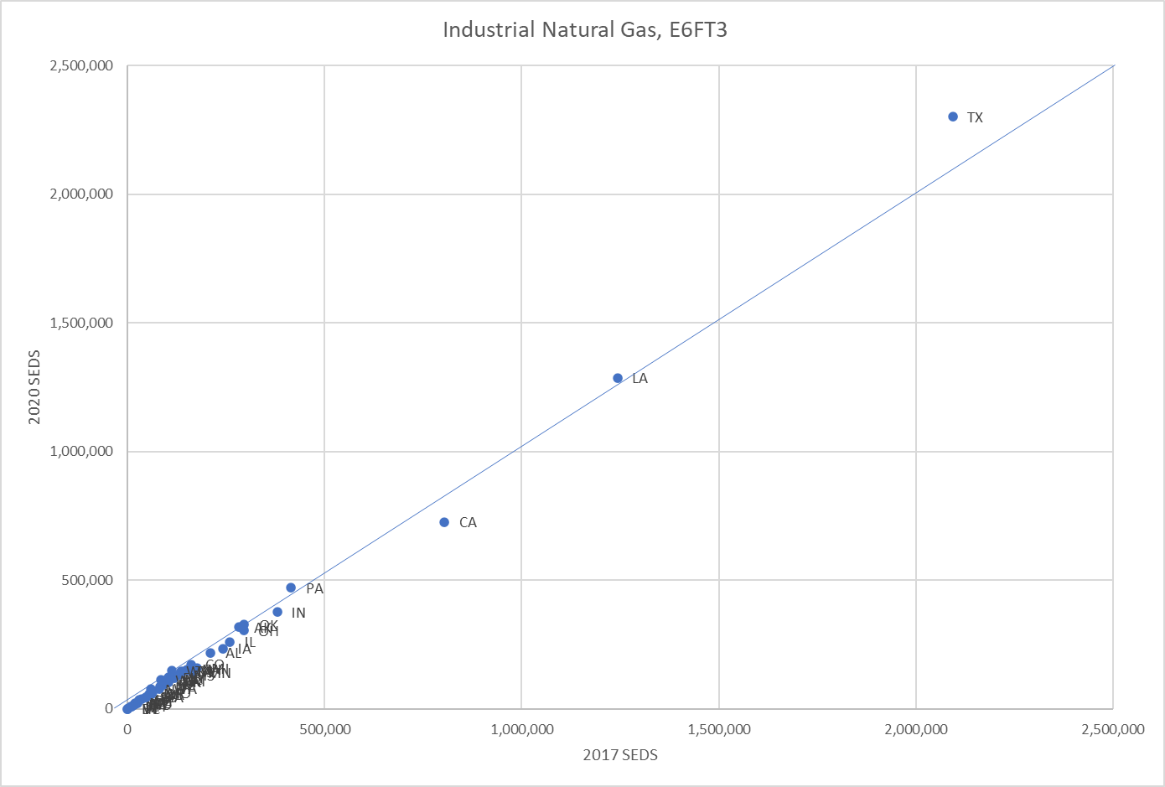
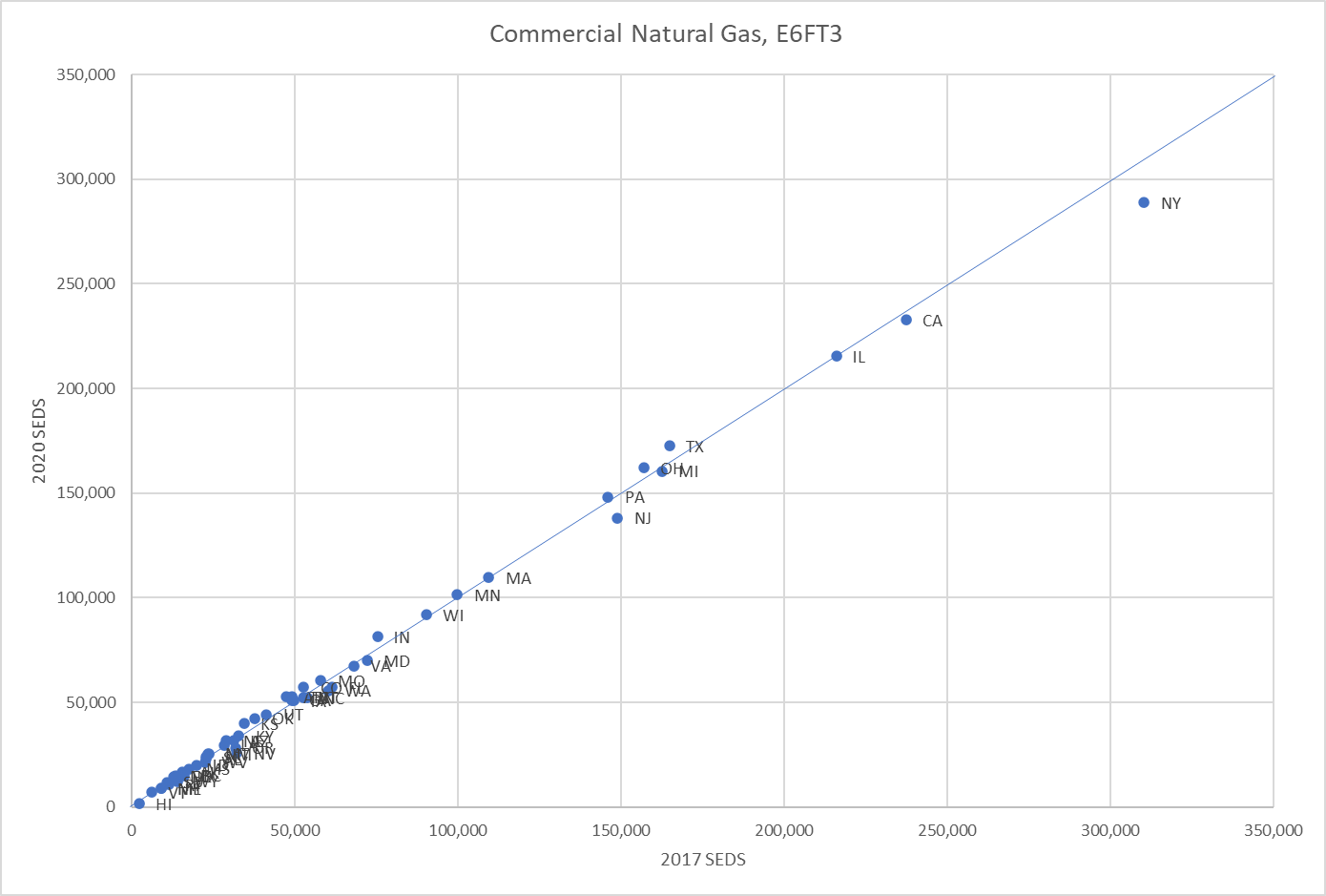
2020 vs 2017 SEDS: good correlation

Slide 13
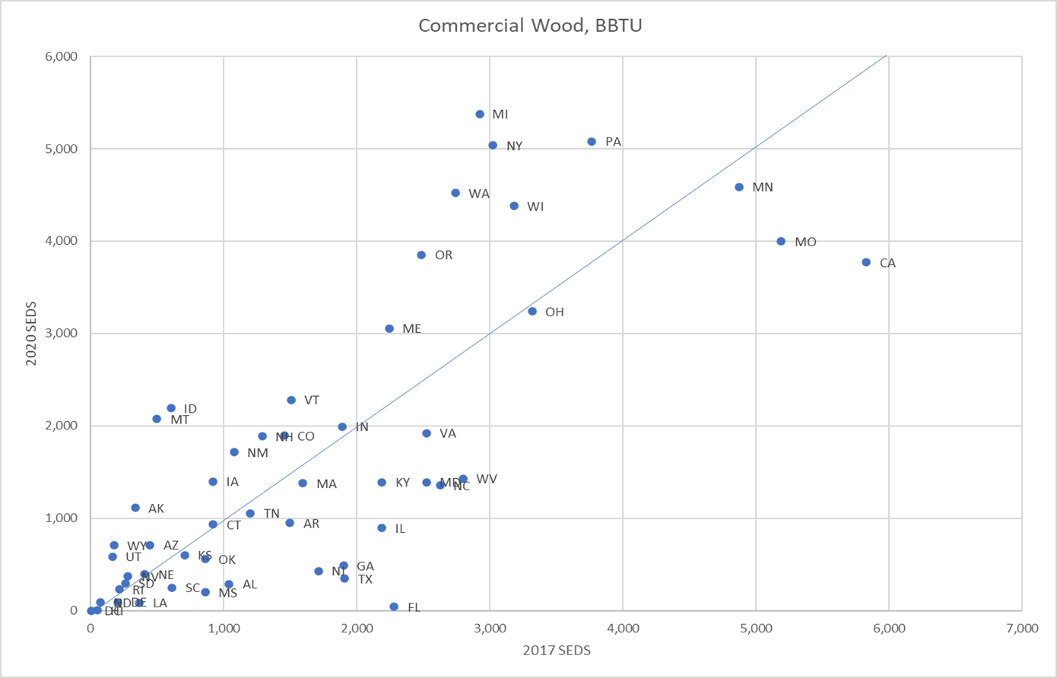
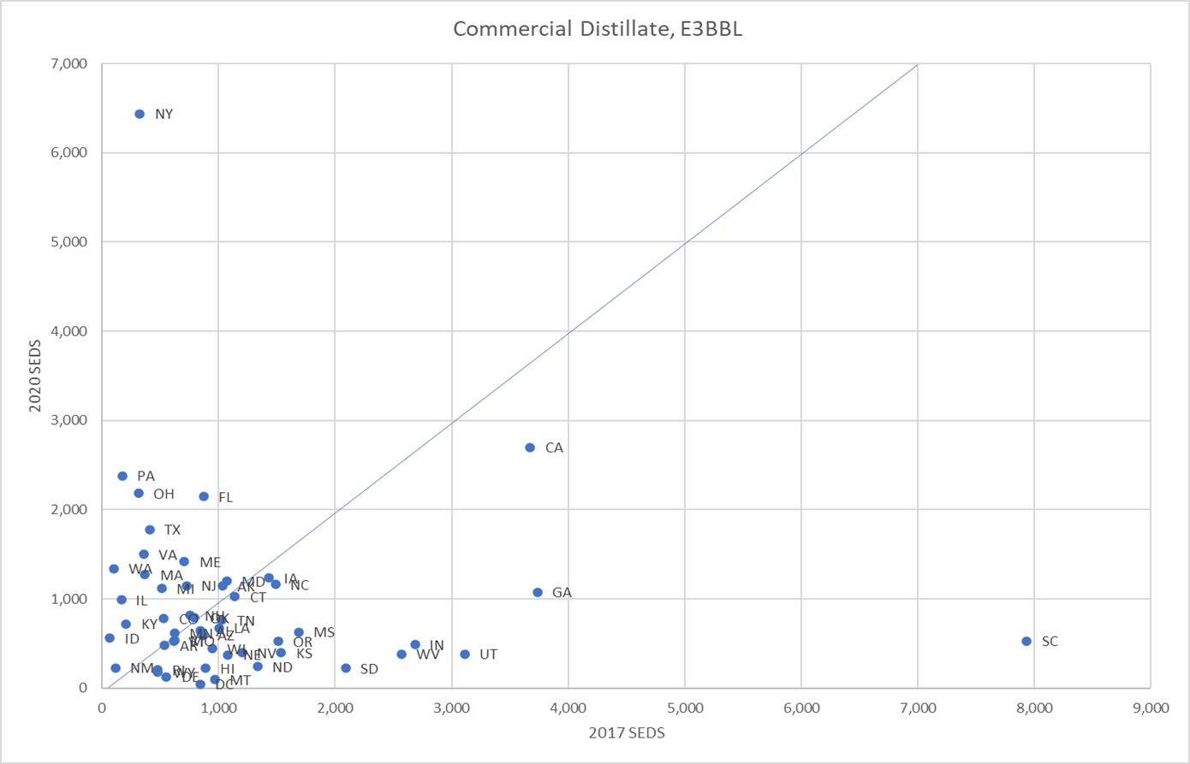
2020 vs 2017 SEDS: not so good correlation

Slide 14
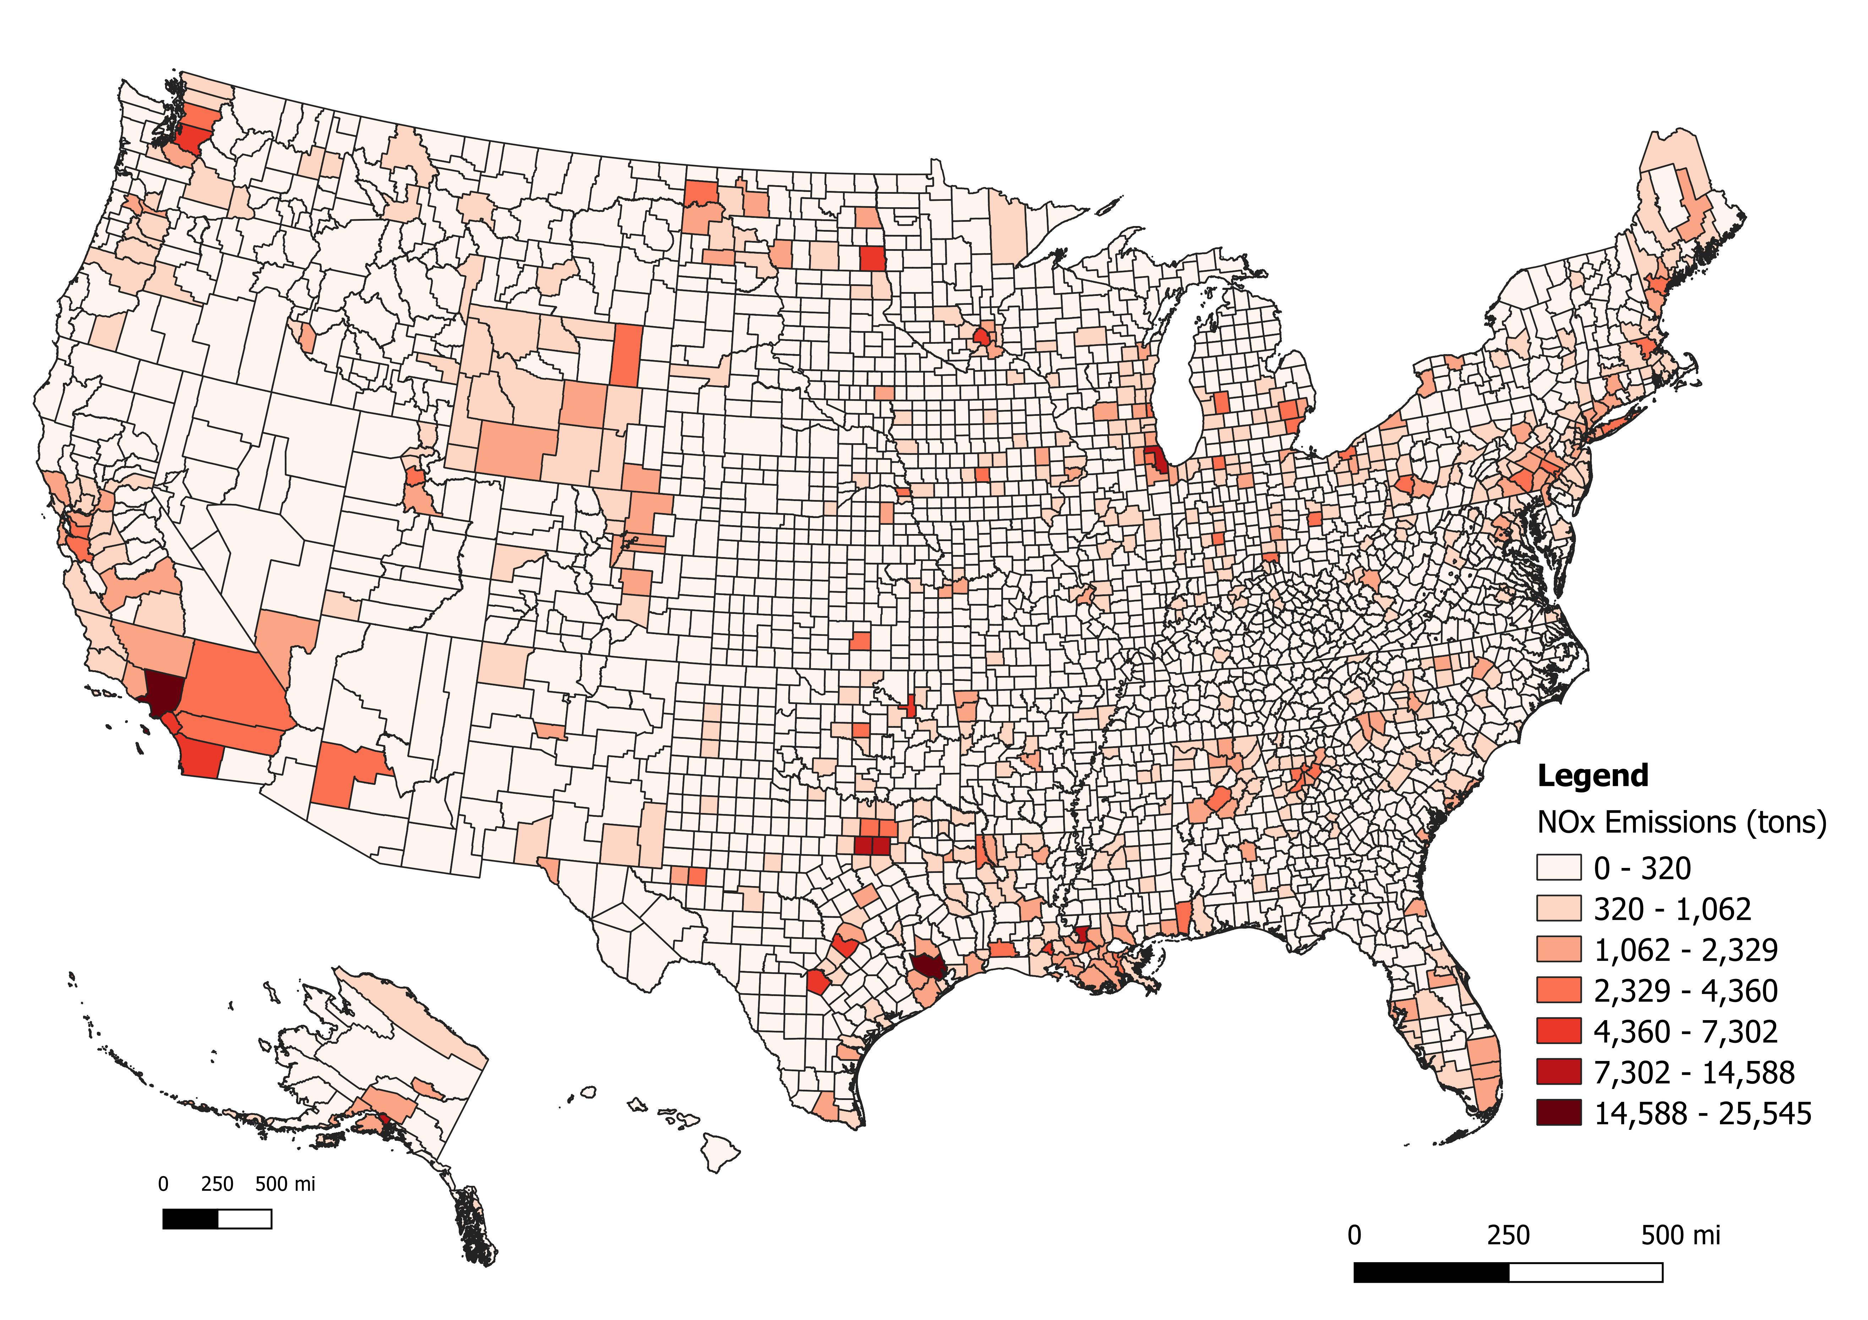
NOX: New Default (left) vs no subtraction (right)

Slide 15
Impact of Applying Default approach: No subtraction minus Default subtraction

Slide 16
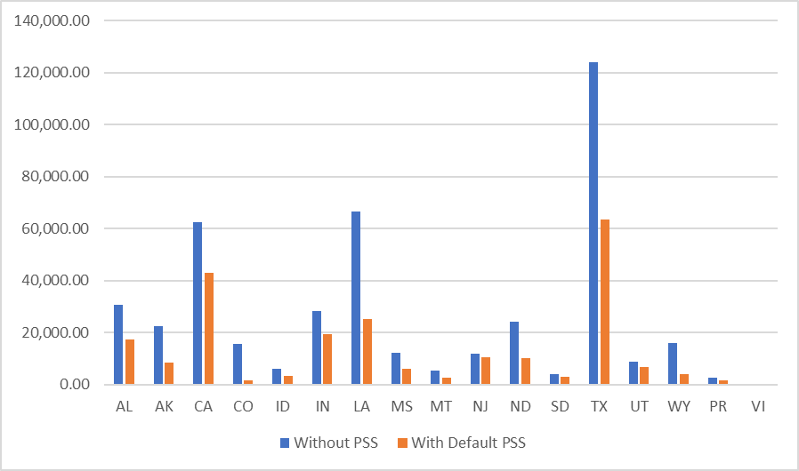
Total ICI Nonpoint NOX (tons): where S/L did NOT submit inputs
Observation:
Biggest impact in S/Ls with more-rigorous Point submittals (CO & WY)

Slide 17
Thank You! Questions?

